Slide 1
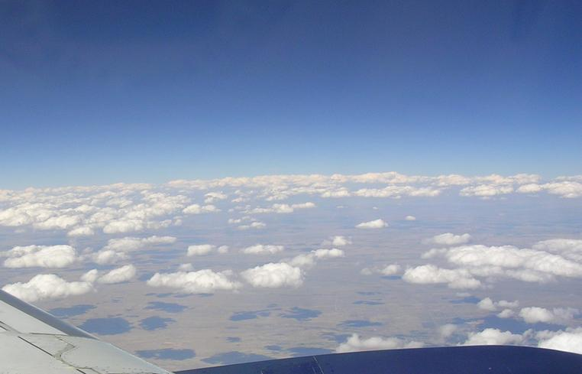
Global Energy and Water Cycle Exchanges Project (GEWEX)
GEWEX
Global Land/Atmosphere System Study (GLASS)
Michael Ek (NCEP/EMC)
Gab Abramowitz (UNSW Sydney)
GLASS Co-chairs
GLASS panel members and other GEWEX collaborators
GEWEX Scientific Steering Group meeting (SSG-30)
Washington DC, 29 January - 01 February 2018
1
Notes:
1

Slide 2

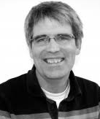
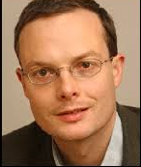
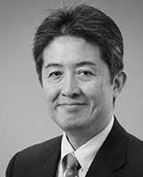
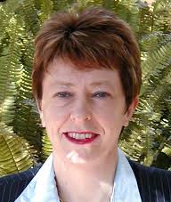
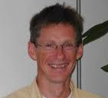
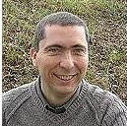

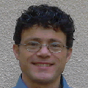
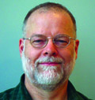
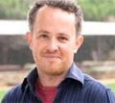
Global Land/Atmosphere System Study (GLASS)
Paul Dirmeyer
Andy Pitman
Ann Henderson-Sellers
Jan Polcher
Taikan Oki
OUR FOUNDERS!
PILPS ERA
Bart van den Hurk
Joe Santanello
Mike Ek
Martin Best
Aaron Boone
Gab Abramowitz
FORMER/CURRENT CO-CHAIRS
2
Notes:
2

Slide 3
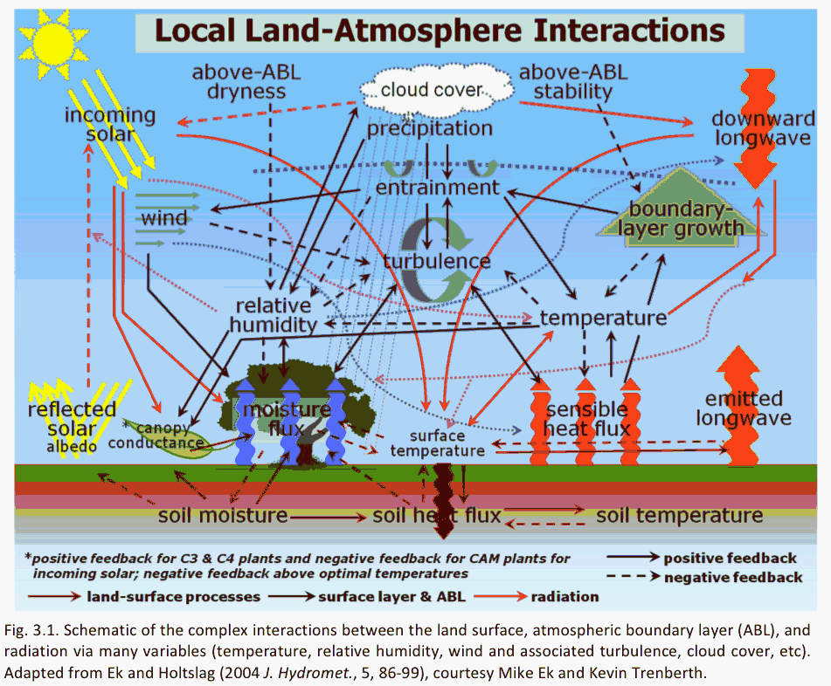
Complexity of land‐atmosphere Interactions
GEWEX Imperatives
GEWEX Plans for 2013 and Beyond:
Diagnostics of stand-alone model components are more straight-forward, but there has been difficulty to establish metrics for coupled systems (e.g., land-atmos.) to quantify strength of the interactions.
Fig. 3.1. Schematic of the complex interactions between the land surface, atmospheric boundary layer (ABL), and radiation via many variables (temperature, relative humidity, wind and associated turbulence, cloud cover, etc). Adapted from Ek and Holtslag (2004 J. Hydromet., 5, 86-99), courtesy Mike Ek & Kevin Trenberth.
3
3
Notes:
3

Slide 4
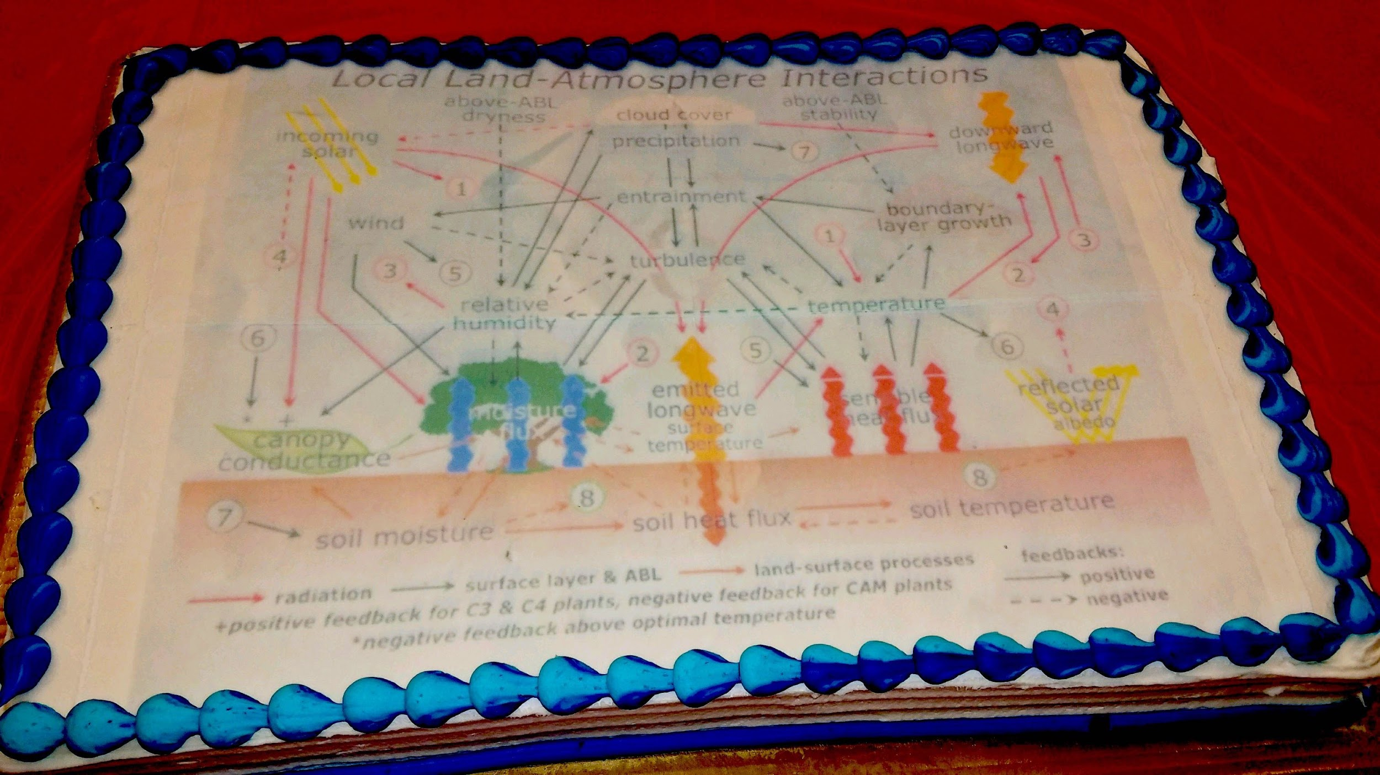
Complexity of land‐atmosphere Interactions
Mike Ek farewell party. 26 Jan 2018. NCEP, College Park, Maryland.

Slide 5
GLASS Vision and Mission
The GEWEX Vision
Water and energy are fundamental for life on Earth. Fresh water is a major pressure point for society owing to increasing demand and vagaries of climate. Extremes of droughts, heat waves and wild fires, as well as floods, heavy rains, and intense storms increasingly threaten to cause havoc as the climate changes. Other challenges exist on how clouds and aerosols affect energy and climate. Better observations and analysis of these phenomena, and improving our ability to model and predict them, will contribute to increasing information needed by society and decision makers for future planning.
GLASS role: Better representation of the Earth System by understanding the role of land.
The GEWEX Mission
To measure and predict global and regional energy and water variations, trends, and extremes, such as heat waves, floods, and droughts, through improved observations and modeling of land, atmosphere, and their interaction, thereby providing the scientific underpinnings of climate services.
GLASS role: Identify and improve modeling of land-surface processes and land-atmosphere interactions to support the GEWEX Mission.
5
5

Slide 6
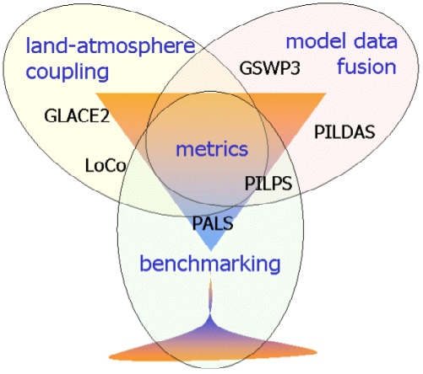
GLASS Structure
The aim of GLASS is to promote community activities that improve:
our best estimates and the model representation of state variables
our understanding of land/atmosphere feedbacks
our understanding of the role of land surface in predictability.
To best achieve these aims, GLASS has been re-structured into three elements:
Water Mgmt
GABLS/DICE
ALMIP2
LUMIP
PLUMBER
ILAMB
LS3MIP
SoilWat
6
6
Notes:
6

Slide 7
GLASS Projects
BENCHMARKING:
PALS Protocol for the Analysis of Land Surface models
PLUMBER PALS Land sUrface Model Benchmarking Evaluation pRoject
ILAMB International Land Atmosphere Model Benchmarking activity
GSWP3 Global Soil Wetness Project phase 3
SoilWat GEWEX Soils and Water initiative
LAND-ATMOSPHERE INTERACTION:
LoCo Local (land-atmosphere) Coupling
LS3MIP Land surface, snow, and soil moisture MIP (CMIP6)
LUMIP Land Use Model Intercomparison Project
GABLS/DICE DIurnal land/atmosphere Coupling Experiment, including GEWEX Atmospheric Boundary Layer Study GABLS4/DICE-over-ICE (Dome C, Antarctica)
7
Notes:
7

Slide 8
GLASS Projects: Cross-cuts
Cross-Cutting projects/actions:
PALS, PLUMBER – LSM benchmarking, links to GSWP3 / LMIP / ILAMB
GSWP3 – Links to carbon community (iLeaps), LMIP (CMIP6)
LS3MIP – (like GLACE-CMIP5) CMIP6 endorsed
DICE – Land-atmosphere interaction, links to GABLS, including GABLS4 “DICE-over-ICE” – land-atmosphere interaction (stable BL-Antarctica), links to GASS
LUMIP – Land use/change, links to iLeaps, heritage of LUCID, CMIP6 endorsed
LoCo – SGP testbed, assessment of land-atmosphere coupling diagnostics.
Recently launched or to be launched:
SoilWat - datasets, improved soil process representation, parameter sensitivity understanding - potential links with GDAP, GHP
PLUMBER2 – as for PLUMBER above
PILDAS??? – part of a future phase of PLUMBER?
8

Slide 9
GLASS achievements 2017 – PLUMBER expansion
The PLUMBER benchmarking MIP from 2015 continued into 2017 with new publications and activities
Several external parties are interested in structring and participating in a PLUMBER2 experiment.
A PLUMBER2 planning meeting is scheduled after the GLASS panel meeting in Canmore, May 2018.
Initial results of bringing ILAMB into the PALS environment are encouraging, and this work has some funding for the next year to continue. Ideally be used for PLUMBER2
9

Slide 10
GLASS achievements 2017 - LoCo
The Local Land-Atmosphere Coupling (LoCo) working group is going strong after being established over a decade ago to focus on the goal of accurately understanding and modeling coupled land-atmosphere processes.
A BAMS review article led by the LoCo WG was accepted Dec 2017 that covers the first decade of LoCo with an eye towards future work, and is already getting attention via early online release (re: Pielke email).
LoCo has closest links with GASS/GABLS and DICE (diurnal cycle coupling experiment), due to the inherent importance of the PBL and model development focus in each. More data sets!
LoCo continues to galvanize the land-atmosphere observing and modeling community in terms of new observations/field programs, establishing new useful “coupling” metrics, and engaging and training a number of young scientists, and putting them in positions of leadership is this effort.
10

Slide 11
GLASS Issues, Bottlenecks and Discussion Items
What to do?
Carry over from SSG-29/2017 (still relevant):
Physical processes: Further study on cold season/high latitude processes, Groundwater, (Distributed) Hydrology, Anthropogenic processes/Water Management, Semi-arid processes, High resolution/scale dependencies (~10^2m/LSM "grey zone”)?
Focus be on specific events/phenomena such as drought (via seasonal and interannual) prediction as well. How to prioritize?
Models “broadening” (e.g. water/energy, carbon/BGC, human dimensions) and disciplines colliding to answer larger questions. How to enhance cooperation? How to balance adding further complexity to our models (both NWP and climate) in order to better represent the Earth System, with what’s practical (in terms of compute resources, observable/measurable quantities and parameters).
From 2017 SSG-29 Action/Recommendation: GLASS to propose contribution to Process Evaluation Study (PROES; GLASS co-chairs), e.g. project with Univ. Reading (soil moisture, ET, remote sensing); also relevant for NOAA/NCAR activities, e.g., A. Berg, A. Tawfik (land-atmosphere coupling/metrics); Best, Lock, Ek (DICE, data mining), Abramowitz et al (land model benchmarking). On-going? YES!
11

Slide 12
GLASS Issues, Bottlenecks and Discussion Items
Collaborations and Communication with Partners
Carry Over from SSG-29/2017 (still relevant):
Interaction with other GEWEX panels and other external groups. GABLS/DICE a good example. Further DICE studies?
How to strengthen GASS activities with relevance to GLASS (and vice versa)? Radiation?
Stronger collaborations with GDAP and use of satellite data sets could benefit GLASS benchmarking projects.
GHP has been strengthened via the recent (October 2016) joint GHP-GLASS workshop on water management, and joint sessions at GLASS and GHP meetings.
Strengthen interaction with other WCRP groups, e.g. CliC (cryosphere/cold season processes).
Strengthen interaction with “outside” groups, e.g. ILEAPS (BGC cycles, land-atmosphere chemistry). Mutual interest in land.
Status of RHP in US.? Partner with GHP, others.
Pan-GLASS meeting in 2020? Include joint sessions with relevance to GASS, GHP, GDAP, others.
12

Slide 13
GLASS Projects – Benchmarking
Scoring system:
PALS – orange
PLUMBER – green
ILAMB – green
GSWP3 – orange
LS3MIP – green
SoilWat – green
Water Mgmt
GABLS/DICE
ALMIP2
LUMIP
PLUMBER
ILAMB
LS3MIP
SoilWat
13

Slide 14
Protocol for analysis of Land Surface models (PALS)
[What is it?]
A web application for automated evaluation and benchmarking of LSMs. PALS hosts Experiments:
  Data sets required to drive/force and evaluate a model for an experiment
  Users run their models locally upload their model simulations for an experiment (including ancillary files)
  PALS automatically runs analysis of the model output, comparing with evaluation data products, other models and empirical benchmarks
First generation PALS site had around 250 users from 60+ institutions:
  Used both for MIPs (e.g. PLUMBER, SavannaMIP) and model development
  Currently offline, with second generation in testing & dev
14

Slide 15
PALS: Participants/Institutes/Contributions
[What is it?]
Strong initial uptake, users at: UKMO, NASA, NOAA, NCAR, ECMWF, ORNL, CSIRO, BureauMet, USGS, COLA, Yale, Imperial, UExter, Ureading, BostonU, UColorado, UWashington, ColumbiaU, UArizona, UMaryland, Stony Brook, UOklahoma, ANU, MonashU, UNSW, 40+ others, 20+ countries
Development, however, has been very slow: only 1 part time developer, sporadic funding (all at UNSW Australia), not managed to get external collaborators yet, although collaboration with ILAMB team is great.
Second generation PALS system (‘modelevaluation.org’) not specific to LSMs, much more flexible, partly to attract new funding possibilities (e.g. discussing linkage with NSW state govt - air quality modelling)
15

Slide 16
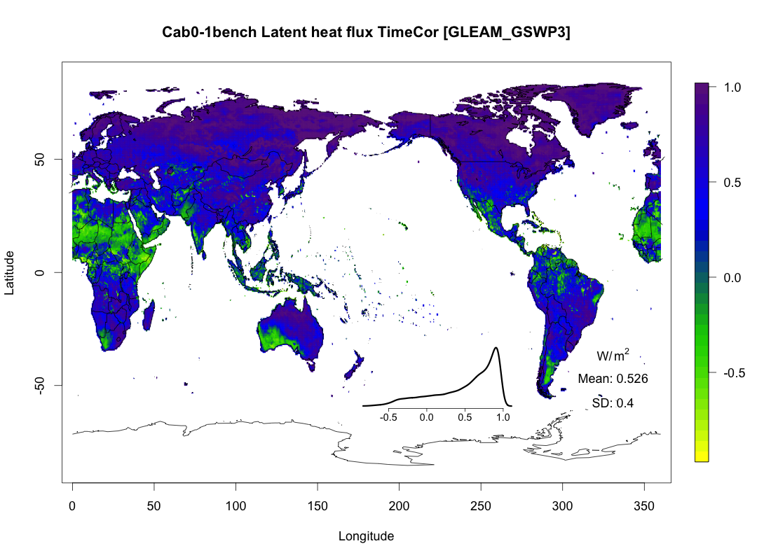
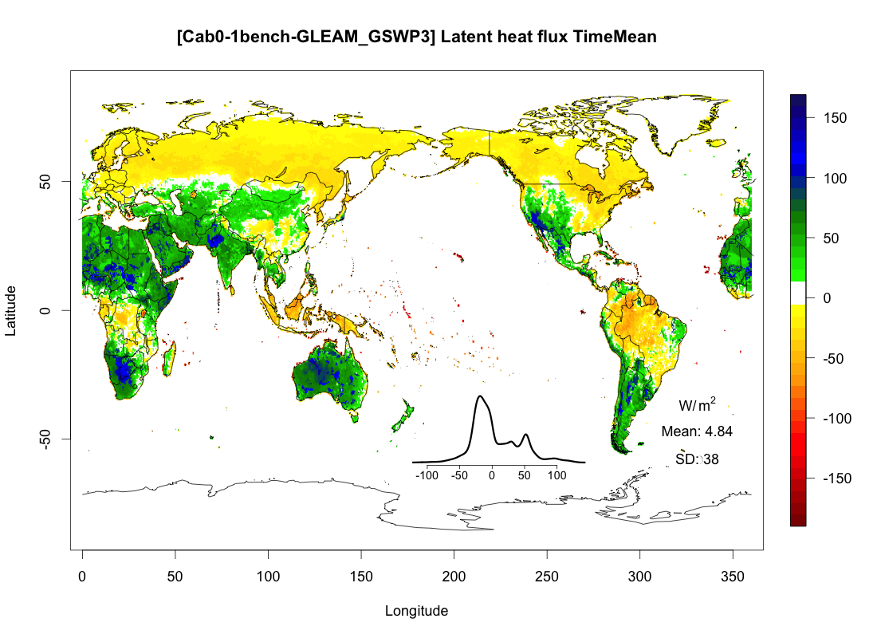
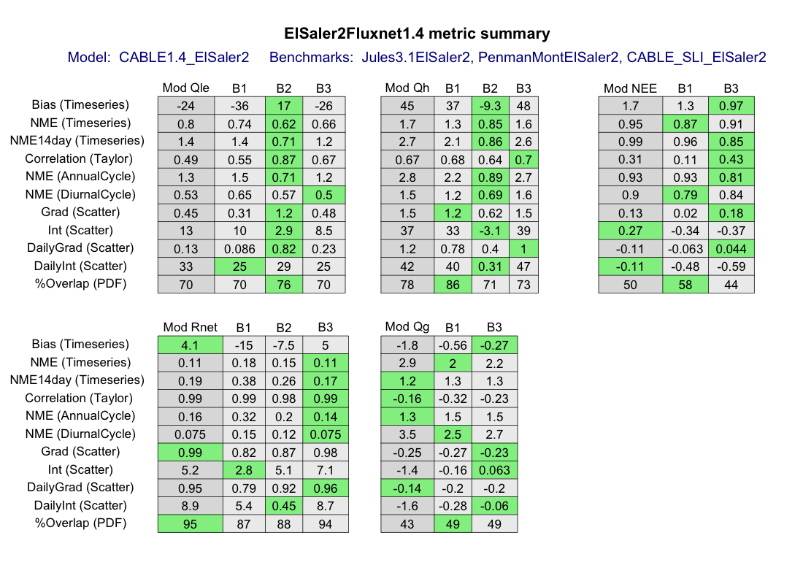


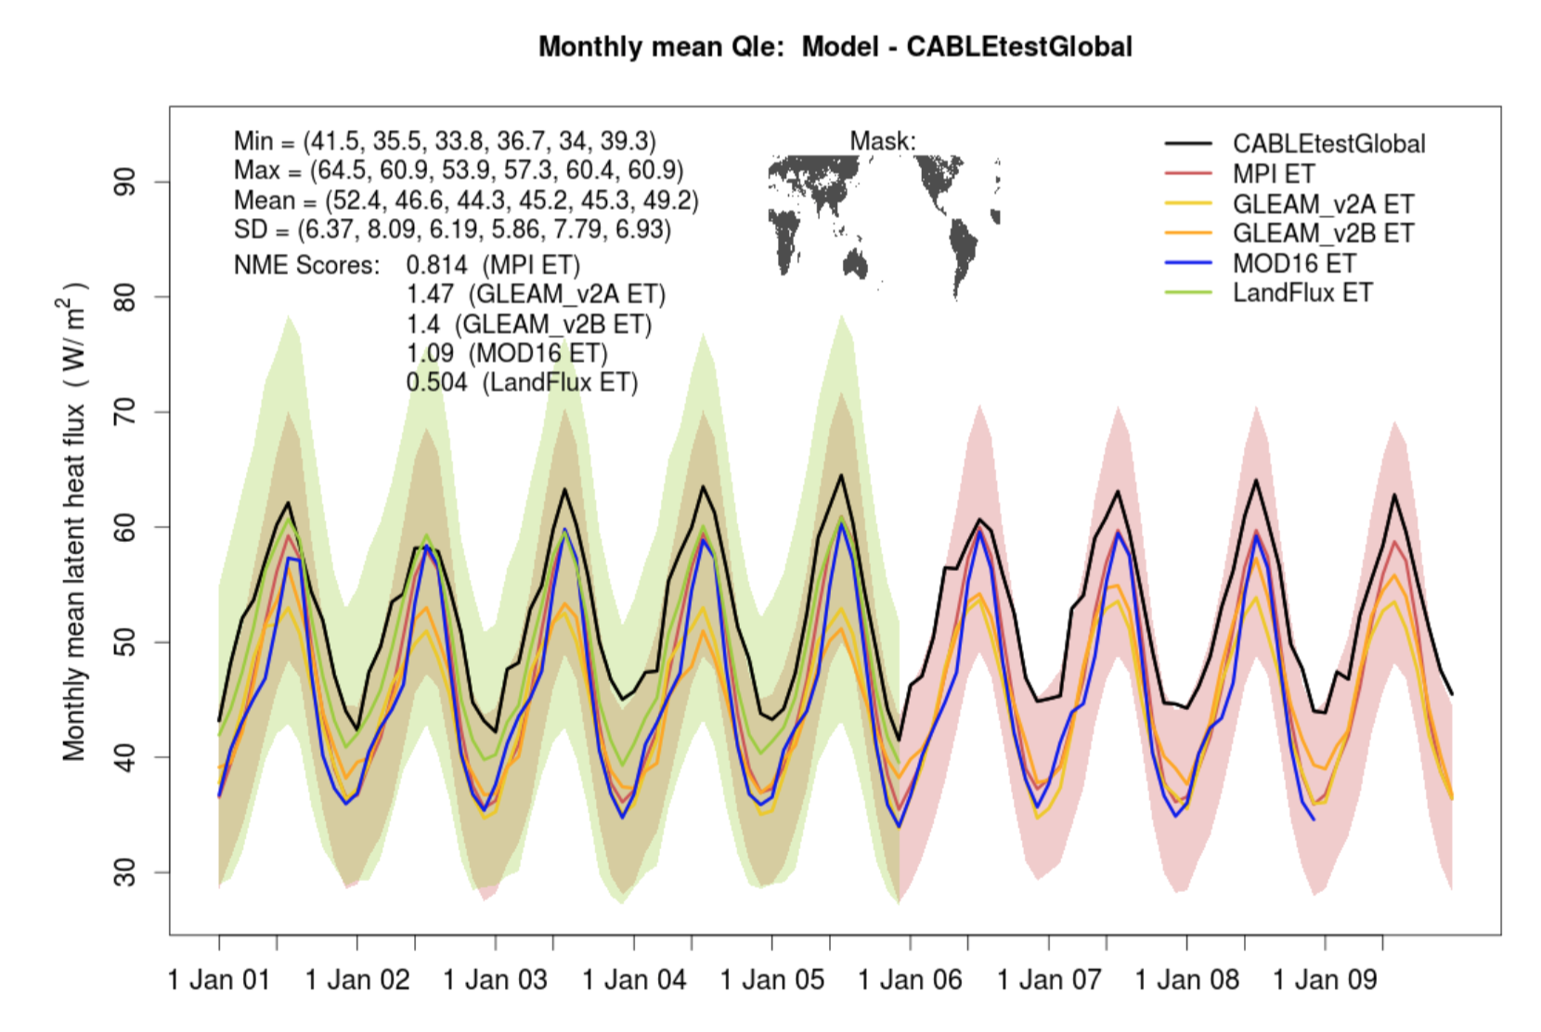
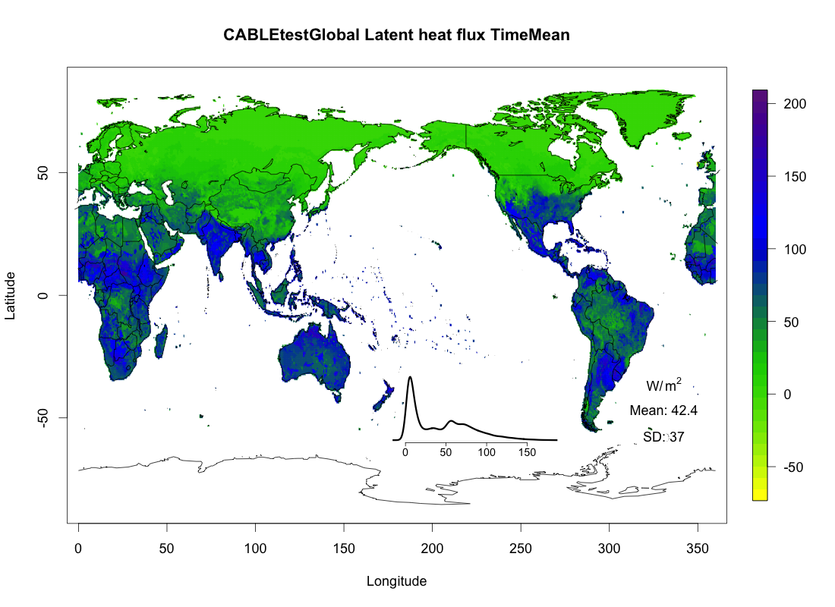
What’s new in PALS phase 2
[What is it?]
Analysis not specific to particular package / language (e.g. R, Python, NCL, Matlab, Fortran etc all possible) – ILAMB, LVT, PALS
Information sent to the Analysis Script when a Model Output is uploaded to a given Experiment (including paths, meta-data):
All Data Sets associated with the Experiment
All Model Outputs that have been uploaded to the Experiment (within current Workspace)
Model Output that is being uploaded and is triggering the analysis
User’s nominated Benchmarks associated with this Model Output
Master Analysis Script
(Editable by workspace owner)
16

Slide 17
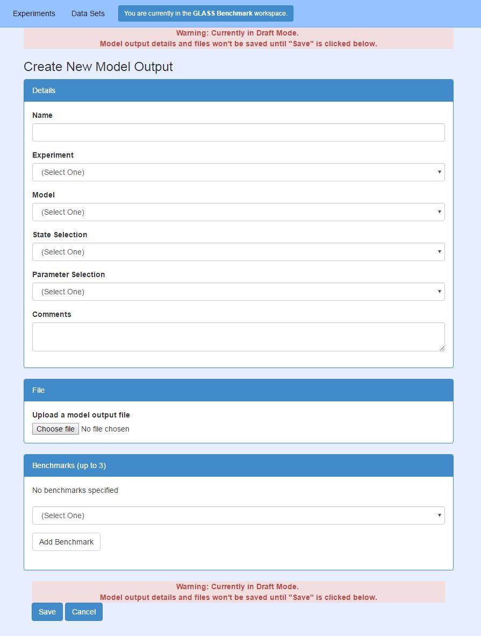
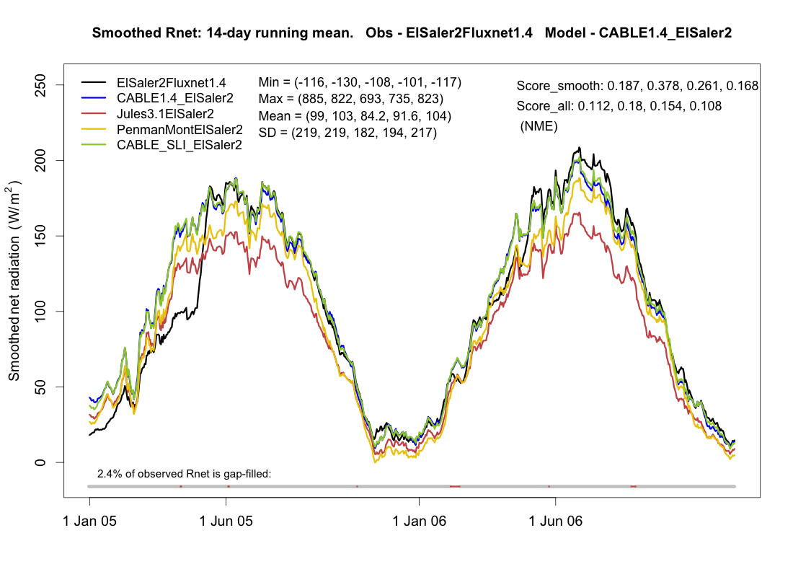
What’s new in PALS phase 2
[What is it?]
Benchmarks
Now defined by the user – choice of up to 3 model outputs that has already been submitted to an Experiment:
Previous model versions
Other LSMs you’re jealous of
Empirical benchmarks as before (but are now created and submitted manually)
17
Notes:
17

Slide 18
PALS: Outline of Future Work [Update]
System is up, functioning, but still needs thorough testing.
Partial funding secured for 2018
PLUMBER2 will be its initiation - planning meeting in May 2018
All source code is public on BitBucket
18
Notes:
18

Slide 19
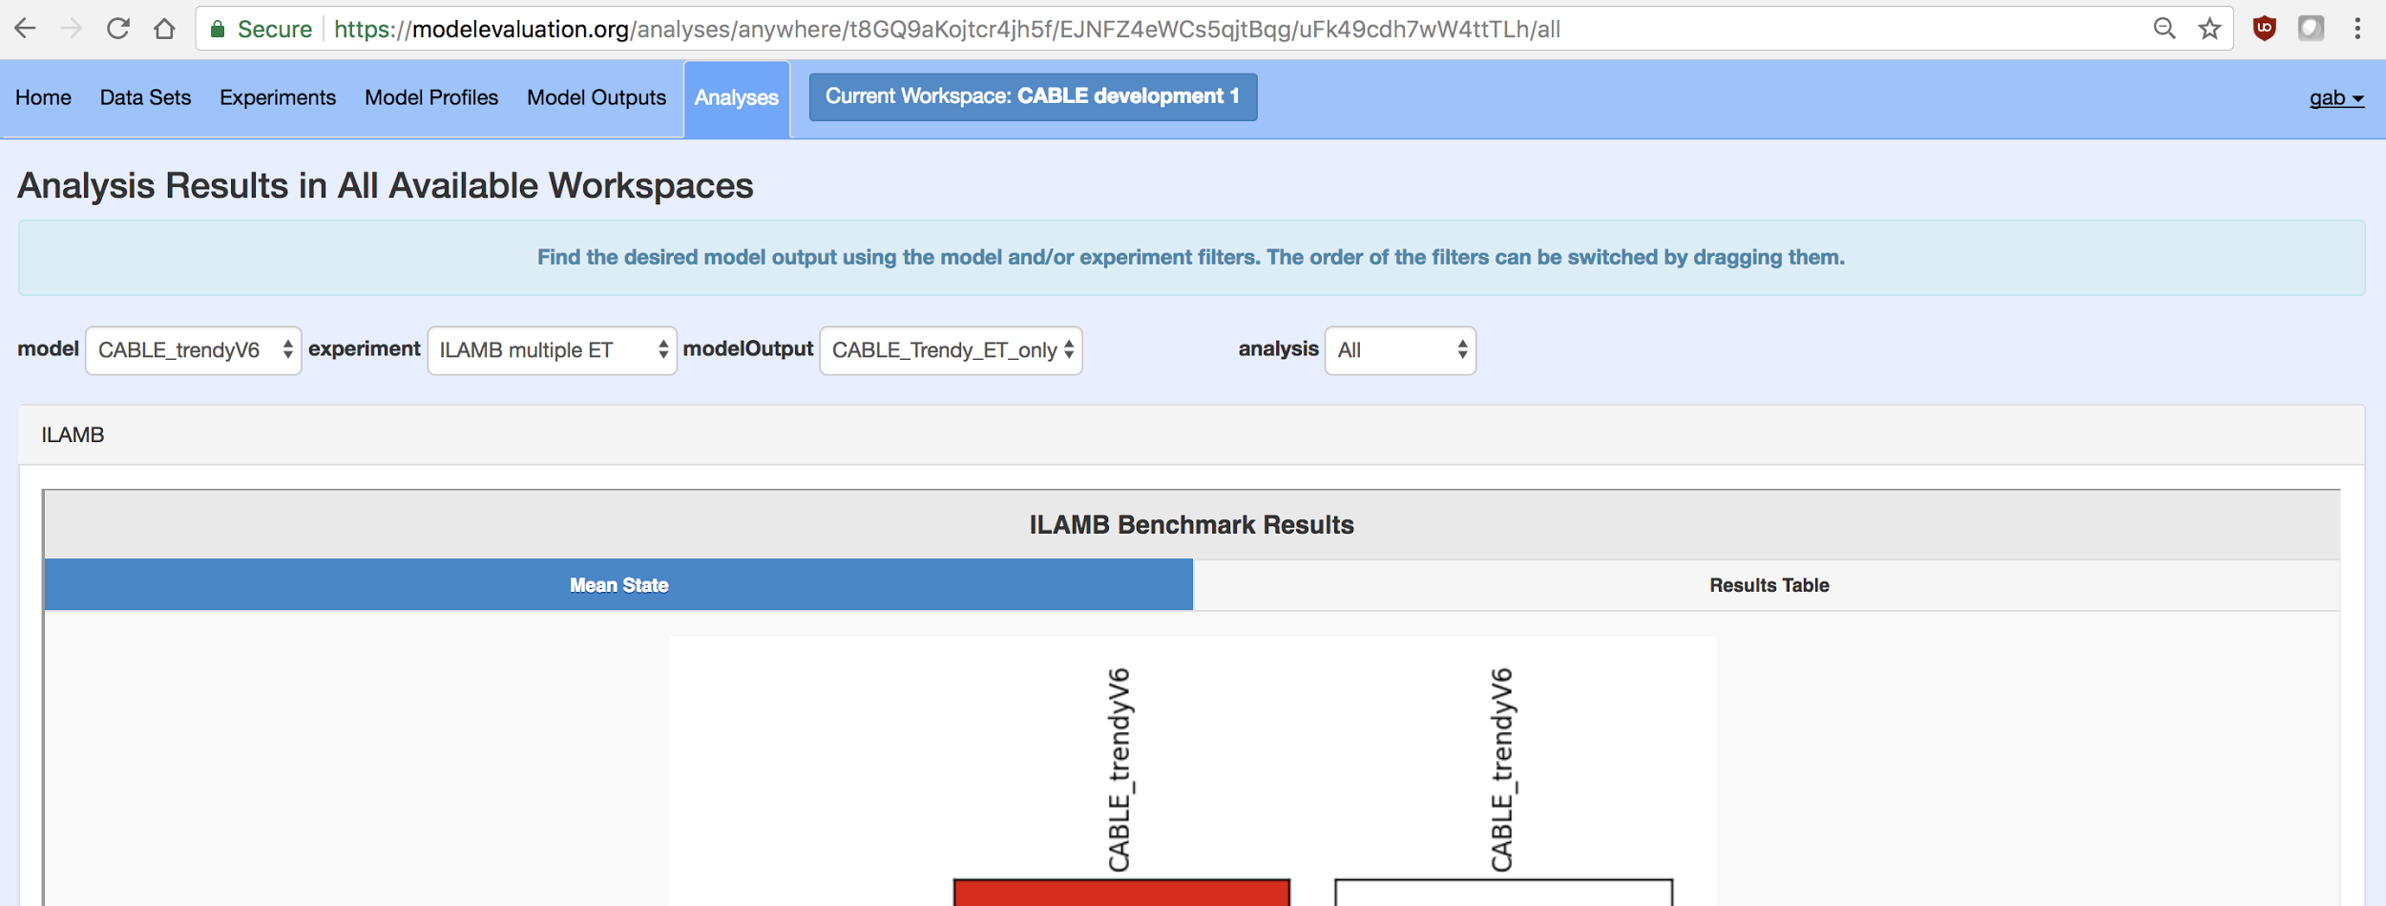
PALS: Outline of Future Work [Update]
Integration of ILAMB into PALS is well advanced (Figure below)
Developing distributed architecture that will allow analysis to be co-located with big model outputs (no need to upload them)
Attempt to be increasingly strict about enforcement of provenance and ancillary data collection
19
Notes:
19

Slide 20
The PALS Land sUrface Model Benchmarking Evaluation pRoject (PLUMBER) [What is it?]
MIP that compared LSMs to benchmarks – i.e. defined performance expectations a priori, before simulations are submitted
Two 1st generation LSMs and 3 empirical models constitute the ‘benchmarks’
15 LSMs, 20 flux tower sites across 9 IGBP vegetation types / 5 continents, sensible and latent heat flux, 8 metrics.
Empirical models were only used out-of-sample – they were not compared to LSMs at sites that are used to train them.
While LSMs perform markedly better than 1st generation LSMs, they perform poorly against empirical models, especially for sensible heat flux
20
Notes:
20

Slide 21
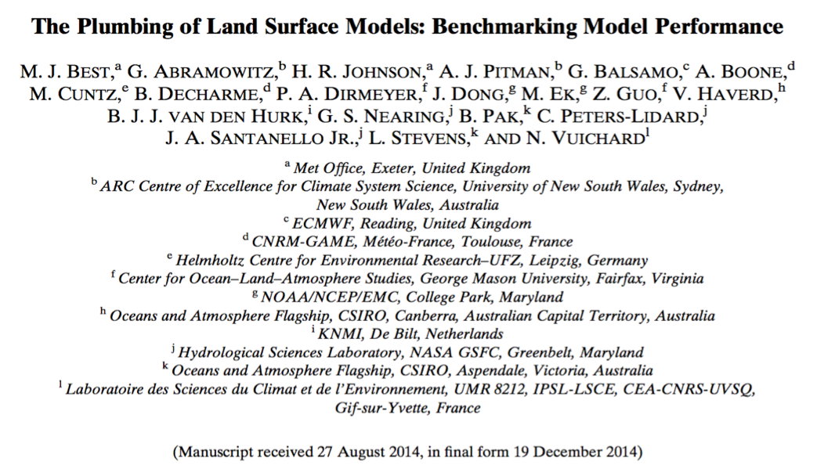
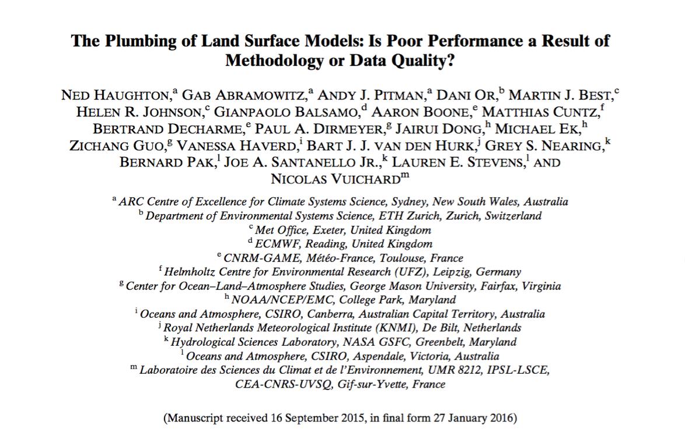
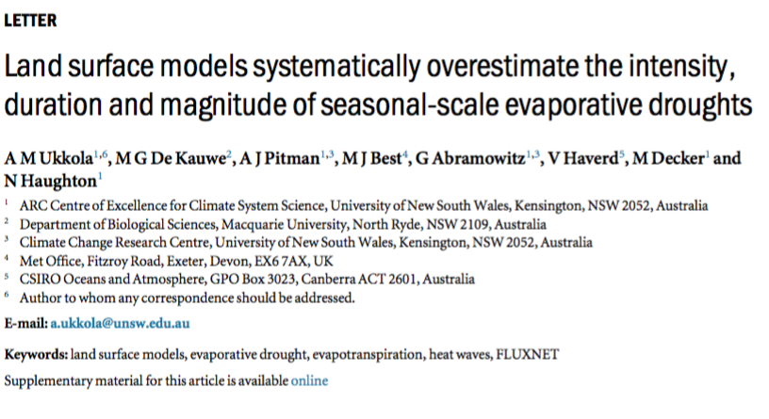
PLUMBER [What is it?]
Participants/Institutes/Contributions
15 different LSM variants participated, including from UKMO, ECMWF, CNRM, LSCE, NOAA, NASA, COLA, CSIRO.
Two papers in JHM (2015, 2016) on PLUMBER work, each with 20+ mostly GLASS coauthors, lead by Martin Best (UKMO) and Ned Haughton (UNSW) – first has 60+ cites so far (G Scholar)…
Other work (e.g. Ukkola et al, 2016, ERL; Haughton et al, 2017; Nearing et al, submitted) using PLUMBER data continues...
21
Notes:
21

Slide 22
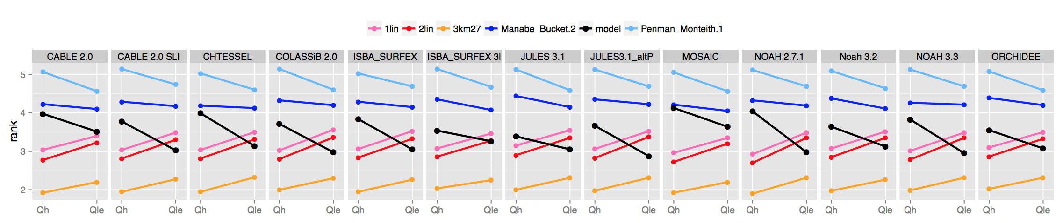
Headline result from PLUMBER [What is it?]
After Best et al, 2015, JHM
Vertical axis: rank of each LSM (black) against the 5 benchmarks, averaged over:
20 Flux tower sites, 4 metrics: bias, correlation, SD, normalised mean error
On average, LSMs outperform Penman-Monteith and Manabe bucket
On average, LSMs sensible heat prediction is worse than an out-of-sample linear regression against downward SW radiation
For all fluxes, models are comfortably beaten by out-of-sample regression against Swdown, Tair and RelHum
22
Notes:
22

Slide 23
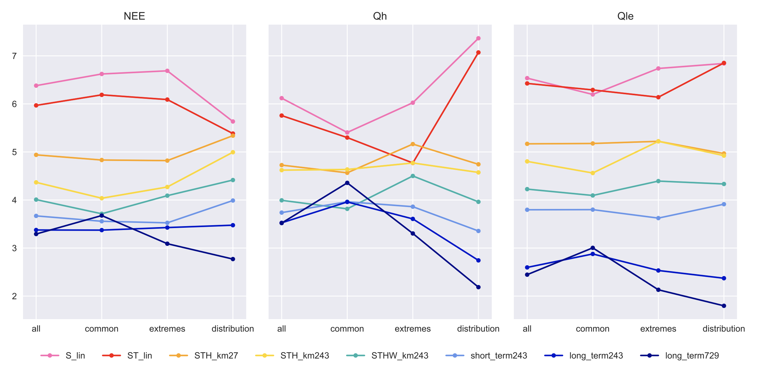
PLUMBER [Update]
Recent paper (Ned Haughton, UNSW; GMS, 2017) extended PLUMBER hierarchy of empirical models used for benchmarking.
Pink, red, orange are original PLUMBER empirical benchmarks
Additional improved 5 empirical models used greater non-linearity, additional inputs and lagged variables, but still no explicit soil or vegetation information
Improvements particularly good for distribution-based metrics (extremes)
23

Slide 24
PLUMBER future work [Update]
A second PLUMBER experiment is being to be planned. Several parties (incl non-GLASS) have expressed an interest in contributing new analyses:
Application of new empirical model hierarchy (earlier slide - Ned Haughton / Gab Abramowitz)
Expansion of tower sites to new Fluxnet dataset (~150 sites instead of 20); energy balance closure and quality control tighter than before (Anna Ukkola / Gab Abramowitz)
Information theory applications to benchmarking can quantify proportion of information used by LSM (Grey Nearing / Martyn Clark)
latent factor analysis exploring the similarity of LSMs (Sujay Kumar)
PALS / modelevaluation.org coupled to ILAMB will be available to host PLUMBER2.
PLUMBER2 planning meeting scheduled for 5 May before OSC and after GLASS panel meeting in Canmore
24

Slide 25
International Land Model Benchmarking (ILAMB) Project
[What is it?]
Building upon past model evaluation studies, the goals of the International Land Model Benchmarking (ILAMB) project are to:
Develop internationally accepted benchmark experiments for land model performance by drawing upon international expertise and collaboration
Promote the use of these benchmarks by the international community for model intercomparison
Strengthen linkages among experimental, remote sensing, and climate modeling communities in the design of new model tests and new measurement programs
Support the design and development of open source benchmarking tools.
25

Slide 26
ILAMB: Participants/Institutes/Contributions
[What is it?]
Project is mainly lead/funded through DOE Regional Climate Modeling Program. Project leadership team includes Forrest Hoffman (ORNL), Jim Randerson (UCI), Bill Riley (LBNL), David Lawrence (NCAR), and Gretchen Keppel-Aleks (U. Michigan).
Collaboration with PALS is actively underway (see PALS slides)
ILAMB is currently being utilized by the international land modeling research community.
ILAMB hosted a workshop in May, 2016 at DOE with approximately 50 participants from around the world. The workshop report, which was released in spring 2017, provides a roadmap for land model benchmarking/assessment activities going forward.
26

Slide 27
Examples/Samples Of Current Work:
Variables and Visualization within ILAMB [What is it?]
Currently integrates analysis of 25 variables in 4 categories from ~60 datasets
  Above ground live biomass, burned area, carbon dioxide, gross primary production, leaf area index, global net ecosystem carbon balance, net ecosystem exchange, ecosystem respiration, soil carbon
  evapotranspiration, latent heat, sensible heat, runoff, evaporative fraction, terrestrial water storage anomaly
  albedo, surface upward SW radiation, surface net SW radiation, surface
upward LW radiation, surface net LW radiation, surface net radiation
  surface air temperature, precipitation, surface relative humidity, surface downward SW radiation, surface downward LW radiation
Graphics and scoring system
  annual mean, bias, relative bias, RMSE, seasonal cycle phase, spatial distribution, interannual variability, variable-to-variable
  Global maps, time series plots averaged over specific regions, individual measurement sites, functional relationships
27

Slide 28
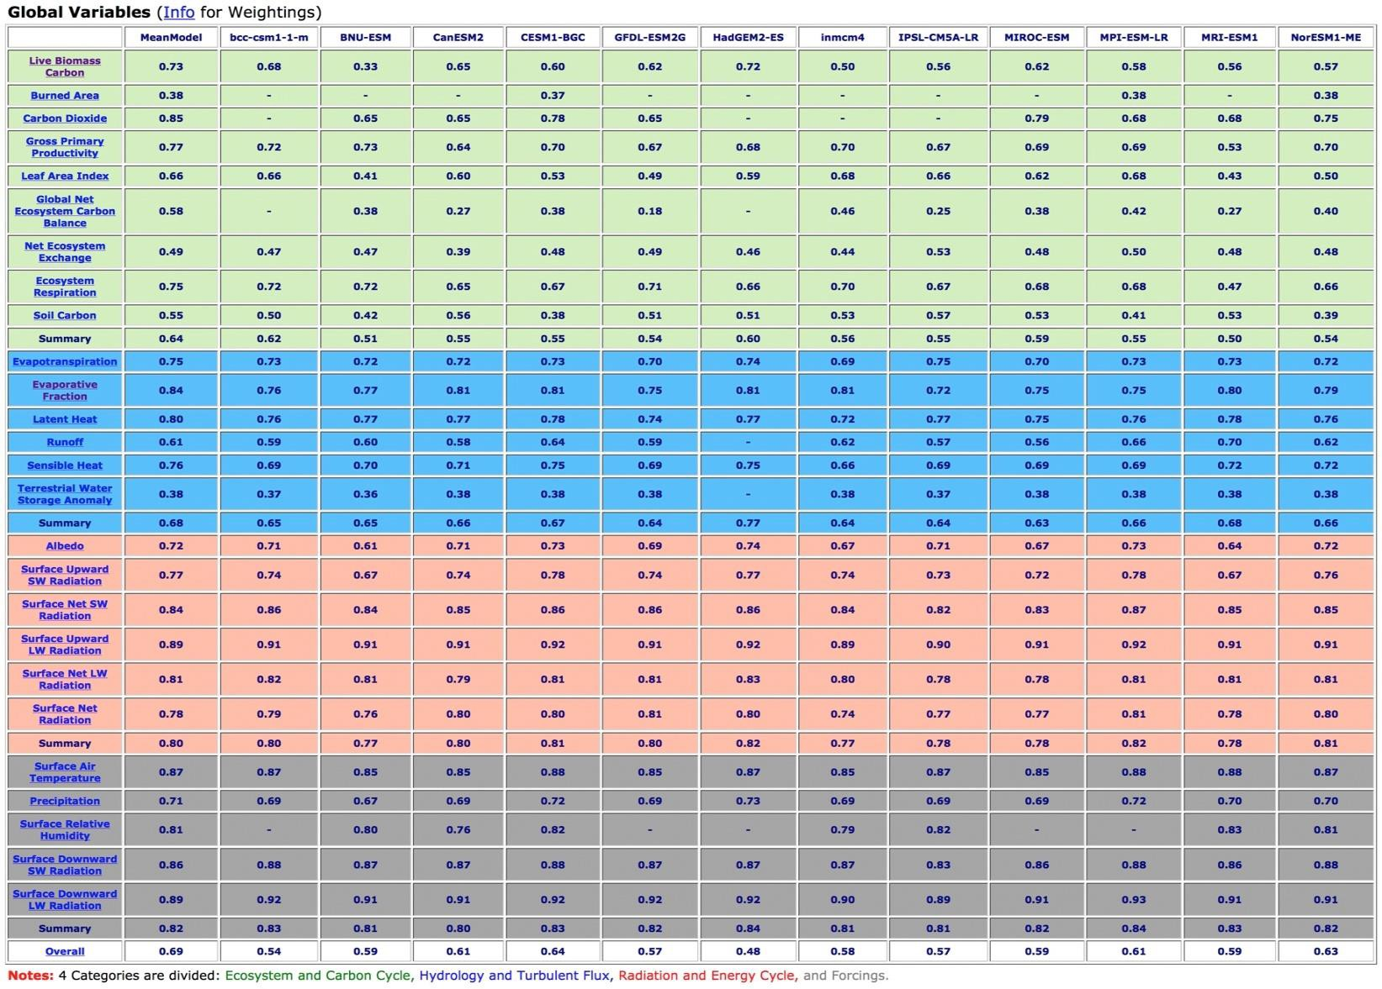
Examples/Samples Of Current Work:
ILAMB global analysis summary table [What is it?]
28

Slide 29
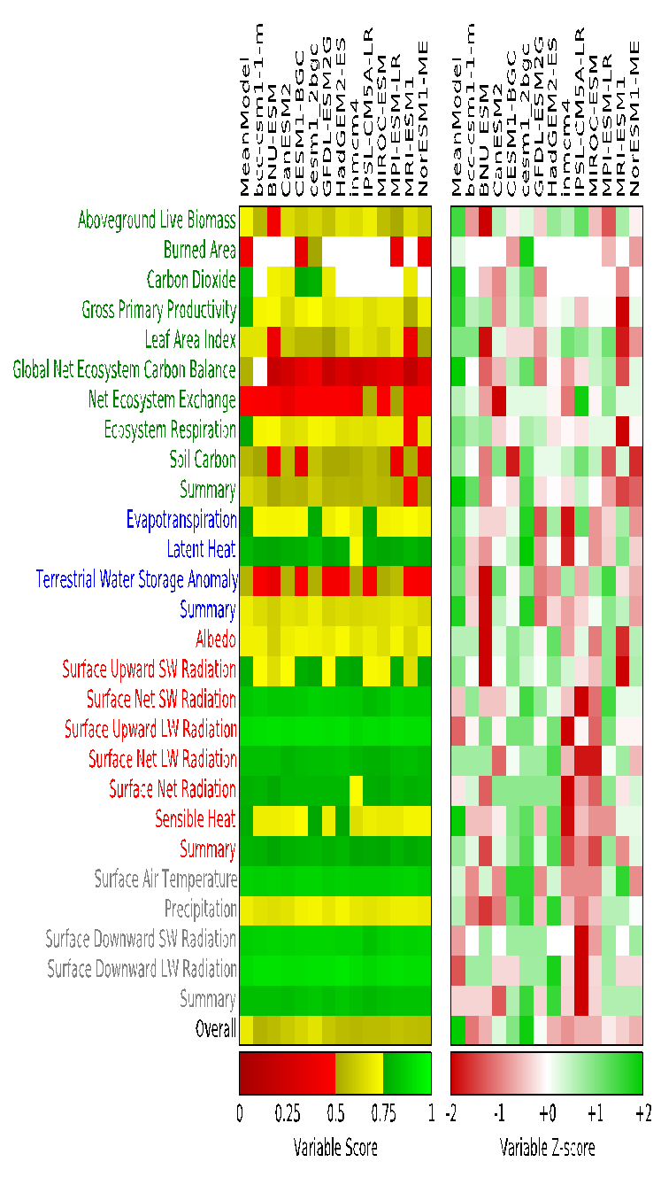

ILAMB Examples/Samples [What is it?]
29

Slide 30
ILAMB: Outline of Future Work [Update]
ILAMB continues to be augmented with new metrics introduced by international collaborators.
ILAMB will be utilized in CMIP6 assessments, including assessments of LS3MIP land-only simulations.
Integration with PALS is being actively pursued (see PALS slides).
30

Slide 31
GSWP3 and LS3MIP [What is it?]
LS3MIP: Land surface, soil moisture and snow model intercomparison project
Part of the CMIP6 experiment suite.
Assess land surface, snow, soil moisture feedbacks on climate variability and climate change, including:
land-atmosphere coupling and its impacts (for climate trends, water resources, predictability);
linking patterns and trends of ECVs to land model properties and biases;
mapping (uncertainty of) water resources over the 20th century (and beyond);
explore model-dependent land-atmospheric coupling;
investigate the ability of climate models to capture observed rates of spring snow cover
understand the linkage between snow-albedo feedback and 21st century warming
LS3MIP focuses primarily on the physical system (carbon cycle and vegetation dynamics covered in more depth by CMIP complements C4MIP and LUMIP, respectively)
Two phases: LMIP (offline) and LFMIP (online, with Feedbacks).
Compare CMIP6 historical and DECK simulations with observations.
Examine changes to energy and water cycles through the historical period through to projected futures.
Coordinated SnowMIP model intercomparisons.

Slide 32
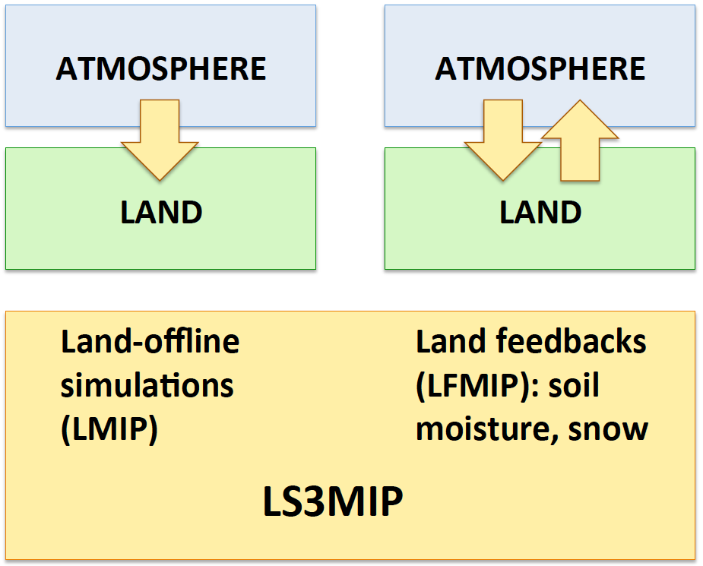
GSWP3 and LS3MIP [What is it?]
LS3MIP =
LMIP
+ LFMIP
[+ ESM-SnowMIP]
GEWEX + CLiC
GSWP3
32
Notes:
32

Slide 33
GSWP3 and LMIP goals [What is it?]
Estimation of terrestrial energy/water/carbon balance and variability during 250-years (1850-2100).
Evaluation/benchmarking of state-of-the-art land surface schemes of ESMs (GSWP3/LMIP) and additional models of broader fields (GSWP3-ISIMIP).
Data production as a long-term land reanalysis with periodical update (GSWP3).
33
Notes:
33

Slide 34
LFMIP [What is it?]
LFMIP experiments include land-atmosphere as well as land-atmosphere-ocean coupled simulations, with combinations of prescribed land conditions, sea surface temperatures and smoothed boundary conditions used to asses the roles of land-climate and land-climate-ocean feedbacks on ECVs and seasonal predictability.
34

Slide 35
Participants of LMIP [What is it?]
Model name | Institute | Country
ACCESS | CSIRO/Bureau of Meteorology | Australia
ACME Land Model | U.S. Department of Energy | USA
BCC-CSM2-MR | BCC,CMA | China
CanESM | CCCma | Canada
CESM | NCAR | USA
CMCC-CM2 | Centro Euro-Mediterraneo sui Cambiamenti Climatici | Italy
CNRM-CM | CNRM-CERFACS | France
EC-Earth | SMHI and 26 other institutes | Sweden and 9 other European countries
FGOALS | LASG, IAP, CAS | China
GISS | NASA GISS | USA
IPSL-CM6 | IPSL | France
MIROC6-CGCM | AORI, University of Tokyo | Japan
MPI-ESM | Max Planck Institute for Meteorology (MPI-M) | Germany
MRI-ESM1.x | Meteorological Research Institute | Japan
NorESM | Norwegian Climate Service Centre | Norway
hadGEM3 | Met Office | UK
35

Slide 36
Participants of GSWP3 [What is it?]
EXP1 Fast-track (1901-2010)
Actual Phase of EXP1 will have more participants also from different communities (e.g., LSMs of LS3MIP, hydrological & ecosystem models from ISI-MIP & Trendy)
Model name | Institute | Country
CLM | NCAR | USA
ISBA | MeteoFrance | France
MATSIRO | University of Tokyo | Japan
TESSEL | ECMWF/KNMI | UK/Netherland
WBM | ETH | Germany
36
Notes:
36

Slide 37
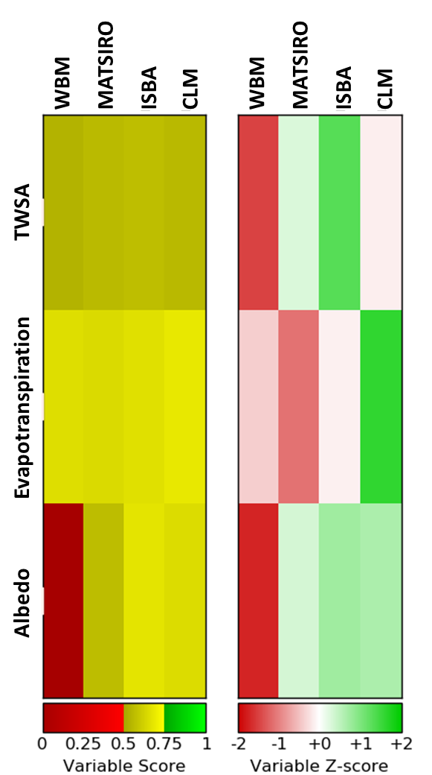
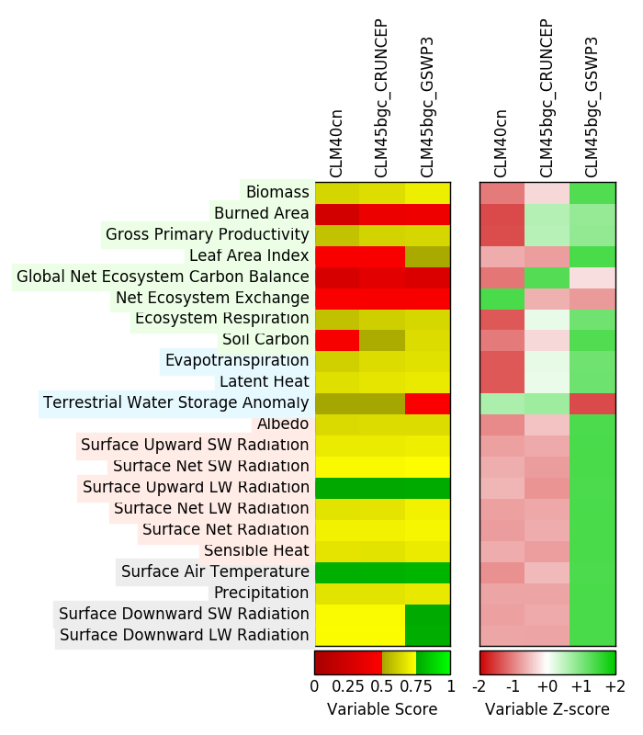
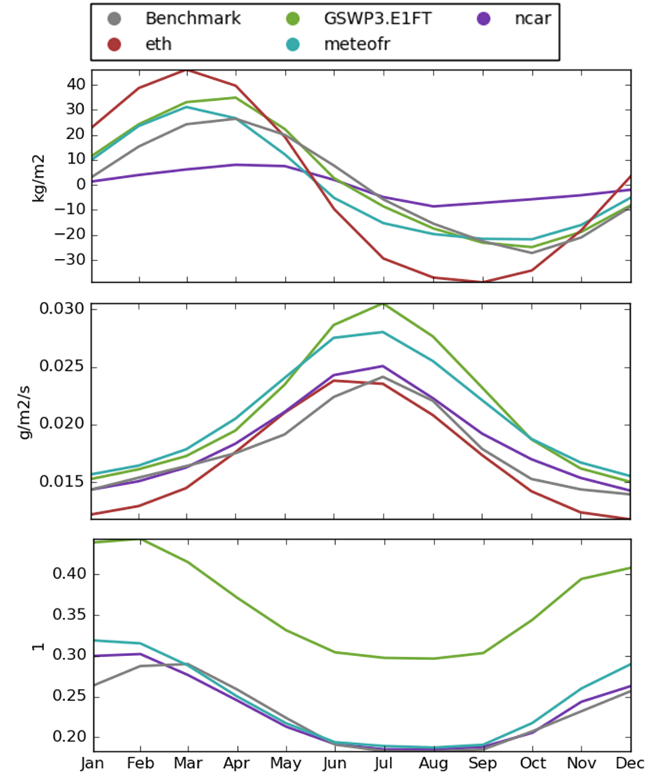
GSWP3/LMIP: [What it is? --previous analysis]
EXP1 Fast-track results are being analyzed.
Forcing data (beta version) is being tested/updated.
Benchmarking skill gain between model version-up (CLM 4.0 -> 4.5) and switching forcing data (CRUNCEP→GSWP3)
Image courtesy of Dave Lawrence
37
Notes:
37

Slide 38
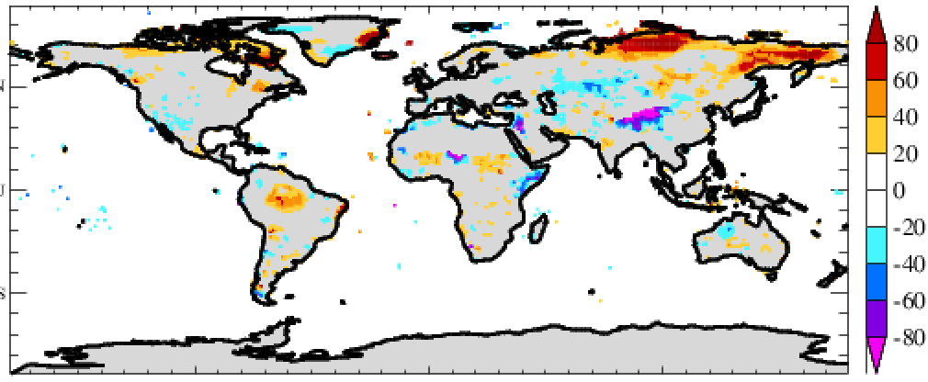
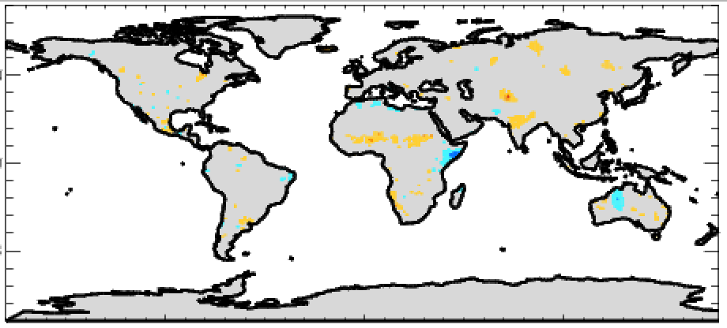
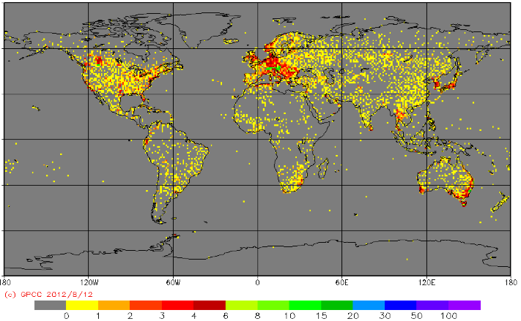
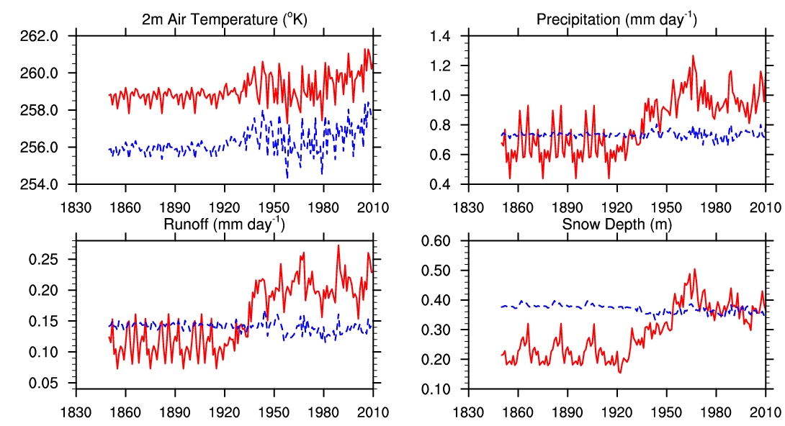
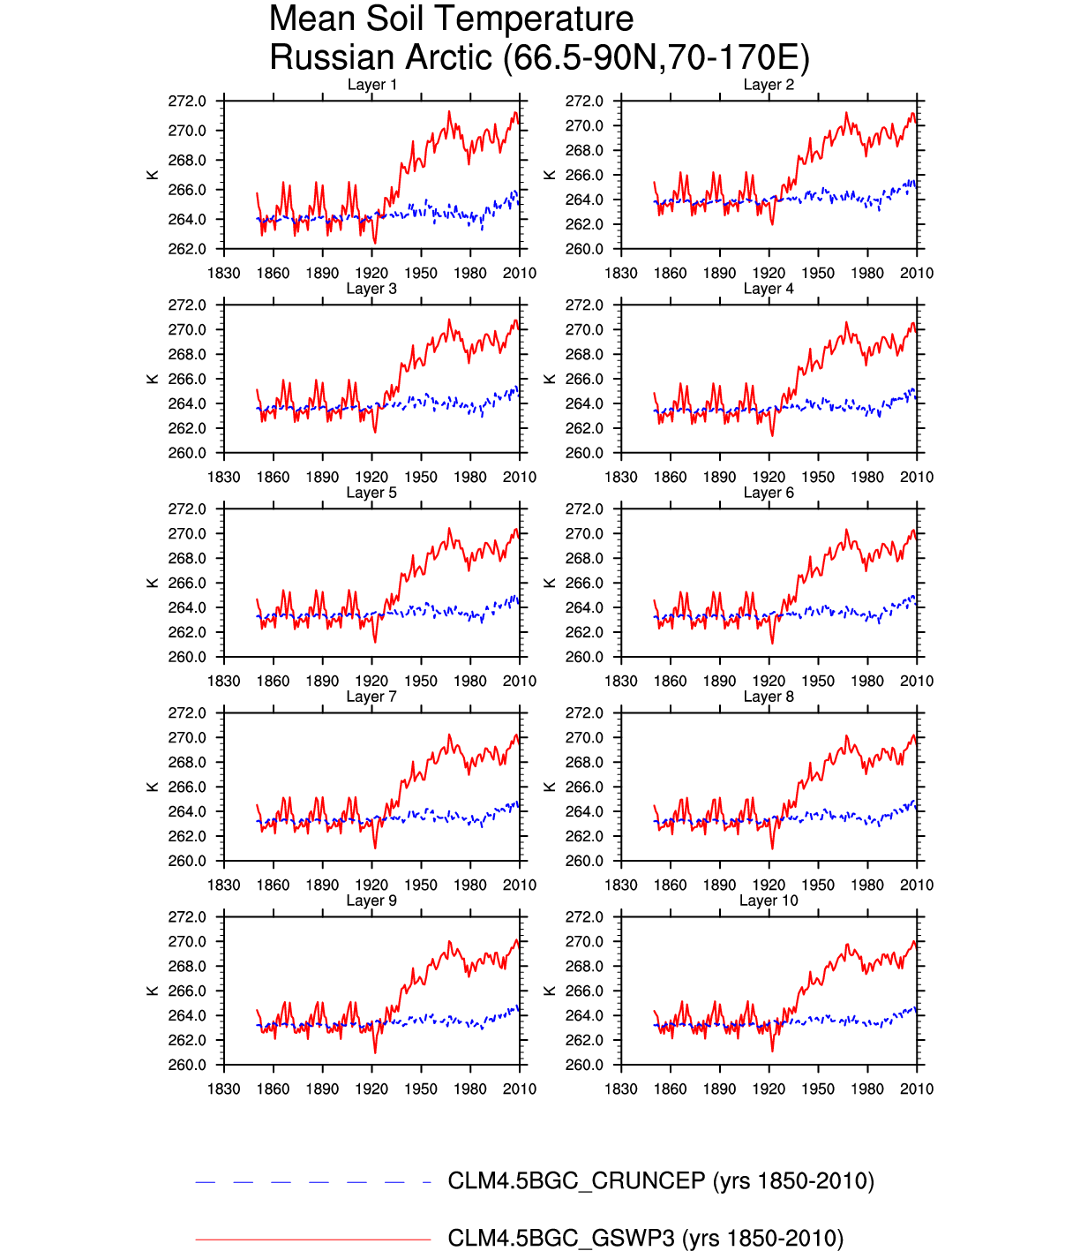
GSWP3/LMIP: [What it is? --previous analysis]
Know problems in forcing data
addressed:
Spurious precipitation trend during early 20th century over high latitude
GSWP3 (GPCC) 1901-1955 % change in P CRUNCEP (CRU)
# of stations per grid box GPCC
Analysis by D. Lawrence, NCAR
- Significant snow increase causes excessive runoff and snow insulation effect
- Correcting GPCC dataset
38

Slide 39
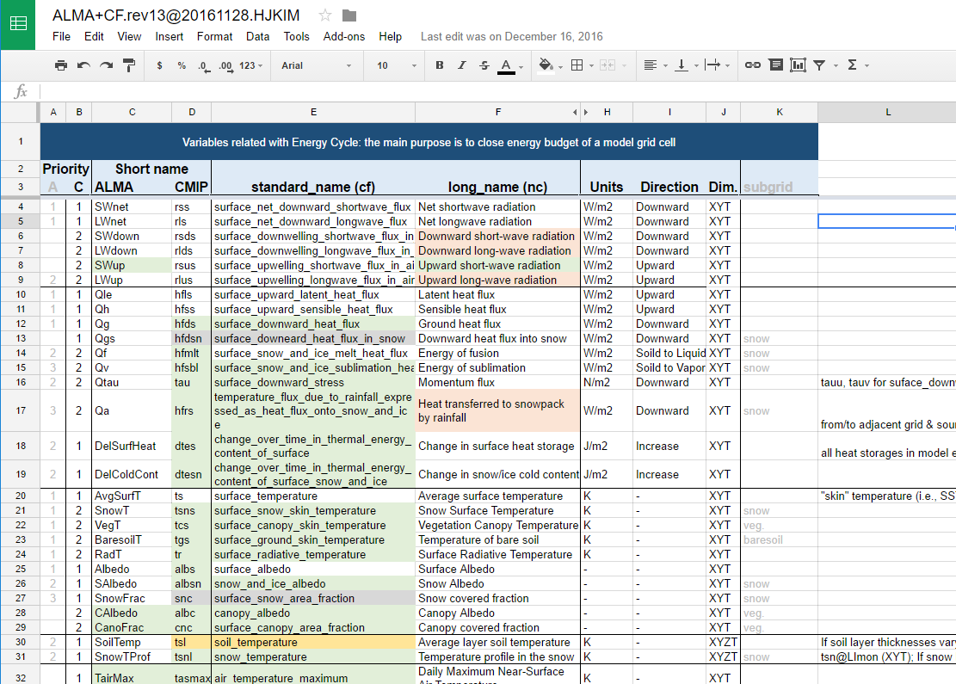
GSWP3/LMIP: [What it is?--previous analysis]
Housekeeping Variable Naming Convention
  Conversion table between ALMA and cf convention
  Update ALMA & Newly defined ~40 cf variables
  New variables, particularly, in cold process and water management
  https://goo.gl/DRXSey
Synergy with Other
Projects:
  ISIMIP (PIK)
  ESM-SnowMIP (CliC)
  SoilWAT (ISMC)
  PALS (GLASS)
  ILAMB (DoE)
39

Slide 40
GSWP3/LMIP: [Update]
Standard forcing data of GSWP3 EXP1 combines spectral nudging dynamic downscaling and bias correction techniques.
20Th Century Reanalysis is spatio-temporally disaggregated to 3-hourly T248 resolution using a global spectral model.
Multiple in-situ measured surface variables (i.e., precipitation, short-/long-wave downward radiation, and air temperature) were used to reduce intrinsic biases of the downscaled reanalysis fields.
Forcing data was frozen and formally released in early July 2017.
After the LS3MIP kick-off telecon September 2017, several technical issues on GSWP3 forcing V1 were raised including negative amount of snowfall and missing value over coastline due to land-sea mask mismatch.
GSWP3 V1.1 is being developed to be released in early 2018. The update will include an extended period up to 2014 as well (Hyungjun Kim)
Princeton forcing data V2 is available online which runs from 1948 until 2016, and V3 will become available later in 2017 (is it?) which will have assimilated station data (Justine Sheffield). Recommended versions will possibly change.
GSWP3-EXP2/EXP3 will follow after GSWP3-EXP1/LMIP (likely in 2018; also EXP2 depends on CMIP6/ScenarioMIP). Data Request of CMIP6-endorsed- MIPs is still being updated.
40

Slide 41
New project: GEWEX Soils Initiative (SoilWat) [What is it?]
How to improve interactions and integration of soil and subsurface processes in present climate models and other related activities of GEWEX.
Three subprojects came of this process that are now all active:
A survey of how basic soil processes are represented in climate models with emphasis on revisiting the pedotrasnfer functions used to convert soil information to parameters for modeling, led by Harry Vereecken and Anne Verhoef
Soil Parameter MIP, or SP-MIP aims to assess the utility of more resolved soil maps and conduct a sensitivity analysis to evaluate several climate models using old and new soil maps and parameters. Led by Lukas Gudmundsson and Matthias Cuntz
A survey of the groundwater database and investigation of strategies for incorporating groundwater in climate models, led by Stefan Kollet and Anne van Loon.
41

Slide 42
GEWEX Soils Initiative (SoilWat) [Update]
“Pedotransfer functions in Earth system sciences; challenges and perspectives” workshop at Fall AGU meeting (December 2017)
Status of these three subprojects (expanded from estimating soil hydraulic properties to other soil characteristics such as thermal properties, solute transport and root water uptake, soil carbon pools and nitrogen mineralization).
Six major actions:
Role of soil structure
Infiltration processes, thermal processes, from point to gridscale and upscaling
“Ksat” in models, but what values of saturation do exist; questions for measures and values
Biotic, biogeochemical processes PTFs, etc
Thermal data information; thermal conductivity
Soil freezing; how to enter soil freezing in LSM.
This effort will be included in some aspects of GLASS land model benchmarking
42

Slide 43
GLASS Projects – Land-Atmosphere Coupling
Water Mgmt
GABLS/DICE
ALMIP2
Scoring system:
LoCo – green
GABLS/DICE – green/orange
LUMIP
PLUMBER
ILAMB
LS3MIP
SoilWat
43

Slide 44
LoCo: Project Overview/Goals [What is it?]
LoCo WG: Joe Santanello (NASA/GSFC), Paul Dirmeyer (GMU),
Kirsten Findell (NOAA/GFDL), Pierre Gentine (Columbia Univ.),
Benoit Guillod (ETH), Craig Ferguson (SUNY-Albany),
Josh Roundy (U. Kansas), Ahmed Tawfik (NCAR)
LoCo: GEWEX-GLASS core theme to understand, model, and predict the role of local land-atmosphere coupling in the evolution of land-atmosphere fluxes and state variables, including clouds.
Answer the following questions:
1. What role do land-atmosphere interactions (i.e., coupling strength) play in hydrologic extremes and abrupt shifts in regional climate?
2. What are the trends in regional coupling strength over the period of record? Where has coupling enhanced (or suppressed) the global warming signal?
3. How do we measure and benchmark coupling?
LoCo WG continues to grow & support initiatives on L-A coupling, supporting a new generation of L-A coupling leaders–“incubator”!
44

Slide 45
Local Land-Atmosphere Coupling (LoCo) [What is it?]
The results of offline projects such as PILPS and GSWP are limited by the lack of atmospheric feedback, and GLACE cannot isolate and evaluate the processes implied in the coupling that lead to model development.
To accurately represent the relationship between soil moisture (SM) and precipitation (P) and coupling strength in models, it is necessary to carefully examine and quantify the full series of interactions and feedbacks (i.e., links in the chain) at the process-level, including the planetary boundary layer (PBL) feedback.
To this end, the LoCo initiative and WG was established over a decade ago to focus on development of quantitative process-based metrics/diagnostics of L-A coupling that could be applied equally to observations and models across scales.
45

Slide 46
LoCo: Participants/Institutes/Contributions
[What is it?]
The LoCo WG is comprised of ~15 GLASS panel and non-panel members. It is not meant to be exclusive, and has a high proportion of young scientists who have been motivated by L-A interaction studies.
LoCo has closest links with GASS/GABLS and DICE, due to the inherent importance of the PBL and model development focus in each. E.g., Joe and Mike are working on a paper bringing the LoCo metrics to bear on the DICE results.
46

Slide 47
LoCo Coupling Metrics Toolkit [What is it?]
Ahmed Tawfik (NCAR -> Raleigh, NC State): working on a land-atmosphere (L-A) coupling metrics toolkit written in modular Fortran 90.
Based on ‘cheat sheet’ compilation of Paul Dirmeyer.
Allow broader exposure/use of these techniques if metrics are well-documented, relatively standardized, and modular.
Release on github, after getting permission from various authors.
Metrics (e.g.):
The Heated Condensation Framework (completed).
Mixing diagram variables like Entrainment Ratios (completed).
RH-Tendency from Mike Ek's work (partially completed).
Intrinsic Biophysical Factors.
Soil Moisture Memory using lagged auto-correlation (not started yet).
Terrestrial Coupling Index via Paul's 2011 GRL paper (not started yet).
CTP-HI-low Findell metrics (not started yet) + Coupled Drought Index (J. Roundy).
47

Slide 48
LoCo: Connection to GLASS Community Projects [What is it?]
LoCo unique as a WG instead of a MIP, that contributes across projects from different angles and informs on future observing networks.
Diagnostics can be used in current GLASS efforts:
DICE: 1st order quantification of impact of land-PBL coupling in Single Column Model (SCM) framework over SGP; currently focus on one-at-a-time site evaluation of fluxes, PBL, etc.
PALS/Benchmarking: Looking ahead to distributed (spatial) benchmarking. Extend to examining coupled benchmarks (beyond offline). Single-site first, e.g. other DICE efforts, LoCo-AMMA(?).
Observations can be used in current GLASS efforts:
SMAP: Launched February 2015. Data available this summer, 9km soil moisture product every 2-3 days, SMAP call for proposals (May)
PBL Profiling: Still a ‘gap’ in Earth Observations, COSMIC GPS-RO proposal, ESA abstract (Oct 2015), NASA WG on PBL missions.
48

Slide 49
LoCo [Update]
The LoCo team led by Joe has submitted a manuscript to BAMS entitled: “Land-Atmosphere Interactions: The LoCo Perspective” which was accepted in December 2017. This paper highlights the first decade of LoCo research, including motivation, participants, projects, LoCo metrics and applications, collaborations, and future plans. See last slide.
There are many studies and publications from the WG in recent years focused on various metrics, models, and applications (see GEWEX-LoCo website and presentations from the panel).
Nice synthesis from Paul can be found here: http://cola.gmu.edu/dirmeyer/Coupling_metrics.html
LoCo coupling metrics toolkit from Ahmed can be found here:
http://www.coupling-metrics.com/
49

Slide 50
LoCo [Update]
Observations of L-A processes and the need for assessment/improvement continues to be a point of emphasis of the LoCo WG
  Focused on: PBL, soil moisture, and fluxes.
  Field campaigns
    Enhanced Sounding for Local Coupling Studies (ESLCS) @ SGP (Craig, Joe, Pierre) in Summer 2015
    Improved soil moisture and co-located L-A measurements from DOE-ARM (Joe, Pierre)
    NY State Mesonet (Craig)
    Land-Atmosphere Feedback Experiment (LAFE: Volker Wulfmeyer, NASA, NOAA) @ SGP in Summer 2017.
    The North American Monsoon GPS Hydrometerological Network @ SW US and Mexico, 20 June - 30 September 2017 (B. Lintner)
  In addition, Joe has received funding for Y2 for his Science Task Group at GSFC focused on PBL retrieval from space.
50

Slide 51
LoCo future work [Update]
A three-pronged approach continues to be in place for LoCo development :
  a) Continue to follow and broaden the science of LoCo & WG membership
    Suggestions: snow, geology, carbon, LULCC, momentum, radiation, fluorescence, monsoon – each are evolving naturally via independent research
    Observations: Pushing for new/better measurements of soil moisture (e.g. exploiting SMAP), fluxes, and PBL. Newly funded NSF project called ‘GRAINEX’ will provide excellent L-A observations over Nebraska focused on irrigation impacts on L-A coupling.
  b) Synthesize what we have now in terms of metrics and message
      BAMS article designed to provide a foundation for LoCo
      Cheat sheets, CoMeT resources
  c) Engage and entrain the operational/model development community
    CMIP6 variable request – didn’t go well. Too late, contacts too busy. Need to be more proactive for next round and new/other MIPs.
    Mike’s idea for distributed coupled testbeds (inc. PBL)
51

Slide 52
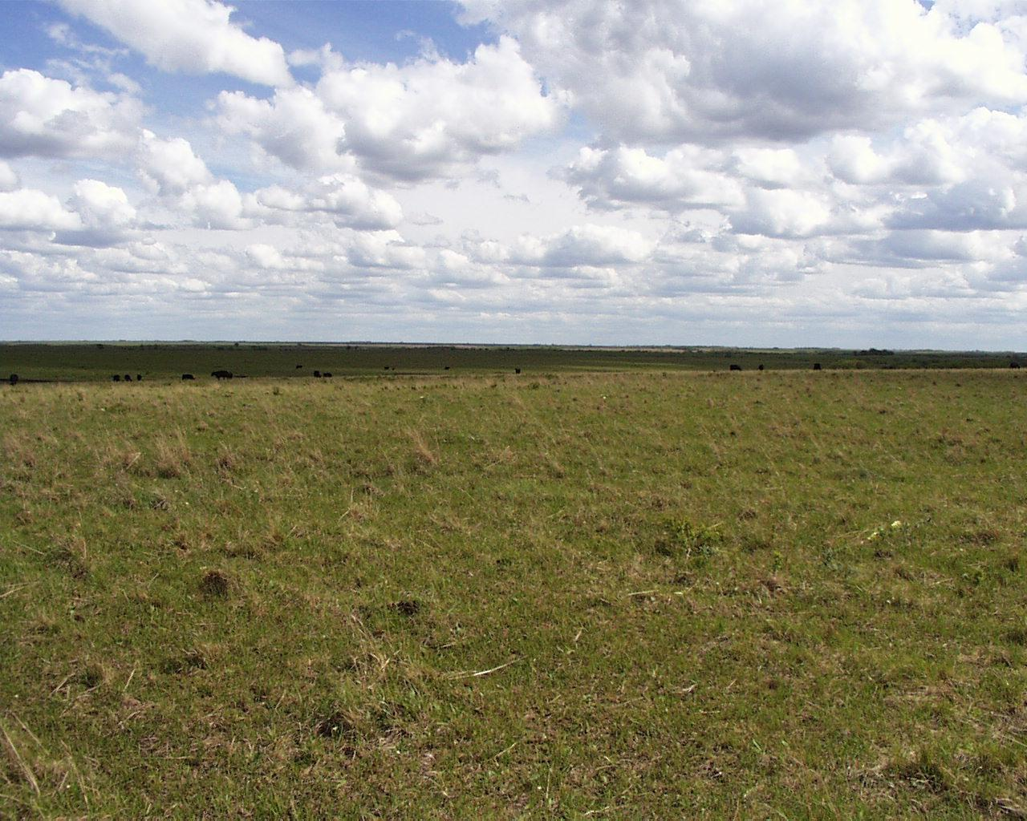
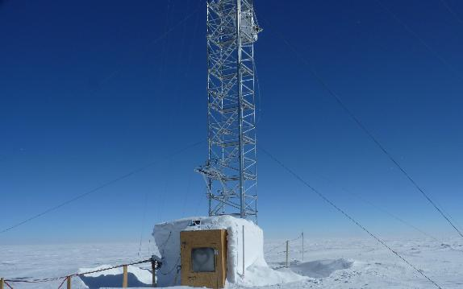
Diurnal land/atmosphere coupling experiment (DICE)
[What is it?]
Study the interactions between land-surface & atmos. boundary layer.
Joint GLASS (land) - GASS (PBL/atmos.) project; follow on to GEWEX Atmospheric Boundary Layer Study (GABLS) #2, where land-atmosphere coupling was identified as a important mechanism.
Leads: Adrian Lock &
Martin Best (UKMO)
“DICE-Over-Ice” (GABLS4)
Dome C - Antarctica
CASES-99 Experiment
Southern Great Plains, USA
Leads: Eric Bazile, Fleur Couvreux, Patrick Le Moigne
(Météo-France, CNRM/GAME)
Objective: Assess impact of land-atmosphere feedbacks.
Stage 1: stand alone land, and single column model (SCM) alone.
Stage 2: Coupled land-SCM.
Stage 3: Sensitivity of LSMs & SCMs to variations in forcing.
  Findings so far: Differences in models’ (LSM+SCM) sensitivity to changes in forcing likely important in GCMs; needs better understooding. Examine further: surface momentum flux & profiles; large errors in evaporation dominate signal and impact of coupling; nocturnal fluxes/boundary layers, soil-surface coupling.
  GABLS4 or “DICE-over-ice”: Antarctica, snow/ice and strongly stable conditions.
52
52

Slide 53
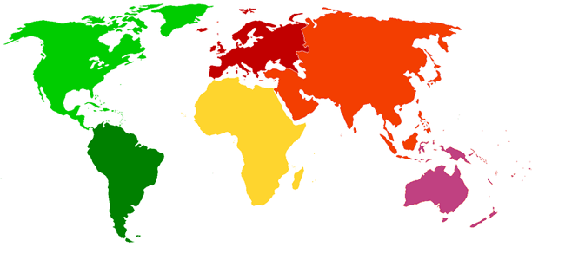
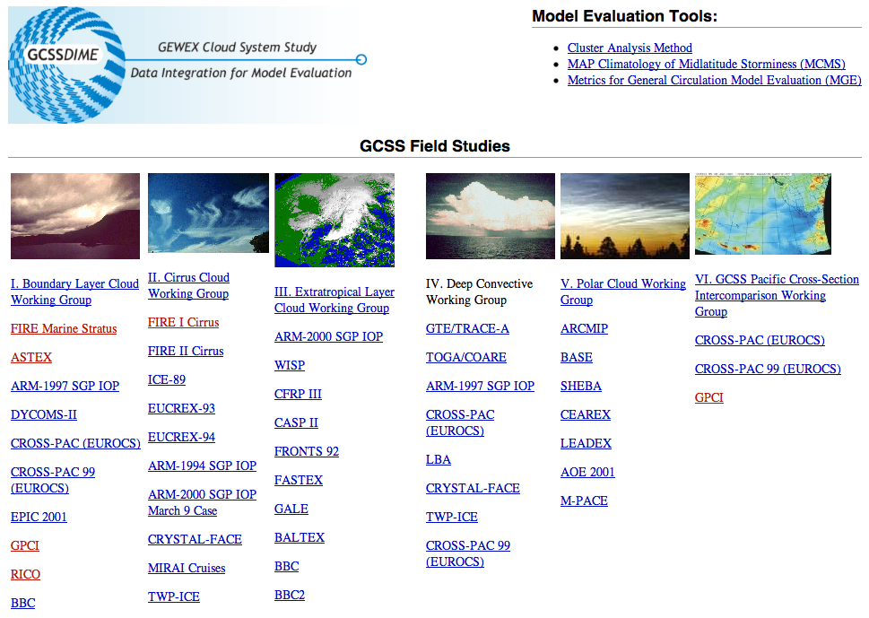
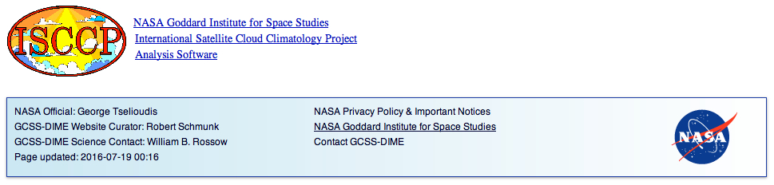
Possible Future DICE efforts: Field Programs for Model Development (land, ice, even ocean) [Update]
SHEBA
NOPEX
BOREAS
Cabauw
Lindenberg
SGP
HAPEX-MOBILHY
FIRE,
DYCOMS
BLX
FIFE
ASTEX
EFEDA
CASES
(DICE-1)
IHOP
LASPEX
HAPEX-Sahel
GATE
TIWE
TOGA-COARE
LBA
Data Mining:
A sampling…
EPIC
Wangara
Antarctica/Dome C
(GABLS4/DICE-over-ice)
Leverage a
GCSS-DIME-like
approach with
many SCM
data sets
Land-Surface “Fluxnet”, Tower data sets, Ship measurements, Radiosondes, Aircraft obs.
53

Slide 54
DICE updates/comments on DICE future [Update]
Martin Best (former GLASS co-chair, but we won’t let him go!)
•Adrian Lock (UKMO) and I are still trying to write up some DICE papers.
•More DICE sites: careful design needed to ensure you can get some proper results out of it, and not just that the models are different.
•Need to have good observational dataset with everything co-located.
•I am hoping that LIAISE can be set up to tackle this…
•We are thinking that some sort of surrogate experiment where we use LES to generate “obs” might be the way to go for the next DICE.
John Edwards (GLASS-GASS liaison)
•Traditionally GABLS (DICE) concentrated on process modelling (~1 day), while PALS/PLUMBER are focused on longer timescales. Focus on diurnal cycle, or do we want to go for the seasonal scale too?
•Need to keep LES studies onboard
•Stable boundary layers, heterogeneity
•Shopping list of cases: vegetated site w/nearly saturated soil (simpler hydrology/physiology), snow surface (beyond GABLS4?), very dry soil site, sparsely vegetated site (LIAISE?)--most focus on dense canopies.
•Benchmarks with better data or ways of initializing the model, like CASES-99, ARM data.

Slide 55
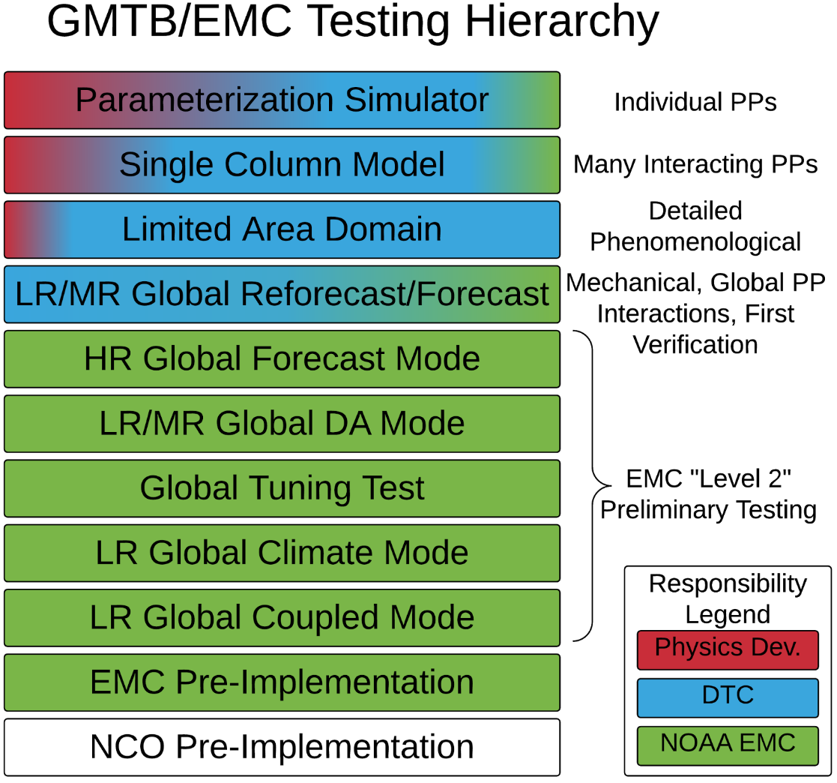
Diurnal land/atmosphere coupling experiment (DICE), and other GLASS/GASS, related initiatives [Update]
The Global Model Test Bed (GMTB) is funded by the NOAA Next-Generation Global Prediction System to foster community involvement in the development of NCEP’s global prediction systems
NCAR & NOAA Lab (Boulder)
GMTB activities
Development and maintenance of testing infrastructure
  Single column model, global workflow, verification, diagnostics
Testing and evaluation
Common Community Physics Package
  A collection of physical parameterizations, grouped in suites, that can be used with multiple dynamic cores
  A framework that enables collaborative development and R2O

Slide 56
GLASS Projects – model-data fusion
Water Mgmt
GABLS/DICE
ALMIP2
Scoring system:
LUMIP – green
PILDAS – orange/red
ALMIP2 – green
Human/Water Mgmt – green
LUMIP
PLUMBER
ILAMB
LS3MIP
SoilWat
56

Slide 57
Land Use Model Intercomparison Project (LUMIP)
[What is it?]
What are the effects of LULCC on climate and biogeochemical cycling (past-future)?
What are the impacts of land management on surface fluxes of carbon, water, and energy and are there regional land-management strategies with promise to help mitigate against climate change?
Three activities:
  Development of an updated and expanded historical and future land-use dataset
  An experimental protocol for specific LUMIP experiments for CMIP6
  Definition of metrics and diagnostic protocols that quantify model performance, and related sensitivities, with respect to LULCC.
57

Slide 58
LUMIP: Participants/Institutes/Contributions
[What is it?]
LUMIP SSG: co-leads David Lawrence (NCAR) and George Hurtt (U. Maryland); Almut Arneth (KIT), Victor Brovkin (Max Planck), Kate Calvin (PNNL), Andrew Jones (LBNL), Chris Jones (Hadley Centre), Peter Lawrence (NCAR), Julia Pongratz (Max Planck), Sonia Seneviratne (ETH-Zurich), Elena Shevliakova (GFDL)
LUMIP is one of the CMIP6 satellite MIPs and therefore is integrated with all CMIP6 activities. In particular, LUMIP was designed in collaboration with LS3MIP, C4MIP, and DAMIP. LUMIP is cross-cutting across GEWEX and iLEAPS activities.
58
Notes:
58

Slide 59
LUMIP: Examples/Samples Of Current Work [update]
LUMIP is one of the CMIP6 satellite MIPs and therefore is integrated with all CMIP6 activities
In particular, LUMIP was designed in collaboration with LS3MIP, C4MIP, and DAMIP.
LUMIP is cross-cutting across GEWEX and iLEAPS activities
LUMIP has been presented at many meetings, including AGU, CESM Workshop, ILAMB, and CRESCENDO meetings
LUH2 (land use datasets) have been made available
  Historic 850-2014
  5+ SSP-RCP 2015-2100 datasets have been released
Coordination of analysis being managed through LUMIP google groups
  https://docs.google.com/document/d/1YWmSJqg5bGG7QVdEUfqolFQkJ6SjK2nXABXyteQv_yU/edit?usp=sharing
59

Slide 60
Project for the Intercomparison of Land Data Assimilation Systems (PILDAS) [what is/was it?]
Enable better communication among developers of land data assimilation systems (LDAS).
Develop and test a framework for LDAS comparison and evaluation.
Compare land assimilation methods, e.g. EnKF, EKF, etc.
Conduct sensitivity studies of assimilation input parameters, such as model and observation errors.
Provide guidance and priorities for future land assimilation research and applications.
Ultimately, produce enhanced global datasets of land surface fields for model initialization.
60

Slide 61
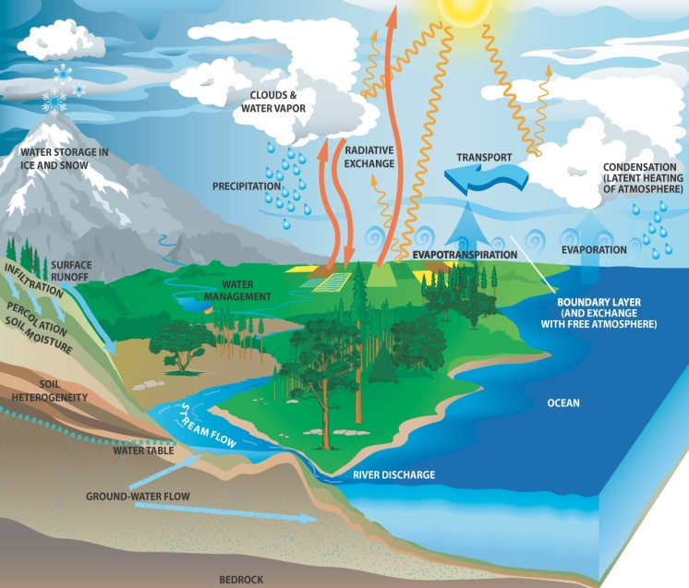
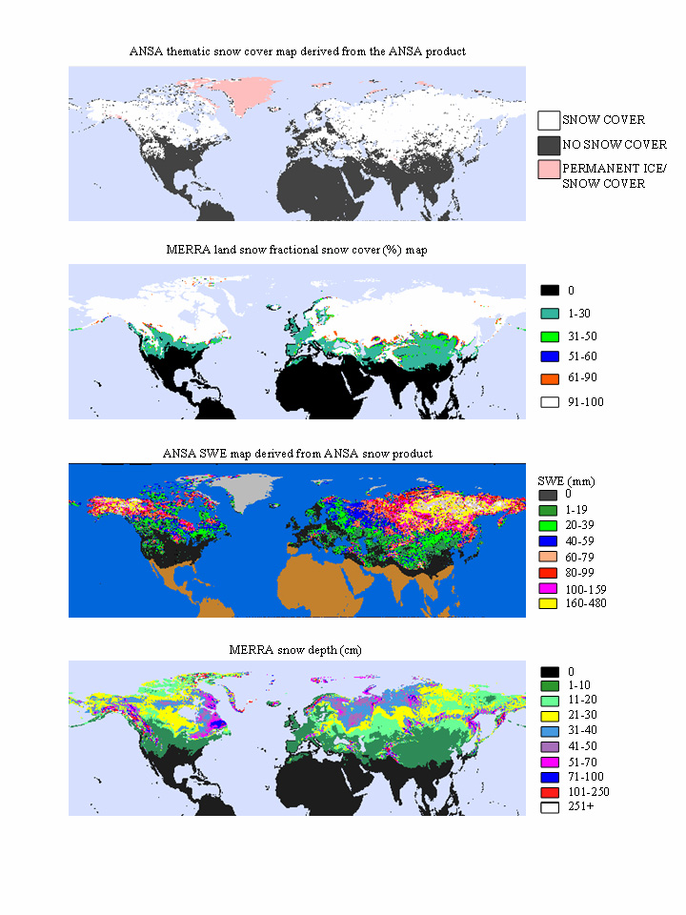
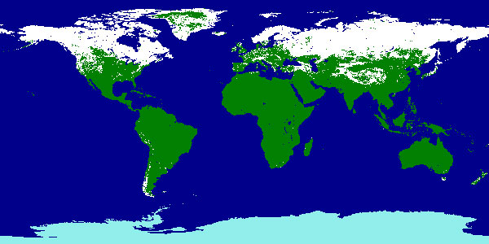
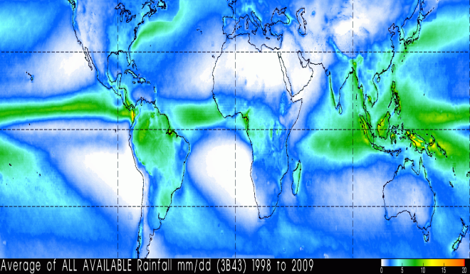
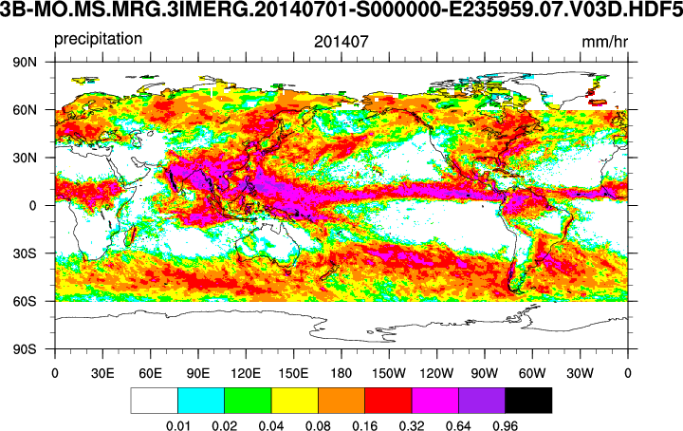
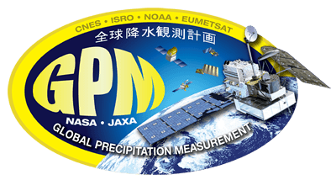









Project for the Intercomparison of Land Data Assimilation Systems (PILDAS) [what to use, what it could be]
Snow
Precipitation
e.g. Snow Cover from Moderate Res. Imaging Spectroradiometer (MODIS)
Figure 1: Snow water equivalent (SWE) based on Terra/MODIS and Aqua/AMSR-E. Future observations will be provided by JPSS/VIIRS and DWSS/MIS. Jiarui Dong (NCEP)
Figure 2: Annual average precipitation from 1998 to 2009 based on TRMM satellite observations. Future observations will be provided by GPM.
e.g. Global Precipitation Measurement (GPM)
C. Peters-Lidard et al (NASA)
Soil Moisture
Terr. Water Storage
Surface Water
e.g. Soil Moisture Active
Passive (SMAP)
Gravity Recovery and Climate Experiment (GRACE)
Surface Water & Ocean Topography (SWOT)
Figure 3: NESDIS “SMOPS” daily product blends soil moisture from a number of sensors, including SMOS, SMAP, ASCAT, AMSR-2. Positive impact on global precip. forecasts. Weizhong Zeng (NCEP), Xiwu Zhan (NESDIS).
Figure 4: Changes in annual-average terrestrial water storage (sum of groundwater, soil water, surface water, snow, and ice) between 2009 and 2010, based on GRACE satellite observations. Future observations will be provided by GRACE-II.
Figure 5: Current lakes and reservoirs monitored by OSTM/Jason-2. Shown are current height variations relative to 10-year
average levels. Future observations
will be provided by SWOT.

Slide 62
Project for the Intercomparison of Land Data Assimilation Systems (PILDAS) [Update]
Currently no community-led projects under this sub-theme within GLASS, so PILDAS for lack of activity is on hold.
Clearly we need a land DA effort under GLASS; this was endorsed after feedback from WGNE panel and others at the Pan-WCRP meeting in Exeter in October 2017.
We note there is still enthusiasm to pursue a scaled-down version of PILDAS (Sujay Kumar et al, NASA), i.e:
“Quantify if the community needs to spend efforts on DA algorithms vs retrievals vs models themselves.
Would be closely related to efforts such as PALS/PLUMBER. Benefit!
A simpler PILDAS experiment would be to align it with benchmarking projects. For example, how does a retrieval based benchmark compare to ground-based benchmark? In other words, is there any utility to assimilating these retrievals (less about DA, but the relevant question is whether the community effort needs to be on improving retrievals or DA algorithms).
Another idea: stand up a statistical benchmark (based on observations) to see if DA systems can beat that. Less about conforming to all the experiment details (which was another problem with the original PILDAS design).”
62

Slide 63


ALMIP2 Project [What is it?]
Phase2
Leads : Aaron Boone (CNRM/Météo-France) and Christophe Peugeot (MSE, Univ. Of Montpellier, France) With J. Demarty & B. Cappelaere (MSE), M. Grippa & L. Kergoat (GET, Toulouse, France)
What is is? AMMA (African Monsoon Multidisciplinary Analysis) Land Surface Intercomparison Project Phase 2 (ALMIP2)
Focused on the local to meso-scale, where the main goal was to improve understanding and modeling of key surface, vegetation and hydrological processes over West Africa, e.g. the subtle hydrology and vegetation processes in the region (large rooting depths, near-surface aquifers, soil crusting, lateral transfer processes, strong runoff variability).
Missing key processes (many semi-arid) specific to this region : significant interactions with groundwater, endoric processes, lateral fluxes (seasonal ponding), hydrophobic soils (crusting), deep rooting plants (dry season evap, with more memory than currently being modeled?)

Slide 64
ALMIP2 Project [Update]
Phase2
Update: The ALMIP2 project is spinning down, with a few publications in the works that will be part of a special collection in J. Hydrometeorol.
As follow on, in addition to GHP links to AMMA, it was suggested that sensitivity to surface forcing could be further investigated by expanding LoCo or DICE (land-atmosphere interaction) for the AMMA region, with details to be determined.
ALMIP2 continues as a French initiative (within AMMA2), heavily dependent on AMMA-CATCH. Some new linked actions in the UK
Aerosols : impact on water, energy and Carbon budgets (LAND-SAF initiative)
Initiative to make an African LDAS?
Longer term: impact of identified physics in coupled GCMs – memory/feedbacks? Impact on WAM position/strength? Depends on progress with model development especially concerning endoric and lateral flow hydrological processes. For now, a possible national (France) Project (proof of concept).

Slide 65
GLASS Connections to Other Projects
GHP: land-atmosphere data sets from RHPs for process studies, e.g.:
-> Hydrological Cycle in the Mediterranean Experiment (HyMeX).
-> Land surface Interactions with the Atmosphere over the Iberian Semi-arid Environment (LIAISE) (Iberian Peninsula), including human effects.
-> Anthropogenic water management: Ebro & Murray-Darling basins? (sufficient obs necessary, including remote sensing), LSM incorporate reservoir, groundwater, irrigation, basin transfer. Joint GHP-GLASS workshop in Gif-sur-Yvette, October 2016; no project specifics yet.
-> Follow-on to ALMIP2?
Monsoons (interactions with CLIVAR): joint initiative of GEWEX & CLIVAR
-> Importance of land-atmosphere interactions within monsoons.
Seasonal to Sub-seasonal (S2S): joint initiative of WWRP and WCRP
-> Potential contribution of land to predictability on the S2S timescales.
ILEAPS: biogeochemical cycles, land-atmosphere chemistry.
Cold Seasons Process: GHP, ILEAPS, CliC, ILEAPS focus on snow, frozen soils/permafrost, tundra, e.g. Saskatchewan & Mackenzie river basins.
WMAC: Promoting model development and coordination across WCRP.
WGNE: Data assimilation & process-level improvement to model physical parameterizations (e.g. PALS/PLUMBER, LoCo/DICE, interested in a new PILDAS).
WMO: Other working groups, e.g. within WWRP., e.g. Year of Polar Prediction (YOPP) project.
65
Notes:
65

Slide 66
WCRP Grand Challenges (GC) and
GEWEX Grand Science Questions (GSQ)
WCRP engages the international climate research community in a number of Grand Science Challenges through community organized workshops, conferences strategic planning on:
Melting Ice and Global Consequences
Clouds, Circulation and Climate Sensitivity
Carbon Feedbacks in the Climate System
Understanding and Predicting Weather and Climate Extremes
Water for the Food Baskets of the World
Regional Sea-Level Change and Coastal Impacts
Near-term Climate Prediction
www.wcrp-climate.org/grand-challenges/grand-challenges-overview
GEWEX Science Questions related to following research areas:
Observations and Predictions of Precipitation
Global Water Resource Systems
Changes in Extremes
Water and Energy Cycles and Processes
www.gewex.org/about/science/gewex-science-questions
66

Slide 67

Alignment with WCRP Grand Challenges (GC) and
GEWEX Science Questions (SQ)
✔
67
Notes:
67

Slide 68
Key science questions in the next 5-10 years
(from GLASS for SSG-29 Report; still relevant for SSG-30)
Land Impact: Explore the impact of the land processes on Seasonal/Drought Prediction, and other high-impact “Earth System events” on society.
Common Interfaces: common modular interface for LSMs (new ALMA), common land-atmosphere coupling modularity, continue improving benchmarking methods/tools/datasets for the community.
(Land) Model Developments/Improvements: Improved cold season processes (interactions between permafrost and greenhouse gas emissions), ground water interactions, anthropogenic processes/water management (irrigation, aquifer uptake, crop harvest, improved LULCC), and the LSM “grey zone” (in anticipation of ever-higher resolution research and NWP applications: lateral fluxes of mass and energy), improved representation of soils and their highly heterogeneous nature.
How to most effectively improve our Earth System models? Perhaps component-by-component with increasing levels of coupling, building to a fully-coupled system; a thorough “model development hierarchy” with benchmarks at each level. GLASS activities would be one part of that development chain, e.g. land-only studies and testing (e.g. PALS/PLUMBER), coupled columns (DICE), regional coupling (LoCo), and so on. This would require an extensive “data mining” effort, and in time a highly multi-discipline, but potentially quite fruitful.
68
Notes:
68

Slide 69
GLASS Panel Membership
Members:
Gab Abramowitz, UNSW
Eleanor Blyth, CEH
Aaron Boone, CNRM-Météo France
Nathan Brunsell, U. Kansas
Martyn Clark, NCAR
Paul Dirmeyer, COLA / George Mason Univ.
John Edwards, UK Met Office
Michael Ek, NCEP -> NCAR
Craig Ferguson, SUNY
Pierre Gentine, Columbia U
Chiel van Heerwaarden, Wageningen U
Hyungjun Kim, U Tokyo
Sujay Kumar, NASA
David Lawrence, NCAR
Aude Lemonsu, CNRM-Météo France
Lifeng Luo, Michigan State Univ.
Pere Quintana Seguí, Ebro Observatory
Joshua Roundy, Univ. Kansas
Joseph Santanello, NASA
Ahmed Tawfik, NCAR
Tomo Yamada, Hokkaido Univ.
Kun Yang, ITP/CAS
Co-Chairs:
Dr. Michael B. Ek
National Centers for Environmental Prediction
Environmental Modeling Center, NOAA/NWS
College Park, Maryland, USA
michael.ek@noaa.gov
ek@ucar.edu (NCAR after 04 February 2018)
January 2015-December 2018
Dr. Gab Abramowitz
Senior Lecturer and Postgraduate Coordinator
Climate Change Research Centre and
ARC Centre of Excellence for Climate Extremes
UNSW Australia
gabsun@gmail.com / gabriel@unsw.edu.au
January 2017-December 2020
69
Notes:
69

Slide 70


Uh oh! These surface fluxes don’t look so good.
Ugh! Look at the hydrology in this thing! It’s leaking everywhere!
..and you’re also going to need an atmospheric alignment to get the right interactions.
GLASS
…and its carbon output is way too high...
Land Models
Atmospheric modellers:
But I like it like this:
I don’t want to have to recalibrate my driving variables (...what about my forecast metrics..!?) How much will this COST?!
Well… at least SEVERAL more funding cycles.

Slide 71


LoCo team BAMS paper: “Land-Atmosphere Interactions: The LoCo Perspective” by Joe Santanello, Paul Dirmeyer et al, 2017.
71

