Slide 1
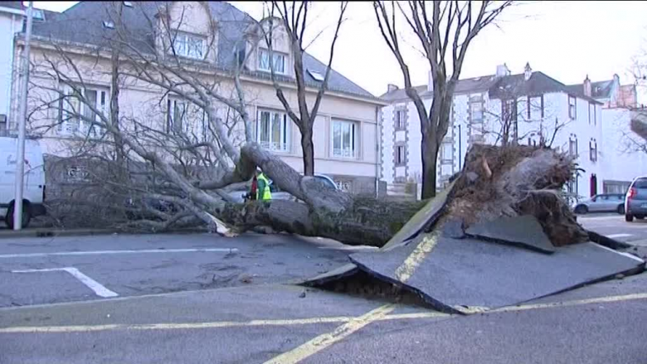
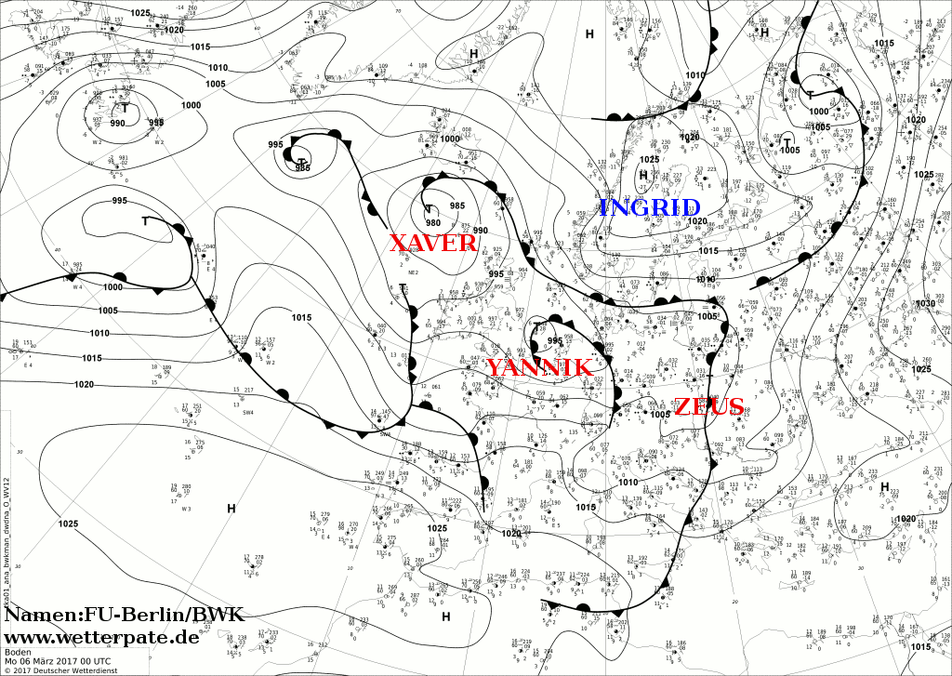
Windstorm “Zeus” (not!)

✓
€270M losses

Slide 2
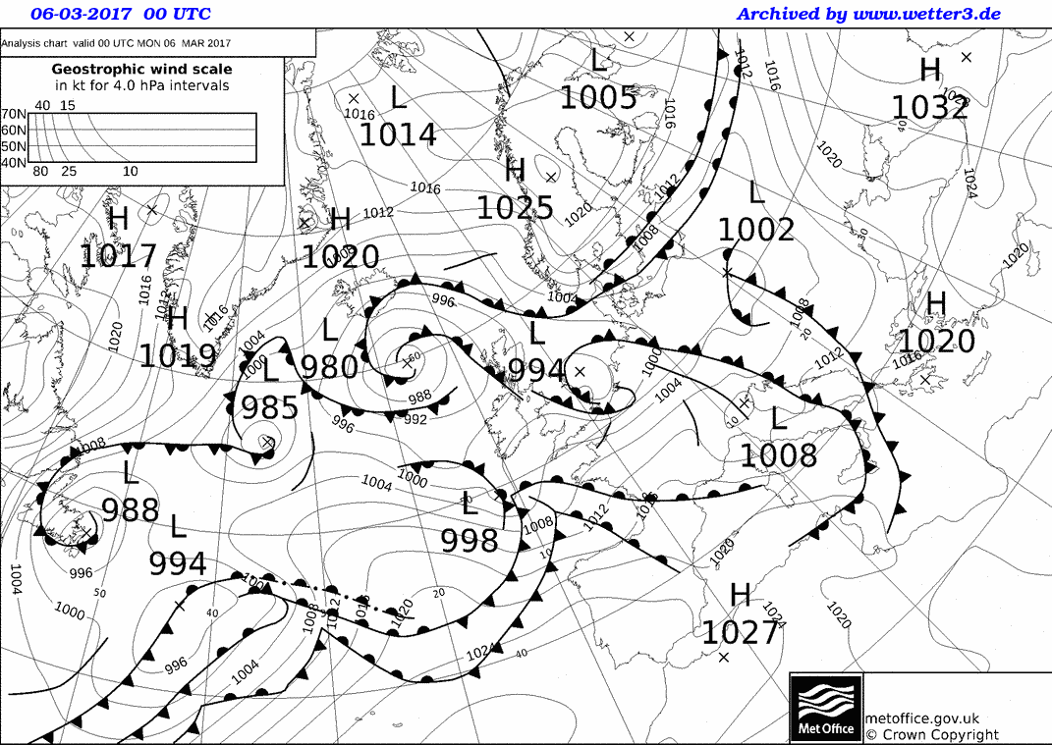
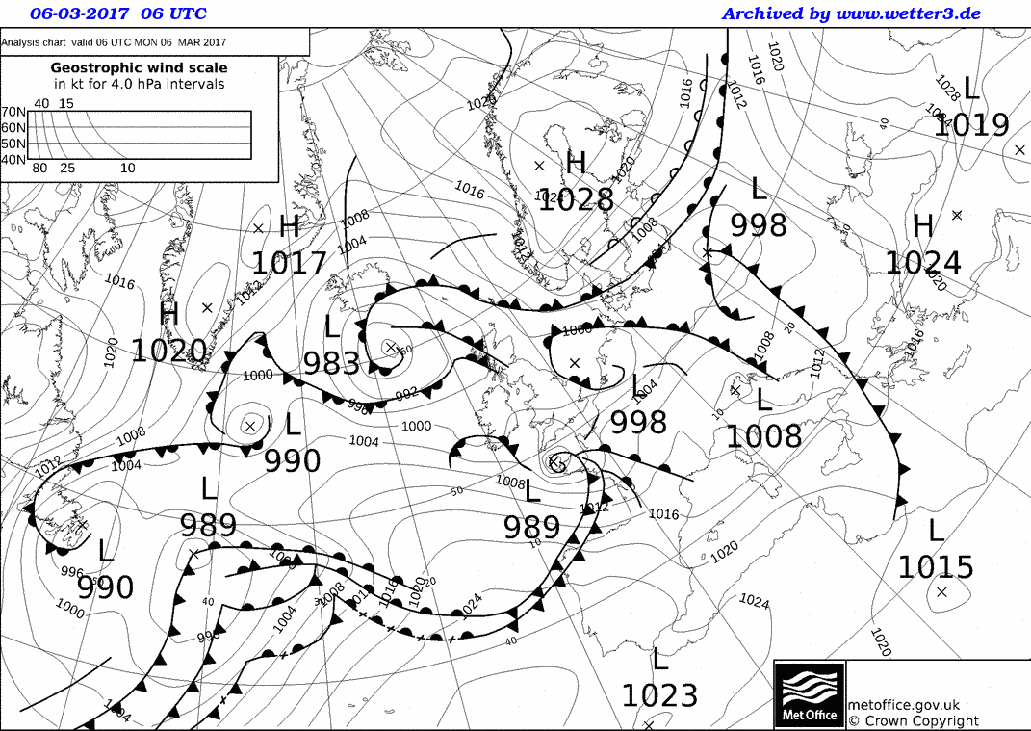

Slide 3
Study aspects of particular cases following enquiries from users (in this case Meteo-France)

Slide 4
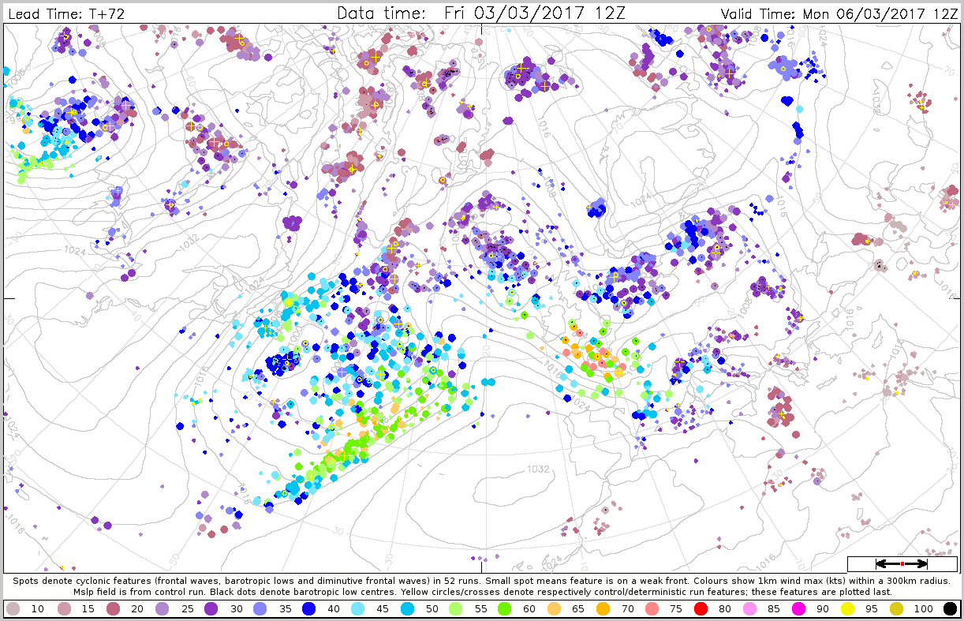
Dalmatian charts, coloured by max wind attribute

Slide 5
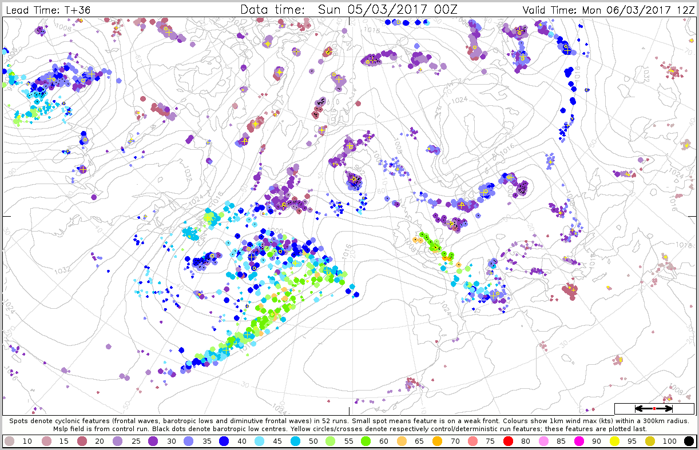
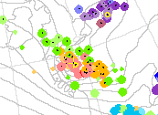
“Poor” Forecasts from 0Z 5th March
0Z 4th
BAD
GOOD

Slide 6

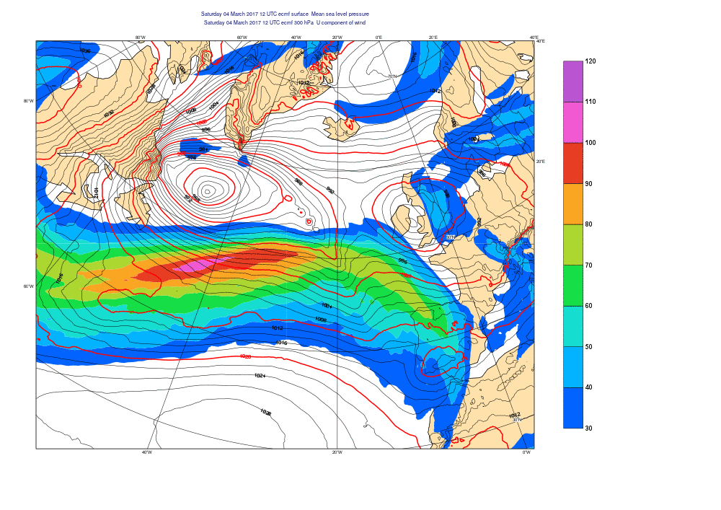
Evolution in “Good” forecast (300mb jet and mslp)
Warm air cyclone crosses jet and develops further as left exit feature, with added input from latent heat release

Slide 7
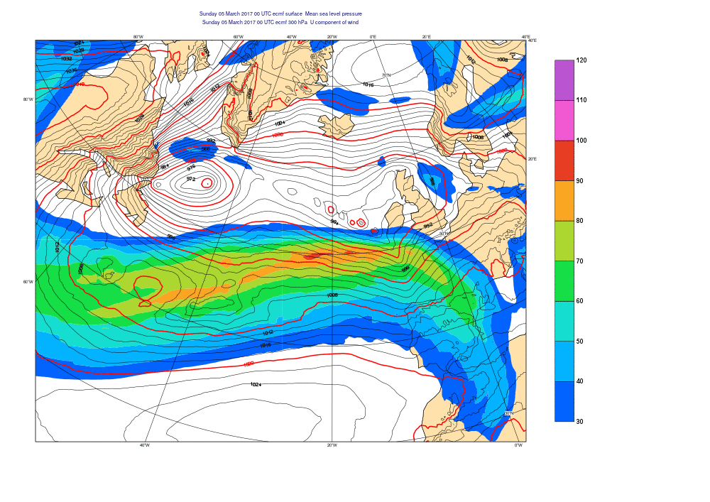
Evolution in “Bad” forecast (300mb jet and mslp)
Cold air cyclone develops afresh, also as left exit feature, but with relatively small input from latent heat release

Slide 8
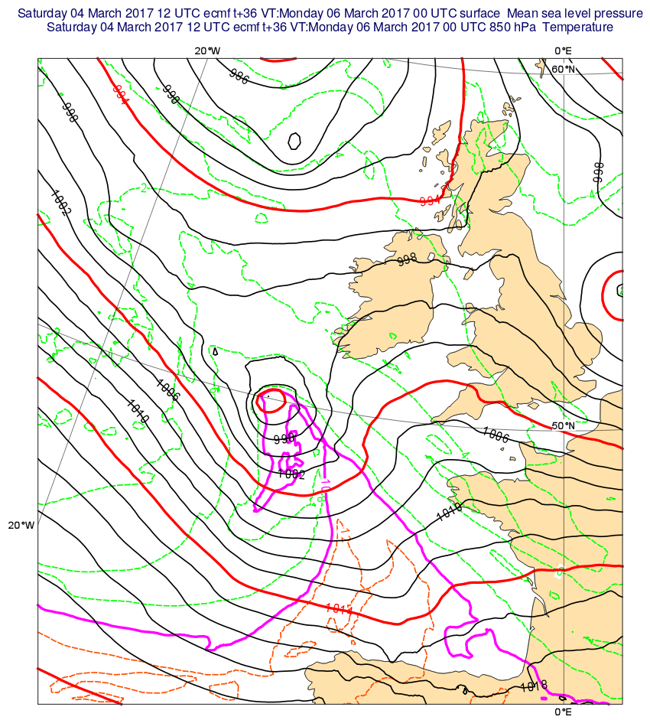
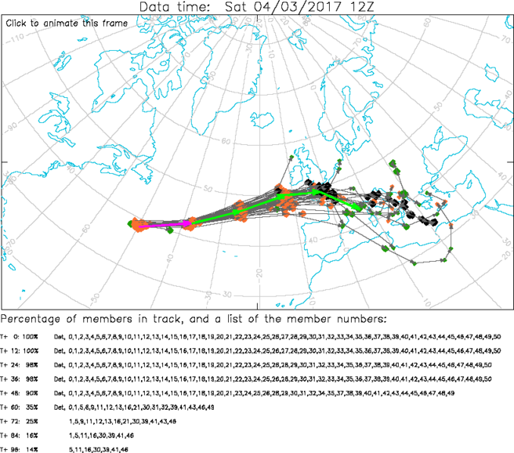
Good

Slide 9
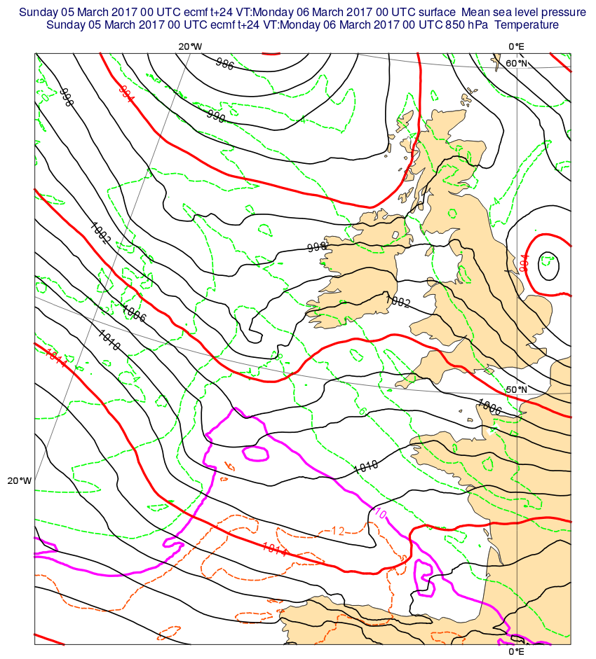
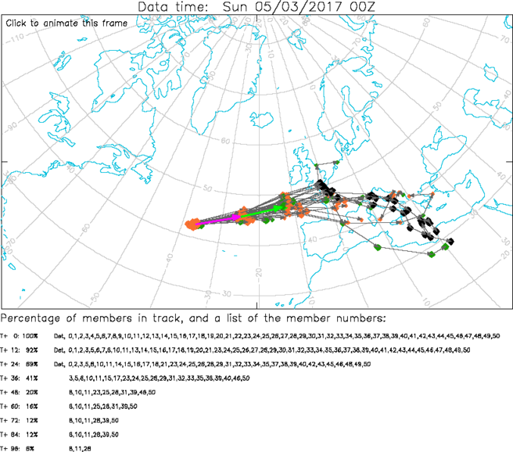
Bad

Slide 10
What caused the “jump” ?
Standard increment charts examined (1000mb and 200mb)
  Values in N Atlantic larger than usual but hard to attribute changes
Interactive ENS member selection:
  Traced back the few good members in the “Bad” 00Z 5th forecasts
  Unfortunately nothing clearly set these apart from the rest at data time
  So detailed observation investigations will not provide concrete conclusions
Need to look at full 3D structure of increments/jets/good members to understand
  Complex! Seems to be very non-linear
  New tools for 3D jet core identification now developed – may help
Is there a resolution limitation (very small storm) ?...

Slide 11
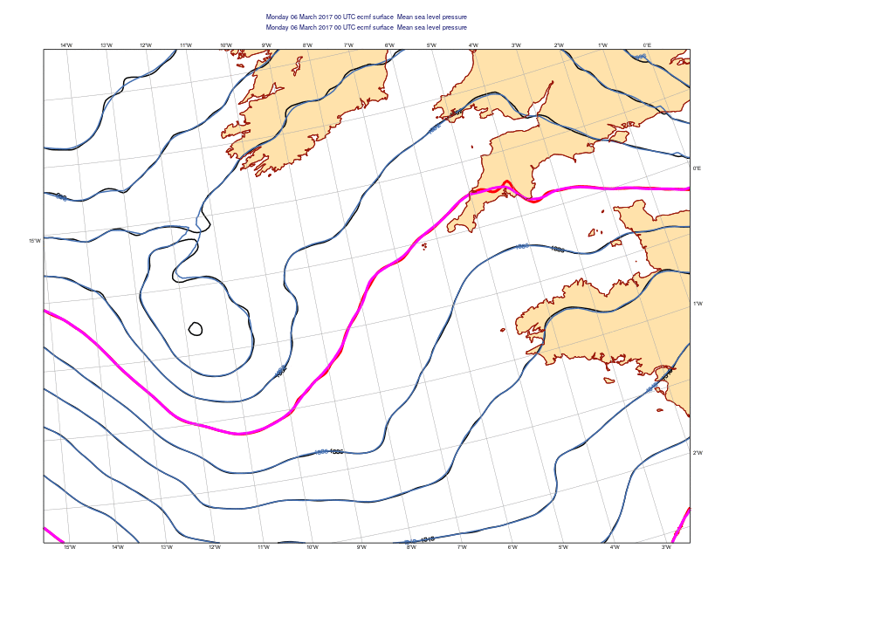
“Good” shorter range forecasts compared – HRES vs Control
2mb interval
HRES has more rapid intensification

Slide 12
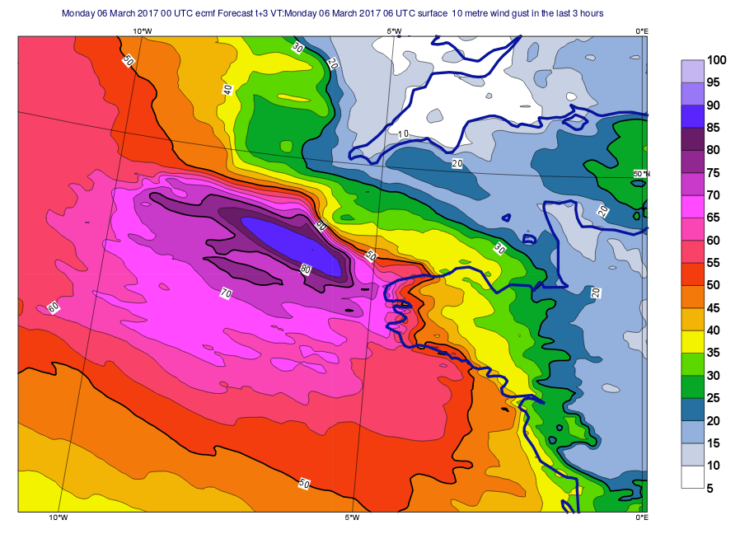
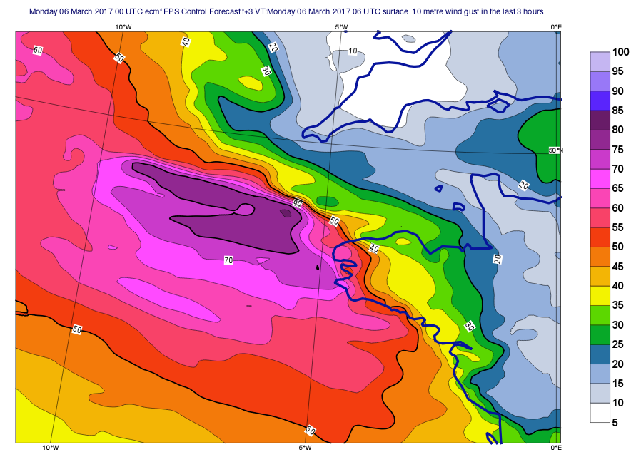
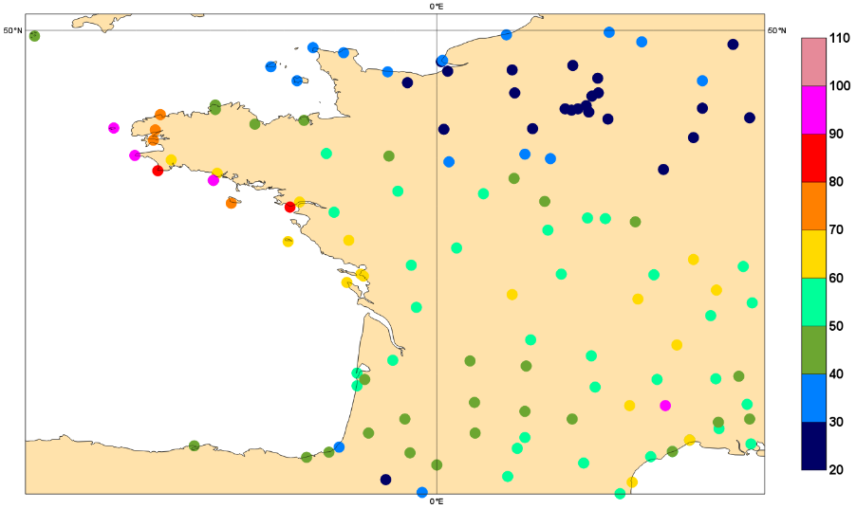
Max Gusts T+3 to T+6
HRES
Control
Peak is 10kts stronger

Slide 13
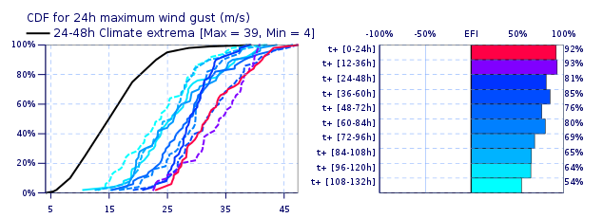
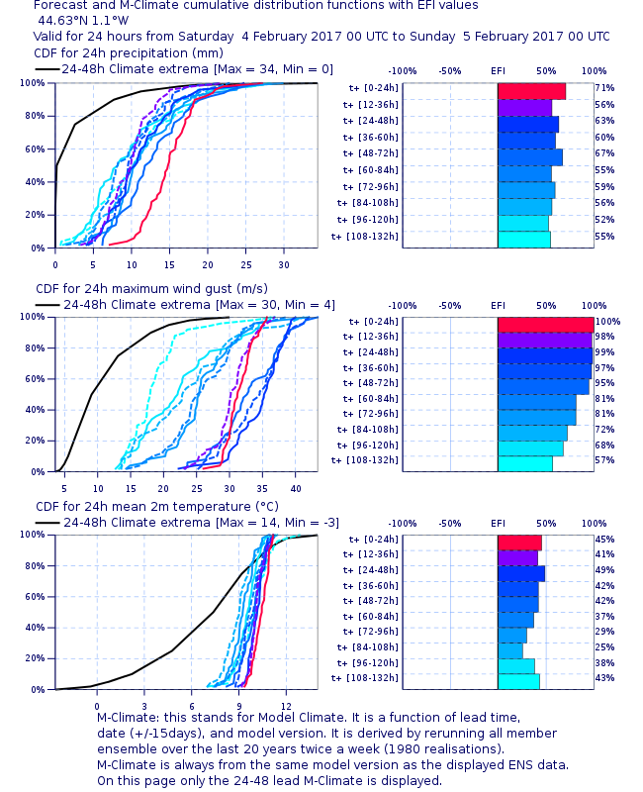
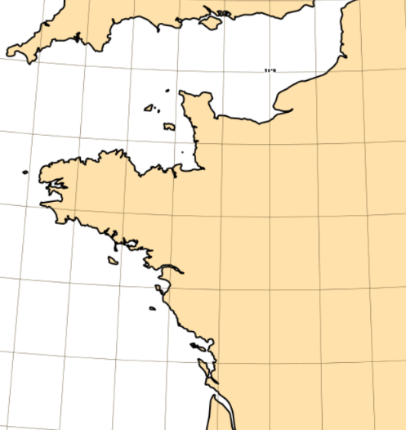
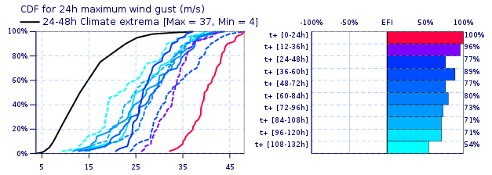
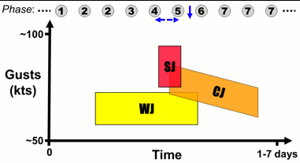
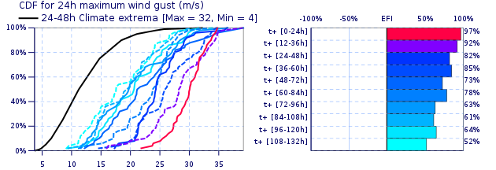
Given (1) small cyclone size, and (2) phase of development, correct prediction for specific regions was always going to be very difficult
Leiv
OBS

