Slide 1
Recent progress of CAMS in the ISSI-BJ International Team
Boqi Liu
CAMS, CMA, China
Annotated by Yvan Orsolini
Following discussions at CAMS, CMA, China (OCT 28, 2017)
with Boqi Liu, Congwen Zhu, Zhiyan Zuo

Slide 2
Schedule of our plan (discussed in March 2017)
Activity 1: lead (CAMS)
EVALUATION WITH SNOW DATA OVER HTP Domain: HTP (0.25x0.25 regular lat-lon 25N 45N 60E-110E)
Surface Variables (tier-1): OROGRAPHY and All snow state variables SNOW_DEPTH (GLACIERS-MASKED), SWE (GLACIERS-MASKED), SNOW_COVER_FRACTION, SNOW_TEMPERATURE, SNOW_DENSITY, SNOW_ALBEDO,T2M, TD2M
Atmospheric Variables (tier-2): METEOROLOGICAL FORCING
Period: 2009-2013
Format: NetCDF-4, ASCII-timeseries at Station Location (0UTC)
PHASE-A: SNOW_DEPTH
FOCUS on Snow depth and Specific years: 2009-13, 5-year period
In-situ observations from CMA
Satellite microwave SWE/SNOW_DEPTH/SNOW_DENSITY from ITP (Kun and Tao Che)
ERAINT-land with 1-layer and multi-layer snow, driven by ERAINT, from ECMWF
ERA5 and ERA5-Land driven by ERA5 (2009-2013)
ECMWF Operational Analysis of 2009-13
JRA55 Reanalysis 2009-2013 (Martin)
MERRA2 Reanalysis 2009-2013 (Martin)
PHASE-B: SNOW_COVER_FRACTION
Satellite IMS SNOW_COVER_FRACTION (Nearest point to station, native resolution)
Snow-cover-days and season statistics
Timeline: started on the 1st of March 2017, tier-1 model output by 31st of March, PHASE-A/PHASE-B results by September 2017.

Slide 3
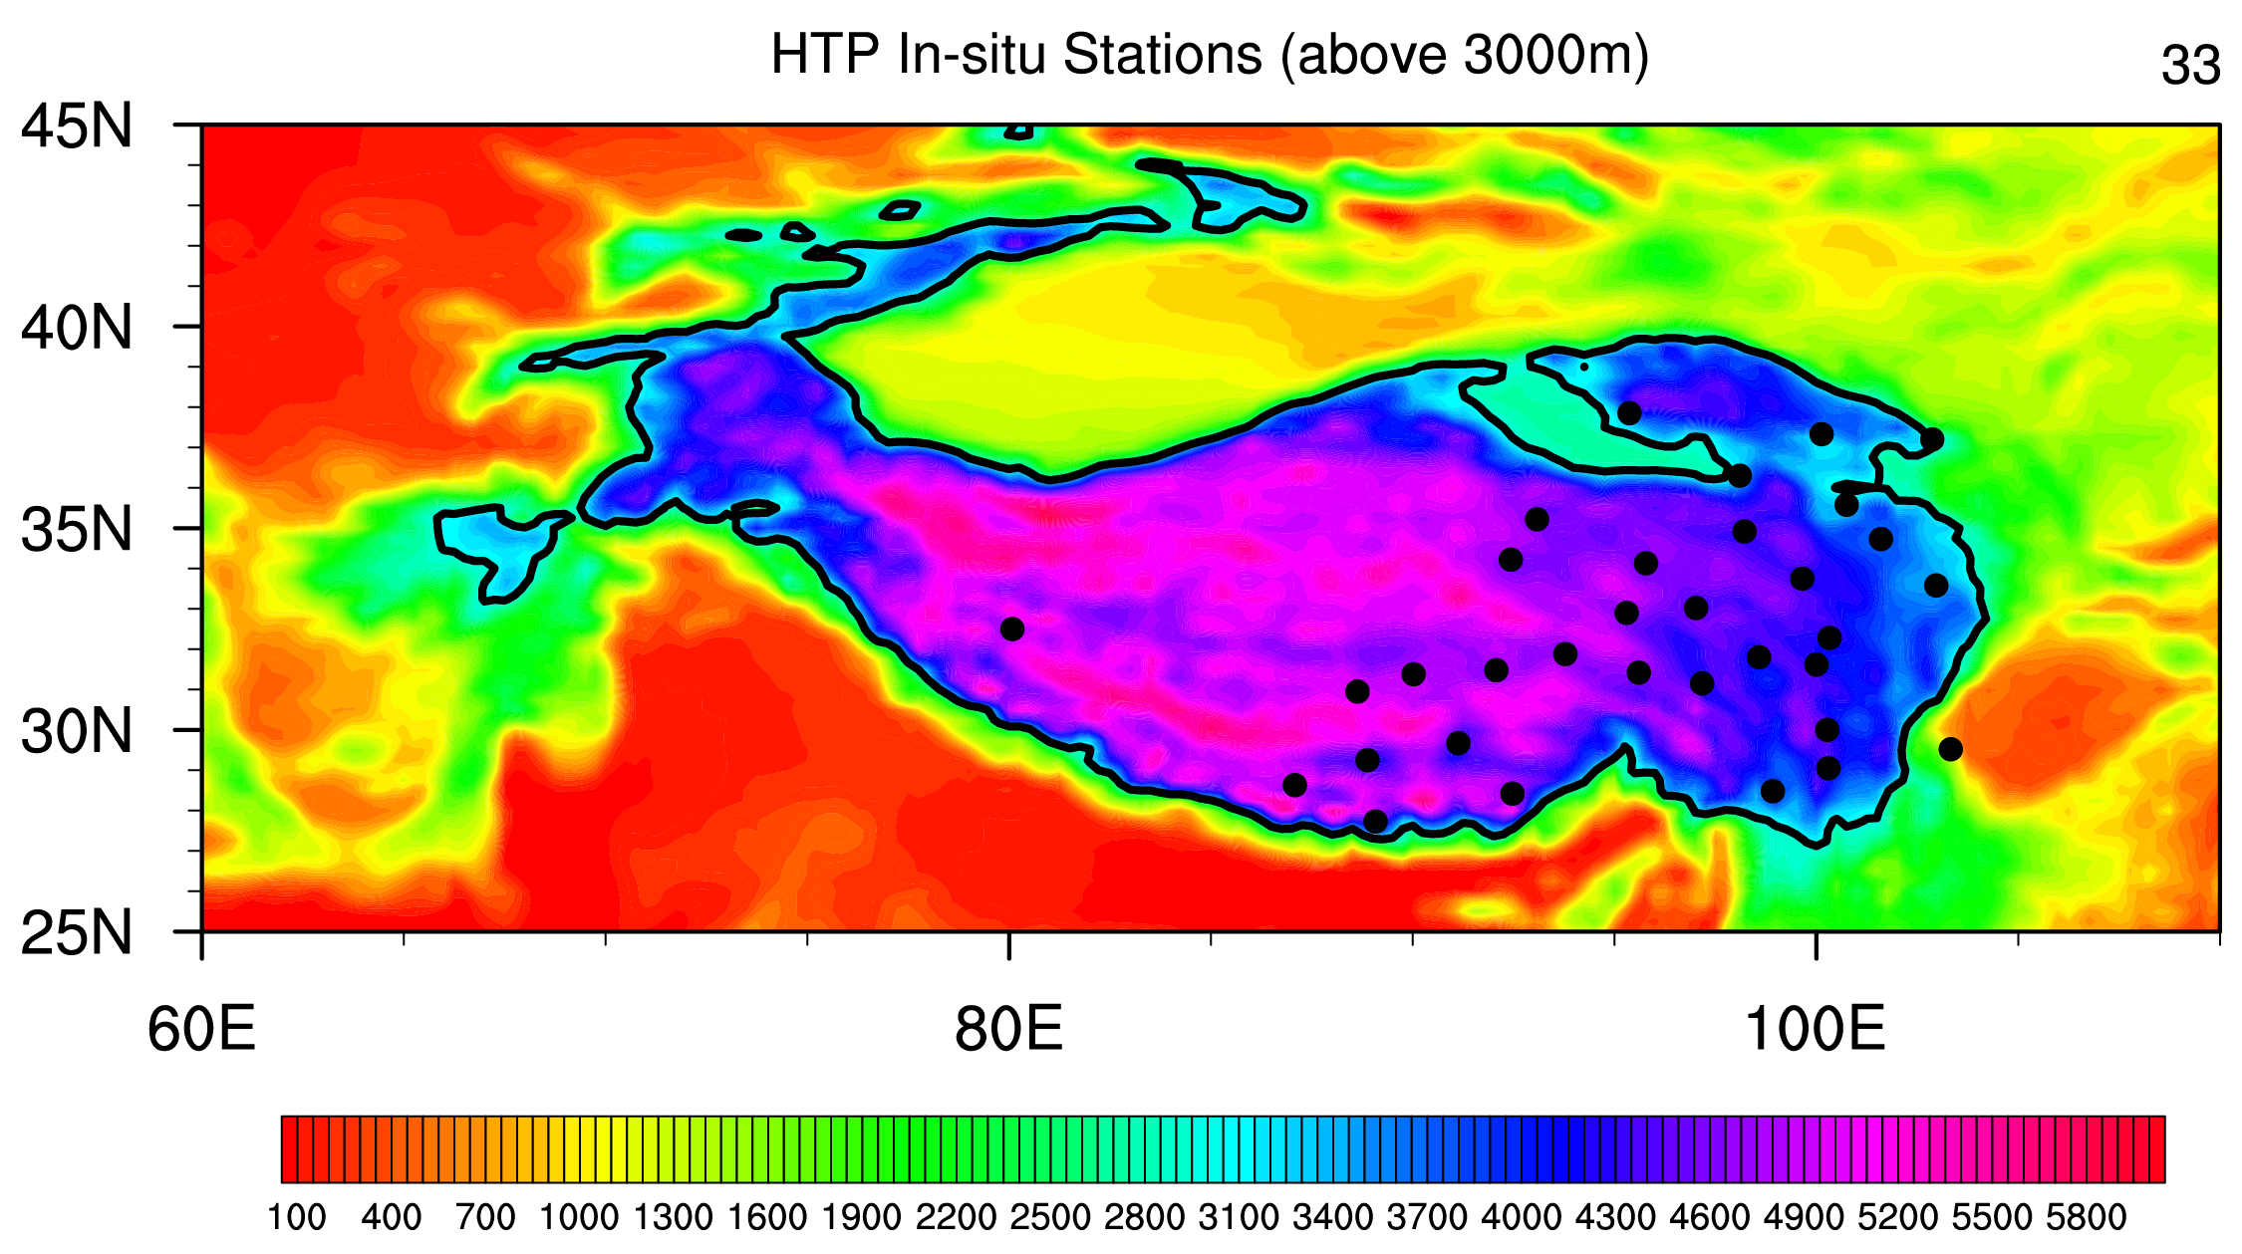
What we’ve done by now?
About data share:
2017.4: Uploading the location information of the in-situ stations onto the ECMWF FTP.
2017.7: Uploading the in-situ snow depth records over the HTP during 2009-2013 onto the ECMWF FTP (123.56.90.200:/data_sites_cams).

Slide 4
What we’ve done by now?
About data comparison:
In-situ observation vs. ERA Reanalysis family (snow depth)
Seasonal evolution of climate-mean (2009-2013) in-situ observed
snow depth (units: dm)

Slide 5
Climate-mean (2009 to 2013) seasonal evolution of snow depth over the HTP (units: m)
ERAI
ERA-Land
EC Oper. Ana.
ERA5
JAN
APR
JUL
OCT

Slide 6
Time series of daily snow depth averaged over the 33 GTS stations during 2009-2013 (Nearest grid points to stations, vs. ERA reanalysis family)
ERA-Interim seems closest to the in-situ observation.
Note units: factor 10 between analyses and obs

Slide 7
In-situ observation vs. ERA-Interim
(horizontal distribution)
In-situ observation
ERA-Interim
ERAINT has better agreement

Slide 8
About data comparison:
In-situ observation vs. MERRA 2 Reanalysis (snow depth, provided by Martin)
In-situ observation
MERRA 2

Slide 9
Time series of daily snow depth averaged over the 33 GTS stations during 2009-2013 (Nearest grid points to stations, vs. MERRA2)
Note: seasonal evolution worst than ECMWF, clear summer excess
Note units: factor 10 between analyses and obs

Slide 10
Brief summary
Compared with the in-situ observation, the seasonal variation of snow depth over the HTP region in the ERA reanalysis family is better than that in the MERRA2.
Except for the ERA-Interim, the snow depth in other reanalysis dataset is one-order of magnitude higher than the in-situ observation. In the ERA-Interim, the magnitude of snow depth is comparable to the in-situ observation in some days during 2009-2013.

Slide 11
Next step?
Station-by-station check to identify the spatial structure of the most evident bias between reanalysis and in-situ observation, in particular about the ERA-Interim. See if there is a altitude-dependent biases.
Phase-B in Activity 1: compare the performance of snow-cover-days (monthly) and its season statistics in the ERA reanalysis family and MERRA2 with the in-situ observation.
Find out more about the new ERA5 : how is snow assimilated , multi-layer snow model ?
Discussion
Does the definition of “snow depth” in the models resemble the that used for the in-situ observation?
How to define the snow-cover-days based on the SNOW_COVER_FRACTION in the model output to make it consistent with the definition of snow-cover-days in the observation?

Slide 12
Next step?
Better characterise the origin of biases in the ECMWF family of re-analyses: precip, land surface model changes, assimlation technique...
Extend comparison of re-analyses over Eurasia, to see if ERA5 is also worst
Find out how is snow assimilated in the new ERA5
What is the next step with the snow land data assimilation ?

Slide 13
Other tasks for the CAMS in the ISSI-BJ International Team
(from the discussion in March 2017)
Active 3: INITIALISATION OF SEASONAL FORECAST, VERIFICATION
Spring forecast evaluation for a specific year 2012-2013 (All Team).
Active 4: FOLLOW-UP PROJECT OPPORTUNITIES
Funding opportunities can be searched in a variety of sources (EU-H2020, Belmont, Norway-China bilateral agreement, CMA-ECMWF bilateral, EC-Copernicus-C3S for EU national institutes, etc.)

Slide 14
Thanks for your time, and welcome comments.

