Slide 1
陆面在天气和气候预测中的作用
Land surface role in weather and climate prediction:
A boundary-condition past, a coupled present, an environmental monitoring & prediction future?
Gianpaolo Balsamo
with contributions of several Colleagues acknowledged on the slides
Presented on 27 February 2017 to ISSI Beijing, People Republic of China
(sub-selection of slides presented at the Chinese Academy of Sciences IAP/ITP)
ECMWF, Earth System Modelling Section, Coupled Processes Team
gianpaolo.balsamo@ecmwf.int

Slide 2
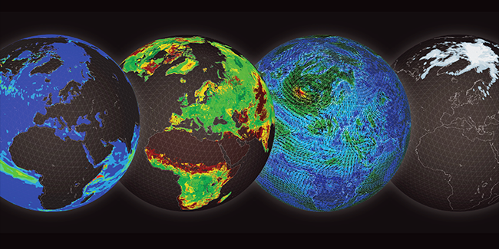
Multi-spheres concept in modelling & prediction
ECMWF 2016 Annual Seminar Earth system modelling for seamless prediction:
On which processes should we focus to further improve atmospheric predictive skill?
http://www.ecmwf.int/en/annual-seminar-2016

Slide 3

EARTH SYSTEM APPROACH
ENSEMBLE MODELLING AND ASSIMILATION. GOAL: 5KM
SCALABILITY ACROSS WHOLE NWP CHAIN
ECMWF
STRATEGY
2016-2025
Notes:
And to deliver this, our new ten year strategy is focussing on an Earth system approach, and the primacy of ensemble prediction with refined resolution to 5 km
for modelling and data assimilation, with scalability at the heart of our developments

Slide 4
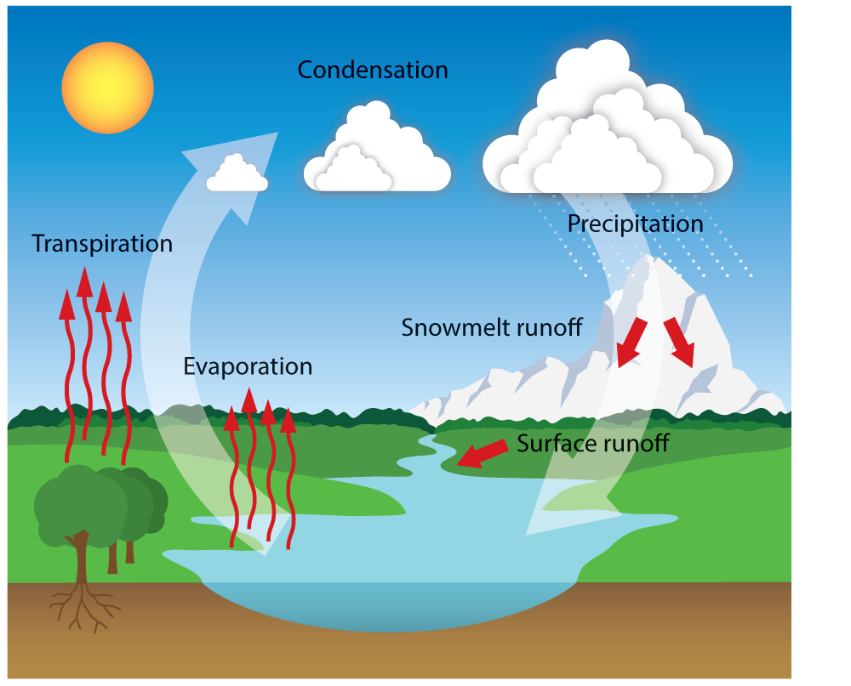
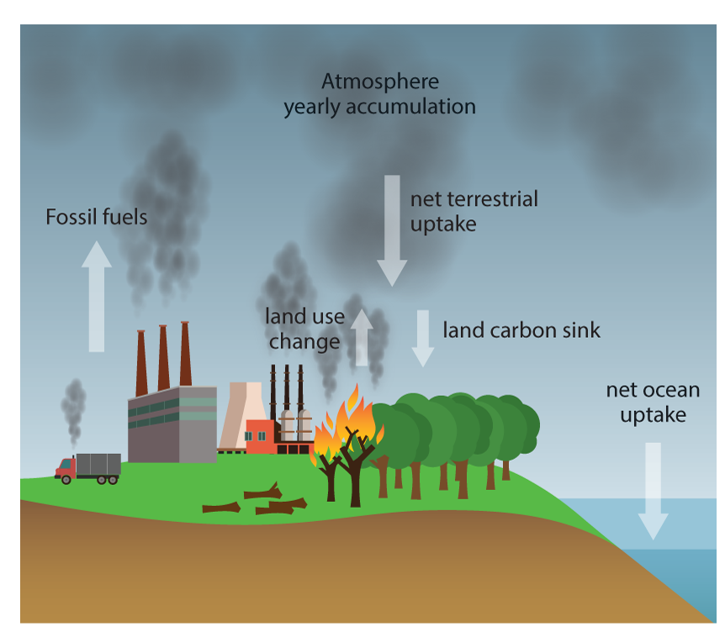
Natural Land & Human-activity @ECMWF:
How can/will natural land modelling include LUC
Notes:
Oceans: from climate to weather"
Developments initiated for long-range forecasting needs (e.g. exploiting ENSO predictability) have included modelling components by the oceanographic and climate community (WAM & NEMO, with a history timeline)
Slide 1

Slide 5
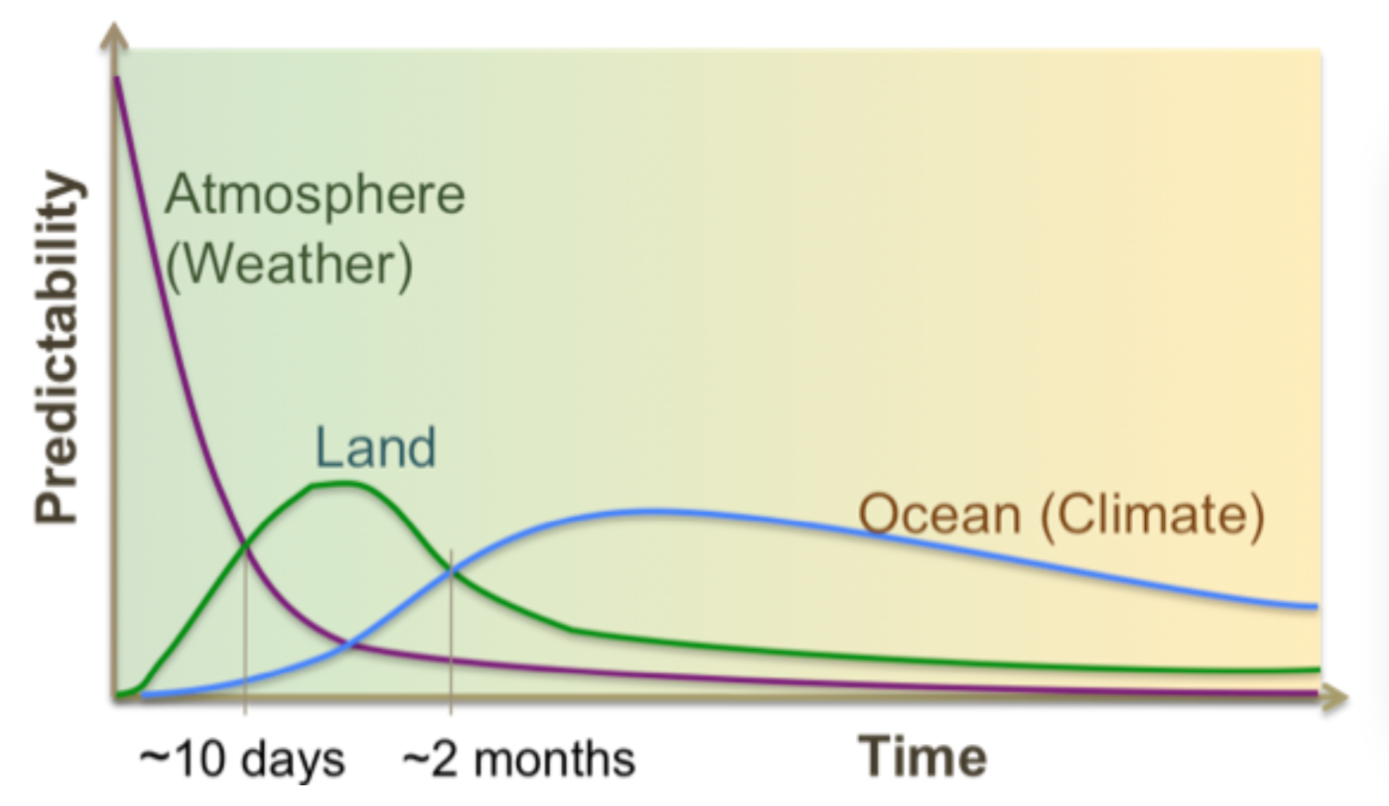
Earth surface role in medium-range and S2S
In order to realize the Land potential models need to represent nature in its:
Memory
Coupling
Variability
Dirmeyer et al. 2015: http://library.wmo.int/pmb_ged/wmo_1156_en.pdf

Slide 6
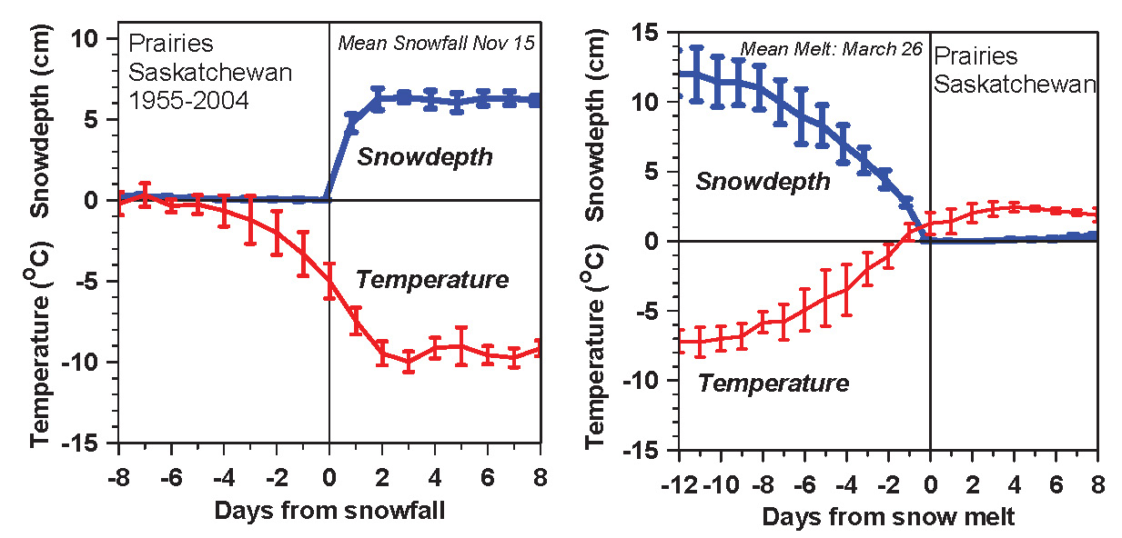
Earth surface role, observational evidence (snow)
Temperature falls/rises about 10K with first snowfall/snowmelt
Snow reflects sunlight; shift to cold stable BL
  Local climate switch between warm and cold seasons
  Winter comes fast with snow
Betts et al. 2014

Slide 7
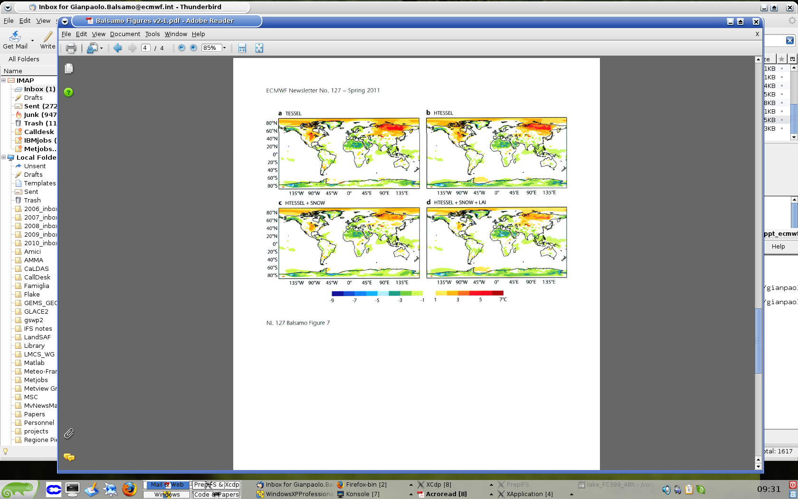
Climate improvements from land developments (soil, snow, vegetation)
simulations colder than ERA-Interim Warmer than ERA-Interim

Slide 8
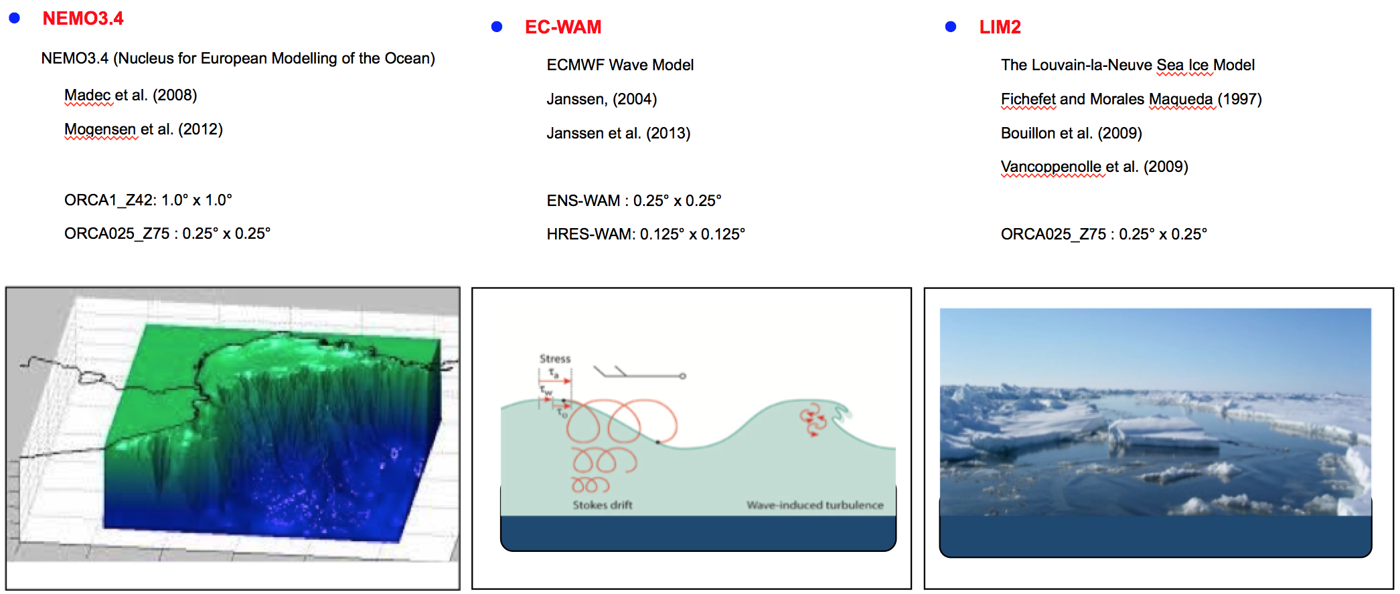
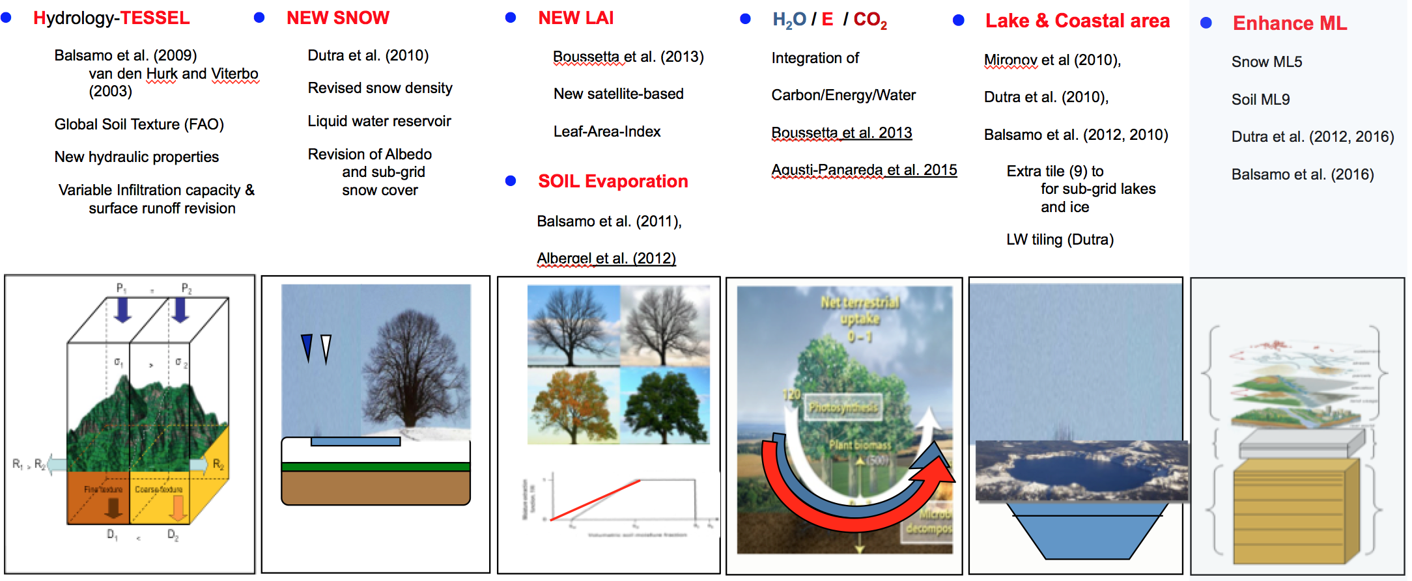
Earth surface modelling components @ECMWF
Ocean 3D-Model
Surface Waves and
currents, Sea-ice.
Land surface 1D-model
soil, snow, vegetation,
lakes and coastal water
(thermodynamics only).

Slide 9
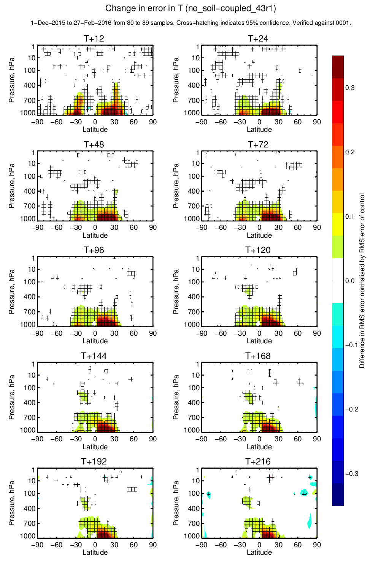
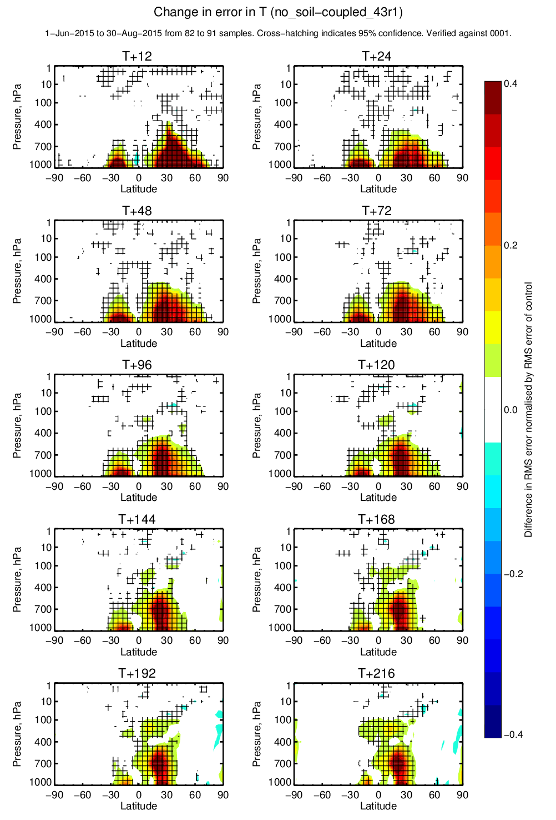
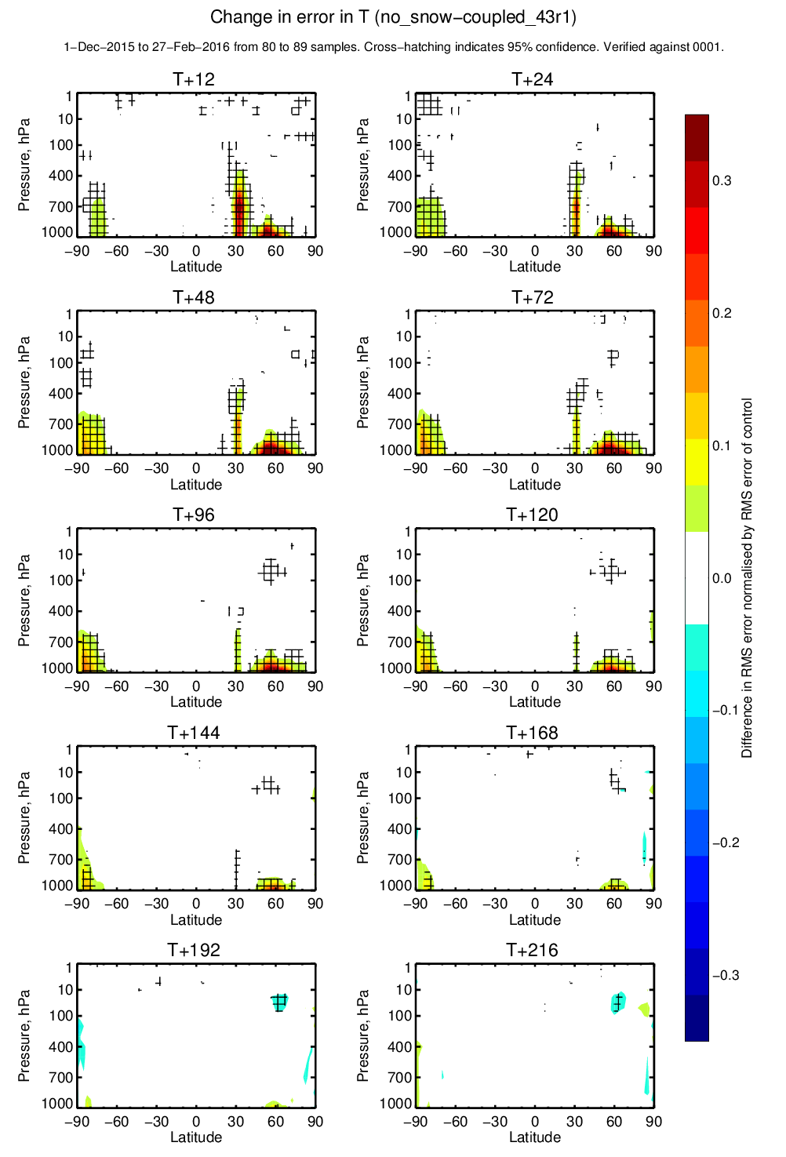
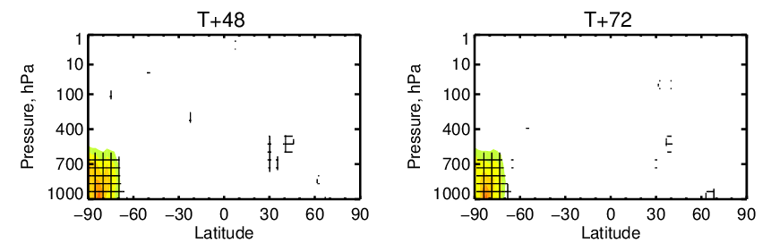
Relative Soil &Snow forecast impact
Soil processes (winter 2015-16)
Soil processes (summer 2015)
Snow processes (winter 2015-16)
Snow processes (summer 2015)
Soil/Biosphere has major impact (20-30%) propagating, throughout the troposphere
Snow has both NH/SH impact (20-30% winter, 10-20% summer) lower troposphere

Slide 10
ERA-Interim/Land and follow-on land reanalysis
Land surface components of ECMWF systems
Motivations for land reanalysis* as support to long-term climate data records
(e.g. ERA-Interim/Land and follow-on)
Impact of land systems changes (few cases)
*NOTE: ERA-Interim/Land is yet missing a key component and contribution to limit model errors via the use of
Land Data Assimilation System (LDAS), and this is an important perspective for future Land reanalysis

Slide 11
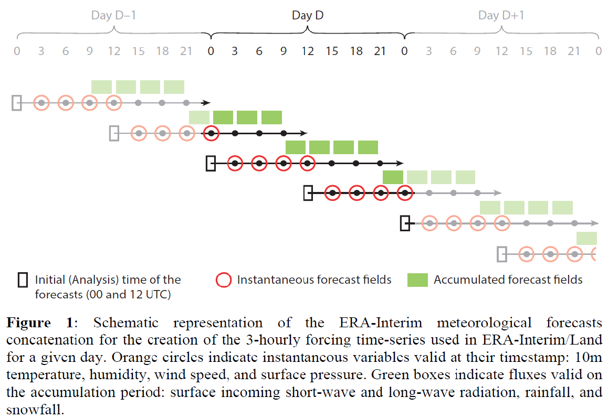
Based on ERA-Interim meteorological forcing and land surface modelling component
ERA-Interim/Land forcing for precipitation and radiation was validated along with a simple bias correction method using GPCPv2.0 monthly precipitation (1979-2010)

Slide 12
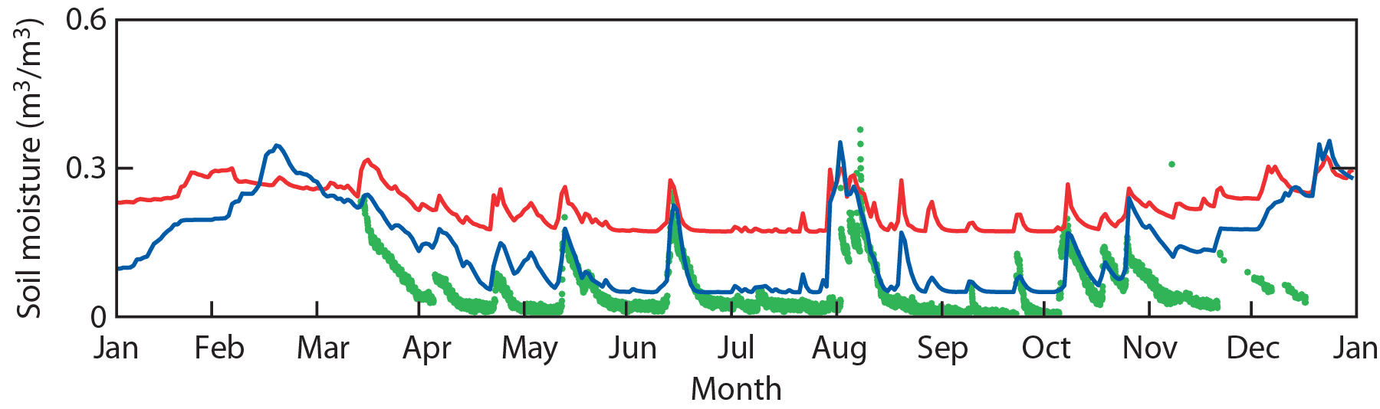
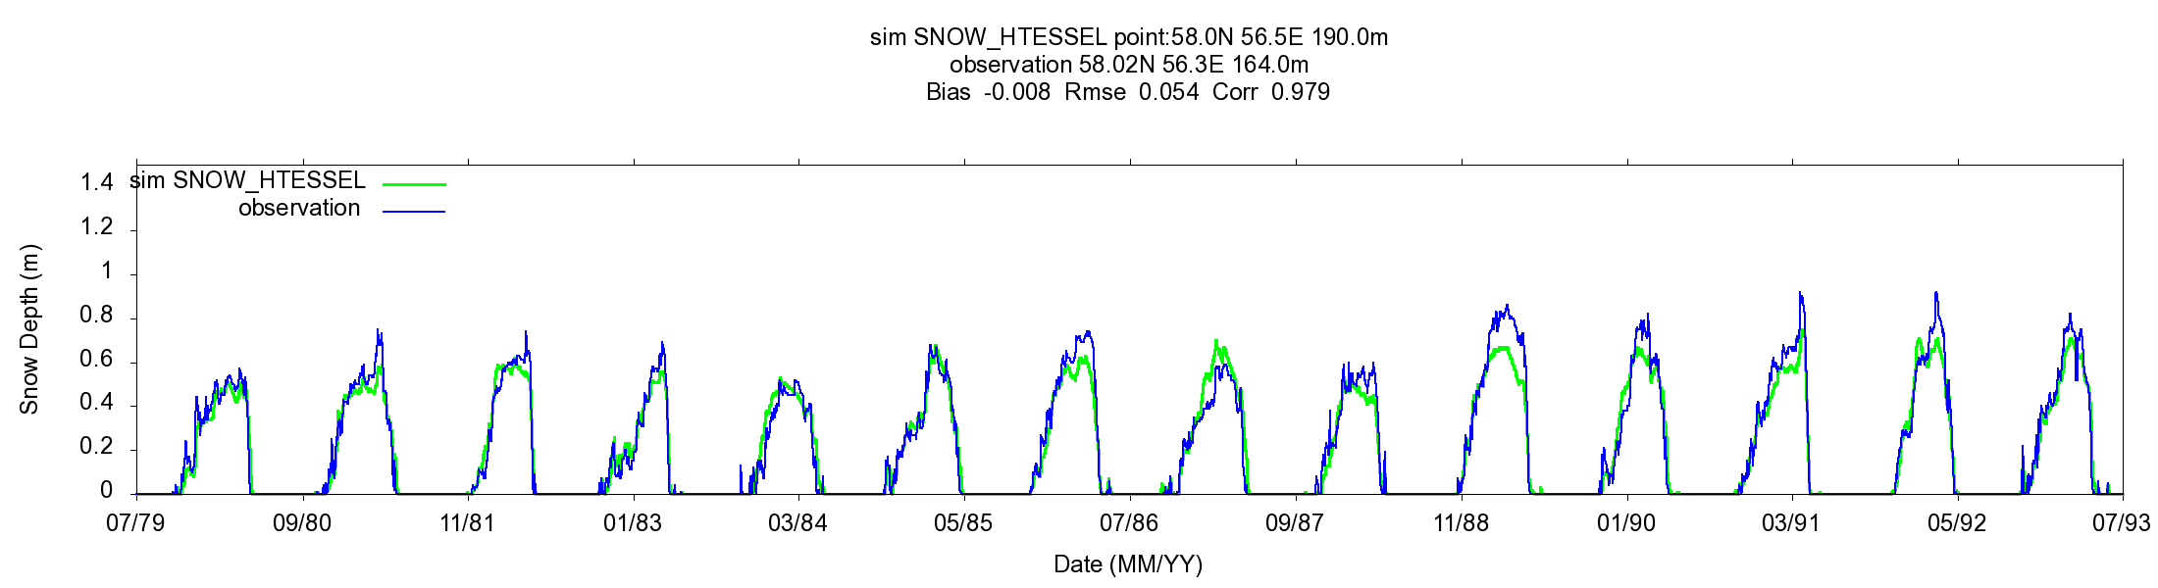
ERA-Interim/Land: storages verification
Albergel et al. (2013 JHM), Balsamo et al. (2013 HESSD)
ERA-Interim/Land integrates land surface modelling improvements with respect to ERA-Interim surface scheme and provided a balanced initial condition for the Monthly/Seasonal Re-Forecasts
Soil moisture
Evolution of soil moisture for a site in Utah in2010. Observations, ERA-Interim, and ERA-Interim/Land.
Snow depth
Evolution of snow depth for a site in Perm Siberia (58.0N, 56.5E) ERA-Interim/Land and in-situ observation between 1979 and 1993.

Slide 13
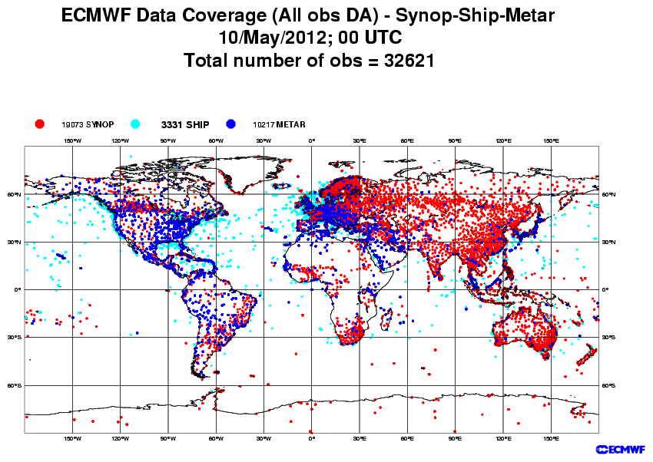
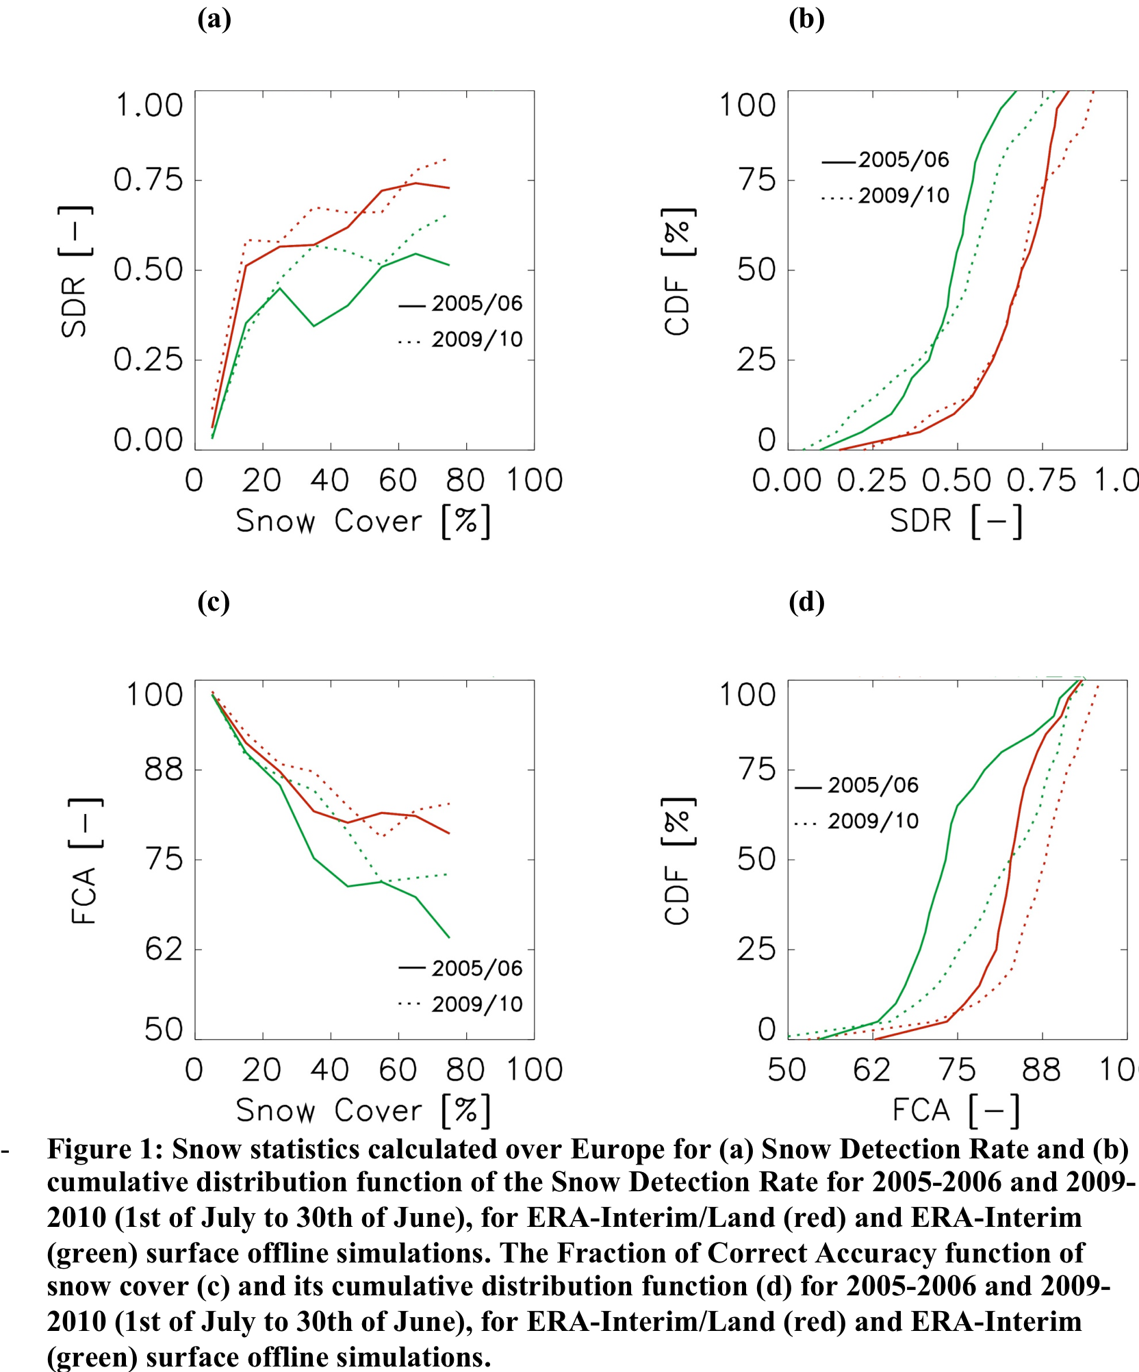
SNOW detection
SYNOP
SDR = Snow Detection Rate (SDR=1 being the best value) measures the fraction of times the snow fields rightly detect the presence of snow divided by the number of times the SYNOP observation detects snow presence (SDR=1 best value)
FCA = Fraction of Correct Accuracy (FCA=100 being the best value) measures the fraction of times the snow fields rightly detect the presence or absence of snow in agreement with the SYNOP message (divided by the total amount of stations).
Balsamo et al. (2014, ECMWF SAC TM729)

Slide 14
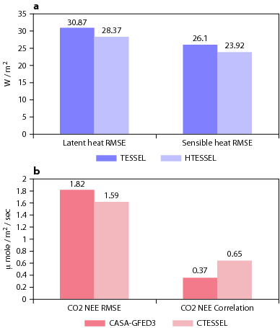
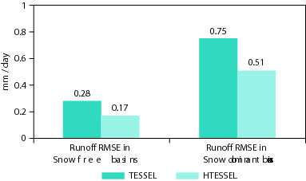
ERA-Interim/Land: fluxes verification
The ERA-Interim/Land fluxes are validated with independent datasets used as benchmarking.
Validation of H₂O / E / CO₂ cycles
E
H₂O
CO₂
GEOLAND-2 R&D support
Figure 2: Mean performance measured for the monthly rivers discharge verified with GRDC observations
Figure 1: Mean performance measured over 36 stations with hourly Fluxes from FLUXNET & CEOP Observations networks

Slide 15
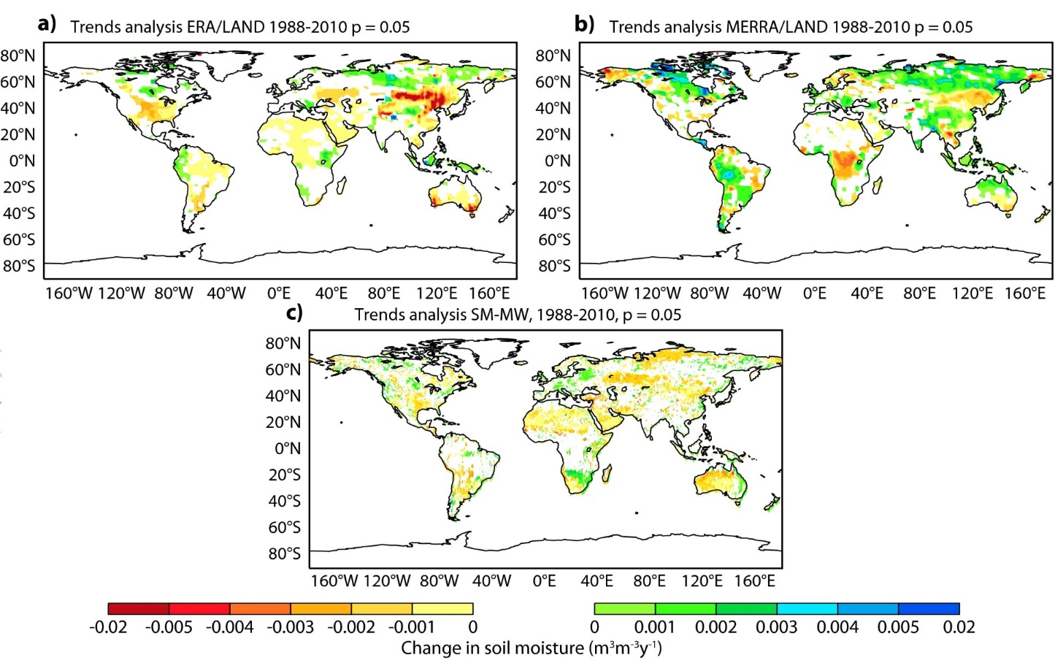
Combining Land-reanalyses, In-situ,
Remote-sensing for characterizing drying trends
Albergel et al. (2013)
72% of – (drying) trends
44% of – (drying) trends
73% of – (drying) trends
1988-2010 trends in monthly surface soil moisture (m³m⁻³y⁻¹) for a) ERA-Interim/Land, b) MERRA-Land and c) SM-MW (ESA-CCI / ECV). Only significant trends (p=0.005) based on the Mann-Kendall test are shown.

Slide 16
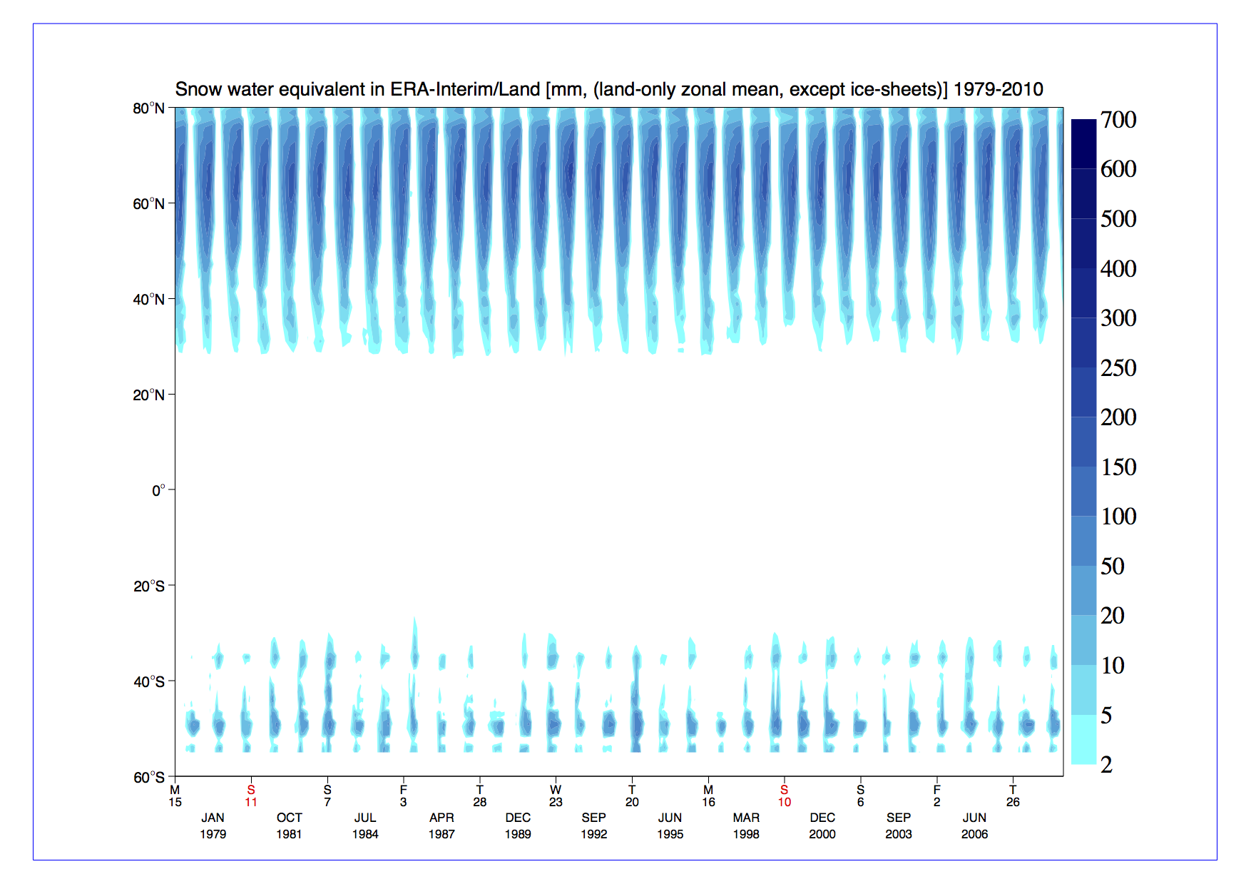
Combining Land-reanalyses, In-situ,
Remote-sensing for characterizing drying trends (what about snow?)

Slide 17
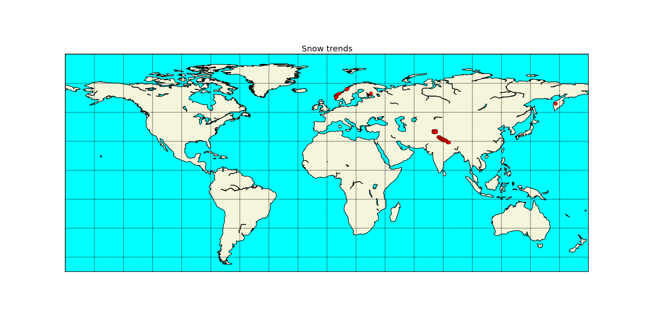

Any trends for Snow in Land-reanalyses? And are those reliable?
(as presented at LGGE-Grenoble)
Significant winter trend 1979-2010
Le test the Mann-Kendall appliqué à la series ERA-Interim/Land retrouve des trends (p<0.05) pour hivers (DJF) et le primptemps (MAM) et pour un certain n. de points.
Significant spring trend 1979-2010

Slide 18
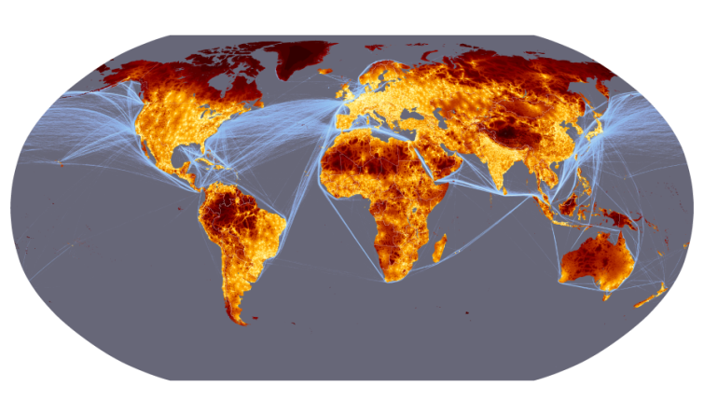
Surface data Challenge and linkage to Travel-Time
SYNOP/METAR/SHIP surface data coverage (ECMWF) Travel-Time from nearest City >50000 citizens; Source: JRC, World-Bank)

