Slide 1
Time stepping schemes for atmospheric modelling
by Michail Diamantakis (room 2107; ext. 2402)
michail.diamantakis@ecmwf.int

Slide 2
Factors influencing choice of time scheme
Type of equation model
Hydrostatic/Anelastic/Non-Hydrostatic
Type of numerical model/resolution/grid
LAM: high uniform resolution & no pole problem
Global models with
Regular lat/lon grids have very high res at poles
Reduced/quasi-uniform/unstructured grids: uniform resolution across the globe
Computer architecture
Numerical techniques that use heavily global communication are becoming unaffordable when applied to high resolution forecasts on Massively Parallel Architectures

Slide 3
Atmospheric model (equation) formulations
Hydrostatic approximation
The very fast vertically propagating sound waves are filtered ⇒ no stability problems associated with very large acoustic CFL numbers in the vertical
Not accurate for very fine resolution (see Sylvie’s lectures)
Anelastic approximation
sound waves filtered but unlike hydrostatic it has a prognostic equation for vertical motion
Non-hydrostatic (NH) equation model
Most accurate description. Must be used for resolutions that can resolve convection explicitly

Slide 4
What motions time-stepping should resolve?
  Rossby waves & gravity waves must be resolved – important for good weather predictions
  Fast acoustic waves can be supressed (damped) – these carry little energy and are not important:
    Ideally an unconditionally stable numerical scheme is needed which damps acoustic modes while is not damping the other significant waves
  Very high orders of accuracy in time-stepping are not necessary:
    In any model, errors from other model components such as parametrizations are usually large enough to make use of very high integration order not a practical option. Usually order 2-3 is sufficient (also depends on space discretization order)

Slide 5
Scalability: an important requirement
CPU clock-speeds have stagnated - even decreasing !
  More and more parallelism the only alternative to increase super-computing power
We want operational NWP solvers to scale well when run on very large number of cores ( >O(10⁴) )
For global lat/lon grid models at convection permitting res:
  If explicit timestepping is used: meridian convergence at poles ⇒ extremely high res which limits severely ∆t
  If implicit: grid anisotropy near poles leads to poor convergence of elliptic solvers + high communication cost
Global spectral transform models at convection permitting res:
  Don’t scale well mainly due to high communication cost

Slide 6
Eulerian flux-form methods for hyperbolic PDEs
Mass conservation:
When the equation model is formulated in flux (conservation) form Eulerian time stepping together with some appropriate space discretization e.g. Finite Volume, Spectral Element can be inherently locally and globally mass conserving
Advective CFL must be < 1 for stability and/or accuracy (unlike semi-Lagrangian semi-implicit which can run at CFL>1)
On quasi-uniform and unstructured meshes
Highly scalable compact stencil explicit methods
For implicit schemes scalability depends strongly on elliptic solver (Müller & Scheichl QJRMS 2013)

Slide 7
Common timestepping schemes
Schemes typically used (or emerging) in atmospheric modelling
  Semi-Lagrangian, semi-implicit: unconditionally stable (see next lecture)
  Flux-form Eulerian (e.g. MPDATA) with semi-implicit timestepping
  Split-explicit: “improved efficiency” explicit schemes
  HEVI: Horizontally Explicit / Vertically Implicit
    suitable for NH models as they use an implicit & unconditionally stable scheme in the vertical where highest CFL numbers occur
  IMEX: implicit-explicit Runge-Kutta schemes
    Implicit in the fast process, explicit in the slow.

Slide 8




MPDATA: positive definite advection
Smolarkiewicz & Margolin (1998)
Upstream approximation of flux eqn:
MPDATA steps
Compute 1st order upstream approximation from etc
Subtract estimate of error to obtain 2nd order accuracy
where

Slide 9
A simple test model: 1d gravity wave equations
Fluid mean depth
Linearized:
Perturbation from
mean depth
Seeking linear analytic solution of the form:
implies a phase speed:

Slide 10
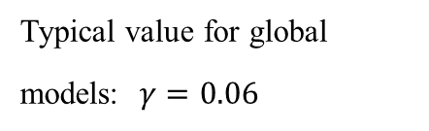
Explicit Leapfrog time stepping on 1D GW eqn
Three-time-level explicit Leapfrog scheme
Leapfrog on general problem:
Leapfrog on 1D GW equations:
Neutral (no damping) + 2nd order BUT
phase + dispersion errors + computational mode
Von Neuman stability:
Solution is a combination of a physical and a “parasitical” computational mode
which can be damped by use of a time filter, e.g. Asselin filter
Typical value for global models: $γ=0.06$

Slide 11
A note on staggering
The prognostic variables can be
  On the same location on the grid, i.e. collocated
  In between (half way) each other, i.e. staggered
    Improved accuracy + dispersion properties
    On explicit techniques staggering results into a more restrictive timestep e.g.: instead of
x x x x x x x
  x o x o x o x o x o x o x

Slide 12
Enhancing stability: forward-backward integration
• Forward-backward scheme: a predictor-corrector type scheme The predictor and the corrector are applied on separate equations.
forward
backward (pseudo-implicit)
Fwd-Bwd versus Leapfrog:
1. Doubles the leapfrog timestep
2. Remains neutral (no damping)
3. Two-time-level scheme ⇒ no computational mode

Slide 13
Runge-Kutta RK3 (WRF) scheme
• Runge-Kutta Wicker & Skamarock (MWR 2002) RK3 scheme:
- three-stage, two-time-level (2nd order) scheme from the RK family
A high order FD scheme used to estimate derivatives
Compared with leapfrog almost doubles (1.62) Δt when 3rd order spatial discretization used
In WRF this is used in combination with time-splitting …

Slide 14
Splitting: the motivation
In an atmospheric model we have motions with multiple time-scales: fast and slow processes co-exist
Explicit techniques are only conditionally stable and impose use of small timesteps
If ∆t is the longest permissible timestep for integrating the slow process then ∆t will be too long for stable integration of the fast process
  Split the integration:
    integrate slow process with ∆t
    integrate fast process with a fraction of it i.e. ∆t/n

Slide 15
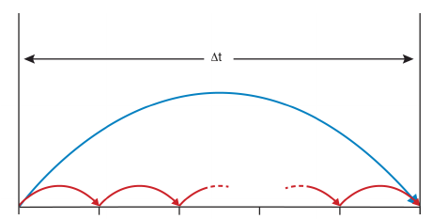
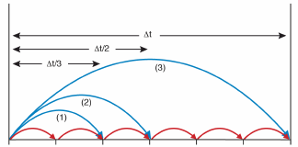
Split-explicit example in a diagram
Split-explicit Euler
Split-explicit RK3
1-cycle/per stage i: slow process integrated with Δt, each stage approximates solution at t+c_{i} Δt where, c_{i}=1/3,1/2,1 the RK3 coefficient
1-cycle: slow process integrated with Δt
n-cycles: fast process integrated with Δt/n
(Diagram courtesy of S.J. Lock, ECMWF Seminar proceedings 2013, HEVI time-stepping for NWP and climate models)

Slide 16
Split-explicit forward Euler integration
Fast forcing term
Slow forcing term
Fast term updated
Slow term kept constant (stored)
1S + n_{s} F evaluations
versus FW-Euler
n_{s} S+ n_{s} F evaluations

Slide 17
Split-explicit RK3 integration
S term is evaluated only once per stage and added at each sub-cycle

Slide 18
Leapfrog (3TL) split-explicit fw-bw example
fast/forward
slow/leapfrog
e.g.
backward
leapfrog
fast F terms updated
Slow terms kept constant

Slide 19
HEVI schemes
NH models: acoustic CFL number poses a severe limit to timestep due to very fast vertically propagating waves & high vertical resolution
Horizontally Explicit, Vertically Implicit schemes:
Explicit scheme (or split explicit) in the horizontal where CFL is not as large as in the vertical due to coarser resolution
Unconditionally stable implicit scheme for the vertical to deal with high acoustic CFL numbers

Slide 20
Some HEVI / split-explicit models
ICON (Germany): global NWP model (13km res)
  forward-backward explicit time-stepping (no splitting) in the horizontal + vertically implicit (midpoint rule)
EU-COSMO: operational NH LAM
  [Leapfrog (old model), RK3 (new model)] + split-explicit in the horizontal + Crank-Nicolson in the vertical
NICAM: cloud resolving NH global model (Japan)
  Split-explicit forward-backward in the horizontal + implicit in vertical
WRF, MPAS (USA): LAM, Global research & operational
  Split-explicit RK3 + vertically implicit

Slide 21
Drawbacks of the split-explicit approach
In deep global NH models O(100km) there is no much benefit from split-explicit approach in the horizontal
  Stratospheric polar jet velocities not far from speed of sound advective CFL similar magnitude to acoustic
    No significant gain from horizontal splitting which works well when having a fast and a slow process
  Splitting needs damping for stabilization
Alternatives:
  Implicit Explicit (IMEX) RK (unconditionally stable implicit scheme for fast processes and cheap explicit for slow)
  IMEX has very general form: HEVI can be written as IMEX

Slide 22
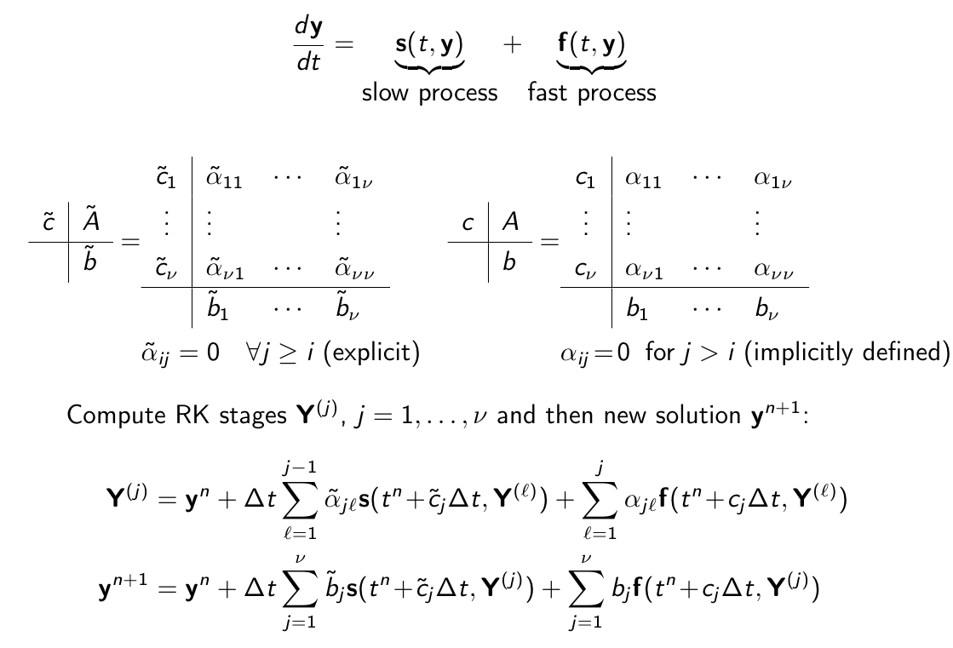
IMEX: Blending explicit with implicit

Slide 23
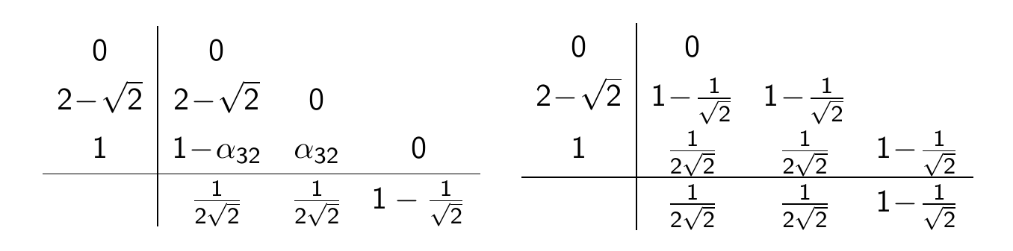
Example of IMEX – ARK2(2,3,2)
Giraldo et al (SIAM J.Sci.Comp., 2013) option in NUMA NH model
2nd order + L-Stable, overall very accurate and stable (Weller et al JCP 2013)

Slide 24
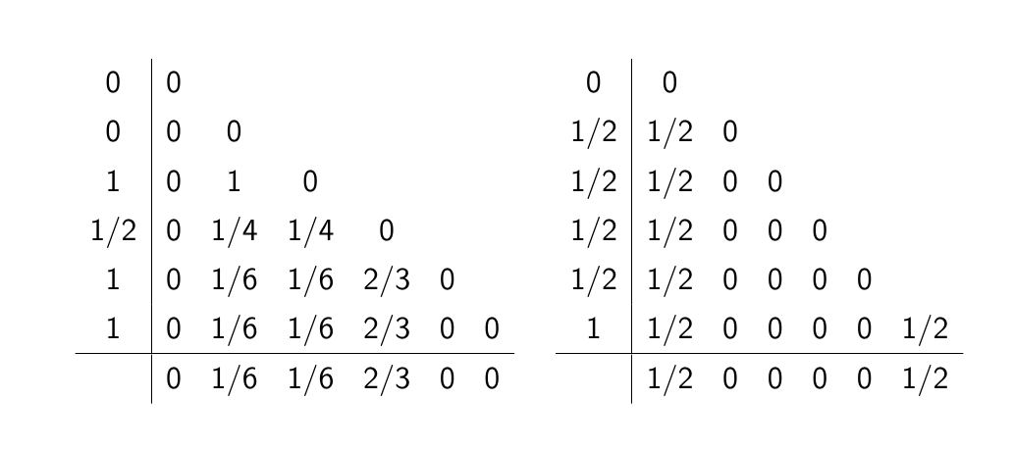
Example of IMEX
2nd order Ulrich & Jablonowski (MWR, 2012) ‘Strang carryover’ UJ3(1,3,2) scheme

Slide 25
Properties of UJ3 scheme
Explicit part: 3rd order Strong Stability Preserving (SSP)
  SSP is a desirable property for a hyperbolic PDE which guarantees that a time discretization is TVD for some norm i.e.
Overall accuracy: 2nd order accurate + small damping
Only final stage Y₆ is implicit:
Has been implemented in research atmospheric model

Slide 26
Overview
There are many choices of numerical techniques
What to choose depends on the problem you solve (mathematical formulation, resolution, domain) and the computer architecture you apply your algorithm
Nowadays mainly due to hardware requirements and interest in developing very high resolution systems there is considerable research & development activity in scalable compact stencil Eulerian techniques which are also suited for developing dynamical cores with formal conservation properties

Slide 27
Some references
Dale Durran’s book: “Numerical methods for Wave Equations in Geophysical Fluid Dynamics” (1999)
Lauritzen et al book: Numerical Techniques for Global Atmospheric Models, Springer 2011
Wicker & Skamarock (MWR 1994): “Efficiency and Accuracy of the Klemp-Wilhemson Time-Splitting Technique”
Wicker & Skamarock (MWR 2001): “Time-Splitting Methods for Elastic Models Using Forward Time Schemes”
Ulrich & Jablonowski (MWR 2012): “Operator-Split Runge-Kutta-Rosenbrock Methods for Nonhydrostatic Atmospheric
Lock, Wood, Weller (QJRMS 2014): “Numerical Analyses of Runge-Kutta implicit-explicit schemes for horizontally …”

Slide 28
Thank you for your attention!

