Slide 1
Microwave observations in the presence of cloud and precipitation
Alan Geer
Thanks to: Bill Bell, Peter Bauer, Fabrizio Baordo, Niels Bormann, Katrin Lonitz and Richard Forbes

Slide 2
Overview
Clear-sky microwave (Monday)
  The microwave spectrum
  Microwave instruments
  Using microwave for temperature and humidity sounding; imaging channels for surface properties and total column moisture
  AMSU-A channel 5 at ECMWF
All-sky microwave (today)
  Effect of cloud and precipitation on microwave radiation
  Modelling the effect of cloud and precipitation:
    Solving the scattering radiative transfer equation
  Clear-sky and all-sky approaches
  All-sky assimilation: impact and mechanisms
  Case study: diagnosing forecast model errors with all-sky radiances

Slide 3
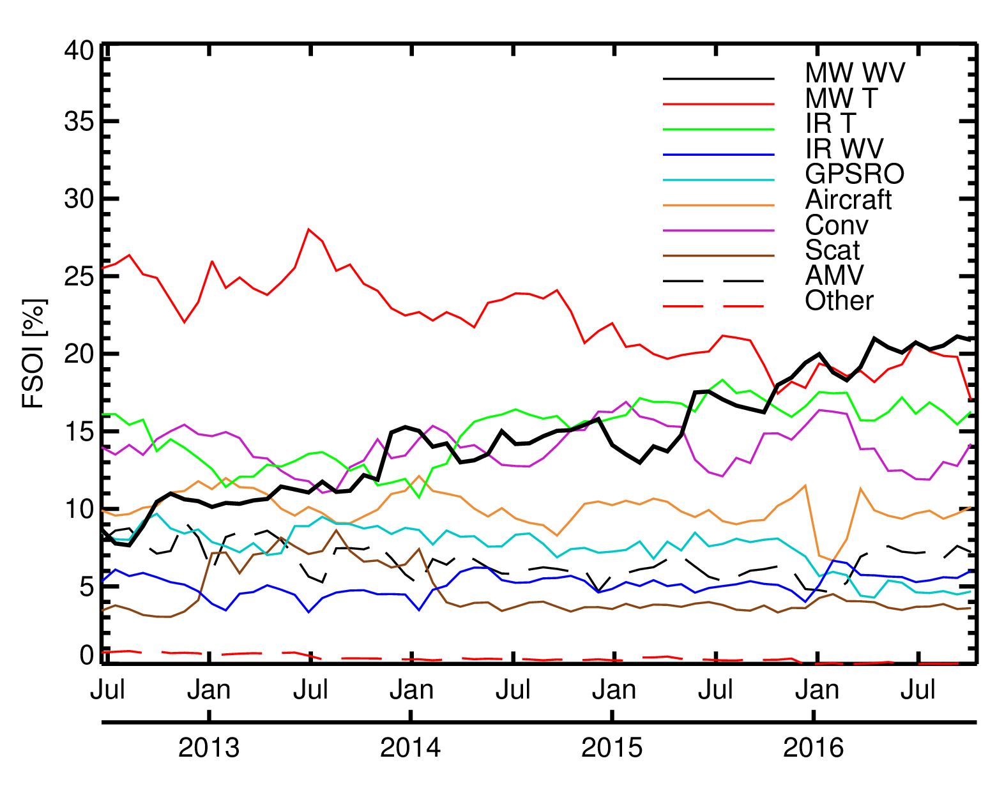
Forecast sensitivity (FSOI) of major observing systems in ECMWF operations
100% = full observing system
Summer 2006
(from Cardinali, 2009)
Microwave WV 6.2 %
Microwave T 35.5 %
Infrared 28.0 %
August 2016
Microwave WV 20.4%
Microwave T 20.1 %
Infrared 21.9 %

Slide 4
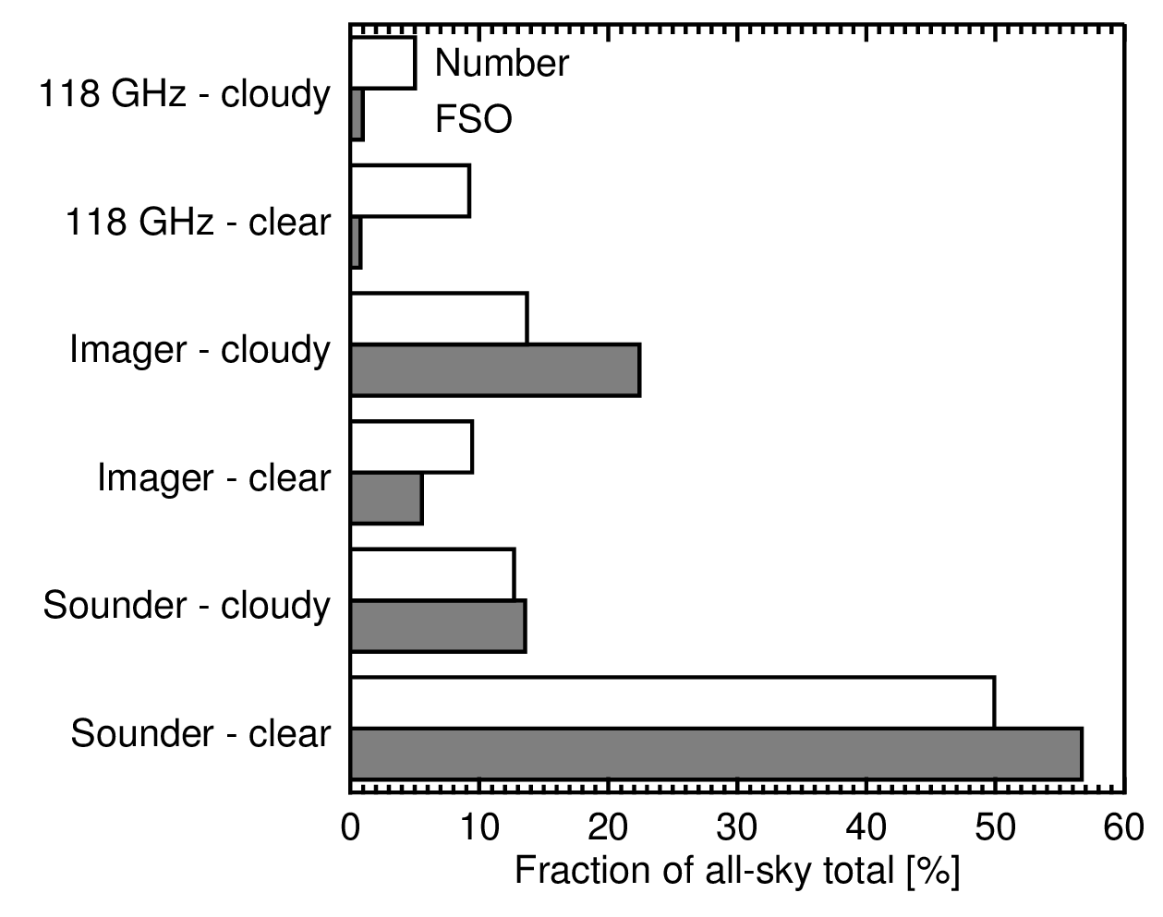
Importance of cloudy and precipitating scenes
100% = 9 all-sky instruments
Imagers: Cloudy and precipitating scenes give more FSO than clear-sky scenes
Sounders: Cloudy and precipitating scenes have same per-obs FSO as clear-sky scenes

Slide 5
Effect of cloud and precipitation on microwave observations: introduction

Slide 6
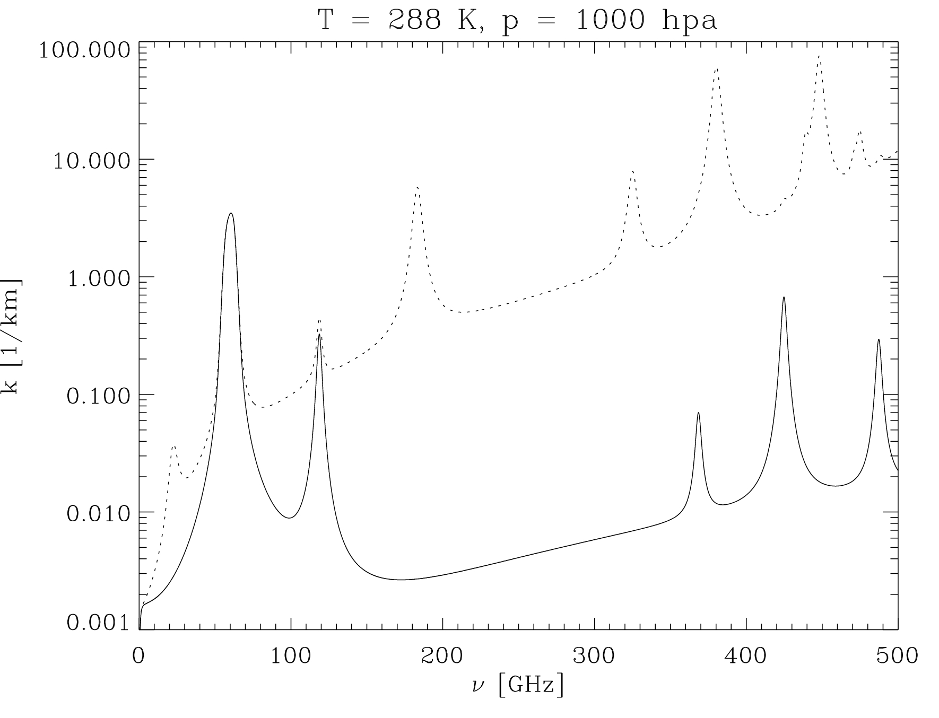
The microwave gas absorption spectrum
Absorption coefficientβ_{a} [1/km]
H₂O Rotation lines
+
Water vapour continuum
O₂ Rotation Lines
+
Dry air continuum
Moist
“Imaging channels” in the windows
Temperature sounding:
60 GHz oxygen line
Dry
Moisture sounding:
22 GHz and 183 GHz water vapour lines

Slide 7
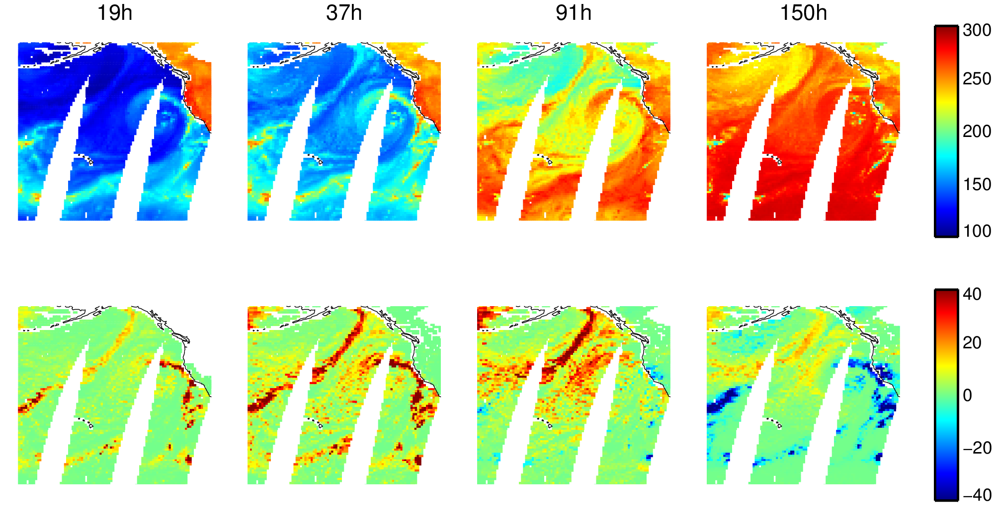
Window channels (“imaging”): surface properties, water vapour, cloud and precipitation
Increasing frequency [GHz]
Observed TB [K]

Slide 8
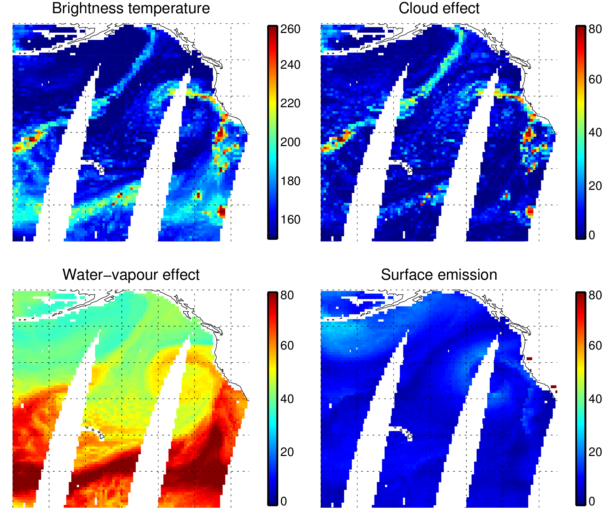
Separating the components: 37h GHz (h=horizontal polarisation)
TB [K]
TB - TB^{CLEAR} [K]
TB^{NO_ATMOSPHERE} - 90
[K]
TB^{CLEAR} – TB^{NO_ATMOSPHERE}
[K]
TB = ΔTB^{HYDROMETEOR} + ΔTB^{WATER_VAPOUR} + ΔTB^{WIND_AND_SURFACE_EMIS} + TB^{BASELINE}
= 80 + 60 + 30 + 90 = 260

Slide 9
Window channels (“imaging”): surface properties, water vapour, cloud and precipitation
Increasing frequency [GHz]
Observed TB [K]
Hydrometeor effect: TB - TBclear [K]
Rain (absorption, increases TB)
Snow/graupel/hail (scattering, decreases TB)
Cloud (absorption, increases TB)

Slide 10
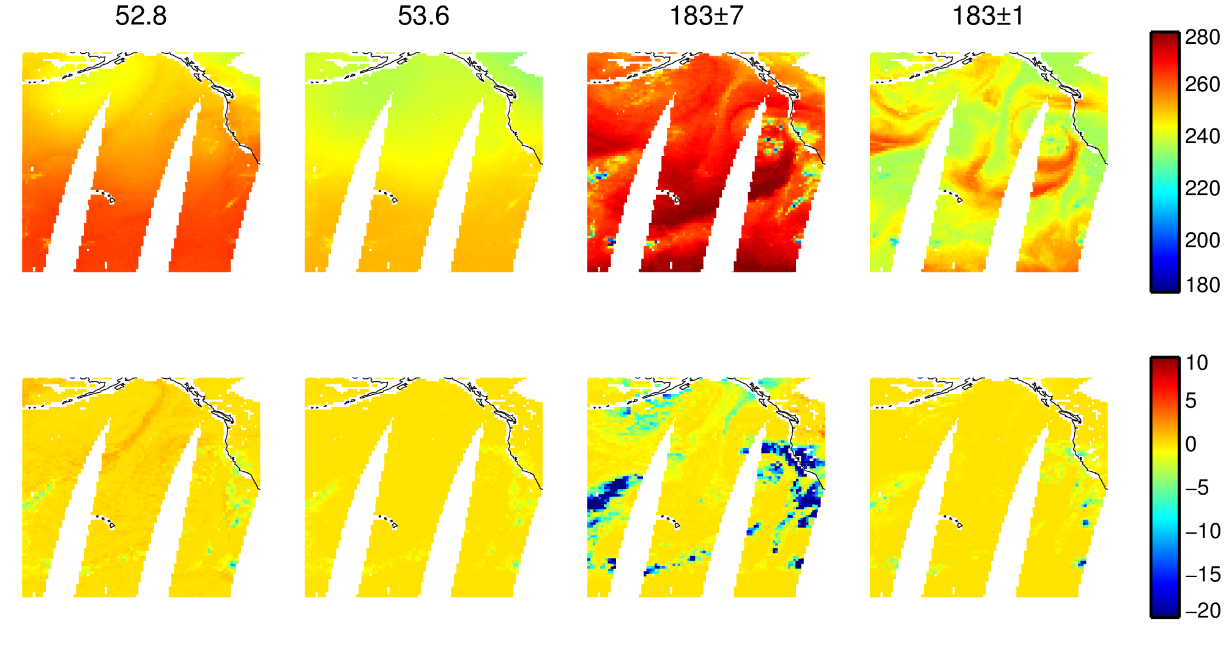
Sounding channels: temperature, water vapour, cloud and precipitation
Temperature sounding:
Lower troposphere Mid troposphere
Water vapour sounding:
Mid troposphere Upper troposphere
Observed TB [K]
Hydrometeor effect: TB - TBclear [K]
Cloud (absorption, increases TB)
Cloud and rain (absorption, pushes up weighting function altitude, decreases TB)
Cloud and snow/ice/graupel (absorption and scattering, decreases TB)

Slide 11
Simulating the effect of cloud and precipitation

Slide 12
Atmospheric particles and microwave radiation
Size parameter
30 GHz frequency ↔ 10mm wavelength (λ)
Particle type | Size range, r | Size parameter, x | Scattering solution
Cloud droplets | 5 – 50 μm | 0.003 – 0.03 | Rayleigh
Drizzle | ~100 μm | 0.06 | Rayleigh
Rain drop | 0.1 – 3 mm | 0.06 – 1.8 | Mie
Ice crystals | 10 – 100 μm | 0.006 – 0.06 | Rayleigh, DDA
Snow | 1 – 10 mm | 0.6 – 6 | Mie, DDA
Hailstone | ~10 mm | 6 | Mie, DDA

Slide 13
Spherical particles interacting with radiation
Negligible scattering (x < 0.002):
  at low microwave frequencies, liquid water cloud acts like a gaseous absorber
Rayleigh scattering (0.002 < x < 0.2):
  an approximate solution for spherical particles much smaller than the wavelength
Mie scattering (0.2 < x < 2000):
  a complete solution for the interaction of a plane wave with a dielectric sphere
  valid for all x, but depends on a series expansion in Legendre polynomials - can be slow to compute
Geometric optics (x > 2000):
  e.g. the rainbow solution for visible light

Slide 14
Non-spherical particles interacting with radiation
Discrete dipole approximation (DDA):
Other solution methods exist, e.g. T-matrix
1. Create a 3D model of a snow or ice particle
2. Discretise into many small polarisable points (dipoles). Grid spacing << wavelength
3. Solve computationally – can be slow

Slide 15
Scattering properties – single particles
Scattering cross-section: [m²]
  the amount of scattering as an equivalent “area”
Absorption cross-section: [m²]
  particles can absorb as well as scatter radiation
Scattering phase function:
  the amount of scattering in a particular direction (expressed in polar coordinates)

Slide 16
Scattering properties - bulk
Sum or average over:
  Different orientations (or, in some ice clouds, a preferred orientation)
  Size distribution
  Particle habits: snow and ice shapes, graupel, cloud drops, rain etc.
Extinction coefficient [1/km] :
Single scatter albedo:
  Ratio of scattering to extinction
Asymmetry parameter – the average scattering direction
  g = 1 → completely forward scattering (~ not scattered at all)
  g = 0 → as much forward as back scattering (not necessarily isotropic)
  g = -1 → complete back-scattering (physically unlikely)

Slide 17
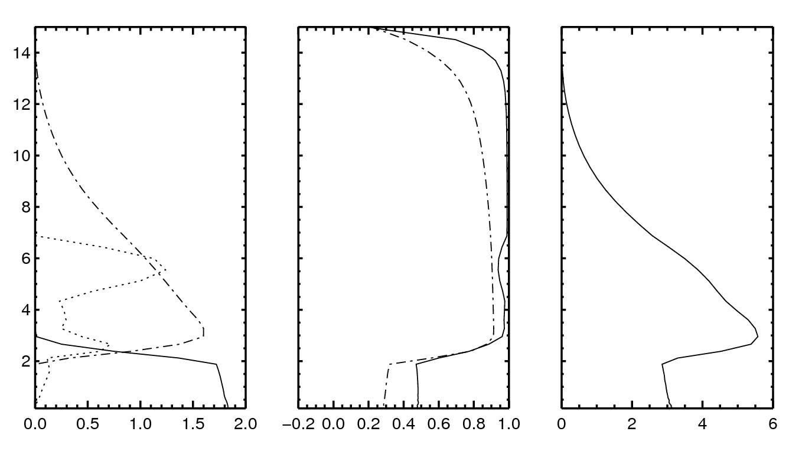
Cloud and precipitation at 91 GHz
Strong scattering in deep convection
Altitude [km]
Single
scatter
albedo
Snow
Asymmetry
Water cloud
Rain
Rain and snow flux [g m² s⁻¹]
Cloud mixing ratio [0.1 g kg⁻¹]
Extinction coefficient β_{e}
[km⁻¹]

Slide 18
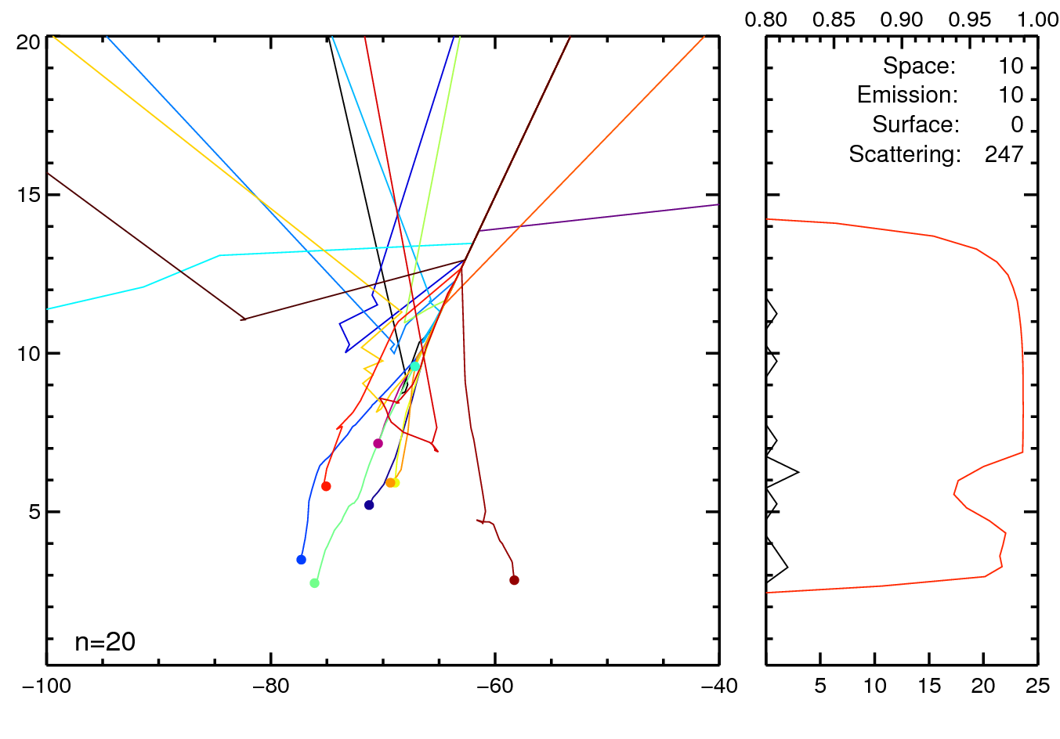
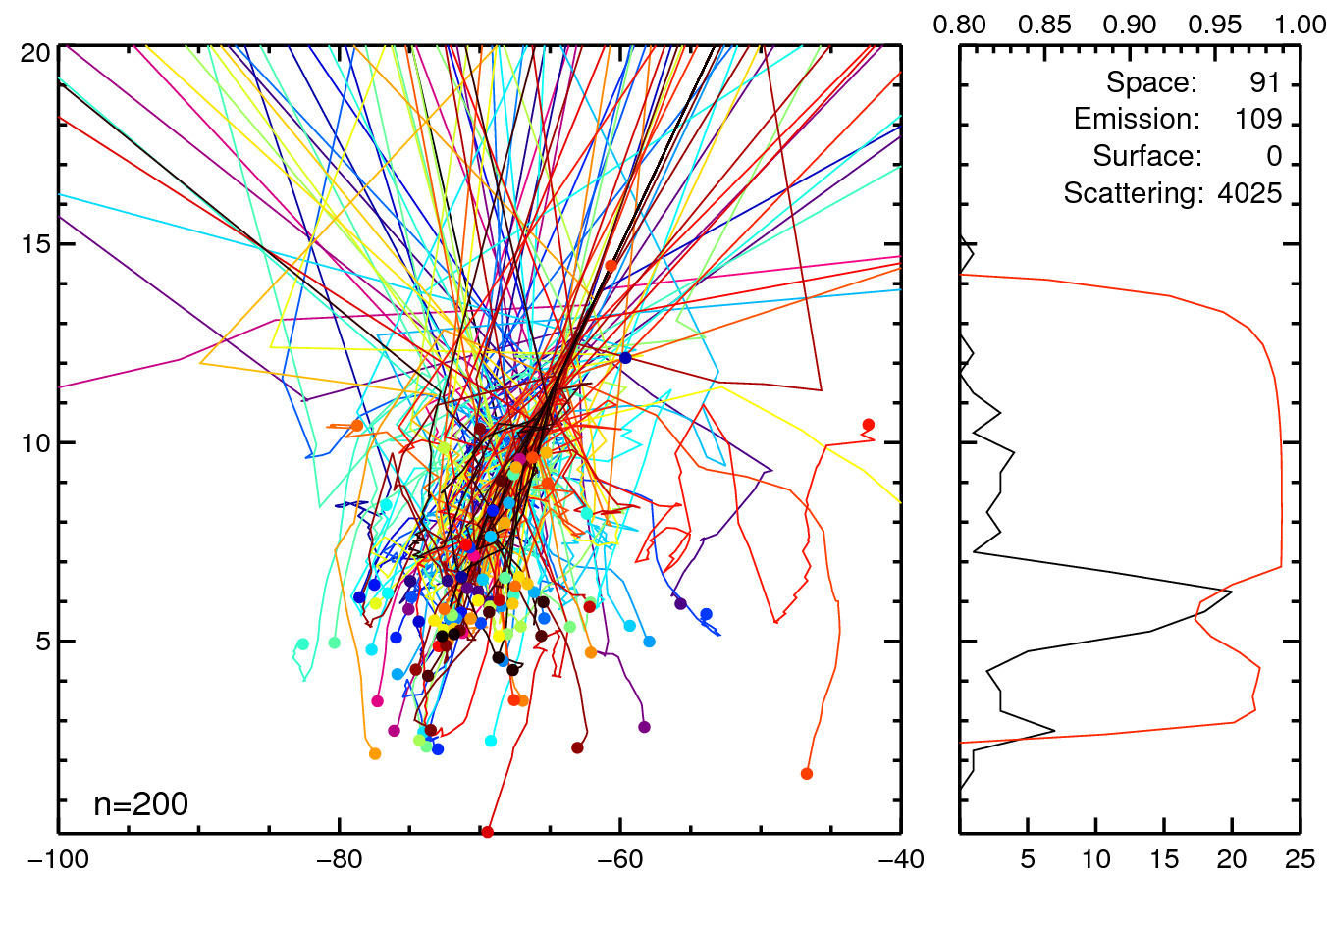
Cloud and precipitation at 91 GHz
Strong scattering in deep convection
To sensor
SSA [0-1]
[km]
Snow
Cloud
Rain
[km]
No. of emissions

Slide 19
H() - radiative transfer model
Sensor
Given p,T, q, cloud and precipitation on each atmospheric level, we can compute:
τ - Layer optical depth
(absorption and scattering)
ω_{s} - Single scattering albedo
- Scattering phase function
(usually represented only by g,
the asymmetry parameter)
= direction vector in solid angle
Now just solve the equation of radiative transfer (discretized on the vertical grid):

Slide 20
Radiative transfer solvers
Scattering phase function
This can be complex to solve:
  , the radiance in one direction, depends on radiance from all other directions:
  and all levels depend on each other
But in non-scattering atmospheres (no cloud and precipitation) it’s easier:
  ω_{s} = 0 , so
  we can do each layer sequentially

Slide 21
Scattering solvers
Reverse Monte-Carlo
  Great for understanding and visualisation
  An easy way to do 3D radiative transfer
  Much too slow for operational use: many thousands of “photons” are required for convergence to a useful level of accuracy
Accurate but too slow for use in assimilation:
  DISORT (Discrete ordinates) – a generalisation of the two-stream approach
  Adding / doubling, SOI (Successive Orders of Interaction)
Two-stream and delta-Eddington approaches
  What we use operationally at ECMWF (in RTTOV-SCATT)
  Though quite crude methods, the accuracy is usually more than sufficient: the main R/T error sources in NWP are rarely in the solver

Slide 22
Clear-sky or ‘all-sky’ assimilation?

Slide 23
Clear-sky or all-sky assimilation?
Clear-sky assimilation:
  Remove any cloud-contaminated observations
  Do not model the effect of cloud on brightness temperatures
  Used for temperature sounding channels (e.g. AMSU-A channel 5)
  Extract small signals of temperature forecast errors (order 0.1K) that would be swamped by errors from displaced clouds and precipitation (10-100K)
All-sky assimilation
  Model the effect of cloud and precipitation on the observations
  Assimilate all data, whether clear, cloudy or precipitating
  Used for water-vapour sounding and imaging channels
  Use the tracing mechanism of 4D-Var to infer the dynamical state from errors in the location/intensity of water vapour, cloud and precipitation

Slide 24
Cloud screening
Use clear-sky radiative transfer but remove situations where the observations are cloudy or precipitating
Cloud screening methods:
  FG departures in a window channel
  Simple LWP or cloud retrieval
    Sounders: Grody et al. (2001, JGR)
    Imagers: Karstens et al. (1994, Met. Atmos. Phys.)
    Imagers: 37 GHz polarisation difference, Petty and Katsaros (1990, J. App. Met.)
  Scattering index (SI)
    Over land, or in sounding channels affected by ice/snow scattering, not cloud absorption: Grody (1991, JGR)
Used for screening AMSU-A channel 5-8 at ECMWF

Slide 25
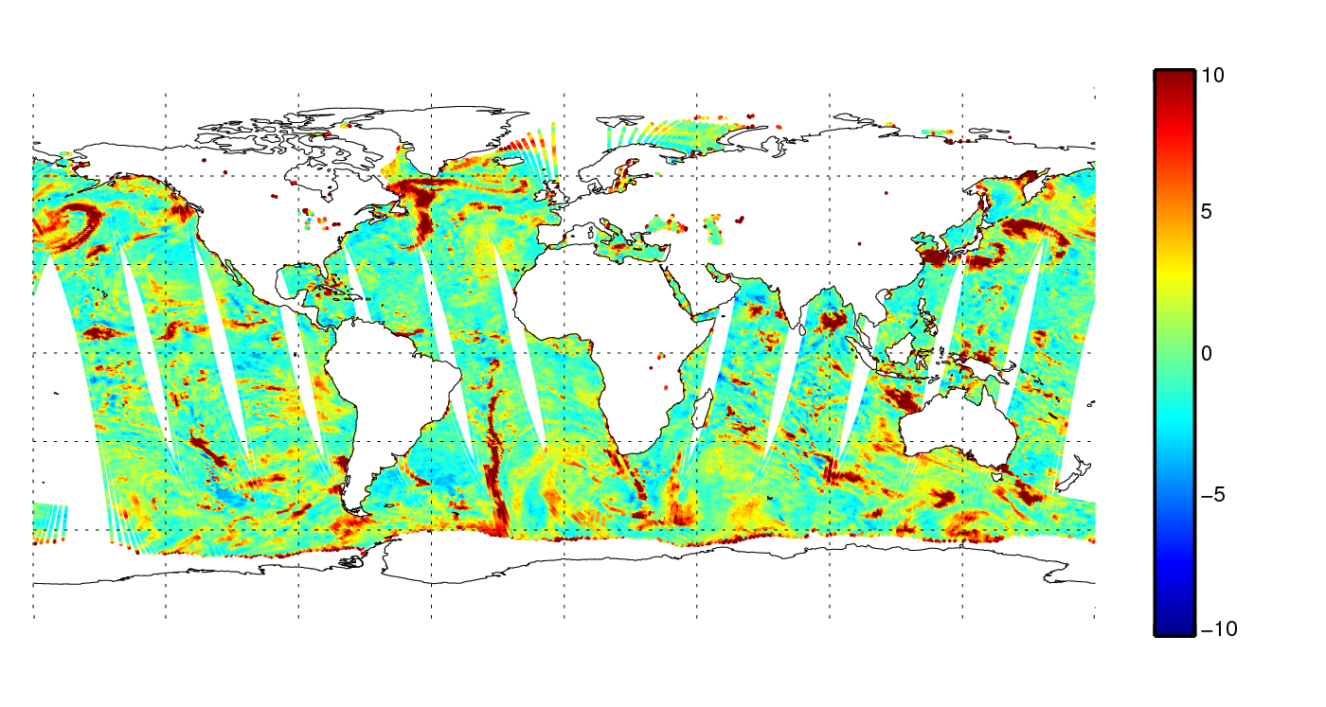
AMSU-A channel 3 departures for cloud screening
50.3 GHz observation minus clear-sky first guess (bias corrected), ocean surfaces
K
Cloud shows up as a warm emitter over a radiatively cold ocean surface

Slide 26
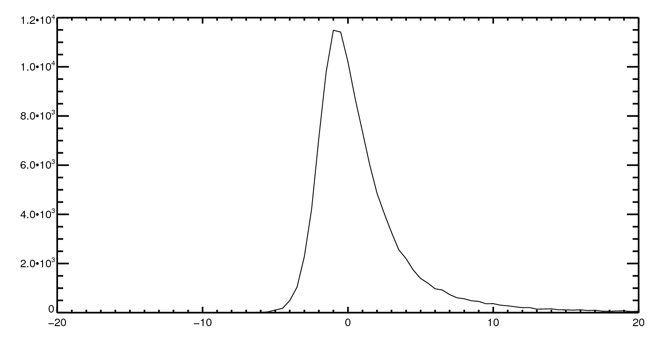
AMSU-A channel 3 departures for cloud screening
50.3 GHz observation minus clear-sky first guess, ocean surfaces
3K limit
20% of observations removed
Warm tail = cloud
FG departure [K]

Slide 27
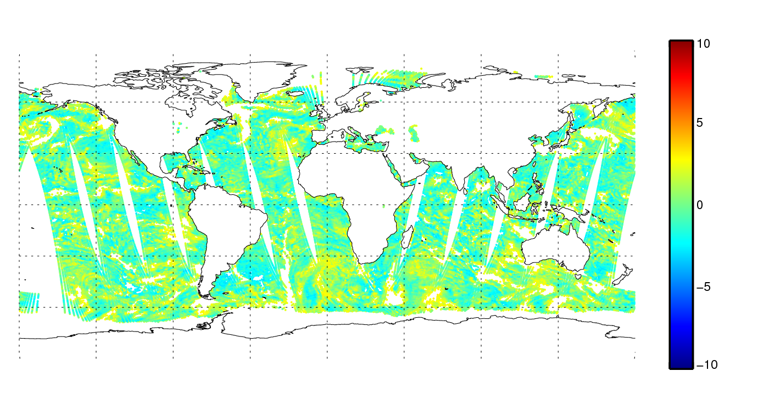
AMSU-A channel 3 departures for cloud screening
50.3 GHz observation minus clear-sky first guess (bias corrected), ocean surfaces
K

Slide 28
Clear-sky assimilation
Model | Observations
✓
×
×
✓?

Slide 29
All-sky assimilation
Model | Observations
✓
✓
✓
✓

Slide 30
All-sky assimilation: impact and mechanism

Slide 31
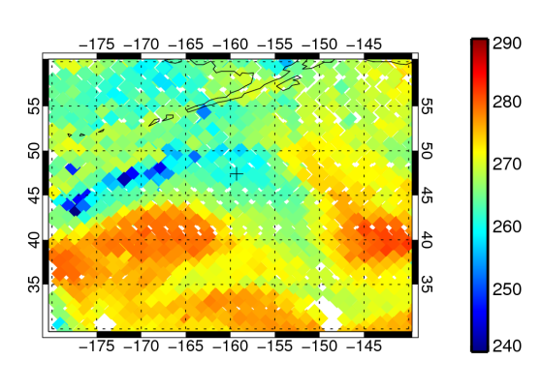
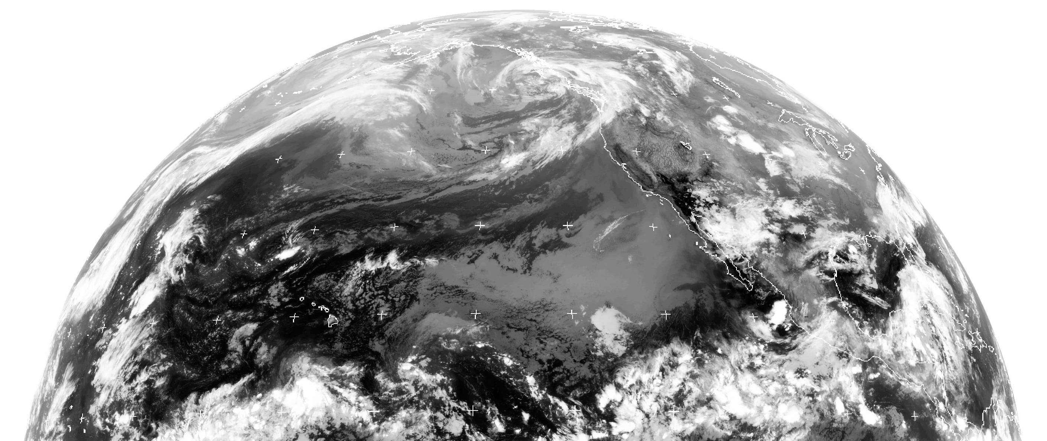
Frontal cloud and precipitation: single-observation example at 190 GHz
Metop-B MHS
190 GHz
08Z, 15 Aug 2013
47°N 159°W
GOES 10μm
Dundee receiving station

Slide 32
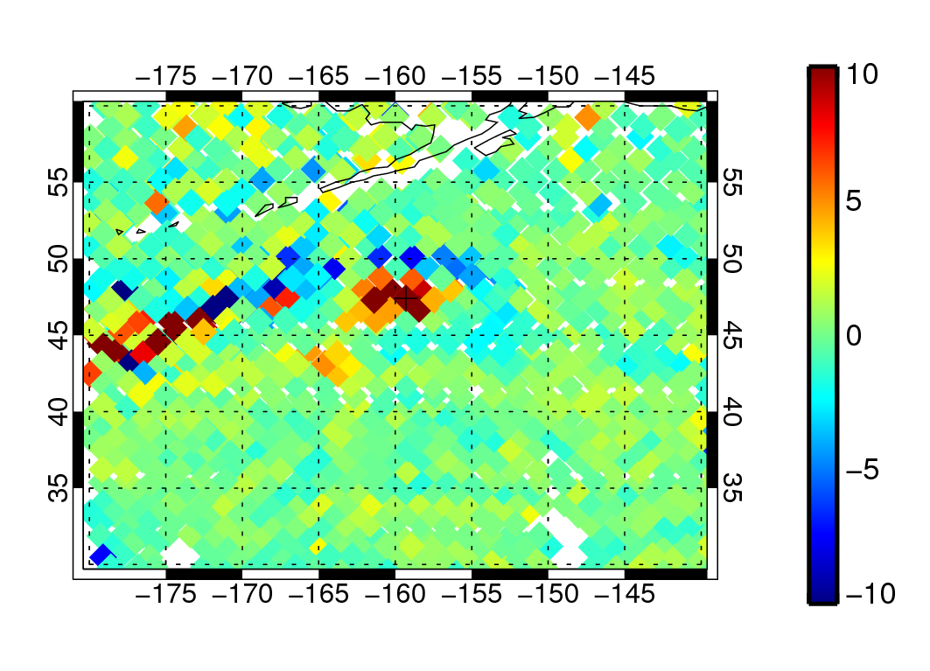
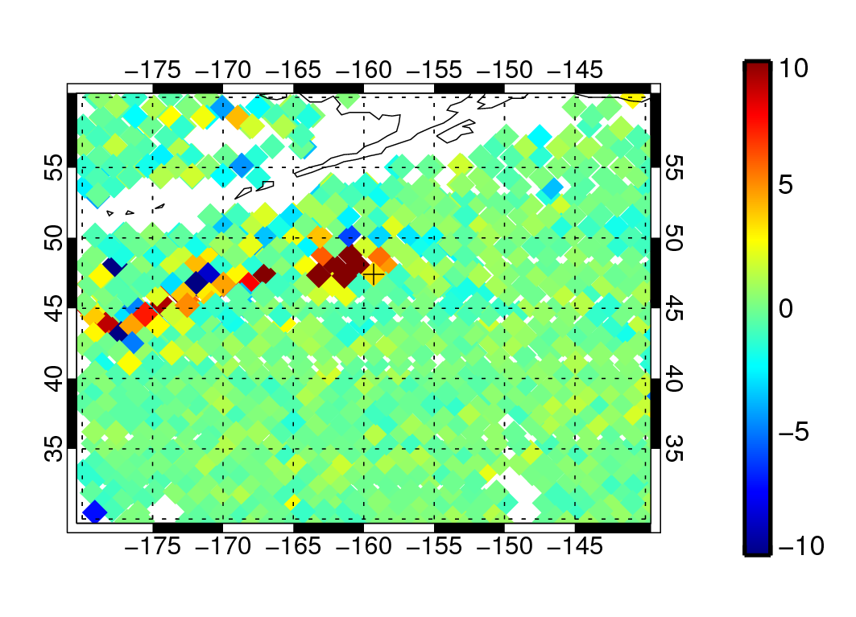
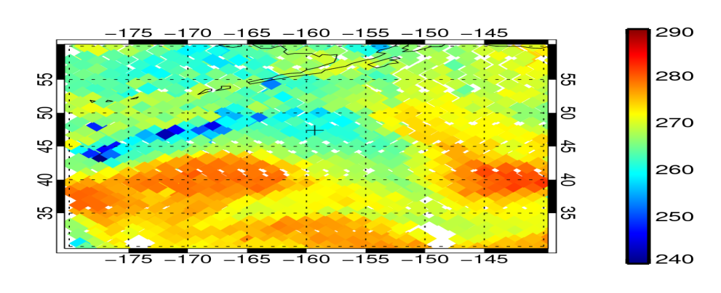
Frontal cloud and precipitation – all observations
[K]
[K]
FG depar
Analysis depar (all obs)
[K]
Obs

Slide 33
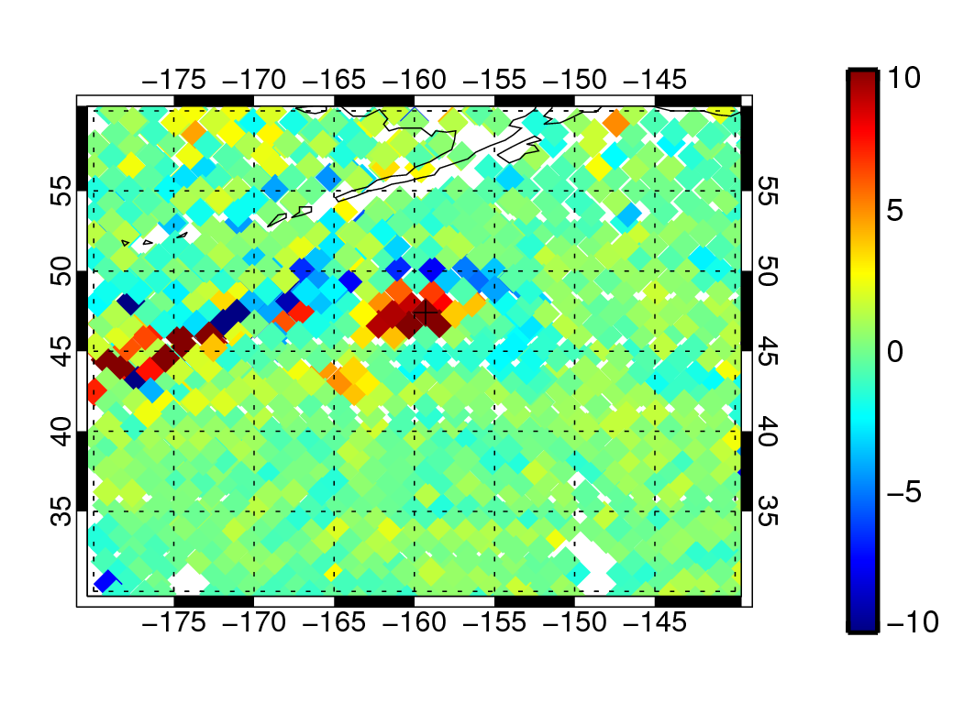
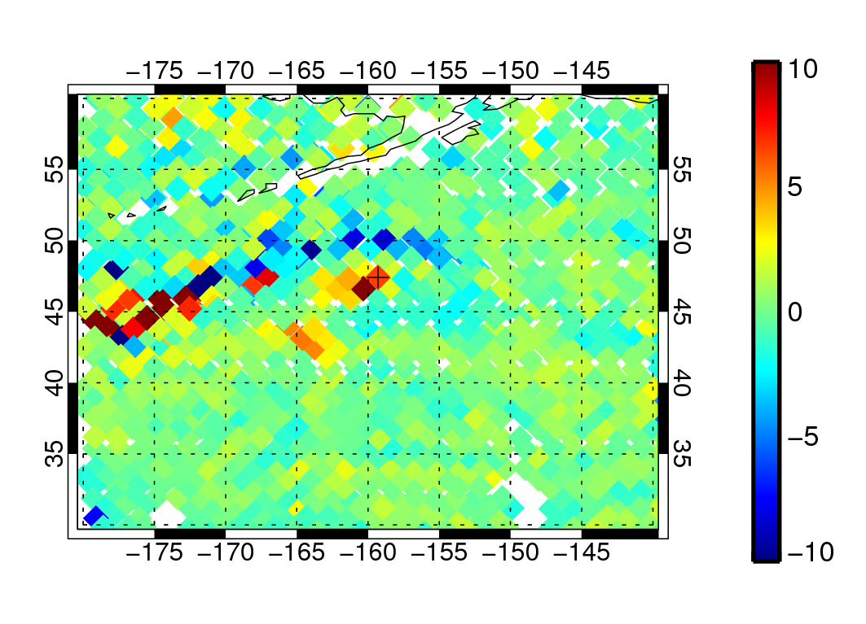
Frontal cloud and precipitation – single all-sky obs
[K]
[K]
FG depar
Analysis depar (all obs)
[K]
[K]
AN dep (single obs, normal obs error)
AN dep (single obs, low obs error, no VarQC or BgQC)
25% error reduction (honest!)
80% error reduction.
Locally better than full observing system!

Slide 34
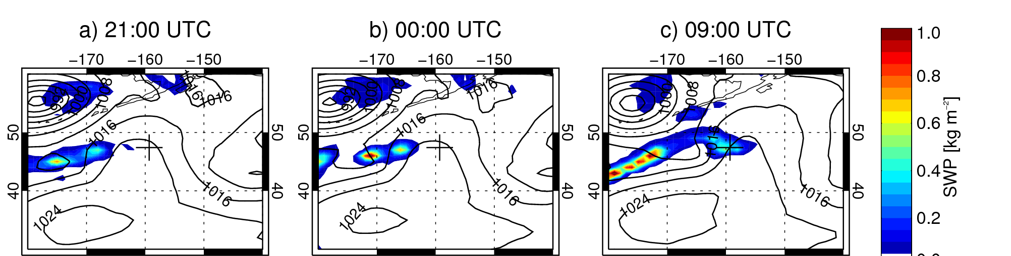
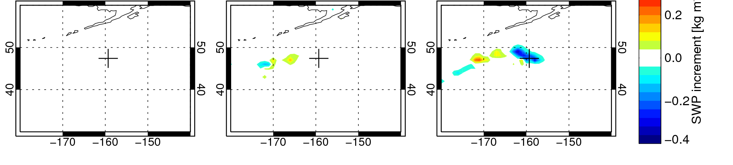
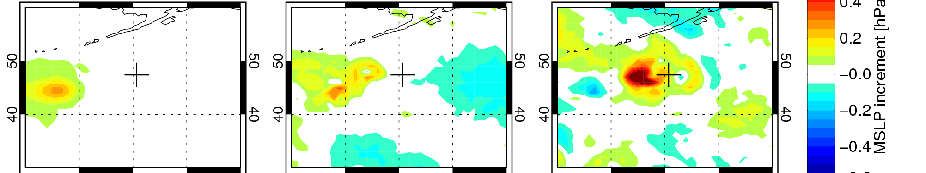
B) Frontal cloud and precipitation – 190 GHz
Time of
observation (08Z)
Start
Assimilation window
End
MSLP and
snow column (FG)
Snow
column
increment
Snow reduction at observation time generated by reduction in strength of low pressure area 1000km away, 11h earlier
MSLP
increment

Slide 35
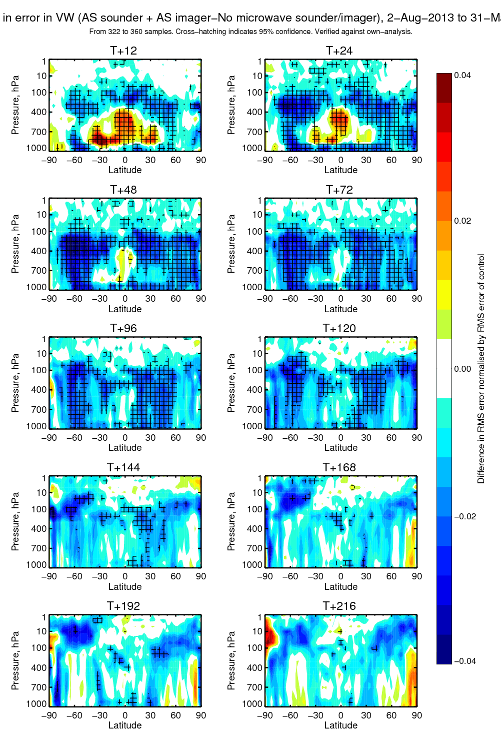
Impact of all-sky microwave humidity sounders and imagers -on top of the otherwise full observing system
Bad
2-3% impact on day 4 and 5 dynamical forecasts
Change in RMS error of vector wind Verified against own analysis
Blue = error reduction (good)
Based on 322 to 360 forecasts
Cross hatching indicates 95%
confidence
Good

Slide 36
Model moist physics developments supported by all-sky assimilation

Slide 37
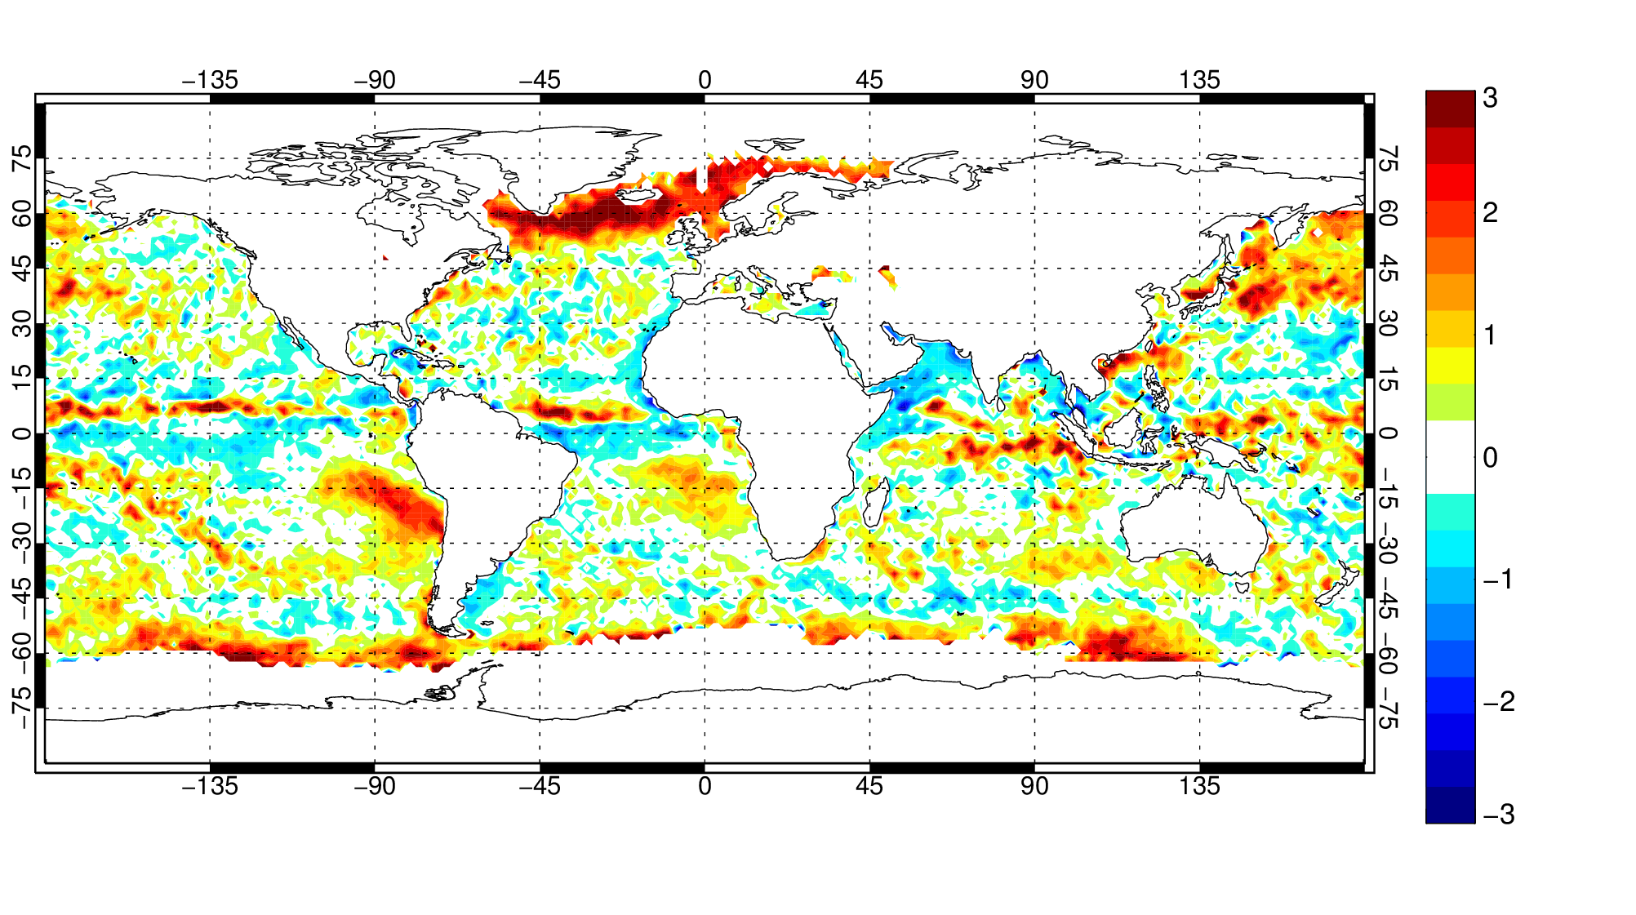
Monthly mean biases at 37 GHz (sensitive to cloud, water vapour and rain)
SSMIS channel 37v, December 2014 – all data over ocean, including observations usually removed by QC
Bias [K]
Diurnal cycle and water content of marine stratocumulus (Kazumori et al., 2015)
Lack of supercooled liquid water in cold air outbreaks

Slide 38
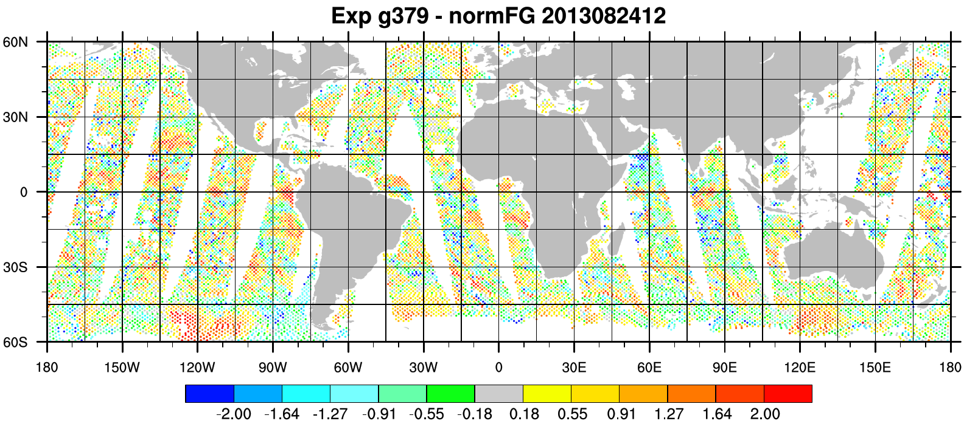
Cold air outbreaks
Thanks to Katrin Lonitz and Richard Forbes
12Z 24th August, 2013, 37v FG departure [normalised]
Cold air outbreak with large +ve FG departures (missing liquid water cloud?)

Slide 39
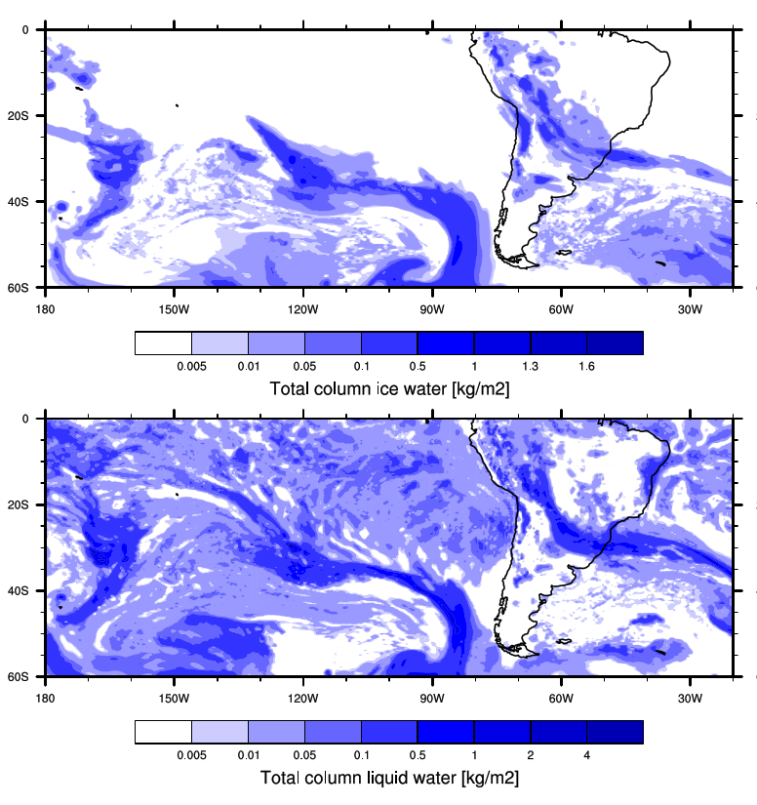
Cold air outbreaks
Thanks to Katrin Lonitz and Richard Forbes
IFS model simulates ice, not liquid water

Slide 40
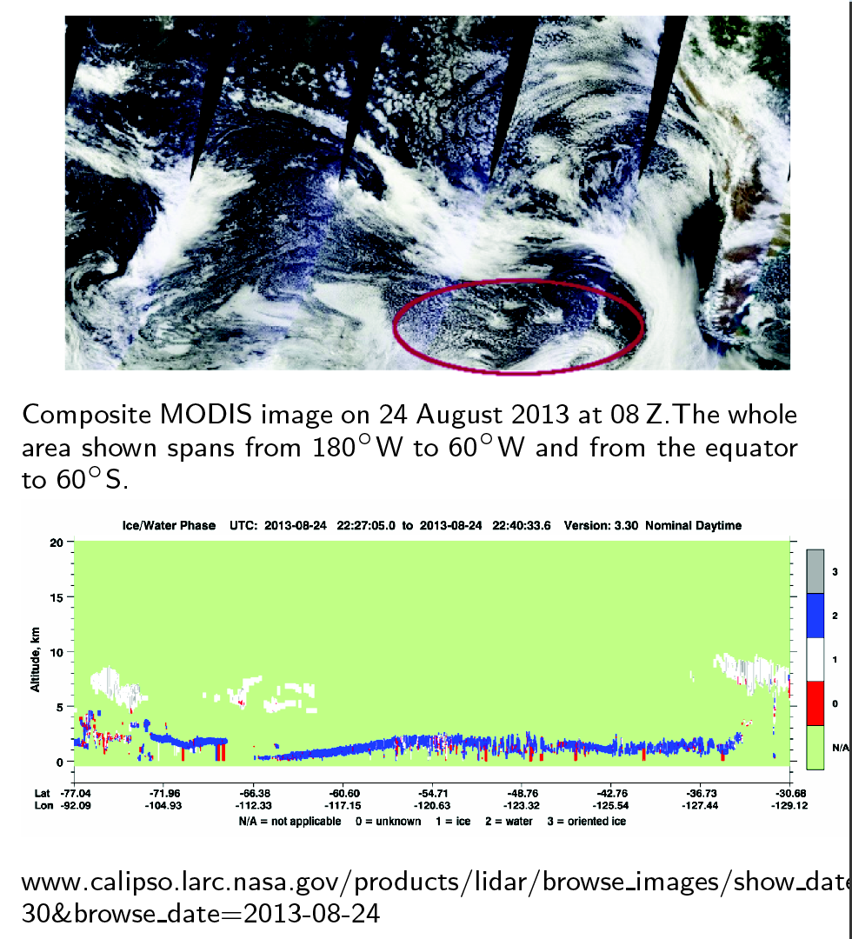
Cold air outbreaks
Thanks to Katrin Lonitz and Richard Forbes
Calipso shows liquid water, not ice in this area

Slide 41
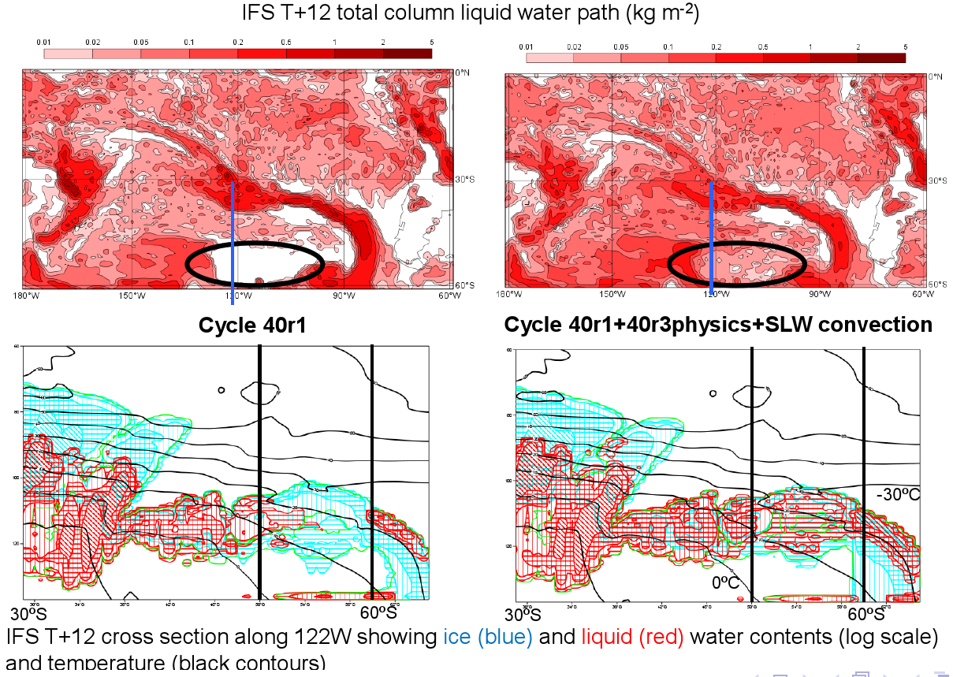
Allow SLW detrainment from shallow convection scheme
Thanks to Richard Forbes and Katrin Lonitz
Vertical cross section through CAO

Slide 42
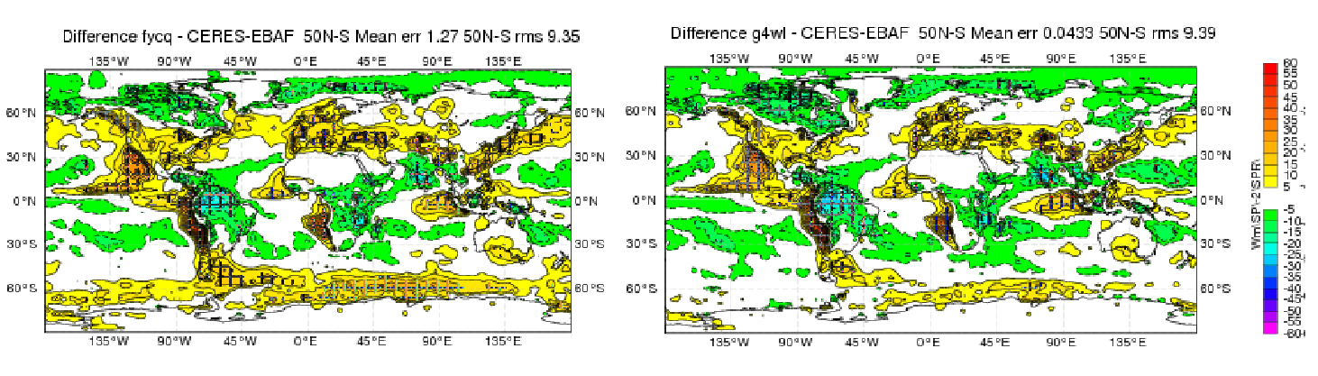
Cold air outbreak bias also affected SW radiative forcing
Thanks to Richard Forbes and Katrin Lonitz
CERES Net TOA SW discrepancy before improvement
CERES Net TOA SW discrepancy after improvement
Just as important in the NH as in the SH

Slide 43
Conclusion
Reasons to assimilate cloud-and precipitation affected data:
  Use more temperature and water vapour information in areas partially affected by cloud, and use it more symmetrically
  Infer the dynamical state of the atmosphere through 4D-Var tracing (or equivalent effect in ensemble data assimilation)
  Initialise model clouds and precipitation, important for short-range forecasting
  Help improve cloud and precipitation in forecast models using the FG departures to highlight errors

