Slide 1
Microwave observations in clear-sky conditions
Alan Geer
Thanks to: Bill Bell, Peter Bauer

Slide 2
Overview
General introduction to the microwave (today)
  The microwave spectrum
  Microwave instruments
Clear-sky microwave (today)
  Imager channels and the surface, water vapour and temperature sounding
  Practical use of AMSU-A channel 5 at ECMWF
All-sky microwave (Wednesday)
  Interaction of particles with microwave radiation
  Solving the scattering radiative transfer equation
  Cloud screening for clear-sky assimilation
  All-sky assimilation

Slide 3
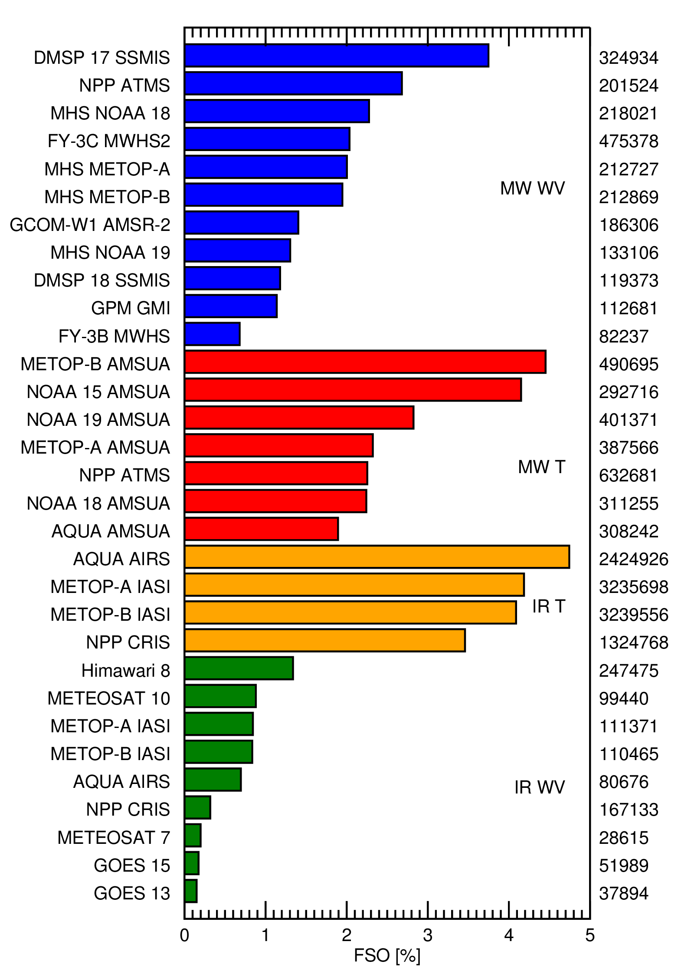
FSOI of satellite radiances, August 2016
100% = full operational observing system
Microwave WV 20.4%
Microwave T 20.1%
Infrared T 16.5%
Infrared WV 5.4%
Microwave instruments together account for 40% of forecast impact, with “moist” assimilation (WV, cloud, precipitation channels) having nearly as much impact as “dry” assimilation (T channels)

Slide 4
General introduction to the microwave

Slide 5
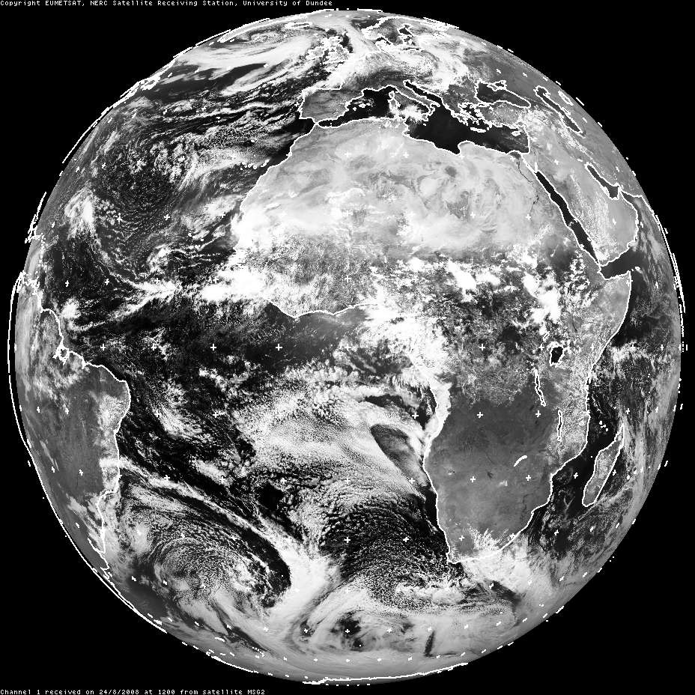
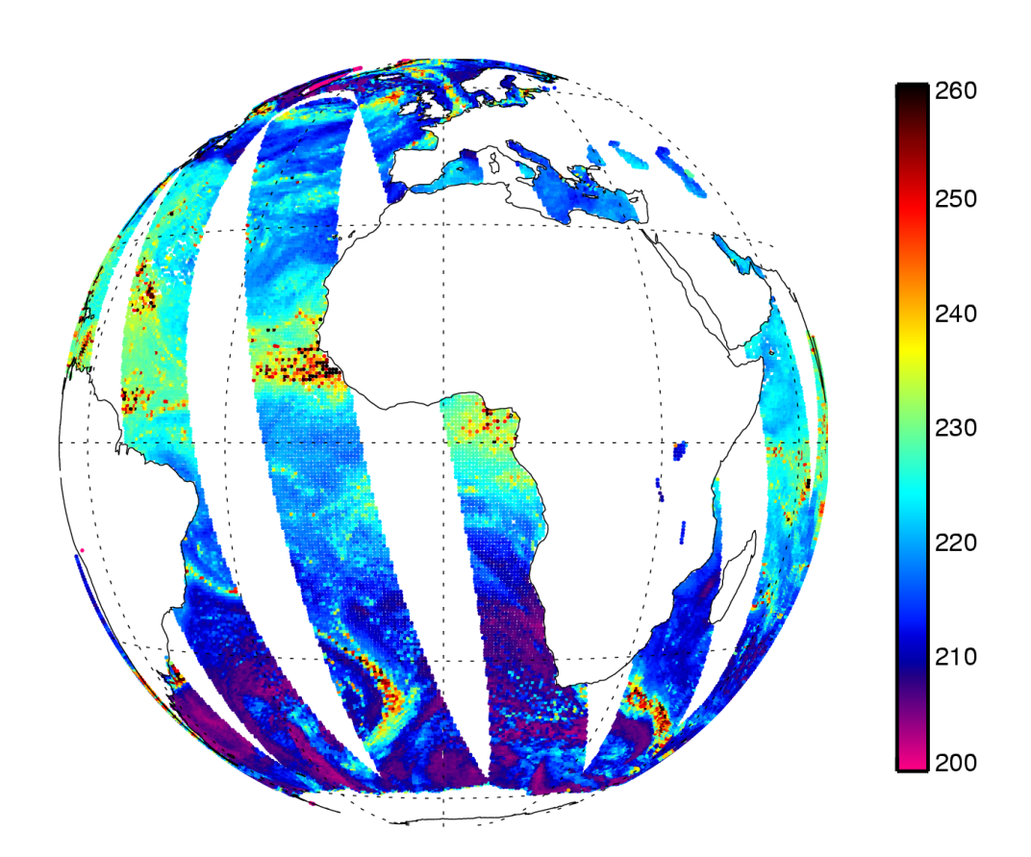
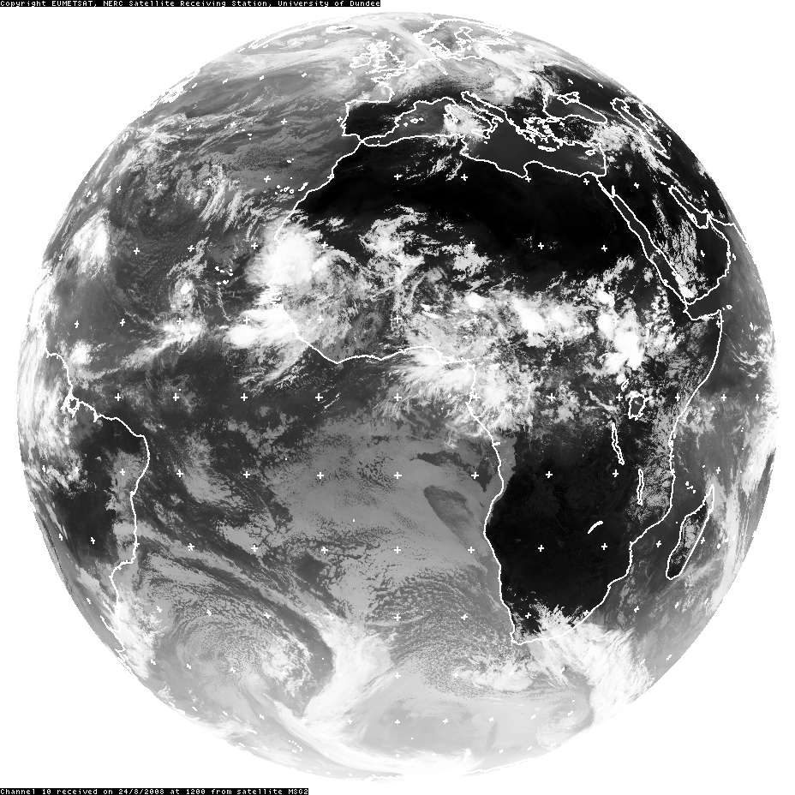
Visible
SEVIRI channel 1
0.56-0.71 μm
Microwave
AMSR-E channel 37v
8108 μm (37 GHz v-pol)
from Dundee Satellite Receiving Station, © Eumetsat
Infrared
SEVIRI channel 10
11-13 μm
TB [K]
Window channels
24th August 2008 at around 12UTC

Slide 6
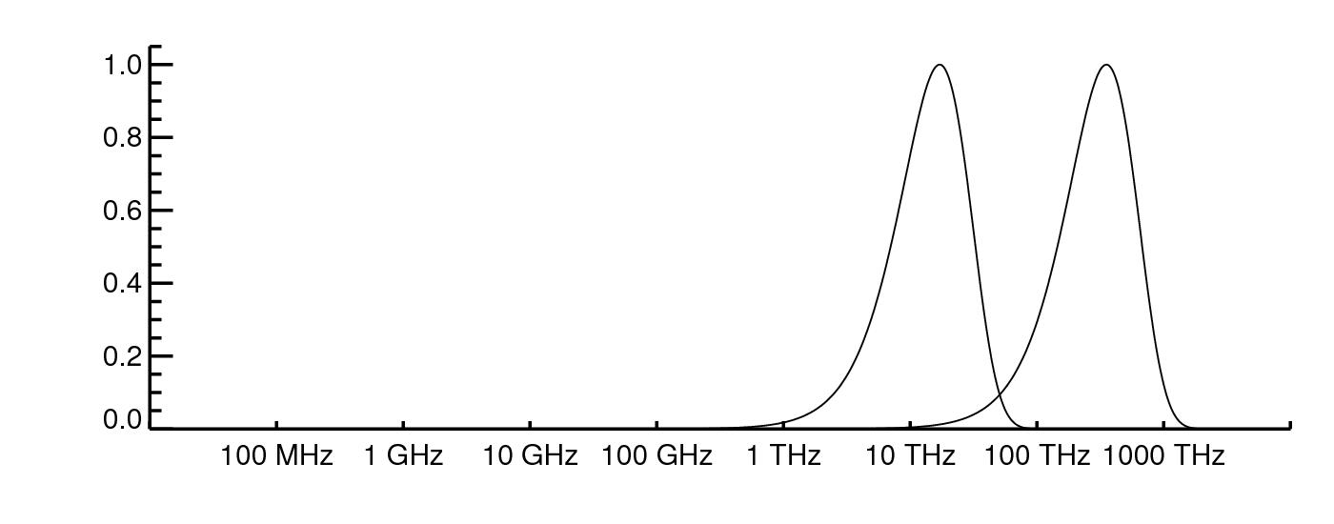
Where is the microwave?
Terrestrial
T = 290K
Solar
T = 6000K
Normalised radiance
Planck function
Frequency
10m
10cm
1mm
10μm
0.1μm
Wavelength
Radio
Infrared
Ultraviolet
Microwave
Visible

Slide 7
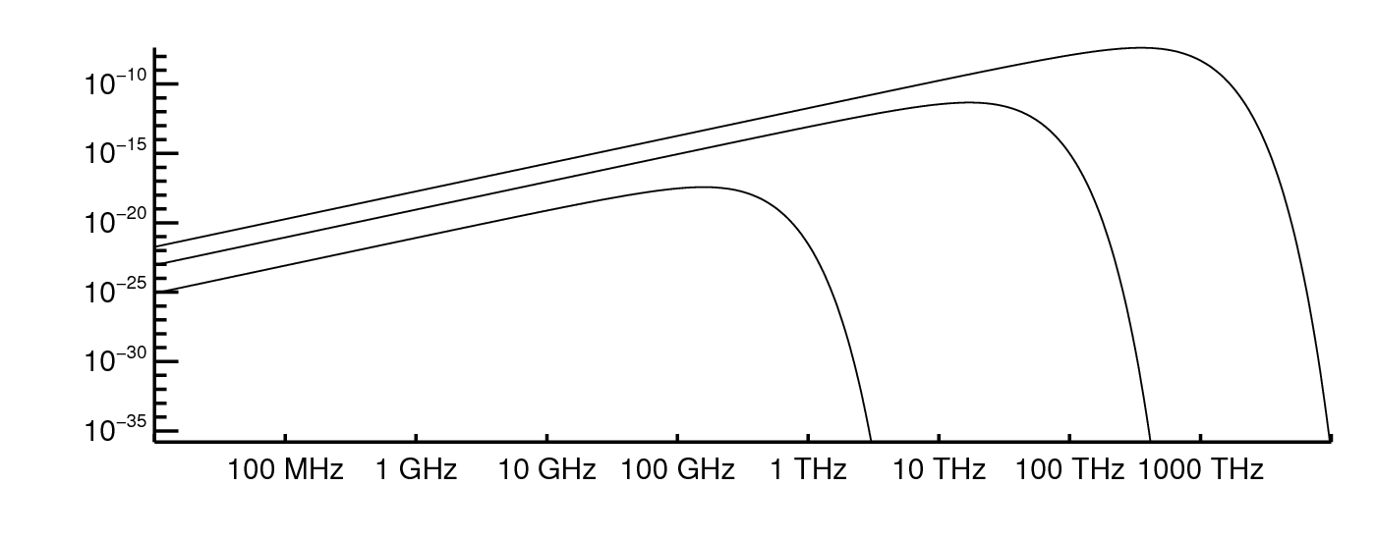
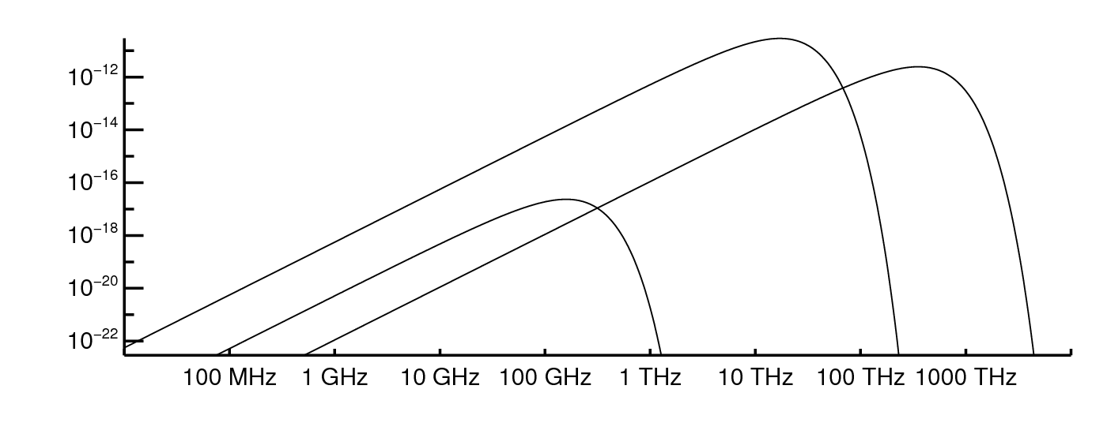
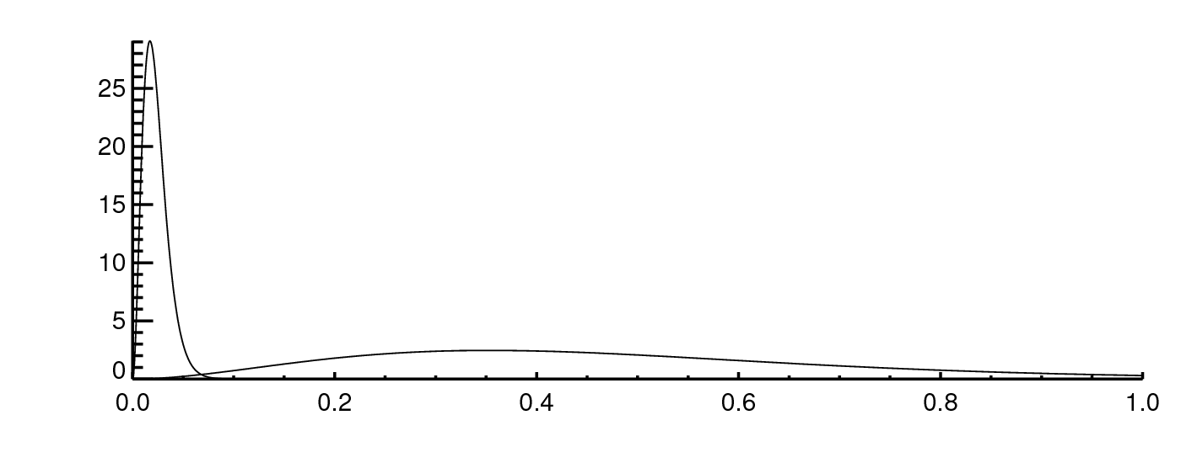
How much energy is there?
Solar
T = 6000K
Planck
Function
Radiance
W m⁻² sr⁻¹ Hz⁻¹
Terrestrial
T = 290K
Deep space
T = 2.7K
Flux
W m⁻² Hz⁻¹
Solar
radiance × 6×10⁻⁵ sr
Terrestrial
radiance × 6.28 sr
Deep space
radiance × 6.28 sr
Flux
10⁻¹² W m⁻² Hz⁻¹
Terrestrial
Solar
Frequency [10³ THz]

Slide 8

Brightness temperature (TB)
Radiance that would be produced by black-body radiation of a specified temperature TB (Planck function)
In the microwave, we can use Rayleigh-Jeans approximation:
Convert radiance (a non-intuitive quantity) into the “radiant temperature”
$$B_{λ}(T_{B})=\frac{2c}{λ^{4}}k_{B}T_{B}$$
Radiance
Brightness temperature

Slide 9
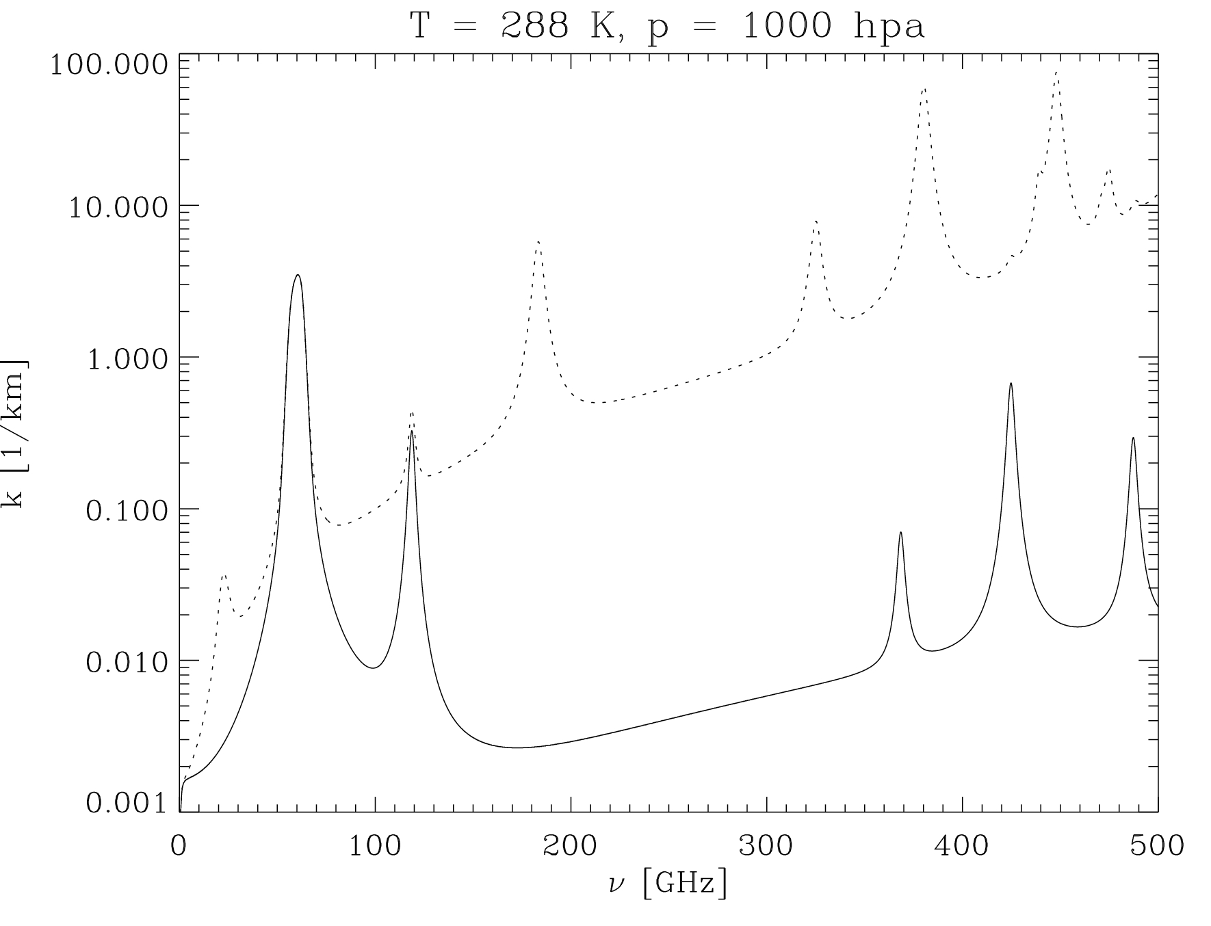
The microwave spectrum
Absorption coefficientβ_{a} [1/km]
H₂O Rotation lines
+
Water vapour continuum
O₂ Rotation Lines
+
Dry air continuum
Moist
“Imaging channels” in the windows
Temperature sounding:
60 GHz oxygen line
Dry
Moisture sounding:
22 GHz and 183 GHz water vapour lines

Slide 10
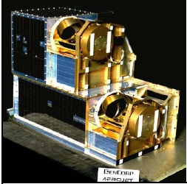
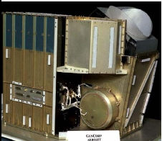
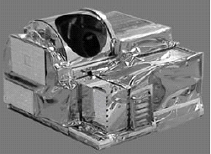
AMSU: cross track microwave sounder
Aperture: D< 30cm
Purpose: temperature and moisture sounding
AMSU A1
AMSU A2
AMSU B
Channels 1&2
(23.8 GHz, 31.4 GHz)
Channels 15-20
(89, 150, 3 × 183GHz)
Channels 3-15
(50-57 GHz, 89 GHz)

Slide 11
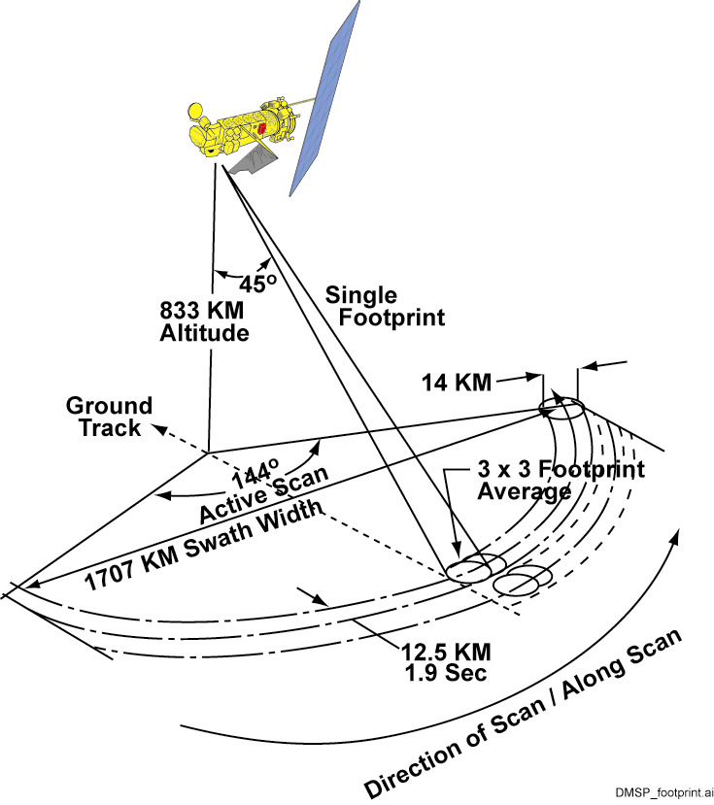
SSMIS – A conical microwave sounder / imager
60 cm

Slide 12
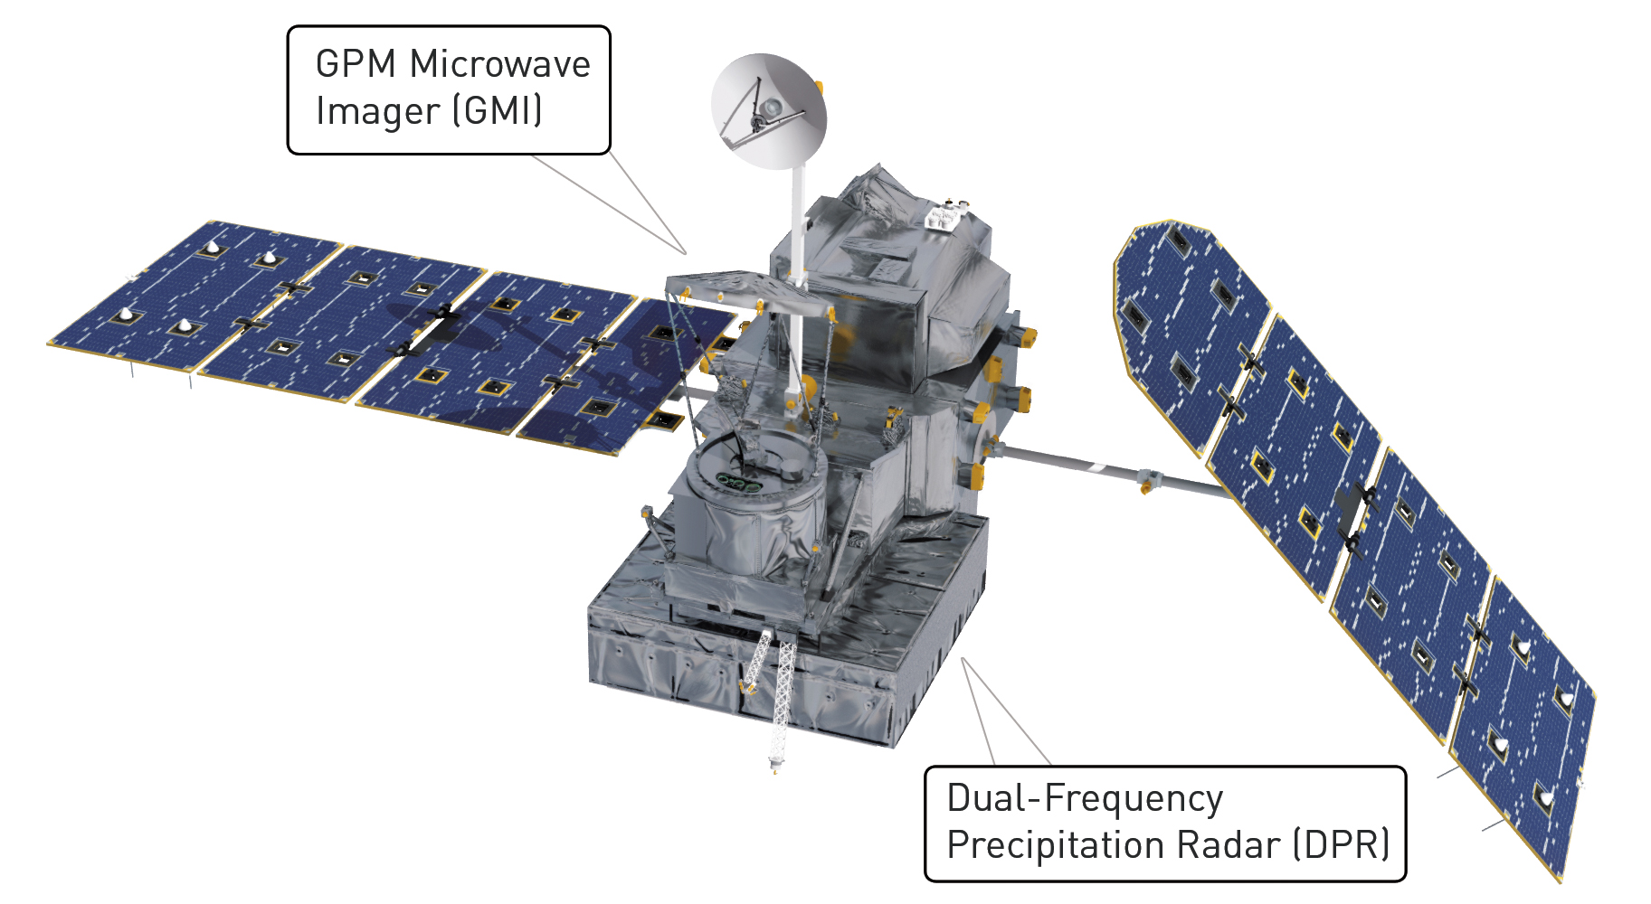
GMI: imager, targeting preciptiation
Global precipitation mission:
Launched Feb 2014
Precipitation radar at 13 GHz and 36 GHz
NOAA
NASA / JAXA

Slide 13
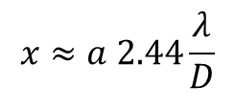
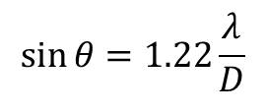
Field of view size and aperture approximate calculations in a diffraction-limited system
Airy disk size:
Aperture size
D
$$\sin{θ}=1.22\frac{λ}{D}$$
Wavelength
$$x≈a 2.44\frac{λ}{D}$$
θ
T-sounder: 50 GHz: λ ≈ 0.006 m
(like AMSU-A) satellite altitude 800 km
aperture 0.3 m
FOV ≈ 40 km
Imager: 20 GHz: λ ≈ 0.016 m
(like GMI) satellite altitude 400 km
45° view angle: a=600 km
aperture 1.2 m
FOV ≈ 20 km
a
Satellite to earth distance
FOV size
x

Slide 14
Active microwave: radar
Global precipitation mission:
Launched Feb 2014
Precipitation radar at 13 GHz and 36 GHz
NOAA
NASA / JAXA

Slide 15
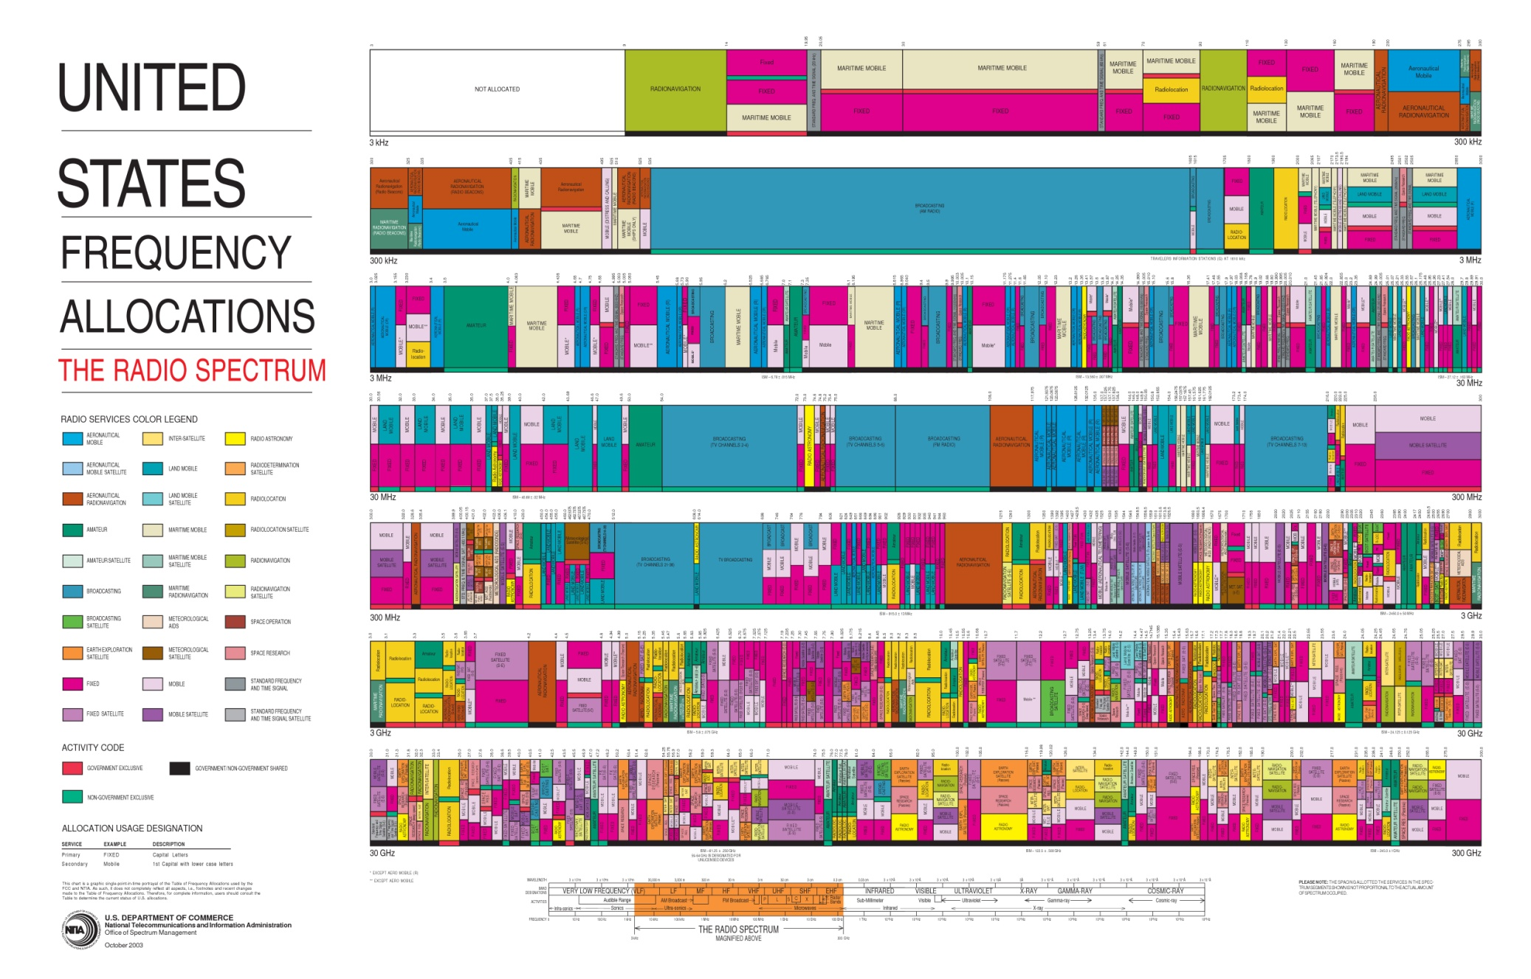
Frequency allocation and protection
3 KHz
Earth observation
Sky Sports
30 GHz
300 GHz

Slide 16
Clear-sky observations: earth surface, atmospheric water vapour and temperature

Slide 17
The microwave spectrum: window channels
Absorption coefficientβ_{a} [1/km]
H₂O Rotation lines
+
Water vapour continuum
O₂ Rotation Lines
+
Dry air continuum
Moist
“Imaging channels” in the windows
Dry

Slide 18
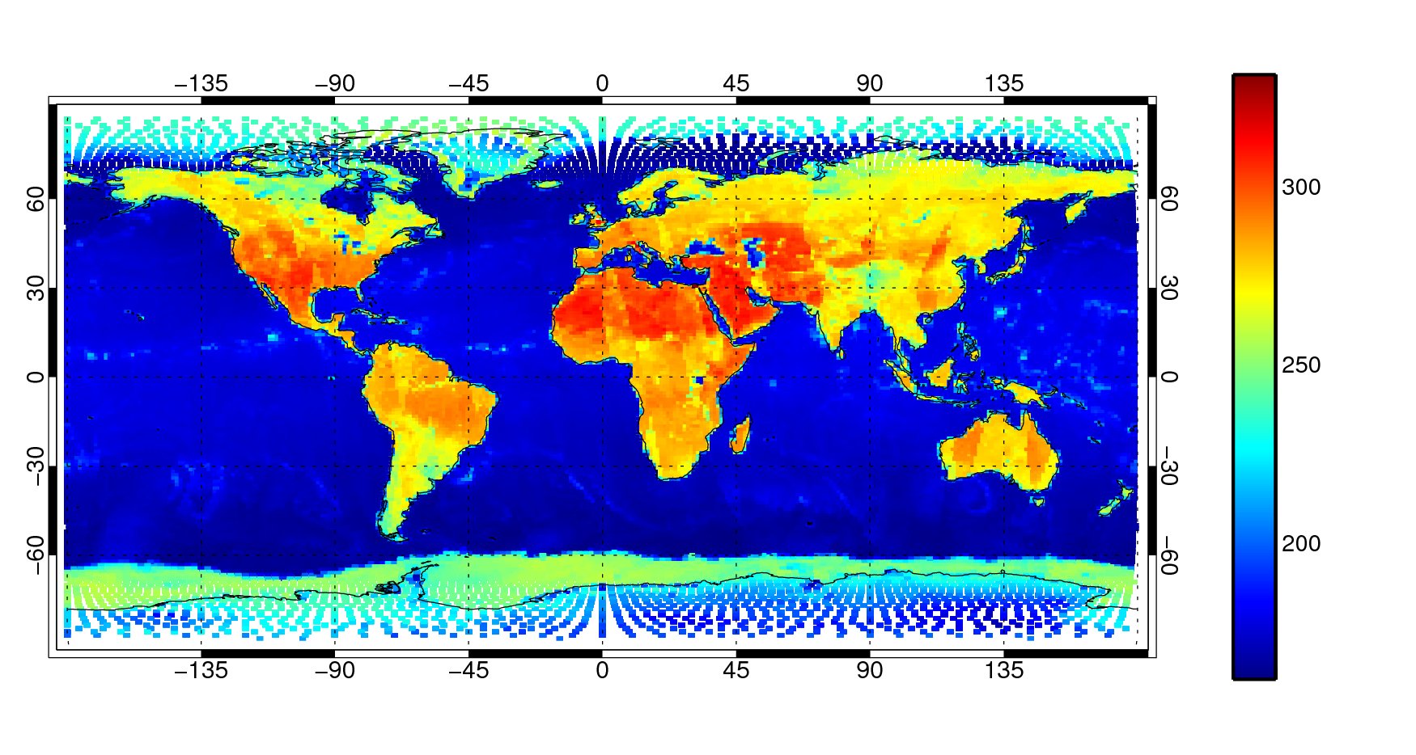
Observations at 10 GHz v-polarisation from AMSR-E, 55° zenith angle
TB [K]
Ocean TB | ≈ 170 K | ≈ -100°C
Land TB | ≈ 280 K | ≈ 10°C
Sea ice and Antarctica TB | ≈ 240 K | ≈ -30°C

Slide 19
Radiation and the earth’s surface
Direct reflection
Emission
Emissivity

Slide 20
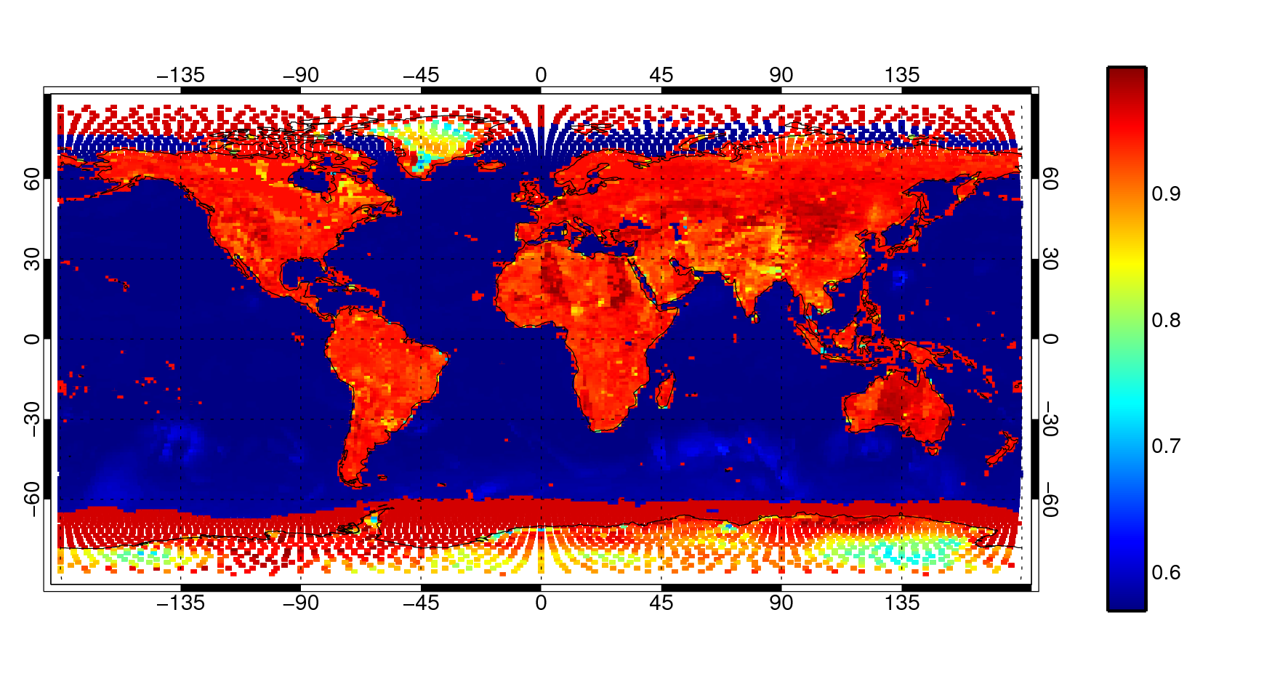
TB [K]
Observed, 10 GHz, v-pol
Surface emissivity
Estimated, 10 GHz, v-pol

Slide 21
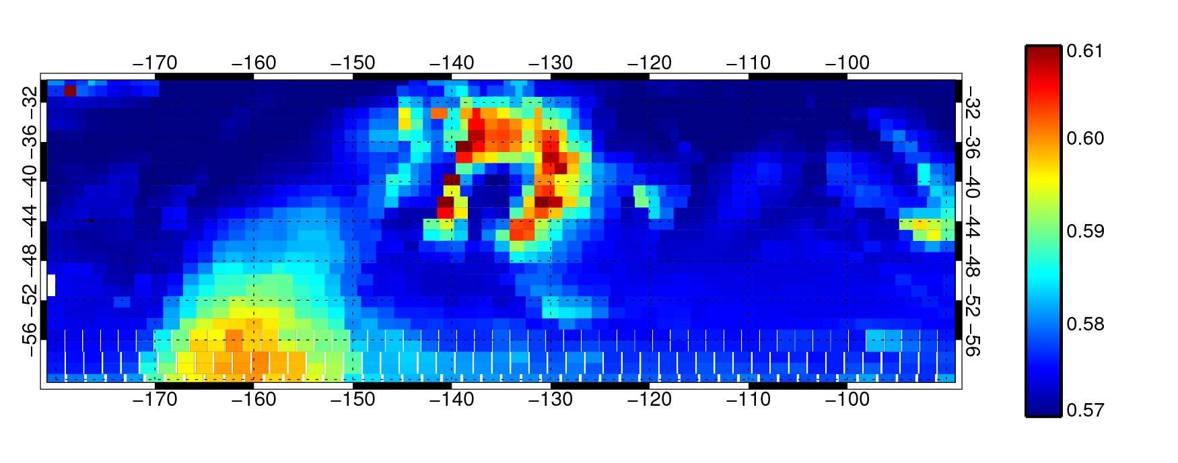
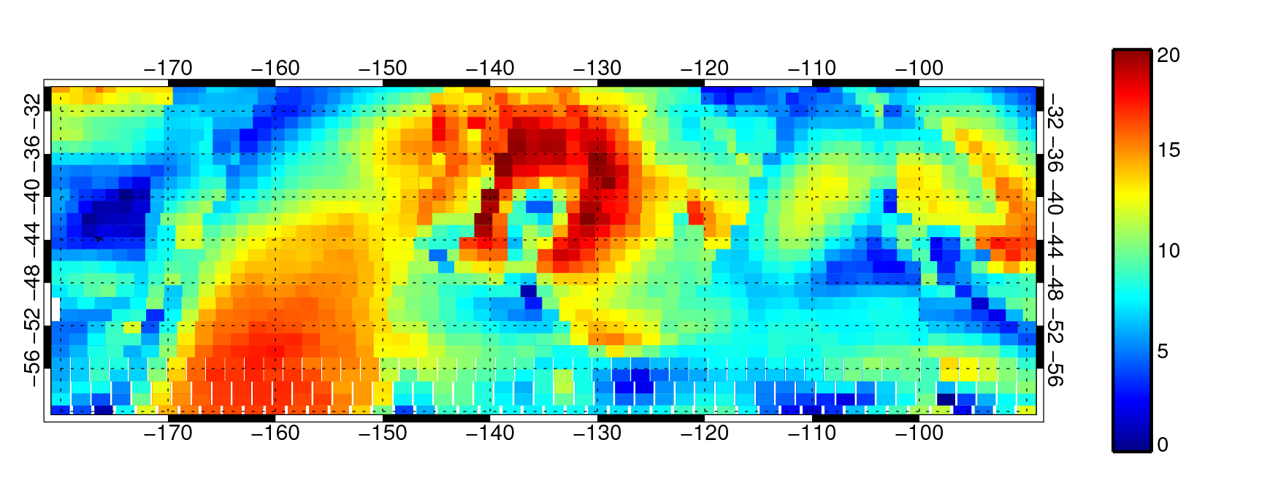
Sea surface emissivity depends on wind speed
Surface emissivity
Modelled, 10 GHz, v-pol
10m wind speed
First guess [ms⁻¹]

Slide 22
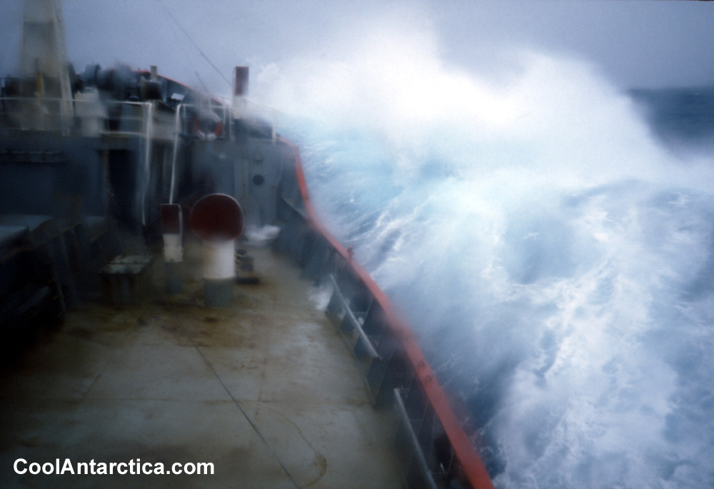
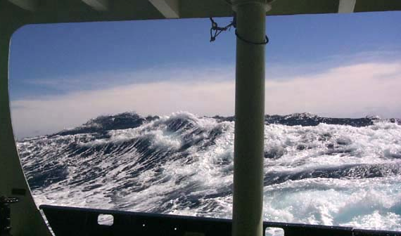
Emissivity physics: oceans
Plane water surface: low emissivity - Fresnel equations
Macro structure: waves, swell – geometric optics
Micro structure, e.g. cm: diffraction from capillary waves
Foam: much higher emissivity than water
Correction for non-specular reflection
NOAA Ocean Explorer

Slide 23
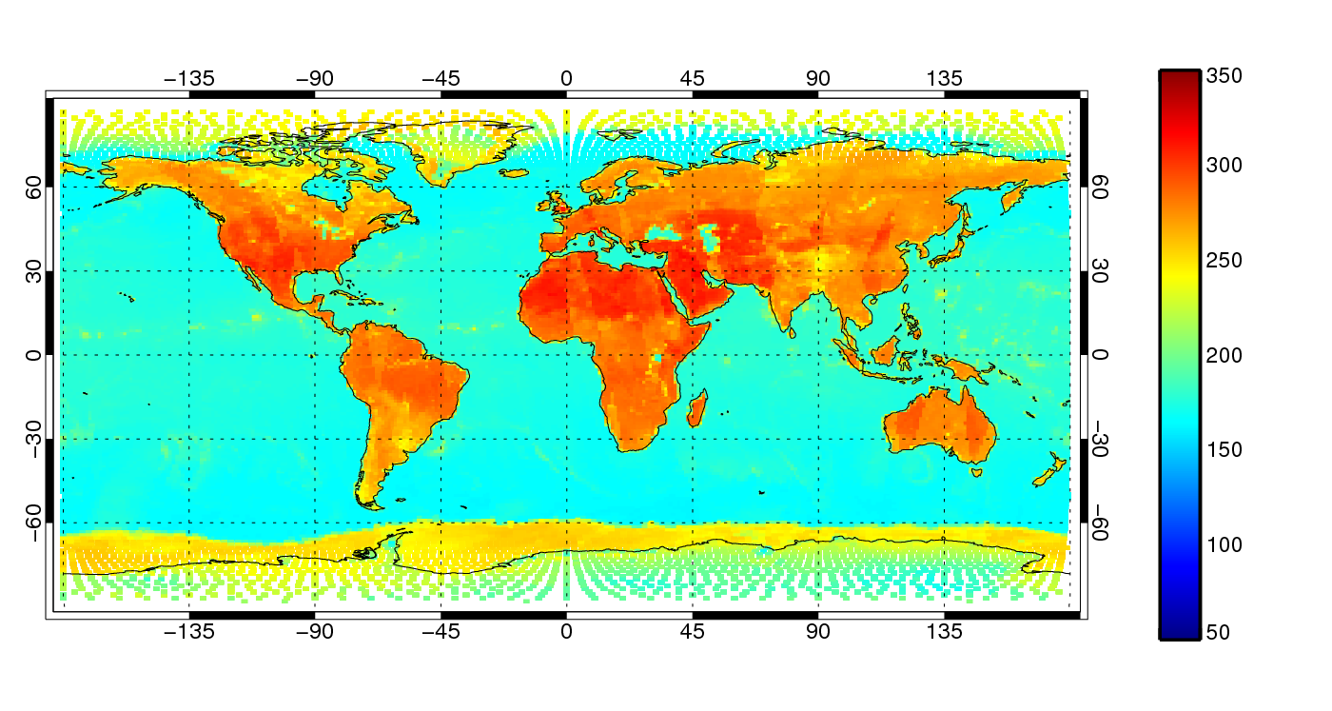
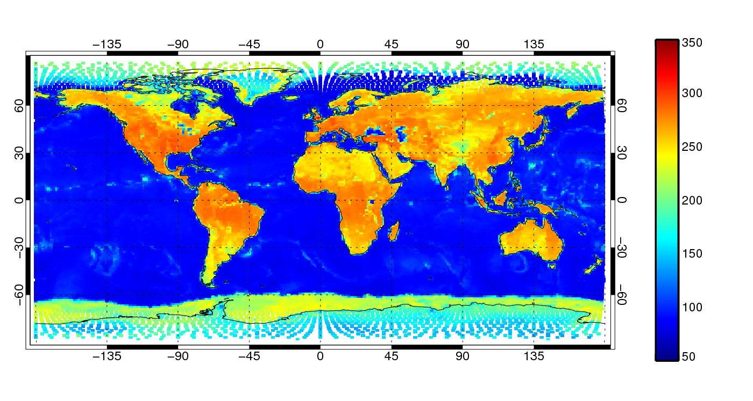
Ocean surface emission is polarised
TB [K]
10 GHz v-pol
Ocean TB:
~150 K v-pol
~90 K h-pol
TB [K]
10 GHz h-pol

Slide 24
Land surface emission
Emissivity is highly variable in time and space:
  Vegetation cover
  Surface roughness and composition: sand, rock, earth
  Soil moisture
  Presence of open water or snow
Surface temperature is also hard to deal with:
  Varies significantly from day to night
  Radiating “skin temperature” is hard to define
    May vary with frequency
    Radiation might come from some distance below the surface in the case of sand desert
Practical solution: emissivity retrievals or emissivity atlases

Slide 25
Window channels: summary
Surface emissivity is the most important radiative effect:
  Land surfaces ~ 0.9
    Moisture, vegetation, surface characteristics
  Ocean surfaces ~ 0.3 – 0.6
    Polarised
    Dependent on sea-state (wind and wave)
NWP information content:
  Oceans:
    Column water vapour, cloud/precipitation, wind speed
  Land:
    Retrieving emissivity for use with sounding channels
    (Soil moisture)
  Cloud and precipitation (tomorrow)

Slide 26
The microwave spectrum: water vapour channels
Absorption coefficientβ_{a} [1/km]
H₂O Rotation lines
+
Water vapour continuum
O₂ Rotation Lines
+
Dry air continuum
Moist
Dry
Moisture sounding:
183 GHz water vapour line

Slide 27
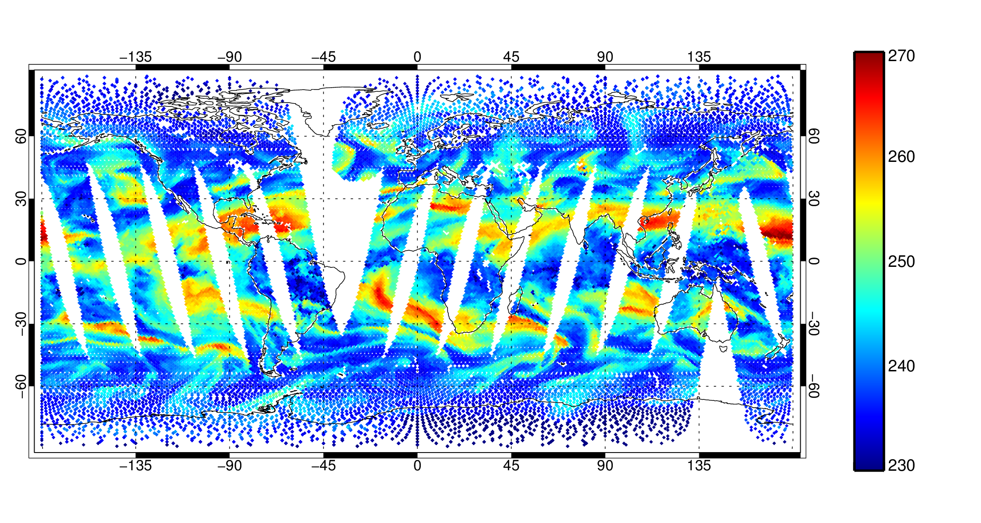
SSMIS F-17 183+/-1 GHz
Observed TB [K]
Convection
High RH
Low RH

Slide 28
Humidity-sounding weighting functions
High humidity: weighting function high in troposphere
TB = 230 K (found at approx. 400 hPa)
TB = 265 K (found at approx. 700 hPa)
Low humidity: weighting function lower in troposphere

Slide 29
The microwave spectrum: temperature channels
Absorption coefficientβ_{a} [1/km]
H₂O Rotation lines
+
Water vapour continuum
O₂ Rotation Lines
+
Dry air continuum
Moist
Temperature sounding:
60 GHz oxygen line
Dry

Slide 30
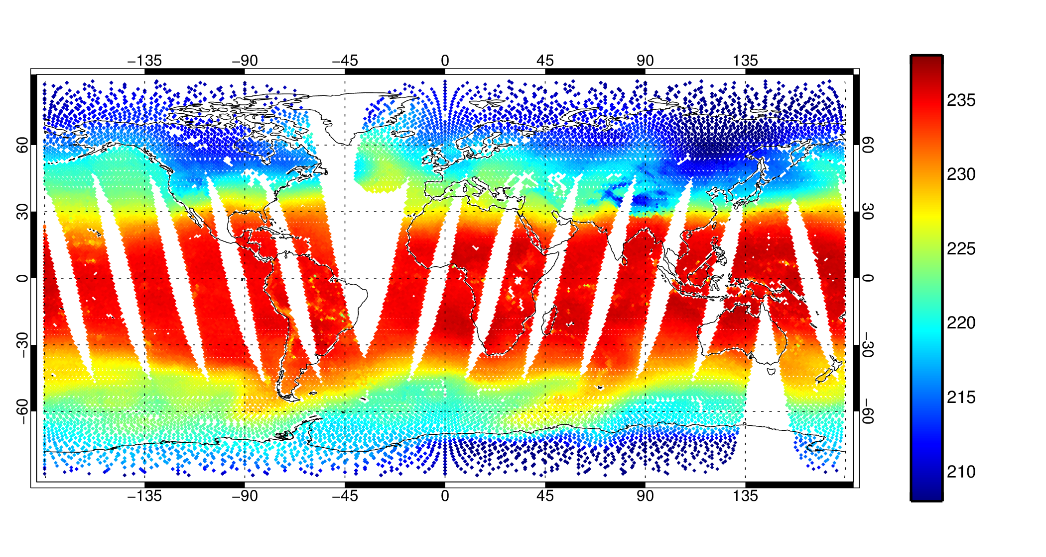
53.6 GHz
SSMIS channel 3: like AMSU-A channel 5, but with a fixed zenith angle
Deep convection
TB [K]
High mountains
Midlatitude Rossby waves

Slide 31
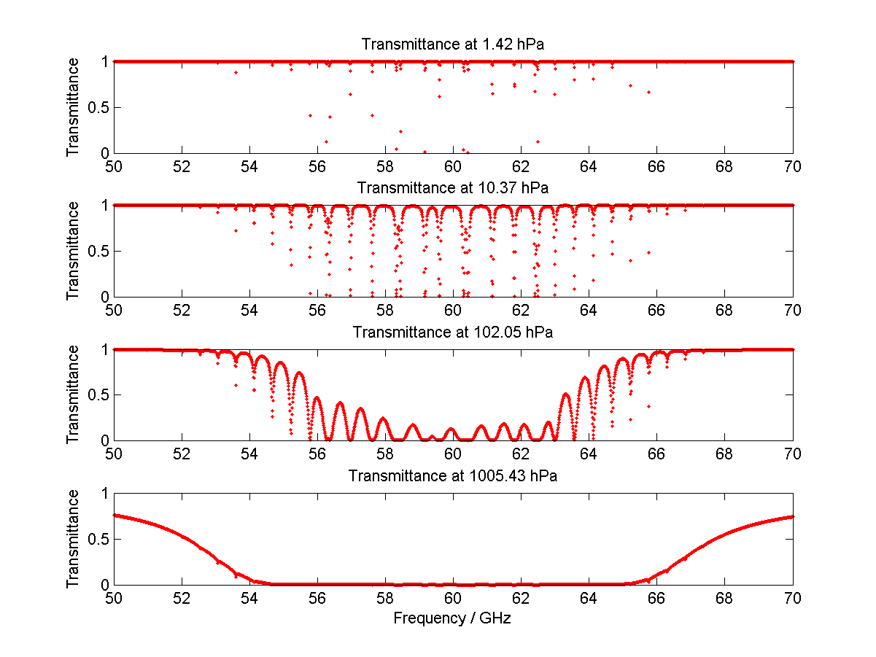
Fine-scale structure in the 60 GHz oxygen line
Typical MW radiometer passband
at 54.4 GHz
Level to TOA transmittance
from Liebe MPM 92 model
Narrow lines ~ several MHz
Increasing pressure
broadening

Slide 32
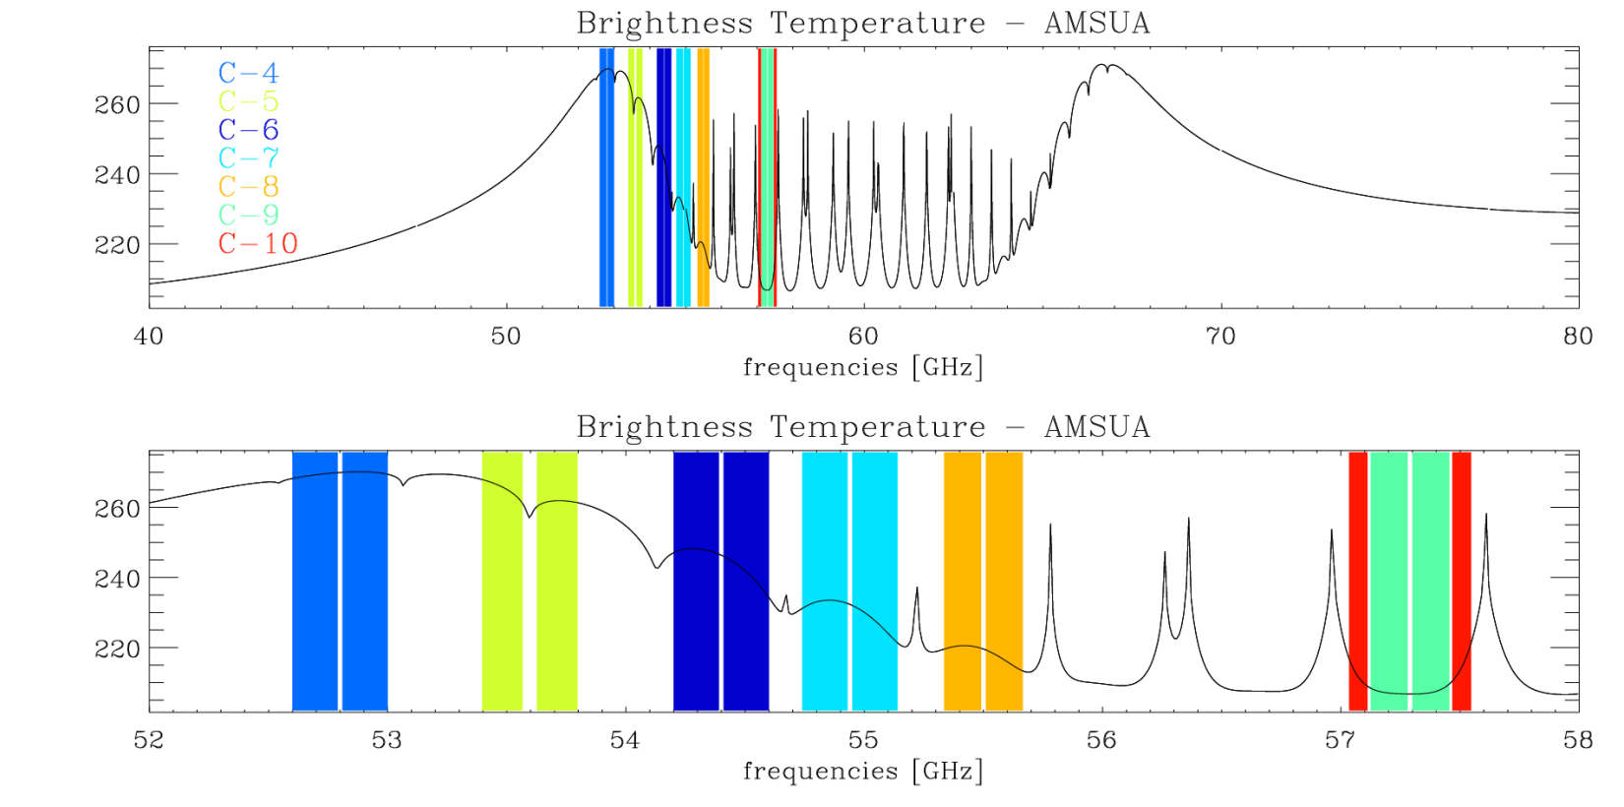
AMSU-A 50-60 GHz temperature channels
Channel positions and bandwidths are based on trade-offs aimed at simultaneously optimising :
  width of the band (wider bands give lower noise)
  flatness of optical depth across the band (narrow weighting functions)

Slide 33
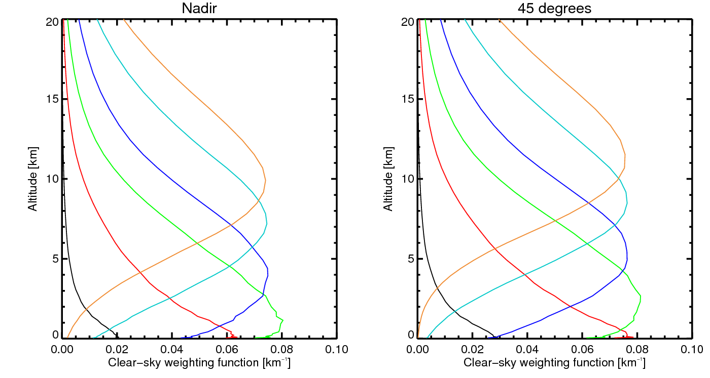
AMSU-A clear-sky nadir weighting functions these are approximately fixed, unlike humidity weighting functions
Channel
Transmittance to space
7 0%
6 0%
5 5%
4 19%
3 56%
2 92%

Slide 34
Use of AMSU-A channel 5 at ECMWF

Slide 35
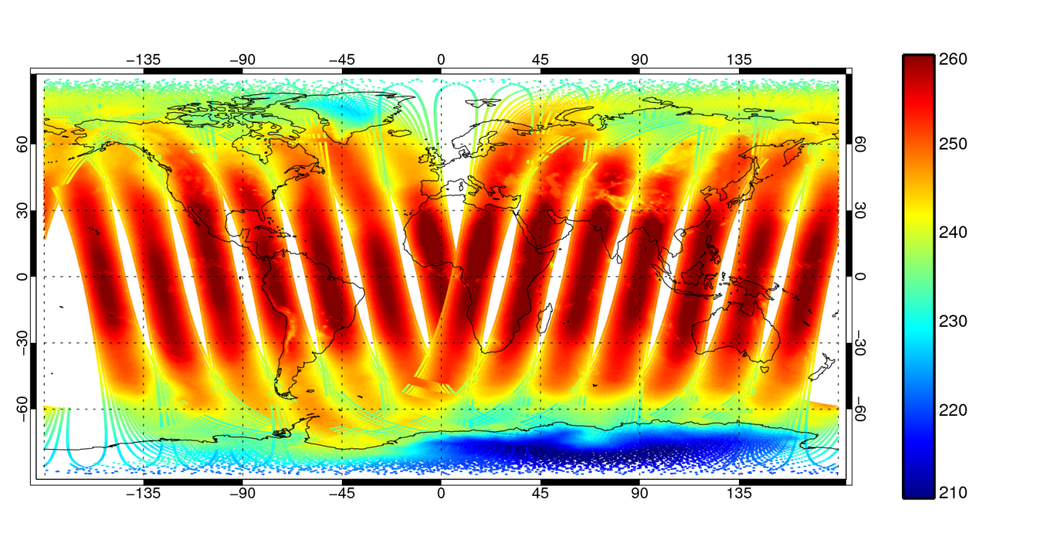
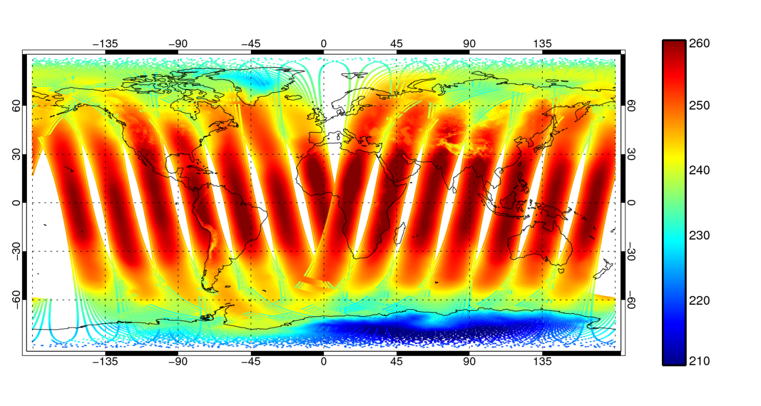
AMSU-A channel 5 radiances:
Metop-A satellite, 9pm 25/4 to 9am 26/4/2012
Observed TB [K]
First guess TB [K]
“Clear sky” assumption: no cloud or precipitation radiative transfer

Slide 36
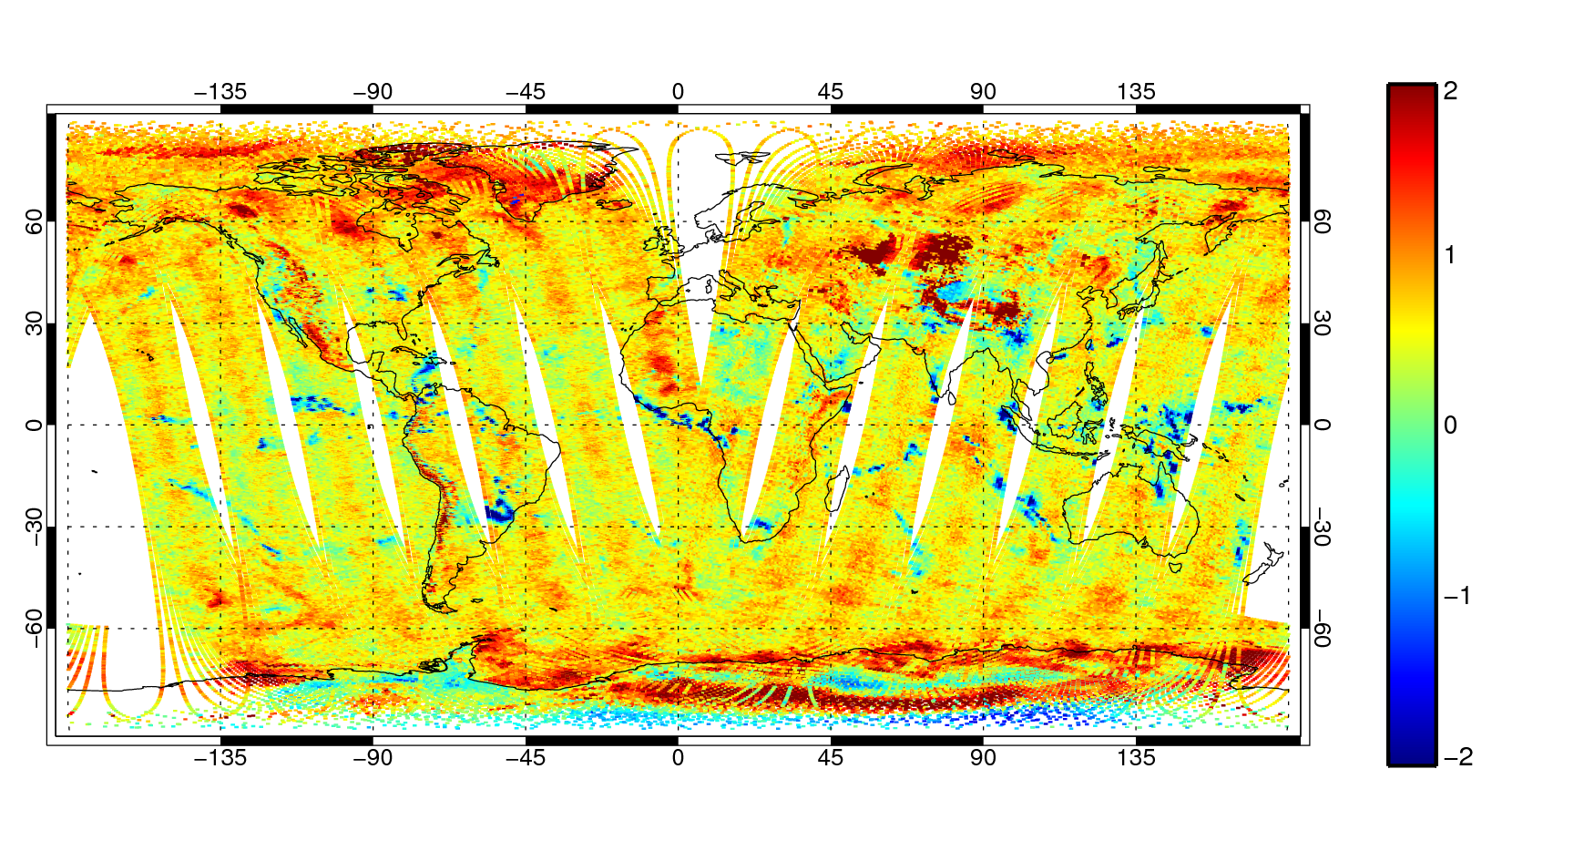
AMSU-A channel 5 radiances
First guess departures [K]
Scan bias
General “warm” bias

Slide 37
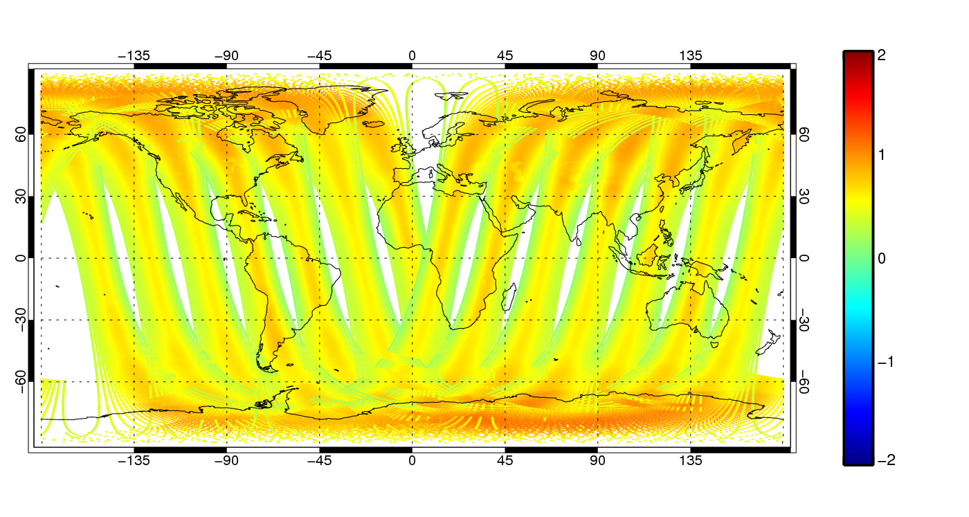
AMSU-A channel 5 radiances
Bias correction [K]
Scan bias correction
Airmass correction (layer mean temperature)
Mean offset

Slide 38
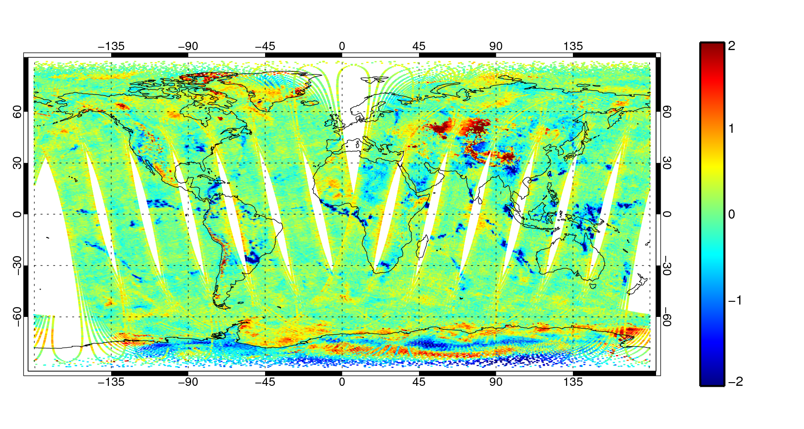
AMSU-A channel 5 radiances
Bias corrected first guess departures [K]
The Andes
Sea ice
Snow and ice
Still some scan bias
Precipitation and cloud

Slide 39
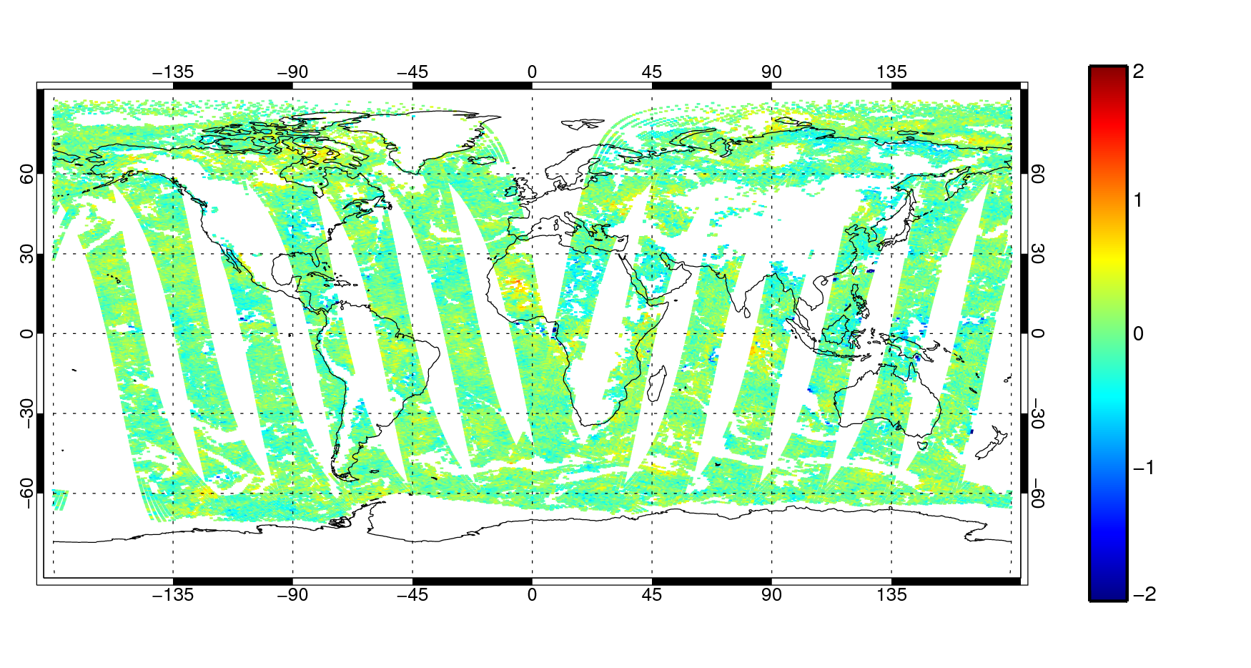
AMSU-A channel 5 radiances
Bias corrected first guess departures [K]
After blacklisting
The Andes
Sea ice
Snow and ice
Still some scan bias
Precipitation and cloud

Slide 40
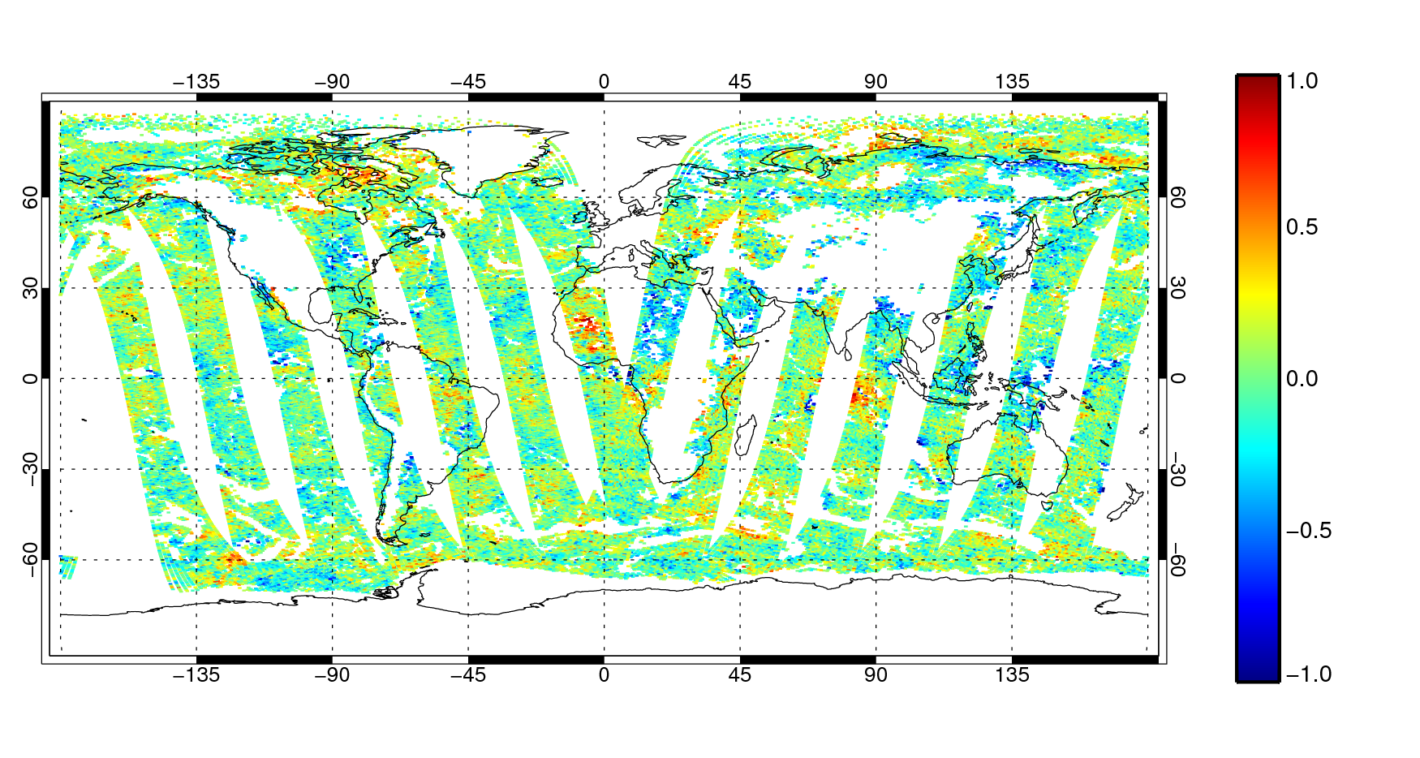
AMSU-A channel 5 radiances
Bias corrected first guess departures [K]
After blacklisting

Slide 41
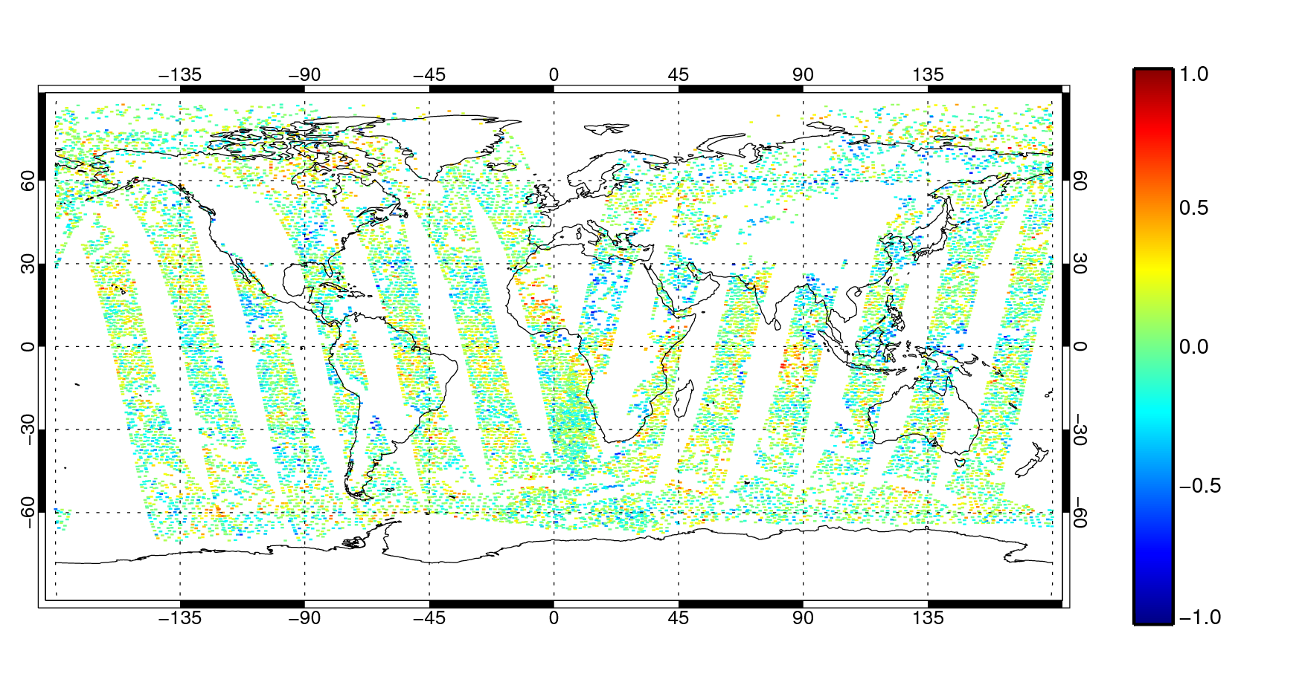
AMSU-A channel 5 radiances
Bias corrected first guess departures [K]
After blacklisting
After active thinning and VarQC

Slide 42
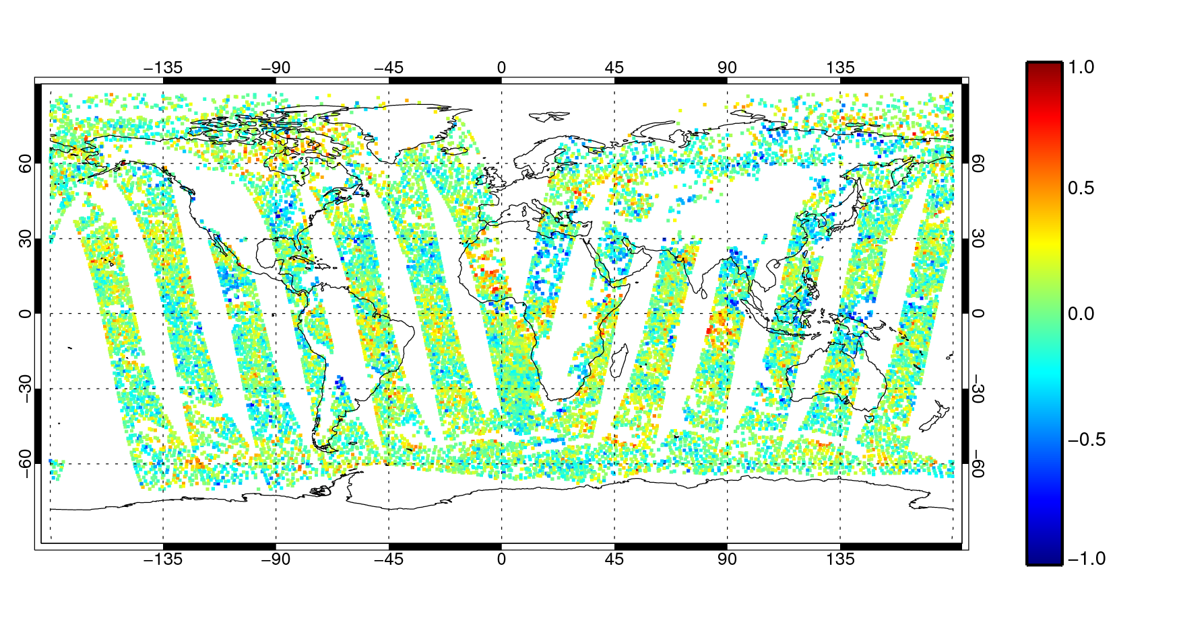
AMSU-A channel 5 radiances
Bias corrected first guess departures [K]
After blacklisting
After active thinning and VarQC

Slide 43
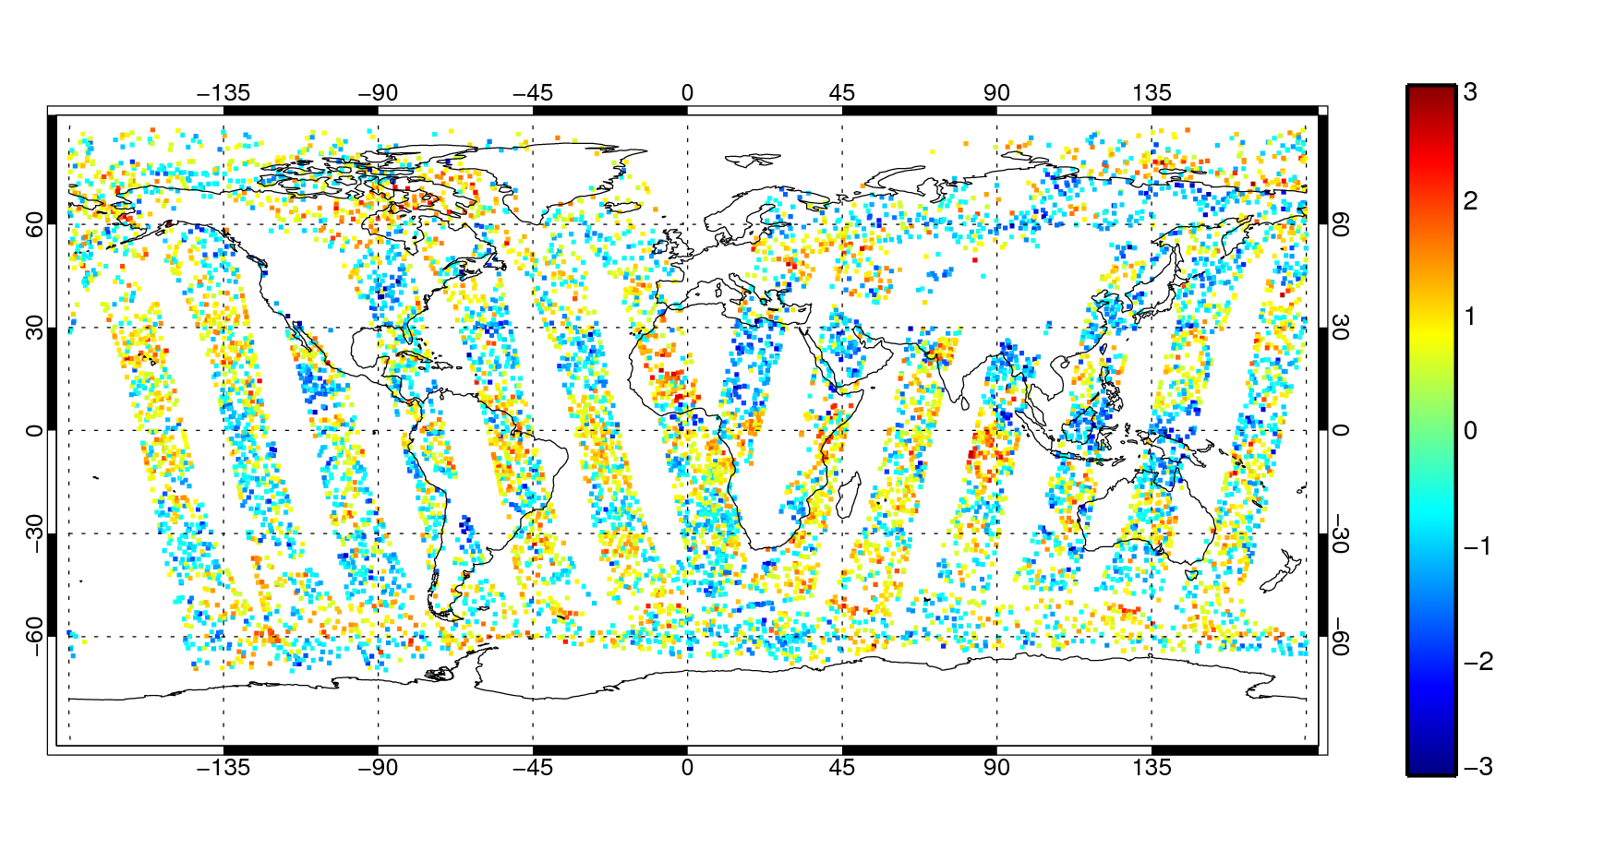
AMSU-A channel 5 radiances
Departures normalised by
observation error, σ_{o} = 0.28K
(Absolute values < 0.5 removed here for visual clarity)

Slide 44
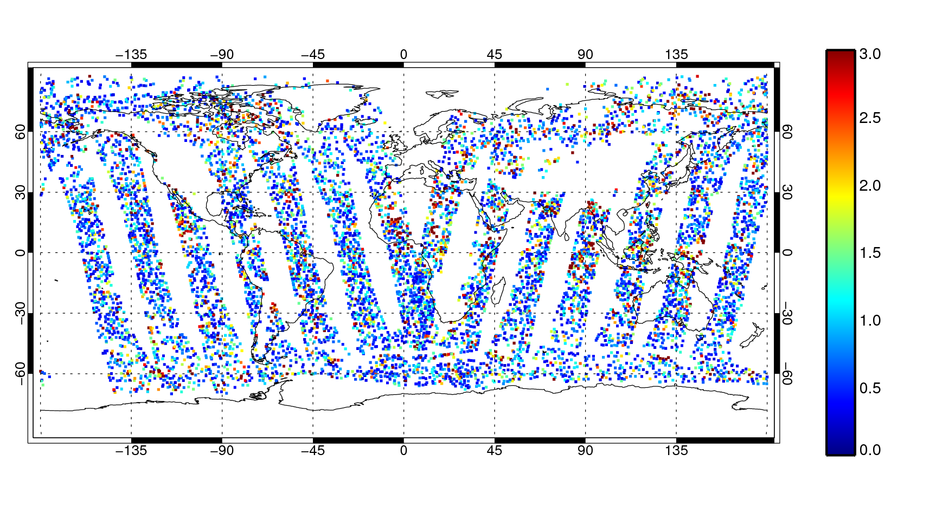
AMSU-A channel 5 radiances
Contribution to cost function (as before, low contribution values removed for clarity)

Slide 45
Now we need to minimise 4D-Var
Feed the minimisation algorithm with…
Cost function
What we just calculated
and its gradient
The TL and adjoint version of the radiative transfer
…and it spits out the analysis:
Health warning - there are a few notational shortcuts and simplifications here… please don’t build an assimilation system based on this slide.

Slide 46
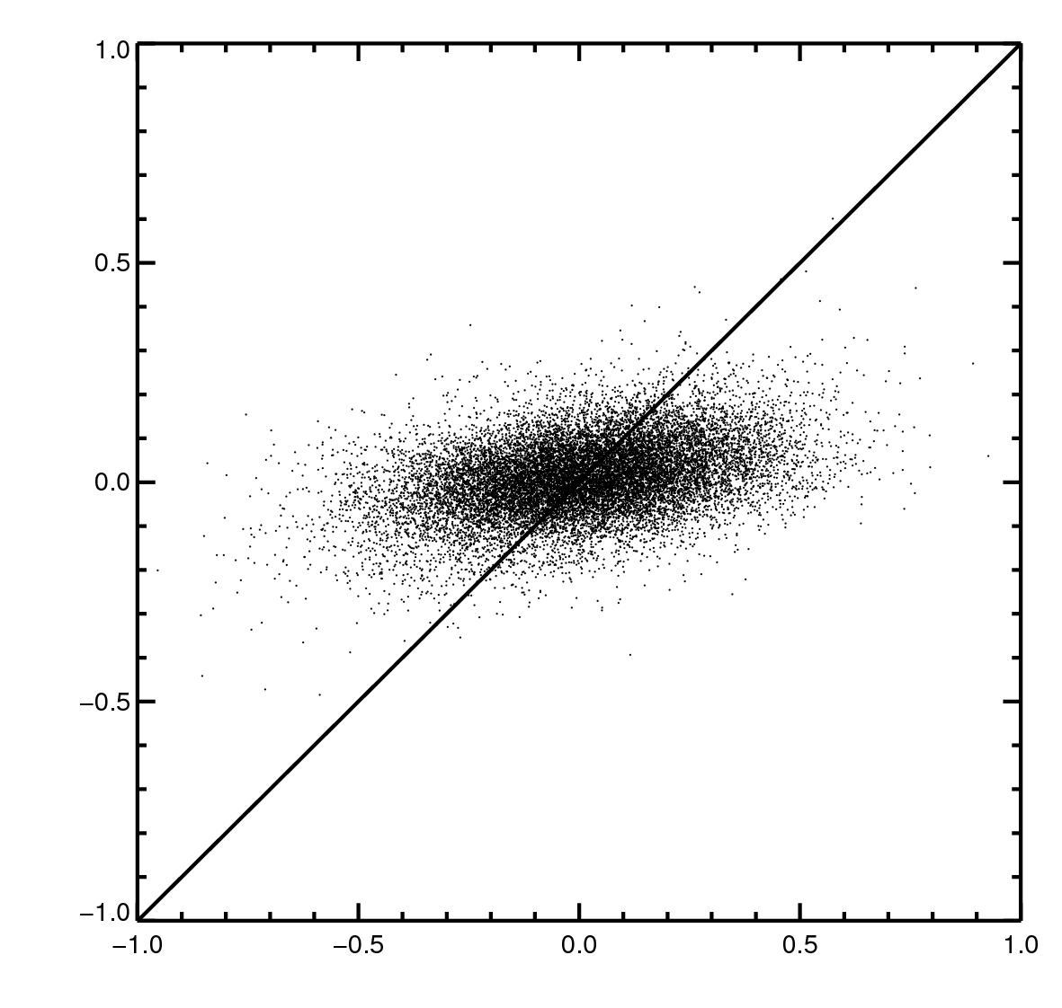
What did 4D-Var do with AMSU-A channel 5, and all the other observations in the analysis?
Increment [K]
Just a little nudge in the direction of the observations
1:1 line - if the analysis exactly fitted the observations
FG departure [K]

Slide 47
Summary: clear-sky microwave
“Imaging” (window) channels:
  In window regions and less-intense lines, e.g. 22 GHz water vapour line
  Sensitive to skin temperature, wind speed, sea ice, column water vapour
Water vapour sounding channels:
  183 GHz water vapour line
  Sensitive to broad-layer tropospheric humidity
Temperature sounding channels:
  60 GHz oxygen line
  Sensitive to broad-layer temperature, with multiple channels to cover from troposphere to stratosphere

