Slide 1
Parameterization of surface fluxes: Outline
Surface layer formulation according to Monin Obukhov (MO) similarity
Roughness lengths
Representation of the different sources of surface stress
Impacts of the surface stress on the large-scale circulation

Slide 2
Mixing across steep gradients
Stable BL
Dry mixed layer
Cloudy BL
Surface flux parametrization is sensitive because of large gradients near the surface.

Slide 3
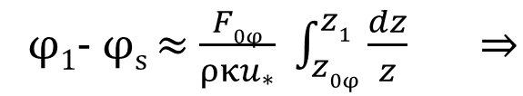

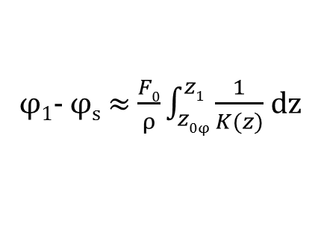
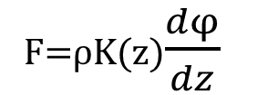
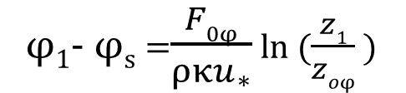


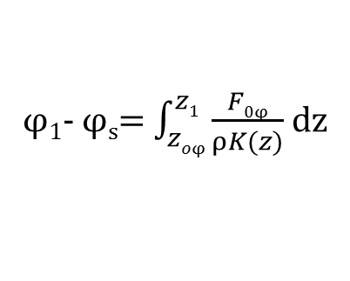
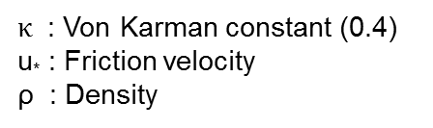
Why is the finite difference formulation in the surface layer different from the other layers?
F=ρK(z)$\frac{dφ}{dz}$
(F=$\overline{w′φ′}$)
φ₂
Finite difference formulation:
model level 2
z₂
F_{1.5} = ρK(z_{1.5}) $\frac{φ2−φ1}{z2−z1}$
F_{1.5}
Flux level 1.5
In surface layer integrate:
φ₁- φ_{s}= $\int_{zoφ}^{z1}{\frac{F0φ}{ρK(z)} }$dz
φ₁
model level 1
z₁
Constant flux layer:
φ₁- φ_{s} ≈ $\frac{F0}{ρ}\int_{z0φ}^{z1}{\frac{1}{K(z)}}$ dz
F_{0φ}
φ_{s}
Surface
In neutral flow:
$$K\left(z\right)=κzu_{∗}$$
φ₁- φ_{s} ≈ $\frac{F0φ}{ρκu_{∗}}$ $\int_{z0φ}^{z1}{\frac{dz}{z}} ⇒$
φ₁- φ_{s} =$\frac{F0φ}{ρ{κu}_{∗}}$ ln ($\frac{z1}{zoφ}$ )
$κ$ : Von Karman constant (0.4)
u* : Friction velocity
ρ : Density
u,v,T,q

Slide 4


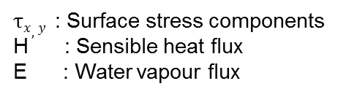
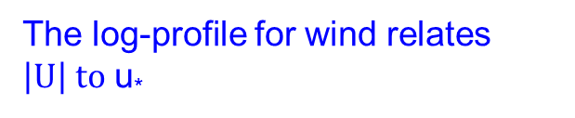
Log-profiles are directly related to neutral transfer laws
The log-profile for $φ$
Lowest model level
U₁, V₁, θ₁,q₁
z₁
The log-profile for wind relates $\left|U\right| to$ u*
0, 0, θ_{s}, q_{s}
Surface
$τx,y$ : Surface stress components
H : Sensible heat flux
E : Water vapour flux
Neutral transfer law for $φ$ :
$Cφn$ is called the neutral transfer coefficient for $φ$

Slide 5
MO similarity profiles are not limited to neutral transfer laws
neutral conditions: log-profile
non-neutral: log-profile + MO stability function
Obukhov length:
The non-neutral transfer laws are simply obtained by replacing the log-term by the log+ψ term. The $ψ$(z/L) functions are observationally based.

Slide 6
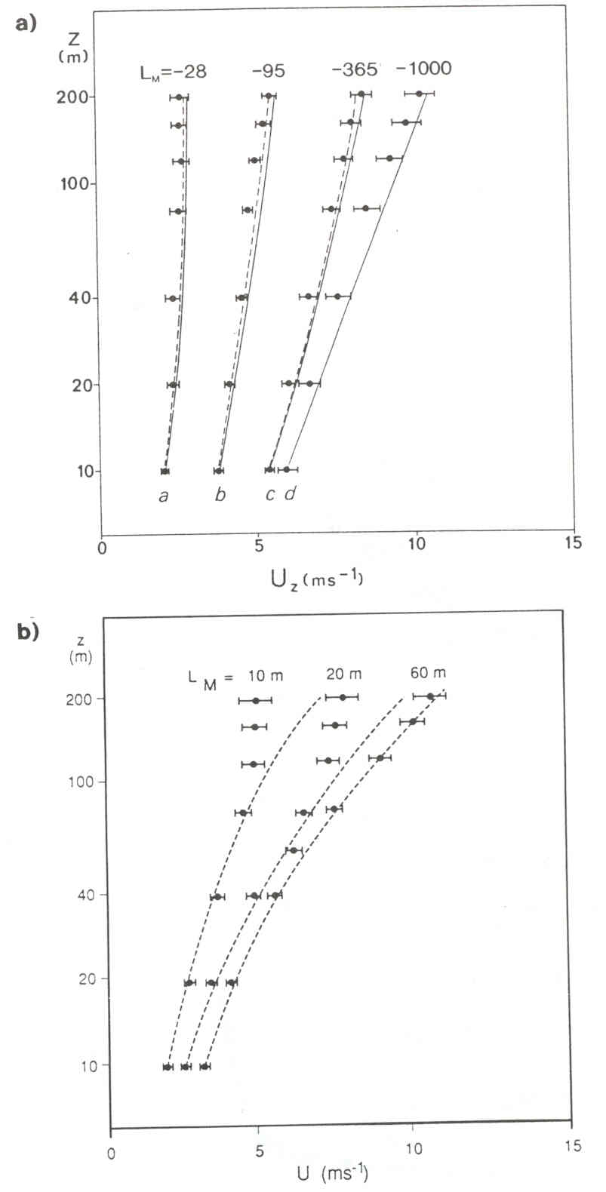
MO wind profile functions applied to observations
Stable
Unstable
Wind profiles extrapolated from the 10 m level upward using empirical ψ-functions (curves). Data is grouped in different stability classes according to L. The dots with horizontal bars indicate the range of observations at each level and stability class. The vertical axis is logarithmic, so a neutral profile, e.g. |L|→ infinite, will give a straight line (Holtslag 1984, BLM, 29, 225-250)

Slide 7

Low wind speeds and the limit of free convection
At zero wind speed, coupling with the surface disappears e.g.
for evaporation and heat flux:
Lowest model level
U₁,V₁, θ₁,q₁
z₁
0 θs q_{s}
Surface
Extension of MO similarity with free convection velocity:
inversion
h
z₁
$cp$ : Air specific heat at constant pressure
w* : Free convection velocity scale (typically 0.5-1 m/s)
Surface
Beljaars 1995, QJRMS, 121, 255-270.
Notes:
Extra term represents near surface wind induced by large eddies in the free convection regime. When surface is heated this extra term guarantees a finite surface wind forcing in the transfer lauw even for vanishing u and v

Slide 8
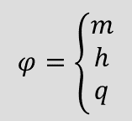
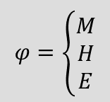
Transfer coefficients
Surface fluxes can be written explicitly as:
Lowest model level
U₁,V₁,T₁,q₁
z₁
0, 0, T_{s}, q_{s}
Surface
$$φ=\left\{\begin{aligned}M \\ H \\ E\end{aligned}\right.$$
$$φ=\left\{\begin{aligned}m \\ h \\ q\end{aligned}\right.$$

Slide 9
Numerical procedure: The Richardson number
The expressions for surface fluxes are implicit i.e they contain the Obukhov length which depends on fluxes. The stability parameter z/L can be computed from the bulk Richardson number by solving the following relation:
This relation can be solved:
  Iteratively;
  Approximated with empirical functions;
  Tabulated.

Slide 10
Surface fluxes: Summary
MO-similarity provides solid basis for parametrization of surface fluxes
Numerical procedure:
  Compute bulk Richardson number:
  Solve iteratively for z/L:
  Compute transfer coefficients:
  Use expression for fluxes in solver:
Surface roughness lengths are crucial aspect of formulation.
Transfer coefficients are typically 0.001 over sea and 0.01 over land, mainly due to surface roughness.

Slide 11
Parameterization of surface fluxes: Outline
Surface layer formulation according to Monin Obukhov (MO) similarity
Roughness lengths
Representation of the different sources of surface stress
Impacts of the surface stress on the large-scale circulation

Slide 12
Surface roughness length (definition)
Example for wind:
Surface roughness length is defined on the basis of logarithmic profile.
For z/L small, profiles are logarithmic.
Roughness length is defined by intersection with ordinate.
10
1
0.1
0.01
Often displacement height is used to obtain U=0 for z=0:
U
Roughness lengths for momentum, heat and moisture are not the same.
Roughness lengths are surface properties.
Notes:
The integration constants that we saw so far z0m, etc are called roughness length because they are related to the small scale inhomogeneities of the surface that determine the air surface transfer

Slide 13
Roughness lengths over the ocean
Roughness lengths are determined by molecular diffusion and ocean wave interaction e.g.
Current version of ECMWF model uses an ocean wave model to provide sea-state dependent Charnock parameter.
Notes:
At low wind speed the sea surface becomes aerodynamically smooth and the sea surface roughness scales with the kinematic viscosity
At high wind speed the charnock parameter is used. For heat and moisture the smooth surface parameterization is retained even in high wind speed cond because obs suggest that the transfer coefficients for heat and moisture have very little dep on wind speedabove 4m/s

Slide 14
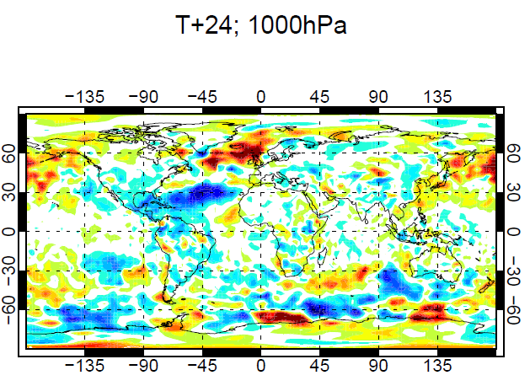
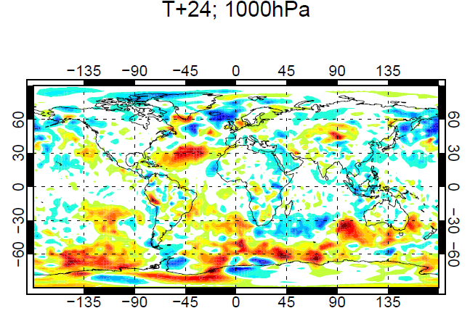
Sensitivity to changes in surface drag over ocean
C_{M}+10%
C_{M}-10%
Extremely sensitive to small changes in the transfer coefficients

Slide 15
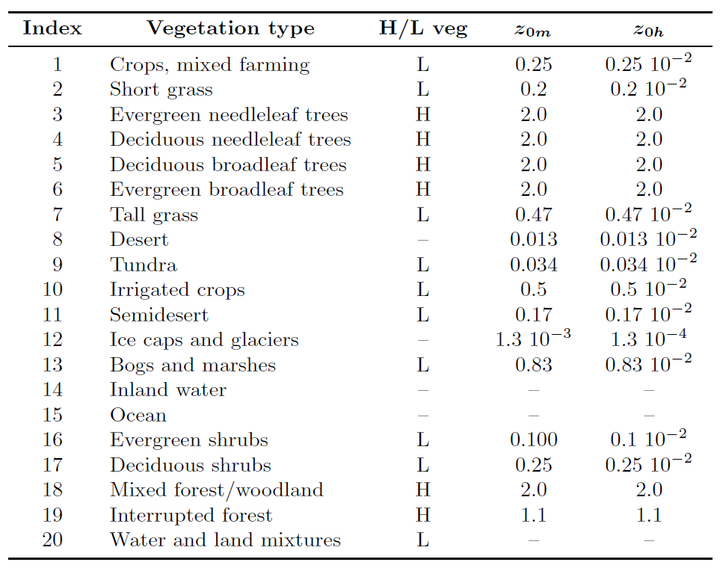
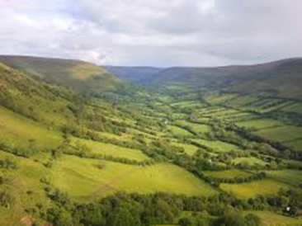
Roughness length over land
Geographical fields based on land use tables:
Llanthony valley, S. Wales
Many models use orographic roughness enhancement to represent drag from sub-grid orography. ECMWF also use used this before 2006 with roughness lengths up to a maximum of 100 m.

Slide 16
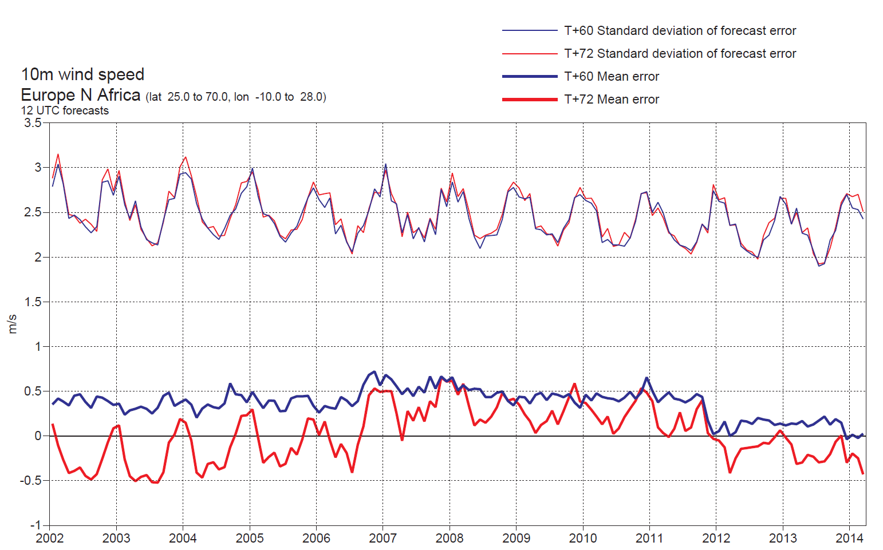
Longstanding near-surface wind (short-range) forecast errors
10m wind speed bias/st dev - Europe
Main cause: the values of the roughness length for momentum
0 UTC
12 UTC

Slide 17
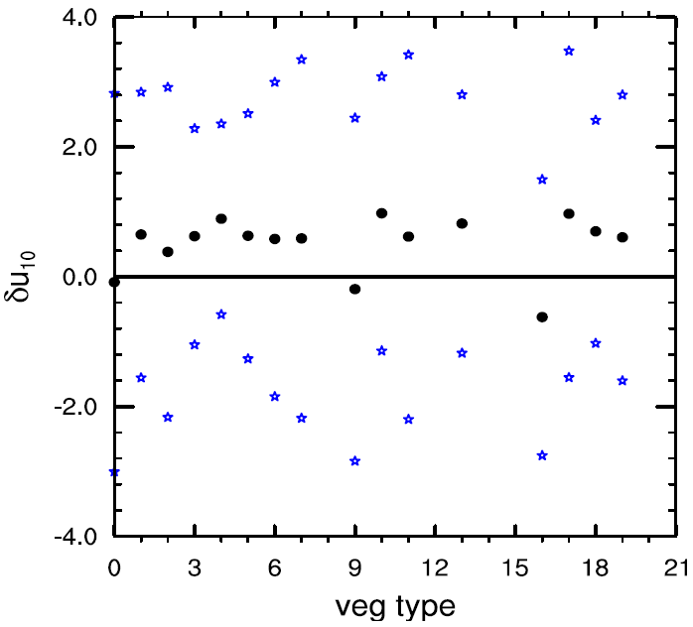
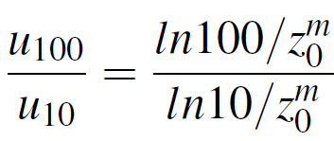
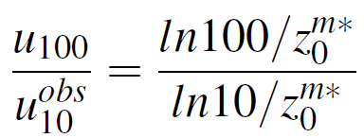
Derivation of a new roughness length table
The 10m winds are mainly controlled by the roughness length values and are generally overestimated by the model.
Forecast 10m winds error compared to synop obs.
(daytime – T511 L91 analysis run August 2010)
The roughness length for momentum
is increased for 10 vegetation types
Sandu et al, ECMWF RD Memo 11104, Newsletter 130

Slide 18
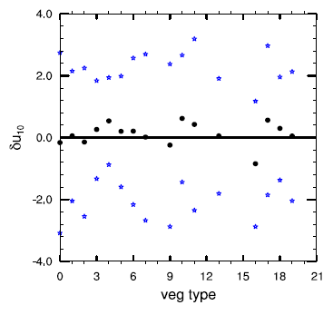
Derivation of a new roughness length table
Forecast 10m winds error compared to synop obs.
(daytime – T511 L91 analysis run August 2010)
OLD
NEW
The 10 wind errors are reduced for the types for which the roughness was changed

Slide 19
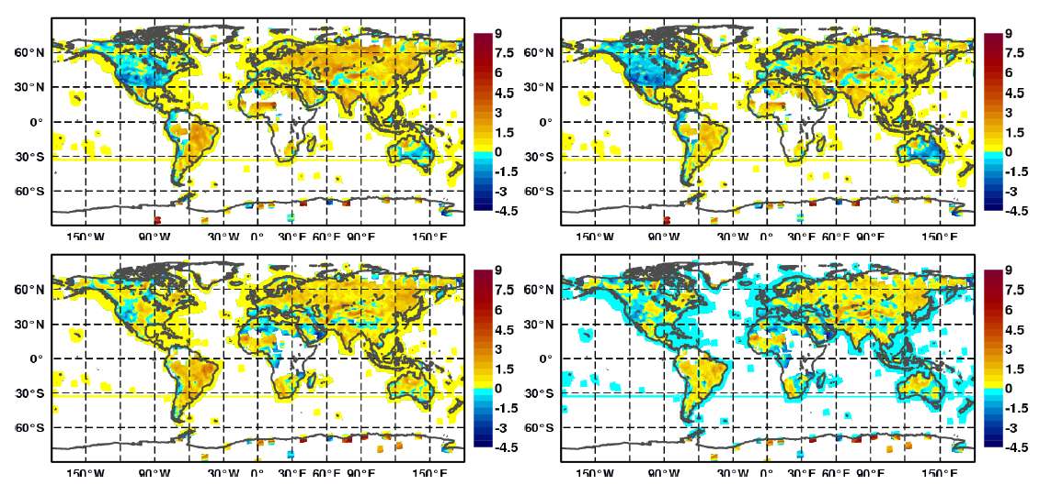
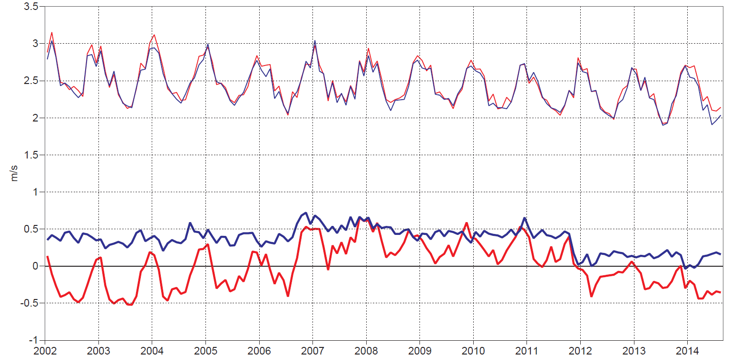
Impact on 10m wind speed in short range forecasts
FC - OBS
OLD
NEW
0UTC
12UTC
10m wind speed bias/st dev - Europe
Implementation of the new table, Nov. 2011
0 UTC
12 UTC

Slide 20
Parameterization of surface fluxes: Outline
Surface layer formulation according to Monin Obukhov (MO) similarity
Roughness lengths
Representation of the different sources of surface stress
Impacts of the surface stress on the large-scale circulation

Slide 21
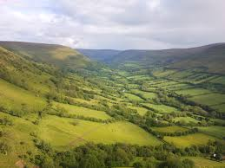
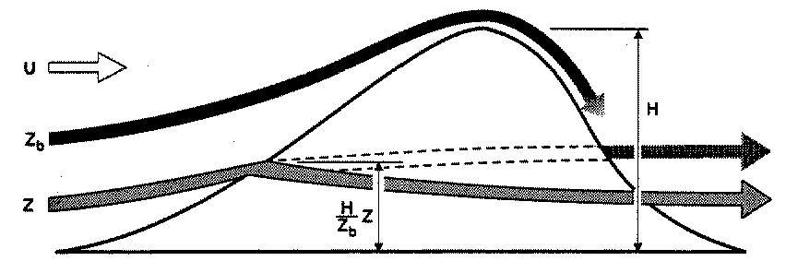
Subgrid drag (stress) mechanisms in the ECMWF model
Scales smaller than 5 km
Scales larger than 5 km
Gravity waves
h
z_{blk}
Low level blocking
    Turbulent Drag - TURB: Traditional MO transfer law with roughness for land use and vegetation
    Turbulent Orographic Form Drag -TOFD : drag from small scale orography (Beljaars et al. 2004); Other models use orographic enhancement of roughness.
  Gravity Wave Drag - GWD : gravity waves are excited by the “effective” sub-grid mountain height, i.e. height where the flow has enough momentum to go over the mountain
  Orographic low level blocking - BLOCK : strong drag at lower levels where the flow is forced around the mountain
Notes:
e.g of partition of surface stress in the ecwmf model – it is considered that the subgrid drag is due to different processes, so the total drag is represented by various schemes. There are two main components of the subgrid drag: a component from the turbulence scheme, which represents drag exerted on the flow by elements of the surface with scales less than 5km, and a component from the subgrid orography scheme which represents drag put on the flow by orography with scales between 5km and the model resolution. Each of these two components can be further broken down in two new components. The drag which is due to vegetation or land use drag is represented through the turbulence scheme itself. While the drag due to subgrid orography with scales less than 5 km is represented in our model through the TOFD scheme – in other models the roughness of land use is increased over orography – orographic envelope or enhacement of roughness.
The SGO scheme represents drag associated with gravity waves, and with the blocking of the flow at low levels by the subgrid orography. If you think of a subgrid mountain, a part of the flow at low levels does not have enough momentum to go over the mountain and goes around it – this the effect parameterized by the blocking component of the scheme – while air at higher levels has enough can go over the mountain and excites gravity waves that propagate and break at higher levels – and this effect is parameterized with the GWD component of the scheme

Slide 22
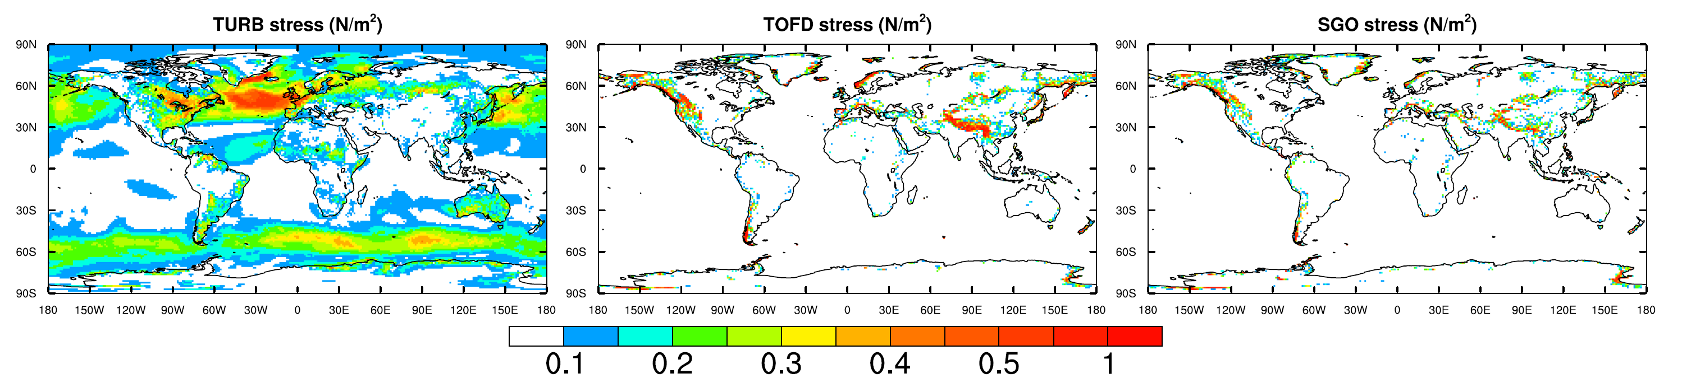
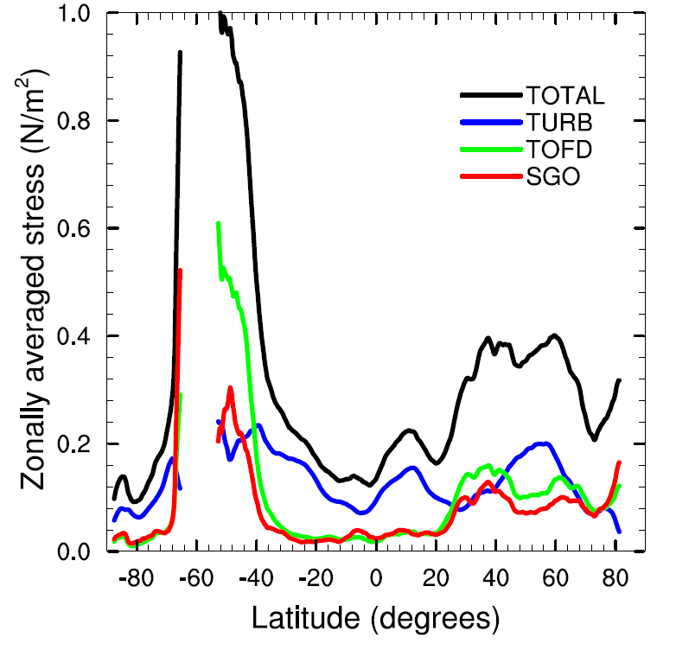
An illustration of the surface stress from the different schemes (u-component)
u-component TURB stress (N/m2)
u-component TOFD stress (N/m2)
u-component SO stress (N/m2)
Similar zonal average but different zonal distribution
Total
TURB
TOFD
SO

Slide 23
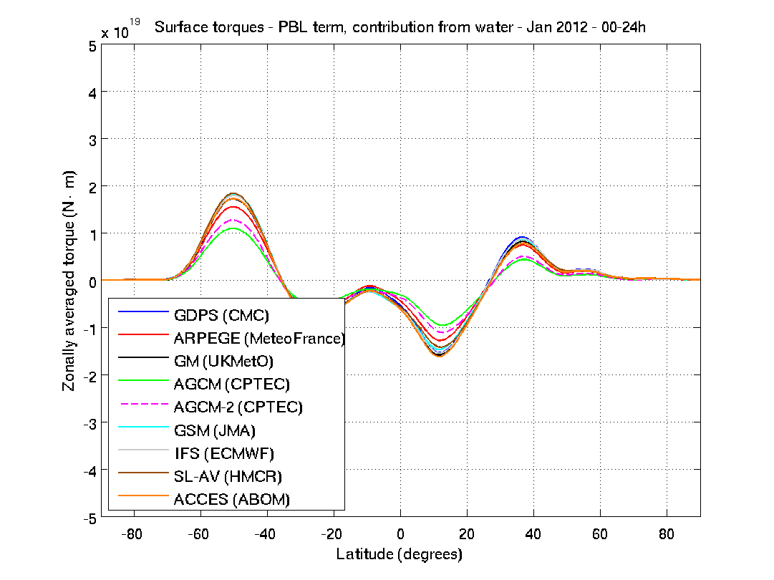
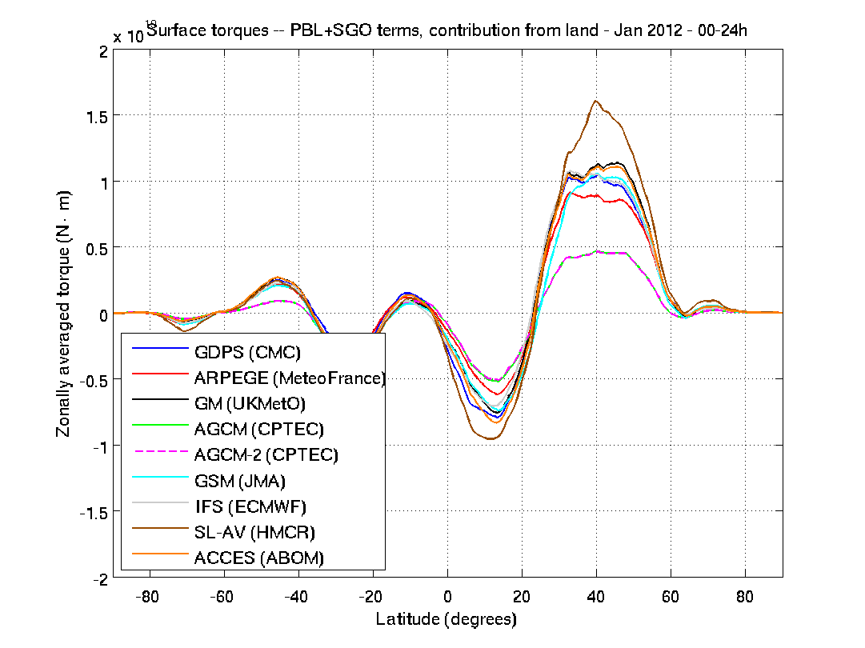
WGNE Drag project – comparison of surface stress
PBL over water
PBL+SGO over land
Major NWP models
Jan 2012
Much better agreement over water than over land !
___________________________________
Link to Drag Project website* (A. Zadra and J. Bacmeister):
http://collaboration.cmc.ec.gc.ca/science/rpn/drag_project/index.html
Notes:
Well, the representation of surface drag in models has in fact received little attention compared to other processes such as clouds, radiation, etc. Until recently, there were papers looking the impacts of one or other type of drag, most of them at the impact of orographic gravity wave drag actually, but no real focus on surface stress and how well the models reproduce it, if they agree etc….
Things started to change in past couple of years. More recently following an initial comparison betwen ec and uk of the stresses, wgne intercomparison
the wgne drag project - agreement over water, much less agreement over land,
for models at comparable resolution, total (physics) torques look very similar (more than expected, according to some participants)

Slide 24
Parameterization of surface fluxes: Outline
Surface layer formulation according to Monin Obukhov (MO) similarity
Roughness lengths
Representation of the different sources of surface stress
Impacts of the surface stress on the large-scale circulation

Slide 25
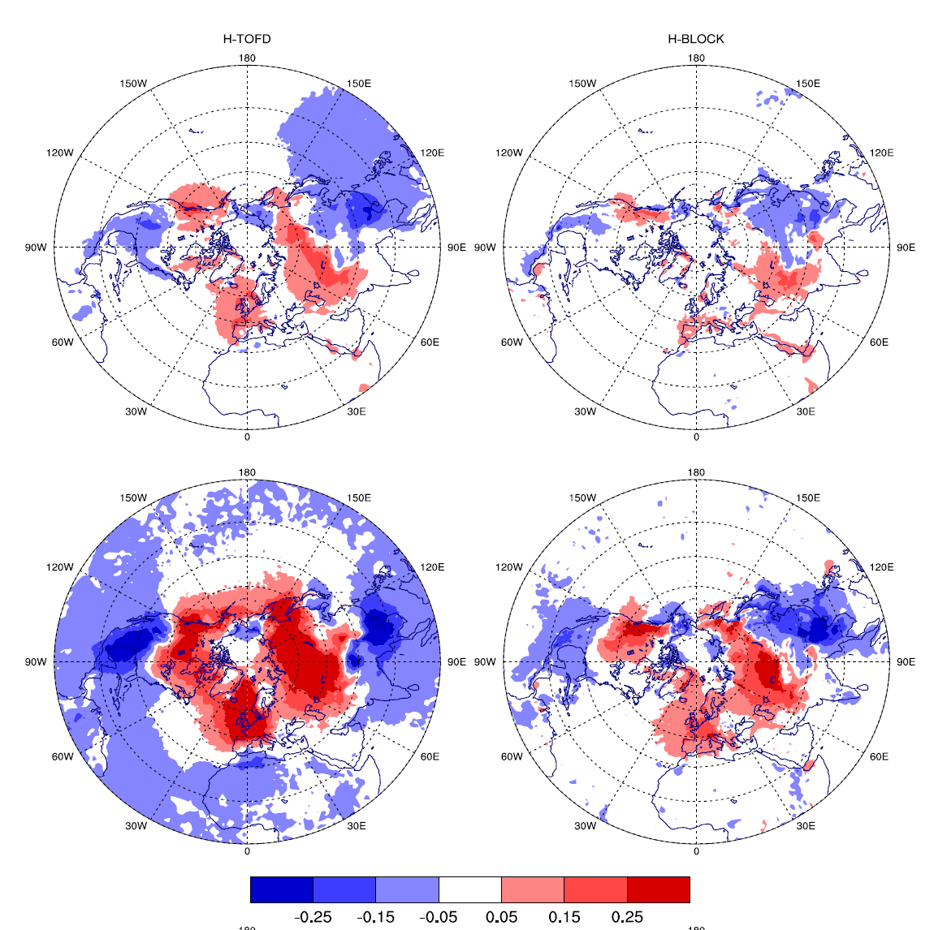
Changing the TOFD and low level blocking strength impacts the forecast from the very short range
H-TOFD
H-BLOCK
Mean change in SP +6h
Mean change in
SP +24h
Sandu et al. 2016, JAMES
hPa
Local response in SP, through geostrophic balance. The meridional pressure gradient is induced by a deceleration of the mid-latitude westerlies
corroborates Zadra et al 2003

Slide 26
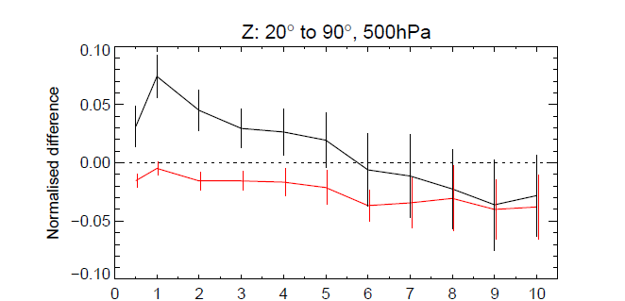
Impact on medium range forecasts
Change in RMSE Z 500hPa
H-TOFD
H-BLOCK
Lead time (days)
Fine balance between improving and degrading the forecast!
It matters how the drag is partitioned between the two schemes
Quasi-indentical response for H-TOFD at 16km
The trouble won’t go away with high resolution anytime soon!
Changes in surface stress also affect longer timescales (seasonal to climate)
See Sigmond and Scinocca, 2010, Sandu et al. 2016, Pithan et al., 2015,2016

Slide 27
Since 2006 used “Turbulent Orographic Form Drag (TOFD)” implemented as a tendency (or flux divergence) on model levels
Orographic form drag (simplified Wood and Mason, 1993):
Shape parameters
Drag coefficient
Silhouette slope
Wind speed
Reference height
Vertical distribution (Wood et al, 2001):

Slide 28
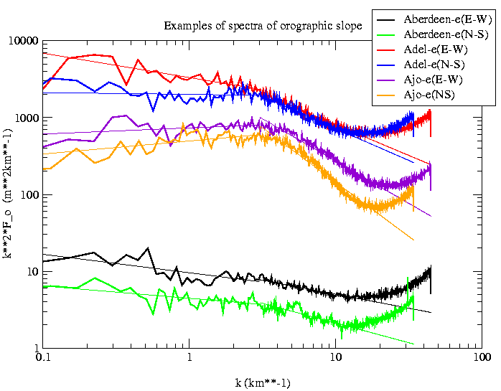
Parameterization of flux divergence with a continuous orographic spectrum:
Assume:
1000 m
100 m
Write flux divergence as:
Beljaars, Brown and Wood, 2004, QJRMS, 130, 1327–1347

Slide 29
Thank you

