Slide 1
Parameterization of continental surfaces in coupled Earth System Modelling: part III
How surface processes influence Earth System predictability?
Gianpaolo Balsamo
Coupling Processes Team, Earth System Model Section
gianpaolo.balsamo@ecmwf.int

Slide 2
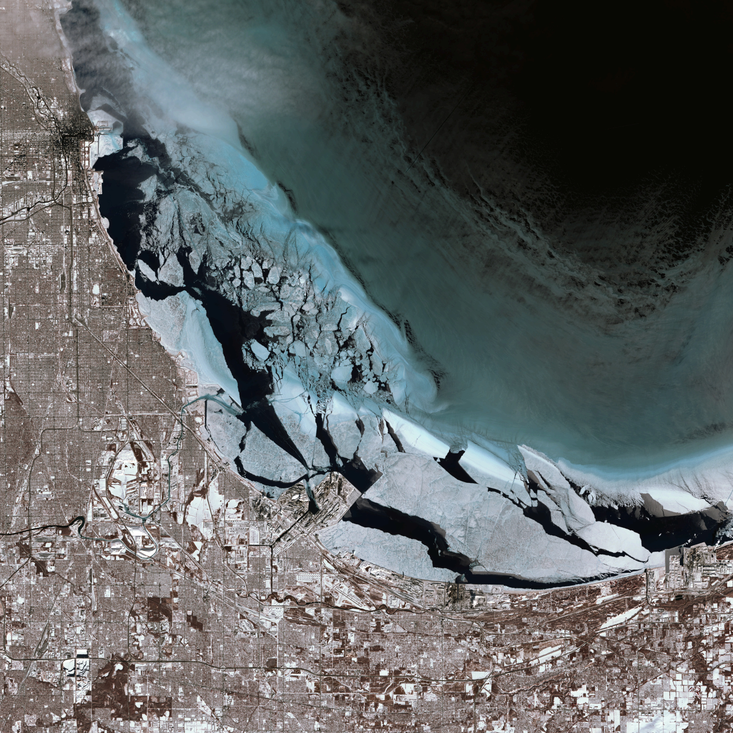
Today’s satellite images are very informative not only about natural land surface…

Slide 3
Context
Why Numerical Weather Prediction had to embrace Earth System Modelling?
  It is much nicer and represent nature better? Do we gain?
Biosphere, Hydrosphere, Cryosphere, and Atmosphere: Do they all matter the same?
  Can we attempt a quantitative evaluation? What are the caveats?
Diurnal and Seasonal amplitude improvements
  How much are they drivers to accurate predictions?
What else is in the “hat” and where do we need (r)evolutionary ideas?
  Bridging gaps between modelling communities.
  Bringing new EO data to guide model development
Roadmap to Global Environmental Monitoring and Prediction
  If we can imagine it, probably we can do it?

Slide 4
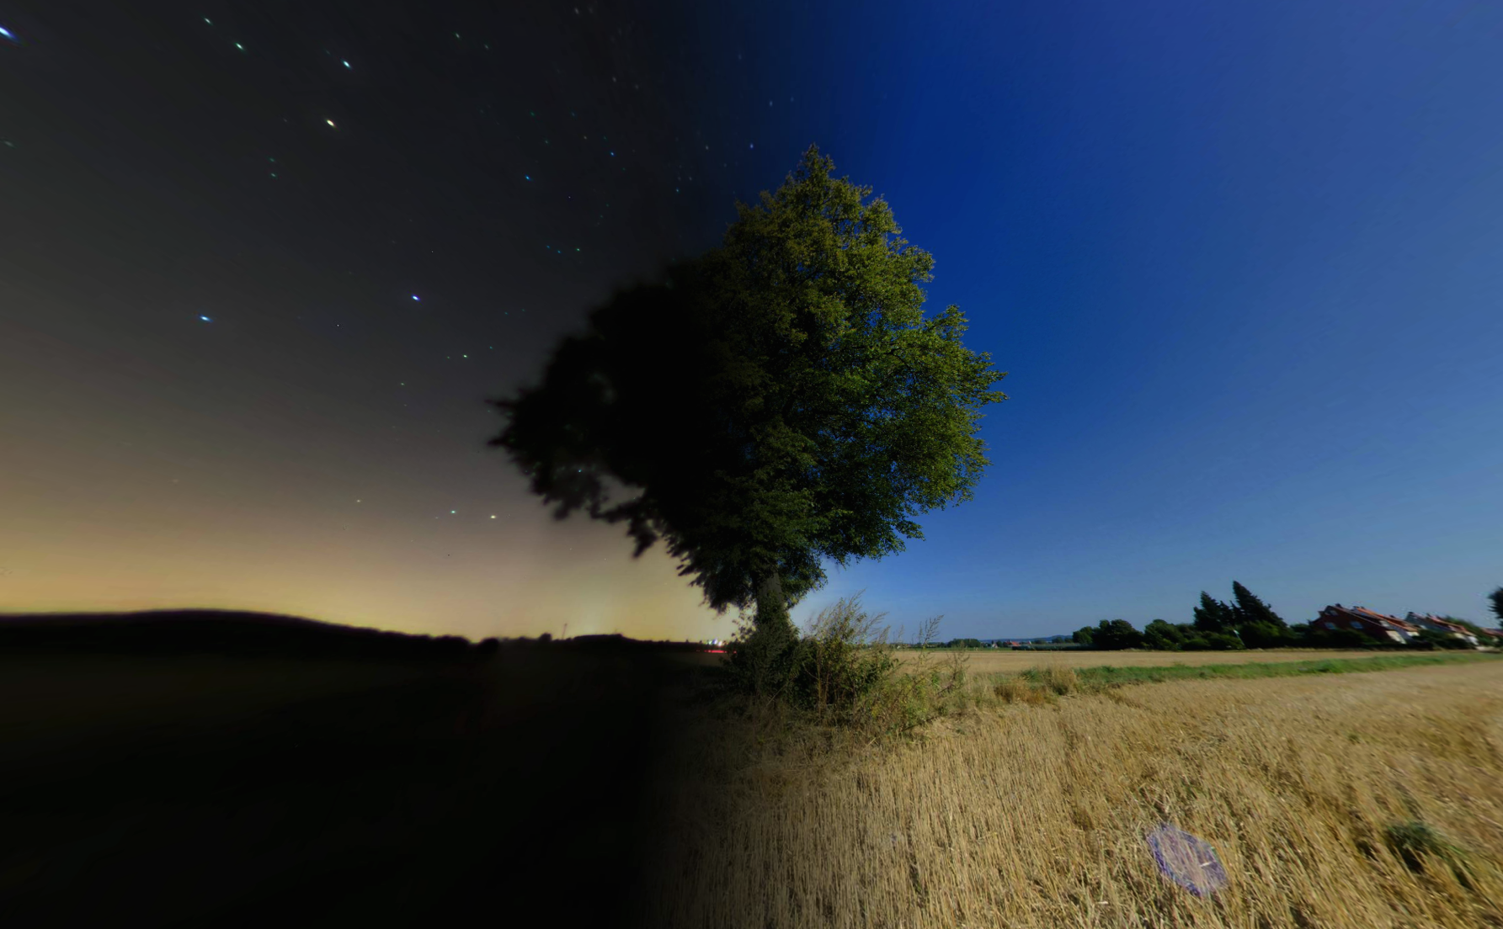
Coupling and diurnal cycle: vegetation
Night
Day

Slide 5
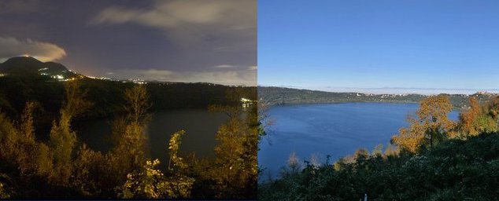
Coupling and diurnal cycle: lakes
Day
Night

Slide 6
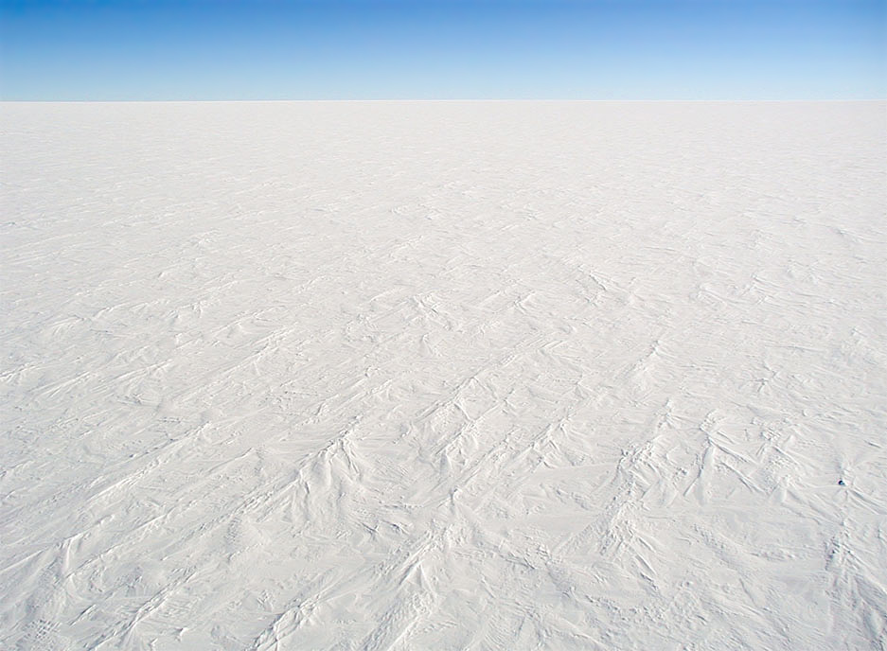
Coupling and diurnal cycle: snow and ice
Night
Day

Slide 7
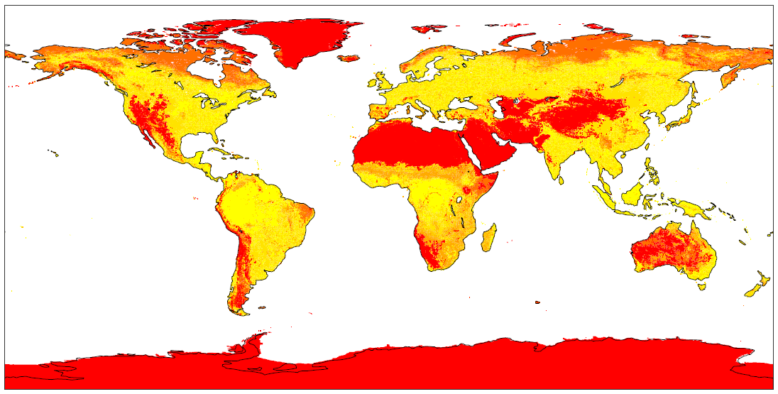
Bare ground fraction
Calculated from GLCC 1km
and assigned vegetation covers

Slide 8
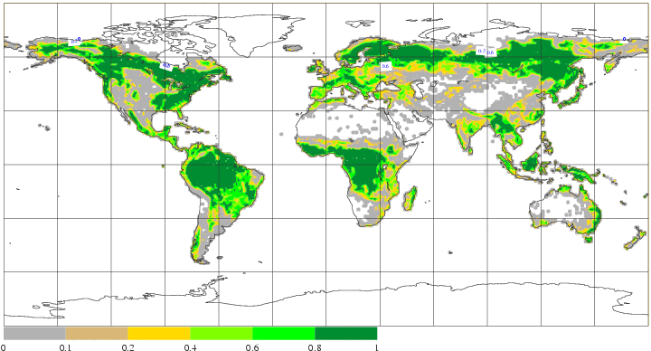
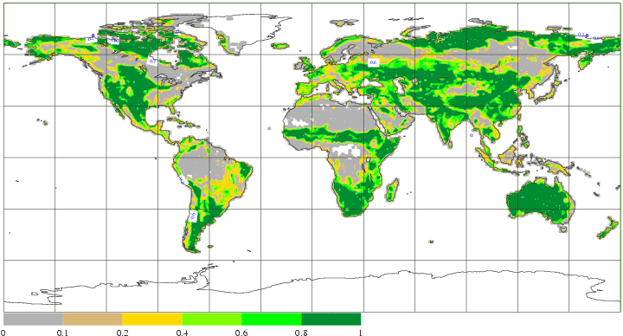
High and Low vegetation fractions
Aggregated from GLCC 1km

Slide 9
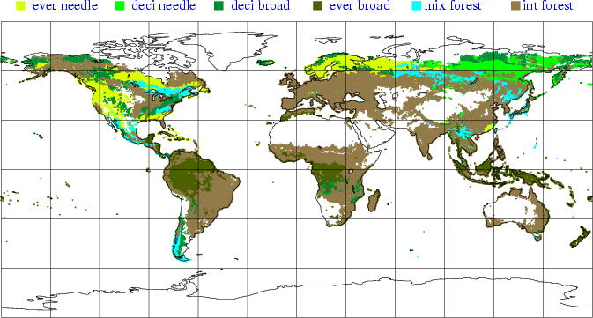
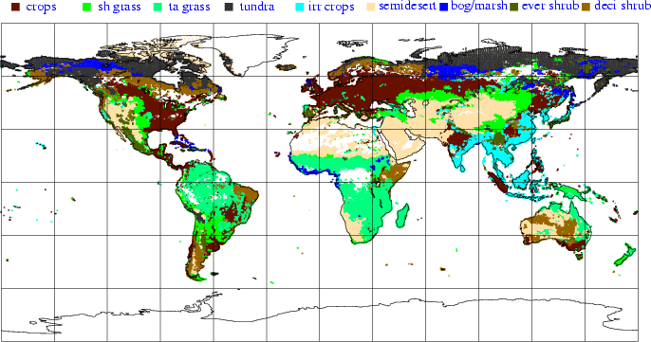
High and Low vegetation types
Aggregated from GLCC 1km

Slide 10
Schematics for the Energy flow
H
LE
Day
D
Night
G

Slide 11
HTESSEL skin temperature equation
Ground heat flux
Grid-box quantities

Slide 12
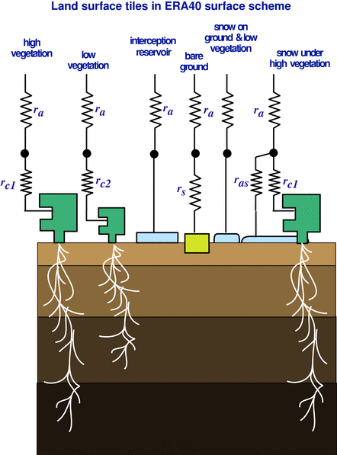
HTESSEL heat transfer
Solution of heat transfer equation with the soil discretized in 4 layers, depths 7, 21, 72, and 189 cm.
No-flux bottom boundary condition
Heat conductivity dependent on soil water
Thermal effects of soil water phase change
↓0.1~0.6 d
↓ 1.1~5.8 d
↓ 10.6 ~ 55.8 d
Time-scale for downward heat transfers in wet/dry soil

Slide 13
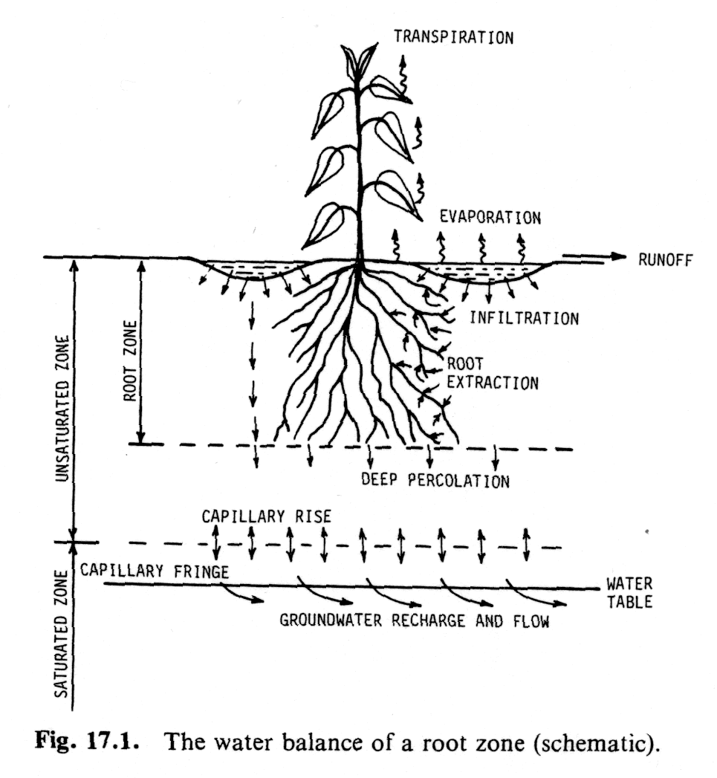
Schematics of the water flow
Boundary conditions:
Top See later
Bottom Free drainage or bed rock
Root extraction
The amount of water transported
from the root system up to the stomata
(due to the difference in the osmotic
pressure) and then available for
transpiration
Hillel 1982

Slide 14
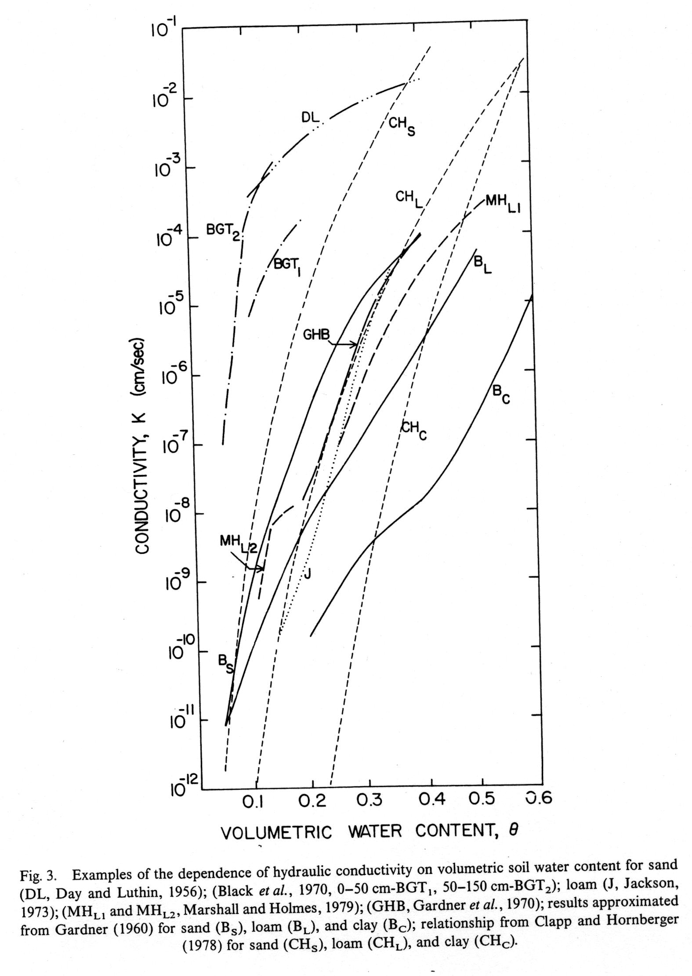
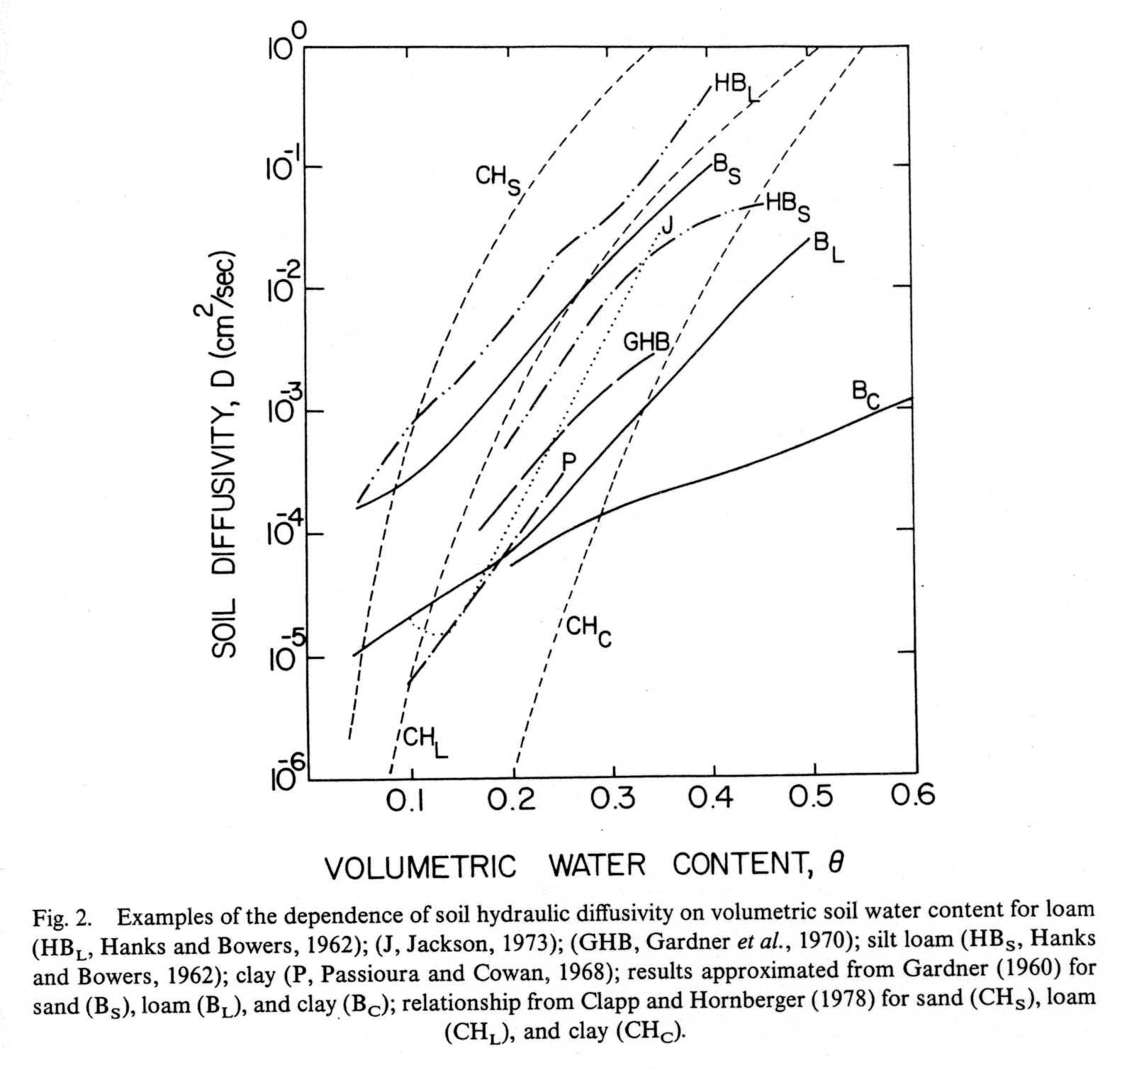
Soil water flux
Darcy’s law
> 3 orders of
magnitude
> 6 orders of
magnitude
Mahrt and Pan 1984

Slide 15
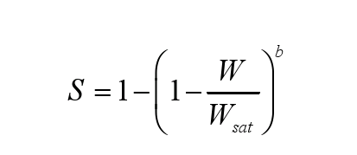
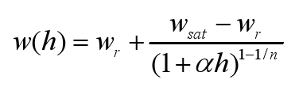
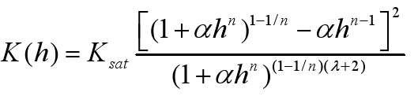
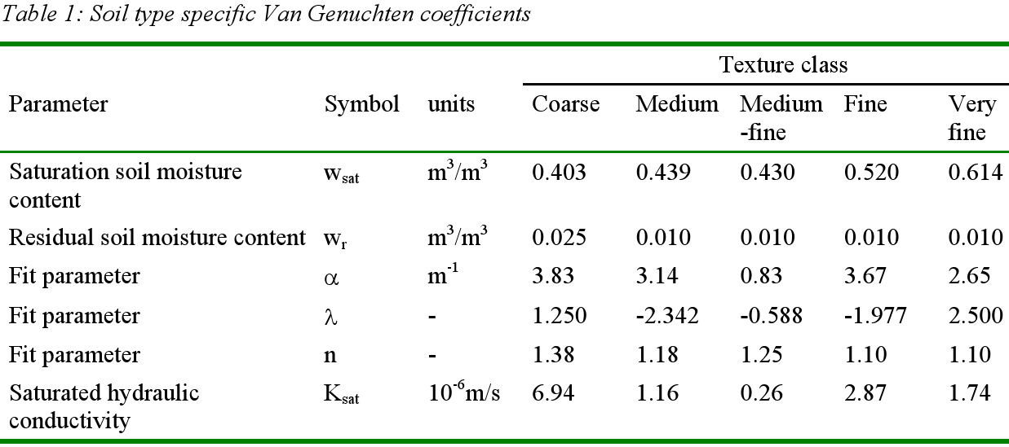
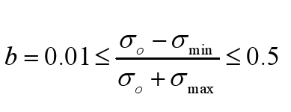
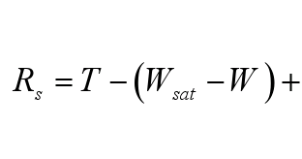
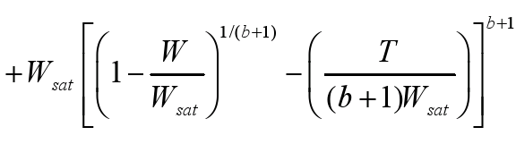
HTESSEL hydrology scheme
A spatially variable hydrology scheme is being tested following Van den Hurk and Viterbo 2003
Use of a the Digital Soil Map of World (DSMW) 2003
Infiltration based on Van Genuchten 1980 and Surface runoff generation based on Dümenil and Todini 1992
Van den Hurk and Viterbo 2003

Slide 16
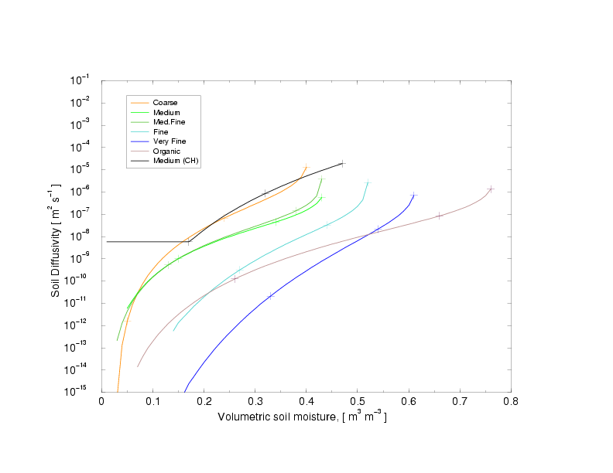
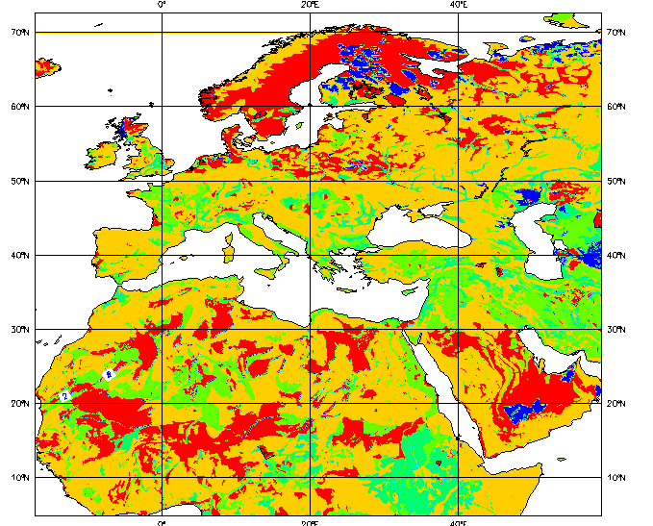
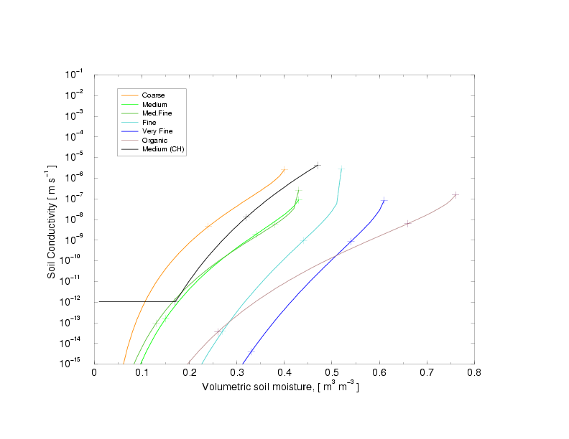
HTESSEL hydrology scheme(2)
█coarse █medium █med-fine █fine █very-fine █organic
Soil Diffusivity
control
Soil Conductivity
control
Dominant soil type from FAO2003 (at native resolution of ~ 10 km)

Slide 17
HTESSEL soil water equations
↓0.1~19.7 d
↓ 1.2~195.9 d
j-1
F_{j-1/2}
↓ 11.7 ~ >> d
D_{j}
F_{j+1/2}
Time-scale for downward water transfers in wet/dry soil
j+1

Slide 18
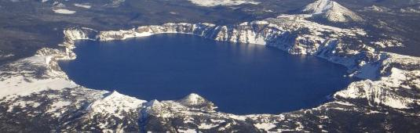
Modelling inland water bodies
A representation of inland water bodies and coastal areas in NWP models is essential to simulate large contrasts of albedo, roughness and heat storage
A lake and shallow coastal waters parametrization scheme has been introduced in the ECMWF Integrated Forecasting System combining
HTESSEL
Hydrology - Tiled ECMWF
Scheme for Surface Exchanges over Land
+
FLake
Fresh water Lake scheme
Lake tile
Mironov et al (2010),
Dutra et al. (2010),
Balsamo et al. (2010, 2012, 2013)
  Extra tile (9) to account
  for sub-grid lakes

Slide 19
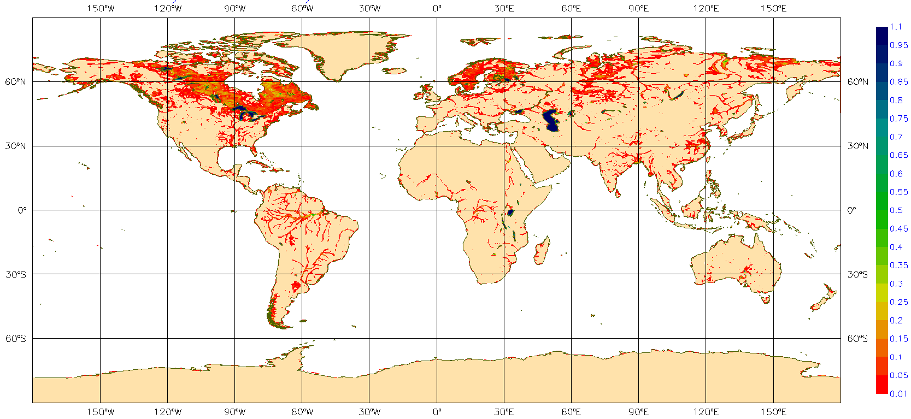
Inland water bodies fraction
Aggregated from GLOBCOVER 300m

Slide 20

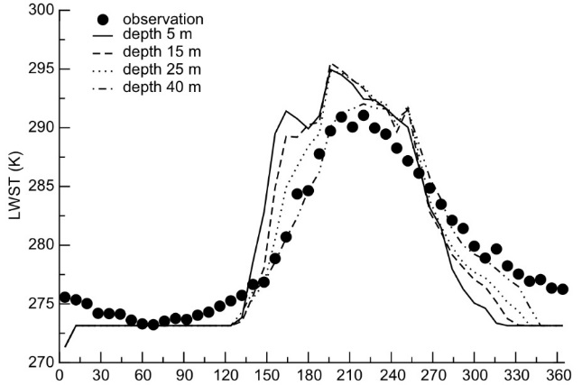
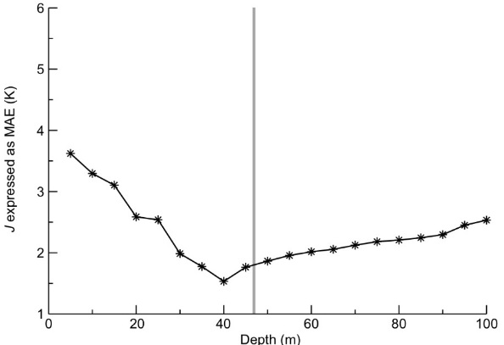
Water bodies heat storage
All inland water bodies are important energy storage drastically changing sensible heat flux
FLake (Mironov et al. 2010, BER) http://lakemodel.net a two-layer bulk model based on a self-similar parametric representation of the evolving temperature profile within lake water and ice
Introduced in the IFS by Dutra et al. (2010,BER), Balsamo et al. (2010,BER; 2012,TELLUS)
Lake depth is a scalar for lake temperature annual cycle
The relationship between the lake temperature (as observed by MODIS) and the lake depth can be used to infer the lake depth in an inversion procedure (Balsamo et al. 2010 BER)
Notes:
20

Slide 21
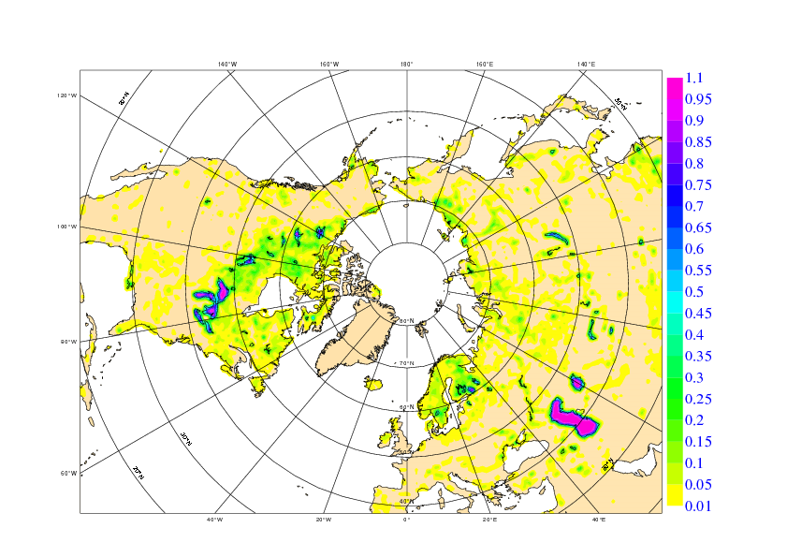
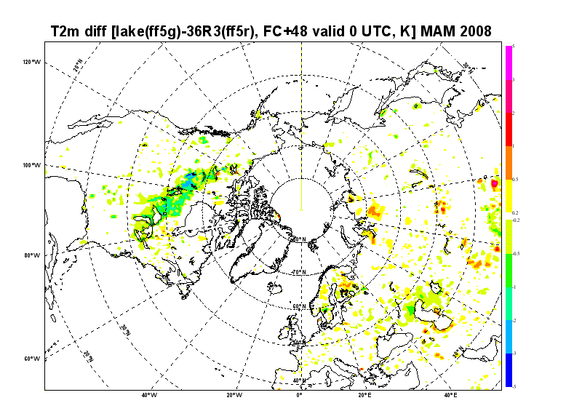
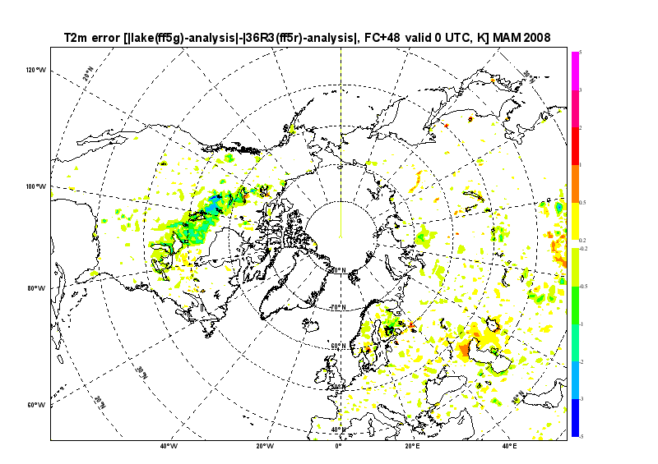
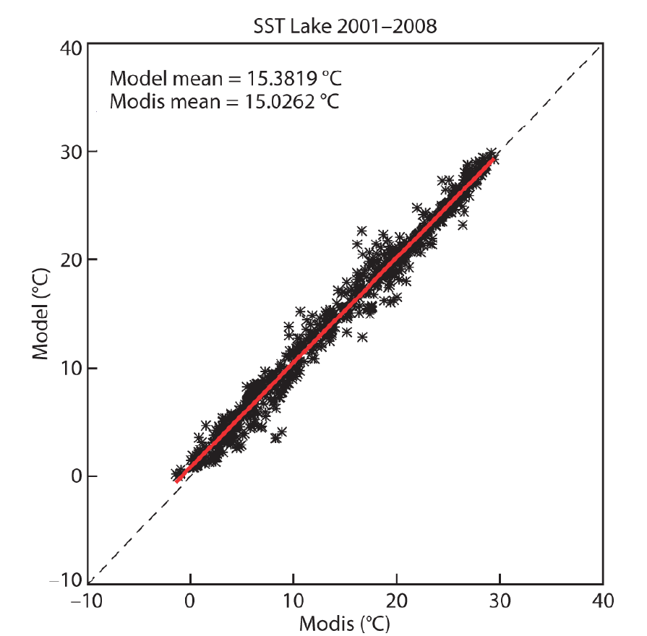
Impact of lakes in NWP forecasts
Balsamo et al. (2012, TELLUS-A) and ECMWF TM 648
Lake cover
Forecasts sensitivity and impact of lakes is shown to produce a spring-cooling on lake areas with benefit on the temperatures forecasts (day-2 (48-hour forecast) at 2m.
The lake surface temperatures are verified with MODIS LSTs
as indicative of the heat-storage accuracy of the lake model
Forecast sensitivity Forecast impact
Cooling 2m temperature
Warming 2m temperature
Improves 2m temperature
Degrades 2m temperature

Slide 22
Lakes are the last newly added tile to ECMWF land surface scheme that went in operational use on the 12th of May 2015. The importance of lakes and their temperature and ice conditions in generating clouds and storms can be appreciated in the video here:
http://time.com/9480/great-lakes-frozen-time-lapse-video/

Slide 23
ECMWF surface model milestones
Vegetation based evaporation 1989
CY48 (4 layers + …) 1993 / ERA15
Initial conditions for soil water 1994
Stable BL/soil water freezing 1996
Albedo of snow forests 1996
OI increments of soil water 1999
TESSEL, new snow and sea ice 2000 / ERA40
HTESSEL, revised soil hydrology 2007
HTESSEL+SNOW, revised snow 2009
HTESSEL+SNOW+LAI, seasonal vegetation 2010
CHTESSEL (carbon-land surface) 2012
LAKETESSEL (addition of lake tile) 2015
…what is next?

Slide 24
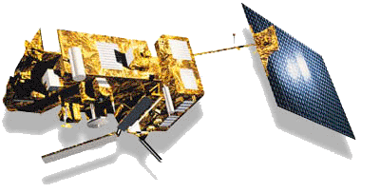

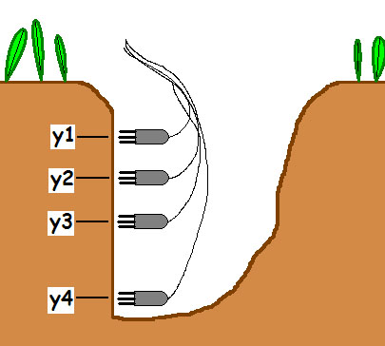
An enhanced soil vertical resolution
The model bias in Tskin amplitude shown by
Trigo et al. (2015) motivated the development of an enhanced soil vertical discretisation to improve the match with satellite products.
1 cm
2 cm
4cm
7 cm
4-layers:
# 0-7 cm
# 7-28 cm
# 28-100 cm
# 100-289 cm
10-layers:
# 0-1 cm
# 1-3 cm
# 3-7 cm
# 7-15 cm
# 15-25 cm
# 25-50 cm
# 50-100 cm
# 100-200 cm
# 200-400 cm
# 400-800 cm

Slide 25
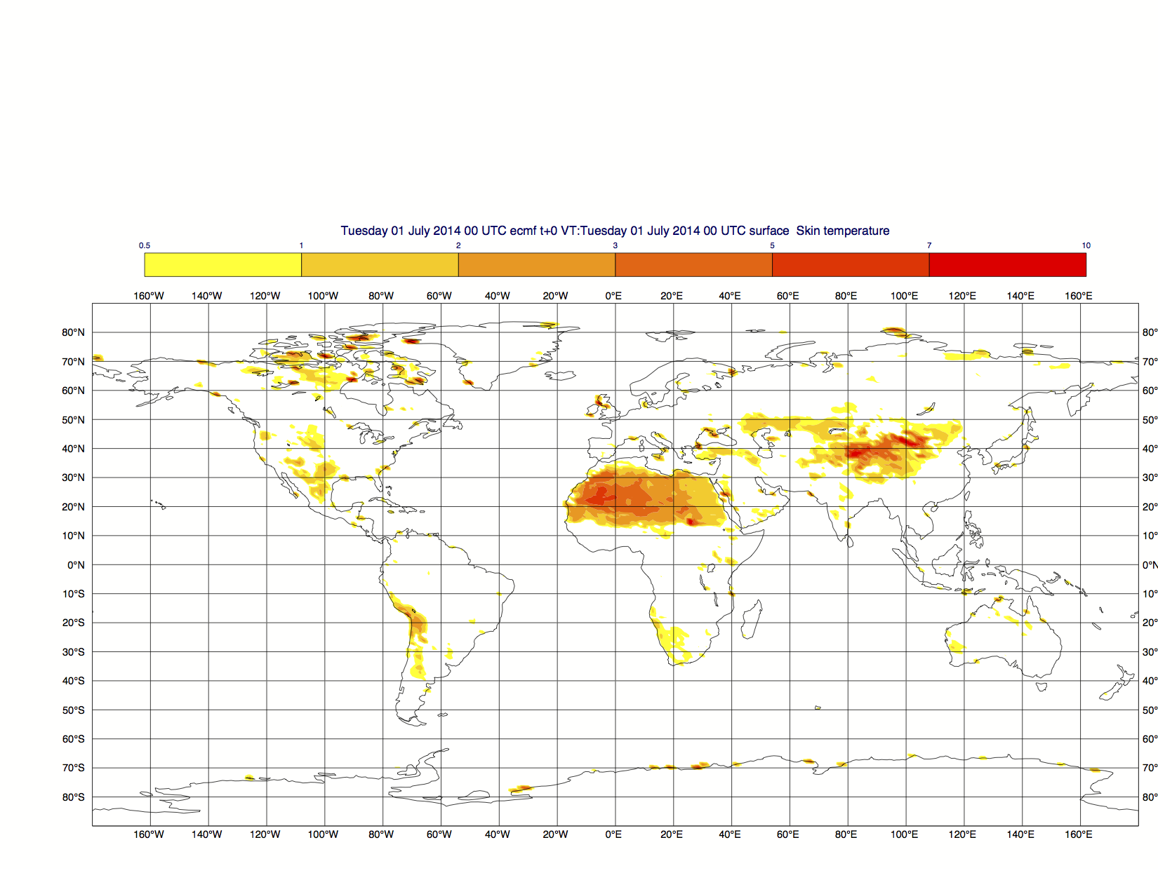
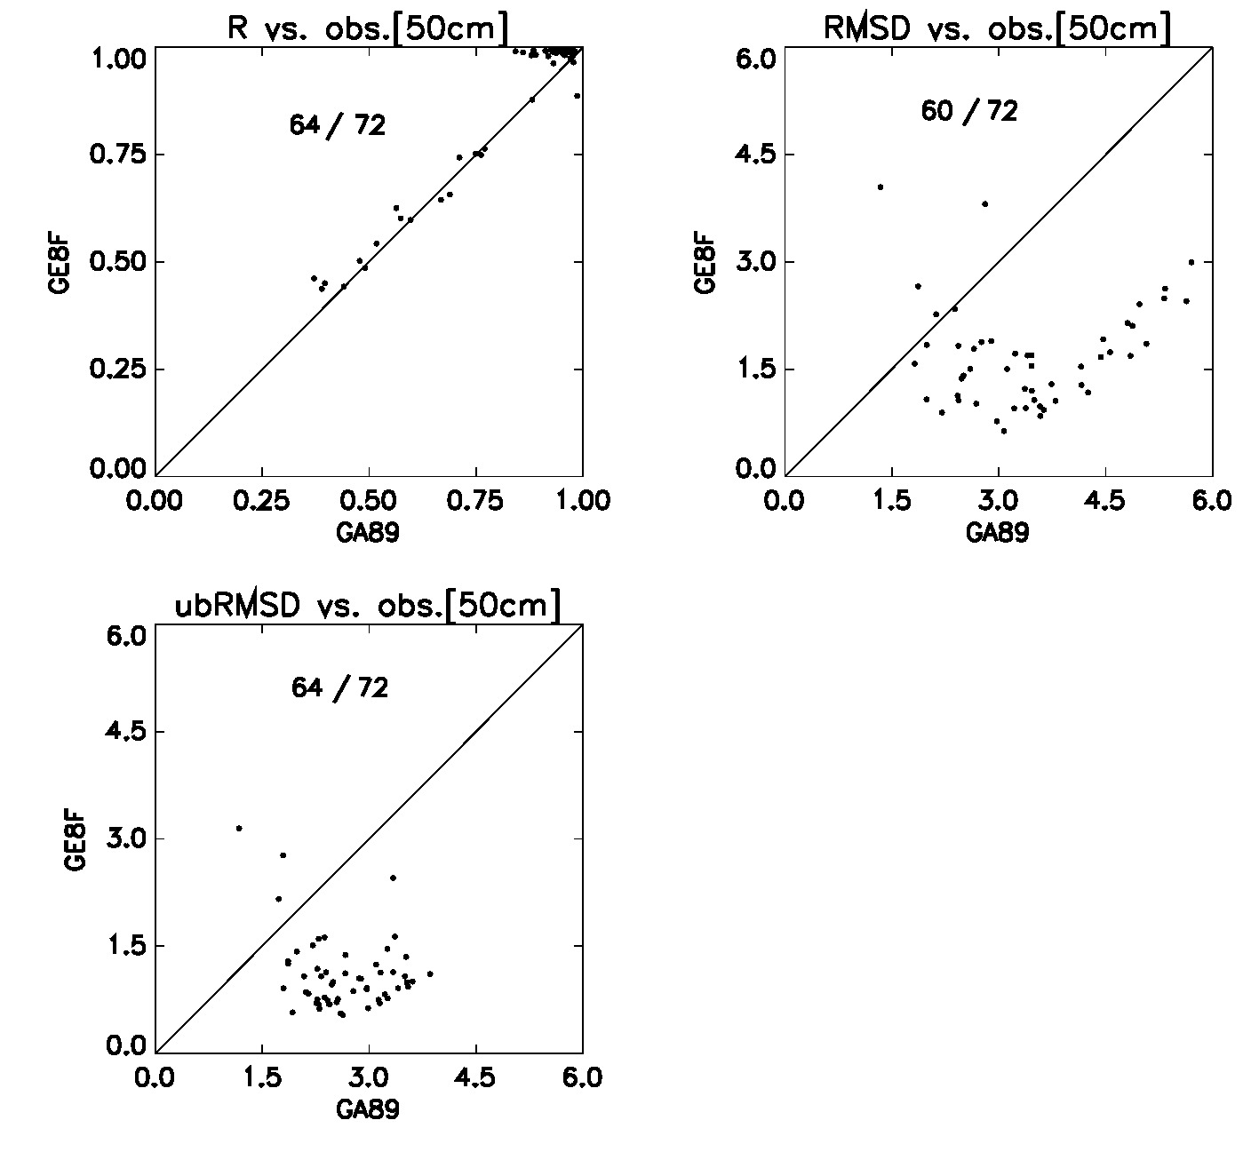
Impact of soil vertical resolution on soil temperature
Sensitivity Max Tskin for July 2014
In-situ validation at 50cm depth
(on 2014, 64 stations)
Results by Clément Albergel
10-layer soil
Higher T-max at the L-A interface
up to 3 degrees warmer on bare soil
(without symmetric effect on Tmin!)
Offline simulations with 10-layer soil
Compared to 4-layer soils
4-layer soils
Improved match to deep soil temperature
(shown is correlation and RMSD)
Correlation with in-situ soil temperature validate the usefulness of increase soil vertical resolution for monthly timescale (0.50 cm deep). Research work will continue using satellite skin temperature data (2nd visit of René Orth ETH).
Notes:
Multilayer: Model_equivalent[obs.50cm] : (12.5*L6+25*L7)/37.5
4 Layers: Model_equivalent[obs.50cm] : (31.5*L2+14*L3)/45.5
**Evaluation over 2014
R_multilayer bigger(better) than R_4_layers for 64 stations out of 72
RMSD_multilayer smaller(better) than RMSD_4_layers for 60 stations out of 72
ubRMSD_multilayer smaller(better) than ubRMSD_4_layers for 60 stations out of 72

Slide 26
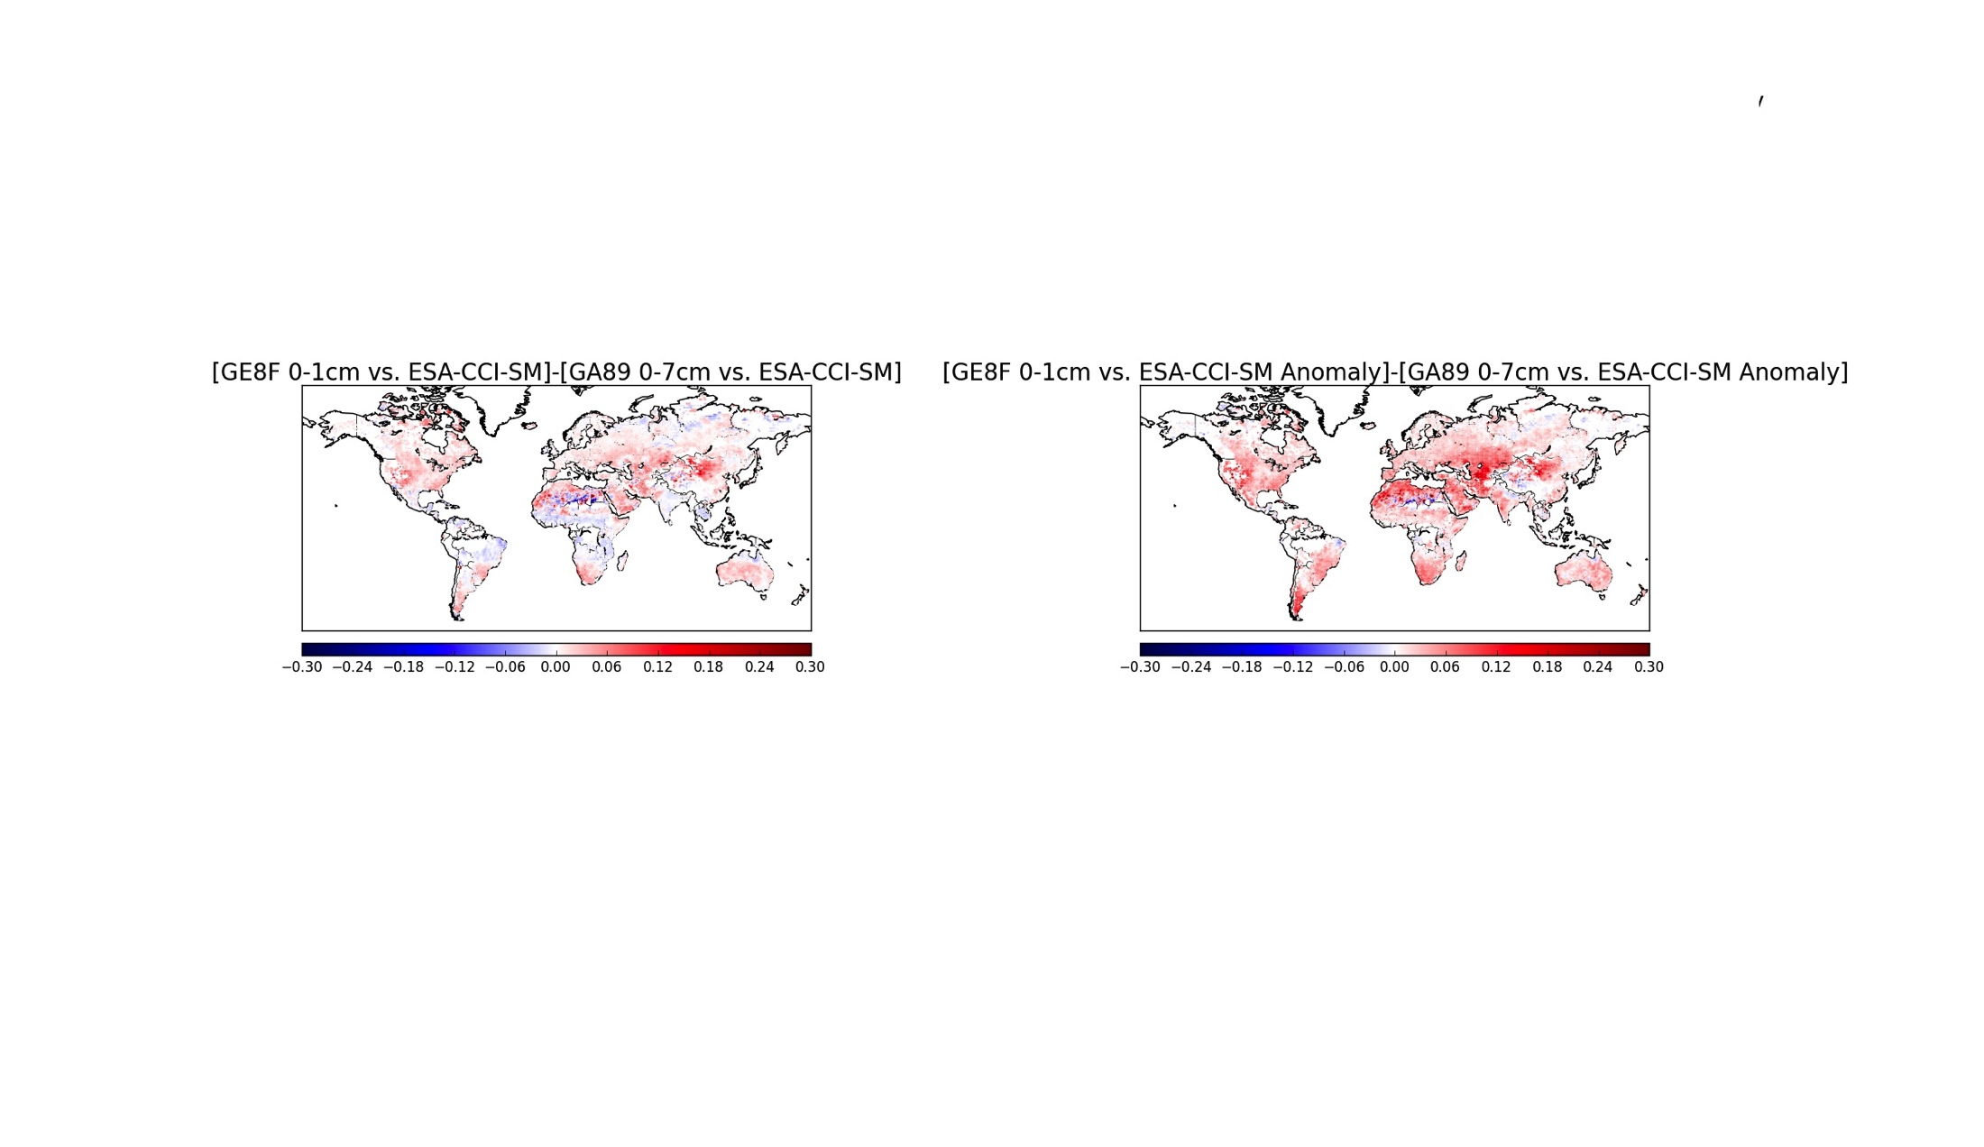
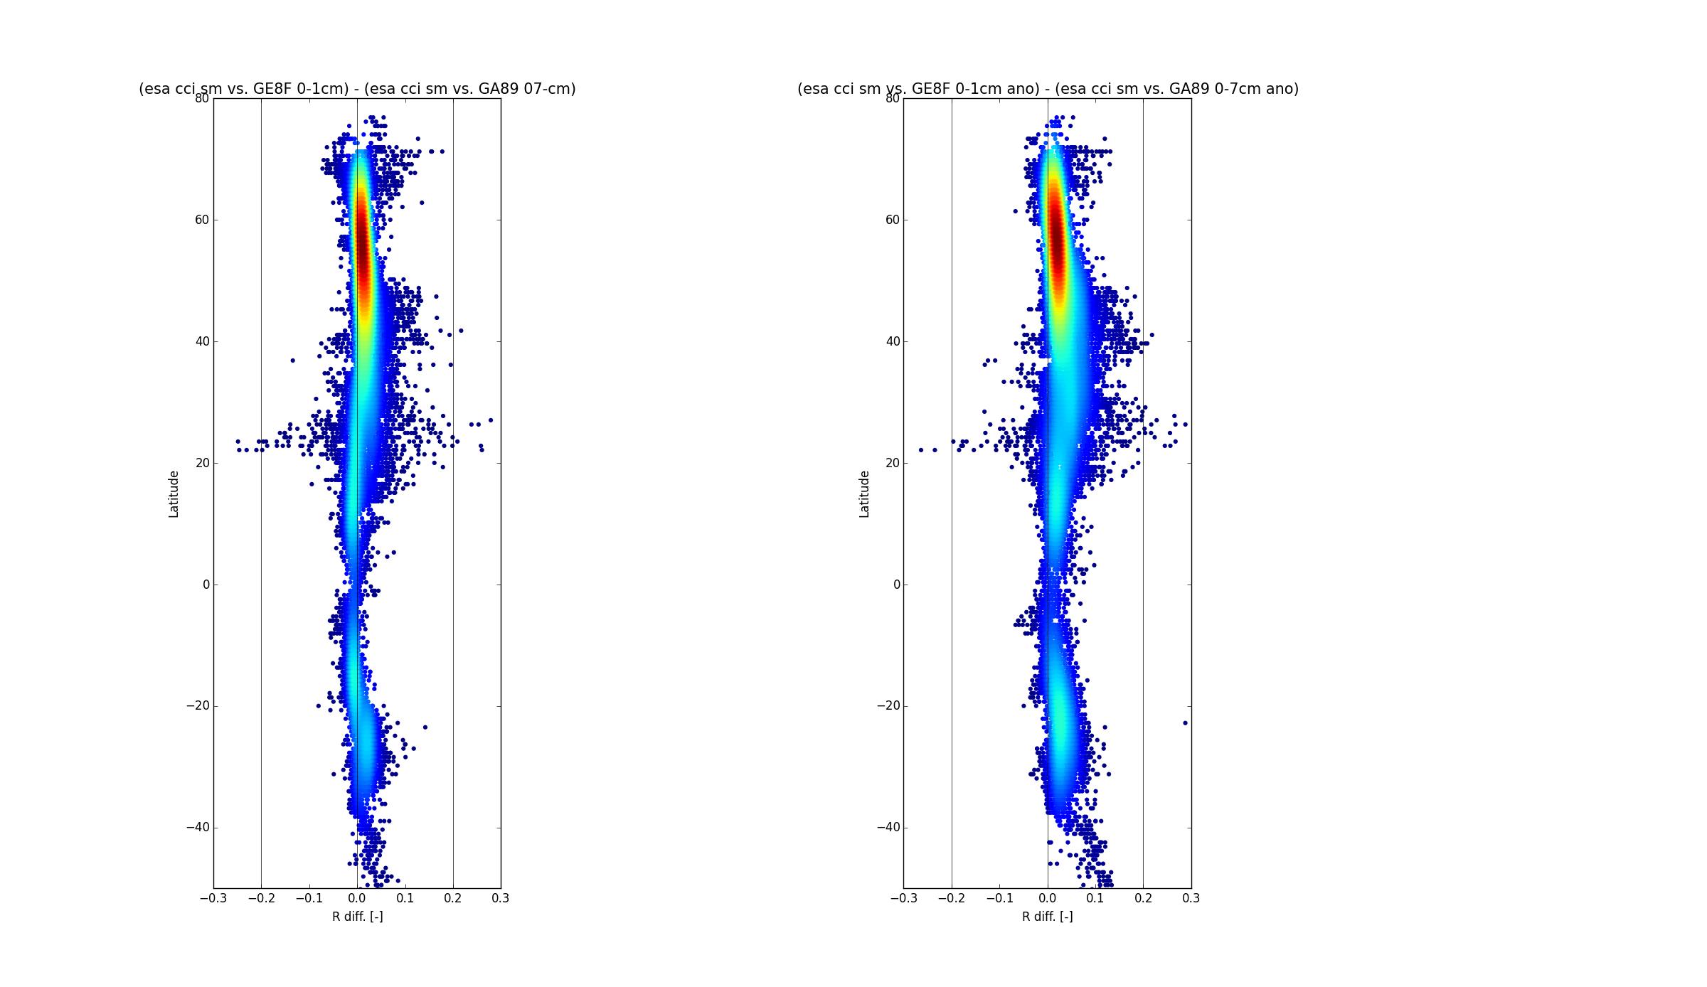
Impact of soil vertical resolution for satellite soil moisture
Impact on Anomaly Correlation with ESA-CCI satellite soil moisture (courtesy of Clément Albergel)
Globally Improved match to satellite soil moisture (shown is ΔACC calculate on 1-month running mean)
Anomaly correlation (1988-2014) measured with ESA-CCI soil moisture remote sensing (multi-sensor) product. This provide a global validation of the usefulness of increase soil vertical resolution.
Notes:
Anomaly correlation calculated as centred reduce on a 1-month sliding window for the period 1988-2014.
Shown is the difference between the experiment (ge8f 0-1 cm depth of top soil) and ga89 (control 41r1).

Slide 27
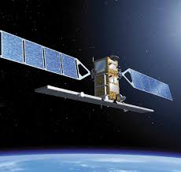
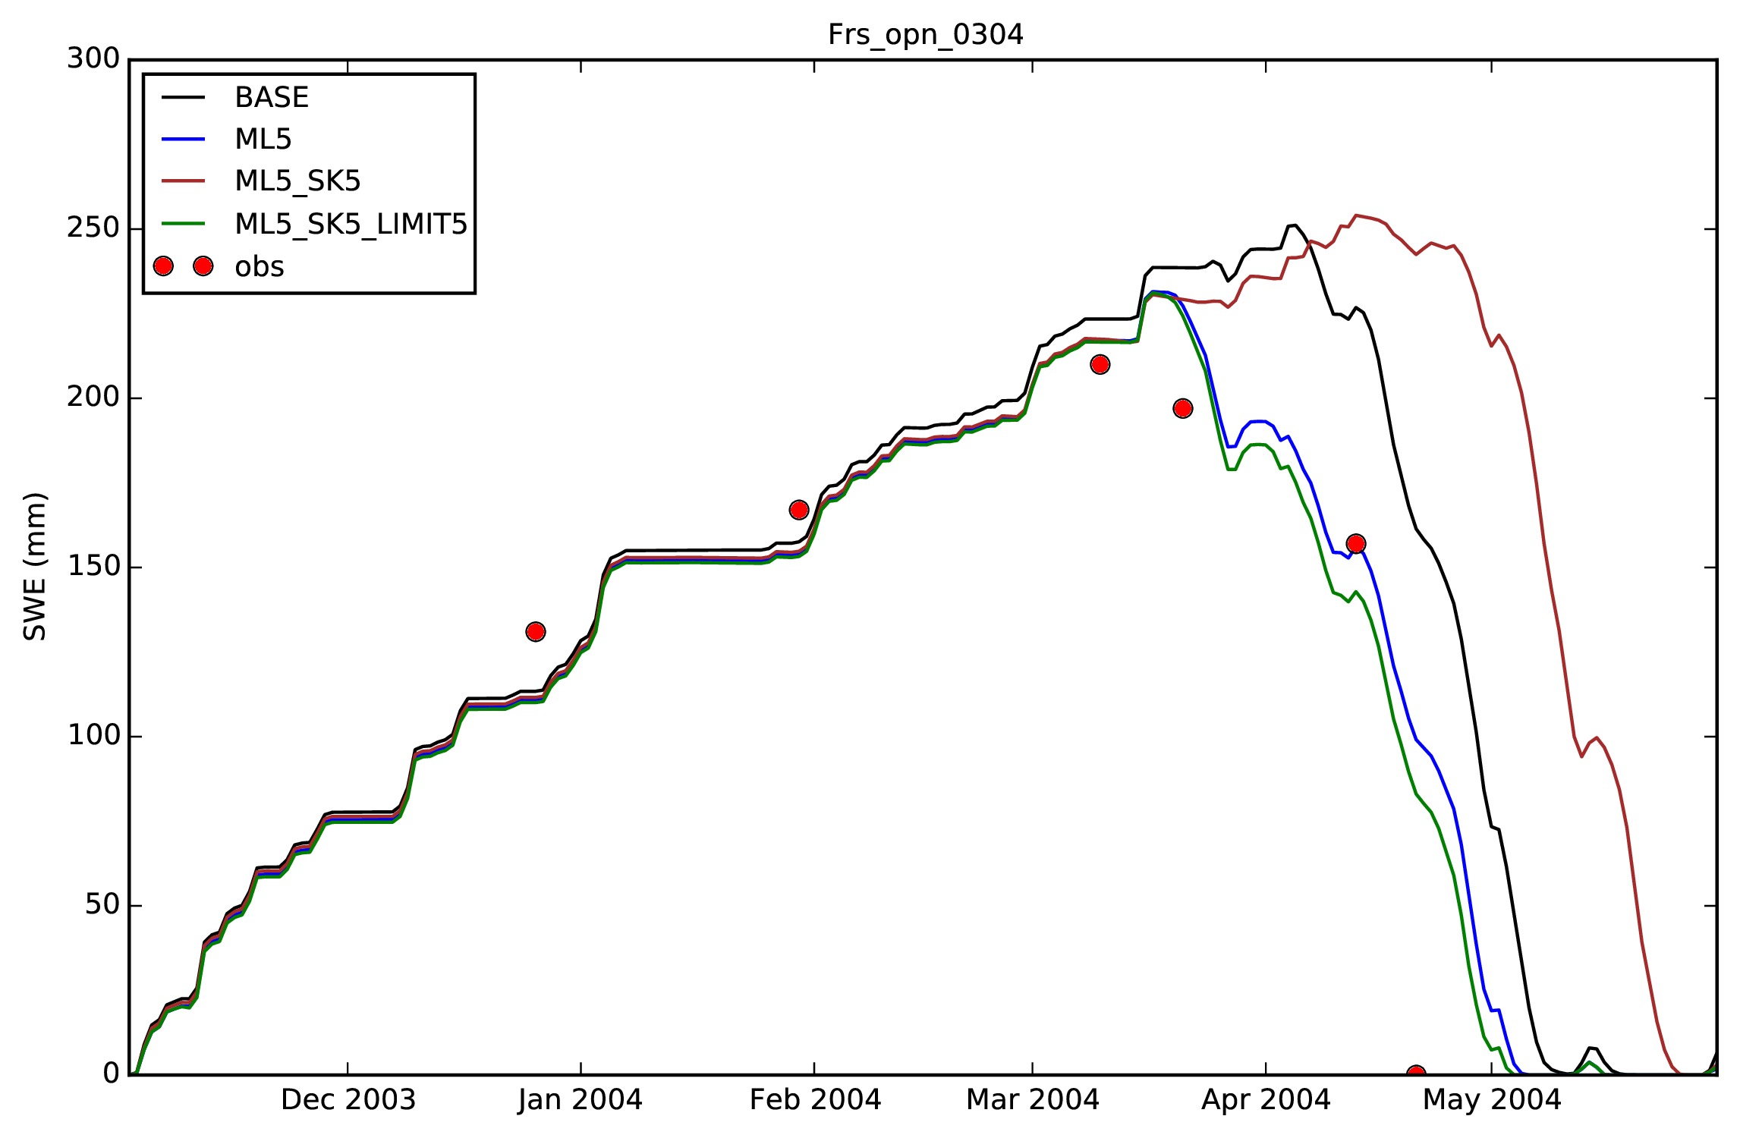
An enhanced snow vertical resolution
The snow temperature representation in a 5-layer scheme can take into account the coupling to the atmosphere and to the underlying soils with dedicated timescale that can better represent accumulation and melting.
10 cm
20 cm
variable
variable
20 cm
10 cm
1-layers:
# 0-X cm
5-layers:
from Emanuel Dutra
Simulations of Snow Water Equivalent (SWE- mm) for the 2003/04 winter season at the Fraser open site (USA Rocky mountains) comparing observations (red circles) with current 1-layer model (BASE-black), 5-layers new snow model (ML5-green).

Slide 28
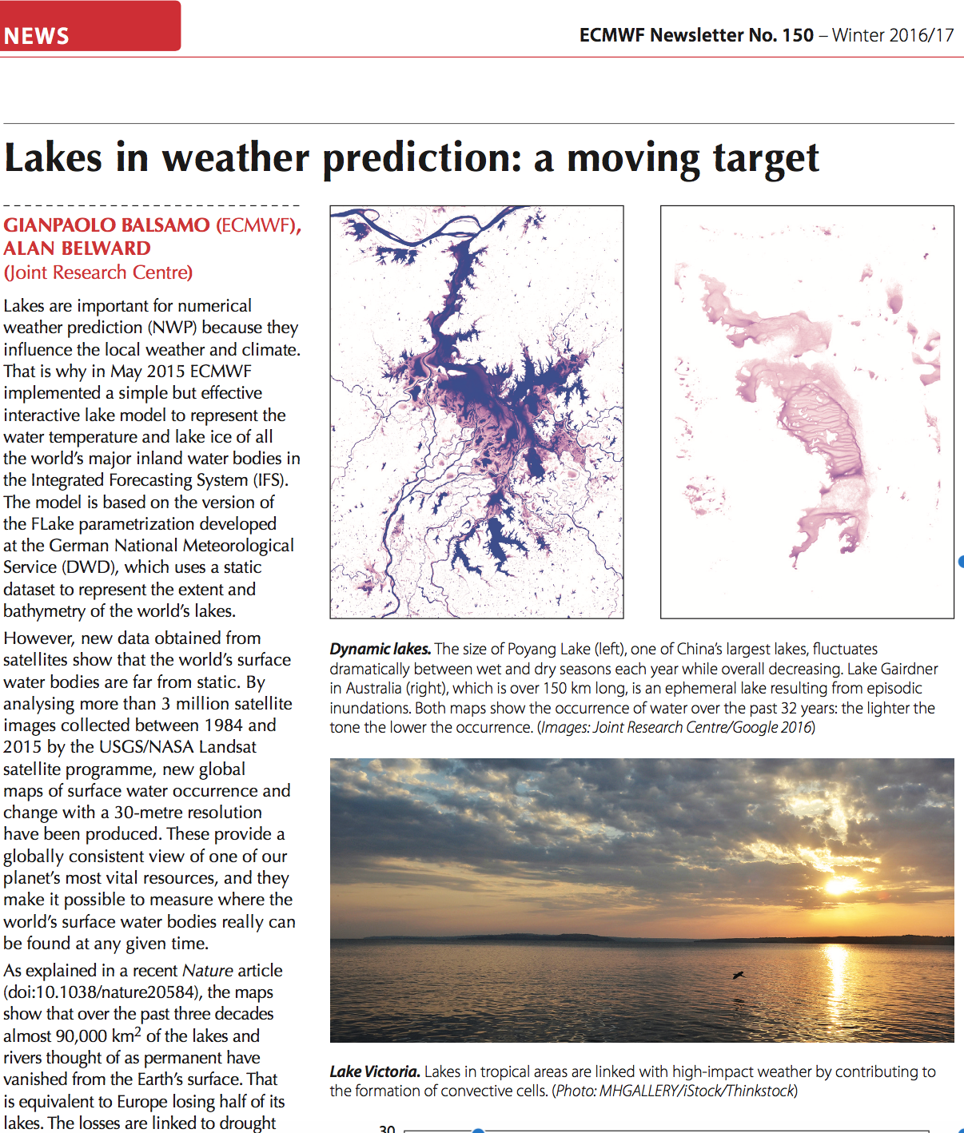
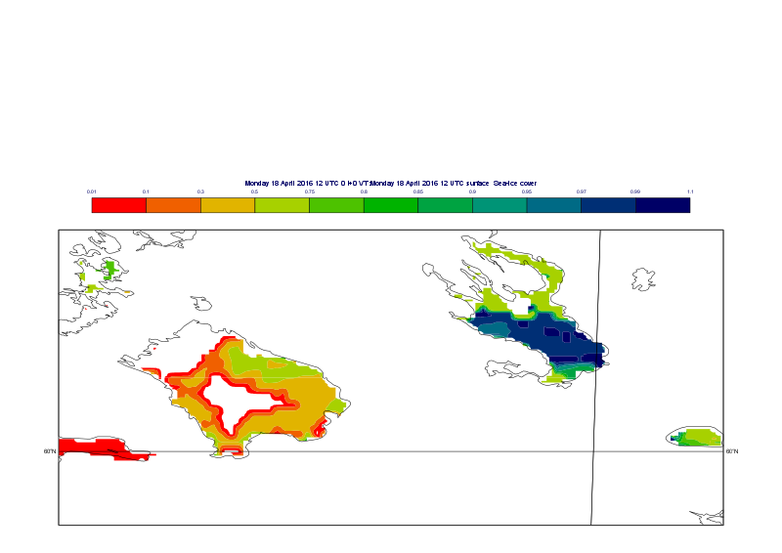
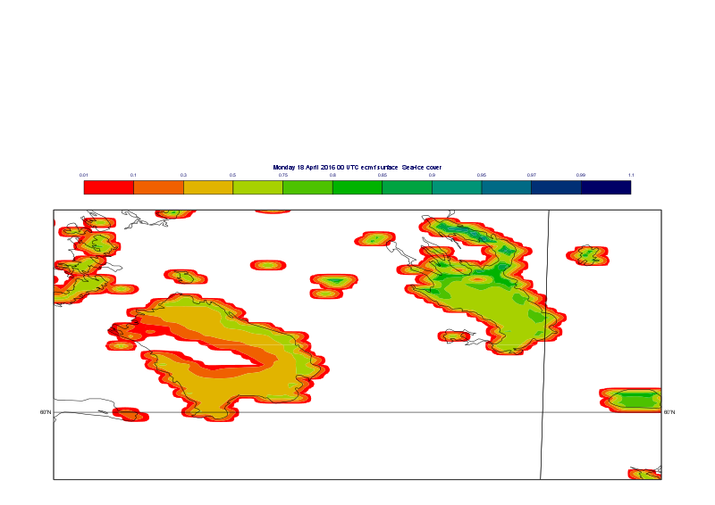
Lakes 3M Challenges
Mapping, Monitoring, and
Modelling for Prediction
Interactive lakes became operational at ECMWF
On May 2015 in every day Forecasts
Here a case Study of 18 April 2016: The Largest European Lakes: Lake Lagoda & Lake Onega
OSI-SAF Satellite Ice
cover 18 April 2016
ECMWF IFS Lake Ice Cover (Ladoga melting faster)

Slide 29
Strategy for surface model development at ECMWF (applied)
Complexity/Cost
Site runs
(Offline)
2D runs
(Offline)
Global (Offline)
Coupled
GCM
Examples:
SEBEX
BERMS
SNOWMIP2
FLUXNET
Coupled GCM + DA
RhoneAGG AMMA
GSWP2
GLACE2
ERA40, ERA-Interim
ERA-Clim
Generality

Slide 30
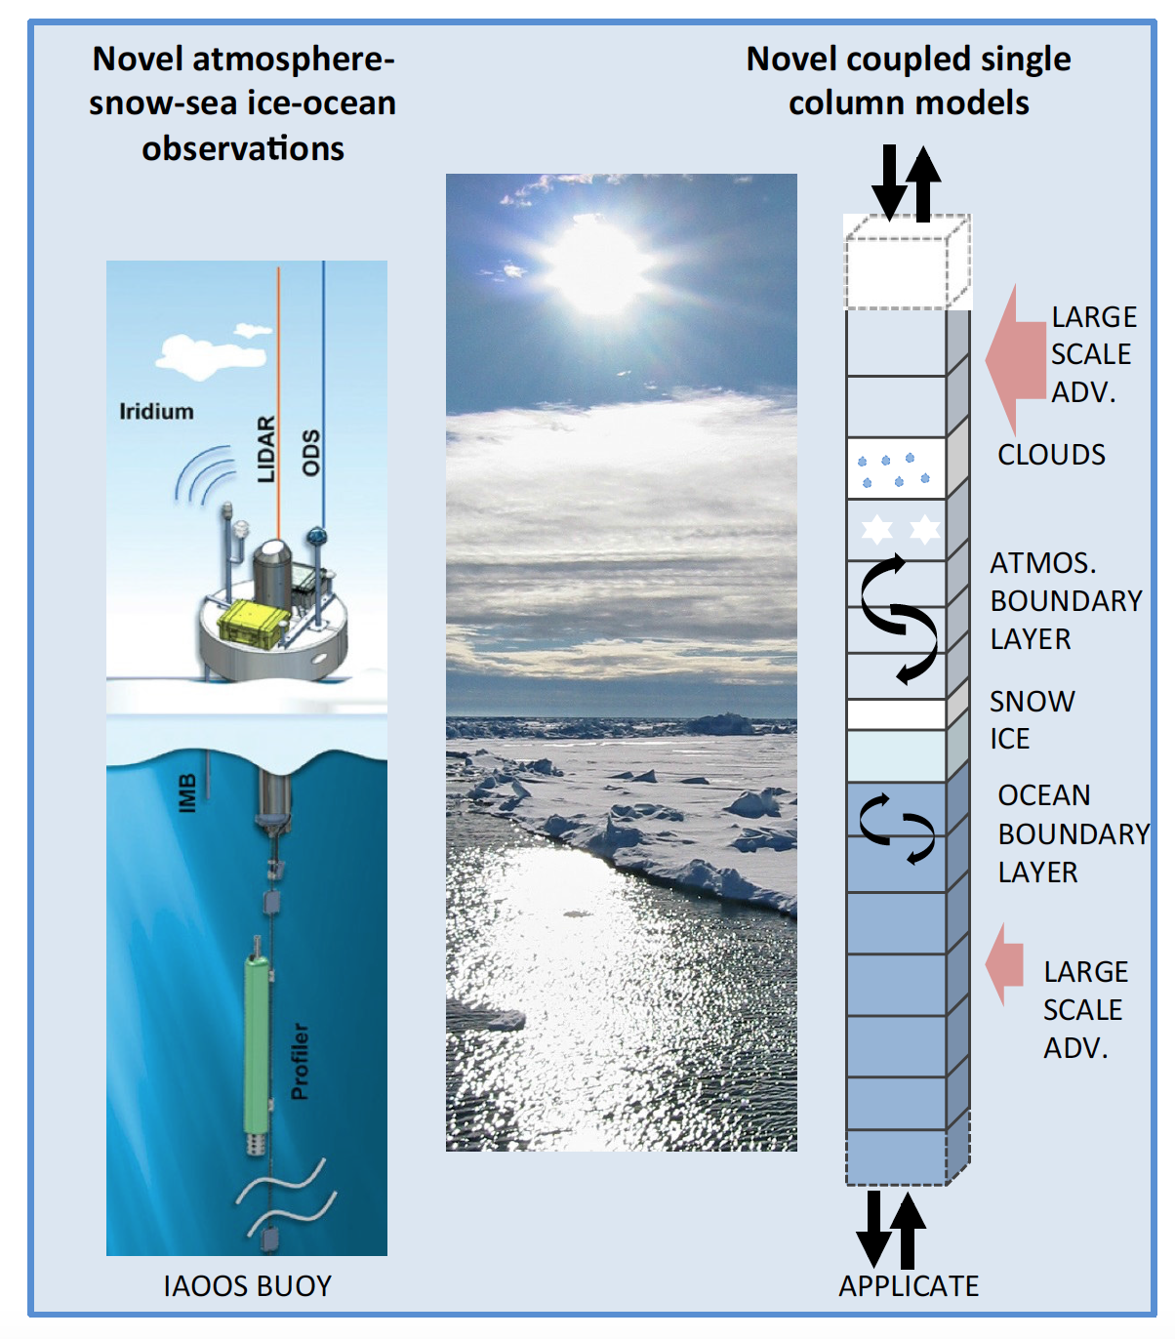
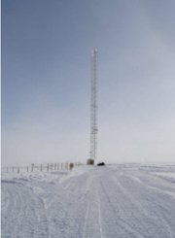
Using models as tool for process understanding:
The need of observations for validation
(from APPLICATE Courtesy of Peter Bauer and Thomas Jung)
Coupled Single Column Modelling
Observation Towers (e.g. Dome-C)

Slide 31
Perspectives
Efforts to improve diurnal and seasonal cycles of surface state variables has transferred into weather and climate improvements and this it will continue (doing things better may not sound attractive but it pays off!)
Surface complexity is needed and permitted by the overall skill of the atmospheric processes.
Surface representation requirements for higher resolution will not saturate at a given scale.
Earth-Observation from Satellites provide guidance for improving processes (not only useful in the data assimilation step, but also in the model development phase) and justify complexity.
In-situ data will provide guidance on process-level fidelity of a scheme. That cannot be expected at global scale and therefore in-situ data will always be a crucial part of verification.
Human influence on the surface (such as urbanization, irrigation) is yet to be represented in many models that can no longer assume natural surfaces to be static (priority not only at ECMWF).

Slide 32
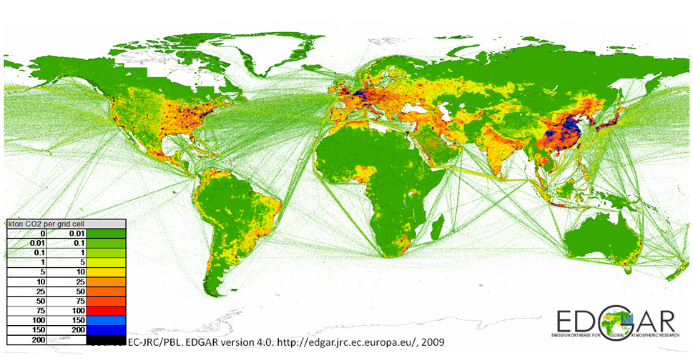
Motivation for enhancing urban modelling @ECMWF
Urban areas are important for the accurate prediction of extreme events such as heatwaves and urban flooding and need to be represented in ECMWF model.
Best and Grimmond (2015) suggested that simple models may be well adapted to global applications
Users lives urban areas and look at the forecast for urban locations.
Urban maps combined with emission factors can provide first guess CO2 anthropogenic fluxes
Number of ECMWF Meteograms
product requests from Member-States
EDGAR 4.2
CO2 Human Emissions
Urban area (a, in %, from ECOCLIMAP,
Masson et al., 2003)

Slide 33
Closing remarks
Surface-state (in the Biosphere, Cryosphere and Hydrosphere compartments) and near-surface atmospheric variables are likely to gain importance as forecasts products per-se.

