Slide 1
Parameterization of continental surfaces in coupled Earth System Modelling: part I
Which surface processes influence Earth System predictability?
Gianpaolo Balsamo
Coupling Processes Team, Earth System Model Section
gianpaolo.balsamo@ecmwf.int

Slide 2
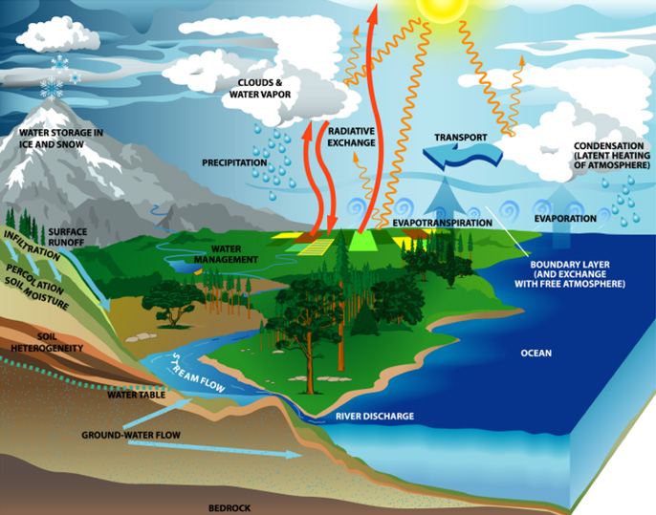
Parameterization of
land-surface processes in NWP
Gianpaolo Balsamo
Introductory lecture
G. Balsamo
Room: 1122 Extension: 2246 gianpaolo.balsamo@ecmwf.int

Slide 3
Context
Why Numerical Weather Prediction had to embrace Earth System Modelling?
  It is much nicer and represent nature better? Do we gain?
Biosphere, Hydrosphere, Cryosphere, and Atmosphere: Do they all matter the same?
  Can we attempt a quantitative evaluation? What are the caveats?
Diurnal and Seasonal amplitude improvements
  How much are they drivers to accurate predictions?
What else is in the “hat” and where do we need (r)evolutionary ideas?
  Bridging gaps between modelling communities
  Bringing new EO data to guide model development
Roadmap to Global Environmental Monitoring and Prediction
  If we can imagine it, probably we can do it?

Slide 4
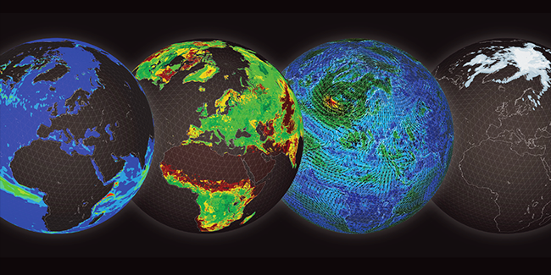
Multi-spheres concept in modelling & prediction
ECMWF 2016 Annual Seminar Earth system modelling for seamless prediction:
On which processes should we focus to further improve atmospheric predictive skill?
http://www.ecmwf.int/en/annual-seminar-2016

Slide 5

EARTH SYSTEM APPROACH
ENSEMBLE MODELLING AND ASSIMILATION. GOAL: 5KM
SCALABILITY ACROSS WHOLE NWP CHAIN
ECMWF
STRATEGY
2016-2025
Notes:
And to deliver this, our new ten year strategy is focussing on an Earth system approach, and the primacy of ensemble prediction with refined resolution to 5 km
for modelling and data assimilation, with scalability at the heart of our developments

Slide 6
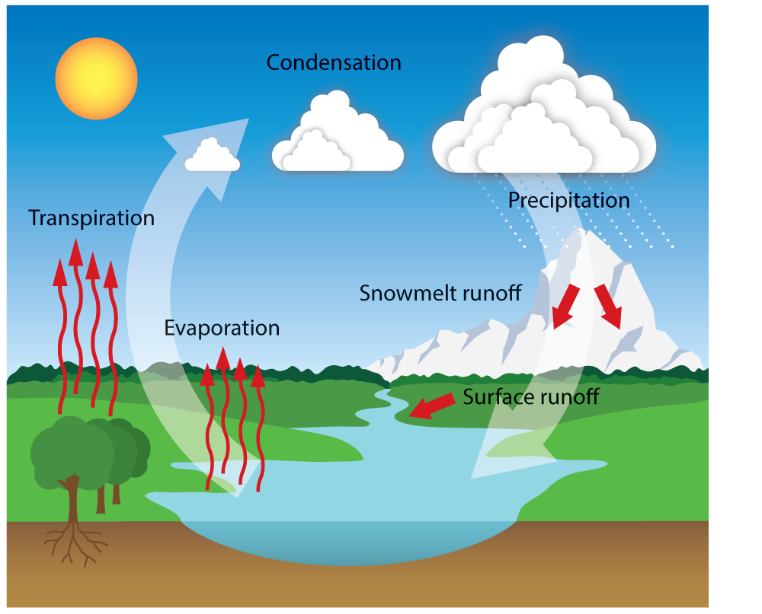
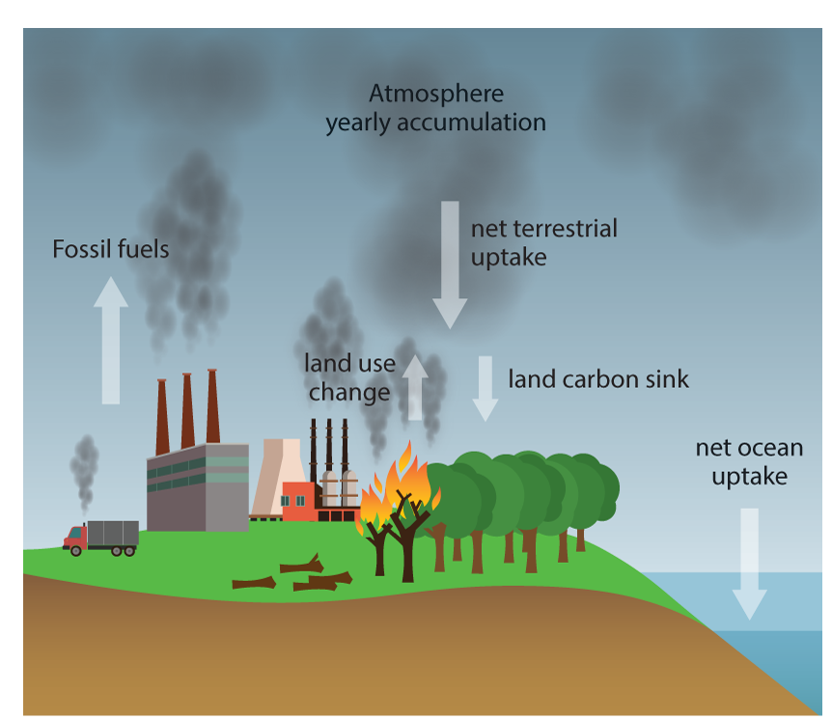
Natural Land & Human-activity @ECMWF:
How can/will natural land modelling include LUC
Notes:
Oceans: from climate to weather"
Developments initiated for long-range forecasting needs (e.g. exploiting ENSO predictability) have included modelling components by the oceanographic and climate community (WAM & NEMO, with a history timeline)
Slide 1

Slide 7
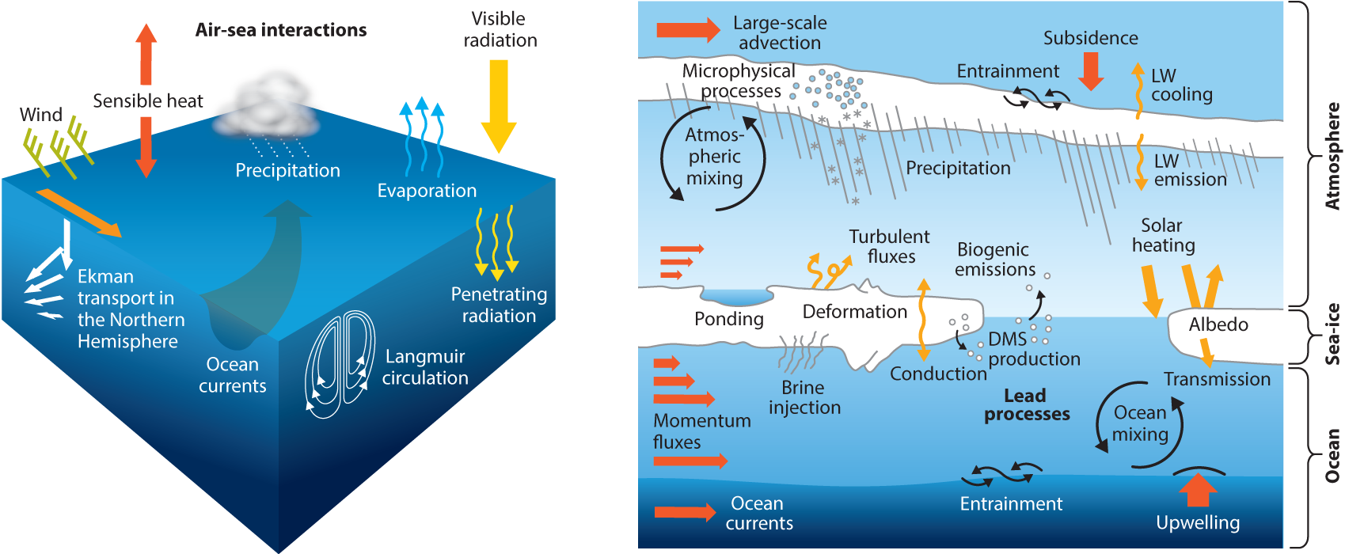
Oceans & marine cryosphere @ECMWF:
How climate modelling fed into weather
Notes:
Oceans: from climate to weather"
Developments initiated for long-range forecasting needs (e.g. exploiting ENSO predictability) have included modelling components by the oceanographic and climate community (WAM & NEMO, with a history timeline)
Slide 1

Slide 8
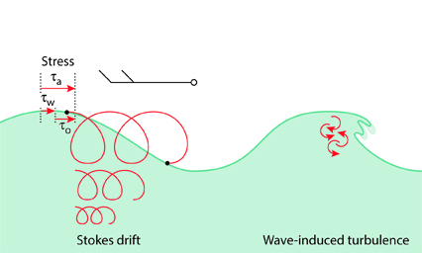
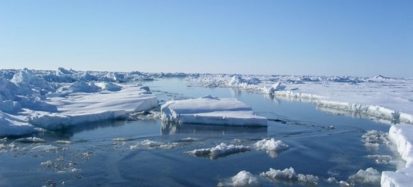
Ocean, waves, sea-ice in ECMWF model (2016-2017)
NEMO3.4
NEMO3.4 (Nucleus for European Modelling of the Ocean)
  Madec et al. (2008)
  Mogensen et al. (2012)
  ORCA1_Z42: 1.0° x 1.0°
  ORCA025_Z75 : 0.25° x 0.25°
EC-WAM
  ECMWF Wave Model
  Janssen, (2004)
  Janssen et al. (2013)
  ENS-WAM : 0.25° x 0.25°
  HRES-WAM: 0.125° x 0.125°
LIM2
  The Louvain-la-Neuve Sea Ice Model
  Fichefet and Morales Maqueda (1997)
  Bouillon et al. (2009)
  Vancoppenolle et al. (2009)
  ORCA025_Z75 : 0.25° x 0.25°

Slide 9



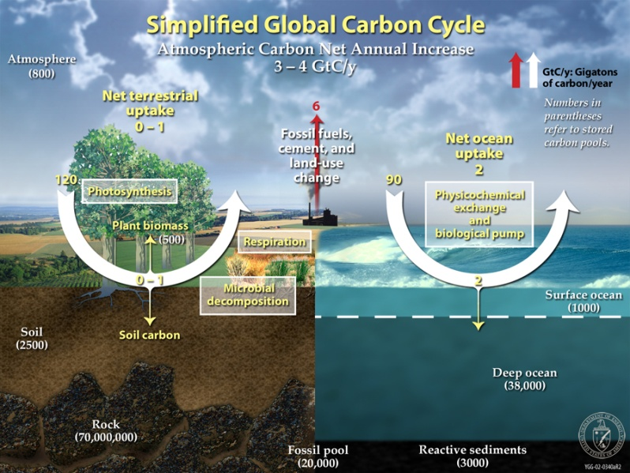
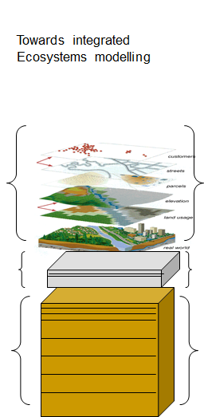
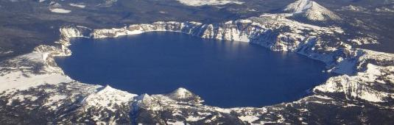
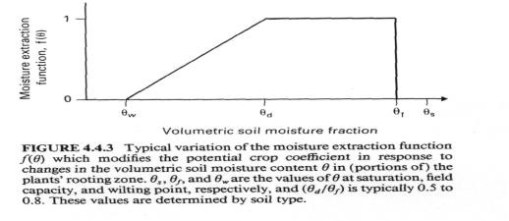
Land surface model at ECMWF (2016-2017)
Hydrology-TESSEL
  Balsamo et al. (2009)
  van den Hurk and Viterbo (2003)
  Global Soil Texture (FAO)
  New hydraulic properties
  Variable Infiltration capacity & surface runoff revision
NEW SNOW
  Dutra et al. (2010)
  Revised snow density
  Liquid water reservoir
  Revision of Albedo
  and sub-grid
  snow cover
NEW LAI
Boussetta et al. (2013)
New satellite-based
Leaf-Area-Index
SOIL Evaporation
Balsamo et al. (2011),
Albergel et al. (2012)
H₂O / E / CO₂
Integration of
Carbon/Energy/Water
Boussetta et al. 2013
Agusti-Panareda et al. 2015
Lake & Coastal area
Mironov et al (2010),
Dutra et al. (2010),
Balsamo et al. (2012, 2010)
  Extra tile (9) to
  for sub-grid lakes
  and ice
  LW tiling (Dutra)
Enhance ML
Snow ML5
Soil ML9
Dutra et al. (2012, 2016)
Balsamo et al. (2016)

Slide 10
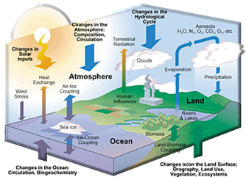
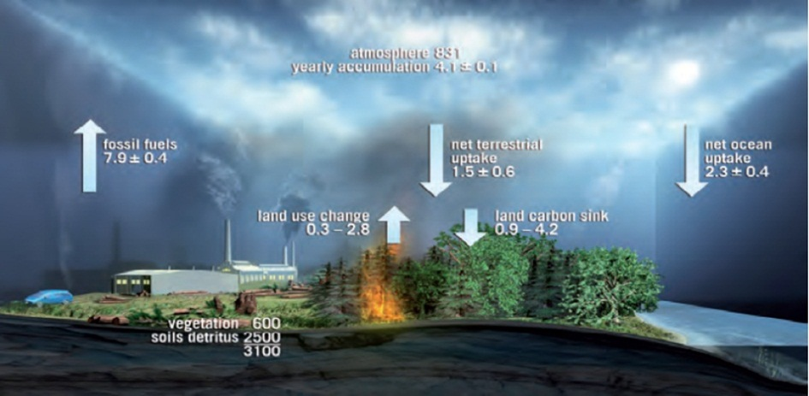
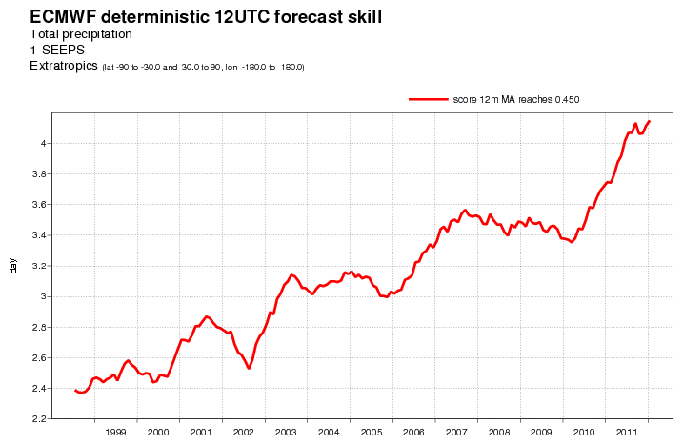
The water and Carbon cycle
Numerical Weather Prediction models have considerably evolved over time with respect to how they represent the land surface and its interaction with the atmosphere
Precipitation forecasts improvements support
(1 day/decade in skill gain) refined LSMs
ECMWF headline score for precipitation: M. Rodwell, R. Forbes
CO2 budget (from ESA – BIOMASS mission report)
4day
The needs of unification of NWP and Climate model are a driver to develop land surface schemes with increased realism
Evolving towards Earth System Models
Enhanced Earth surface complexity is supported by quality of atmospheric forcing
3day
2day

Slide 11
Impact of Earth Surface in Global Environmental prediction
The surface is characterized by many slow processes
A slow process makes initial condition a priority: they need to be accurate to extract predictability from the modelling components
Can we say all surface predictability rely on initial condition accuracy?
What is the value of surface process representation in models?
Value of Earth Surface Global Environmental prediction
The surface is where we live and it sustains all human activities.
Forecasting the surface state has value per se (e.g. floods, droughts, biomass-anomalies, sea-state, ice & snow conditions all matters for users).
Most importantly better surface can sustain medium/extended range skill.
But can we prove it experimentally? And which surface process does what?

Slide 12
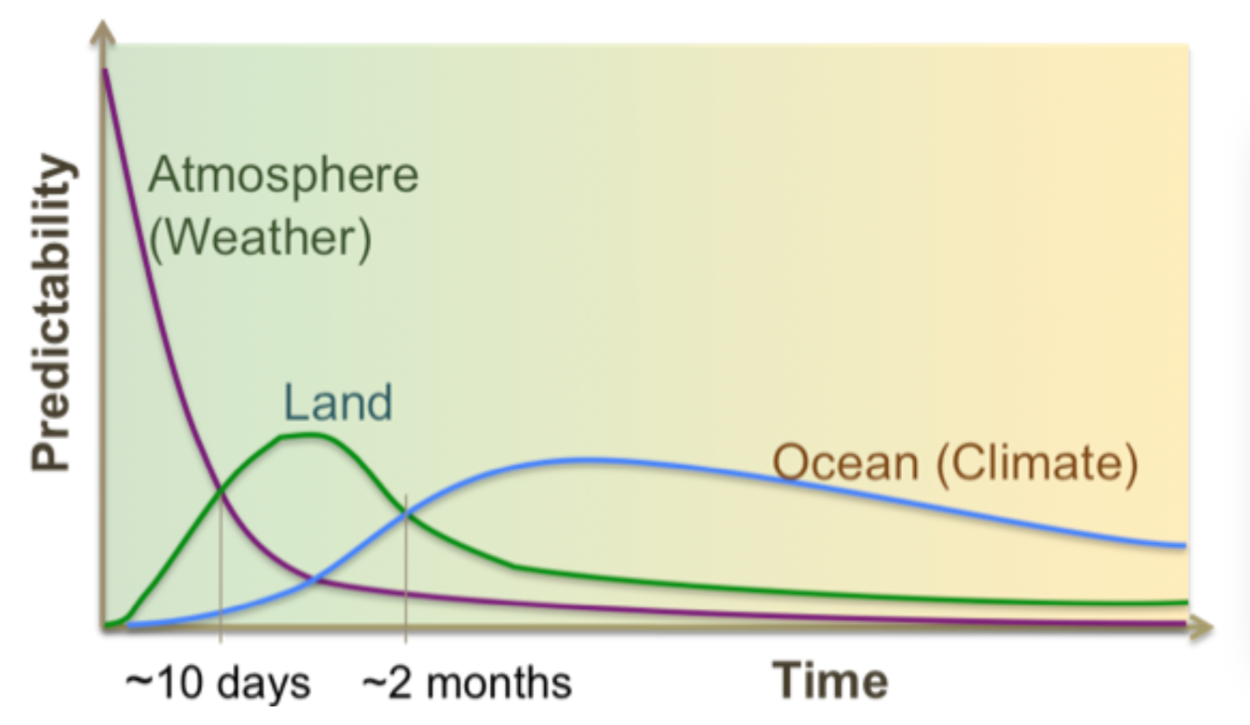
Earth surface role in medium-range and S2S
In order to realize the Land potential models need to represent nature in its:
Memory
Coupling
Variability
Dirmeyer et al. 2015: http://library.wmo.int/pmb_ged/wmo_1156_en.pdf

Slide 13
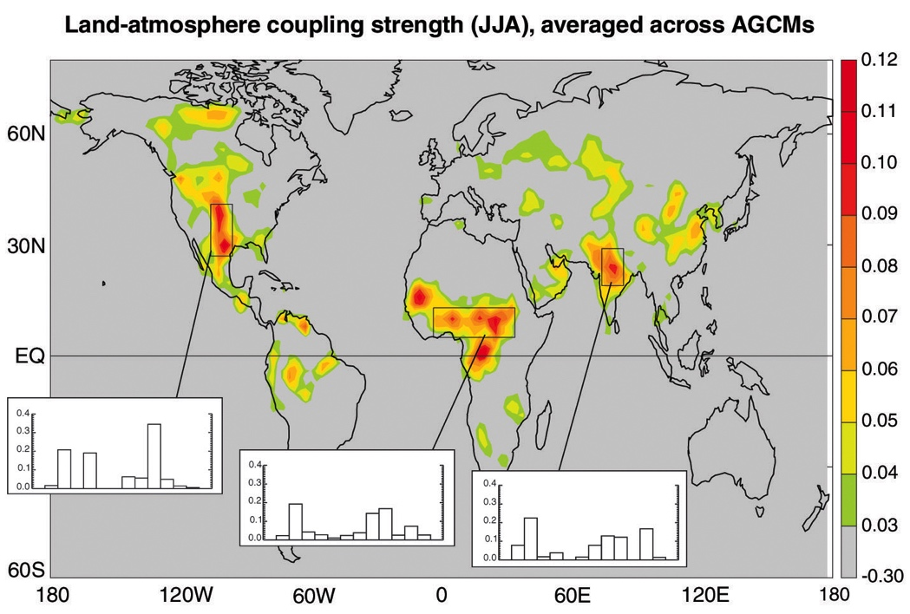
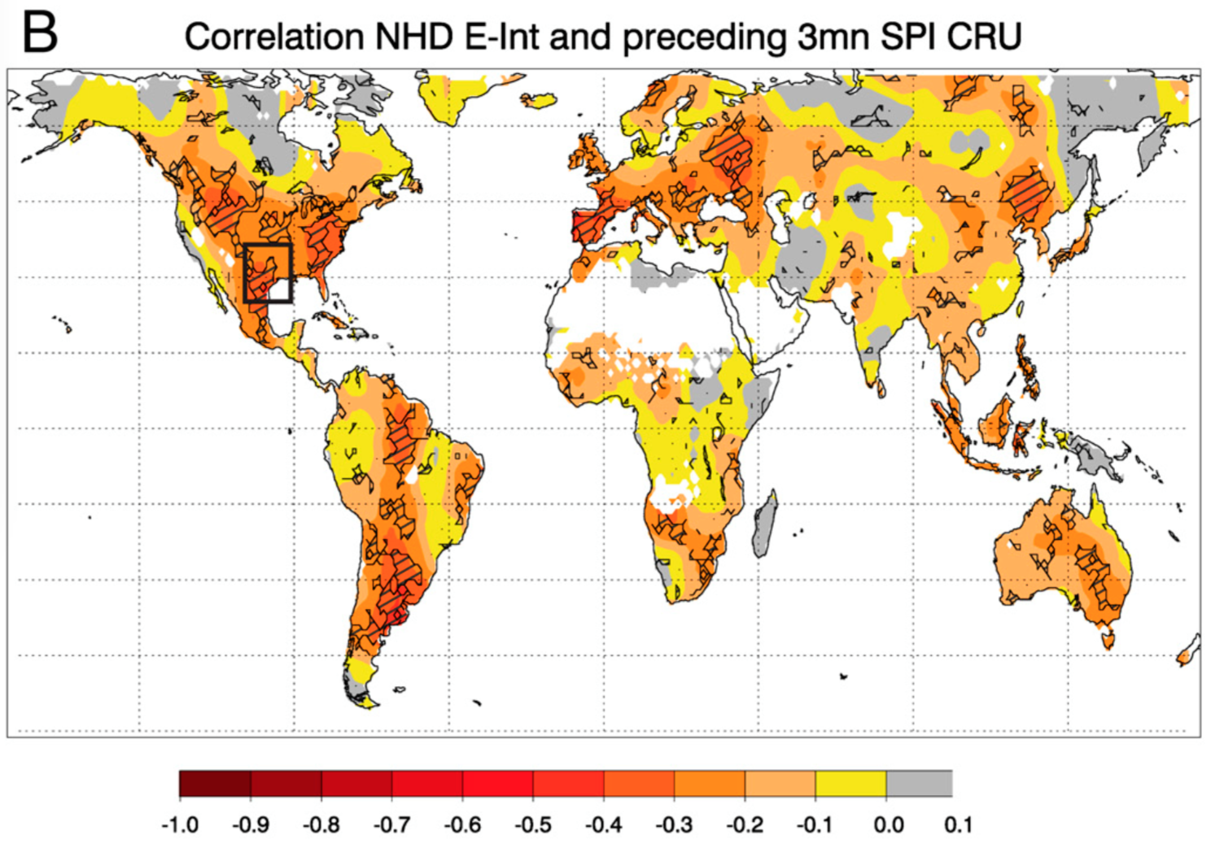
Earth surface role, experimental evidence (soil moisture)
Koster et al. 2004 Science
Land-coupling (SM-T) in Northern Hemisphere JJA
Mueller and Seneviratne 2012 PNAS
Hot-Days correlation with 3-month antecedent P deficit
Albergel et al. 2013JHM show dominance of significant drying trends for soil moisture in both reanalysis and satellite-based soil moisture dataset, with possibly larger areas of land surface predictability

Slide 14
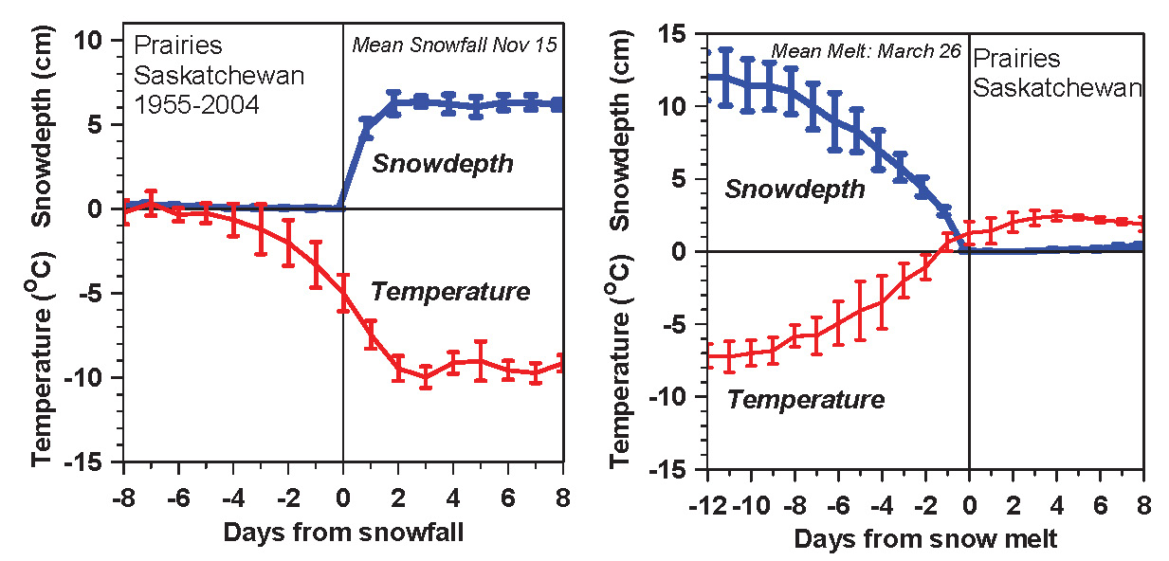
Earth surface role, observational evidence (snow)
Temperature falls/rises about 10K with first snowfall/snowmelt
Snow reflects sunlight; shift to cold stable BL
  Local climate switch between warm and cold seasons
  Winter comes fast with snow
Betts et al. 2014

Slide 15
Earth surface role, literature (sea-ice)
Temperature falls/rises about 10K with first snowfall/snowmelt
“Arctic sea ice …has strong feedback effects on the other components of the climate system”
Vihma 2014, Survey in Geophysics
“Arctic sea ice change includes global scale impacts, as
well as regionally changing interaction mechanisms and
Trends”
Doscher et al. 2014, ACP

Slide 16
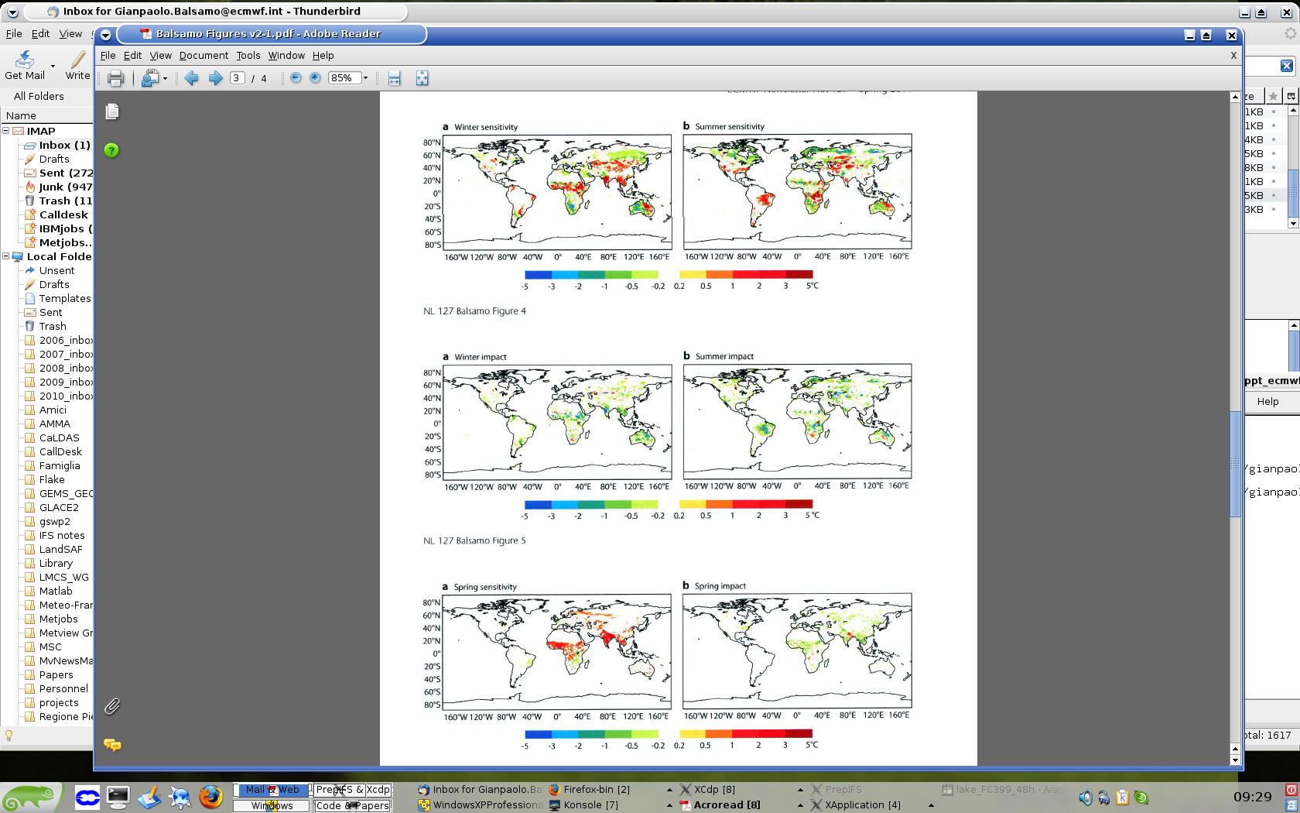
Weather forecasts impact of soil/snow processes improved representation
Hydrology-TESSEL
  Balsamo et al. (2009)
  van den Hurk and Viterbo (2003)
  Global Soil Texture (FAO)
  New hydraulic properties
  Variable Infiltration capacity & surface runoff revision
NEW SNOW
  Dutra et al. (2010)
  Revised snow density
  Liquid water reservoir
  Revision of Albedo
  and sub-grid
  snow cover
Forecast Impact (+36-hour forecast, mean error at 2m temperature)
Improving 2m temperature Degrade 2m temperature

Slide 17
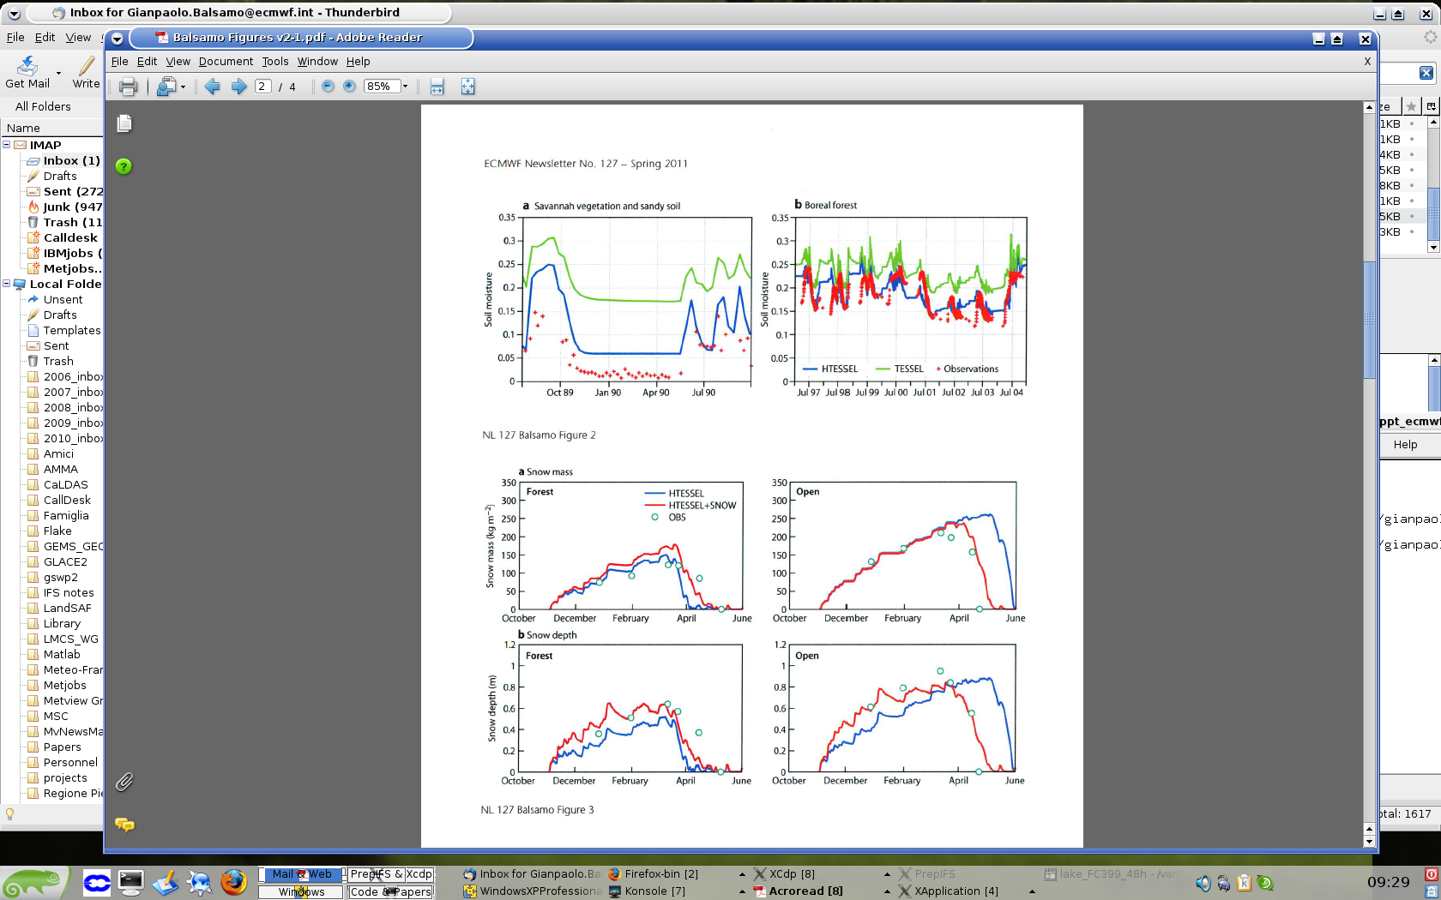
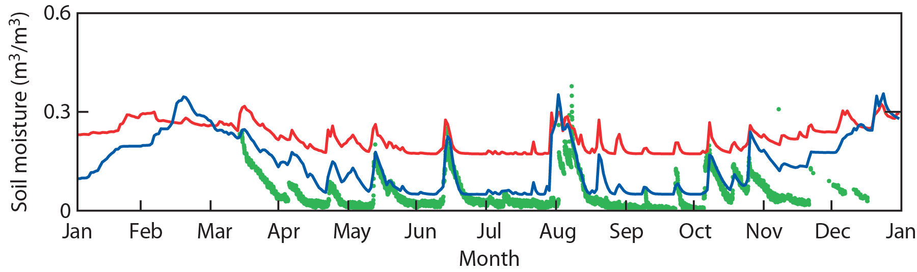
Soil moisture and Snow-pack modelling evaluated in-situ
Balsamo et al 2009 JHM, Dutra et al. 2010 JHM
Evolution of soil moisture for a site in Utah in2010. Observations, old, and new schemes.
Evolution of snow mass and depth at SNOWMIP 2 observational sites in the new and old scheme

Slide 18
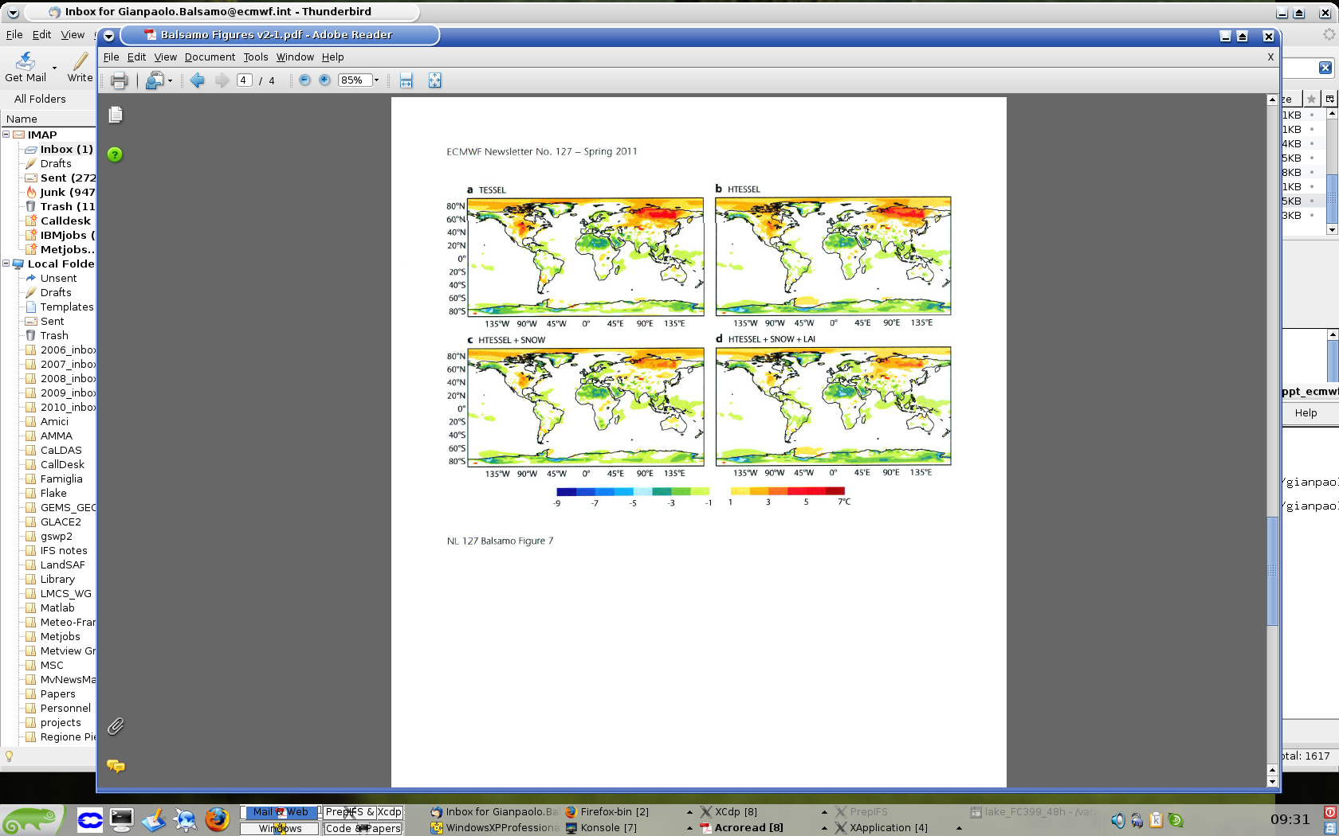
Climate improvements from land developments (soil, snow, vegetation)
simulations colder than ERA-Interim Warmer than ERA-Interim

Slide 19
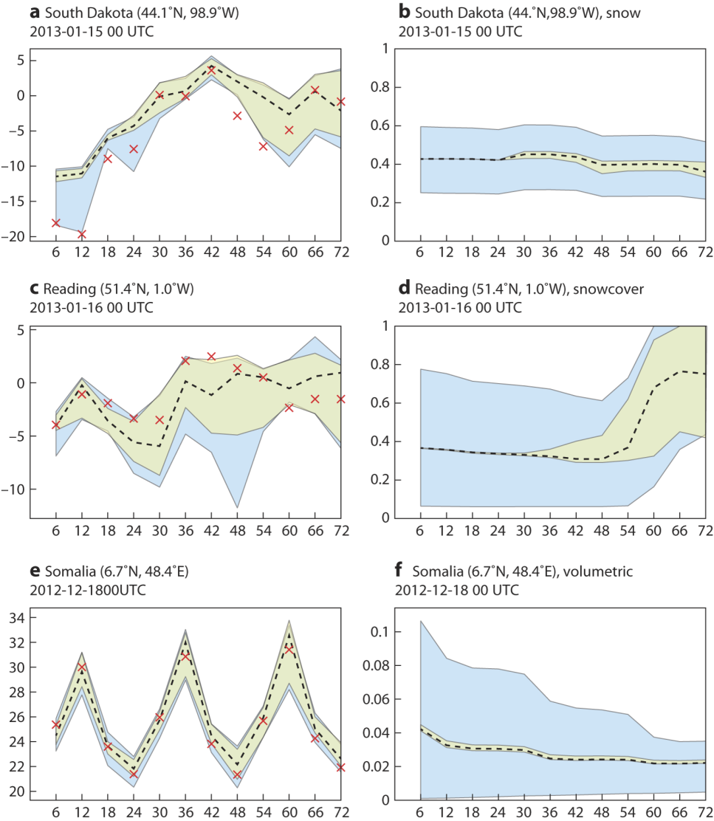
Representing land-related forecast uncertainties
EDA/ENS system includes
land surface components (CY40R1)
and perturbation also to the
assimilated observations (CY40R3)
Accounting for land surface
uncertainties (particularly for snow)
enhances the ensemble spread of
2m temperature prediction and its
usefulness for forecasters
The uncertainty is situation dependent
and perturbations permit to capture
the occurrence of extremes
(e.g. clear sky nights combined
with snow covered surface
can generate very cold temperatures)
Small snow cover errors →
large temperature impact

Slide 20
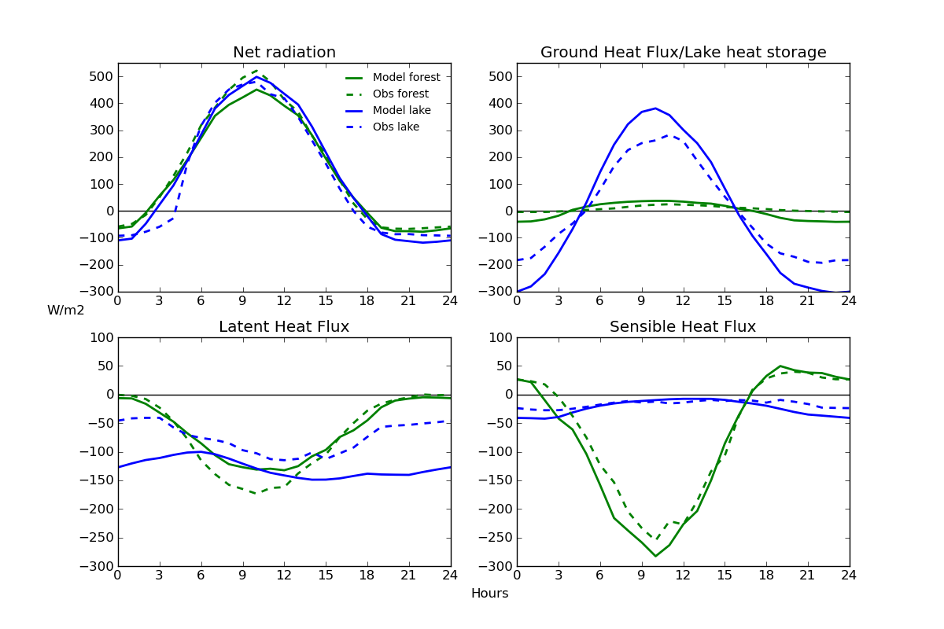
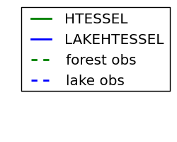
Energy fluxes: diurnal cycle impact of lakes
Manrique-Suñén et al. (2013, JHM)
Monthly diurnal cycle of energy fluxes for July
Very good representation by the model of diurnal cycles and particularities of each surface
Lake tile
Mironov et al (2010),
Dutra et al. (2010),
Balsamo et al. (2010, 2012, 2013)
  Extra tile (9) to account
  for sub-grid lakes
Forest evaporation is driven by vegetation, so it is zero at night
Lake SH maximum is at night
Lake LH diurnal cycle: over-estimation in evaporation
Forest SH maximum is at midday
Main difference between lake & forest sites is found in energy partitioning

Slide 21
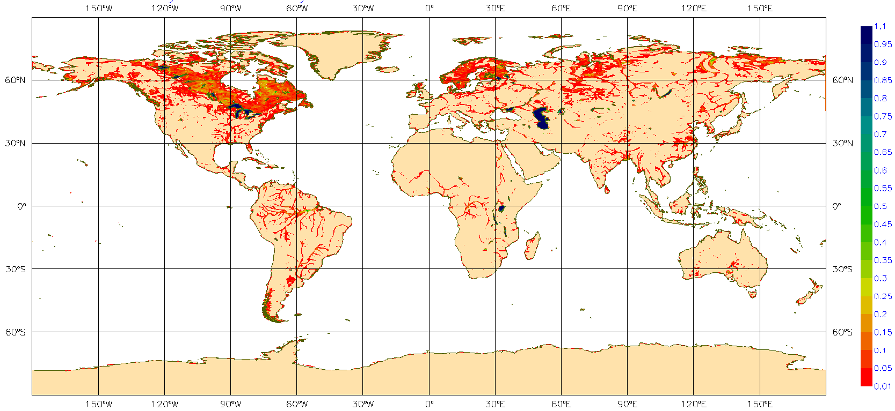
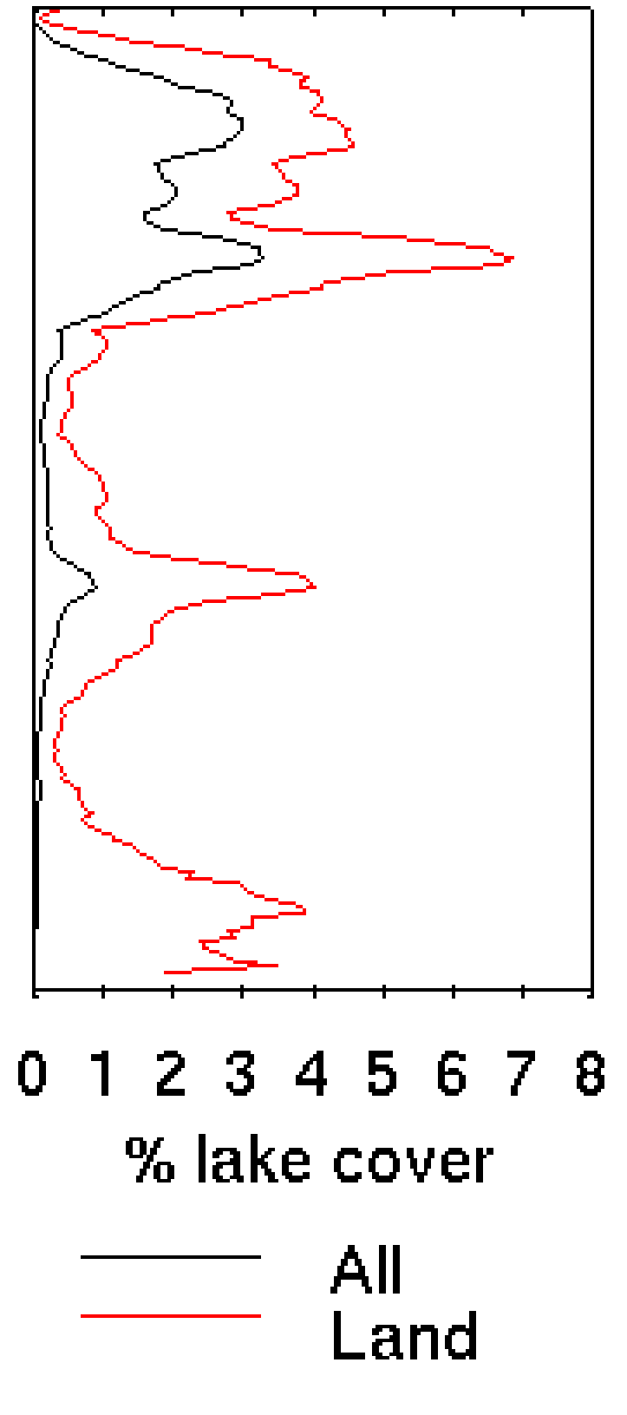
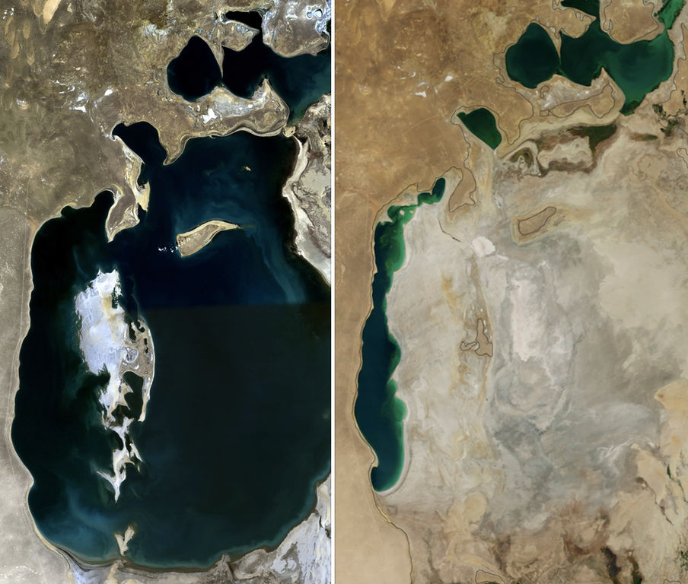
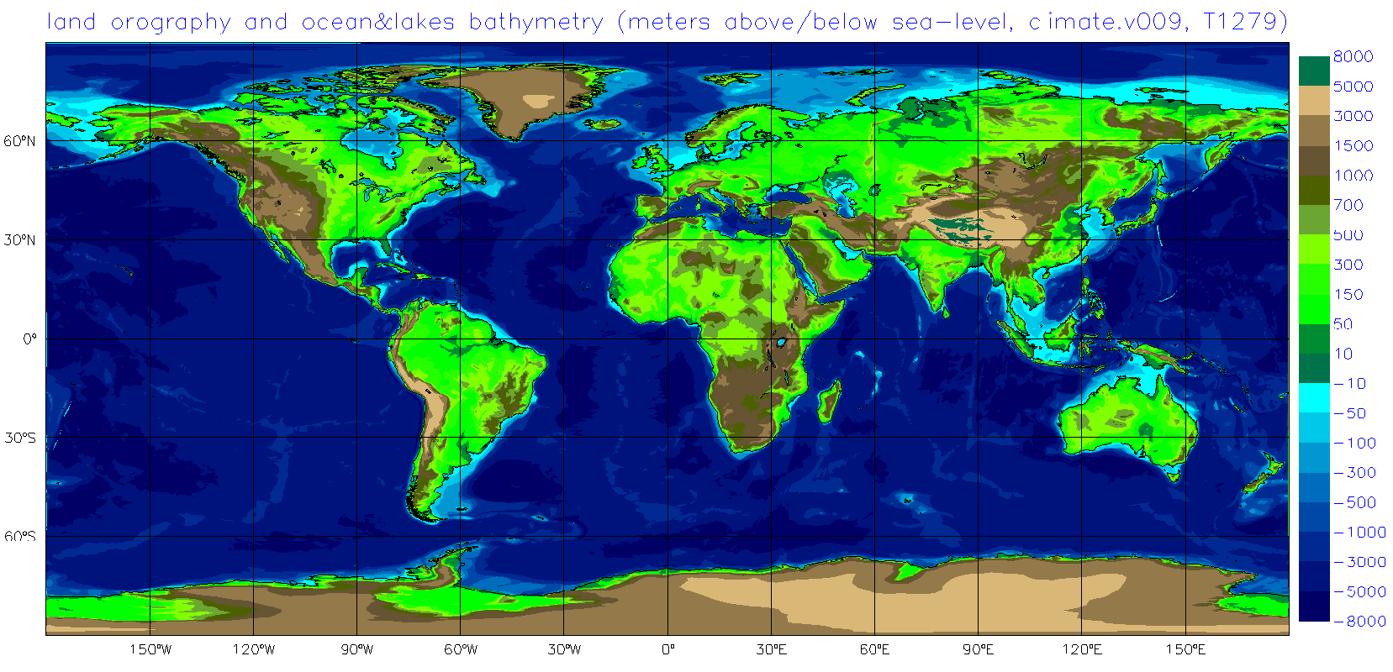
Global surface physiography description: e.g. Lake cover/depth
Sizeable fraction of land surface has sub-grid lakes: different radiative, thermal
roughness characteristics compare to land → affect surface fluxes to the atmosphere
LAKE COVER FRACTION Nº Points 0.05< lake fraction<0.5
LAKE & SEA BATHYMETRY / NEW OROGRAPHY
But is it correct to assume
LAKE COVER as constant?
Canada | 309/754 41%
USA | 175/482 36%
Europe | 170/385 44%
Siberia | 104/467 22%
Amazon | 81/629 13%
Africa | 74/584 13%
Lake cover & lake bathymetry are among the surface important fields to describe size and volume of the water bodies that are associated to thermal inertia. Physiography has been completely revised in 40R3
source: ESA-GlobCover/GLDBv1
Lake Aral in 1989 and 2014
(source: NASA)

Slide 22
Designing a “Process-denial” experiment for the ECMWF Earth-System
With the scope of trying to answer to the proposed seminar question on process relevance for NWP & Climate timescales independently from initial conditions skill.
A surface “process-denial protocol” (persistence) in a given set processes applied:
(1) Soil processes (2) Snow processes (3) Sea-ice processes (4) Lakes processes
(5) All the above processes
PROTOCOL:
Using the 43r1 ECMWF model cycle due to become operational later in 2016
  Latest atmospheric and land physics package (run at Tco399L137, about ¼ of degree)
  New ¼ degree ocean 75-layer with a top 1m slab (NEMO3.4)
  New ¼ degree sea-ice model (LIM2)
1 full year of daily forecast (tendency=0 for each process) (June2015-June 2016, 10-day FC)
4-year climate integration (August 2000-2004, 13-month prediction, at 0.7 degree resolution)
CAVEAT & ADVANTAGE:
Model dependent results! A single quantitative evaluation allows a comparative discussion!

Slide 23
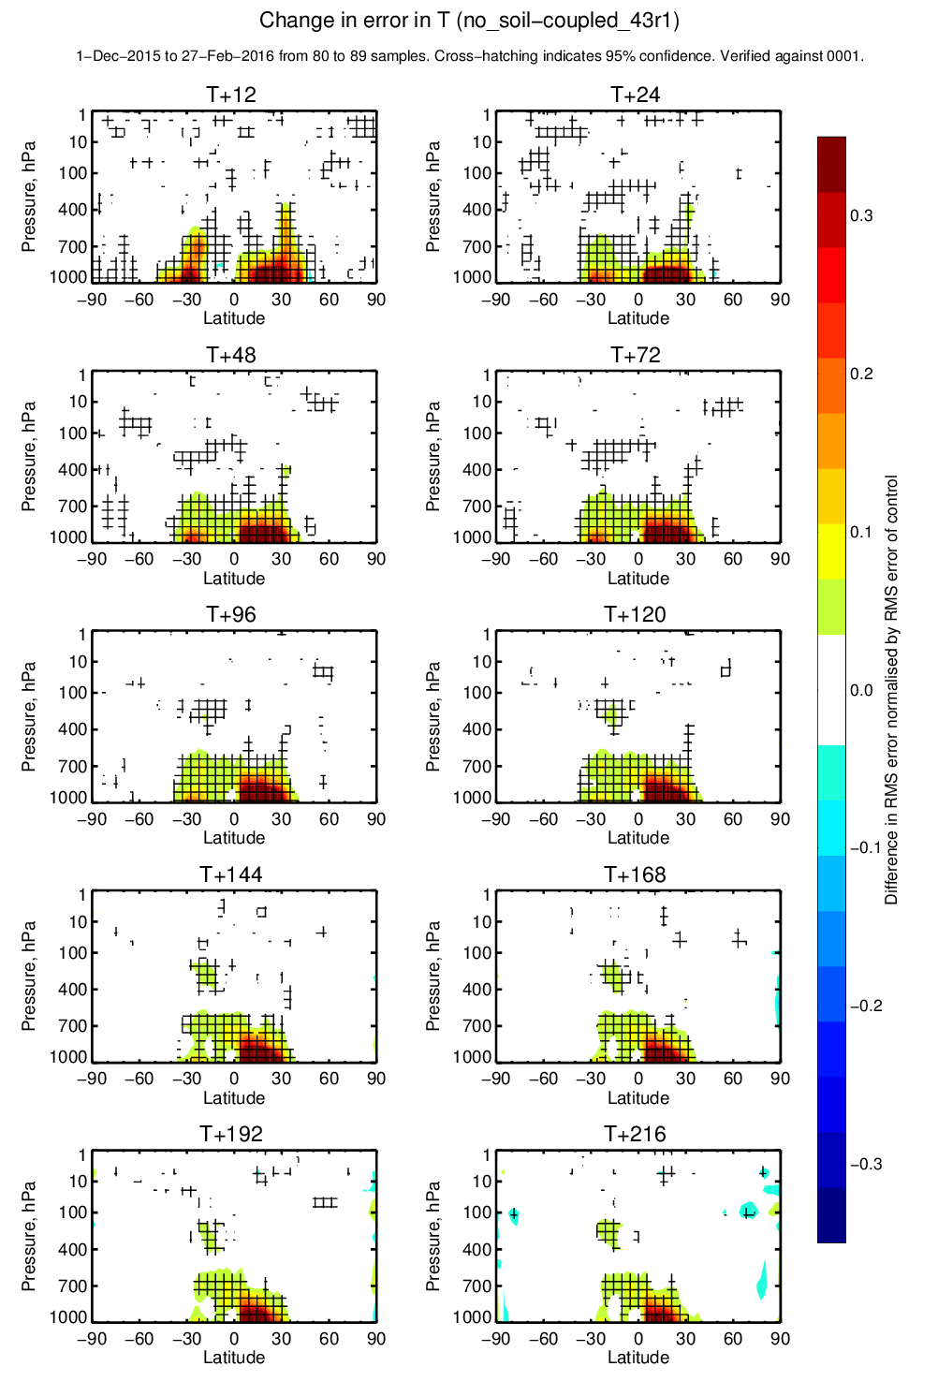
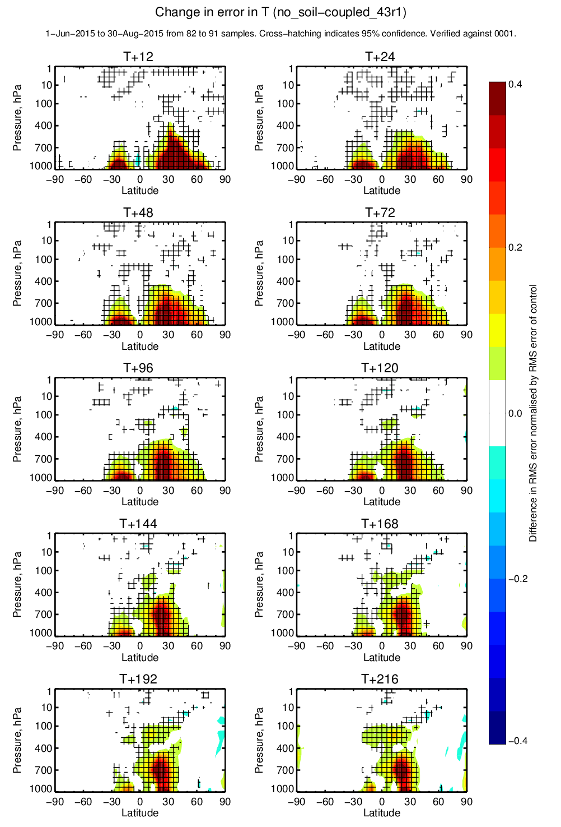
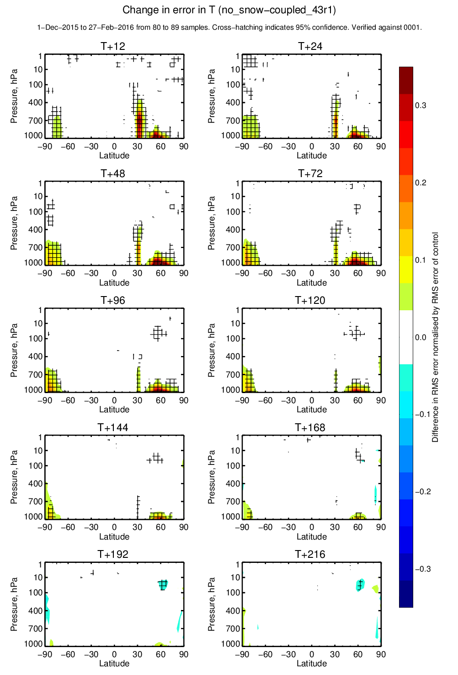
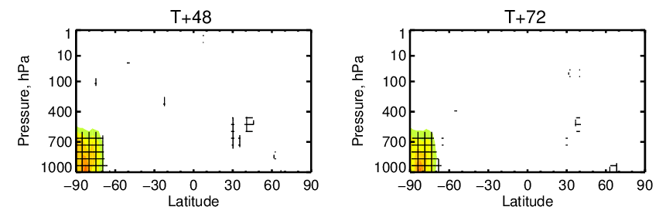
Soil and Snow forecast impact
Soil processes (winter 2015-16)
Soil processes (summer 2015)
Snow processes (winter 2015-16)
Snow processes (summer 2015)
Soil/Biosphere has major impact (20-30%) propagating, throughout the troposphere
Snow has both NH/SH impact (20-30% winter, 10-20% summer) lower troposphere

Slide 24
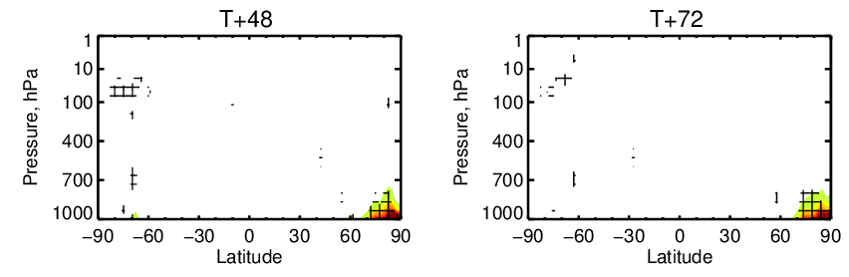
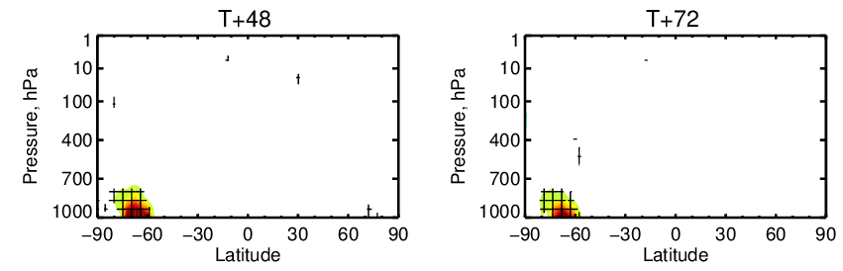
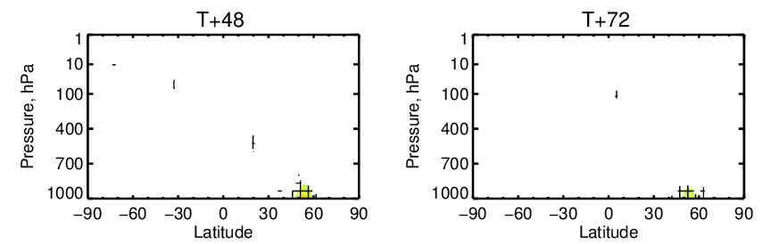
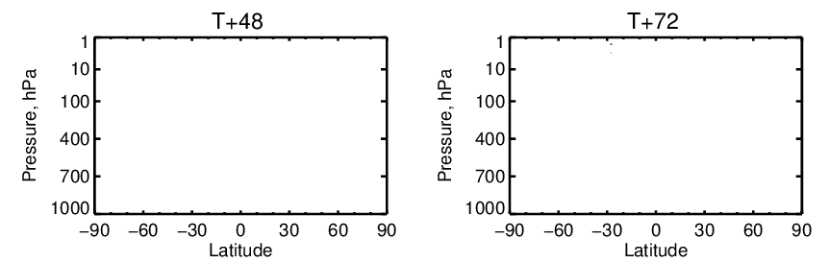
Sea-ice and Lakes forecast impact
Sea-ice processes (winter 2015-16)
Sea-ice processes (summer 2015)
Lakes processes (winter 2015-16)
Lakes processes(summer 2015)
Sea-ice has major surface impact (20-30%) lower troposphere
Lakes have surface impact (5-10% winter, ~0% summer), initial condition dominate!

Slide 25
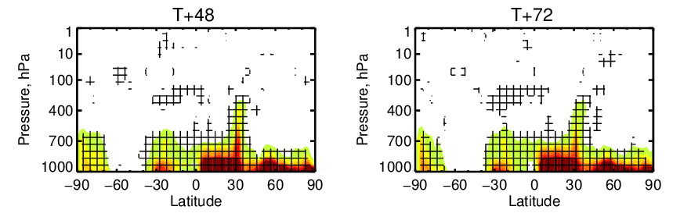
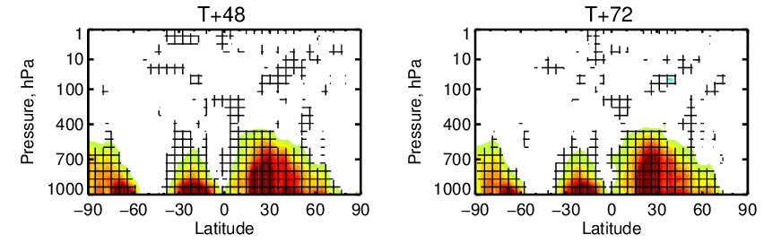
Surface (all the above) temperature forecast impact
All the above surface processes
winter 2015-16
summer 2015
The surface elements do add up to when all processes are disabled (30-40%).
Temperature deterioration extend up to 700hPa both in winter and in summer.
There is no apparent compensation.

Slide 26
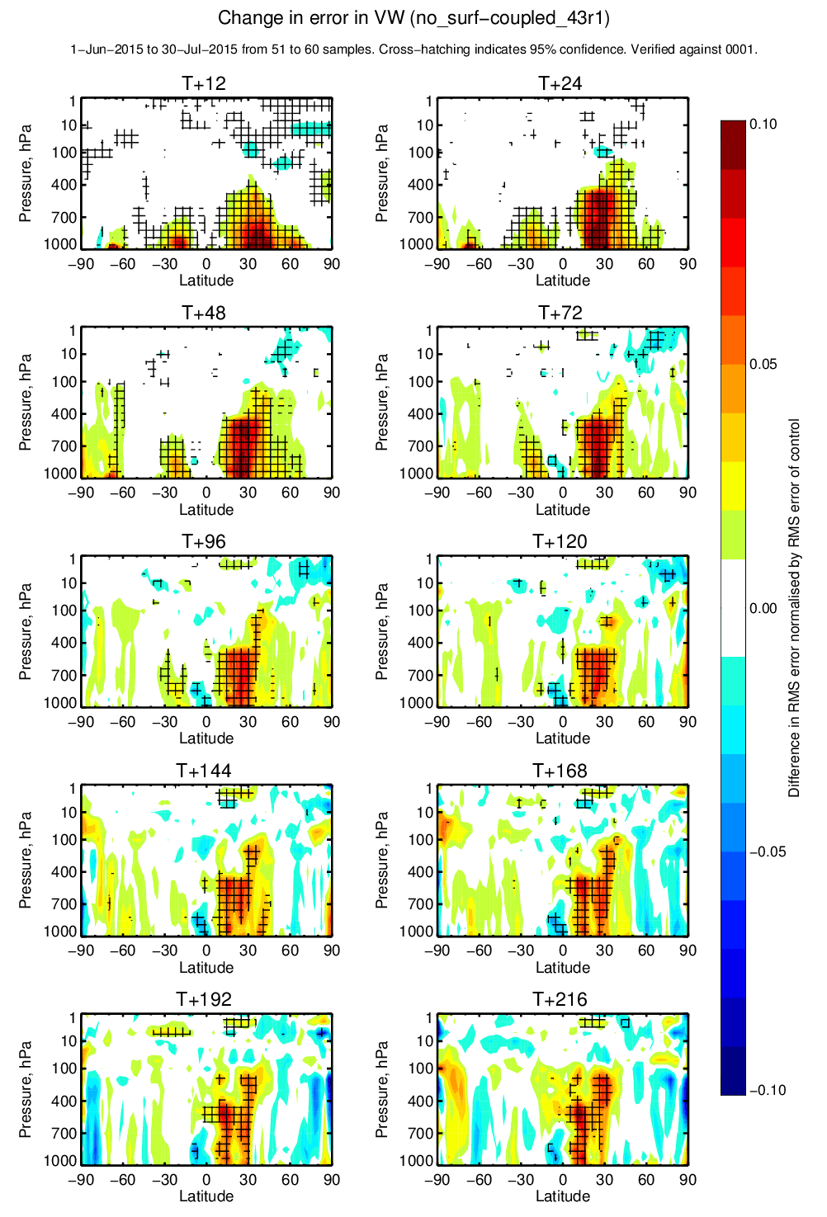
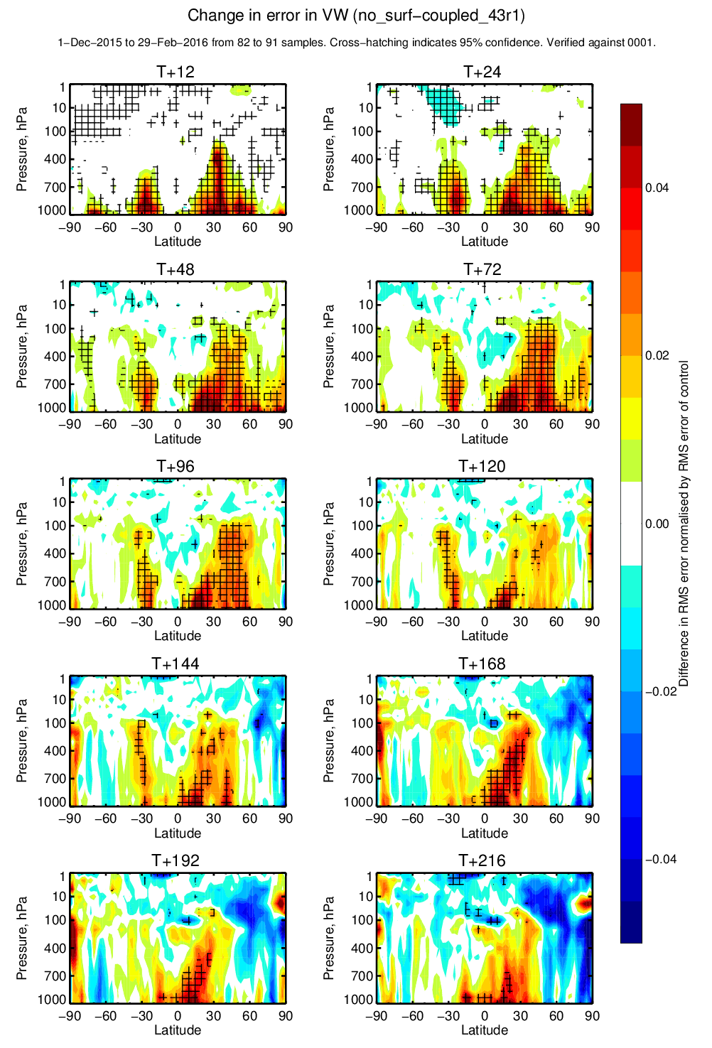
Surface (all the above) wind forecast impact
All the above surface processes
winter 2015-16
summer 2015
Wind deterioration (5-10%) propagates up to 100hPa in winter and in summer.
This is consistent with large scale thermal gradients deterioration.
Note that these errors are large as they are zonal averages!

Slide 27
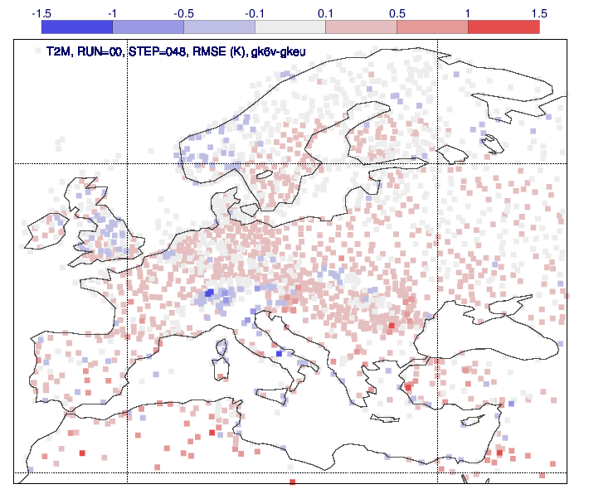
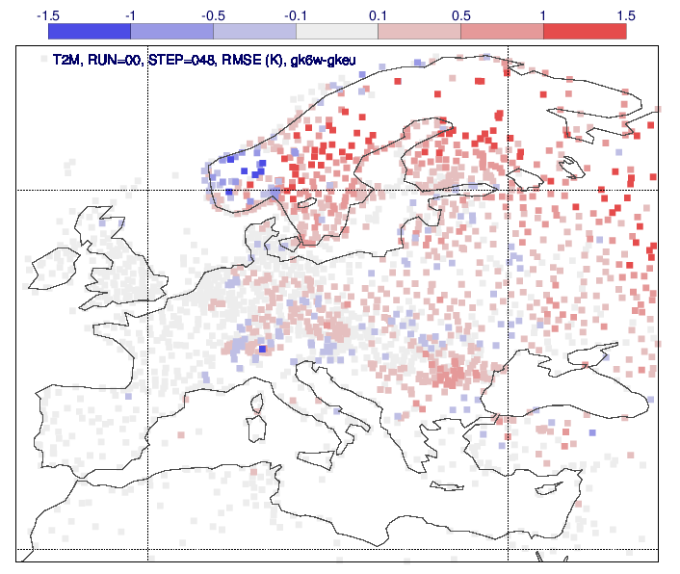
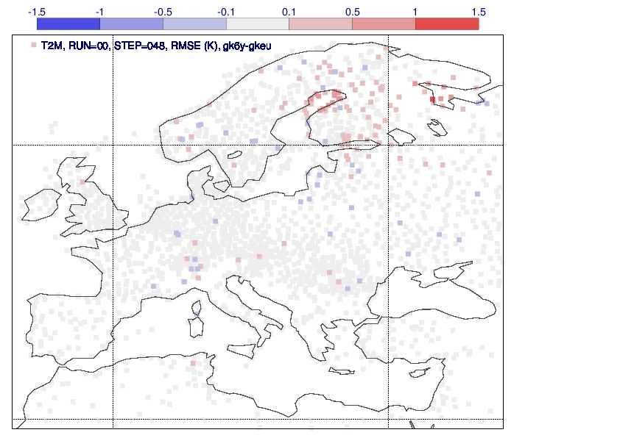
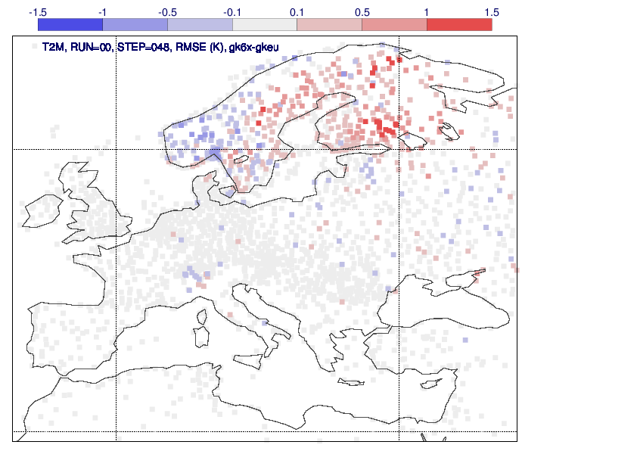
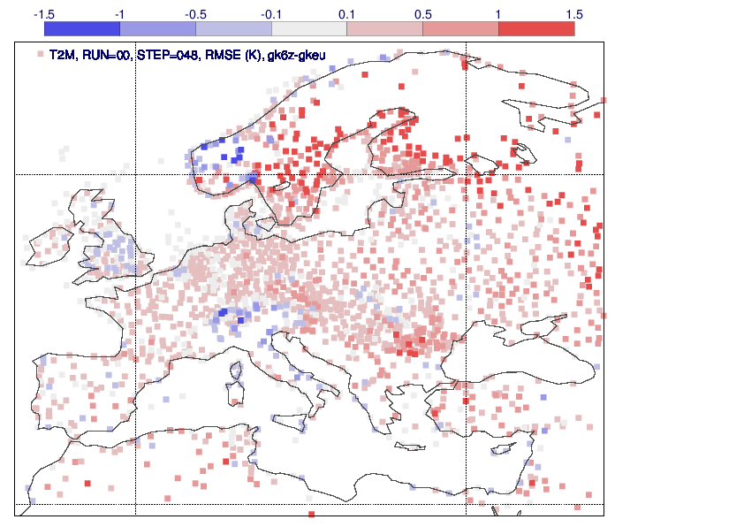
Surface processes forecast impact (locally vs in-situ data)
European winter 2015-16
Soil processes
Snow processes
Sea-ice processes
Lakes processes
Evaluated for 48-h forecast vs SYNOP 2m temperature
Local deterioration can be large for a missing process (red-colors)
Global diagnostics cannot be the only guidance
All the above surface processes

Slide 28
Weather impact of surface processes
Evaluating the 3-day forecast-range skill deterioration induced by the surface process being deactivated (366 forecasts 1st June 2015 to 1st June 2016)

Slide 29
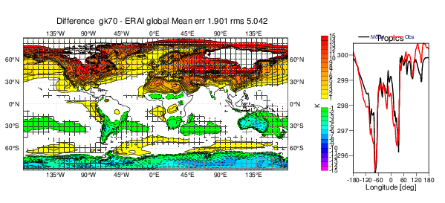
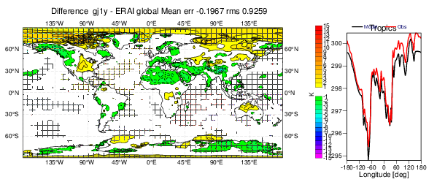
Surface (all above) climate surface temperature (T2m) impact
All surface
processes
disabled
(except ocean)
Control Climate
Mean T2m RMS error 2000-2004
of a 13-month coupled forecast
Initialized in August.
First month integration excluded.
Evaluated vs. ERA-Interim

Slide 30
Climate impact of surface processes
Evaluated for the 1-year forecast range (annual mean) based on the skill deterioration induced by the surface process being deactivated

Slide 31
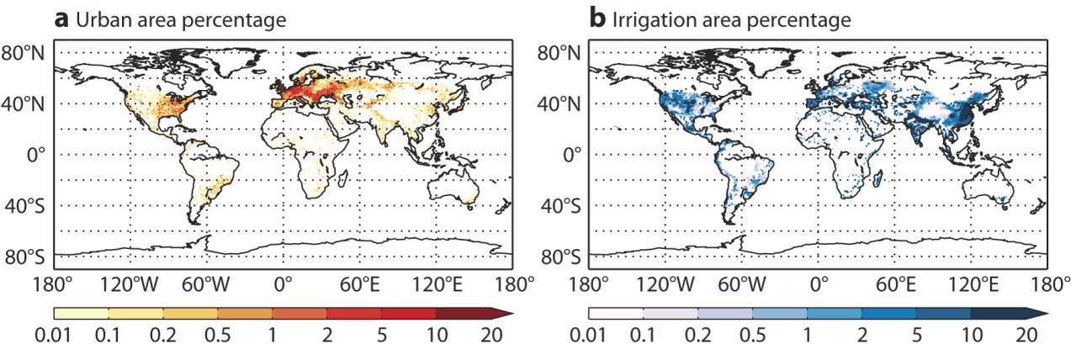
Missing surface components: An example
Human action on the land and water use is currently neglected in most NWP models…
Urban area (a, in %, from ECOCLIMAP, Masson et al., 2003) and
Irrigated area (b, in %, from Döll and Siebert, 2002)
Also water bodies are changing over time

Slide 32
The way forward
…modelling should be always guided by observations…
in case of land surface our senses are also amazing instruments ☺
http://www.youtube.com/watch?v=jfa29pq6NFs

