Slide 1
Data Assimilation Training
Model error in data assimilation
Patrick Laloyaux - Earth System Assimilation Section
patrick.laloyaux@ecmwf.int
Acknowledgement: Jacky Goddard, Mike Fisher, Yannick Tremolet, Massimo Bonavita, Elias Holm, Martin Leutbecher, Simon Lang, Sarah-Jane Lock

Slide 2
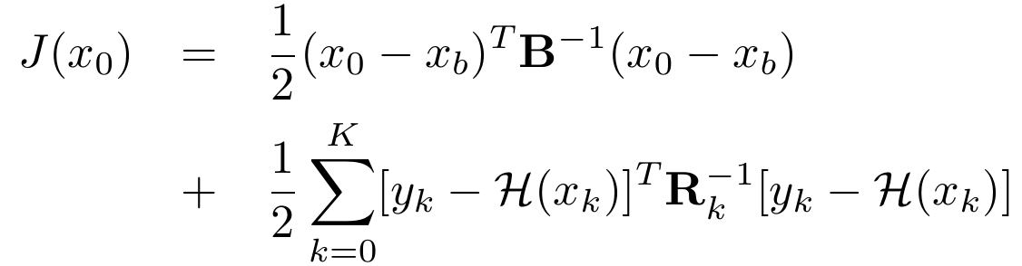

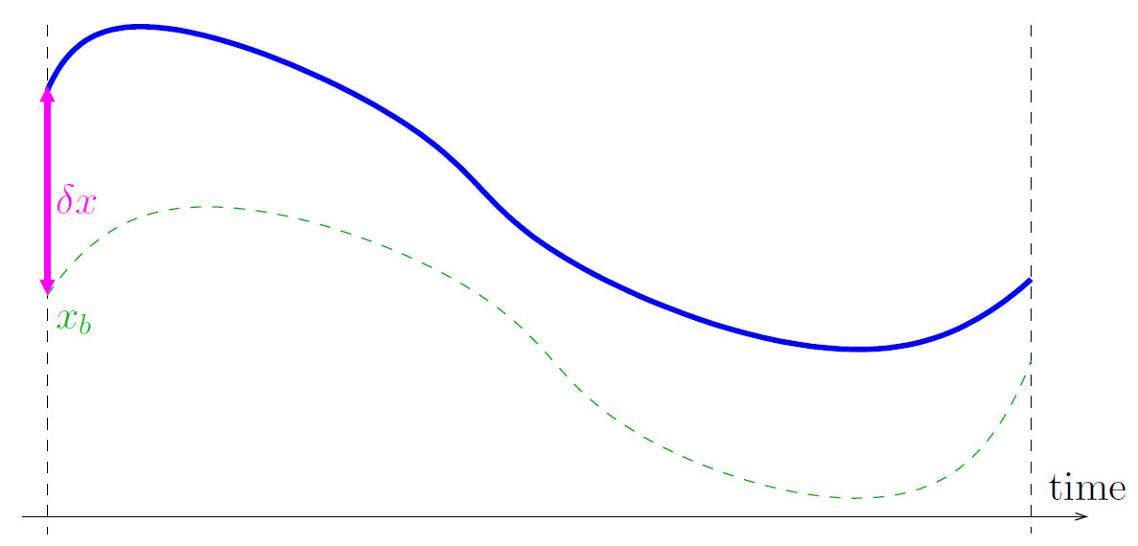
Variational formulation in textbooks
Concerned with the problem of combining model predictions with observations when errors are random with zero-mean
Bias-blind data assimilation
→ compute an optimal initial condition where the model is a strong constraint
designed for models and observations with random, zero-mean errors

Slide 3
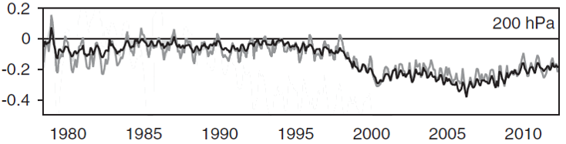
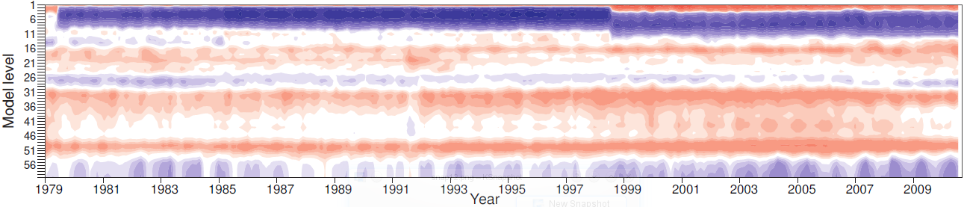
Errors in reality
Errors are often systematic rather than random, zero-mean
Observation-minus-background statistics show evidence of biases
Increments show evidence of biases
ERA-Interim temperature departures for radiosondes (K)
Temperature analysis increments in ERA-Interim (1979 - 2010)
To deal with biases in observations, ECMWF has been developing the variational bias correction (VarBC)

Slide 4
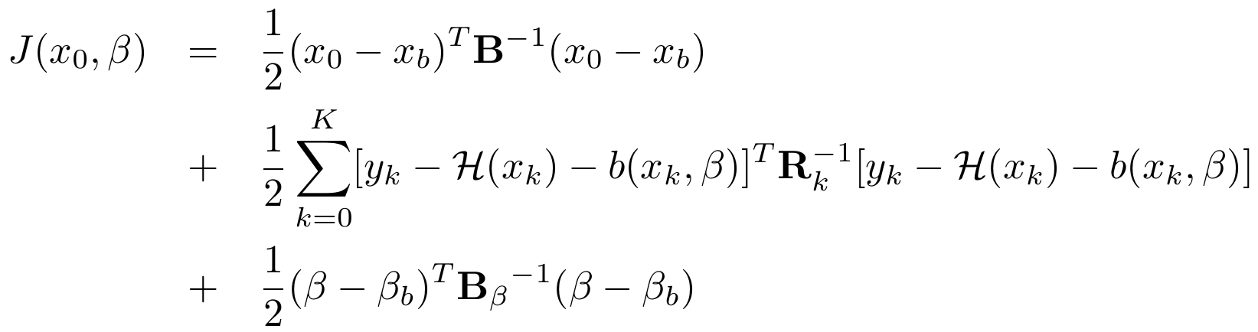
Variational bias correction
Bias-aware data assimilation (VarBC)
the model is a strong constraint
designed to estimate simultaneously the initial condition and parameters that represent systematic errors in the system
the bias model copes with instrument miscalibration (e.g. radiances systematically too warm by 1K) or systematic errors in the observation operator

Slide 5
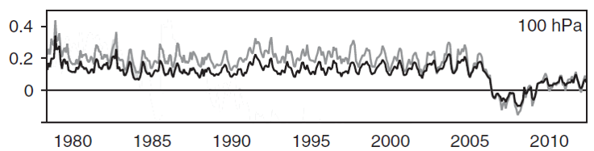
Model biases
Errors are often systematic rather than random, zero-mean
Observation-minus-background statistics show evidence of biases
The model has a cold bias at 100hPa

Slide 6
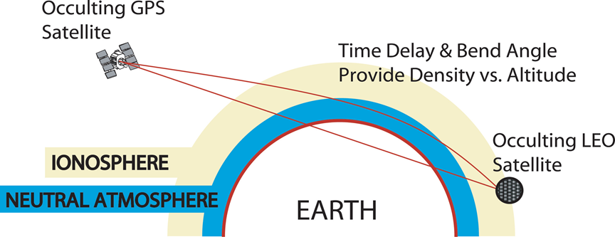
GPS radio occultation (GPS-RO)
The GPS satellites are used for positioning and navigation.
GPS-RO is based on analysing the bending caused by the atmosphere along paths between a GPS satellite and a receiver placed on a low-earth-orbiting satellite.
As the LEO moves behind the earth, we obtain a profile of bending angles. Temperature profiles can then be derived (a vertical interval between 10-50 km)
→GPS-RO can be assimilated without bias correction. They are good for highlighting model errors/biases
→GPS RO have good vertical resolution properties (sharper weighting functions in the vertical)

Slide 7
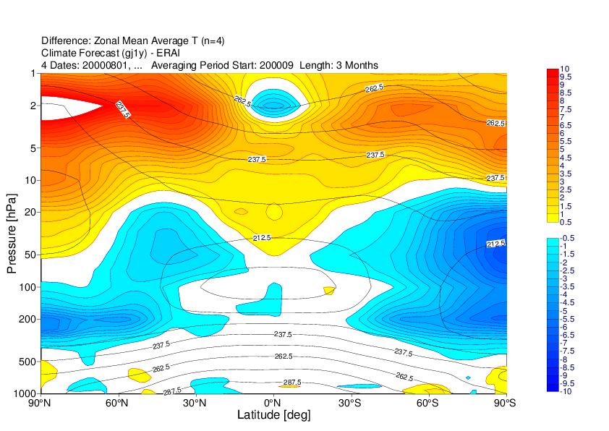
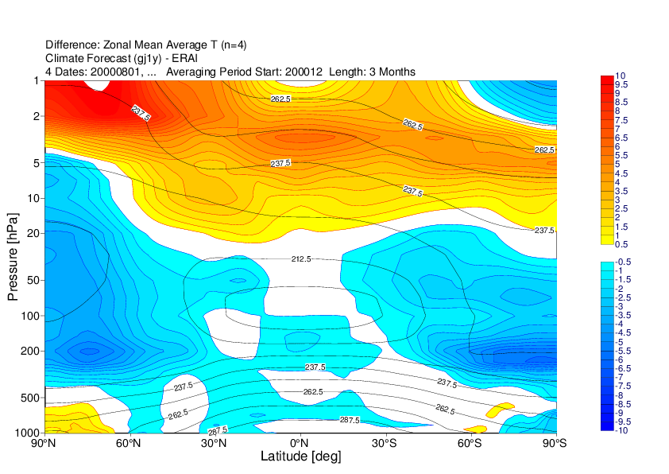
Model biases
Another method to estimate model biases:
compute model-free integrations
use ERA-Interim as a proxy of the truth
compute the mean difference between the model-free integration and ERA-Interim
Temperature biases for SON (left) and DJF (right)
This diagnostic shows a warm bias in the stratosphere and a cold bias in the upper troposphere.
The methodology is far to be perfect especially in the stratosphere where the quality of ERA-Interim is not well assessed

Slide 8
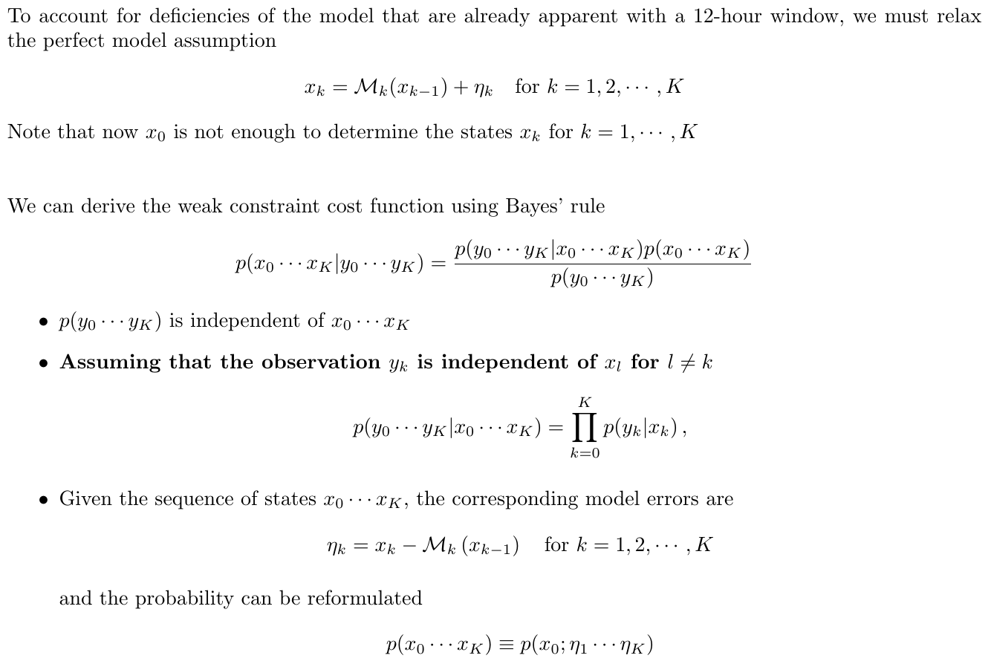
Weak constraint formulation

Slide 9
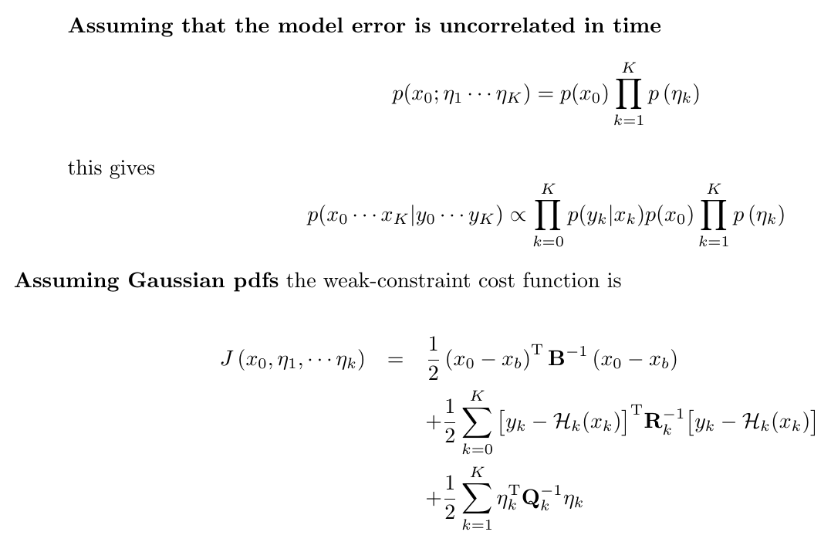
Weak constraint formulation

Slide 10
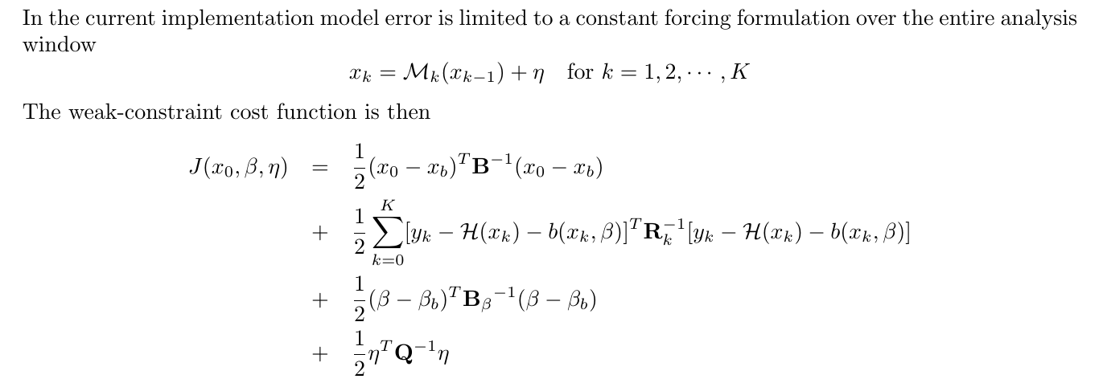
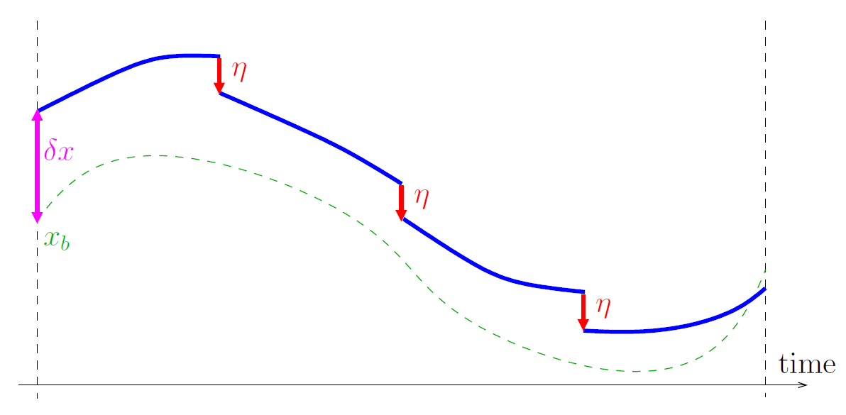
Weak constraint formulation
The weak constraint formulation increases the number of degrees of freedom to fit the data

Slide 11
Outline
Bias-blind and bias-aware variational formulations
Results of the weak constraint 4D-Var in stratosphere and troposphere
Ongoing work and challenges for the future

Slide 12
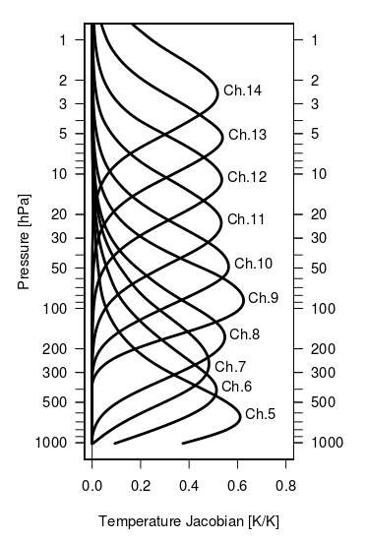
Results of the weak constraint 4D-Var
The Advanced Microwave Sounding Unit (AMSU) is a multi-channel microwave radiometer. The instrument measures radiances that reach the top of the atmosphere.
By selecting channels, AMSU can perform atmospheric sounding of temperature and moisture.
From channel 9 to 14 (stratosphere), AMSU provides weighted average of the atmospheric temperature profile.

Slide 13
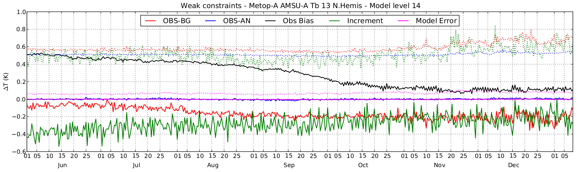
Results of the weak constraint 4D-Var in the stratosphere
Background and analysis departures with AMSU-A Channel 13
The mean of the background departures is systematically negative which might be due to a warm bias in the model (this is consistent with the model bias found previously)
Model error estimated by the weak constraint 4D-Var is very small and around zero. The proposed formulation corrects for random errors and not for systematic errors

Slide 14
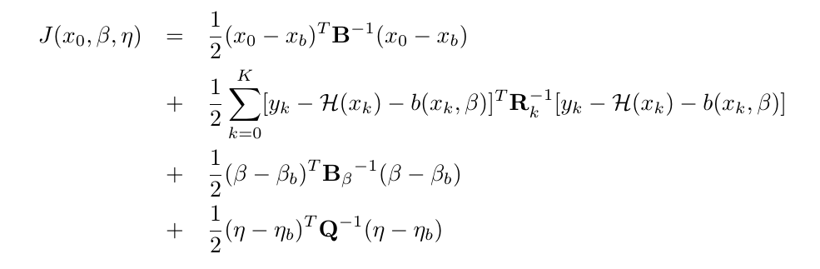
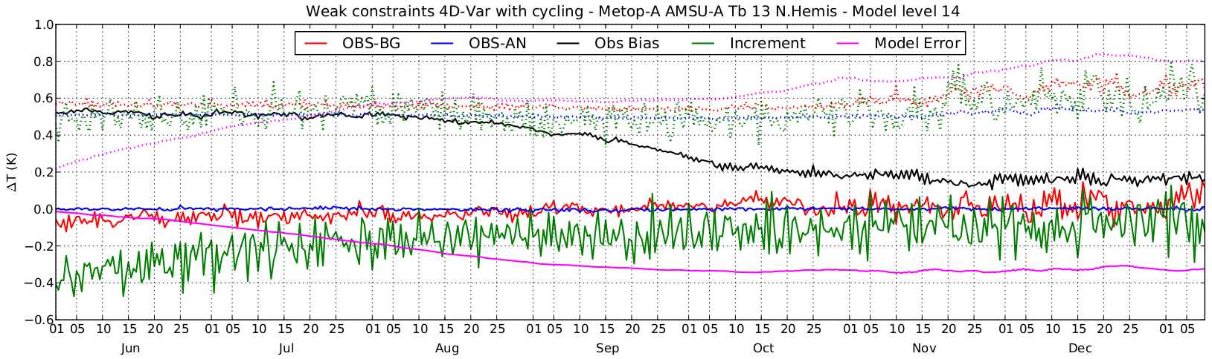
Weak constraint formulation
To correct for systematic errors, the model error is cycled. A prior estimate of the background model error comes from the previous assimilation window and is updated
The mean of the background departures is now around zero
The model error estimates now a model bias (long spin-up)
The increment is now smaller

Slide 15
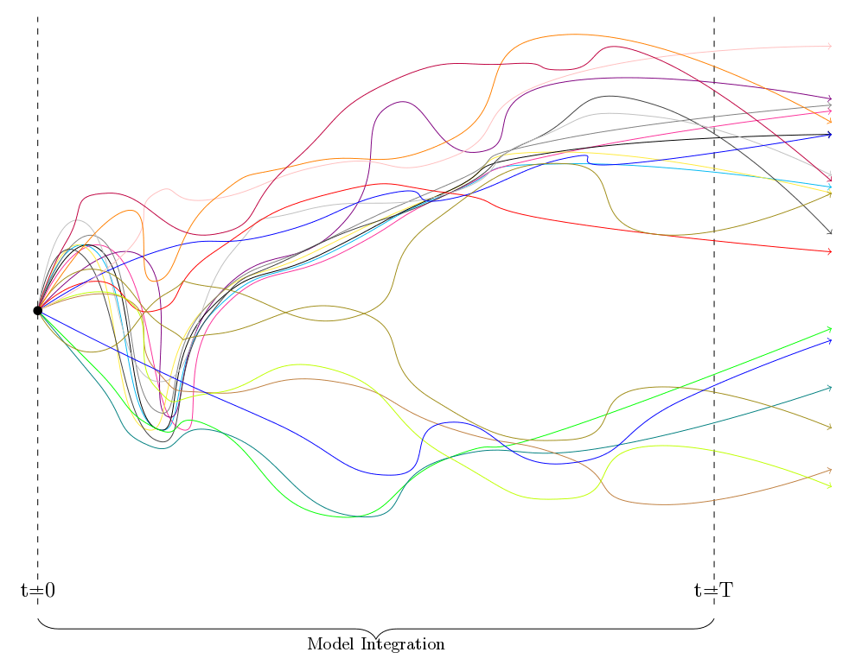
Weak constraint formulation
Estimate the model error covariance matrix (Q)
run the ensemble forecasting system (ENS) with SPPT and SKEB (51 members with the same initial condition for 20 days)
differences after 12 hours are used to compute Q

Slide 16
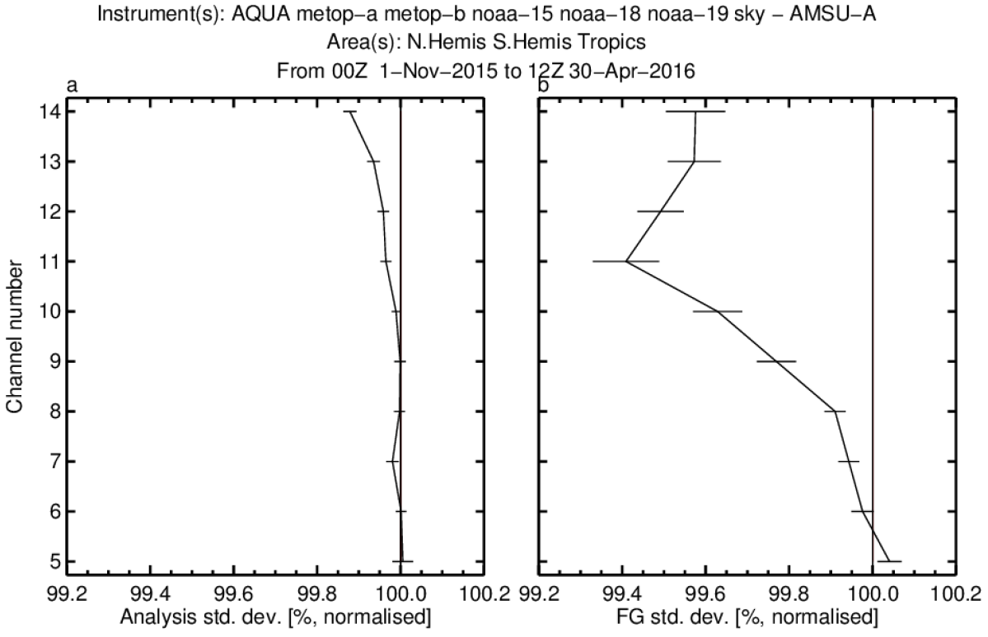
Results of the weak constraint 4D-Var in the stratosphere
Difference in analysis and fg standard deviation with respect to AMSUA
Courtesy of Jacky Goddard

Slide 17
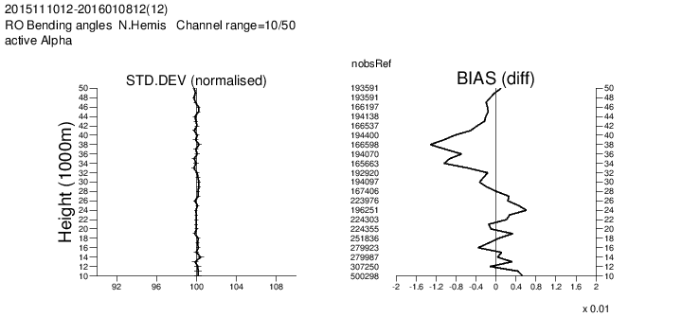
Results of the weak constraint 4D-Var in the stratosphere
GPS radio occultation (RO) observations represent an excellent verification alternative in the stratosphere
Difference in standard deviation and mean departure between 3d fcts and GPSRO
Courtesy of Jacky Goddard

Slide 18
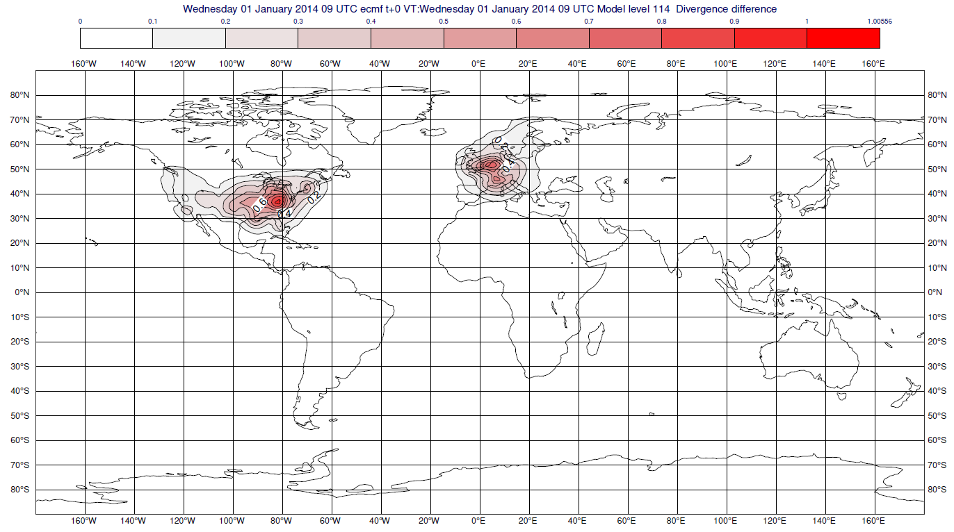
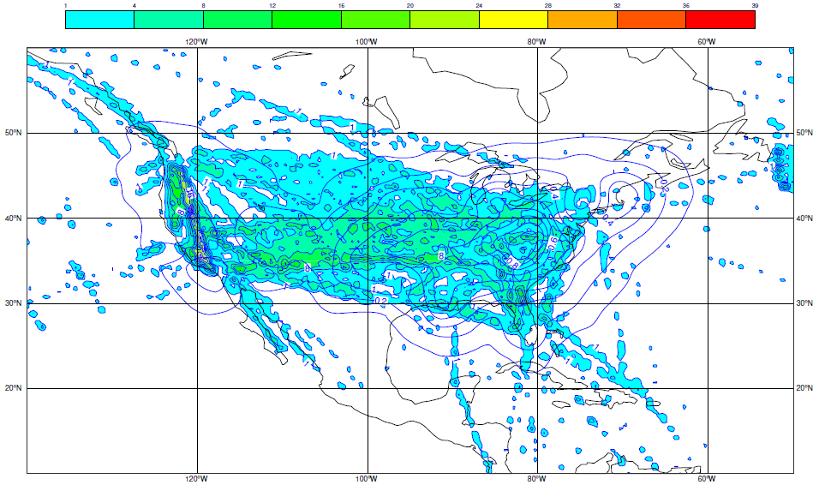
Results of the weak constraint 4D-Var in the troposphere
Statistics from the model error have been computed
Correlation between level 52 (63 hPa) and 114 (850 hPa) for the divergence of model error
This suggests that 4D-Var is misinterpreting aircraft observation errors as model errors
→ weak constraint is activated only above 40 hPa
Courtesy of Jacky Goddard

Slide 19
Weak constraint formulation
Biased observations can be fitted by the VarBC method (correct) or by specifying a spurious model error. We think that the latter happens with aircraft data.

Slide 20
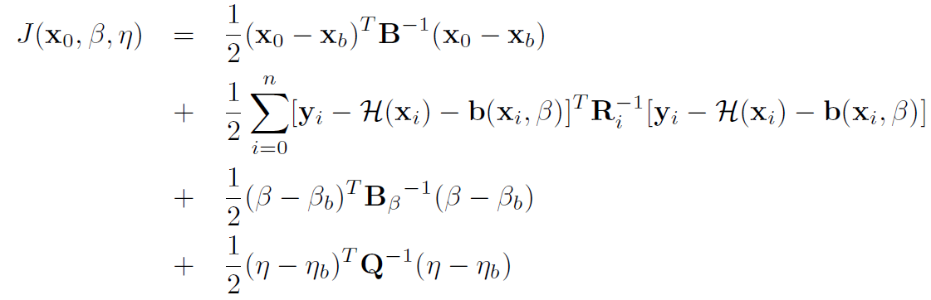

Summary
Errors in models and observations are often systematic rather than random, zero-mean
Bias-aware data assimilation (VarBC + Weak Constraint)
positive impact of weak constraint 4D-Var above 40hPa
→ misinterpreting aircraft observation errors as model errors

Slide 21
Future work
Weak constraint 4D-VAR is at the cutting edge of science
Investigation into relationship between VarBC and model error term
bias correction with three predictors (ascending, cruising, descending)
activate weak constraint for all levels
Better estimate the Q matrix
benefit from new SPPT scheme
SPP scheme under development
Weak Constraint 4D-Var allows the perfect model assumption to be removed
and the use of longer assimilation windows.
How much benefit can we expect from long window 4D-Var?

