Slide 1
Data Assimilation Training
Reanalysis
Patrick Laloyaux - Earth System Assimilation Section
patrick.laloyaux@ecmwf.int
Acknowledgement: Paul Poli, Dick Dee, Hans Hersback, Adrian Simmons

Slide 2

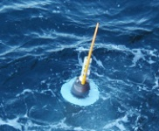
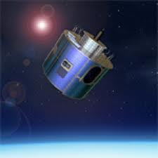


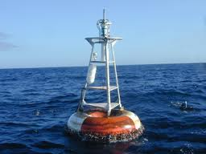

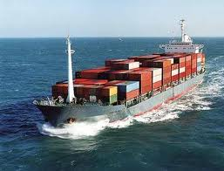
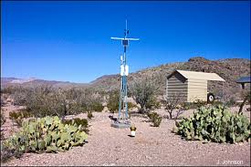
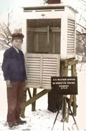
Earth Science has three pillars
Earth Observations
Measurements from many platforms with different types of sensors
Reanalysis methods
Observations
Model
Understanding
Polar-orbiting Satellite
Argo Float
Geostationary Satellite
Bathythermograph
Aircraft
Buoy
Balloon, Radiosonde
Ship
(Semi-) Automatic Station
Observer,
with instruments

Slide 3
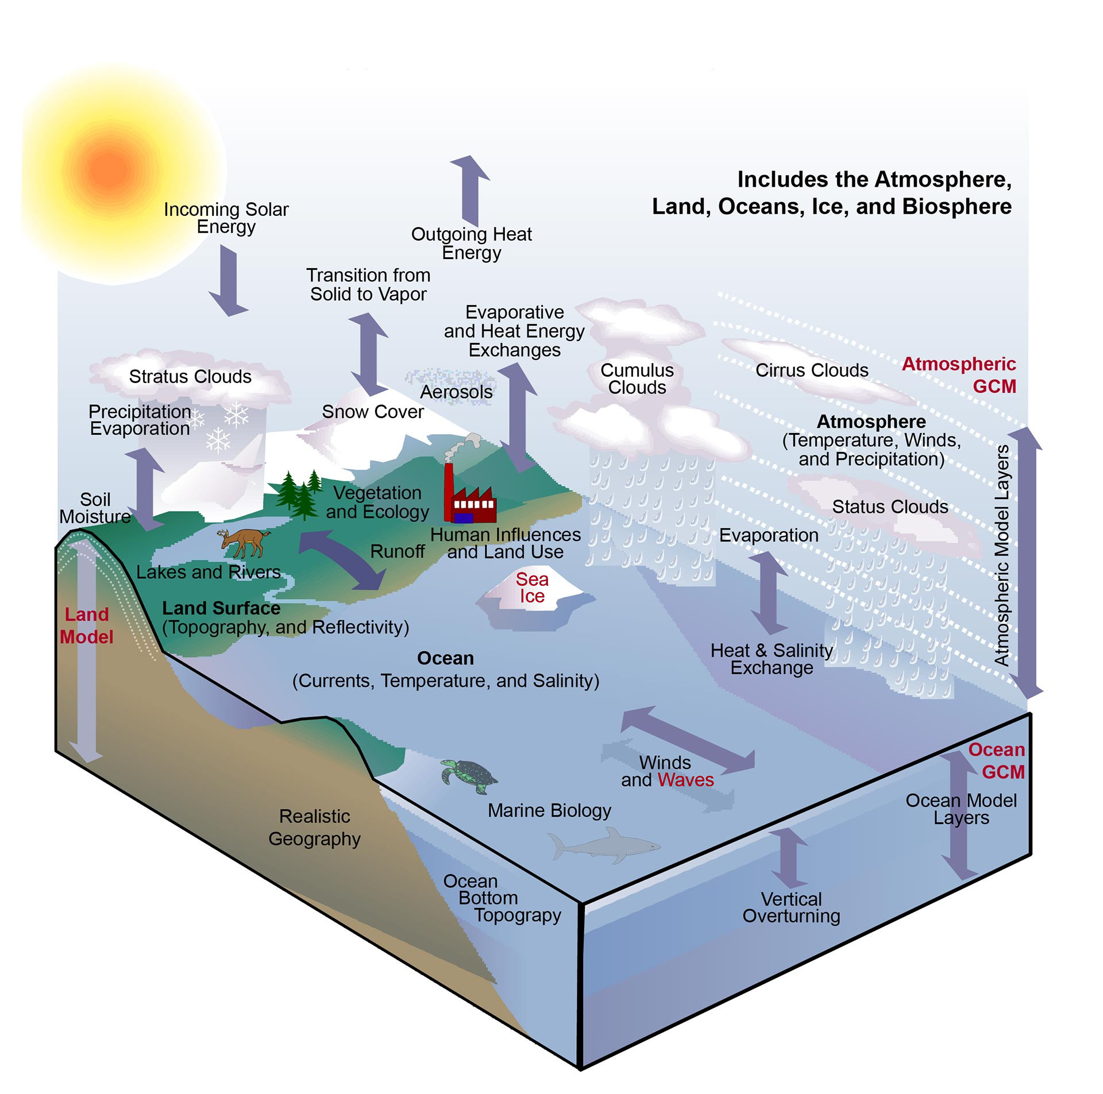
Earth Science has three pillars
Earth Modelling
State-of-the-art numerical models based on physical laws
• link geophysical variables
• enforce balance
• ensure mass conservation
Reanalysis methods
Observations
Model
Understanding
Karl and Trenberth 2003

Slide 4
Earth Science has three pillars
Earth Understanding
Confronting the models with the observations to identify limitations • imperfections in the observations • mistakes in model concepts
• systematic errors (bias)
From there, we can improve the instruments, and refine the models (infinite loop)
Reanalysis methods
Observations
Model
Understanding

Slide 5
Earth Science has three pillars
Reanalysis Methods
Definition:
reanalysis aims to assimilate historical observational data spanning an extended period, using a single invariant, modern version of a data assimilation system and numerical weather prediction model to reconstruct the past climate and/or weather
Reanalysis methods
Observations
Model
Understanding

Slide 6
Different methods to reconstruct the past climate and/or weather
“Observations-only”
climatology
Reconstruction based on observations, little use of model
Reanalysis
Balance between use of observations and model
“Model only” integration
Reconstruction based on a model, little use of observations

Slide 7
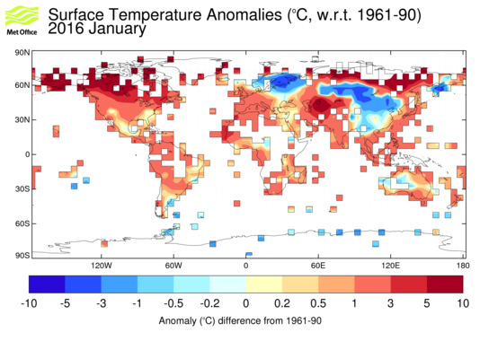
“Observations-only” climatology - CRUTEM4
Observations: archive of monthly mean temperatures provided by 5500 weather stations distributed around the world
Method:
each station temperature is converted to an anomaly from the 1961-90 average temperature for that station.
each grid-box value is the mean of all the station anomalies within that grid box.
A gridded dataset (5 degree grid) of historical near-surface air temperature anomalies over land available for each month from January 1850 to present

Slide 8
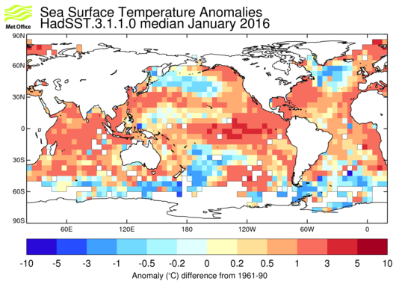
“Observations-only” climatology - HadSST3
Observations: in-situ measurements of Sea Surface Temperature (SST) from ships and buoys coming from ICOADS and GTS archives
Method:
the measurements are converted to anomalies.
bias adjustments to reduce the effects of spurious trends caused by changes in SST measuring practices
A gridded dataset (5 degree grid) of historical SST anomalies available for each month from January 1850 to present

Slide 9
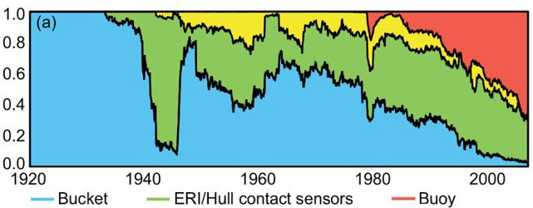
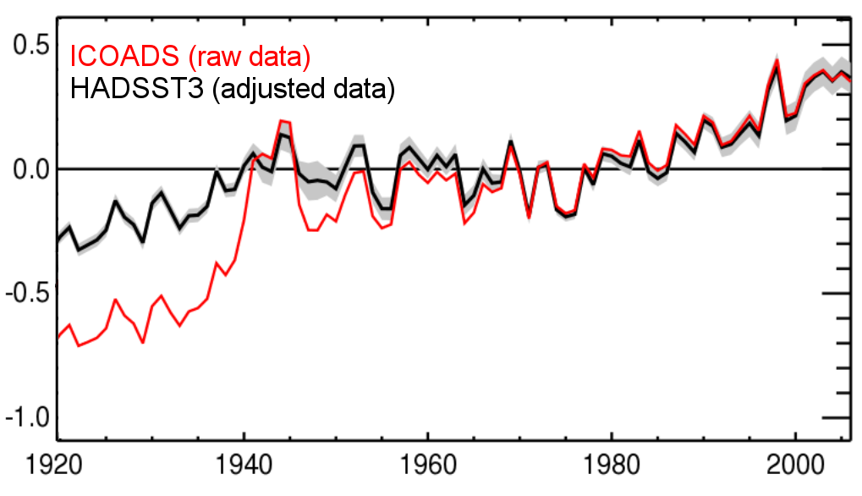
Bias adjustment of Sea Surface Temperature in HadSST3
Evolution of instruments for SST measurements
Different instruments and sampling methods lead to different observation biases
• buckets have cold biases
• ERI have small warm biases
Annual SST anomalies (relative to 1961-1990)
Spurious climate signal in the raw data due to a change in the observing system
Raw data are bias corrected to produce HADSST3
Adjustments suffer from
• poor documentation of sampling characteristics
• no proper overlap for intercomparison
“Observations-only” climatology:
• long record (extending back to 1850), based only on observations
• spatial and temporal discontinuities
• no use of a NWP model, but average operator, bias correction, QC, interpolation

Slide 10
Different methods to reconstruct the past climate and/or weather
“Observations-only”
climatology
Reconstruction based on observations, little use of model
Reanalysis
Balance between use of observations and model
“Model only” integration
Reconstruction based on model, little use of observations

Slide 11
“Model only” integration - ERA-20CM
Model: the IFS atmospheric model developed for NWP at low resolution (125 km)
Method:
the model is integrated from 1900 to 2010
observations are not assimilated but the model is constrained by atmospheric forcings
CMIP5 atmospheric forcing are used:
• Solar irradiance (CMIP5)
• Greenhouse gases (CMIP5)
• Ozone for radiation (CMIP5)
• Tropospheric aerosols (CMIP5)
• Stratospheric aerosols (CMIP5)
• Sea-surface temperature and sea-ice cover (Hadley Centre)
These forcings are based indirectly on observations!

Slide 12
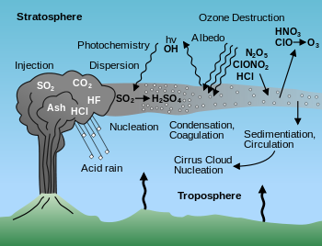
The example of stratospheric aerosols
Stratospheric aerosols mainly have a volcanic origin
Volcanic sulphate can remain in the stratosphere for many months, where it mixes within large predominantly zonal bands, increasing atmospheric opacity
In the IFS model used in operation, volcanic sulphate is assumed to be constant (evenly distributed over the stratosphere, assuming a constant volume-mixing ratio)

Slide 13
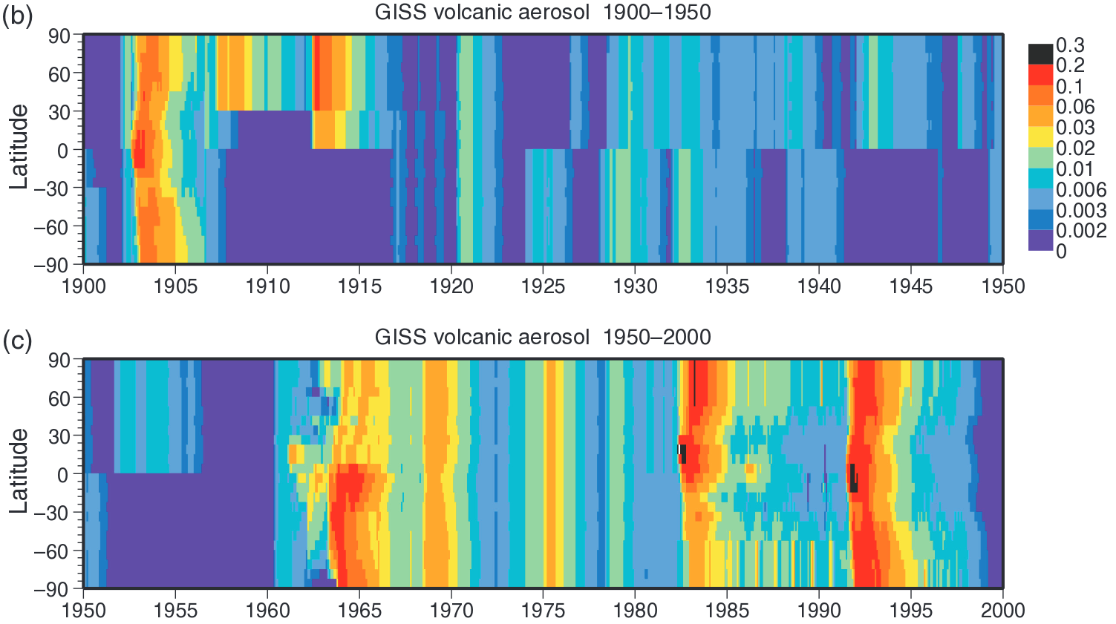
Stratospheric aerosols in ERA-20CM
CMIP5 dataset reconstructs the evolution of volcanic sulphate (1850 to present)
Major eruptions are clearly visible: Santa Maria (1902), Novarupta (1912), Agung (1963), Fernandina (1968), El Chichon (1982) and Pinatubo (1991)

Slide 14
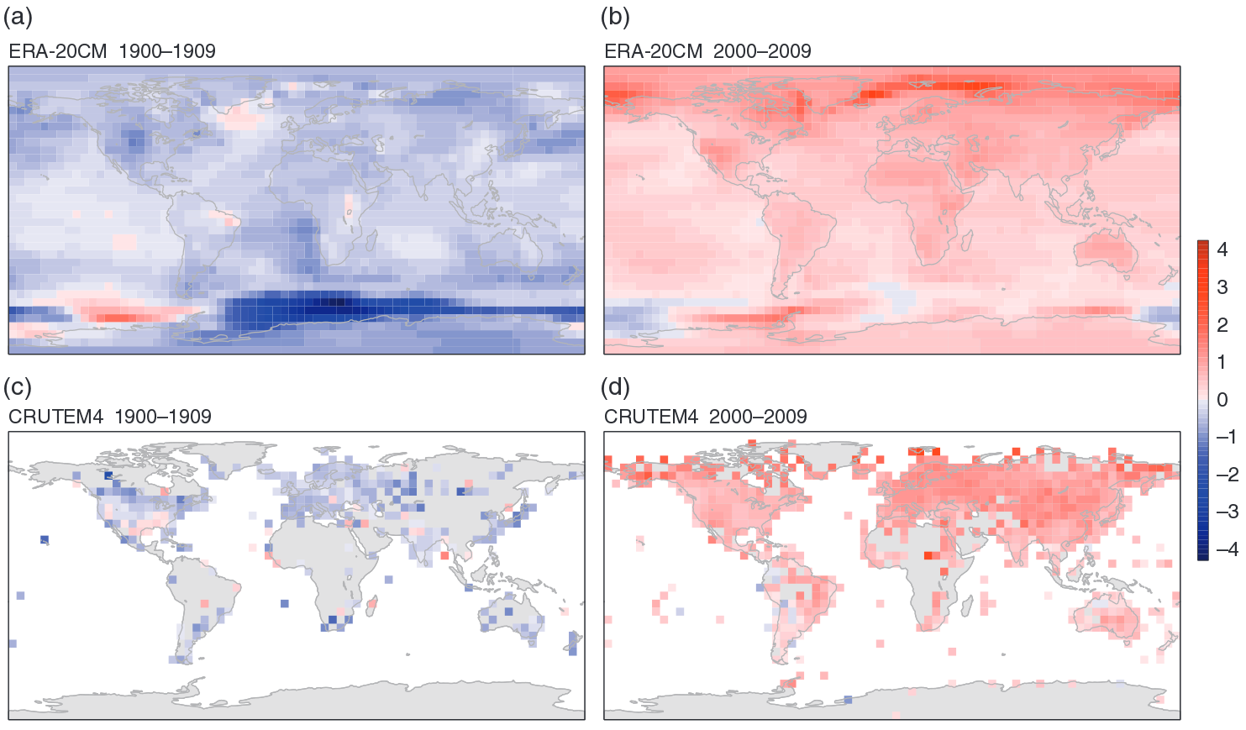
Comparison between ERA-20CM with CRUTEM4
Temperature anomalies for 1900-1909 (left) and 2000-2009 (right)
Similar global warming in the “model-only” and the “observation-only” reconstructions
Differences in Southern United States for 1900-1909

Slide 15
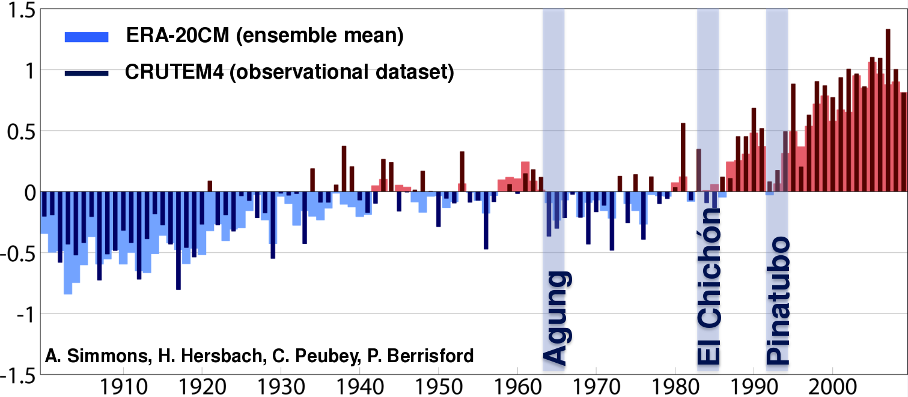
Comparison between ERA-20CM with CRUTEM4
Annual mean anomalies for ERA-20CM (light) and CRUTEM4 (dark)
ERA-20CM reproduces the long term variation and capture interannual variability after volcanic eruptions
“Model only” integration:
• long record (extending back to 1900), based on a forced NWP model
• space and time consistency
• capture interannual variability, not expected to reproduce actual synoptic weather

Slide 16
Different methods to reconstruct the past climate and/or weather
“Observations-only”
climatology
Reconstruction based on observations, little use of model
Reanalysis
Balance between use of observations and model
“Model only” integration
Reconstruction based on model, little use of observations

Slide 17
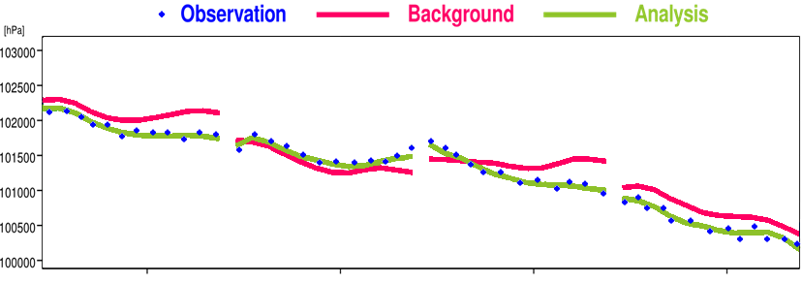
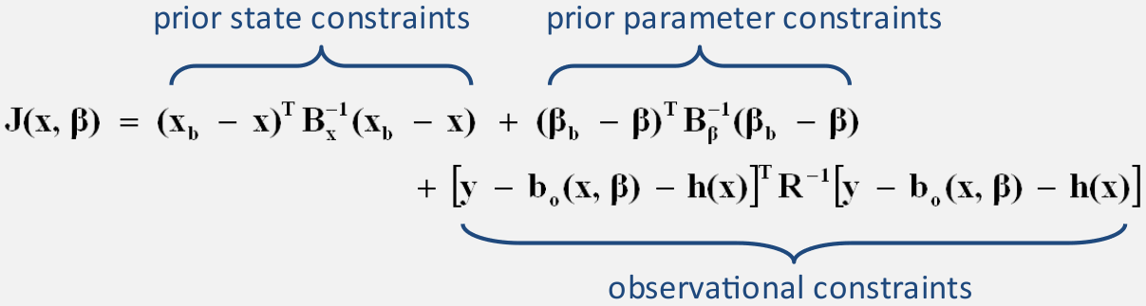
Reanalyses over the satellite era
• use an invariant version of a data assimilation system and NWP model
• use as many observations as possible, including from satellites
• run over a long time period (1979 to present)
ERA-Interim: model and assimilation system from cycle 31R2 (released in December 2006, deterministic 4D-Var)
For each 12-hour assimilation window, 4D-Var computes an estimate for all the model outputs and prognostic variables at any given time

Slide 18

Reanalyses
  Reanalysis uses a NWP model (physical laws) which allows to:
• deal with missing data
(the model is used to “fill in the blanks”, from past and neighbouring information)
• ensure consistency in horizontal and vertical dimensions
• ensure consistency across geophysical variables
Reanalysis uses and evaluates all observations in a consistent way:
• observation accuracy explicitly taken into account
• quality control (QC) procedures apply across all observation types
Reanalysis uses the widest variety of observations (40,000 millions in ERA-Interim)
• reduce the model biases
• reproduce actual synoptic situation
Notes:
Reanalysis uses and evaluates all observations in a consistent way:
• observation accuracy explicitly taken into account
• quality control (QC) procedures apply across all observation types
• the background prediction provides QC advantage w.r.t statistical reconstruction

Slide 19
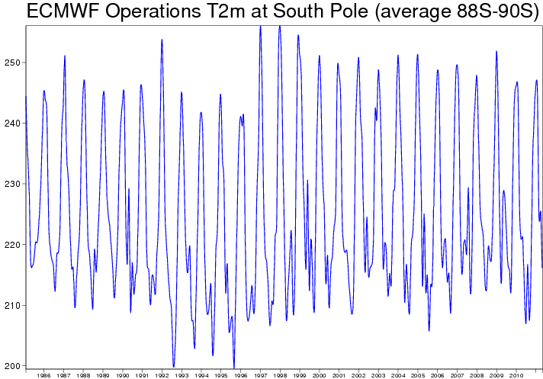
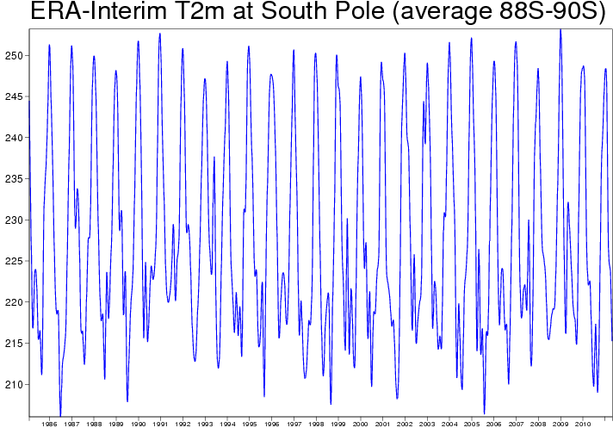
Why not use simply operational NWP analysis?
The models and data assimilation methods have improved a lot over time, so analysis timeseries feature spurious changes.
1 Feb 1985
1 May 2011
1 Feb 1985
1 May 2011
Was there a sudden change in
South Pole summer variability in 1997?
No.
To remove these spurious sources of variability, model and data assimilation systems are frozen and rerun to produce a reanalysis dataset

Slide 20
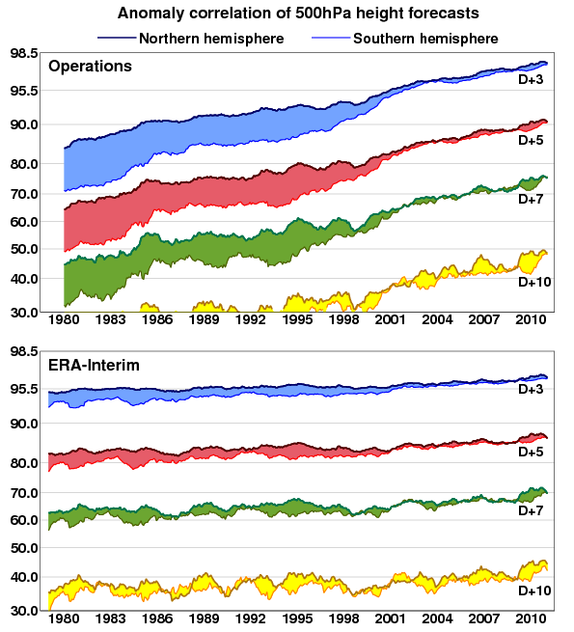
Reanalysis supports NWP development and evaluation
Rate of improvements in operations:
• model
• data assimilation
• observing system
Rate of improvement in reanalysis:
• observing system
The comparison shows that most of the improvements in operational forecasts comes from a better model and data assimilation system
These improvements benefits from better observations

Slide 21
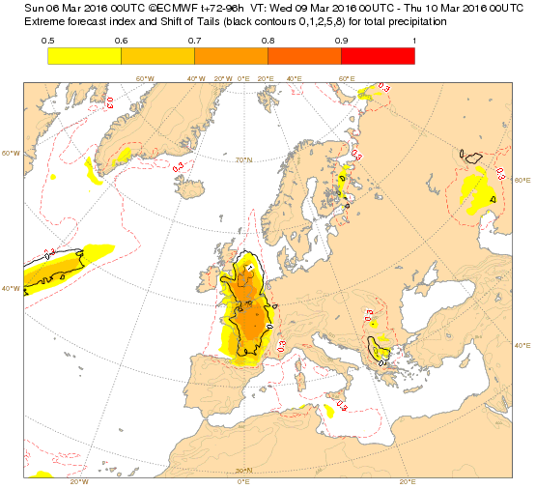
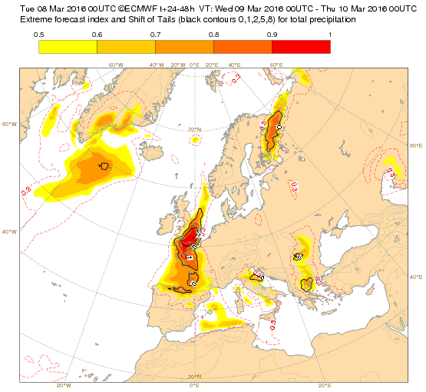
Reanalysis supports the computation of operational products
Extreme Forecast Index (EFI) detects extreme events in a given ensemble forecast.
Difference between the ensemble forecast distribution and a reference (M-climate)
• reference distribution is an ensemble of re-forecast for the most recent 20 years
• initial conditions taken from ERA-Interim (atmosphere) and ORAS4 (ocean)
EFI for precipitation (warning 4-days in advance)
EFI for precipitation (warning 1-day in advance)

Slide 22
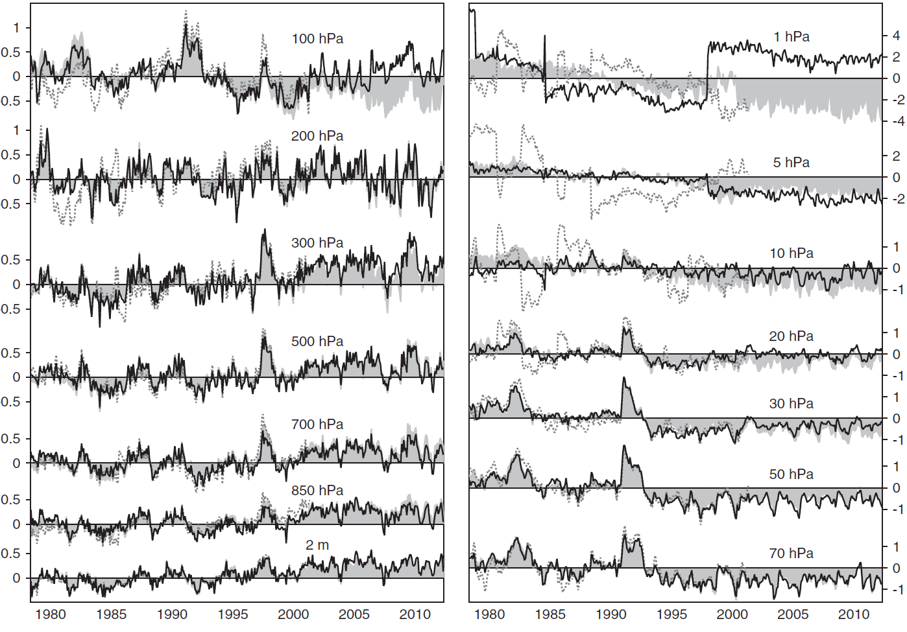

Climate signals in reanalysis
Solid line: ERA-Interim temperature anomalies relative to 1979-2001 (monthly and globally averaged)
Simmons et al. 2014.
Good trends for surface temperature
El-Nino, El Chichon and Pinatubo events
Issue at 1hPa with the introduction of a new satellite (AMSU-A)
→ Improve the use of these observations to improve climate signal
Some climate signals may be affected by changes in the observing system

Slide 23
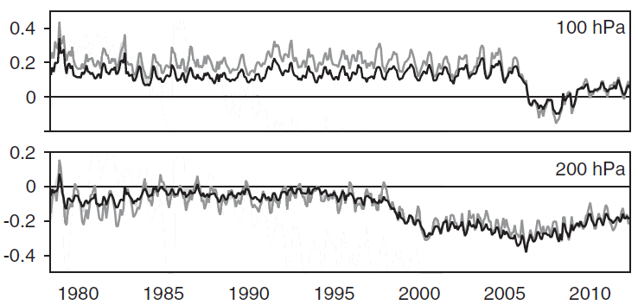
Use departure statistics to detect biases
ERA-Interim observation-minus-analysis (black lines) and observation-minus-background (grey lines) differences for radiosonde temperatures (K)
Simmons et al. 2014.
100hPa: before 2006, cold bias in the analysis relative to the assimilated radiosondes. Assimilation of GPSRO data from late 2006 onwards brings the analysis into much closer agreement with radiosondes
200hPa: in the late 1990s, warm bias in the analysis relative to the assimilated
radiosondes. This is associated with the assimilation of an increasing amounts of temperature data from commercial aircrafts (warm-biased)

Slide 24
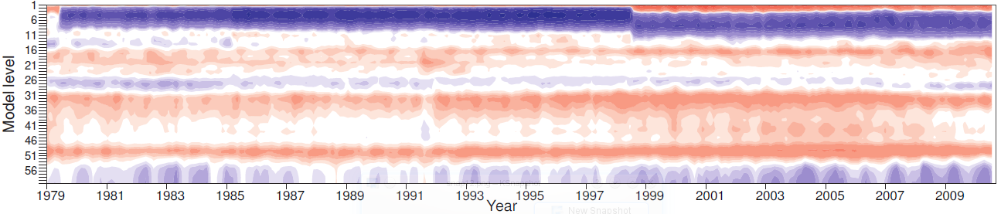
Use analysis increments to detect biases
Mean temperature analysis increments in ERA-Interim (1979 - 2010)
Warm increments produced by the assimilation of AMSUA measurements in the stratosphere and by the assimilation of aircraft measurements in the troposhere
We can explain most of the features by now (putting together many time-series of increments, observation mean departures and bias corrections).
In practice, it is about near to impossible to know how mean increments will turn out in advance in a reanalysis.

Slide 25
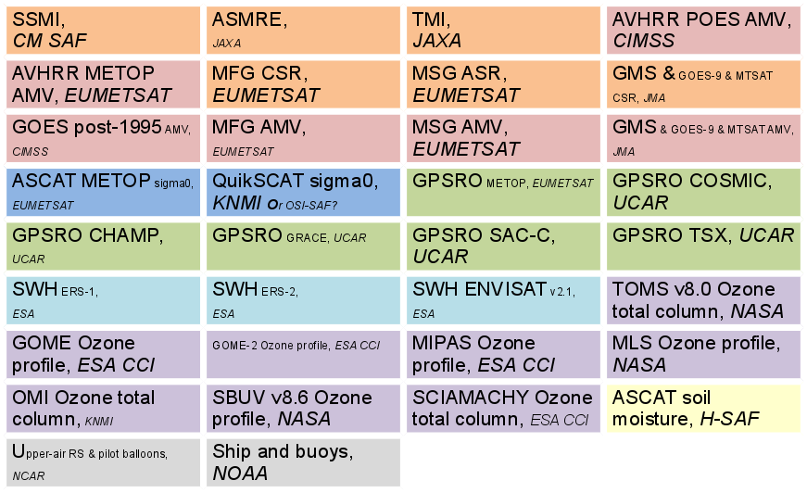
ERA-Interim will be replaced by ERA-5
Reanalysis is worth repeating as all ingredients continue to evolve:
• model, data assimilation, observation reprocessing
• with each new reanalysis, understanding of model/observations biases is improved
ERA-Interim: model and assimilation from cycle 31R2 (released in December 2006)
ERA-5: model and assimilation from cycle 41R2 (released in March 2016)
ERA-5 took on board 10 years of research and development in NWP model and data assimilation methods:
• EDA technique
• surface analysis (SEKF),
• better bias correction
• improved model physics
• higher resolution,…
Improved observations: 34 observation data records either reprocessed or updated

Slide 26
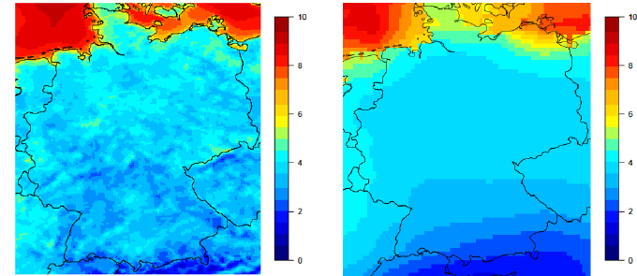
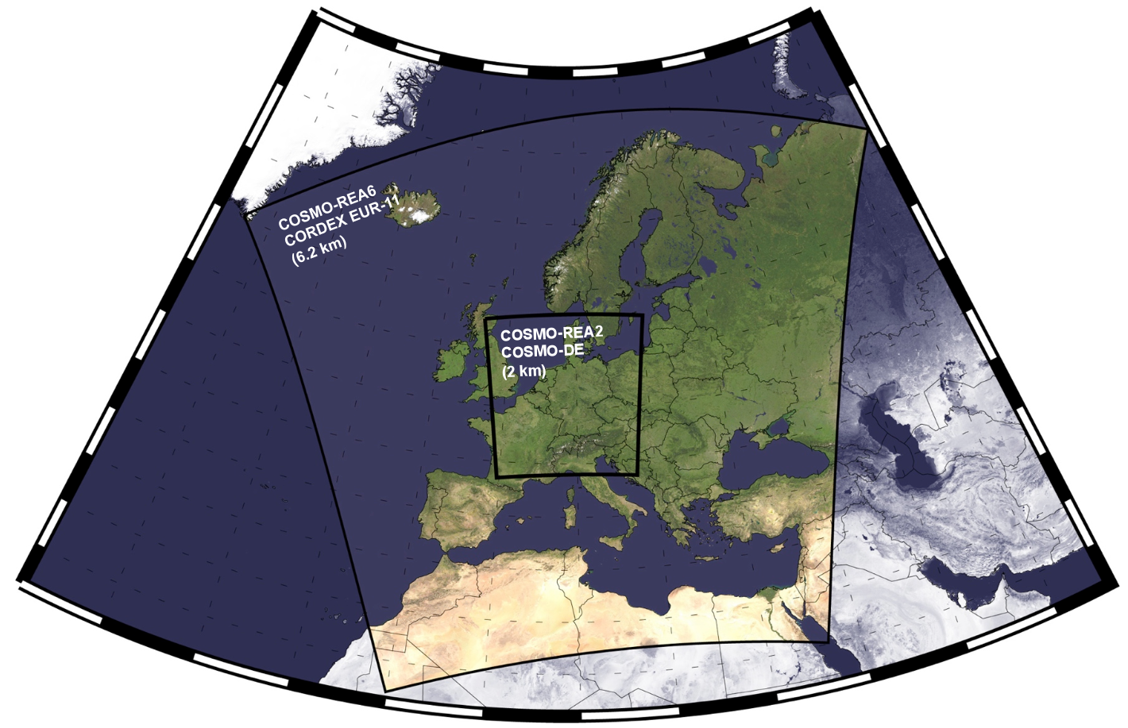
From global to regional reanalysis
Global reanalyses have a coarse resolution, not sufficient to analyse regional events
Dynamical downscaling: high-resolution model running on a regional domain, boundary condition is from a lower-resolution global reanalysis
Regional reanalysis: high-resolution reanalysis (model & assimilation) running on a regional domain, boundary condition is from a lower-resolution global reanalysis
10 m surface winds from COSMO-REA6 regional reanalysis (6km) compared to a global reanalysis (125km) for February 2007
A. K. Kaiser-Weiss et al., 2015
Nested approach could be used

Slide 27
Different methods to reconstruct the past climate and/or weather
“Observations-only”
climatology
Reconstruction based on observations, little use of model
Reanalysis
Extended climate reanalysis
Balance between use of observations and model
“Model only” integration
Reconstruction based on model, little use of observations

Slide 28
Another type of reanalysis: extended climate reanalysis
ERA-Interim (1979 to present)
• use an invariant version of a data assimilation system and NWP model
• use as many observations as possible, including from satellites
• produce the best state estimate at any given time
ERA-20C (1900 to 2010)
• use an invariant version of a data assimilation system and NWP model
• use only a restricted set of observations
• focus on consistency and low-frequency climate variability

Slide 29
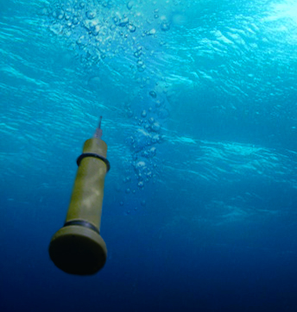
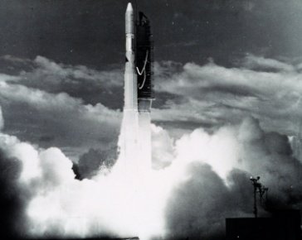
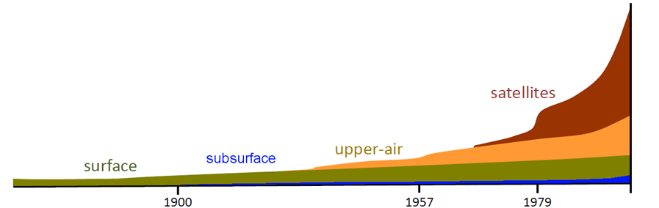
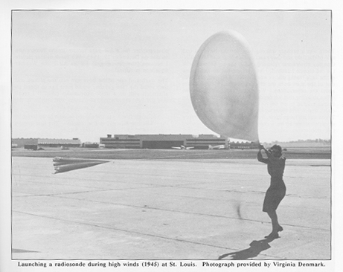
Evolution of the observing system
20th century saw an explosion in the number of measurements from many platforms and types of sensors.
Manual stations, limited data exchange
1938: First radiosonde networks, systematic soundings
1973: First operational satellite soundings (NOAA-2)
1999: First Arguo probe for ocean monitoring
ERA-20C assimilates only surface pressure and ocean surface winds from conventional instruments (targeting a consistent observing system)

Slide 30
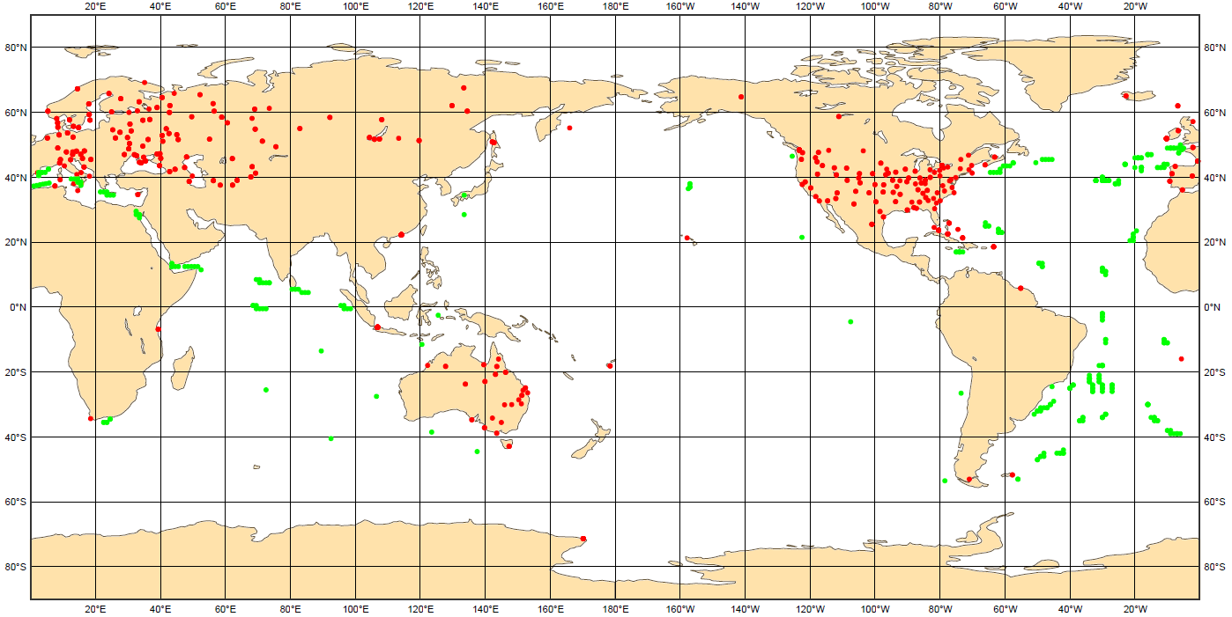
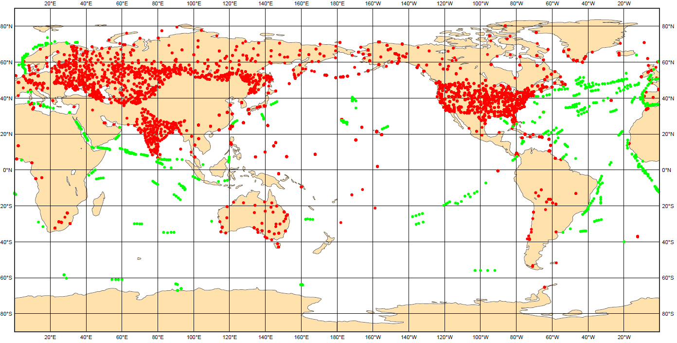
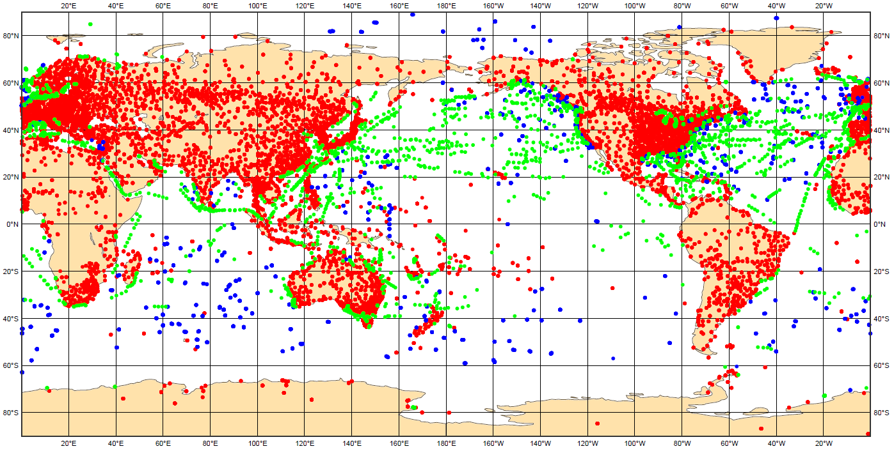
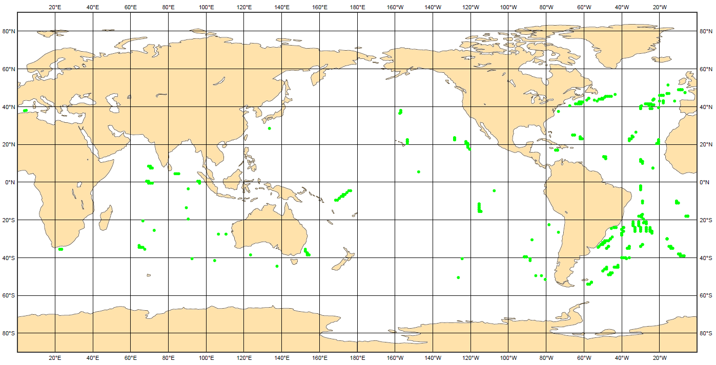
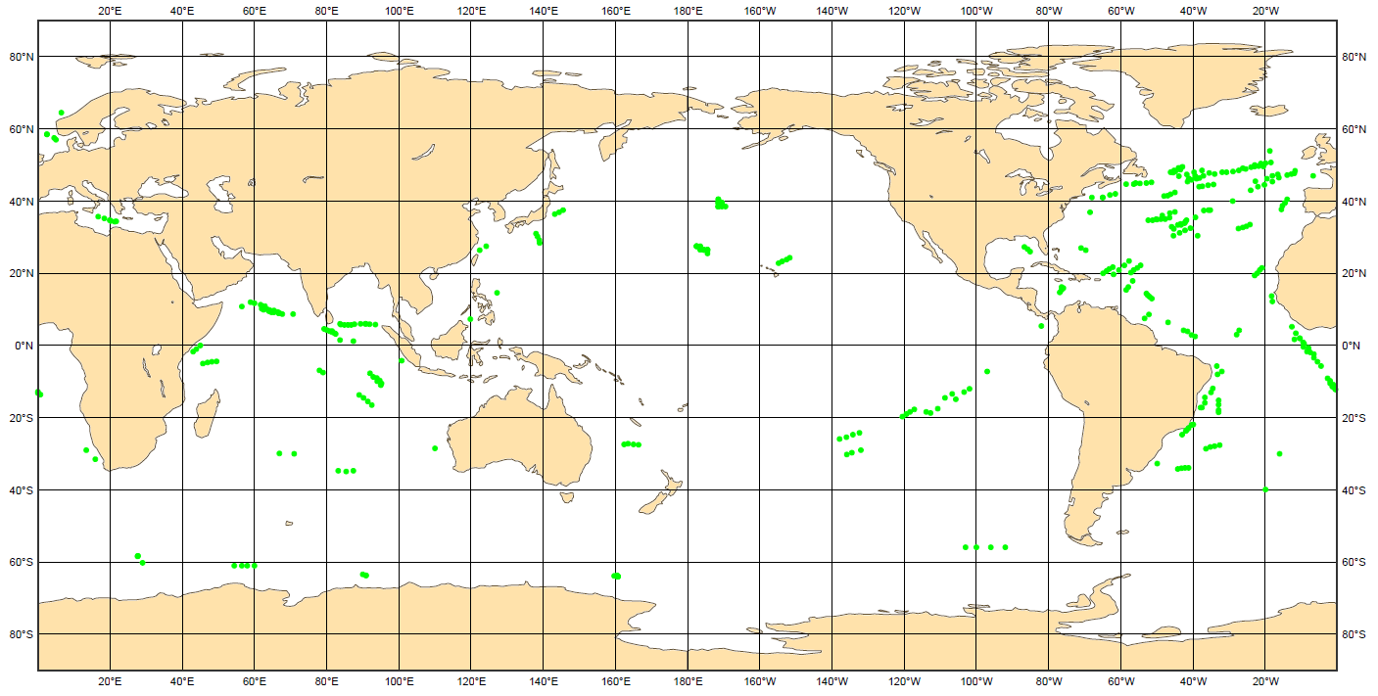
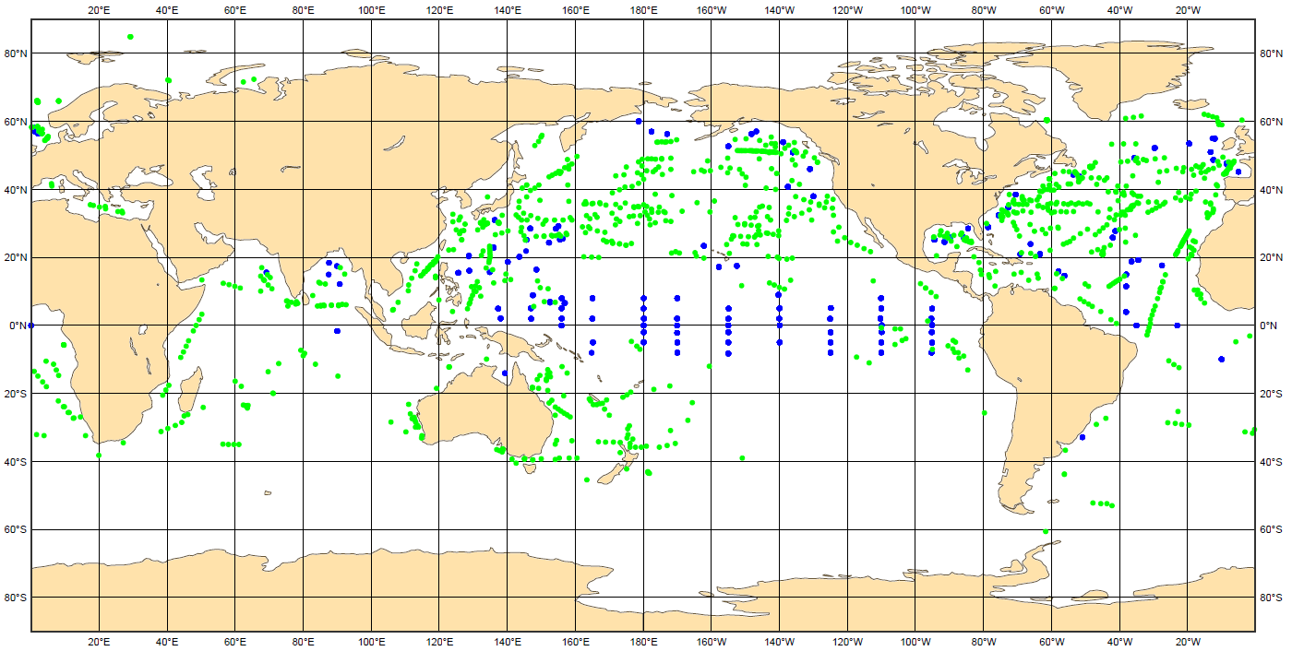
Observing system still evolves
Surface pressure observations (observations per day) Stations Ships Buoys
1900 1950 2010
• observations initially concentrated in the northern hemisphere
• global coverage increases with time
• few observations for the poles even for the recent period
Surface marine wind observations (observations per day) Ships Buoys
1900 1950 2010

Slide 31
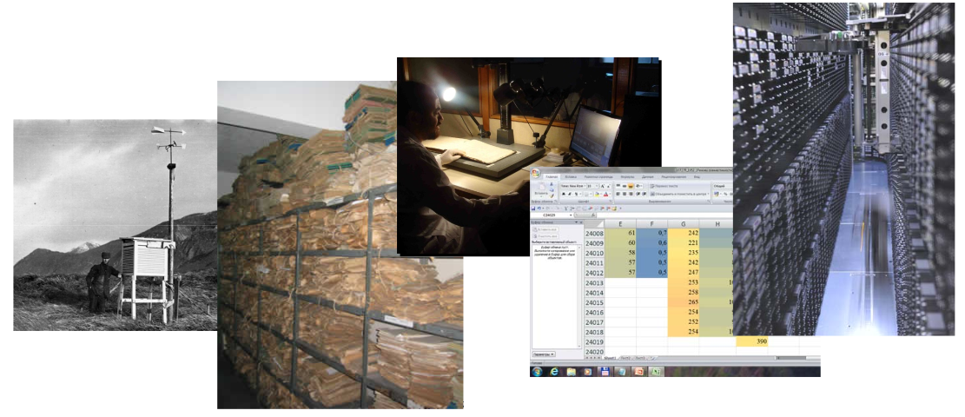
Historical data record has to be improved
Data rescue activities:
• inventory past measurements
• produce high resolution image
• digitalize (manual keying or automatic recognition software)
• reformat to ASCII files
• import to our MARS system

Slide 32



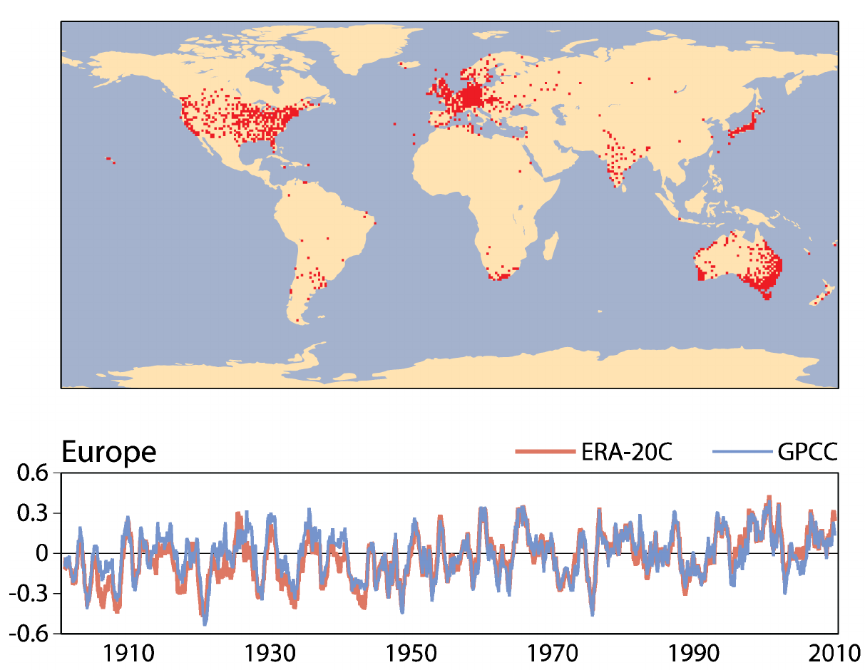
ERA-20C
ERA-20C: the ECMWF atmospheric reanalysis of the 20th century
Model: IFS (CY38R1, Jun 2012)
Forcing: SST/SIC prescribed (HADISST2)
Observation: surface conventional
Assimilation: 4D-Var
Resolution: 125km (T159L91)
Period: 1900-2010
Atmosphere
Land
Wave
Precipitation anomaly averaged over Europe in mm/day (12-month running mean, anomalies relative to 1961-1990)
GPCC precipitation independent gridded dataset
→ ERA-20C represents well the inter-annual fluctuations for the whole century, especially from 1945 onwards

Slide 33
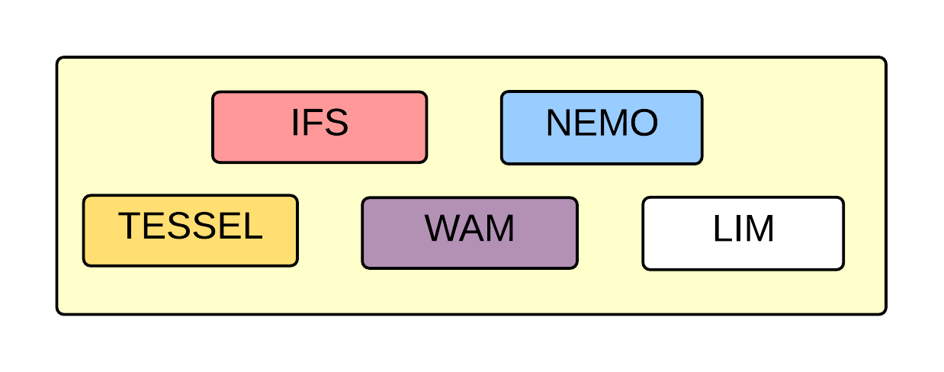
Extended climate reanalyses for the coupled earth model
ECMWF coupled Earth model for medium-range weather forecasting
ECMWF coupled Earth model
Karl and Trenberth 2003
New coupled assimilation system (CERA) for the coupled Earth model:
atmospheric and ocean observations assimilated simultaneously
ocean observations can impact atmospheric estimate and conversely

Slide 34


From ERA-20C to CERA-20C
ERA-20C: the ECMWF atmospheric reanalysis of the 20th century
Model: IFS (CY38R1, Jun 2012)
Forcing: SST/SIC prescribed (HADISST2)
Observation: surface conventional
Assimilation: 4D-Var
Resolution: 125km (T159L91)
Period: 1900-2010
Atmosphere
Land
Wave
CERA-20C: the first ECMWF coupled reanalysis of the 20th century
Atmosphere
Land
Wave
Ocean
Sea ice
Model: IFS/NEMO/LIM2 (CY41R2, Mar 2016)
Forcing: SST nudged (HADISST2)
Observation: surface conventional, salinity and temperature profiles
Assimilation: new CERA system (10-member ensemble coupled hybrid DA)
Resolution: T159L91/ORCA1 Z42
Period: 1901-2010

Slide 35
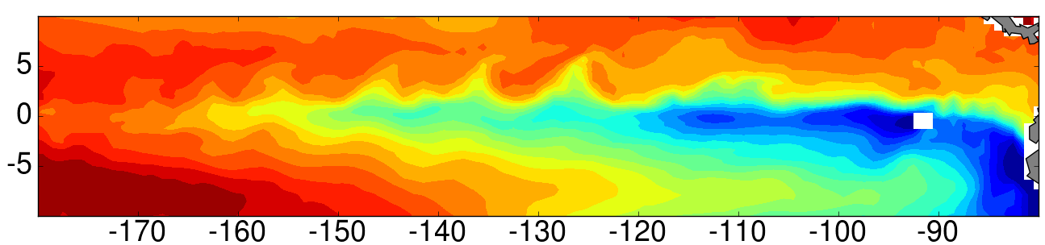
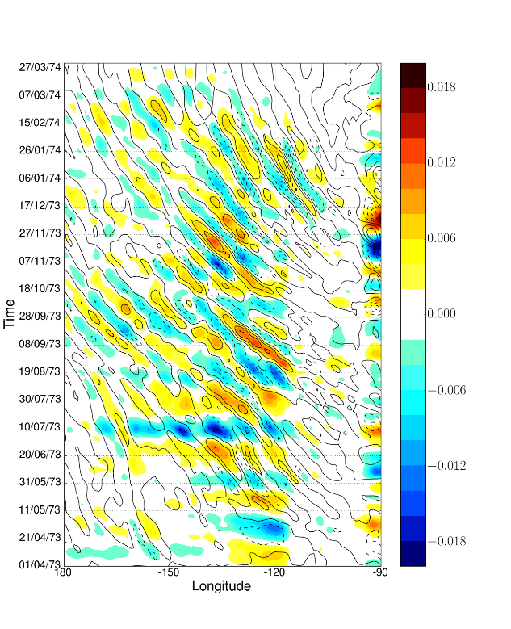
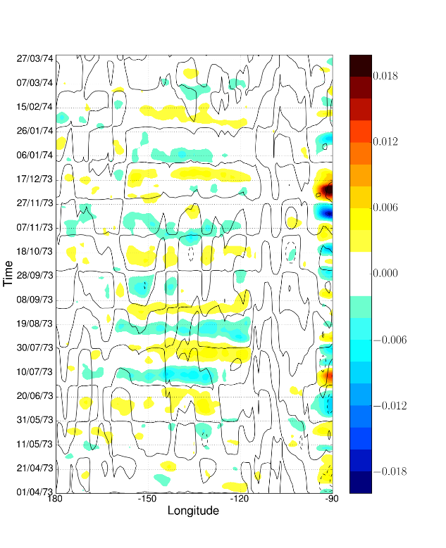
Tropical Instability Waves
TIW are westward-propagating waves near the equator (intraseasonal coupled process)
CERA-20C
ERA-20C
CERA-20C
→ represents TIWs thanks to the ocean dynamics
→ atmosphere is responding accordingly (surface wind stress is sensitive to the ocean TIW)
ERA20C
→ no TIWs and wind stress signals (forced by monthly SST)
high-pass filtered SST (colour) and wind stress (contour)
Courtesy of E. de Boisseson

Slide 36
Summary of important concepts
Key aspects that require particular attention in reanalysis
• external forcing fields for the NWP model
• biases in the model and observations
• changes in the observing system
• specification of background and observation errors
Reanalysis neither produces “gridded observations” nor “model data”
• extract information from observations using the model to propagate the information in space and time, and across variables
Unlike NWP, a very important concern in reanalysis is the consistency in time, spanning several years
Reanalysis is worth repeating as all ingredients continue to evolve
• models, data assimilation, observation reprocessing and data rescue
• with each new reanalysis, understanding of model/observations biases is improved

Slide 37



ECMWF reanalysis products
A
Atmosphere/land including ocean waves
1) 1979 - 1981
FGGE
2) 1994 - 1996
ERA-15
3) 2001 - 2003
ERA-40
4) 2006 - …
ERA-Interim
5) 2016 - …
ERA5
Ocean including sea ice
2006
ORAS3
2010 - …
ORAS4
2016 - …
ORAS5
Centennial
2013 - 2015
ERA-20CM/20C
2016
CERA-20C
Enhanced land
2012
ERA-Int/Land
2014
ERA-20C/Land
2017 - …
ERA5L
Atmospheric composition
2008 - 2009
GEMS
2010 - 2011
MACC
2017 - …
CAMS

Slide 38
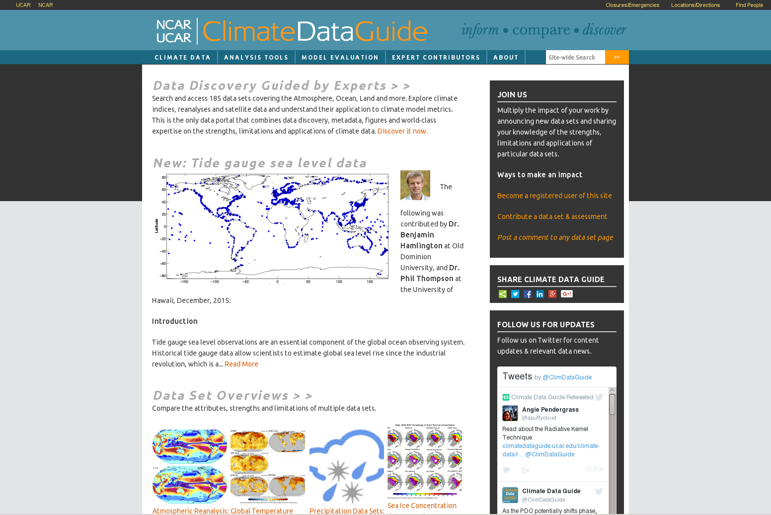
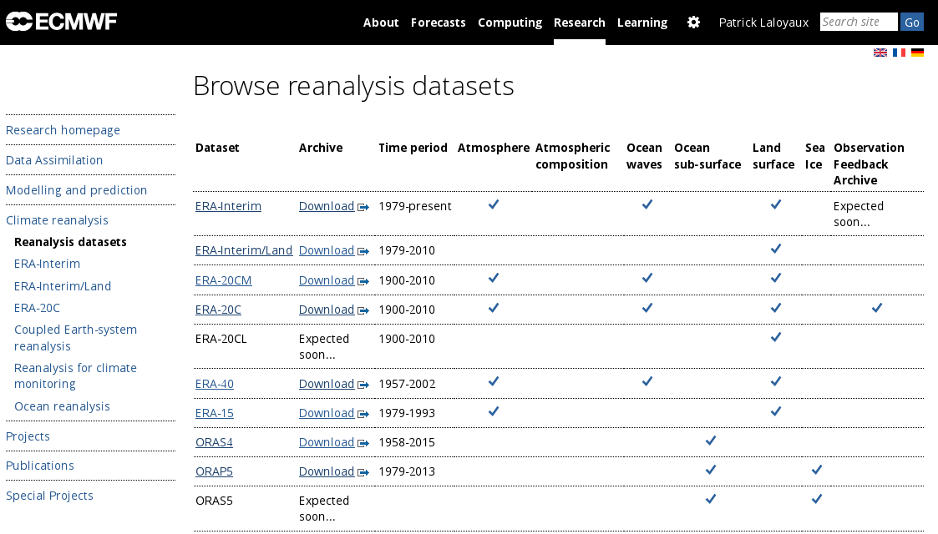
Websites
https://climatedataguide.ucar.edu/
Dataset overviews
http://www.ecmwf.int/en/research/climate-reanalysis
ECMWF reanalysis datasets

Slide 39
Further readings
Reanalysis:
Toward a consistent reanalysis of the climate system.
D.Dee et al., BAMS, 95, 1235–1248, 2014.
The need for a dynamical climate reanalysis.
Bengtsson et al., BAMS, 88, 495-501, 2007.
The ERA-Interim reanalysis: configuration and performance of the data assimilation system.
Dee et al., QJRMS, 137, 553-597, 2011.
Estimating low-frequency variability and trends in atmospheric temperature using ERA-Interim. Simmons et al., QJRMS, 140, 329-353, 2014.
ERA-20CM: A twentieth-century atmospheric model ensemble.
H. Hersbach et al., QJRMS, 141, 2350-2375, 2015.
ERA-20C: An atmospheric reanalysis of the 20th century.
P. Poli et al., Journal of Climate, In press.
Observation recovery:
ERA-CLIM: Historical Surface and Upper-Air Data for Future Reanalyses
A. Stickler et al., Bull. Amer. Meteor. Soc., 95, 1419-1430, 2014.
Coupled assimilation:
A coupled data assimilation system for climate reanalysis.
P. Laloyaux, M. Balmaseda, D. Dee, K. Mogensen and P. Janssen. QJRMS. In press
Origin and impact of initialisation shocks in coupled atmosphere-ocean forecasts.
D. Mulholland, P. Laloyaux, K. Haines, M. Balmaseda. MWR. In Press.
Impact of scatterometer wind data in the ECMWF coupled assimilation system.
P. Laloyaux, J.-N. Thépaut and D. Dee. MWR. In Press.

