Slide 1
Conventional and actively sensed observations
Lars Isaksen
Earth System Assimilation Section, ECMWF
Acknowledgements to: Saleh Abdalla, Giovanna De Chiara, Sean Healy, Bruce Ingleby and Mike Rennie

Slide 2
Overview of Lecture
Overview of conventional observations and some actively sensed observations
The contribution of conventional and actively sensed observations to NWP forecast skill
Why observations are essential for data assimilation
Why variational data assimilation is very flexible with respect to observation usage
More about assimilating actively sensed observations

Slide 3
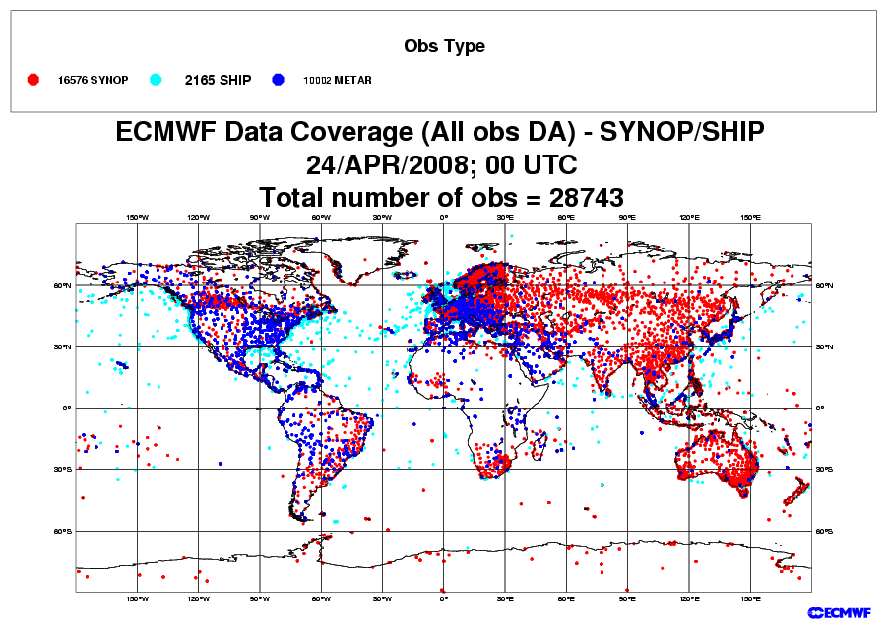
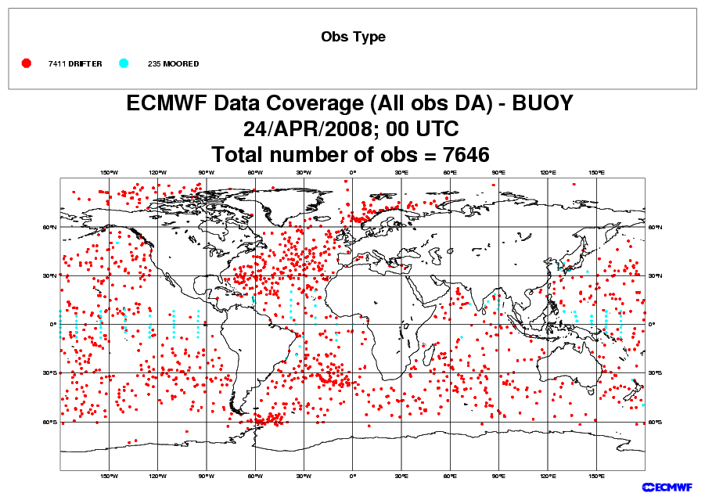
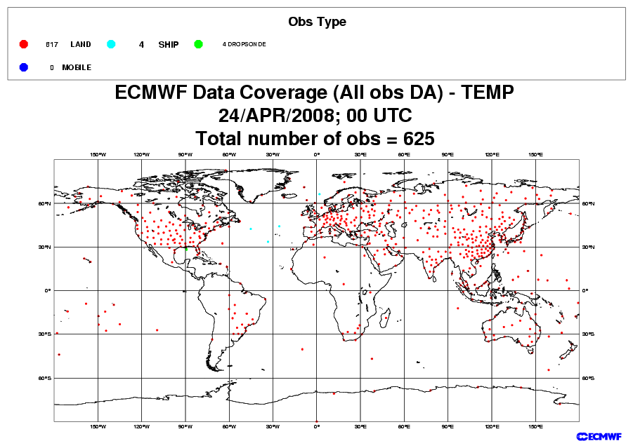
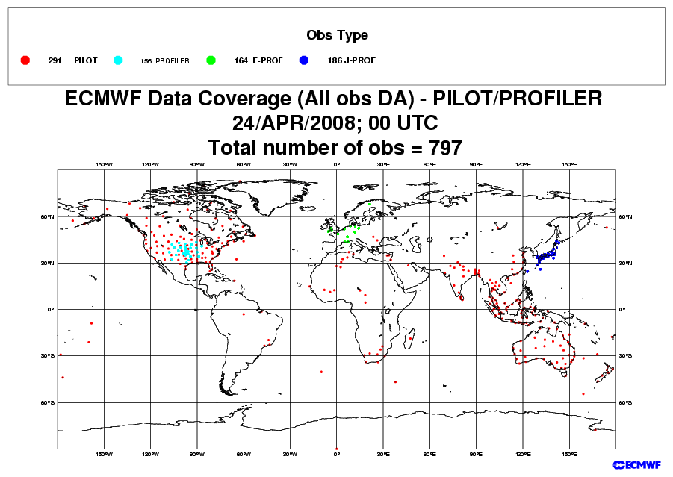
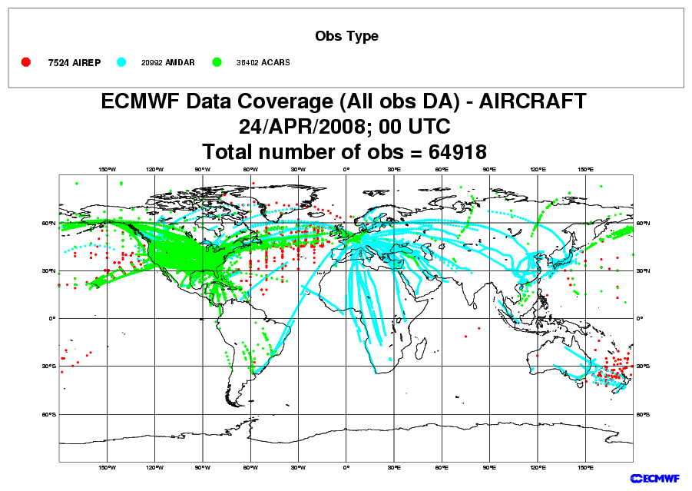
In situ observations used by ECMWF’s analysis
SYNOP/METAR: MSLP, 2m-Rel.Hum
SHIP: MSLP, 10m-Wind
Drifters: MSL Pressure, 10m-Wind
Radiosonde balloons (TEMP):
Wind, Temperature, Humidity
PILOT/Profilers: Wind
Note: We only use a limited number of the observed variables; especially over land. Primarily because the model cannot represent the features.
Aircraft: Wind, Temperature, Humidity

Slide 4
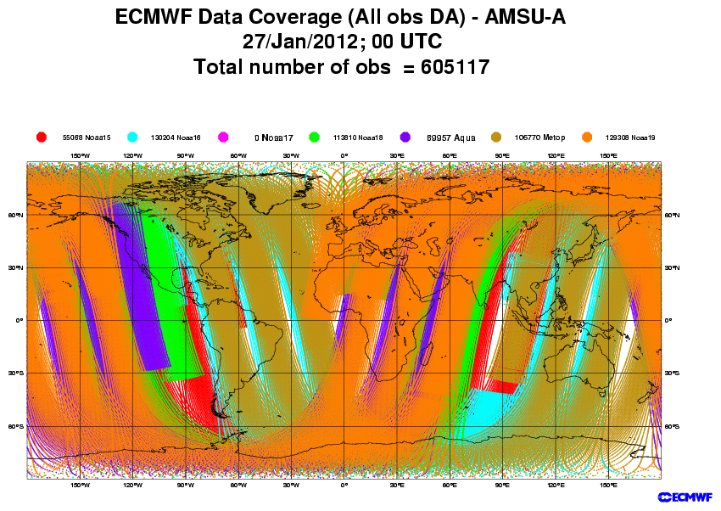
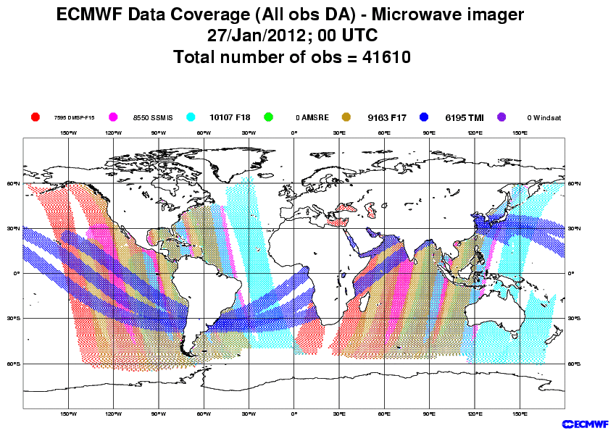
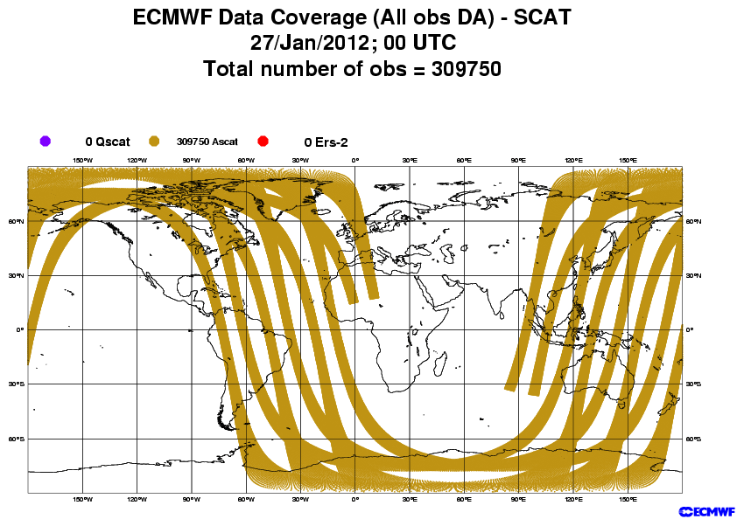
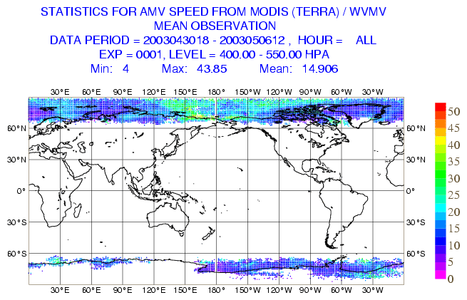
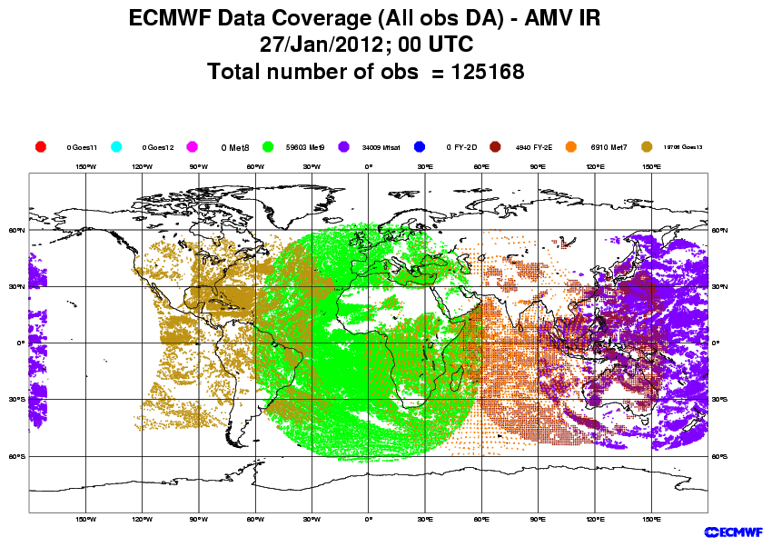
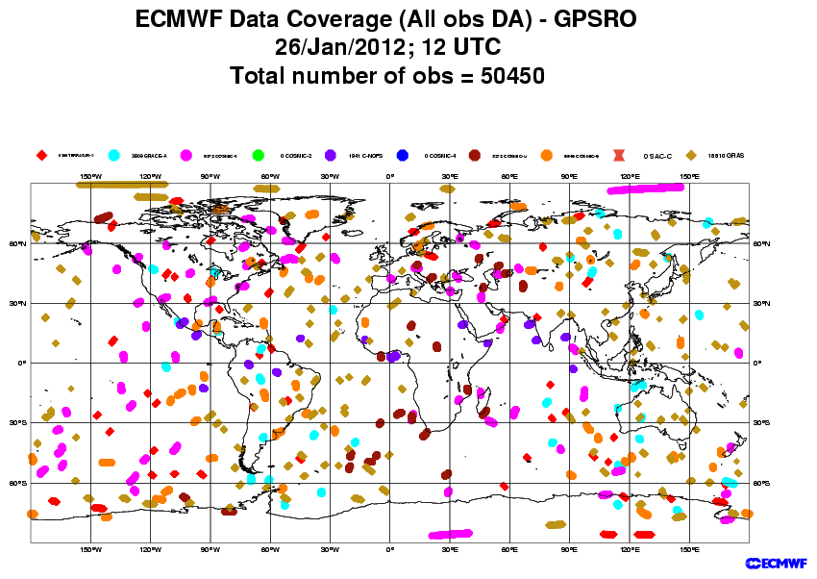
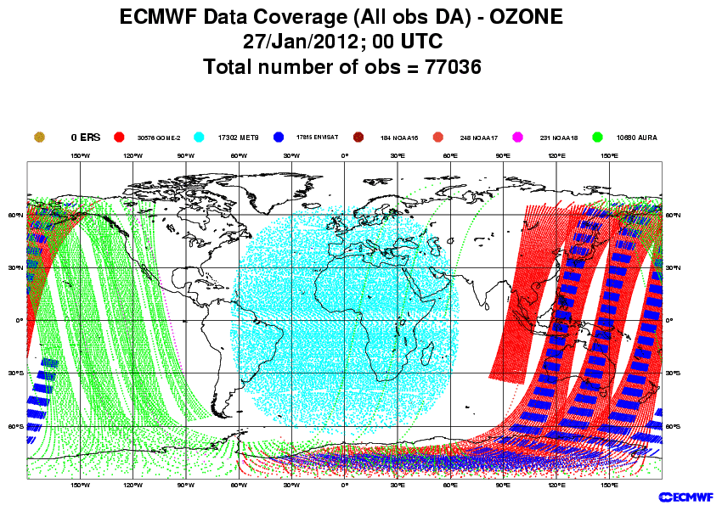
Satellite data sources used by ECMWF’s analysis
Sounders: NOAA AMSU-A/B, HIRS, AIRS, IASI, MHS
Imagers: SSMI, SSMIS, AMSR-E, TMI
Scatterometer ocean low-level winds: ASCAT
Geostationary+MODIS: IR and AMV
GPS radio occultations
Ozone

Slide 5
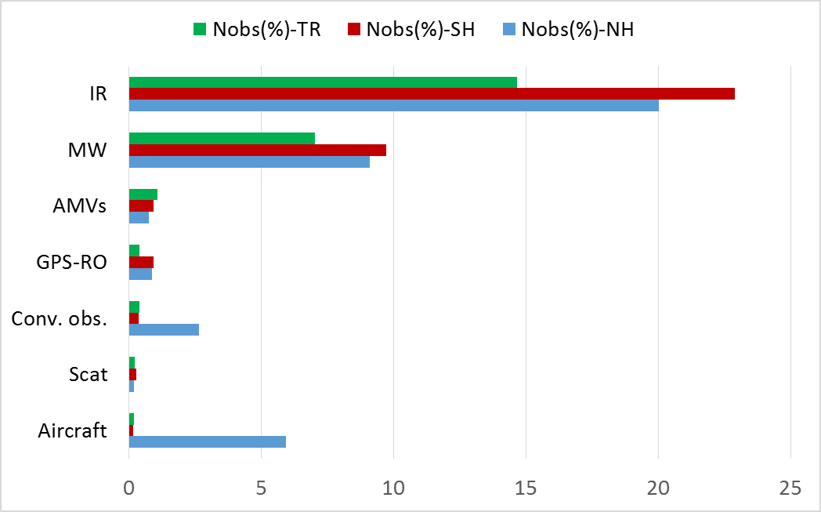
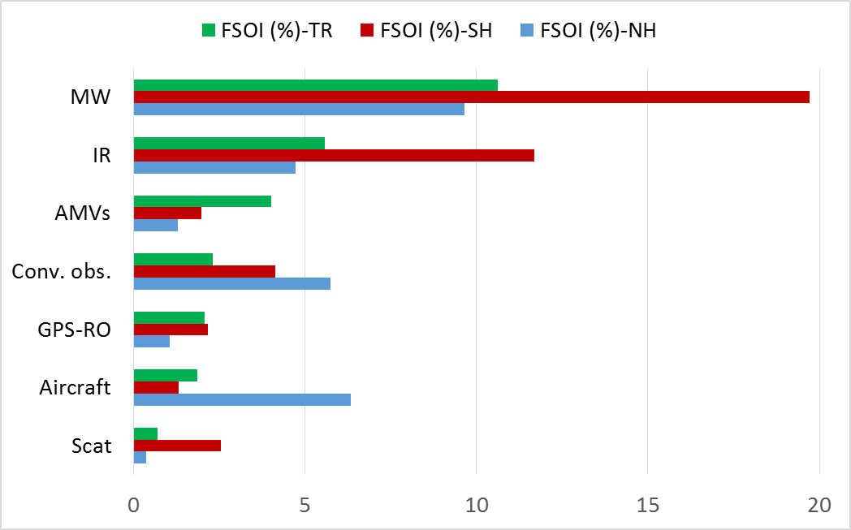
Number of observations and their total FSOI by type of observation: NH, SH, TR
May – August 2016
FSOI: Forecast Sensitivity to Observation Influence (24h forecast). Cristina Lupu will explain FSOI in details on Wednesday

Slide 6
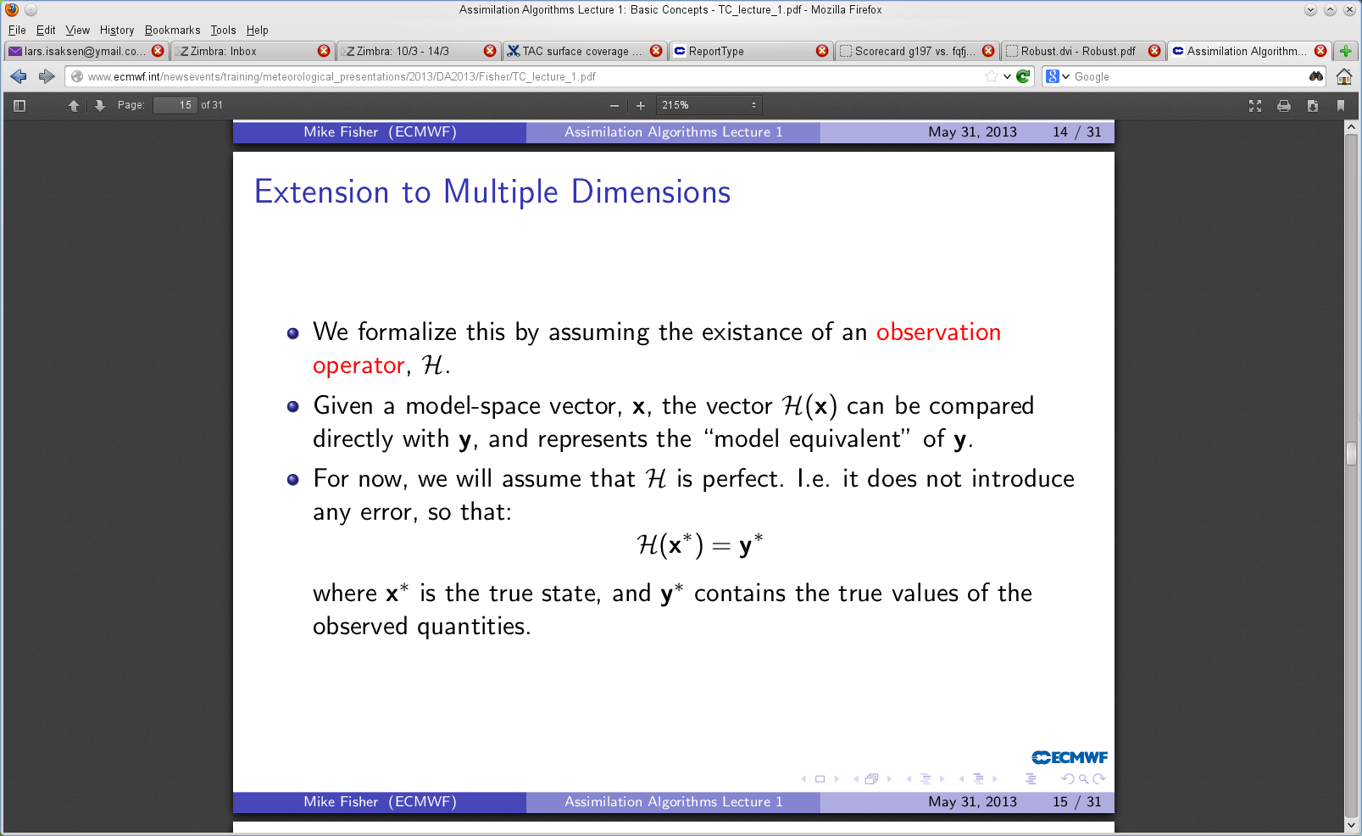
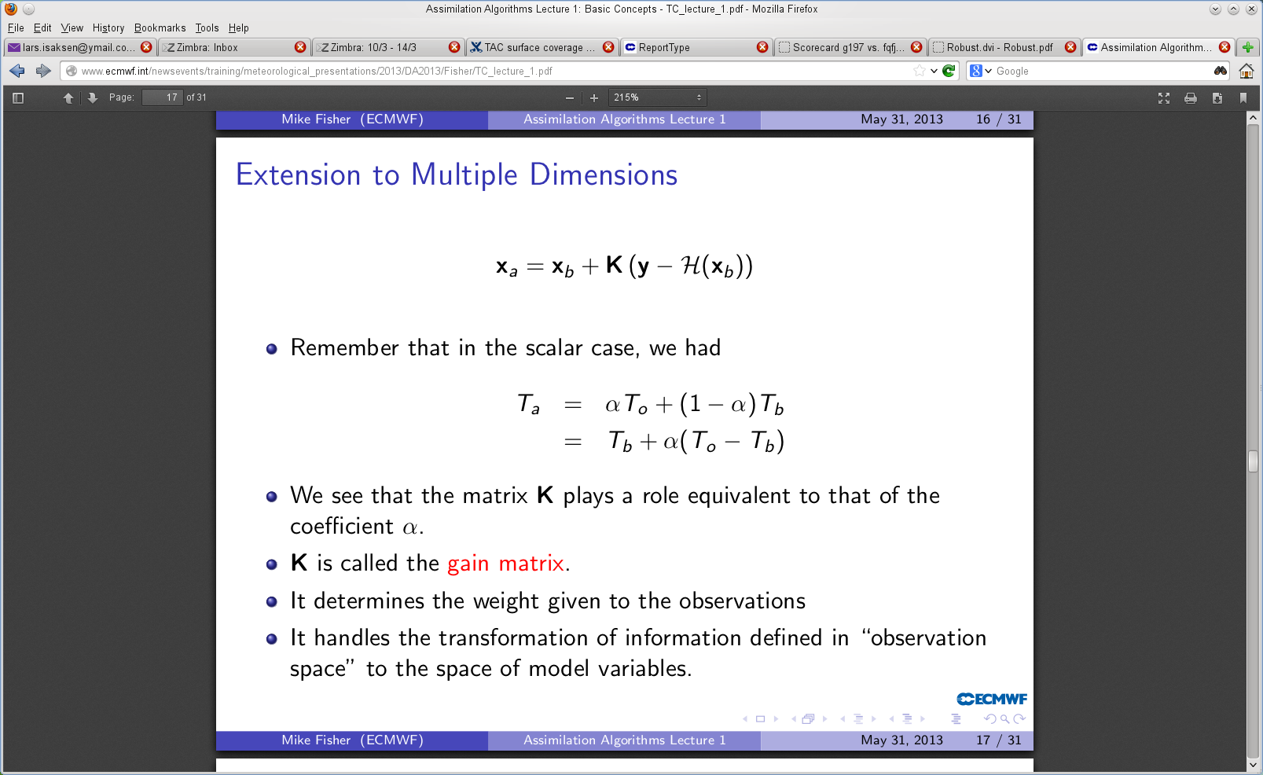
The definition of the observation operator H

Slide 7
Role of the observation operator H
The observation operator H enables the comparison of model and observations.
Accurately computing H(x) is important for deriving accurate background departures and analysis increments.
Observation operator approximations need to be taken into account, e.g., interpolation error and representativeness error due to finite model resolution.
H may be non-linear. (See next talk by Tony McNally)
Difficulties may arise when the observations are significantly influenced by geophysical quantities that are not analysed or well described in the model (e.g. surface emissivity, skin temperature, clouds or precipitation).

Slide 8
DA jargon: Comparing model and observations
The forecast model provides the background (or prior) information to the analysis
Observation operators allow observations and model background to be compared (“o-b”)
The differences are called departures or innovations
They are central in providing observation information that corrects the background model fields
These corrections, or increments, are added to the background to give the analysis (or posterior estimate)
Observation operators also allow comparison of observations and the analysis (analysis departures “o-a”)

Slide 9
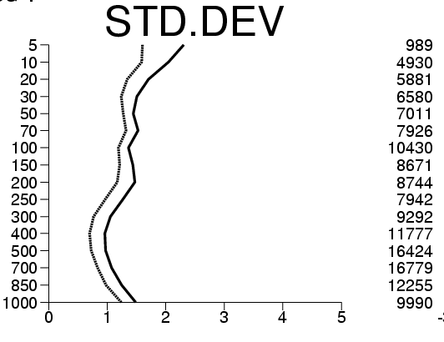
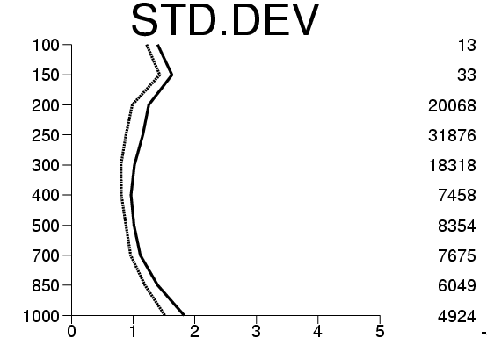
Example: Statistics of departures
Background departures:
Analysis departures:
(o-b)
(o-a)
= observations
= analysis state
= background state
Radiosonde temperature
Aircraft temperature
Pres-sure
(hPa)
Number
of obser-vations
The standard deviation of the analysis departures is here approximately 30% smaller – the analysis has “drawn” to the observations.

Slide 10
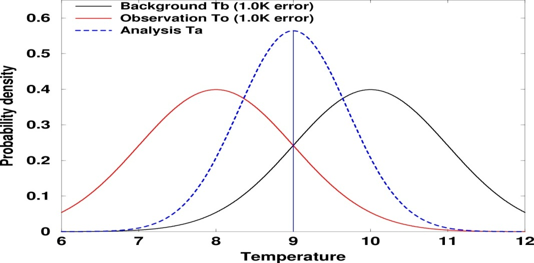
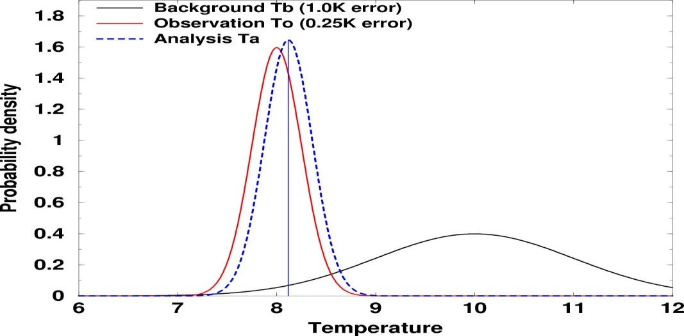
Observations and model background have errors
It is important to specify them accurately
Observed temperature (T_{o}): 8˚C
Background forecast temperature (T_{b}): 10˚ degrees.
Analysis (T_{a}): x˚C

Slide 11
Representativeness Errors
Errors introduced by the interpolation operator, and also by the finite resolution of the model fields, are often accounted for by adding “representativeness” errors to the “instrument” error of the observations.
For some data, e.g. radiosonde winds, the representativeness errors are the dominant contribution to the observation errors in the matrix R.
In effect, we compare model and observations not in observation space, but in model-equivalent space. We ask what would the observed quantity be if we degraded the atmosphere down to model resolution?

Slide 12
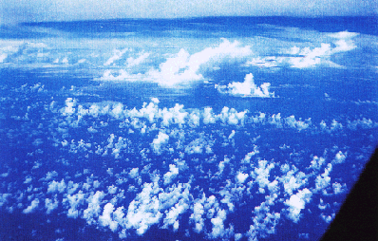
Representativeness Errors
Model grid box small, but it is still not possible to represent all features
Grid box 9km x 9km x 150m

Slide 13
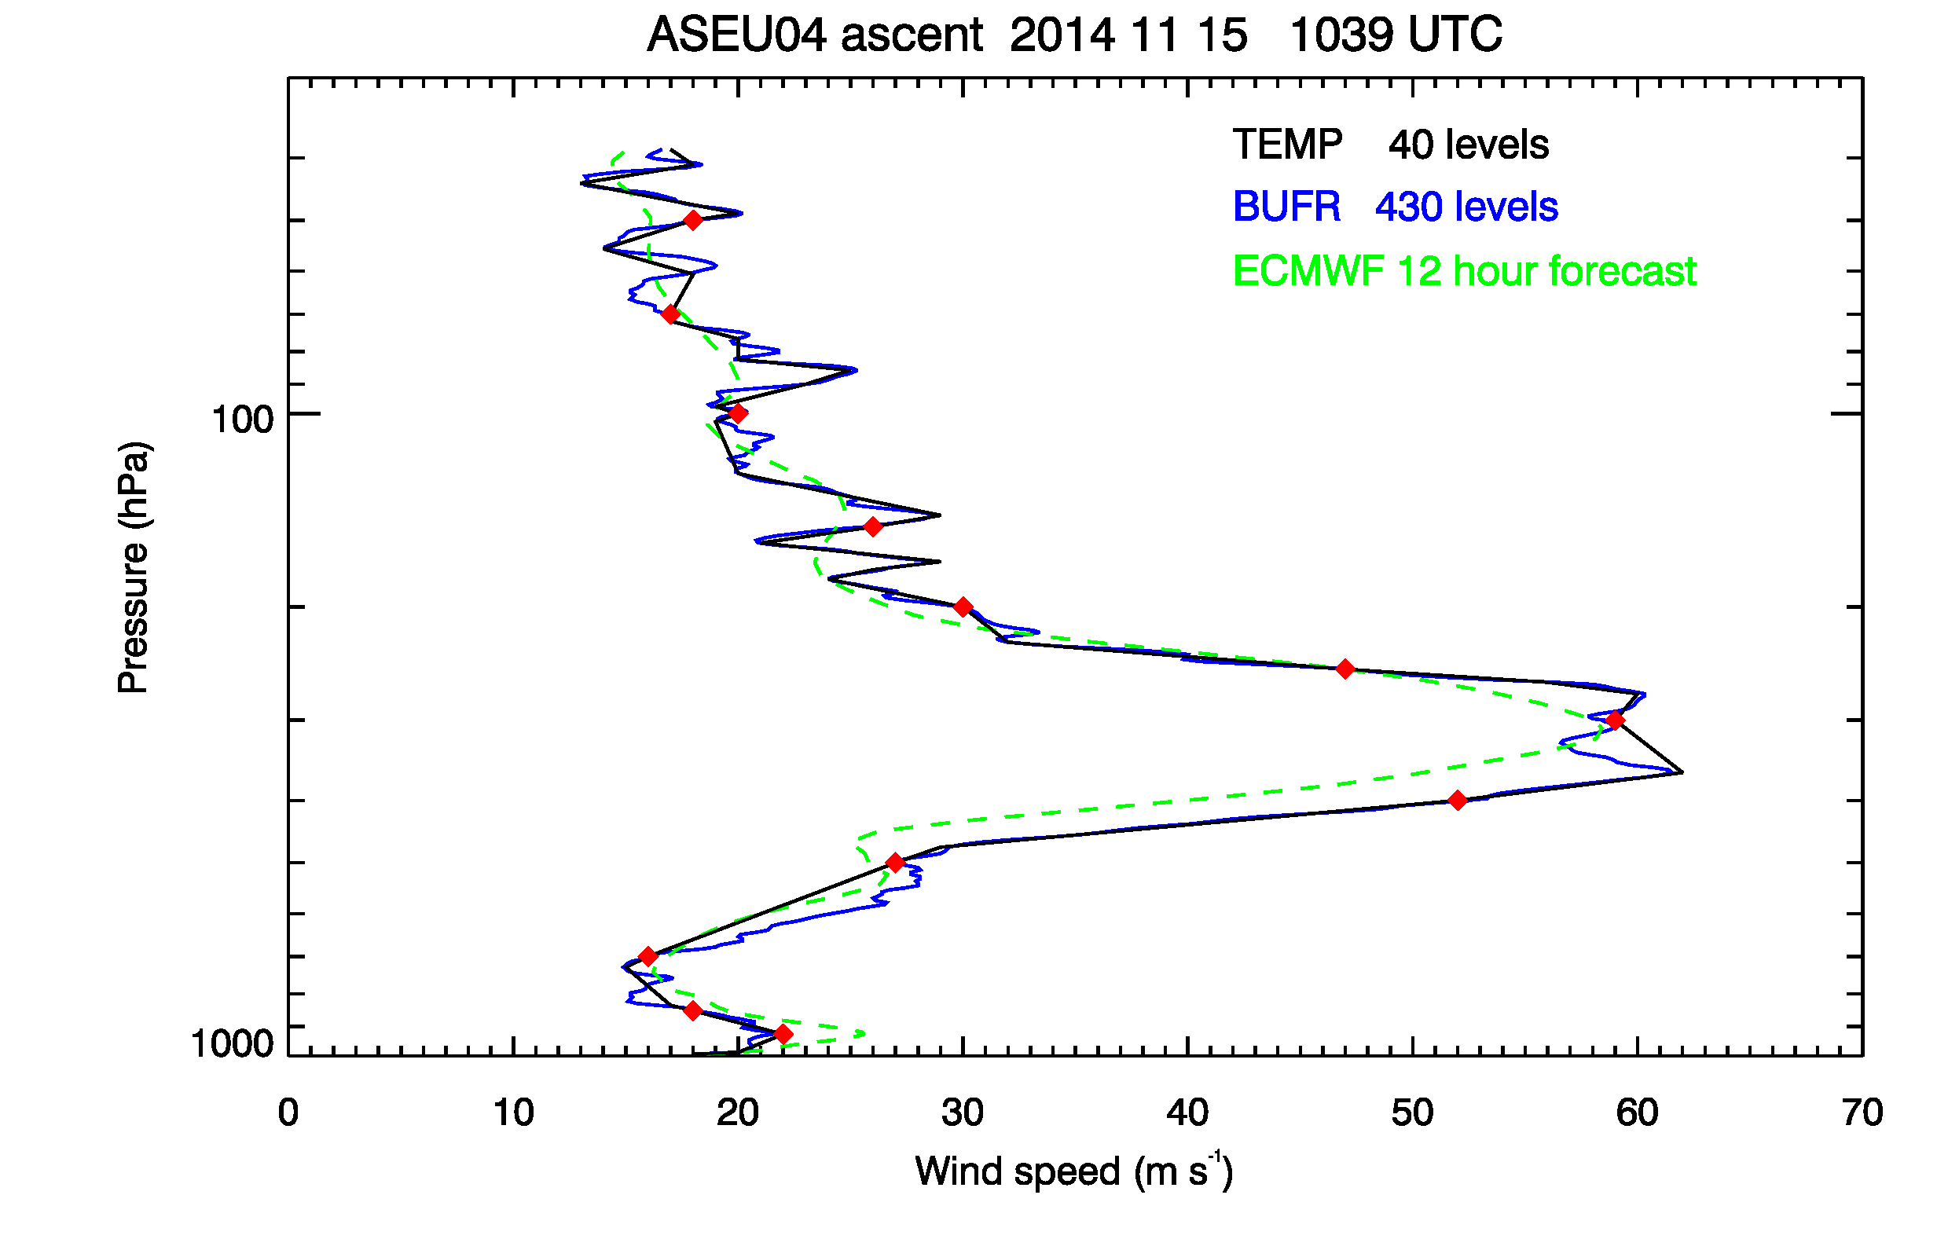
Radiosonde wind speed compared to ECMWF 12-h forecast
An example of representativeness aspects
Bruce Ingleby, ECMWF

Slide 14
Quality control of observations is very important
Blacklisting
Data skipped due to systematic bad performance or due to different considerations (e.g. data being assessed in passive mode)
Departures and flags available for all data for further assessment
Data extraction
Check out duplicate reports
Ship tracks check
Hydrostatic check
Thinning
Some data is not used to avoid over-sampling and correlated errors
Departures and flags are still calculated for further assessment
Model/4D-Var dependent QC
First guess based rejections
VarQC rejections
Used data → Increments
Analysis

Slide 15
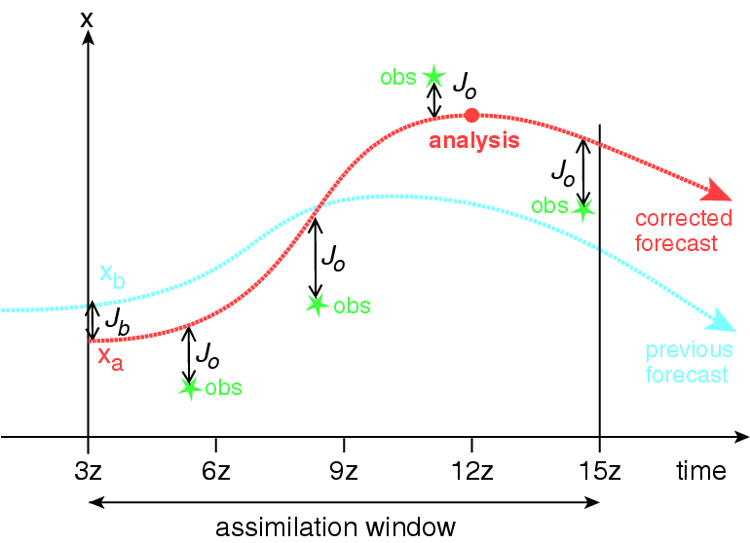
ECMWF use a 4D Variational (4D-Var) Data Assimilation method
Around 20,000,000 observations within a 12-hour period are used simultaneously in one global (iterative) estimation problem
“Observation – model” values are computed at the observation time at high resolution: 16 km
4D-Var finds the 12-hour forecast that take account of the observations in a dynamically consistent way
Based on a tangent linear and adjoint forecast models, used in the minimization process at lower resolution
80,000,000 model variables (surface pressure, temperature, wind, specific humidity and ozone) are adjusted
9Z 12Z 15Z 18Z 21Z
Notes:
The size of the control vector is approx 80M.

Slide 16
Variational data assimilation allows easy use of direct observations
Variational data assimilation allows direct assimilation of radiances and other “non state space”
In 3D-Var (x-y-z):
  All observations are used simultaneously to produce the analysis
  Background constraints, like mass-wind balance, are imposed
  Spatial consistency is ensured
In 4D-Var (x-y-z-time):
  Consistency in time. Frequent data can be used.
  The dynamics of the model acts as additional constraint

Slide 17
This flexibility is very important
The ‘observation operators’ makes the use of observations in variational assimilation systems particularly flexible.
There is no need to convert the observed data to correspond to the model variables.
This has been shown to be of real importance for the assimilation of radiance data, for example
Every observed quantity that can be related to model variables in a meaningful way, can be used in variational data assimilation.

Slide 18
BUOY data – an example of important conventional observations
Good quality Pmsl pressure data (small percentage rejected or bias corrected)
Background msl pressure over ocean also good quality in general
Quasi-continuous in time
Well distributed over most oceans – tropical Pacific gap
Coverage in otherwise very sparse areas

Slide 19
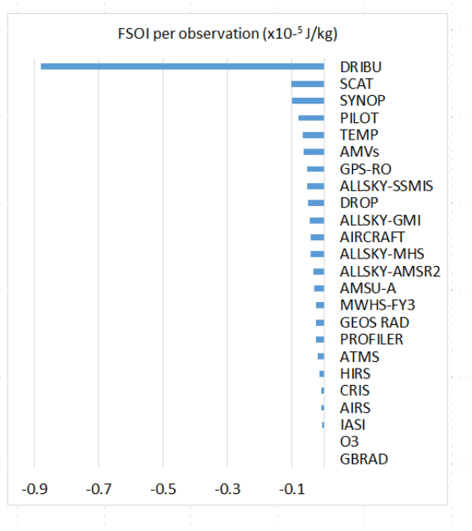
Forecast sensitivity
FSOI: Forecast Sensitivity to Observation Impact
  Uses a particular norm (usually energy) – dimensional
  Negative values indicate smaller errors (at T+24)
FSOI calculated for ECMWF operational system since 2012
Drifting buoys have largest FSOI per datum, results for March 2016 (C Lupu, ECMWF) right

Slide 20
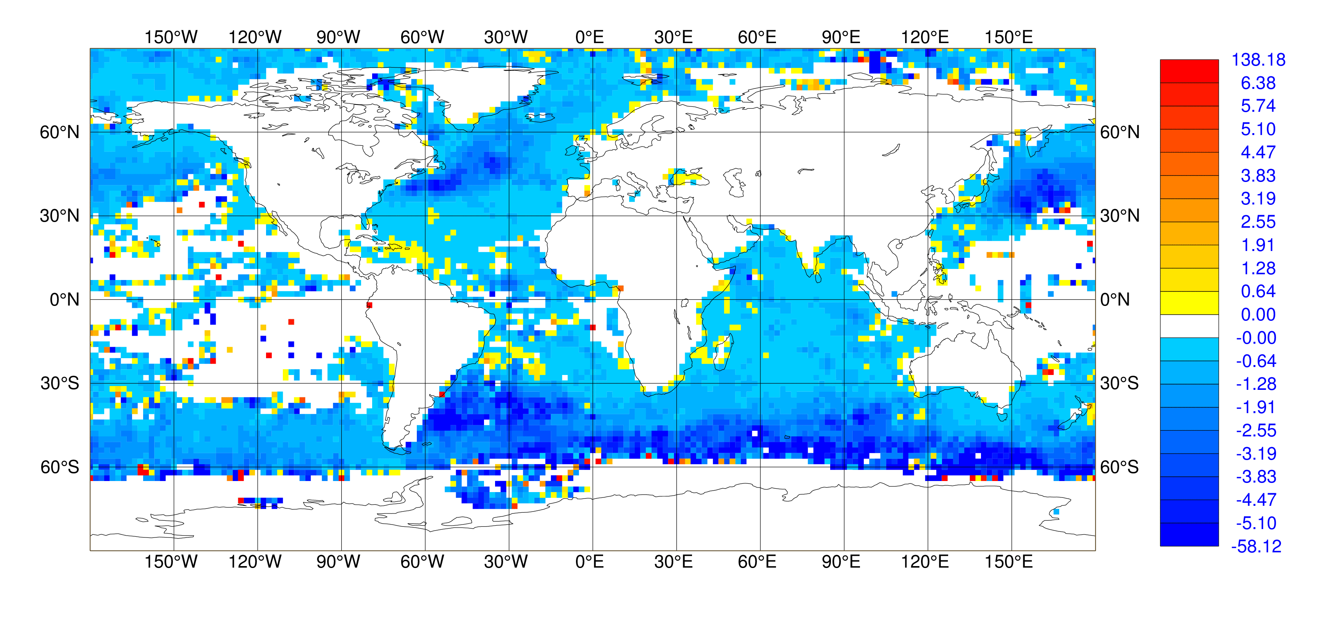
FSOI for BUOY Pmsl
Uses energy norm vs analysis at T+24
Mean value -1.17 J
Small sample points are noisy but clear overall pattern

Slide 21
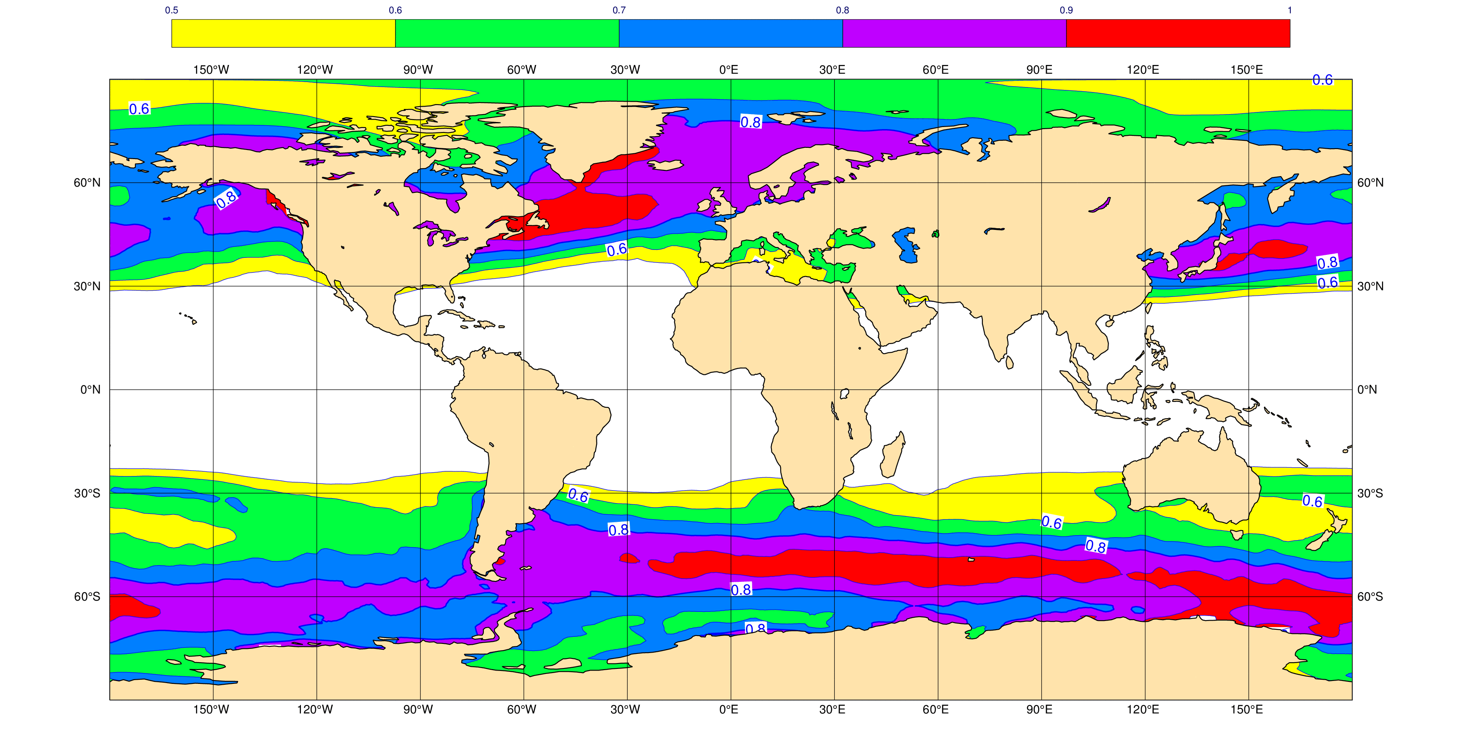
Baroclinic development (rms of Eady index, 2014-2015)
Index calculated from 850 to 300 hPa. Hoskins and Valdes (JAS, 1990)
NH maxima near Gulf Stream and Kuroshio (as for FSOI)

Slide 22
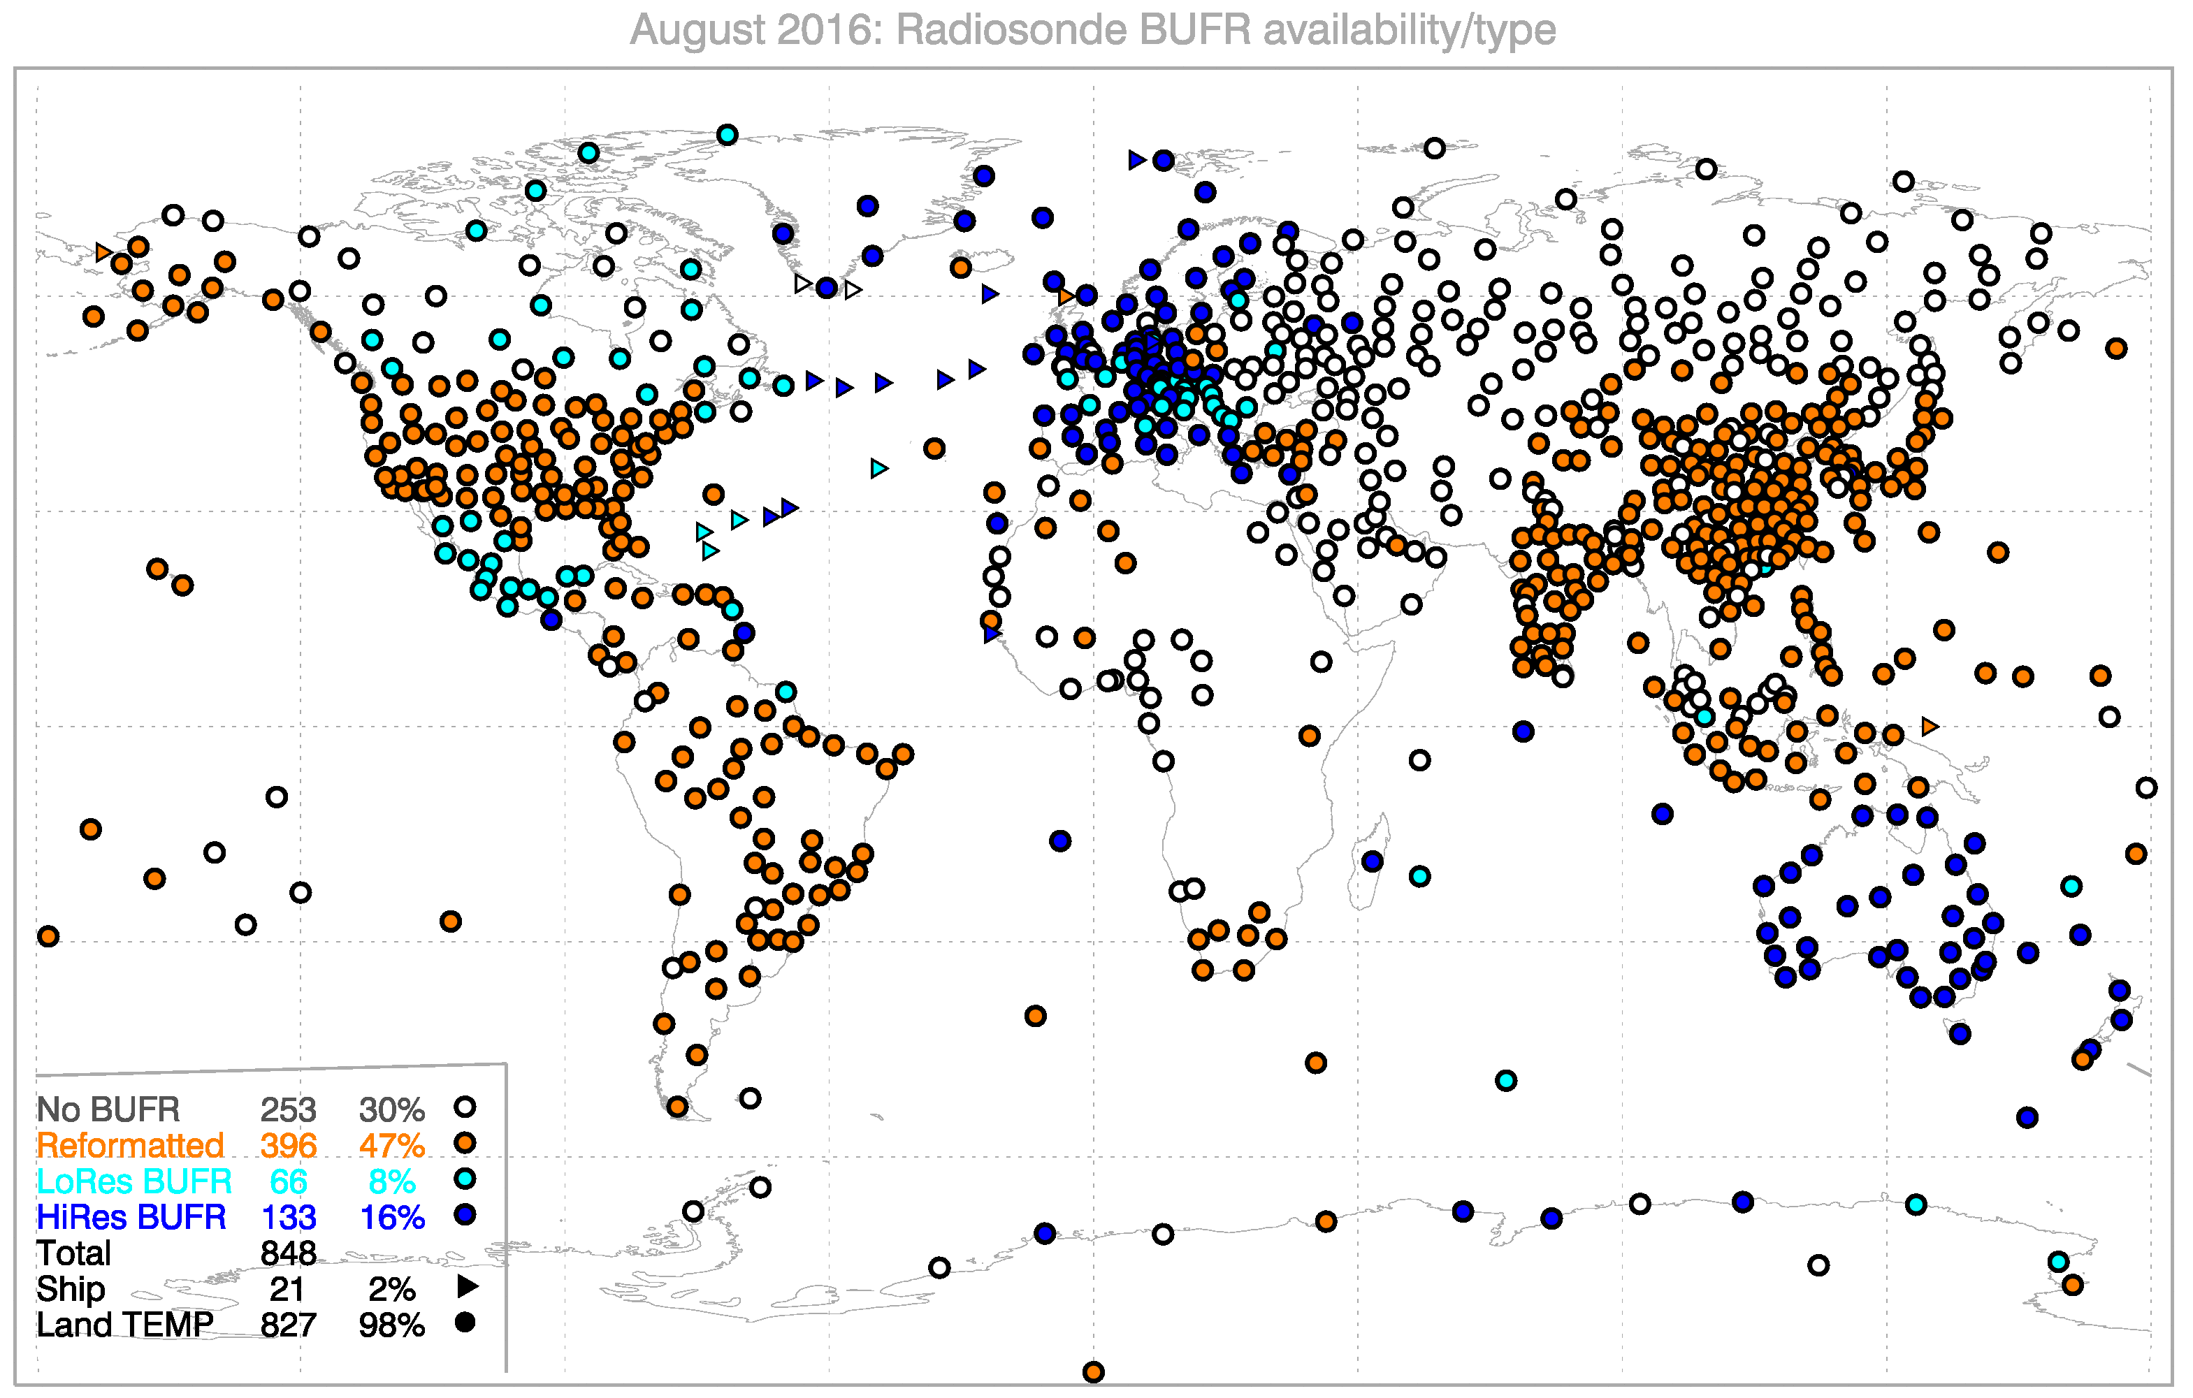
Migration to radiosonde BUFR format
Migration slow, most reformatted TEMP reports (orange) are unusable
https://software.ecmwf.int/wiki/display/TCBUF Ingleby et al (2016, BAMS)

Slide 23
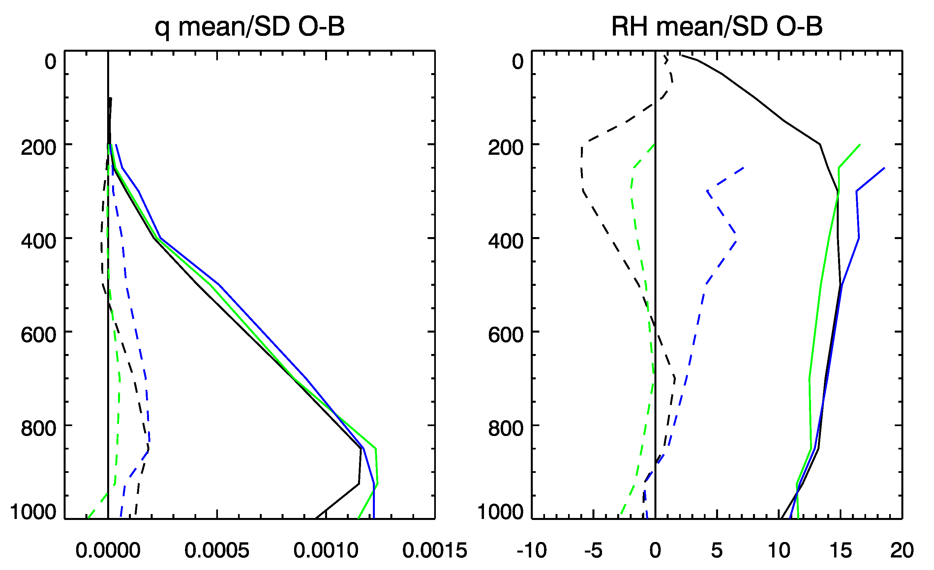
Aircraft and radiosonde humidity
WVSS-II on some aircraft (mainly North America) gives good humidity.
Results for April-June 2014 over North America:
TEMP
AMDAR (WVSS-II)
TAMDAR

Slide 24
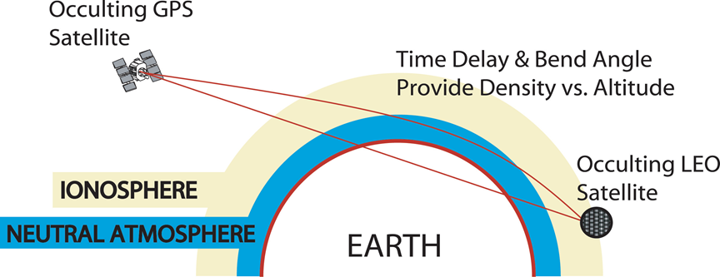
GPS RO geometry
(Classical mechanics: Compare this picture with the deflection of a charged particle by a spherical potential!)
Tangent point
20,200km
α
800km
α
Setting occultation: as the LEO moves behind the earth
we obtain a profile of bending angles, α, as a function of
impact parameter, . The impact parameter is the distance of closest approach for the straight line path. It is directly analogous to angular momentum of a particle.

Slide 25
1D bending angle assimilation at Met Office, NCEP, MF, ECMWF (until 2014)
Most centres assimilate bending angles with a 1D operator: ignore the 2D nature of the measurement and integrate
The forward model is quite simple:
  evaluate geopotential heights of model levels
  convert geopotential height to geometric height and radius values
  evaluate the refractivity, N, on model levels from P,T and Q.
  Integrate, assuming refractivity varies ~(exponentially*quadratic) between model levels. (Solution in terms of the Gaussian error function).
Convenient variable (x=nr)
(refractive index * radius)

Slide 26
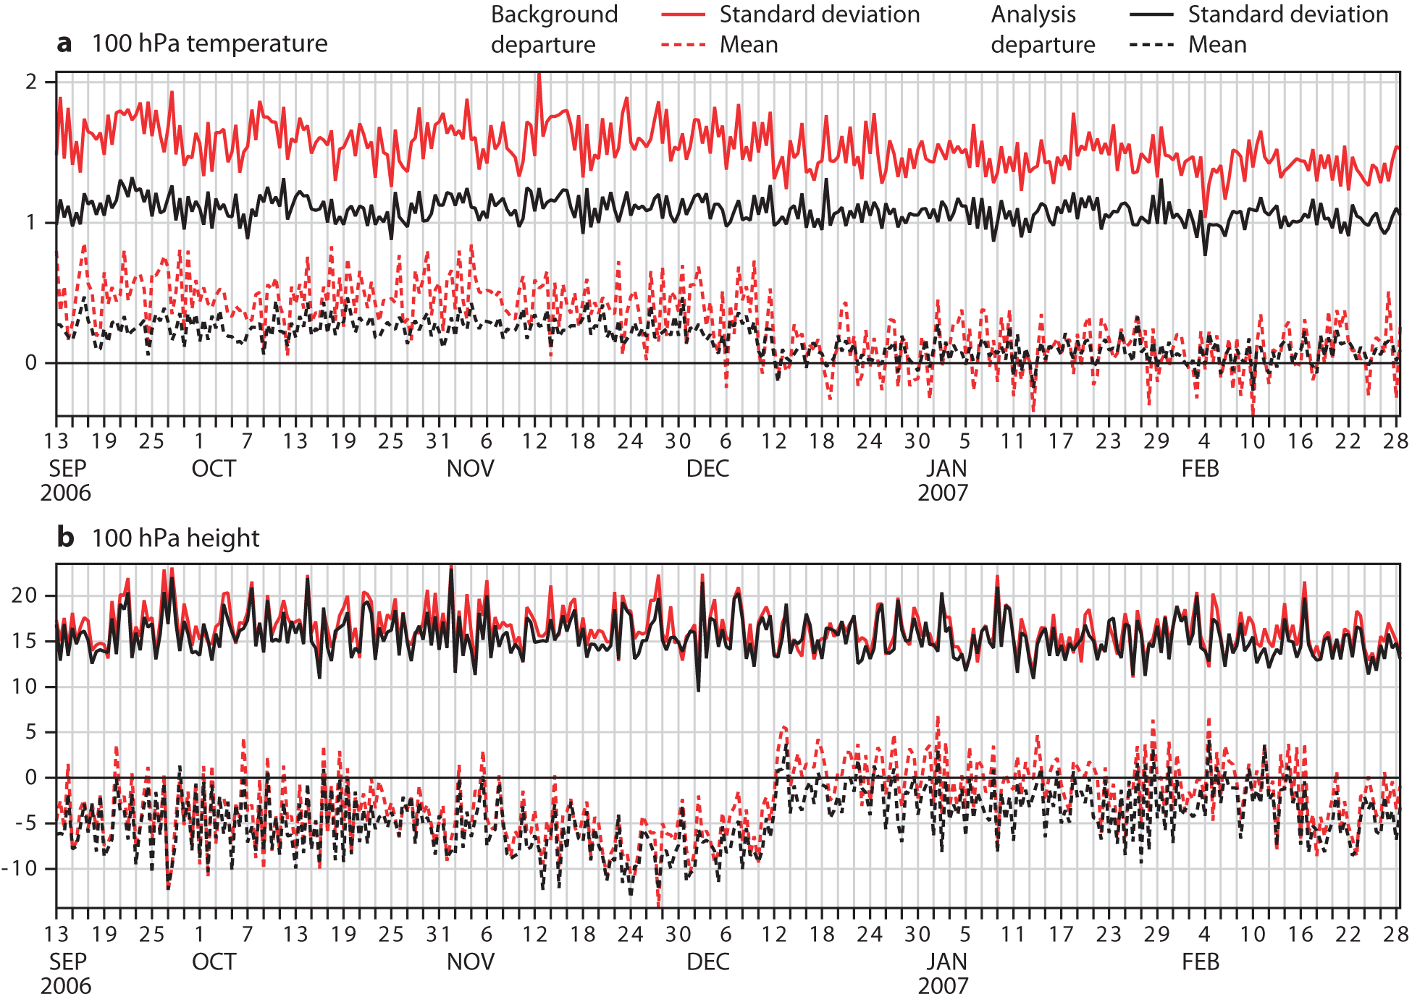
Impact of GPS-RO on ECMWF operational biases against radiosonde measurements
Operational implementation
Notes:
You can see the striking improvement in the fit to radiosondes T and Z measurements at 100 hPa in the SH.

Slide 27
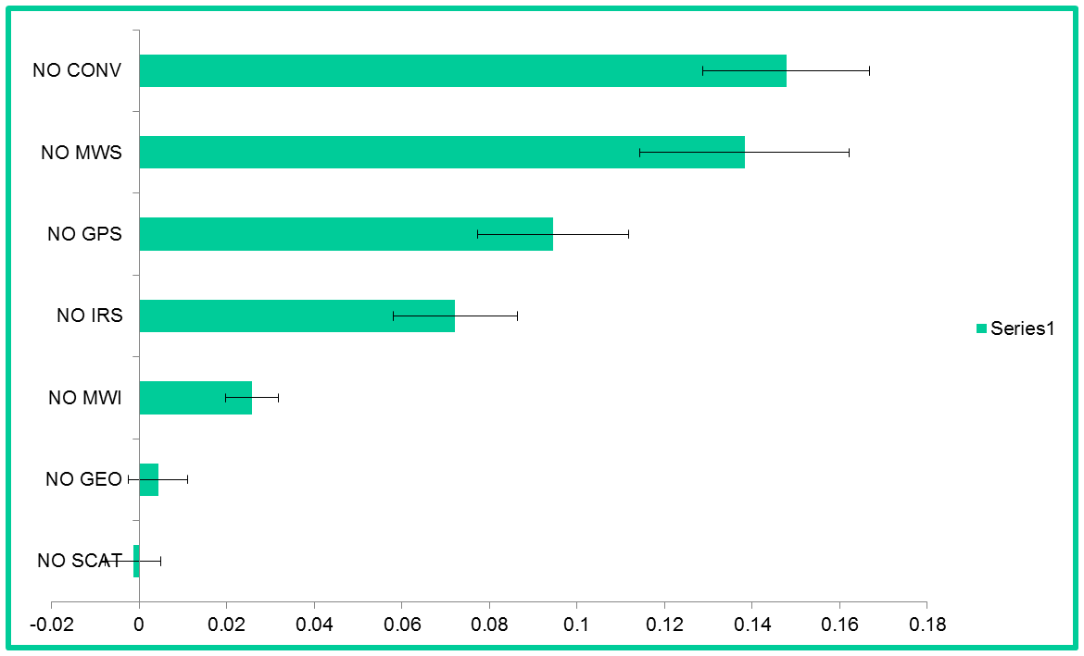
Observing System Experiments 500z (SH-24h)
Recent observing system experiments (OSEs) at ECMWF to put GPS-RO impact in context
See McNally (2014):
http://www.ecmwf.int/sites/default/files/elibrary/2014/14686-impact-satellite-data-global-nwp.pdf

Slide 28
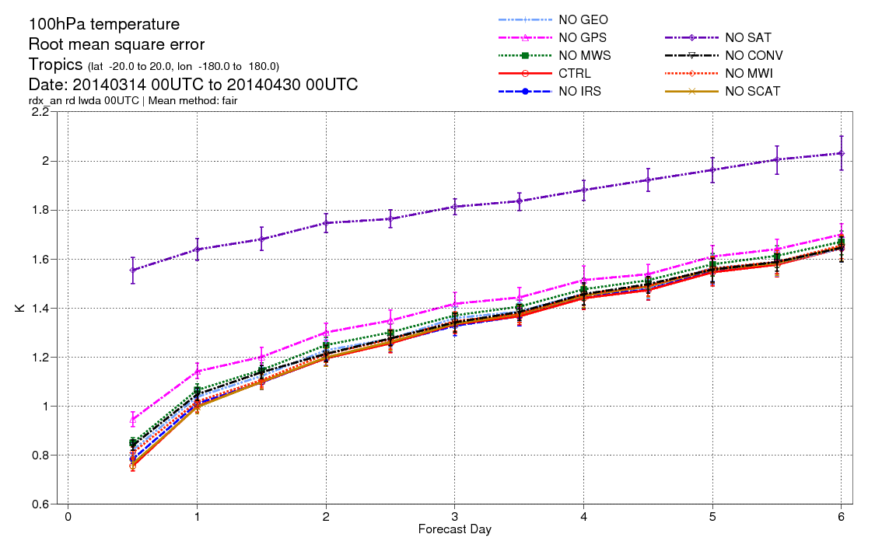
GPS-RO impact on temperature
NO GPS

Slide 29
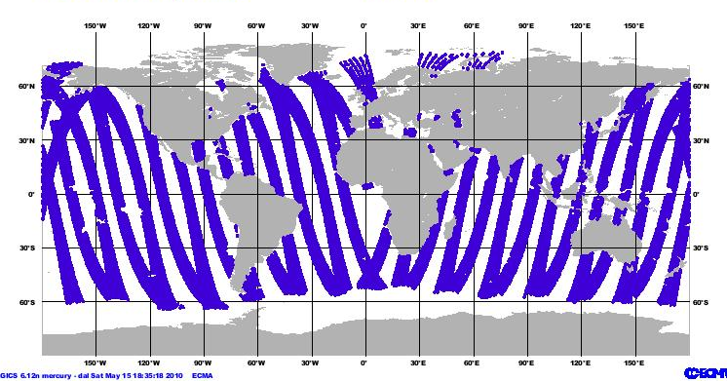
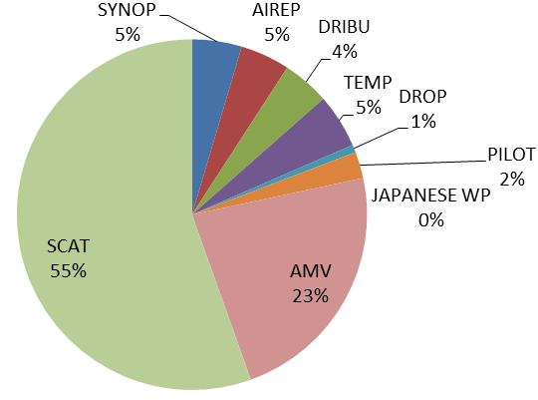
Why is Scatterometer important?
The scatterometer measures the ocean surface winds (ocean wind vector).
Ocean surface winds:
affect the full range of ocean movement
modulate air-sea exchanges of heat, momentum, gases, and particulates
direct impact on human activities
Wind observations below 850 hPa
FSO values relative quantities (in %)
Wide daily coverage of ocean surface winds
Ex: 1 day of ASCAT-A data
[Horanyi et al., 2013]

Slide 30

Scatterometer
A Scatterometer is an active microwave instrument (side-looking radar)
  Day and night acquisition
  Not affected by clouds
The return signal, backscatter (σ₀ sigma-nought), is sensitive to:
  Surface wind (ocean)
  Soil moisture (land)
  Ice age (ice)
Incoming
Returned
Scatterometer was originally designed to measure ocean wind vectors:
  Measurements sensitive to the ocean-surface roughness due to capillary gravity waves generated by local wind conditions (surface stress)
  Observations from different look angles: wind direction

Slide 31
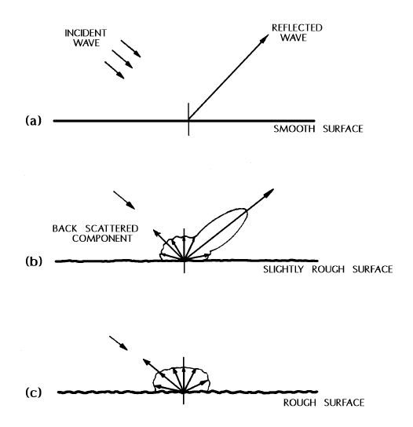


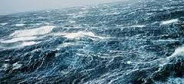
Dependency of the backscatter on... Wind speed

Slide 32

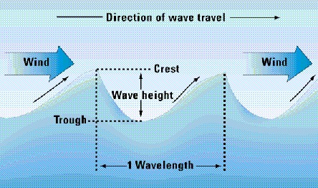
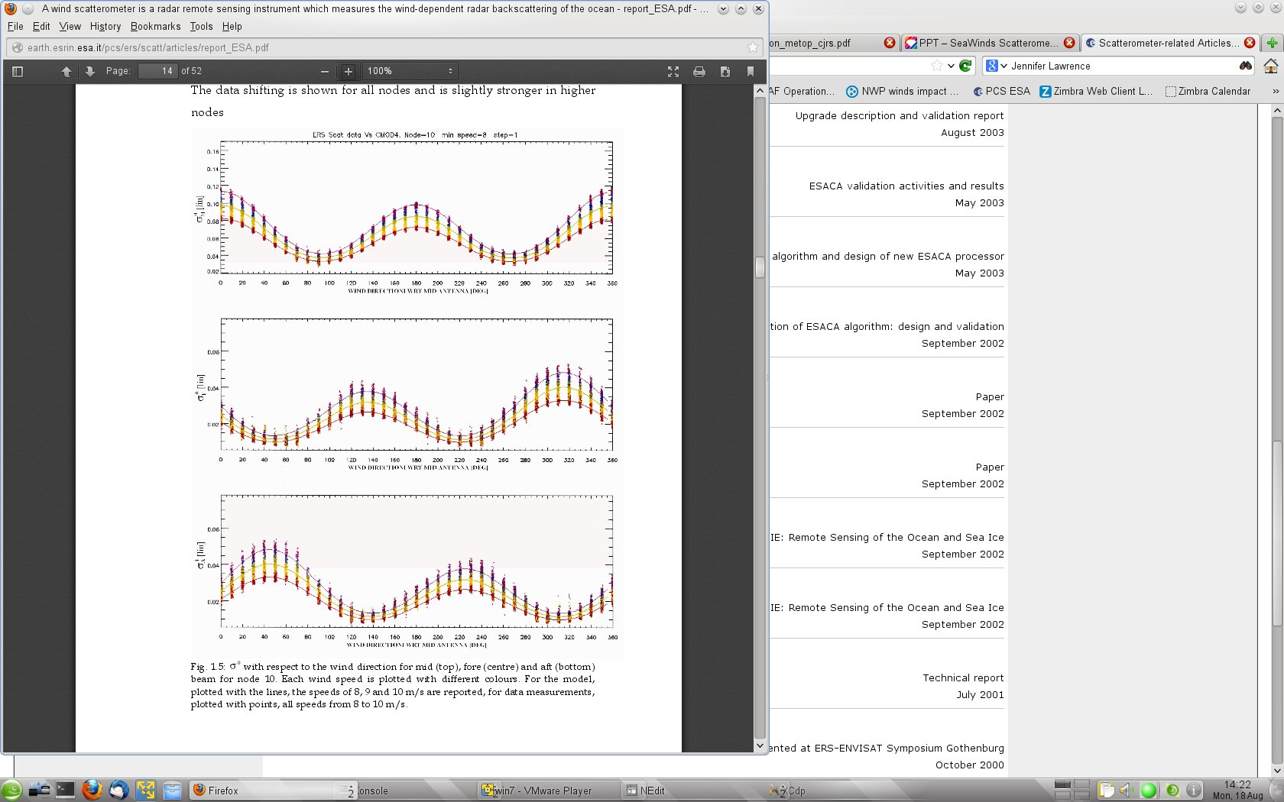
Dependency of the backscatter on... Wind direction
upwind
downwind
upwind
downwind
Wind direction wrt Beam

Slide 33

How can we relate backscatter to wind speed and direction?
The relationship is determined empirically
Ideally collocate with surface stress observations
In practice with buoy and 10m model winds
$$σ_{0}=GMF(U_{10N},φ,θ,p,λ)$$
U_{10N}: equivalent neutral wind speed
φ : wind direction w.r.t. beam pointing
θ : incidence angle
p : radar beam polarization
λ : microwave wavelength

Slide 34
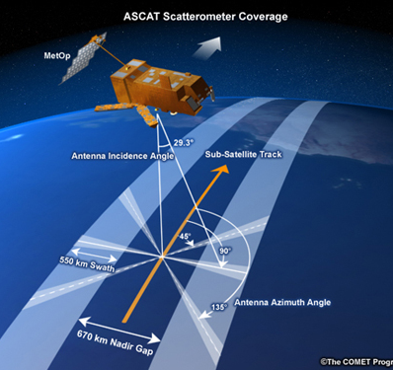
C- band scatterometers
Used on European platforms (1991 onwards):
SCAT on ERS-1, ERS-2 by ESA
ASCAT on Metop-A, Metop-B by EUMETSAT
f~5.3 GHz (λ~5.7 cm)
VV polarization
Three antennae

Slide 35
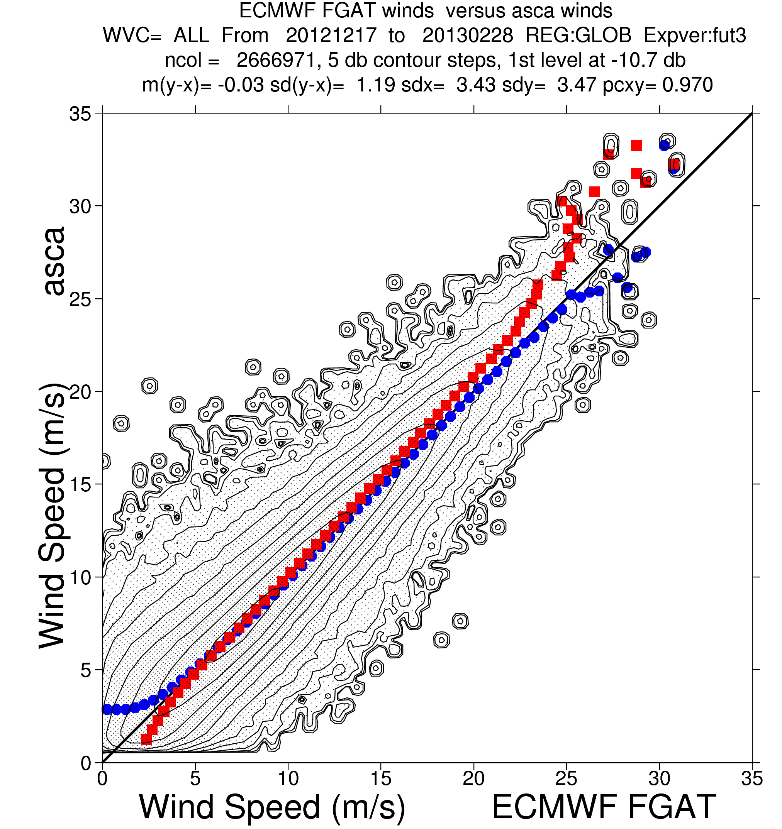
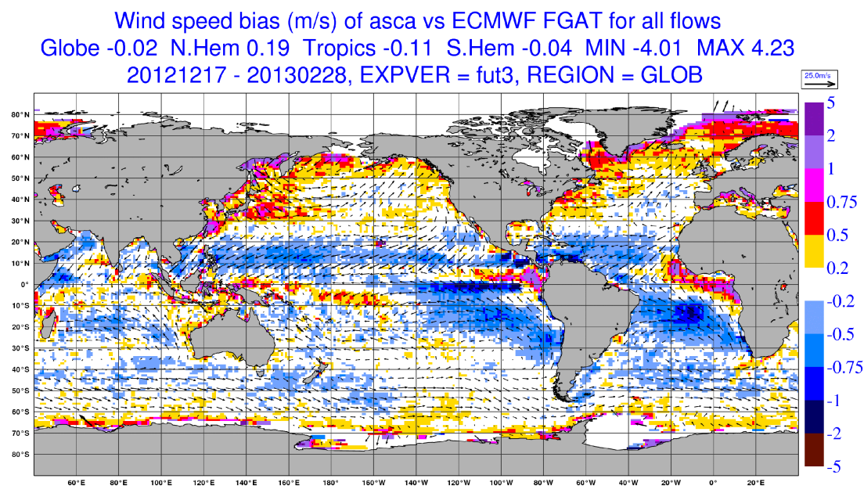
ASCAT-A wind data

Slide 36
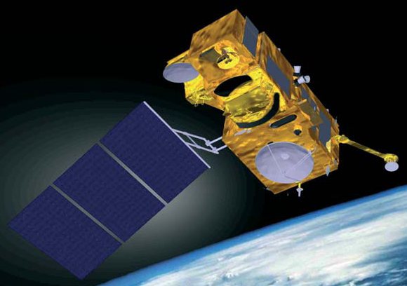
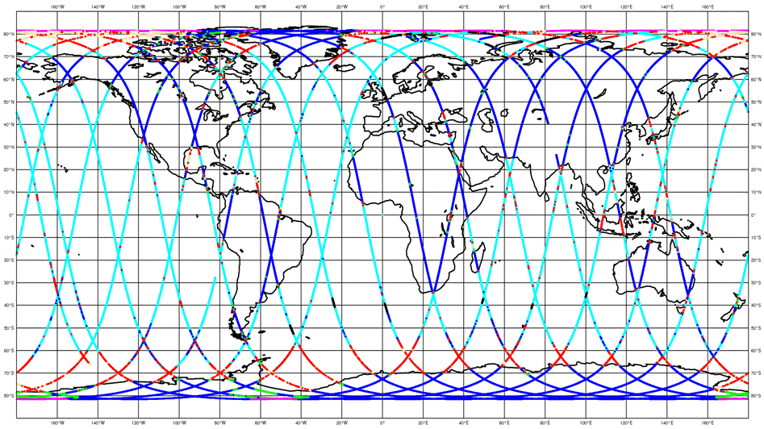
Radar Altimeters
Sentinel-3
Radar altimeter is a nadir looking instrument.
Specular reflection.
Electromagnetic wave bands used in altimeters:
Primary:
Ku-band (~ 2.5 cm) – ERS-1/2, Envisat, Jason-1/2/3, Sentinel-3
Ka-band (~ 0.8 cm) – SARAL/AltiKa (only example)
Secondary:
C-band (~ 5.5 cm) – Jason-1/2/3, Topex, Sentinel-3
S-band (~ 9.0 cm) – Envisat
Radar Altimeter (SRAL)
Envisat 1-day coverage
Main parameters measured by an altimeter:
  Sea surface height (ocean model)
  Significant wave height (wave model)
  Wind speed (used for verification)

Slide 37
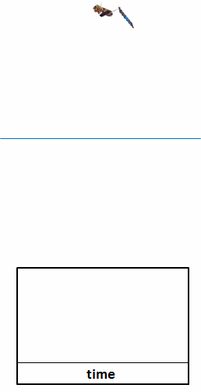

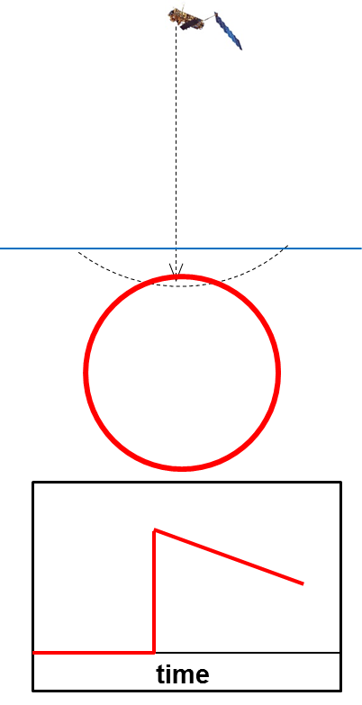


How Altimeter Works
radar signal
Height=∆t/2 × c
a t m o s p h e r e
ocean surface
surface
emitted signal returned signal
illuminated
area
flat surface
rough surface
Power of
illumination
power
time
time

Slide 38

Surface wind speed
waveform
amplitude of
returned signal
➔ wind speed
power
emitted signal backscatter
time
  Backscatter is related to water surface Mean Square Slope (MSS)
  MSS can be related to wind speed
  Stronger wind → higher MSS → smaller backscatter
  Errors are mainly due to algorithm assumptions, waveform retracking (algorithm), unaccounted-for attenuation & backscatter.

Slide 39
Comparison between Jason-2 NRT wind speed and ECMWF model AN (top) and in-situ measurements (bottom) for all data;
1 May 2013 – 30 April 2014
Typical locations of in-situ measurements

Slide 40
Significant Wave Height (SWH)
slope of leading edge
➔ SWH
waveform
power
time
  SWH is the mean height of highest 1/3 of the surface ocean waves
  Higher SWH → smaller slope of waveform leading edge
  Errors are mainly due to waveform retracking (algorithm) and instrument characterisation.

Slide 41
Altimeter summary
Radar Altimeter ➔
- Significant wave height (SWH);
- Surface wind speed (U10);
- Sea surface height (SSH);
- Sea ice, … etc.
Altimeter wind and wave data are used for:
- Wave data assimilation;
- Monitoring the model performance;
- Assessment of model changes;
- Use in reanalyses (assimilation and validation);
- Estimation of effective model resolution;
- Estimation of absolute random model error;
- Long-term assessments and climate studies.

Slide 42
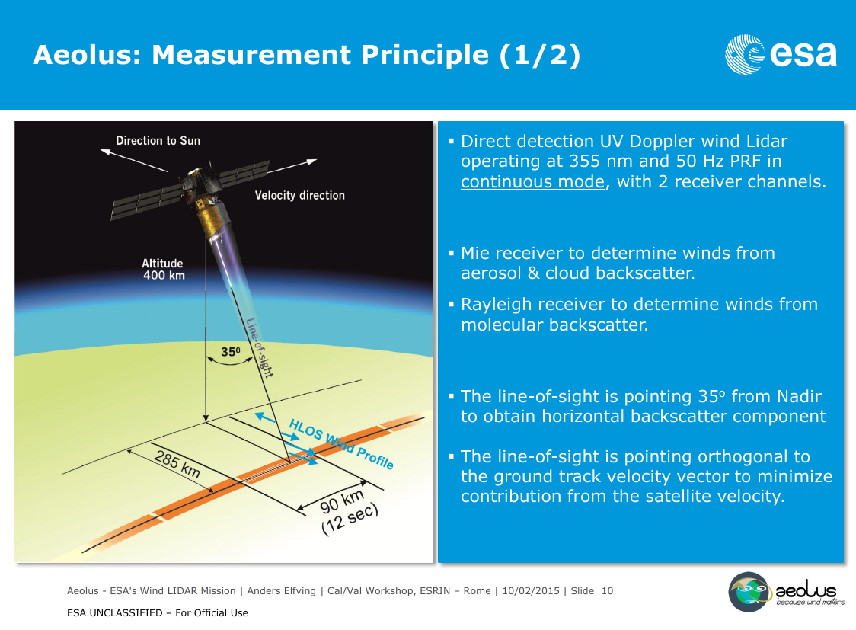
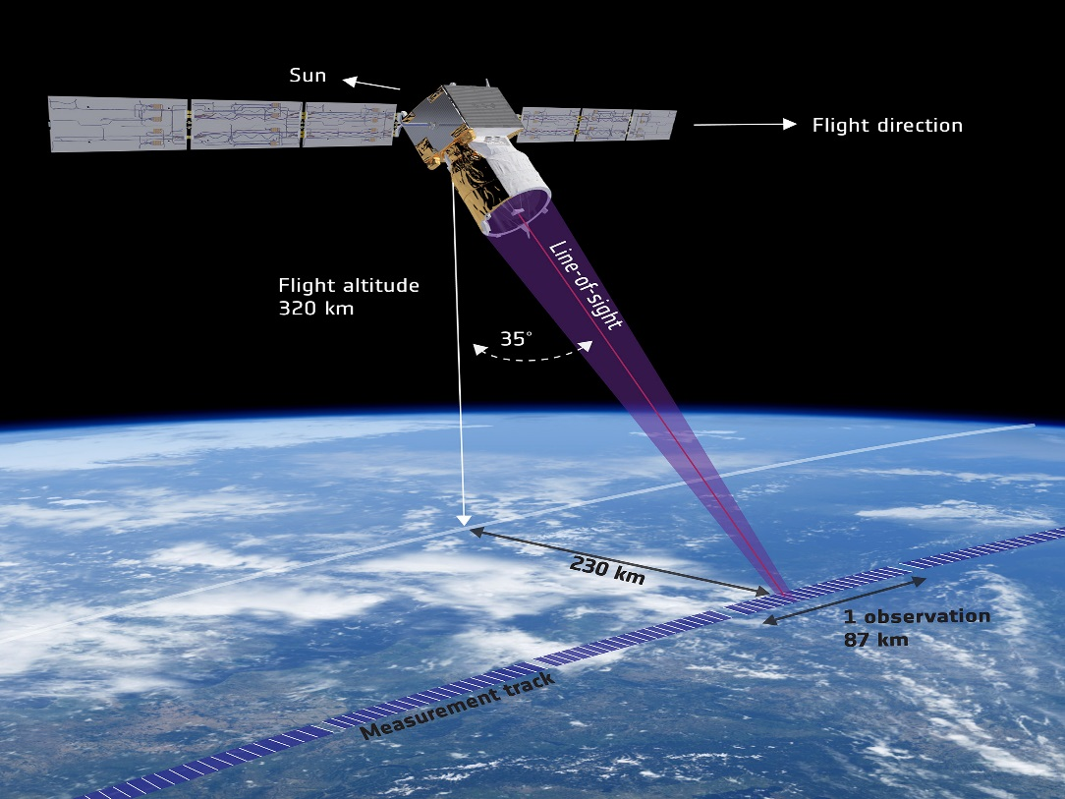

Slide 43
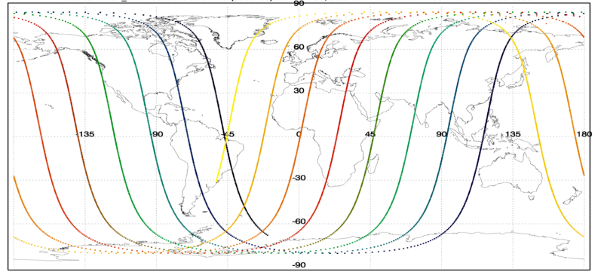
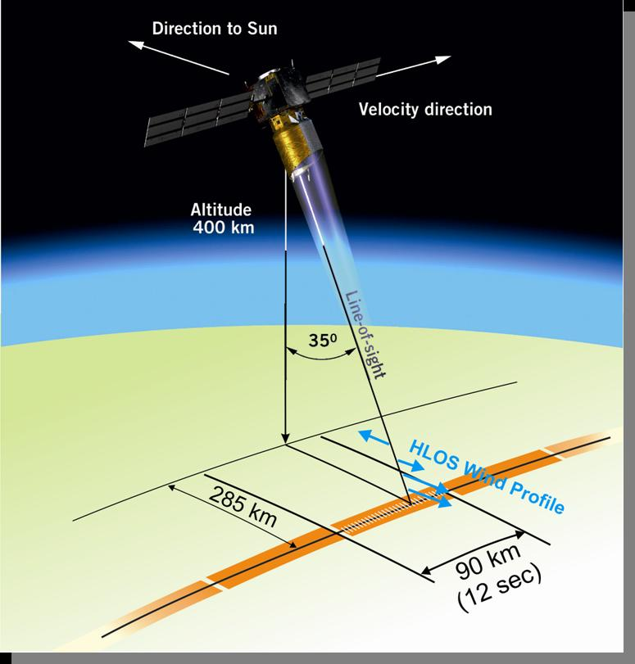
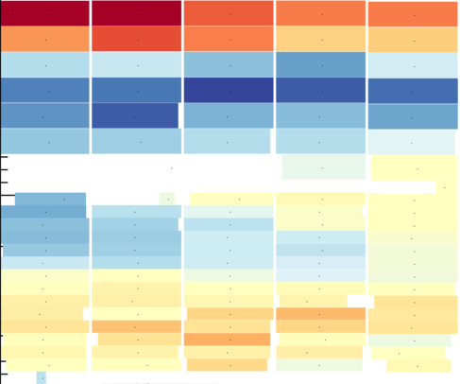
Aeolus geometry and HLOS wind observation sampling
12 hrs coverage, ~72K “good” winds; ~11% increase in wind GOS
Coverage up to ~83 °N/S
UV laser
320 km
Mostly zonal component of wind
Example of Aeolus vertical sampling (24 bins)
30 km ~10 hPa
16 km
16 km
230 km
Mie
Rayleigh
BRC
Continuous coverage along-track
0 km
0 km
WGS84

Slide 44



Clear air winds: Rayleigh scattering
$I∝λ^{−4};$ scatterer size < $\frac{λ}{10},$air molecules → ultra-violet
Thermal motion → Doppler broadening
  e.g. 459 m/s for T=15 °C
  scattering effect due to acoustic waves (at high pressure) has to be considered
Wind measured as shift in
mean of distribution
Spectrum
Doppler shift
$$σ_{v}=\frac{2}{λ}\sqrt{\frac{kT}{m}}$$
Rayleigh (Gaussian)
Rayleigh-Brillouin
-5
0
5
Δf (GHz)
Notes:
Return signal strength depends on concentration of molecules

Slide 45

Example global horizontal coverage of Aeolus in 24 hours
B
~2500 km
A
Simulate Aeolus using ECMWF short-range forecast fields from analysis prior to forecast bust
Notes:
Used T511 AUX_MET data. i.e. short range forecast (background) for the 00 UTC LWDA cycle on 15/3/2014

Slide 46




Rayleigh
Mie

Slide 47


    Challenges with Meso-scale Data Assimilation
General
Quick evolving processes
Rapid updates requires (hourly or sub-hourly)
Uncertainties and predictability
Remote sensing observations
More timely use of information from GEO satellites
Novel observations for convective scale DA
Assimilate cloud-affected radiances
    Non-linear observation operators
    Accuracy and efficiency of radiative transfer in all-sky
Covariance modeling
    Traditional balance (e.g. geostrophic & hydrostatic)
    not applicable at high-resolution
    Impact on ensemble size
Complex, non-linear, flow-dependent relationship
between model variables
Significant model error (in phase and amplitude)
Source: Thibaut Montmerle, Météo-France

Slide 48
Topics covered by today’s lecture
Overview of conventional observations and some actively sensed observations
The contribution of conventional and actively sensed observations to NWP forecast skill
Why observations are essential for data assimilation
Why variational data assimilation is very flexible with respect to observation usage
More about assimilating actively sensed observations

Slide 49
Thank you for your attention!
Questions?

