Slide 1
Data assimilation diagnostics:
Assessing the observations impact in the forecast
Cristina Lupu
with contributions from: Alan Geer, Tony McNally and Carla Cardinali
Data Assimilation Training Course, 29 March 2017

Slide 2
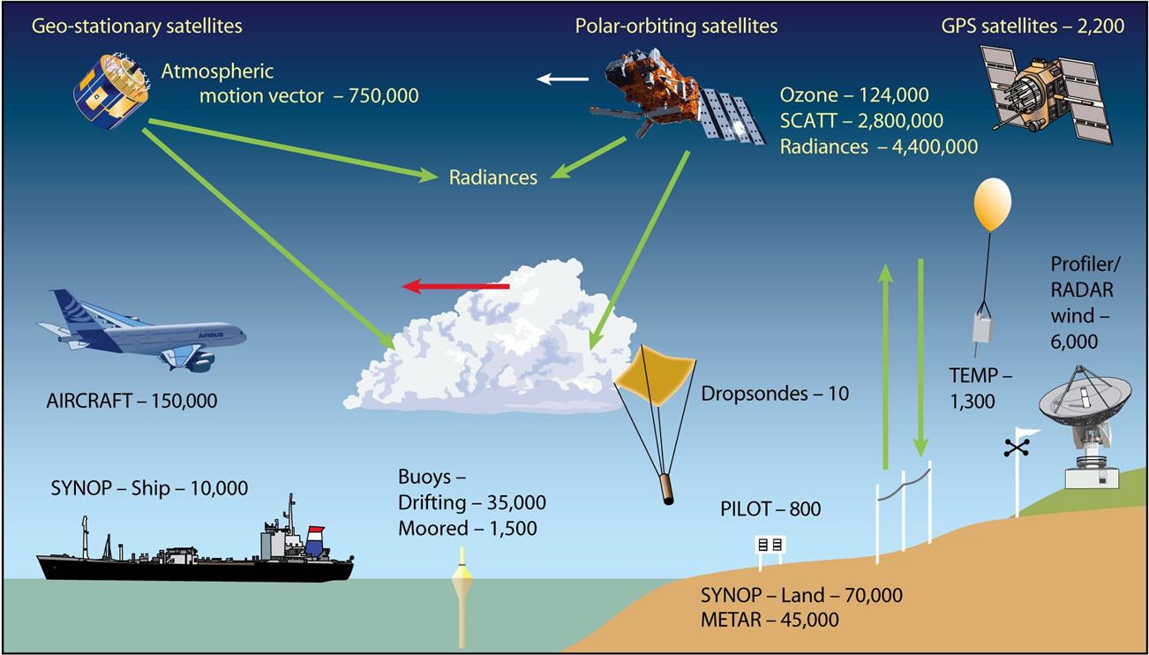
The Global Observing System Network
ECMWF 4D-Var data assimilation system is assimilating ~10⁷ observations per a 12-h assimilation window;
Conventional observations
  Surface-based
  Upper-air
Satellite observations
  IR and MW radiances from
  polar and geos. satellites
  AMVs
  Radio occultation
  Scatterometer
  Other (ozone, etc)
Credit: The World Meteorological Organization (WMO)

Slide 3
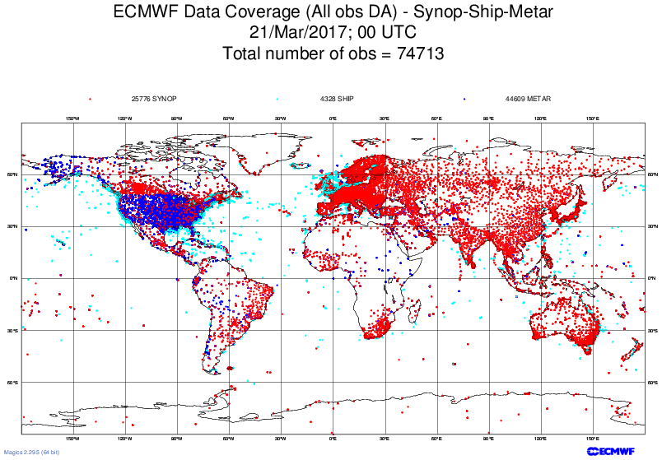
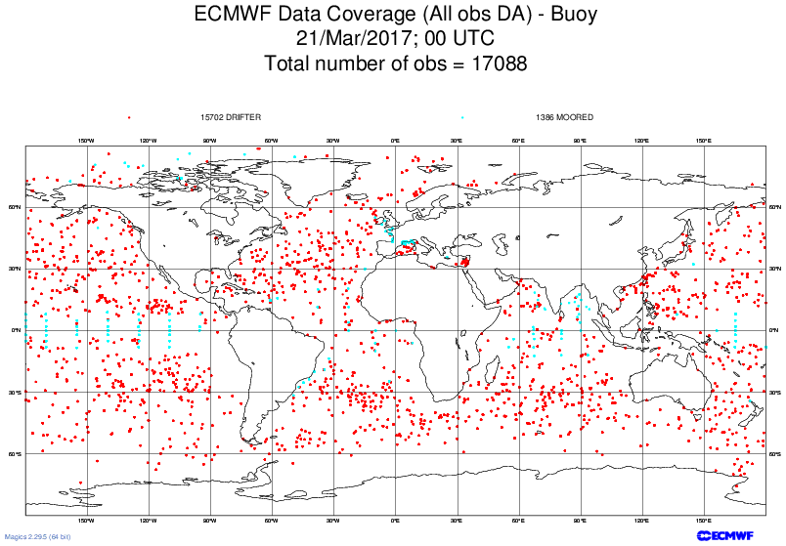
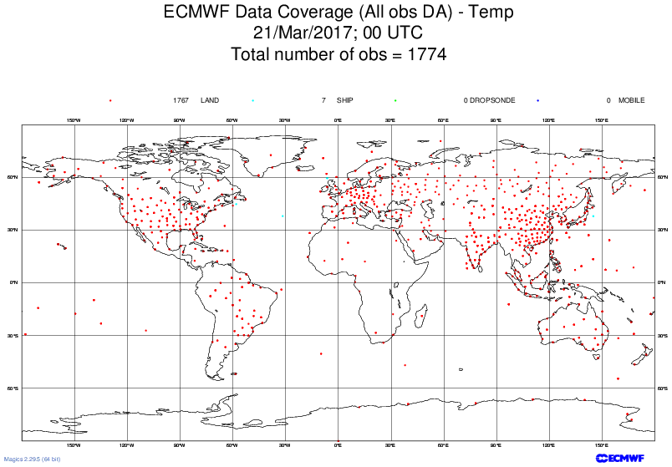
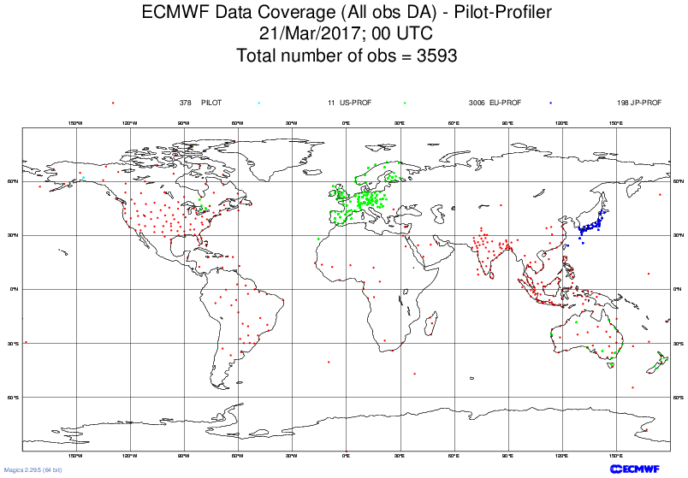
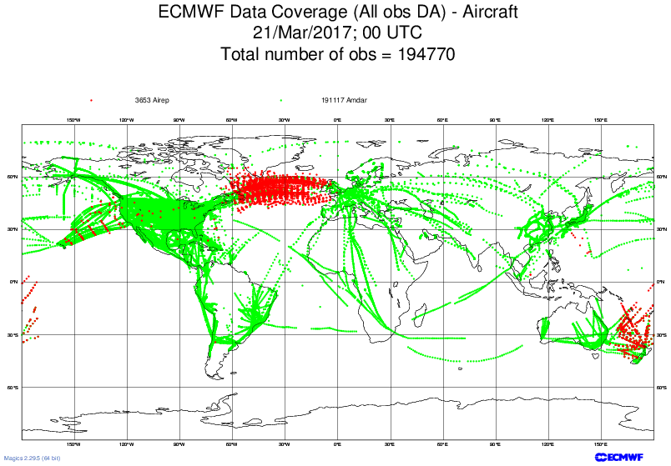
Data sources : Conventional observations
Instrument | Parameters
SYNOP-SHIP- METAR | 10-m wind, MSL pressure, 2m-rel humidity, temperature
BUOY | Wind, temperature, MSL pressure
TEMP TEMPSHIP DROPSONDES | Wind, temperature, spec. humidity
PROFILER | Wind
PILOT | Wind
AIRCRAFT | Wind, temperature, spec. humidity

Slide 4
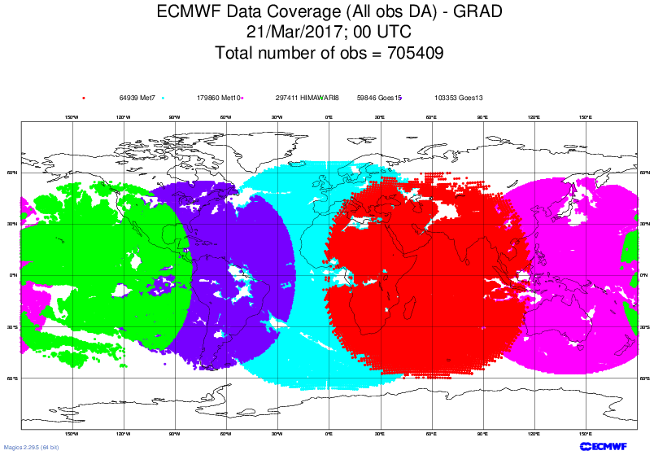
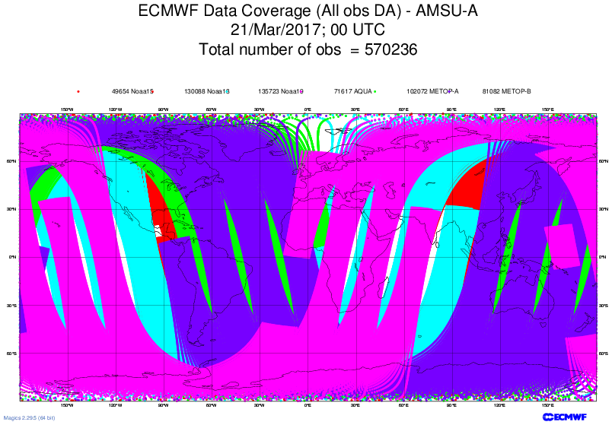
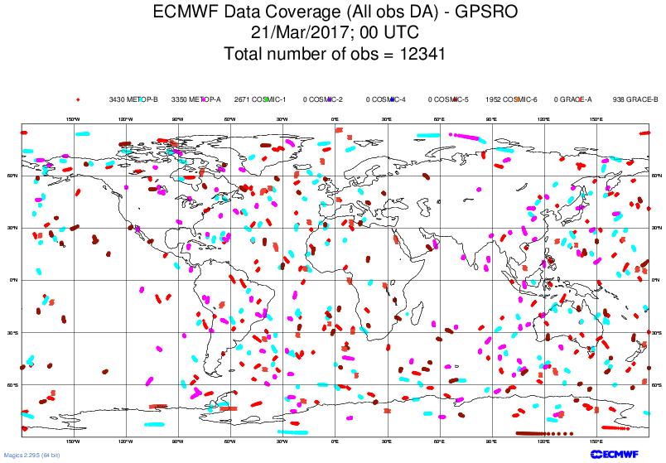
Data sources: Satellite observations
Obs. type | Instrument / Satellite
High spectral resolution IR sounder | IASI on MetOp-A +B; AIRS on Aqua; CrIS on S-NPP
Geostationary IR radiances | MET-7, MET-10, GOES-13, GOES-15, Himawari-8
MW T sounder | AMSU-A on NOAA-15/18/19; Aqua and MetOp-A +B; ATMS on S-NPP
MW Q sounder | ATMS on S-NPP MHS on NOAA-18/19 and MetOp-A + B MWHS2 on FY-3C
MW Q imager | SSMIS on DMSP-F17/F18; AMSR2 on GCOM-W; GMI on GPM; SAPHIR on Megatropiques
Atmospheric Motion Vectors (AMVs) | MET-7, MET-10, GOES-13, GOES-15, Himawari-8, NOAA-15/18/19 AVHRR, Aqua Modis, MetOp-A +B, NPP, Dual MetOp
Scatterometer | ASCAT on MetOp-A + B
Radio occultation | MetOp-A +B, GRACE-A, COSMIC-1/6, TerraSAR-X, TanDEM-X
Ozone Ground-Based Radar | Aura OMI, NOAA-19 SBUV-2, MetOp-A+B GOME-2
GEOS satellites
LEO satellites
GPSRO

Slide 5
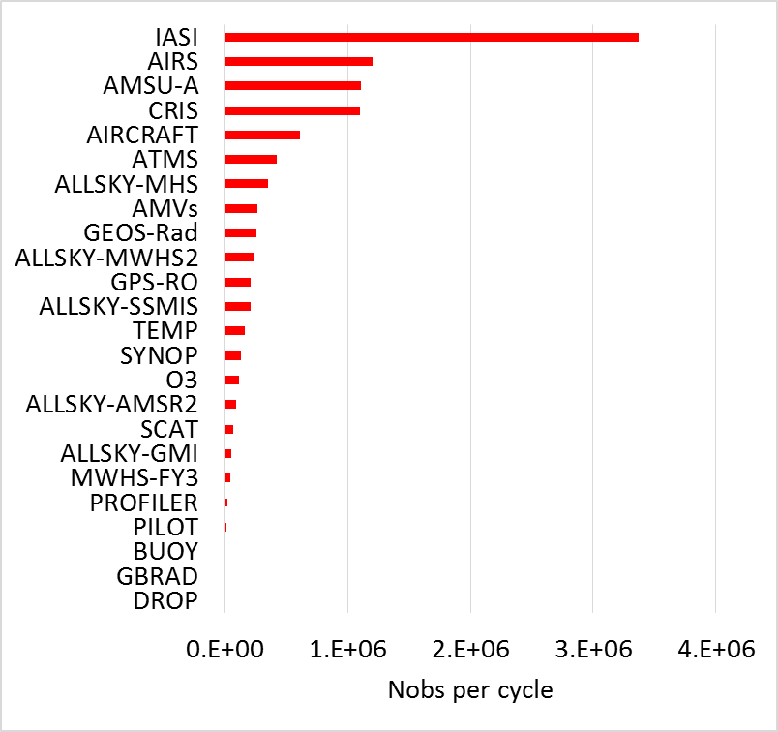
With millions of observations assimilated every analysis cycle, how do we quantify the value provided by all these data?
What diagnostics are available to measure impact?
Which observation types provide the largest total impacts, or largest impact per observation?
How do impacts vary by location or channel?
Do all observations provide benefit?

Slide 6
What diagnostics are available for evaluating observations impact on forecast?
Observing System Experiments – OSEs
Adjoint–based diagnostic methods
  FSOI - Forecast Sensitivity Observation Impact

Slide 7
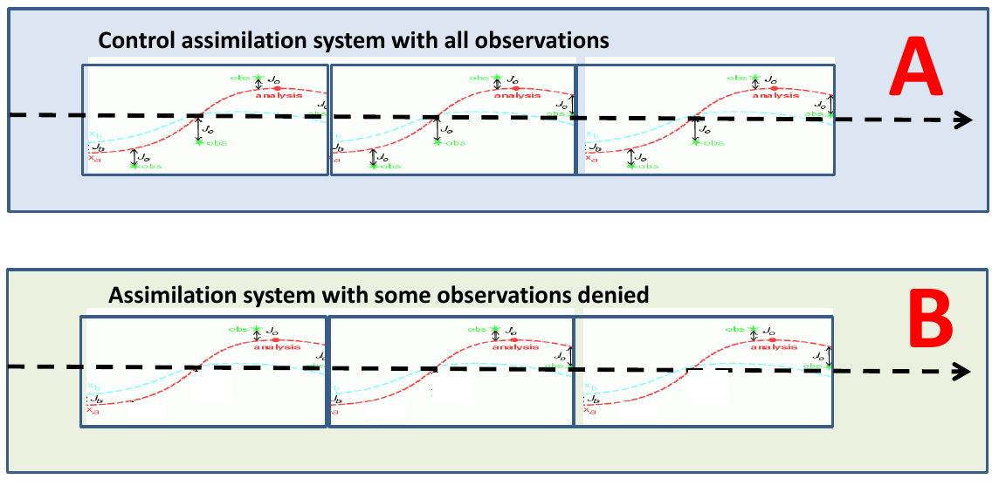
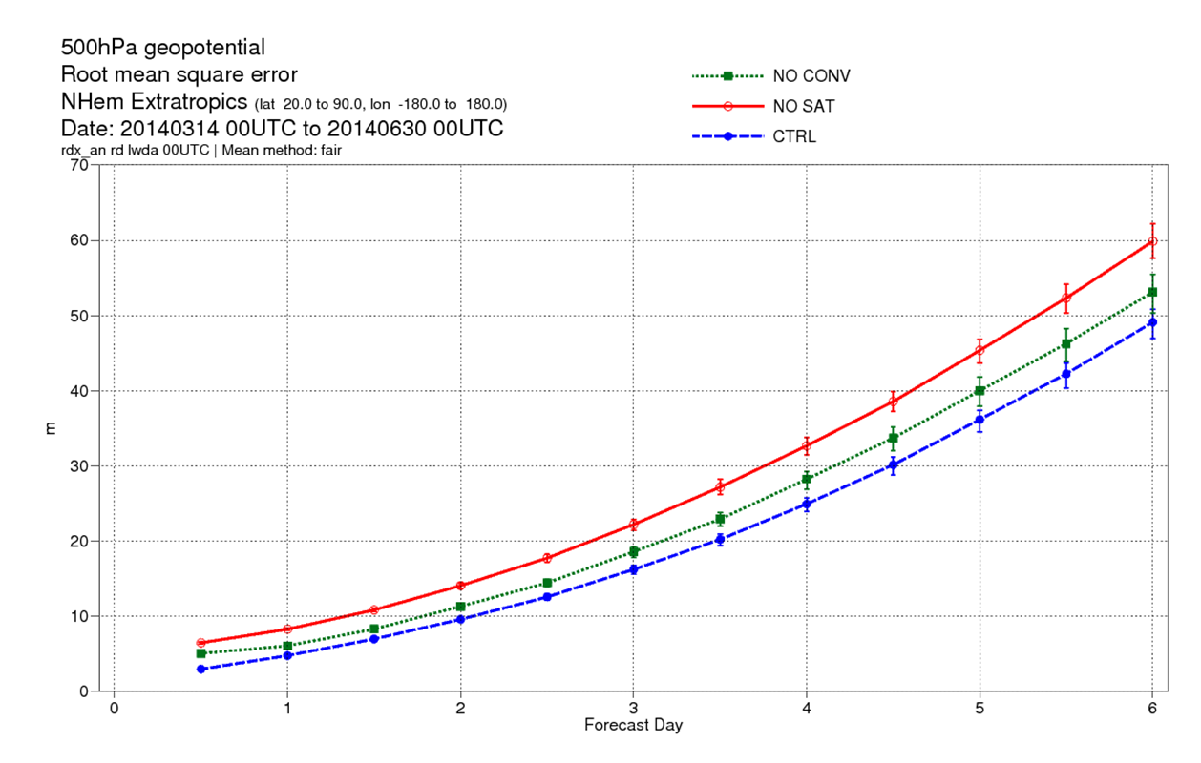
Observing System Experiments (OSEs)
  Denial or addition experiments: subsets of observations are removed (or added) to the data assimilation system to assess their impact on any forecast metric;
  Valid for any forecast range or measure:
    Range (12-h, 5 days, 10 days…)
    Parameter (geopotential height, temperature, wind, humidity…)
    Altitude (surface, 500hPa, 1hPa)
    Region (global, NH, SH, Tropics, Europe)
  Costly, requires re-running the data assimilation system for each subset of observations examined.
  OSEs run at ECMWF: McNally, 2014; Radnoti et al., 2010; Kelly et al., 2004.
B
A

Slide 8
Day 6 fractional increase in RMSE compared to control
OSEs denial experiments from McNally, 2014
500 Z NH
200 VW TR
500 Z SH
850 RH TR

Slide 9
Adjoint-based diagnostic methods
Estimates of observation impact using the adjoint (transpose) of the data assimilation system have become increasingly popular as an alternative/complement to traditional OSEs.
  Enable a simultaneous estimate of forecast impact for any and all observations assimilated.
  Impact assessed without denial - FSOI measures the impact of observations when the entire observation dataset is present in the assimilation system
  Used at several centers now for routine monitoring or experimentation: ECMWF, Met Office; Meteo France, JMA, NRL, GMAO
  Implemented at ECMWF by C. Cardinali (2009); FSOI statistics are published on the ECMWF monitoring website.
http://www.ecmwf.int/en/forecasts/charts/obstat/

Slide 10
Forecast Sensitivity Observation Impact Measure
Cardinali (2009) following Langland and Baker (2004)
Fcst Error
observations assimilated
Time
-12 h
0 h
+24 h
The difference measures the collective impact at 24-h of all observations assimilated at 0-h. (model space)
Can we measure their individual contributions?
(observation space)

Slide 11
Observational impact on the analysis
Recall the linear analysis equation:
x_{a} - analysis vector
x_{b} - background vector
y - observation vector
H(x_{b}) - forward observation operator
H - Jacobian or tangent linear
approximation of H
R – observation error covariance
B – background error covariance
– Kalman gain matrix
(model space)
(observation space)
is the innovation vector
is the analysis increment
The sensitivity of the analysis system to the observations is:
DFS, Cardinali et al. 2004; Lupu et al., 2011;
Adjoint property for a linear operator:
For any vector g in model space, there is a corresponding vector K^{T}g in observation space such that:

Slide 12
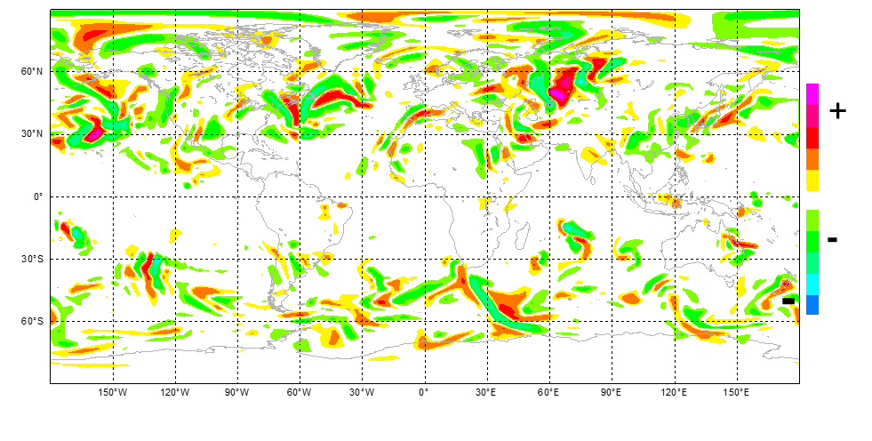
Observational impact on the forecast
Define a scalar cost function of the forecast error:
where x^{f}=Mx is the forecast model state, x_{t} is the truth atmospheric state, M is the nonlinear model and C- is a matrix
of energy norm coefficients. The verifying analysis is a proxy for the truth atmospheric state.
Using the chain rule, the sensitivity of e with respect to observations is:
where the sensitivity of the forecast error to initial conditions is :
The forecast error is mapped onto the initial conditions by the adjoint of the model, providing, for example, regions that are particularly sensitive to forecast error growth.
The variation of the forecast error due to the assimilated observations is:

Slide 13

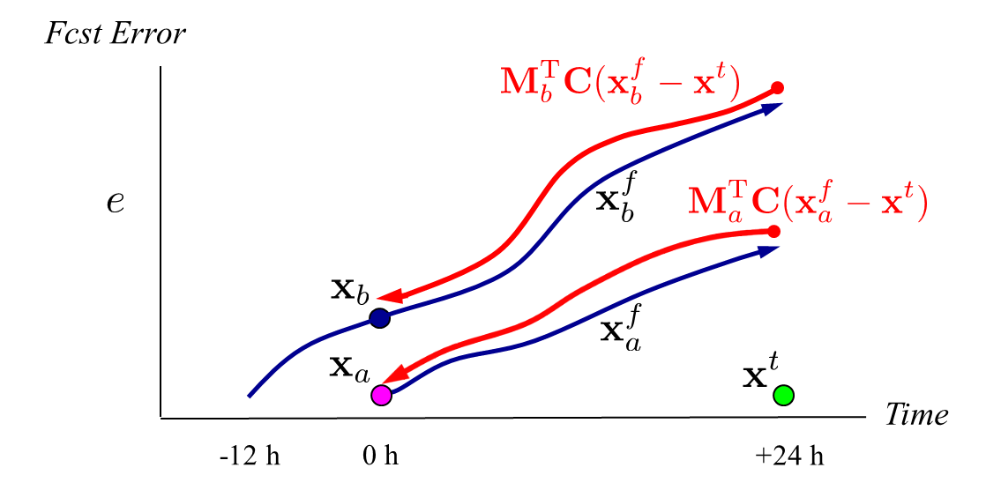

FSOI in the IFS - summary
Given forecasts from an analysis and background state, use an dry energy-weighted forecast error norm as the measure of forecast error:
Sensitivity gradient: Higher than
first-order approximation of impact
required due to quadratic nature of e
Langland and Baker (2004); Errico (2007);
adjoint analysis scheme
adjoint forecast model
Summation of individual observation impacts

Slide 14
FSOI in the IFS - summary
FSOI is a function of sensitivity gradient, the adjoint of the gain matrix and the innovation vector;
FSOI is computed at ECMWF for a 12-h window; The sensitivity gradient is valid at the starting time of the 4D-Var window, typically 9 UTC and 21UTC;
The impact of observations can be summed up over time and space in different subsets to compute the total contribution of the different components of the observing system towards reduction of the forecast errors;
FSOI is influenced by simplified adjoint model (dry/moist physical processes) used to carry the forecast error information backwards and by the selection of the total energy norm (dry/moist), (Janisková and Cardinali, 2016)
Total energy norm:
u- is the zonal wind, v is the meridional wind,
R_{d} is the dry air constant, T_{r} is the reference temperature (350 K), p_{r} is the reference pressure (1000 hPa) and T is the air temperature, q specific humidity with a certain weight w_{q}, Lc is the latent heat of condensation. ECMWF→ w_{q}=0

Slide 15
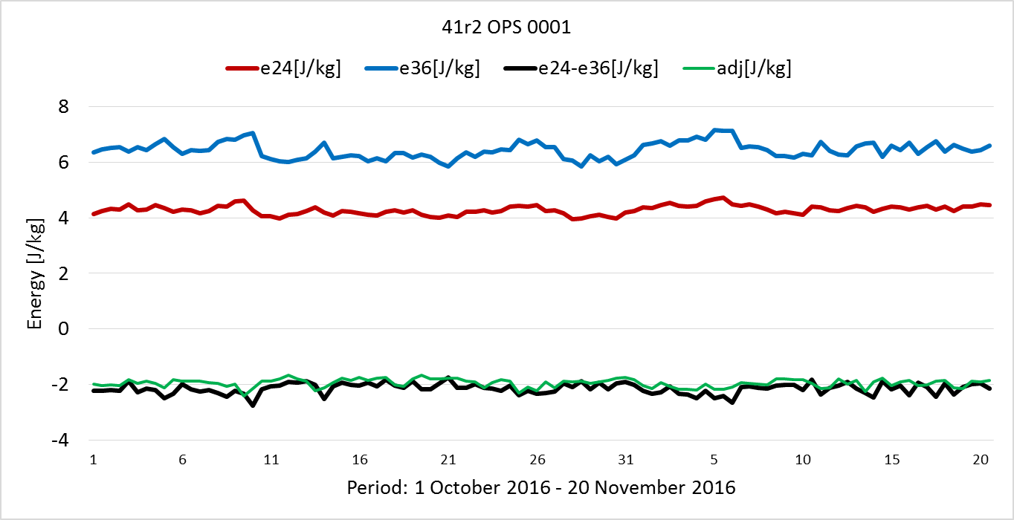
Observation impact calculation
Difference of nonlinear forecast error norm (model space)
2. FSOI (observation space) – adjoint-based estimate of
the assimilation of the complete set of observations consistently results in a more accurate 24-h forecast;
Average total observation impact is 95.4% of the total forecast impact.
[J/kg] | e₂₄ | e₃₆ | e₂₄-e₃₆ | adj
CY41R2 | 4.28 | 6.43 | - 2.15 | - 2.05

Slide 16
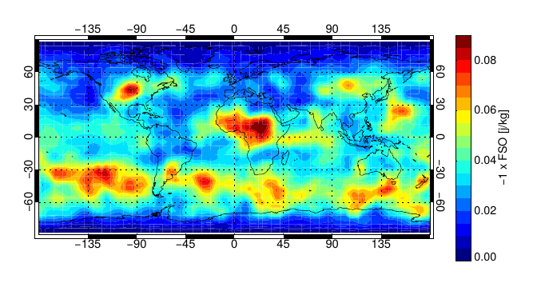
Observation impact calculation
Difference of nonlinear forecast error norm (model space)
2. FSOI (observation space) – adjoint-based estimate of
FSOI –all observations (July-August 2016)
the assimilation of the complete set of observations consistently results in a more accurate 24-h forecast;
Average total observation impact is 95.4% of the total forecast impact.
[J/kg] | e₂₄ | e₃₆ | e₂₄-e₃₆ | adj
CY41R2 | 4.28 | 6.43 | - 2.15 | - 2.05
Largest FSOI values in the Southern extra-tropics ➔ consistent with faster error growth in the winter storm tracks;

Slide 17
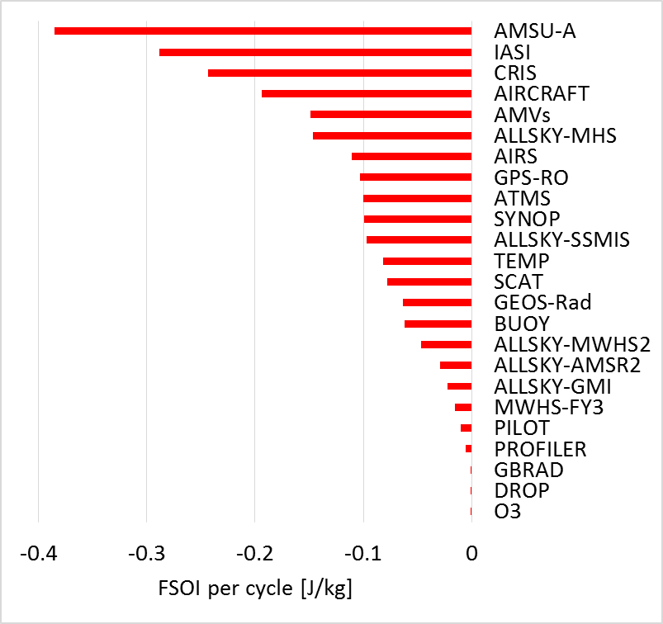

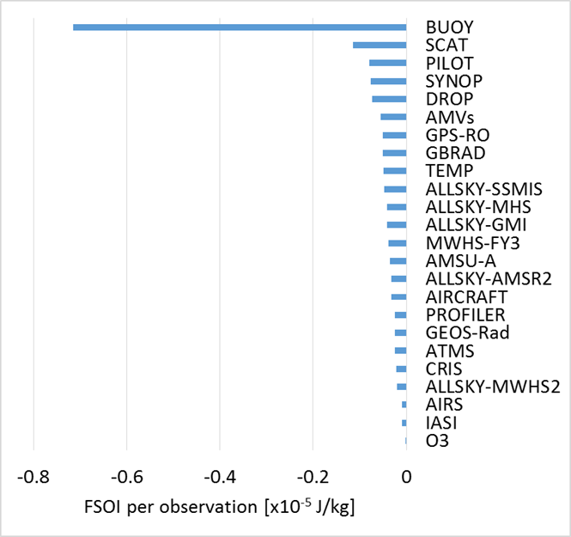
Impact of major observing systems on reducing 24-h forecast errors, May-Sept. 2016
Measured using a global dry energy norm, surface to model top
Negative (positive) FSOI indicate that the assimilation of an observation or subset of observations decreased (increased) 24-hour forecast error and will be referred as beneficial (detrimental).
Total FSOI impact
Total data count
Impact per observation
beneficial
beneficial
Report of 6th Workshop on the Impact of Various Observing Systems on NWP (WMO, 2016)
Observing types with the most significant contributions to error reduction for global NWP: MW sounders (AMSU-A, ATMS), hyper-spectral IR sounders (IASI, CrIS, AIRS), radiosondes, aircraft data and satellite winds (AMVs).
On a per observation basis, the impact is dominated by buoys, radiosondes, AMVs and aircraft observations.

Slide 18
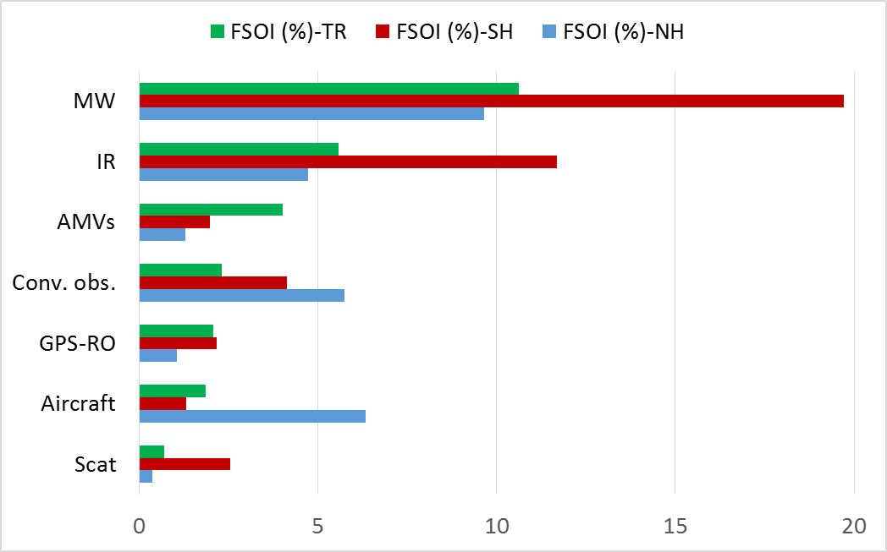
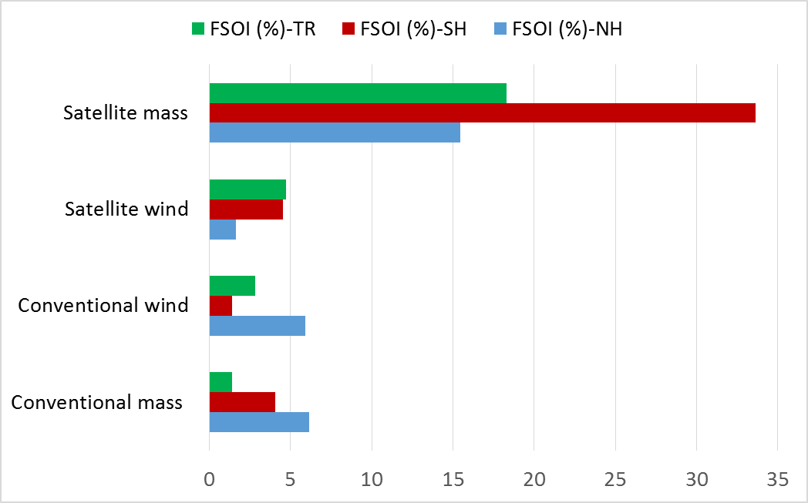
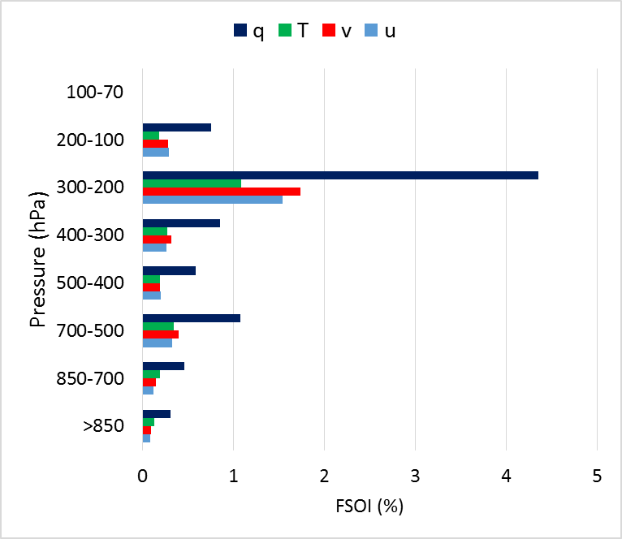
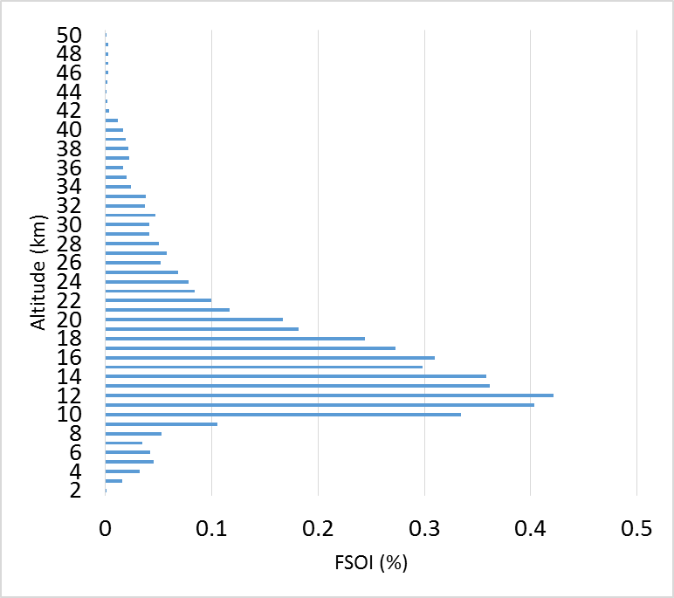
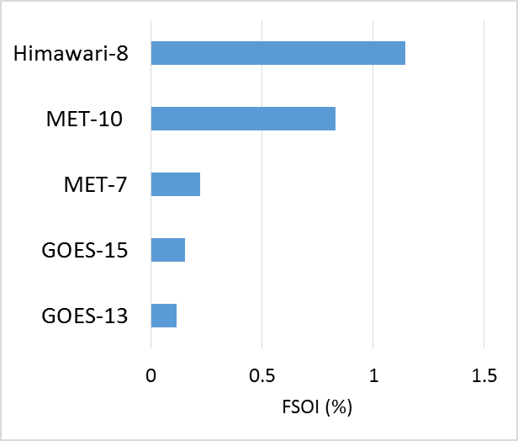
Examples of Observing System Impacts
Observation impacts can be sorted by conditional information (e.g. region, separate channels or separate satellites, wind and mass observations, etc)
Relative impact of wind and
mass observations
Relative impact by region
Aircraft: Relative impact by parameter
GPSRO: Relative impact by altitude
Geos Rad: Relative impact by satellite

Slide 19
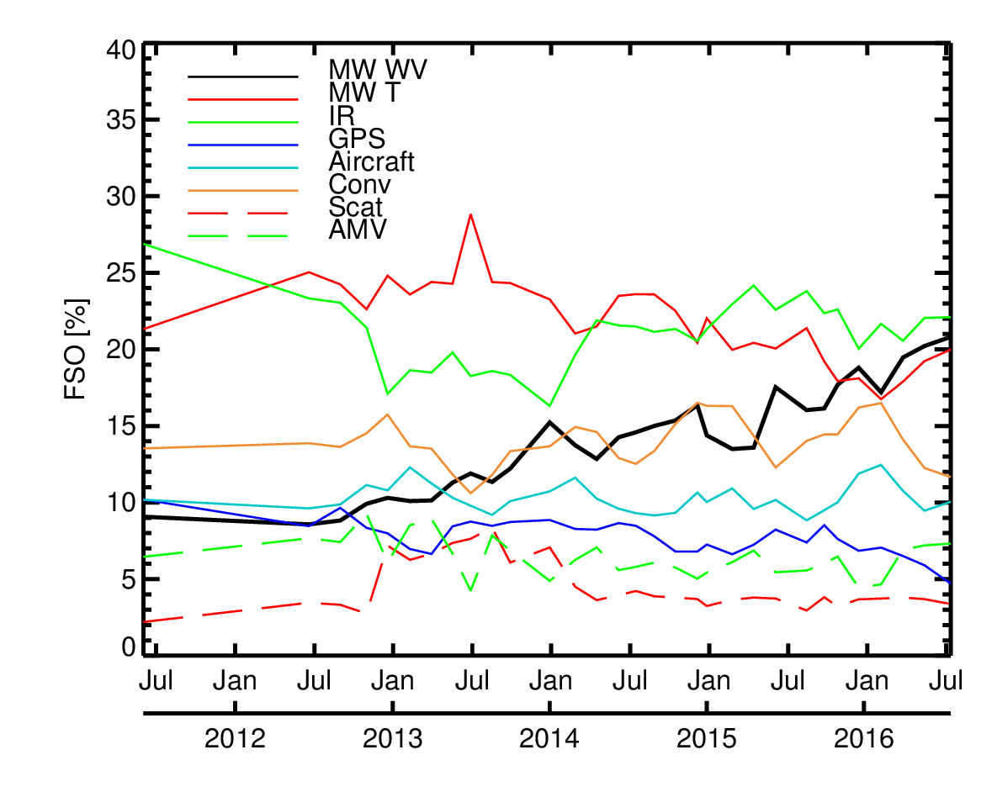
FSOI of major observing systems in ECMWF operations
Summer 2006
(from Cardinali, 2009)
Microwave WV 6.2 %
Microwave T 35.5 %
Infrared 28.0 %
August 2016
Microwave WV 20.4%
Microwave T 20.1 %
Infrared 21.9 %
Microwave water vapour, cloud and precipitation observations now provide significant real benefits, equivalent to clear-sky MW temperature sounding and IR sounding.

Slide 20
What’s happened recently?
All-sky assimilation of humidity sounding channels on SSMIS
GMI and AMSR-2 added in all-sky
F18, all-sky over snow, MWHS-2
ATMS and Metop-B MHS added in clear skies
All-sky assimilation of all four MHS (transferred from clear-sky)

Slide 21
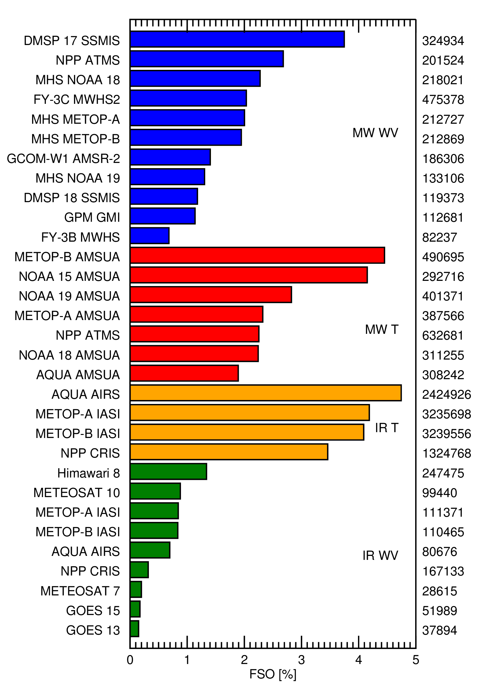
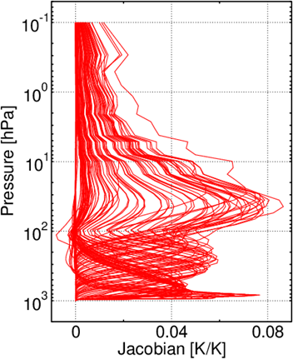
FSOI of satellite radiances, August 2016
100% = full operational observing system
An SSMIS (combining imaging and humidity sounding channels) is nearly equivalent to the best of the temperature-sounding AMSU-As
Microwave WV 20.4%
Microwave T 20.1%
Infrared T 16.5%
Infrared WV 5.4%
Amount of information coming from humidity/cloud/precip is equivalent to what’s coming from T sounding
Impact of individual channels (e.g.,CrIS)

Slide 22
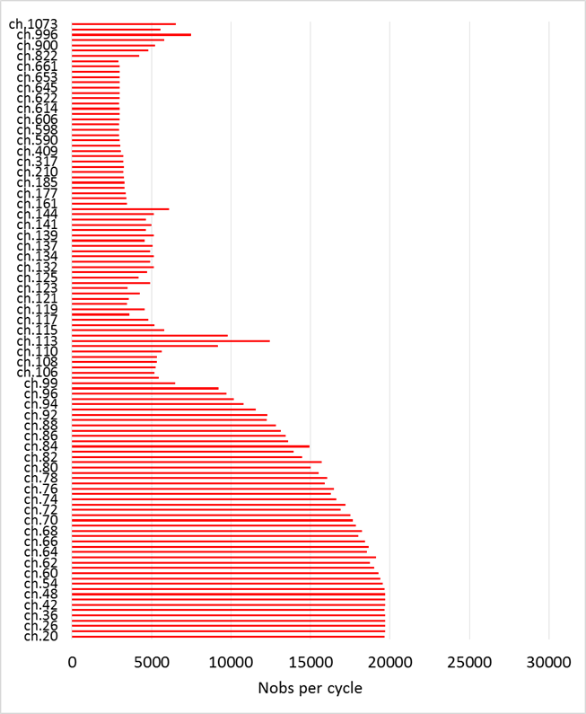
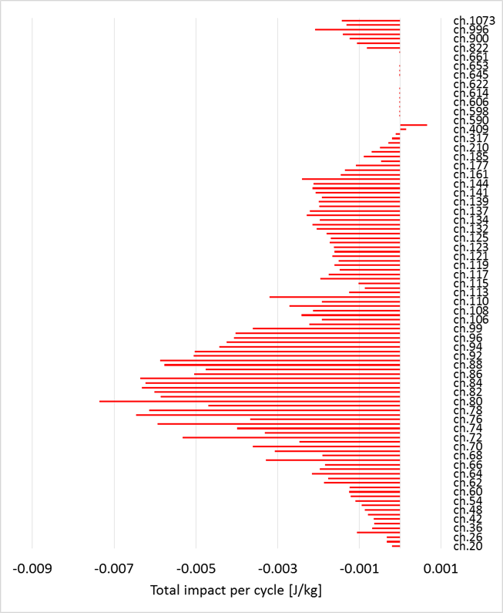

Assessing Impacts of Hyper-Spectral Instruments (CrIS)
WV
O₃
T
T
The subset of CrIS stratospheric-sensitive sounding channels (wavenumbers range 690-710 cm⁻¹) give the greatest impact followed by the subset of tropospheric-sensitive sounding channels (wavenumbers range 720-760 cm⁻¹).
The water-vapour and ozone sensitive channels show a very small but positive impact on improving the short-range forecast.

Slide 23
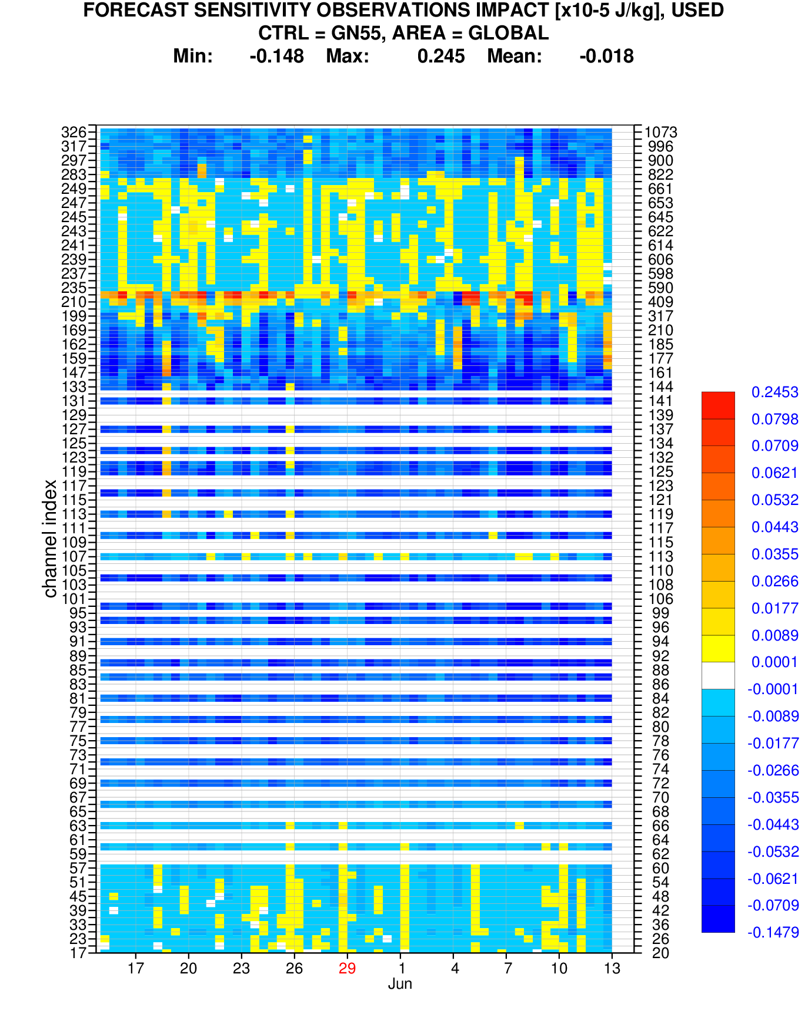
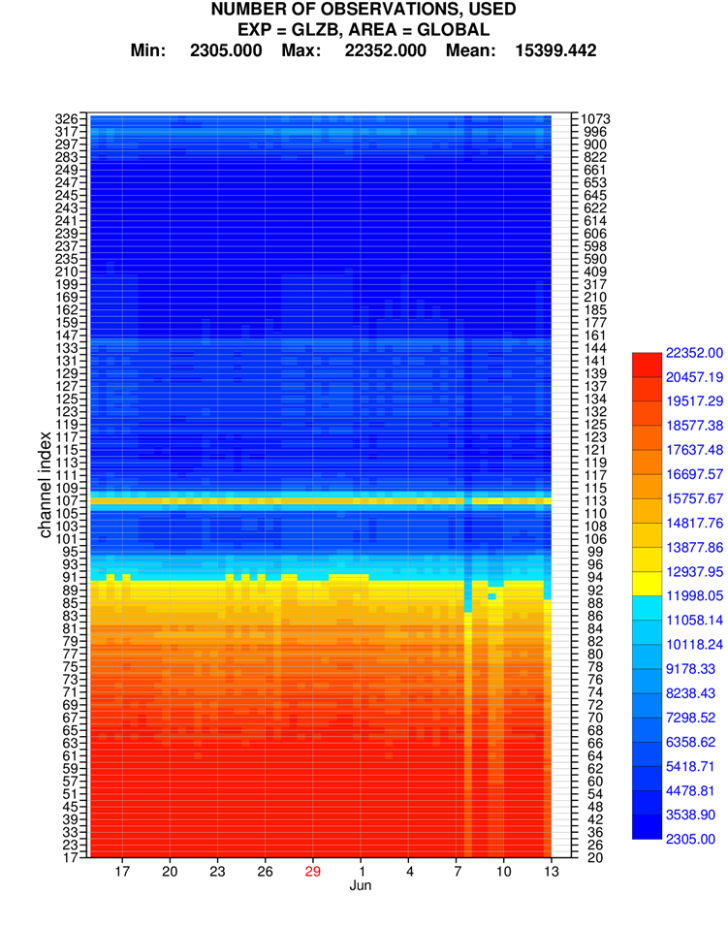
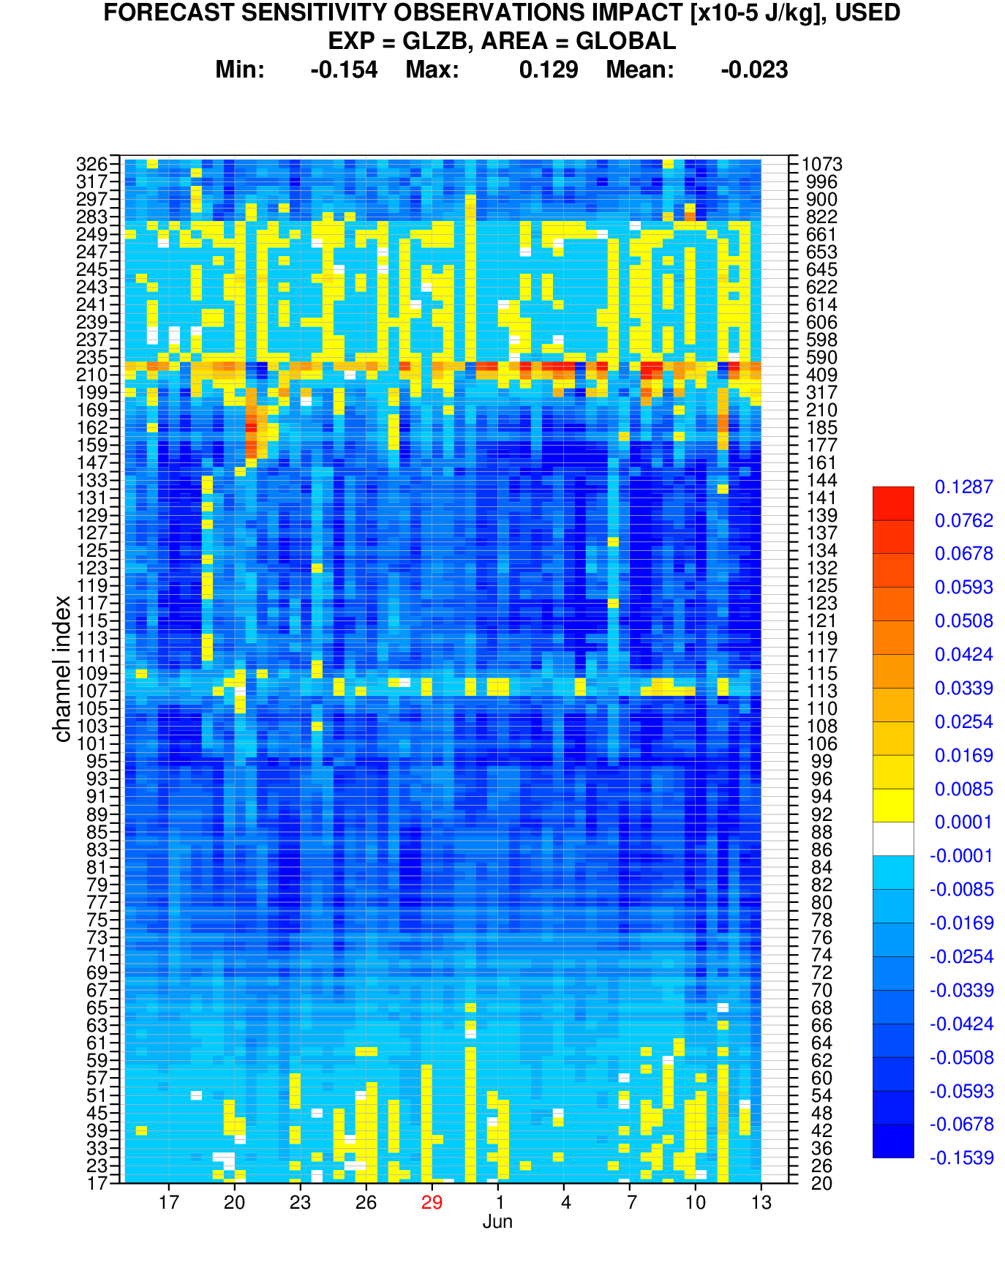
CrIS Hovmoeller Channels vs time: Nobs & FSOI
Detrimental impact
Beneficial impact

Slide 24
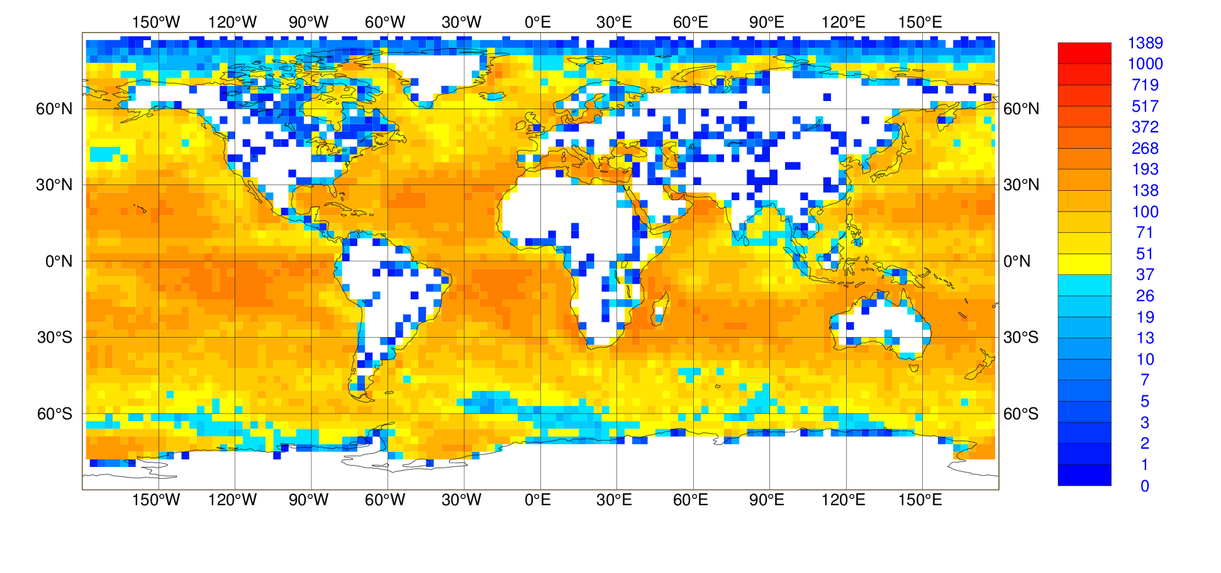
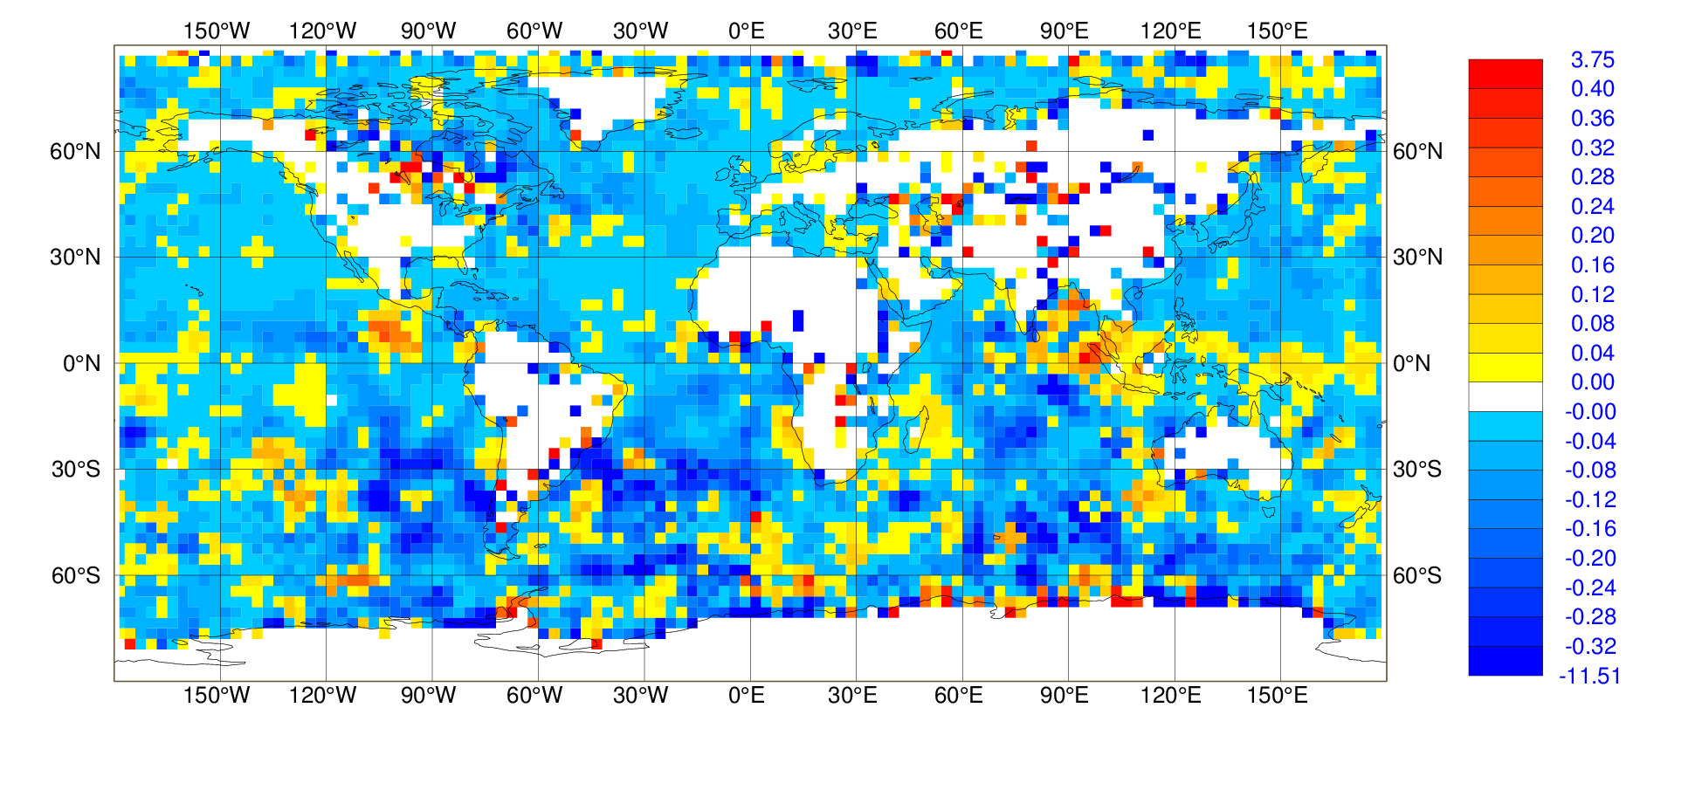

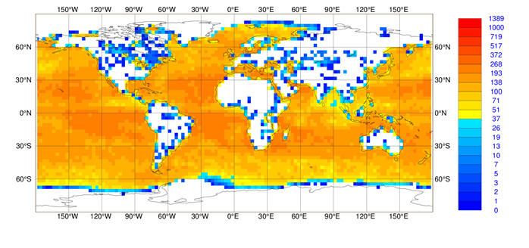
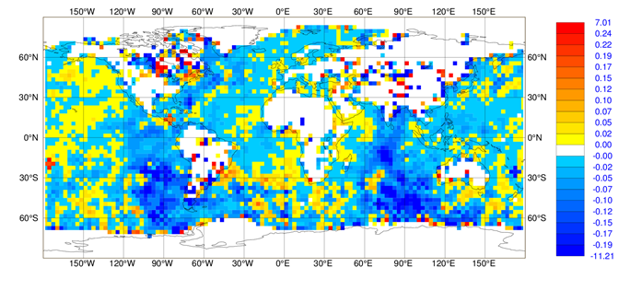
Data coverage and FSOI [J/kg]
Mid-tropospheric (ch. 105 @ 715 cm⁻¹)
Nobs
FSOI
Water vapour (ch. 1073 @ 1658.75 cm⁻¹)
Global sums are beneficial (negative), but many obs degrade the forecast!

Slide 25
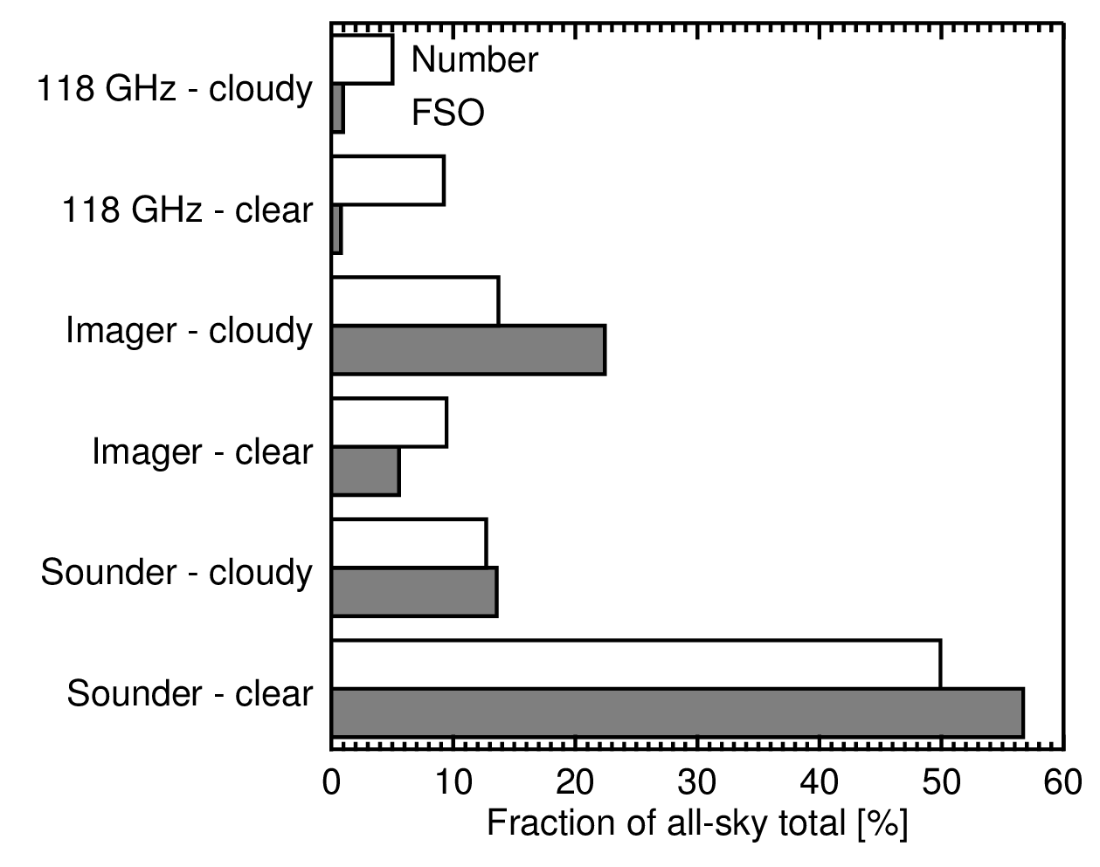
Importance of cloudy and precipitating scenes
100% = 9 all-sky instruments
Imagers: Cloudy and precipitating scenes give more FSOI than clear-sky scenes
Sounders: Cloudy and precipitating scenes have same per-obs FSOI as clear-sky scenes

Slide 26
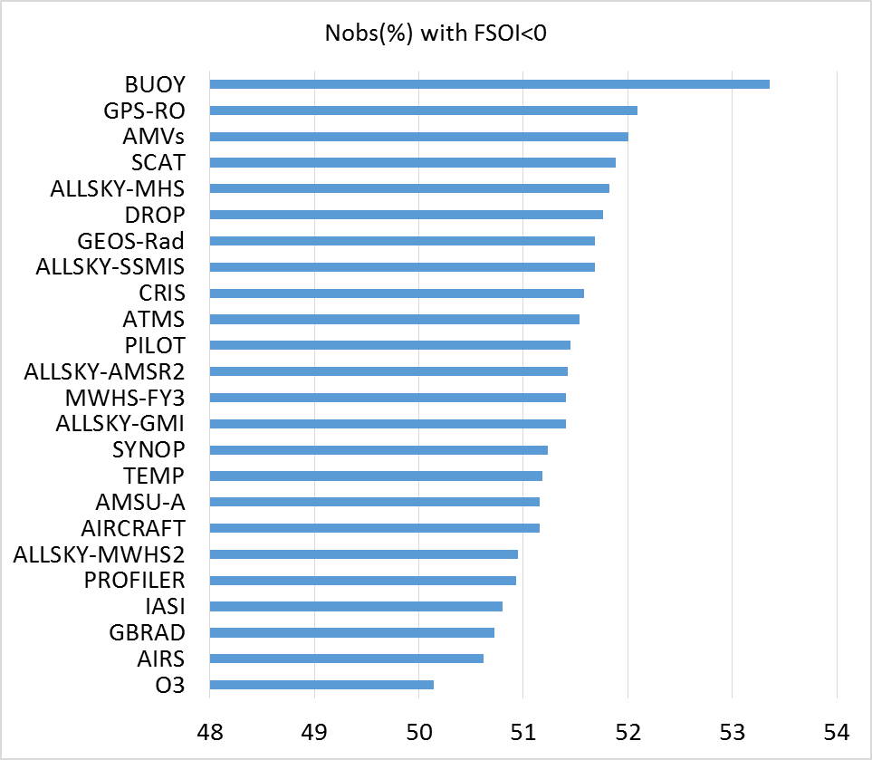
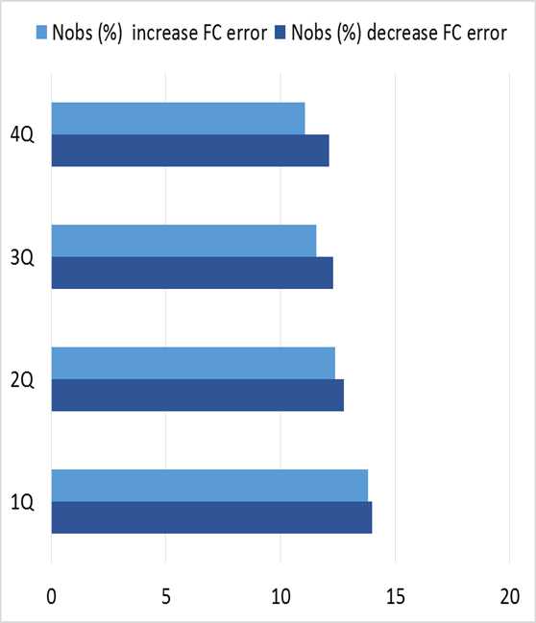
What fraction of the assimilated observations improve the forecast ?
The numbers of observations that improve or degrade the forecast are both large.
Observations assimilated towards the end of the window are more beneficial than the observations assimilated at the beginning of the window.
For all data types, only 50-52% of the observations lead to positive impact on the 24-h forecast!

Slide 27
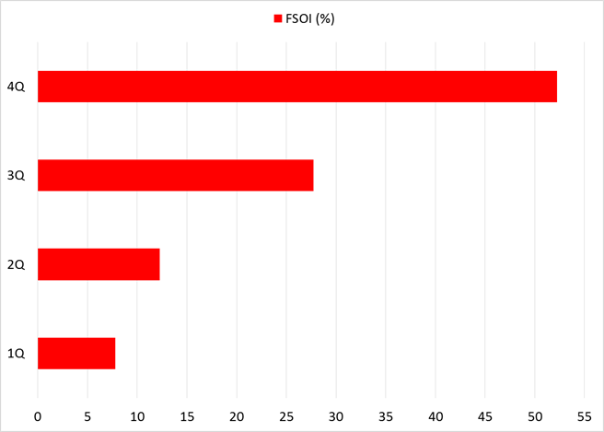

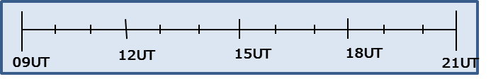
FSOI depend on observation time in the 4D-Var window
52%
28%
Observations late (4Q) in the 4D-Var window are clearly more influential than data early (1Q) in the window
12%
FSOI (4Q) >FSOI (1Q)
8%
1Q
4Q

Slide 28
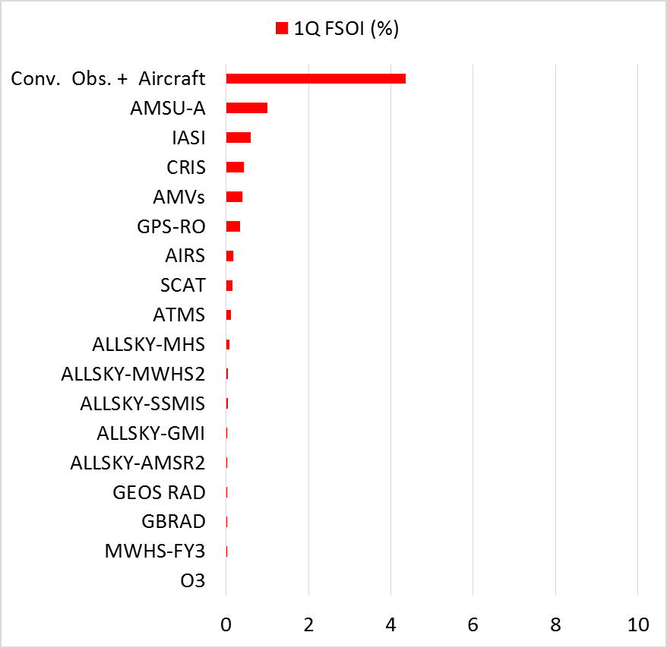
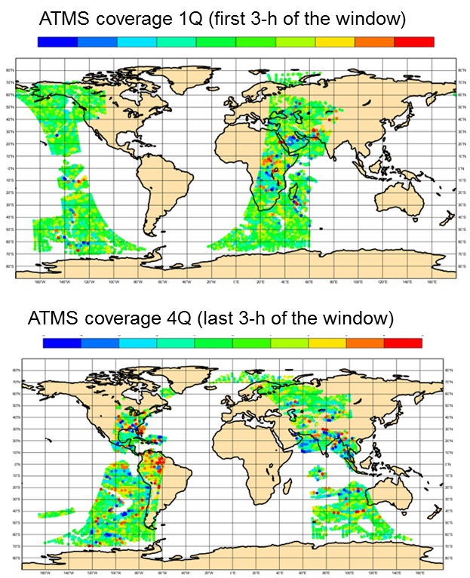
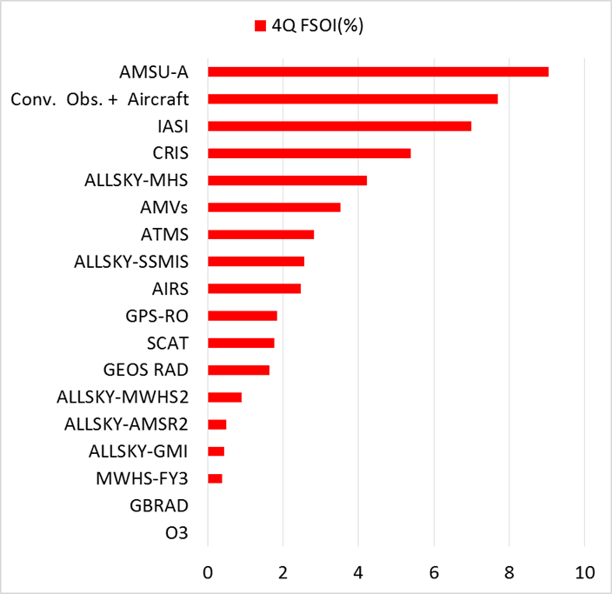

FSOI by instrument in the 4D-Var window

Slide 29
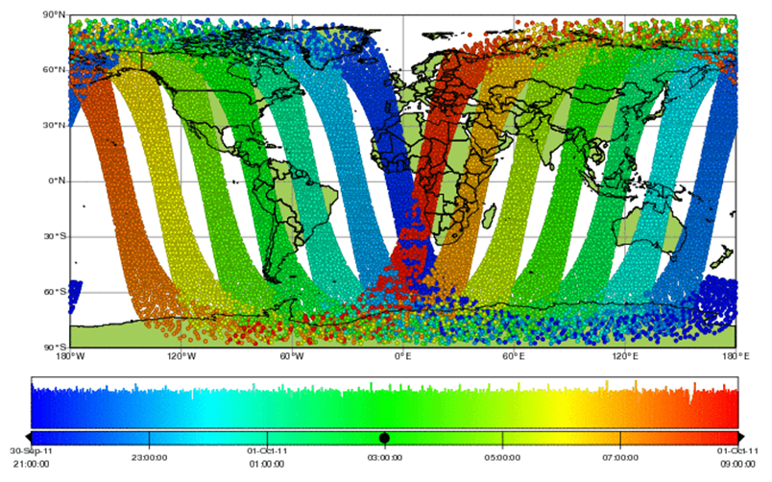
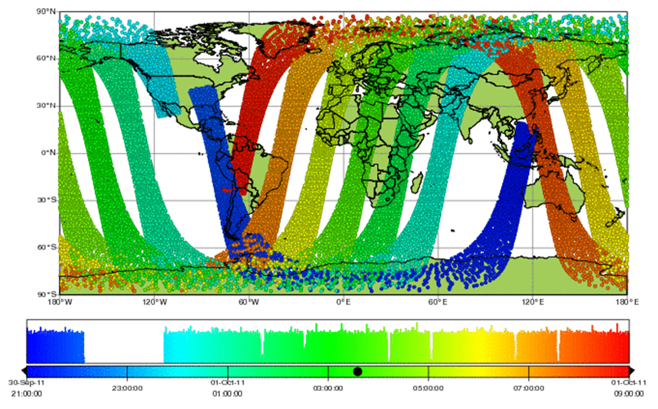
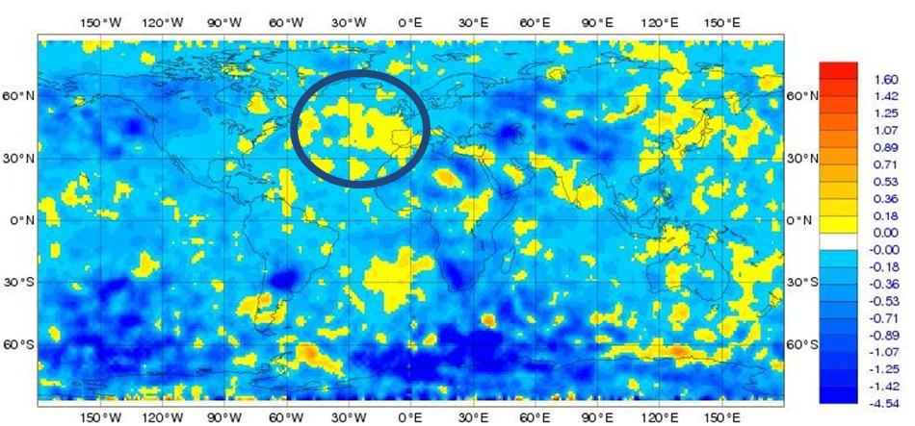
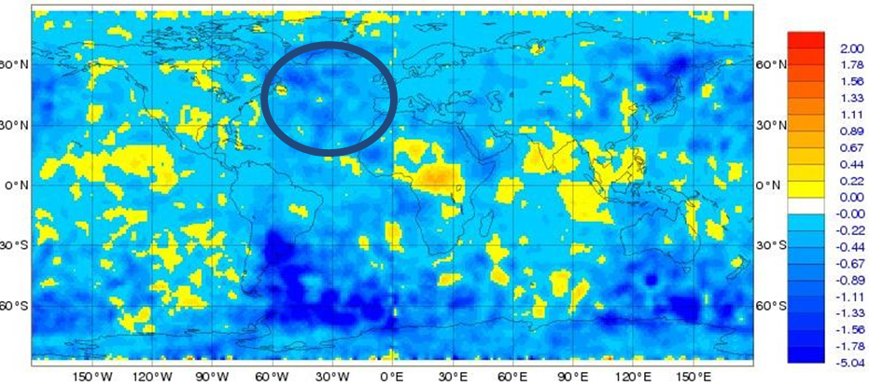
AMSU-A MetOp-A versus NOAA-15
Observing the Atlantic…
…at the beginning of the 4D-Var window (MetOp-A)
…at the end of the 4D-Var window (NOAA-15)
21 23 1 3 5 7 9
21 23 1 3 5 7 9
FSOI-negative impact over the N. Atlantic
FSOI-positive impact over the N. Atlantic

Slide 30
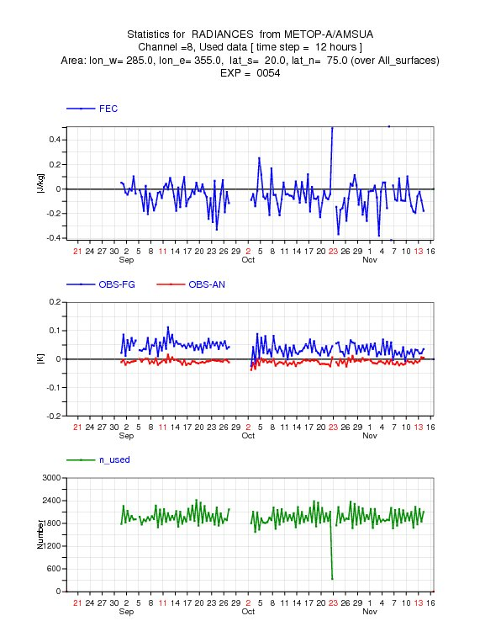
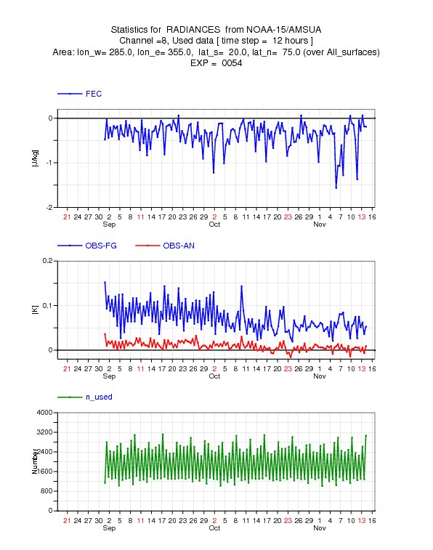
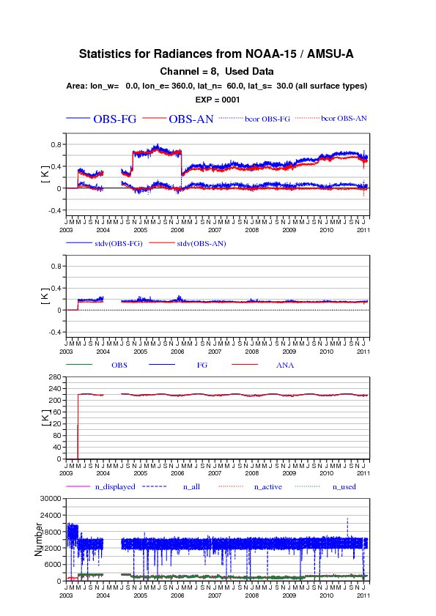
AMSU-A ch8: FSOI Time series over N. Atlantic
METOP-A
NOAA-15
FSOI
FSOI

Slide 31


A case study of a FSOI spike in the North Atlantic on 6th Nov. 2011
Operational FSOI monitoring
SSMIS, N Atlantic, autumn 2011
FSOI

Slide 32

FSOI North Atlantic, autumn 2011
AMSU-A on NOAA-19
DRIBU
Aircraft
OD/RD 20 March 2012
Slide 32

Slide 33

6th November: a rapidly developing storm
Mean sea level pressure: analysis and subsequent forecasts
Minimum pressure goes from 990hPa to 950hPa between 00Z, 6/11 and 18Z, 7/11

Slide 34

Mean sea level pressure: evolved increments
(forecast from 00Z 6th Nov minus forecast from 12Z 5th Nov)
00Z 6th Nov analysis shifts the storm to the NW

Slide 35


Forecast sensitivity 00Z 6th November
FSOI:log scale
MSL

Slide 36

Forecast sensitivity: 00Z 6th November
Total in the 30 by 30 degree box, by report type
MSL
OD/RD 20 March 2012

Slide 37

All-sky SSMIS: channel 19v
Cloud and precip shifted ~250km to the NW in accordance with observations

Slide 38




Denial OSEs vs. operations
Mean sea-level pressure increment at 00Z, 6th November
Operations: total increment
Ship and DRIBU: change in increment
Blacklisted inside box
All-sky SSMIS F-17 (change)
AIREP (change)

Slide 39
Closing remarks
Methods to measure the observation contribution to the forecast quality
  OSEs give the only clear definitive answer to the question “what if I did not have this satellite ?”
    The only measure of medium-range observation impact
    Extremely expensive to run long periods
  FSOI Adjoint-derived observations impact give the observation impact on short-range forecast (24h-48h) were verification is least reliable
    Allows detailed evaluation of observations impact (e.g., individual channels, different regions or separate satellites);
    Very affordable (compared to OSE)
    Problems relating TE metric to parameters and consistency of adjoint model (dry/wet)
    Poor observation error tuning can produce misleading results (Lupu, 2013, 6th WMO Symposium on Data Assimilation)
    Research on FSOI with an observation-based objective function (Cardinali, 2016, 6th Workshop on the Impact of Various Observing Systems on NWP)
  FSOI Ensemble-derived observations impact (not covered here, see Kalnay et al., 2012); Used now at NCEP, JMA, Env. Canada

Slide 40
Closing remarks
Satellite observations, especially radiance data, are critical for global NWP, but conventional data remain very important.
  Observing types with the most significant contributions to error reduction for global NWP: MW sounders, hyper-spectral IR sounders, radiosondes, aircraft data and AMVs.
  On a per observation basis, the impact is dominated by buoys, radiosondes, AMVs and aircraft observations.
  At ECMWF, the extension of the use of MW humidity-sounding radiances to all-sky leads to a significant improvement of the forecast impact in the ECMWF system (Geer et al., submitted to QJRMS)
Only a small majority (50-52%) of observations improves the forecast, and most of the overall benefit comes from a large number of observations having small-moderate impacts
  Reliance on statistics of background and observation errors implies a distribution of positive and negative impacts, regardless of data quality.
  Imperfect DA method, errors in the verifying analysis may contribute to the number of observations harming the forecast.
Observations late in the 4D-Var window are more influential than data early in the window.
Interpretation of forecast improvement or degradation as depicted by the FSOI tool is necessary.

Slide 41
Citations I
Cardinali, C., 2009: Monitoring the observation impact on the short-range forecast. Q. J. R. Meteorol. Soc., 135: 239-250.
Cardinali, C., 2013: Observation impact on the short-range forecast, Advanced Data Assimilation for Geosciences: Lecture Notes of the Les Houches School of Physics: Special Issue.
Daescu D. N., 2008: On the sensitivity equations of four-dimensional variational (4D-Var) data assimilation. Mon. Wea. Rev., 136: 3050--3065.
Errico, R. M. 2007. Interpretation of an adjoint-derived observational impact measure. Tellus 59A, 273–276.
Gelaro, R. and Y. Zhu, 2009: Examination of observation impacts derived form observing system experiments (OSEs) and adjoint models. Tellus, 61A, 179–193.
Gelaro, R., Y. Zhu and R. M. Errico, 2007: Examination of various-order adjoint-based approximations of observation impact. Meteorologische Zeitschrift, 16, 685-692.
Geer A.J., F. Baordo, K. Befort, N. Bormann, P. Chambon, S.J. English, M. Kazumori, H. Lawrence, P. Lean , C. Lupu, 2017: The growing impact of satellite observations sensitive to humidity, cloud and precipitation, to be submitted to Q. J. R. Meteorol. Soc.
Janiskova M. and C. Cardinali, 2016: On the Impact of the Diabatic Component in the Forecast Sensitivity Observation Impact Diagnostics, ECMWF Tech. Memo, 786, 18pp.
Kalnay, E., Ota, Y., Miyoshi, T. and Liu, J. 2012. A simpler formulation of forecast sensitivity to observations: application to ensemble Kalman filters. Tellus A. 64.
Langland, R. H. and Baker, N. 2004. Estimation of observation impact using the NRL atmospheric variational data assimilation adjoint system. Tellus 56A, 189–201.

Slide 42
Citations II
Lupu, C., C. Cardinali and A.P. McNally, 2015: Adjoint-based forecast sensitivity applied to observation error variances tuning, Q. J. R. Meteorol. Soc., 141, 3157-3165.
Lupu, C., P. Gauthier and S. Laroche, 2012: Assessment of the impact of observations on analyses derived from Observing System Experiments, Mon. Wea. Rev., 140, 245-257.
Lupu, C., P. Gauthier and S. Laroche, 2011: Evaluation of the impact of observations on analyses in 3D- and 4D-Var based on information content, Mon. Wea. Rev., 139, 726-737.
Lorenc, A. C. and Marriott, R. T., 2014: Forecast sensitivity to observations in the Met Office Global numerical weather prediction system. Q.J.R. Meteorol. Soc., 140: 209–224. doi:10.1002/qj.2122
McNally, A. P., 2014: Impact of satellite data for global NWP: evaluation. In: Proceedings of ECMWF Seminar on Use of satellite Observations in Numerical Weather Prediction, Reading, UK, 8-12 September 2014.
Rabier, F., E. Klinker, P. Courtier and A. Hollingsworth, 1996: Sensitivity of forecast errors to initial conditions. Q.J.R. Meteorol. Soc., 122: 121-150.
Sato, Y. and L.P. Riishojgaard, 2016: Sixth WMO Workshop on the Impact of Various Observing Systems on Numerical Weather Prediction, Shanghai, China, 10-13 May 2016:
https://www.wmo.int/pages/prog/www/WIGOS-WIS/reports/6NWP_Shanghai2016/WMO6-Impact-workshop_Shanghai-May2016.html

Slide 43
Thank you for your attention !
Questions?

