Slide 1
Data Assimilation Training Course
Final Discussion and Q&A

Slide 2
Data Assimilation
Data Assimilation has two main goals:
  Optimally blend information from observations and model to produce an accurate and physically consistent estimate of the initial state of the atmosphere and of the other components of the Earth System
  Quantify the uncertainty of our estimate of the initial state (this is necessary to be able to initialise an ensemble forecast!)

Slide 3
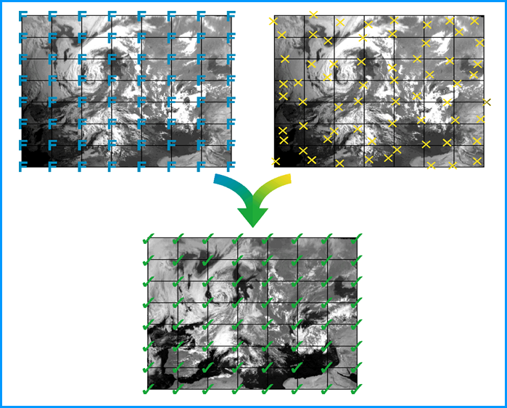
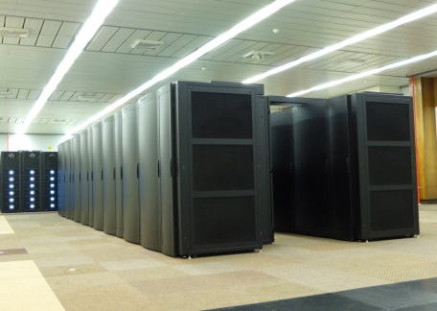


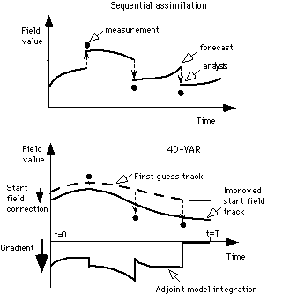
Model Forecast (with errors)
Observations (with errors)
People (with a lot of good ideas)
Computer (with a lot of CPUs)
Analysis (with - smaller – errors)
Notes:
What are the ingredients?, well we start with a model on grid (the model contains errors, which for some we know, for some we do not), but we need to do our best at estimating and characterising them. Likewise with observations, sometimes indirectly related to the model, with errors, heterogeneous in time, space, and in terms of measured quantities. The data assimilation process can be seen as a mixer, which requires as additional input a big and powerful computer and equally importantly clever people with a lot of good ideas to produce this analysis, which will statistically be more accurate than the prior informations put in the system

Slide 4
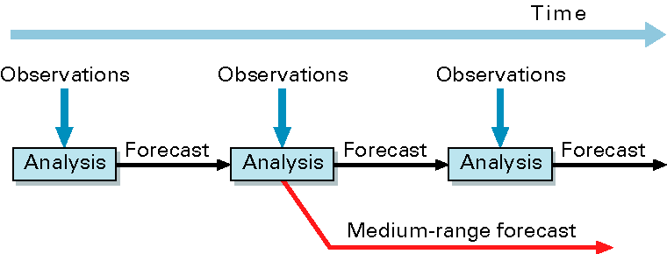
The Data assimilation cycle
An analysis is not produced by observations alone!
The observations are used to correct errors in the short forecast from the previous analysis time (the background forecast).
The background carries information from past observations into the current analysis
The analysis is constructed so as to respect the physical and dynamical balances of the model the model is an integral part of the analysis algorithm

Slide 5
The observations

Slide 6
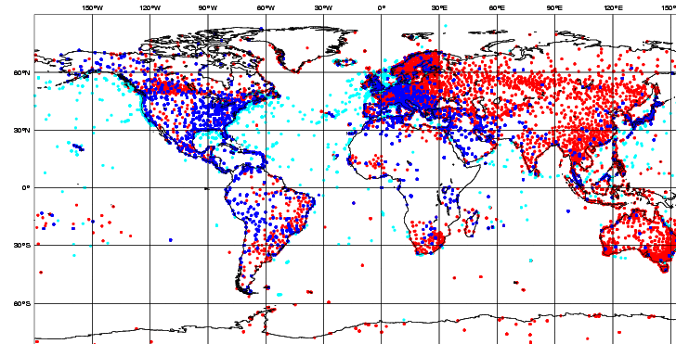
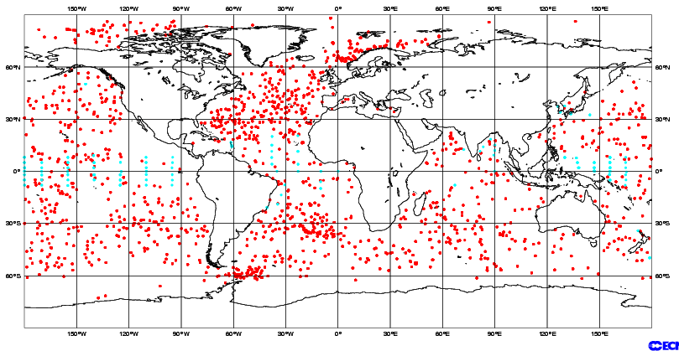
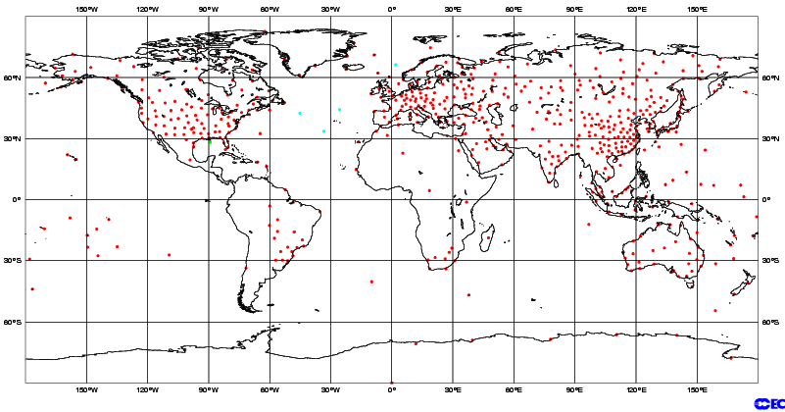
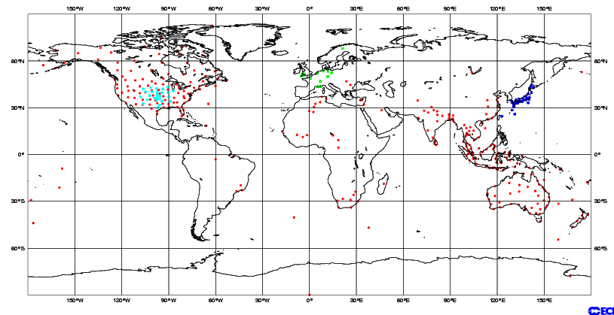
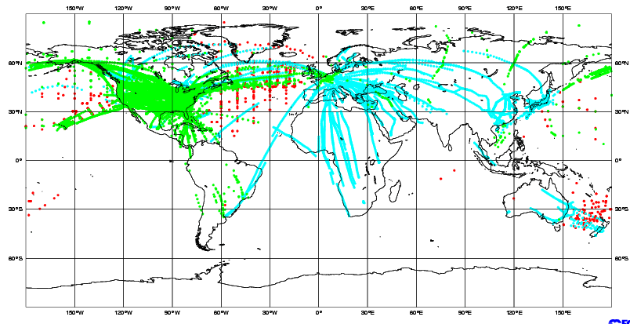
Distribution of in situ observations
SYNOP/METAR/SHIP
DRIBU
Radiosonde balloons (TEMP)
PILOT/Profilers
Aircraft

Slide 7
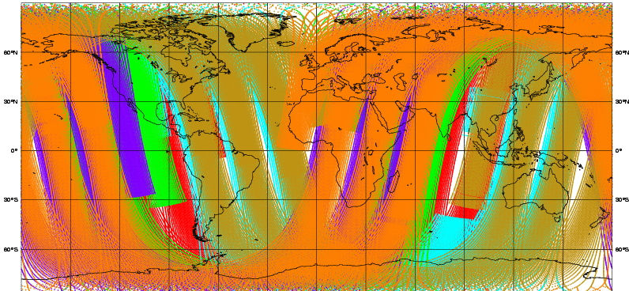
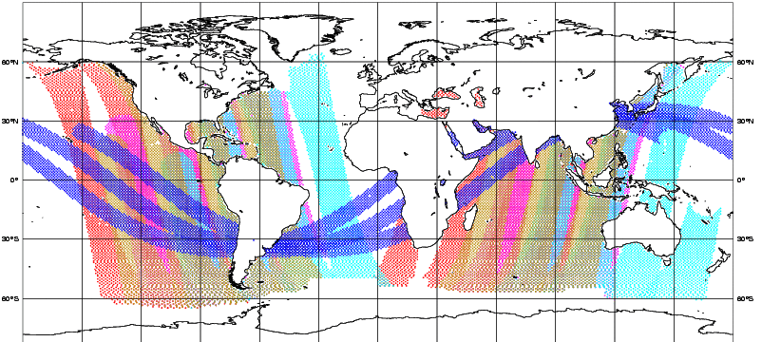
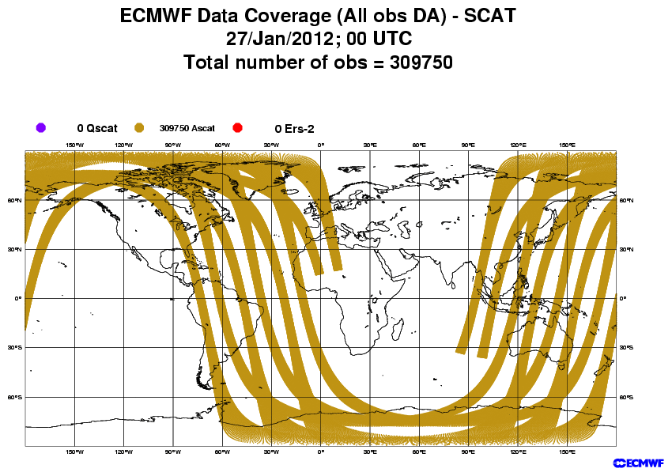
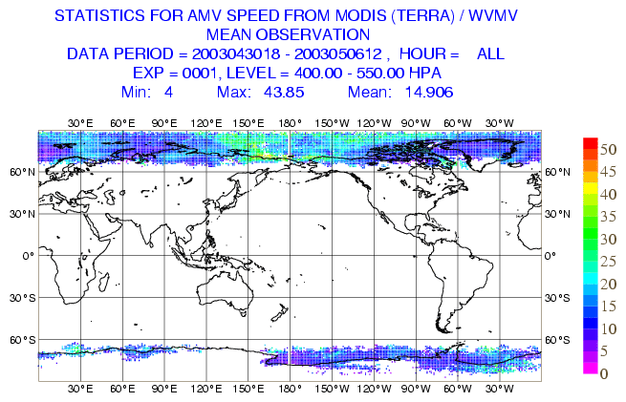
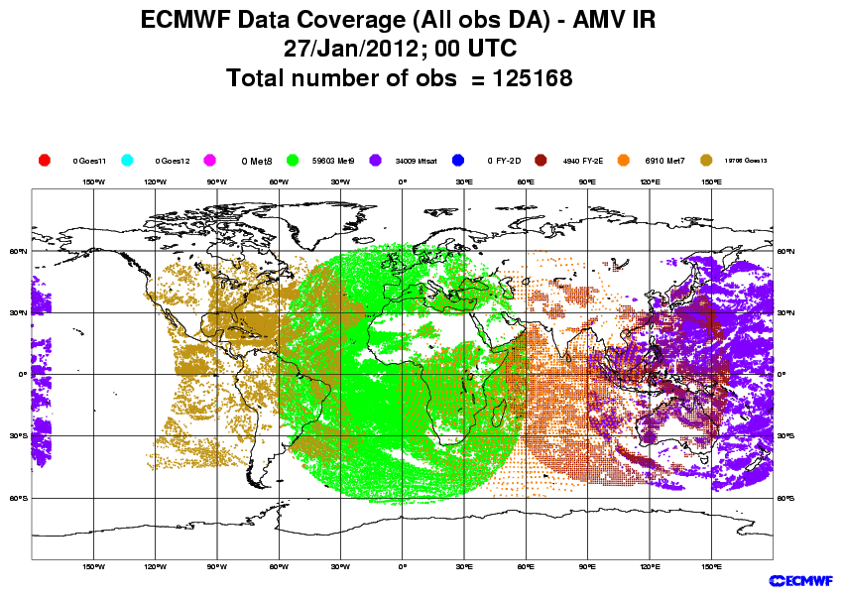
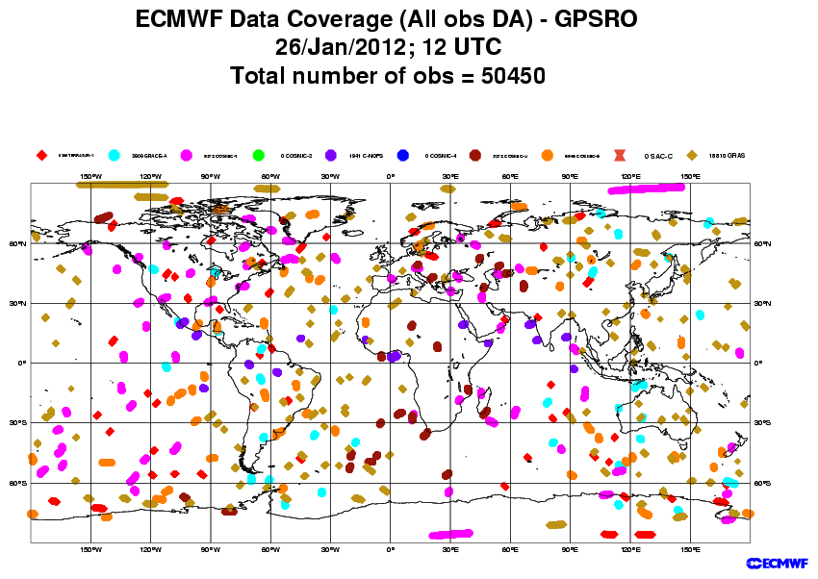
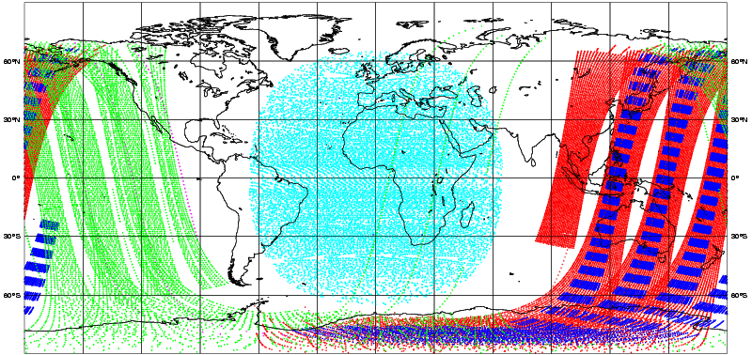
Satellite data sources used by ECMWF’s analysis
Sounders: NOAA AMSU-A/B, HIRS, AIRS, IASI, MHS
Imagers: SSMI, SSMIS, AMSR-E, TMI
Scatterometer ocean low-level winds: ASCAT
Geostationary+MODIS: IR and AMV
GPS radio occultations
Ozone

Slide 8
Observations
In situ (Conventional) and Actively sensed observations (scatterometers, radar altimeters, GPS-RO, Aeolus): Lars Isaksen’s talk
Satellite Radiances: Tony McNally’s talk

Slide 9
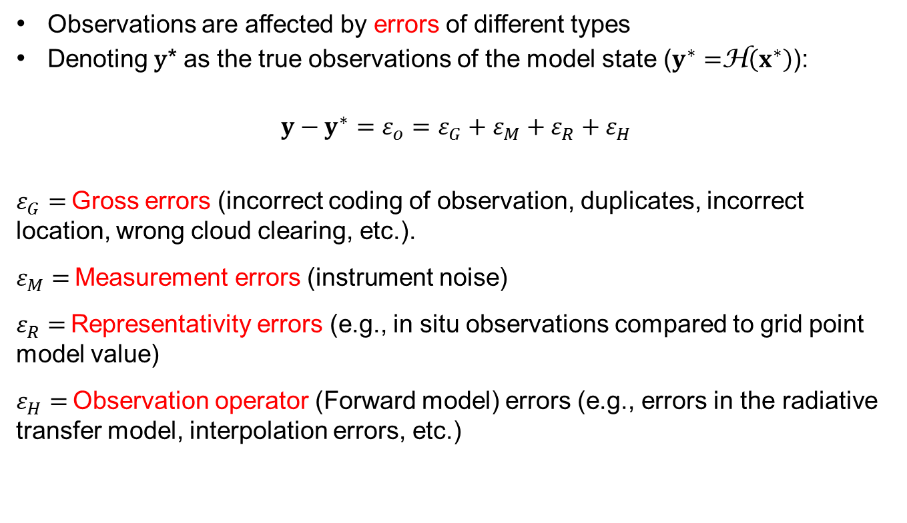
Observation errors
Observations are affected by errors of different types
Denoting y* as the true observations of the model state ($y^{∗}=$H$\left(x^{∗}\right)$):
$$y−y^{∗}=ε_{o}=ε_{G}+ε_{M}+ε_{R}+ε_{H}$$
$ε_{G}=$ Gross errors (incorrect coding of observation, duplicates, incorrect location, wrong cloud clearing, etc.).
$ε_{M}=$ Measurement errors (instrument noise)
$ε_{R}=$ Representativity errors (e.g., in situ observations compared to grid point model value)
$ε_{H}=$ Observation operator (Forward model) errors (e.g., errors in the radiative transfer model, interpolation errors, etc.)

Slide 10
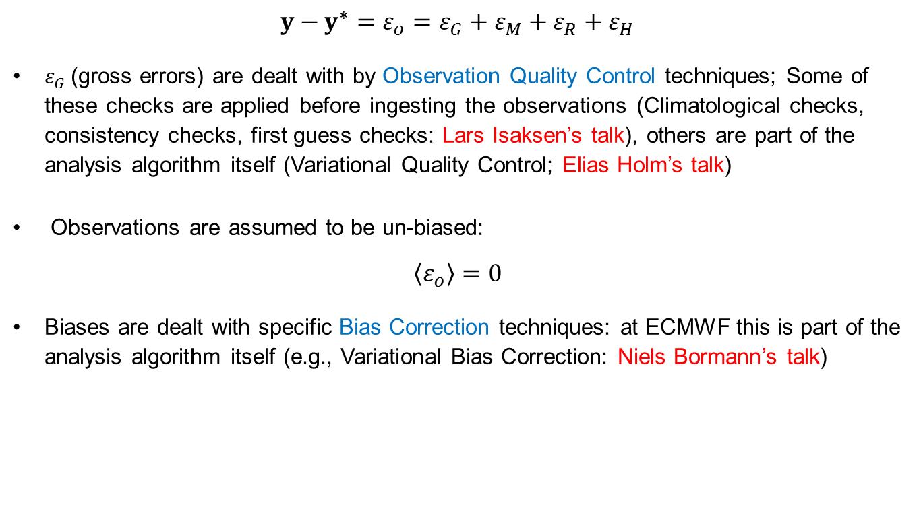
Observation errors
$$y−y^{∗}=ε_{o}=ε_{G}+ε_{M}+ε_{R}+ε_{H}$$
$ε_{G}$ (gross errors) are dealt with by Observation Quality Control techniques; Some of these checks are applied before ingesting the observations (Climatological checks, consistency checks, first guess checks: Lars Isaksen’s talk), others are part of the analysis algorithm itself (Variational Quality Control; Elias Holm’s talk)
Observations are assumed to be un-biased:
$$\left\langle ε_{o}\right\rangle =0$$
Biases are dealt with specific Bias Correction techniques: at ECMWF this is part of the analysis algorithm itself (e.g., Variational Bias Correction: Niels Bormann’s talk)

Slide 11
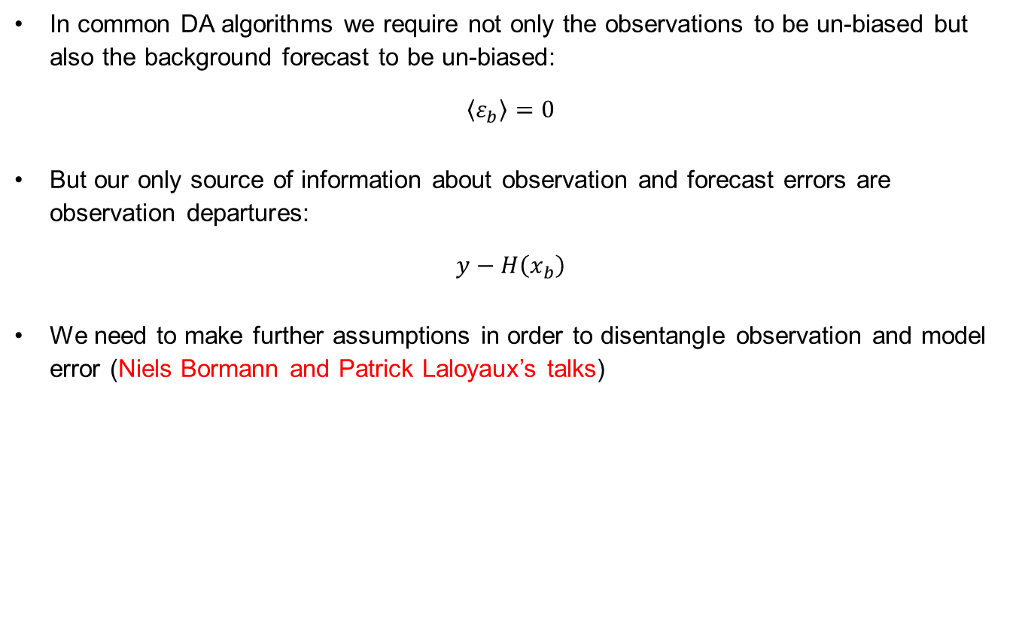
Observation errors
In common DA algorithms we require not only the observations to be un-biased but also the background forecast to be un-biased:
$$\left\langle ε_{b}\right\rangle =0$$
But our only source of information about observation and forecast errors are observation departures:
$$y−H\left(x_{b}\right)$$
We need to make further assumptions in order to disentangle observation and model error (Niels Bormann and Patrick Laloyaux’s talks)

Slide 12
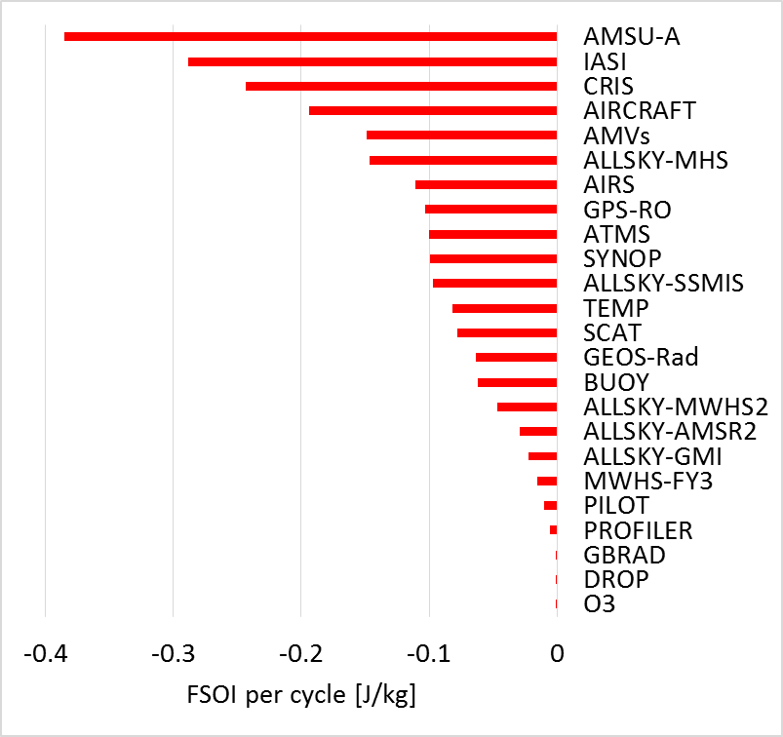
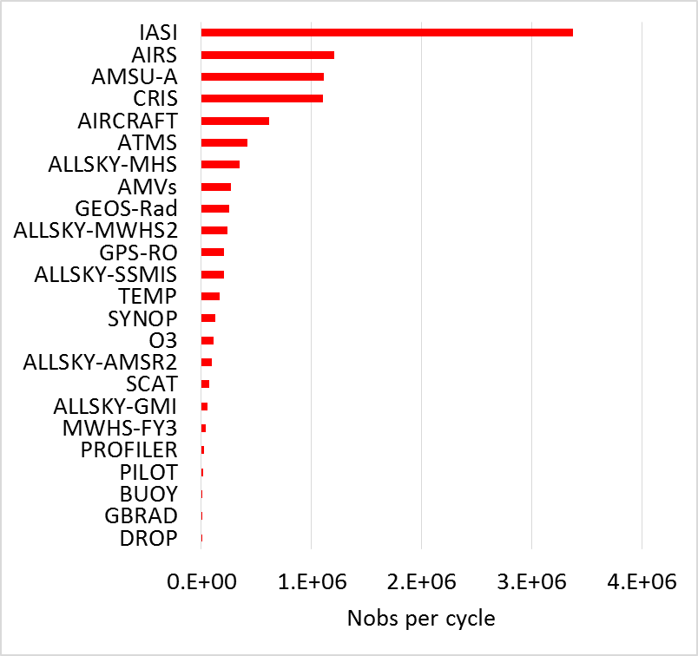
Observation impact
It is also important to monitor and evaluate the impact different types of observations have on the quality of the analyses and forecasts
To do this we routinely look at observation departures (with respect to both analysis and forecast fields: see Lars Isaksen’s talk)
We can also perform Observing System Experiments (OSEs: Cristina Lupu’s talk)
We routinely compute adjoint-based diagnostic quantities (Forecast Sensitivity to Observation Impact: Cristina Lupu’s talk)
Total FSOI impact
Total data count
beneficial

Slide 13
The forecast model

Slide 14
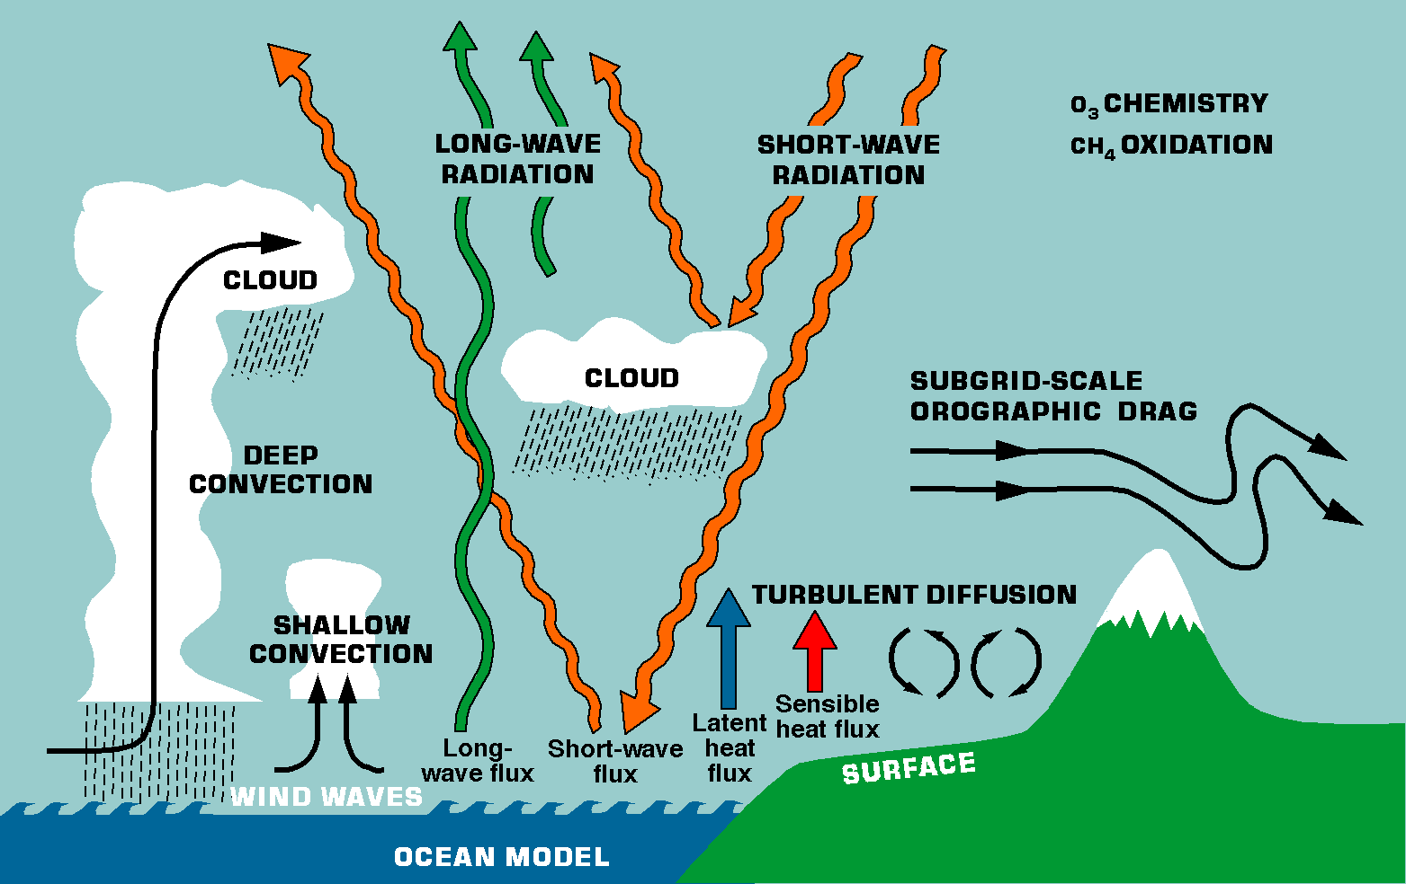
The forecast model is a very important part of the data assimilation system
Most important physical processes in the ECMWF model

Slide 15
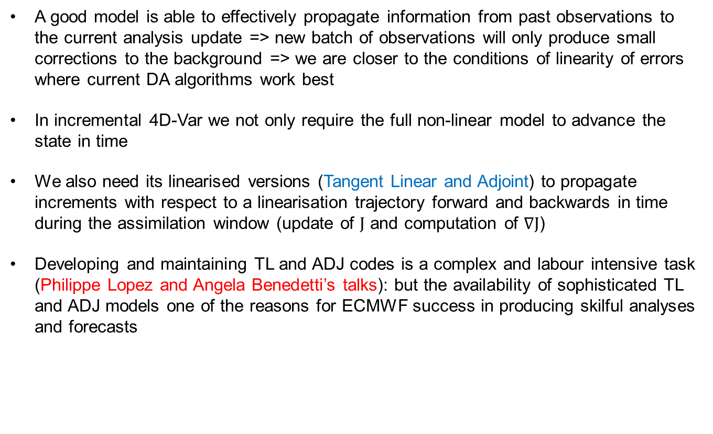
The forecast model
A good model is able to effectively propagate information from past observations to the current analysis update => new batch of observations will only produce small corrections to the background => we are closer to the conditions of linearity of errors where current DA algorithms work best
In incremental 4D-Var we not only require the full non-linear model to advance the state in time
We also need its linearised versions (Tangent Linear and Adjoint) to propagate increments with respect to a linearisation trajectory forward and backwards in time during the assimilation window (update of J and computation of $∇J$)
Developing and maintaining TL and ADJ codes is a complex and labour intensive task (Philippe Lopez and Angela Benedetti’s talks): but the availability of sophisticated TL and ADJ models one of the reasons for ECMWF success in producing skilful analyses and forecasts

Slide 16
Model errors
Despite their increasing complexity and sophistication models are far from perfect!
Many sources of model error: missing physical processes, errors in parametrizations of physical processes, discretisation errors (from continuous PDEs to discrete formulation), etc.,
We represent model errors in two ways:
  Explicitly perturbing the model integration in our ensemble data assimilation system (EDA; see Massimo Bonavita’s talk – Assimilation Algorithms (5))
  Using an explicit model error term in the 4D-Var cost function (weak constraint 4D-Var: see Sebastien Massart talk on 4D-Var and Patrick Laloyaux’s talk on Model Error)
A lot of work still needs to be done in this area, especially in terms of diagnosing the model error statistical characteristics

Slide 17
Blending observations and model information: the Bayes perspective

Slide 18
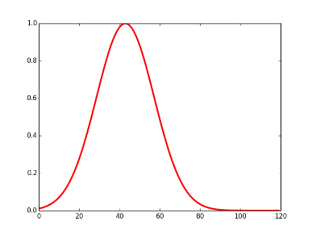
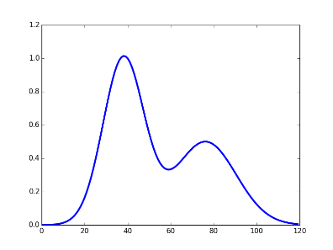
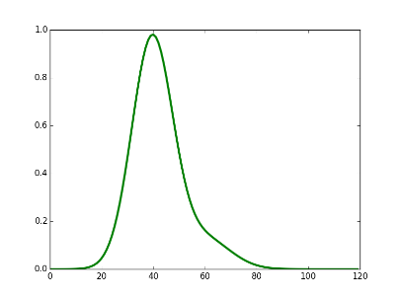




The Bayes perspective
At an abstract level, we can think of the analysis process as updating our prior knowledge about the state, represented by a background forecast and the pdf of its errors, with new observations, represented by their values and the pdf of their errors:
$p\left(x|y\right)=\frac{p\left(y|x\right)p\left(x\right)}{p\left(y\right)}=\frac{p\left(y|x\right)p\left(x_{b}|x\right)}{p\left(y\right)}$ $p\left(y|x\right)p\left(x_{b}|x\right)$
$p\left(x_{b}|x\right)$ = prior pdf (encapsulate our knowledge about the state before new observations)
$p\left(y|x\right)$ = observations likelihood (pdf of the observations conditioned on the state)
$p\left(x|y\right)$= posterior pdf (updated pdf of the state after the analysis)
$p\left(y\right)$= marginal pdf of the observations (does not depend on $x$: normalising constant in Bayes’ law)
$${p\left(y|x\right)}_{}$$
$${p\left(x_{b}|x\right)}_{}$$
DA
$${p\left(x|y\right)}_{}$$

Slide 19
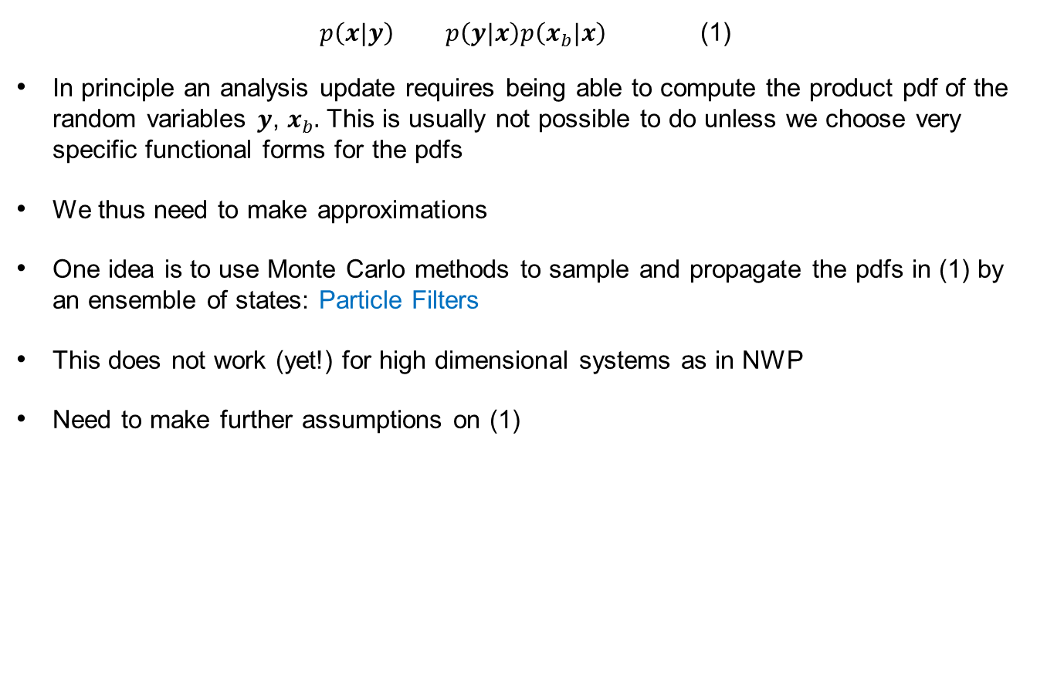
Particle Filters
$p\left(x|y\right)$ $p\left(y|x\right)p\left(x_{b}|x\right)$ (1)
In principle an analysis update requires being able to compute the product pdf of the random variables $y$, $x_{b}.$ This is usually not possible to do unless we choose very specific functional forms for the pdfs
We thus need to make approximations
One idea is to use Monte Carlo methods to sample and propagate the pdfs in (1) by an ensemble of states: Particle Filters
This does not work (yet!) for high dimensional systems as in NWP
Need to make further assumptions on (1)

Slide 20
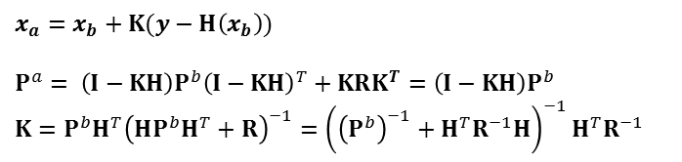
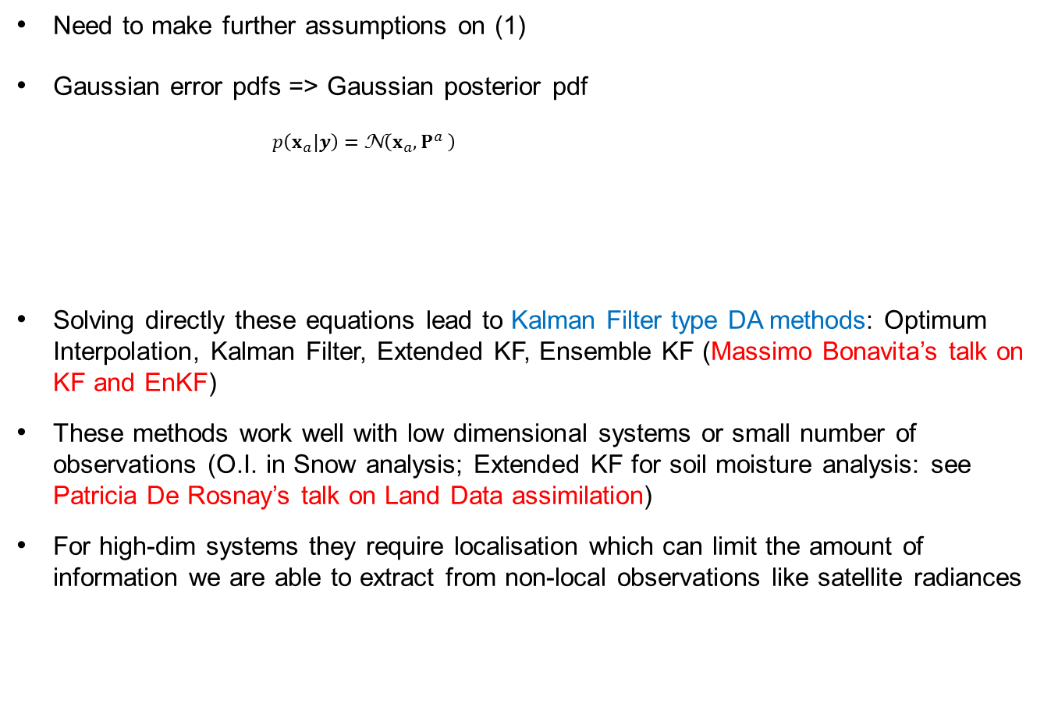
Kalman Filter methods
Need to make further assumptions on (1)
Gaussian error pdfs => Gaussian posterior pdf
  $p\left(x_{a}|y\right)=$ N$\left(x_{a},P^{a} \right)$
Solving directly these equations lead to Kalman Filter type DA methods: Optimum Interpolation, Kalman Filter, Extended KF, Ensemble KF (Massimo Bonavita’s talk on KF and EnKF)
These methods work well with low dimensional systems or small number of observations (O.I. in Snow analysis; Extended KF for soil moisture analysis: see Patricia De Rosnay’s talk on Land Data assimilation)
For high-dim systems they require localisation which can limit the amount of information we are able to extract from non-local observations like satellite radiances
$x_{a}=x_{b}+K(y−H\left(x_{b}\right))$
$$P^{a}= \left(I−KH\right)P^{b}{\left(I−KH\right)}^{T}+KRK^{T}=\left(I−KH\right)P^{b}$$
$$K=P^{b}H^{T}{\left(HP^{b}H^{T}+R\right)}^{−1}={\left({\left(P^{b}\right)}^{−1}+H^{T}R^{−1}H\right)}^{−1}H^{T}R^{−1}$$

Slide 21
Variational methods
The Kalman Filter analysis update equation can be formulated as an equivalent minimization problem:
This is the basis of Variational methods (3D-Var, 3D-Var FGAT, 4D-Var: see Sebastien Massart’s lectures)
Solving the KF update through iterative algorithms (conjugate gradient, Newton’s methods)
These methods do not require direct access to the elements of the error covariance matrices. We can represent error covariances by operators (i.e., pieces of code) acting on analysis increments (see Elias Holm talk on background error modelling)
Variational methods work well on high dimensional systems and are generally used in global NWP

Slide 22
Hybrid Data Assimilation methods
The Kalman Filter equations require estimating and advancing in time not only the state but also its error covariance:
Pª_{t} = (I – KH)P^{b}_{t} (I – KH)^{T} + KRK^{T}
P^{b}_{t+1} = M Pª_{t} M^{T} + Q_{t+1}
4D-Var can implicitly do this but only inside the assimilation window (12 hours at ECMWF)
The idea of Hybrid DA methods is to combine a variational DA system to estimate the state with an ensemble data assimilation system (EnKF/EDA) to estimate and cycle the errors of the state (see Massimo Bonavita’s talk on Hybrid data assimilation)
Ensemble DA systems also provide the initial conditions for Ensemble Prediction
All major global NWP Centres run Hybrid DA systems for Atmospheric DA

Slide 23
Hybrid Data Assimilation: Applications
x_{i}^{b}
x_{i}^{b}
y+ε_{i}º
4D-Var
x_{i}ª
Forecast
4D-Var
i=1,2,…,25
SST+ε_{i}^{SST}
EDA
EDA background perturbations
Updated P^{b}
x^{b}
4D-Var
xª
Forecast
x^{b}
HRES 4DVar

Slide 24
Earth System Data Assimilation
We have discussed Data Assimilation methods with an emphasis on global Atmospheric NWP applications
The DA methods presented are however general: which one to apply to a given problem depends on the characteristics of the problem (size of the state vector, number and quality of observations, available computing resources, available manpower,…)
You have seen applications in Atmospheric Composition DA (4D-Var: Antje Inness’s talk); in Ocean Data Assimilation (3D-Var FGAT: Hao Zuo’s talk); in Land Data Assimilation (O.I., Simplified Extended KF: Patricia de Rosnay’s talk)
In current ECMWF DA the Earth system’s components are at most only weakly coupled (through a coupled model background forecast)
Phil Browne’s talk has given you a sense of some of the challenges and the potential benefits of a stronger coupling in the data assimilation for the different components of the Earth System

Slide 25
Earth System Data Assimilation
We have discussed Data Assimilation methods for the Earth System with an emphasis on producing the best initial state estimate for forecasting at short, extended and even seasonal timescales
An increasingly important application of Earth System DA is to help to reconstruct the past climate and weather (see Patrick Laloyaux’s talk on Reanalysis methods)
As DA methods have dramatically improved over the years we are able to make better use of past observational records and more robustly estimate climatic trends

Slide 26
Earth System DA: Challenges
We have tried to provide you with a description of the state of the art in data assimilation methods for Earth System applications
As you have gathered from the various talks a number of challenges lie ahead
We would like to highlight a few of the more exciting:
  All current methods rely implicitly or explicitly on an assumption of Gaussian errors and quasi-linear error evolution: can we go beyond it?
  Coupling among the different Earth System components is weak in data assimilation: what are the best ways towards a strong coupling approach?
  Volume of observations (especially satellite derived) keeps on increasing at a very fast rate: Are our current DA methods able to make good use of all these data?
  ….

Slide 27
Thank you for being such an attentive audience!

