Slide 1
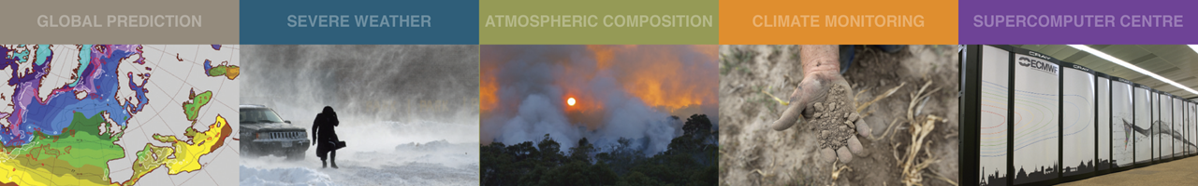
Current Satellite Observing Network and its Future Evolution
  A brief introduction to the Satellite GOS
  What does WMO do?
  EPS Second Generation / Meteosat Third Generation
  ESA Earth Explorer missions: EarthCARE and Aeolus
  Quick summary of other missions
Stephen English
Stephen.English@ecmwf.int

Slide 2
Roughly 1/3rd from American, 1/3rd from European and 1/3rd from Asian countries.

Slide 3
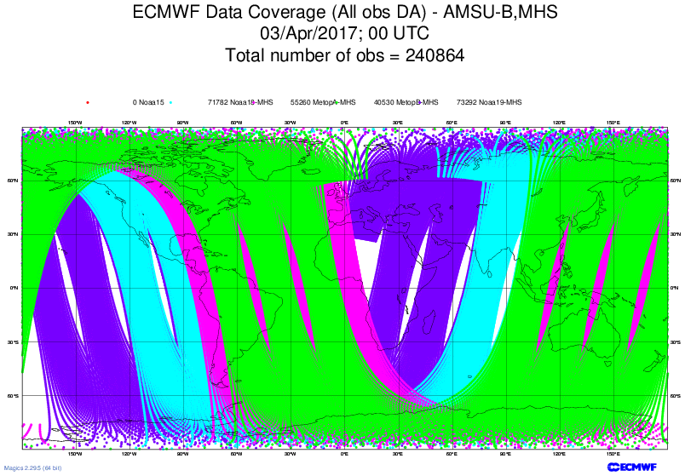
Data coverage e.g. MHS
NOAA-18 NOAA-19 Metop-A Metop-B

Slide 4
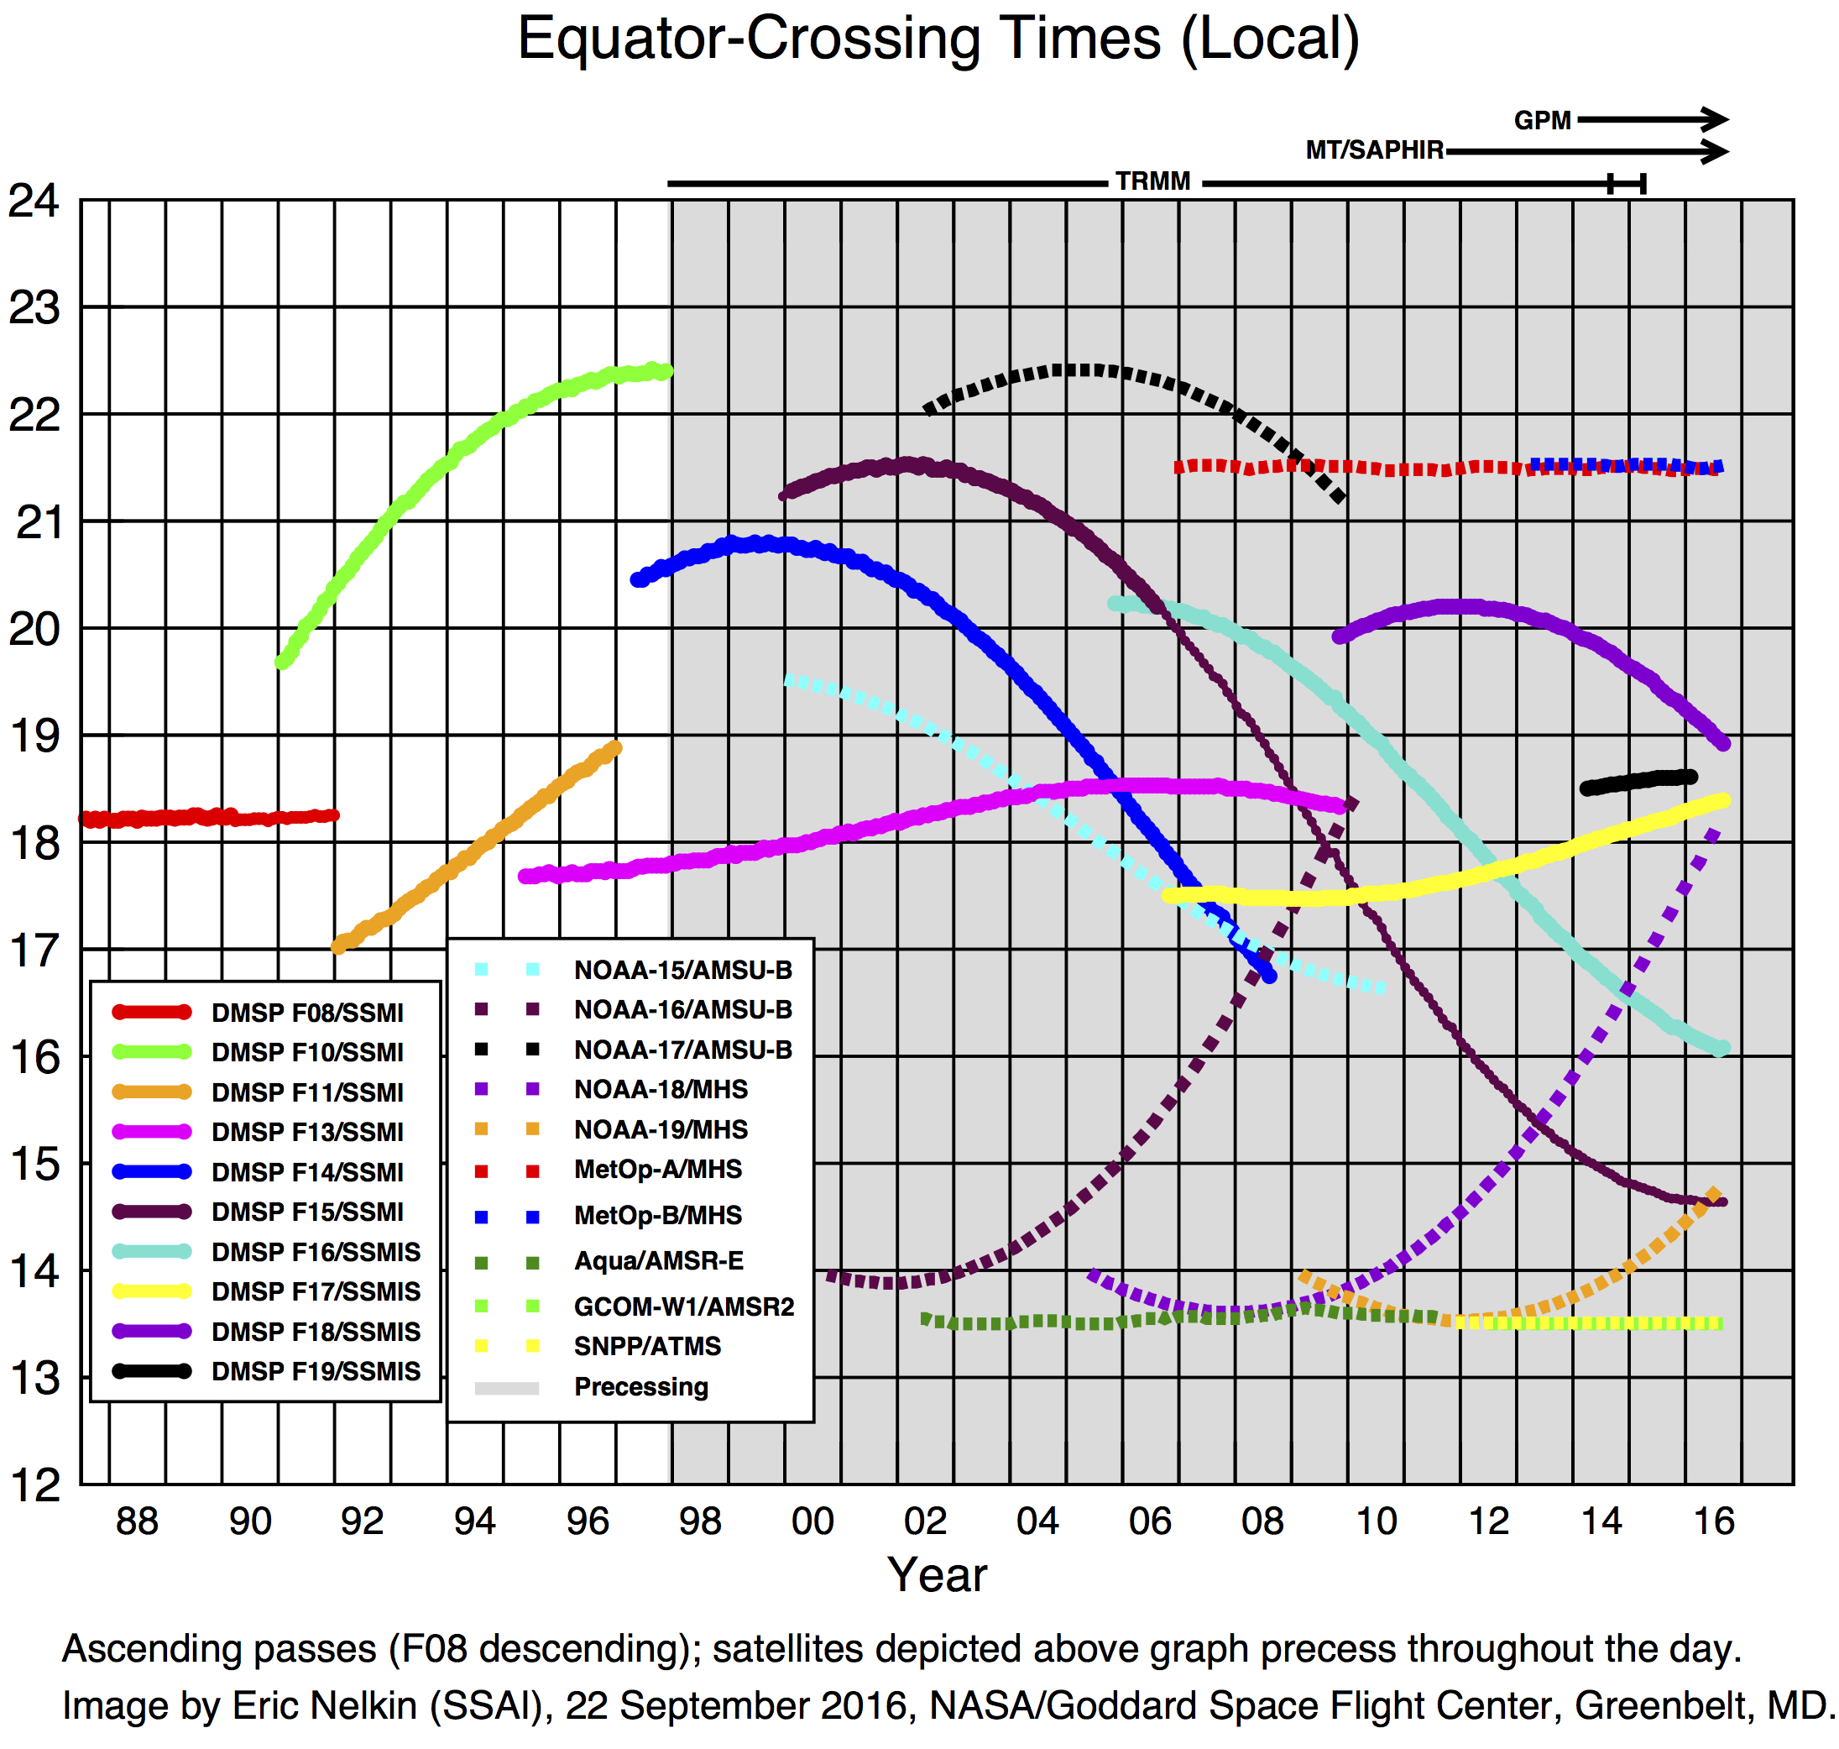
Satellite Equatorial Crossing Times (courtesy of Eric Nelkin)
Mid AM
Early AM
PM
Europe
China
South Korea?
US
China
e.g. Metop
T
i
m
e
e.g. currently NOAA-18
e.g. currently NOAA-18
Notes:
Colours for satellite names denotes what they started as e.g. NOAA-18 started as PM, and has drifted to Early AM

Slide 5
WMO Coordination and WIGOS
WMO is striving towards a coordinated global observing system (WMO Integrated Global Observing System – WIGOS)
Trying to make sure national efforts are complementary
WIGOS Design
China
Europe
United States
Others
(Korea, Canada…..)
Japan
India
Russia

Slide 6
WMO Integrated Global Observing System (WIGOS)
Examples of questions we use NWP Data Assimilation techniques to study:
Very specific questions e.g. Would it be beneficial for the Chinese FY3 program to move to the “early morning orbit” with the Europeans occupying the “mid morning orbit” and the Americans the “afternoon orbit”?
Preparation for future instruments such as lidar and radar (EarthCARE) – will these observations make a difference?
Which observations are most critical to forecast skill?
Monitoring the quality of observations – protecting the operational system e.g. HCN event.
Protecting our needs e.g. Radiofrequency interference.

Slide 7
Developing WIGOS
Vision for WIGOS in 2025 adopted June 2009
Vision for WIGOS in 2040 drafted:
  Goal of new WIGOS vision by 2018 or 2019
  Sets goals for the Space Agencies and attempts to coordinate
WMO Space provide detailed support for satellite data from www.wmo-sat.info:
  OSCAR lists what exists, what is planned, what it can do, how this compares to requirements:
  http://www.wmo-sat.info/oscar/
  SATURN provides detailed information to prepare for forthcoming launches: data availability, formats, meta data, test data, points of contact:
  https://www.wmo-sat.info/satellite-user-readiness/
  The Product Access Guide provides information on existing datasets and how to obtain them:
  https://www.wmo-sat.info/product-access-guide/

Slide 8
EPS Second Generation
A little of the history that led to EPS-SG…
1970s : Research sounders with a few channels = SCAMS,VTPR+
1979 : TOVS (NOAA) = HIRS/2→/3,MSU,SSU,AVHRR
1999 : ATOVS (NOAA) = HIRS/3→/4,AMSU-A,AMSU-B→MHS,AVHRR
2002 : A-train: AIRS,MODIS,CloudSat,Calipso+
2007 : EPS First Generation (Metop) = ATOVS + IASI, ASCAT, GRAS, GOME-2
2011 : S-NPP = ATMS, CrIS, VIIRS, OMPS (USA)
2013 : FY3-C = MWHS-2, MWTS-2, MWRI, IRAS, GNOS, … (China)
2014 : Meteor M N2 = MTVZY-GA, IKFS, … (Russia)
2021: EPS-SG
  EPS-SG-A (3 sats) 2021-2042 = mostly EPS follow on instruments
  EPS-SG-B (3 sats) 2022-2043 = mostly new instruments

Slide 9
EPS Second Generation
1. Updated counterparts to Metop 1st generation
  ATOVS + AVHRR/MODIS → MWS + MetImage
  IASI → IASI-NG
  ASCAT → SCA (on EPS-SG-B)
  GOME-2 → Sentinel-5 UVNS
  GRAS → RO
2. New capability
  MWI: based on SSM/I
  3MI: based on POLDER and PARASOL (VIS/NIR/SWIR)
  ICI: completely new! Sub-mm imager for cloud ice

Slide 10
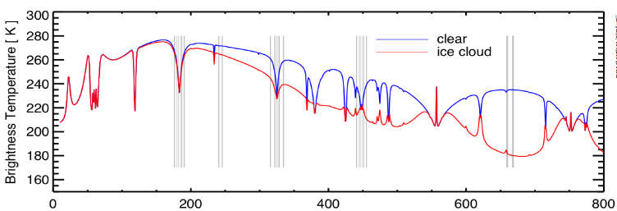
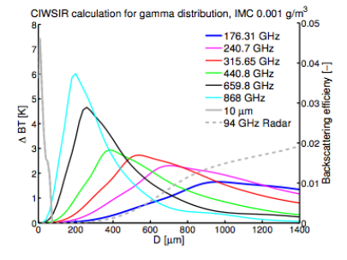
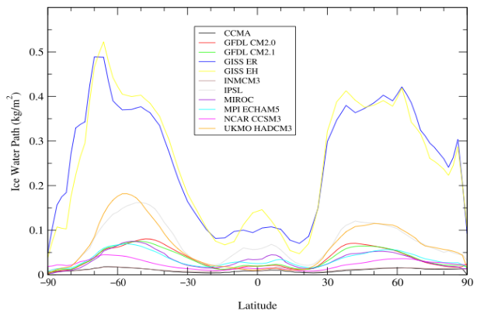
EPS-SG: Ice Cloud Imager - ICI
Ice water path
+
Some information on particles (size, shape, orientation….)
ICI
From CloudIce proposal (Buehler et al.)
From John and Soden (2006)

Slide 11
EPS-SG: Multi-Viewing Multi-Channel Multi-Polarisation Imaging Mission - 3MI
3MI = POLDER + MODIS heritage
Multi-directional : 10-14 views for one pixel
              Exploits bi-directional reflectivity
Multi-polarization : ±60, 0º
Multi-spectral : 12 channels
388 to 2130 nm (close to MODIS specification)

Slide 12
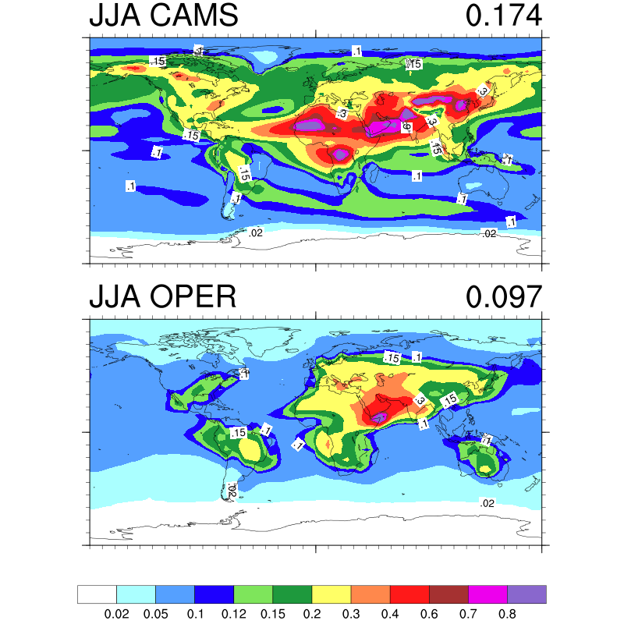
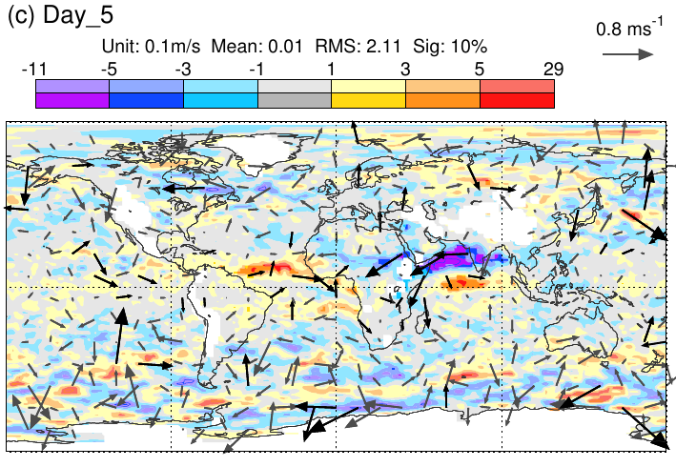
Aerosol impacts – aerosol climatology change in ECMWF Cy43r3
Aerosol optical depth at 550 nm
CAMS vs Operational climatology
Improved summer monsoon
850 hPa wind impact
(From 43r3 report)

Slide 13
Meteosat Third Generation
A little of the history that led to MTG
1977 : Meteosat-1: 3 channel MVIRI instrument (by ESA)
1989 : Meteosat-4: first operational Meteosat
1995 : EUMETSAT takes over Meteosat operations
2002 : 2nd generational Meteosat: 12 channel SEVIRI on Meteosat-8
2005 : NASA plan GIFTS Geo interferometer launch but it never flies
2016 : NOAA launch GOES-16 with lightning imager
2016 : CMA launch FY4-A with GIIRS interferometer and a lightning imager
2020: Meteosat Third Generation
  MTG-I 2020 (4 sats) 2020-2039
  MTG-S 2022 (2 sats) 2022-2037

Slide 14
Meteosat Third Generation
1. Updated counterparts to Meteosat second generation
  SEVIRI → FCI 16 channel imager
    European rapid scan 2.5 minutes, full disk 10 minutes.
2. New instruments
  IRS: IR interferometer
  LI: Lightning imager (777.4nm)
  UVN: Ultraviolet, Visible and Near IR imager

Slide 15
MTG: Infrared Sounder - IRS
An imaging Fourier-interferometer
Resolution of 0.625 cm⁻¹
Two bands
  700–1210 cm⁻¹ Long-Wave InfraRed (LWIR)
  1600–2175 cm⁻¹ Mid-Wave InfraRed (MWIR)
Spatial resolution of 4 km.
Full Disk basic repeat cycle of 60 min.
Note China’s FY4 series also carries an interferometer in Geo orbit
FY4-A launched last year successfully
ECMWF workshop in January 2017 dedicated to exploitation of high temporal Advanced IR Sounder information.

Slide 16
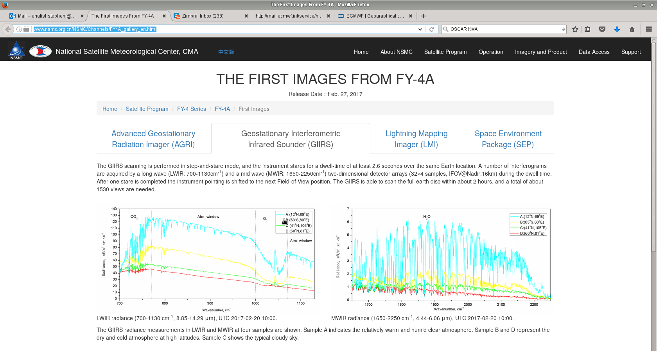
First images and data from FY4-A
http://www.nsmc.org.cn/NSMC/Channels/FY4A_gallery_en.html

Slide 17
Aeolus: doppler wind lidar
  Active measurement of Doppler shift in backscattered laser
  Direct information on horizontal line of sight wind mostly in the zonal direction
  Provides a “curtain” of observations along orbit (2D cross section)
    Vertical resolution 250m (PBL) to 2km (Stratosphere)
    Horizontal resolution ~90km
  Winds are derived from molecular (Rayleigh) or particulate (Mie) backscattering
  Technologically challenging and launch date has changed many times. Now expected sometime in period December 2017 – January 2018.

Slide 18
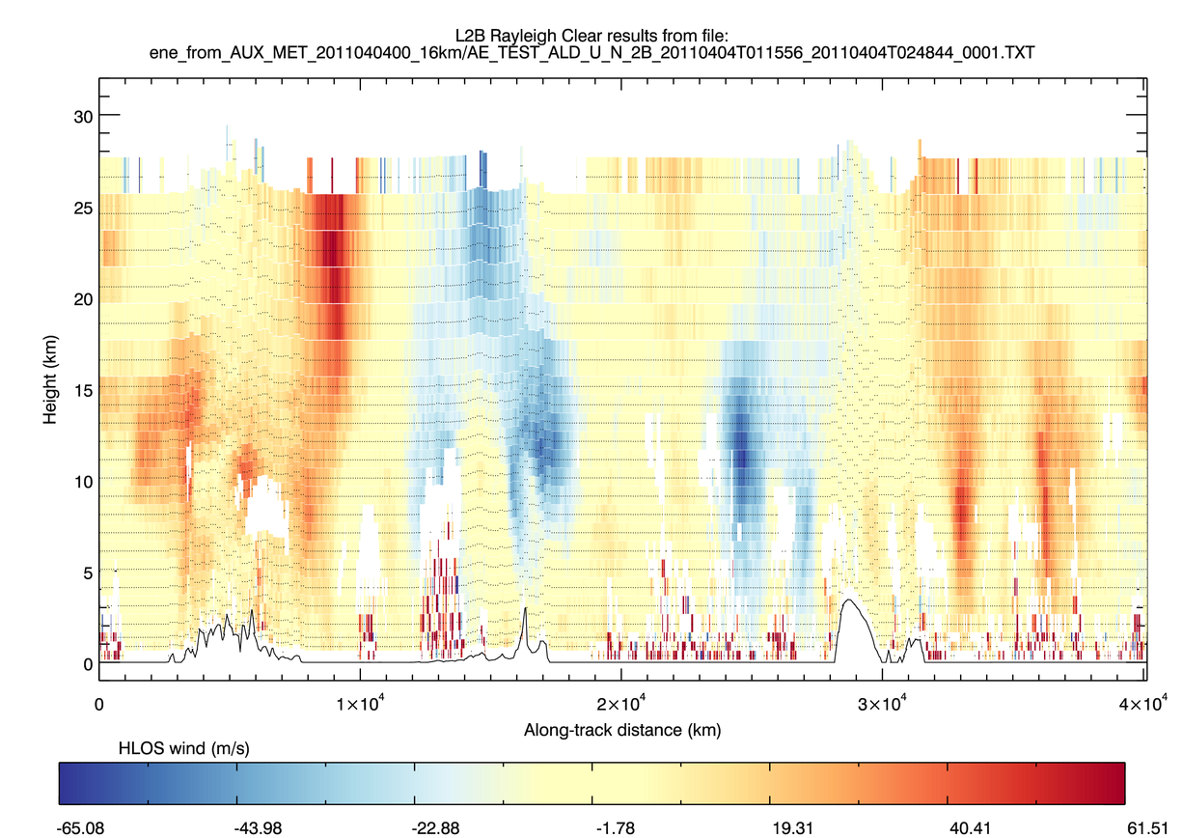
Simulated Aeolus wind observations
(M Rennie)

Slide 19
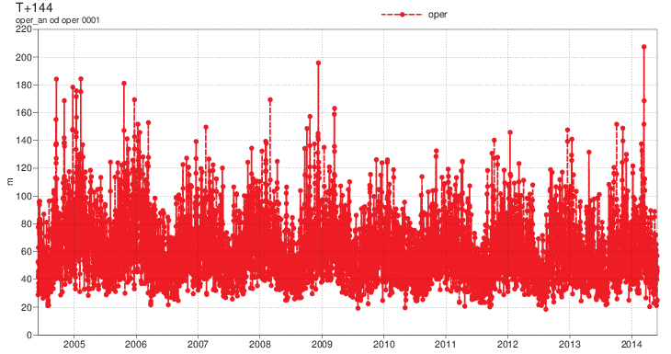
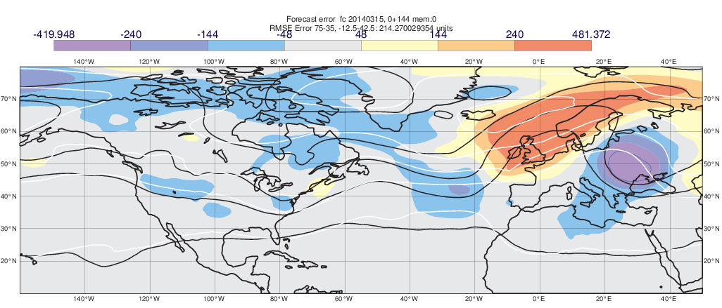
Aeolus: doppler wind lidar; why we need it!
A very poor forecast for Europe at day 6.
RMSE 4X normal value.
Day 6
Day 5
Error propagation from
Tropics and interaction with convection in USA
Day 4
Day 3
Day 2
(E Kallen)
Notes:
But on any given day some forecasts can be poor!
ECMWF suffered a (mercifully extremely rare) data corruption problem on Saturday 28 June, which I’ll ask Florence just to say something about briefly.
If we come back to an occasion where the issue was meteorological rather than data corruption. On 15 March 2014 ECMWF had its worst 6 day forecast for over a decade!
Forecast had a ridge over western Europe and a trough over central Europe whereas in fact the flow was essentially zonal.
Largest EDA spread on the globe was over the eastern tropical Pacific and the signal of this reached Europe 6 days later.
2-3 days into the forecast strong convection appeared over southern U.S. and amplified the propagating error.
This indicates the importance of improved observations of tropical winds and the launch of the Aeolus satellite next year should help. It also suggests that the process of amplification of errors by convection needs to be understood better.

Slide 20
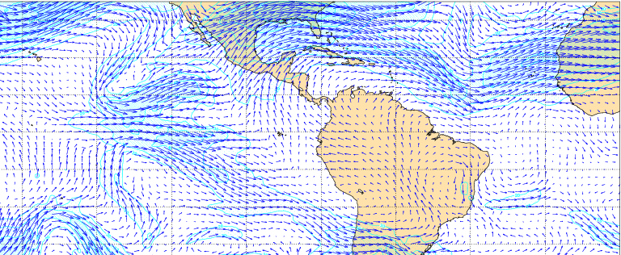
Traced to tropical wave:
Work by Zagar demonstrated assimilation of Z only can’t generated the wind increments for tropical equatorial Rossby waves.
200 mb winds on 15 March
“truth”
Geopotential only
Geopotential and wind
(Zagar, 2004)

Slide 21
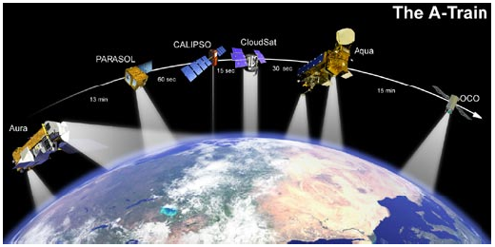
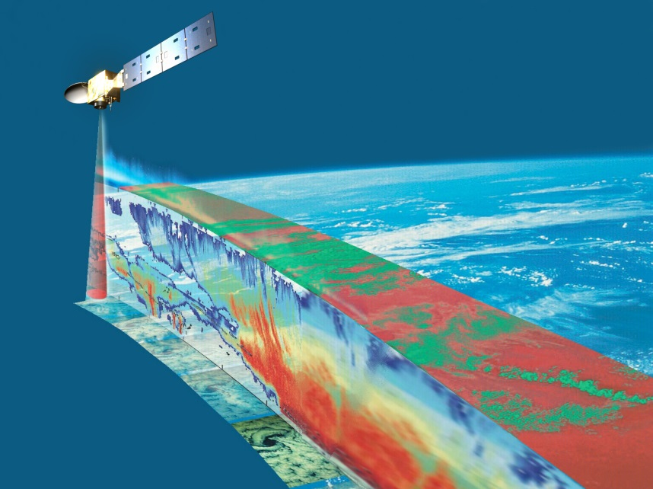
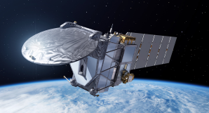
EarthCARE: cloud radar and lidar
EarthCare
ThA-Train
  Launched 2006
  NASA
  700-km orbit
  CloudSat 94-GHz radar
  CALIPSO 532/1064-nm lidar
  MODIS, CERES and AMSR-E radiometers
EarthCARE
  Expected launch c. 2018
  ESA+JAXA
  400-km orbit (more sensitive)
  CPR: 94-GHz Doppler radar
  ATLID: 355-nm lidar
  MSI and BBR radiometers

Slide 22
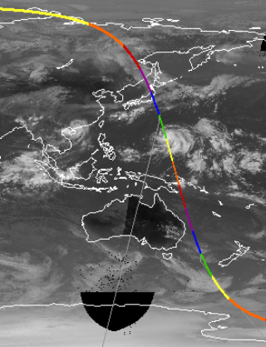
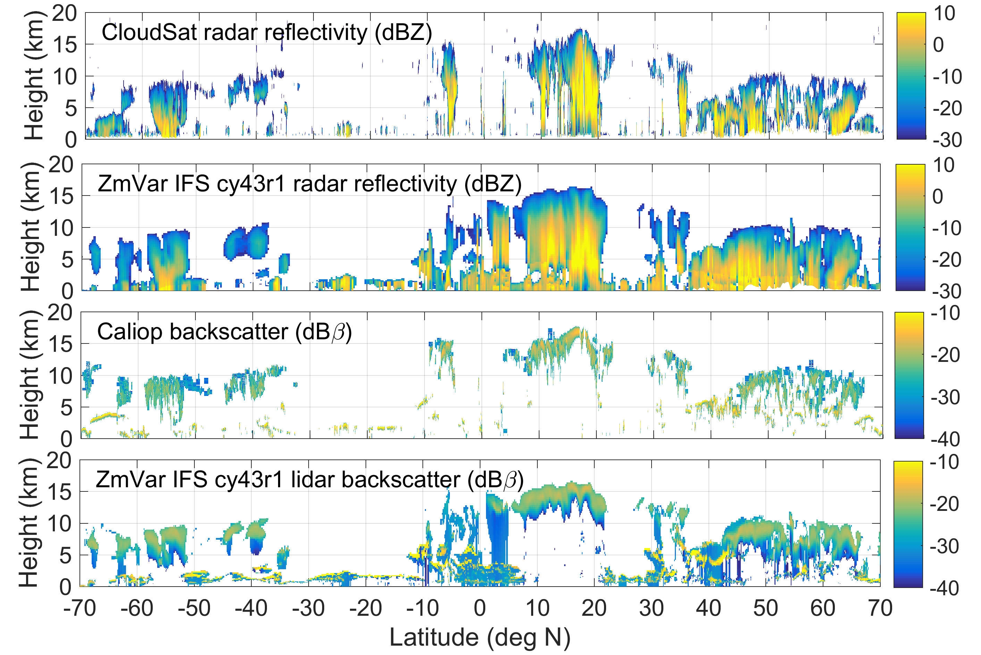
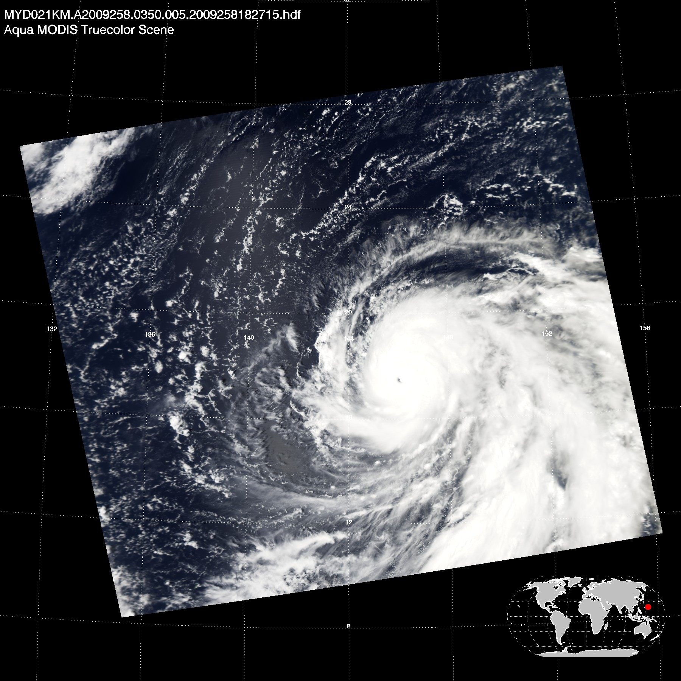

EarthCARE - clouds
Typhoon Choi-wan
(Sept. 15th 2009)
Demonstration with Cloudsat and Calipso data.
(Fielding and Janiskova)
11

Slide 23
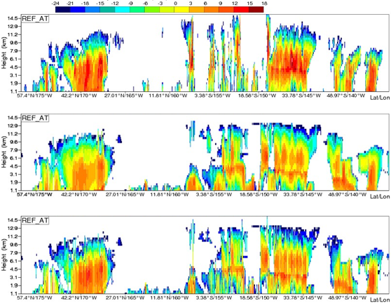
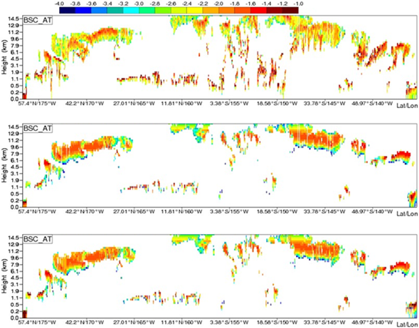
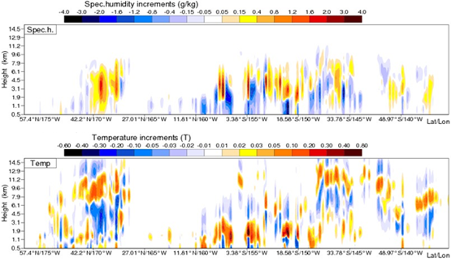
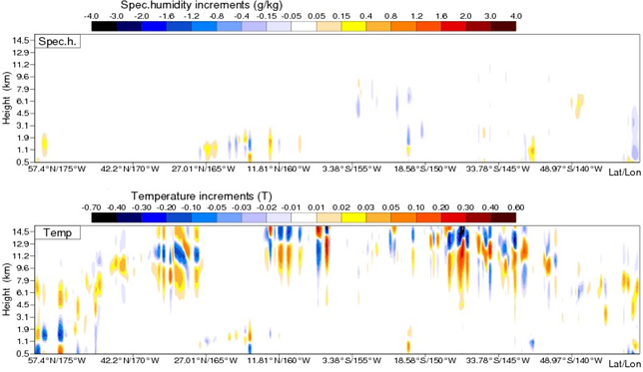
EarthCARE: assimilation in 4D-Var
O
B
A
δq
δT
Radar
Lidar
(S Di Michele and M Janisková)

Slide 24
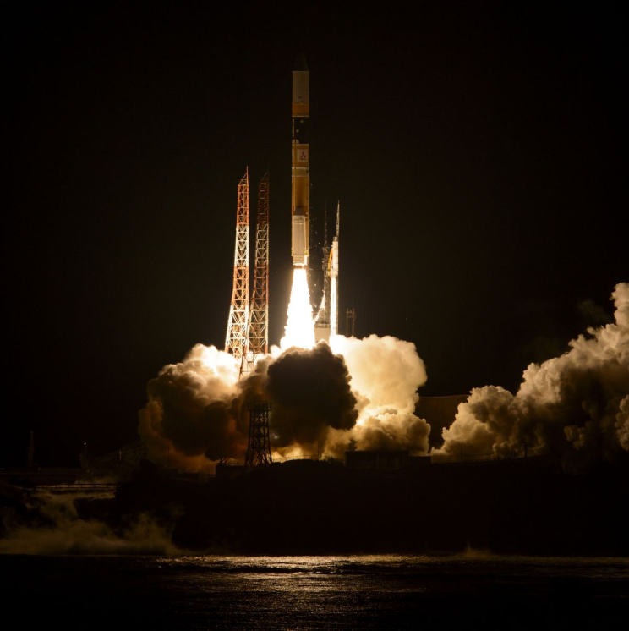
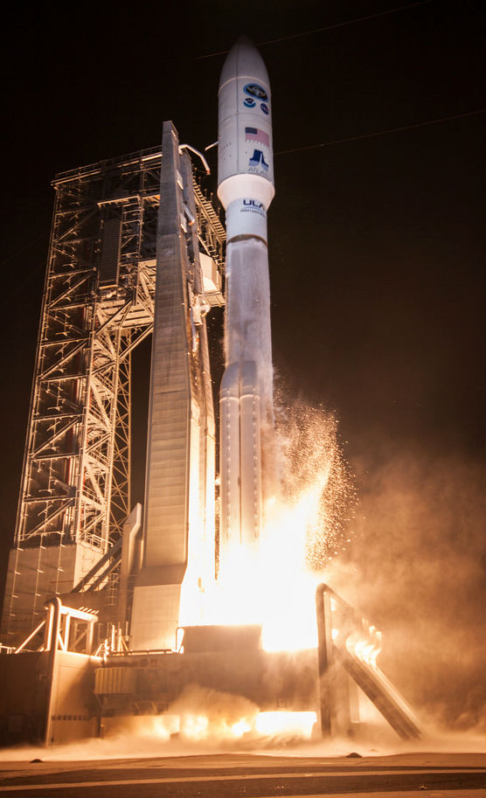
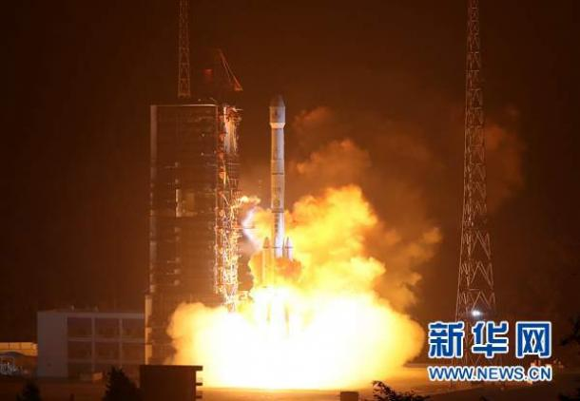
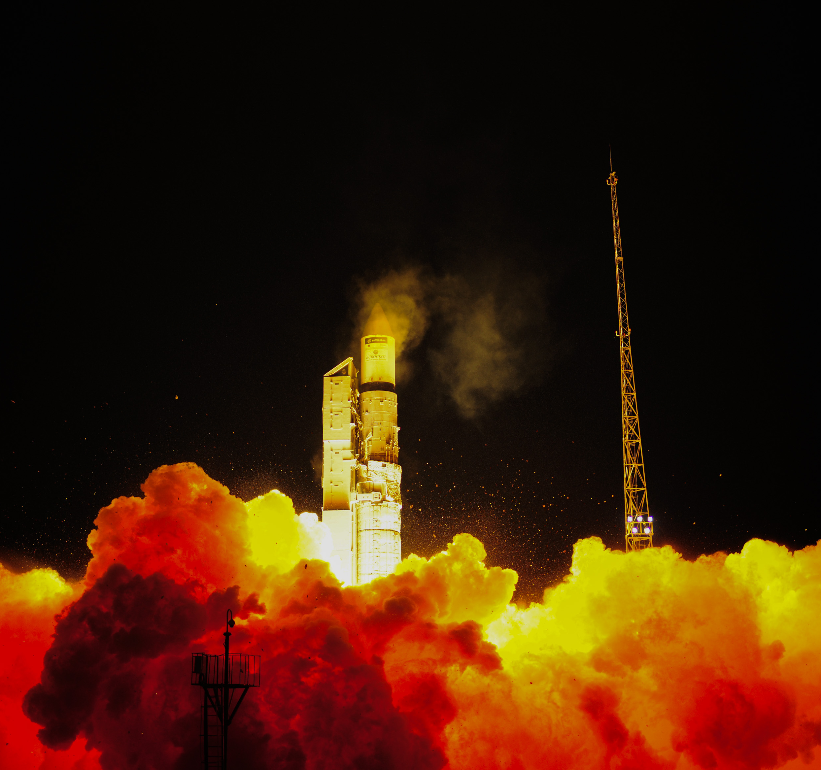
Some missions 2014-18
GPM
Feb 2014
FY4-A
Dec 2016
2014
GPM February
Sentinel-1A October
Himawari-8 October
2015
SMAP January
Sentinel-2A June
MSG-4 July
2016
Sentinel-3A February
INSAT-3DR September
GOES-16 November
Himawari-9 November
FY4-A Dec
2017
Sentinel-2B March
JPSS-1
FY3-D
COSMIC-2a
Aeolus
Meteor-M N2
2018
Sentinel-5p
Metop-C
GOES-S
OceanSat-3
ELEKTRO-L
EarthCARE
GEO-KOMPSAT-2A
GOES-16
Nov 2016
Sentinel-3
Feb 2016
Meghatropiques Oct 2011
Sentinel-1 April 2014
FY3C
Sept 2013

Slide 25
Summary
We live in an incredible era for earth observation!!!
Next few years will see a remarkable number of new and exciting new data sources
Challenging:
  Need for generic tools (monitoring, observation operator, etc.)
  Need for international collaboration (e.g. NWPSAF that funds this course!)
  Need to realise WIGOS and the WMO Vision
  Need for easy to use information systems (OSCAR)
  Need for easier route to operations for new datasets (SATURN)

