Slide 1



04, 2016, Reading
Unified Framework for Discrete Integrations of Compressible and Soundproof PDEs of Atmospheric Dynamics

Slide 2
Part I: Analytic Formulations:
Introduction;
Eulerian & Lagrangian reference frames;
Atmospheric PDEs;
Nonhydrostatic (all-scale) PDEs;
Perturbation forms;
Unified framework;
Conservation law forms;
Generalised coordinates;
Examples
Part II: Integration Schemes:
Forward-in-time integrators, E-L congruence;
Semi-implicit algorithms;
Elliptic boundary value problems;
Variational Krylov solvers;
Preconditioning;
Boundary conditions

Slide 3
Part I: Analytic Formulations
Meteorology has a large portfolio of diverse analytic formulations of the equations of motion, which employ variety of simplifying assumptions while focusing on different aspects of atmospheric dynamics.
Examples include: shallow water equations, isosteric/isentropic models, hydrostatic primitive equations, incompressible Boussinesq equations, anelastic systems, pseudo-incompressible equations, unified equations, and fully compressible Euler equations.
Many of these equations can be written optionally in Eulerian or Lagrangian reference frame and in terms of various dependent variables; vorticity, velocity or momentum for dynamics, and total energy, internal energy or entropy for thermodynamics.
However, with increasing computational power the non-hydrostatic (i.e., all-scale) systems come into focus, thus reducing the plethora of options.

Slide 4
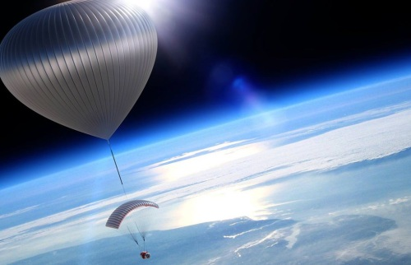
Two reference frames
Eulerian ⬅ ➔ Lagrangian
(the archetype problem, AP)
The laws for fluid flow --- conservation of mass, Newton’s 2nd law, conservation of energy, and 2nd principle of thermodynamics --- are independent on reference frames ➔ the two descriptions must be equivalent, somehow.

Slide 5
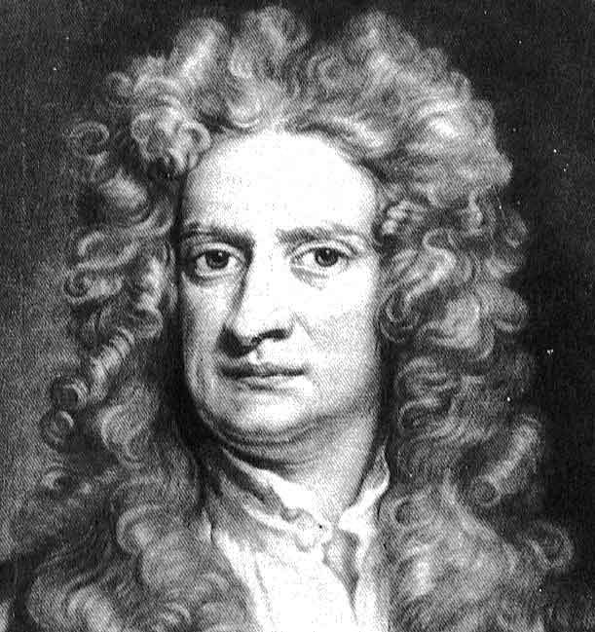

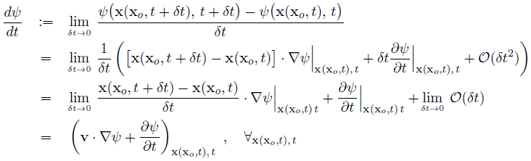

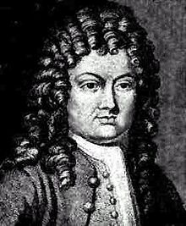

Fundamentals:
Newton, 1642-1727
physics (re measurement)
math (re Taylor series)
physics (relating observations
in the two reference frames)
Taylor , 1685-1731

Slide 6
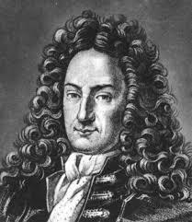


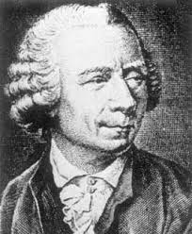

More math:
parcel’s volume evolution;
0 < J < ∞, for the flow to
be topologically realizable
flow divergence, definition
flow Jacobian
Leibniz, 1646-1716
Euler expansion formula,
and the rest is easy ➔
Euler, 1707-1783

Slide 7




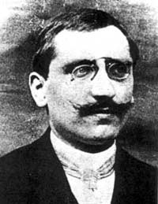
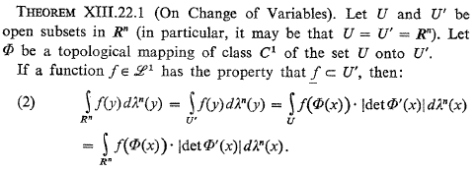
mass continuity
key tools for deriving conservation laws
Lebesque1875-1941

Slide 8
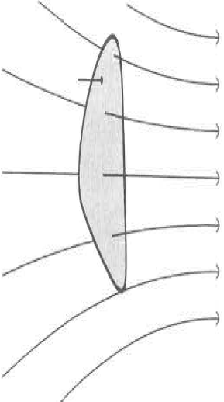
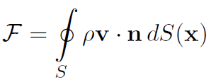
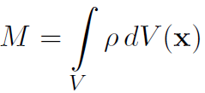

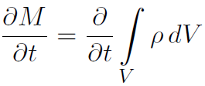
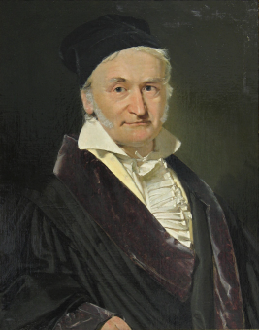
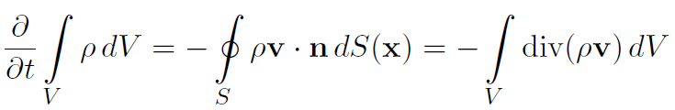
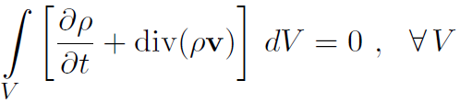

Digression: an alternative semi-heuristic, popular Eulerian argument in terms of flow through a fixed volume:
mass flux through the bounding surface
instantaneous total mass
Gauss, 1777-1855
➔

Slide 9
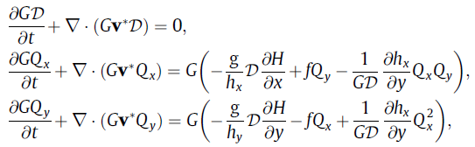
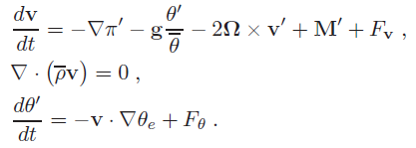
Elementary examples:
Shallow-water equations
(Szmelter & Smolarkiewicz, JCP, 2010)
anelastic system
See: Wedi & Smolarkiewicz, QJR, 2009, for discussion; and a special issue of JCP, 2008, “Predicting Weather, Climate and Extreme Events” for an overview of computational meteorology

Slide 10
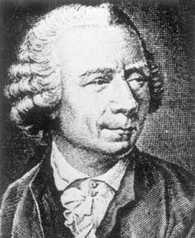
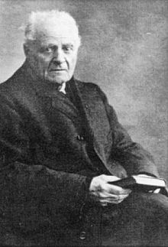
All leading weather and climate codes are based on the compressible Euler equations, yet much of knowledge about non-hydrostatic atmospheric dynamics derives from the soundproof equations  descendants of the classical, reduced incompressible Boussinesq equations
Euler, 1707-1783
Boussinesq, 1842-1929

Slide 11
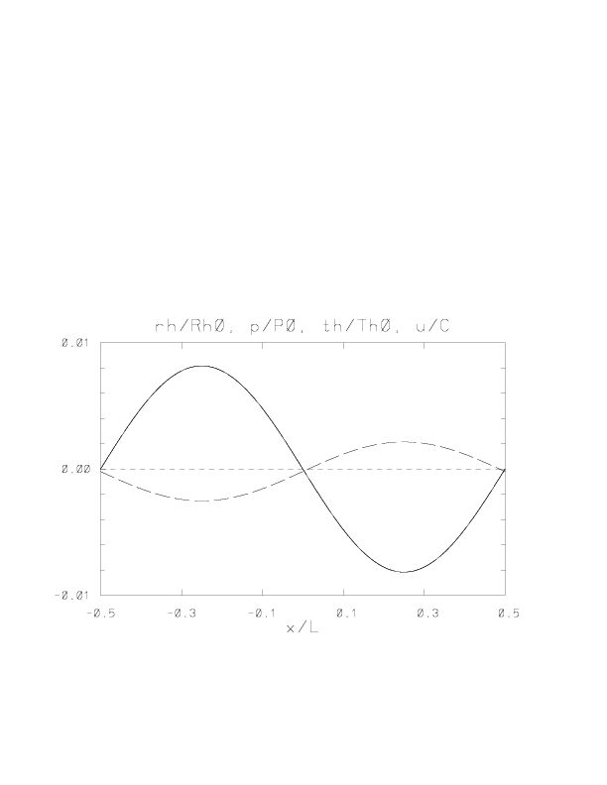

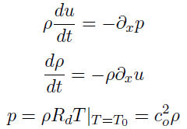
Why bother? Handling unresolved acoustic modes, while insisting on large time steps relative to speed of sound, makes numerics of non-hydrostatic atmospheric models based on the compressible Euler equations demanding
pressure and density solid lines, entropy long dashes, velocity short dashes

Slide 12



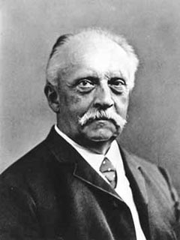


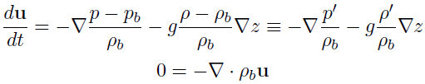
From compressible Euler equations to incompressible Boussinesq equations
3D momentum equations under gravity
mass continuity and adiabatic entropy equations
perturbation about static reference (base) state:
momentum equation, perturbation form:
Helmholtz,
1821-1894
for problems with small vertical scales and density perturbations:
incompressible Boussinesq equations

Slide 13
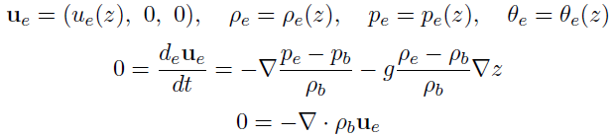
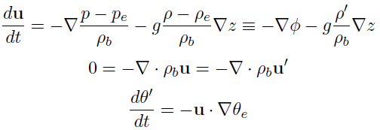
Perturbation forms in the context of initial & boundary conditions
Take incompressible Boussinesq equations:
which also require initial conditions for pressure and density perturbations. Then consider an unperturbed ambient state, a particular solution to the same equations
subtracting the latter from the former gives the form
that takes homogeneous initial conditions for the perturbations about the environment !

Slide 14


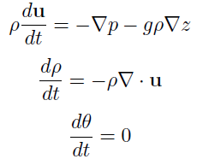
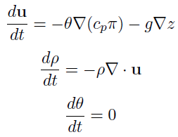


compressible Euler equations
Perturbation forms in terms of potential temperature and Exner function
F.M. Exner,
1876-1930
⬅➔

Slide 15
● The incompressible Boussinesq system is the simplest nonhydrostatic soundproof system. It describes small scale atmospheric dynamics of planetary boundary layers, flows past complex terrain and shallow gravity waves, thermal convection and fair weather clouds.
● Its extensions include the anelastic equations of Lipps & Hemler (1982, 1990) and the pseudo-incompressible equations of Durran (1989, 2008).
In the anelastic system the base state density is a function of altitude; in the pseudo-incompressible system the base state density is a (different) function of altitude, and the pressure gradient term is unabbreviated.
● In order to design a common approach for consistent integrations of soundproof and compressible nonhydrostatic PDEs for all-scale atmospheric dynamics, we manipulate the three governing systems into a single form convenient for discrete integrations:
Notes:
Time averages are over 12 months, after spin up.

Slide 16
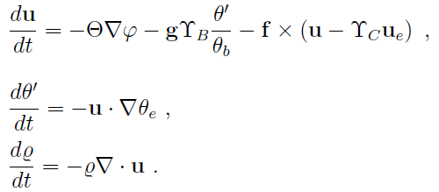
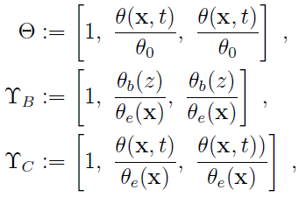
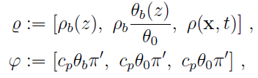

Unified Framework, combined symbolic equations:
(Smolarkiewicz, Kühnlein & Wedi, JCP, 2014)
gas law
conservation-law forms ➔

Slide 17
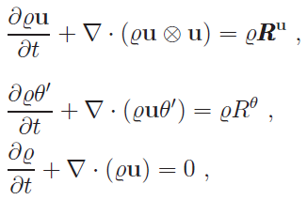


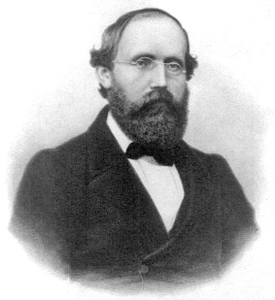


Combined equations, conservation form:
specific vs. density variables
Accounting for curvilinear coordinates:
Riemann,
1826-1863
⬅ ➔
recall “the archetype problem, AP”
➔ example ➔ integration schemes ➔

Slide 18
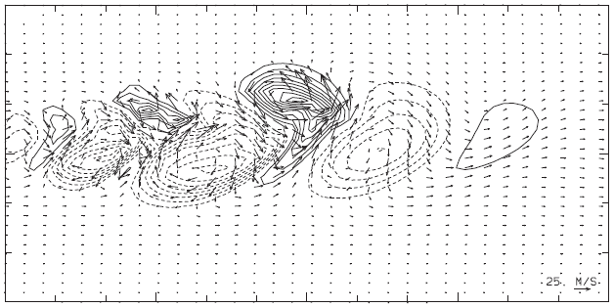
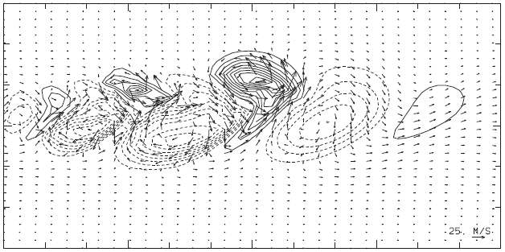
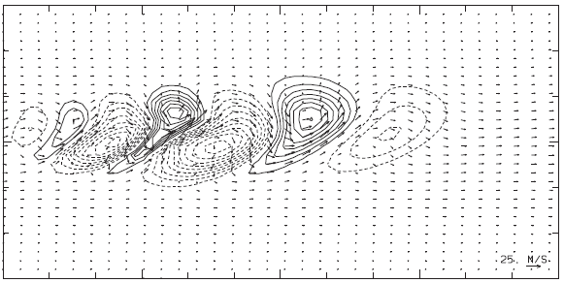
Global baroclinic instability (Smolarkiewicz, Kühnlein & Wedi , JCP, 2014)
8 days, surface θ’, 128x64x48 lon-lat grid,
128 PE of Power7 IBM
CMP, 2880 dt=300 s,
wallclock time=2.0 mns
PSI, 2880 dt=300 s,
wallclock time=2.3 mns,
ANL, 2880 dt=300 s,
wallclock time=2.1 mns,

Slide 19
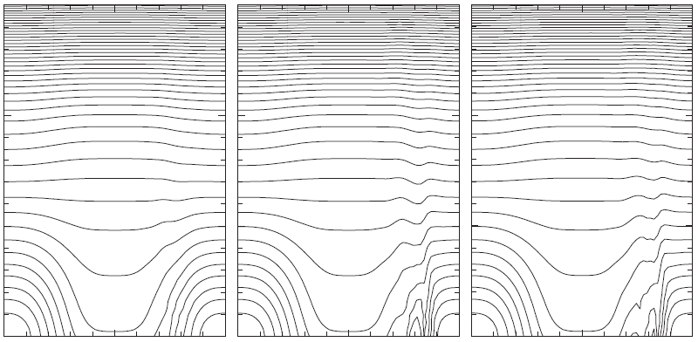
The role of baroclinicity
anelastic pseudoincompressible compressible

Slide 20
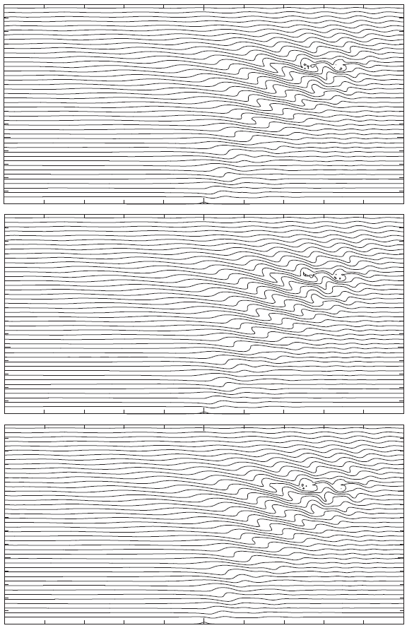
CPS
1.5h, surface lnθ, 320x160 Gal-Chen grid,
domain 120 km x 60 km
``soundproof’’ dt=5 s
``acoustic’’ dt=0.5 s
320 PE of Power7 IBM
PSI
ANL

Slide 21
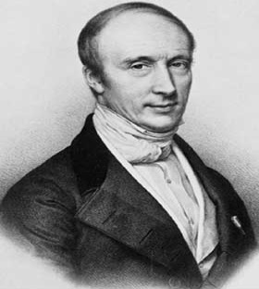
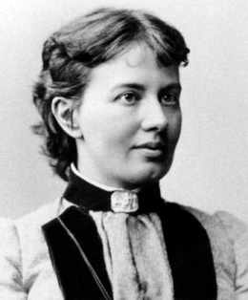
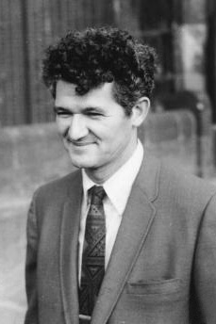
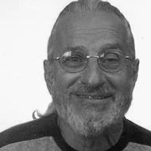
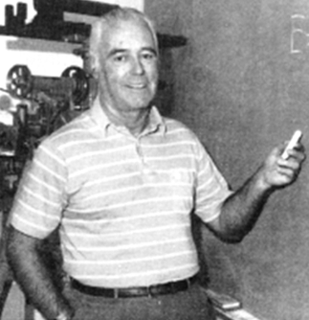
Part II: Integration Schemes
A) Forward-in-time (FT) non-oscillatory (NFT) integrators for all-scale flows,
Cauchy,
1789-1857
Kowalevski,
1850-1891
Lax, 1926-
Wendroff,
1930-
Robert,
1929-1993

Slide 22
● Generalised forward-in-time (FT) nonoscillatory (NFT) integrators for the AP
EUlerian/LAGrangian congruence
Eulerian
Lagrangian (semi)

Slide 23
Motivation for Lagrangian integrals

Slide 24
Motivation for Eulerian integrals
forward-in-time temporal discretization:
Second order Taylor expansion about t=nδt & Cauchy-Kowalewski procedure ➔
Compensating 1st error term on the rhs is a responsibility of an FT advection scheme (e.g. MPDATA). The 2nd error term depends on the implementation of an FT scheme

Slide 25
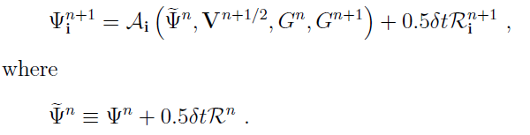

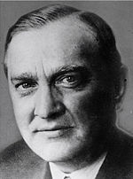

Given availability of a 2nd order FT algorithm for the homogeneous problem (R≡0),
a 2nd order-accurate solution for an inhomogeneous problem with “arbitrary” R is:
“Banach principle”, an important tool for systems with nonlinear right-hand-sides:
1892-1945
Eulerian semi-implicit compressible algorithms ➔ ➔ ➔

Slide 26







Semi-implicit formulations (solar MHD example)
➔ thermodynamic/elliptic problems for “pressures” Φ

Slide 27
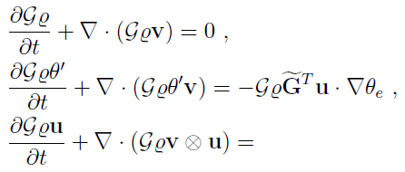


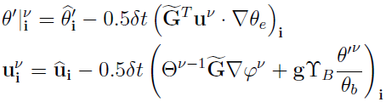



in some detail for compressible Euler PDEs
of all-scale atmospheric dynamics
semi-implicit ``acoustic’’ scheme:
(RE: Banach principle)
(RE: thermodynamic pressure)
simple but computationally unaffordable; example ➔

Slide 28
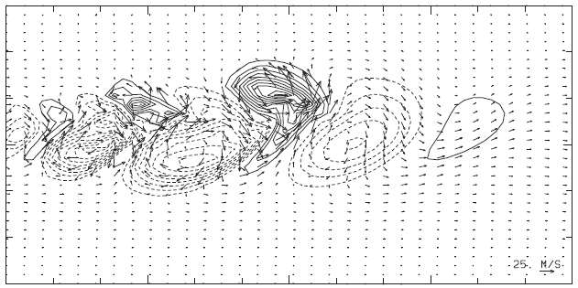
8 days, surface θ’, 128x64x48 lon-lat grid,
128 PE of Power7 IBM
CPI2, 2880 dt=300 s,
wallclock time=2.0 mns
CPEX, 432000 dt=2 s,
wallclock time=178.9 mns
This huge computational-efficiency gain comes at the
cost of increased mathematical/numerical complexity

Slide 29

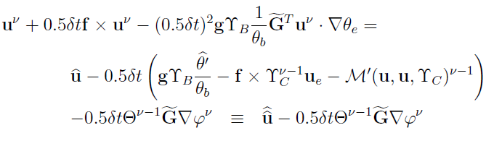



(RE: elliptic pressure)
➔
elliptic boundary value problems (BVPs):
Poisson problem in soundproof models relies on the mass continuity equation
and …➔
diagonally preconditioned Poisson problem for pressure perturbation

Slide 30









Helmholtz problems for large-time-step compressible models also rely on mass continuity equation:
combine the evolutionary form of the gas law & mass continuity in the AP for pressure perturbation, to then derive the Helmholtz problem
And how does one solve this “thing” ?

Slide 31
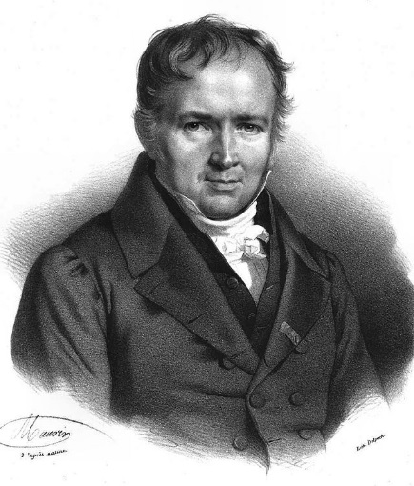
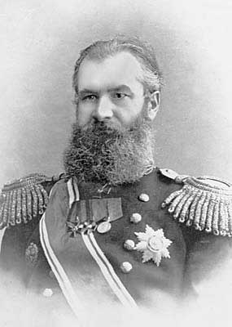


Part II: Integration Schemes
B) Elliptic solvers for boundary value problems (BVP) in atmospheric models
Poisson,
1781-1840
Helmholtz,
1821-1894
Krylov,
1863-1945
Schur,
1875-1941
Richardson,
1881-1953

Slide 32
Taxonomy:
Direct methods (e.g., spectral, Gaussian elimination, conjugate-gradients (CG)) vs. Iterative methods (e.g., Gauss-Seidel, Richardson, multigrid, CG)
Matrix inversion vs. matrix-free methods
Approximate vs. Exact projection ➔ user-friendly libraries vs. bespoke solvers
Multiple terminologies & classifications; common grounds; the state-of-the-art
Basic tools and concepts:
Banach principle, Neumann series, Gaussian elimination, Thomas 3-diagonal algorithm, Fourier transformation, calculus of variations, multigrid
Physical analogies:
Heat equation, damped oscillation equation, energy minimisation

Slide 33










Notion of variational Krylov-subspace solvers: i) basic concepts and definitions
symbolism:
≡
linear BVP
pseudo-time augmentation
➔
where
is the solution error, so
➔
where
➔
is the domain integral
as
gives the exact solution to
provided
:= negative definiteness (comments on dissipativity, semi-definiteness and null spaces)

Slide 34





i) basic concepts and definitions, cnt.
Next, the “energy” functional
➔
➔
given
:= self-adjointness or symmetry in matrix representation,
a common property of Laplacian, since
(comment on suitable boundary conditions)

Slide 35






i) basic concepts and definitions, cnt. 2
only for exact solution, otherwise it defines the residual error
➔
can be rewritten as
➔
➔
➔
Richardson iteration ( )
(comments on stability vs convergence, and spectral implications)

Slide 36




Notion of variational Krylov-subspace solvers: ii) canonical schemes
Steepest descent and minimum residual
By the same arguments like applied to continuous equations , Richardson iteration implies
and
For self adjoint operators implies
Because the exact solution minimises the energy functional,
one way to assure the optimal convergence is to minimise
➔
And from self adjointness
Steepest descent

Slide 37






Digression, orthogonality of subsequent iterates
➔
Minimum residual:
Self adjointness can be difficult to achieve in practical models, the minimum residual circumvents this by minimising instead ➔
➔
Steepest descent and minimum residual are important for understanding, but otherwise uncompetitive. The tyru foundation is provided by conjugate gradients and residuals
➔
3 term recurrence formula
a.k.a 2nd order Richardson, due to Frankel 1950

Slide 38






Conjugte gradient (CG) and conjugate residual (CR):
the coefficients of which could be determined via norms’ minimisation, analogous to steepest descent and minimum residual, or instead ➔
➔
CG
CR

Slide 39




… variational Krylov-subspace solvers: iii) operator preconditioning
The best asymptotic convergence rate one can get from plain CG methods is in
the inverse proportionality to (condition number )^{1/2} of the problem at hand
P (“left” preconditioner) approximates L but is easier to invert.
Preconditioned conjugate residual:
replacing
➔

Slide 40







Preconditioners, e ≈ P ⁻¹(r), examples:
1)
➔
2)
3)
➔

Slide 41








Non-symmetric preconditioned generalized conjugate residual scheme GCR(k):

Slide 42





A few remarks on boundary conditions:
LH
CE

Slide 43
Principal conclusions
Soundproof and compressible nonhydrostatic models form complementary elements of a general theoretical-numerical framework that underlies non-oscillatory forward-in-time (NFT) flow solvers
The respective PDEs are integrated using essentially the same numerics
The resulting flow solvers can be available in compatible Eulerian and semi-Lagrangian variants
The flux-form flow solvers readily extend to unstructured-meshes
P.K. Smolarkiewicz, C. Kühnlein, N.P. Wedi, A consistent framework for discrete integrations of soundproof
and compressible PDEs of atmospheric dynamics, J. Comput. Phys. 263 (2014) 185-205
P.K. Smolarkiewicz, W. Deconinck, M. Hamrud, G. Mozdzynski, C. Kühnlein, J. Szmelter, N. Wedi, A finite-volume module for simulating global all-scale atmospheric flows, J. Comput. Phys. 314 (2016) 287-304.
C. Kühnlein, P.K. Smolarkiewicz, An unstructured-mesh finite-volume MPDATA for compressible atmospheric dynamics, J. Comput. Phys. 334 (2017) 16-3.
P.K. Smolarkiewicz, L. Margolin, Variational methods for elliptic problems in fluid models, in: ECMWF Proceedings, Workshop on Developments in Numerical Methods for Very High Resolution Global Models, 2000, pp.137–159, Reading, UK.
The research leading to these results has received funding from the European Research Council under the European Union’s Seventh Framework Programme (FP7/2012/ERC Grant agreement no. 320375)

