Slide 1
Bias correction in data assimilation
Niels Bormann, based on material from
Hans Hersbach and Dick Dee
Meteorological Training Course
Data Assimilation
30 March 2017

Slide 2
Overview of this lecture
In this lecture the variational bias correction scheme (VarBC) as used at ECMWF is explained.
VarBC replaced the tedious job of estimating observation bias off-line for each satellite
instrument or in-situ network by an automatic self-adaptive system.
This is achieved by making the bias estimation an integral part of the ECMWF variational
data assimilation system, where now both the initial model state and observation bias
estimates are updated simultaneously.
By the end of the session you should be able to realize that:
many observations are biased, and the characteristics of bias vary widely depending on the type of instrument,
distinguishing model bias from observation bias is often difficult,
the success of an adaptive system implicitly relies on a redundancy in the underlying observing system.

Slide 3
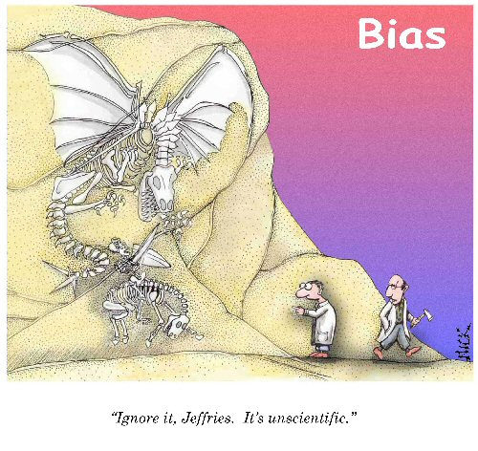
Everyone knows that models are biased.
Not everyone knows that most observations are biased as well.
So… where is the bias term in this equation?
model background constraint
observational constraint

Slide 4
Outline
Introduction
  Biases in models, observations, and observation operators
  Implications for data assimilation
Variational analysis and correction of observation bias
  The need for an adaptive system
  Variational bias correction (VarBC)
Extension to other types of observations
Limitations due to the effects of model bias

Slide 5
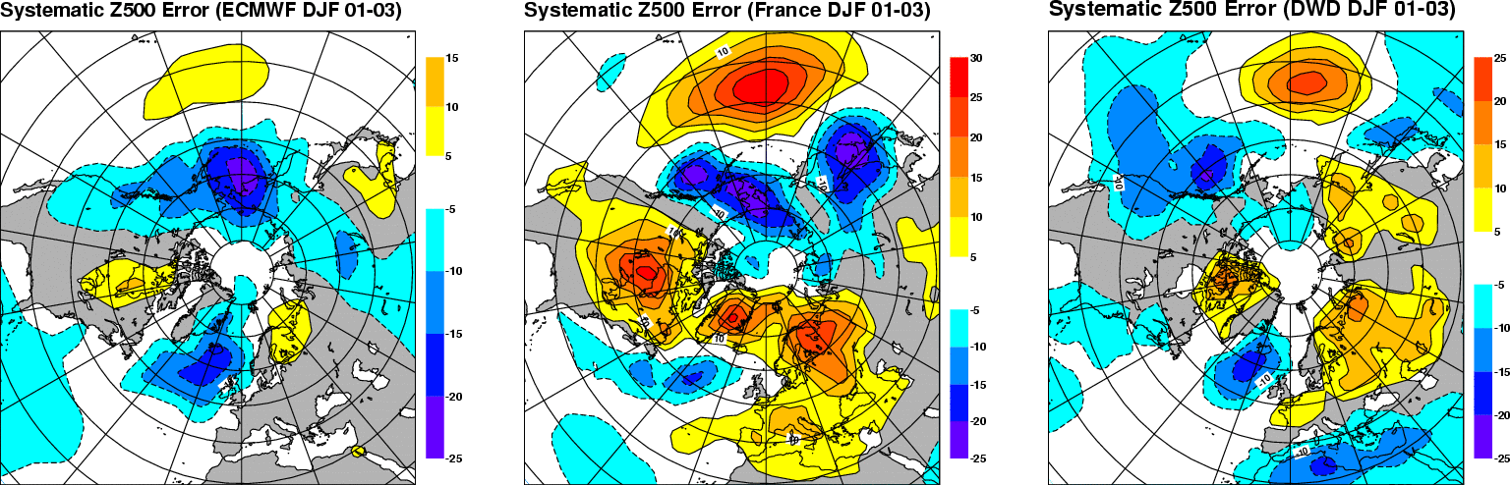
Model bias:
Systematic Day-3 Z500 errors in three different forecast models
ECMWF
Meteo-France
DWD
Different models often have similar error characteristics
Period DJF 2001-2003
Notes:
The above figure shows systematic Z500 errors at D+3 for three different models (ECMWF, Meteo-France and German Weather Service). The first point to notice is that at D+3 the different models show similar systematic errors. While this is perhaps not too surprisingly for the ECMWF and Meteo-France model (some of the model development is shared), the similarity between the ECMWF and the DWD model is astonishing. Summarizing, the above results show that different models have similar systematic error characteristics.

Slide 6
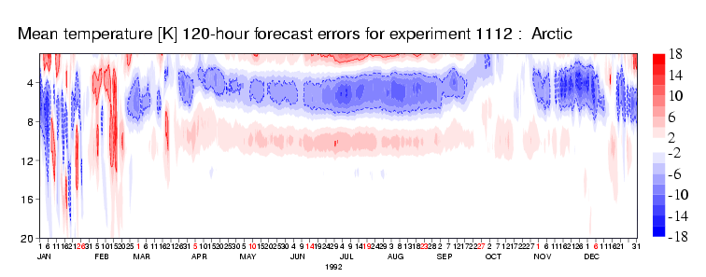
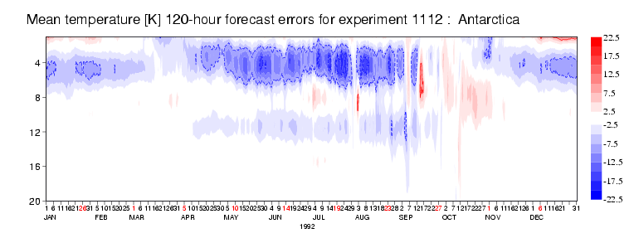
Model bias:
Seasonal variation in upper-stratospheric model errors
T255L60 model currently used for the ERA-Interim reanalysis
0.1hPa
(65km)
Summer: Radiation, ozone?
40hPa
(22km)
0.1hPa
(65km)
40hPa
(22km)
Winter: Gravity-wave drag?

Slide 7
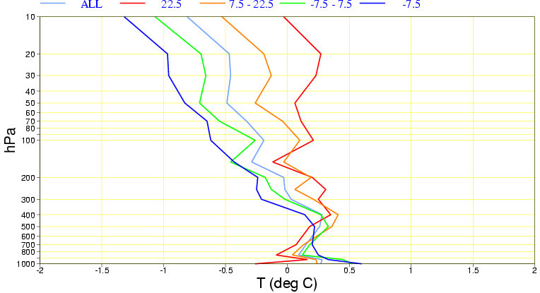
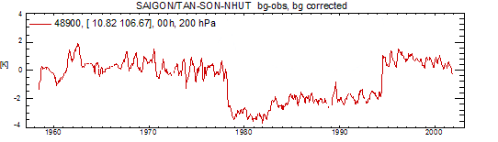
Observation bias:
Radiosonde temperature observations
Daytime warm bias due
to radiative heating of
the temperature sensor
(depends on solar elevation
and equipment type)
Mean temperature anomalies
for different solar elevations
Bias changes due to change of equipment
observed – ERA-40 background
at Saigon (200 hPa, 0 UTC)

Slide 8
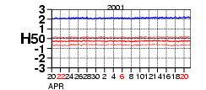
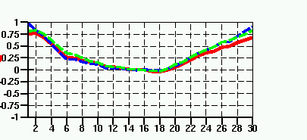
Observation and observation operator bias:
Satellite radiances
Monitoring the background departures (averaged in time and/or space):
Constant bias (HIRS channel 5)
Diurnal bias variation in a geostationary satellite
Obs-FG bias [K]
Bias depending on scan position
(AMSU-A ch 7) NH Trop SH
Air-mass dependent bias (AMSU-A channel 14)
Obs-FG bias [K]
high zenith angle
nadir
high zenith angle

Slide 9
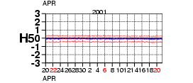
Observation and observation operator bias:
Satellite radiances – sources of bias
Monitoring the background departures (averaged in time and/or space):
HIRS channel 5 (peaking around
600hPa) on NOAA-14 satellite has
+2.0K radiance bias against FG.
Obs-FG bias [K]
Same channel on NOAA-16 satellite has
no radiance bias against FG.
Obs-FG bias [K]
NOAA-14 channel 5 has an instrument bias.

Slide 10
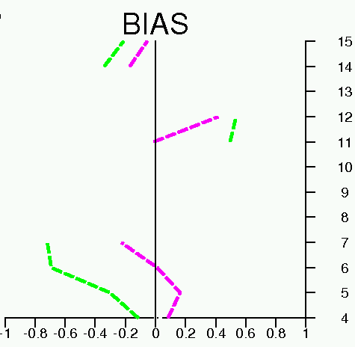
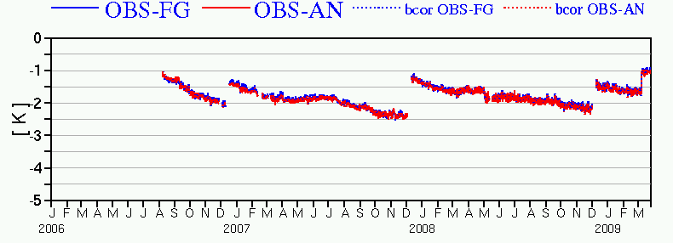
Observation and observation operator bias:
Satellite radiances – sources of bias
Different bias for HIRS due to change in spectroscopy used in the radiative transfer model:
Obs-FG bias [K]
Other common causes for biases in radiative transfer:
Bias in assumed concentrations of atmospheric gases (e.g., CO₂, aerosols)
Neglected effects (e.g., clouds)
Incorrect spectral response function
….
Channel number
Old spectroscopy
New spectroscopy
Drift in bias due to ice-build up on sensor:
METEOSAT-9, 13.4µm channel:
Obs –FG Bias
Sensor decontamination

Slide 11
Implications for data assimilation:
Bias problems in a nutshell
Observations and observation operators have biases, which may change over time
  Daytime warm bias in radiosonde measurements of stratospheric temperature; radiosonde equipment changes
  Biases in satellite radiance measurements and radiative transfer models
  Biases in cloud-drift wind data due to problems in height assignment
Models have biases, and changes in observational coverage over time may change the extent to which observations correct these biases
  Stratospheric temperature bias modulated by radiance assimilation
  This is especially important for reanalysis (trend analysis)
Data assimilation methods are primarily designed to correct small random errors in the model background
  Systematic inconsistencies among different parts of the observing system lead to all kinds of problems

Slide 12
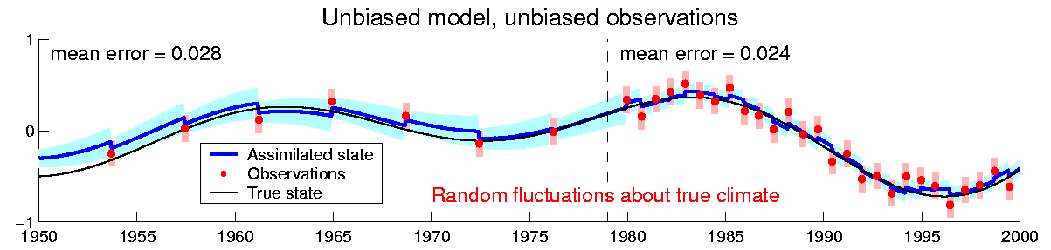
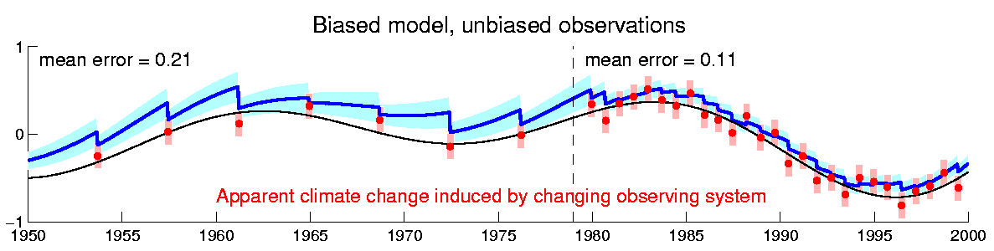
Implications for data assimilation:
The effect of model bias on trend estimates
Most assimilation systems assume unbiased models and unbiased data
Biases in models and/or data can induce spurious trends in the assimilation

Slide 13
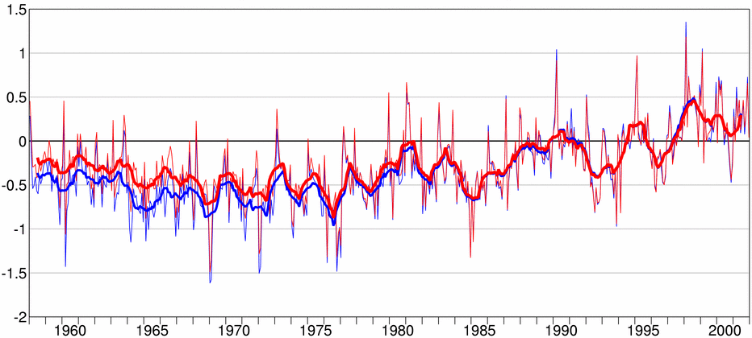
Implications for data assimilation:
ERA-40 surface temperatures compared to land-station values
Surface air temperature anomaly (ºC) with respect to 1987-2001
Northern hemisphere
Based on monthly CRUTEM2v data (Jones and Moberg, 2003)
Based on ERA-40 reanalysis

Slide 14
Outline
Introduction
  Biases in models, observations, and observation operators
  Implications for data assimilation
Variational analysis and correction of observation bias
  The need for an adaptive system
  The variational bias correction scheme: VarBC
Extension to other types of observations
Limitations due to the effects of model bias

Slide 15
Variational analysis and bias correction:
A brief review of variational data assimilation
Minimise
background constraint (J_{b})
observational constraint (J_{o})
The input x_{b} represents past information propagated by the forecast model
(the model background)
The input [y – h(x_{b})] represents the new information entering the system
(the background departures)
The function h(x) represents a model for simulating observations
(the observation operator)
Minimising the cost function J(x) produces an adjustment to the model background based on all used observations
(the analysis)

Slide 16
Variational analysis and bias correction:
Error sources in the input data
Minimise
background constraint (J_{b})
observational constraint (J_{o})
Errors in the input [y – h(x_{b})] arise from:
  errors in the actual observations
  errors in the model background
  errors in the observation operator
There is no general method for separating these different error sources
  we only have information about differences
  there is no true reference in the real world!
The analysis does not respond well to conflicting input information
A lot of work is done to remove biases prior to assimilation:
    ideally by removing the cause
    in practise by careful comparison against other data

Slide 17
Satellite radiance bias correction at ECMWF, prior to 2006
Scan bias and air-mass dependent bias for each satellite/sensor/channel were estimated off-line from background departures, and stored in files (Harris and Kelly 2001)
Error model for brightness temperature data:
where
Predictors, for instance:
  1000-300 hPa thickness
  200-50 hPa thickness
  surface skin temperature
  total precipitable water
Average the background departures:
Periodically estimate scan bias and predictor coefficients:
  typically 2 weeks of background departures
  2-step regression procedure
  careful masking and data selection

Slide 18
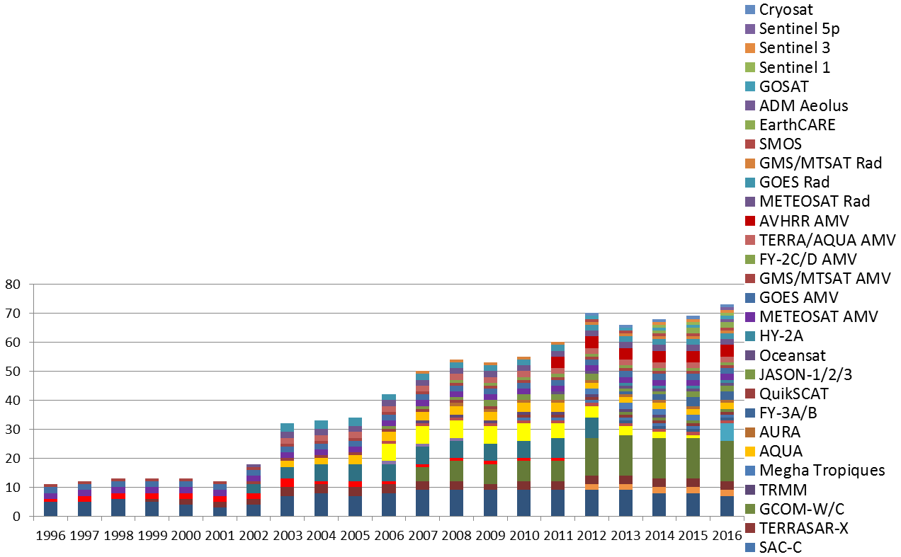
The need for an adaptive bias correction system
The observing system is increasingly complex and constantly changing
It is dominated by satellite radiance data:
  biases are flow-dependent, and may change with time
  they are different for different sensors
  they are different for different channels
How can we manage the bias corrections for all these different components?
This requires a consistent approach and a flexible, automated system

Slide 19
The Variational Bias Correction scheme:
The general idea
The bias in a given instrument/channel (bias group) is described by (a few) bias parameters:
typically, these are functions of air-mass and scan-position (the predictors)
These parameters can be estimated in a variational analysis along with the model state
(Derber and Wu, 1998 at NCEP, USA)
The standard variational analysis minimizes
Modify the observation operator to account for bias:
Include the bias parameters in the control vector:
Minimize instead
What is needed to implement this:
        The modified operator and its TL + adjoint
        A cycling scheme for updating the bias parameter estimates
        An effective preconditioner for the joint minimization problem

Slide 20
Variational bias correction:
The modified analysis problem
The original problem:
J_{b}: background constraint
J_{o}: observation constraint
The modified problem:
J_{b}: background constraint for x
J_{β}: background constraint for β
Parameter estimates
from previous analysis
J_{o}: bias-corrected observation constraint
A model for the observation bias

Slide 21
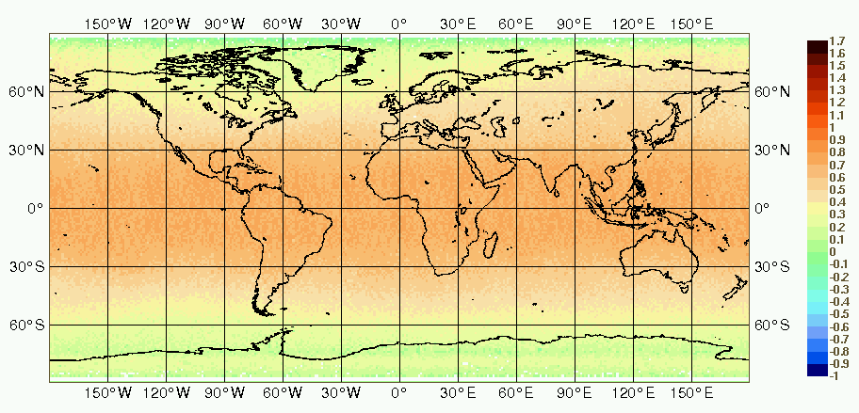
The need for an adequate bias model
Prerequisite for any bias correction is a good model for the bias (b(x,β)):
Ideally, guided by the physical origins of the bias.
In practice, bias models are derived empirically from observation monitoring.
Constant bias (HIRS channel 5)
Diurnal bias variation in a geostationary satellite
Obs-FG bias [K]
Air-mass dependent bias (AMSU-A ch 10)
Bias depending on scan
position (AMSU-A ch 7)
1.7
1.0
Obs-FG bias [K]
0.0
high zenith angle
nadir
high zenith angle
-1.0

Slide 22
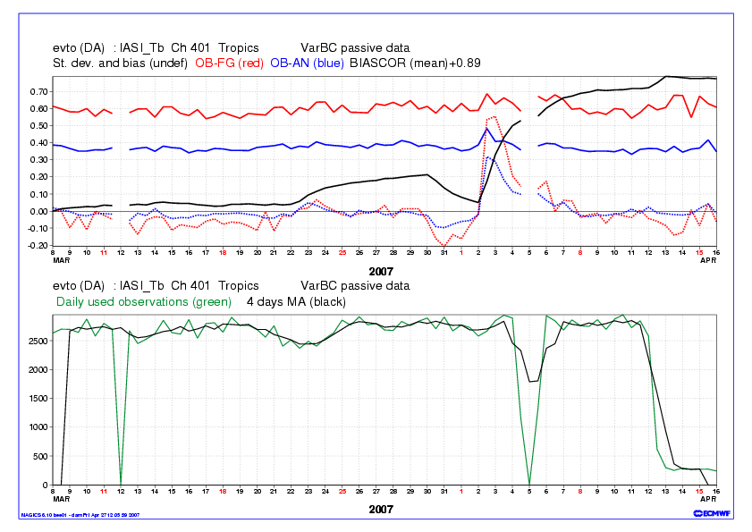
Example 1:
Spinning up new instruments – IASI on MetOp A
IASI is a high-resolution interferometer with 8461 channels
Initially unstable – data gaps, preprocessing changes

Slide 23
Example 2:
NOAA-9 MSU channel 3 bias corrections (cosmic storm)
200 hPa temperature departures from radiosonde observations
Variational bias correction smoothly handles the abrupt change in bias:
    initially QC rejects most data from this channel
    the variational analysis adjusts the bias estimates
    bias-corrected data are gradually allowed back in
    no shock to the system!

Slide 24
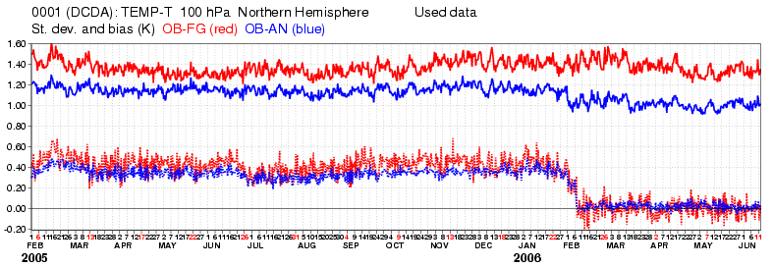
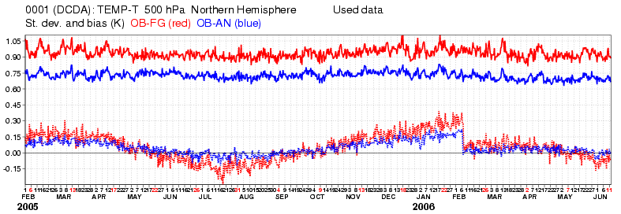
Example 3:
Fit to conventional data
Introduction of VarBC
in ECMWF operations

Slide 25
Outline
Introduction
  Biases in models, observations, and observation operators
  Implications for data assimilation
Variational analysis and correction of observation bias
  The need for an adaptive system
  Variational bias correction (VarBC)
Extension to other types of observations
Limitations due to the effects of model bias

Slide 26
Extension to other types of observations
Current bias ‘classes’ in the ECMWF operational system:
Radiances: clear sky/all sky, infrared/microwave, polar/geostationary
Total column ozone: currently only OMI
Aircraft data: one group per aircraft
Ground-based radar precipitation: one group embracing US stations
Other automated bias corrections, but outside 4D-Var:
Surface pressure
Radiosonde temperature and humidity
Soil moisture (in SEKF surface analysis)
Specific:
ERA-Interim: VarBC for radiances only
ERA-20C: the 20th century reanalysis using surface observations only
MACC: atmospheric composition

Slide 27
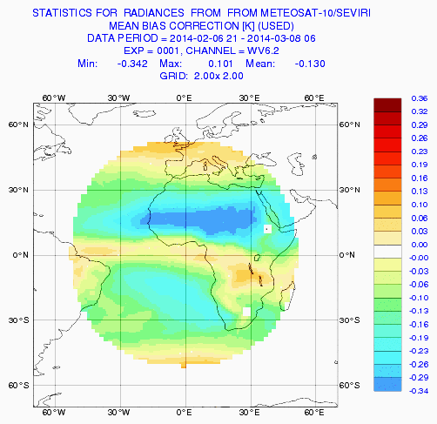
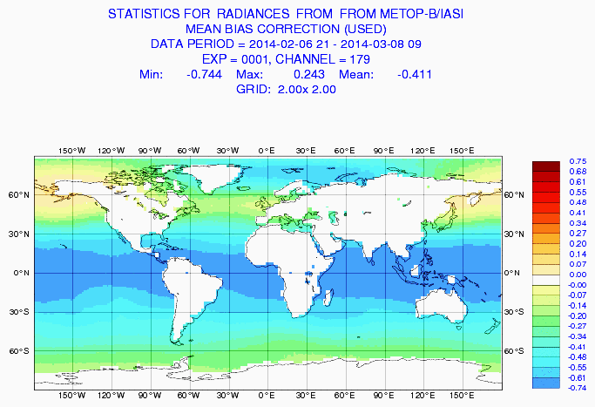
VarBC for satellite radiances
~1,500 channels (~40 sensors on ~25 different satellites)
Anchored to each other, GPS-RO, and all conventional observations
Bias model: β₀ + ∑β_{i} p_{i}(model state) + ∑β_{j} p_{j}(instrument state)
(~11,400 parameters in total)

Slide 28
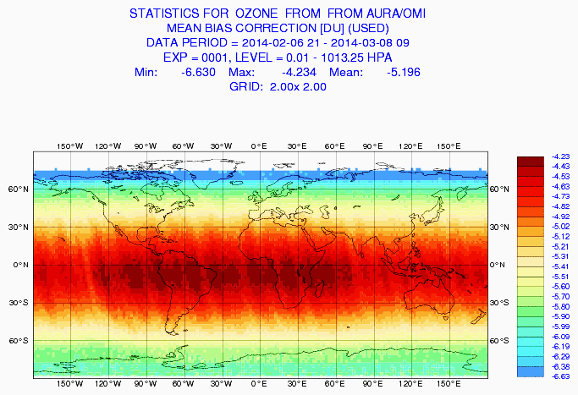
VarBC for ozone
OMI, (SCIAMACHY, GOMOS, SEVIRI, GOME2, GOME in past)
Anchored to SBUV/2
Bias model: β₀ + β₁ x solar elevation

Slide 29
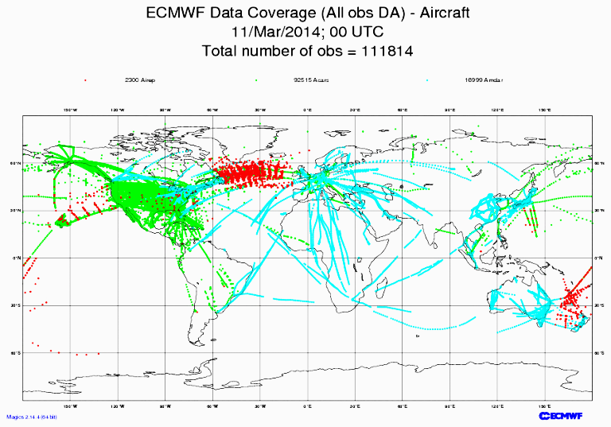
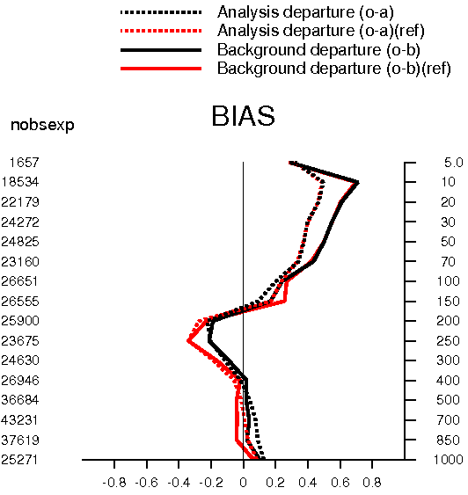
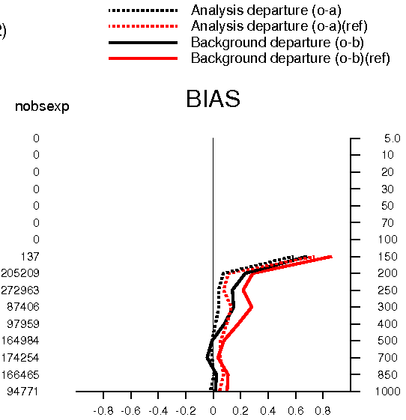
VarBC for aircraft temperature
For each aircraft separately (~5000 distinct aircraft)
Anchored to all temperature-sensitive observations
Bias model: β₀ + β₁ x ascent rate + β₂ x descent rate
Average temperature departures for the northern hemisphere during a
2-week period
Aircraft
Radiosonde
Control
Impact

Slide 30
Outline
Introduction
  Biases in models, observations, and observation operators
  Implications for data assimilation
Variational analysis and correction of observation bias
  The need for an adaptive system
  Variational bias correction (VarBC)
Extension to other types of observations
Limitations due to the effects of model bias

Slide 31
Limitations of VarBC:
Interaction with model bias
VarBC introduces extra degrees of freedom in the variational analysis, to help improve the fit to the (bias-corrected) observations:
It works well (even if the model is biased) when the analysis is strongly constrained by observations:
model
abundant observations
It does not work as well when there are large model biases and few observations to constrain them:
model
observations
VarBC is not designed to correct model biases: Need for a weak-constraint 4D-Var (Laloyaux)

Slide 32
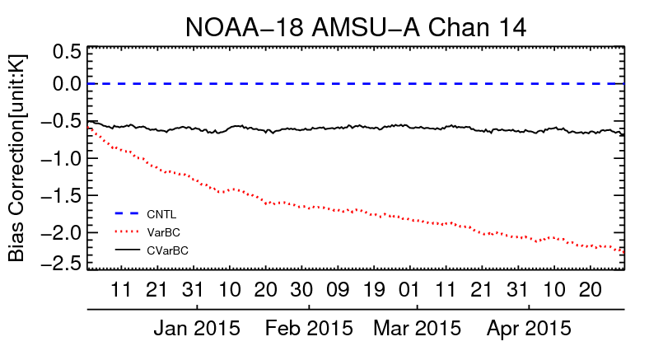
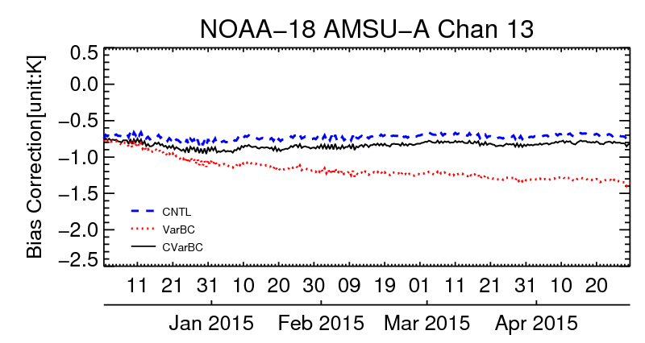
Limitations of VarBC:
Interaction with model bias
Example: Stratospheric temperature biases
Using VarBC for all satellite radiances sensitive to stratospheric temperature leads to unrealistic drifts in the bias corrections due to model bias (red line)
Additional anchoring is imposed through assimilating AMSU-A channel 14 without a bias correction (blue line)
(channel sensitive to temperature around 1-5 hPa)
(channel sensitive to temperature around 2-10 hPa)

Slide 33
Summary
Biases are everywhere:
Most observations cannot be usefully assimilated without bias adjustments
Manual estimation of biases in satellite data is practically impossible
Bias estimates can be updated automatically during data assimilation
Variational bias correction works best in situations where:
  there is sufficient redundancy in the data; or
  there are no large model biases
Challenges:
How to develop good bias models for observations
How to separate observation bias from model bias

Slide 34
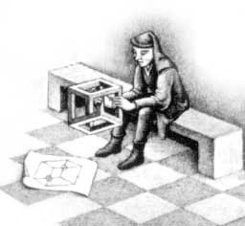
Additional information
Harris and Kelly, 2001: A satellite radiance-bias correction scheme for data assimilation. Q. J. R. Meteorol. Soc., 127, 1453-1468
Derber and Wu, 1998: The use of TOVS cloud-cleared radiances in the NCEP SSI analysis system. Mon. Wea. Rev., 126, 2287-2299
Dee, 2004: Variational bias correction of radiance data in the ECMWF system. Pp. 97-112 in Proceedings of the ECMWF workshop on assimilation of high spectral resolution sounders in NWP, 28 June-1 July 2004, Reading, UK
Dee, 2005: Bias and data assimilation. Q. J. R. Meteorol. Soc., 131, 3323-3343
Dee and Uppala, 2009: Variational bias correction of satellite radiance data in the ERA-Interim reanalysis. Q. J. R. Meteorol. Soc., 135, 1830-1841
Han and Bormann, 2016: Constrained adaptive bias correction for satellite radiance assimilation in the ECMWF 4D-Var system. ECMWF Technical Memorandum 783.
Feel free to contact me with questions:
Niels.Bormann@ecmwf.int

