Slide 1
Assimilation Algorithms: Ensemble Kalman Filters
Massimo Bonavita
ECMWF
Massimo.Bonavita@ecmwf.int
Acknowledgements to Mats Hamrud, Mike Fisher

Slide 2
Outline
The Standard Kalman Filter
Kalman Filters for large dimensional systems
Approximate Kalman Filters: the Ensemble Kalman Filter
Ensemble Kalman Filters in hybrid Data Assimilation

Slide 3
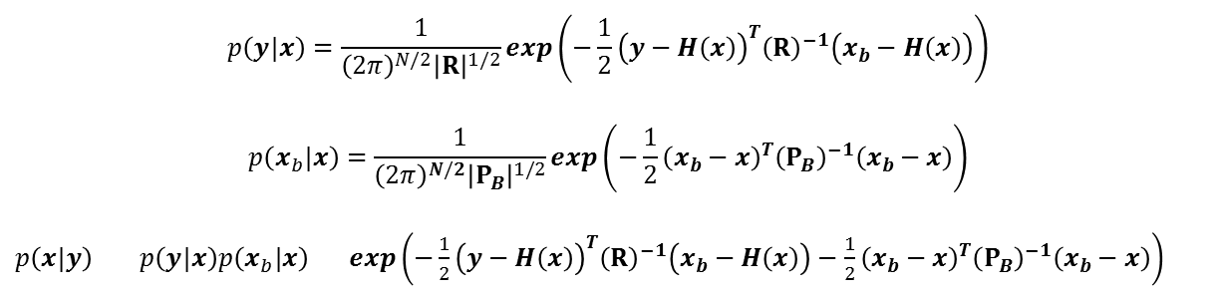
The Standard Kalman Filter
In the Overview of Assimilation Methods lecture we have seen that, assuming all errors have Gaussian statistic, the posterior (i.e., analysis) distribution 𝑝(𝒙|𝒚) can also be expressed as a Gaussian distribution:
Kalman Filter methods try to find the mean and covariance of this posterior distribution
Note that, under this Gaussian assumption, knowing the mean and covariance of 𝑝(𝒙|𝒚) means knowing the full posterior pdf
$$p\left(y|x\right)=\frac{1}{{\left(2π\right)}^{N/2}{\left|R\right|}^{1/2}}exp\left(−\frac{1}{2}{\left(y−H\left(x\right)\right)}^{T}{\left(R\right)}^{−1}\left(x_{b}−H\left(x\right)\right)\right)$$
$$p\left(x_{b}|x\right)=\frac{1}{{\left(2π\right)}^{N/2}{\left|P_{B}\right|}^{1/2}}exp\left(−\frac{1}{2}{\left(x_{b}−x\right)}^{T}{\left(P_{B}\right)}^{−1}\left(x_{b}−x\right)\right)$$
$p\left(x|y\right)$ $p\left(y|x\right)p\left(x_{b}|x\right)$ $exp\left(−\frac{1}{2}{\left(y−H\left(x\right)\right)}^{T}{\left(R\right)}^{−1}\left(x_{b}−H\left(x\right)\right)−\frac{1}{2}{\left(x_{b}−x\right)}^{T}{\left(P_{B}\right)}^{−1}\left(x_{b}−x\right)\right)$

Slide 4

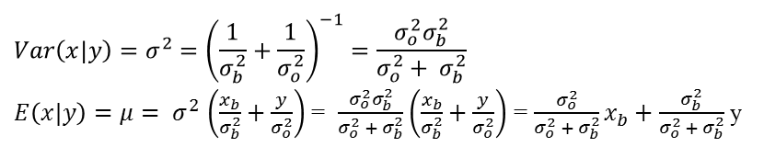
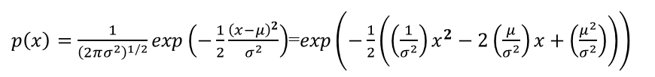

The Standard Kalman Filter
A simple univariate example:
  Assume we are analysing a single state variable x, whose errors are Gaussian distributed around its background forecast x_{b}:
  We have one observation of the state variable, also with Gaussian errors:
  Applying Bayes theorem we find:
  Comparing to a standard Gaussian distribution:
  we see that the posterior distribution is also Gaussian with mean and variance:
$p\left(x_{b}|x\right)=\frac{1}{{\left(2πσ_{b}^{2}\right)}^{1/2}}exp\left(−\frac{1}{2}\frac{{\left(x_{b}−x\right)}^{2}}{σ_{b}^{2}}\right)$ ~ N$\left(x_{b},σ_{b}^{2}\right)$
$p\left(y|x\right)=\frac{1}{{\left(2πσ_{o}^{2}\right)}^{1/2}}exp\left(−\frac{1}{2}\frac{{\left(y−x\right)}^{2}}{σ_{o}^{2}}\right)$ ~ N$\left(y,σ_{o}^{2}\right)$
$p\left(x|y\right) p\left(y|x\right)p\left(x_{b}|x\right) exp\left(−\frac{1}{2}\frac{{\left(y−x\right)}^{2}}{σ_{b}^{2}}−\frac{1}{2}\frac{{\left(x_{b}−x\right)}^{2}}{σ_{b}^{2}}\right)$ $exp\left(−\frac{1}{2}\left(\left(\frac{1}{σ_{b}^{2}}+\frac{1}{σ_{o}^{2}}\right)x^{2}−2\left(\frac{x_{b}}{σ_{b}^{2}}+\frac{y}{σ_{o}^{2}}\right)x\right)\right)$
$p\left(x\right)=\frac{1}{{\left(2πσ^{2}\right)}^{1/2}}exp\left(−\frac{1}{2}\frac{{\left(x−μ\right)}^{2}}{σ^{2}}\right)$=$exp\left(−\frac{1}{2}\left(\left(\frac{1}{σ^{2}}\right)x^{2}−2\left(\frac{μ}{σ^{2}}\right)x+\left(\frac{μ^{2}}{σ^{2}}\right)\right)\right)$
$$Var\left(x|y\right)=σ^{2}={\left(\frac{1}{σ_{b}^{2}}+\frac{1}{σ_{o}^{2}}\right)}^{−1}=\frac{σ_{o}^{2}σ_{b}^{2}}{σ_{o}^{2}+ σ_{b}^{2}}$$
$E\left(x|y\right)=μ{= σ}^{2}\left(\frac{x_{b}}{σ_{b}^{2}}+\frac{y}{σ_{o}^{2}}\right)$ = $\frac{σ_{o}^{2}σ_{b}^{2}}{σ_{o}^{2} + σ_{b}^{2}}$ $\left(\frac{x_{b}}{σ_{b}^{2}}+\frac{y}{σ_{o}^{2}}\right)$ = $\frac{σ_{o}^{2}}{σ_{o}^{2} + σ_{b}^{2}}x_{b}+\frac{σ_{b}^{2}}{σ_{o}^{2} + σ_{b}^{2}}$ y

Slide 5
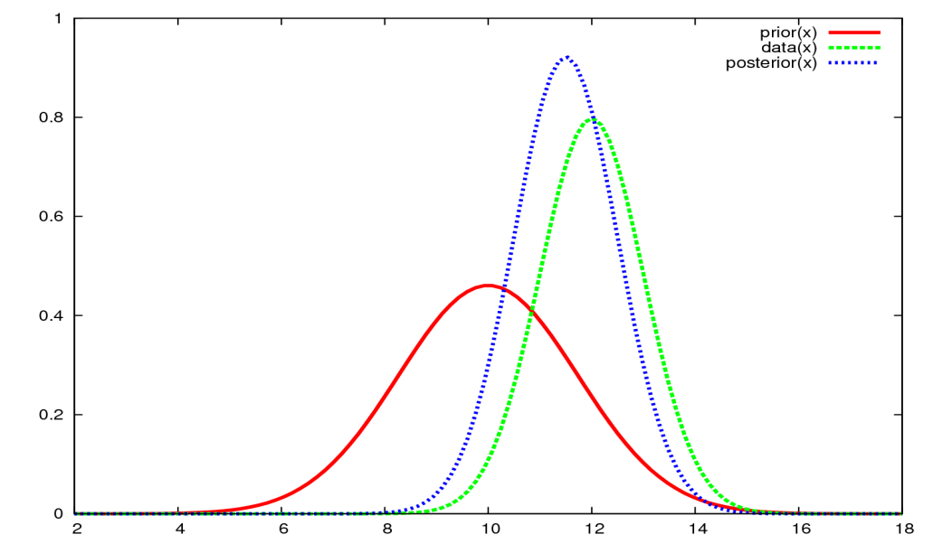
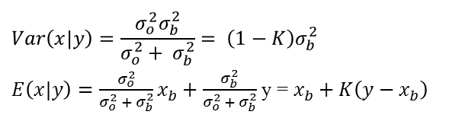

The Standard Kalman Filter
A simple univariate example:
  Introducing the Kalman gain: $K=\frac{σ_{b}^{2}}{σ_{o}^{2}+ σ_{b}^{2}}$ the equations for the mean and variance can be recast as:
  The posterior variance is thus reduced (1-K<0) with respect to the prior (background) variance, while the posterior mean is a linear, weighted average of the prior mean and the observation.
$$Var\left(x|y\right)=\frac{σ_{o}^{2}σ_{b}^{2}}{σ_{o}^{2}+ σ_{b}^{2}}= \left(1−K\right)σ_{b}^{2}$$
$E\left(x|y\right)=$ $\frac{σ_{o}^{2}}{σ_{o}^{2} + σ_{b}^{2}}x_{b}+\frac{σ_{b}^{2}}{σ_{o}^{2} + σ_{b}^{2}}$ y = $x_{b}+K\left(y−x_{b}\right)$

Slide 6
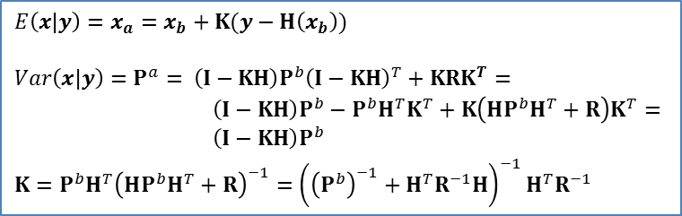
The Standard Kalman Filter
These Kalman Filter analysis update equations can be generalised to the multivariate case (Wikle and Berliner, 2007; Bromiley, 2014):
  These are the same update equations obtained in Assimilation Algorithms Lecture 1. They were derived without making assumptions of Gaussianity, but looking for the analysis estimate which had the minimum variance and could be expressed as a linear combination of the background and the observations (we called it the BLUE, Best Linear Unbiased Estimate). Linearity of observation operator and model was invoked.
  We have now seen that if the background and the observations are normally distributed, the Kalman Filter update equations provide us with the mean and the covariance of the posterior distribution. Under these hypotheses the posterior distribution is also Gaussian, thus it is completely defined by its mean and covariance.
$E\left(x|y\right)=x_{a}=x_{b}+K(y−H\left(x_{b}\right))$
$$Var\left(x|y\right)=P^{a}= \left(I−KH\right)P^{b}{\left(I−KH\right)}^{T}+KRK^{T}=$$
$\left(I−KH\right)P^{b}−P^{b}H^{T}K^{T}+K\left(HP^{b}H^{T}+R\right)K^{T}=$
$\left(I−KH\right)P^{b}$
$$K=P^{b}H^{T}{\left(HP^{b}H^{T}+R\right)}^{−1}={\left({\left(P^{b}\right)}^{−1}+H^{T}R^{−1}H\right)}^{−1}H^{T}R^{−1}$$

Slide 7
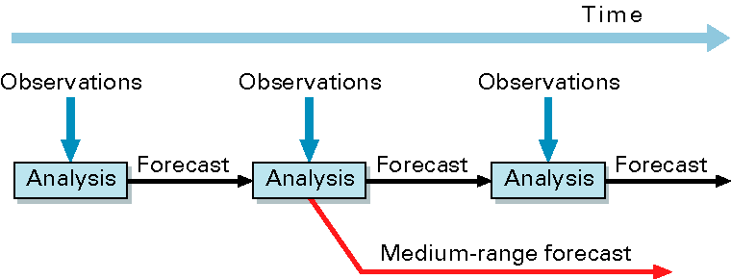
The Standard Kalman Filter
In NWP applications of data assimilation we want to update our estimate of the state and its uncertainty at later times, as new observations come in: we want to cycle the analysis
For each analysis in this cycle we require a background x^{b}_{t} (i.e. a prior estimate of the state valid at time t)
Usually, our best prior estimate of the state at time t is given by a forecast from the preceding analysis at t-1 (the “background”):
x^{b}_{t} = M(xª_{t-1})
What is the error covariance matrix (=> the uncertainty) associated with this background?

Slide 8
The Standard Kalman Filter
What is the error covariance matrix associated with the background forecast?
x^{b}_{t} = M(xª_{t-1})
Subtract the true state x* from both sides of the equation:
x^{b} - x*_{t} = ε^{b}_{t} = M(xª_{t-1}) - x*_{t}
Since xª_{t-1} = x*_{t-1} + εª_{t-1} we have:
ε^{b}_{t} = M(x*_{t-1} + εª_{t-1}) - x*_{t} ≈
M(x*_{t-1}) + Mεª_{t-1} - x*_{t} =
Mεª_{t-1} + η_{t}
Here we have defined the model error η_{t} = M(x*_{t-1}) - x*_{t}
We will also assume that no systematic errors are present in our system
< εª > = < η> = 0 => < ε^{b} > = 0

Slide 9
The Standard Kalman Filter
The background error covariance matrix will then be given by:
<ε^{b}_{t} (ε^{b}_{t})^{T}> = P^{b}_{t} = <(Mεª_{t-1} + η_{t}) (Mεª_{t-1} + η_{t})^{T}> =
M<εª_{t-1} (εª_{t-1})^{T}> M^{T} + <η_{t} (η_{t})^{T}> =
M Pª_{t-1} M^{T} + Q_{t}
Here we have assumed < εª_{t-1} (η_{t} )^{T}> = 0 and defined the model error covariance matrix Q_{t} = <η_{t} (η_{t})^{T}>
Note how the background error is described as the sum of the errors of the previous analysis propagated by the model dynamics to the time of the update (M Pª_{t-1} M^{T}) and the errors introduced by the model (Q_{t})
We now have all the equations necessary to propagate and update both the state and its error estimates

Slide 10
The Standard Kalman Filter
xª_{t-1}
Pª_{t-1}
t-1
t
t+1
  3. Compute the Kalman Gain
  K = P^{b} H^{T}(H P^{b} H^{T} + R)⁻¹
  4. Update state estimate
  xª_{t} = x^{b}_{t} + K (y - H(x^{b}_{t}))
  5. Update state error estimate
  Pª_{t} = (I – KH)P^{b}_{t} (I – KH)^{T} + KRK^{T}
1. Predict the state ahead x^{b}_{t} = M(xª_{t-1})
2. Predict the state error cov.
P^{b}_{t} = M Pª_{t-1} M^{T} + Q_{t}
1. Predict the state ahead x^{b}_{t+1} = M(xª_{t})
2. Predict the state error cov.
P^{b}_{t+1} = M Pª_{t} M^{T} + Q_{t+1}
Propagation
Propagation
Update
New Observations

Slide 11
The Standard Kalman Filter
Under the assumption that the model M and the observation operator H are linear operators (i.e., they do not depend on x^{b}), the Kalman Filter produces an optimal sequence of analyses (xª₁, xª₂, …, xª_{t-1}, xª_{t})
The KF analysis xª_{t} is the best (minimum variance) linear unbiased estimate of the state at time t, given x^{b}_{t} and all observations up to time t (y₀,y₁,…,y_{t}).
Note that Gaussianity of errors is not required. If errors are Gaussian the Kalman Filter provides the exact conditional probability estimate, i.e. p(xª_{t}| x^{b}₀; y₀,y₁,…,y_{t}). This also implies that if errors are Gaussian then the state estimated with the KF is also the most likely state (the mode of the pdf).

Slide 12
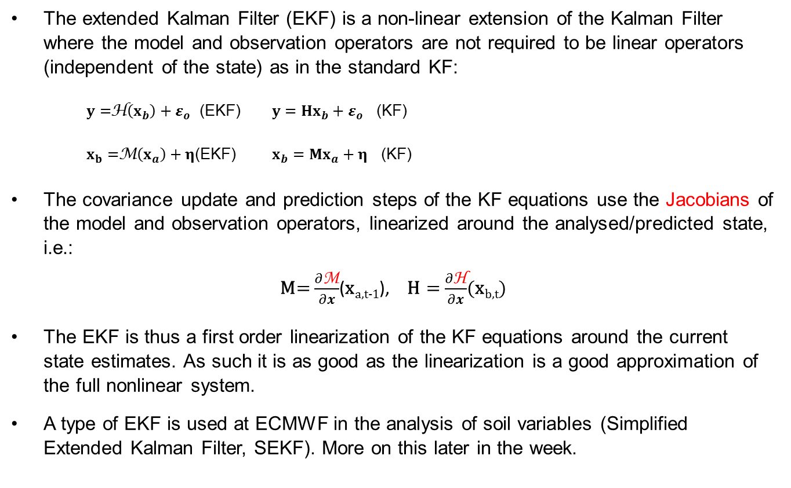
Extended Standard Kalman Filter
The extended Kalman Filter (EKF) is a non-linear extension of the Kalman Filter where the model and observation operators are not required to be linear operators (independent of the state) as in the standard KF:
  $y=$H$\left(x_{b}\right)+ε_{o}$ (EKF) $y=Hx_{b}+ε_{o}$ (KF)
  $x_{b}=$M$\left(x_{a}\right)+η$(EKF) $x_{b}=Mx_{a}+η$ (KF)
The covariance update and prediction steps of the KF equations use the Jacobians of the model and observation operators, linearized around the analysed/predicted state, i.e.:
M= $\frac{∂\text{M}}{∂x}$(x_{a,t-1}), H = $\frac{∂\text{H}}{∂x}$(x_{b,t})
The EKF is thus a first order linearization of the KF equations around the current state estimates. As such it is as good as the linearization is a good approximation of the full nonlinear system.
A type of EKF is used at ECMWF in the analysis of soil variables (Simplified Extended Kalman Filter, SEKF). More on this later in the week.

Slide 13
Kalman Filters for large dimensional systems
The Kalman Filter is unfeasible for large dimensional systems
The size N of the analysis/background state in the ECMWF 4DVar is O(10⁸): the KF requires us to store and evolve in time state covariance matrices (P^{a/b}) of O(NxN)
  The World’s fastest computers can sustain ~ 10¹⁵ operations per second
  An efficient implementation of matrix multiplication of two 10⁸x10⁸ matrices requires ~10²² (O(N^{2.8}))operations: about 4 months on the fastest computer!
  Evaluating P^{b}_{t} = M Pª_{t-1} M^{T} + Q_{k} requires 2*N≈2*10⁸ model integrations!
A range of approximate Kalman Filters has been developed for use with large-dimensional systems.
All of these methods rely on a low-rank approximation of the state covariance matrices of background and analysis errors.

Slide 14
Kalman Filters for large dimensional systems
Main assumption: P^{a/b} has rank M<<N (e.g. M≈100).
Then we can write P^{b}= X^{b}(X^{b})^{T}, where X^{b}_{k} is N x M.
The Kalman Gain then becomes:
K = P^{b} H^{T}(H P^{b} H^{T} + R)⁻¹ =
X^{b}(X^{b})^{T}H^{T}(H X^{b}(X^{b})^{T} H^{T} + R)⁻¹ =
X^{b} (HX^{b})^{T}(H X^{b}(HX^{b})^{T} + R)⁻¹
Note that, to evaluate K, we apply H to the M columns of X^{b} rather than to the N columns of P^{b}.
The N x N matrices P^{a/b} have been eliminated from the computation! In their place we have to deal with N x M (X^{b}) matrices in state space and their observation space projections L x M (HX^{b}) matrices (L = number of observations)

Slide 15
Kalman Filters for large dimensional systems
The approximated KF described above is called Reduced-rank Kalman Filter
There is a price to pay for these huge gains in computational cost
The analysis increment is a linear combination of the columns of X^{b}:
xª - x^{b} = K (y – H(x^{b})) = X^{b} (HX^{b})^{T} ((HX^{b})(HX^{b})^{T} + R)⁻¹ (y – H(x^{b}))
The analysis increments are formed as a linear combination of the columns of X^{b}: they are confined to the subspace spanned by X^{b}, which has at most rank M << N.
This severe reduction in rank of P^{a/b} has two main effects:
  There are too few degrees of freedom available to fit the ≈10⁷ observations available during the analysis window: the analysis is too “smooth”;
  The low-rank approximations of the covariance matrices suffer
  from spurious long-distance correlations.

Slide 16
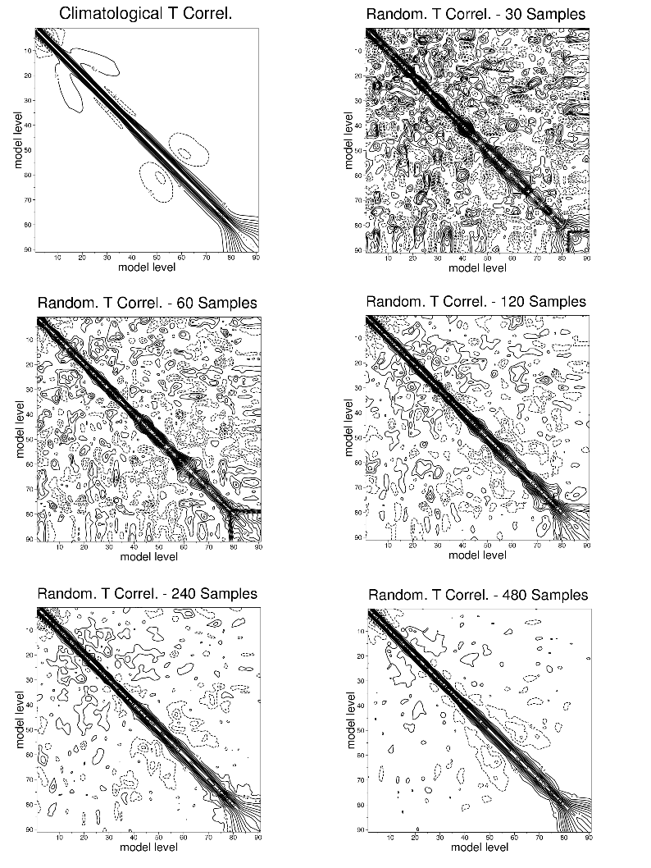
Random sampling of vertical background error correlation matrix for different ensemble sizes

Slide 17
Kalman Filters for large dimensional systems
There are two ways around the rank deficiency problem:
  Domain localization (e.g. Houtekamer and Mitchell, 1998; Ott et al. 2004);
Domain localization solves the analysis equations independently for each grid point, or for each of a set of regions covering the domain.
Each analysis uses only observations that are local to the grid point (or region) and the observations are usually weighted according to their distance from the analysed grid point (e.g., Hunt et al., 2007)
This guarantees that the analysis at each grid point (or region) is not influenced by distant observations.
The method acts to vastly increase the dimension of the sub-space in which the analysis increment is constructed because each grid point is updated by a different linear combination of ensemble perturbations
However, performing independent analyses for each region can lead to difficulties in the analysis of the large scales and in producing balanced analyses.

Slide 18
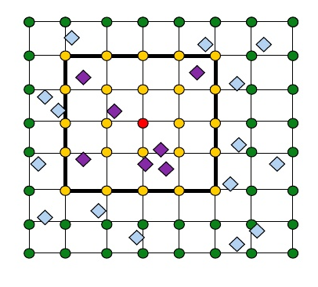
Kalman Filters for large dimensional systems
There are two ways around the rank deficiency problem:
  1. Domain localization (e.g. Houtekamer and Mitchell, 1998; Ott et al. 2004);
Analysed grid point
Local observations

Slide 19
Kalman Filters for large dimensional systems
  Covariance localization (e.g. Houtekamer and Mitchell, 2001).
Covariance localization is performed by element wise (Schur) multiplication of the error covariance matrices with a predefined correlation matrix representing a decaying function of distance (vertical and horizontal).
P^{b} --> ρ_{L °} P^{b}
In this way spurious long range correlations in P^{b} are suppressed.
As for domain localization, the method acts to vastly increase the dimension of the sub-space in which the analysis increment is constructed.
Choosing the product function is non-trivial. It is easy to modify P^{b} in undesirable ways. In particular, balance relationships may be adversely affected.
In order to suppress sampling noise some of the information content of the observations is lost

Slide 20
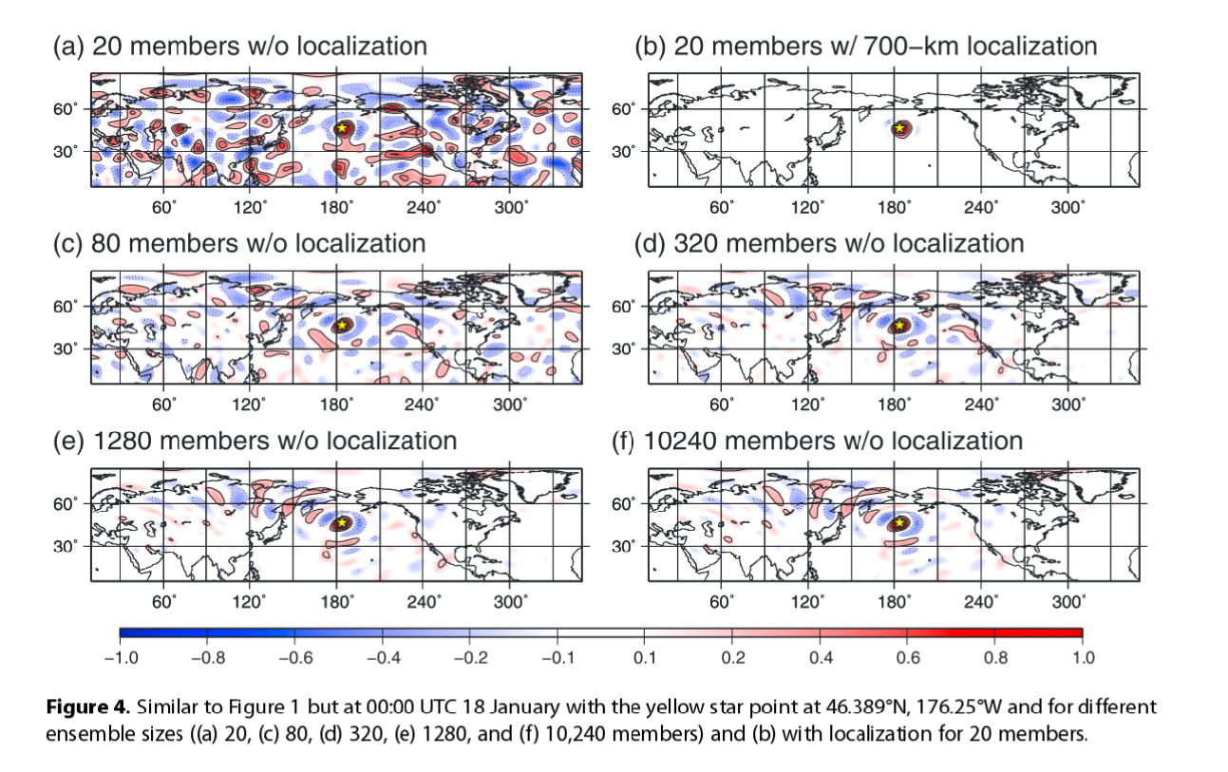
Kalman Filters for large dimensional systems
Miyoshi et al., 2014

Slide 21
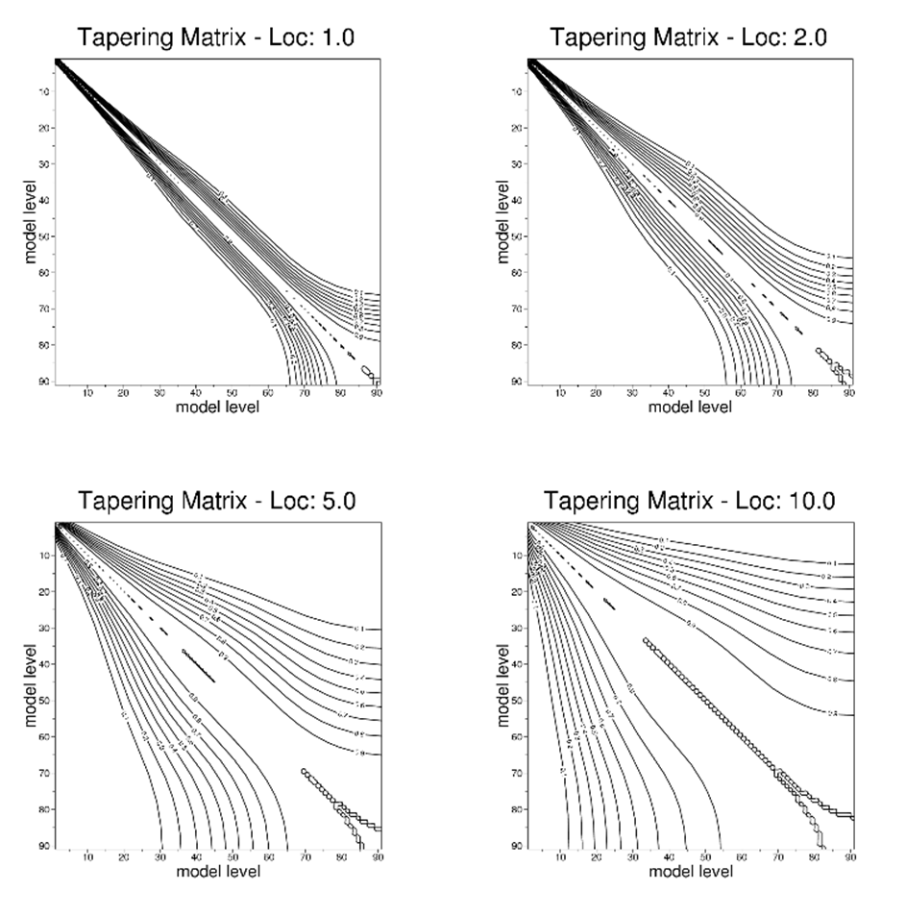
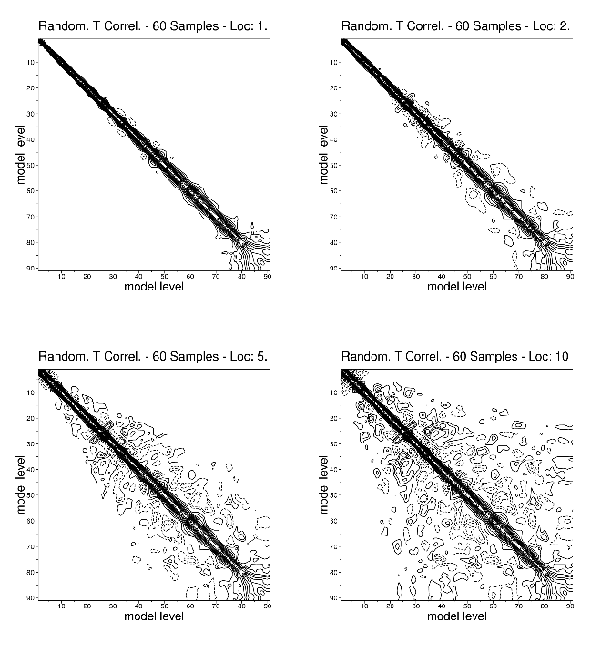
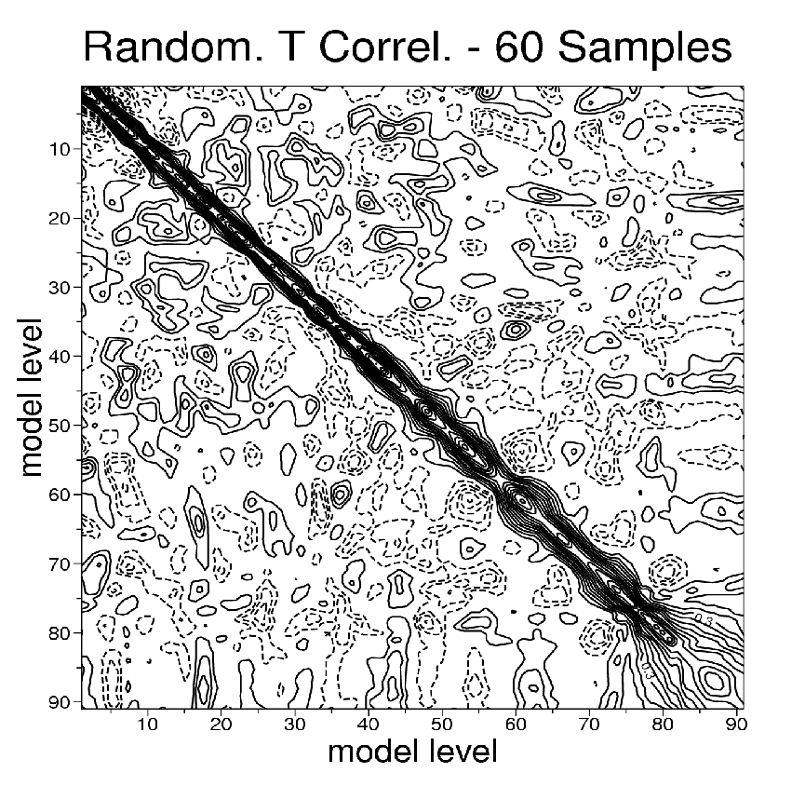
Standard Error of sample correlation ≈ (1-ρ²)/√(N_{ens}-1)
for small ρ, N_{ens} it becomes >= ρ;
since ρ -> 0 for large horiz./vert. distances apply distance based covariance localization on the sample P^{f}
P^{f}_{sampled}
ρ_{L}
=
P^{f}_{local}
=
Notes:
.

Slide 22
Kalman Filters for large dimensional systems
Domain/Covariance localization is a practical necessity for using the KF in large dimensional applications
Finding the right amount of localization is an (expensive) tuning exercise: a good trade-off needs to be found between computational effort, sampling error and imbalance error
Finding the “optimal” localization scales as functions of the system characteristics is an area of current active research (e.g., Flowerdew, 2015; Periáñez et al., 2014; Menetrier et al., 2014)

Slide 23
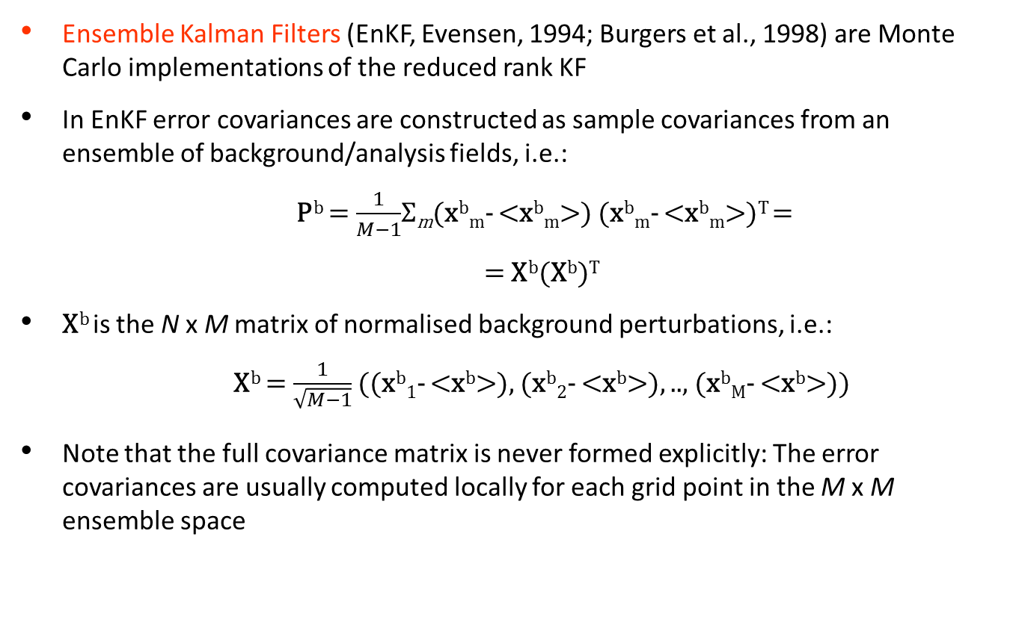
Ensemble Kalman Filters
Ensemble Kalman Filters (EnKF, Evensen, 1994; Burgers et al., 1998) are Monte Carlo implementations of the reduced rank KF
In EnKF error covariances are constructed as sample covariances from an ensemble of background/analysis fields, i.e.:
  P^{b} = $\frac{1}{M−1}$Σ_{m}(x^{b}_{m}- <x^{b}_{m}>) (x^{b}_{m}- <x^{b}_{m}>)^{T} =
  = X^{b}(X^{b})^{T}
X^{b} is the N x M matrix of normalised background perturbations, i.e.:
  X^{b} = $\frac{1}{\sqrt{M−1}}$ ((x^{b}₁- <x^{b}>), (x^{b}₂- <x^{b}>), .., (x^{b}_{M}- <x^{b}>))
Note that the full covariance matrix is never formed explicitly: The error covariances are usually computed locally for each grid point in the M x M ensemble space

Slide 24
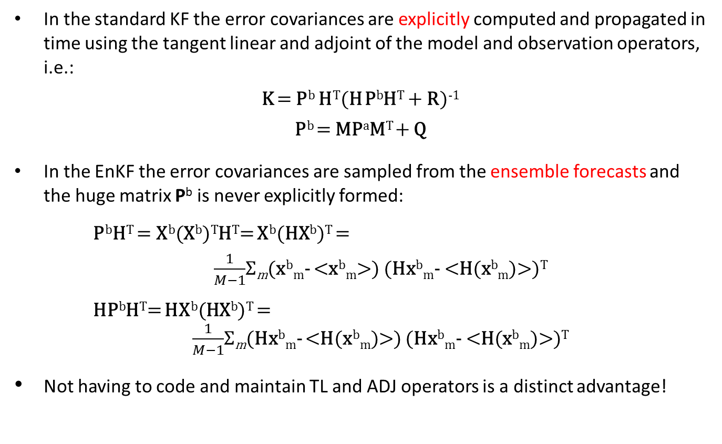
Ensemble Kalman Filters
In the standard KF the error covariances are explicitly computed and propagated in time using the tangent linear and adjoint of the model and observation operators, i.e.:
K = P^{b} H^{T}(H P^{b}H^{T} + R)⁻¹
P^{b} = MPªM^{T} + Q
In the EnKF the error covariances are sampled from the ensemble forecasts and the huge matrix P^{b} is never explicitly formed:
  P^{b}H^{T} = X^{b}(X^{b})^{T}H^{T}= X^{b}(HX^{b})^{T} =
  $\frac{1}{M−1}$Σ_{m}(x^{b}_{m}- <x^{b}_{m}>) (Hx^{b}_{m}- <H(x^{b}_{m})>)^{T}
  HP^{b}H^{T}= HX^{b}(HX^{b})^{T} =
  $\frac{1}{M−1}$Σ_{m}(Hx^{b}_{m}- <H(x^{b}_{m})>) (Hx^{b}_{m}- <H(x^{b}_{m})>)^{T}
Not having to code and maintain TL and ADJ operators is a distinct advantage!

Slide 25
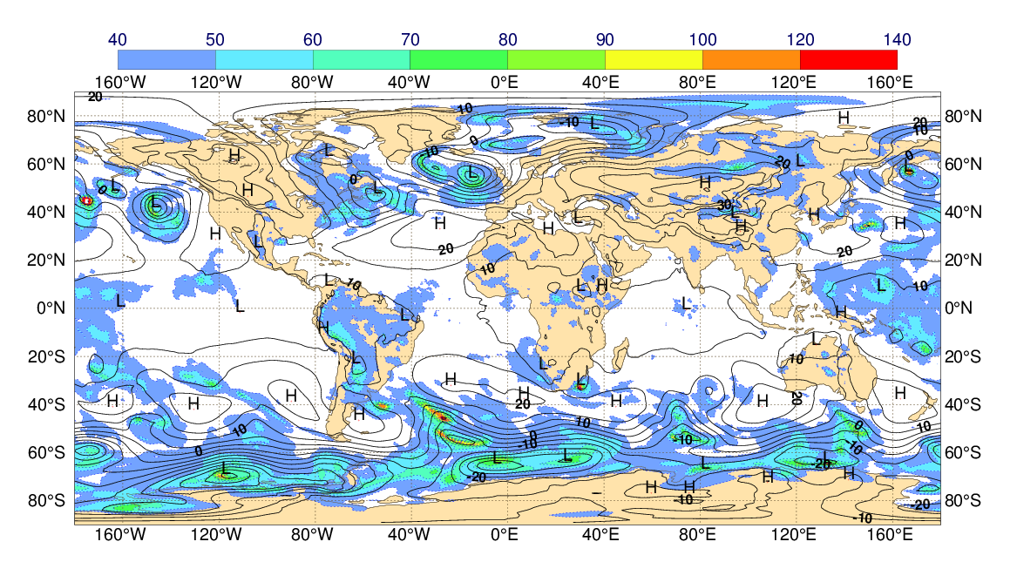
Ensemble Kalman Filters
In the EnKF the error covariances are sampled from the ensemble forecasts. They reflect the current state of the atmospheric flow
Standard deviation of surface pressure background t+6h fcst (shaded, Pa)
Z1000 background t+6h fcst (black isolines)

Slide 26
Ensemble Kalman Filters
The Ensemble Kalman Filter is a Monte Carlo technique: it requires us to generate a sample {x^{b}_{m}; m=1,..,M} drawn from the pdf of background error: how to do this?
We can generate this from a sample {xª_{t-1,m}; m=1,..,M} from the pdf of analysis error for the previous cycle:
x^{b}_{t,m} = M(xª_{t-1,m}) + η_{m}
where η_{m} is a sample drawn from the pdf of model error.
How do we generate a sample from the analysis pdf? Let us look at the analysis update again:
xª = x^{b} + K (y – H(x^{b})) = (I-KH) x^{b} + Ky
If we subtract the true state x* from both sides (and assume y*=Hx*)
eª = (I-KH) e^{b} + Keº
i.e., the errors have the same update equation as the state

Slide 27
Ensemble Kalman Filters
Consider now an ensemble of analysis where all the inputs to the analysis (i.e., the background forecast and the observations) have been perturbed according to their errors:
xª’ = (I-KH) x^{b}’ + Ky’
If we subtract the unperturbed analysis xª = (I-KH) x^{b} + Ky
εª = (I-KH) ε^{b} + Kεº
Note that the observations (during the update step) and the model (during the forecast step) are perturbed explicitly (i.e., we add random numbers with prescribed statistics).
The background is implicitly perturbed , i.e.:
x^{b} = M(xª_{t-1,m}) + η_{m}
Hence, one way to generate a sample drawn from the pdf of analysis error is to perturb the observations and the model with perturbations drawn from their error covariances.
The EnKF based on this idea is called Perturbed Observations (Stochastic) EnKF (Houtekamer and Mitchell, 1998). It is also the basis of ECMWF EDA (more on this later)

Slide 28
Ensemble Kalman Filters
Another way to construct the analysis sample without perturbing the observations is to make a linear combination of the background sample:
Xª=X^{b}T
where T is a M x M matrix chosen such that:
Xª(Xª)^{T} = (X^{b}T) (X^{b}T)^{T} = Pª = (I-KH)P^{b}
Note that the choice of T is not unique: Any orthonormal transformation Q (QQ^{T}=Q^{T}Q=I) can be applied to T and give a valid analysis sample
Implementations also differ on the treatment of observations (i.e., local patches, one at a time)
Consequently there are a number of different, functionally equivalent, implementations of the Deterministic EnKF (ETKF, Bishop et al., 2001; LETKF, Ott et al., 2004, Hunt et al., 2007; EnSRF, Whitaker and Hamill, 2002; EnAF, Anderson, 2001;…)

Slide 29
Ensemble Kalman Filters
We might want to ask the questions:
  How good is the EnKF for state estimation?
  How does it compare with 4D-Var?

Slide 30
Ensemble Kalman Filters
We might want to ask the questions:
  How good is the EnKF for state estimation?
  How does it compare with 4D-Var?
The short answer: it depends…

Slide 31
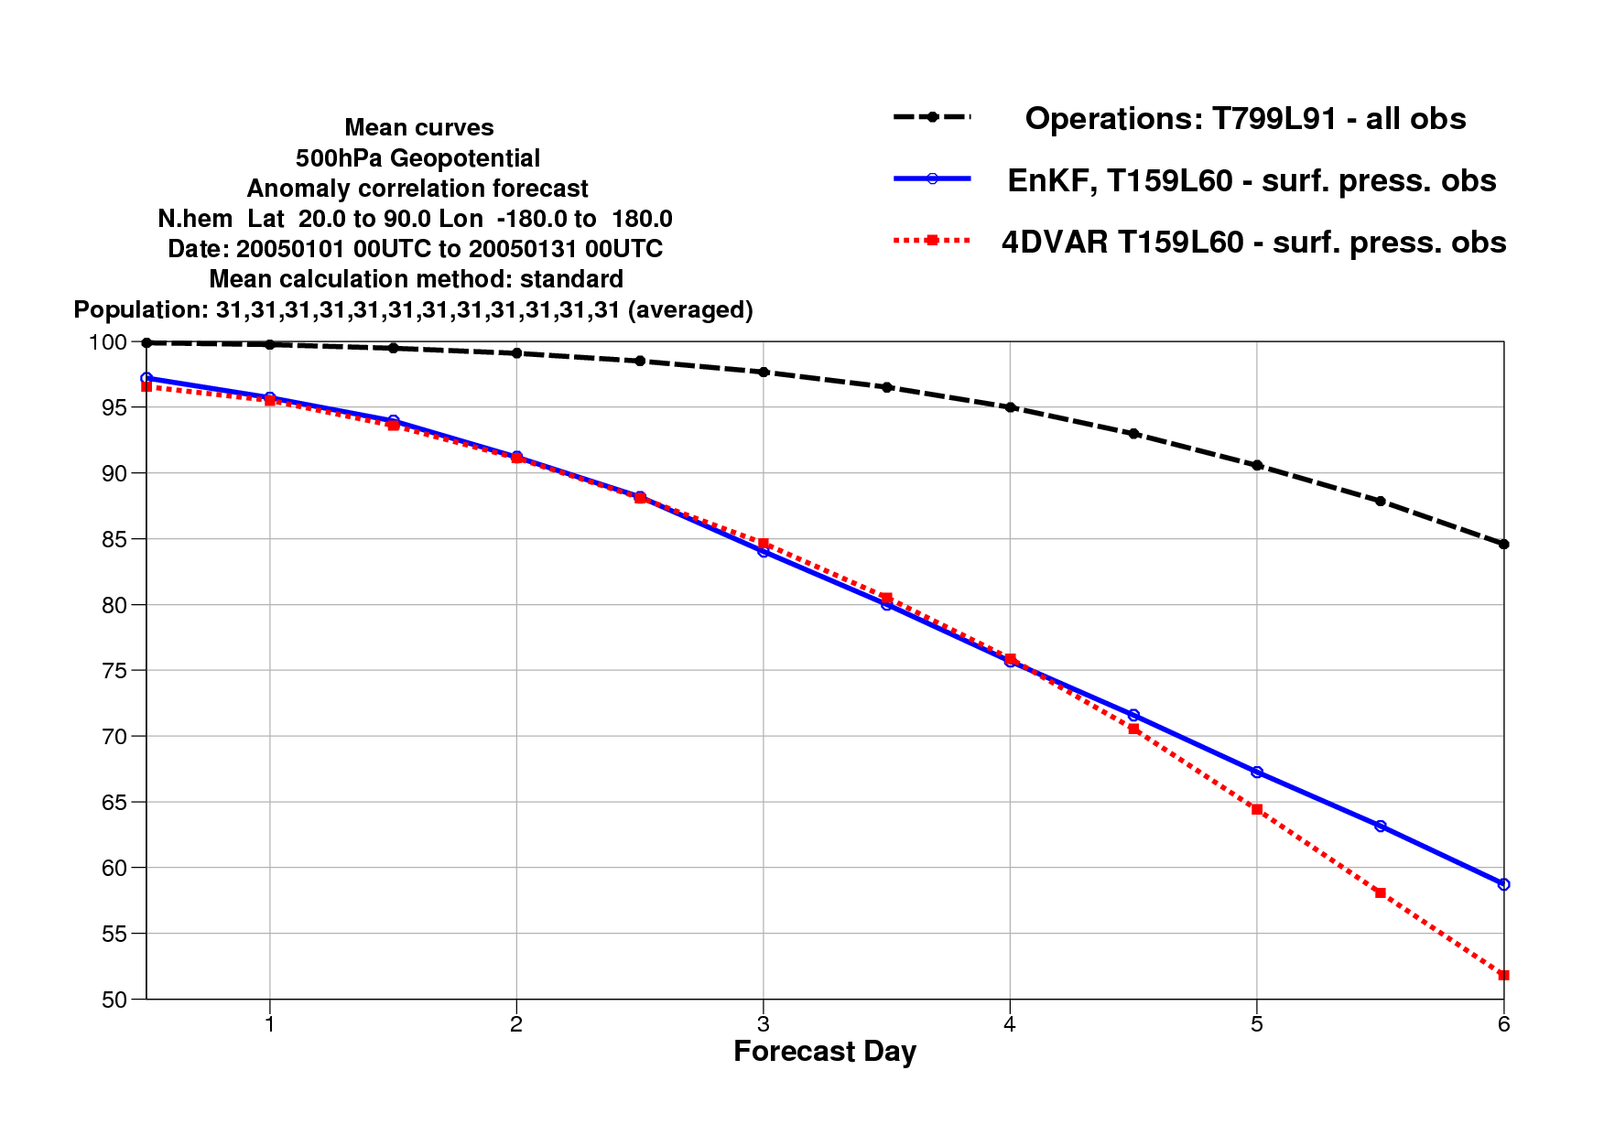
Ensemble Kalman Filters
For sparsely observed systems the EnKF works quite well:
N.Hem. 500 hPa AC
4DVar Surface Pressure obs.
EnKF Surface Pressure obs.

Slide 32
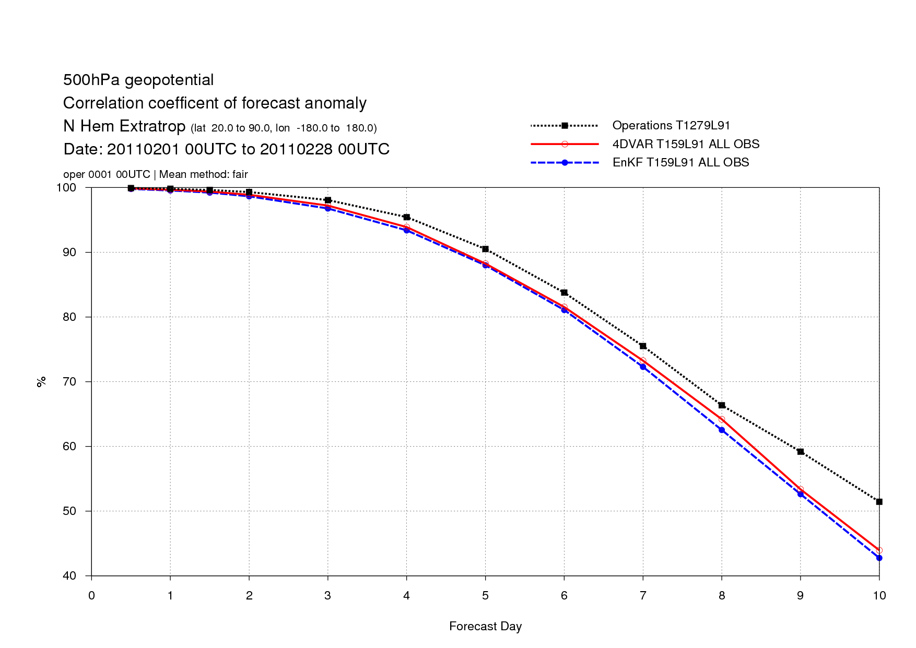
Ensemble Kalman Filters
For fully observed systems the EnKF works not quite as well:
N.Hem. 500 hPa AC
4DVar All observations
EnKF All observations

Slide 33
Ensemble Kalman Filters
Plus:
  Background error estimates reflect state of the flow
  Provides an ensemble of analyses: can use to initialise ensemble prediction
  Competitive with 4DVar for sparsely observed systems
  Very good scalability properties
  Relative ease of coding and maintenance (No TL and ADJ models)

Slide 34
Ensemble Kalman Filters
Cons:
  The affordable ensembles are relatively small (O(100)), thus sampling noise and extreme rank deficiency of the sampled error covariances become performance limiting factor for the EnKF
  For well observed systems (like the Atmosphere) the rank deficiency of the sampled covariances means there are not enough degrees of freedom to fit the available observations
  Careful localization of sampled covariances becomes necessary: This is an on-going research topic for both EnKF and Ensemble Variational hybrid systems
  Note how covariance localization becomes conceptually and practically more difficult for observations (satellite radiances) which are non-local, i.e. they sample a layer of the atmosphere (Campbell et al., 2010). As non-local satellite radiances are the backbone of the current NWP observing system, this is an important problem (for both EnKF and En-Var systems)

Slide 35
Ensemble Kalman Filters in hybrid DA
While the pure EnKF is not currently competitive with variational methods for state estimation in global NWP, its good scalability properties and ease of maintenance make it a popular choice as a Monte Carlo system to estimate and cycle the error covariances (P^{a/b}) needed in a variational analysis system and to initialise an ensemble prediction system: hybrid Variational-EnKF analysis systems (NCEP, CMC, UKMO)

Slide 36
Dual-Res Coupled Hybrid
Var/EnKF Cycling
member 1
forecast
Generate new ensemble perturbations given the latest set of observations and first-guess ensemble
member 1
analysis
T574L64
EnKF
member update
member 2
forecast
member 2
analysis
recenter analysis ensemble
Ensemble contribution to background error covariance
member N
analysis
member N
forecast
GSI Hybrid EnVar
Replace the EnKF ensemble mean analysis
and inflate
T1534L64
high res
forecast
high res
analysis
Previous Cycle
Current Update Cycle
from Daryl Kleist
36

Slide 37
Summary
For linear model M and the observation operators H the Kalman Filter produces an optimal (minimum error variance) sequence of analyses (xª₁, xª₂, …, xª_{t-1}, xª_{t})
We have shown that under the additional assumption of Gaussian errors the Kalman Filter provides the exact posterior probability estimate, p(xª_{t}| x^{b}₀; y₀,y₁,…,y_{t}).
Kalman Filters are impractical for large-dimensional systems like in NWP, due to the impossibility of storing and evolving the state error covariance matrices (P^{a/b})
We need to use reduced-rank representations of the state error covariance matrices: this can be done, but has other drawbacks (need for localisation, physical imbalances, etc.)
The Ensemble Kalman Filter is a Monte Carlo implementation of a reduced-rank Kalman Filter. It works well for sparsely observed systems, but for well observed systems the severe rank reduction can be an issue
The EnKF is currently used in many global NWP Centres as the error cycling component of a hybrid Variational-EnKF system

Slide 38
Bibliography
Anderson, J. L., 2001. An ensemble adjustment Kalman filter for data assimilation. Mon. Wea. Rev. 129, 2884–2903.
Bishop, C. H., Etherton, B. J. and Majumdar, S. J., 2001. Adaptive sampling with ensemble transform Kalman filter. Part I: theoretical aspects. Mon. Wea. Rev. 129, 420–436.
Bromiley, P.A., 2014: Products and Convolutions of Gaussian Probability Density Functions, TINA Memo N. 2003-003. Available at http://www.tina-vision.net/docs/memos/2003-003.pdf
Burgers, G., Van Leeuwen, P. J. and Evensen, G., 1998. On the analysis scheme in the ensemble Kalman filter. Mon. Wea. Rev. 126, 1719–1724.
Campbell, W. F., C. H. Bishop, and D. Hodyss, 2010: Vertical covariance localization for satellite radiances in ensemble Kalman Filters. Mon. Wea. Rev.,138,282–290.
Evensen, G., 1994. Sequential data assimilation with a nonlinear quasi-geostrophic model using Monte Carlo methods to forecast error statistics. J. Geophys. Res. 99(C5), 10 143–10 162.
Evensen, G . 2004 . Sampling strategies and square root analysis schemes for the EnKF . No.: 54 . p.: 539-560 . Ocean Dynamics

Slide 39
Bibliography
Fisher, M., Leutbecher, M. and Kelly, G. A. 2005. On the equivalence between Kalman smoothing and weak-constraint four-dimensional variational data assimilation. Q.J.R. Meteorol. Soc., 131: 3235–3246.
Flowerdew, J. 2015. Towards a theory of optimal localisation. Tellus A 2015, 67, 25257, http://dx.doi.org/10.3402/tellusa.v67.25257
Houtekamer, P. L. and Mitchell, H. L., 1998. Data assimilation using an ensemble Kalman filter technique. Mon. Wea. Rev. 126, 796–811.
Houtekamer, P. L. and Mitchell, H. L., 2001. A sequential ensemble Kalman filter for atmospheric data assimilation. Mon. Wea. Rev. 129, 123–137.
Hunt, B. R., Kostelich, E. J. and Szunyogh, I., 2007. Efficient data assimilation for spatiotemporal chaos: a local ensemble transform Kalman filter. Physica D, 230, 112–126.
Liu C, Xiao Q, Wang B. 2008. An ensemble-based four-dimensional variational data assimilation scheme. part i: Technical formulation and preliminary test. Mon. Weather Rev. 136: 3363–3373.
Lorenc, A.C.,2003: The potential of the ensemble Kalman filter for NWP—A comparison with 4D-VAR. Q. J. R. Meteorol. Soc., 129: 3183–3203.

Slide 40
Bibliography
Ménétrier, B., T. Montmerle, Y. Michel and L. Berre, 2014: Linear Filtering of Sample Covariances for Ensemble-Based Data Assimilation. Part I: Optimality Criteria and Application to Variance Filtering and Covariance Localization. Mon. Wea. Rev, doi: http://dx.doi.org/10.1175/MWR-D-14-00157.1
Miyoshi, T., K. Kondo, and T. Imamura, 2014: The 10,240-member ensemble Kalman filtering with an intermediate AGCM, Geophys. Res. Lett., 41, 5264–5271, doi:10.1002/2014GL060863.
Ott, E., Hunt, B. H., Szunyogh, I., Zimin, A. V., Kostelich, E. J. and co-authors. 2004. A local ensemble Kalman filter for atmospheric data assimilation. Tellus 56A, 415–428.
Periáñez, Á., Reich, H. and Potthast, R. 2014. Optimal localization for ensemble Kalman filter systems. J. Met. Soc. Japan. 62, 585 597.
Thépaut, J.-N., Courtier, P., Belaud, G. and Lemaître, G. 1996. Dynamical structure functions in a four-dimensional variational assimilation: A case-study. Q. J. R. Meteorol. Soc., 122, 535–561
Whitaker, J. S. and Hamill, T. M., 2002. Ensemble data assimilation without perturbed observations. Mon. Wea. Rev. 130, 1913–1924.
Wikle, C.K. and Berliner, L.M., 2007: A Bayesian tutorial for data assimilation. Physica D: Nonlinear Phenomena, vol. 230, no. 1-2, pp. 1–16.

