Slide 1
Assimilation Algorithms: EDA and Hybrid Data Assimilation
Massimo Bonavita
ECMWF
Massimo.Bonavita@ecmwf.int
Acknowledgements to Lars Isaksen, Elias Holm, Mike Fisher

Slide 2
Outline
A variational implementation of the EnKF: the EDA
Hybrid Data Assimilation: Motivation
Hybrid Data Assimilation systems in global NWP

Slide 3
The Ensemble of Data Assimilations (EDA)
In the previous lecture on Ensemble Kalman Filters we have seen that EnKF are commonly used in hybrid DA systems for estimating and cycling error covariance information used by the variational analysis and initialise ensemble prediction systems
Ensemble sizes of O(100-200) are commonly used. To save on computational expense the EnKF ensemble is run at a reduced spatial resolution with respect to the deterministic variational analysis cycle

Slide 4
Dual-Res Coupled Hybrid
Var/EnKF Cycling
member 1
forecast
Generate new ensemble perturbations given the latest set of observations and first-guess ensemble
member 1
analysis
T574L64
EnKF
member update
member 2
forecast
member 2
analysis
recenter analysis ensemble
Ensemble contribution to background error covariance
member N
analysis
member N
forecast
GSI Hybrid EnVar
Replace the EnKF ensemble mean analysis
and inflate
T1534L64
high res
forecast
high res
analysis
Previous Cycle
Current Update Cycle
from Daryl Kleist
4

Slide 5
The Ensemble of Data Assimilations (EDA)
In the previous lecture on Ensemble Kalman Filters we have seen that EnKF are commonly used in hybrid DA systems for estimating and cycling error covariance information used by the variational analysis and initialise ensemble prediction systems
Ensemble sizes of O(100-200) are commonly used. To save on computational expense the EnKF ensemble is run at a reduced spatial resolution wrto the deterministic variational analysis cycle
Can we replicate the error cycling job done by the EnKF using only 4D-Var?

Slide 6
The Ensemble of Data Assimilations (EDA)
Can we replicate the error cycling job done by the EnKF using only 4D-Var?
Yes, by applying the same error simulation concepts used for the stochastic (perturbed observations) EnKF
Ensemble of Data Assimilations (EDA; Isaksen et al., 2007)

Slide 7
The Ensemble of Data Assimilations (EDA)
For a linear system (linear model M, linear observation operator H) the data assimilation update can be written as:
(1)
Assuming background (P^{b}), observation (R) and model errors (Q) to be statistically independent, the evolution of the system error covariances is given by:
(2)
Consider now the evolution of this system if we perturb the observations and the forecast model with random, zero mean noise drawn from the respective error covariances:
(3)
where ζ~N(0,R), η~N(0,Q).

Slide 8
The Ensemble of Data Assimilations (EDA)
If we define the differences between the perturbed and unperturbed state their evolution is obtained by subtracting the unperturbed state evolution equations from the perturbed ones, i.e. (3)-(1):
(4)
We see that the perturbations evolve with similar updates as the control: what about their error statistics?
(5)

Slide 9
The Ensemble of Data Assimilations (EDA)
It can then be seen that the perturbations from a DA system run with perturbed observations and model error evolve with the same update equations as the |DA system errors:
However we require to draw perturbations from the correct error covariance matrices R (observation errors) and Q (model errors), which are themselves subject to non-negligible uncertainties
(5)
(2)

Slide 10
The Ensemble of Data Assimilations (EDA)
What does all this mean in practice?
  We can use an ensemble of perturbed data assimilation cycles to simulate the errors of our reference DA cycle;
  The ensemble of perturbed DAs should be as similar as possible to the reference DA (i.e., same or similar K matrix, M, H, and resolution)
  The applied perturbations ζ ,η should have the correct error covariances (R, Q);
  There is no need to explicitly perturb the background forecast x_{b}
  This is a Monte Carlo method: the expectation operator used in (5) implies that results strictly hold for infinite ensemble sizes. In practice non-negligible sampling errors are to be expected

Slide 11
The Ensemble of Data Assimilations (EDA)
What does all this mean in practice?
  25 ensemble members using 4D-Var assimilations at reduced resolution
  TCo639 outer loop, TL191/TL191 inner loops. (Reference DA: TCo1279 outer loop, TL255/TL319/TL399 inner loops).
  Observations randomly perturbed according to their estimated error covariances (R)
  SST perturbed with climatological error structures
  Model error (Q) represented by stochastic perturbations during the background forecast integration (SPPT, Leutbecher, 2009)

Slide 12
The Ensemble of Data Assimilations (EDA)
η₁
x_{b,1}(t_{k})
x_{b,1}(t_{k+1})
4DVAR
x_{a,1} (t_{k})
Forecast
y+ε_{o,1}
SST pert. 1
η₂
x_{b,2}(t_{k})
x_{b,2}(t_{k+1})
4DVAR
x_{a,2}(t_{k})
Forecast
y+ε_{o,2}º
SST pert. 2
………………………………………………………….
η₂₅
x_{b,25}(t_{k})
x_{b,25}(t_{k+1})
4DVAR
x_{a,25}(t_{k})
Forecast
y+ε_{o,25}
SST pert. 25

Slide 13
The Ensemble of Data Assimilations (EDA)
The EDA simulates the error evolution of the 4DVar analysis cycle. As such it has two main applications:
  Provide an ensemble of initial conditions to initialize the ensemble prediction system
  Provide a flow-dependent estimate of background error covariances for use in the 4D-Var assimilation (both for the HRES DA system and the EDA members themselves)

Slide 14
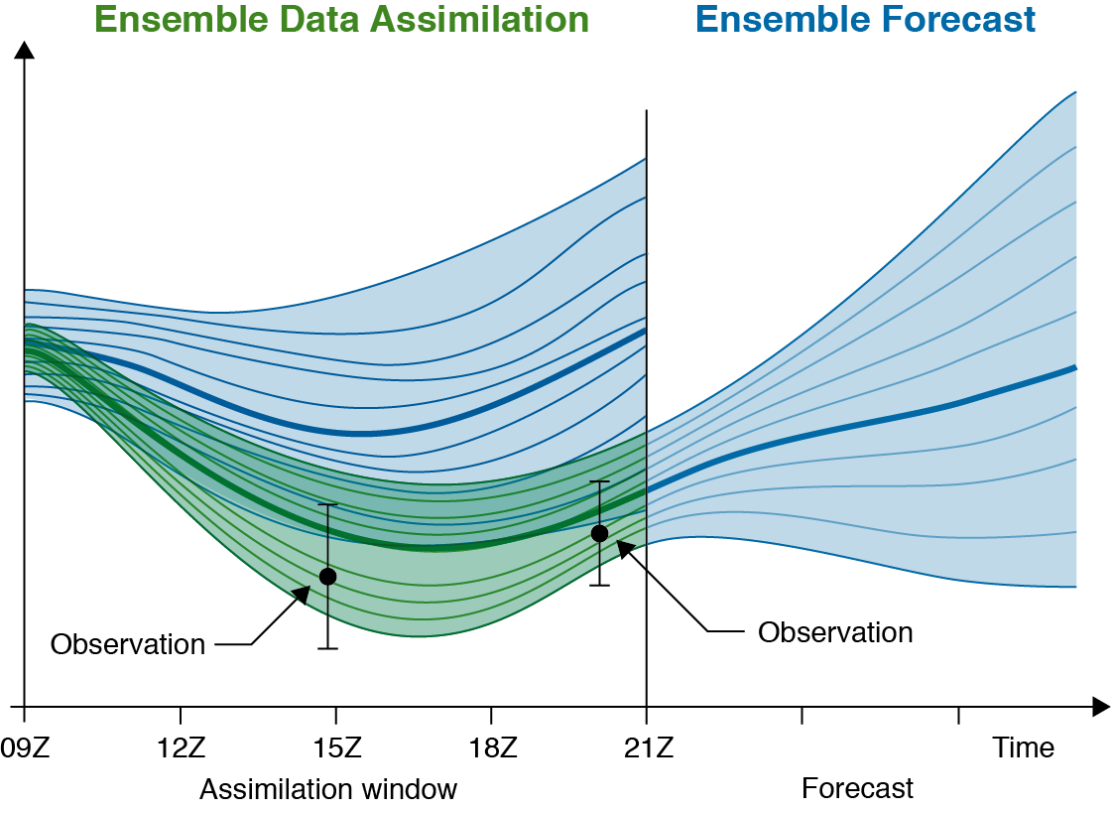
The Ensemble of Data Assimilations (EDA)

Slide 15
The Ensemble of Data Assimilations (EDA)
The EDA is the system used at ECMWF to simulate the error evolution of the 4DVar analysis cycle.
It is conceptually similar and it is based on the same assumptions of a Perturbed Observations (Stochastic) EnKF.
There are advantages to using an ensemble of 4DVar to simulate the error of a reference high resolution 4DVar:
  The two systems are more similar to one another in terms of Kalman Gain than an EnKF and a 4DVar; error estimates should thus be more accurate
  There are technical and maintenance synergies
There are also some disadvantages. In particular running an ensemble of 4DVar is considerably more expensive than running an EnKF. Current efforts are aimed at reducing the computational costs of the EDA in order to make a larger ensemble computationally affordable

Slide 16
Hybrid Data Assimilation

Slide 17
Hybrid Data Assimilation: Motivation
If we neglect model error (perfect model assumption) the problem of finding the model trajectory that best fits the observations over an assimilation interval (t=0,1,…,T) given a background state x_{b} and its error covariance P^{b} can be solved by finding the minimum of the 4DVar cost function:
The 4DVar solution is equivalent, for the same x_{b}, P^{b}, and linear H, M, to the Kalman Filter solution at the end of the assimilation window (t=T) (Fisher et al.,2005).

Slide 18
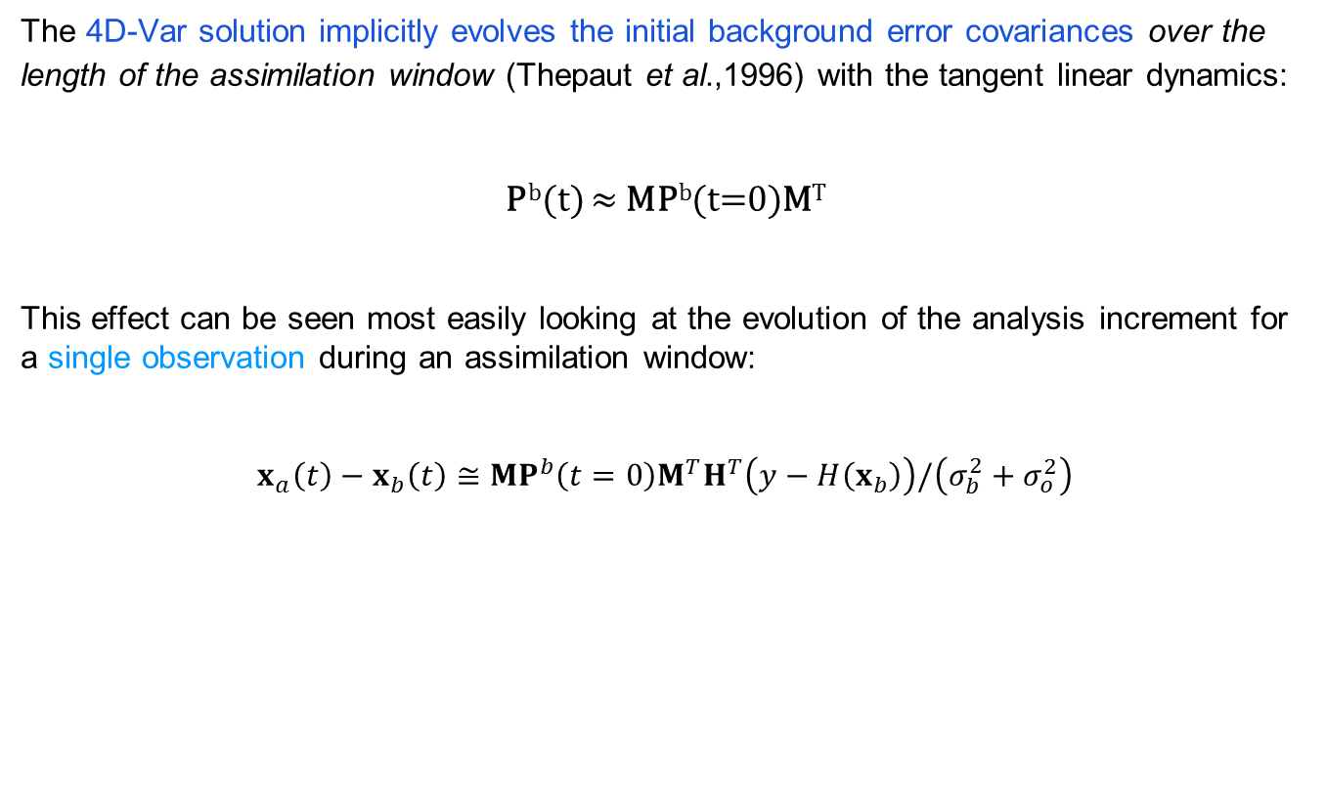
Hybrid Data Assimilation: Motivation
The 4D-Var solution implicitly evolves the initial background error covariances over the
length of the assimilation window (Thepaut et al.,1996) with the tangent linear dynamics:
P^{b}(t) ≈ MP^{b}(t=0)M^{T}
This effect can be seen most easily looking at the evolution of the analysis increment for a single observation during an assimilation window:
$$x_{a}\left(t\right)−x_{b}\left(t\right)≅MP^{b}\left(t=0\right)M^{T}H^{T}\left(y−H\left(x_{b}\right)\right)/\left(σ_{b}^{2}+σ_{o}^{2}\right)$$

Slide 19
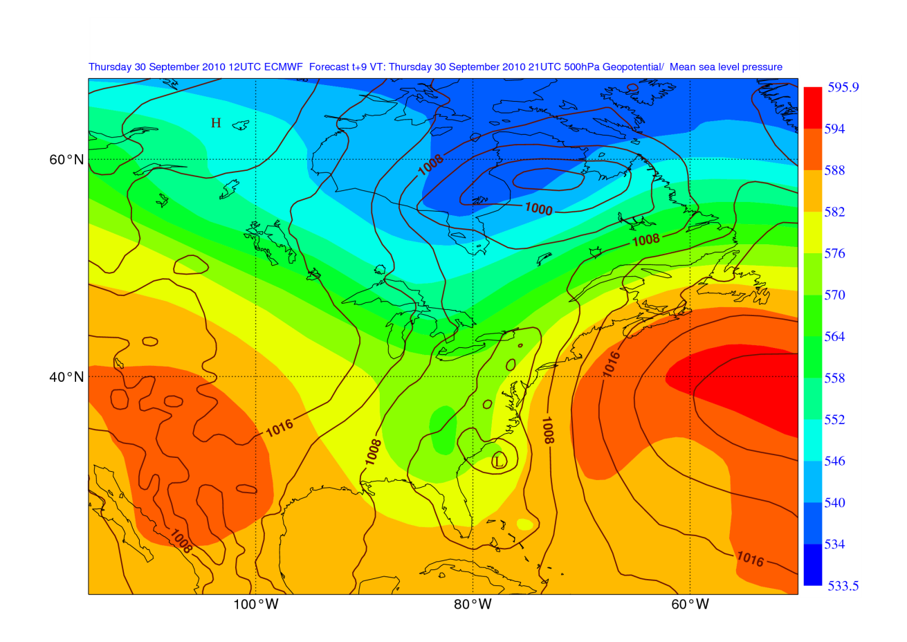
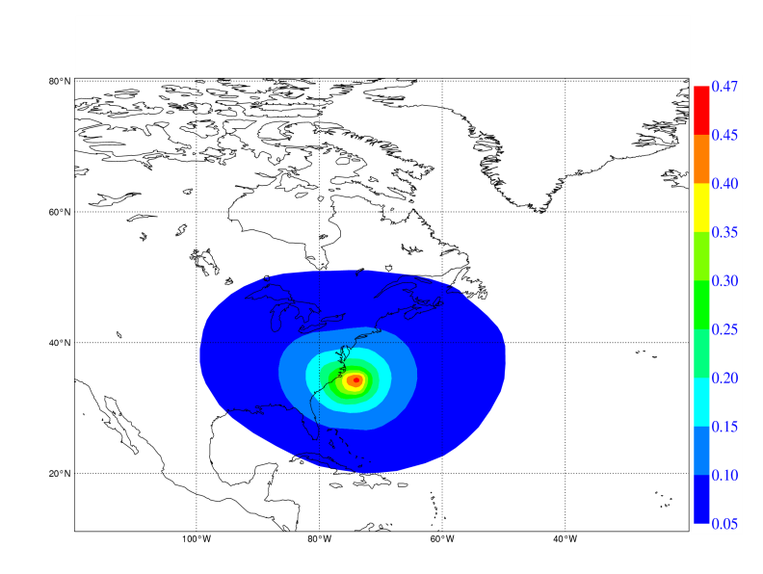
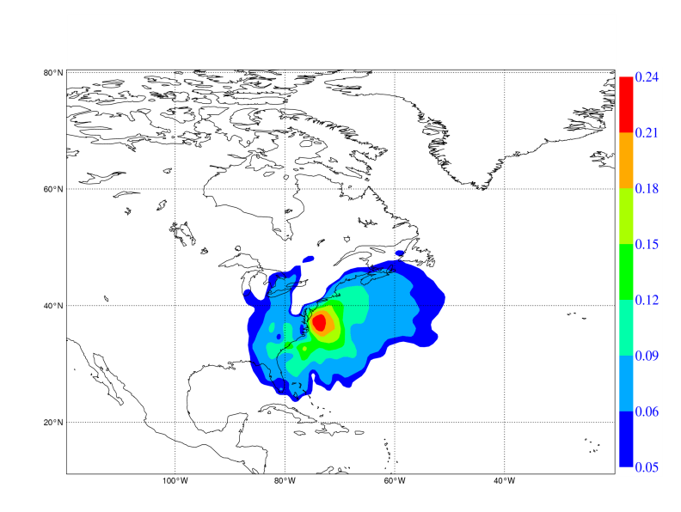
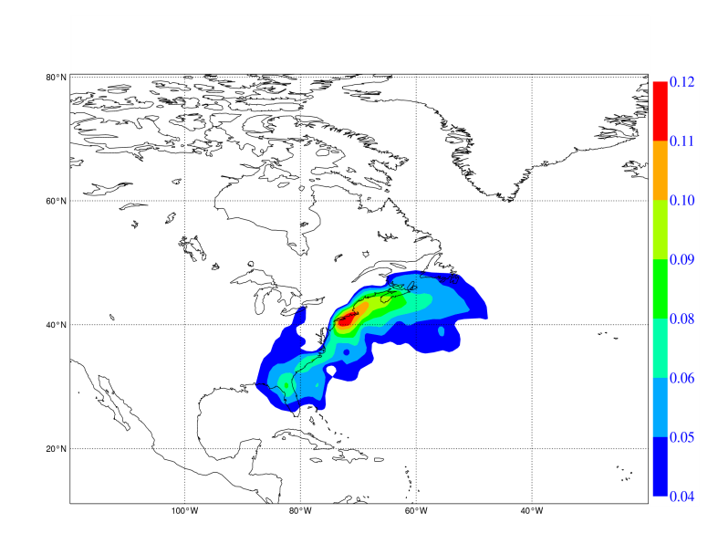
MSLP (solid lines)
500 hPa Z (shaded) background forecast
Temperature analysis increments for a single temperature observation at the start of the assimilation window
t=0h
t=3h
t=9h

Slide 20
Hybrid Data Assimilation: Motivation
The 4D-Var solution implicitly evolves the initial background error covariances over the
length of the assimilation window (Thepaut et al.,1996) with the tangent linear dynamics:
P^{b}(t) ≈ MP^{b}(t=0)M^{T}
But it does not propagate error information from one assimilation cycle to the next: P^{b} is not evolved according to Kalman Filter equations ( i.e., P^{b} = MPªM^{T} + Q) but is reset to a climatological, stationary estimate at the beginning of each assimilation window.
Only information about the state (x_{b}) is propagated from one cycle to the next.

Slide 21
Hybrid Data Assimilation: Motivation
Hybrid Data Assimilation: Use an EnKF/Ensemble Data Assimilation system to produce flow-dependent error covariance information to be used in the high resolution Variational analysis
This approach would have the benefit of:
Integrate flow-dependent state error covariance information into the variational analysis
Keep the full rank representation of P^{b} and its implicit evolution inside the assimilation window
More robust than pure EnKF for limited ensemble sizes and large model errors
Allow for flow-dependent quality control of observations

Slide 22
Hybrid Data Assimilation: Applications
The next question to address is: how do we integrate the flow-dependent error
covariance information from the EnKF/EDA systems into the variational analysis?
Extended control variable method (Met Office)
4D-Ensemble-Var (NCEP, CMC, DWD)
Hybrid EDA 4D-Var (ECMWF, Météo France)

Slide 23
Hybrid Data Assimilation: Applications
Extended (alpha) control variable (Lorenc, 2003)
Conceptually it adds a flow-dependent term to the background error model:
P^{b}_{clim} is the static, climatological background error covariance
P_{ens} ○ C_{loc} is the localised ensemble sample covariance
In practice this hybrid covariance model is done through augmentation of the control variable:
and introducing an additional term in the 4D-Var cost function:

Slide 24
Hybrid Data Assimilation: Applications
Extended (alpha) control variable
The analysis increment is now a weighted sum of a component from the static, climatological P^{b}_{clim} and a component from the flow-dependent, ensemble based P^{b}_{ens}
The flow-dependent increment is a linear combination of ensemble background perturbations X’, modulated by the α fields of coefficients
If the α fields were homogeneous δx_{ens} could only span N_{ens}-1 degrees of freedom; instead α are spatially varying fields, which effectively increases the available degrees of freedom since at different grid points the increment will be a different linear combination of ensemble perturbations
C_{loc} is a covariance (localization) model for the flow-dependent increments: it controls the spatial variation of α

Slide 25
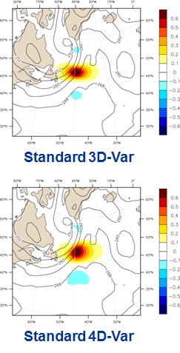
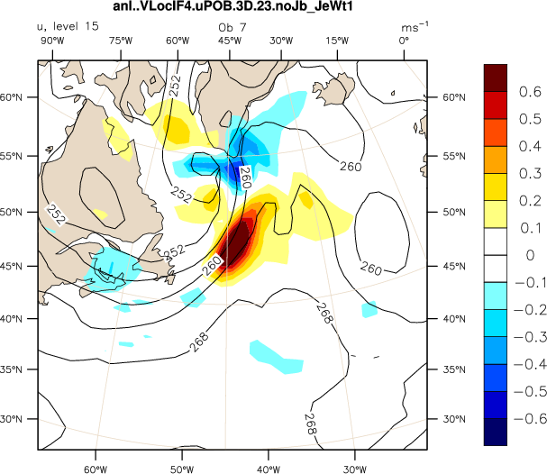
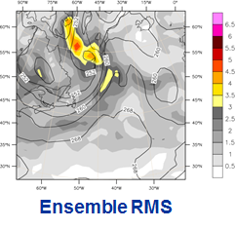
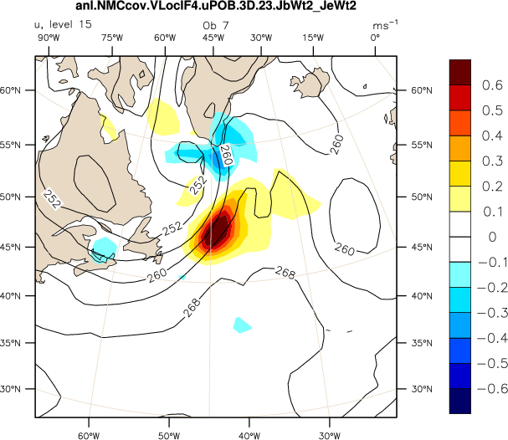
Hybrid Data Assimilation: Applications
Extended (alpha) control variable
Pure ensemble 3D-Var
from A.Clayton (UKMO)
50/50 hybrid 3D-Var

Slide 26
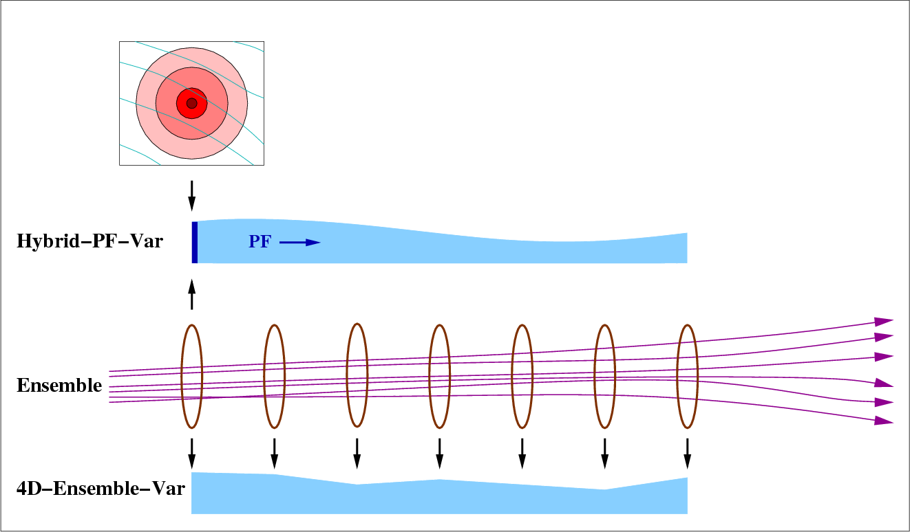
Hybrid Data Assimilation: Applications
4D-Ensemble-Var (Liu et al., 2008)
In the extended control variable method one uses the ensemble perturbations to estimate P^{b} only at the start of the 4DVar assimilation window: the evolution of P^{b} inside the window is done by the tangent linear dynamics (P^{b}(t) ≈ MP^{b}M^{T})
In 4D-En-Var P^{b} is sampled from ensemble trajectories throughout the assimilation window:
from D. Barker (UKMO)

Slide 27
Hybrid Data Assimilation: Applications
4D-Ensemble-Var (Liu et al., 2008)
The 4D-Ens-Var analysis increment is thus a localised linear combination of ensemble trajectories’ perturbations:
This is fundamentally the same state update procedure of the LETKF version of EnKF (Hunt et al., 2007)
While traditional 4DVar requires repeated, sequential runs of M, M^{T}, ensemble trajectories from the previous assimilation time can be pre-computed in parallel
However these ensemble trajectories need to be stored and read-in: we are trading computational cost for I/O cost
As in the EnKF, 4D-Ens-Var does not require developing and maintaining the TL and Adjoint models

Slide 28
Hybrid Data Assimilation: Applications
Hybrid EDA 4D-Var (Isaksen et al., 2007; Bonavita et al., 2012, 2015)
In Hybrid 4D-Var we use the perturbations from the EDA background forecasts to update the background error covariance model used in 4D-Var
The ensemble perturbations are not used directly to construct the analysis increments, but to update the P^{b} used in 4D-Var

Slide 29
Hybrid Data Assimilation: Applications
x_{i}^{b}
x_{i}^{b}
y+ε_{i}º
4D-Var
x_{i}ª
Forecast
4D-Var
i=1,2,…,25
SST+ε_{i}^{SST}
EDA
EDA background perturbations
Updated P^{b}
x^{b}
4D-Var
xª
Forecast
x^{b}
HRES 4DVar

Slide 30
Hybrid Data Assimilation: Applications
How does the background error model update works?
In variational DA, the background error covariance matrix B is usually defined implicitly in terms of a transformation from an increment defined in terms of model variables (x-x_{b}) to one defined in terms of a control variable χ:
(x-x_{b}) = Lχ
so that the implied B=LL^{T}.
In the current ECMWF wavelet formulation (Fisher, 2003), the variable transform can be written as:
  K is the balance operator, i.e. the operator that links the control variables to the model variables
  Σ_{b} is the grid point variance of background errors
  C_{j}(λ,φ) is the vertical correlation matrix for wavelet index j
  The wavelet transform is defined by the set of basis functions ψ_{j}

Slide 31
Hybrid Data Assimilation: Applications
How does the background error model update works?
In standard 4D-Var the background error variances (Σ_{b}) and the background error correlations (C_{j}(λ,φ)) are computed offline from a climatology of EDA background perturbations.
In Hybrid EDA 4D-Var these quantities are updated using the latest set of EDA background perturbations
In this way the B model is continuously updated and is able to represent the “errors of the day”

Slide 32
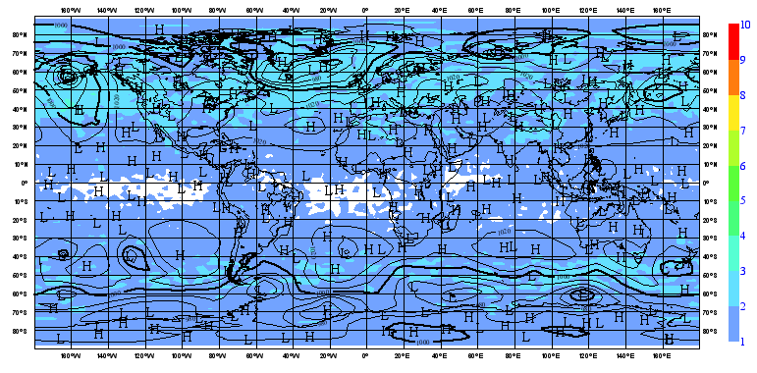
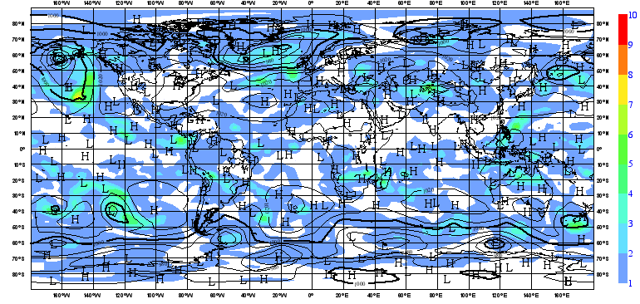
Hybrid Data Assimilation: Applications
500 hPa Vorticity errors
estimated from climat. B
How does the background error model update works?
500 hPa Vorticity errors
estimated from online B

Slide 33
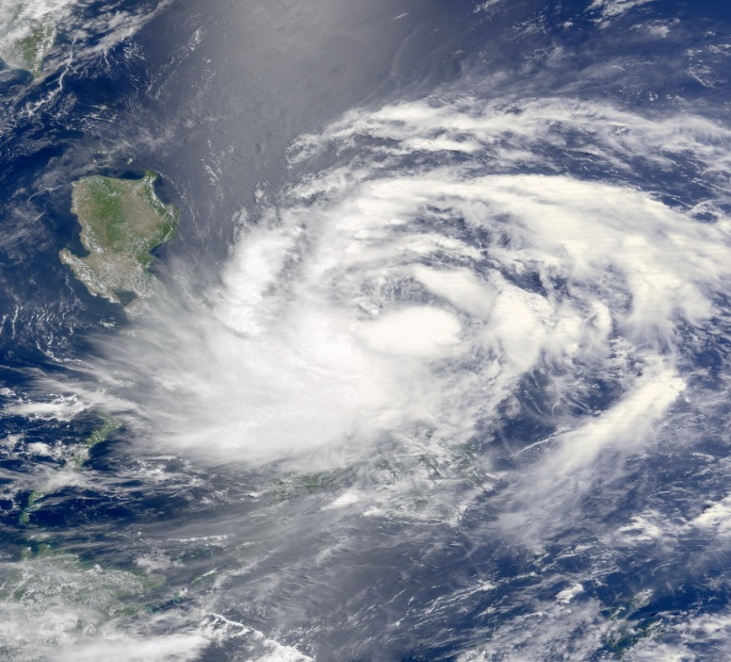
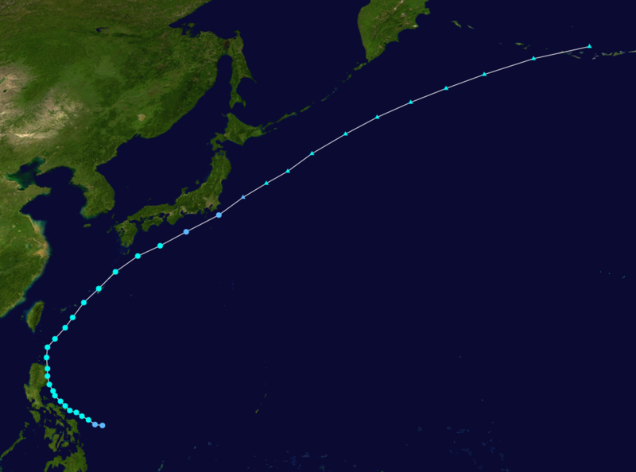
Hybrid Data Assimilation: Applications
Inside 4DVar EDA derived background error estimates change the shape and size of analysis increments
Tropical Cyclone Aere, Philippines 8-9 May 2011.

Slide 34
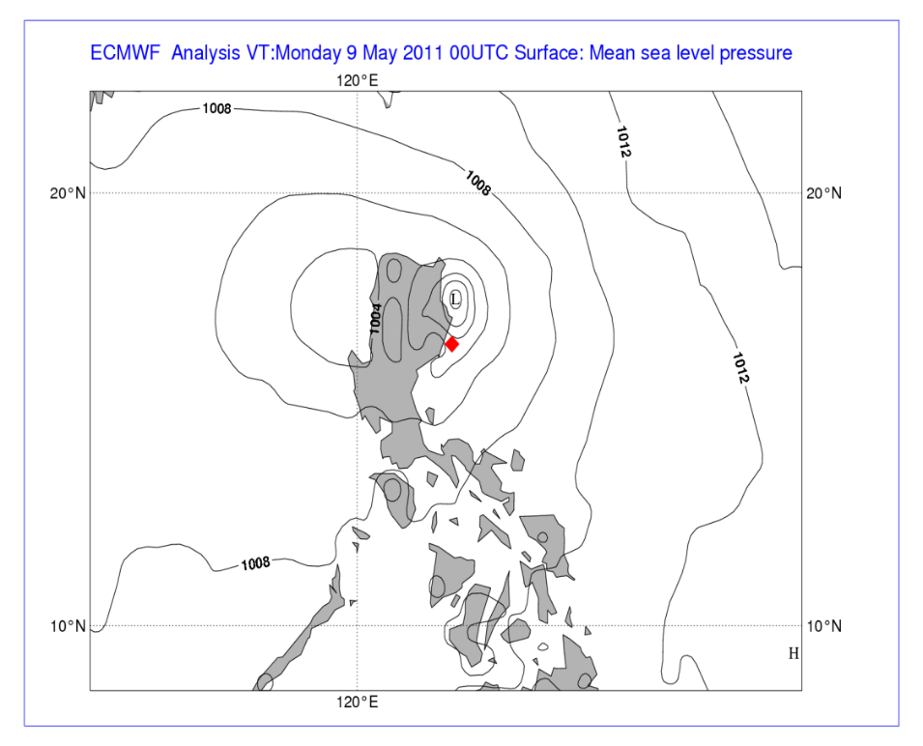
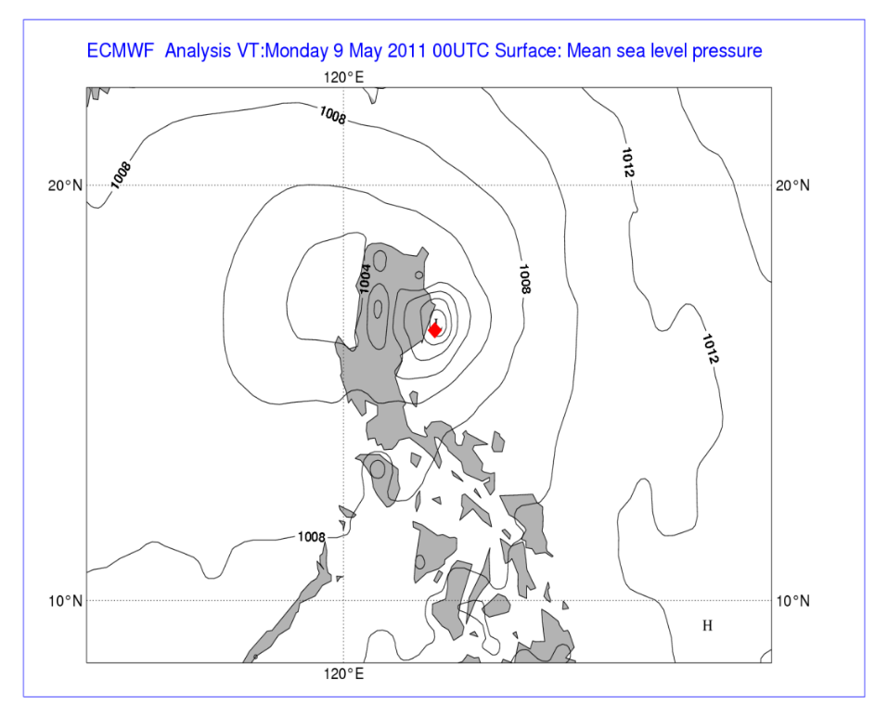
Hybrid Data Assimilation: Applications
Inside 4DVar EDA derived background error estimates change the shape and size of analysis increments
Significant operational analysis error, corrected by 4DVar with EDA variances
4DVar with Climat. errors 4DVar with EDA errors

Slide 35
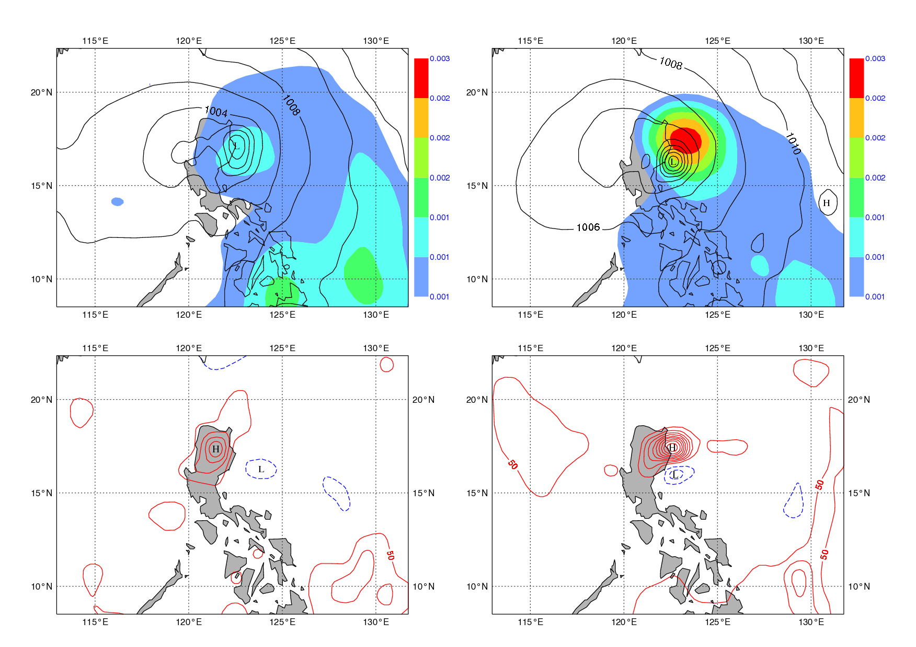
Hybrid Data Assimilation: Applications
Static errors EDA errors
Static SP ana incr. EDA SP ana incr.

Slide 36
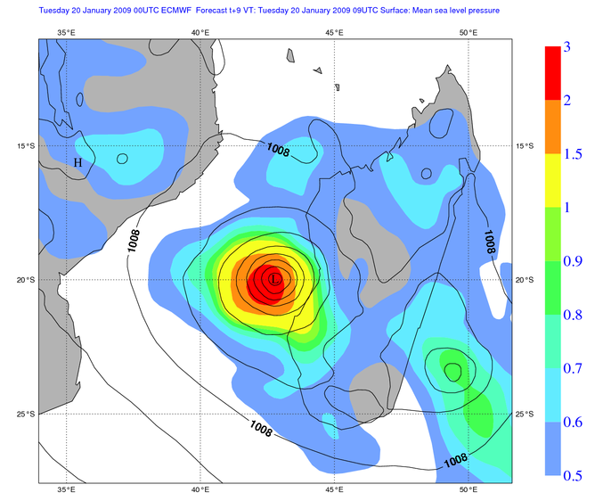
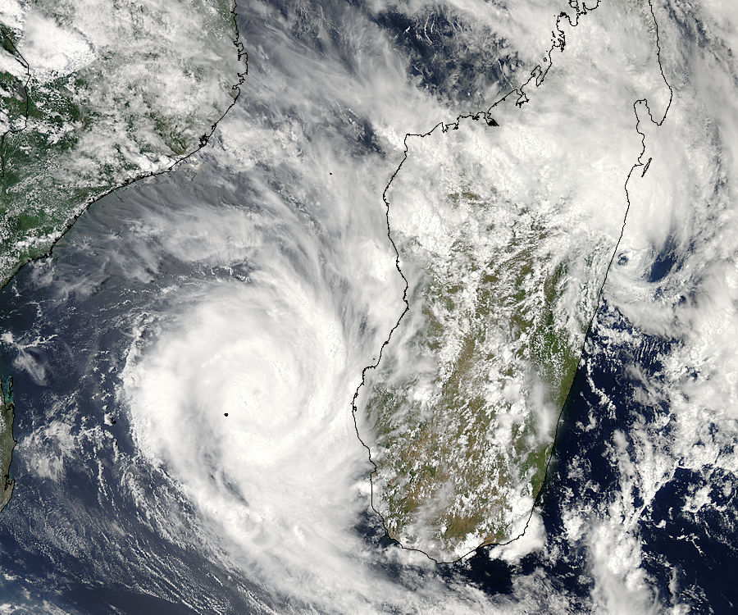
Hybrid Data Assimilation: Applications
The online update of B involves not only the background error variances (Σ_{b}) but also the background error correlations (C_{j}(λ,φ))
hPa
Hurricane Fanele, 20 January 2009
EDA derived background error variance for Surface pressure

Slide 37
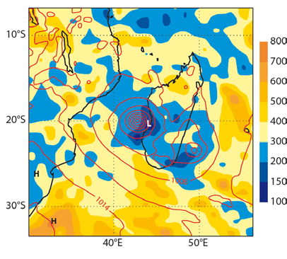
Hybrid Data Assimilation: Applications
The online update of B involves not only the background error variances (Σ_{b}) but also the background error correlations (C_{j}(λ,φ))
Km
Hurricane Fanele, 20 January 2009
EDA derived background error correlation length scale for Surface pressure

Slide 38
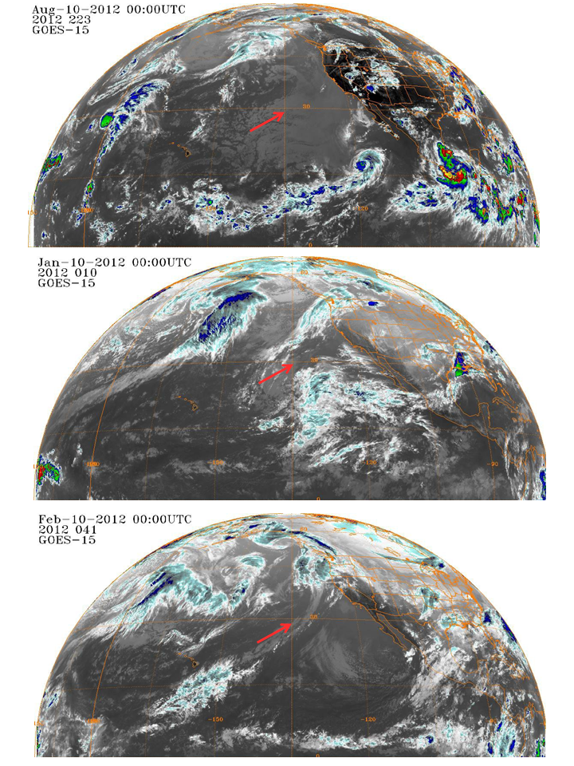
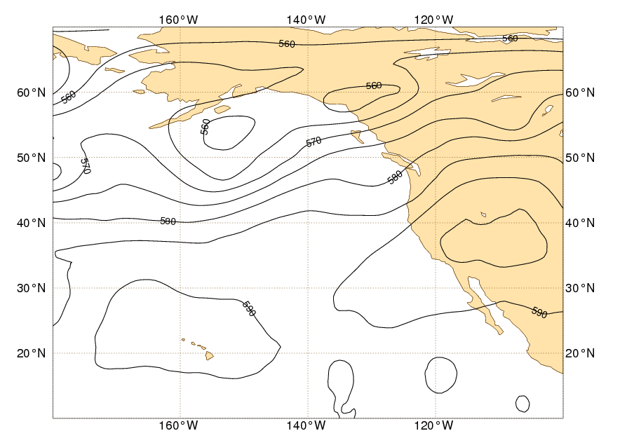
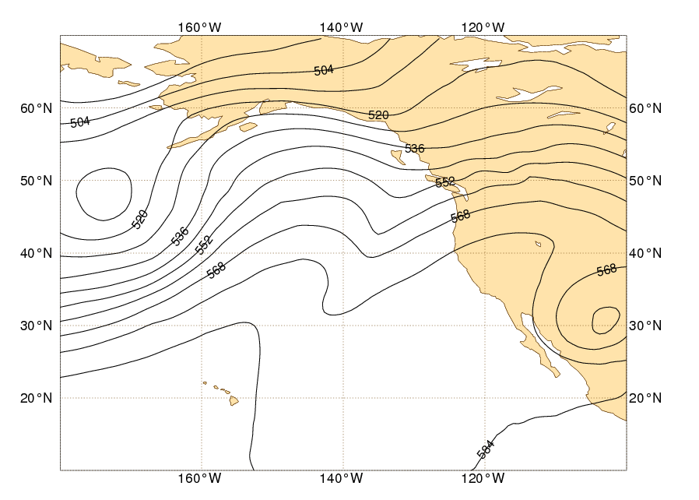
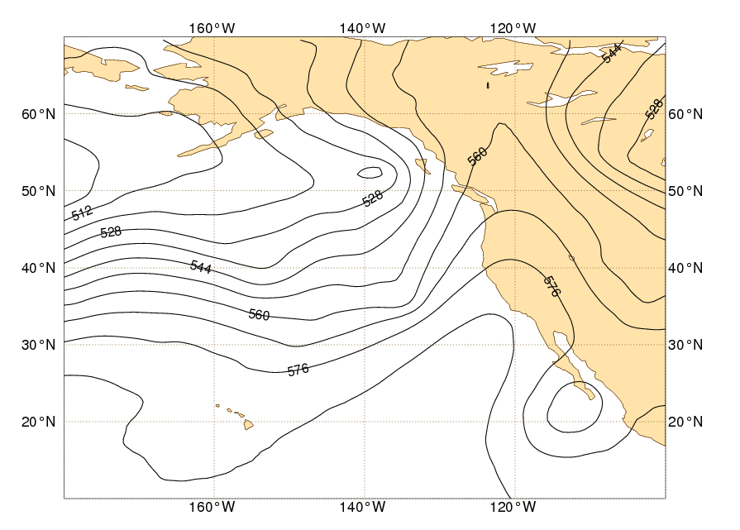
Wavelet B Computation

Slide 39
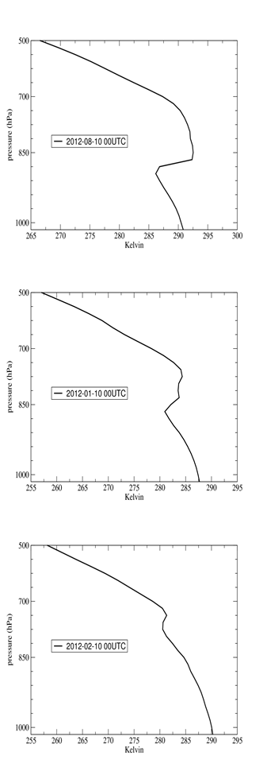
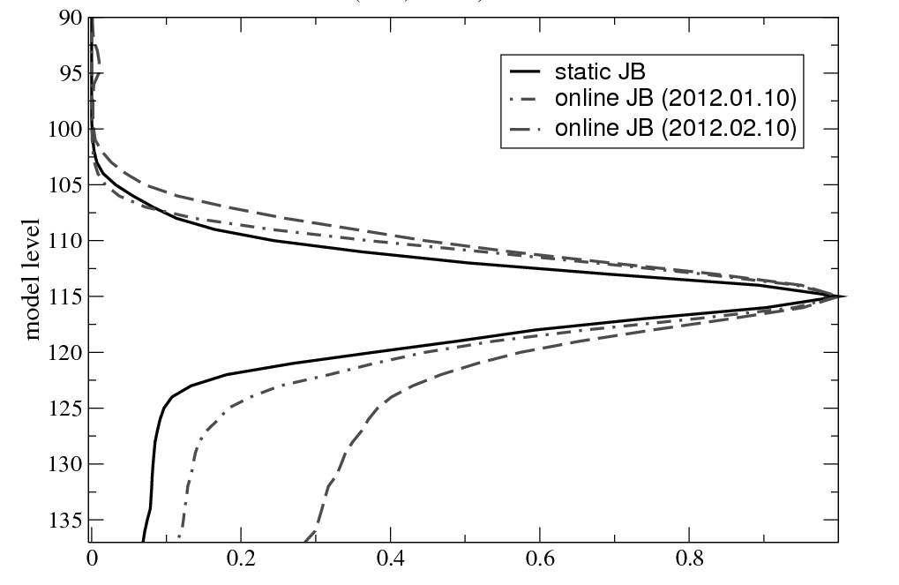
Vertical bg error correlation for Vorticity,
~850hPa
August 2012
Jan 2012
Feb 2012

Slide 40
Summary
The EDA is a variational implementation is a variational implementation of the Perturbed Observations (Stochastic) EnKF.
It is used at ECMWF to estimate the state error covariances in order to a) initialise the ensemble prediction system and b) to provide estimates of the background error covariances for 4D-Var analysis
Advantages: closer to reference 4D-Var, simpler to maintain and update
Disadvantages: computational cost
Hybrid DA: 3/4D-Var in combination with EnKF/EDA for error estimation and cycling
Superior results than stand-alone 4D-Var or EnKF
Various flavours of Hybrid DA possible: a) with direct use of ensemble perturbations (extended control variable, 4D-Ens-Var); b) updating a B model (hybrid EDA 4D-Var)
Common issue: limited affordable ensemble size introduces sampling problems. Different techniques to tackle them (localisations, spatial averaging, time averaging, etc.).
Estimates of P^{a/b} only as good as our knowledge of R, Q.

Slide 41
Bibliography
Bonavita M., L. Raynaud and L. Isaksen, 2010: Estimating background-error variances with the ECMWF Ensemble of Data Assimilations system: the effect of ensemble size and day-to-day variability. Q. J. R. Meteorol. Soc., 137: 423–434.
Bonavita M., L. Isaksen and E. Holm, 2012: On the use of EDA background error variances in the ECMWF 4D-Var. Q. J. R. Meteorol. Soc.. Early Online Release, doi: 10.1002/qj.1899
Bonavita M., E. Holm, L. Isaksen and M. Fisher, 2015: The evolution of the ECMWF hybrid data assimilation system, Q.J.R. Meteorol. Soc., 142: 287–303. DOI: 10.1002/qj.2652.
Fisher, M. Leutbecher M, Kelly GA. 2005 On the equivalence between Kalman smoothing and weak-constraint four-dimensional variational data assimilation. Q. J. R. Meteorol. Soc. 131 3235–3246.
Fisher, M., 2003: Background error covariance modelling. Proceedings of the ECMWF Seminar on recent developments in data assimilation for atmosphere and ocean, ECMWF, pages 45–63. (Available from: http://www.ecmwf.int/publications/)
Isaksen, L., M. Bonavita, R. Buizza, M. Fisher, J. Haseler, M. Leutbecher and Laure Raynaud, 2010: Ensemble of data assimilations at ECMWF. ECMWF Technical Memorandum No. 636. (Available from: http://www.ecmwf.int/publications/)

Slide 42
Bibliography
Hunt, B. R., Kostelich, E. J. and Szunyogh, I., 2007. Efficient data assimilation for spatiotemporal chaos: a local ensemble transform Kalman filter. Physica D, 230, 112–126.
Liu C, Xiao Q, Wang B. 2008. An ensemble-based four-dimensional variational data assimilation scheme. part i: Technical formulation and preliminary test. Mon. Weather Rev. 136: 3363–3373.
Lorenc, A.C.,2003: The potential of the ensemble Kalman filter for NWP—A comparison with 4D-VAR. Q. J. R. Meteorol. Soc., 129: 3183–3203.
Ott E, Hunt BR, Szunyogh I, Zimin AV, Kostelich EJ, Corazza M, Kalnay E, Patil DJ. 2004. A local ensemble Kalman filter for atmospheric data assimilation. Tellus 56A: 415–428.
Raynaud, L., L. Berre, and G. Desroziers, 2008: Spatial averaging of ensemble-based background-error variances. Q. J. R. Meteorol. Soc., 134, 1003–1014.
Thepaut, J.-N., Courtier, P., Belaud, G. and Lemaıtre, G., 1996: Dynamical structure functions in a four-dimensional variational assimilation: A case study. Q. J. R. Meteorol. Soc., 122, 535–561

