Slide 1
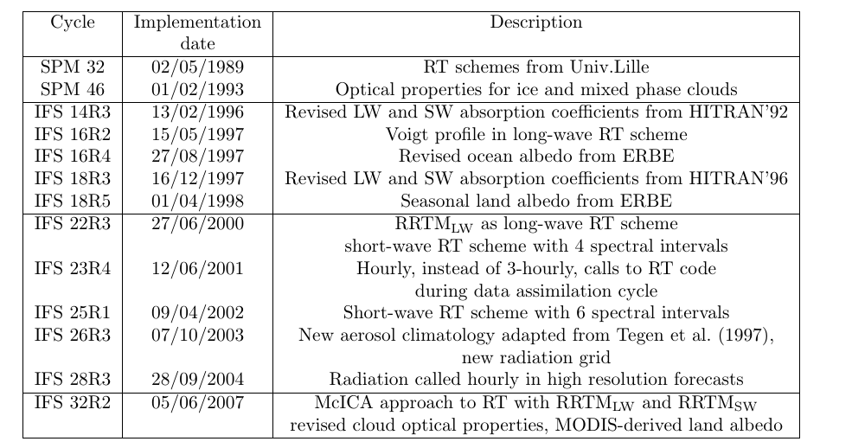
The history of ECMWF radiation schemes
IFS 43R3
Summer 2017
ECRAD (Hogan&Bozzo 2016) new modular design, improved efficiency, improved LW fluxes computation, LW scattering, new aerosol climatology

Slide 2
The ECMWF radiation schemes
A number of radiation schemes are in use at ECMWF. Since January 2011, have been active
  McRad including RRTM_LW and RRTM_SW is used in the forward model for operational 10-day forecasts at Tco1279L137, EPS 15-day forecasts at Tco639 L91, and seasonal forecasts at T_{L}159 L62.
  The tangent linear and adjoint of the “old” SW radiation scheme in a 2-spectral interval version
  The tangent linear and adjoint of the “old” LW radiation scheme with 6 spectral intervals,
  These last two schemes are used in the assimilation (cf. P.Lopez’s presentation in TC PA module)
  … and all the dedicated RT scheme used to simulate radiances (RTTOV-based) in the analysis of satellite data (cf. TC DA module)
  A dedicate RT code to compute spectral irradiance in the UV spectrum (a modified version of RRTM-SW in the CAMS system)

Slide 3
McRad, a new radiation package for the ECMWF IFS
McRad (operational with CY32R2, 5 June 2007)
Includes MODIS land surface albedo
A new SW radiation transfer scheme (RRTMG_SW) consistent with RRTMG_LW introduced in June 2000
McICA: Monte-Carlo Independent Column Approximation: a new treatment of clouds in RT schemes
Revised cloud optical properties. Ice: Fu et al. (1996,1998) Water: Lindner and Li (2000) and Slingo (1989)
More extensive use of the flexible radiation grid

Slide 4
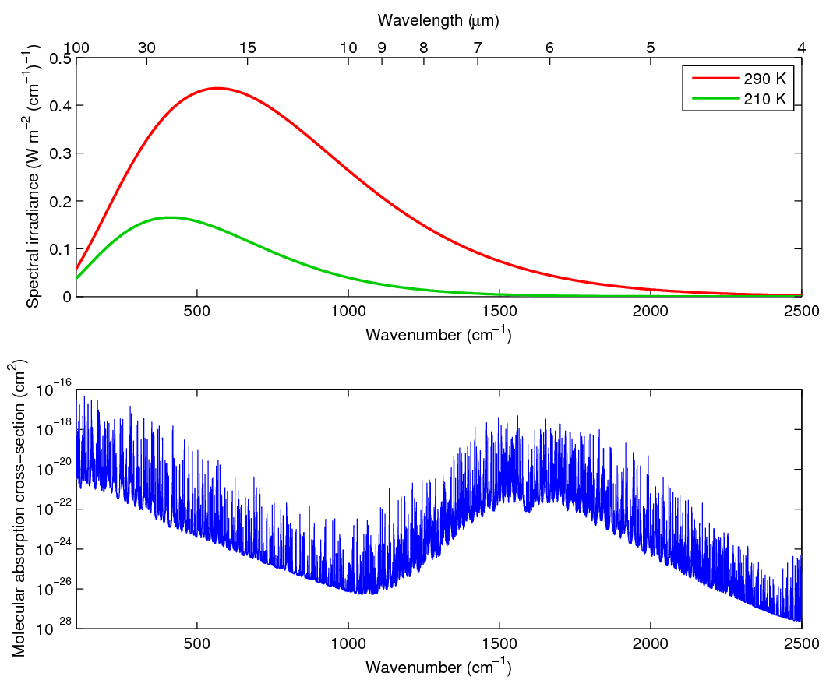
How do we integrate across the spectrum?
Consider first just one gas
Line-by-line model predicts spectrum (e.g. HITRAN)
Need ~10⁵ monochromatic radiation calculations
Water vapour spectrum Planck function

Slide 5
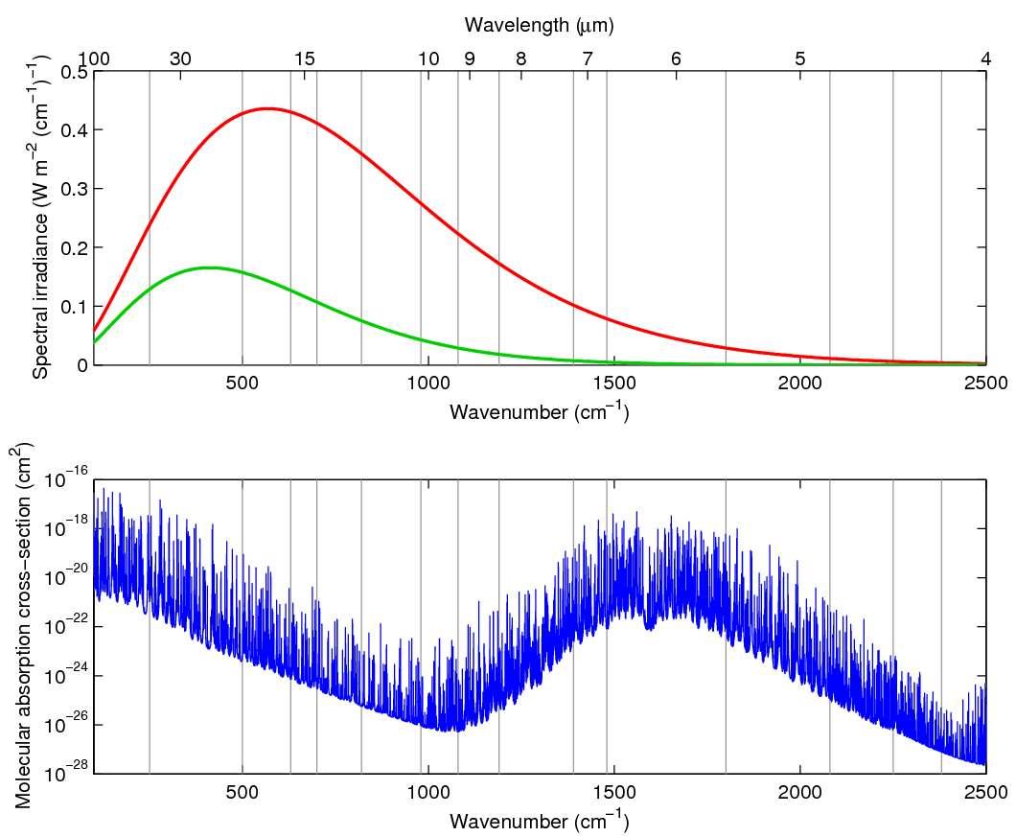
Divide into bands
Divide into the 16 longwave bands of well validated RRTM-LW model (Mlawer et al. 1997)
14 shortwave bands for RRTM-SW
Water vapour spectrum Planck function

Slide 6
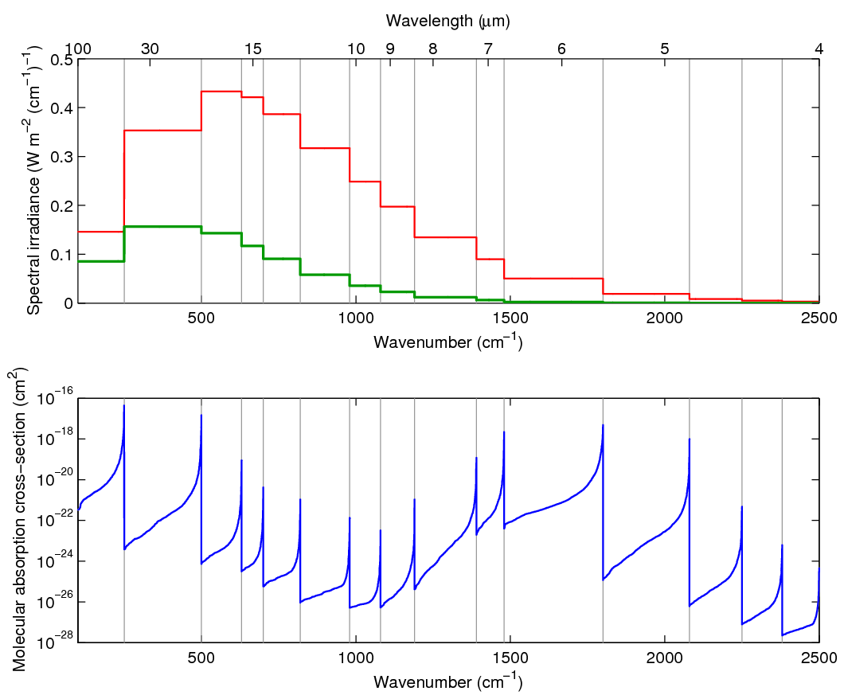
The k-distribution method
In each band, sort absorption spectrum and average the Planck function
More conducive to numerical integration
Lacis & Oinas (1991)
Water vapour spectrum Planck function

Slide 7
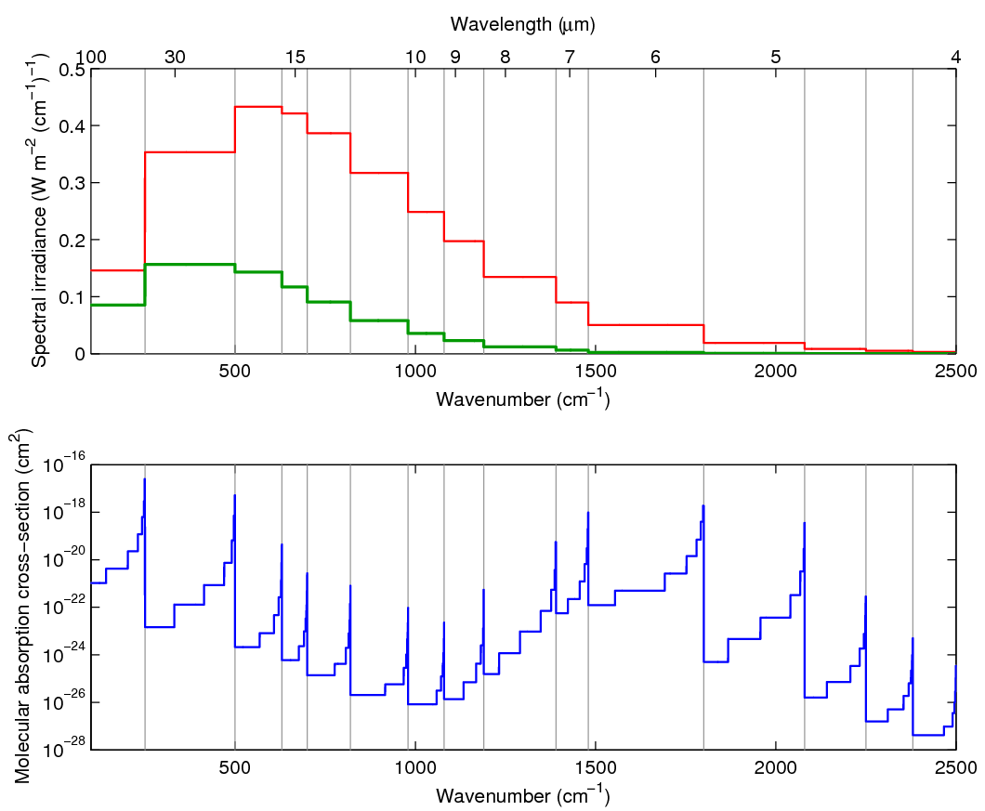
The correlated k-distribution (CKD) method
Discretize sorted absorption coefficients into 2-16 intervals in each band
Numerical integration now needs ~120 monochromatic calculations for longwave when all gases considered
K-distribution correlated in height
Water vapour spectrum Planck function

Slide 8
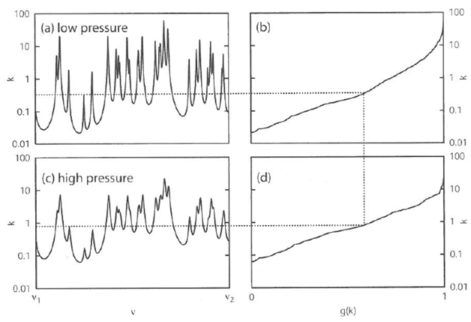
RRTM Mlawer et al., 1997: JGR, 102D, 16663-16682
Aer Inc. Morcrette et al., 1998: ECMWF Tech.Memo., 252
The use of the correlated-k method (mapping k(v) ->g(k)) allows radiative transfer to be performed as a monochromatic process
The original RRTM integrates each of the LW and SW bands with 16 pseudo-monochromatic channels (g-points)
The ECMWF model uses a version with less g-points
RRTMG
A two stream algorithm performs the vertical radiative transfer
M<N

Slide 9
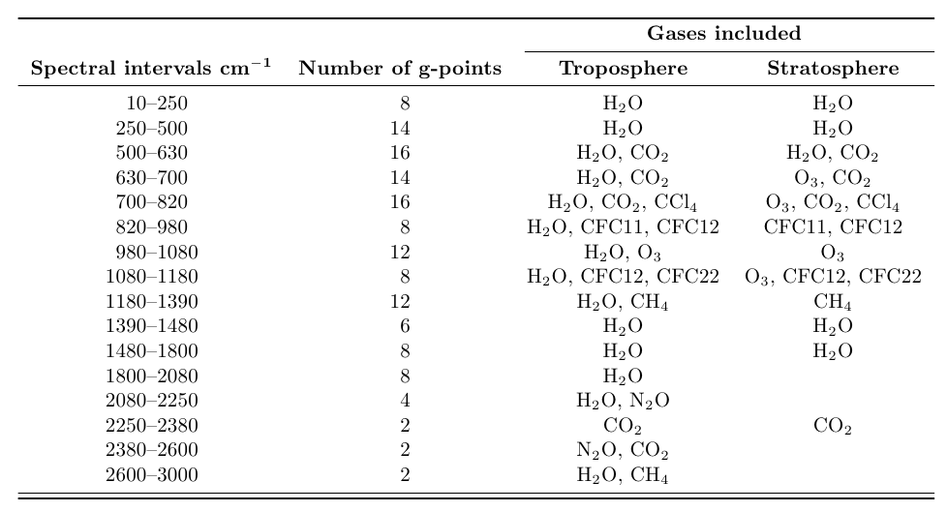
RRTMG-LW configuration
~100 microns
~100 hPa
16
B
A
N
D
S
~3 microns
140 g-points

Slide 10
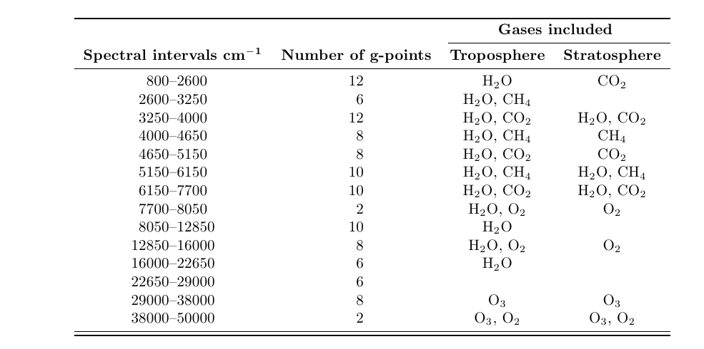
RRTMG-SW configuration
~3 microns
14
B
A
N
D
S
0.2 microns
112 g-points

Slide 11
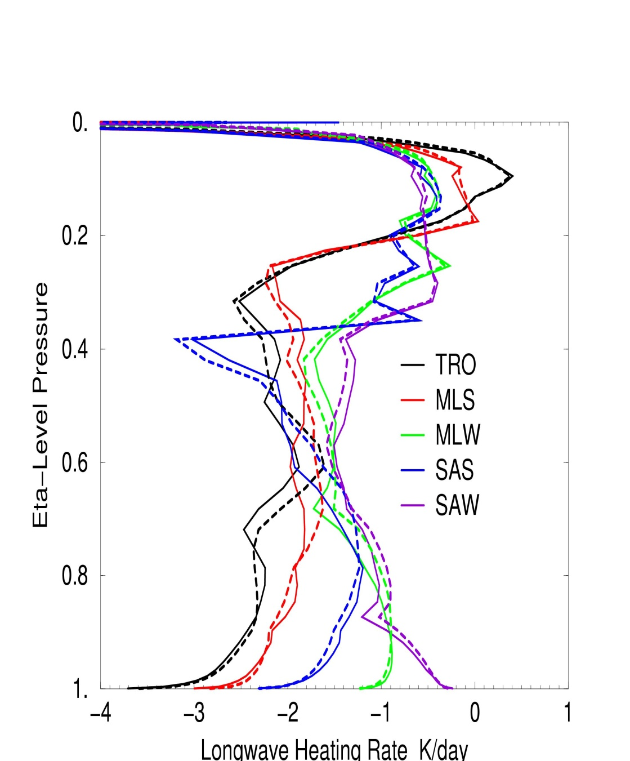
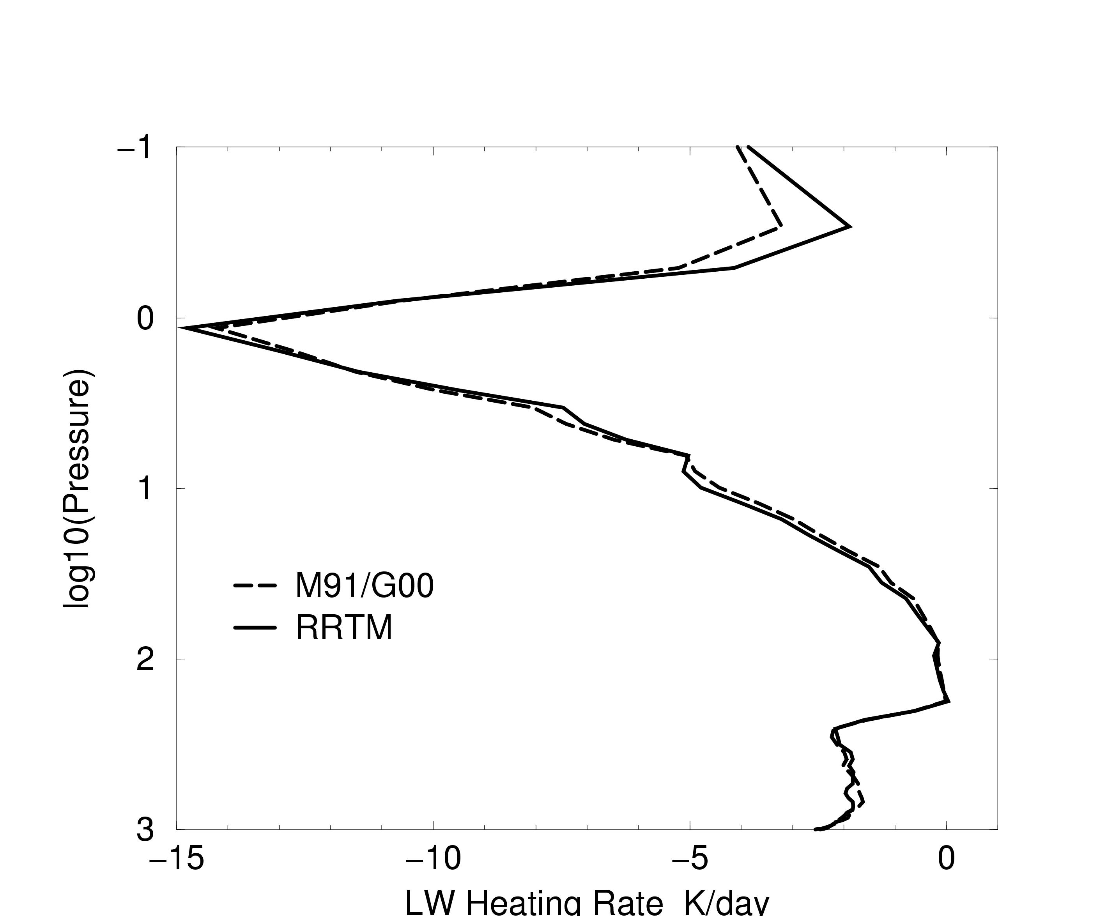
RRTM_LW vs. M91/G00:
Impact when operationally introduced in 2000
MLS profile

Slide 12
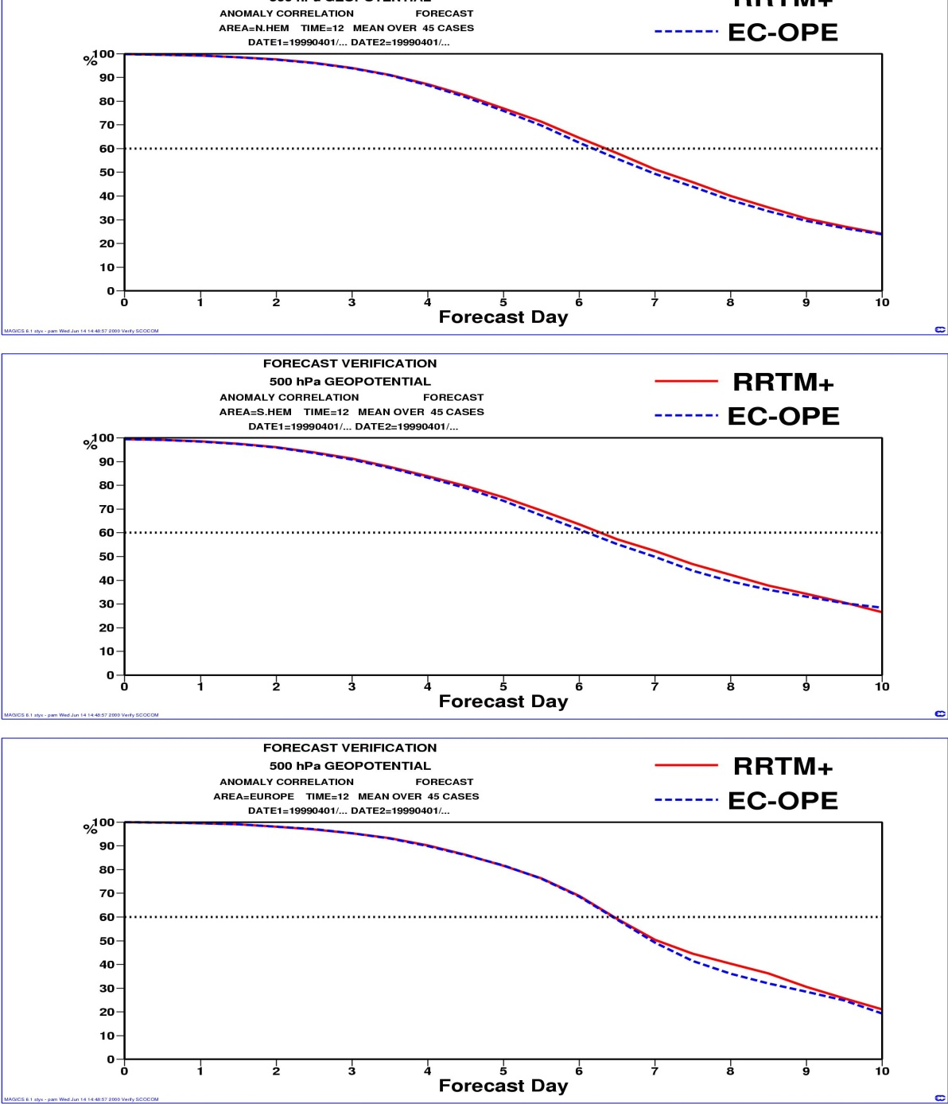
RRTM_LW vs. M91/G00 - 4
Objective scores: RRTM vs. M91/G00
Small detectable improvement in the forecast skill scores

Slide 13
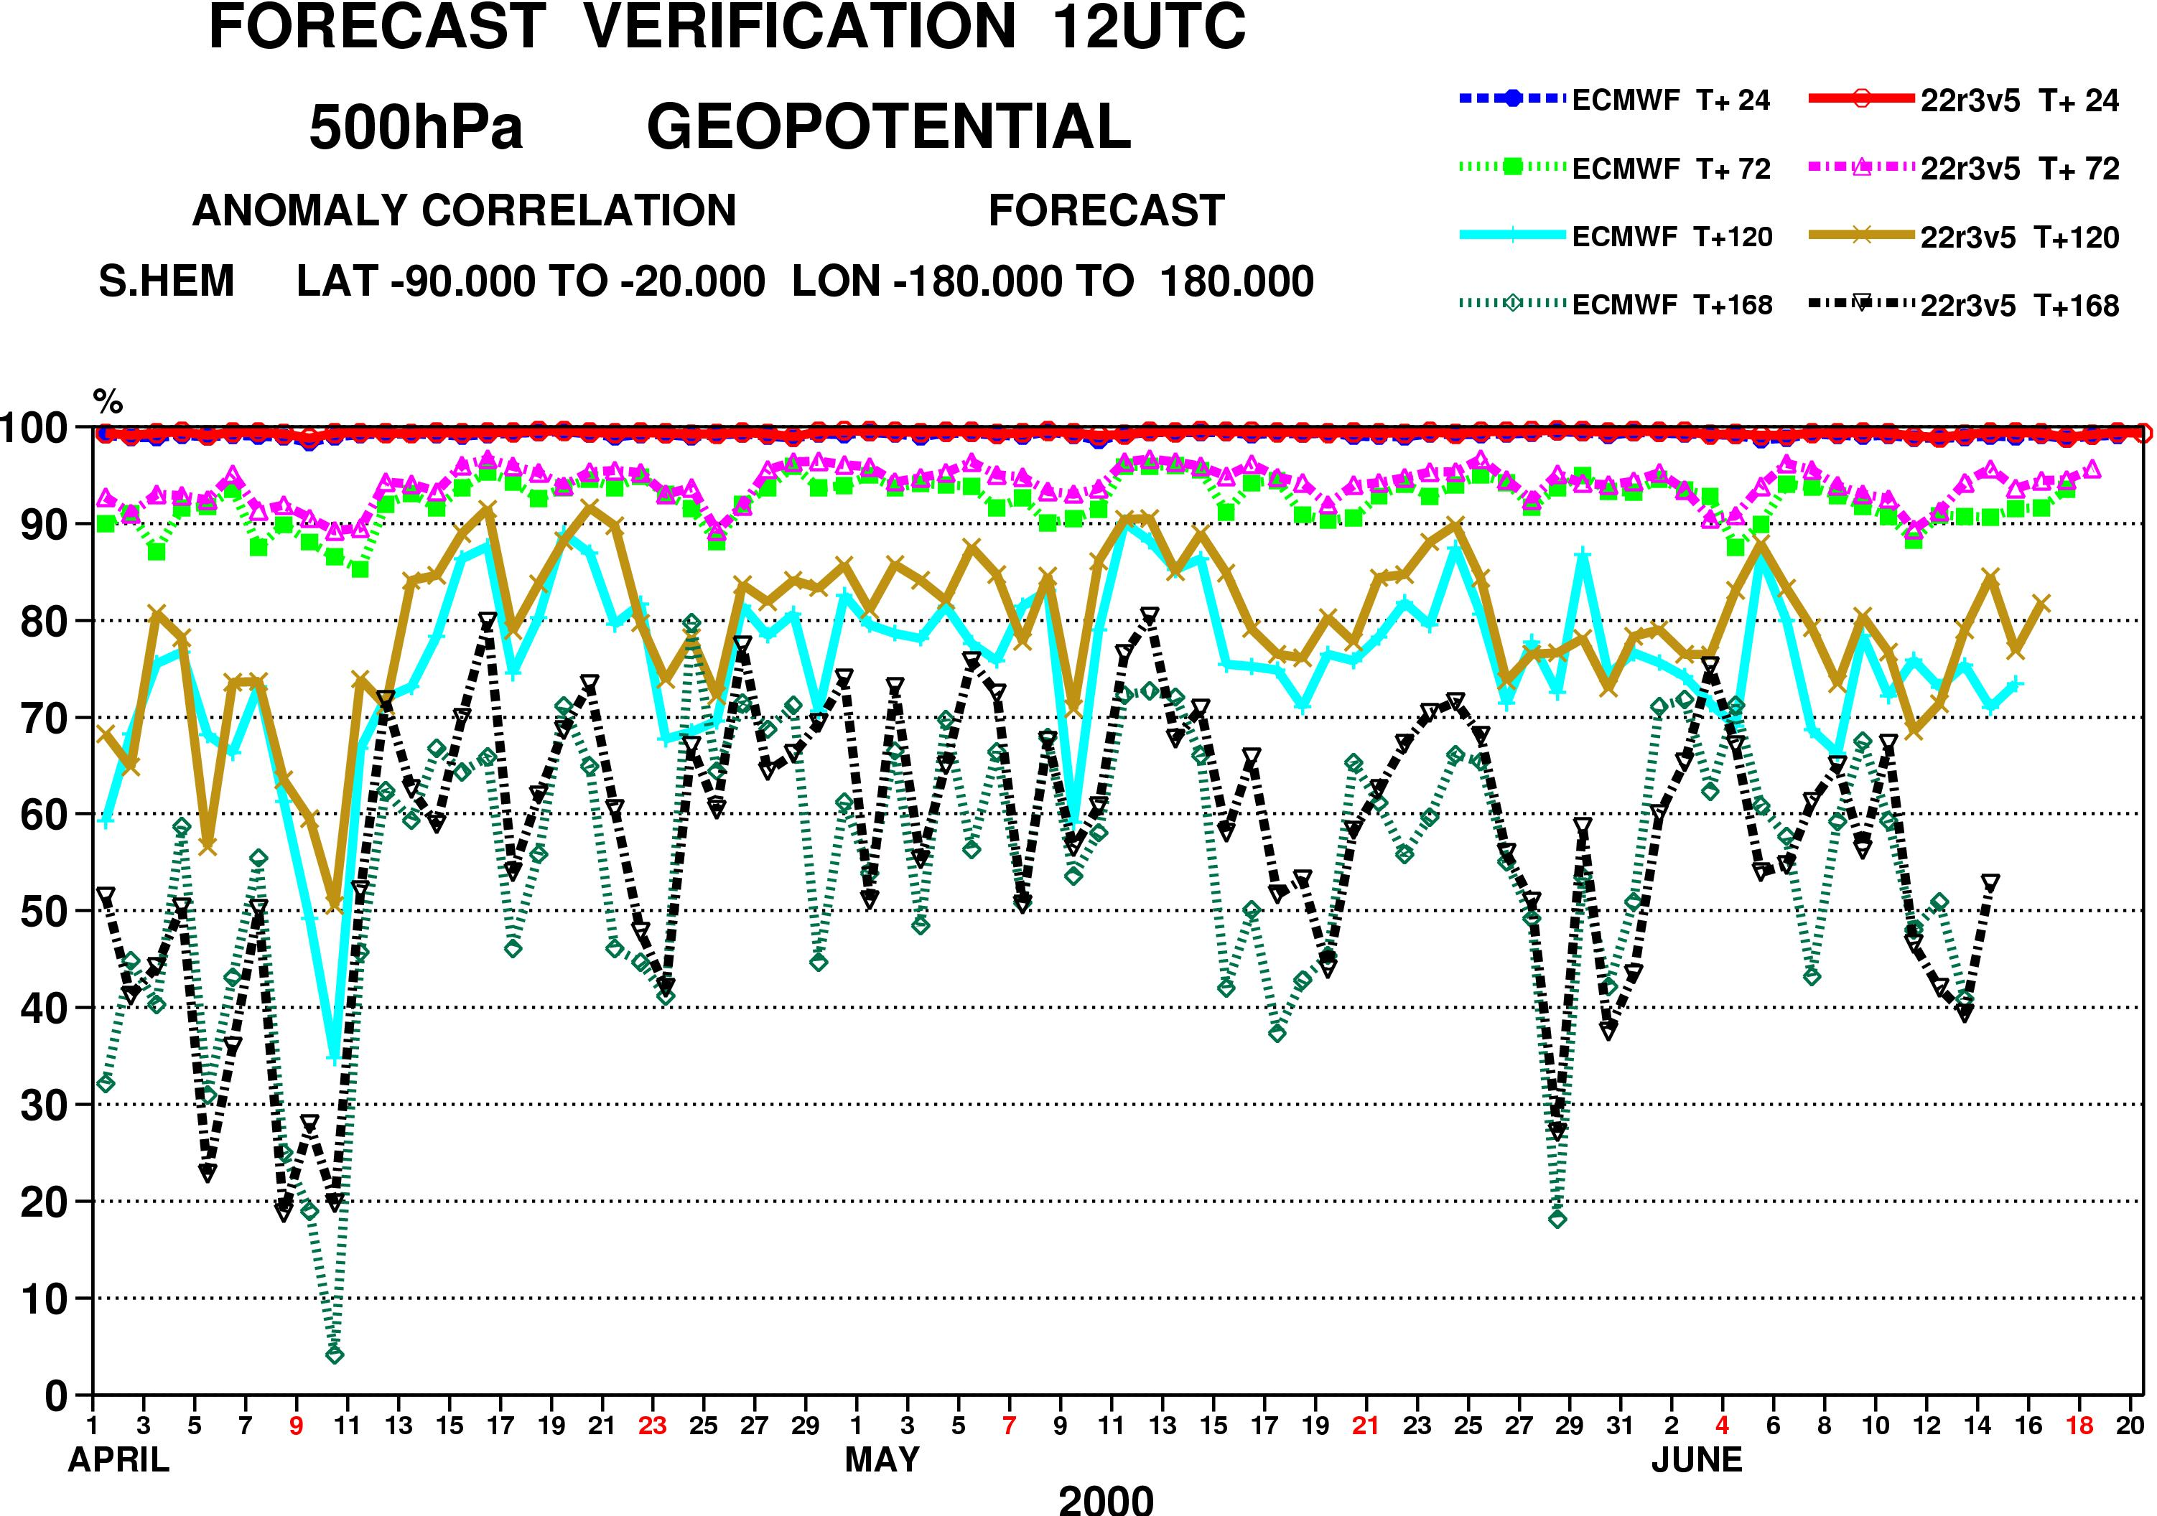
RRTM vs. M91/G00 - 5
M91/G00
RRTM

Slide 14
Improving cloud-radiation interaction -1 most models until ~2000
Easy way to tackle the problem: compute the clear and cloud part of the grid box (according to cloud fraction and overlap at each level) and merge fluxes
0
Input from cloud scheme: cloud fraction, LWC/IWC
200
400
Pressure hPa
600
800
1000

Slide 15
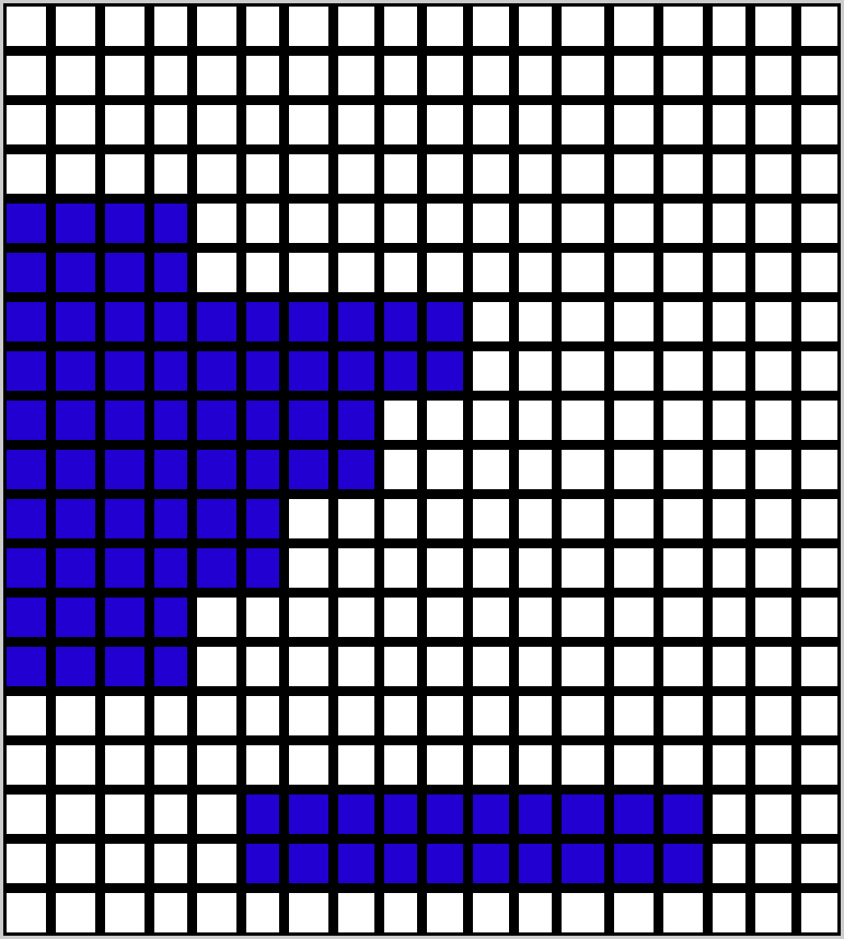
Improving cloud-radiation interaction -2
independent column approximation (if we had infinite computing power)
K = number of spectral intervals (g-points)
<F> average flux in the grid box
N = number of independent sub-columns
Ntot = total number of transmission
function computations
0
200
400
Pressure hPa
600
ICA RT scheme:
Ntot = N * K ~ O(10^3)
800
1000
1 g-points K
1
N
Number of sub-columns

Slide 16

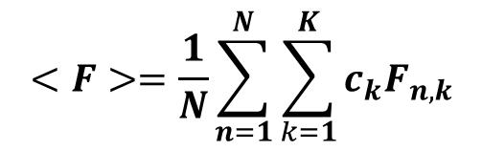
Improving cloud-radiation interaction -3
monte-carlo independent column approximation
Barker et al. (2003), Pincus et al. (2003)
Cloud generator: Raisanen et al. (2004)
Pressure hPa
0
0
200
400
Stochastic cloud generator: transforms the grid-box input profile from the cloud scheme into a set of M sub-grid profiles
Pressure hPa
600
800
1000
1
Number of sub-columns
N
1000
1
Numberof g-points
K
$$<F>=\frac{1}{N}\sum_{n=1}^{N}{\sum_{k=1}^{K}{c_{k}F_{n,k}}}$$
$$<F>\sim \sum_{k=1}^{K}{c_{k}F_{n_{k},k}}$$
McICA: approximates into
randomly assigning a different cloud profile for each g-point from the distribution of M profles created by the cloud generator

Slide 17
ECMWF+McICA - configuration
Random errors are a consequence of the incomplete pairing of sub-columns and spectral intervals.
The errors are unbiased with sufficiently large samples (140+112 for RRTMG)
No explicit need for cloud fraction: at each level the cloud, if present, fills the whole layer. Cloud overlap assumption in the cloud generator as in Hogan and Illingworth (2000,2003)
A way to deal with uncertainty in sub-grid cloud distribution

Slide 18
McICA: : How does the model deal with radiative noise?
In long seasonal runs and high-resolution 10-day forecasts
  How does the model survive noise in radiative heating rate?
  How does the model survive noise in layer cloud fraction?
Tests with 31x10-day FC at T_{L}319L60 from 20010401 to 20010501
Tests with 4-month simulations at T_{L}95 L60 for same period
  control (control)
  Systematic perturbation (cloud effective radius)
  random perturbation within Gaussian distribution x -> x (1+σ*ran)
    σ=2 CF sqrt (HR_{LW}²+HR_{SW}²) applied on x = HR (random3) (heating rate)

Slide 19
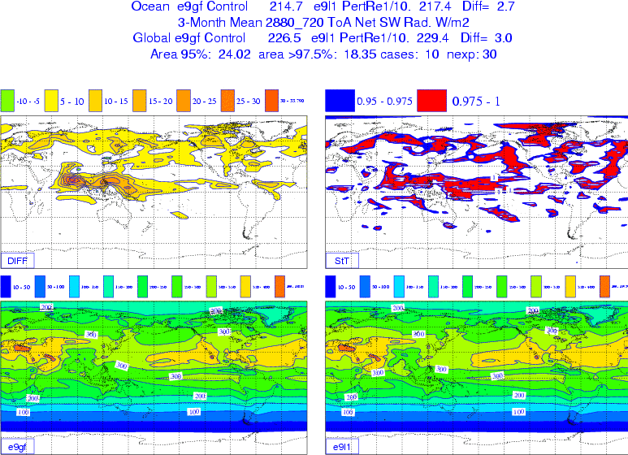
McICA: How does the model deal with radiative noise?
Systematic
perturbation:
Re +1 μm
De +10 μm
T_{L}95 L60 starting
24-hour apart from
20010401 to
20010430
Results averaged
over JJA
Difference Perturb-Control
Student t-test
Ref=Control
Systematic perturbation

Slide 20
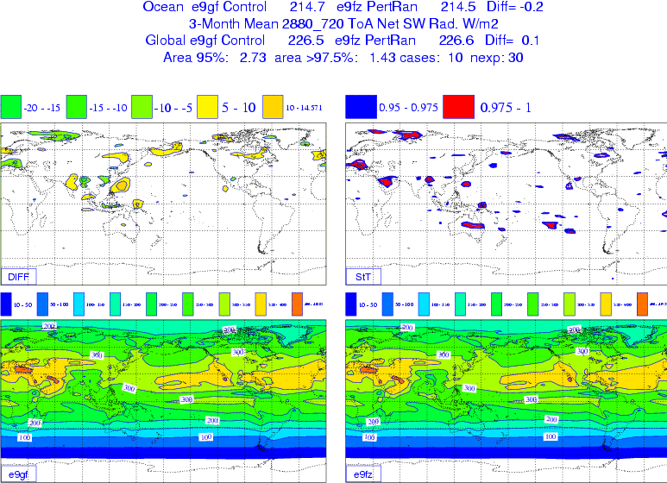
McICA: How does the model deal with radiative noise?
Random
perturbation:
Difference Random-Control
t-test
Uncorrelated random noise applied to radiative fluxes or heating rates does not (significantly) affect the mean circulation

Slide 21
Impact of the change in radiation scheme
Impact in sets of 13-month runs at T_{L}159 L91
Impact in 10-day forecasts at T_{L}799 L91

Slide 22
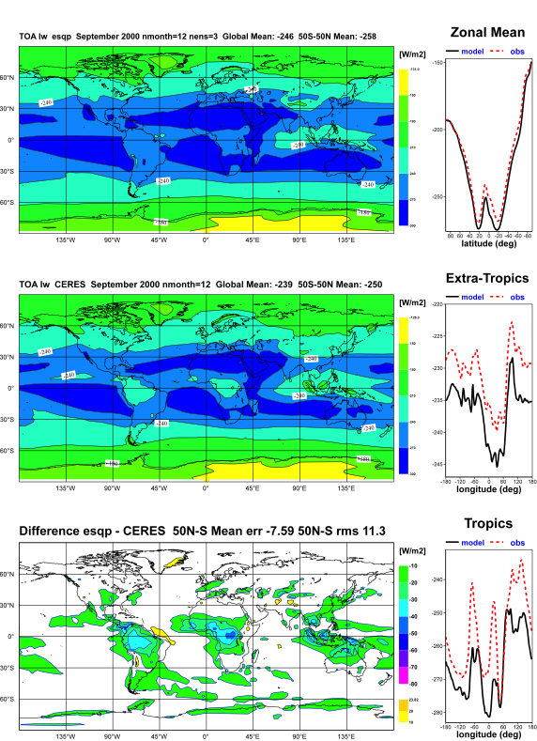
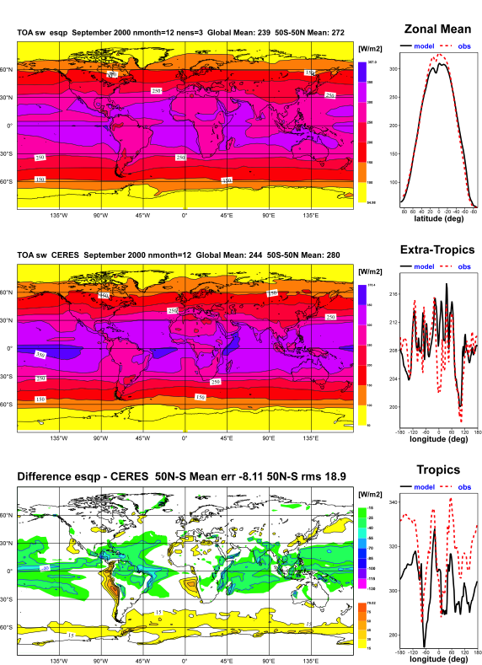
The problem in ECMWF model “climate” runs? Example from 31R1
Outgoing LW Radiation
TOA SW Rad
Lack of cloudiness over tropical continents:
Too large OLR over Africa, South America
Model
Too much cloudiness over tropical oceans
Too much reflection at TOA, too little
downward SW radiation at the ocean surface. Little reflection in stratocumulus regions and close to Antarctica
CERES
Model-CERES

Slide 23
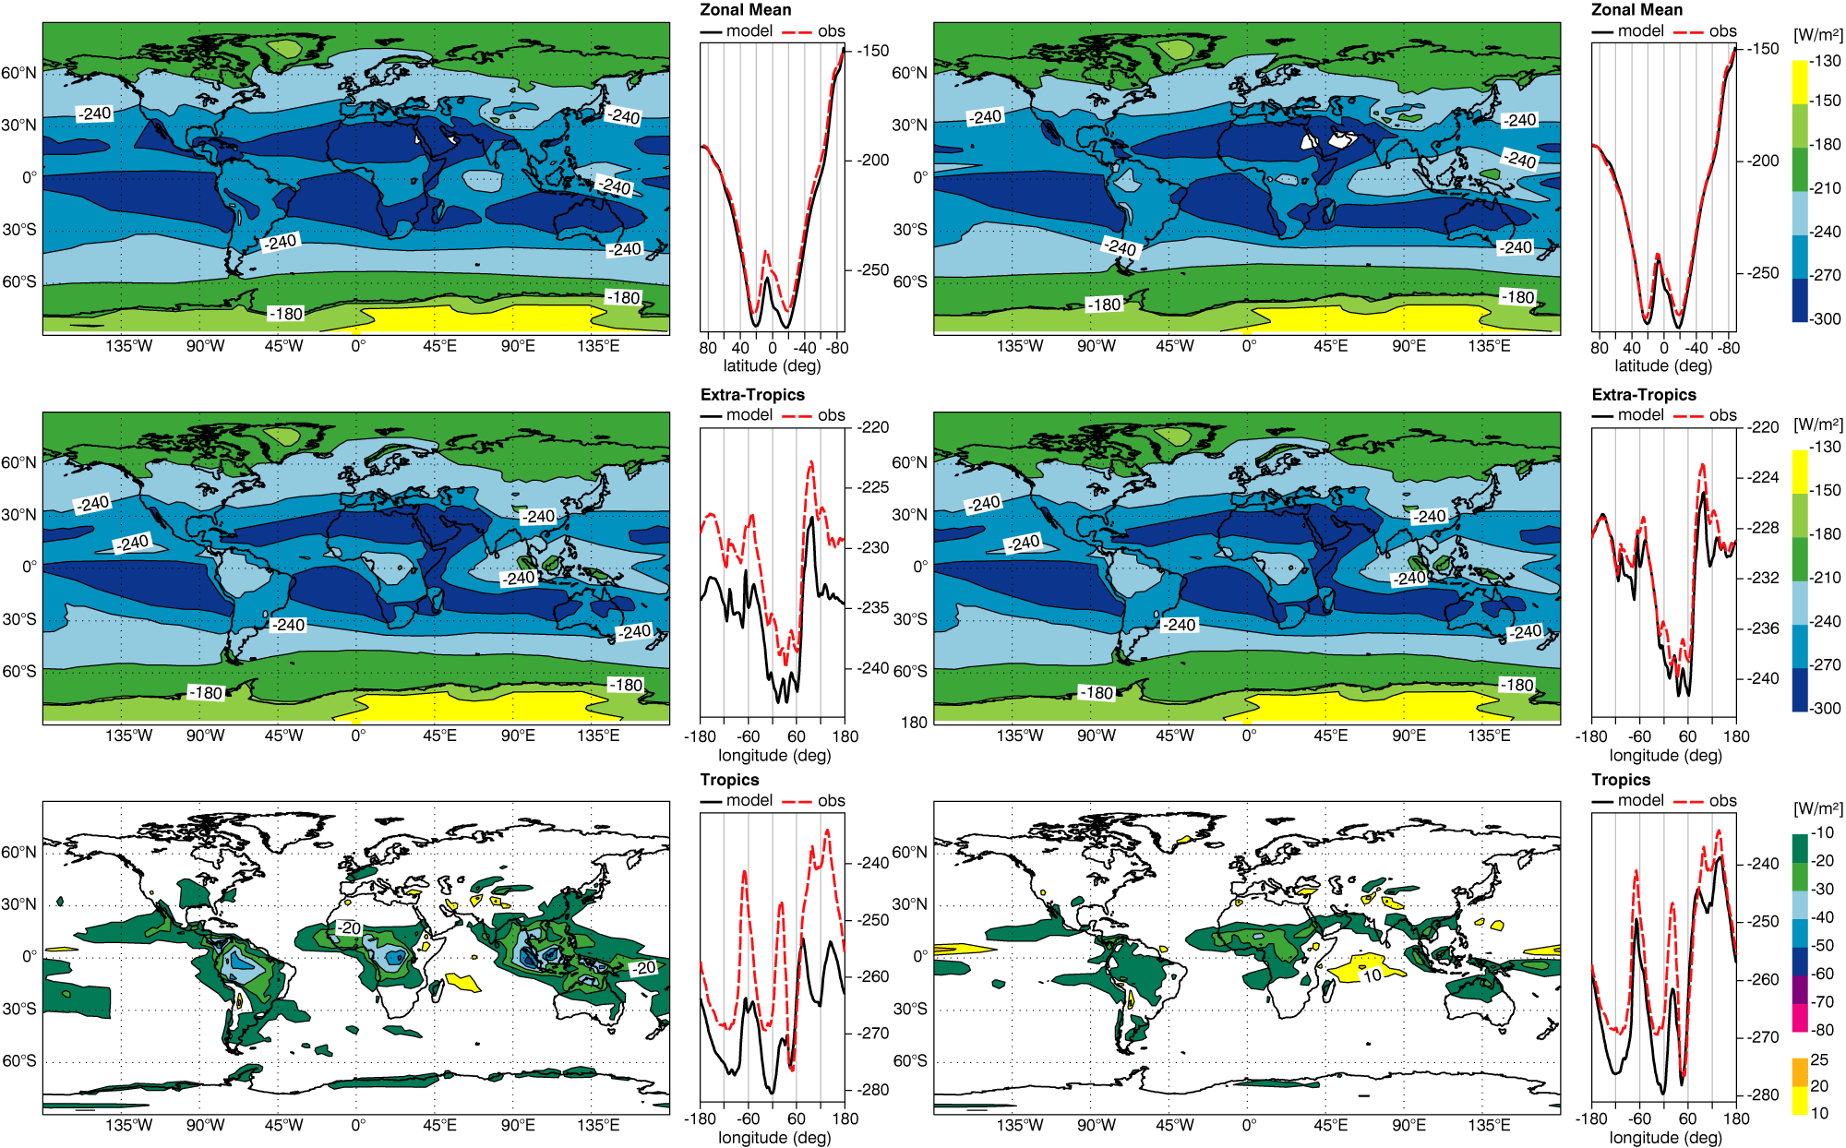
Impact on OLR in ensembles of 1-year simulations
Cy31r2
McRad
CERES
CERES
31r2-CERES
McRad-CERES

Slide 24
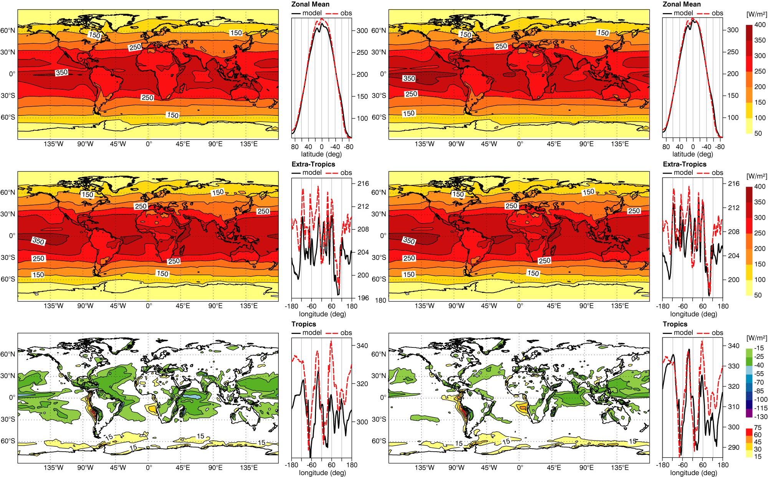
Impact on TOA absorbed SW radiation in ensembles of 1-year simulations
Cy31r2
McRad
CERES
CERES
31r2-CERES
McRad-CERES

Slide 25
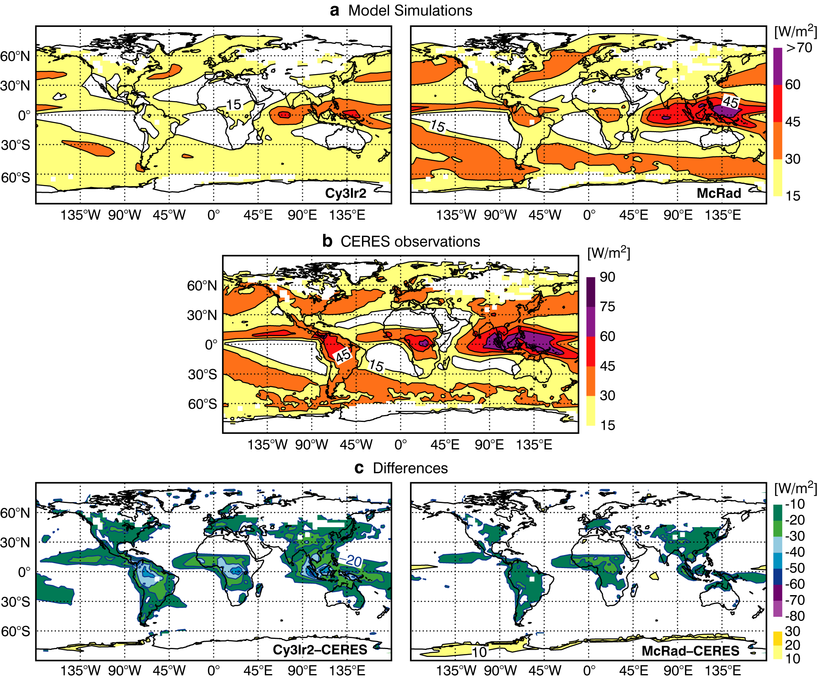
Impact on long-wave cloud forcing in ensembles of 1-year simulations
Much better cloud
LW radiative
effect
at mid-latitudes

Slide 26
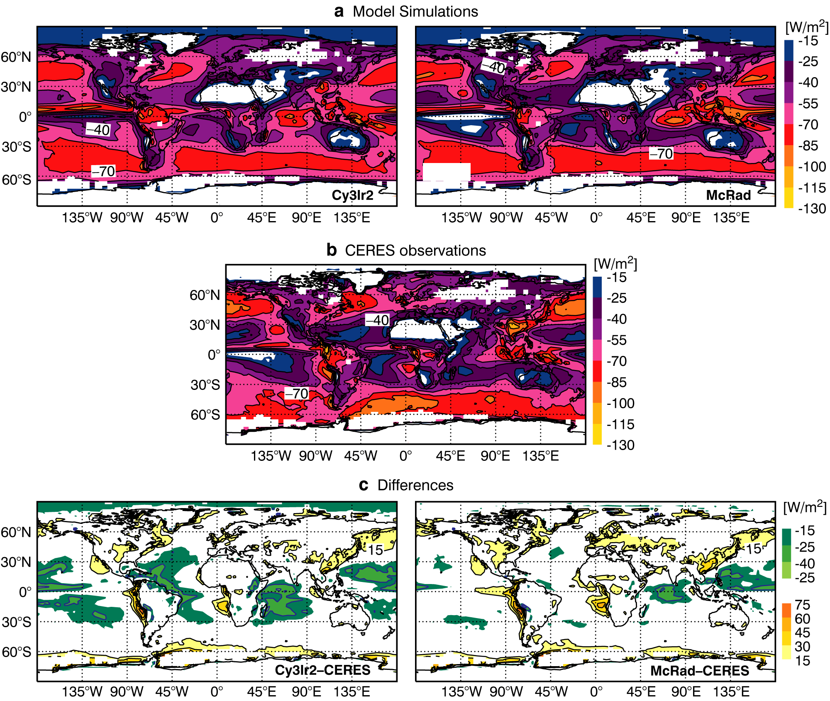
Impact on short-wave cloud forcing in ensembles of 1-year simulations
Better cloud SW
radiative effect
in mid-latitudes

Slide 27
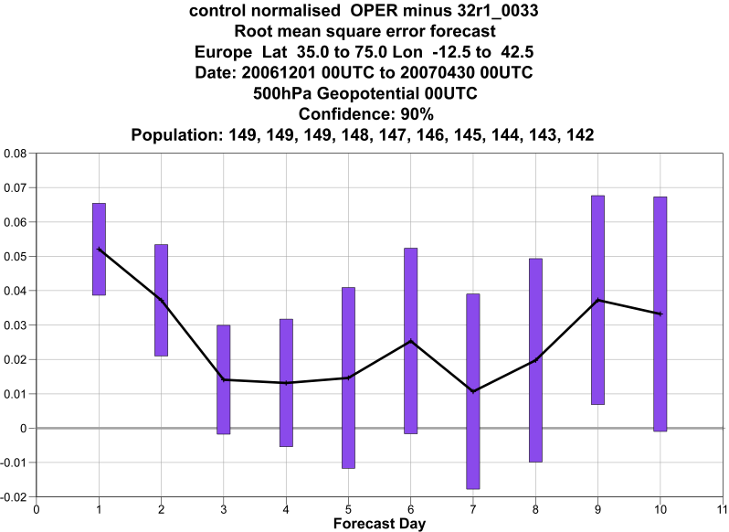
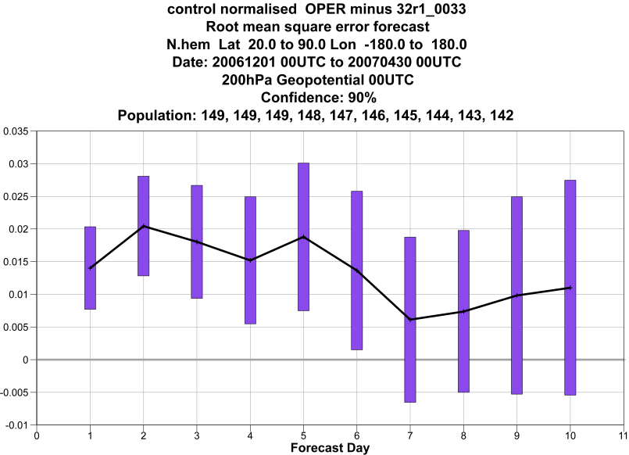
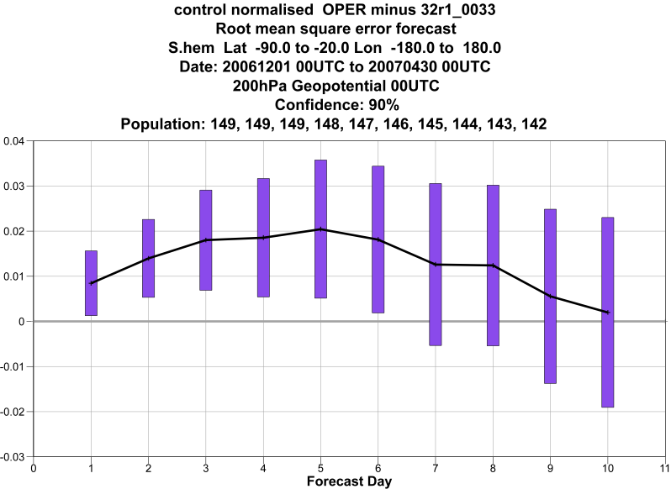
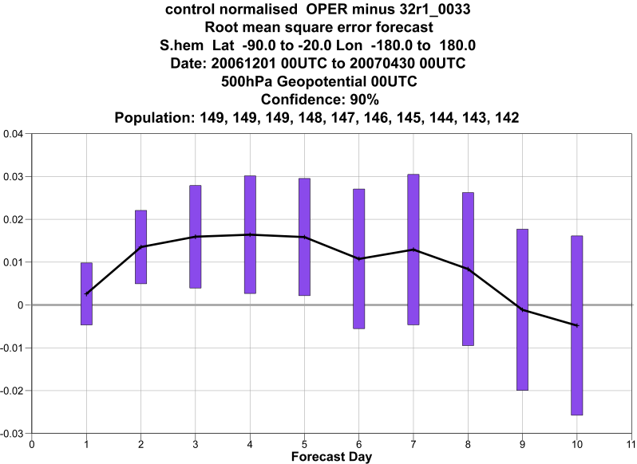
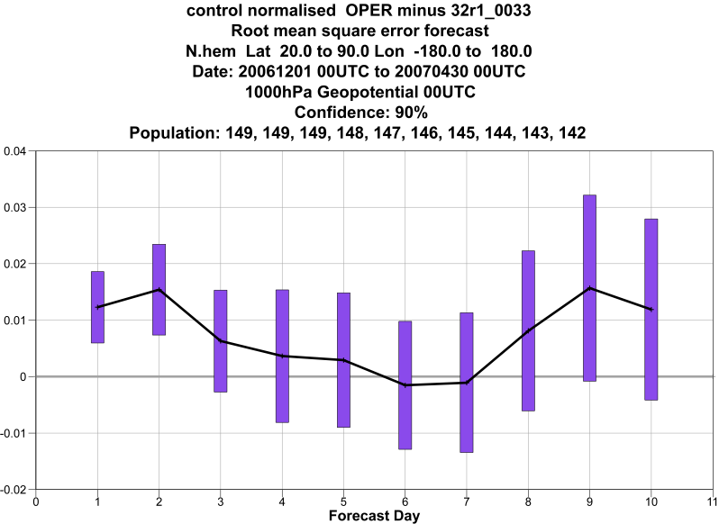
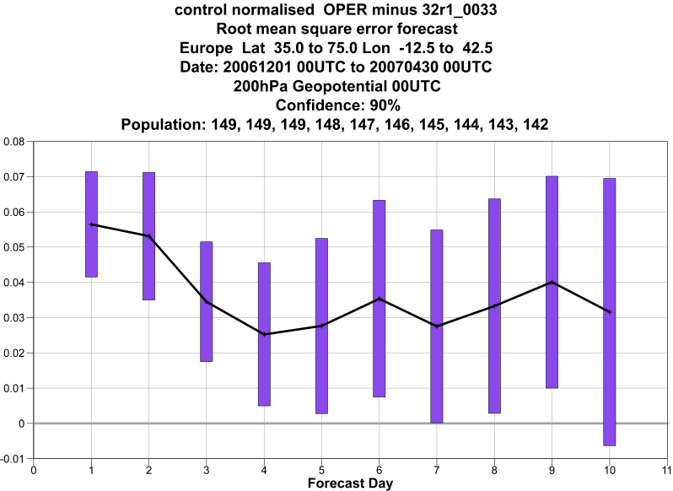
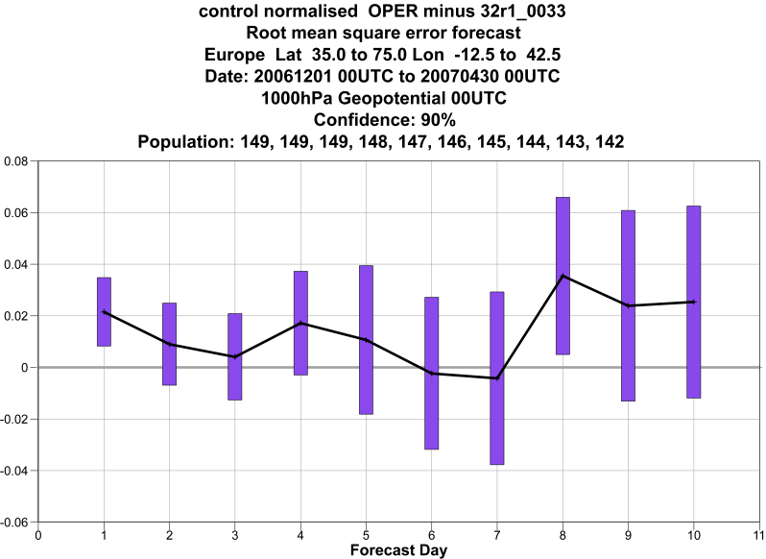
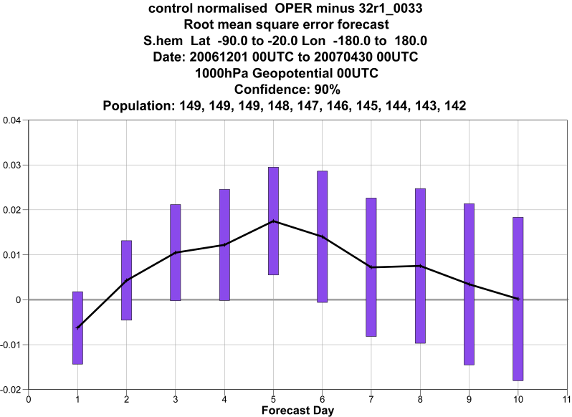
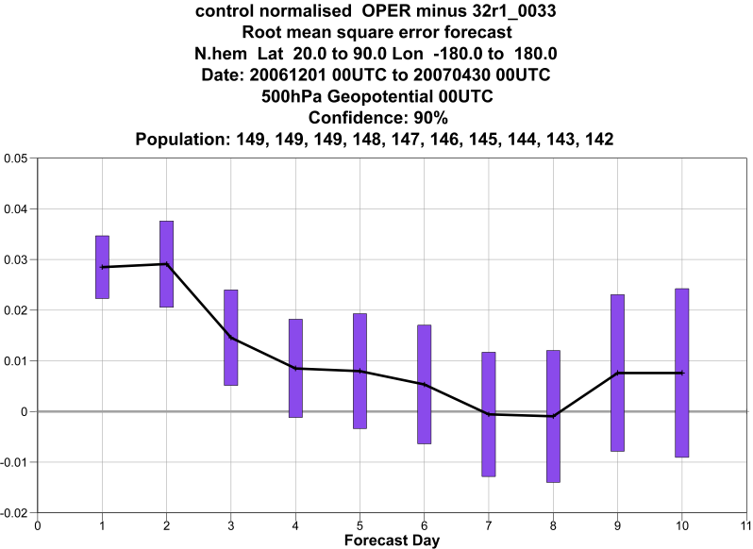
Impact in T_{L}799 L91 10-day FCs Dec’06-Apr’07. RMS GPH
NH 200
Eur 200
SH 200
+
Eur 500
-
NH 500
SH 500
10
NH 1000
Blue line is zero line
SH 1000
0.02 level
Eur 1000

Slide 28
McRAD spatio-temporal resolution
Even if optimised, McRAD is computationally expensive
Operationally, the RT code runs on a spatial grid coarser than the rest of the physics and with a longer time step
  HiRes 10 day forecasts: model Tco1279 (~9 km at the equator) McRAD Tco511 (~20 km). Model time step 10 min, McRAD 1h
  Ensemble forecasts: model Tco639 (~16 km), McRAD Tco255 (~30 km). Model time step 20min, McRAD 3h
LW flux constant between radiation calls, SW flux adjusted for correct solar zenith angle and path length. Minor impact on diurnal cycle, larger for the 3h time step

Slide 29
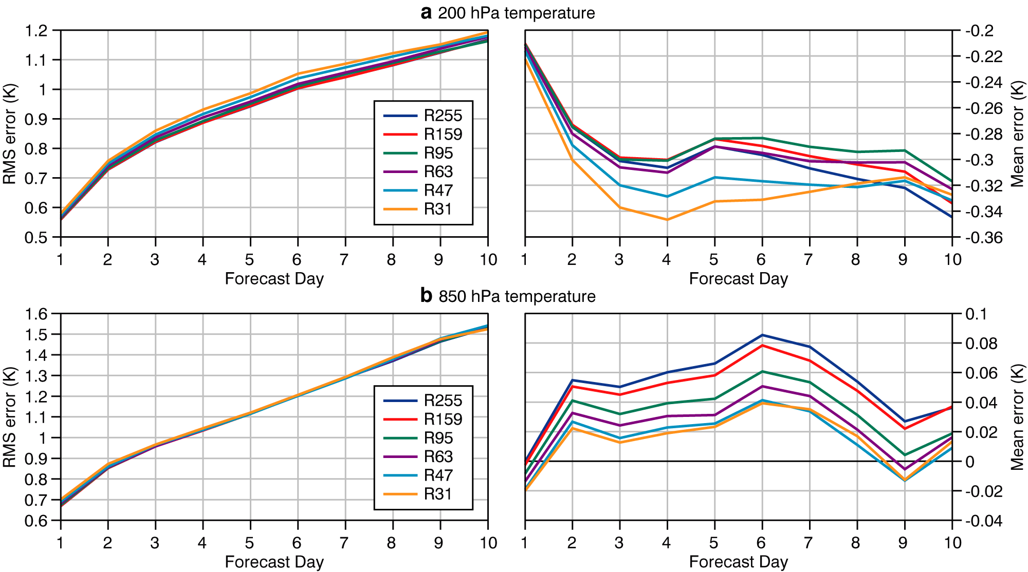
Impact of reduced radiation grid
For 93 FCs at T_{L}399 L62
spanning a year
Tropics: 20ºN-20ºS

Slide 30
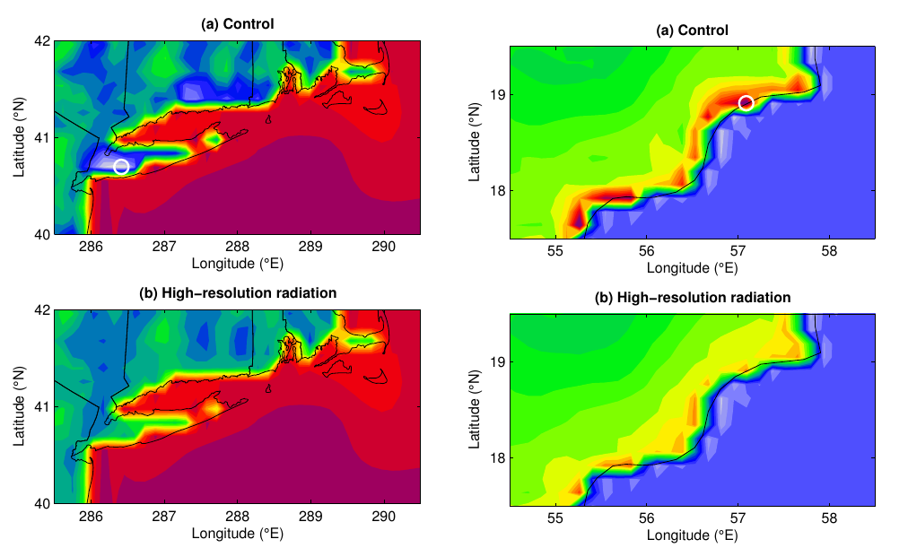
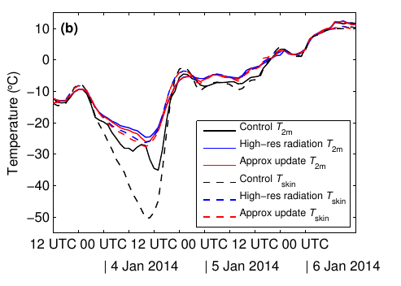
Extreme temperature errors at coastlines a cold case
Approximate solution of the surface energy balance taking into account local albedo and changes in the skin temperature reduces the impact of the coarse radiation grid and time step
Hogan&Bozzo 2015

Slide 31
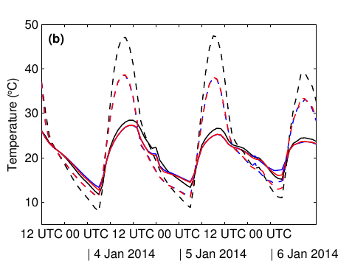
Extreme temperature errors at coastlines
a warm case
Hogan&Bozzo 2015

Slide 32
Solar Zenith Angle between time steps
SZA averaged between time steps: too shallow Sun’s elevation at dusk and dawn -> too large path length -> too large O3 absorption in the stratosphere.
Fix: computing the averaged SZA between time steps but only for the sun lit portion
Larger errors for radiation time step>=3h
Hogan and Hirahara, 2015

Slide 33
Conclusions on McRad
As McRad modifies the cloud-radiation interactions, its impact is felt right from the start of the model integrations.
Thanks to McICA and the revised cloud optical properties, improvements in TOA radiation is seen both in the tropics and at higher latitudes.
Whereas McICA does not increase the computational burden, RRTM_SW does. But RRTM_SW and RRTM_LW share the same heritage: based on the same state-of-the-art line-by-line model (LBLRTM), same database of spectroscopic parameters, and both extensively validated as part of the ARM program.
Going for a lower spatial resolution for full radiation computations does not affect the quality of the high-resolution 10-day forecasts and of the EPS. But biases are introduced in surface fields and these can lead to large errors occasionally

Slide 34
Impact of aerosols radiative forcing on NWP
Small/neutral impact on large scale circulation
Aerosol absorption optical depth
  Reducing column absorption over Arabia improves Indian Summer Monsoon
  Excessive biomass burning in CAMS in Central Africa led to erroneous warming of 0.5-1 K at 850 hPa and a degradation of scores

Slide 35
Aerosol impact on Indian Summer Monsoon
Four estimates of West India rainfall (mm d⁻¹)
OPER overpredicts
CAMS aerosol reduces bias
~20/30% improvement of model bias
OPER 925-hPa zonal wind bias 1 May to 21 Aug 2016
Effect of CAMS aerosol: reduce onshore wind bias

Slide 36
Ongoing developments
New radiation scheme more efficient and ready to test other options (e.g. full-spectrum correlated-k Hogan (2010) , 3D radiative transfer)
Revision of the current aerosol climatology (Tegen et al. (1997), 5 species sea salt,dust,organic,black carbon and sulphates) -> towards interactive aerosols?
Interactive radiative active gases (e.g. Ozone)
Code efficiency improvements. Number of g-points maybe over-dimensioned ? Will need to reduce at least 10x to improve the efficiency. Positive tests with stochastic spectral integration (Pincus and Stevens 2009,2013, Bozzo et al. 2014).

