Slide 1
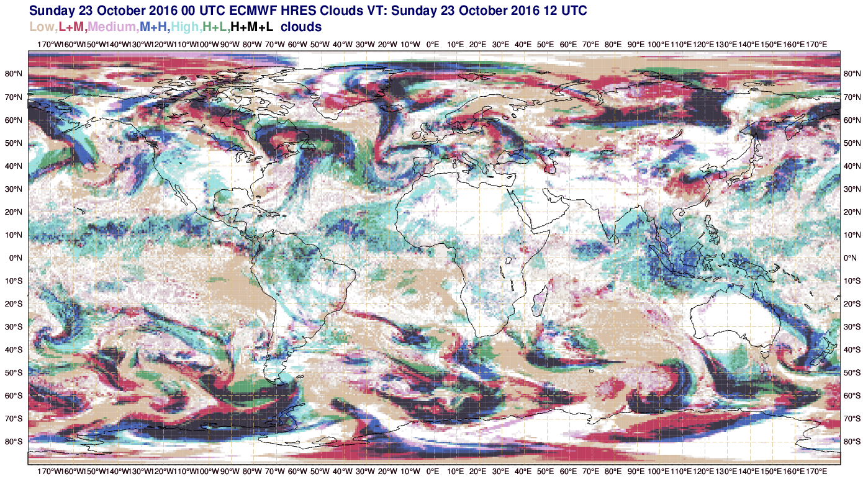
3
3
1
3
3
2
2
1
2

Slide 2
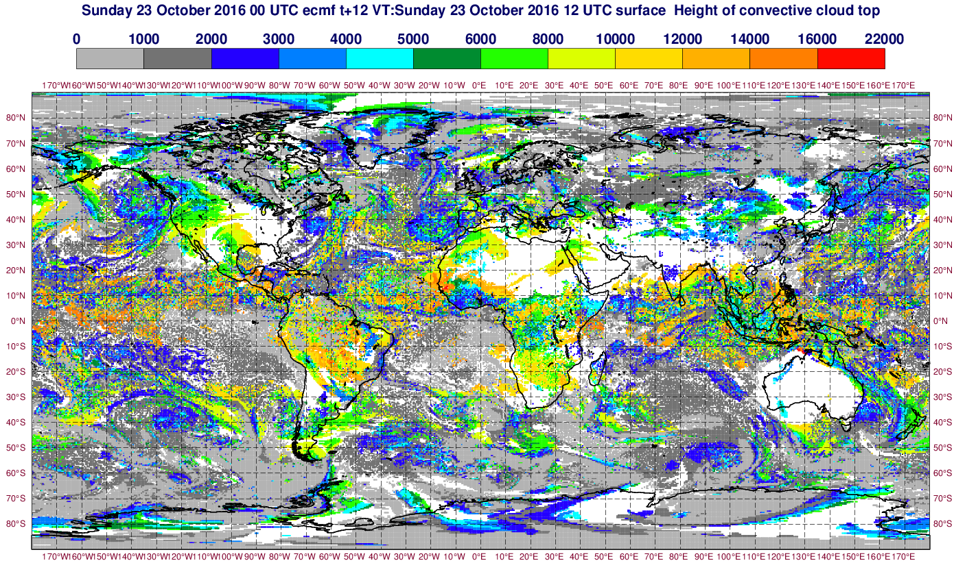
3
3
1
3
3
2
2
1
2

Slide 3
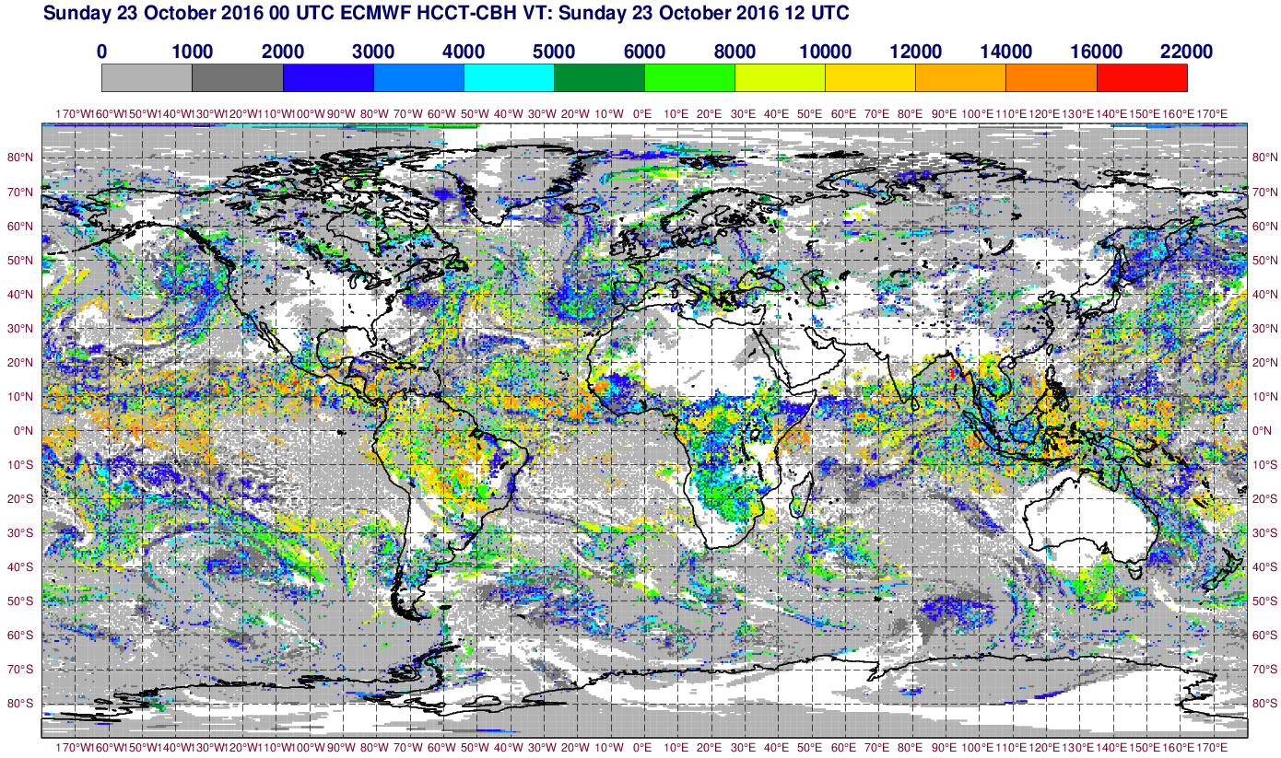
3
3
1
3
3
2
2
1
2

Slide 4
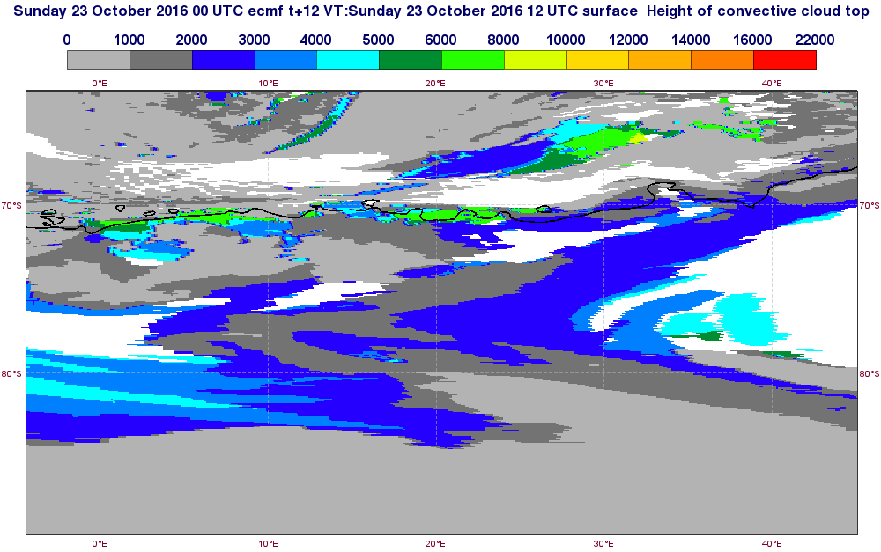
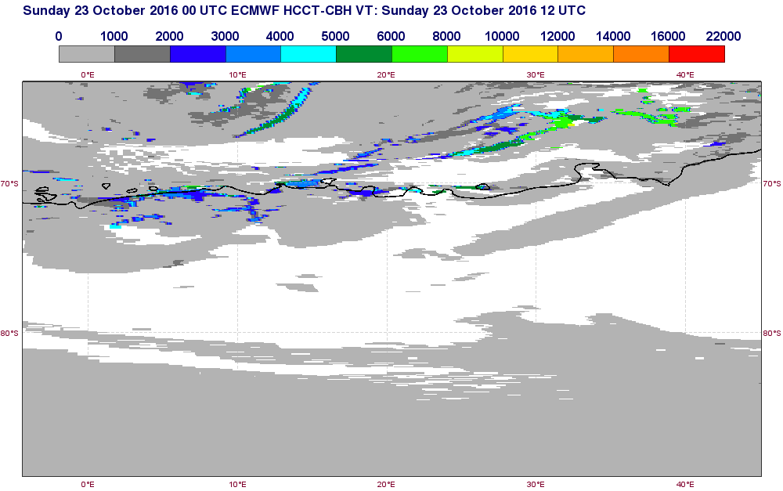
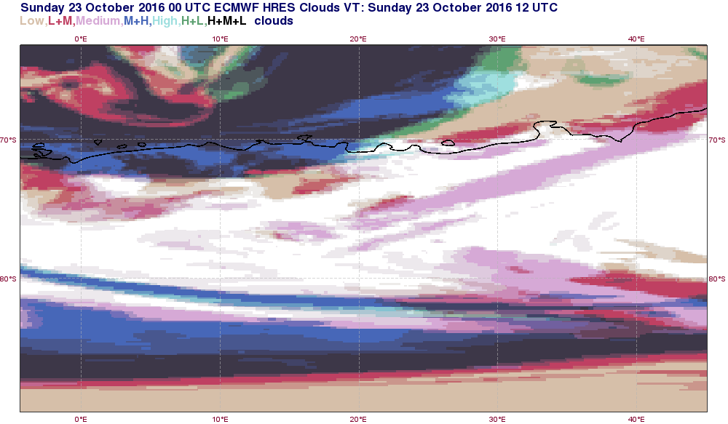
HCCT
HCCT-CBH
CLOUDS

Slide 5
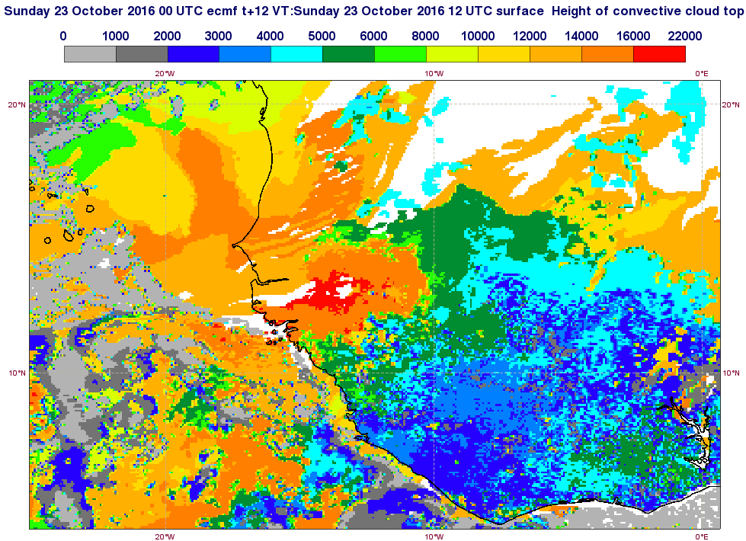
Areas of convectively inactive grid boxes surrounded by thick convective clouds produced by DMC

