Slide 1

MARS – Introduction and basic concepts
Computer User Training Course 2016
Carsten Maass
User Support
advisory@ecmwf.int
© ECMWF September 28, 2016
Notes:
!!!!!!!!!!!!!!!!!!!! RUN EXAMPLES BEFORE PRACTICALS so that data is cached !!!!!!!!!!!!!!!!!!!
MARS is the central system to fulfil our 2nd most important task: archiving all the data we produce and making them available to our users.

Slide 2
Contents
Introduction
Meteorological content
MARS language
Retrieving data
Practicals
Notes:
General overview, key figures
List most important archive content
Learn about the quasi meteorological language to phrase MARS requests
Some knowledge of the architecture should enable us to better understand the execution of a request
How to retrieve data efficiently
Plenty of time for “hands-on”

Slide 3
Introduction
Meteorological Archival and Retrieval System
Meteorological data (GRIB: fields, BUFR, ODB: observations)
Large amount of data (size of archive & number of fields)
Operational & Research environment
Batch & interactive modes
Large number of users with different requirements:
  large datasets rarely ↔ few fields very often
Heterogeneous environment
Notes:
What is special about MARS:
As little downtime as possible (99% available)
Large number of addressable units = high granularity

Slide 4
Terminology – Forecast lead times
Medium-range
  the high-resolution and the ensemble forecasts of weather, at the space and time-scales represented by the relevant model, up to 10 and 15 days ahead, respectively, and the associated uncertainty
Extended-range (monthly)
  ensembles of individual forecasts and post-processed products of average conditions (e.g. weekly averages) up to 46 days ahead, and the associated uncertainty
Long-range (SEAS)
  ensembles of individual forecasts and post-processed products of average conditions (e.g. monthly averages) up to 13 months ahead, and the associated uncertainty

Slide 5
Terminology – … more
Re-forecast
  forecasts run for past decades necessary to estimate the model climate and the level of skill and to generate some of the operational products
www.ecmwf.int/en/what-naming-convention-ecmwf-real-time-products
www.ecmwf.int/en/forecasts/documentation-and-support
Notes:
http://www.ecmwf.int/en/what-naming-convention-ecmwf-real-time-products
http://www.ecmwf.int/en/forecasts/documentation-and-support
http://www.ecmwf.int/en/forecasts/documentation-and-support/key-characteristics-forecasting-system

Slide 6
Meteorological content – HRES
Atmospheric Forecast (10 day forecast based on 00/12 UTC Analysis) at T_{CO}1279 / O1280 L137 (9 km)
  Surface
  Model levels (137)
  Pressure levels (25)
  Isentropic levels (16 PT, 1 PV)
  1 hourly steps from 0 to 90, 3 hourly from 93 to 144 and 6 hourly from 150 to 240 hours
Notes:
Single prediction that uses observations, prior information about the Earth-system, and ECMWF's highest-resolution model.
T1279 since 26 Jan 2010
Hourly steps since 15 Nov 2011
137 levels since 25 June 2013

Slide 7
Meteorological content – ENS
Medium-range forecasts to 15 days, 91 Levels
26 member Ensemble of Data Assimilations (EDA, stream enda)
1 control forecast (as HRES but with lower resolution)
50 different forecasts with perturbed initial conditions
Truncation at day 15 from T_{CO}639 / O640 (18Km) to T_{CO}319 / O320 (~36 km)
Two additional calibration/validation runs were added
www.ecmwf.int/en/forecasts/documentation-and-support/extended-range-forecasts
Notes:
Atmosphere (+wave) and ocean components run coupled in the ENS from the medium to the extended range. (00 and 12 UTC)
The hindcast system consists of a 11-member ensemble of 32-day monthly integrations, starting on the same day and month as the real-time forecast for each of the past 20 years
GRIB headers use ECMWF local extension definition 30
Care is needed when computing differences for flux parameters (quantities accumulated since the beginning of the forecast, e.g. precipitation and snowfall) across the truncation timestep at 360
Hindcasts for 20 years, 11-member ensemble: 20x11-members for the back-statistics.
The resolution of the oceanic component is unchanged from the previous monthly system:
* The zonal resolution is 1.4 degrees.
* The meridional resolution varies from 0.3 degrees in the equatorial region (within 10 degrees of the equator),
smoothly increasing to 1.4 polewards of 30 degrees.
* There are 29 vertical levels.

Slide 8
Meteorological content – ENS products
Control forecast
Calibration/Validation forecasts
50 perturbed forecasts / 26 EDA members
Initial condition perturbations
Ensemble mean and standard deviation
Extreme forecast index
Event probabilities
Cluster mean, cluster representatives and standard deviation
Trajectories (of tropical cyclones)
Notes:
Extreme forecast index control ?
Hindcasts will change with the integration of Monthly Forecast.
With Cy40r1: DCDA, DCWV, ENDA, EWDA discontinued

Slide 9
Meteorological content – Data formats
WMO formats
Fields in GRIB (GRid In Binary), ECMWF local extensions
  Spherical Harmonics (upper-air fields, T1279)
  Gaussian Grid (surface fields, N640)
  Latitude/Longitude (wave and ocean products)
Observations in BUFR (Binary Universal Form Representation)
  Instrument specific
Notes:
ODB-A for observation feedback (since Nov 2011)

Slide 10
MARS language
Mechanism to name fields
Request syntax:
    verb,
    keyword1 = value1,
    … = value2,
    keywordN = valueN
verb: action to be taken (e.g. retrieve, list, read)
keyword: a known MARS variable, e.g. type or date
value: value assigned to the keyword, e.g. Analysis or temperature
Notes:
MARS language is also used by product generation / dissemination

Slide 11
MARS language
verb and keyword=value (multiple keywords are comma separated)
Spaces and tab characters are ignored
*, ! and # indicated commented line
Directives are not case sensitive
Values: predefined names, numeric values or strings (filenames)
Abbreviations: enough letters to uniquely identify keyword or value
Acronyms: usually initial letters of names
/ is used as list separator → specify pathnames in quotes

Slide 12
MARS language – Retrieve request
retrieve, action
    class = od, identification
    stream = oper,
    expver = 1,
    date = -3, date & time related
    time = 12,
    type = analysis, data related
    levtype = model levels,
    levelist = 1/to/137,
    param = temperature,
    grid = 2.5/2.5, post-processing
    target = “analysis” storage

Slide 13
MARS language – Identification of archive
class | ECMWF classification (od, rd, e4, …)
stream expver domain origin system method | originating forecasting system or (oper, wave, enfo, seas, …) version of the experiment (01 operational, 11, aaaa) area covered by the data (Global, Mediterranean, …) originating centre of the data (kwbc, egrr, …) seasonal forecast operational system (1, 2, 3) to specify how the seasonal forecast is produced, e.g. in System 2, method=0 for runs without ocean assimilation (0, 1, …, 3)
Notes:
Domain vs. area
Kwbc=Washington, egrr=MetOffice

Slide 14
MARS language - Date & time
time | base time or observation time (00, 06, 09:30, …)
date | base date of the model (-1, 20010225, …)
step | forecast time-step [hours] from base time (12, 24, 240, …)
reference | reference forecast time step for ENS cluster (96,…)
refdate | date of real-time forecast associated to re-forecast/hindcast (stream=mnfh)
hdate | base date of a re-forecast/hindcast (stream=enfh)
range | observations: period in minutes from base time (360,…) ocean fields: extension of the time series/average
fcmonth | month from seasonal forecast base date (1, 6, …)
fcperiod | period, in days, for an averaged field (26-32)
Notes:
Refdate for (old) monthly FC. hdate for VarEPS hindcasts.

Slide 15
MARS language – Fields
type | type of field (an, fc, …)
levtype | type of level (pl, ml, sfc, pt, pv)
levelist | levels for the specified levtype (off if levtype=sfc)
param | meteorological parameter (t, temperature, 130, 30.128)
number | ensemble member (1, 2, …)
channel | brightness temperature frequency band
diagnostic, iteration | sensitivity forecast products
frequency, direction | 2-d wave spectra products
product, section, latitude, longitude | ocean products

Slide 16
MARS language – Storage
target | UNIX pathname where retrieved data is stored
source | UNIX pathname from where to read data
fieldset | temporary storage; can be considered a MARS variable
Unix pathnames (using /) have to be enclosed in quotes, e.g.
  target = “/scratch/ms/gb/uid/analysis”
Notes:
Multi-target: [] to use grib_api keys , e.g. for paramID (so that the output is uniform).

Slide 17
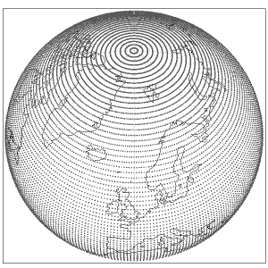
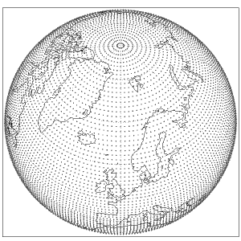
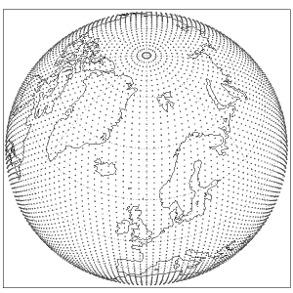
MARS language - Post-processing (1/2)
grid | output grid mesh Latitude/longitude increments in degrees (2.5/2.5) Type and resolution of Gaussian grid, e.g. grid = F320 – full (or regular) Gaussian grid grid = N320 – ECMWF original reduced Gaussian grid (only selected resolutions supported) grid = O320 – ECMWF octahedral (reduced) Gaussian grid All above with 320 latitude lines between the pole and equator
F80 regular (or full)
N80 original reduced
O80 octahedral reduced
Notes:
The Gaussian grids are defined by the quadrature points used to facilitate the accurate numerical computation of the integrals involved in the Fourier and Legendre transforms. The grids are labelled by N where N is the number of latitude lines between the pole and the equator. For example, for the N=640 Gaussian grid, there are 640 lines of latitude between the pole and the equator giving 1280 latitude lines in total.
The grid points in latitude, θk , are given by the zeros of the Legendre polynomial or order N: P N 0 (μk=sinθk) = 0. A consequence of this is that a Gaussian grid has:
latitude lines which are not equally spaced;
no latitude points at the poles;
no line of latitude at the equator;
latitude lines which are symmetric about the equator.
Regular (or full) Gaussian grid
A regular Gaussian grid has the following characteristics:
there are 4N longitude points along each latitude circle;
each latitude circle has a grid point at 0o longitude;
the longitudinal resolution in degrees is 90o/N;
the points get closer together (i.e. more crowded) as the latitude increases towards the poles;
the total number of grid points is 8N2.
Reduced (or quasi-regular) Gaussian grid
A reduced Gaussian grid:
has the same number of latitude lines (2N) as the corresponding regular Gaussian grid;
has a grid point at 0o longitude on each latitude circle;
has a decreasing number of longitude points towards the poles;
has a quasi-regular grid spacing in distance at each latitude;
provides a uniform CFL (Courant–Friedrichs–Lewy) condition.
Up to IFS cycle 41r1, ECMWF has used a original reduced Gaussian grid. This has 4N longitude points at the latitude nearest to the equator, with the number of longitude points reducing in blocks as the latitudes approach the poles.
With the planned horizontal resolution increase, ECMWF introduces a slightly different form of the reduced Gaussian grid which is referred to as the octahedral reduced Gaussian grid or, more simply, the octahedral grid.

Slide 18
MARS language - Post-processing (2/2)
area | desired sub-area in degrees (north/west/south/east)
frame | number of grid points from sub area inwards (5)
resol | triangular truncation (319, auto, av)
rotation | lat/lon of South Pole
accuracy | number of bits per data value in GRIB (16)
style | specify post-processing style (dissemination)
Notes:
Area vs. domain
Style: When STYLE=dissemination, remove automatic truncation.
Postprocessing in dissemination starts from 0.125/0.125 grid and only multiples of this can be requested.
Nov 04: Relinked with new libemos 264, now more aware of style=dissemination

Slide 19
MARS language – Values
Single value, predefined names, numbers, mnemonics
  param = temperature
List of values, separated by /
  step = 12/24/48
Range of values, using keywords: to, / and by
  date = 20020101/to/20020131
  step = 24/to/240/by/24

Slide 20
MARS language – Values
Expected number of fields is computed by multiplying number of values after expansion of ranges
  date = 20020101/to/20020131 31 fields
Certain keywords accept all as valid value
  levelist = all
Most keywords accept off as valid value
  levtype = surface,
  levelist = off
Not all possible combinations keyword = value name an archived field

Slide 21
Request examples - Ensemble forecast
Retrieval of surface temperature and 10-m wind components (U and V), 20 first members of the EPS for 2nd Jan 2001 for time steps 12, 36 and 60. It retrieves 180 fields.
retrieve,
    class = od,
    stream = enfo,
    expver = 1,
    date = 20010102,
    time = 12,
    step = 12/36/60,
    type = pf,
    levtype = sfc,
    param = st/10u/10v,
    number = 1/to/20,
    target = “perturbed.sfc”

Slide 22
Request examples – Operational analysis
Retrieval of sea surface temperature for first 10 days of May 2002, all synoptic times. It retrieves 40 fields.
retrieve,
    class = od,
    stream = oper,
    expver = 1,
    date = 20020501/to/20020510,
    time = 00/06/12/18,
    type = an,
    levtype = sfc,
    param = sea surface temperature,
    target = “sst”

Slide 23
Retrieving data – Calling MARS in a script
directives from input stream
directives from file
mars <<EOF
retrieve,
type = an,
date = -1,
target = “$SCRATCH/my_an”
EOF
cat > my_request <<EOF
retrieve,
type = an,
date = -1,
target = “$SCRATCH/my_an”
EOF
mars my_request

Slide 24
MARS Practical
Point your browser to
or on software.ecmwf.int navigate to
  User Documentation > MARS user documentation > MARS example requests
and follow the instructions
software.ecmwf.int/wiki/display/UDOC/MARS+example+requests

Slide 25
Retrieving data – Hints
Avoid default values, if possible
Be aware that there is only a syntax check, you may still have a request that does not describe any archived data.
Check the MARS output to discover possible problems with the retrieval
  INFO request execution and report
  WARNING unusual aspect of execution
  ERROR system or data errors
  FATAL terminates execution

Slide 26
Parameter database - apps.ecmwf.int/codes/grib/
GRIB table based view
Links to IFS documentation
Links to comprehensive list of class, stream and type
https://software.ecmwf.int/wiki/display/GRIB/Documentation
Notes:
NetCDF download (conversion) on-the-fly.
Parameter database will be integrated into MARS catalogue.

Slide 27
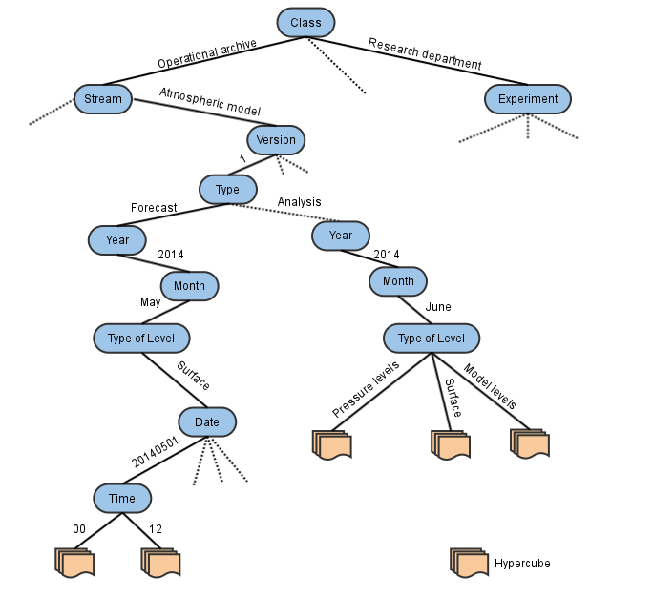
Retrieving data - MARS tree
Notes:
Smallest database object is 1 file = hypercube = last page in webmars catalogue browser
Hypercube contains multiple fields.
Smallest addressable unit is 1 field,

Slide 28
Additional resources
MARS documentation
software.ecmwf.int/wiki/display/UDOC/MARS+user+documentation
FAQ
http://www.ecmwf.int/search/faqs
ECMWF real-time datasets www.ecmwf.int/en/forecasts/datasets

