Slide 1

TIGGE Status
PDEF5 3-5 Sept 2019
Manuel Fuentes
Chair TIGGE Panel
Manuel.Fuentes@ecmwf.int
With thanks to Richard Mladek (ECMWF), FeiFei Yang (CMA), Doug Schuster (NCAR) + all TIGGE Partners

Slide 2
Outline
TIGGE (& S2S) Database status
Plans
Actions from PDEF4 (9-12 Oct 2018)

Slide 3

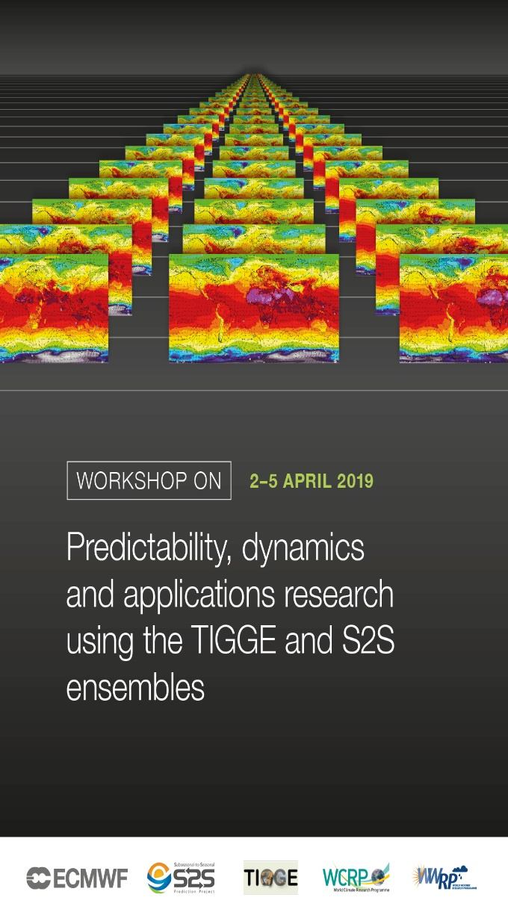
TIGGE-S2S Workshop – April 2019
Workshop on Predictability, dynamics and applications
research using the TIGGE and S2S ensembles
ECMWF, Reading, 2-5 April 2019
To bring together the users and data providers of the
TIGGE and S2S databases around the following themes:
Database technical development
Predictability and Dynamics
Prediction and Verification
Multi-Model approaches to prediction
Application Studies
https://www.ecmwf.int/en/learning/workshops/workshop-predictability-dynamics-and-applications-research-using-tigge-and-s2s-ensembles

Slide 4
Similar web infrastructure & user experience
TIGGE
S2S
Corporate Website | http://tigge.ecmwf.int/
Technical Website | http://confluence.ecmwf.int//display/TIGGE
Data Portal | http://apps.ecmwf.int/datasets/data/tigge/
History | http://apps.ecmwf.int/datasets/history/tigge-prod/
Usage statistics | http://confluence.ecmwf.int/display/TIGGE/Usage+statistics
Corporate Website | http://s2s.ecmwf.int/
Technical Website | http://confluence.ecmwf.int//display/S2S/
Data Portal | http://apps.ecmwf.int/datasets/data/s2s/
History | http://apps.ecmwf.int/datasets/history/s2s-prod/
Usage statistics | http://confluence.ecmwf.int/display/S2S/Usage+statistics

Slide 5
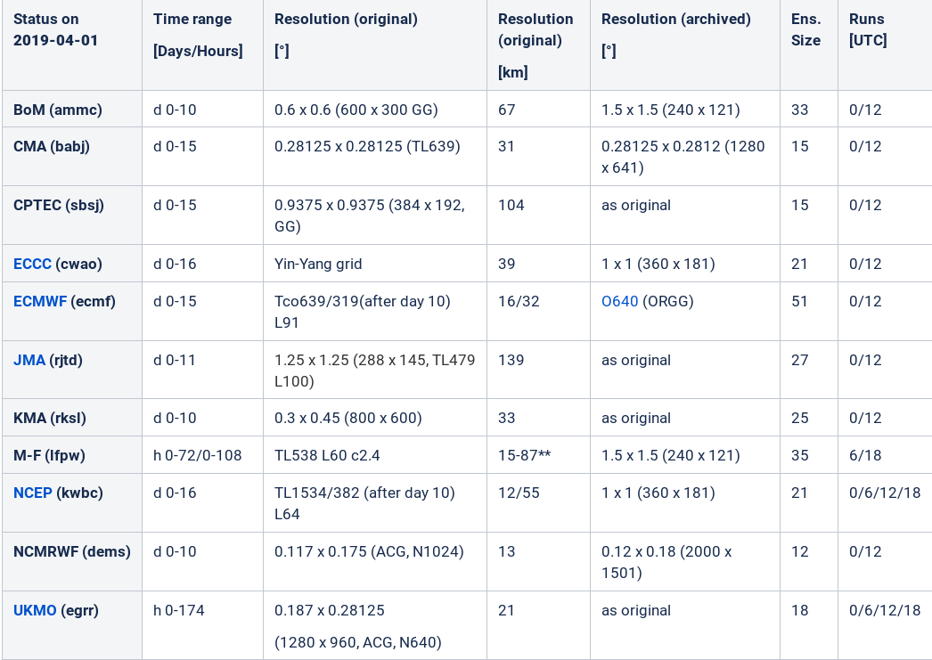
Summary of TIGGE Database configurations

Slide 6
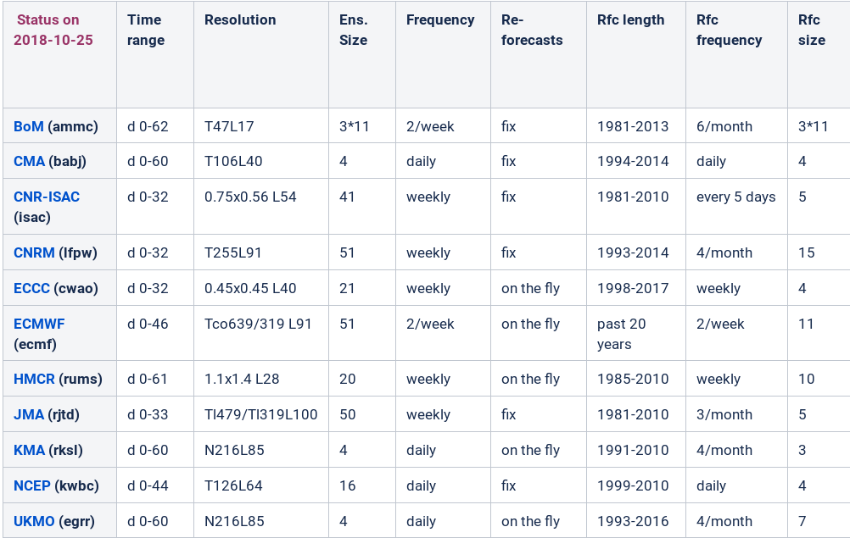
Summary of S2S Database configurations

Slide 7
TIGGE usage: aggregate of all Archive Centres

Slide 8
TIGGE: Number of active users per month

Slide 9
Usage of Tropical Cyclone Tracks from NCAR Archive
https://rda.ucar.edu/datasets/ds330.3/

Slide 10
TIGGE & S2S databases: status (March – Aug 2019)
Contents | TIGGE | S2S
Archive size | 3.3 PiB 3.4 PiB | 98 TiB 101 TiB
Number of fields | 7 billion | 2 billion
Time span | 2006-present (13 years) | 2015-present (4+ years)
Activity @ ECMWF | TIGGE (since 2014) | S2S (since 2015)
Nr active users | 3122 3266 | 1094 1202
Delivered data | 437 TiB 510 TiB | 496 TiB 605 TiB
Delivered fields | 9,952,064,925 | 14,592,148,484
Nr requests | 6,586,637 | 10,813,658
Volume data on disk | 170 TiB (5%) 167 TiB (4.7%) | 77 TiB (80%) 85 TiB (84%)

Slide 11
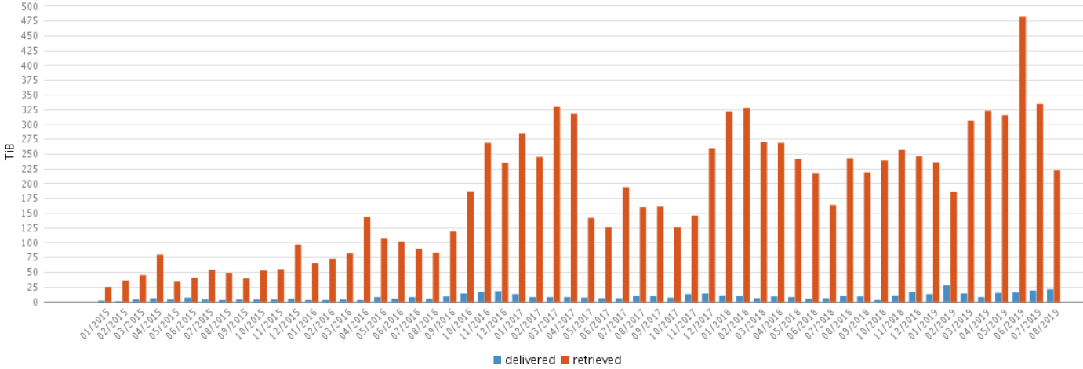
TIGGE Database @ ECMWF: Activity
Retrieved data volumes per month
  Volume of data retrieved from MARS before post-processing vs volume of data delivered to users after post-processing data volumes
  Volume of data retrieved from MARS before post-processing vs volume of data delivered to users after post-processing.

Slide 12
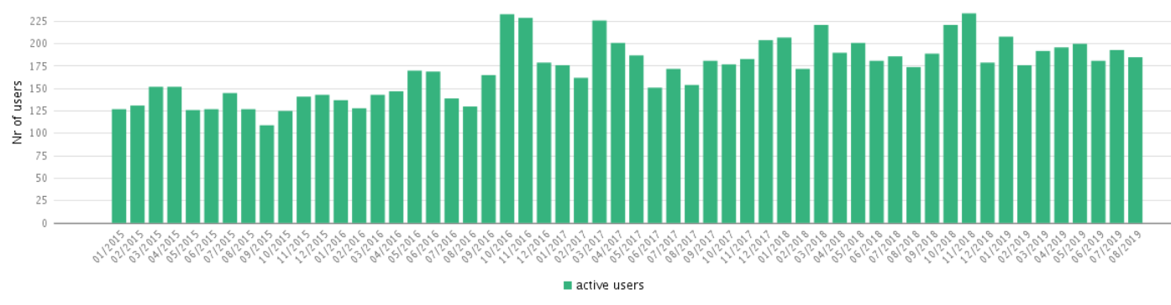
TIGGE Database @ ECMWF: Number of active users

Slide 13
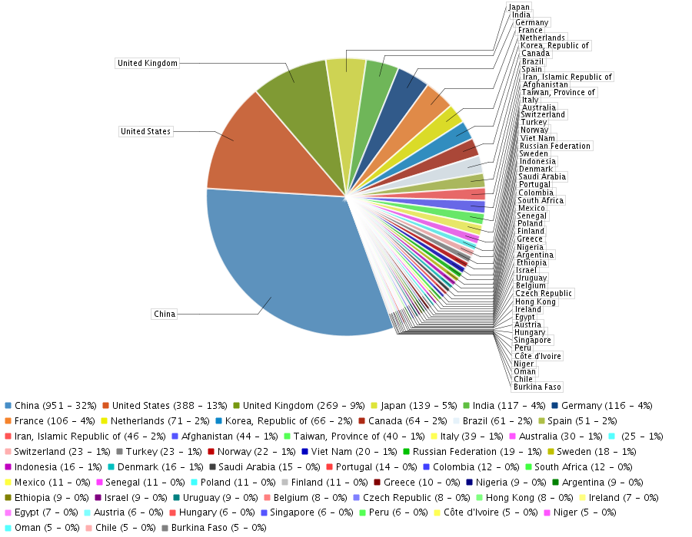
TIGGE Database @ ECMWF: User distribution

Slide 14
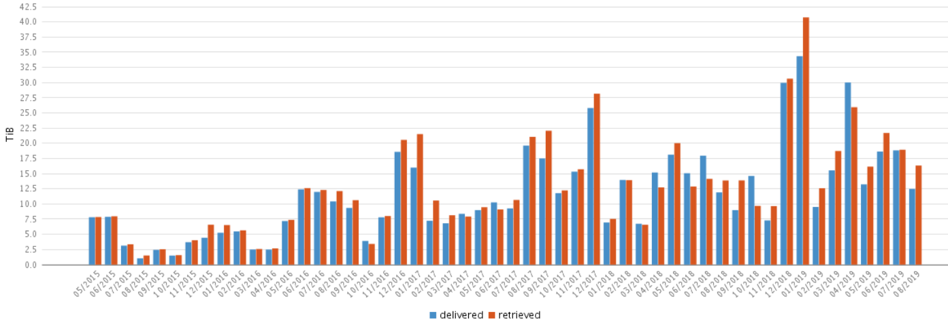
S2S Database @ ECMWF: Activity
Retrieved data volumes per month
  Volume of data retrieved from MARS before post-processing vs volume of data delivered to users after post-processing data volumes
  Volume of data retrieved from MARS before post-processing vs volume of data delivered to users after post-processing.

Slide 15
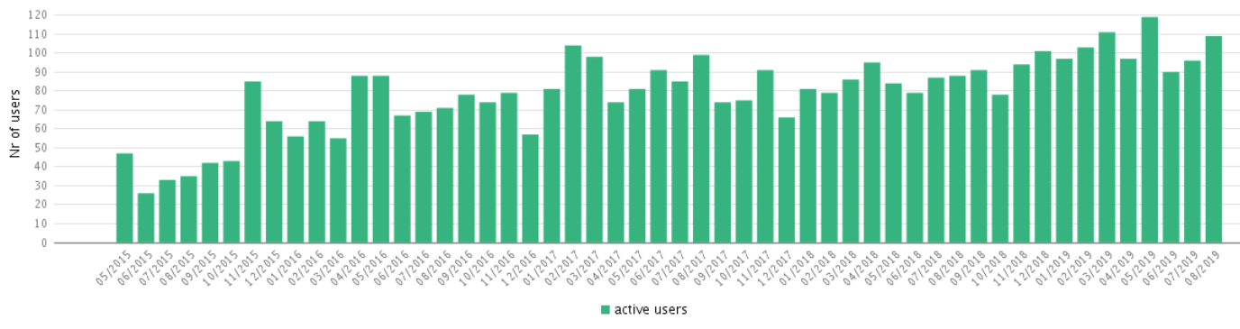
S2S Database @ ECMWF: Number of active users

Slide 16
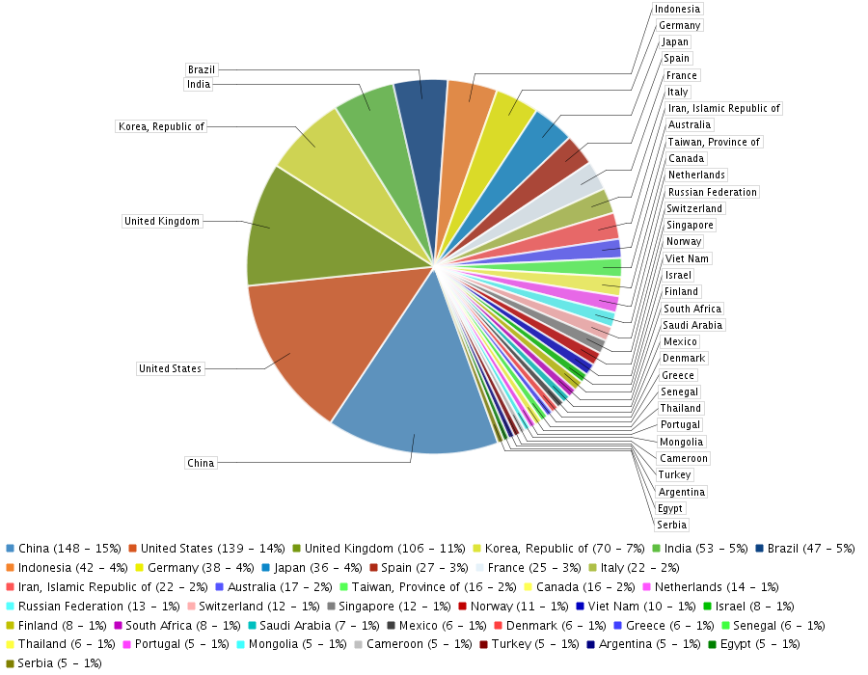
S2S Database @ ECMWF: User distribution

Slide 17
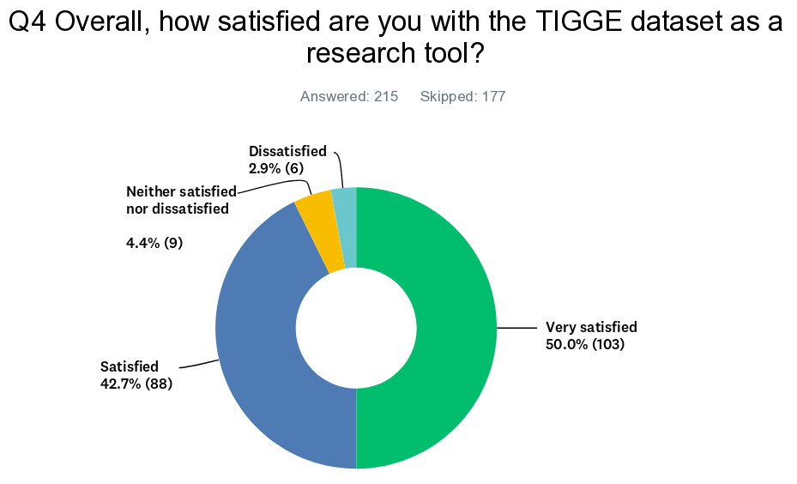
TIGGE User Survey (2018)
Sent to 3,791 registered users, received 383 replies (10.3%)
Percentage of replies:
  93% used TIGGE
  12% used TIGGE-LAM
  17% used TIGGE tropical cyclone tracks (in CXML format)
Quick summary TIGGE (gridded data) related:
  overall, 93% satisfied or very satisfied with TIGGE datasets as a research tool
  87% at least satisfied with exploring the data via the dedicated web Data Portals
  85% at least satisfied with the Web API interface to get the data programmatically
  86% at least satisfied with the TIGGE documentation
  almost 50 additional research articles identified (out of 270 in total)
Full report available:
  https://confluence.ecmwf.int/display/TIGGE/Related+research

Slide 18
TIGGE & S2S Timeline
Definition phase
Implementation phase
S2S Phase II
S2S Phase I
TIGGE Phase III
TIGGE Phase II
TIGGE Phase I
2005
2006
2013
2014
2018
2019
2023

Slide 19
Future plans
TIGGE Phase III: 2019 – 2023
  Get official confirmation from all TIGGE partners to continue (Oct 2019)
  Additions to TIGGE
    BoM resume their contribution (Q4 2019)
    DWD Icon-EPS (Q4 2019)
    Deterministic forecasts at TIGGE resolution ?
S2S Phase II: 2019 - 2023
  Add Ocean variables (Q3 2019)
  Add more models to S2S: NASA GMAO (Q4 2019)
  Pilot Realtime projects (Nov 2019)
ECMWF Data Centre move to Bologna will cause disruption (Q2 2020)

Slide 20
Actions from PDEF4 Tokyo (9-12 Oct 2018)
Challenge 2: Construction of ensembles
Action 3.2: TIGGE
3.2.2: Write a letter from WWRP to operational centres contributing to TIGGE which re-iterates the ongoing value of the TIGGE dataset in research.
  Stage 1 is to make clear the value of TIGGE in research (and R2O) and to argue for a representative on TIGGE Panel and invite them to TIGGE/S2S workshop. ☑
  Stage 2 – following workshop, write from WMO to op centre leader (PR) to request continuation of contribution to TIGGE until end of 2023. ☒ (in progress)
  https://confluence.ecmwf.int/display/TIGGE/Letter+to+TIGGE+partners
3.2.5: Re-instate the TIGGE Panel with a chair (a member of PDEF WG) and one person from each contributing operational centre who is responsible for data transfer. ☑
3.2.9: Modify the CMA portal in a consistent way with translation into Mandarin. ☒ (in progress)
3.2.10: Send an electronic survey to existing TIGGE users. ☑
  https://confluence.ecmwf.int/display/TIGGE/User+survey

Slide 21
Actions from PDEF4 Tokyo (cont)
Action 3.3: TIGGE-LAM… ☑ => service discontinued June 2019
Action 4.5: Engage with CMA, encouraging the use of TIGGE in ensemble research. ☑ ???
Action 4.6: Organise joint workshop with S2S on “Predictability, Dynamics and Applications Research using the TIGGE and S2S Ensembles” at ECMWF, 2-5 April 2019. ☑
Action 4.7: Continue compilation of publication statistics of research using TIGGE and TIGGE-LAM data. Use Web of Science and Google Scholar to compile stats on publication referencing TIGGE. Also use TIGGE survey results. ☑ (in progress)
Action 4.9: Work to get high resolution operational forecasts (sub-sampled) submitted to TIGGE alongside the operational ensembles. Would be very useful in evaluation ☒

Slide 22
Thank you for your attention!

