Slide 1
Time stepping schemes for atmospheric modelling: alternatives to SLSI method
by Michail Diamantakis (room 2107; ext. 2402)
michail.diamantakis@ecmwf.int

Slide 2
Factors influencing choice of time scheme
Type of equation model
  Hydrostatic/Anelastic/Non-Hydrostatic
Type of computer architecture
    Techniques relying heavily on global communication are unaffordable on Massively Parallel architectures
Type of numerical model/resolution/grid
  LAM: very high resolution but no pole problem
  Global: lower resolution but poles are present
    Regular lat/lon grids have very high res at poles
    Reduced/quasi-uniform/unstructured grids: uniform resolution across the globe

Slide 3
Atmospheric model (equation) formulations
Hydrostatic approximation
  vertically propagating sound waves filtered ⇒ no stability problems associated with very large acoustic CFL numbers in the vertical (simply don’t exist)
  Sufficient for relatively coarse global resolutions (≥ 10km)
Boussinesq (anelastic) approximation
  sound waves filtered but unlike hydrostatic it has a prognostic equation for vertical motion
Non-hydrostatic (NH) equation model
  The choice for “convection permitting” (cloud resolving) at resolutions typically O(1km) or less

Slide 4
What motions time-stepping should resolve?
  Rossby waves & slow gravity waves must be resolved – important for good weather predictions
  Fast acoustic waves can be supressed (damped) – these carry little energy and are not important:
    Ideally an unconditionally stable numerical scheme is needed which damps these fast modes while is not damping the other significant waves
  Very high orders of accuracy in time-stepping are not necessary:
    In any model, errors from other model components such as parametrizations are usually large enough to make use of very high integration order not a practical option. Usually order 2-3 is sufficient (also depends on space discretization order)

Slide 5
Scalability: an important requirement
The modern trend is that CPU clock-speed is decreasing!
  Massive parallelism the only alternative to increase super-computing power
Most current operational NWP solvers do not scale well in massively parallel architectures
Global models + lat/long grids at convection permitting res:
  Explicit: meridian convergence at poles ⇒ limits severely ∆t (too many time steps to do ⇔ expensive)
  Implicit: grid anisotropy near poles leads to poor convergence of elliptic solvers + high communication cost
Global spectral models on reduced Gaussian grids:
  high communication /transformation cost

Slide 6
Eulerian flux-form techniques
Eulerian flux-form methods is an “attractive” alternative to SLSI methods for convection permitting resolution.
  Scalability (on quasi-uniform and unstructured meshes)
    High scalability for explicit methods (local methods)
    For implicit schemes scalability depends strongly on elliptic solver (see Müller & Scheichl QJRMS 2013)
  Mass conservation:
    When the equation model is formulated in flux (conservative) form Eulerian time stepping together with some appropriate space discretization e.g. Finite Volume, Discontinuous Galerkin etc can be inherently locally and globally mass conserving

Slide 7
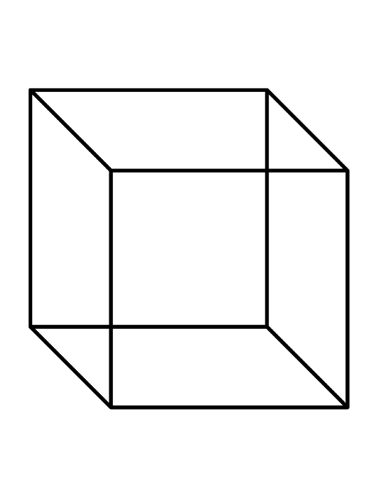
Conservation: Lagrangian / flux-form Eulerian
Lagrangian continuity equation in simple Cartesian coordinates (non-conservation form)
  Discrete equation on grid-points
Eulerian continuity in flux-form (conservation form):
  Discrete equation applied on finite volumes/areas, change proportional on mass flux ⇒ exact mass conservation independently of numerical accuracy!
Control volume ΔA
Flux through neighbouring faces ∆S: loss=gain
∆S

Slide 8
Overview of Eulerian schemes
Some types of Eulerian schemes used (or emerging) in atmospheric modelling
  Split-explicit: “improved efficiency” explicit schemes
  Swemi-implicit: Unconditionally stable but unlike SL methods advective CFL must be <1 to avoid phase speed errors
  HEVI: Horizontally explicit / vertically implicit
    suitable for NH models as they use an implicit & unconditionally stable scheme in the vertical where highest CFL numbers occur
  IMEX: implicit-explicit Runge-Kutta schemes
    Implicit in the fast process, explicit in the slow. Suitable for NH models

Slide 9




MPDATA: positive definite advection
Smolarkiewicz & Margolin (1998)
Upstream approximation of flux eqn:
MPDATA steps
Compute 1st order upstream approximation from etc
Subtract estimate of error to obtain 2nd order accuracy
where

Slide 10
A simple test model: 1d gravity wave equations
Fluid mean depth
Perturbation from
mean depth
Seeking linear analytic solution of the form:
implies a phase speed:

Slide 11
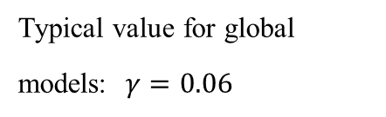
Explicit Leapfrog time stepping on 1D GW eqn
Three-time-level explicit Leapfrog scheme
Leapfrog on general problem:
Leapfrog on 1D GW equations:
Neutral (no damping) + 2nd order BUT
phase + dispersion errors + computational mode
Von Neuman stability:
Solution is a combination of a physical and a “parasitical” computational mode
which can be damped by use of a time filter, e.g. Asselin filter
Typical value for global models: $γ=0.06$

Slide 12
A note on staggering
The prognostic variables can be
  On the same location on the grid, i.e. collocated
  In between (half way) each other, i.e. staggered
    Improved accuracy + dispersion properties
    On explicit techniques staggering results into a more restrictive timestep e.g.: instead of
x x x x x x x
  x o x o x o x o x o x o x

Slide 13
Enhancing stability: forward-backward integration
• Forward-backward scheme: a predictor-corrector type scheme The predictor and the corrector are applied on separate equations.
forward
backward (pseudo-implicit)
Fwd-Bwd versus Leapfrog:
1. Doubles the leapfrog timestep
2. Remains neutral (no damping)
3. Two-time-level scheme ⇒ no computational mode

Slide 14
Runge-Kutta RK3 (WRF) scheme
• Runge-Kutta Wicker & Skamarock (MWR 2002) RK3 scheme:
- three-stage, two-time-level (2nd order) scheme from the RK family
A high order FD scheme used to estimate derivatives
Compared with leapfrog almost doubles (1.62) Δt when 3rd order spatial discretization used
In WRF this is used in combination with time-splitting …

Slide 15
Splitting: the motivation
In an atmospheric model we have motions with multiple time-scales: fast and slow processes co-exist
Explicit techniques are only conditionally stable and impose use of small timesteps
If ∆t_{max} is the longest permissible timestep for integrating the slow process then ∆t_{max} will be too long for the fast process instability
  Split the integration:
    integrate slow process with ∆t_{max}
    integrate fast process with a fraction of it i.e. ∆t_{max} /n

Slide 16
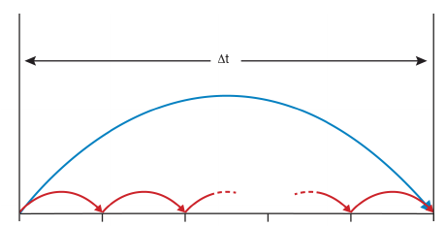
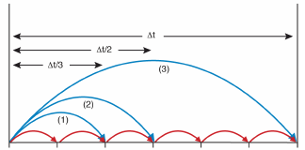
Split-explicit example in a diagram
Split-explicit Euler
Split-explicit RK3
1-cycle/per stage i: slow process integrated with Δt, each stage approximates solution at t+c_{i} Δt where, c_{i}=1/3,1/2,1 the RK3 coefficient
1-cycle: slow process integrated with Δt
n-cycles: fast process integrated with Δt/n
(Diagram courtesy of S.J. Lock, ECMWF Seminar proceedings 2013, HEVI time-stepping for NWP and climate models)

Slide 17
Split-explicit forward Euler integration
Fast forcing term
Slow forcing term
Fast term updated
Slow term kept constant (stored)
1S + n_{s} F evaluations
versus fw-Euler
n_{s} S+ n_{s} F evaluations

Slide 18
Split-explicit RK3 integration
S term is evaluated only once per stage and added at each sub-cycle

Slide 19
Leapfrog (3TL) split-explicit fw-bw example
fast/forward
slow/leapfrog
e.g.
backward
leapfrog
fast F terms updated
Slow terms kept constant

Slide 20
Motivation for HEVI schemes
NH models: very fast vertically propagating acoustic waves AND high vertical resolution ⇒ severe CFL restrictions for explicit schemes e.g.
SI techniques not limited by acoustic CFL BUT require a 3D elliptic equation to be solved
Vertical resolution is much higher than horizontal near the surface:
  Horizontal CFL not as large as vertical and therefore an explicit scheme can be used horizontally
  Combine a cheap explicit approach for the horizontal and an unconditionally stable implicit for the vertical: Horizontally Explicit Vertically Implicit (HEVI) methods

Slide 21
Some HEVI models
ICON (Germany): global NWP model (13km res)
  forward-backward explicit time-stepping (no splitting) in the horizontal + vertically implicit (midpoint rule)
EU-COSMO: operational NH LAM
  [Leapfrog (old model), RK3 (new model)] + split-explicit in the horizontal + Crank-Nicolson in the vertical
NICAM: cloud resolving NH global model (Japan)
  Split-explicit forward-backward in the horizontal + implicit in vertical
WRF, MPAS (USA): LAM, Global research & operational
  Split-explicit RK3 + vertically implicit

Slide 22
Split-explicit HEVI versus IMEX
In deep global NH models O(100km) there is no much benefit from split-explicit approach in the horizontal
  Stratospheric polar jet velocities not far from speed of sound advective CFL similar magnitude to acoustic
  No significant gain from horizontal splitting which works well when having a fast and a slow process
  Splitting needs damping for stabilization
Implicit Explicit (IMEX) RK is like an unsplit HEVI:
  HEVI “philosophy”: unconditionally stable implicit RK time stepping for fast processes and cheap explicit RK for slow
  the combined scheme properties can be analysed and understood (see Lock et al, QJRMS 2014)

Slide 23
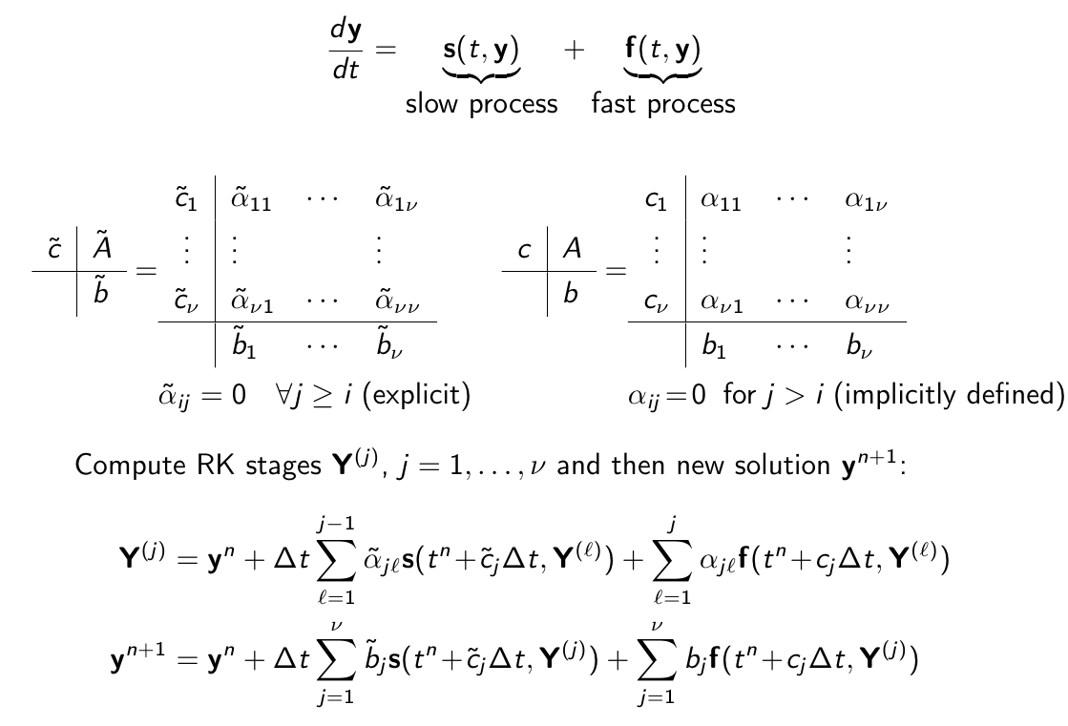
IMEX: Blending explicit with implicit

Slide 24
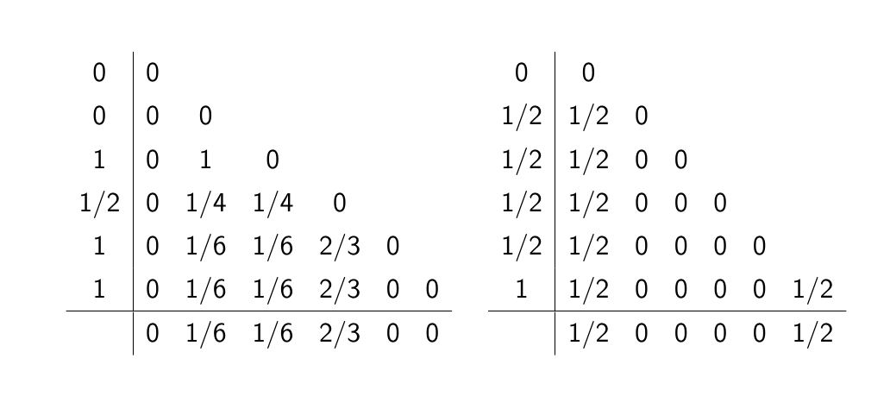
Example of IMEX
2nd order Ulrich & Jablonowski (MWR, 2012) ‘Strang carryover’ UJ3(1,3,2) scheme in RK (J. Butcher) notation
Good stability + little damping + good phase speeds and group velocities

Slide 25
UJ3 scheme features
Explicit part: 3rd order Strong Stability Preserving (SSP)
Overall accuracy: 2nd order accurate + small damping
Only final stage Y₆ is implicit:
Has been implemented in research atmospheric model
In the published paper, implicit part is solved as a RK-Rosenbrock scheme:
Requires solution of a very large dimension linear system
Other approaches can be used in IMEX e.g. derive Helmholtz equation (Weller et al, JCP 2013)

Slide 26
Overview
There are many choices of numerical techniques
What to choose depends on the problem you solve (mathematical formulation, resolution, domain) and the computer architecture you apply your algorithm
SLSI on uniform or quasi-uniform grids have served well the NWP and climate community the last 2 decades and they will continue to do so in the current decade
Nowadays mainly due to hardware changes and interest in developing very high resolution systems there is considerable research & development activity in the more scalable Eulerian techniques which are also suited for developing inherently conserving dynamical cores

Slide 27
Some references
Wicker & Skamarock (MWR 1994): “Efficiency and Accuracy of the Klemp-Wilhemson Time-Splitting Technique”
Wicker & Skamarock (MWR 2001): “Time-Splitting Methods for Elastic Models Using Forward Time Schemes”
Ulrich & Jablonowski (MWR 2012): “Operator-Split Runge-Kutta-Rosenbrock Methods for Nonhydrostatic Atmospheric
Lock, Wood, Weller (QJRMS 2014): “Numerical Analyses of Runge-Kutta implicit-explicit schemes for horizontally …”
Dale Durran’s book: “Numerical methods for Wave Equations in Geophysical Fluid Dynamics” (1999)
Lauritzen et al book: Numerical Techniques for Global Atmospheric Models, Springer 2011

Slide 28
Thank you for your attention!

