Slide 1
Initial ensemble perturbations
- basic concepts
Linus Magnusson
Acknowledgements: Erland Källén, Martin Leutbecher, …, …

Slide 2
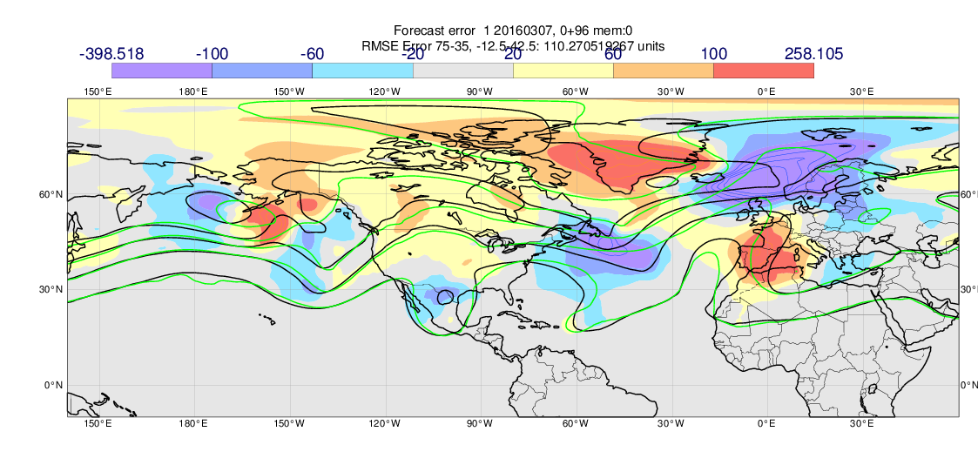
Z500 error 7 March 00z + 4 days

Slide 3
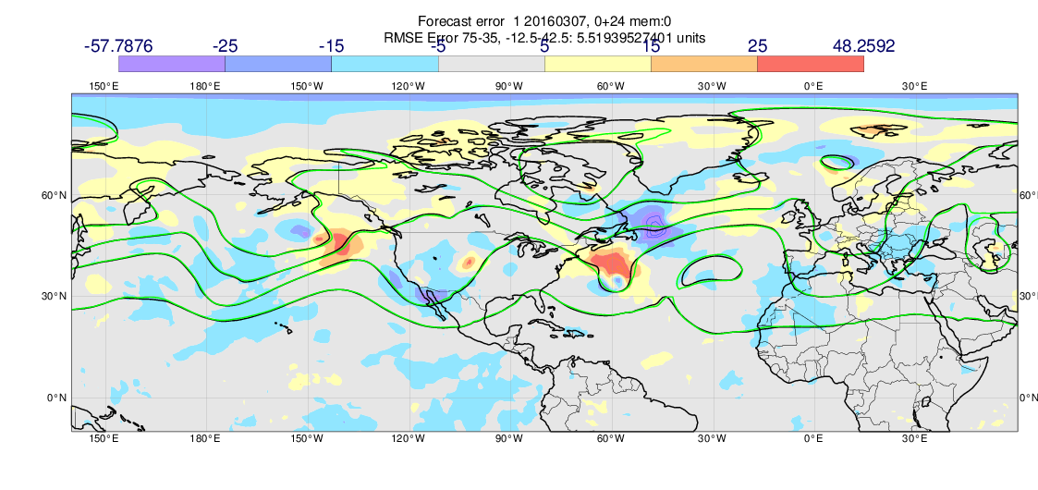
Z500 error 7 March 00z + 1 days

Slide 4
Introduction
Optimal analysis
Perturbed forecast
=
+
Perturbation
Perturbations added to a subset or all model variables
“How to construct the initial perturbations?”
“Why does not pure random numbers work?”
Notes:
The initial state for the perturbed forecast is created by adding an initial perturbation to the analysis, which is our best estimate for the state of the atmosphere. In this presentation I will discuss different methods to create these initial perturbations.

Slide 5
Introduction
Starring list
Analysis – best estimate
Uncertainty estimate
Bifurcation line
Perturbed members
Truth (unknown)
“If we knew the truth, we have started the forecast for it.”

Slide 6
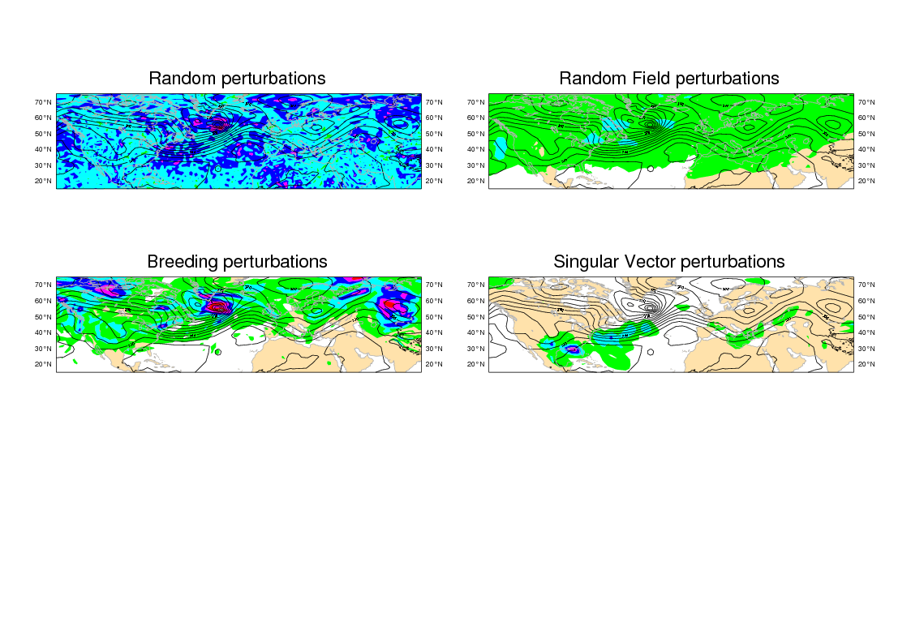
Desirable properties of initial perturbations
Sampling analysis uncertainty
  Mean amplitude
  Geographical distribution
  Spatial scale
  ”Error of the day”
Sustainable growth
High quality of probabilistic forecast

Slide 7
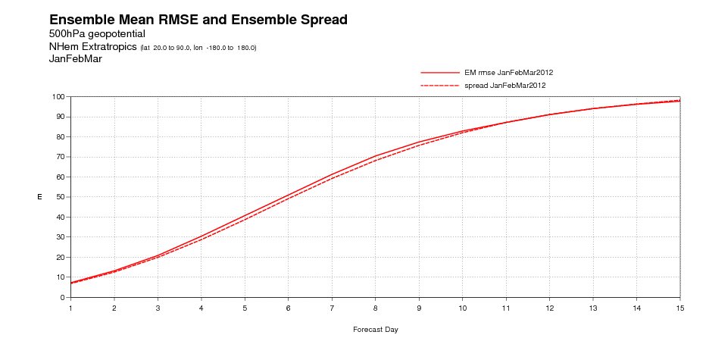
Ensemble mean RMSE and ensemble spread
Saturation
level
dE/dt
Initial uncertainty
cf. Bengtsson, Magnusson and Källén, MWR (2008)
Optimally: Ensemble mean RMSE = ensemble spread
Notes:
Initial perturbation amplitude: tuneable
dE/dt : model dependent + model error simulation
Saturation level: Model activity

Slide 8
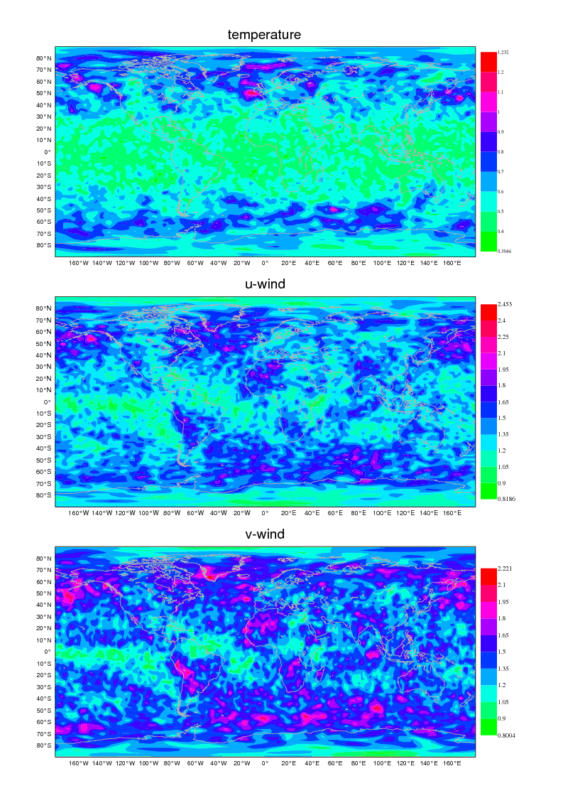
Random Perturbations (why does it not work?)
Analysis error estimate
Random grid-point
number (-1 to 1) x
x global tuning factor
Notes:
Pure random perturbations constructed by adding a random number to each variable scaled with its estimated error

Slide 9
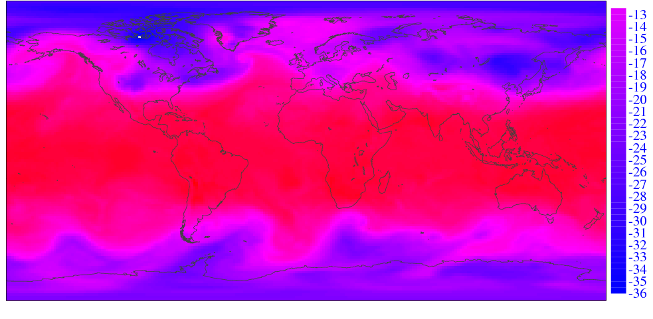
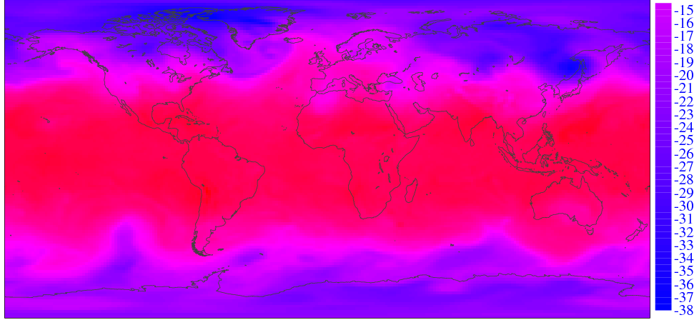
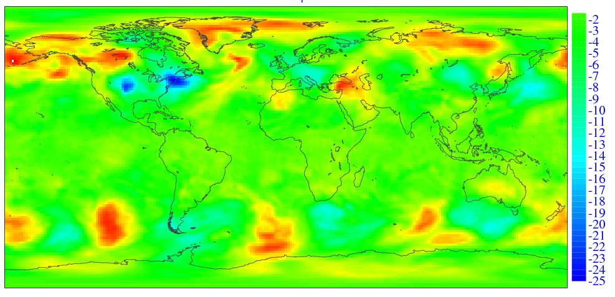
Random Field (RF) perturbation (for benchmarking)
Analysis Random date 1
Analysis Random date 2
-
Random Field Perturbation
x normalizing factor =
Not flow-dependent, but linear balances maintained
cf. Magnusson, Nycander and Källén, Tellus A (2009)
Notes:
The perturbations are calculated by taking the difference between two randomly selected atmospheric states. The difference is globally rescaled. Linear balances maintained. Corresponds to the atmospheric variability, not analysis error.

Slide 10
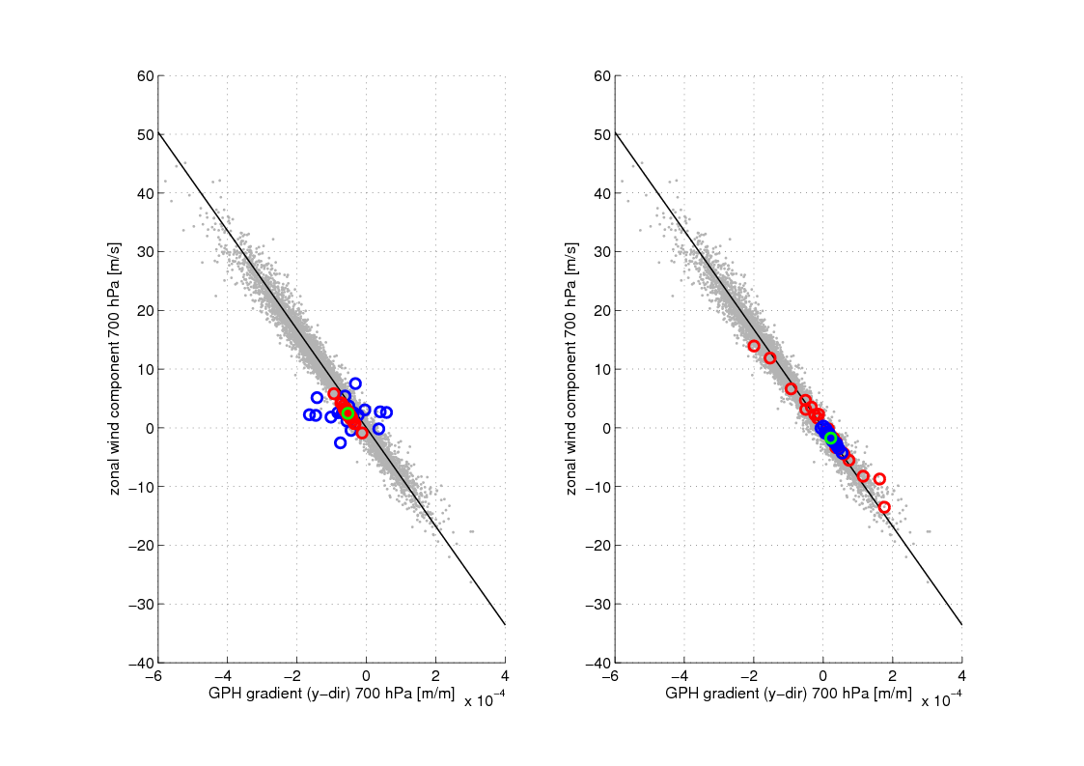
Geostrophic balance and perturbations
Initially
+48h
Blue – random pert., Red – random field, climatology - grey
Notes:
Random perturbations adjusts to the balance quickly and losing amplitude while random field perturbations start to grow

Slide 11

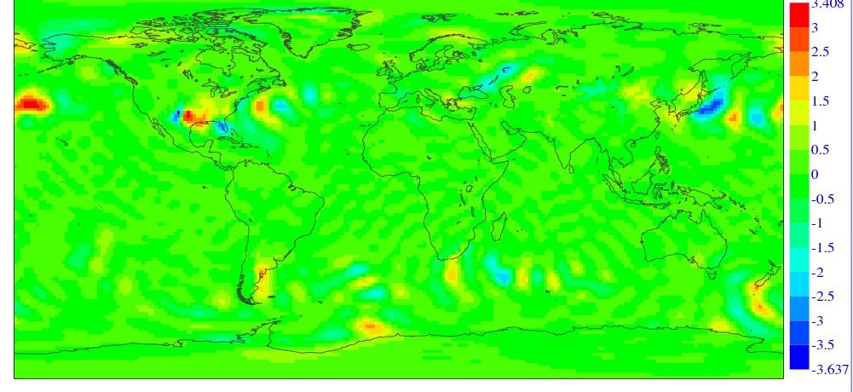
Singular vectors
Optimize perturbation growth for a time interval
Atmospheric state
Norm dependent!
M tangent linear operator. Δx(t)=M(t,x₀)Δx(0)
(More about this tomorrow)
Singular vector perturbation
Notes:
SV are optimized to yield the highest perturbation growth during a certain time interval. The optimisation condition could be formulated as follows. Maximize alpha. Norm dependent. Use of a tangent linear model and its adjoint. Solve an eigenvalue problem. Example of a SV perturbation (combination of 50 first). Upper panel temperature. Perturbations located in regions with high gradients.

Slide 12
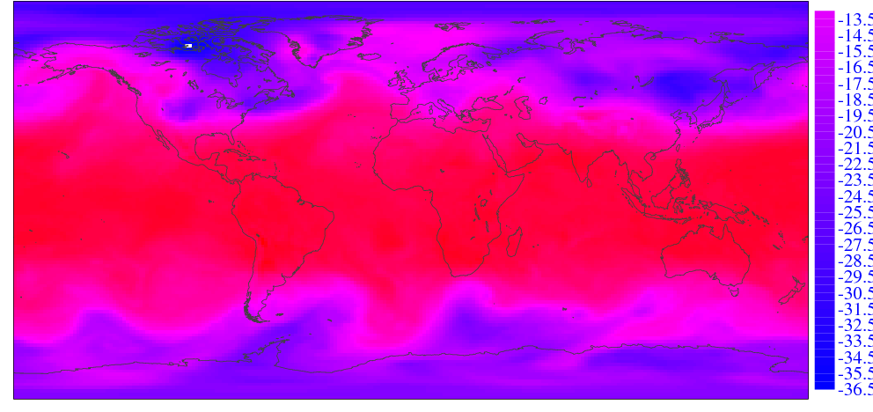
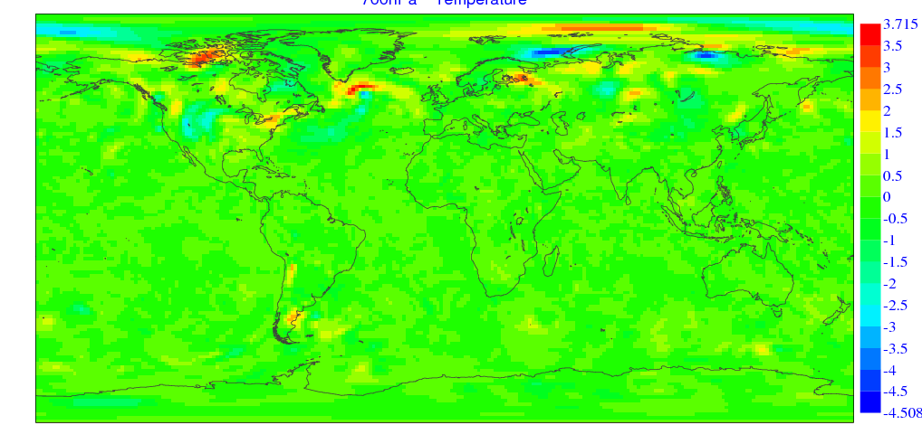
Breeding perturbations
Perturbed Forecast +06h
Unperturbed Forecast +06h
-
Breeding vector
x normalizing factor =
Notes:
Breeding vectors are aimed to sample growing modes from the past, which (hopefully) will grow in the future. BV are calculated as the difference between one perturbed and one unperturbed short forecast. The difference is rescaled and added to the new analysis. Cycling procedure. Fast growing structures from the past used as perturbations. Sampling Lyapunov vectors. Example shows perturbations in a later stage of cyclone development.

Slide 13
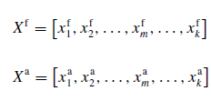


Ensemble transform perturbations (further development of BV)
(Wei et al., Tellus A, 2008)
(x=pf-em), compare with BV
Make the perturbations orthogonal
C and Γ from eigenvalue problem:
Error norm
Simplex transformation
Regional re-scaling
ETKF perturbations similar idea (Wang and Bishop, JAS, 2003)
Notes:
ET is used by e.g. NCEP. Orthogonalising BV in an error variance norm. Simplex transformation in order to increase the number of directions spanned.ETKF builds on the same idea but using another norm.

Slide 14
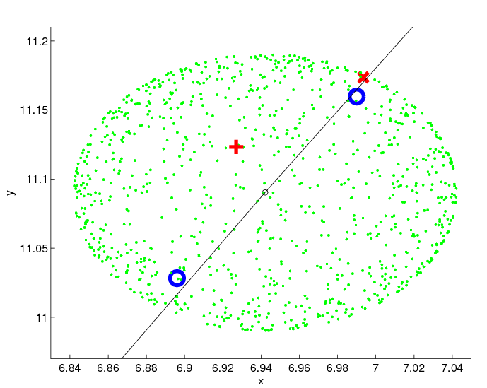
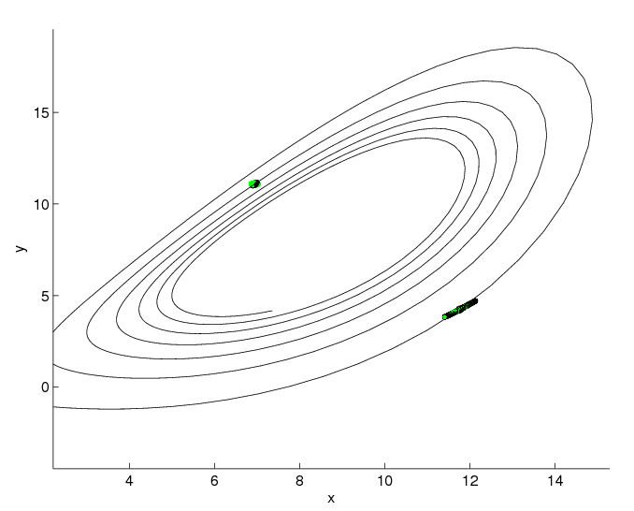
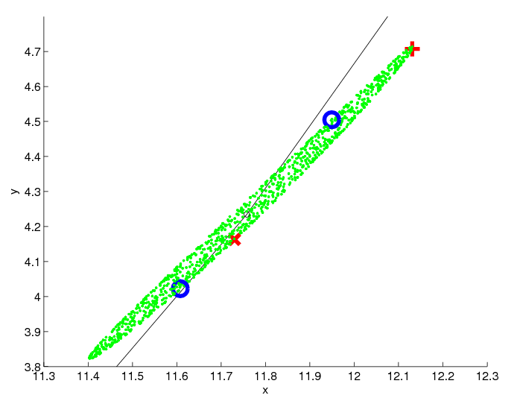
Perturbation methods Lorenz-63
Initial point
After 1 time unit
Random pert.
✚ 1st SV
✖ 2nd SV
BV
Notes:
Results from the Lorenz-63 model. Here 1000 random perturbation are put initially on a sphere around the control trajectory. In addition 2 BV and 2 SV are constructed. Here one clearly see one disadvantage with BV. The two perturbations are linearly dependent. This is present in low order models but a linear dependence appears also in NWP-model results. Studying the results after one time unit, we see that all random perturbations are located on a plane, the attractor of the system. Therefore, if regarding the dynamics of the system it should be possible to construct perturbations ending up in the edge of the distribution (RF). The first SV fulfils the optimation condition – it found the most unstable direction. And the section SV found the other principal axis of the ellipse.

Slide 15

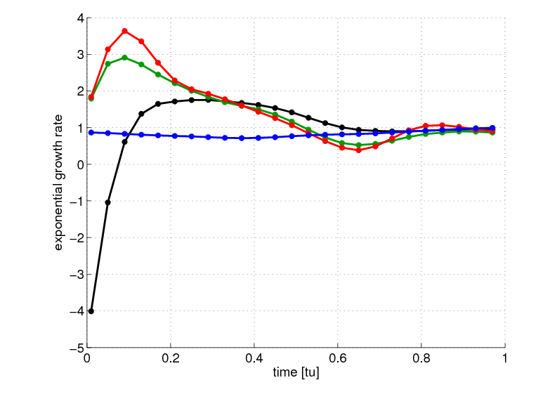
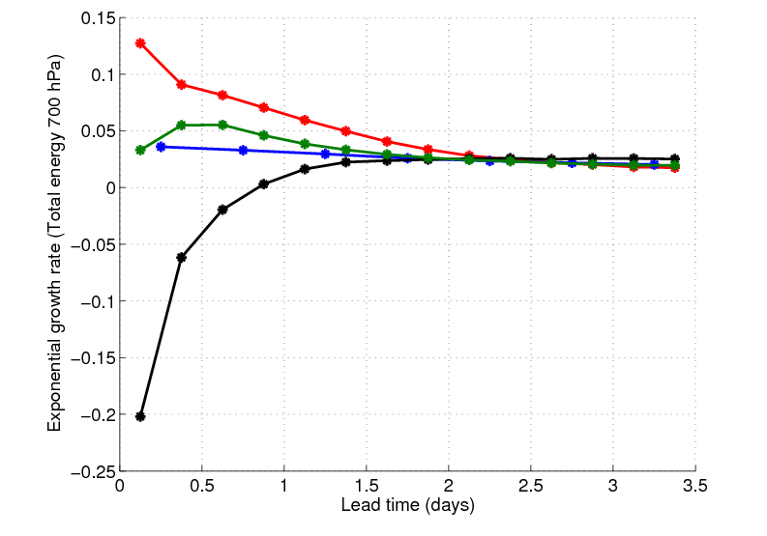
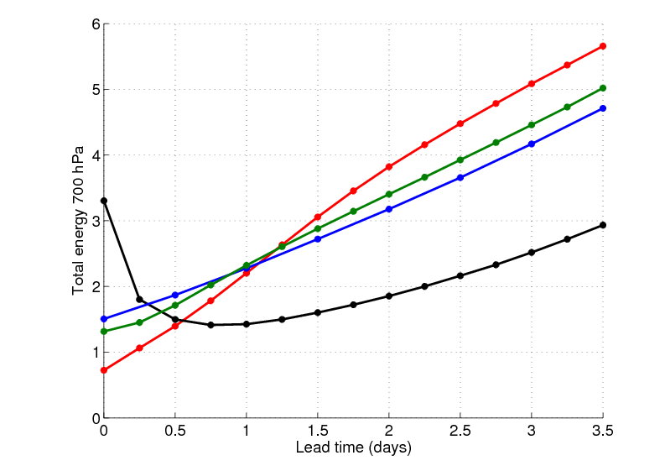
Exponential perturbation growth
Lorenz-63
NWP-model (ECMWF)
SV – red, BV – blue, Random Field Pert. – Green, Random Pert. - black
Notes:
For a chaotic system, the perturbation growth is in mean exponential (Lyapunov exponent). In order to investigate the growth of the perturbations, the exponential perturbation growth is calculated as a function of forecast time (time from the initialisation).Yields instantaneous growth. For L63, we see that BV has the same growth as LV from the beginning – well sampling LV. SV faster growth at the beginning – approaches LV after a transient time. RP decreases initially, by obtain a period of fast perturbation growth. Transient period. RF – fast growing.
NWP-model results: similar properties as L63.

Slide 16
Evolution of ensemble spread
(one case, total pert. energy 700 hPa)
Initially
Maximum – red
Notes:
Here is one example of initial spread distributation from the three methods. For random perturbation perturbations. The spread is rather homogeneous. And so also for RF. Breeding and SV enhenced in special regions. SV smallest amplitude.

Slide 17
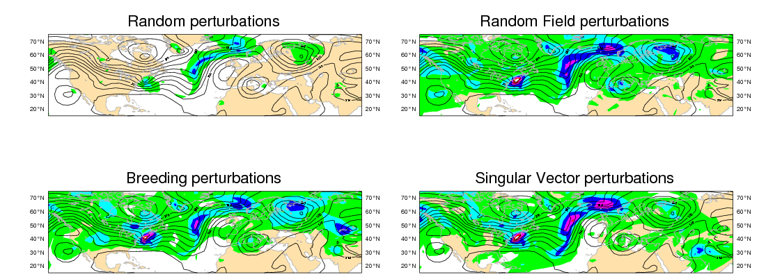
Evolution of ensemble spread
(one case, total pert. energy 700 hPa)
+48h
Maximum – red, Scale 48: twice the scale for +00h
Notes:
There is the same case but after 48 hours. For RP, we see that the amplitude is lower than the other ones, even if it started with the highest. All 4 methods has the spead in the same regions.

Slide 18
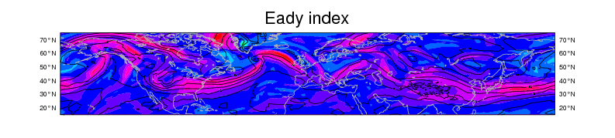
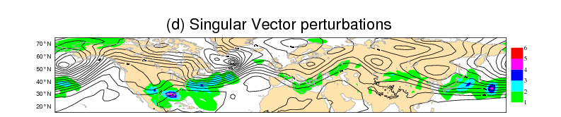
Connections between perturbations and baroclinic zones
Fastest growth rate of normal modes
Notes:
To investigate this further. The Eady-index is used to quantify the baroclinicity. Example SV. The correlation has been calculated between the Eady index and the ensemble spread.

Slide 19
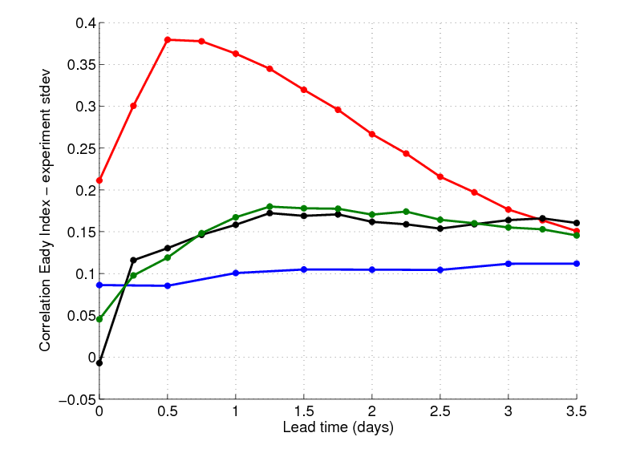
Correlation Eady index – Ens. Stdev z500
SV - Red
ET - Blue
RF – Green
RP - Black
(20N-70N)
Notes:
Here are the correlations plotted as a function of forecast time. The absolutely highest correlations are found for SV. Not surprising. Initially RP uncorrelated. RF close to. But both quickly obtain correlations. The perturbations that grow, growth in baroclinic regions.
Mature structures for BV. All converges after 2-3 days.

Slide 20
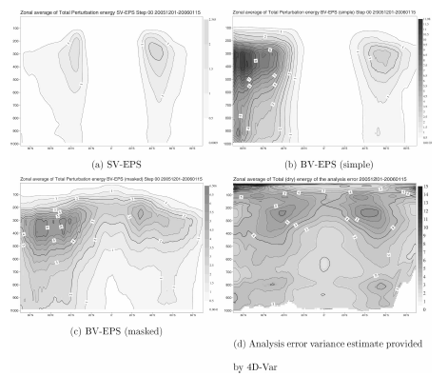
Mean initial perturbation distribution
Figure 2. Magnusson, Leutbecher and Källén. 2008 (MWR)
Notes:
SV lacks spread in the tropics by definition. BS lacks due to fastest growth in the mid-latitudes. A regional rescaling mask partly solves the issue.

Slide 21
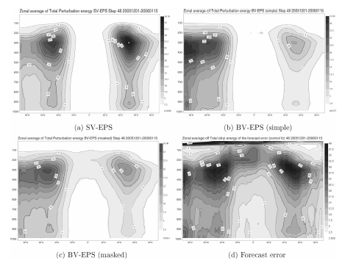
Mean perturbation distribution after 48 hours
Figure 3. Magnusson, Leutbecher and Källén. 2008 (MWR)
Notes:
Similarities after 48 hours. BV lacks spread on the southern hemisphere. Problems in the tropics.

Slide 22
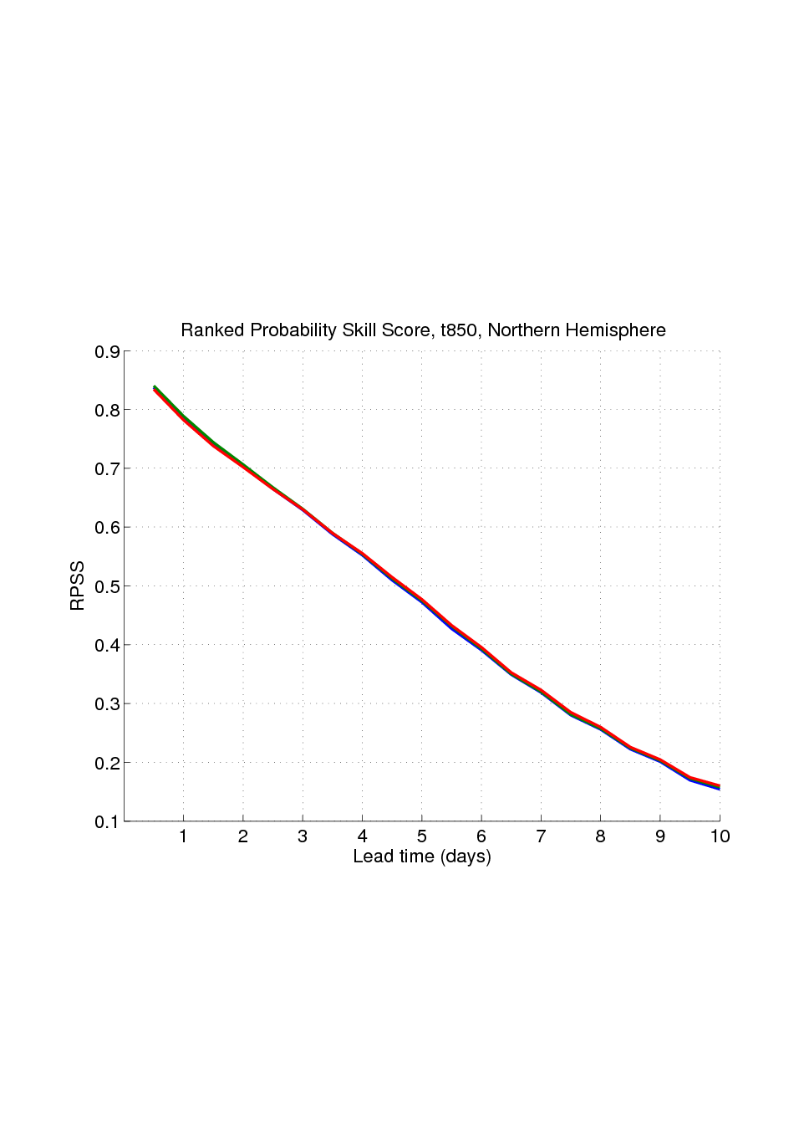
Ranked Probability skill score - t850
Different initial perturbations
(N.Hem)
SV - Red
ET - Blue
RF – Green
Different Centres
(from Park et al.(2008),
Courtesy R. Buizza )
Notes:
Forecast skill. Comparison between different methods – only small differences. Comparison between different centres – much larger. Model matters!

Slide 23
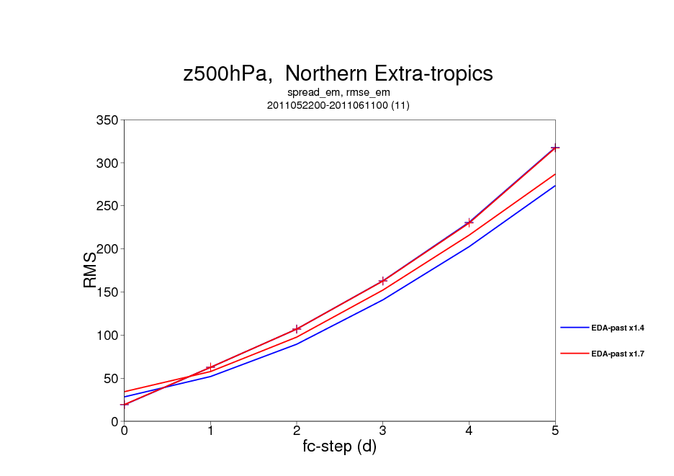
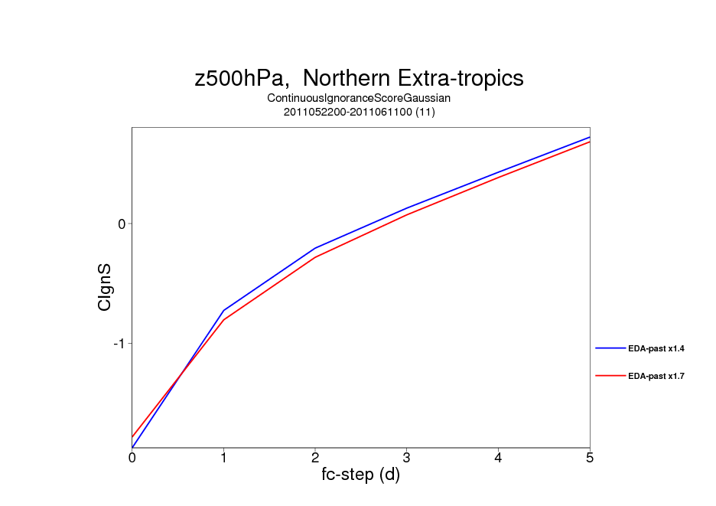
Other things to consider - Importance of initial amplitude scaling
Two models with different tuning of the initial amplitude
Perturbation growth is highly model dependent!
Notes:
The tuning of the initial spread more important than the choice of method

Slide 24
Other things to consider - Perturbation symmetry
+/- symmetry -> rank N/2
Simplex transformation -> rank N-1
No clear advantage for simplex transformation in our metrics

Slide 25
Desirable properties for initial perturbations
 | SV | BV and ET |  | RF | Random
Sampling analysis uncertainty
Mean amplitude |  | v | v
Geographical |  |  | v |  | V
Spatial scale | v | V | v
Growth | v (too fast?) | V | v
An Error of the day | V | v
Fc Error of the day | V | V | V |  | V
Fc Quality | V | V | V
Notes:
Summary from my point of view. BV and SV misses the tropics.

Slide 26
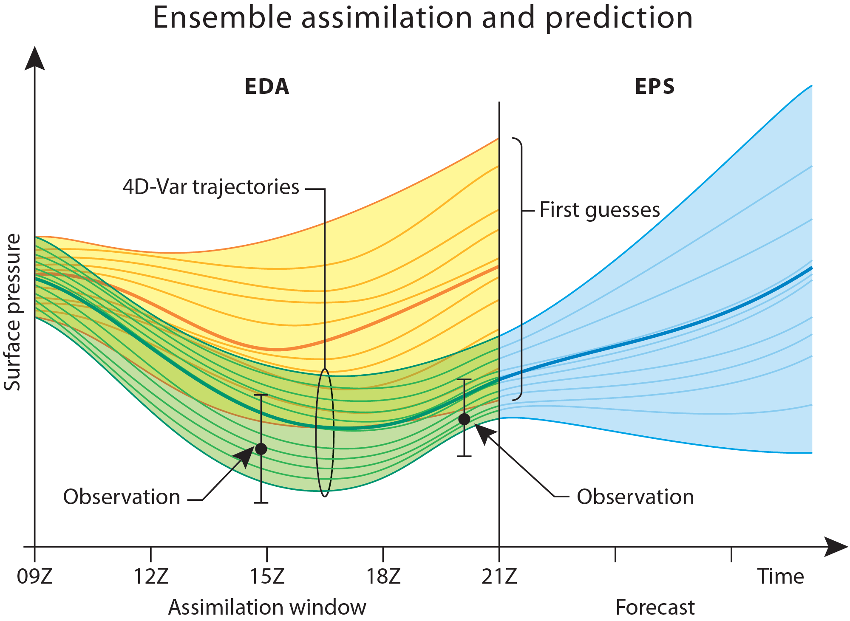
Notes:
How does EDA address these requirements? Should address them all.

Slide 27
