Slide 1

Introduction to Coupled
Ocean-Atmosphere Variability
Implications for Predictability
Basis for extended range prediction
Simple conceptual models to understand predictability
Magdalena A. Balmaseda
European Center for Medium Range Weather Forecast, Reading, UK

Slide 2
Ocean Atmosphere Interaction
Why does it matter?
Predictability: How far into the future can we predict the weather/climate?
  How does the atmosphere respond to the ocean?
  How predictable is the ocean?
Modelling: Which air-sea processes need to be represented to predict the weather/climate at different time scales?
  Momentum flux (wind-wave-currents…) and mixing, diurnal cycle, baroclinic instability over sharp SST fronts, SST and tropical convection (MJO, ENSO) …

Slide 3
This talk will cover
Implications for Predictability
  Basis for extended range prediction
  Some examples of air-sea interaction
The ocean and its circulation
  Some facts
  Wind driven and thermohaline circulations
Modes of variability at different time scales
  From diurnal to decadal
  Known modes
  ENSO
The El Nino 2015/16

Slide 4
Ocean and Predictability
Ocean is responsible for the slow time scales
  The ocean has a large heat capacity and slow adjustment times relative to the atmosphere.
Atmospheric response to ocean forcing: very sensitive to the structure, location, and amplitude of the ocean forcing.
  Response to large-scale spatial SST gradients
  Response over warm pool: deep atmospheric convection
  Response to sharp SST fronts
    example: mid latitude storm tracks over western boundary currents
Without any atmospheric response to boundary forcing, there can not be interannual-decadal atmospheric “predictability”
Hasselmann 1976
Latif et al 2002, Timmermann 2005…

Slide 5
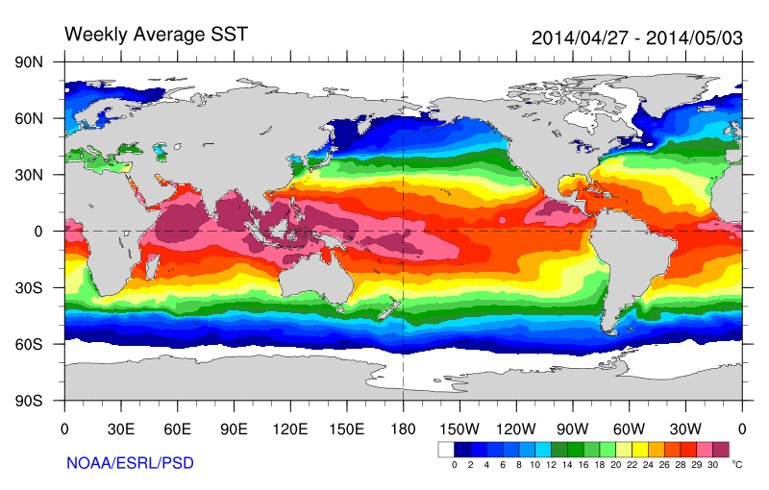
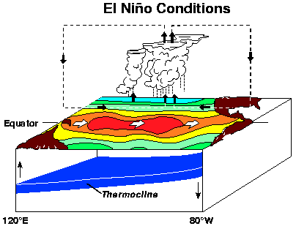
Traditional view:
Atmosphere response to SST
Atmospheric bridge
Large Scale Pressure Gradients, mainly in the tropics
Convective forcing
Lau 1977

Slide 6
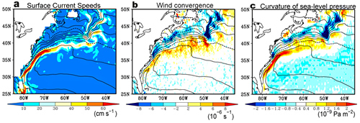
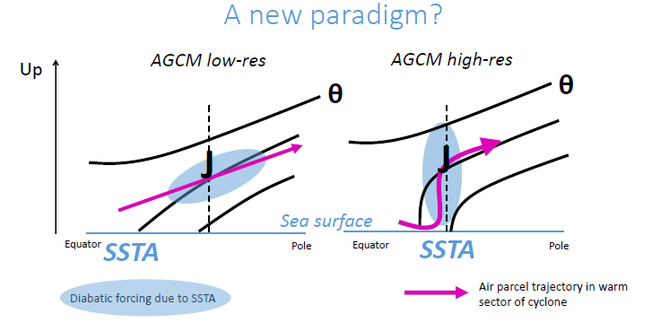
O-A interaction over SST fronts
Minobe et al 2008
Air-Sea Interaction also occurs at small scales, such as that of the Western Boundary currents (above and right) and Tropical Instability Waves TIW (left).
From Czaja, 2016
Notes:
Hoskins and Valdes 1990.
Chelton and Song: from observations
Nakamura et al 2004, Amer geophys Union
Minobe et al Nature, 2008
Feliks et al 2003,2006.
O’Reilly and Czaja, 2014
The response of mid-latitude atmosphere to the SST fronts has very strong implications for modelling (need of high resolution models) and predictability (Balmaseda et al 2010, Scaife et al 2011, Keely et al 2012)

Slide 7
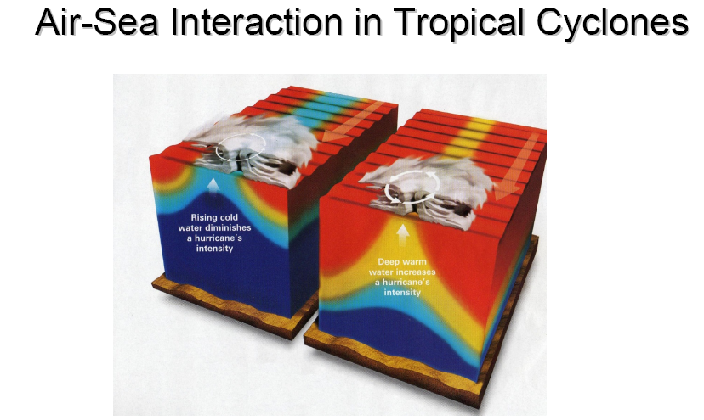
Heat Flux exchange: ocen mixing and upwelling
Wind-Wave interaction
Ocean Initial conditions also matter
From Ginis 2008

Slide 8
This talk will cover
Implications for Predictability
  Basis for extended range prediction
  Some examples of air-sea interaction
The ocean and its circulation
  Some facts
  Wind driven and thermohaline circulations
Modes of variability at different time scales
  From diurnal to decadal
  Known modes
  ENSO
The El Nino 2015/16

Slide 9
Some facts
Spatial/time scales The radius of deformation in the ocean is small (~30km) compared to the atmosphere (~3000km).
  Radius of deformation =c/f where c= speed of gravity waves. In the ocean c~<3m/s for baroclinic processes. Smaller spatial scales and Longer time scales
The heat capacity of the ocean is vastly greater than that of the atmosphere (1000 times).
  The total atmospheric heat content ~ the ocean heat content of 3.5m layer
The ocean is strongly stratified in the vertical, although deep convection also occurs
  Density is determined by Temperature and Salinity
The ocean is forced at the surface by the wind/waves, by heating/cooling, and by fresh-water fluxes.
Role of the ocean in meridional heat transports
  Why is it different in the different basins? Why is the Atlantic heat transport always northward?
  Presence of bifurcations?

Slide 10
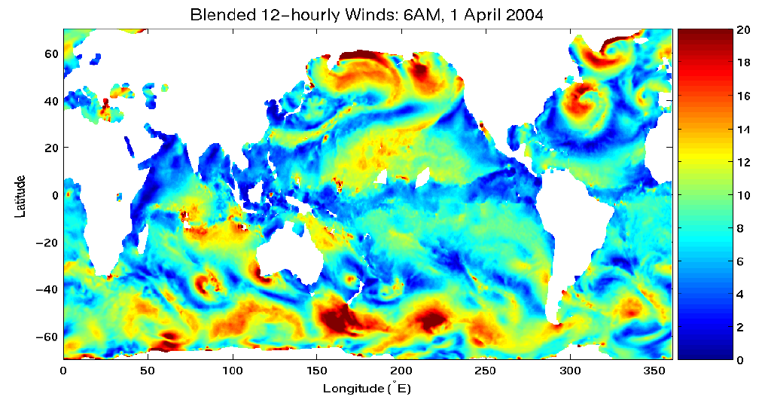
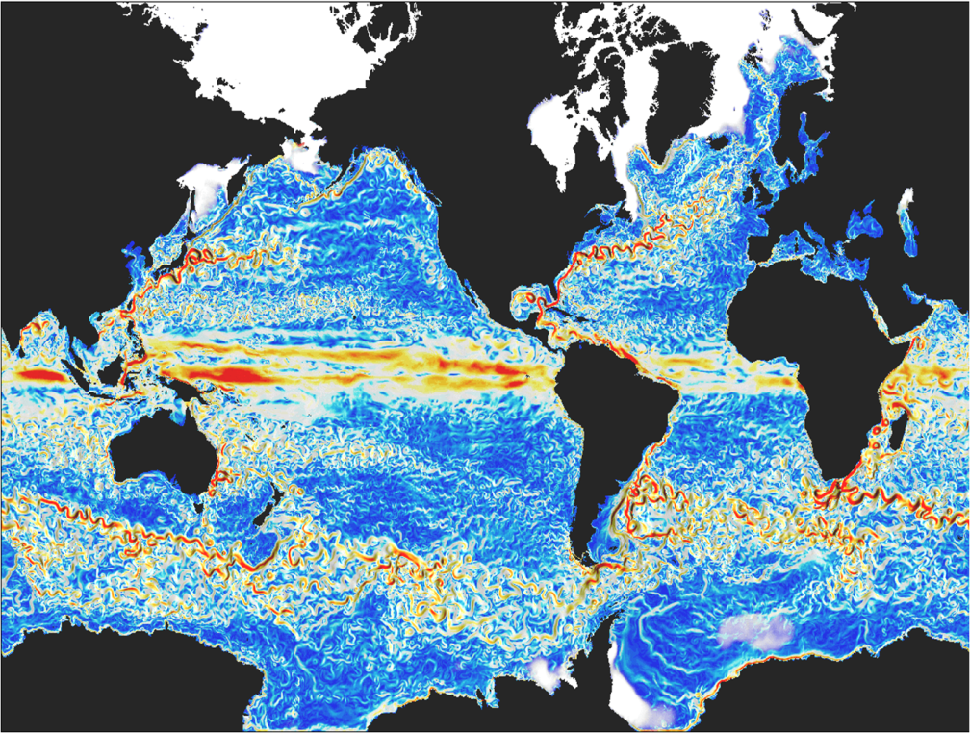
(Zhang et al., )
2 - Ocean Weather
Atmospheric wind speed (12h)
Ocean current speed (model simulation, 5 day mean)
Notes:
10
Note the different spatial scales of atmosphere and ocean.

Slide 11
Ocean Circulation
Wind Driven:
  Gyres
  Western Boundary Currents
  Ekman Pumping: upwelling regions (coastal, equatorial) and subduction
Bouyancy Driven: Thermohaline Circulation
  Ubiquitous upwelling maintaining the stratification
  Deep circulation concentrated in the western boundary
  Sinking of water in localized areas and wind/tide mixing
  Multiple equilibria
Adjustment processes
  Equatorial Kelvin waves (c ~2-3m/s) (months)
  Planetary Rossby waves (months to decades)

Slide 12
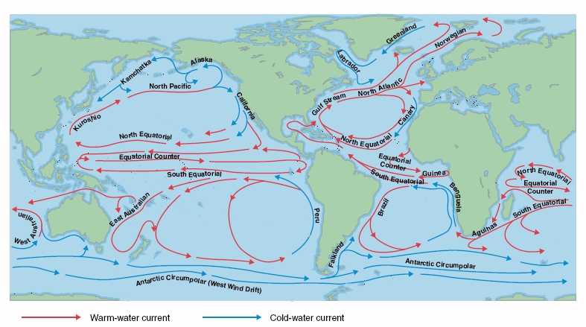
Wind driven circulation
Sverdrup (1947), Stommel (1948), Munk (1950)
The surface circulation of the ocean is largely wind driven: sub-tropical gyres, western boundary currents, coastal upwelling. Note also the countercurrents which flow against the wind and the vigorous Antarctic circumpolar current
The wind driven circulation is responsible for important SST patterns, ENSO, meridional heat transports, ocean heat absorption.
Notes:
The winds drive large part of the ocean circulation. But the structure of the wind driven currents is not so obvious. For instance there are strong currents, such as the North Equatorial Countercurrents in the Atlantic and Pacific Oceans go upwind. And, why are strong currents found offshore of east coasts but not offshore of west coasts?
Three seminal papers address these issues. Sverdrup (1947) showed that the circulation in the upper ~1000m of the ocean related to the curl of the wind stress. Stommel (1948) showed that the oceanic gyres is asymmetric because the Coriolis force varies with latitude. Munk (1950) considered the effect of eddy viscosity in the ocean gyres and western boundary currents.
The wind driven circulation influences the SST patterns and heat transports.

Slide 13
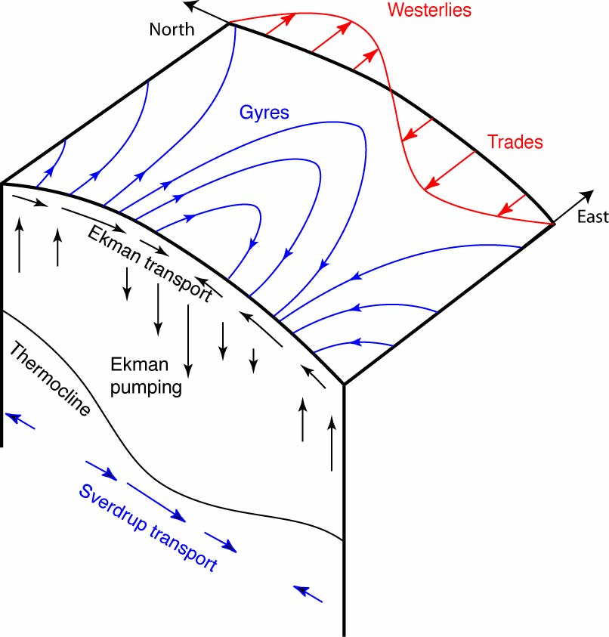
Ekman and Sverdrup Transports
The wind driven circulation results in meridional transports of mass and heat.
It also influences the vertical distribution of heat (hurricanes, recent hiatus in surface warming)
Ekman transport in the upper ocean (Ekman layer), a balance between wind stress, vertical mixing and rotation.
Convergence and divergence of Ekman transports create subduction/upwelling (Ekman pumping).
The Sverdrup transport is a transport in the ocean interior that feeds the large scale Ekman pumping.
Sverdrup transport is equatorward in subtropical regions of Ekman pumping and poleward in subpolar regions of Ekman suction.
Notes:
The Ekman layer is the thin frictional layer at the top of the ocean, driven directly by the wind. ), the Ekman transport at right angles to the wind .
The Ekman layer transports drive circulation in the ocean interior through the Sverdrup transport mechanism.
Spatial variations in the wind, for instance with latitude (westerlies and trades), translate into variations of the Ekman transport, giving rise to convergence and divergence regions.
Where there is convergence, there must be vertical velocity downward, escaping from the Ekman layer. Where there is divergence, there must be vertical velocity upward, feeding the Ekman transport. We think of these downward and upward velocities as "squashing" or "stretching" the water column beneath the Ekman layer (i.e. most of the ocean depth).
The ocean is a rotating. Its angular momentum (vorticity) has two separate and important components - one is due to local "vorticity" in the flow itself (strong eddying) and the other is due to just the rotation of the earth, which gives everything on the earth angular momentum. These two pieces are called the relative vorticity and the planetary vorticity.
Over most of the ocean the planetary vorticity is more important that the relative vorticity ( with the only notable exceptions being in the very strong western boundary currents and in the east-west equatorial currents). The planetary vorticity is largest and positive at the north pole ( largest and negative at the south pole), and it is zero on the equator. Therefore the important component of the angular momentum increases northward, from large/negative at the south pole through 0 at the equator to large/positive at the north pole.
When the frictional Ekman layer exports water downward (very small downward vertical velocity), at the top of the ocean, it squashes the water columns, which must then spin more slowly to conserve angular momentum. This can be accomplished by either spinning more slowly in the location of the water column ("inducing negative relative vorticity"), or moving to another latitude where the local rotation rate (parallel to the local vertical) is slower - this would be equatorward. If on the other hand there is Ekman divergence, then the water columns are "stretched", and the column must spin faster, either in place or by moving to higher latitude. Since the general circulation is very large scale and not filled with ever-increasing vortices, the response is to move in latitude rather than to spin up locally. This response to Ekman pumping or suction is called the "Sverdrup flow“, and the flow associated with the response is called "Sverdrup transport". Sverdrup transport is equatorward in subtropical regions of Ekman pumping and poleward in subpolar regions of Ekman suction.

Slide 14
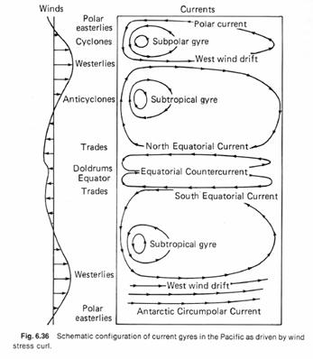
Wind driven circulation profile

Slide 15
Western Boundary Currents (WBC)
Narrow Currents flowing poleward on the western part of the basins.
  Concieved as part of the Gyre Circulation.
  Gulf stream:Narrow boundary current off North American coast (Florida)
  Pacific has counterpart (Kuro-shio)
  Gulf Stream cannot collapse, as long as winds blow, continents exist, and the Earth rotates
The existence of WBC can be anticipated from the existence of Rossby Waves (see later), which travel to the west with group velocity:
This means energy is carried to the western boundary where it is concentrated so generating western boundary currents such as the Gulf stream or the Kuroshio.
This westward energy propagation may also be important in ENSO through the delay-oscillator mechanism. (see later)

Slide 16
What maintains the ocean stratification?
Thought experiment:
The temperature profile becomes homogeneous (well mixed) with increasing time t1, t2, t3 …
26C
heated
thermocline
t1
Ellis 1751: The temperature of the ocean at the equator is warm (heated by the atmosphere) at the surface, but is cold at depth: i.e. the ocean is not in thermal equilibrium.
t2
Temperature profile from the surface to the deep ocean (4000m)
t3
t4
t5
1C
insulated

Slide 17
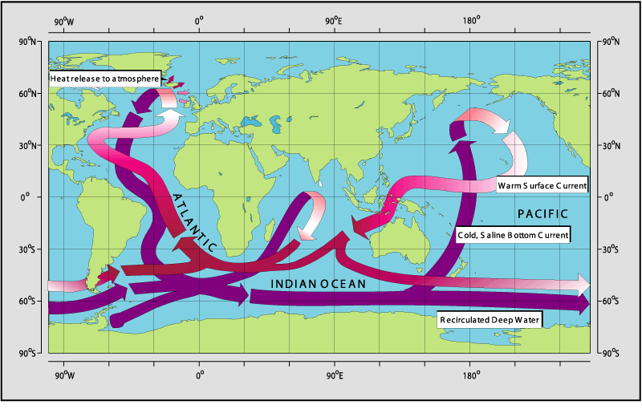
Thermo+Haline= Circulation driven by density differences.
Related to localized deep water formation areas.
Important for meridional heat transports and ocean stratification.
Thermohaline Circulation
Notes:
This cartoon shows the 3 dimension circulation of the ocean. Note the differences between the North Atlantic which has deep water formation and the North Pacific which does not. Note also the Indonesian throughflow.
The following slides provide (not shown in the presentation) provide an overview an overview of
Multiple equilibrium of the THC using simple box models.
Historical facts on the debate on the THC (pulled or pushed?)

Slide 18
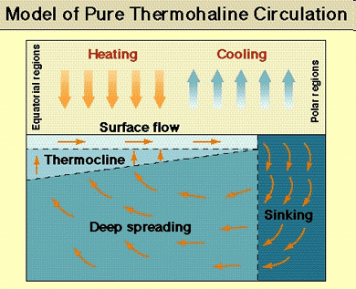
Thermohaline circulation
The circulation is driven by density differences.
Density differences forced to heat and fresh water fluxes, which in some areas act in different directions.
In the current climate, sinking at high latitudes appears localized in small regions
Upwelling is more widespread.
Stommel box model can present bifurcations. Different solutions depending on the balance between heat and fresh water fluxes.

Slide 19
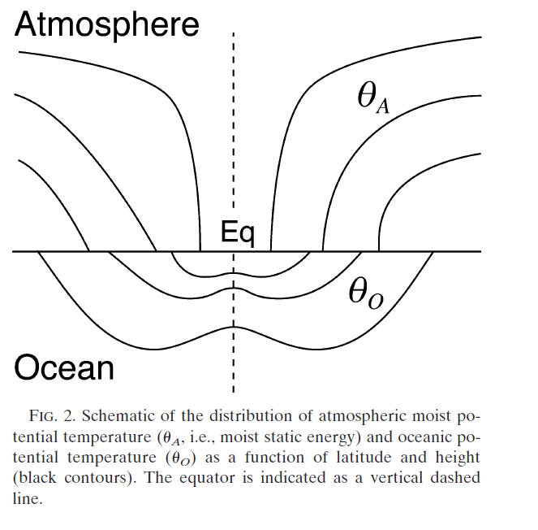
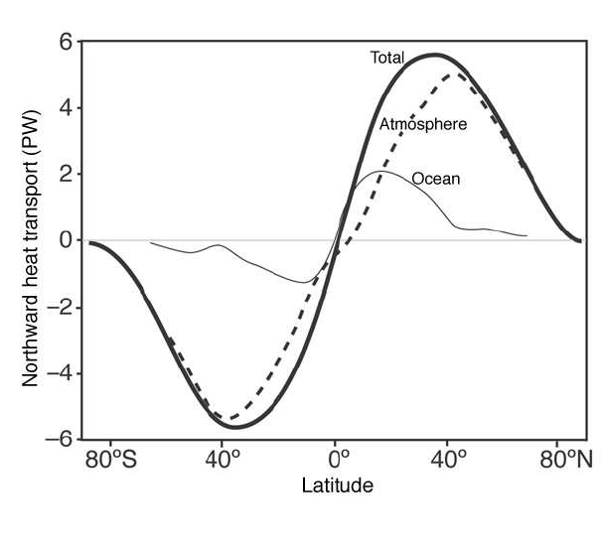
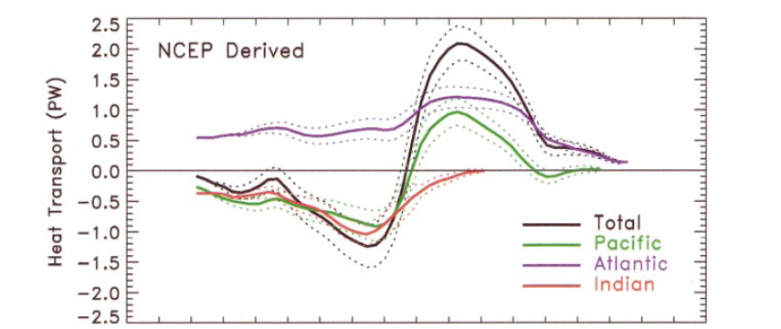
Meridional Heat transport: MOC x Stratification
Ocean and atmosphere heat transport
Oceanic heat transport by basins
Stratification of Ocean/Atmosphere
From Czaja and Marshall 2006.
40S Eq 40N
Trenberth and Caron 2001
Notes:
Ocean heat transports by basins: Note the Atlantic heat transport is positive at all latitudes
See also Ganachaud and Wunsh 2003, JClim
The ocean heat transport dominates at low latitudes
The atmospheric heat transport dominates at mid-high latitudes
Questions?
What determines the partition?
Does it change it time? Bjerkness compensation.
Does it change from different ocean basins?
Stone (1978), Trenberth and Caron (2001), Cazja and Marshall (2006)

Slide 20
Meridional SST gradients
What determines the sharp frontal areas and their latitudinal position?
What determines the zonal structure of SST (Atlantic versus Pacific, for instance)? (Does the Gulf Stream tilt because of the Rockies, because of bathimetry, because of AMOC)?.
What is the impact on the atmosphere of the SST structure? (storm tracks)
See Seager, American Scientist 2006 for a good (popular) discussion of these topics.
Brayshaw et al, 2011, JAS, for more recent findings
Notes:
Hoskins and Valdes, JAS 1990
Minobe et al, Nature 2008
Nakamura et al, GRL, 2008,
Seager et al, Quart. Journal Roy. Met. Soc, 2002
Brayshaw et al, JAS, 2012

Slide 21
Ocean Circulation in the Equilibrium
Wind Driven Buoyancy Driven
What about the transient behaviour?
Response to external forcing: diurnal, seasonal, …
Response to a perturbation: Adjustment processes?
Modes of variability and bifurcations?

Slide 22
Dynamical Adjustment
Vertically stratified fluid and rotation
Kelvin waves: equatorially confined, eastward propagating and non dispersive.
  It takes about 2 months for a the first baroclinic Kelvin wave to cross the Equatorial Pacific
Rossby waves: westward propagating and dispersive
  Lower frequencies for shorter waves
  Speed decreases with latitude
Equatorial Radius of Deformation
a~40Km at mid latitudes (H~800m,g’~0.02,f~10⁴s⁻¹)
It takes 10 years for the first baroclinic Rossby mode to cross the Atlantic at 40N
Notes:
Kelvin waves travel eastward along the equator, polewards along eastern boundaries and equatorward along western boundaries. These can provide fast channels of communication in the ocean and travel large distances-eg across the Pacific ~15,000km wide.

Slide 23
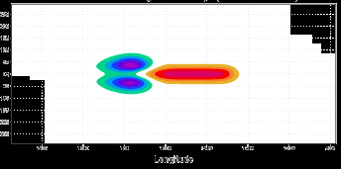
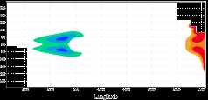
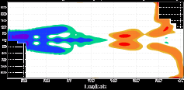
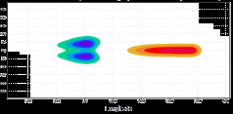
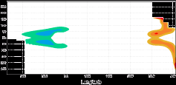
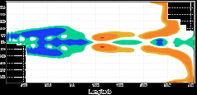
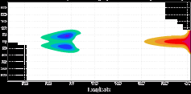
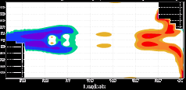
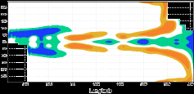
Kelvin & Rossby waves and Delayed Oscillator
T=0
t=75days
t=200days
t=25days
t=100days
t=225days
t=50days
t=125days
t=250days
Notes:
Evolution of the perturbation to the surface of the ocean generated by a wind perturbation.
The adjustment takes place in the way of equatorially confined Kelvin waves, propagating eastward, and Rossby waves, propagating westards. When the +ve Kelvin wave hits the Eastern coast, it reflects as a +ve Rossby wave (day100-125).
When the original –ve Rossby wave hits the Western coast (days=200/225), it reflects as a –ve Kelvin wave, which eventually will terminate the equatorial warming

Slide 24
Vertical Stratification and Satellite altimetry
The density of the second layer is only a little greater than that of the upper layer.
Typically g’~g/300
A 10cm displacement of the top surface is associated with a 30m displacement of the interface (the thermocline).
10cm
30 m
If we observe sea level, one can infer information on the vertical density structure

Slide 25
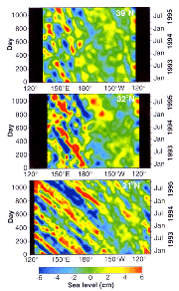
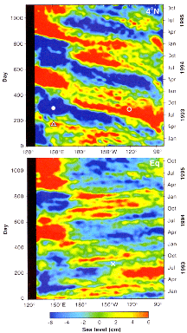
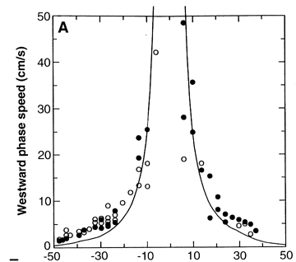
Rossby/Kelvin Waves from Space
4N
39N
Rossby waves
32N
Phase speed as a function of latitude
EQ
21N
Kelvin wave
Chelton et al 1996

Slide 26
Time scales for ocean-atmosphere interaction
ATM delay:
days-weeks
ATM response
ATM forcing
Heating/cooling
Evaporation/precip
Momentum transfer
Turbulent Kinetic energy for mixng
OCN forcing
OCN response
OCN delay:
Hours-days-decades
days
weeks
Months/years
Decades and beyond
Boundary layer processes
Equatorial Ocean Dynamics:
ENSO, IOD
Seasonal ML variations: NAO?
Subtropical Gyre, Rossby Waves, THC, MOC
Pacific/ Atlantic Decadal Variability
Tropical cyclones
Surface waves
Diurnal Cycle
Madden-Julian Oscillation
Tropical Instability Waves
Notes:
The interaction between the ocean and atmosphere is complex, involving exchange of turbulent fluxes of heat and momentum.
The heat exchange depends on the air-se temperature, wind speed, and moisture (among others).
The momentum exchange depends on the difference wind speed and ocean currents, and on the sea state.
In the ocean, the fresh-water flux is also important, since it affects the buoyancy.
This talk does not deal with the turbulent process determining the air-sea fluxes, but on the implication of this exchange on the predictability of the climate system.
The interaction between the ocean and atmosphere gives rise to a wide range of time scales in the climate system.
The nature of the ocean-atmosphere interaction has implications for modeling and for predictability.
For modeling: Do we need an ocean model for the weather forecast?
For predictability: how far ahead do we expect to predict the climate?
Traditionally the interactions are intuitively classified into 1-way and 2-ways coupling, depending on whether or not a separation of scales in the two media is a reasonable approximation. Example: how good is the approximation on considering constant SST in the forecasts range of 1-10 days? And 10-30 days?

Slide 27
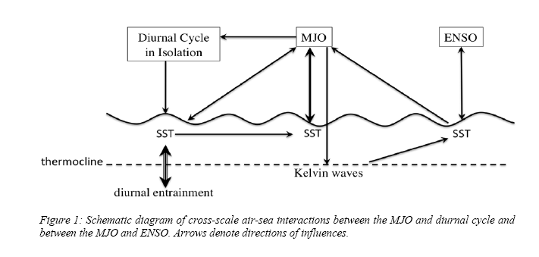
Air-Sea coupling: Scale interaction
North
PDO
AMO
Equator
South
Notes:
Diurnal rectifies in Intraseasonal
Intraseasonal affects Interannual (ENSO)
Seasonal affects ENSO
ENSO affects decadal
ENSO affects tropical cyclones,intraseasonal (MJO, TIWs),…
Mean affects all, all affect mean

Slide 28
Air-Sea coupled modes and time scales
ENSO: Interannual
  Tropical Dynamic/thermodynamic
  Essential for Seasonal Prediction
MJO: Intraseasonal
  Tropical Ocean mixed layer
  Essential for Monthly Prediction
Seasonal Cycle
Forced by the sun.
PDO, AMO: Decadal
  Tropical/midlatitudes Deeper ocean dynamics
  Decadal predictions
Diurnal:
  Tropical, summer Ocean diurnal layer
Others: Tropical cyclones, SST fronts

Slide 29
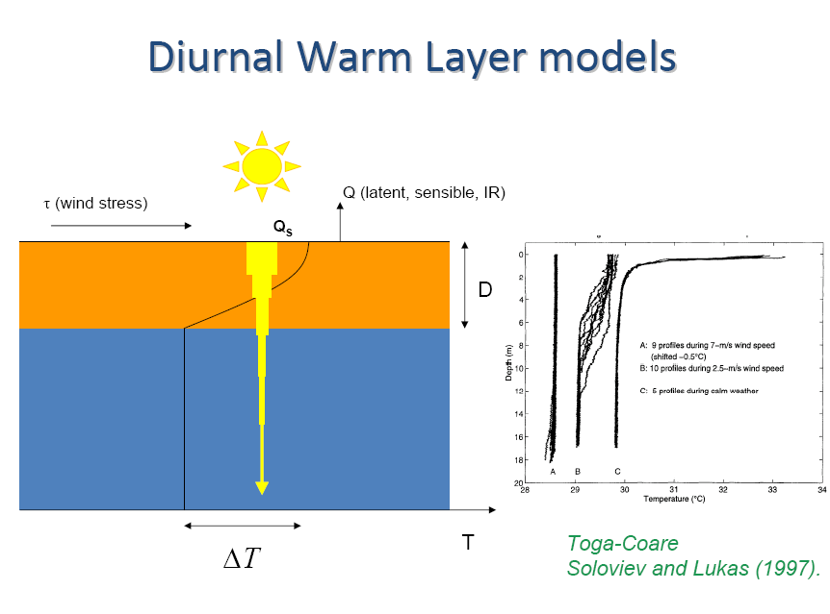
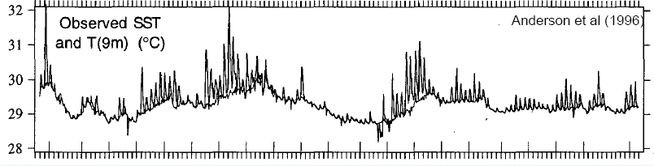
Diurnal Warm Layers: amplification of diurnal cycle
Stably stratified (warm) thin layers form during the day.
They isolate the deeper ocean by reducing vertical mixing.
The increase the value of peak temperature.
They trigger convection events, which can rectify in MJO

Slide 30
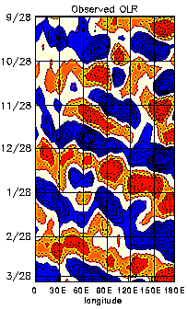
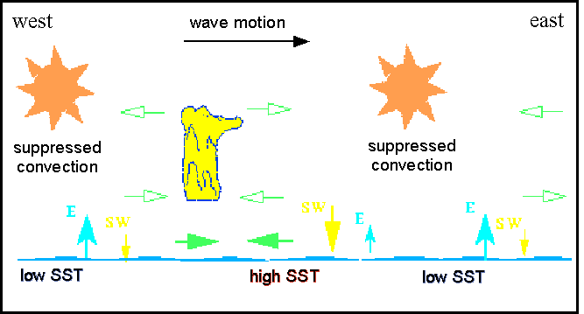
Madden-Julian Oscillation (MJO):30-60 days
Eastward propagating atmospheric disturbances associated to deep convection (see OLR above).
Bridge connecting diurnal and interannual variability. They can trigger ENSO.
Backbone of Monthly forecasts. Impacts NAO regimes

Slide 31
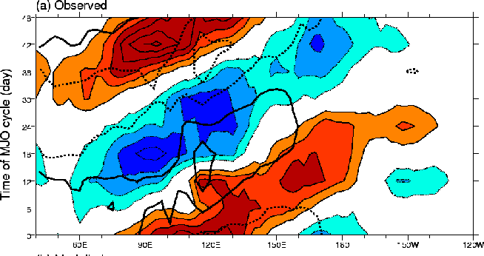
MJO: Coupled Mode
Composites of SST anomalies (contours) and OLR (colours) of MJO events. SST and convection are in quadrature.
The lead-lag relationship between SST and deep convection seems instrumental for setting the propagation speed of the MJO.
A two way coupling is required. Thin ocean layers are needed to represent this phase relationship.

Slide 32
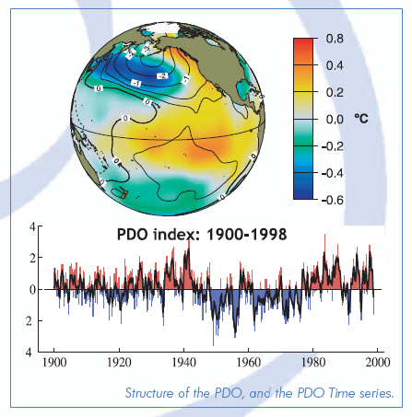
Decadal: Pacific Decadal Oscillation
Considerable debate: Is it integrated red noise? Or a truly coupled mode?
Influences marine ecosystems (Mantua et al 1997), North American rainfall (Latif and Barnet 1994,1996, Waliser 2008)
Latif et al, using results from a coupled model, hypotesized there is a coupled feedback (meridional SST gradients and gyre circulation).
Link with ENSO decadal variability.
More recently, link with ocean heat absorption and hiatus decades

Slide 33
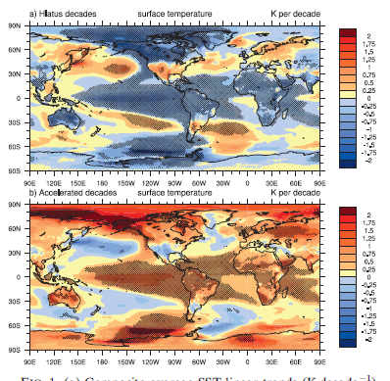
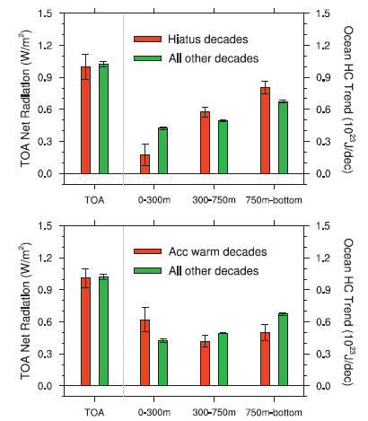
PDO, Hiatus decades and deep ocean warming
SST trends
Warming Rates
Hiatus decades
Accelerated decades
Meehl et al 2011, NG, Meehl et al 2013, JClim
The warming penetrates deeper during the hiatus decades, with less surface warming (weaker stratification).
Stronger surface warming and stratification in accelerated decades.

Slide 34
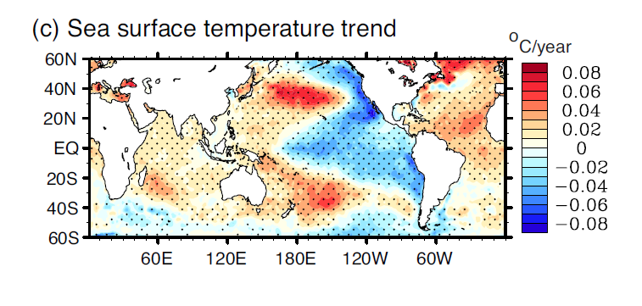
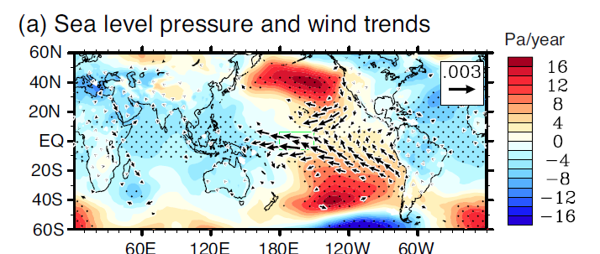
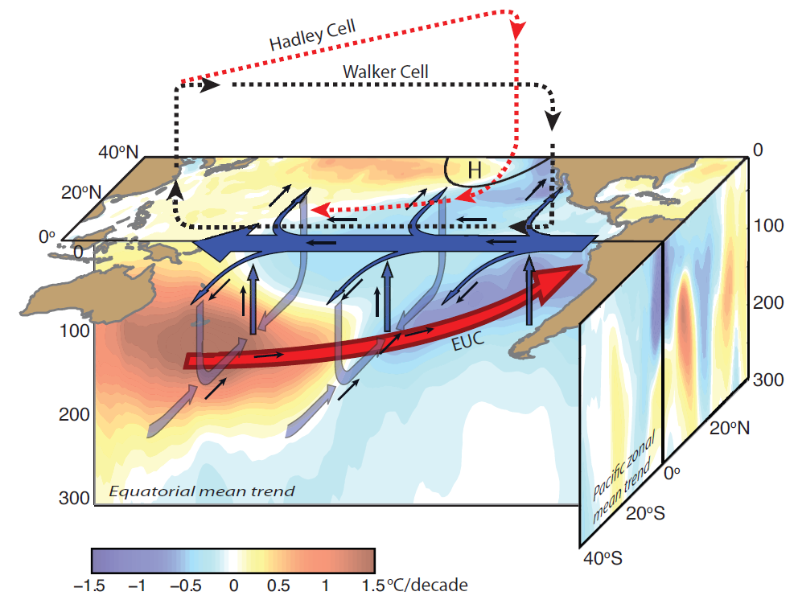
PDO and wind driven circulation
Intensified Walker circulation steepens the Equatorial Thermocline.
Intensified Hadley circulation, stronger gyres.
Stronger-deeper Ekman pumping and subduction. Increased ocean heat absortion
Stronger Poleward heat transport.
From England et al 2014

Slide 35
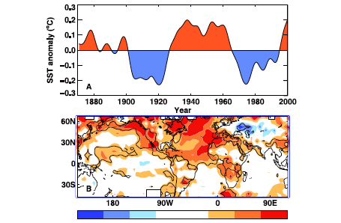
Atlantic Multidecadal Oscillation: AMO
From King et al 2005
Changes in the AMO linked to NE Brazil and Sahel rainfall, North Atlantic hurricane frequency, European and North American climate
  Warm AMO phase during the 40-50’s associated to decreased NE Brazil rainfall, increased Sahel rainfall, increased hurricane frequency
Evidence from observations and model studies.
Connected to the AMOC (Atlantic Meridional Overturning circulation)

Slide 36
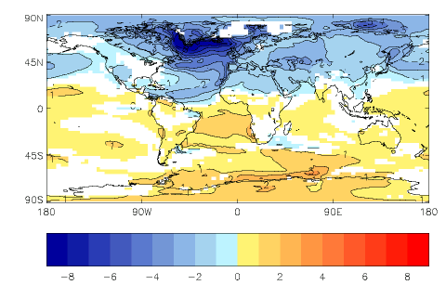
Sensitive to the Stability of the THC
Vellinga and Wood 2002:
Surface Air Temperature change 20-30 years after the THC slowdown by large fresh water input. The THC recovers after 120 years
Bryden et al 2005 suggested the slowing down of the AMOC based on 5 snapshots But large uncertainty due to possible aliasing
RAPID program is monitoring the AMOC at 26N since 2004.
But this is not long enough. It needs to be sustained.
Estimation of the AMOC using models and data assimilation is a big challenge
A weakening of the AMOC can also explain the increased heat uptake by the deep ocean (and hiatus of the surface warming).

Slide 37
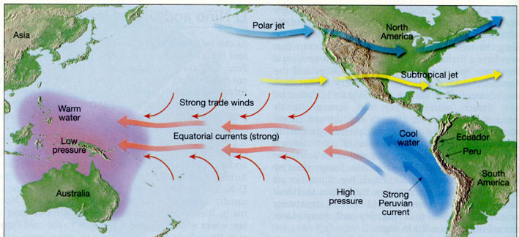
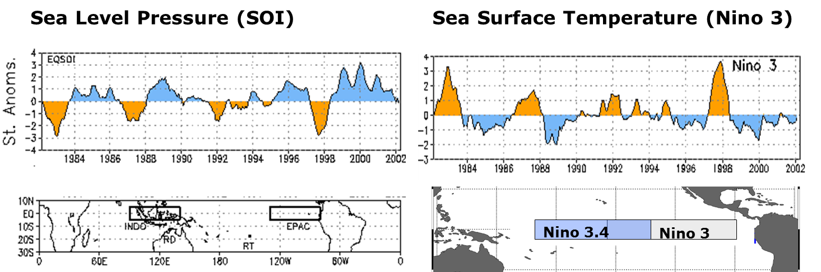
Interannual Time scales: ENSO
ENSO: El Nino -Southern Oscillation
Largest mode of O-A interannual variability
Best known source of predictability at seasonal time scales
It affects global patterns of atmospheric circulation, with changes in rainfall, temperature, hurricanes, extreme events
SOI: Southern Oscillation Index (SLP Darwin – Tahiti)
Notes:
Main Characters in ENSO history
Walker 1924, 1928 : Southern Oscillation Darwin-Tahiti
Peruvian fishermen: El Nino current interannual variability
Bjerkness 1966, 1969: EN-SO Coupled Ocean Atmosphere interaction and positive feedback
Wirtky 1975: Western Pacific Sea level as a predictor of El Nino (Kelvin wave propagation)
Conceptual models of ENSO 80’s. (Anderson and McCreary, Schopf and Sarez, Cane and Zebiak, Battisti and Hirst). Encompassed by Jin, JAS,1997
90’s Development of coupled GCMs
90’sTAO array: Back-bone of the ENSO observing system

Slide 38
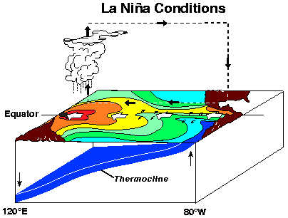
EL Nino (warm) and La Nina (cold)
El Nino is associated with reduced easterly (maybe even westerly) winds at the surface, a reduced thermocline slope and warm water in the east.
Normal/La Nina is associated with strong(er) easterly winds at the surface, a stronger thermocline tilt and cold water in the east.
Notes:
Walker 1924, 1928 (SOI)
Bjerkness 1966, 1969
Wirtky 1975: Sea-level
Philander 1990

Slide 39
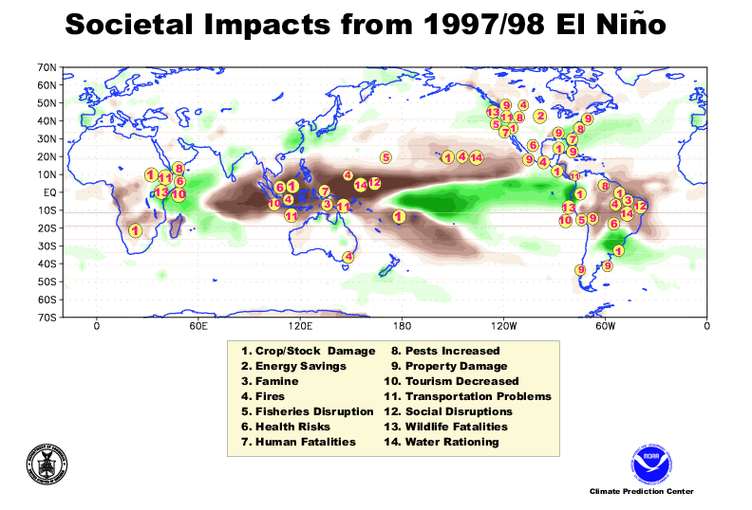
El Niño and Large Scale Precipitation
Increased Precipiation
Decreased Precipiation

Slide 40
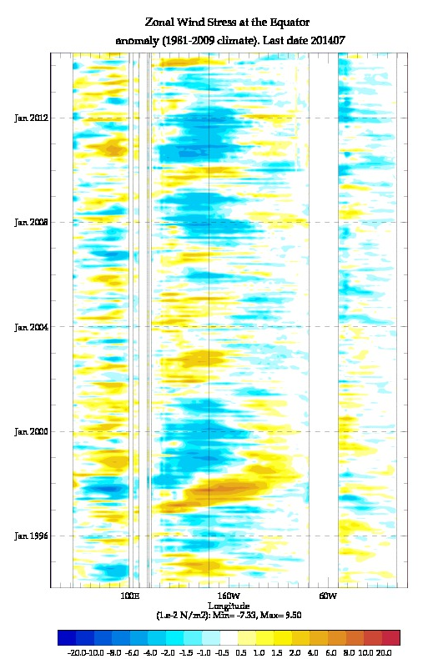
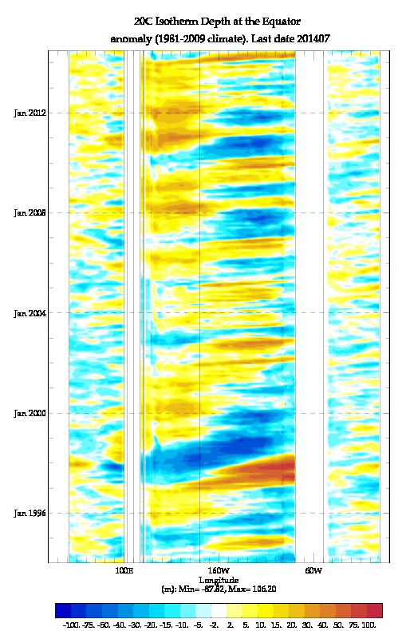
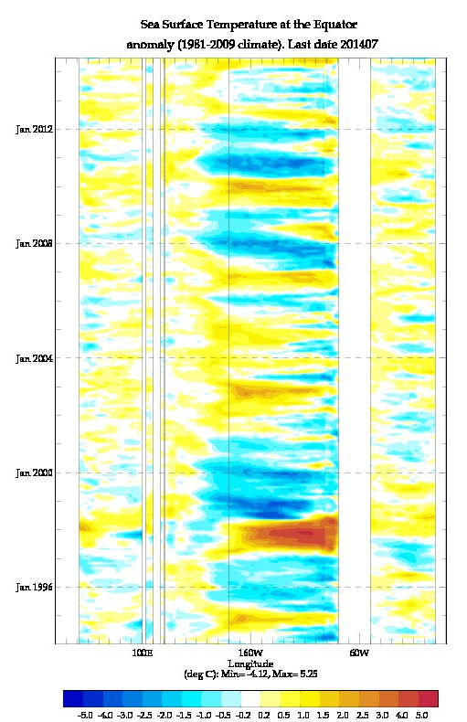
Last 20 years of Equatorial Anomalies
Taux Anomalies
D20 Anomalies
SST Anomalies
Note the strong 1997-8 El Nino and 1998-9 La Nina in Taux, D20 and SST
After them, ENSO has shown short-cycles of Central Pacific anomalies (no reaching the East Coast)
Until 2014, when a strong Kelvin wave was generated….

Slide 41
Kelvin & Rossby waves and Delayed Oscillator
T=0
t=75days
t=200days
t=25days
t=100days
t=225days
t=50days
t=125days
t=250days
Notes:
Evolution of the perturbation to the surface of the ocean generated by a wind perturbation.
The adjustment takes place in the way of equatorially confined Kelvin waves, propagating eastward, and Rossby waves, propagating westards. When the +ve Kelvin wave hits the Eastern coast, it reflects as a +ve Rossby wave (day100-125).
When the original –ve Rossby wave hits the Western coast (days=200/225), it reflects as a –ve Kelvin wave, which eventually will terminate the equatorial warming

Slide 42
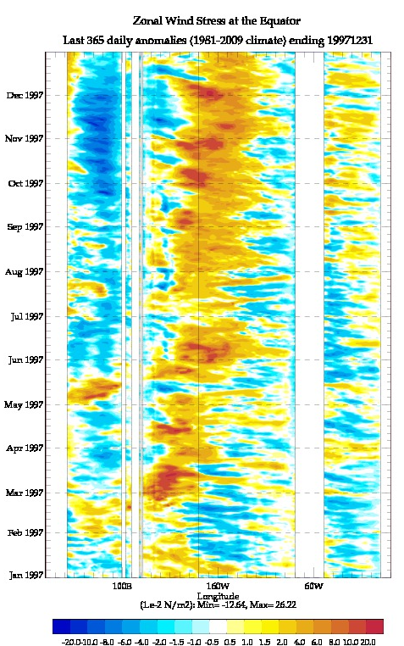
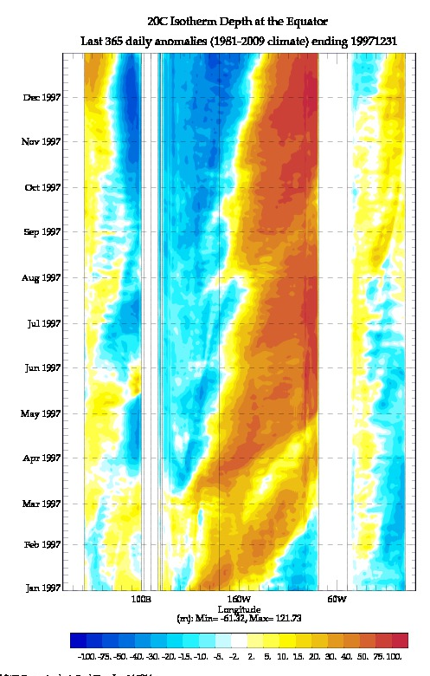


Daily Equatorial Anomalies: Jan 1997-Jan 1998
Taux Anomalies
D20 Anomalies
SST Anomalies
SL Anomalies
  March 1997@ Strong Westerly Wind bursts (WWB) in the West Pacific.
  Associated eastward propagating groups of Kelvin waves. The latest reaching the Eastern Coast
  SST anomalies develop in the West (as a displacement off the warm pool), and in the East, when the Kelvin waves arrive and depress the thermocline
  May/June 1997: More WWB . Or is this already ENSO? Bjerknes feedback in action.

Slide 43


Daily Equatorial Anomalies: Jan 1997-Jan 1998
D28 Anomalies
“Warm Pool”
Fresh Water Flux Anomalies
Blue is into the ocean
  Warm pool moves to the Central Pacific, taking with it the Atmospheric Deep Convection and Rainfall

Slide 44

El Nino Feedbacks: A complex Story
The strength of the feedbacks may change in a changing climate
From Philip et al 2010
Notes:
What is the relative strength of each feedback?
What is the relative importance of the Stochastic forcing?

Slide 45



Multitude of conceptual models for EL Nino
Bjerknes Feedback & EquatorialWaves
Delayed Oscillator Mechanism: BF+ Resonant Basin mode
  It does not explain the “a-periodicity”. Mostly adiabatic
System switching between 2 equilibriums.
  Switch is external: seasonal cycle, stochastic
Coupled Instability, stochastically triggered.
  Very unpredictable? How does it end?
Discharge/recharge mechanism

Slide 46

The 2015/16 strong El Nino and the false alarm in 2014
Great expectation in 2014 for a big El Nino
  Last one was in 1997/98
  There had been a hiatus decade (since ~2015) with negative phase of PDO
  Long lasting Californian drought
  Models and Experts predicted the possibility of a large warm event

Slide 47






Equatorial Anomalies: Sep 2013-Now (20th Sep 2015)
Taux Anomalies
D20 Anomalies
SST Anomalies
Sep 2015
Timing and properties of WWB?
2014 is Jan-Feb
2015 is March-May …
Background State?
Extra Equatorial SST?
Sep 2014
Killer Waves
Sep 2013

Slide 48




D28 Anomalies
P-E Anomalies

Slide 49




Temperature Anomalies
APR 2014
APR 2015

Slide 50




Temperature Anomalies
AUG 2014
AUG 2015

Slide 51




Growth of Perturbations: Temperature
INI Pert: APR 2015-2014
Final Pert: Aug 2015-2014

Slide 52






Another view
Depth 20C Isotherm (D20)
2015
2014
JFM
SST
June
North-West Trop Pac thermocline is deeper in JFM 2014. Possibly causing off Equatorial SST peak values later in June and associated convection.
In Central/East Eq Pac thermocline is deeper in 2015, possibly helping to lock convection at Equator, and preventing the seasonal northward migration of the ITZC

Slide 53






SST
P-E
July 2014
June 2014
July 2015
June 2015
Note SST>30deg North-West Trop Pac in 2014. In Central Pac in 2015.
Note narrower ITZC in 2014. Broader and 2015
Note ITZC northward migration in 2014, while it stays broad and close to the Eq in 2015
In 2015 the convection in West Pac is supressed (and SST cooling).

Slide 54
El Nino 2015/16: example of scale interactions
Interaction with low frequency variability:
  The events of 2014 prepare the ground for El Nino 2015
Interaction of intraseasonal variability:
  Do some properties of the WWB determine the outcome (timing, freq, strength, fetch)
  Are these properties “random”?. Or are they modulated by background state?
Interaction with the seasonal cycle: poleward migration of ITZC
  Possible role of the extra Equatorial anomalies.
Interaction with mean state:
  threshold values of SST to trigger deep convection

Slide 55
Summary of Coupled Ocean-Atmosphere Variability
The ocean-atmosphere interaction involves many time scales and a multiplicity of feedbacks.
This can lead to chaotic behaviour and abrupt regime transitions, but also to predictability (if oscillations, slow transitions, wave adjustment)
The nature of air sea interaction can be large-scale and small scale
Large scale: mainly in the tropics. Atmos responds to large and small scale SST anomalies and gradients. Organized deep convection and associated wind-driven circulation are key elements.
  SST anomalies can trigger deep convection (diurnal, MJO, ENSO…)
  Zonal SST gradients influence the Walker circulation (ENSO)
  Meridional SST gradient influence the Hadley and Gyre circulations (decadal)
Small scale: the atmos response to sharp SST fronts (WBC and TIWs) is receiving increased attention.
  Impact on storm tracks, blocking, NAO and possible decadal variability.
  Strong implications for modelling and predictability

Slide 56






Equatorial Anomalies: Sep 2013-Now (20th Sep 2015)
Taux Anomalies
D20 Anomalies
SST Anomalies
May 2016
May 2015
May 2014

Slide 57
Some additional References
On Simple dynamical systems and predictability
Hasselmann, K., 1976: Stochastic climate models. Part 1, Theory. Tellus 28,473-495
Saravanan et al 2000, Latif et al 2002, Timmerman et al 2005
On Ocean Circulation: Given in main presentation
On Ocean Heat Transports:
Stone (1978), Trenberth and Caron (2001), Cazja and Marshall (2007)
On Air Sea interaction at Mid-latitiudes
Frankignoul,C., 1985: Sea surface temperature anomalies, planetary waves and air-sea feedback in the middle latitudes. Rev. Geophys., 23, 357-390.
Kushnir and coauthors, 2002: Atmospheric GCM response to extratropical SST anomalies. Synthesis and evaluation. J. Climate, 15, 2233-2256.
Seager et al, Quart. Journal Roy. Met. Soc, 2002
On Air-Sea interaction in sharp SST fronts
Nakamura et al 2004: Observed associations among storm tracks, jet streams and midlatitude oceanic fronts. Earth’s Climate: The Ocean-Atmosphere Interaction, Geophys. Monogr., Vol. 147, Amer. Geophys. Union, 329–345
Small and coauthors, 2008: Air-Sea interaction over ocean and eddies. Dyn. Atmos. Oceans, 45,274-319
Hoskins and Valdes, JAS 1990, Minobe et al, Nature 2008, Nakamura et al, GRL, 2008,
On El Nino
Neelin, J.D., and coauthors, 1998: ENSO theory. J. Geophys. Res., 103, 14261-14290.
.On the MJO
Zhang, C. 2005: Madden-Julian Oscillation. Rev. of Geophysics, 43, RG2003
Arakawa and Kitoh, 2003: Comparison of local precipitation-SST relationship between the observatins and a reanalyisis dataset. Geophys. Res. Lett. 31, L12206.
Arakawa and Kitoh, 2003: Comparison of local precipitation-SST relationship between the observatins and a reanalyisis dataset. Geophys. Res. Lett. 31, L12206.

Slide 58
Additional Slides
Discharge-Recharge mechanism: oscillations and bifurcations in ENSO
Stability analysis of the thermohaline circulation: Stommel box model

Slide 59




Recharge/Discharge mechanism
West
T_{w} h_{w}
East
T_{e} h_{e} τ_{e}
R describes the Bjerkness Feedback for tropical ocean-atmosphere interaction.
It leads to instability when
αbγ is the recharge/discharge mechanism, leading to oscillations for real ω
μ Is the coupling intensity
F.F Jin, Parts I and II, JAS, 1997

Slide 60

Kind of solutions
1
2
3
Weak coupling: 2 decaying modes
Medium coupling: Oscillations
Strong coupling: 2 unstable modes
The parameters depend on the background ocean state
The presence of bifurcation leads to chaotic behaviour
Generalizations can include:
  Seasonal cycle
  Stochastic forcing
  Kelvin waves

Slide 61

Recharge/Discharge mechanism
F.F Jin, Parts I and II, JAS, 1997

Slide 62






Thermohaline Stability:
Longworth,Marotzke, and Stocker, 2005
Generalization of the Stommel model by including diffusion and wind forcing.
The equations here are only for the diffusive case (no wind)
Φ is a salinity flux. P is precipitation
q is the circulation
T/S/ρ temperature/salinity/density
Kd is the diffusivity
Reducing the number of variables, taking time derivative of q, assuming constant temperature gradient and using the time derivative of S
We calculate now the equilibrium solution by setting the time derivative to zero. We treat q>0 and q<0 separately.

Slide 63




Equilibrium Solutions
Stommel Box model K_{d}=0
1) Temperature dominated: 2 solutions
Scaling KαT=1
Temperature driven:
Stable
Unstable
q_{crit}
2) Salinity dominated (only possible for negative values of q )
Salinity Driven: stable
φ
Stability and bifurcations
For weak values of the circulation (0<q<qcrit) the equibrium is unstable, and a bifurcation can exist between a salinity driven mode (q<0) and a temperature driven mode (q>0)

Slide 64

Impact of diffusivity
With increasing values of Kd the unstable branch disappears (green curve)

Slide 65

1) THC is pushed by deep water formation
Stommel 1958, et al 1960: Keeping the ocean cold requires the existence of a deep circulation, with upwelling in the ocean interior maintaining the stratification and a Equatorward Flowing Deep Western Boundary Current. It needs the existence of localized deep water formation
Swallow et al 1961: Observations confirm the existence of the deep WBC predicted by Stommel
Stommel 1961; Bi-stable equilibrium of the THC (box model). Role of Salinity

Slide 66
2) THC is pulled by mechanical wind/tidal mixing
Munk, 1966.: by inferring the rates of upwelling and corresponding isopycnal diffussion, he concludes that the Stommel model would required too a strong mixing, not consistent with observations.
Munk and Wunsch, 1998: Convection can not drive the THC. Mixing or upwelling is required to pump cold water upward through the thermocline and drive the meridional overturning circulation. Tides and winds are the primary source of energy driving the mixing.
Gargett and Holloway, 1992: using numerical models show that the strength of the meridional overturning is very sensitive to the parameters controlling the vertical diffusion.
Marotzke and Scott (1999): using numerical models show that the overturning is not limited by the rate of convection
Wunsch, 2002, Science: What is the Thermohaline Circulation?

