Slide 1
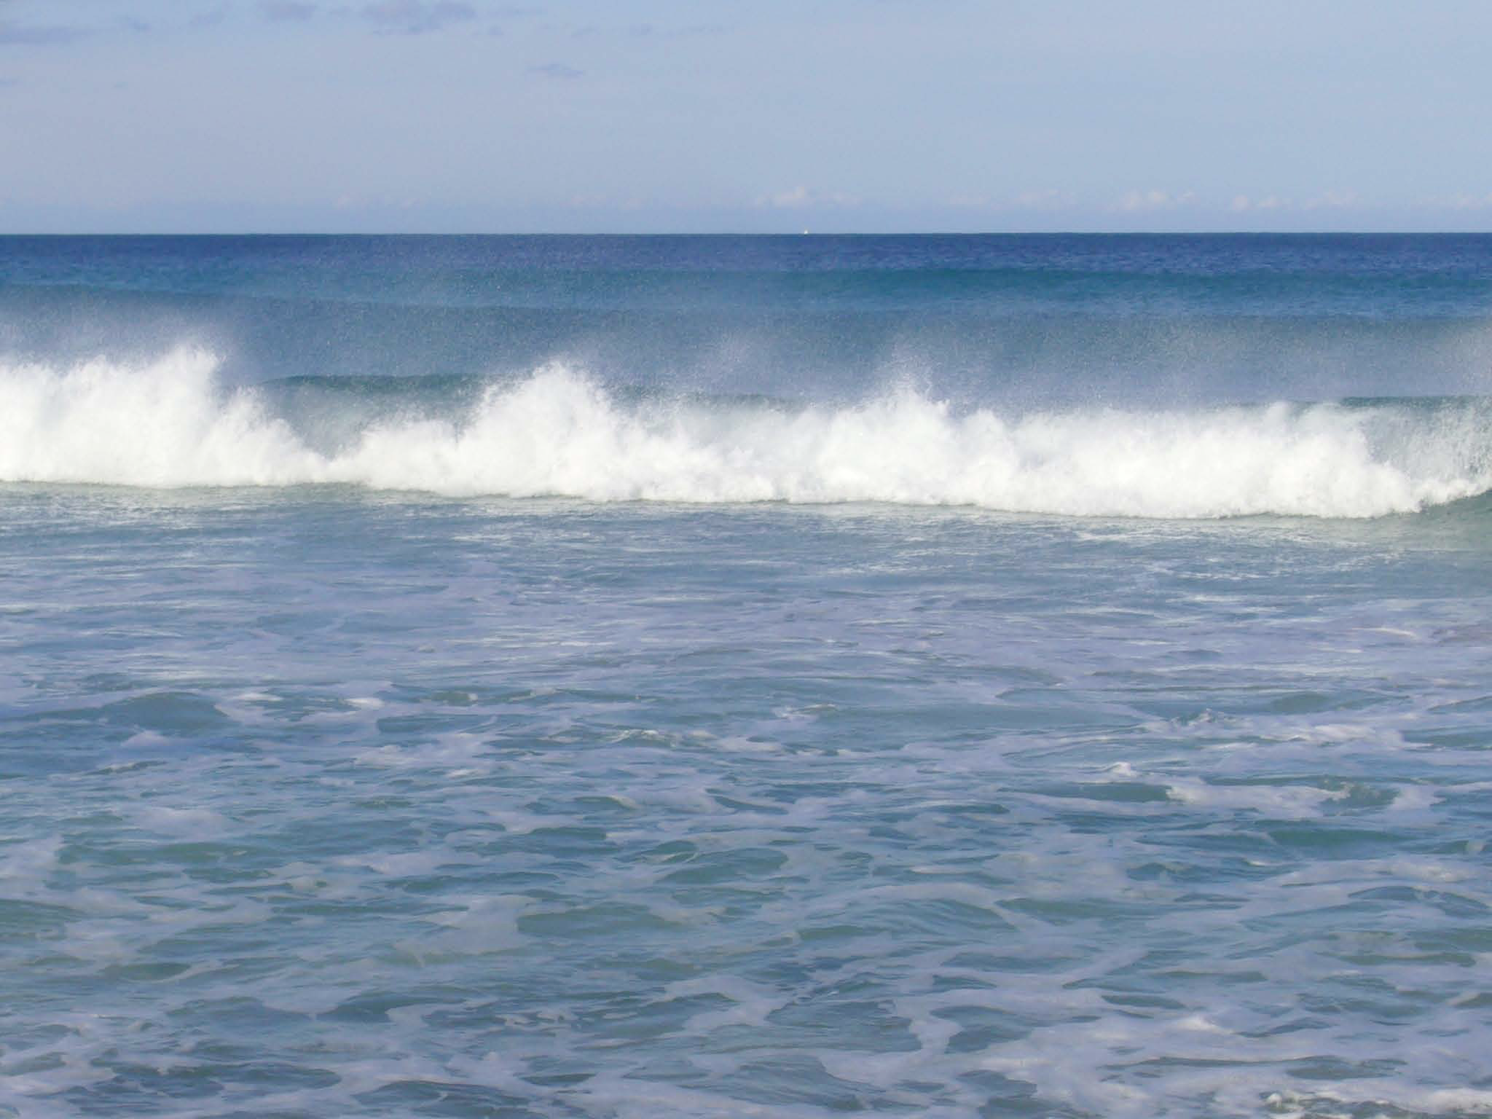
Implications for Predictability
Basis for extended range prediction
Simple conceptual models to understand predictability
Data assimilation in the ocean
And prospects for coupled DA
Magdalena A. Balmaseda

Slide 2
Outline of lecture
General remarks
  Applications of ocean data assimilation
  Ocean versus Atmosphere DA
  The Ocean Observing System
An example of Ocean DA: NEMOVAR
  Background co-variances
  Balance relationships: temperature, salinity, sea level and velocity
  Altimeter assimilation
  Bias correction
Outlook
  Strengths and weakness of current approaches
  Coupled Data Assimilation

Slide 3
OCEAN DA: components
The blue ocean: ocean dynamics.
  Primary variables: potential temperature (T), salinity (S) current (U,V) and sea surface height (SSH).
  Density is a function of T and S though the equation of state.
The white ocean: sea-ice. Not covered here
  Sea ice concentration and thickness. Very few thickness obs
  Non gaussian errors. Unknown balance relationships
The green ocean: biogeochemistry. Not covered

Slide 4
Why do we do ocean DA?
Forecasting: initialization of coupled models
  NWP, monthly, seasonal, decadal.
  Different depths of the ocean are involved at different time scales
  Climate resolution (global ~1, 1/4 degrees, …1/12)
Reconstruct & monitor the ocean (re-analysis)
Monitor/forecast the ocean mesoscale and biochemestry
  High resolution ocean analysis (regional, ~1/3-1/9-1/12 degrees)
  Defence, commercial applications (oil rigs …), safety and rescue, environmental (algii blooms, spills)

Slide 5
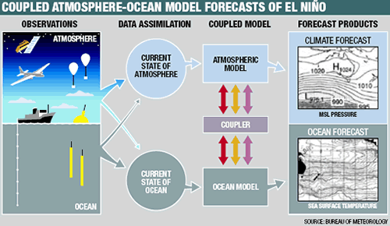
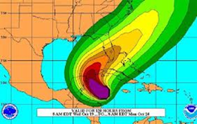
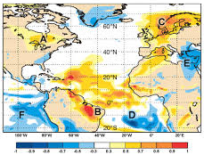

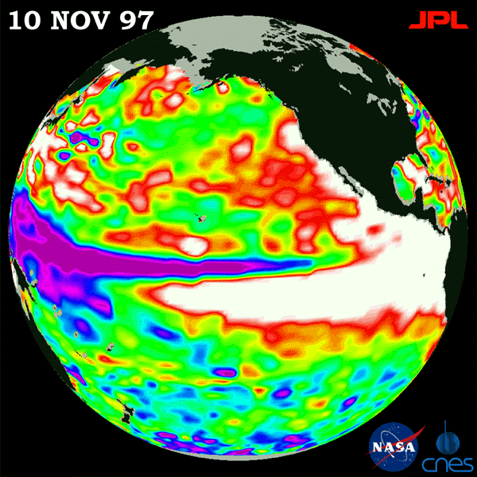
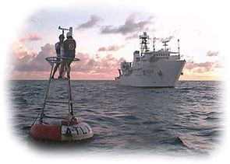
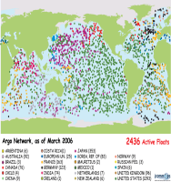
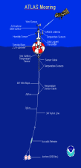
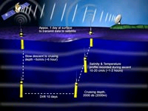
End-To-End Coupled Forecasting System
COUPLED MODEL
Tailored Forecast PRODUCTS
Atmosphere model
Ocean+WAM model
Extreme Forecast Index
Atmosphere model
ENSEMBLE GENERATION
PROBABILISTIC CALIBRATED FORECAST
OCEAN
Ocean+WAM model
Seasonal forecasts of Tropical cyclones
Atmosphere model
Ocean+WAM model
ENSO outlook
Initialization
Forward Integration
Forecast Calibration

Slide 6
Calibration and Reforecasts:
-Correcting model error
-Extreme Events
-Tailored products (health, energy, agriculture)
Ocean/Atmosphere reanalyses
Real time Probabilistic Coupled Forecast
time
Hindcasts, needed to estimate climatological PDF, require a historical ocean and atmospheric reanalyses
Consistency between historical and real-time initial conditions is required.

Slide 7
Ocean versus Atmosphere: some facts
Spatial/time scales The radius of deformation in the ocean is small (~30km) compared to the atmosphere (~3000km).
  Radius of deformation =c/f where c= speed of gravity waves.
  In the ocean c~<3m/s for baroclinic processes.
  Smaller spatial scales and Longer time scales
The ocean is strongly stratified in the vertical, although deep convection also occurs
  Density is determined by Temperature and Salinity
The ocean is forced at the surface by the wind/waves, by heating/cooling, and by fresh-water fluxes.
  Uncertainty in forcing fluxes contributes to uncertainty in model results.
The electromagnetic radiation does not penetrate into the ocean, which makes the deep ocean difficult to observe from satellites.
  The surface of the ocean can however be observed from space
The ocean has continental boundaries; dealing with them is not trivial in data assimilation

Slide 8
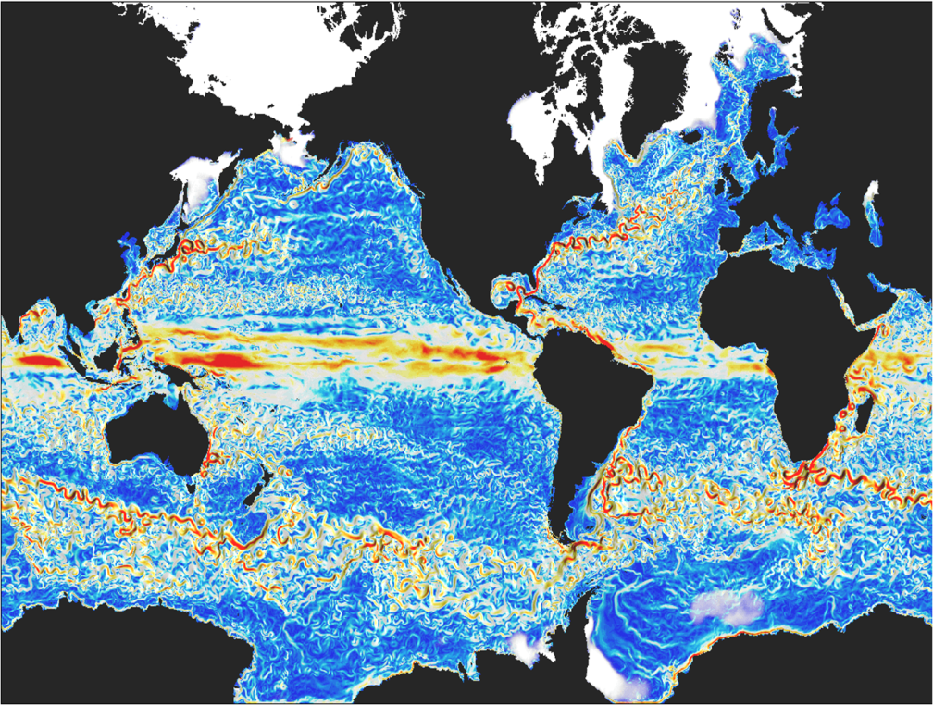
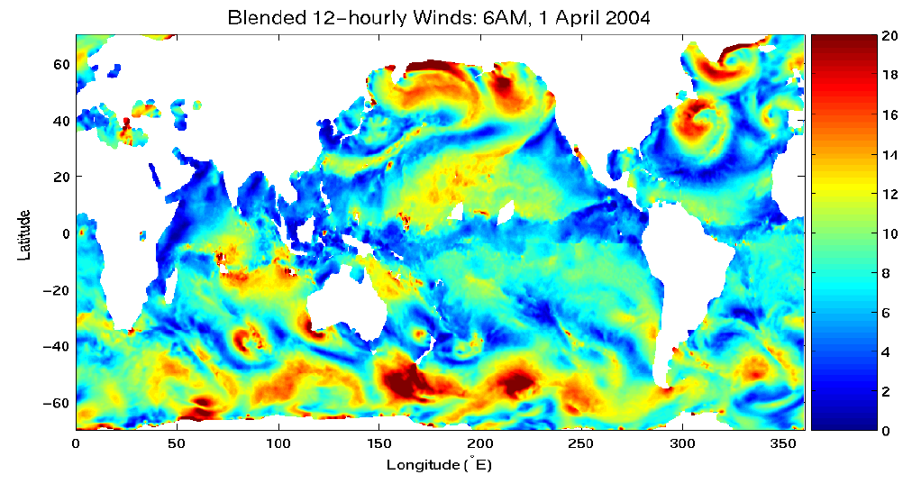
2 - Ocean Weather
(Zhang et al., )
Atmospheric wind speed (12h)
Ocean current speed (model simulation, 5 day mean)
Notes:
8
Note the different spatial scales of atmosphere and ocean.

Slide 9
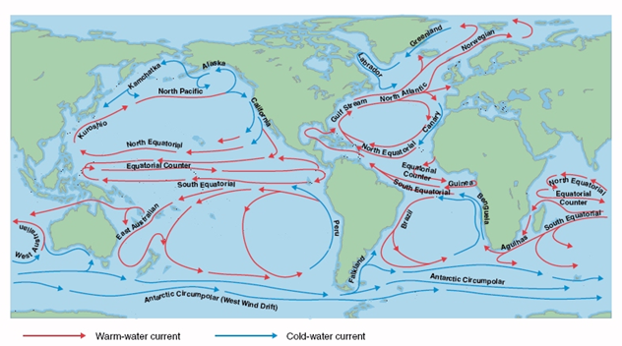
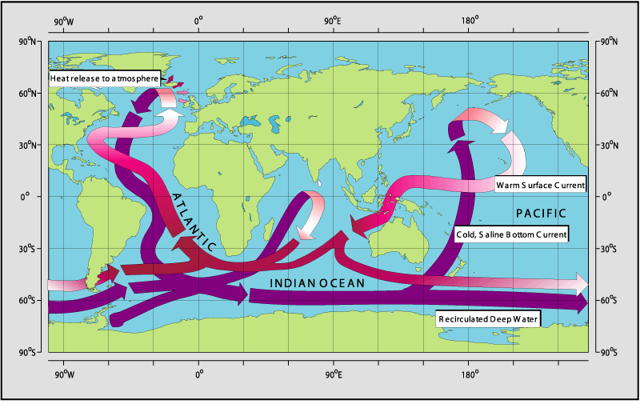
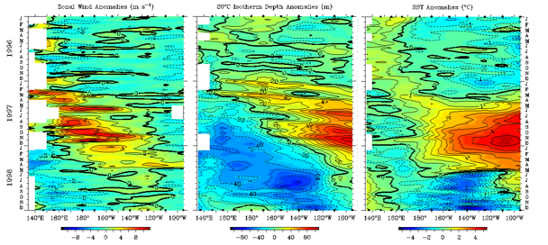
Ocean time scales: from hours to centuries
Wind Driven: Gyres, Western Boundary Currents, Upwelling regions (coastal, equatorial), Ekman pumping and subduction
Density Driven: Thermohaline Circulation
Zonal wind
Thermocline Depth
SST
Interannual and Decadal variability: Adjustment processes
Equatorial Kelvin waves (c ~2-3m/s) (months). ENSO
Planetary Rossby waves (months to decades)

Slide 10
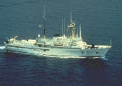
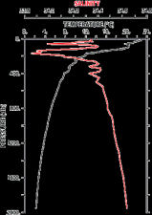
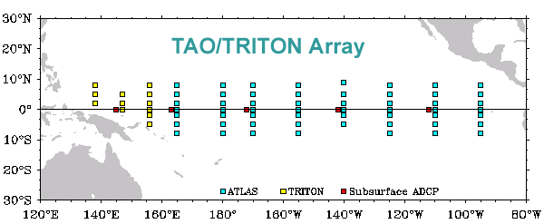

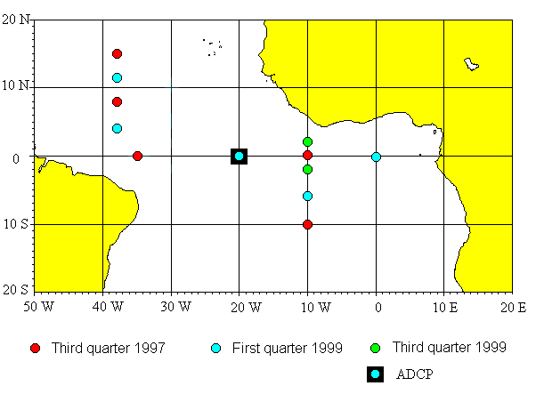
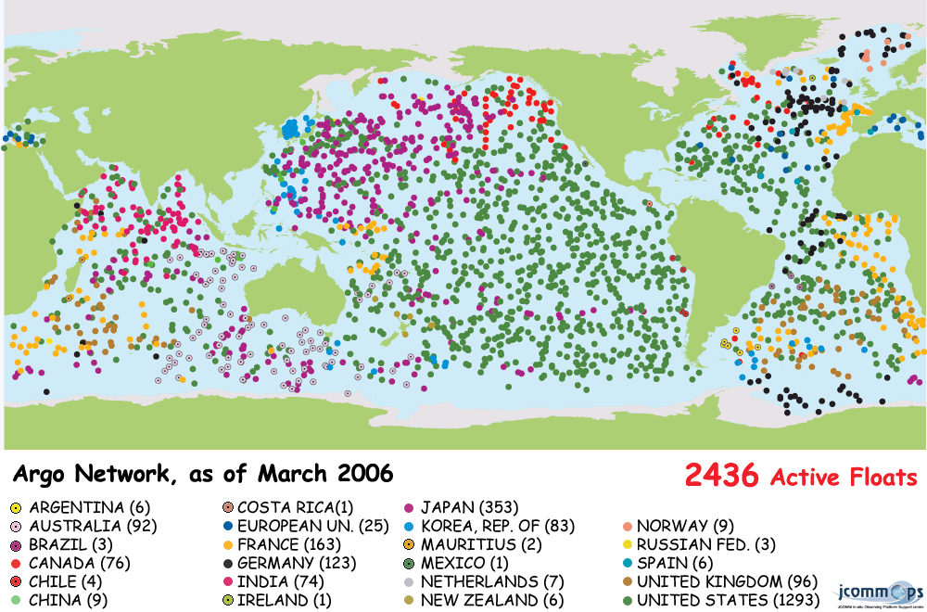
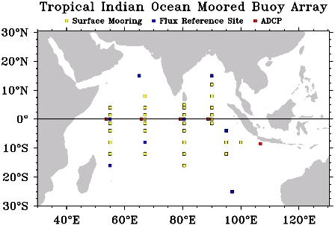
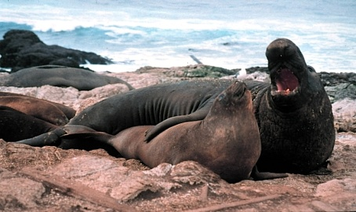
The Ocean Observing system
XBT (eXpandable BathiThermograph)
ARGO floats
Moorings
Satellite
SST
Sea Level
Elephant seals
Notes:
Ocean Observing System: the ocean has been poorly observed.
The electromagnetic radiation does not penetrate into the ocean (it is trapped in the upper meters), which is a major problem for full explotation of the satellite revolution
Moorings (Tao, PIRATA AND TRITON) (T and S)
XBTs (dropped from ships of opportunity) (T)
CTDs (High quality but very few- obtained by research ships) T and S
SST from satellite (IR,MW), ship and buoys.
SSS from a few ships, from a few moorings, from satellite in future. (eg SMOS, Aquarius)
Sea level from altimetry (ERS,TOPEX, Jason1, 2)
Current meters (very few ~5 along equatorial pacific)
Subsurface temperature and salinity from ARGO
Elephant seals with T/S sensors provides information about the subsurface in the arctic regions.
(T=Temperature, S=Salinity, SST=Sea Surface Temperature, SSS=Sea Surface Salinity, IR=infrared, MW=micro-wave)

Slide 11
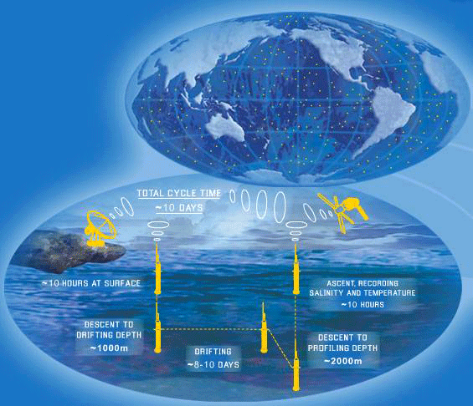
Time evolution of the Ocean Observing System
1982
1993
2001
2008
XBT’s 60’s Satellite SST Moorings/Altimeter ARGO
Gravity info:
GRACE
GOCE
TRITON
SSS info:
Aquarius
SMOS
1998-1999 PIRATA
Notes:
The ocean observing system has been slowly evolving in time. Only with the advent of the Argo program (completed in 2007), has the subsurface of the ocean (temperature and salinity) been observed with truly global coverage.

Slide 12
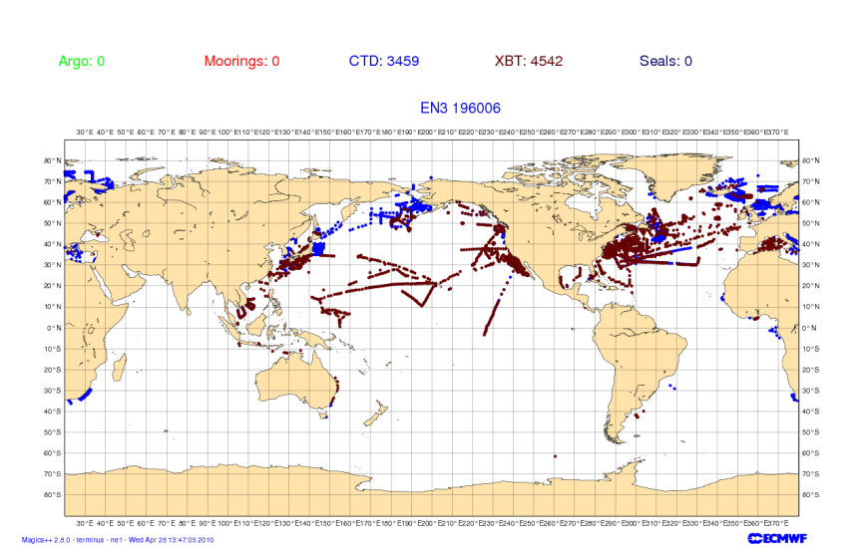
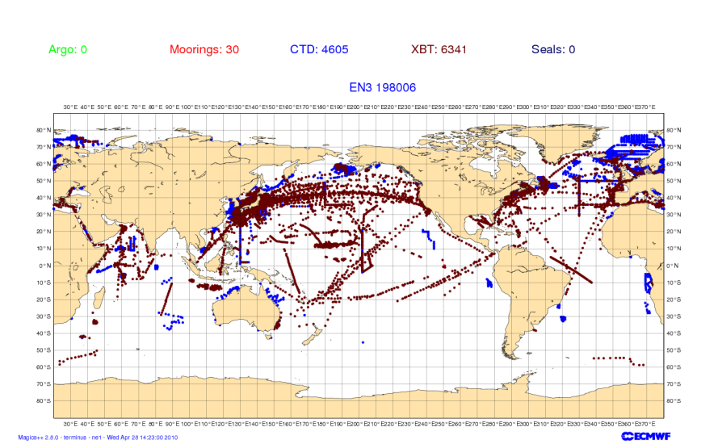
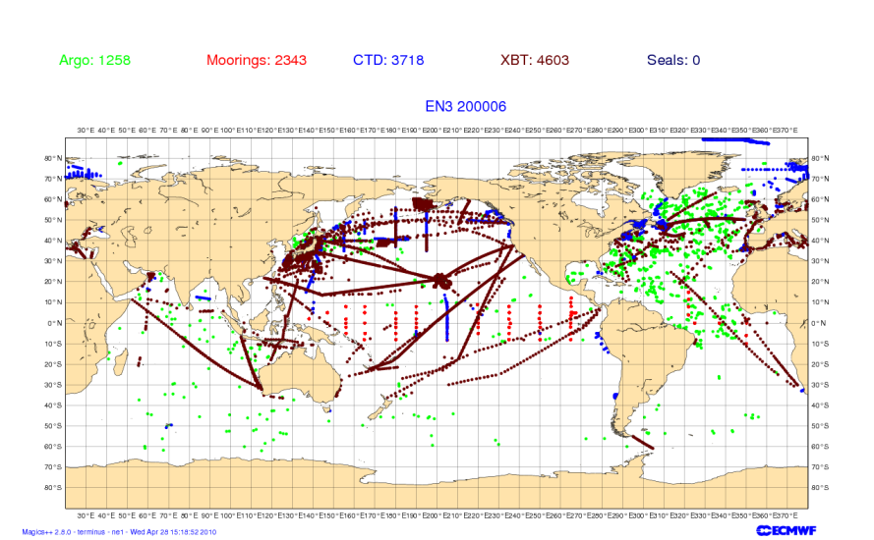
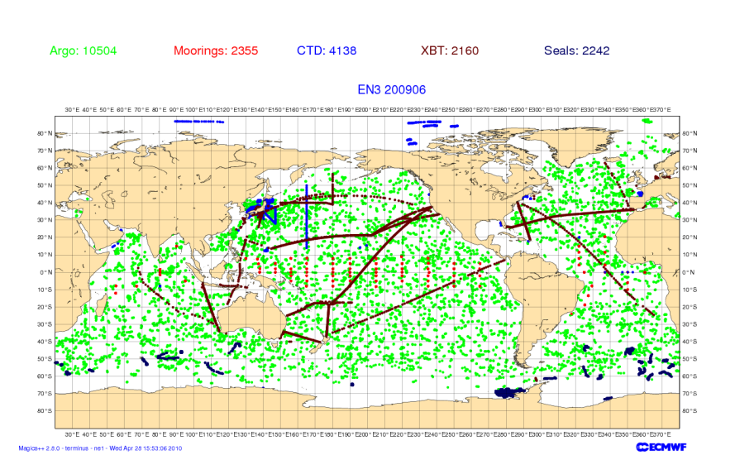
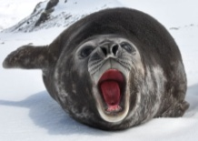
Changes to the T/S obs. network
Very uneven distribution of observations.
Southern ocean poorly observed until ARGO period.
Notes:
EN3 v2a dataset with XBT fallrate corrections
Available from the Met. Office (http://hadobs.metoffice.com/en3/).

Slide 13
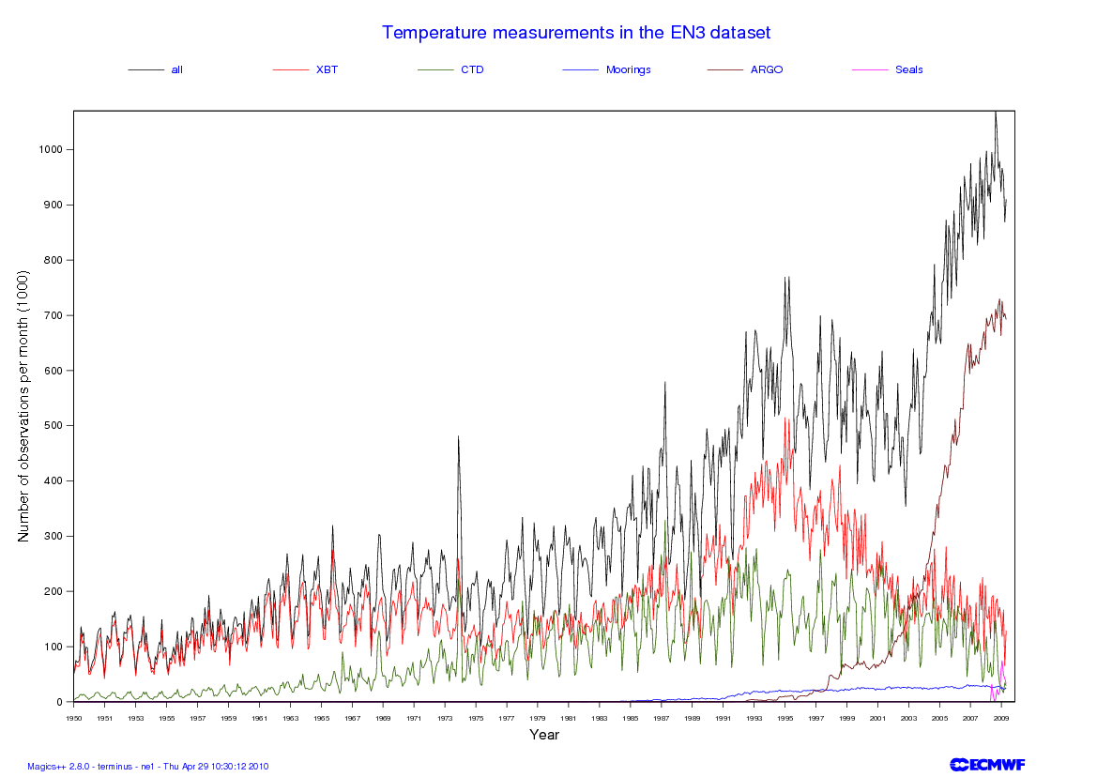
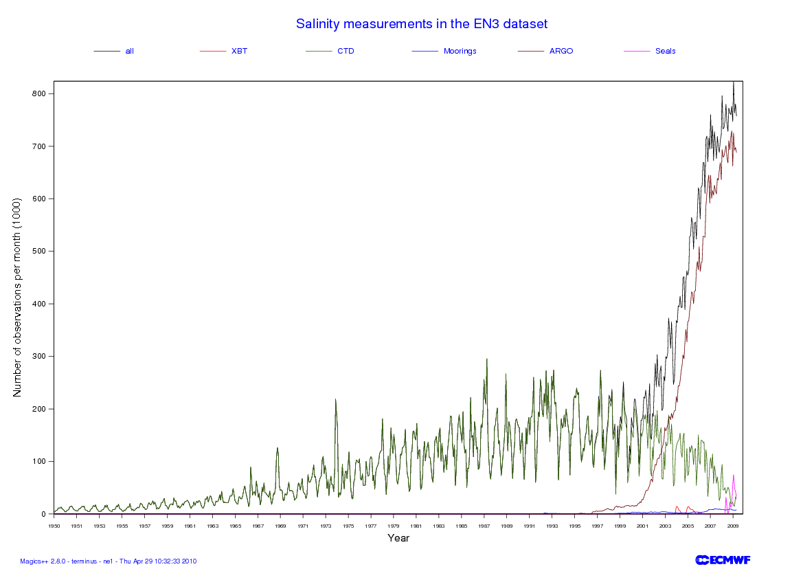
No. of T obs. as function of time
No. of S obs. as function of time
Notes:
Coverage is not uniform in space in the early years which is dominated by localized scientific cruises.
In the later years ARGO has become the primary source of temperature information with close to global coverage.

Slide 14
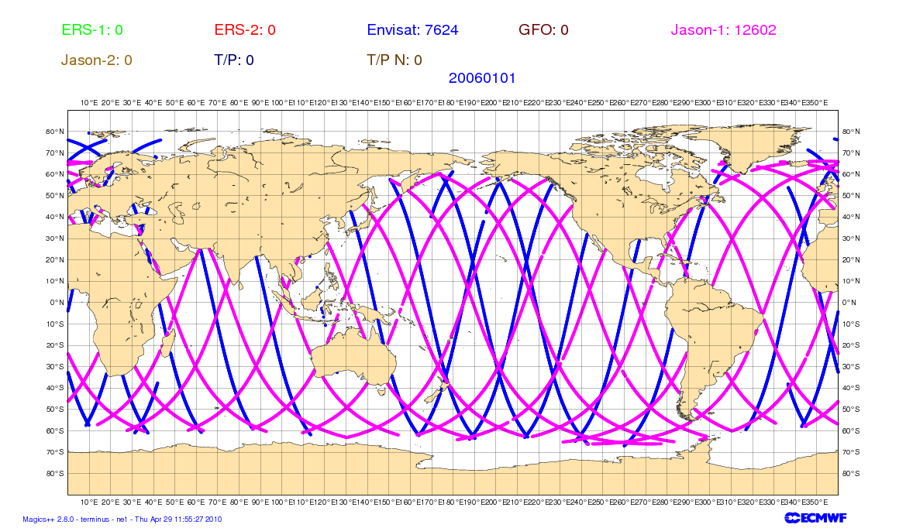
SSH observational coverage 20060101

Slide 15
What about altimetry?
Vertical Stratification and Satellite altimetry
The density of the second layer is only a little greater than that of the upper layer.
Typically g’~g/300
A 10cm displacement of the top surface is associated with a 30m displacement of the interface (the thermocline).
10cm
30 m
If we observe sea level, one can infer information on the vertical density structure

Slide 16
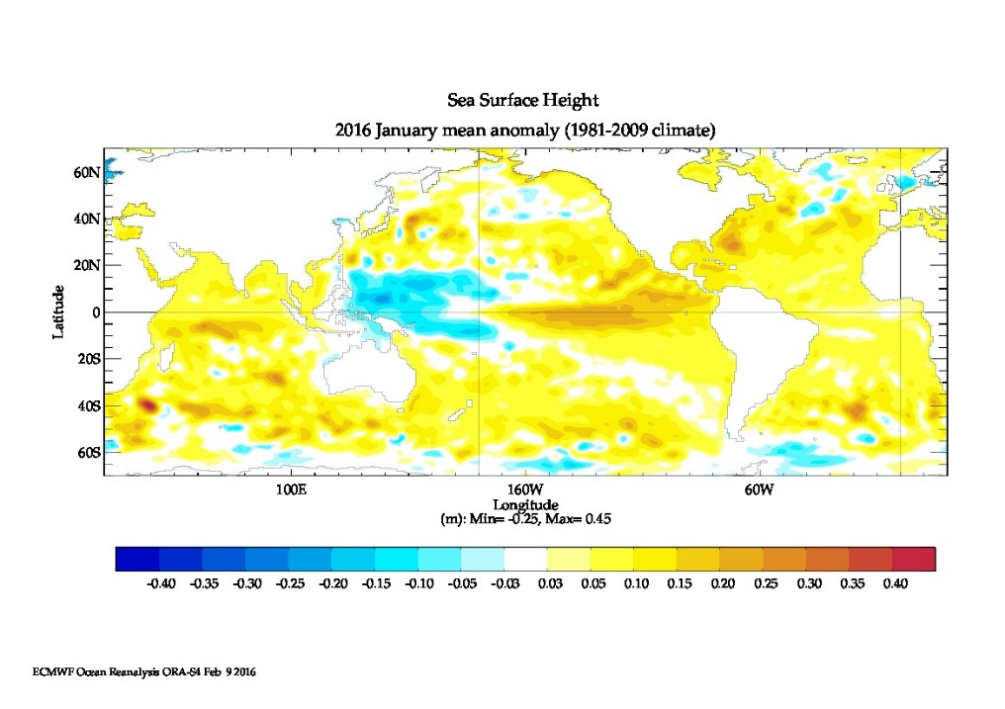
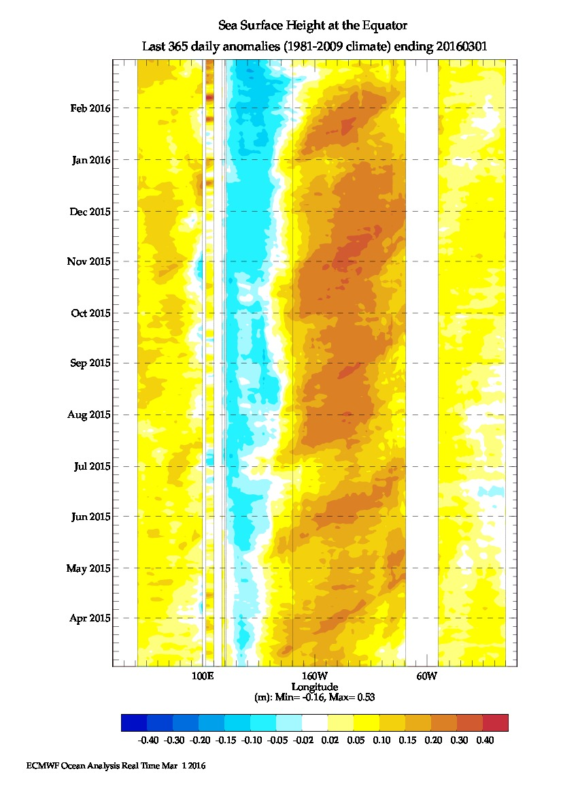
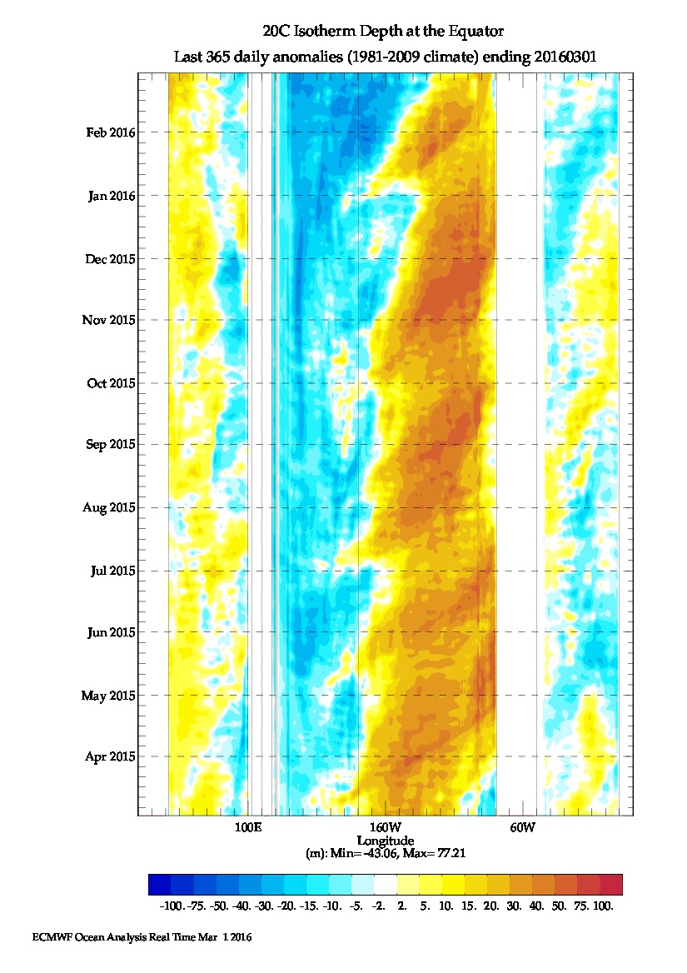
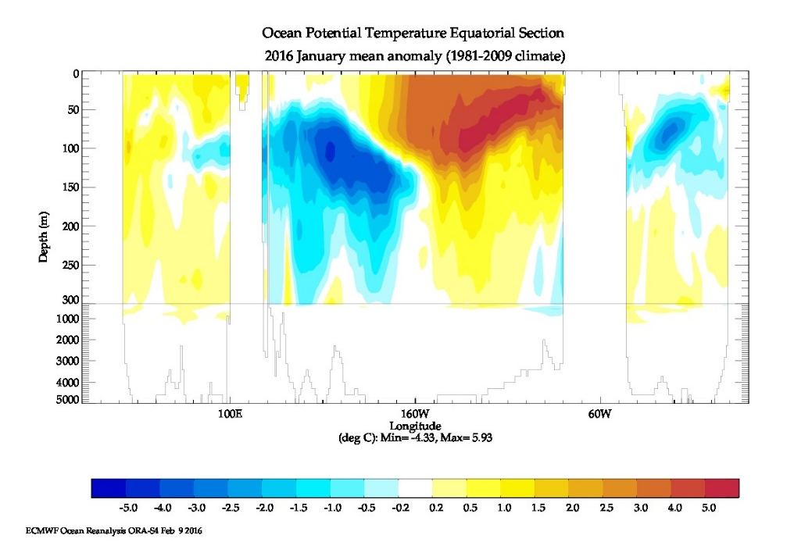
El Nino 2015/2016
Daily Equatorial Anomalies: March 2015-March 2016
SL Anomalies Feb 2016
SL Anomalies
D20 Anomalies
Lon/Depth Temp anom Feb 2016

Slide 17
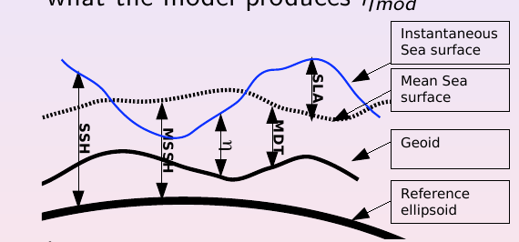
Assimilation of altimeter data
Altimeter measures SSH (respect reference ellipsoide)
Model represents η (ssh referred to the Geoid)
SSH-Geoid= η
Geoid was poorly known (not any longer) and changes in time (*)
Alternative: Assimilate Sea Level Anomalies (SLA) respect a time mean
Obs: SSH anomalies = SSH-MSSH = Obs SLA
Mod: η anomalies = η – MDT = Mod SLA
Where: MSSH= Temporal Mean SSH ;
MDT = Temporal Mean of model SL Mean Dynamic Topography
MSSH – Geoid = MDT

Slide 18
Ocean assimilation systems
DA systems based on optimum interpolation (OI), variational techniques (e.g. 3D/4D-Var) or various ensemble Kalman filter based methods.
  Or various hybrid combinations, just like for the atmospheric systems.
First guess given by an ocean model forced by atmospheric fluxes.
Usually observations are used to modify Temperature (T), Salinity (S), SSH. Velocities are derived via balance relationships.
How to deal with coast lines is not trivial.
  E.g. we don’t want increments (result of analysis) from the Pacific to propagate to the Atlantic across Panama.
To avoid initialization shock increments are typically applied via Incremental Analysis Update (IAU) which applies the increments as a forcing term over a period of time.
Bias correction is very important is very important for reanalyses applications

Slide 19
Example of ocean DA:NEMOVAR
Variational DA system for the NEMO ocean model
Collaborative project CERFACS, ECMWF, INRIA and the Met Office.
NEMOVAR solves a linearized version of the full non-linear cost function.
Incremental 3D-Var FGAT running operationally at ECMWF and Metoffice.
4D-Var working on research model
Diffusion operators are used for background correlation model (not discussed here, quite expensive).
Partition into balance and unbalance components is adopted for the formulation of B.

Slide 20



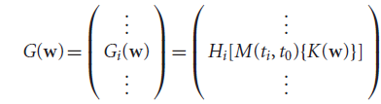



NEMOVAR algorithm
Weaver et al 2003,2005
Daget et al 2009
Mogensen et al 2012
Balmaseda et al 2013
4D observation array
w is the control vector
Departure vector
Solution
In w space, B is block diagonal, representing the spatial covariance model. The variables are linearly independent.
Question: how to specify the spatial covariances?. In the current version of NEMOVAR, this is done by diffusion operator (Weaver and Courtier 2001)
IAU,Bloom et al 1996

Slide 21
Background errors for ocean assim B.
Typical length scales for the applications at ECMWF :
  ~1-2 degree at mid latitudes
  ~15-20 degrees along the eq.
The background error correlation scales are highly non isotropic to reflect the nature of equatorial waves- Equatorial Kelvin waves which travel rapidly along the equator ~2m/s but have only a limited meridional scale as they are trapped to the equator.
Complex structures and smaller length scales near coastlines are usually ignored.
Background errors are correlated between different variables (multivariate formulation) through balance relations (next slides).
  E.g. an temperature observation gives rise to an increment in salinity.
The background errors include some (but not all) flow dependent aspects.

Slide 22
Linearized balance operator
Define the balance operator symbolically by the sequence of equations
Temperature
Salinity
Treated as approximately
mutually independent without cross correlations
SSH
u-velocity
v-velocity
Density
Pressure
(Weaver et al., 2005, QJRMS)
Notes:
22
The balance relationship described above between Temperature and Salinity and density and velocity can be expressed in a matrix form adequate for a multivariate 3D-var. Weaver et al 2005. Note the separation into balance and unbalance components.

Slide 23
Components of the balance operator
Salinity balance
(approx. T-S conservation)
SSH balance
(baroclinic)
u-velocity balance
(geostrophy with
β-plane approx. near eq.)
v-velocity
(geostrophy, zero at eq.)
Density
(linearized eq. of state)
Pressure
(hydrostatic approx.)
Notes:
23

Slide 24
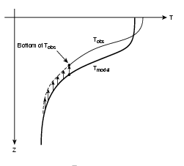
T/S/SSH balance: vertical displacement of the profile.
S
Tanal
Sanal
Tmodel
Smodel
A) Lifting of the profile
B) Applying salinity Increments

Slide 25
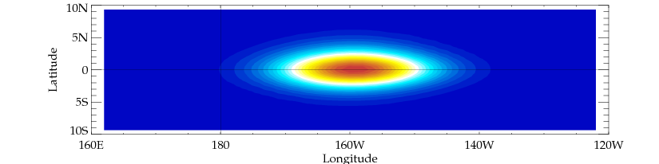

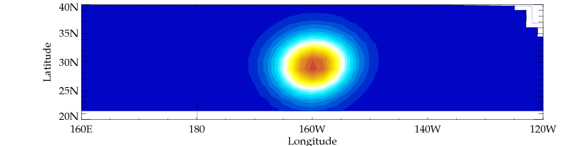
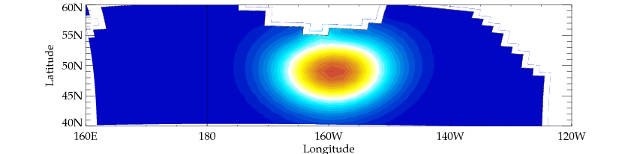
Horizontal correlation of T at 100m
From single observation of temperature experiment.
Wider longitudinal length scales at equator.
At 50 N the coast line comes into play.

Slide 26
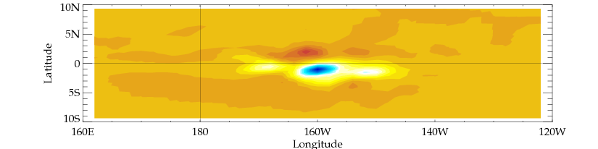
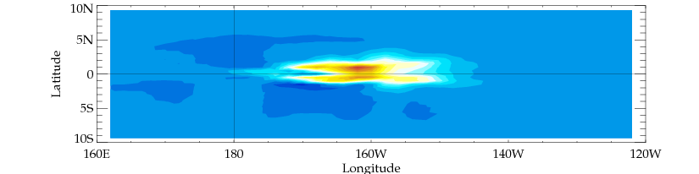
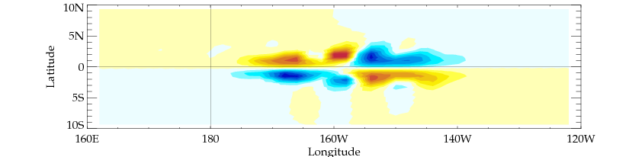

Horiz. cross correlation of T at 100m
T
S
U
V
SSH
From single observation of temperature experiment.
The specific background determines the shape due to the balance relations.
S, U, V, SSH increments are from balance with T only.

Slide 27
Assimilation of altimeter data
Observed SLA (Sea Level Anomaly) from altimeter
Respect to 7 year mean of measurements. Provided
Ingredients:
  The choice of MDT for of the reference global mean is not trivial and the system can be quite sensitive to this choice. Active area of research.
The GLOBAL mean sea level (GMSL) needs to be removed prior to Assimilation
  Ocean models are volume preserving, and can not represent changes in GLOBAL sea level due to density changes (thermal expansion, ….).
GMSL can be assimilated separately: The difference between Altimeter GMSL and Model Steric Height is added to the model as a fresh water flux.
A Mean Sea Level or MDT respect a similar period
Notes:
However the altimeter only provides information about the time anomaly, respect a mean sea surface height (SSH) or mean sea level (usually as the time mean 1993-2002). Also called Mean Dynamic Topography (MDT)
Measurements of mean sea level would help to correct the mean state. Three satellites to help improve the mean sea level are in progress. (Two are already in orbit). GRACE, CHAMP, GOCE
Using a mean sea level from geodetic missions is an active area of research.

Slide 28
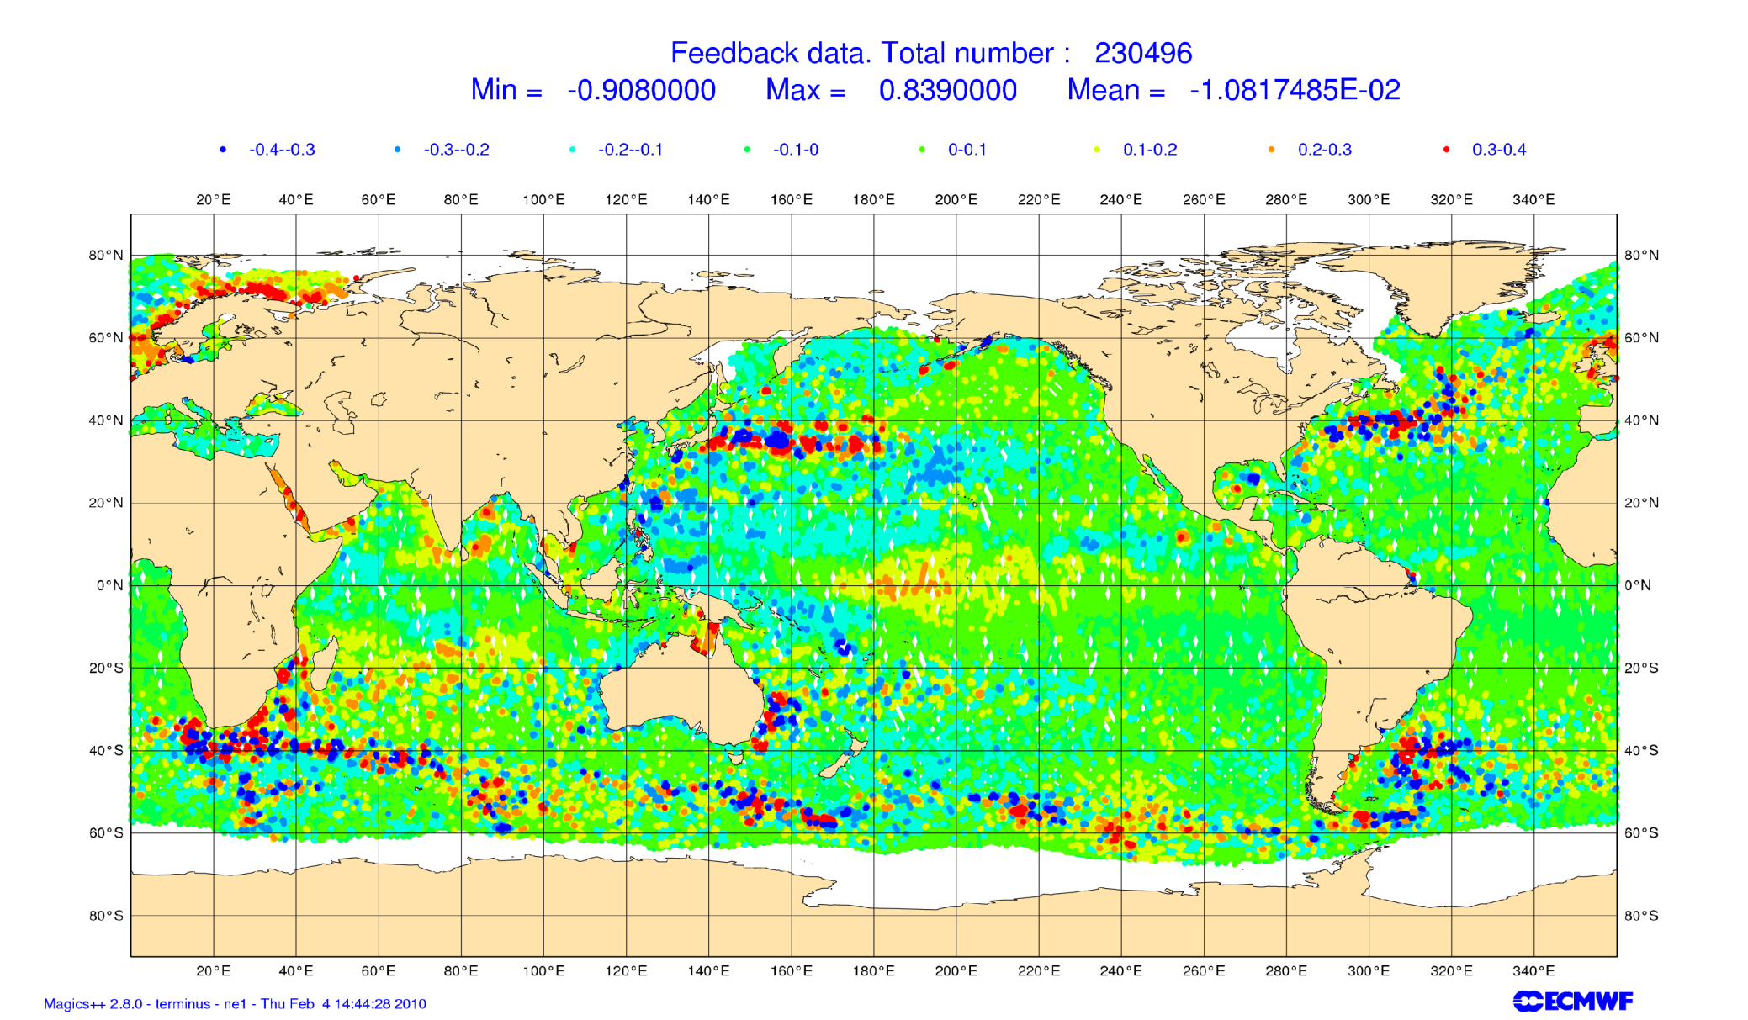
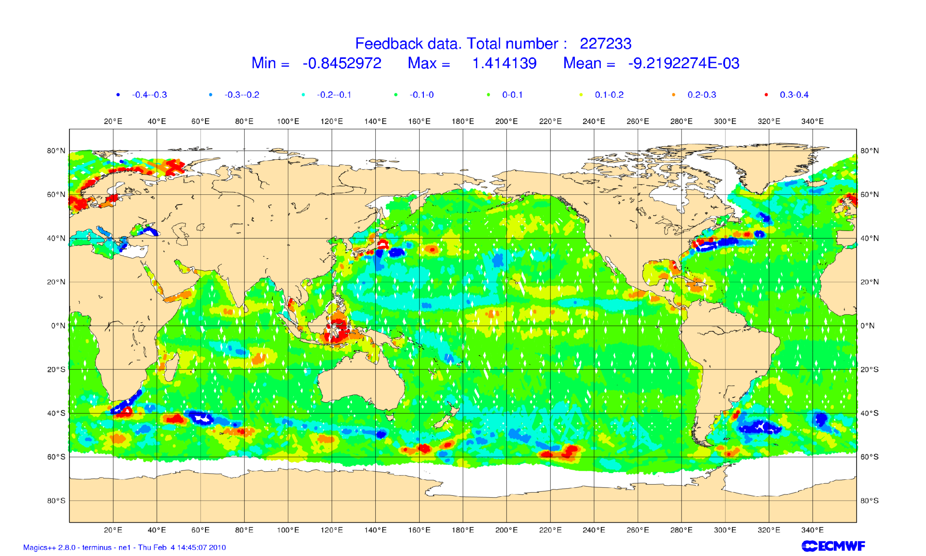
Obs SLA 10 days
Other SLA issues:
The SLA along track data has very high spatial resolution for the 1 degree “class” of ocean assimilation systems.
  Features in the data which the model can not represent.
This can be dealt with in different ways:
  Inflate the observation error to account for non representativeness of the “real” world in the assimilation system.
  Construction of “superobs” by averaging.
  Thinning
Model (1 deg) SLA in 10 days

Slide 29
Why a bias correction scheme?
Bias Correction Scheme
Models/forcing have systematic error (correlated in time)
Changes in the observing system can be damaging for the representation of the inter-annual variability.
Part of the error may be induced by the assimilation process.
What kind of bias correction scheme?
Multivariate, so it allows to make adiabatic corrections (Bell et al 2004)
First guess + adaptive component.
Generalized Dee and Da Silva bias correction scheme
Balmaseda et al 2007

Slide 30
Impact of data assimilation on the mean
Assim of mooring data
NoAssim
PIRATA
Large impact of data in the mean state: Shallower thermocline
Notes:
This figure shows the time evolution of the depth of the equatorial thermocline in the Atlantic for 2 experimens:
CTL, (ocean forced by wind, in black), and Assim (in red, where the subsurface data have been assimilated)
The advent of the temperature data for the PIRATA moorings in 1998/1999 can be appreciated in the ASSIM experiment by the sudden shallowing of the thermocline:
The PIRATA data corrects for a systematic error of the background (which has too depth thermocline). The net effect is an spurious jump that induces spurious interannual variability.
To prevent this sort of behaviour, an adequate and explicit treatment of background bias is required

Slide 31
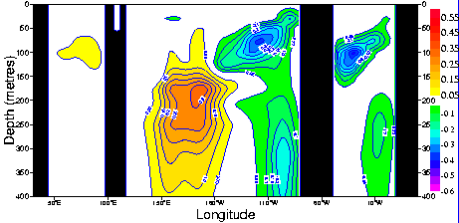
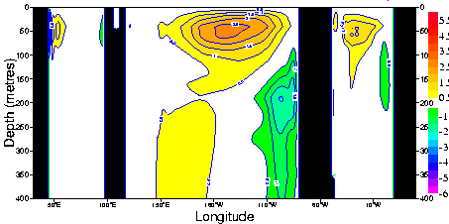
The systematic error may be the result of the assimilation
T-Assim incr (C.I=0.05 C/10 days)
Mean A-O (T)
NINO 3
No assim
assim
100m
Vertical velocity (C.I=0.5m/day)
200m

Slide 32
Bias Correction Algorithm
Seasonal term, estimated offline from rich-data (Argo) Period
Slow varying term, estimated online from assimilation increments dk
Bias online: Time evolution
Need to determine:
Offline bias correction
Time evolution of on-line bias: α (memory) and β (updating factor)
A(y): Partition of bias into T/S and pressure gradient.
  Function of latitude. At the equator the bias correction is mainly adiabatic (pressure gradient)
Refinement of Balmaseda et al 2007, Dee 2005, Bell et al 2004
The offline bias correction is estimated from Argo period.
The correction is applied since 1957-00-01 to present.
It is a way of extrapolating Argo information into the past.

Slide 33
Effect of bias correction on the time-evolution
Assim of mooring data
No Assim
Bias corrected Assim
Notes:
The a-priori (iterative) estimation of the bias corrects the solution before the PIRATA moorings appear, hence preventing the shock.

Slide 34
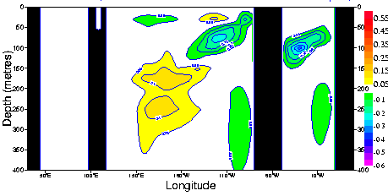
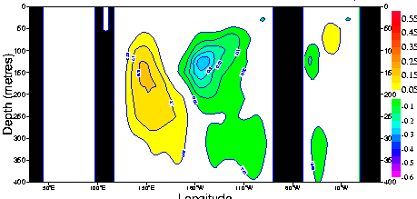
a)Impact of Balance in Bias
Assim incr (C.I=0.05 C/10 days)
Experiment E0
No bias correction
Experiment EP
Correcting bias in pressure gradient
Experiment ET
Correcting bias in Temperature

Slide 35
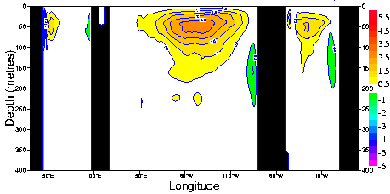

b)Impact of Balance in Bias
Vertical velocity (C.I=0.5m/day)
Experiment E0
No bias correction
Experiment EP
Correcting bias in pressure gradient
Experiment ET
Correcting bias in Temperature

Slide 36
Room for improvements
Choice of control variable
  Separate assimilation of T and S can be problematic.
  Use density instead?
Difficult to parameterize covariance structure. Flow dependence
  Coordinate transformation (isopycnal diffusion)
  Hybrid methods (ens + var)
Different spatial/time scales
  Include bias as control vector (weak constrain)
More scalable algorithms: diffusion operator is expensive
What if error is in the forcing fields?
  Coupled data assimilation?

Slide 37
Motivations for coupled data assimilation
Main drivers:
  Need for improved representation of boundary layer and surface fields:
    Ocean needs improved surface fluxes. Atmosphere needs improved SST and sea-ice.
    Coupling should improve the frequency and timing of coupling. Diurnal cycle
  Potential for better use of surface observations.
    Observations of in one media can influence both media.
  Coupling should reduce initialization shocks
    Consistency between ocean and atmosphere surface boundary conditions during initialization
    Same model used for assimilation and forecast
Perceived challenges:
  Complexity of the system (technical and scientific)
  Dealing with different time scales
    Can we have different assimilation windows in ocean and atmosphere?
  Difficulty specifying the cross-covariance of errors.
  More degrees of freedom, more difficult to constrain
    Model systematic error can be larger in coupled model

Slide 38
What do we mean by “coupled data assimilation”?
Strongly Coupled: Assimilation into a coupled model where observations in one medium are used to generate analysis increments in the other [minimization of a joint cost function with controls in both media].
or
Weakly coupled: the first guess (background) for each medium is generated by a coupled integration. The minimization is done separately in each media.
or
Reduced systems: atmosphere with corrections in ocean mixed layer model; ocean with correction of surface fluxes.

Slide 39
Some existing efforts
Assimilation of ocean observations with surface fluxes as control variable: uncoupled systems – ECCO groups, Yuan & Rienecker, …
Ocean assimilation into a coupled model (no atmospheric estimation)– GFDL (Zhang et al., 2005)-MRI (Fujii et al. 2009)
Corrections to flux drag coefficients in coupled model - 4DVar system on slow manifold – FRCGC (Sugiura et al., 2008)
EnKF and EnsOI in coupled AOGCM – constraining with prior atmospheric assimilated states – GMAO, BOM (POAMA3), GFDL (Zhang et al 2007)
Weakly Coupled: First guess for atmosphere and ocean from AOGCM integration (or weakly coupled DA)- NCEP (Saha et al., 2010)-CERA at ECMWF (Laloyaux et al 2015), MetOffice (Lea et al 2015)
Coupled DA in simplified models (Tardif et al 2014, Smith et al 2014, Bennett et al).
Assimilation of coupled anomalies into a coupled OAGCM, with coupled covariances. Slow manifold

Slide 41


The CERA system
Weakly coupled data assimilation system initially intended for the reanalysis.
The atmosphere (IFS) runs coupled to the ocean (NEMO) in the “outer” loops (trajX).
The minimization of the cost function is done separately for the ocean and the atmosphere.
Laloyaux et al QJMS, submitted

Slide 42

Slower Error growth in tropics
Courtesy of Patrick Laloyaux

Slide 43
Coupled assimilation schemes
Fully coupled assimilation
  coupled model for the nonlinear trajectories
    balanced fields
  one analysis calculated by one minimization process
    balanced analysis
    coupled adjoint for a 4D-VAR approach
    modelisation of covariances between atmosphere and ocean
Weakly coupled assimilation
  coupled model for the nonlinear trajectories
    balanced fields
  two analysis computed in parallel by two minimization processes
    avoid the development of new adjoint codes
    covariances between atmosphere and ocean are not required
    possible information exchange during the minimizations
    Balance between ocean-atmos analyses is not guaranteed

Slide 44
Considerations on coupled assimilation
The motivation for coupled DA comes also from other fields:
Ocean-SeaIce Atmosphere-Chemistry Ocean-Biochemistry
Coupled DA is not a panacea, and can become a cliché
  Model error is an issue: some aspects may be improved by coupling (diurnal cycle, momentum flux, heat exchange); others can get worse, especially if observing system is poor.
  CDA itself may not reduce initialization shock.
  CDA does not guarantee better heat/energy budgets, but at least more traceable.
Coupled DA should go hand in hand with model developments
  Modelling of the diurnal cycle.
  Modelling of boundary layer processes.
Coupled DA addresses different time scales:
  Fast time scales for weather forecasting
  Slow time scales for climate reanalysis.
  Coupling the components but decoupling the time scales
The increasing interest in coupled DA is a good opportunity to
  reflect: why do we want to do it? Are we ready?
  revise existing practices:
    is the software adequate?
    are the methods sound? Different strengths and weakness?
    is the observing system adequate?
  look for an elegant and sustainable solution

Slide 45
Summary
Data assimilation in the ocean serves a variety of purposes, from climate monitoring to initialization of coupled model forecasts and ocean mesoscale prediction.
This lecture dealt mainly with ocean DA for initialization of coupled forecasts and reanalyses. Global Climate resolution. NEMOVAR as an example.
Compared to the atmosphere, ocean observations are scarce. The main source of information are temperature and salinity profiles (ARGO/moorings/XBTs), sea level from altimeter, SST from satellite/ships and geoid from gravity missions.
Assimilation of ocean observations reduces the large uncertainty(error) due to the forcing fluxes. It also improves the initialization of seasonal forecasts and decadal forecasts and it can provide useful reconstructions of the ocean climate.
Data assimilation changes the ocean mean state. Therefore, consistent ocean reanalysis requires an explicit treatment of the bias. More generally, we need a methodology that allows the assimilation of different time scales.
The separate initialization of the ocean and atmosphere systems can lead to initialization shock during the forecasts. A more balance “coupled” initialization is desirable, but it remains challenging. Considerable momentum is gathering in this direction.

