Slide 1
Initialization Techniques in Seasonal Forecasting
Nature climate
Flux correction
Normal initialisation
Anomaly initialisation
Model climate
  Magdalena A. Balmaseda

Slide 2
Outline
The importance of the ocean initial conditions in SF
Ocean Model initialization
  The value of observational information: fluxes, SST, ocean observations
  The difficulties
  The traditional Full Initialization approach: pros and cons.
Other approaches. Assessment
  Full Initialization, Anomaly Initialization
  Coupled Initialization

Slide 3
The basis for extended range forecasts
Forcing by boundary conditions changes the atmospheric circulation, modifying the large scale patterns of temperature and rainfall, so that the probability of occurrence of certain events deviates significantly from climatology.
  Important to bear in mind the probabilistic nature of SF
The boundary conditions have longer memory, thus contributing to the predictability. Important boundary forcing:
  Tropical SST: ENSO, Indian Ocean Dipole, Atlantic SST
  Land: snow depth, soil moisture
  Sea-Ice
  Mid-Latitude SST
  Atmospheric composition: green house gases, aerosols,…
  Stratosphere
Notes:
This talk will deal only with the initialization of the ocean, with emphasis on the prediction of tropical SST.

Slide 4
Importance of Initialization
Atmospheric point of view: Boundary condition problem
  Forcing by lower boundary conditions changes the PDF of the atmospheric attractor
“Loaded dice”
Oceanic point of view: Initial value problem
  Prediction of tropical SST: need to initialize the ocean subsurface.
    Emphasis on the thermal structure of the upper ocean
    Predictability is due to higher heat capacity and predictable dynamics

Slide 5
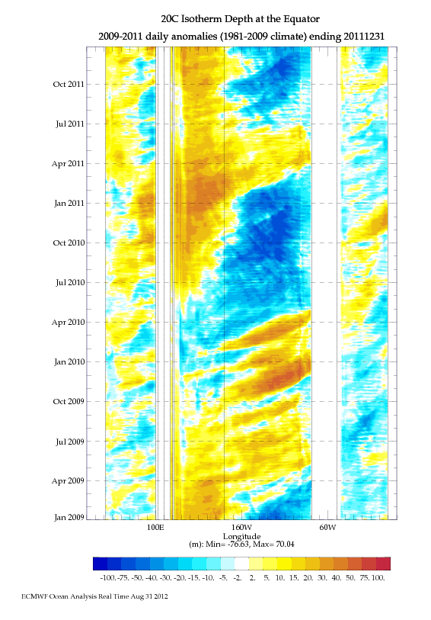
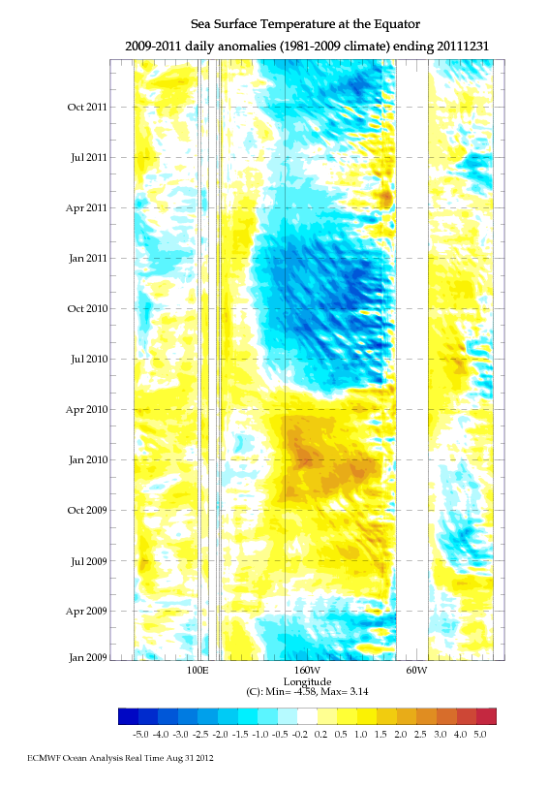
Need to Initialize the subsurface of the ocean
2OC Isotherm Depth Eq Anomaly
SST Eq Anomaly

Slide 6
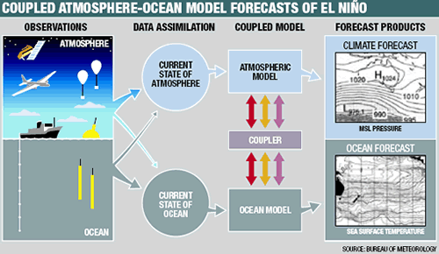
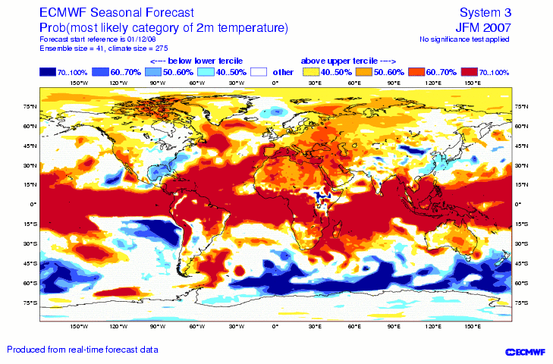
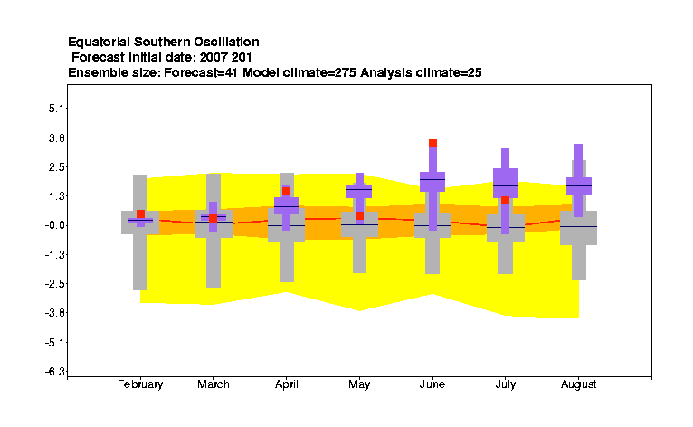

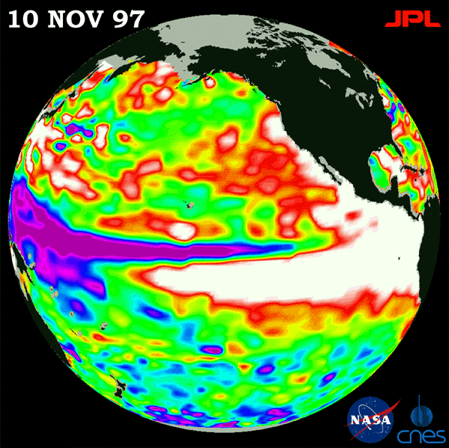
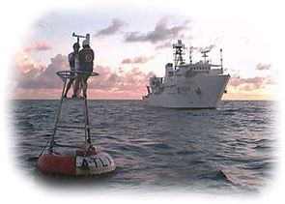
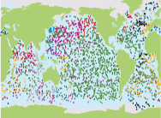
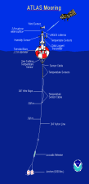
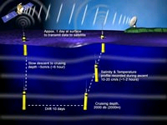
End-To-End Seasonal forecasting System
COUPLED MODEL
Tailored Forecast PRODUCTS
Atmosphere model
Ocean model
Atmosphere model
ENSEMBLE GENERATION
PROBABILISTIC CALIBRATED FORECAST
OCEAN
Ocean model
Atmosphere model
Ocean model
Initialization
Forward Integration
Forecast Calibration

Slide 7
Dealing with model error: Hindcasts
Ocean reanalysis
Real time Probabilistic Coupled Forecast
time
Coupled Hindcasts, needed to estimate climatological PDF, require a historical ocean reanalysis
Consistency between historical and real-time initial conditions is required.
Hindcasts are also needed for skill estimation

Slide 8
Initialization Problem: Production of Optimal I.C.
Optimal Initial Conditions: those that produce the best forecast.
  Need of a metric: lead time, variable, region (i.e. subjective choice)
  Usually forecast of SST indices, lead time 1-6 months
Theoretically, initial conditions should represent accurately the state of the real world and project into the model attractor, so the model is able to evolve them.
    Difficult in the presence of model error
Practical requirements: Consistency between re-forecasts and real time fc
  Need for historical ocean reanalysis
Current Priorities:
    Initialization of SST and ocean subsurface.
    Land/ice/snow

Slide 9
A decade of progress on ENSO prediction
Initialization into Context
S1 S2 S3
Steady progress: ~1 month/decade skill gain
How much is due to the initialization, how much to model development?
Half of the gain on forecast skill is due to improved ocean initialization
Balmaseda et al 2010, OceanObs

Slide 10
How do we initialize the ocean?
To a large extent, the large scale ocean variability is forced by the atmospheric surface fluxes.
  Different ocean models forced by the same surface fluxes will produce similar tropical variability.
  Daily fluxes of heat (short and long wave, latent, sensible heat), momentum and fresh water fluxes. Wind stress is essential for the interannual variability.
  OCEAN MODEL +
Fluxes from atmospheric models: Constrained by SST
  have large systematic errors and a large unconstrained chaotic component
Fluxes from atmospheric reanalysis: Constrained by SST+ Atmos Obs.
  Reduced chaotic component and systematic error. But still large errors/uncertainty
Fluxes from atmos reanalysis+Ocean Obs ( SST+Atmos Obs+Ocean Obs): Ocean re-analysis. Difficulties: Changing observing system and model error

Slide 11
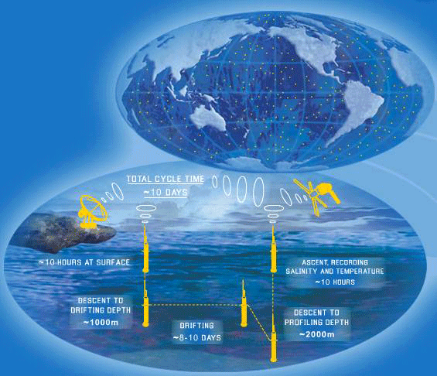
Information to initialize the ocean
Ocean model Plus:
  SST
  Atmospheric fluxes from atmospheric reanalysis
  Subsurface ocean information
Time evolution of the Ocean Observing System
1982
1993
2001
XBT’s 60’s Satellite SST Moorings/Altimeter ARGO
Notes:
Traditionally, ocean measurements (in-situ T and sometimes S) were only available form scientific cruises (CTDs) and Ships of Opportunity (XBT’s, T only).
Satellite and Ocean observations: The electromagnetic radiation does not penetrate into the ocean, so satellites can not be used to measure the ocean vertical thermal structure. They are essential for SST though.
Altimeter derived sea-level variations as a proxy for thermocline variations in well stratified regions.
The equatorial mooring arrays (TAO/TRITON in the Pacific, PIRATA in the Atlantic and RAMA in the Indian ocean) provide continous timeseries of temperature, salinity and currents (among others). The TAO moorings starting around 1993.
Argo has been a real revolution in the ocean observing system: for the first time, measurements of temperature and salinity of the upper 2000m of the ocean, uniformly distributed around the globe, are available in real time. The Argo program started around 2000, and was mature by 2005.

Slide 12
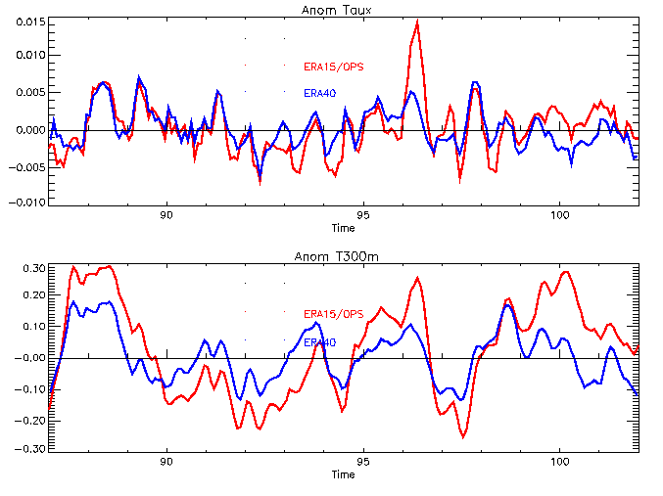
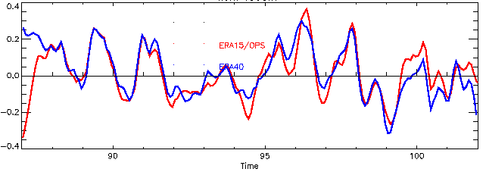
Uncertainty in Surface Fluxes:
Need for Data Assimilation
Equatorial Atlantic: Taux anomalies
ERA15/OPS
ERA40
Large uncertainty in wind products lead to large uncertainty in the ocean subsurface
The possibility is to use additional information from ocean data (temperature, others…)
Equatorial Atlantic upper heat content anomalies. No assimilation
Questions:
  Does assimilation of ocean data constrain the ocean state? YES
  Does the assimilation of ocean data improve the ocean estimate? YES
  Does the assimilation of ocean data improve the seasonal forecasts. YES
Equatorial Atlantic upper heat content anomalies. Assimilation

Slide 13
The Assimilation corrects the ocean mean state
Mean Assimation Temperature Increment
Equatorial Pacific
(x)
Data assimilation corrects the slope and mean depth of the equatorial thermocline
z
Free model
Data Assimilation

Slide 14
Data coverage for Nov 2005
Ocean Observing System
Data coverage for June 1982
Changing observing system is a challenge for consistent reanalysis
Today’s Observations will be used in years to come
  ▲Moorings: SubsurfaceTemperature
  ◊ ARGO floats: Subsurface Temperature and Salinity
  + XBT : Subsurface Temperature
Notes:
Which means that the observation coverage is not homogeneous in time.
Changes in the changing system can create spurious variability, if not treated with care
Notice the different spatial sampling of the ocean before and after Argo.

Slide 15
Impact of data assimilation on the mean
Assim of mooring data
CTL=No data
PIRATA
Large impact of data in the mean state leading to spurious variability
This is largely solved by the introduction of bias correction
Notes:
This figure shows the time evolution of the depth of the equatorial thermocline in the Atlantic for 2 experiments:
CTL, (ocean forced by wind, in black), and Assim (in red, where the subsurface data have been assimilated)
The advent of the temperature data for the PIRATA moorings in 1998/1999 can be appreciated in the ASSIM experiment by the sudden shallowing of the thermocline:
The PIRATA data corrects for a systematic error of the background (which has too depth thermocline). The net effect is an spurious jump that induces spurious interannual variability.
To prevent this sort of behaviour, an adequate and explicit treatment of background bias is required
Reasons for a bias correction scheme:
A substantial part of the analysis error is correlated in time.
Changes in the observing system can be damaging for the representation of the inter-annual variability.
Part of the error may be induced by the assimilation process.
A bias correction scheme was first introduced in the ECMWF Ocean ReAnalysis System 3 (ORA-S3) (Balmaseda et al 2008)
Multivariate, so it allows to make adiabatic corrections (Bell et al 2004)
It allows time dependent error (as opposed to constant bias).
First guess of the bias non zero would be useful in early days (additive correction rather than the relaxation to climatology in S2)
Generalized Dee and Da Silva bias correction scheme, by Balmaseda et al (2007)

Slide 16
Need to correct model bias during assimilation
There is a model for the time evolution of the bias
This is an important difference with respect to the atmos data assimilation, where FG is assumed unbiased
Without explicit bias correction changes in the observing system can induce
  Spurious signals in the ocean reanalysis
  Non-stationarity of the forecast bias, leading to forecast errors.
Ideally, the bias information should be propagated during the forecast (for this the FG model and FC model should be the same, e.i. coupled model)
Notes:
The Bias Correction scheme has been further improved in the ECMWF ORAS4 (Balmaseda et al 2013)
A seasonal cycle of the model bias in T/S and pressure gradient is estimated from the Argo period, and applied to the reanalysis since the beginning of the record.
This is a way of extrapolating the Argo information into the past. It assumes that model errors are stationary (except for the seasonal cycle)
Some naming convention and background information
FG=First Guess.
In the case of the ECMWF ORAS4, the first guess is given by a 10-day ocean simulation, starting from the last analyzed state, using atmospheric reanalysis fluxes.
FC=ForeCast, which is produced by a coupled model. Even if the initial conditions and ocean model are the same as the FG, the atmospheric forcing is given by the coupled model instead.

Slide 17
Effect of bias correction on the time-evolution
Assim of mooring data
CTL=No data
Bias corrected Assim
Notes:
The a-priori (iterative) estimation of the bias corrects the solution before the PIRATA moorings appear, hence preventing the shock.

Slide 18
Ocean Initialization at the ECMWF
Ocean Reanalysis System 4 (ORAS4): 1958 to present. 5 ens members
Main Objective: Initialization of seasonal forecasts
  Historical reanalysis brought up-to-date => Useful to study and monitor climate variability
Operational ORA-S4 NEMO-NEMOVAR
  ERA-40 daily fluxes (1958-1989) and ERA-Interim thereafter
  Retrospective Ocean Reanalysis back to 1958, 5 ensemble members
  Multivariate offline+on-line Bias Correction (pressure gradient, Temp,Sal, offline from recent period )
  Assimilation of SST, temperature and salinity profiles, altimeter sea level anomalies an global sea level trends
  Balance constrains (T/S and geostrophy)
  Sequential, 10 days analysis cycle, 3D-Var FGAT. Incremental Analysis Update
Mogensen et al 2012, Balmaseda et al 2012

Slide 19
ORAS4: 5 ens members 195709 to present
Main Ingredients
Ocean Model: NEMO. Approx resolution 1x1 deg, 42 levels
Multivariate Data Assimilation: NEMOVAR (3Dvar FGAT). Balance constrains
Data: EN3-XBT corrected (T/S). Altimeter, SST as in figure. GTS after 2010
Bias Correction: estimated from Argo period
Forcing: ERA40/ERA-INTERIM/OPS
Ensemble Generation: wind perturbations, observation coverage, deep ocean
Assimilation cycle: 10 days, IAU
Initialization of coupled forecasts
Historical reanalysis brought up-to-date

Slide 20
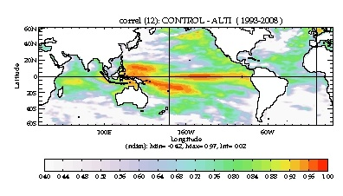
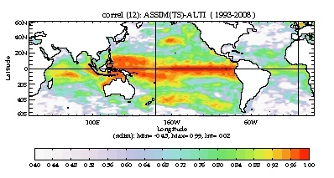
Time correlation with altimeter SL product
CNTL: NoObs
NEMOVAR T+S
ORAS4 T+S+Alti
CNTL
NEMOVAR TS
ORAS4 (TS+Alti)

Slide 21
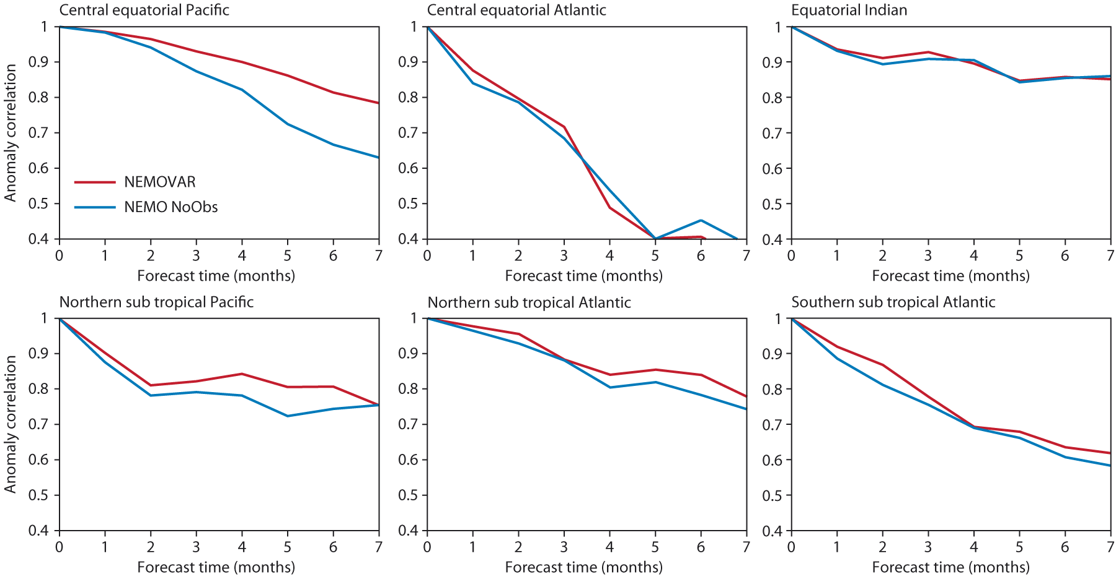
Impact on Seasonal Forecast Skill
Consistent Improvement everywhere. Even in the Atlantic, traditionally challenging area
ORAS4
CNTL
Notes:
Here CNTL is an ocean model simulation similar to ORAS4 but without assimilating subsurface T/S or altimeter. The SST are constrained.
Assimilating ocean observations improves the forecast skill, especially in the Equatorial Pacific.
With ORAS4 is the first time that forecasts in the Equatorial Atlantic are improved with data assimilation in the ocean.

Slide 22
Quantifying the value of observational information
The outcome may depend on the coupled system
In a good system information may be redundant, but not detrimental.
  If adding more information degrades the results, there is something wrong with the methodology (coupled/assim system)
Experiments conducted with the ECMWF S3
  Balmaseda and Anderson 2009, GRL
  SST (SYNTEX System Luo et al 2005, Decadal Forecasting Keenlyside et al, 2008)
  SST+ Atmos observations (fluxes from atmos reanalysis)
  SST+ Atmos observations+ Ocean Observations (ocean reanalysis)

Slide 23
Impact of “real world” information on skill:
Reduction in Error (MAE) in SST SF by adding observational information
The additional information about the real world improved the forecast skill, except in the Equatorial Atlantic
Optimal use of the observations needs more sophisticated assimilation techniques and better models, to reduced initialization shock

Slide 24
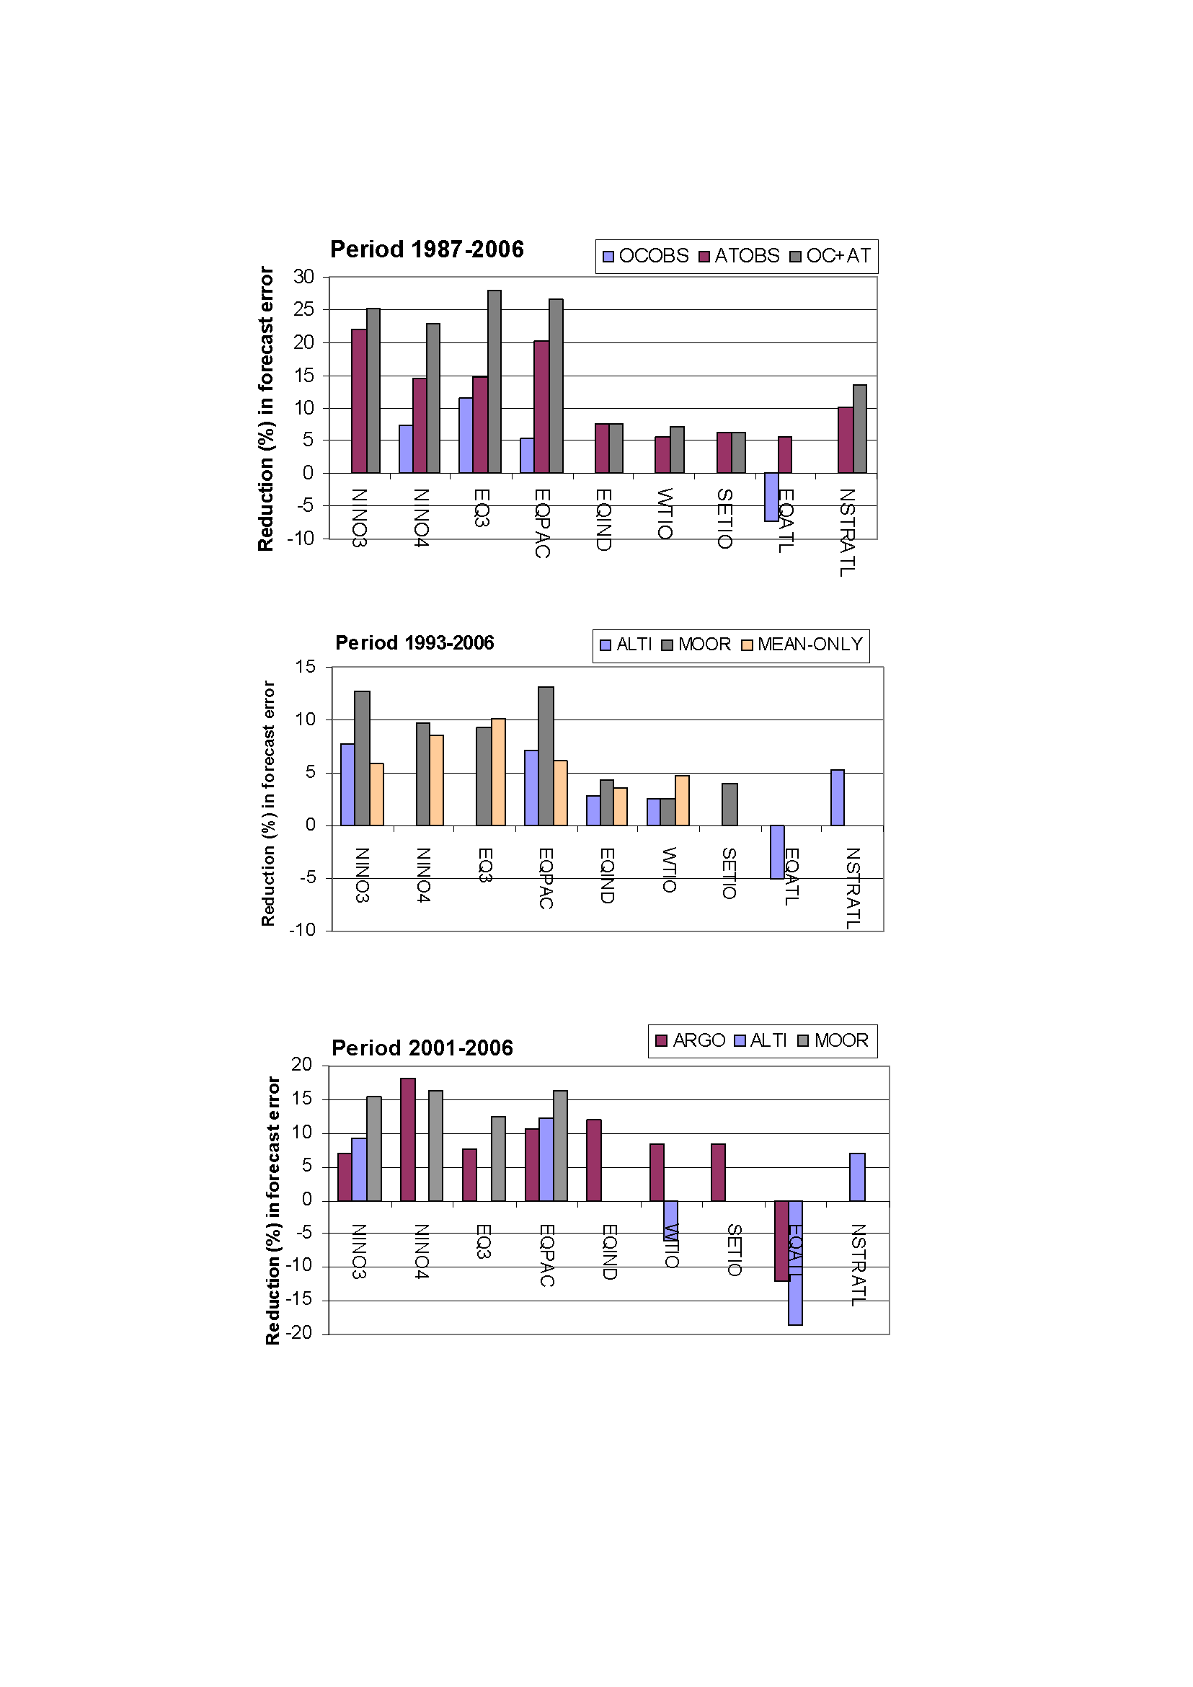
Assessing the Ocean Observing System (S3)
No observation system is redundant
  Not even in the Pacific, where Argo, moorings and altimeter still complement. Lessons for other basins?
There were obvious problems in the Eq Atlantic: model error, assimilation, and possibly insufficient observing system
From Balmaseda and Anderson 2009
See also Fujii et al 2008
Important to bear in mind
The assessment depends on the quality of the coupled model
Need records long enough for results to be significant => any observing system needs to stay in place for a long time before any assessment is possible.

Slide 25
Initialization and forecast drift
Different initializations produce different drift in the same coupled model.
Warm drift in ALL caused by Kelvin Wave, triggered by the slackening of coupled model equatorial winds
SST only has very little equatorial heat content, and the SST cool s down very quickly.
SST+ATMOS seems balanced in this region. Not in others
ALL ATMOS+SST SST only
Sign of non linearity:
The drift in the mean affects the variability

Slide 26
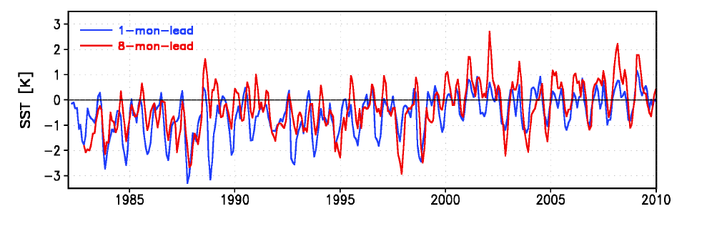
Seasonal Forecasts Approach Some caveats
SST FC bias CFS.v2
Kumar et al 2011 MWR
Non-stationary model error.
  Seasonal cycle dependence, which is known and catered for.
  Other unknown dependences not considered: trends, changes in observing system
  Drift depends of lead time. A large number of hindcasts is needed. This is even more costly in decadal forecasts.
Initialization shock can be larger than model bias
Non-linearities and non-stationarity can sometimes render the aposteriori calibration invalid

Slide 27
Perceived Paradigm for initialization of coupled forecasts
Real world
Model world
Medium range
Being close to the real world is perceived as advantageous. Model retains information for these time scales.
Model attractor and real world are close?
Decadal or longer
Need to initialize the model attractor on the relevant time and spatial scales.
Model attractor different from real world.
Seasonal?
At first sight, this paradigm would not allow a seamless prediction system.
Seasonal traditional approach as in Medium range BUT (see next slide)
Not clear how to achieve initialization in model attractor
  Anomaly Initialization (decadal forecasts, Smith et al 2007)
  Full initialization with coupled models of the slow component only
  Other more sophisticated (EnKF, coupled DA, weakly coupled DA)

Slide 28
Anomaly Initialization
Full Initialization
Model climatology +observed anomaly
Long coupled integration
As Medium range but:
Model bias taken into account during DA.
A posteriori calibration of forecast is needed. Calibration depends on lead time.
The model during the initialization is different from the forecast model. Bias correction estimated during initialization can not be applied during the forecasts
The model climatology does not depend of forecast lead time. Cheaper in principle than hindcasts.
But hindcasts are still needed for skill estimation
Acknowledgment of existence of model error during initialization.
Model error is not corrected (“bias blind algorithm”):

Slide 29
Anomaly Initialization (Cont)
Two flavours
One-Tier anomaly initialization (Smith et al 2007). Ocean observations are assimilated directly. Background error covariance formulation derived from coupled model (EOFs, EnOI, EnKF). Emphasis on large spatial scales
Two-Tier anomaly initialization (Pohlmann et al 2009). Nudging of anomalies from existing ocean re-analysis. The spatial structures are those provided by the source re-analysis.
Limitations
It assumes quasi-linear regime.
Sampling: how to obtain an observed climatology equivalent to the model climate?

Slide 30
Initialization Shock and Skill
c
non-linear interactions important
Initialization shock
Model Climate
Anomaly Ini
b
a
phase space
Real World
Full Ini Perfect
L
Forecast lead time
Notes:
In the case of imperfect models, the model and the real world attractor will be different.
The behaviour of the forecast will depend on the initial conditions. If the initial conditions are in the model attractor (purple line), the forecast will not experience any adjustment processes. If the initial conditions are close to the real world, there are at least 3 cases:
Case a)There is adjustment but not initialization shock: the adjustment occurs assimptotically. Being close to the real world is advantageous, and the forecasts are better than if in the model attractor.
Case b) There is initialization shock in the adjustment process, in such a way that in the earlier stage of the forecast the results are worse than if the i.c were in the model attractor. After the initialization shock the model converge to the model attractor solution. This occurs because the amplitude of the initialization shock does not go beyond the limit of non linearity
Case c) The initialization shock goes beyond the limit of non linearity. There is not guarantee that the solution would converge to the model attractor.

Slide 31
Initialization Shock and non linearities
non-linear interactions important
Model Climate
phase space
Empirical Flux Corrections
Real World
Forecast lead time
Notes:
Flux correction may be a good alternative to keep the model errors small enough so the non-linear interaction can be neglected.

Slide 32
Comparison of Strategies for dealing with systematic errors in a coupled ocean-atmosphere forecasting system as part of the EU FP7 COMBINE project
Nature climate
Flux correction
Normal initialisation
Anomaly initialisation
Model climate
Magnusson et al. 2012a, Clim Dyn . Also ECMWF Techmemo 658
Magnusson et al. 2012b, Clim Dyn. Also ECMWF Techmemo 676

Slide 33
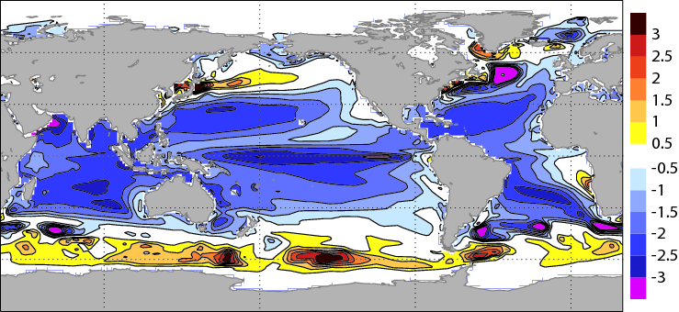
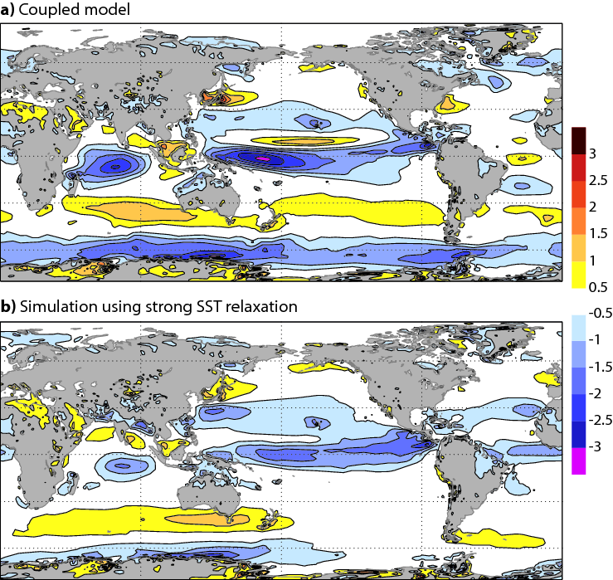
Coupled model error
10m winds: model - analysis
SST bias: model - analysis
Part of the error comes from the atmospheric component (too strong easterlies at the equator)
The error amplifies in the coupled model (positive Bjerkness feedback).
Possibility of flux correction
From Magnusson et al 2012 Clim Dyn.

Slide 34
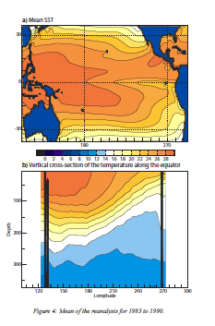
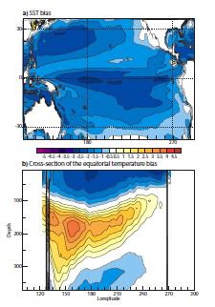
Different mean states
Analysis
Coupled Free
Coupled Ucor
Coupled UHcor
Ucor: surface wind is corrected when passed to the ocean
UHCor: surface wind and heat flux are corrected when passed to the ocean

Slide 35
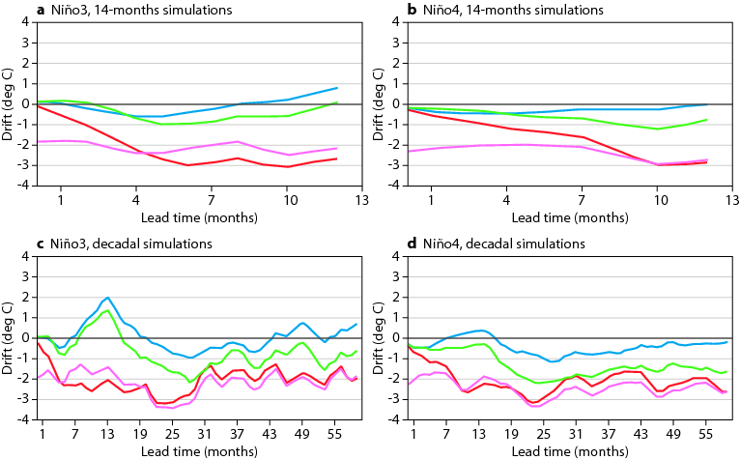
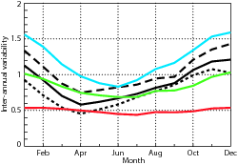
Comparison of Forecast Strategies:
MEAN DRIFT
Interannual Variability
Nino 3 SST Drift 1-14 month forecast
FC sdv / AN sdv
Analysis Full Ini Anomaly Ini U Correction U+H correction

Slide 36
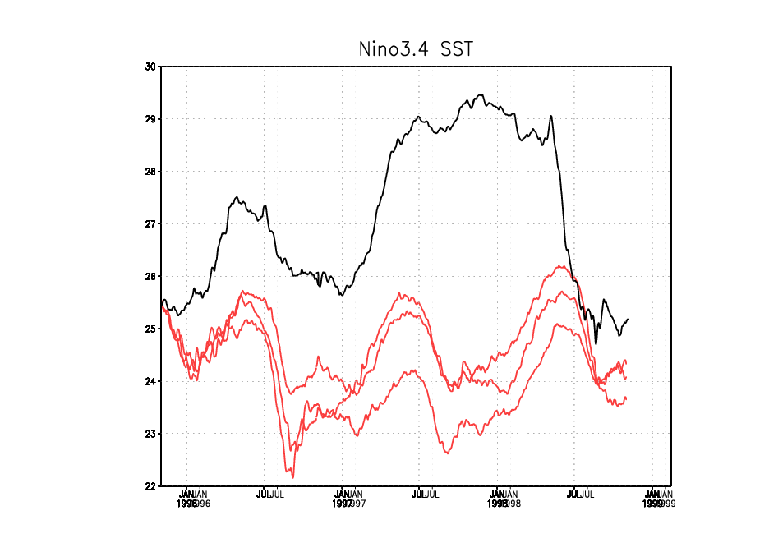
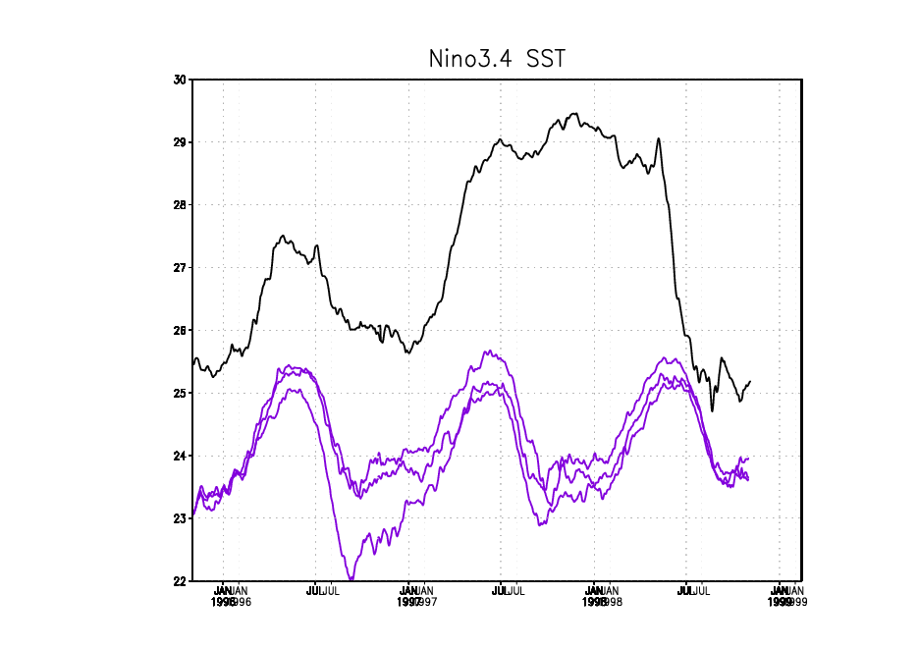
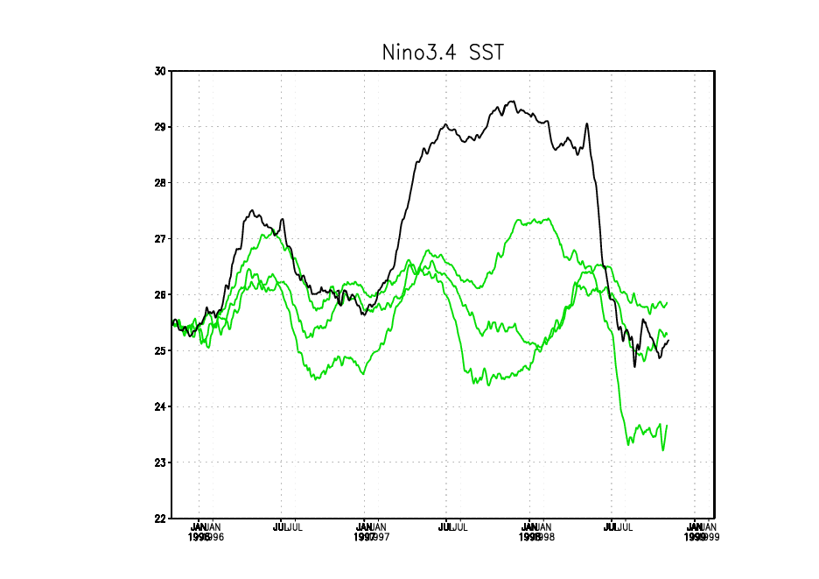
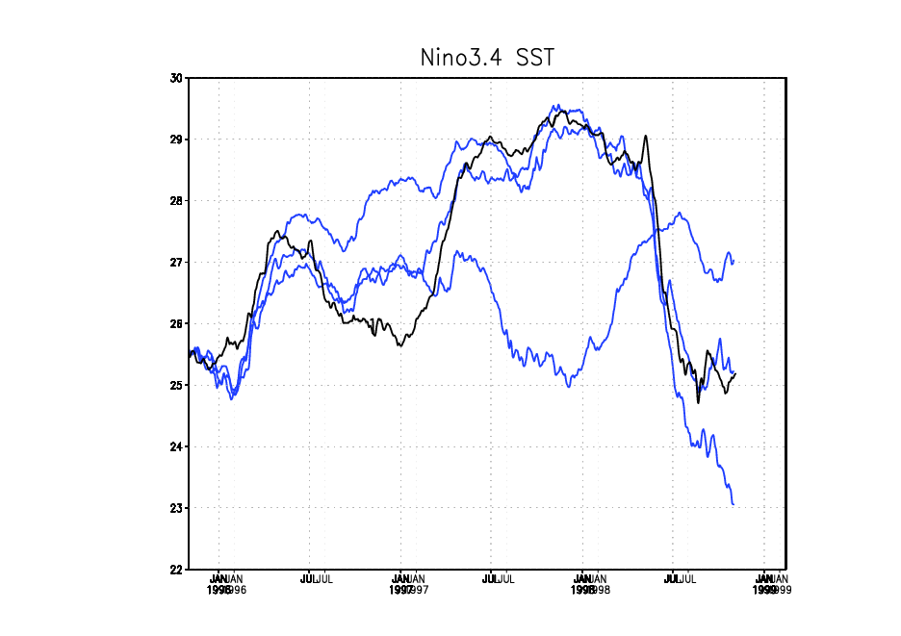
Nino3.4 SST forecasts November 1995 – November 1998
Full Initialization
Anomaly Initialisation
U-flux correction
U- and H-flux correction
96
97
98
99
Linus Magnusson et al.

Slide 37
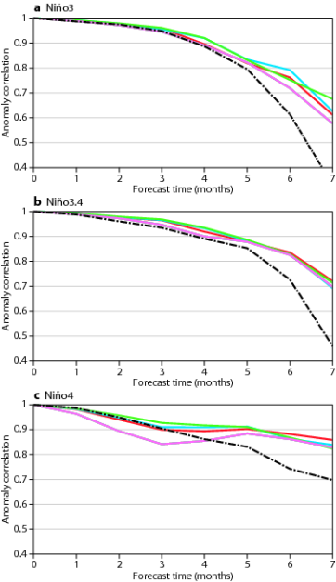
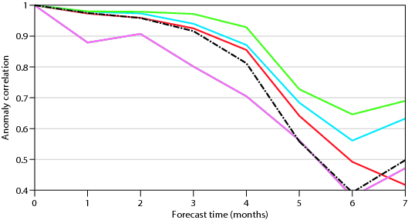
Impact on Forecast Skill (ACC)
The impact of initialization/forecast strategy depends on the region.
When the mean state matters (convective precip), the anomaly Initialization
underperforms
SST
Precip
Persistence Full Ini Anomaly Ini
U Correction U+H correction

Slide 38
What about Full Coupled Initialization?
Advantages:
  Hopefully more balanced ocean-atmosphere i.c and perturbations. Important for tropical convection
  Framework to treat model error during initialization and fc
    If the FG and FC models are the same, the (3D) bias correction estimated during the initialization can (should) be applied during the forecast.
  Consistency across time scales (seamlessness):
    currently, weather forecasts up to 10 days use “extreme flux correction”, since SST is prescribed. For longer lead times a free coupled model is used. More gradual transition?
Current Approaches
  Weakly Coupled Data assimilation: FG with coupled model, separate DA of ocean and atmos.
  Example is NCEP with CFSR, and ECMWF-ESA CERA project
  Strongly Coupled Data assimilation: Coupled FG, Coupled Covariances. Usually EnKF
Challenges:
  Different time scales of ocean atmosphere . Long window weak constrain?
  Cross-covariances. Ensemble methodology more natural?

Slide 39
Coupled Initialization and Forecast Shock
C1
Coupled Ini (CERA)
AN mod = FC mod
U1
Uncoupled Ini
AN mod = FC mod
M1
Uncoupled Ini
AN mod .ne. FC mod

Slide 40
Forecast Shock depends on Initialization
Coupled Ini with CERA has the slowest Forecast Error Growth
From Mulholland et al, MWR

Slide 41
Summary
Seasonal Forecasting (SF) of SST is an initial condition problem
Assimilation of ocean observations reduces the large uncertainty (error) due to the forcing fluxes. Initialization of Seasonal Forecasts needs SST, subsurface temperature, salinity and altimeter derived sea level anomalies.
Data assimilation improves forecast skill.
Data assimilation changes the ocean mean state. Therefore, consistent ocean reanalysis requires an explicit treatment of the bias
The separate initialization of the ocean and atmosphere systems can lead to initialization shock during the forecasts. A more balance “coupled” initialization is desirable, but it remains challenging.
Initialization and forecast strategy go together. The best strategy may depend on the model. The anomaly initialization used in decadal forecasts is suboptimal in seasonal.
”

