Slide 1
The Seasonal Forecast System at ECMWF
Tim Stockdale
European Centre for Medium-range Weather Forecasts
t.stockdale@ecmwf.int

Slide 2
Contents
Seasonal forecasting with coupled GCMs
  Why use GCMs?
  How we make a forecast
  Basic calibration – how, why, and what are the problems?
  Model error
Operational forecasts: ECMWF System 4
  System design
  How good are the El Nino forecasts?
  How good are the atmospheric forecasts?
Forecast interpretation
  Meaning of probabilistic forecasts
  Outlook

Slide 3
Sources of seasonal predictability
  KNOWN TO BE IMPORTANT:
    El Nino variability - biggest single signal
    Other tropical ocean SST - important, but multifarious
    Climate change - impact is substantial in many regions
    Local land surface conditions - e.g. soil moisture in spring
  OTHER FACTORS:
    Volcanic eruptions - definitely important for large events
    Mid-latitude ocean temperatures - still somewhat controversial
    Remote soil moisture/ snow cover - evidence stronger in some cases
    Sea ice anomalies - local effects, but remote?
    Dynamic memory of atmosphere - most likely on 1-2 months
    Stratospheric influences - polar vortex, solar cycle, QBO, ozone, …
  Unknown or Unexpected - ???

Slide 4
Methods of seasonal forecasting
Empirical forecasting
    Use past observational record and statistical methods
    Works with reality instead of error-prone numerical models ☺
    Limited number of past cases means that it works best when observed variability is dominated by a single source of predictability ☹
    A non-stationary climate is problematic ☹
Two-tier forecast systems
    First predict SST anomalies (ENSO or global; dynamical or statistical)
    Use ensemble of atmosphere GCMs to predict global response
    Some people still use regression of a predicted El Nino index on a local variable of interest
Single-tier GCM forecasts
    Include comprehensive range of sources of predictability ☺
    Predict joint evolution of SST and atmosphere flow ☺
    Includes indeterminacy of future SST, important for prob. Forecasts ☺
    Model errors are an issue! ☹

Slide 5
Step 1: Build a coupled model
IFS (atmosphere)
  T_{L}255L91 Cy36r4, 0.7° grid for physics, full stratosphere
  Modifications to stratospheric physics and lakes
  Singular vectors from EPS system to perturb atmosphere initial conditions
  Ocean currents coupled to atmosphere boundary layer calculations
NEMO (ocean)
  Global ocean model, 1x1 mid-latitude resolution, 0.3 near equator
  Sophisticated 3D-VAR ocean analysis system, including analysis of salinity, multivariate bias corrections and use of altimetry.
Coupling
  Fully coupled, no flux adjustments, except no physical model of sea-ice

Slide 6
Step 2: Make some forecasts
Initialize coupled system (cf. Magdalena’s lecture earlier today)
  Aim is to start system close to reality. Accurate SST is particularly important, plus ocean sub-surface.
  Don’t worry too much about “imbalances”
Run an ensemble forecast
  Explicitly generate an ensemble on the 1st of each month, with perturbations to represent the uncertainty in the initial conditions; run forecasts for 7 months
Worry about model error later ….

Slide 7
Creating the ensemble
Wind perturbations
  Perfect wind would give a good ocean analysis, but uncertainties are significant. We represent these by adding perturbations to the wind used in the ocean analysis system.
  BUT only have 5 member ensemble, and only limited representation of other sources of uncertainty in ocean analysis (e.g. observation error)
SST perturbations
  SST uncertainty is not negligible
  SST perturbations added to each ensemble member at start of forecast.
  BUT perturbations based on SST analyses that used the same input data
Atmospheric unpredictability
  Atmospheric ‘noise’ soon becomes the dominant source of spread in an ensemble forecast. This sets a fundamental limit to forecast quality.
  To ensure that noise grows rapidly enough in the first few days, we activate ‘stochastic physics’ and use EPS singular vectors.
  In System 4, stochastic physics increases spread at all timescales.

Slide 8
RMSE and spread in different systems
r.m.s. error of forecasts has been systematically reduced (solid lines) ….
.. but ensemble spread (dashed lines) is still substantially less than actual forecast error.
Substantial amounts of forecast error are not from the initial conditions.

Slide 9
Step 3: Remove systematic errors
Model drift is typically comparable to signal
  Both SST and atmosphere fields
Forecasts are made relative to past model integrations
  Model climate estimated from 30 years of forecasts (1981-2010), all of which use a 15 member ensemble. Thus the climate has 450 members.
  Model climate has both a mean and a distribution, allowing us to estimate e.g. tercile boundaries.
  Model climate is a function of start date and forecast lead time.
  EXCEPTION: Nino SST indices are bias corrected to absolute values, and anomalies are displayed w.r.t. a 1971-2000 climate.
Implicit assumption of linearity
  We implicitly assume that a shift in the model forecast relative to the model climate corresponds to the expected shift in a true forecast relative to the true climate, despite differences between model and true climate.
  Most of the time, assumption seems to work pretty well. But not always.

Slide 10
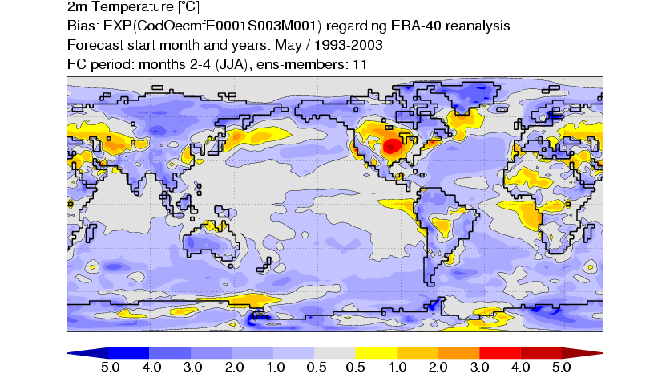
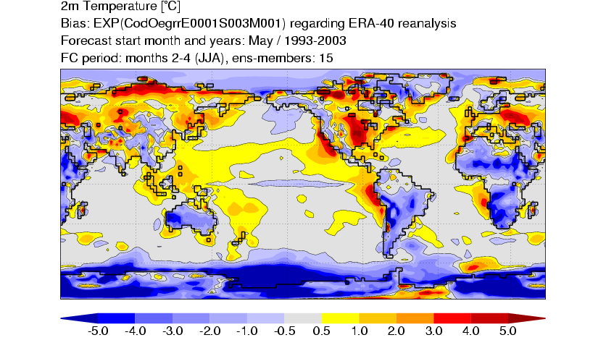
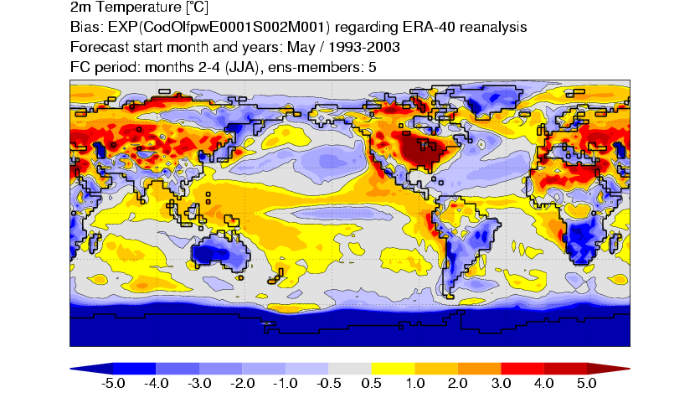
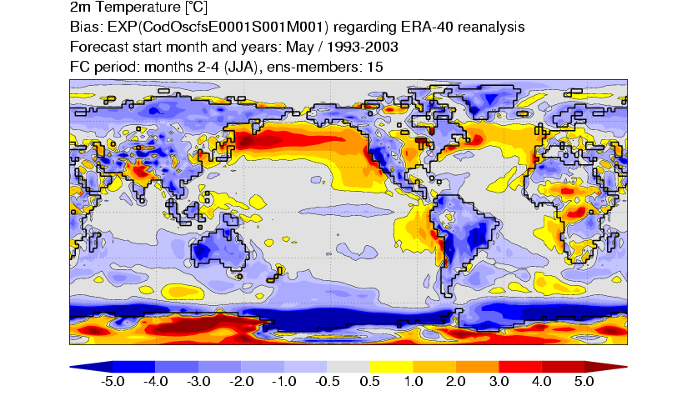
Biases (eg JJA 2mT as shown here) are often comparable in magnitude to the anomalies which we seek to predict
ECMWF
Met Office
Météo-France
CFS
Plots courtesy Paco Doblas-Reyes

Slide 11
SST bias is a function of lead time and season.
Some systems have less bias, but it is still large enough to require correcting for.

Slide 12
Nino plumes: variance scaling
  Model Nino SST anomalies in S4 have too large amplitude
  Problem is especially acute in boreal spring and early summer (model bias of “permanent La Nina” does not allow spring relaxation physics to apply; this was something S3 did very well)
  We plot the “Nino plumes” corrected for both mean and variance, instead of just the mean.
  This is done by scaling the model anomalies so that the model variance matches the observed variance in the calibration period
  We use the same approach (cross-validated) when calculating scores
  This affects the plotting, not the model data itself
  The spatial maps are not affected: the tercile and quintile probability maps are already implicitly standardized w.r.t. model variance
  General technique: is also used in our multi-model system

Slide 13
Variance adjusted
Unadjusted model anomalies

Slide 14
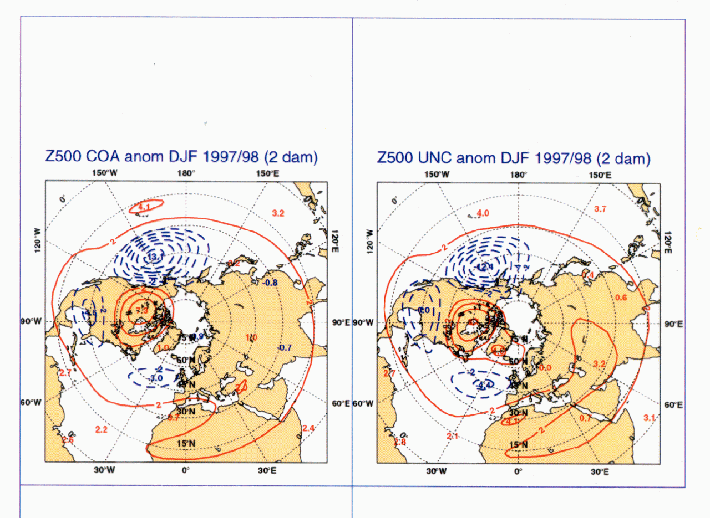
Despite SST bias and other errors, anomalies in the coupled system can be remarkably similar to those obtained using observed (unbiased) SSTs …..

Slide 15
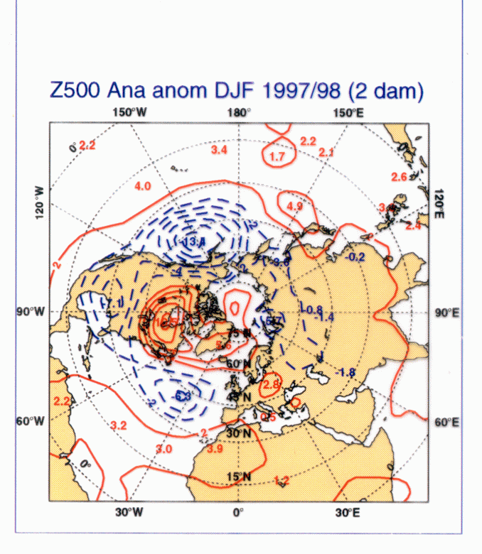
… and can also verify well against observations

Slide 16
Model errors are still serious …
Models have errors other than mean bias
  E.g. weak wind and SST variability in System 2
  Past models underestimated MJO activity (S4 better)
  Suspected too-weak teleconnections to mid-latitudes
Mean state errors interact with model variability
  Nino 4 region is very sensitive (cold tongue/warm pool boundary)
  Atlantic variability suppressed if mean state is badly wrong
Forecast errors are often larger than they should be
  With respect to internal variability estimates and (occasionally) other prediction systems
  Reliability of probabilistic forecasts is often not particularly high (S4 better)

Slide 17
Trends
Capturing trends is important. Time-varying CO2 and other factors are important in this.
There is a strong link between seasonal prediction and decadal/ multi-decadal climate prediction.

Slide 18
Operational seasonal forecasts
Real time forecasts since 1997
  “System 1” initially made public as “experimental” in Dec 1997
  System 2 started running in August 2001, released in early 2002
  System 3 started running in Sept 2006, operational in March 2007
  System 4 started running in July 2011, operational in November 2011
  System 5 undergoing configuration testing now
Burst mode ensemble forecast
  Initial conditions are valid for 0Z on the 1st of a month
  Forecasts are usually complete by late on the 2nd.
  Forecast and product release date is 12Z on the 8th.
Range of operational products
  Moderately extensive set of graphical products on web
  Raw data in MARS
  Formal dissemination of real time forecast data

Slide 19
System 4 configuration
Real time forecasts:
  51 member ensemble forecast to 7 months
  SST and atmos. perturbations added to each member
  15 member ensemble forecast to 13 months
  Designed to give an ‘outlook’ for ENSO
  Only once per quarter (Feb, May, Aug and Nov starts)
Re-forecasts from 1981-2010 (30 years)
  15 member ensemble every month
  15 members extended to 13 months once per quarter
  Extended to 51 members for Feb, May, Aug and Nov starts

Slide 20
How many re-forecasts?
Re-forecasts dominate total cost of system
  System 4: 5400 back integrations (must be in first year)
  612 real-time integrations (per year)
Re-forecasts define model climate
  Need both climate mean and the pdf, latter needs large sample
  May prefer to use a “recent” period (30 years? Or less??)
  System 2 had a 75 member “climate”, S3 had 275, S4 has 450.
  Sampling is basically OK
Re-forecasts provide information on skill
  A forecast cannot be used unless we know (or assume) its level of skill
  Observations have only 1 member, so large ensembles are less helpful than large numbers of cases.
  Care needed e.g. to estimate skill of 51 member ensemble based on past performance of 15 member ensemble
  For regions of high signal/noise, System 4 gives adequate skill estimates
  For regions of low signal/noise (eg <= 0.5), need hundreds of years

Slide 21
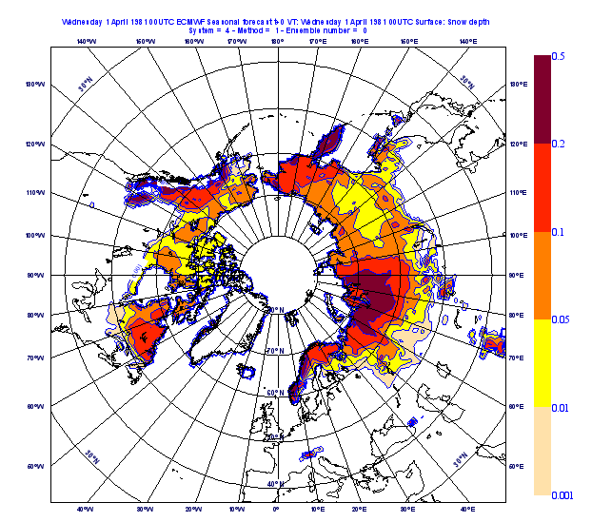
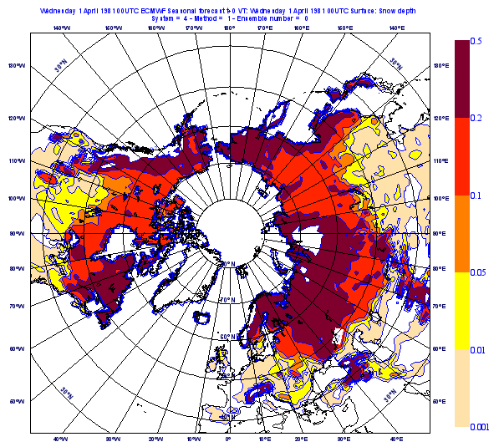
Land surface
Snow depth limits, 1st April

Slide 22
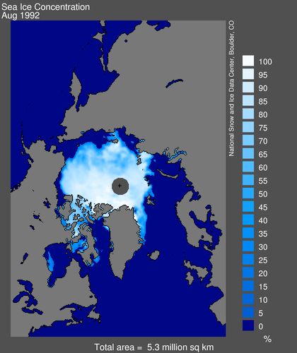
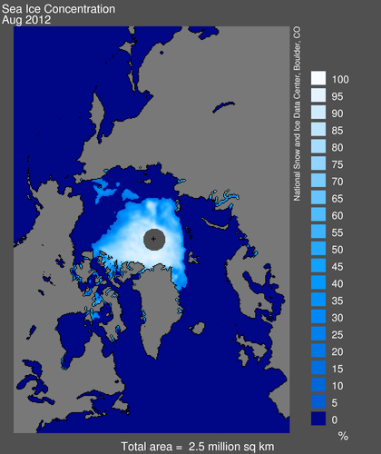
Sea ice
S4 does not have a physical ice model, but each ensemble member uses ice cover from one of the previous 5 years. This captures the downwards trend in arctic ice, and also samples uncertainty in the ice cover to be expected during the forecast.

Slide 23
QBO
System 4
30hPa
System 3
50hPa

Slide 24
Ozone
S4 uses interactive ozone, which is able to improve temperature forecasts in the stratosphere.
Ozone re-analyses are dominated by spurious changes, and cannot be used to initialize forecasts. For S4, we were forced to use a climatological initial condition instead.

Slide 25
Stratospheric trends - problems
Spurious cooling in recent re-forecasts/forecasts. This is due to an erroneous trend in initial conditions of stratospheric water vapour, which in turn is due to changes in the observing system.
This affects both ERA interim and operational analyses.
(Independent of the trend issue, lower stratosphere humidity is problematic in both ECMWF analyses and forecasts)
Notes:
Global mean T at 50 hPa. The observed cooling at this altitude is mainly driven by trends in ozone, which our model does not include. The volcanic spikes of El Chichon and Pinatubo are also clear in the observed data.

Slide 26
Example forecast products
A few examples only – see web pages for full details and assessment of skill
All graphical products come with corresponding skill estimate
Note: Significance values on plots
  A lot of variability in seasonal mean values is due to chaos
  Ensembles are large enough to test whether any apparent signals are real shifts in the model pdf
  We use the w-test, non-parametric, based on the rank distribution
  NOT related to past levels of skill

Slide 27
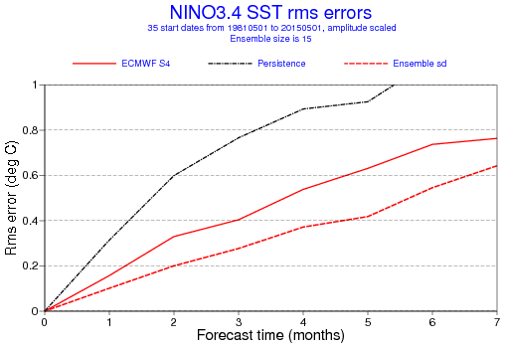
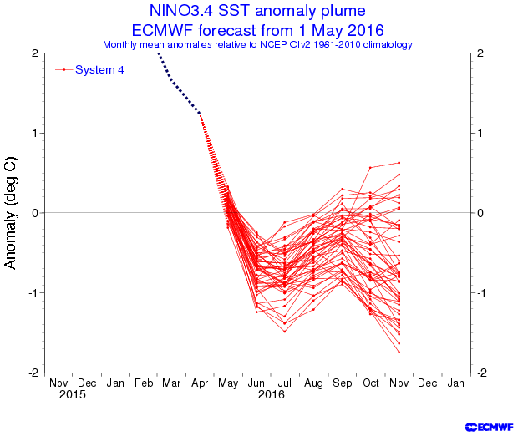
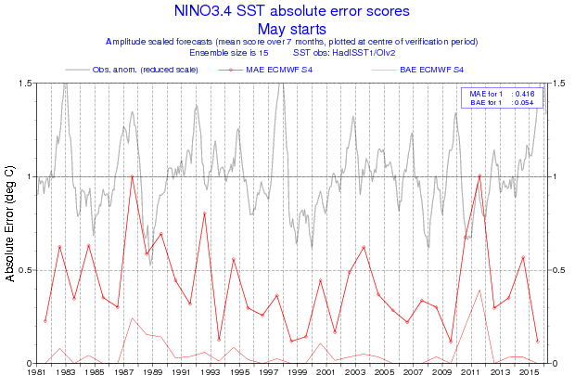
ENSO
Past performance

Slide 28
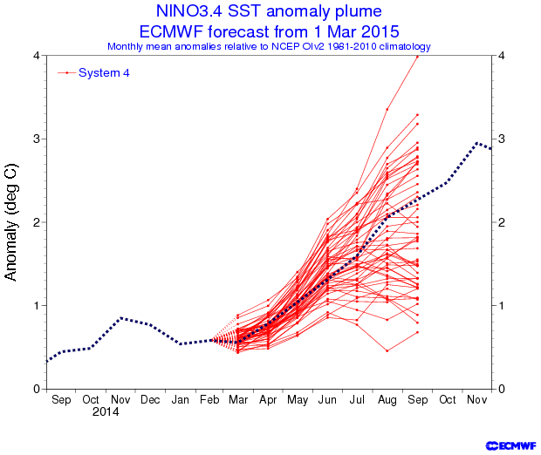
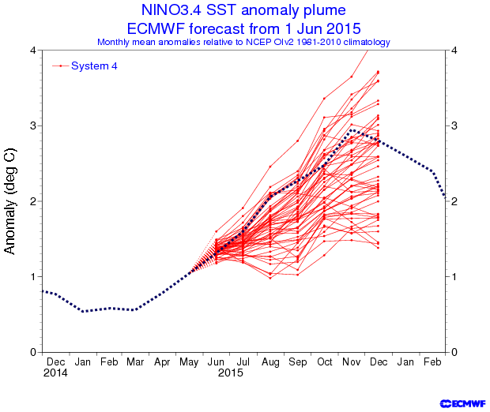
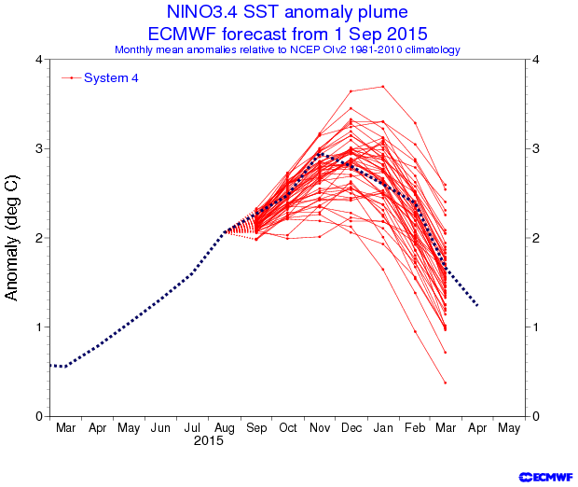
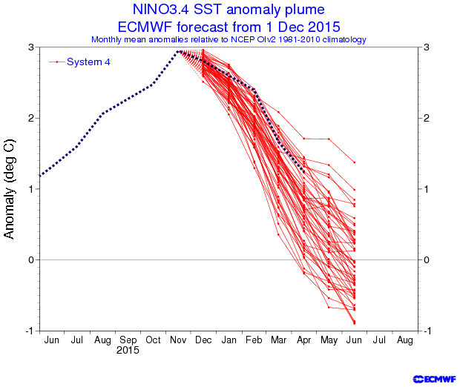

Slide 29
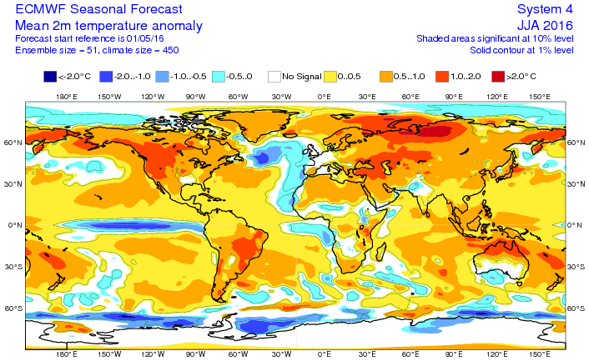

Slide 30
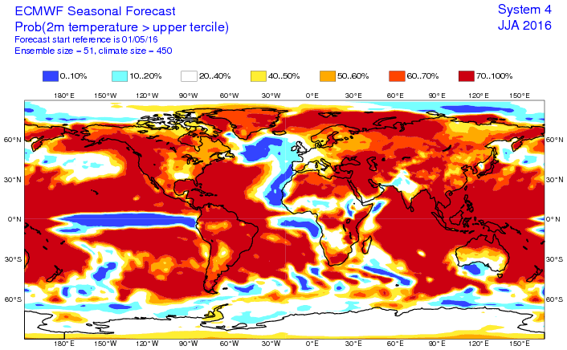

Slide 31
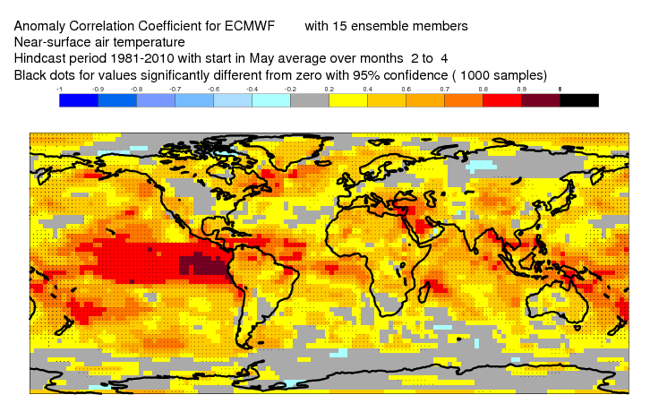
Measure of past skill (ACC)

Slide 32
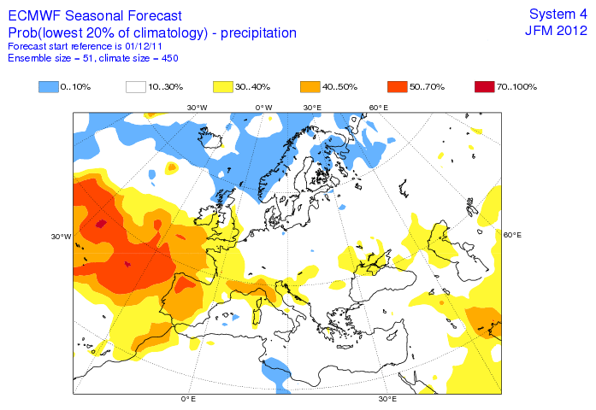
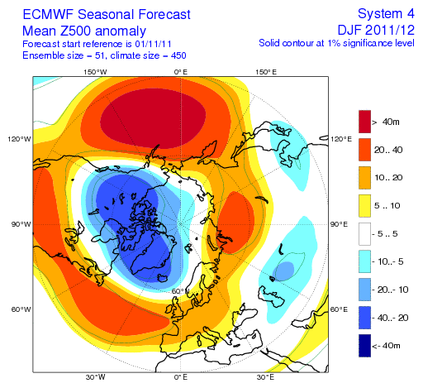
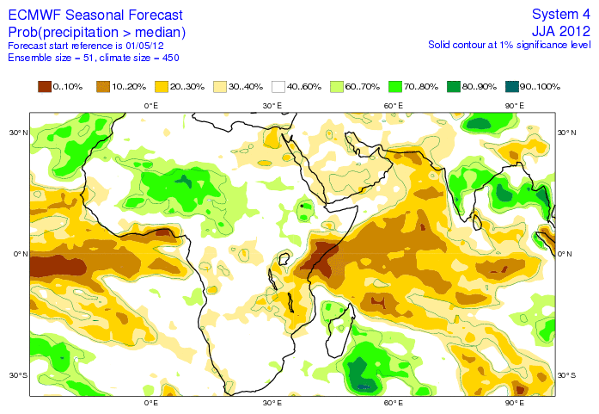
Other operational plot examples

Slide 33
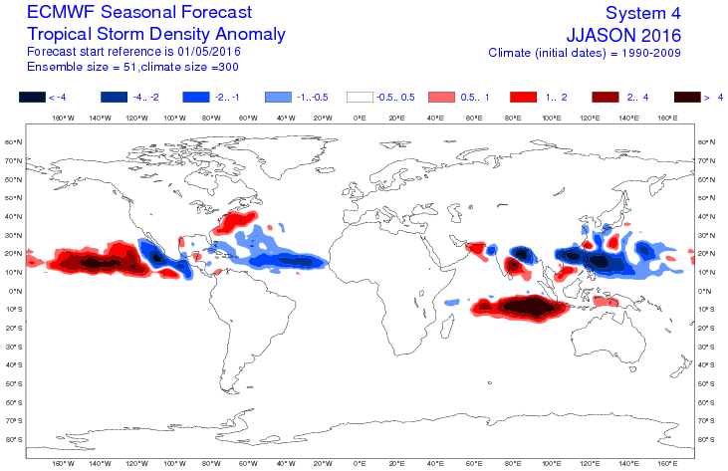
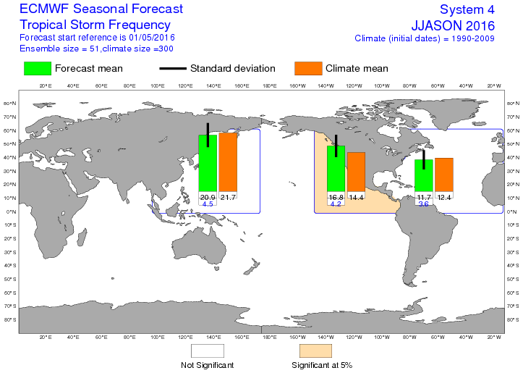
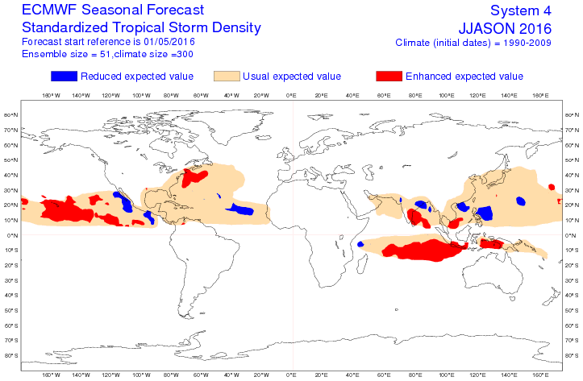
Tropical storm forecasts

Slide 34
SST forecast performance
Actual rms errors > model estimate of “perfect model” errors
NOTE: In System 4, stochastic physics gives substantially increased spread to Nino SSTs, due to representation of low-frequency model error. This gives better probabilistic scores, but means the ensemble spread is not a predictability limit: in future systems, we can reduce the amplitude of the stochastic “noise” as model errors are reduced.

Slide 35
More recent SST forecasts are better
1981-1995
1996-2010

Slide 36
Seasonal dependence

Slide 37
Nino 1+2

Slide 38
Equatorial Atlantic

Slide 39
NINO 4

Slide 40
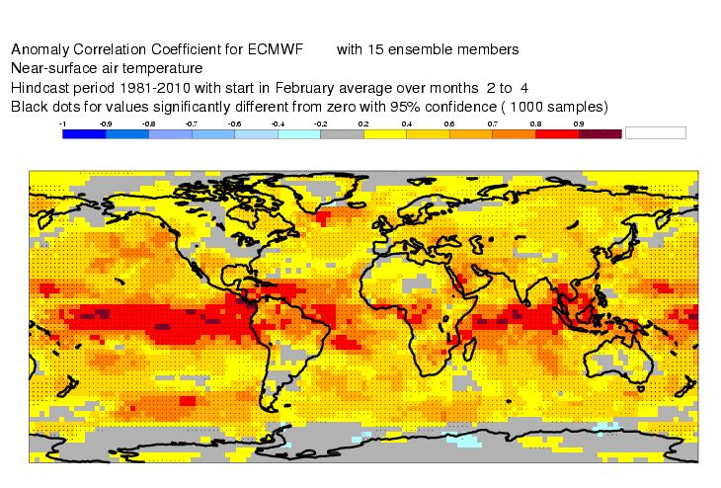
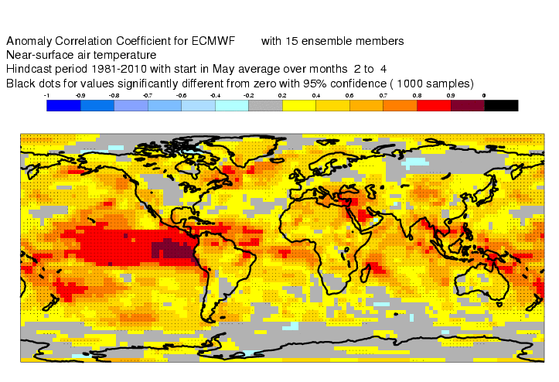
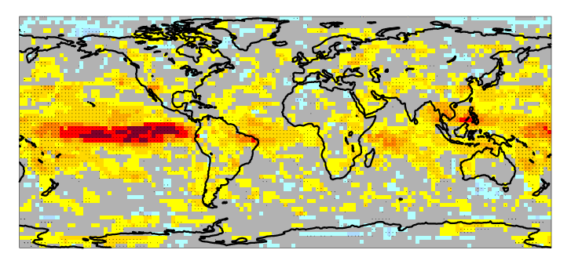
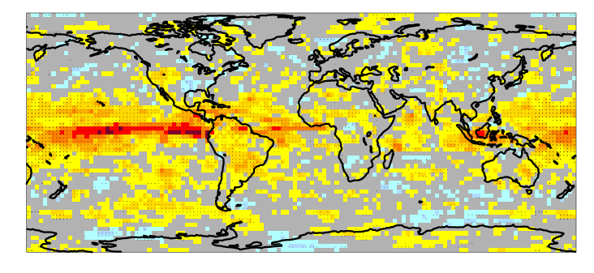
How good are the atmospheric forecasts?
Deterministic skill: ACC
MAM
JJA
T2m
Precip

Slide 41
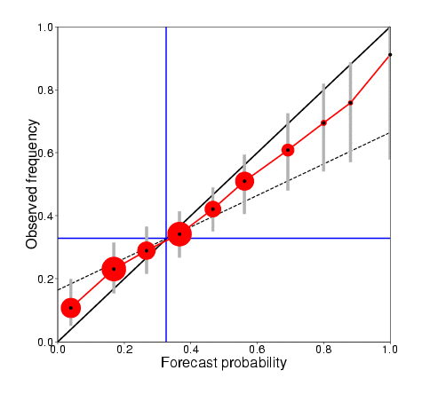
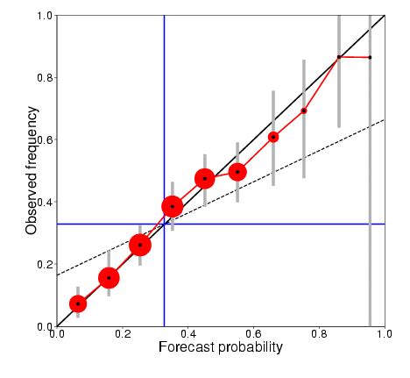
Scores for Europe: JJA
15 members
JJA Europe T2m>upper tercile
Re-forecasts from 1 May, 1981-2010
Reliability score: 0.987
ROC skill score: 0.38
51 members
JJA Europe T2m>upper tercile
Re-forecasts from 1 May, 1981-2010
Reliability score: 0.996
ROC skill score: 0.43

Slide 42
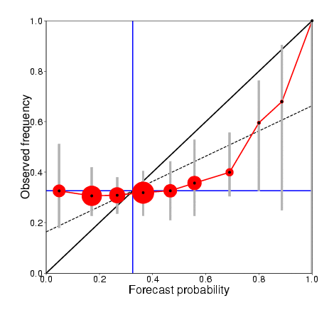
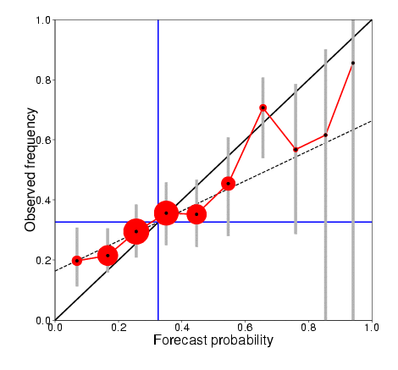
Scores for Europe: DJF
15 members
DJF Europe T2m>upper tercile
Re-forecasts from 1 Nov, 1981-2010
Reliability score: 0.902
ROC skill score: 0.06
51 members
DJF Europe T2m>upper tercile
Re-forecasts from 1 Nov, 1981-2010
Reliability score: 0.981
ROC skill score: 0.22

Slide 43
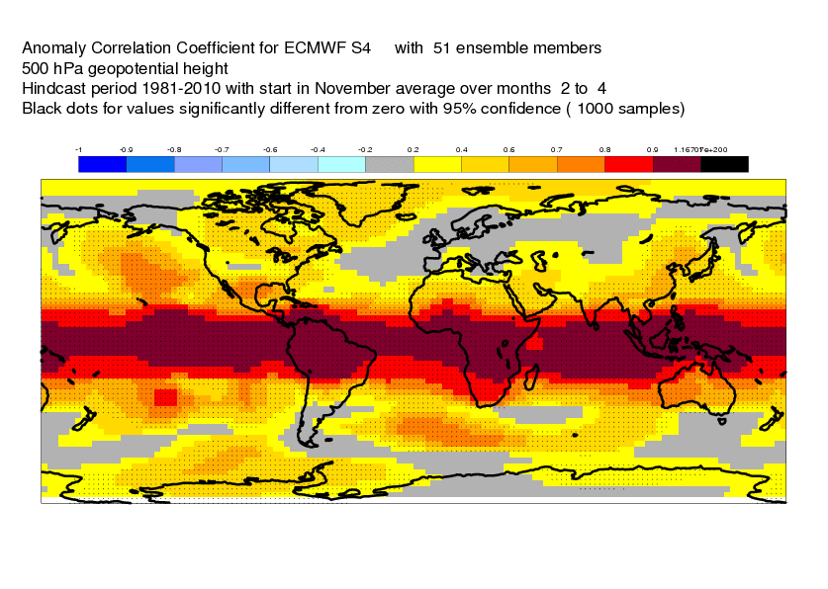
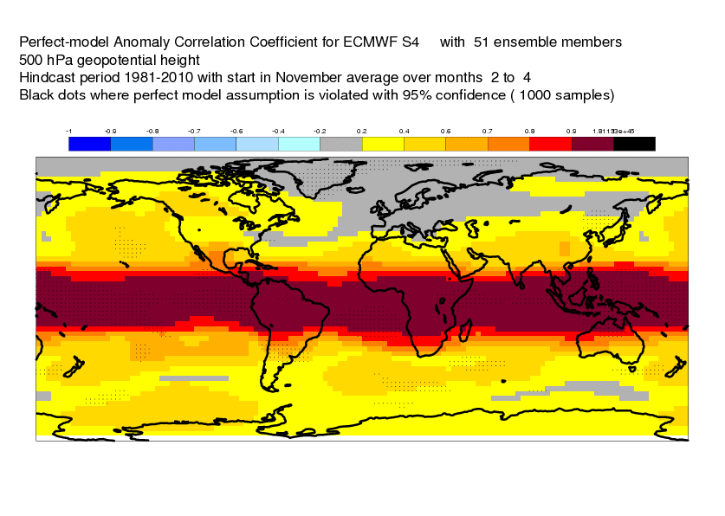
S4 ACC
DJF Z500
S4 ACC
perfect model limit

Slide 44
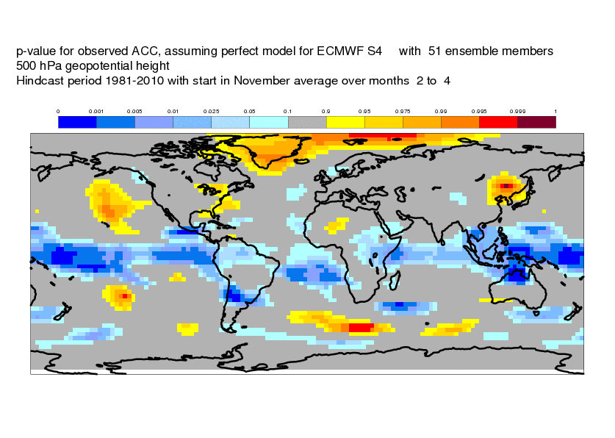
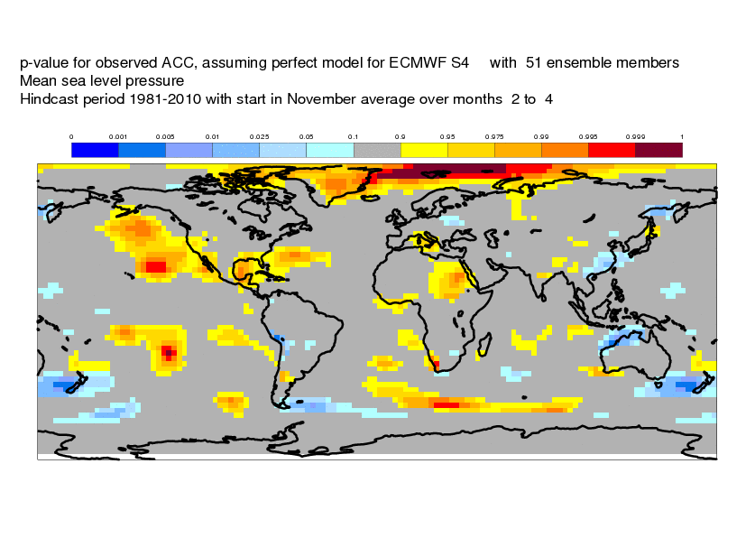
Predictive skill vs. Predictability limit
DJF Z500
DJF MSLP
Indistinguishable from perfect
Worse than perfect
Better than perfect

Slide 45
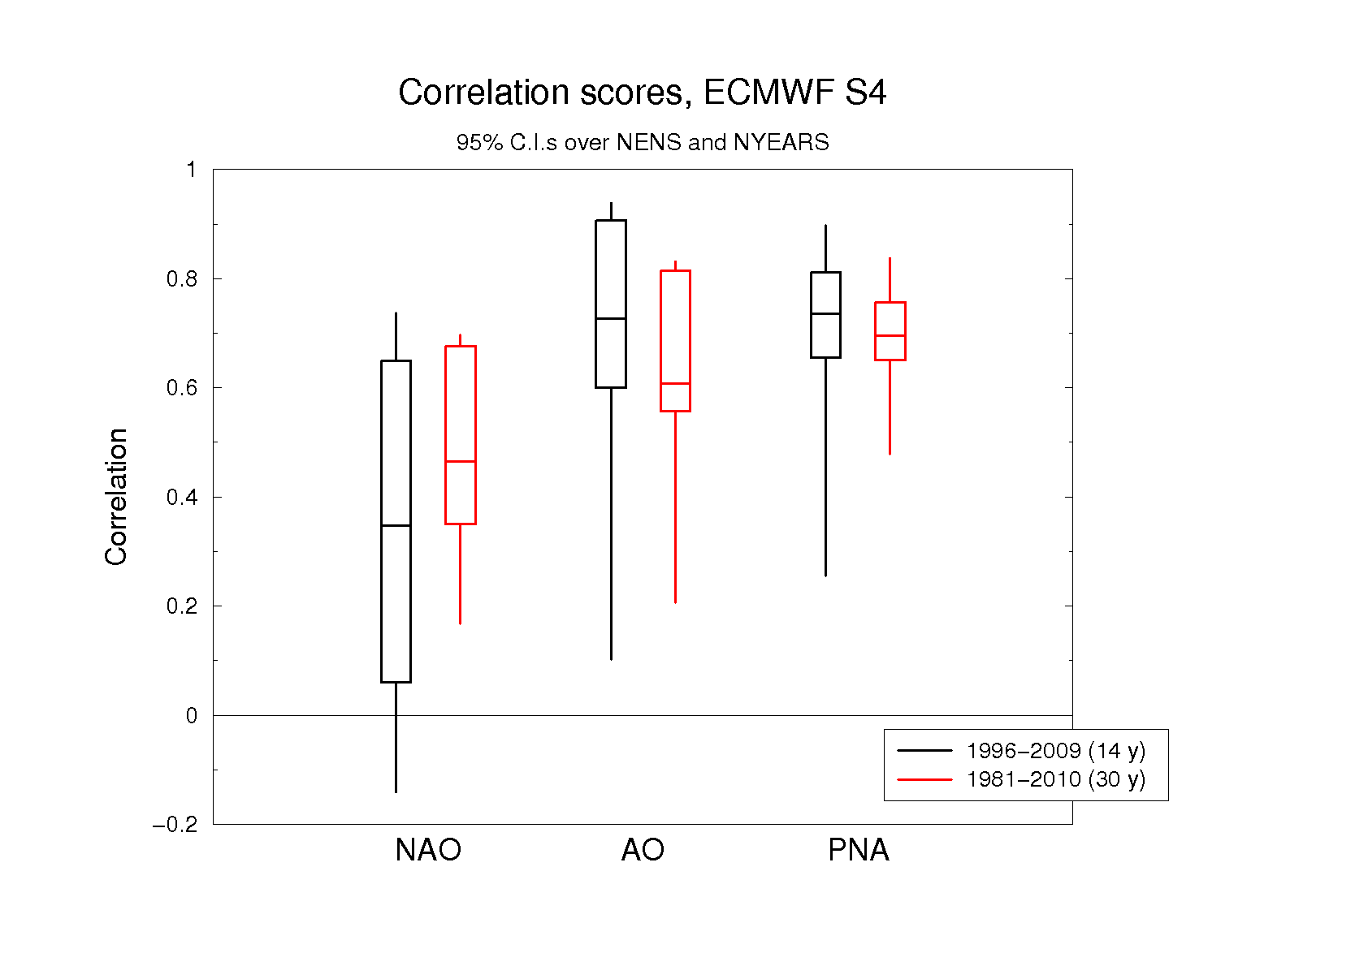
Challenge: sampling errors are large!
Box = 95% interval, bootstrapping on ensemble size
Whiskers = 95% interval,
bootstrapping on years included

Slide 46
How good are the forecasts?
Skill (ACC, BSS, ROC, …) relative to climate is typically moderate to high in the tropics, moderate to low in mid-latitudes.
Reliability is on average moderately good; large ensemble sizes are needed to measure this in low-predictability areas.
Even with large ensemble sizes, the limited number of years means that skill assessments have large uncertainties in mid-latitude regions.
Can average skill over many gridpoints, seasons etc, but trade resolution to gain accuracy.
Indications that in some cases the forecast spread is too large.

Slide 47
Model error and forecast interpretation
Model error is still quite large, relative to requirements
  It still dominates some SST forecast errors (e.g. west Pacific)
  Mean state and variability errors are very significant
  Errors cannot be easily fixed
Products typically account for sampling error only
  Don’t take model probabilities as true probabilities
Estimating forecast skill can be difficult
  In many cases, data is insufficient to produce sensible estimates
  This problem will not go away
In the end we need trustworthy models
  (Multi-model ensembles are helpful, but only partially span the space of model errors)

Slide 48
Some final comments
Plenty of scope for improving model forecasts
  Nino SST forecasts, while good, are still worse than predictability limits
  Model errors still obvious in many cases, some processes poorly treated
  Ocean initial conditions ~OK in Pacific since about 1993, recently improved elsewhere by ARGO
Model output -> use of forecast
  Calibration and presentation of forecast information
  Potential for multi-model ensembles
  Integration with decision making
Timescale for improvements
  Optimist: in 10 years, we’ll have much better models, pretty reliable forecasts, confidence in our ability to handle climate variations
  Pessimist: in 10 years, modelling will still be a hard problem, and progress will largely be down to improved calibration

