Slide 1
Post-Processing of Ensemble Forecasts
Tim Stockdale / Renate Hagedorn
European Centre for Medium-range Weather Forecasts
t.stockdale@ecmwf.int

Slide 2
Outline
Motivation
Methods
Training data sets
Results
This lecture is focussed on application to medium-range forecasts, but the theory and methods are general.

Slide 3
Motivation
Raw ENS forecasts are subject to forecast bias and dispersion errors, i.e. uncalibrated
The goal of calibration is to correct for such known model deficiencies, i.e. to construct predictions with statistical properties similar to the observations
A number of statistical methods exist for post-processing ensembles
Calibration needs a record of prediction-observation pairs
Calibration is particularly successful at station locations with long historical data record (-> downscaling)

Slide 4
Calibration methods
Bias correction
Multiple implementation of deterministic MOS
Ensemble dressing
Bayesian model averaging
Non-homogenous Gaussian regression
Logistic regression
Analogue method

Slide 5
Bias correction
As a simple first order calibration a bias correction can be applied:
This correction is added to each ensemble member, i.e. spread
is not affected
Particularly useful/successful at locations with features not resolved by
model and causing significant bias
with: e_{i} = ensemble mean of the i^{th} forecast
o_{i} = value of i^{th} observation
N = number of observation-forecast pairs

Slide 6
Bias correction
OBS
DET
EPS

Slide 7
Multiple implementation of det. MOS
A possible approach for calibrating ensemble predictions is to simply correct each individual ensemble member according to its deterministic model output statistic (MOS)
BUT: this approach is conceptually inappropriate since for longer lead-times the MOS tends to correct towards climatology
  all ensemble members tend towards climatology with longer lead-times
  decreased spread with longer lead-times
  in contradiction to increasing uncertainty with increasing lead-times
(Discontinued?) experimental product at http://www.nws.noaa.gov/mdl/synop/enstxt.php, but no objective verification yet…

Slide 8
Ensemble dressing
Define a probability distribution around each ensemble member (“dressing”)
A number of methods exist to find appropriate dressing kernel (“best-member” dressing, “error” dressing, “second moment constraint” dressing, etc.)
Average the resulting n_{ens} distributions to obtain final pdf

Slide 9
Ensemble Dressing
(Gaussian) ensemble dressing calculates the forecast probability for the
quantiles q as:
Key parameter is the standard deviation of the Gaussian dressing kernel
Simple approach: “best member” dressing, take standard deviation from r.m.s. difference of (obs-best member) from training set.
with: Φ = CDF of standard Gaussian distribution
x_{i} = bias-corrected ensemble-member
~

Slide 10
Ensemble Dressing
Common approach: second-moment constraint dressing
BUT: this can give negative or unstable variances, if model is already near to or over-dispersive.
Ensemble dressing to generate a pdf is only suitable for under-dispersive forecasts.
error variance of the
ensemble-mean FC
average of the ensemble variances
over the training data

Slide 11
Bayesian Model Averaging
BMA closely linked to ensemble dressing
Differences:
  dressing kernels do not need to be the same for all ensemble members
  different estimation method for kernels
Useful for giving different ensemble members (models) different weights:
Estimation of weights and kernels simultaneously via maximum
likelihood, i.e. maximizing the log-likelihood function:
with: w₁ + w_{e} (n_{ens} - 1) = 1
g₁, g_{e} = Gaussian PDF’s

Slide 12
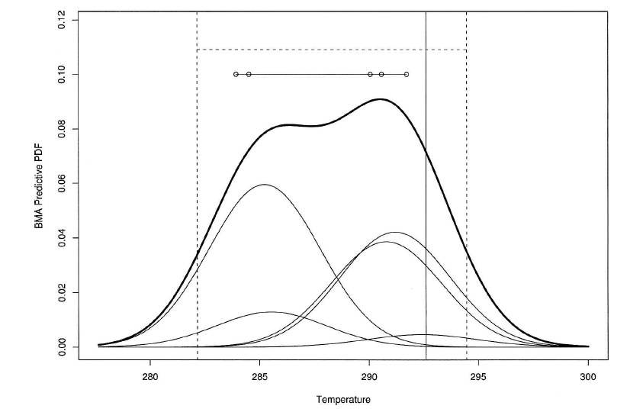
BMA: example
90% prediction interval of BMA
single model
ensemble members
OBS
Ref: Raftery et al., 2005, MWR

Slide 13
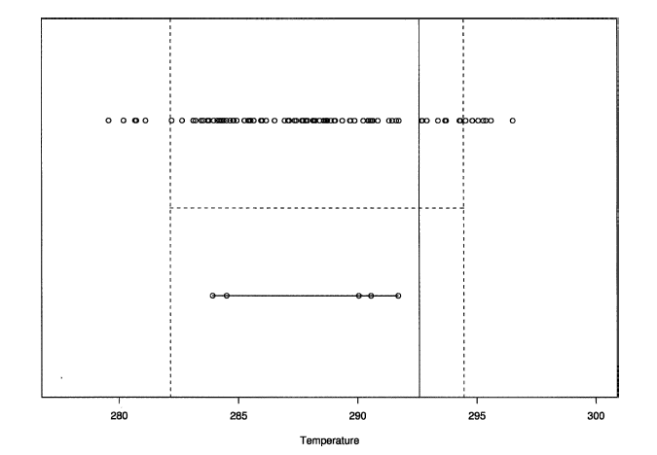
BMA: recovered ensemble members
100 equally likely values
drawn from BMA PDF
OBS
single model
ensemble members
Ref: Raftery et al., 2005, MWR

Slide 14
Non-homogenous Gaussian Regression
In order to account for existing spread-skill relationships we model
the variance of the error term as a function of the ensemble spread s_{ens}:
• The parameters a,b,c,d are fit iteratively by minimizing the CRPS of the
training data set
• Interpretation of parameters:
➢ bias & general performance of ens-mean are reflected in a and b
➢ large spread-skill relationship: c ≈ 0.0, d ≈ 1.0
➢ small spread-skill relationship: d ≈ 0.0
• Calibration provides mean and spread of Gaussian distribution
(called non-homogenous since variances of regression errors not the same for all values
of the predictor, i.e. non-homogenous)

Slide 15
Logistic regression
Logistic regression is a statistical regression model for Bernoulli-
distributed dependent variables
• P is bound by 0,1 and produces an s-shaped prediction curve
➢ steepness of curve (β₁) increases with decreasing spread, leading to
sharper forecasts (more frequent use of extreme probabilities)
➢ parameter β₀ corrects for bias, i.e. shifts the s-shaped curve

Slide 16
How does logistic regression work?
GP: 51N, 9E, Date: 20050915, Lead: 96h
+ training data
100 cases (EnsMean)
(height = obs yes/no)
+ test data
(51 members)
(height = raw prob)
calibrated prob
event observed
yes/no (0/1)
event threshold

Slide 17
Example: LR-Probability worse!
GP: 51N, 9E, Date: 20050915, Lead: 168h
+ training data
100 cases (EM)
height of obs y/n
+ test data
(51 members)
(height = raw prob)
calibrated prob
event observed
yes/no (0/1)
event threshold

Slide 18
Example: LR-Probability (much) better!
GP: 15.5S, 149.5W, Date: 20050915, Lead: 168h
+ training data
100 cases (EM)
(height = obs y/n)
+ test data
(51 members)
(height = raw prob)
calibrated prob
event observed
yes/no (0/1)
event threshold

Slide 19
Analogue method
Full analogue theory assumes a nearly infinite training sample
Justified under simplifying assumptions:
  Search only for local analogues
  Match the ensemble-mean fields
  Consider only one model forecast variable in selecting analogues
General procedure:
  Take the ensemble mean of the forecast to be calibrated and find the n_{ens} closest forecasts to this in the training dataset
  Take the corresponding observations to these n_{ens} re-forecasts and form a new calibrated ensemble
  Construct probability forecasts from this analogue ensemble

Slide 20
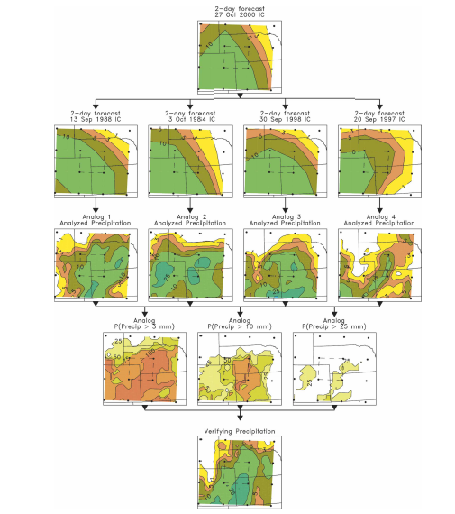
Analogue method
Forecast to be calibrated
Closest re-forecasts
Corresponding obs
Probabilities of analog-ens
Verifying observation
Ref: Hamill & Whitaker, 2006, MWR

Slide 21
Training datasets
All calibration methods need a training dataset, containing a number of forecast-observation pairs from the past
  The more training cases the better
  The model version used to produce the training dataset should be as close as possible to the operational model version
For research applications often only one dataset is used to develop and test the calibration method. In this case cross-validation has to be applied.
For operational applications one can use:
  Operational available forecasts from e.g. past 30-40 days
  Data from a re-forecast dataset covering a larger number of past forecast dates / years

Slide 22
“Perfect” Reforecast Data Set
 | 2014
 | Apr |  | May |  |  |  |  |  |  |  |  |  |  |  |  |  |  |  |  |  |  |  |  |  |  |  |  |  |  |  |  |  |  | Jun
 | 29 | 30 | 01 | 02 | 03 | 04 | 05 | 06 | 07 | 08 | 09 | 10 | 11 | 12 | 13 | 14 | 15 | 16 | 17 | 18 | 19 | 20 | 21 | 22 | 23 | 24 | 25 | 26 | 27 | 28 | 29 | 30 | 31 | 01 | 02
1981
1982
1983
1984
1985
. . . .
2006
2007
2008
2009
2010

Slide 23
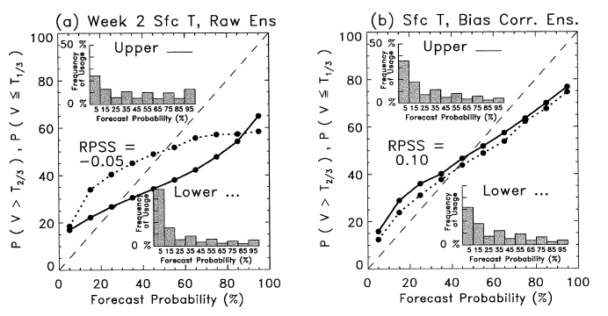
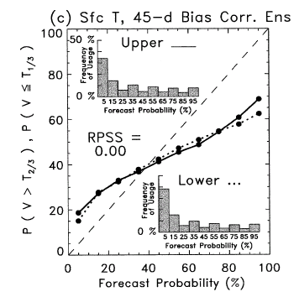
Early motivating results from Hamill et al., 2004
Raw ensemble
Bias corrected
with refc data
Achieved with
“perfect”
reforecast system!
Bias corrected
with 45-d data
LR-calibrated
ensemble

Slide 24
The 45-day unified ENS ensemble system
Unified ENS ensemble system enables the production of a unified reforecast data set, to be used by:
  EFI model climate
  15 day ENS calibration
  Monthly forecasts anomalies and verification
Efficient use of resources (computational and operational)
“Realistic” reforecast system has to be an optimal compromise between affordability and needs of all three applications
Use 11 member ensemble, twice per week, for last 20 years

Slide 25
Unified ENS Reforecasts
(From 12th May 2015)
Used in EFA and SOT
Used in monthly forecast
 | 2014
 | Apr |  | May |  |  |  |  |  |  |  |  |  |  |  |  |  |  |  |  |  |  |  |  |  |  |  |  |  |  |  |  |  |  | Jun
 | 29 | 30 | 01 | 02 | 03 | 04 | 05 | 06 | 07 | 08 | 09 | 10 | 11 | 12 | 13 | 14 | 15 | 16 | 17 | 18 | 19 | 20 | 21 | 22 | 23 | 24 | 25 | 26 | 27 | 28 | 29 | 30 | 31 | 01 | 02
1994
1995
1996
1997
1998
. . . .
2009
2010
2011
2012
2013
Thursday

Slide 26
Testing the benefits of reforecast calibration
(Reference: Hagedorn et al, 2012)
One goal of the TIGGE* project is to investigate whether multi-model predictions are an improvement to single model forecasts
The goal of using reforecasts to calibrate single model forecasts is to provide improved predictions
Questions:
  What are the relative benefits (costs) of both approaches?
  What is the mechanism behind the improvements?
  Which is the “better” approach?
* TIGGE stands for: THORPEX Interactive Grand Global Ensemble

Slide 27
Comparing 9 TIGGE models & the MM
T-850hPa, DJF 2008/09
NH (20°N - 90°N)
DMO vs. ERA-interim
Symbols used for
significance level
vs. MM (1%)

Slide 28
Comparing 4 TIGGE models & the MM
T-850hPa, DJF 2008/09
NH (20°N - 90°N)
DMO vs. ERA-interim

Slide 29
Comparing 4 TIGGE models, MM, EC-CAL
T-850hPa, DJF 2008/09
NH (20°N - 90°N)
DMO & refc-cali vs. ERA-interim
EC-CAL, day 1-4:
significant reduction of RMSE
(below MM-RMSE)
slightly increased spread and
better SPR-ERR relation
(better than MM which is
over-dispersive)

Slide 30
Comparing 4 TIGGE models, MM, EC-CAL
2m Temperature, DJF 2008/09
NH (20°N - 90°N)
BC & refc-cali vs. ERA-interim

Slide 31
Mechanism behind improvements
2m Temperature, DJF 2008/09
Northern Hemisphere (20°N - 90°N)
Verification: ERA-interim
RMSE (solid)
SPREAD (dash)

Slide 32
Mechanism behind improvements
2m Temperature, DJF 2008/09
Northern Hemisphere (20°N - 90°N)
Verification: ERA-interim
RMSE (solid)
SPREAD (dash)

Slide 33
Mechanism behind improvements
2m Temperature, DJF 2008/09
Northern Hemisphere (20°N - 90°N)
Verification: ERA-interim
RMSE (solid)
SPREAD (dash)
EC-CAL:
significant reduction of RMSE
(below MM-RMSE after day5)
improved SPR-ERR relation
(perfect for “pure” NGR,
but greater RMSE reduction of
“MIX” calibration more important
than better SPR-ERR)

Slide 34
What about station data?
T-2m, 250 European stations
DJF 2008/09
Multi-Model
ECMWF
Met Office
NCEP
CMC
Dashed: REFC-NGR
Dotted: 30d-BC
Solid: no BC

Slide 35
Impact of calibration & MM in EPSgrams
2m Temperature
FC: 30/12/2008
ECMWF
ECMWF-NGR
TIGGE
Analysis
Monterey
London

Slide 36
A separate study …
(Reference: Hamill, 2012)
Examining precipitation forecasts over the US
Four high skill models; compare ECMWF “re-forecast calibrated” with multi-model (no re-forecasts)
Conclusions:
“Raw multimodel PQPFs were generally more skillful than reforecast-calibrated ECMWF PQPFs for the light precipitation events but had about the same skill for the higher-precipitation events”
“Multimodel ensembles were also postprocessed using logistic regression and the last 30 days of prior forecasts and analyses; Postprocessed multimodel PQPFs did not provide as much improvement to the raw multimodel PQPF as the reforecast-based processing did to the ECMWF forecast.”
“The evidence presented here suggests that all operational centers, even ECMWF, would benefit from the open, real-time sharing of precipitation forecast data and the use of reforecasts.”

Slide 37
Summary on MM vs. calibration
What are the relative benefits/costs of both approaches?
  Both multi-model and a reforecast calibration approach can improve predictions, in particular for (biased and under-dispersive) near-surface parameters
What is the mechanism behind the improvements?
  Both approaches correct similar deficiencies to a similar extent
Which is the “better” approach?
  On balance, reforecast calibration seems to be the easier option for a reliable provision of forecasts in an operational environment
  Both approaches can be useful in achieving the ultimate goal of an optimized, well tuned forecast system

Slide 38
Overall summary
The goal of calibration is to correct for known model deficiencies
A number of statistical methods exist to post-process ensembles
Each method has its own strengths and weaknesses
  Analogue methods seem to be useful when large training dataset available
  Logistic regression can be helpful for extreme events not seen so far in training dataset
  NGR method useful when strong spread-skill relationship exists, but relatively expensive in computational time
Greatest improvements can be achieved on local station level
Bias correction constitutes a large contribution for all calibration methods
ECMWF reforecasts are a very valuable training dataset for calibration

Slide 39
References and further reading
Gneiting, T. et al, 2005: Calibrated Probabilistic Forecasting Using Ensemble Model Output Statistics and Minimum CRPS Estimation. Monthly Weather Review, 133, 1098-1118.
Hagedorn, R, T. M. Hamill, and J. S. Whitaker, 2008: Probabilistic forecast calibration using ECMWF and GFS ensemble forecasts. Part I: 2-meter temperature. Monthly Weather Review, 136, 2608-2619.
Hagedorn, R., Buizza, R., Hamill, T. M., Leutbecher, M. and Palmer, T. N., 2012: Comparing TIGGE multimodel forecasts with reforecast-calibrated ECMWF ensemble forecasts. Q.J.R. Meteorol. Soc. doi: 10.1002/qj.1895
Hamill, T.M., 2012: Verification of TIGGE Multi-model and ECMWF Reforecast-Calibrated Probabilistic Precipitation Forecasts over the Contiguous US. Monthly Weather Review, doi: 10.1175/MWR-D-11-00220.1
Hamill, T.M. et al., 2004: Ensemble Reforecasting: Improving Medium-Range Forecast Skill Using Retrospective Forecasts. Monthly Weather Review, 132, 1434-1447.
Hamill, T.M. and J.S. Whitaker, 2006: Probabilistic Quantitative Precipitation Forecasts Based on Reforecast Analogs: Theory and Application. Monthly Weather Review, 134, 3209-3229.
Raftery, A.E. et al., 2005: Using Bayesian Model Averaging to Calibrate Forecast Ensembles. Monthly Weather Review, 133, 1155-1174.
Wilks, D. S., 2006: Comparison of Ensemble-MOS Methods in the Lorenz ’96 Setting. Meteorological Applications, 13, 243-256.

