Slide 1
Layout of these lectures
Introduction
General remarks
Model development and validation
Snow and frozen soil hydrology
Snow atmosphere coupling
The Earth energy budget
Soil/Water/Vegetation contrasts
Lecture 1
Lecture 2
Lecture 3

Slide 2
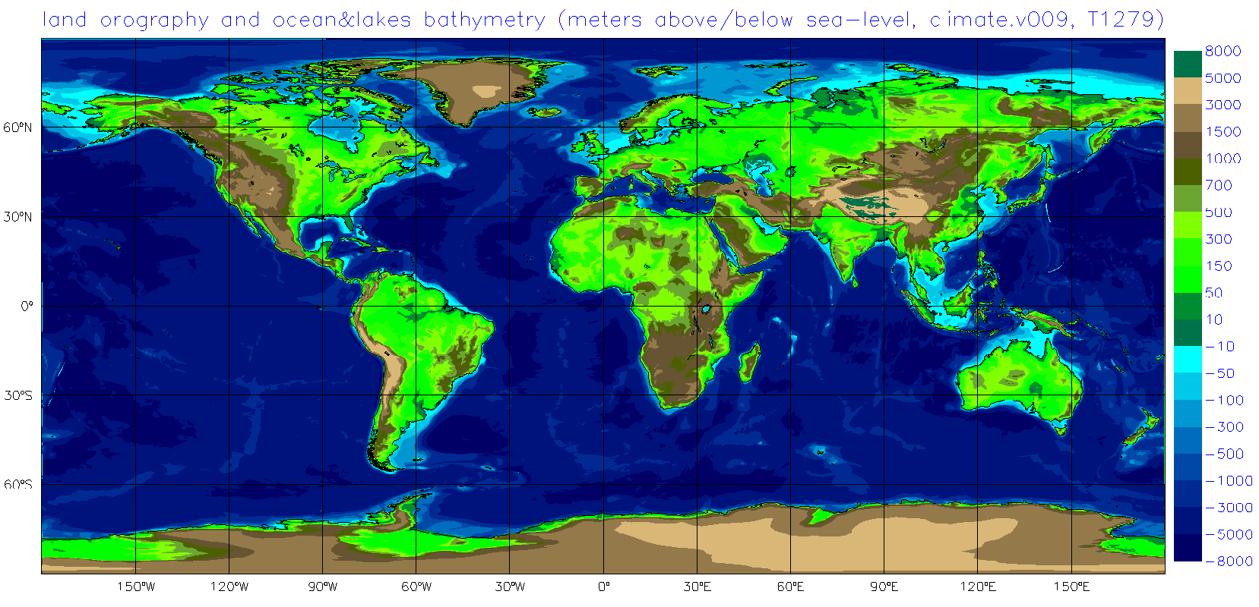
The IFS Earth orography and bathymetry

Slide 3
Thermal budget of a ground layer at the surface
H
LE
Day
D
Night
G

Slide 4
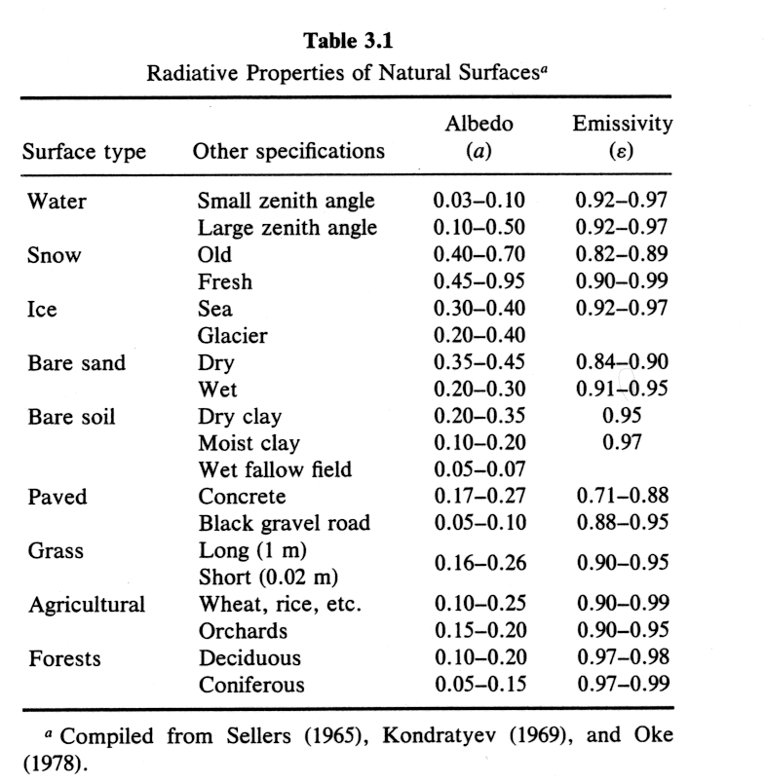
The surface radiation
Surface albedo
Surface emissivity
Skin temperature
In some cases (snow, sea ice, dense canopies) the impinging solar radiations penetrates the “ground” layer and is absorbed at a variable depth. In those cases, an extinction coefficient is needed.
Arya, 1988

Slide 5
The other terms
Sensible heat flux
specify the surface
Evaporation
Ground heat flux

Slide 6
HTESSEL
Skin layer at the interface between soil (snow) and atmosphere; no thermal inertia, instantaneous energy balance
At the interface soil/atmosphere, each grid-box is divided into fractions (tiles), each fraction with a different functional behaviour. The different tiles see the same atmospheric column above and the same soil column below.
If there are N tiles, there will be N fluxes, N skin temperatures per grid-box
There are currently up to 6 tiles over land (N=6)

Slide 7
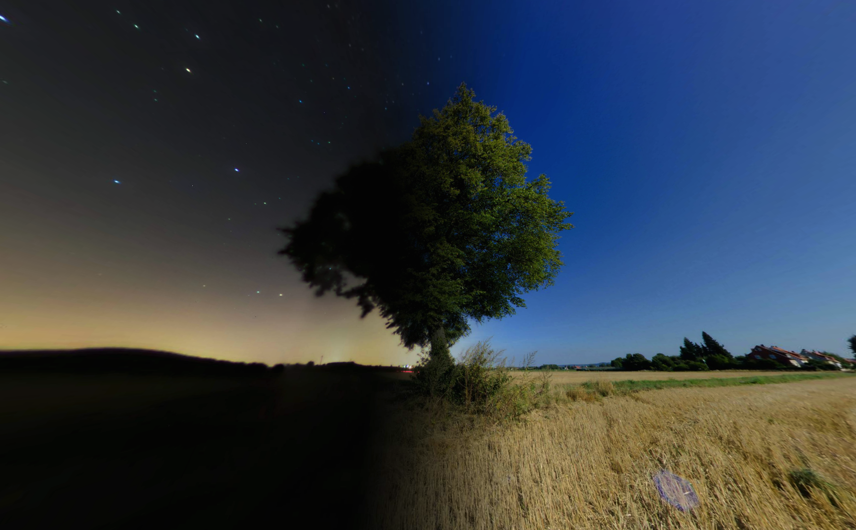
Coupling and diurnal cycle: vegetation
Night
Day

Slide 8
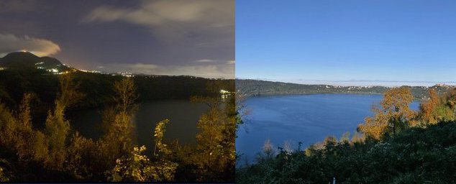
Coupling and diurnal cycle: lakes
Day
Night

Slide 9
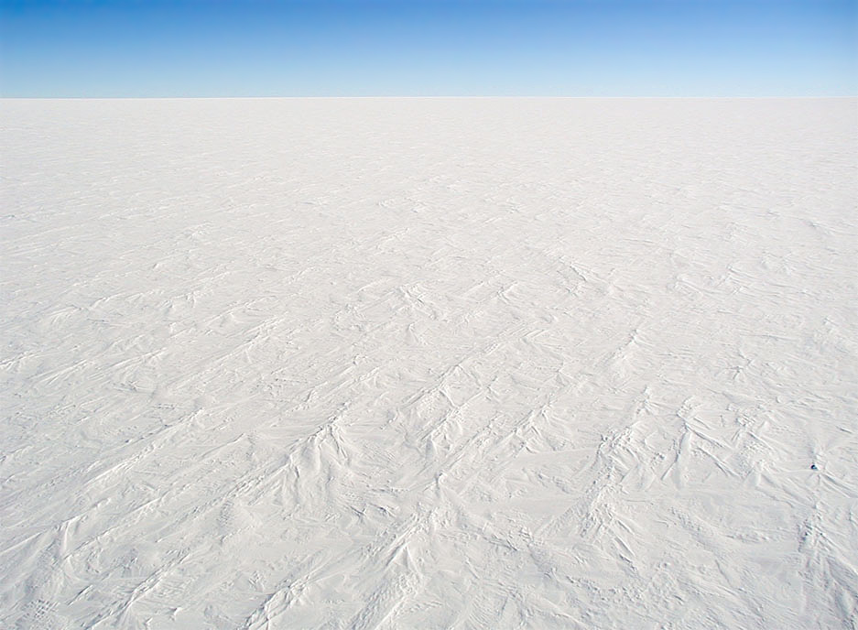
Coupling and diurnal cycle: snow and ice
Night
Day

Slide 10
HTESSEL skin temperature equation
Grid-box quantities

Slide 11
Ground heat flux
In the absence of phase changes, heat conduction in the soil obeys a Fourier law
Boundary conditions:
  Top Net surface heat flux
  Bottom No heat flux OR prescribed climate

Slide 12
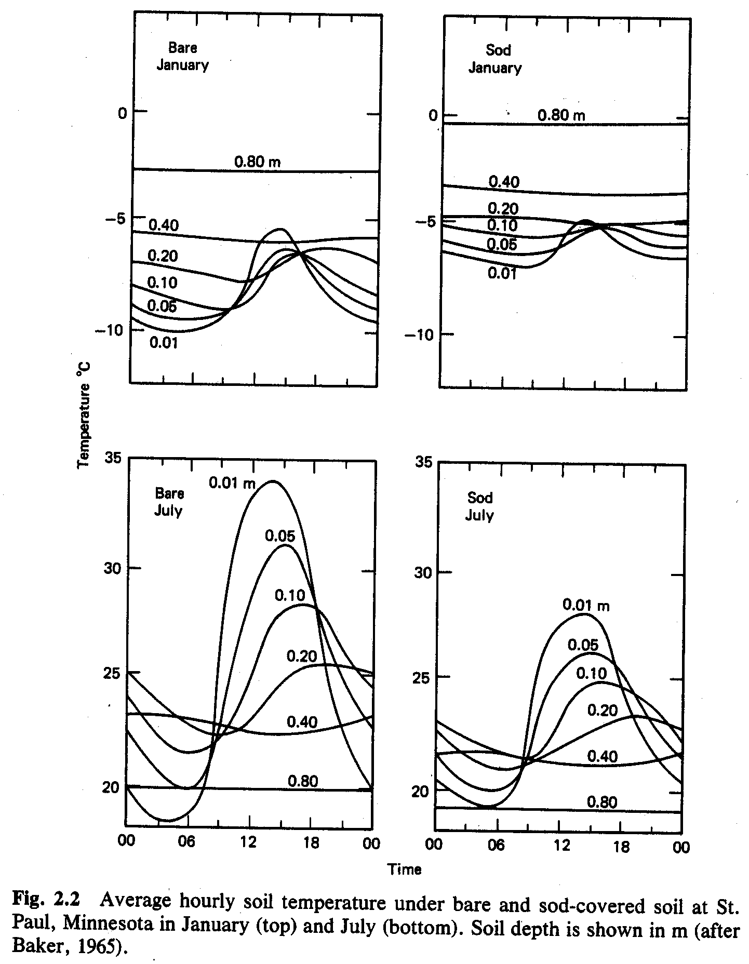
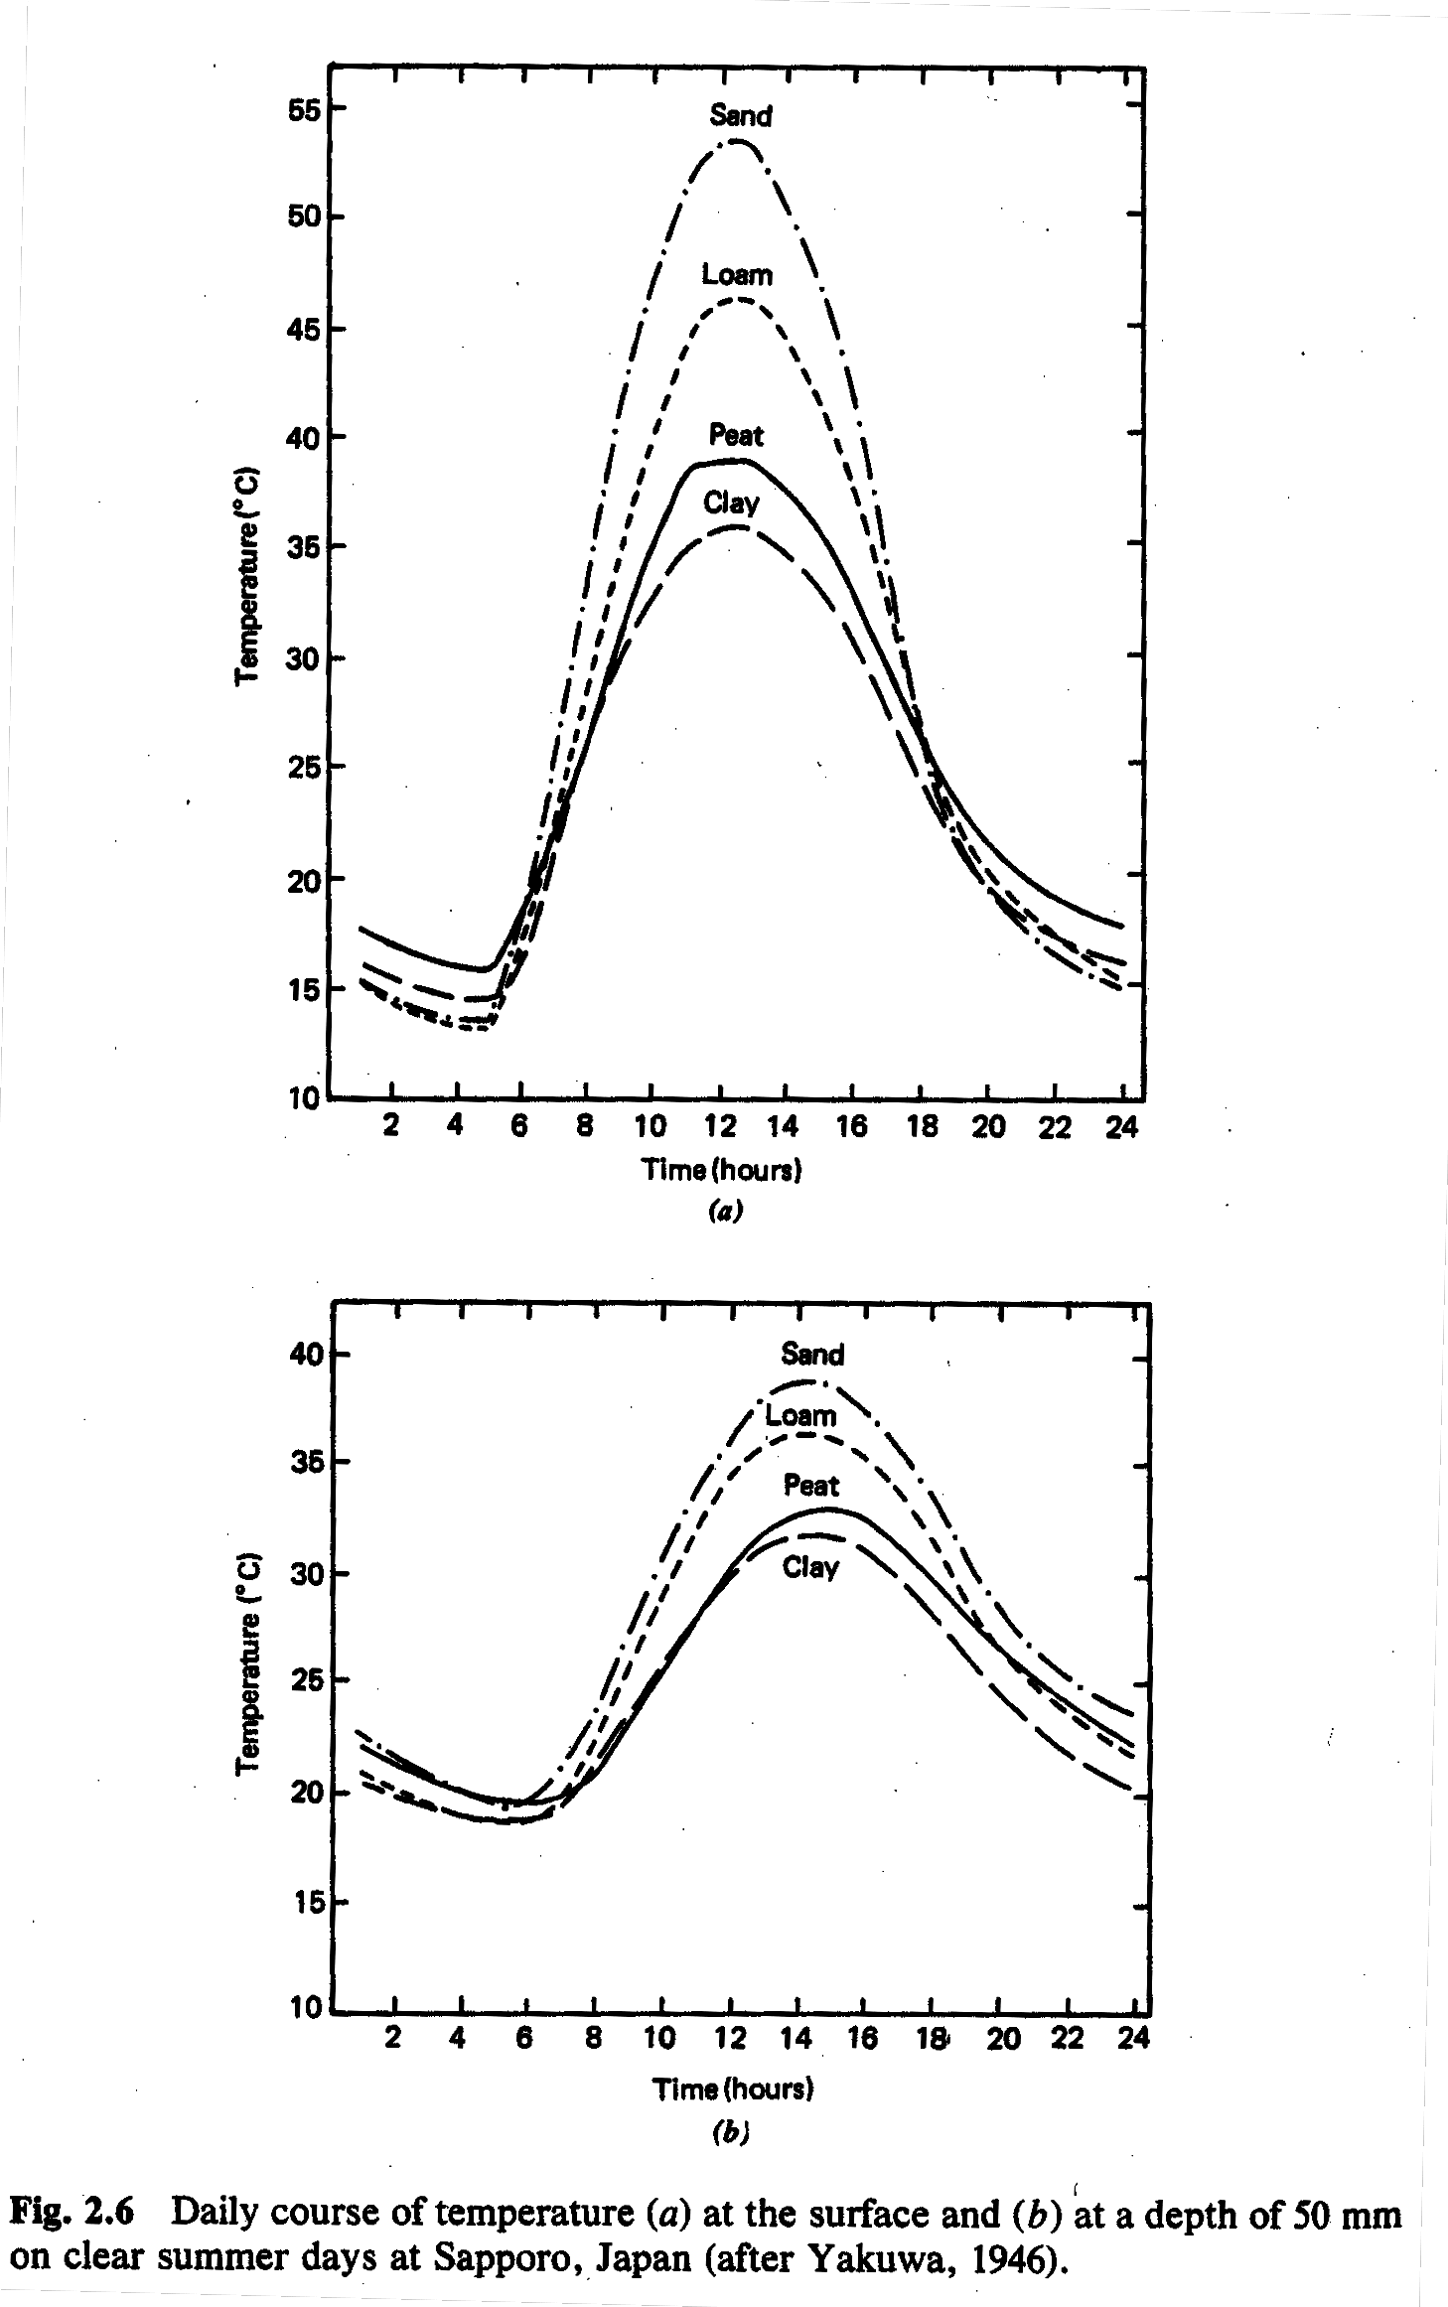
Diurnal cycle of soil temperature
summer
winter
surface
bare
sod
summer
50 cm depth
Rosenberg et al 1983

Slide 13
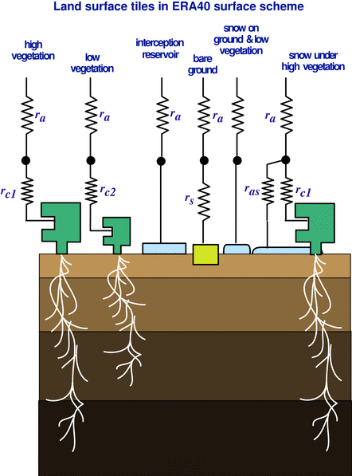
HTESSEL heat transfer
Solution of heat transfer equation with the soil discretized in 4 layers, depths 7, 21, 72, and 189 cm.
No-flux bottom boundary condition
Heat conductivity dependent on soil water
Thermal effects of soil water phase change
↓0.1~0.6 d
↓ 1.1~5.8 d
↓ 10.6 ~ 55.8 d
Time-scale for downward heat transfers in wet/dry soil

Slide 14
Recap: The surface energy equation
Equation for
For:
  a thin soil layer at the top
  G (T_{s},T_{sk}) is known, or parameterized or G << R_{n}
  we have a non-linear equation defining the skin temperature

Slide 15
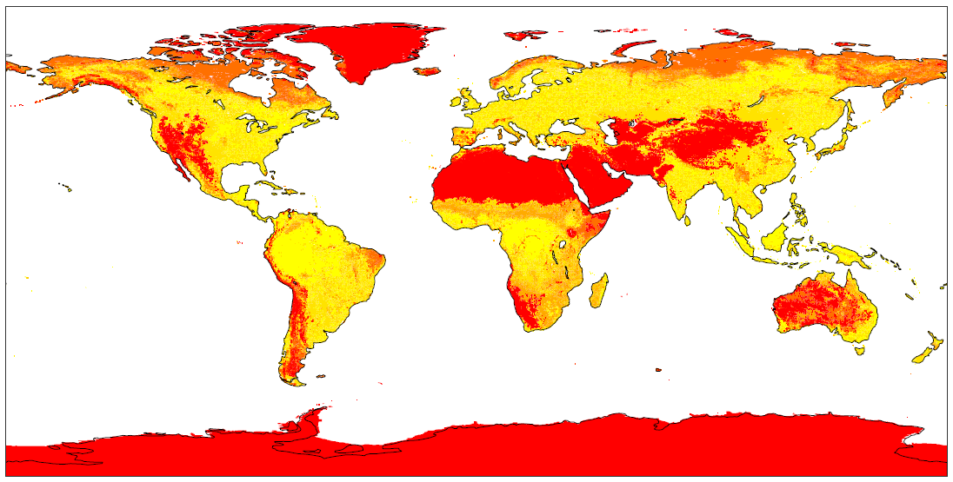
Bare ground fraction
Calculated from GLCC 1km
and assigned vegetation covers

Slide 16
Bare ground evaporation
Soil (bare ground) evaporation is due to:
  Molecular diffusion from the water in the pores of the soil matrix up to the interface soil atmosphere (z_{0q})‏
  Laminar and turbulent diffusion in the air between z_{0q} and screen level height
All methods are sensitive to the water in the first few cm of the soil (where the water vapour gradient is large). In very dry conditions, water vapour inside the soil becomes dominant

Slide 17
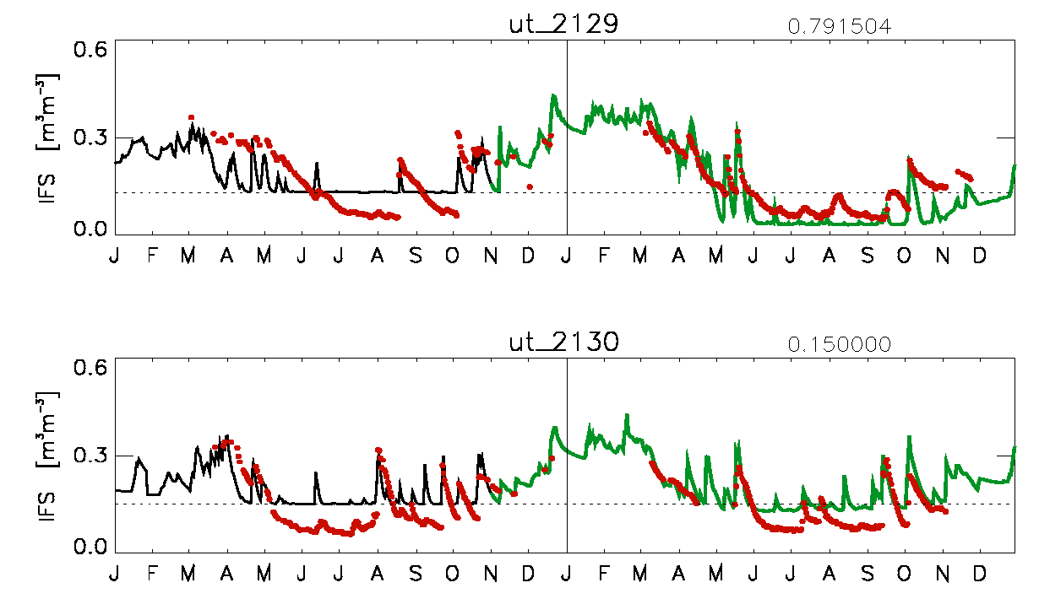
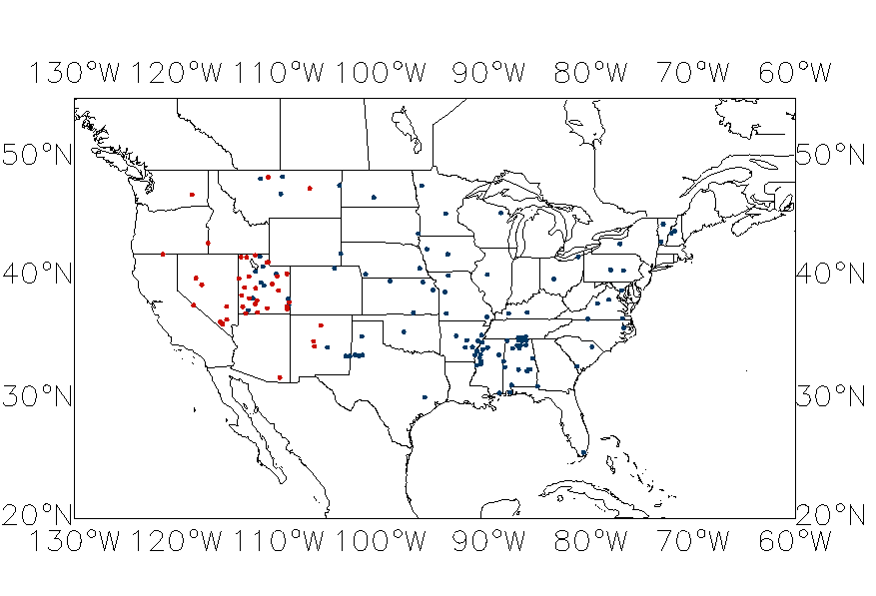
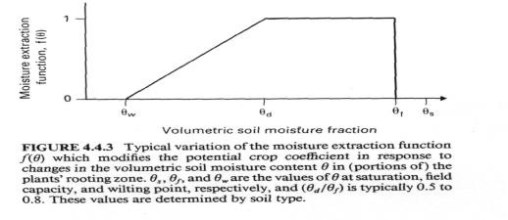
HTESSEL bare soil evaporation
(Balsamo et al. 2011, Albergel et al. 2012)
ut_2129
####2010###
R = 0.583
Bias = 0.005
RMSD= 0.068
####2011###
R = 0.906
Bias = 0.033
RMSD= 0.056
ut_2130
####2010###
R = 0.685
Bias = -0.036
RMSD= 0.064
####2011###
R = 0.812
Bias = -0.037
RMSD= 0.052
SOIL Evaporation
Balsamo et al. (2011)
based on
Mahfouf and Noilhan (1991)
f₂(w₁)
The introduction of bare ground
evaporation revision (green-line) is quite
effective in reducing the soil moisture
below the wilting point in non-vegetated
area (upper panel of figure above, at
79% bare ground, SCAN site in Utah).
R_{c}=R_{soil} f₂(w₁)
ICOS Annual meeting, Bruxelles 1/6/2011 - G. Balsamo

Slide 18
HTESSEL Transpiration
Sensible heat (H), the resistance formulation
Evaporation (E), the resistance formulation (the big leaf approximation, Deardorff 1978, Monteith 1965)‏

Slide 19
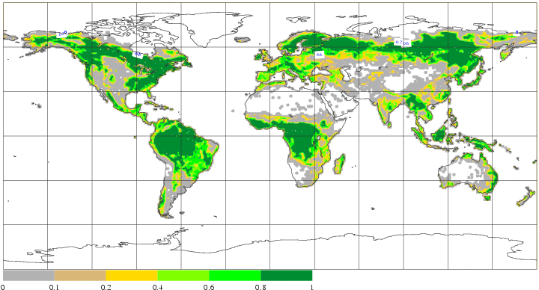
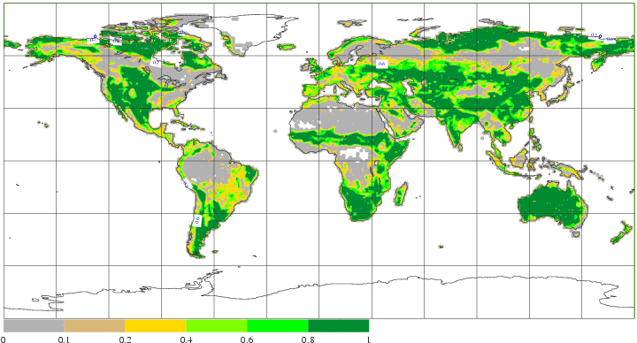
High and Low vegetation fractions
Aggregated from GLCC 1km

Slide 20
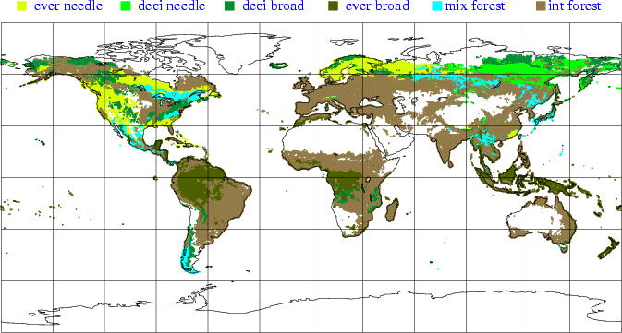
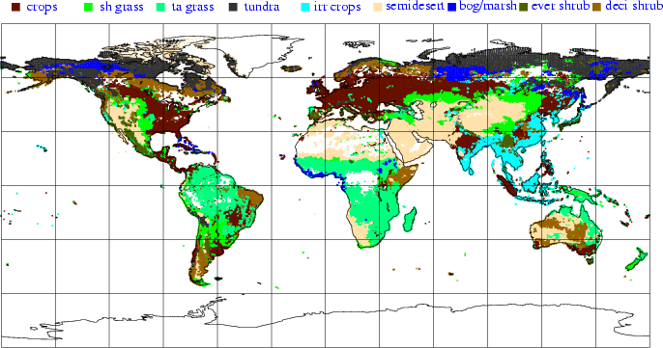
High and Low vegetation types
Aggregated from GLCC 1km

Slide 21
Interception: Canopy water budget

Slide 22
HTESSEL: interception
Interception layer for rainfall and dew deposition

Slide 23
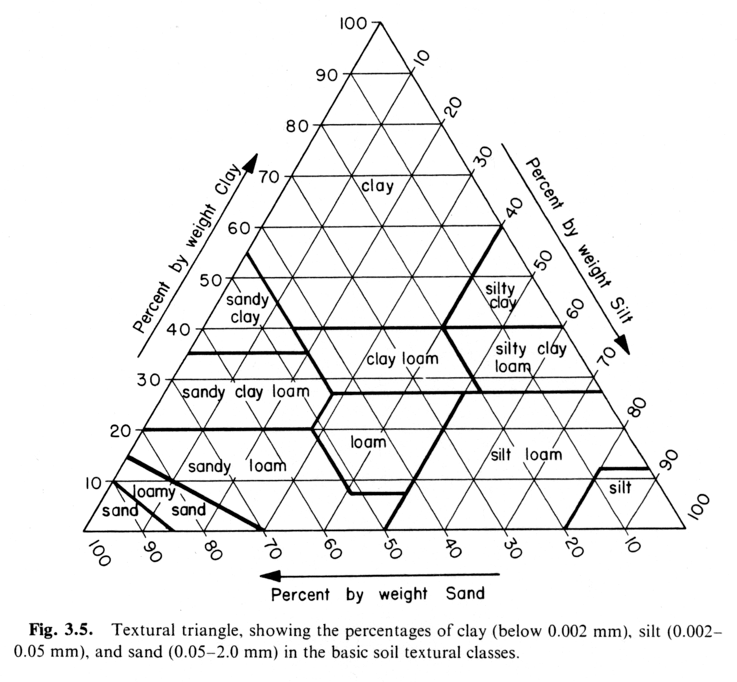
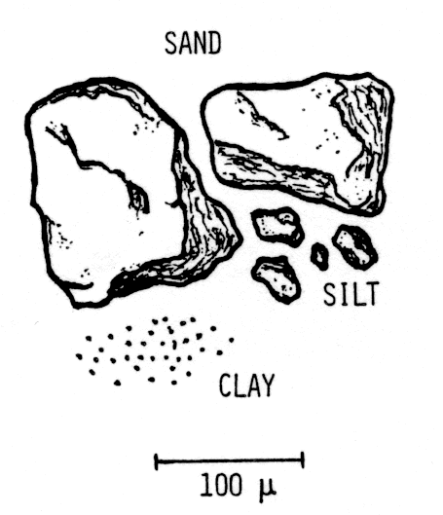
Soil science miscellany
The soil is a 3-phase system, consisting of
  minerals and organic matter soil matrix
  water condensate (liquid/solid) phase
  moist air trapped gaseous phase
Texture - the size distribution of soil particles
Hillel 1982, 1998

Slide 24
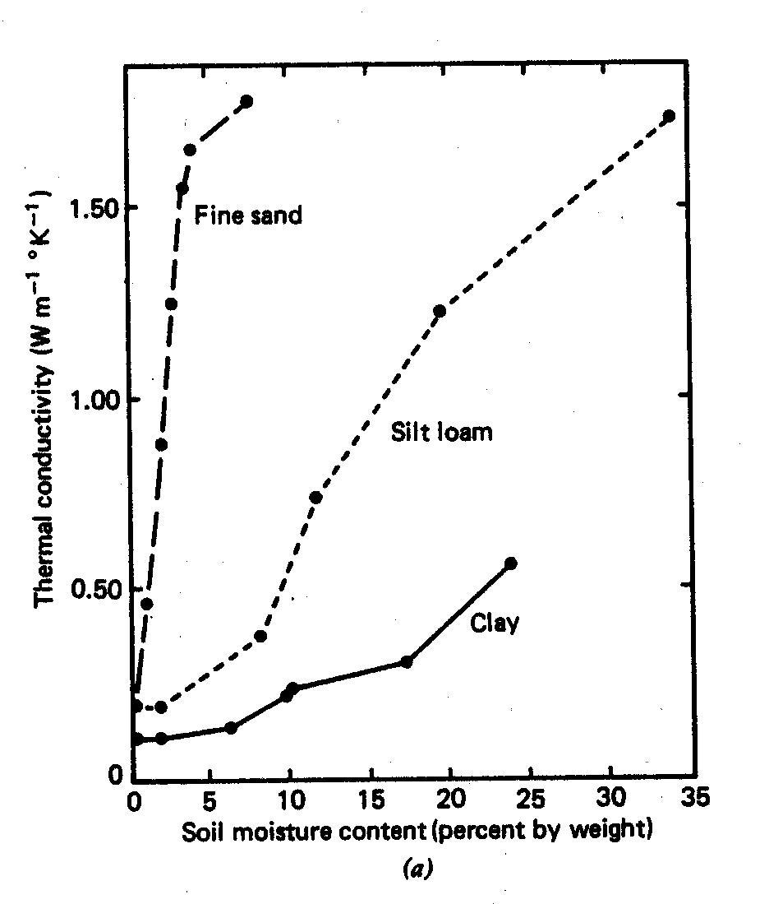
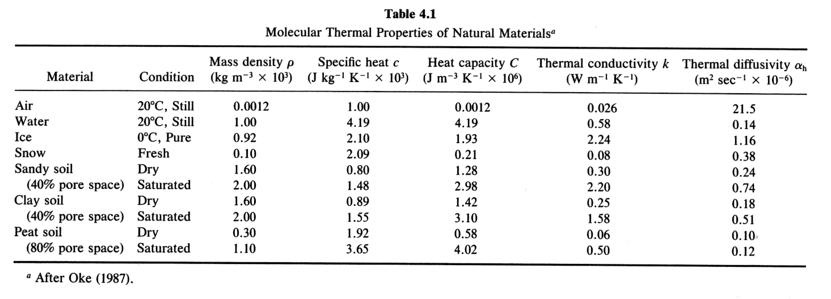
Soil properties
Rosenberg et al 1983
Arya 1988

Slide 25
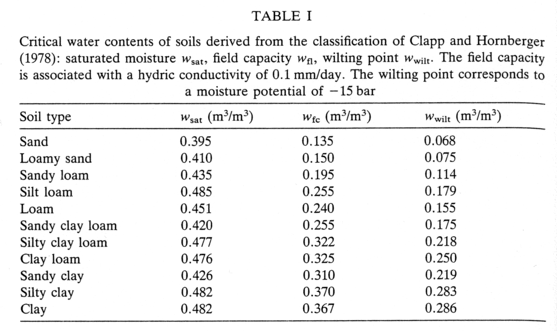
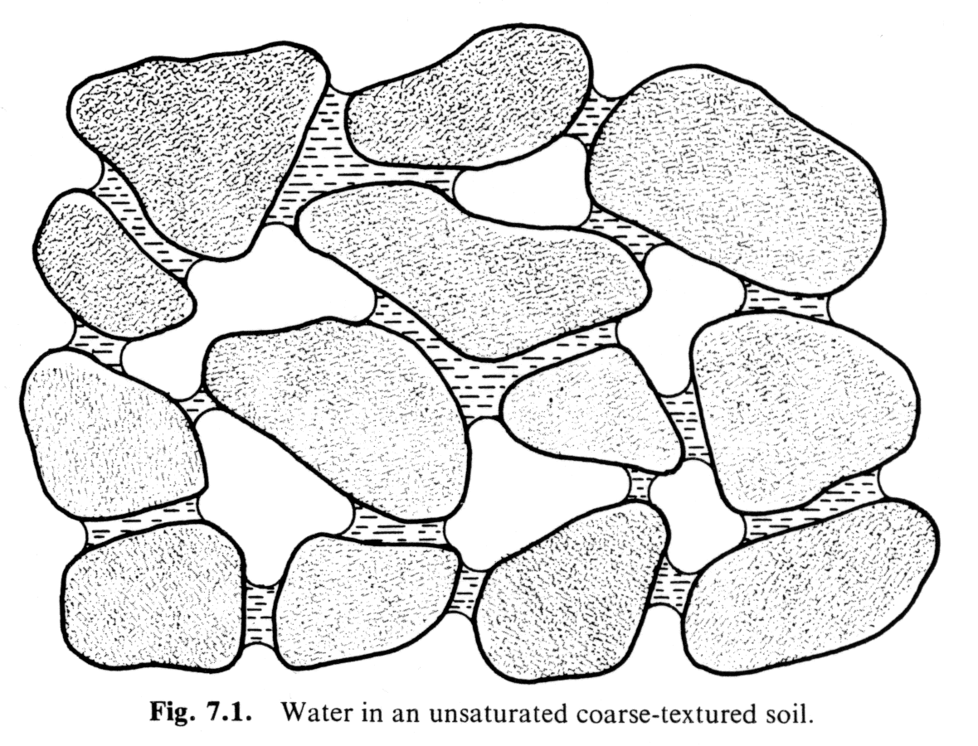
More soil science miscellany
Hillel 1982
Jacquemin and Noilhan 1990
3 numbers defining soil water properties
  Saturation (soil porosity) Maximum amount of water that the soil can hold when all pores are filled 0.472 m³m⁻³
  Field capacity “Maximum amount of water an entire column of soil can hold against gravity” 0.323 m³m⁻³
  Permanent wilting point Limiting value below which the plant system cannot extract any water 0.171 m³m⁻³

Slide 26
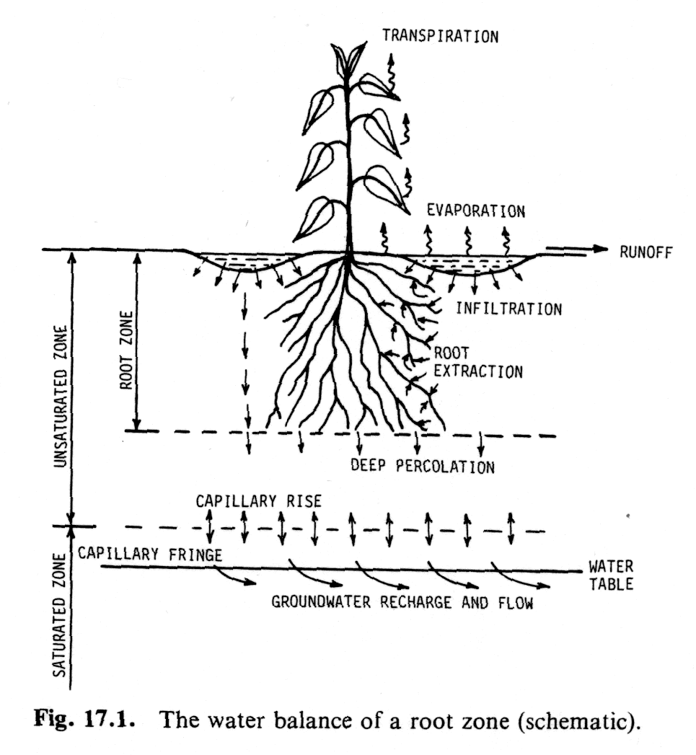
Schematics
Boundary conditions:
Top See later
Bottom Free drainage or bed rock
Root extraction
The amount of water transported
from the root system up to the stomata
(due to the difference in the osmotic
pressure) and then available for
transpiration
Hillel 1982

Slide 27
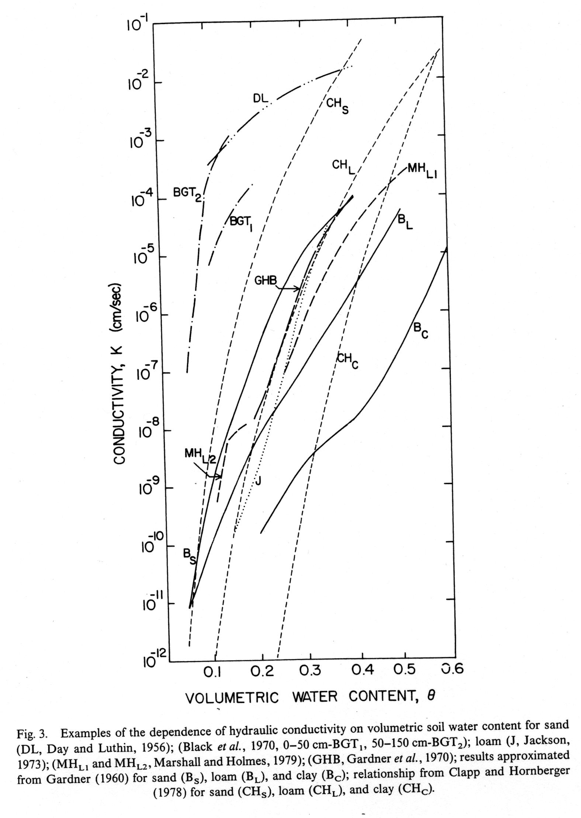
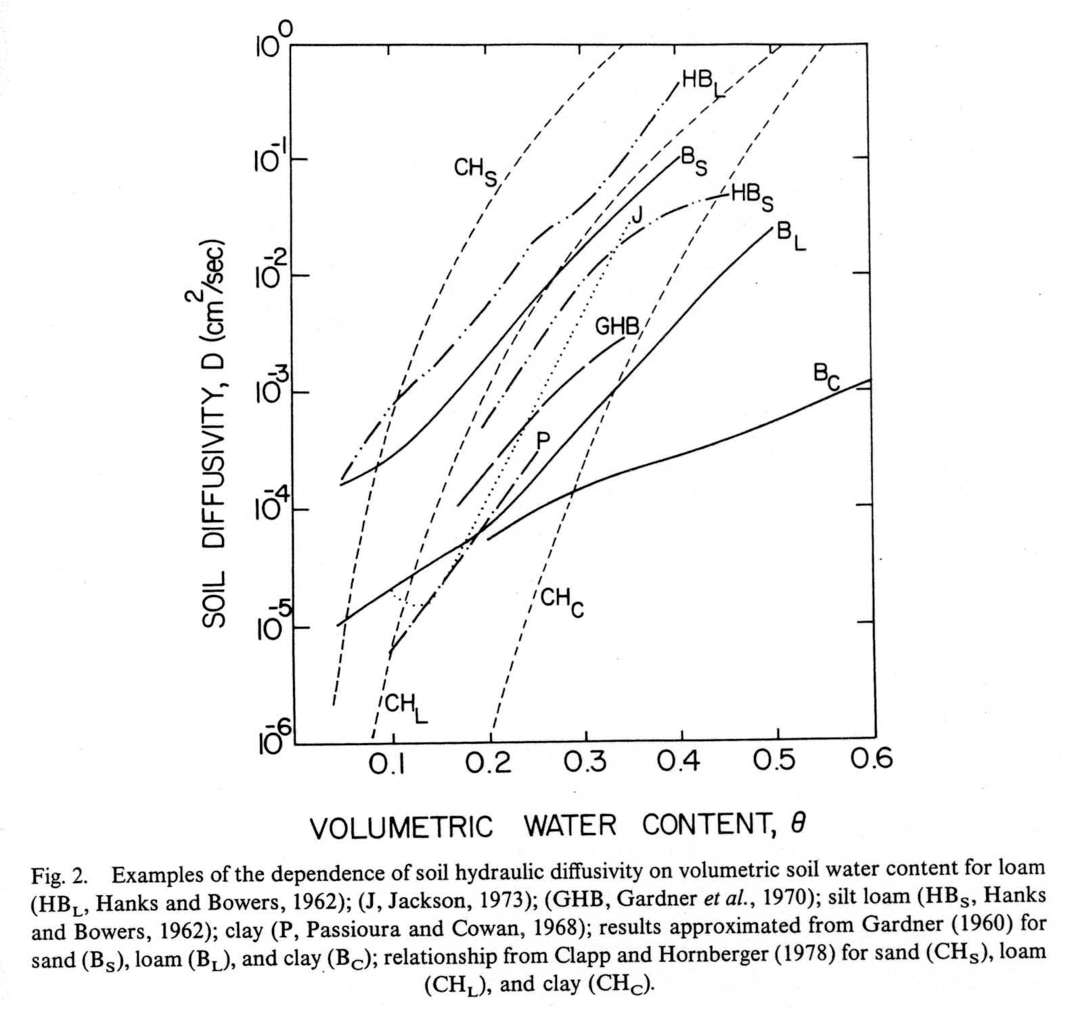
Soil water flux
Darcy’s law
> 3 orders of
magnitude
> 6 orders of
magnitude
Mahrt and Pan 1984

Slide 28
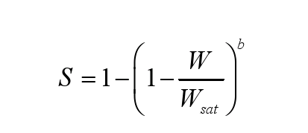
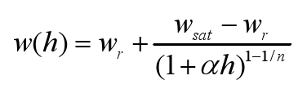
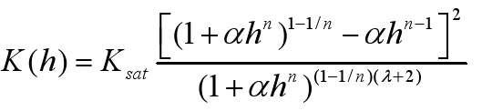
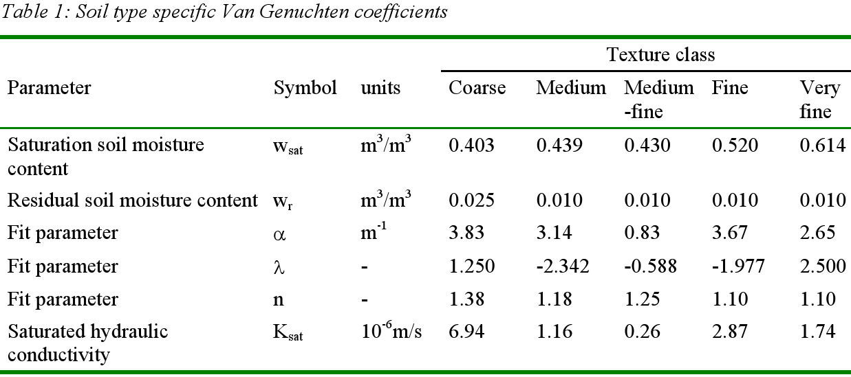
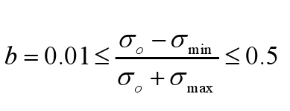
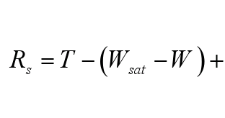
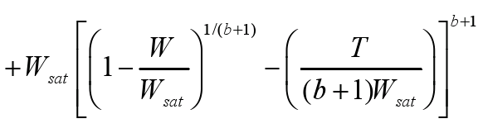
HTESSEL hydrology scheme
A spatially variable hydrology scheme is being tested following Van den Hurk and Viterbo 2003
Use of a the Digital Soil Map of World (DSMW) 2003
Infiltration based on Van Genuchten 1980 and Surface runoff generation based on Dümenil and Todini 1992
Van den Hurk and Viterbo 2003

Slide 29
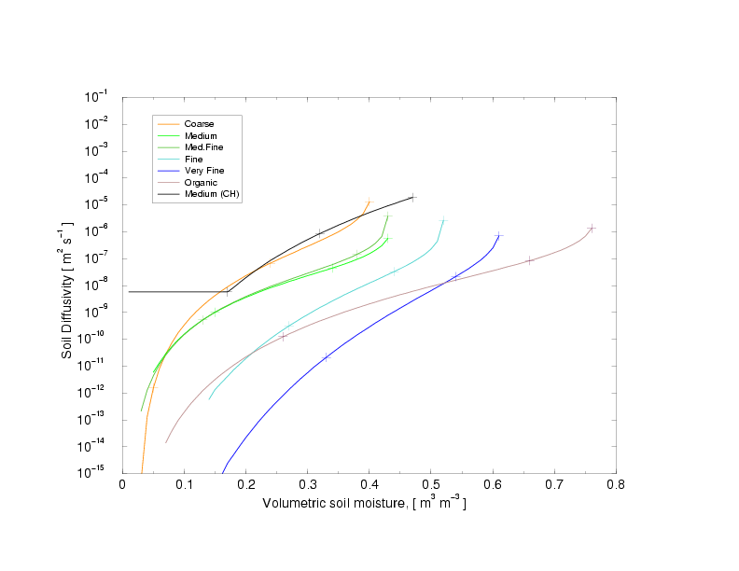
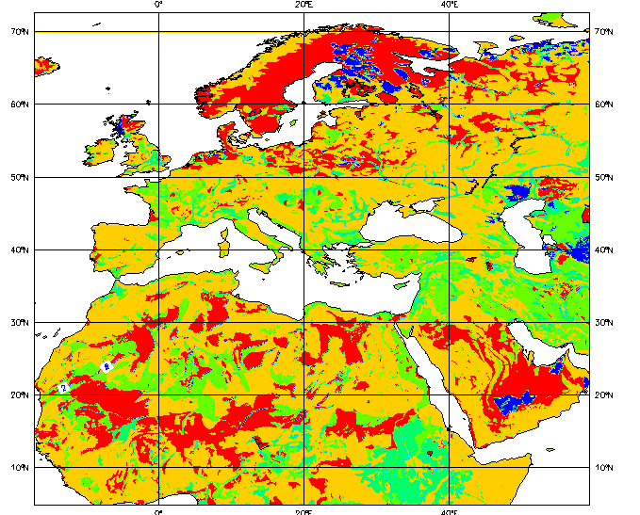
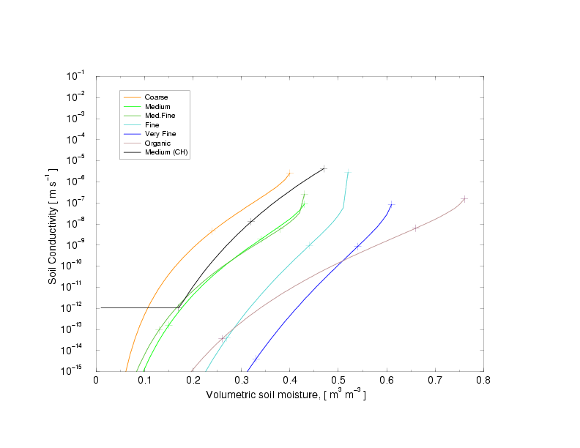
HTESSEL hydrology scheme(2)
█coarse █medium █med-fine █fine █very-fine █organic
Soil Diffusivity
control
Soil Conductivity
control
Dominant soil type from FAO2003 (at native resolution of ~ 10 km)

Slide 30
HTESSEL soil water equations
↓0.1~19.7 d
↓ 1.2~195.9 d
j-1
F_{j-1/2}
↓ 11.7 ~ >> d
D_{j}
F_{j+1/2}
Time-scale for downward water transfers in wet/dry soil
j+1

Slide 31
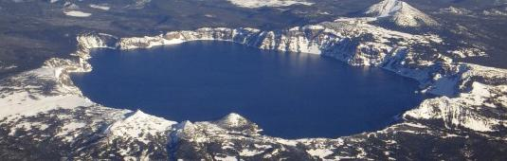
Modelling inland water bodies
A representation of inland water bodies and coastal areas in NWP models is essential to simulate large contrasts of albedo, roughness and heat storage
A lake and shallow coastal waters parametrization scheme has been introduced in the ECMWF Integrated Forecasting System combining
HTESSEL
Hydrology - Tiled ECMWF
Scheme for Surface Exchanges over Land
+
FLake
Fresh water Lake scheme
Lake tile
Mironov et al (2010),
Dutra et al. (2010),
Balsamo et al. (2010, 2012, 2013)
  Extra tile (9) to account
  for sub-grid lakes

Slide 32
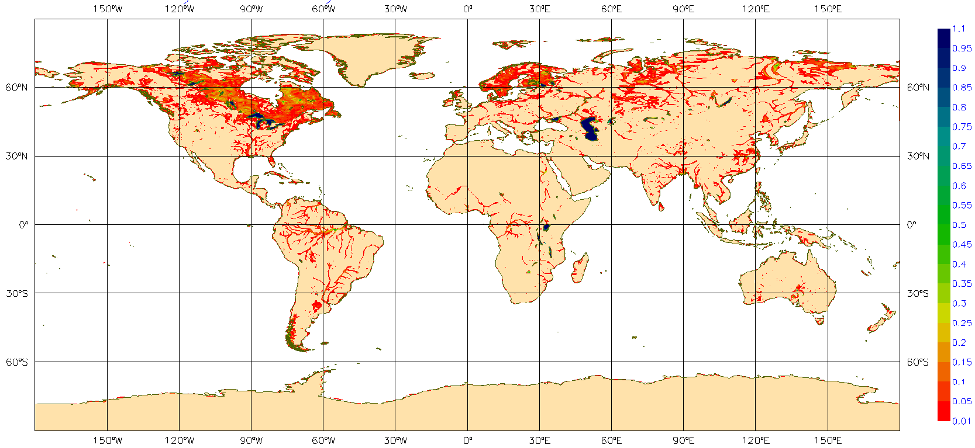
Inland water bodies fraction
Aggregated from GLOBCOVER 300m

Slide 33

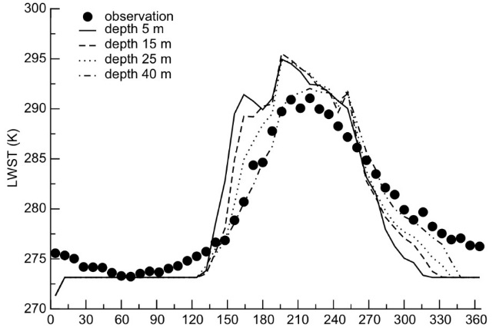
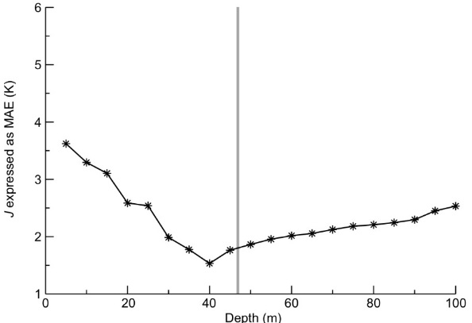
Water bodies heat storage
All inland water bodies are important energy storage drastically changing sensible heat flux
FLake (Mironov et al. 2010, BER) http://lakemodel.net a two-layer bulk model based on a self-similar parametric representation of the evolving temperature profile within lake water and ice
Introduced in the IFS by Dutra et al. (2010,BER), Balsamo et al. (2010,BER; 2012,TELLUS)
Lake depth is a scalar for lake temperature annual cycle
The relationship between the lake temperature (as observed by MODIS) and the lake depth can be used to infer the lake depth in an inversion procedure (Balsamo et al. 2010 BER)
Notes:
33

Slide 34
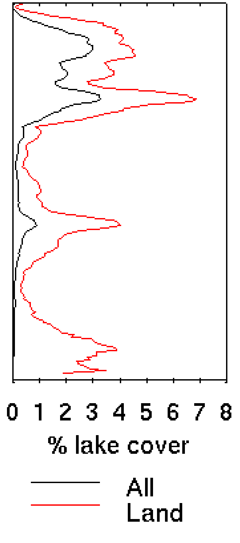
Introduction of Lakes in HTESSEL
Dutra, 2010 (BER), Balsamo et al. 2010 (BER)
A sizeable fraction of land surface has sub-grid lakes: different radiative, thermal
roughness characteristics compare to land → affect surface fluxes to the atmosphere
LAKE COVER FRACTION
Canada | 309/754 41%
USA | 175/482 36%
Europe | 170/385 44%
Siberia | 104/467 22%
Amazon | 81/629 13%
Africa | 74/584 13%

Slide 35
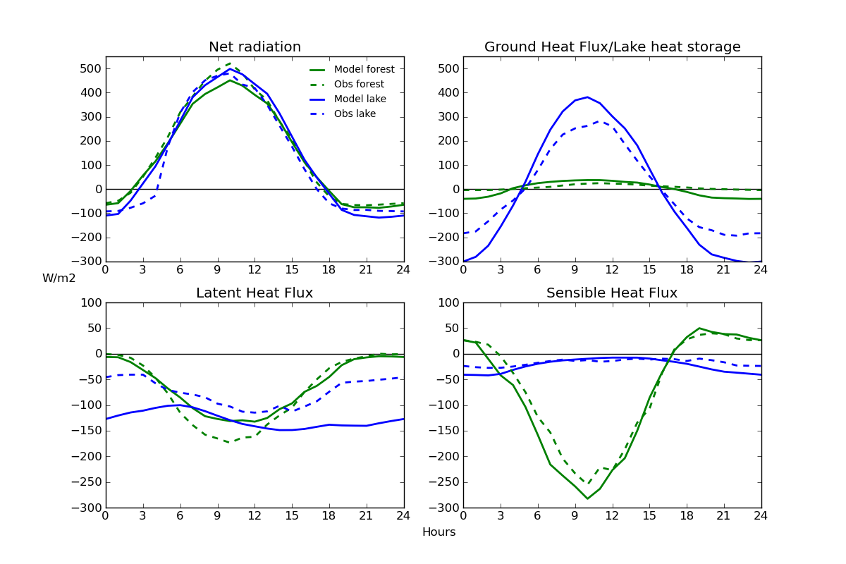
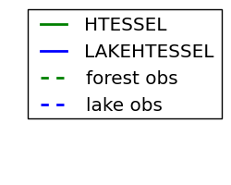
Energy fluxes: Diurnal cycles
Manrique-Suñén et al. (2013, JHM)
Monthly diurnal cycle of energy fluxes for July
Very good representation by the model of diurnal cycles and particularities of each surface
Forest evaporation is driven by vegetation, so it is zero at night
Lake SH maximum is at night
Lake LH diurnal cycle: overestimation in evaporation
Forest SH maximum is at midday
Main difference between both sites is found in the energy partitioning into SH and G

Slide 36
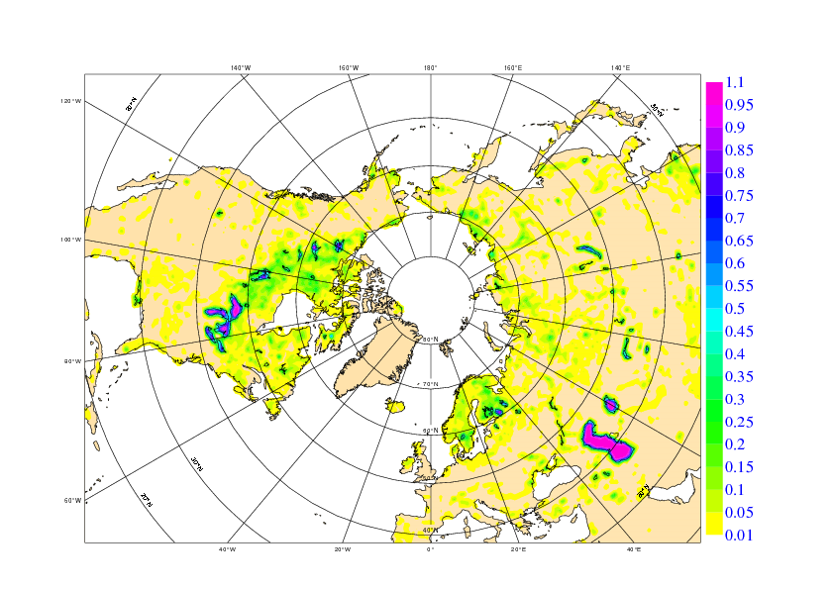
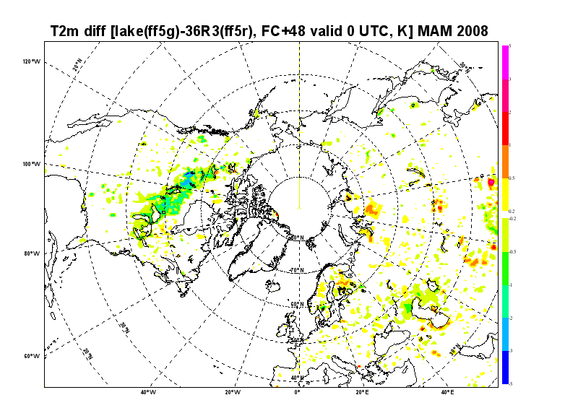
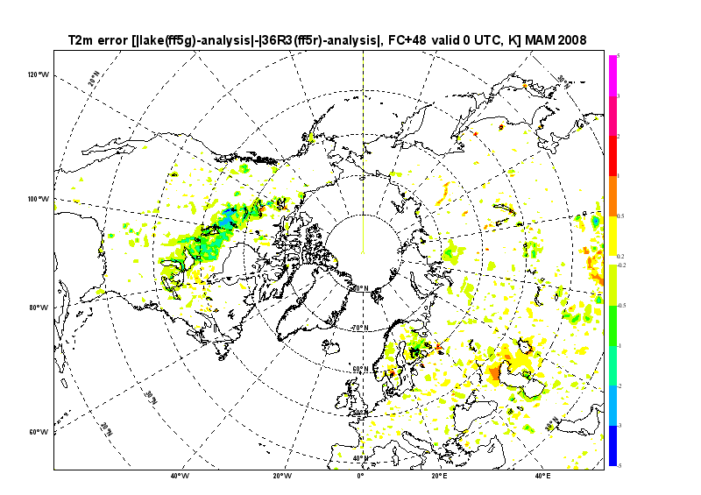
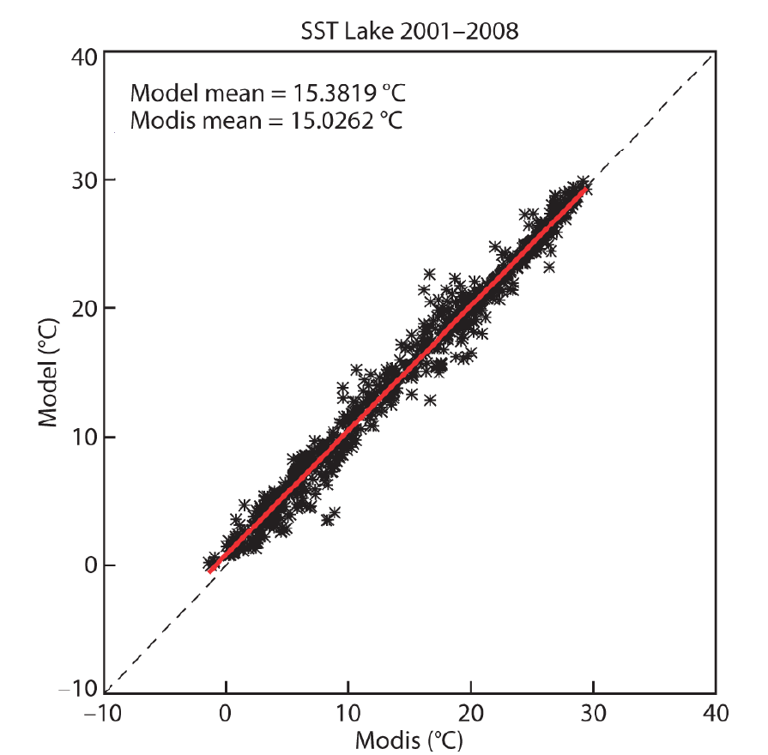
Impact of lakes in NWP forecasts
Balsamo et al. (2012, TELLUS-A) and ECMWF TM 648
Lake cover
Forecasts sensitivity and impact of lakes is shown to produce a spring-cooling on lake areas with benefit on the temperatures forecasts (day-2 (48-hour forecast) at 2m.
The lake surface temperatures are verified with MODIS LSTs
as indicative of the heat-storage accuracy of the lake model
Forecast sensitivity Forecast impact
Cooling 2m temperature
Warming 2m temperature
Improves 2m temperature
Degrades 2m temperature

Slide 37
Lakes are the new added tile to ECMWF land surface scheme that went in operational use on the 12th of May 2015.
The importance of lakes and their temperature and ice conditions in generating clouds and storms can be appreciated here:
http://time.com/9480/great-lakes-frozen-time-lapse-video/

Slide 38
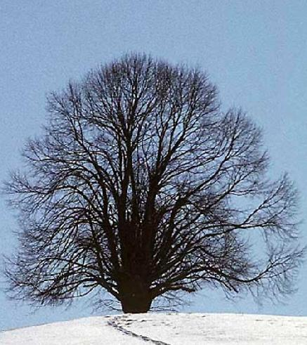

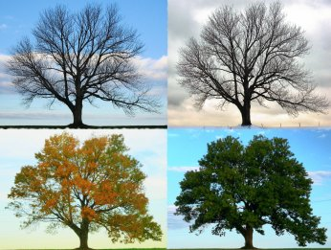
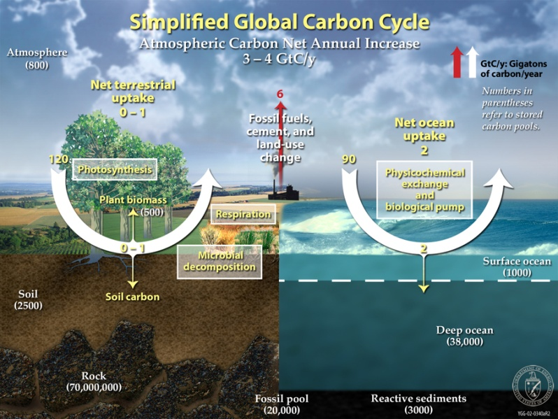
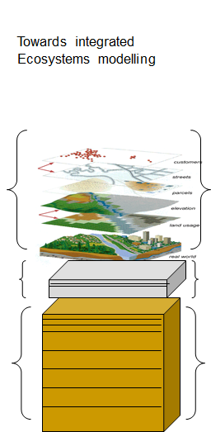
Land surface model status and plans
Hydrology-TESSEL
  Balsamo et al. (2009)
  van den Hurk and Viterbo (2003)
  Global Soil Texture (FAO)
  New hydraulic properties
  Variable Infiltration capacity & surface runoff revision
NEW SNOW
  Dutra et al. (2010)
  Revised snow density
  Liquid water reservoir
  Revision of Albedo
  and sub-grid
  snow cover
NEW LAI
Boussetta et al. (2013)
New satellite-based
Leaf-Area-Index
SOIL Evaporation
Balsamo et al. (2011),
Albergel et al. (2012)
H₂O / E / CO₂
Integration of
Carbon/Energy/Water
Boussetta et al. 2013
Agusti-Panareda et al. 2015
Lake & Coastal area
Mironov et al (2010),
Dutra et al. (2010),
Balsamo et al. (2012, 2010)
  Extra tile (9) to
  for sub-grid lakes
  and ice
  LW tiling (Dutra)
Enhance ML
Snow ML5
Soil ML9
Dutra et al. (2012, 2016)
Balsamo et al. (2016)

