Slide 1
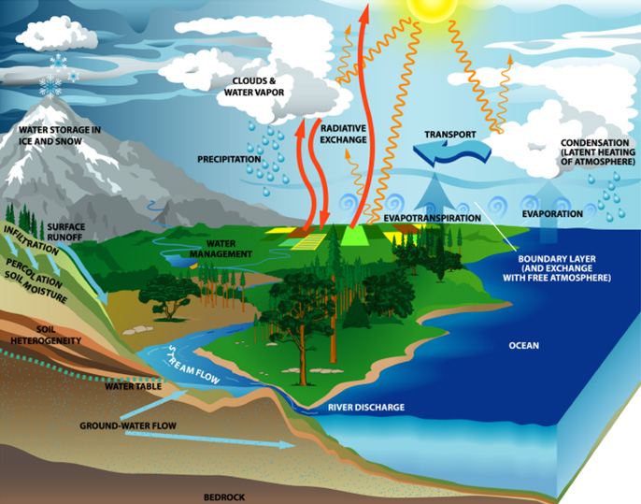
Parameterization of
land-surface processes in NWP
Gianpaolo Balsamo
Introductory lecture
G. Balsamo
Room: 001 Extension: 2246 gianpaolo.balsamo@ecmwf.int

Slide 2
Layout of these lectures
Introduction
General remarks
Model development and validation
The Earth energy budget
Soil/Water/Vegetation contrasts
Snow and frozen soil hydrology
Snow atmosphere coupling
Lecture 1
Lecture 2
Lecture 3

Slide 3
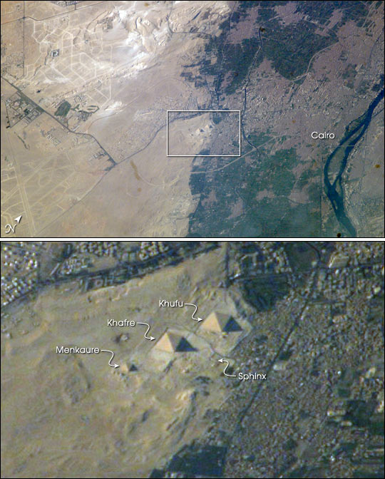
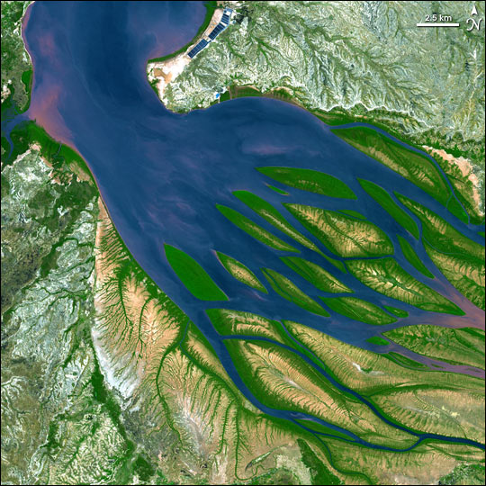
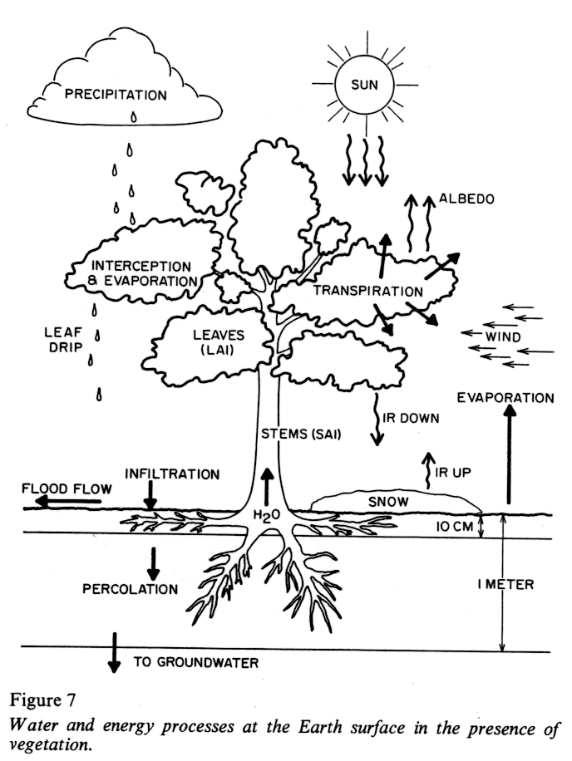
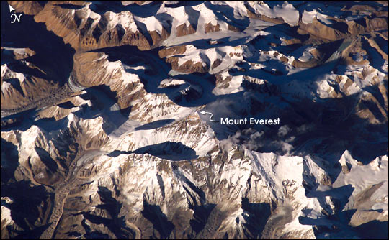
The challenges for Land Surface Modeling
Capture natural diversity of land surfaces (heterogeneity) via a simple set of equations
Focus on elements which affects more directly weather and climate (i.e. soil moisture, snow cover).

Slide 4
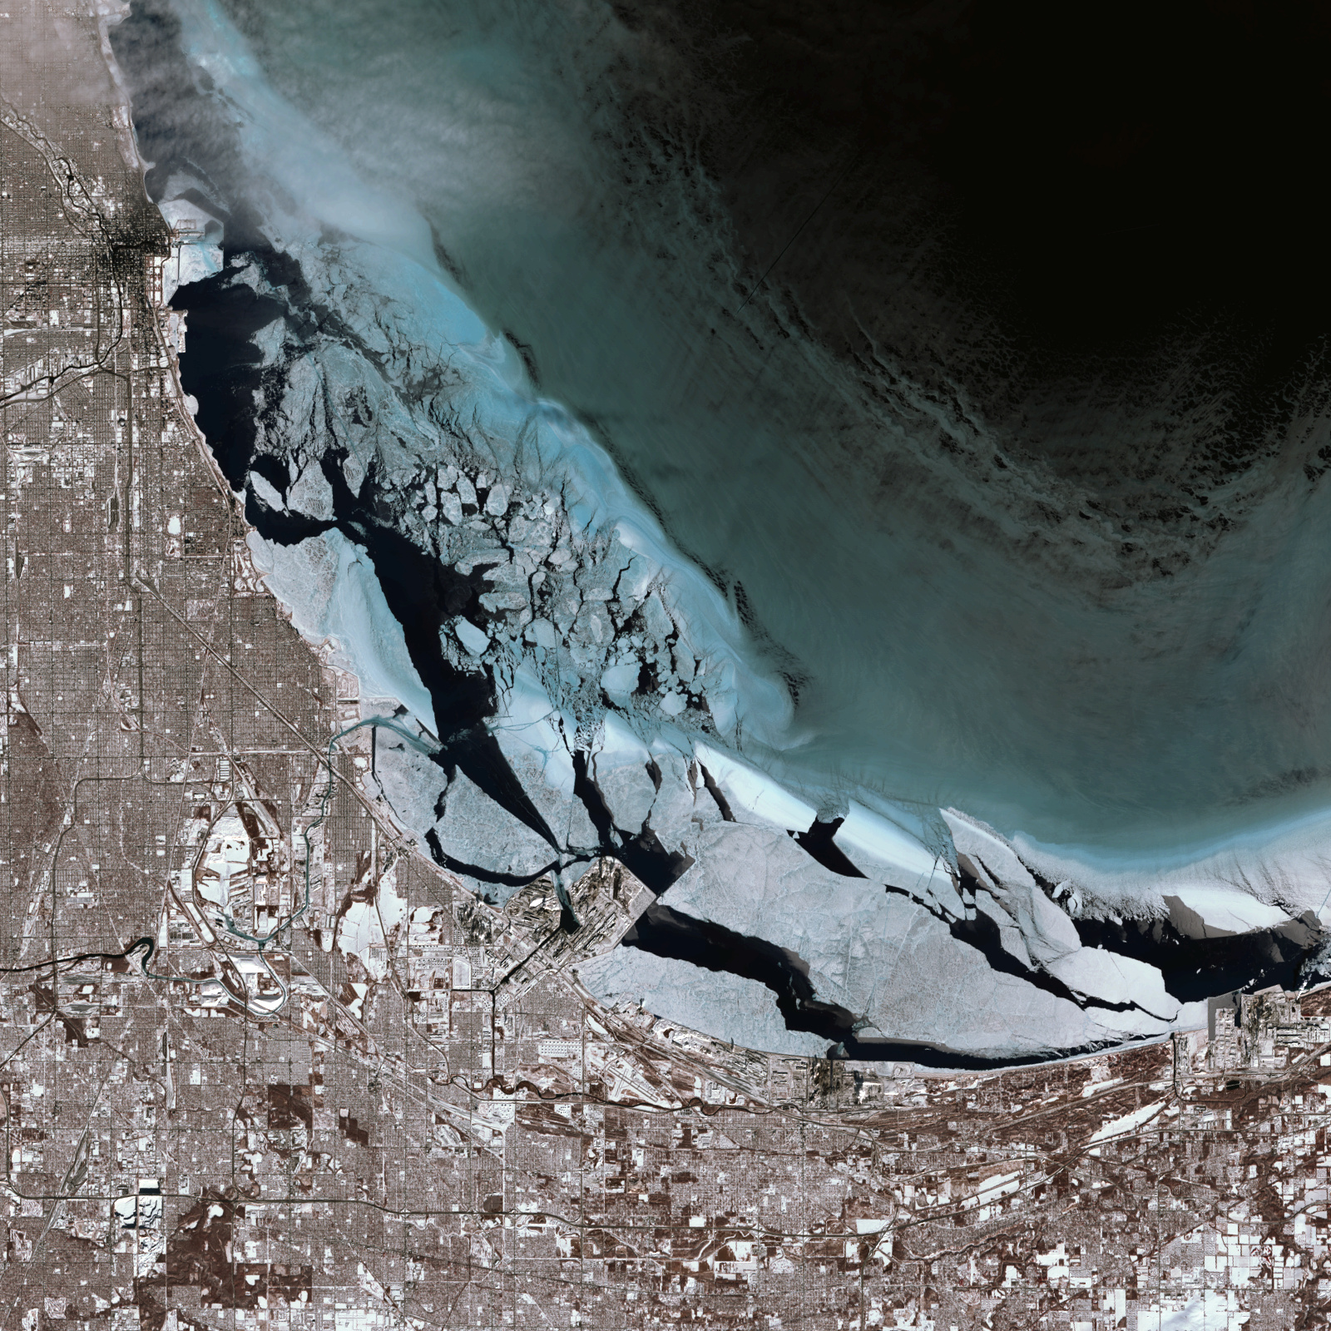
Today’s satellite images are very informative not only about natural land surface…

Slide 5
Methodology
Plant and soil science (a bite)‏
ECMWF model and its evolution
Justification and examples
Terrestrial Hydrometeorology, by W.J. Shuttleworth
Environmental Soil Physics, by D. Hillel
and few links to lecture notes by P. Viterbo
http://www.ecmwf.int/newsevents/training/lecture_notes/pdf_files/PARAM/Land_surf.pdf
http://www.ecmwf.int/newsevents/training/lecture_notes/pdf_files/PARAM/Rol_land.pdf
http://www.ecmwf.int/newsevents/training/lecture_notes/pdf_files/PARAM/Surf_ass.pdf
Further readings

Slide 6
Earth energy cascade
The sun emits 4 x 10²⁶ W
the Earth intercepts 1.37 kW/m²
This energy is distributed between
  Direct reflection (~30%)‏
  Conversion to heat, mostly by surface absorption (~43%), re-radiated in the infrared
  Evaporation, Precipitation, Runoff (~22%)‏
  Rest of the processes (~5%, Winds, Waves, Convection, Currents, Photosynthesis, Organic decay, tides, … )‏
Robinson & Henderson-Sellers, 1999

Slide 7
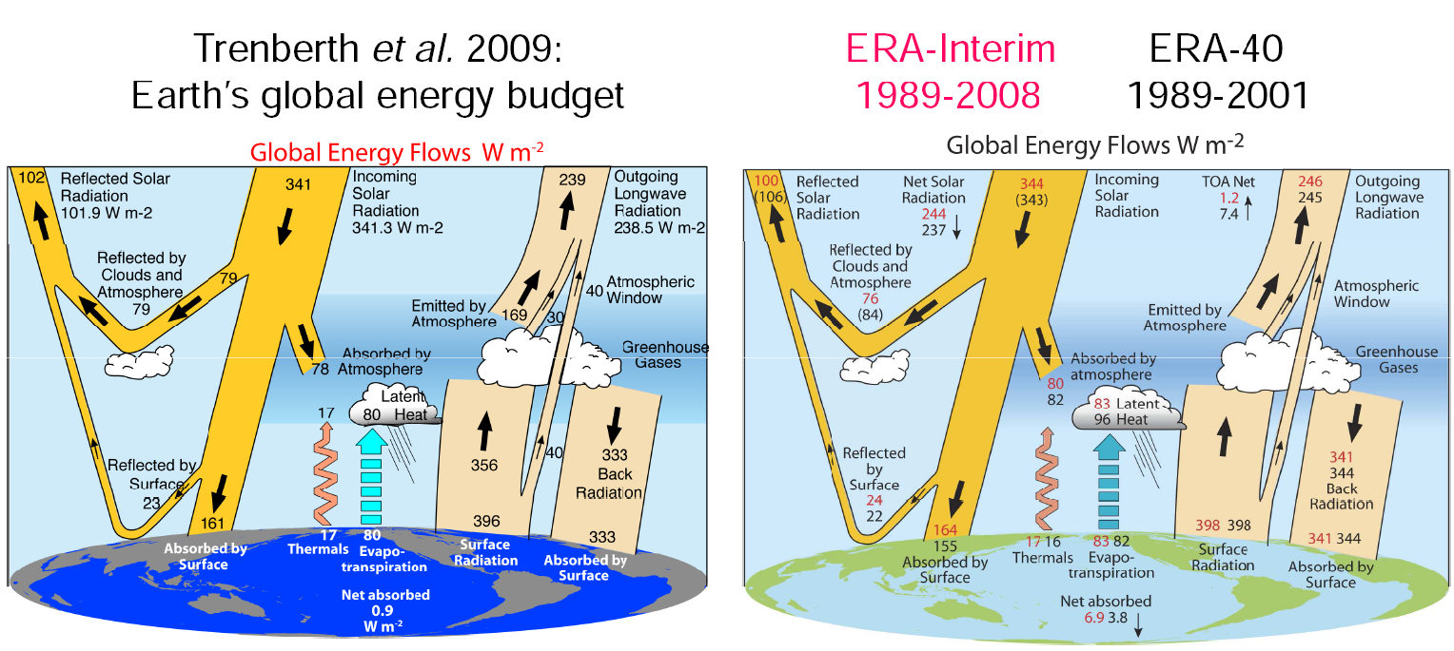
Role of land surface (1)‏
Atmospheric general circulation models need boundary conditions for the enthalpy, moisture (and momentum) equations: Fluxes of energy, water at the surface.

Slide 8
Role of land surface at ECMWF
  ECMWF model(s) and resolutions
  Length Horizontal Vertical Remarks
  Deterministic 10 d T1279 (16 km) L137 00+12 UTC
  Monthly/VarEPS (N=51) 0-10d T639(30 km) L91 (SST tendency)
  11-32d T399(60 km) L91 (Ocean coupled)
  Seasonal forecast 6 m T159 (125 km) L62 (Ocean coupled)
  Assimilation physics 12 h T255(80 km)/ L137 T95(200 km) inner
  T159(125 km)
  ERA-40 Reanalysis 1958-2002 T159(125 km) L60 3D-Var+surface OI
  ERA-Interim Reanalysis 1989-today T255(80 km) L91 4D-Var+surface OI
Land surface modelling (and data assimilation systems) need flexibility & upscalability (conservation) properties to be used by at a wide range of spatial resolutions in spite of natural heterogeneity of land surfaces.
Errors in the treatment of land surface are likely to affect all forecasts products.

Slide 9
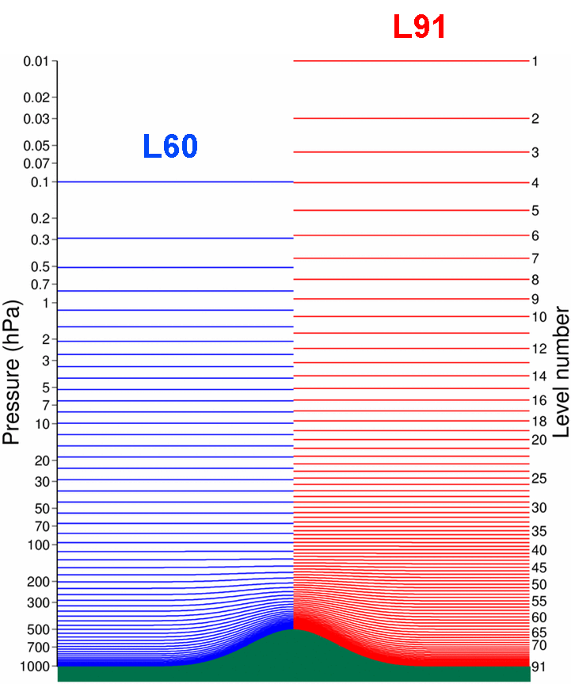
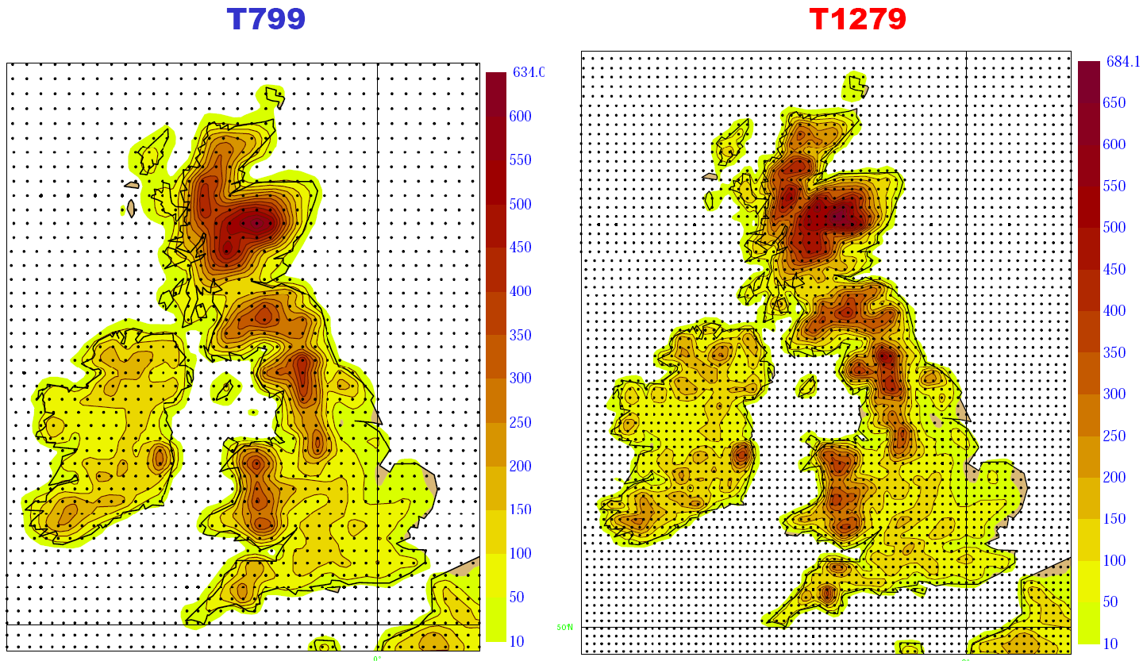
ECMWF deterministic model
Vertical resolution
91 levels
Horizontal resolution upgrades:
T511 ~ 40km (21 Nov 2000)
T799 ~ 25 km (1 Feb 2006)
T1279 ~ 16 km (26 Jan 2010)
T2047 ~ 10 km (in 2015, TBC)
Vertical resolution upgrades:
L60 (21 Nov 2000) L91 (1 Feb 2006) L137 (June 2013)
12 levels 15 levels
<850 hPa

Slide 10
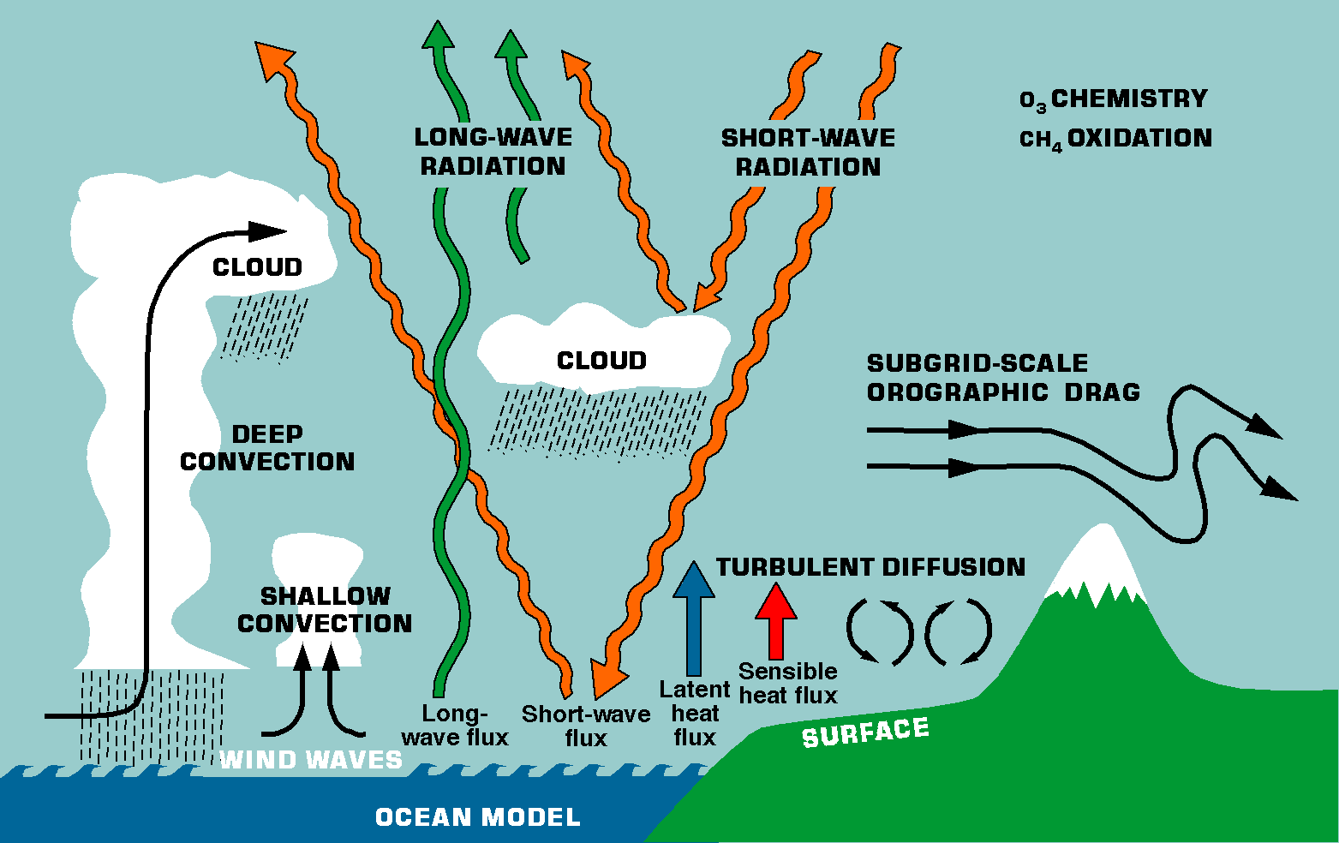
Role of land surface (3)‏
Feedback mechanisms for other physical processes, e.g.:
  Surface evaporative fraction¹ (EF), impacting on low level cloudiness, impacting on surface radiation, impacting on …
  Bowen ratio² (Bo), impacting on cloud base, impacting on intensity of convection, impacting on soil water, impacting on …
(1) EF = (Latent heat)/(Net radiation) (2) Bo = (Sensible heat)/(Latent heat)‏

Slide 11
Role of land surface (4)‏
Partitioning between sensible heat and latent heat determines soil wetness, acting as one of the forcings of low frequency variability (e.g. extended drought periods).
At higher latitudes, soil water only becomes available for evaporation after the ground melts. The soil thermal balance and the timing of snow melt (snow insulates the ground) also controls the seasonal cycle of evaporation.
The outgoing surface fluxes depend on the albedo, which in turn depends on snow cover, vegetation type and season.
Surface (skin) temperatures of sufficient accuracy to be used in the assimilation of TOVS satellite radiances (over land there is no measured input field analogous to the sea surface temperature)‏
Notes:
To reduce and add figures

Slide 12
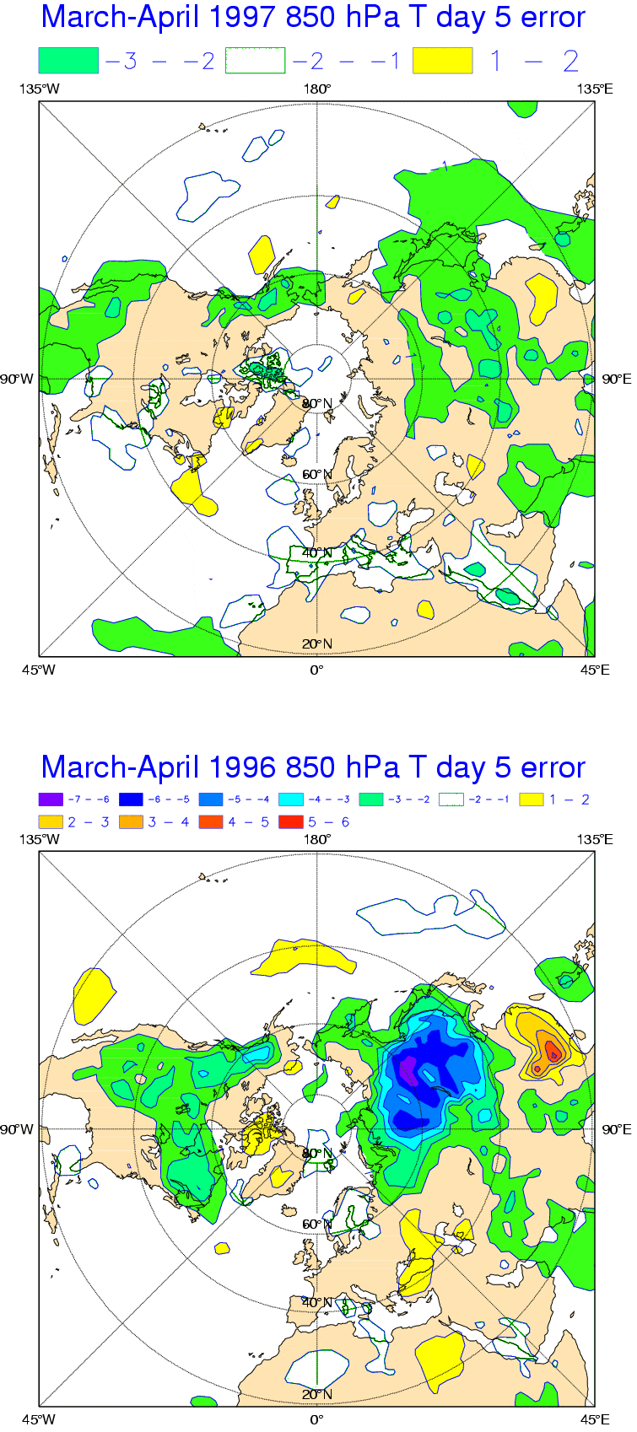
Systematic errors 850 hPa T
1996 operational bias
1997 operational bias
Viterbo and Betts, 1999
A smaller albedo of snow in the boreal forests (1997) reduces dramatically the spring (March-April) error in day 5 temperature at 850 hPa

Slide 13
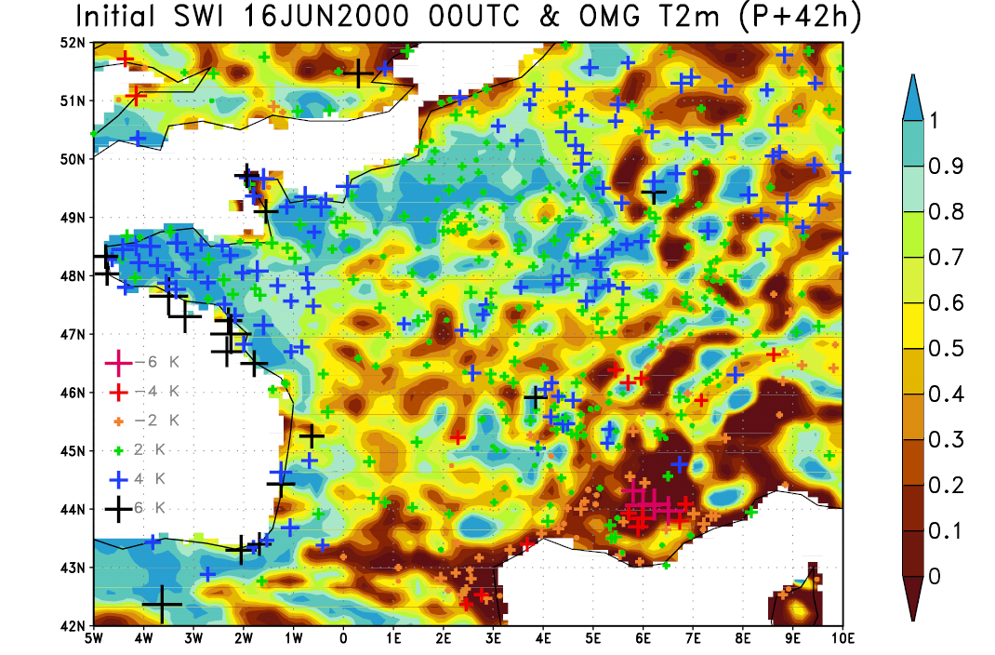
Near surface atmospheric errors
wet soil
dry soil
Balsamo, 2003
In the French forecast model (~10km) local soil moisture patterns anomalies at time t₀ are shown to correlate well with large 2m temperature forecast errors (2-days later)‏

Slide 14
Global budgets (1)‏
Mean surface energy fluxes (Wm⁻²) in the ERA40 atmospheric reanalysis (1958-2001); positive fluxes downward
R_{S} R_{T} H LE G Bo=H/LE
Land 134 -65 -27 -40 2 0.7
Sea 166 -50 -12 -102 3 0.1
Land surface
  The net radiative flux at the surface (R_{S}+R_{T}) is downward. Small storage at the surface (G) implies upward sensible and latent heat fluxes.
Bowen ratio: Land vs Sea
  Different physical mechanisms controlling the exchanges at the surface
    Continents: Fast responsive surface; Surface temperature adjusts quickly to maintain zero ground heat flux
    Oceans: Large thermal inertia; Small variations of surface temperature allowing imbalances on a much longer time scale
Notes:
To reduce and add figures

Slide 15
Global budgets (2)‏
Surface fluxes and the atmosphere
  Sensible heat (H) at the bottom means energy immediately available close to the surface
  Latent heat (LE) means delayed availability through condensation processes, for the whole tropospheric column
  The net radiative cooling of the whole atmosphere is balanced by condensation and the sensible heat flux at the surface. Land surface processes affect directly (H) or indirectly (condensation, radiative cooling, …) this balance.

Slide 16
Terrestrial atmosphere time scales
Terrestrial
Atmosphere
Atmosphere recycling time scales associated with land reservoir
  Precipitation 4.5/107 = 15 days
  Evaporation 4.5/71 = 23 days
4.5
Evaporation
71
Rain
107
Runoff
36
Land
Chahine, 1992
[•] = 10¹⁵ kg = teratons
[•] = 10¹⁵ kg yr⁻¹

Slide 17
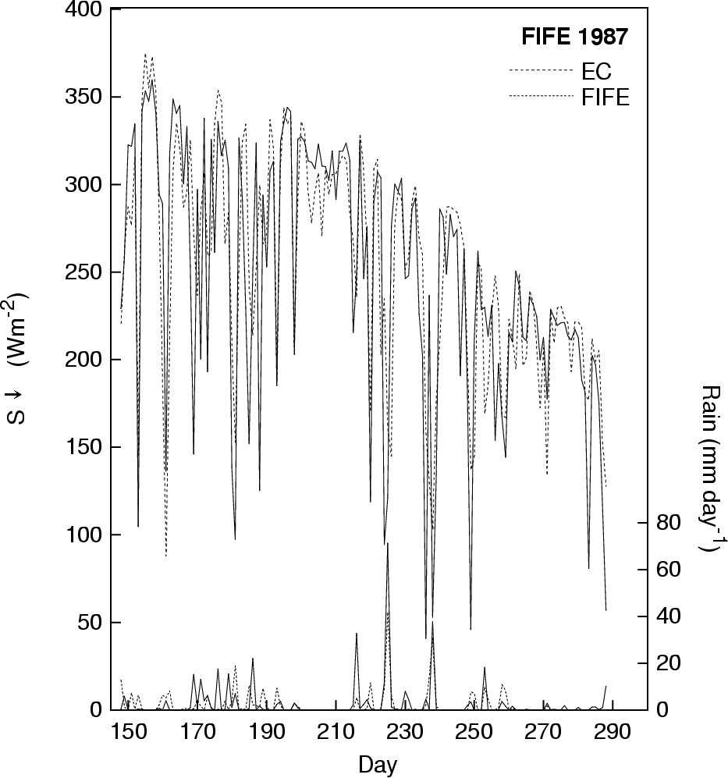
Surface time scales (memory) (1)‏
Diurnal time scale
  Forcing time scale determined by the quasi-sinusoidal radiation modulated by clouds
Downward solar radiation
Betts et al 1998
1 May
1 July
1 Sep

Slide 18
Surface time scales (memory) (2)‏
Diurnal/weekly time scale
  Forcing time scale determined by the “quasi-random” precipitation (synoptic/mesoscale)‏
Precipitation
Betts et al 1998
1 May
1 July
1 Sep

Slide 19
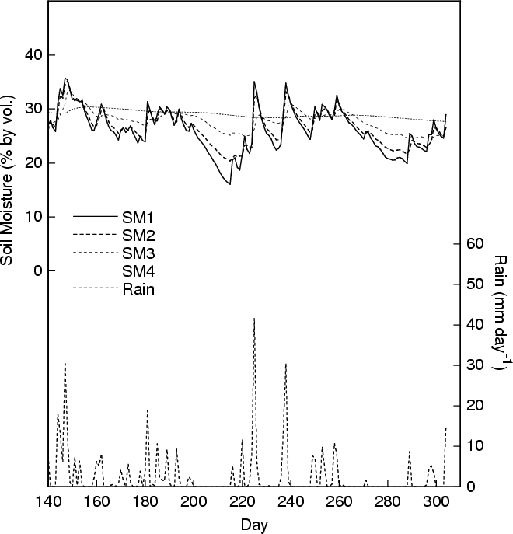
Surface time scales (memory) (3)‏
Weekly/monthly time scale
  Internal time scale determined by the physics of soil water exchanges/transfer
Betts et al 1998

Slide 20
Surface time scales (memory) (4)‏
Weekly/monthly time scale
  Evaporation time scale determined by the ratio (net radiative forcing)/(available soil water)‏
R_{n}=150 Wm⁻² ~ (5 mmd⁻¹)‏
Soil water=150 mm
(5 mmd⁻¹)/(150 mm) = 30 days

Slide 21
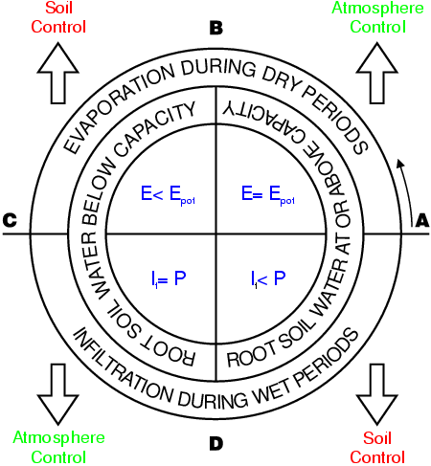
The hydrological rosette
Driver
Water exchange
Soil state
Rate
Dooge, 1992

Slide 22
A diversity of land models !!!
Pitman et al 1993, with modifications
Notes:
To improve by highlight

Slide 23
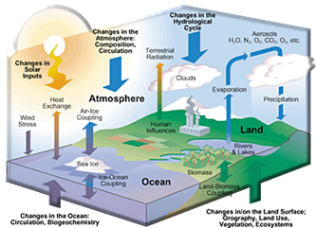
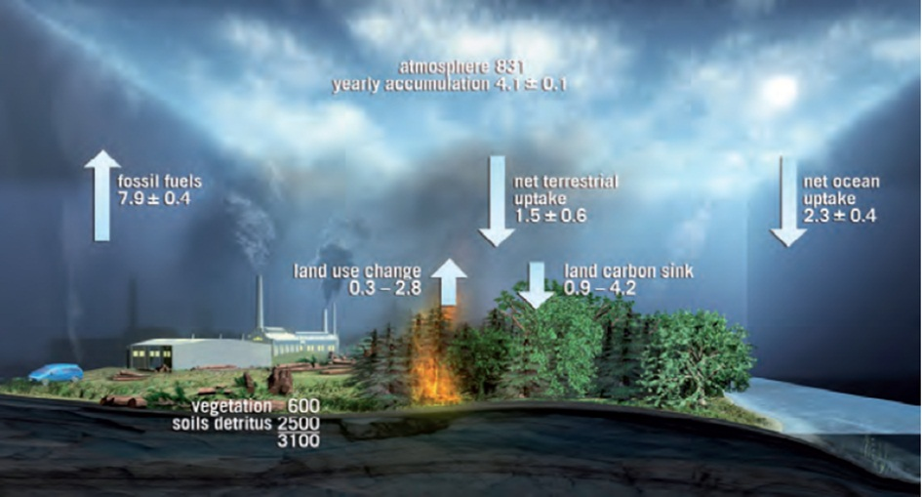
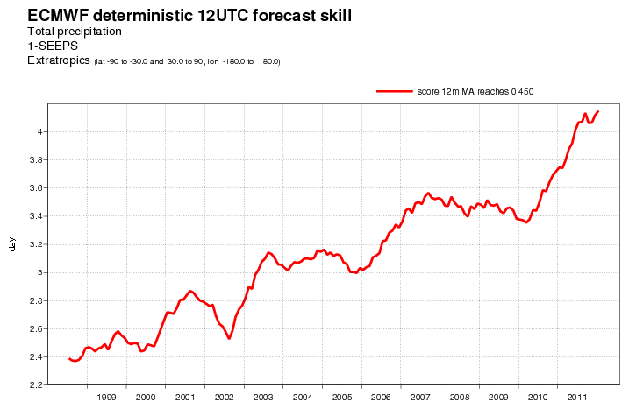
The Water, Energy and Carbon cycle
Numerical Weather Prediction models have considerably evolved over time with respect to how the represent the land surface and its interaction with the atmosphere
CO2 budget (from ESA – BIOMASS mission report)
Precipitation forecasts improvements support
(1 day/decade in skill gain) refined LSMs
ECMWF headline score for precipitation: M. Rodwell and R. Forbes
The needs of unification of NWP and Climated model are a driver to develope land surface schemes with increased realism
Evolving towards Earth System Models
4j
3j
2j

Slide 24
Strategy for land surface model development at ECMWF
Complexity/Cost
Site runs
(Offline)
2D runs
(Offline)
Global (Offline)
Coupled
GCM
Coupled GCM + DA
Generality

Slide 25
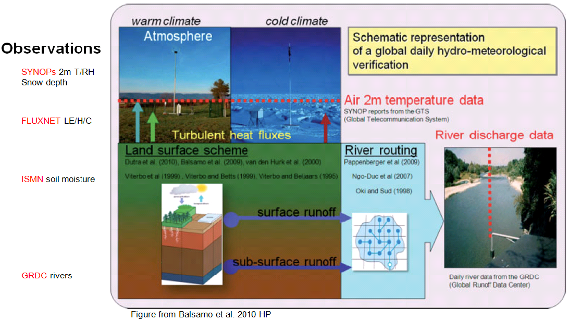
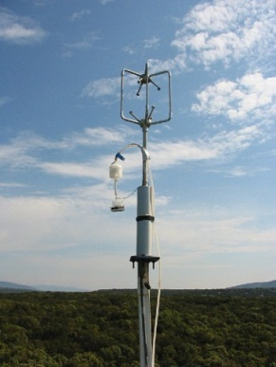
An Integrated & Process-oriented verification to support development
FLUXNET data
The combined verification of multiple processes permit to avoid tuning in favor of a more physically-based development

Slide 26
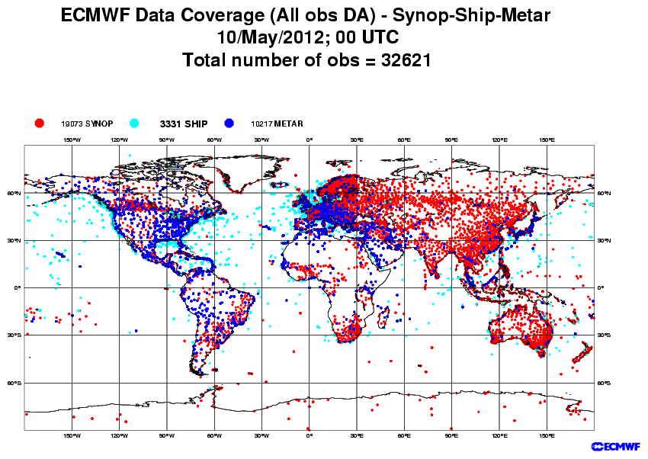
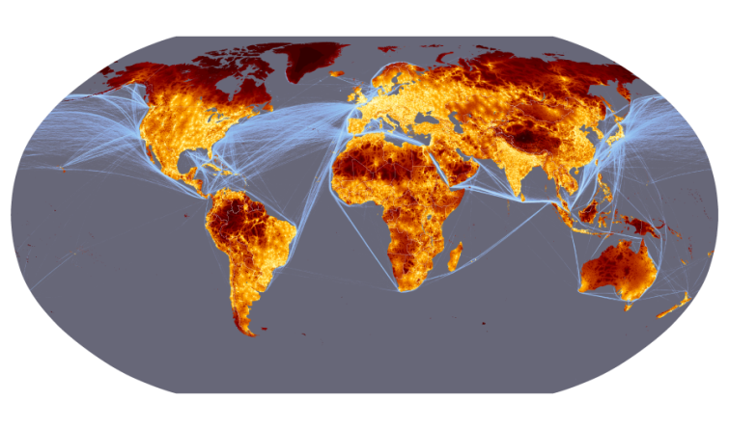

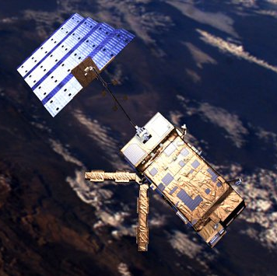
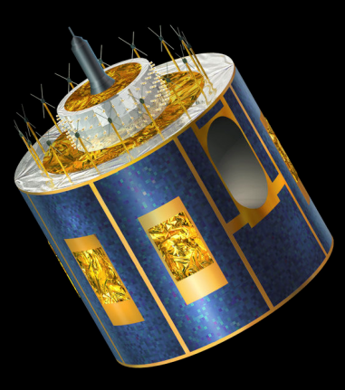
Satellite Remote Sensing
Ground-based conventional observations
SYNOP/METAR/SHIP stations
Proximity map for 50000 inhabitants settlement.
Source:
JRC, World-Bank)
SMOS ESA METOP ESA
METEOSAT (MSG) EUMETSAT

Slide 27
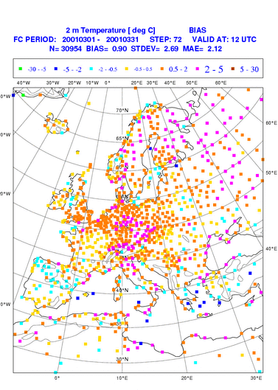
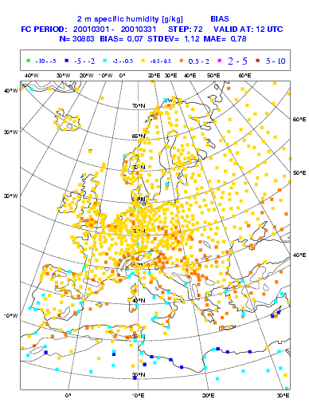
Europe 2m forecast errors for March 2001
72 H FC verifying at 12 UTC
2RH
2T

Slide 28
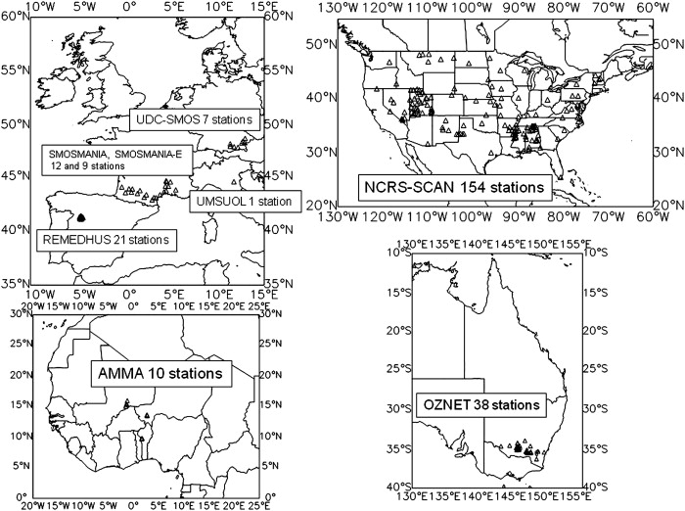
Soil moisture verification
International Soil Moisture Network (ISMN) TU-Wien
http://www.ipf.tuwien.ac.at/insitu/
From Albergel et al. (2012).

Slide 29
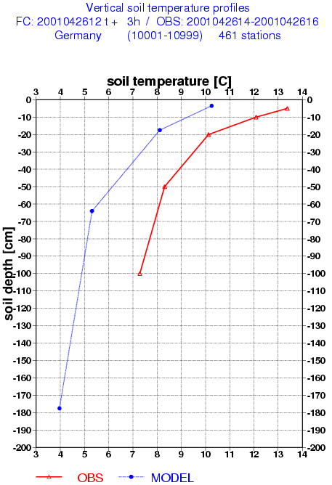
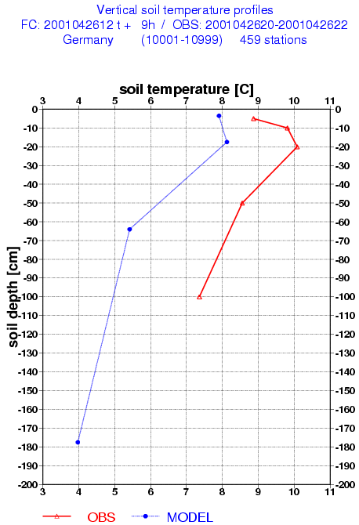
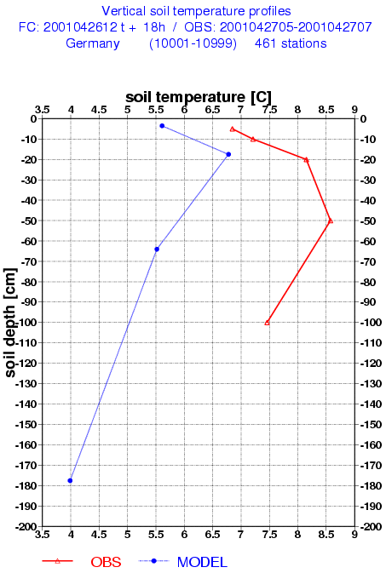
Soil temperature verification
Averaged over Germany stations 26 April 2001
Verifying at 15 UTC
Verifying at 21 UTC
Verifying at 06 UTC

Slide 30
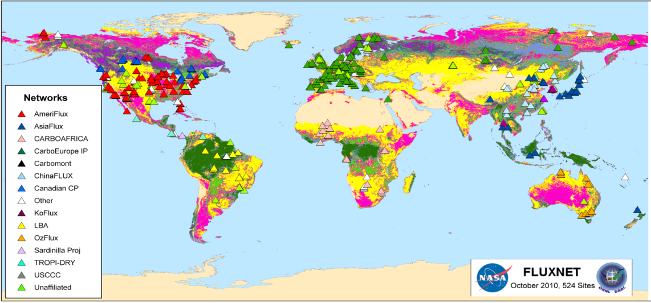
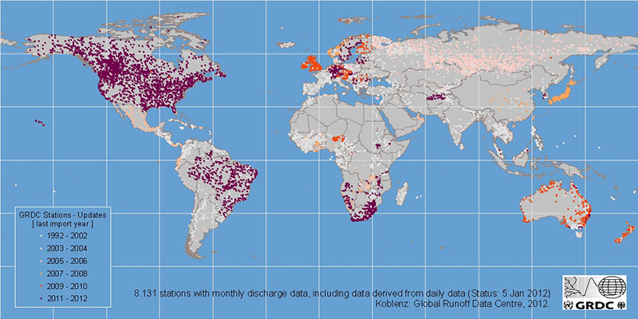
Land Fluxes (E, H₂O, CO₂) verification
FLUXNET tower sites:
http://www.fluxdata.org/
GRDC
(Global Runoff Data Centre):
http://www.gewex.org/grdc.html

Slide 31
ECMWF surface model milestones
Vegetation based evaporation 1989
CY48 (4 layers + …) 1993 / ERA15
Initial conditions for soil water 1994
Stable BL/soil water freezing 1996
Albedo of snow forests 1996
OI increments of soil water 1999
TESSEL, new snow and sea ice 2000 / ERA40
HTESSEL, revised soil hydrology 2007
HTESSEL+SNOW, revised snow 2009
HTESSEL+SNOW+LAI, seasonal vegetation 2010
CHTESSEL (carbon-land surface) 2012
LAKETESSEL (addition of lake tile) 2013

Slide 32
TESSEL model and validation
Model Description
  Viterbo and Beljaars, 1995. J. Climate, 2716-2748.
  van den Hurk et al, 2000. EC Tech Memo 295.
1D validation
  Cabauw
  Beljaars and Viterbo, 1994. BLM, 71, 135-149.
  Viterbo and Beljaars, 1995. J. Climate.
  FIFE
  Viterbo and Beljaars, 1995. J. Climate.
  Betts et al. 1996. JGR, 101D, 7209-7225.
  Betts et al., 1998. Mon. Wea. Rev., 126, 186-198.
  Douville et al, 2000: MWR, 128, 1733-1756.
  ARME
  Viterbo and Beljaars, 1995. J. Climate.
  SEBEX
  Beljaars and Viterbo, 1999. Cambridge Univ Press.
  van den Hurk et al, 2000.
  All the above + HAPEX-MOBIHLY+BOREAS
  van den Hurk et al, 2000.
US Summer 1993
  Beljaars et al. 1996. MWR, 124, 362-383.
  Betts et al. 1996. JGR, 101D, 7209-7225.
  Viterbo and Betts, 1999: JGR, 104D, 19,361-19,366.
Soil water initial conditions
  Viterbo, 1996.
  Douville et al, 2000.
Soil freezing
  Viterbo et al., 1999. QJRMS, 125,2401-2426.
Snow forest albedo
  Viterbo and Betts, 1999. JGR, 104D, 27,803-27,810.
Mississippi river basins
  Betts et al., 1998. J. Climate, 11, 2881-2897.
  Betts et al., 1999. JGR, 104D,19,293-19,306.
Mackenzie river basin
  Betts and Viterbo, 2000: J. Hydrometeor, 1, 47-60.
Impact of land on weather
  Viterbo and Beljaars, 2002: Springer,

Slide 33
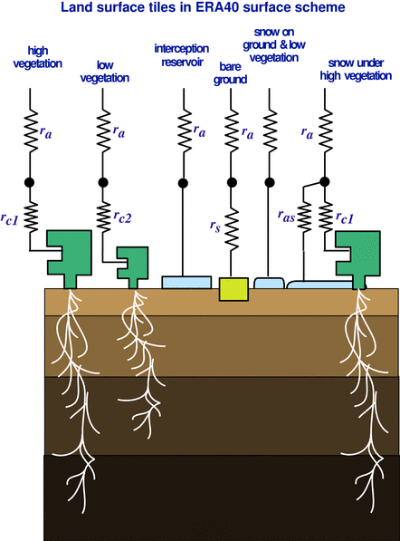
(CH)TESSEL scheme in a nutshell
Tiled ECMWF Scheme for Surface Exchanges over Land
Revised canopy
resistances,
including air
humidity stress on
forest
New treatment
of snow under
high vegetation
High and low
vegetation
treated separately
+ 2 tiles (ocean & sea-ice)‏
No root
extraction or
deep percolation
in frozen soils
Variable root depth

Slide 34



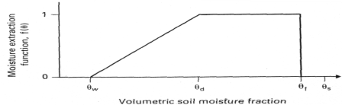
Land surface model evolution
2000/06 2007/11 2009/03 2009/09 2010
TESSEL
  Van den Hurk et al. (2000)
  Viterbo and Beljaars (1995), Viterbo et al (1999)
  Up to 8 tiles (binary Land-Sea mask)
  GLCC veg. (BATS-like)
  ERA-40 and ERA-I scheme
Hydrology-TESSEL
  Balsamo et al. (2009)
  van den Hurk and Viterbo (2003)
  Global Soil Texture (FAO)
  New hydraulic properties
  Variable Infiltration capacity & surface runoff revision
NEW SNOW
  Dutra et al. (2010)
  Revised snow density
  Liquid water reservoir
  Revision of Albedo
  and sub-grid snow cover
NEW LAI
Boussetta et al. (2010)
New satellite-based
Leaf-Area-Index
SOIL Evaporation
Mahfouf and Noilhan (1991)

Slide 35
Strategy for land surface model development at ECMWF (applied)
Complexity/Cost
Site runs
(Offline)
2D runs
(Offline)
Global (Offline)
Coupled
GCM
Examples:
SEBEX
BERMS
SNOWMIP2
FLUXNET
Coupled GCM + DA
RhoneAGG AMMA
GSWP2
GLACE2
ERA40, ERA-Interim
ERA-Clim
Generality

Slide 36
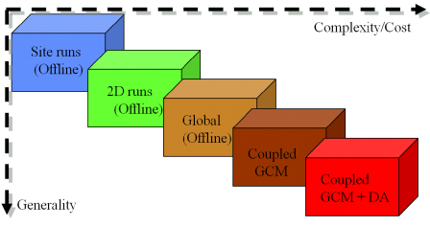
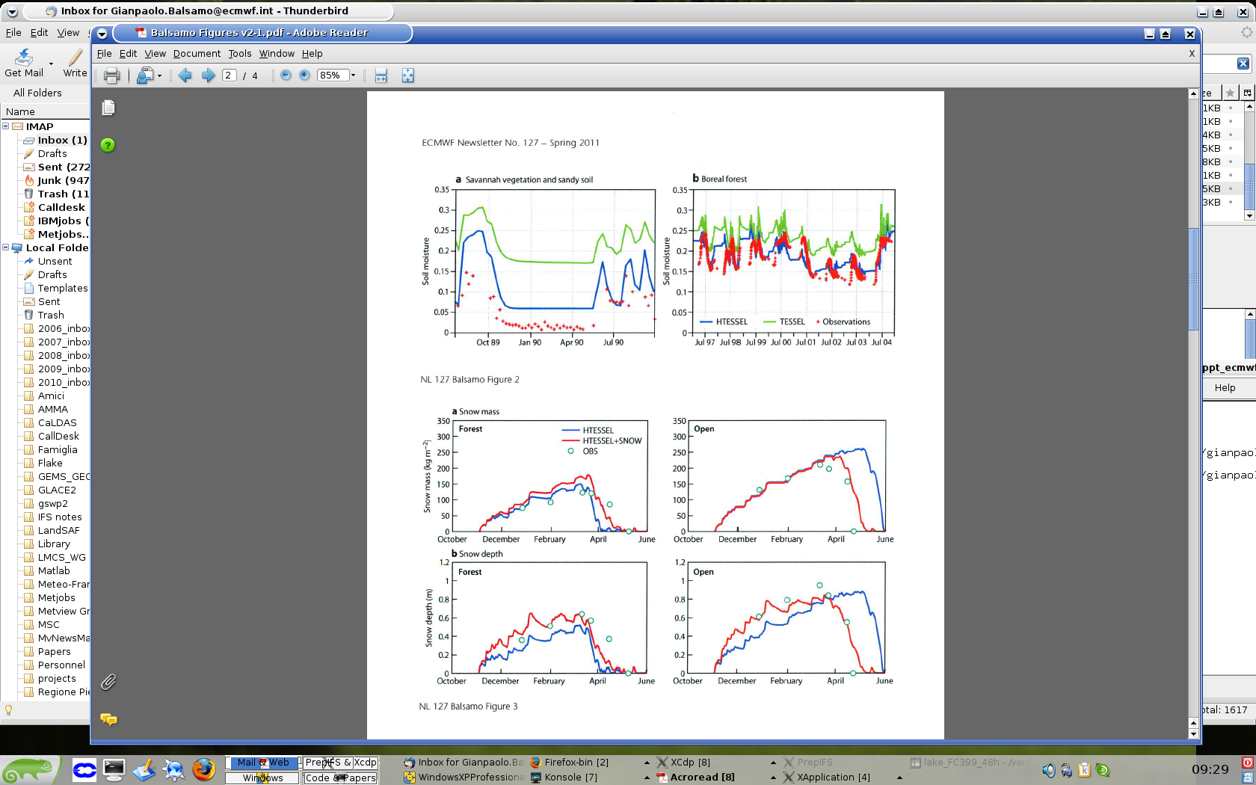
Soil hydrology
(Balsamo et al. 2009)

Slide 37
New snow scheme
(Dutra et al. 2010)

Slide 38
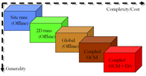
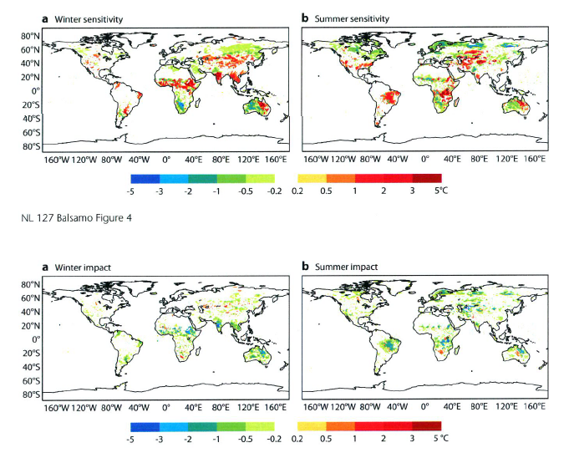
Forecasts (+36-h) impact
Forecast sensitivity
Cooling 2m temperature Warming 2m temperature
Forecast Impact
Improving temperature Degrade 2m temperature

Slide 39
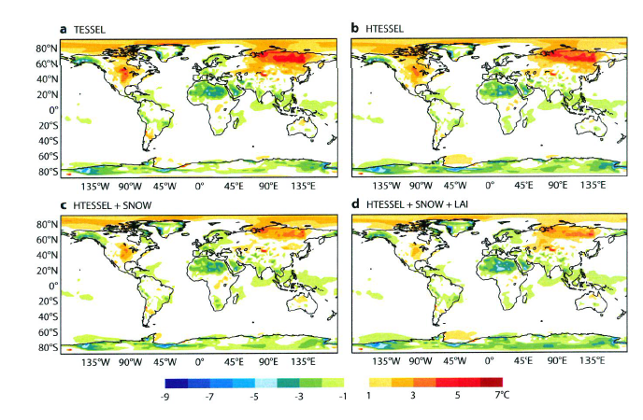
Climate simulation impact
simulations colder than ERA-Interim Warmer than ERA-Interim

Slide 40
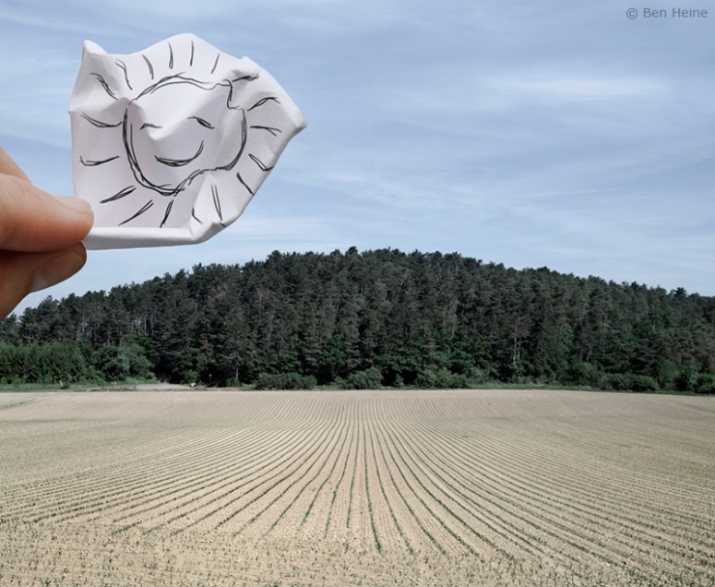
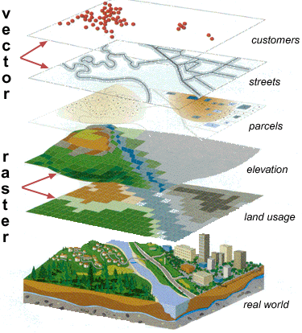
Perspectives for the land surface in Earth System Prediction
Modularity of the land system is a key to ESP model integrations and inter-operability of parameterizations
Vers une modélisation intégrée des écosystèmes
pour répondre aux besoins d’ applications variées
Better characterisation of the vertical profiles
Better respresentation on heterogeneity and ecosystems interaction
Unification of processes (cryosphere)
Complexity needs a step-wise approach
The assimilation methods are integral part of the model diagnostics
A better coupling between sub-systems is the ultimate goal, achievable by enhanced knowledge on each sub-system and the mutual interactions

Slide 41
Parameterization of land-surface processes
…modelling should be always guided by observations…but in case of land surface your senses are also amazing instruments ☺
http://www.youtube.com/watch?v=jfa29pq6NFs

