Slide 1
Land Surface(2)
Cold processes: Snow/soil
Emanuel Dutra
emanuel.dutra@ecmwf.int

Slide 2
Layout of these lectures
Introduction
General remarks
Model development and validation
Cold processes: Snow & soil
Snow atmosphere coupling
Earth Energy budget
Soil/Water/Vegetation Contrasts
Lecture 1
Lecture 2
Lecture 3

Slide 3
Outline
Snow in the climate system, an overview:
      Observations;
      Modeling;
      Forecasts impact.
Snow representation in the ECMWF model:
      Energy/Water balance;
      Density/ Albedo / Snow cover fraction;
      Evaluation examples.
Soil heat & water in frozen conditions
      Soil heat transfer and phase changes
      Soil water in frozen conditions
  Ongoing & future work.

Slide 4
Snow in the climate system
Snow cover is the seconds largest component of the Cryosphere (after seasonally frozen ground) with a mean maximum areal extend of 47 million km² (98% in the Northern Hemisphere, and 1/3 of the total land );
Several fundamental physical properties of snow modulate the energy/water exchanges between the surface and the atmosphere:
    Surface reflectance:
      Albedo, snow-albedo feedback.
    Thermal properties:
      Effective de-coupling heat and moisture transfers.
    Phase changes:
      Delayed warming during the melt period.
  Implications for all forecasts ranges (medium to seasonal).
  Predictability impact.
  Climate change impacts.
(see Armstrong and Brun (2008 ) for a good reference of snow and climate)

Slide 5
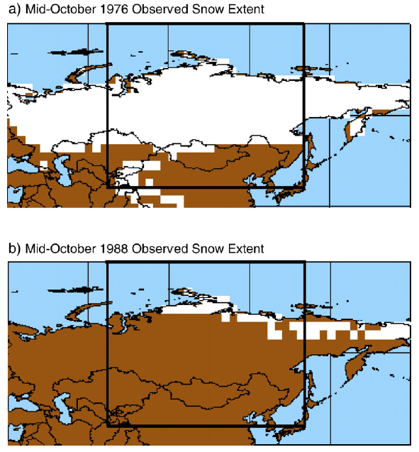
Snow cover and NH variability - observations
In addition to cover a substantial part of the Northern hemisphere,
Large inter-annual variability
In particular during the accumulation period (e.g. Mid October)
This has been widely studied as potential source of long-range predictability
Can these anomalies in snow-cover in October influence Winter circulation ?
Other teleconnections:
Snow cover in Eurasia and Indian summer monsoon: questionable (see Peings and Douville 2010)
(Gong et al. 2007)

Slide 6
Snow cover and NH variability - observations
October snow cover anomalies correlated with
Winter (DJF) surface temperature
Winter (DJF) sea level pressure
(Gong et al. 2007,
Cohen and Saito 2003)
The spatial anomaly patterns resemble the Artic Oscillation pattern of variability
This allows the development of statistical prediction models for winter variability based on early Autumn snow cover that beat current dynamical seasonal forecast systems (why… ?)

Slide 7
Trends and climate change implications
Snow cover extent in the N.H land:
  Red satellite data
  Black CMIP5 mean
Normalized by maximum extend in each month
April/May observed trends are within the CMIP5 range#
June observed trend is very large in the last years and not captured by any model (models only get there around 2050 ! )
What are the models (we) missing?
(Derksen and Brown 2012)

Slide 8
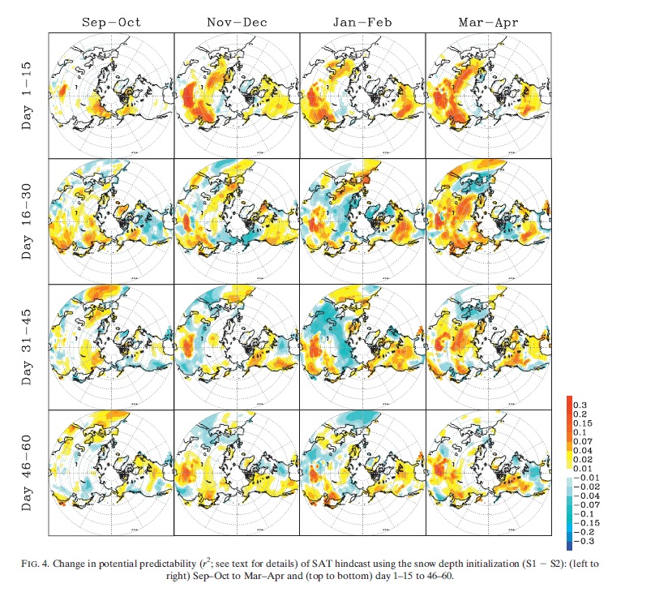
Snow initialization and sub-seasonal forecasts
Changes in potential predictability r² between initializing snow depth or not
General increase of about 10% in particular during the first month.
In this study the signal in actual predictability is smaller, but there is still some signal..
Jeong et al. 2012

Slide 9
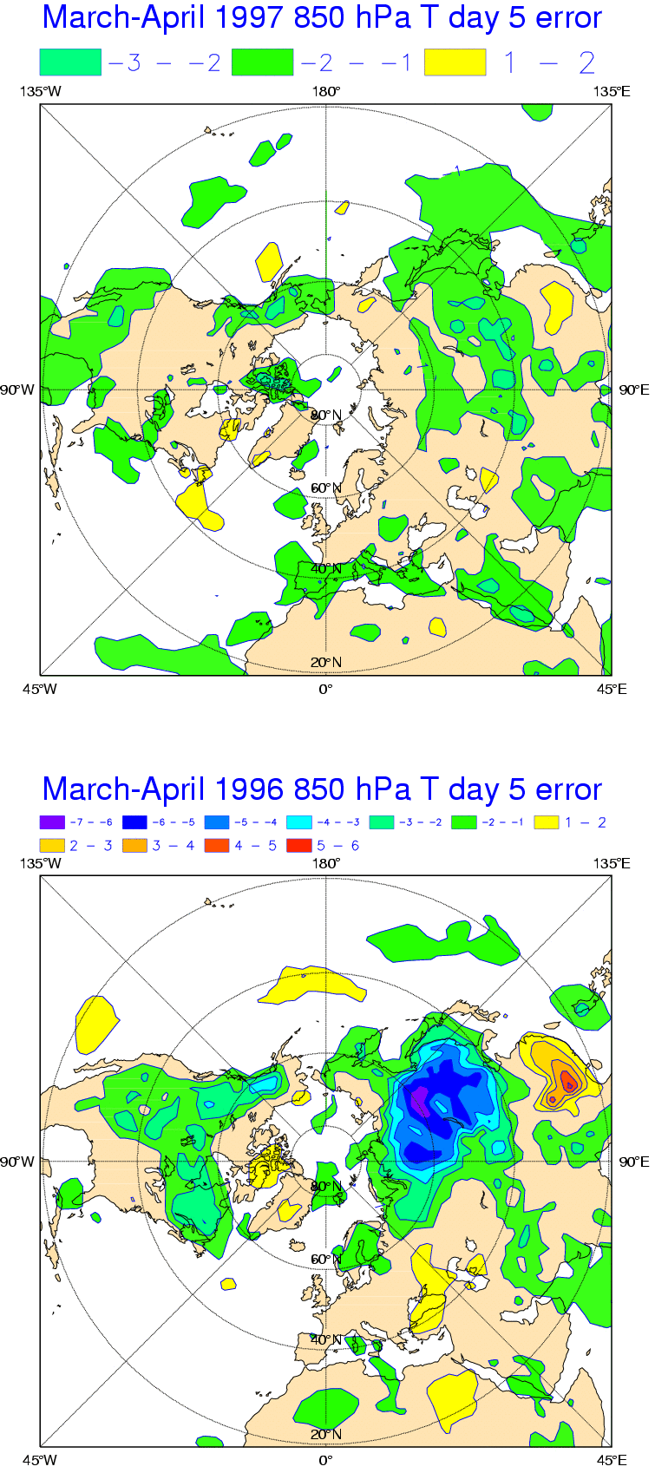
Case study: Boreal forest albedo
The surface albedo is the direct regulator of the energy available to the surface. The albedo of natural surfaces has a limited range (0.1-0.3), but in non-forested snow covered areas can reach values up to 0.8.
Snow covered boreal forests have a much lower albedo than grassland to their south and tundra to their north; the presence of boreal forests has a direct control on the climate of high-latitudes.
1997
Operational
Bias
(FAL)
1996
Operational
Bias
(CON)
Viterbo and Betts 1999

Slide 10
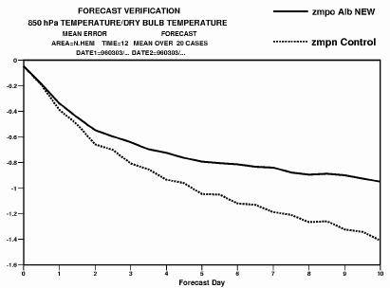
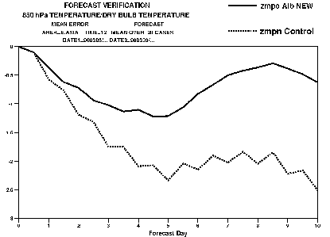
Case study: Boreal forest albedo
850 hPa temperature bias
20 forecasts every 3 days, March-April 1996
No data assimilation
Northern Hemisphere
Eastern Asia
0
0
FAL
FAL
-1
-1
-2
CON
CON
-3
0
Forecast day
10
0
Forecast day
10
Considering a lower value of snow Forest ALbedo was beneficial.

Slide 11
Outline
Snow in the climate system, an overview:
      Observations;
      Modeling;
      Forecasts impact.
Snow representation in the ECMWF model:
      Energy/Water balance;
      Density/ Albedo / Snow cover fraction;
      Evaluation examples.
Soil heat & water in frozen conditions
      Soil heat transfer and phase changes
      Soil water in frozen conditions
  Ongoing & future work.

Slide 12
Snow in HTESSEL
Two tiles:
Exposed snow;
Snow under high vegetation
Single snow-pack evolution
Prognostic evolution:
1)Snow mass
2)Snow density
3) Snow temperature
4) Snow Albedo
Diagnostics:
Snow depth
Snow cover fraction
Liquid water content
See Dutra et al. 2010 for more details

Slide 13
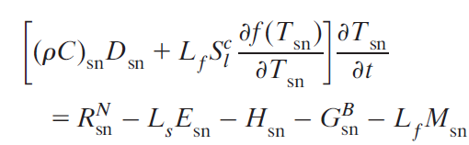
Snow in HTESSEL – energy balance
Heat capacity
Net radiation
Sensible
Basal
Melting
Latent
Snow depth
Heat capacity barrier
Diagnostic liquid water
Internal freezing/melting
Snow liquid water capacity

Slide 14
Snow in HTESSEL – water balance
Snow mass
Rainfall
Snow runoff
Snowfall
Sublimation
Rainfall and Sublimation only over the snow cover fraction
Rainfall is considered to reach the snow at freezing point
Runoff is the rate at which liquid water leaves the snowpack
Runoff is generated when the liquid water content exceeds the snow liquid water capacity
Before 2009 liquid water was not considered

Slide 15
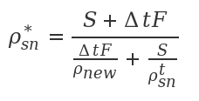
Snow in HTESSEL – density
1st term: overburden – increase density due to the snow weight
2nd term: thermal metamorphism: snow crystal destruction with time as function of temperature and density
3rd term: Increased density due to re-freezing
Snow density update after snowfall;
Snowfall density as a function of Wind speed, and air temperature
Snow density formulation before 2009

Slide 16
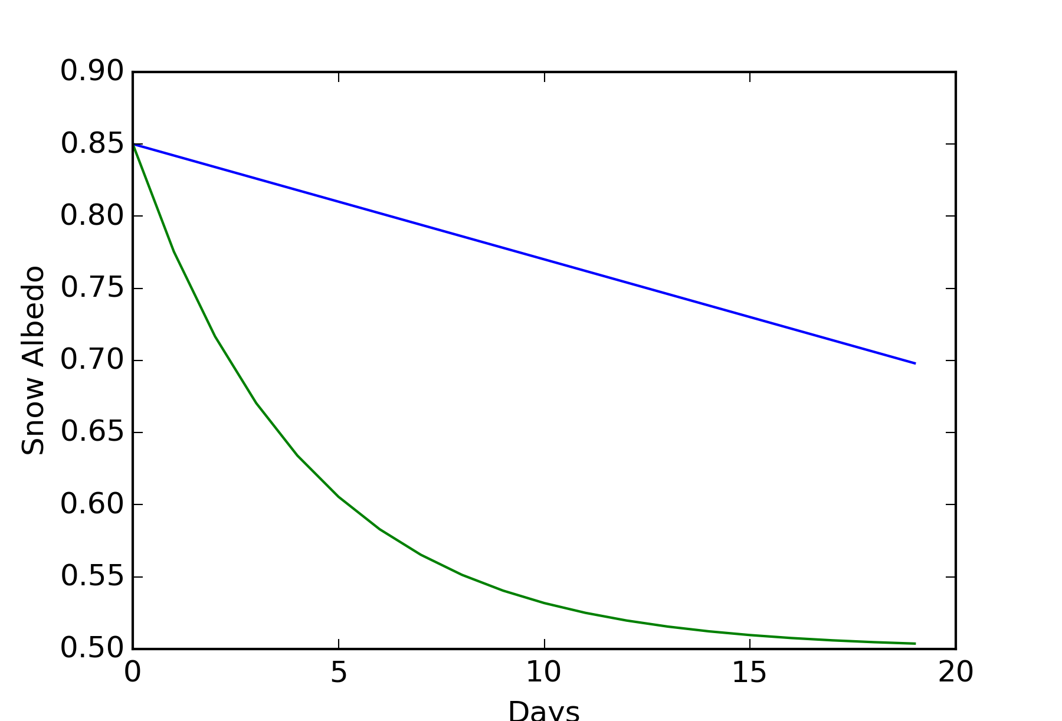

Snow in HTESSEL – snow albedo
Linear decay in normal conditions;
Exponential decay in melting condictions;
Min/Max albedos of 0.5 and 0.85.
Reset snow albedo after snowfall : requires 10 kg m² to reset to maximum
For snow under high vegetation we keep the albedo constant (derived from Satellite data)
Neglect seasonal variations

Slide 17
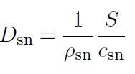
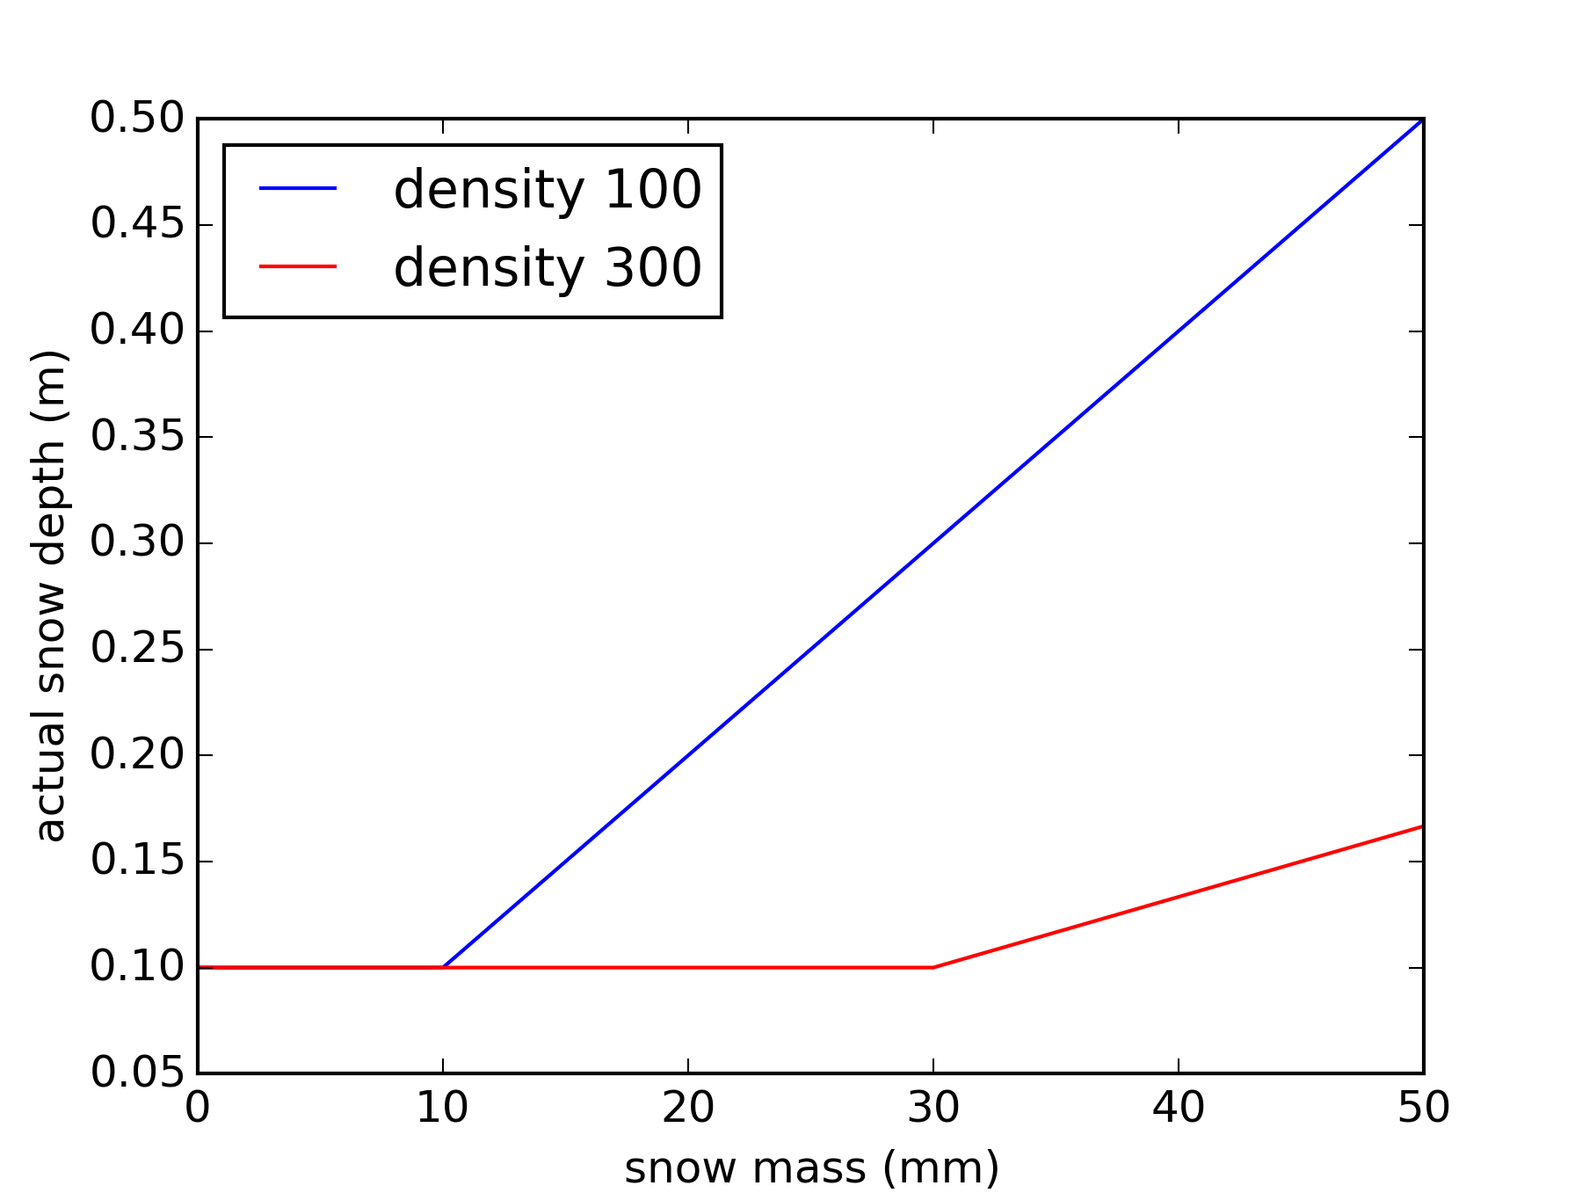
Snow in HTESSEL – snow cover fraction
Snow cover fraction as a function of snow depth
Affects the tile fraction : direct albedo effect
Energy balance indirectly
Actual snow depth:
We have a depth “barrier” at 10 cm
Pile the snow as snow mass / snow-cover fraction reduces

Slide 18
Outline
Snow in the climate system, an overview:
      Observations;
      Modeling;
      Forecasts impact.
Snow representation in the ECMWF model:
      Energy/Water balance;
      Density/ Albedo / Snow cover fraction;
      Evaluation examples.
Soil heat & water in frozen conditions
      Soil heat transfer and phase changes
      Soil water in frozen conditions
  Ongoing & future work.

Slide 19
Point evaluation
Point simulations (offline) in a forest and open areas nearby
CTR (gray) : model before 2009
NEW (black) : current model
Better simulations of snow mass
  Albedo changes
  Liquid water representation
Improved snow density
  Before – exponential increase
  Snow follows closely observations. Still some problems during melting

Slide 20
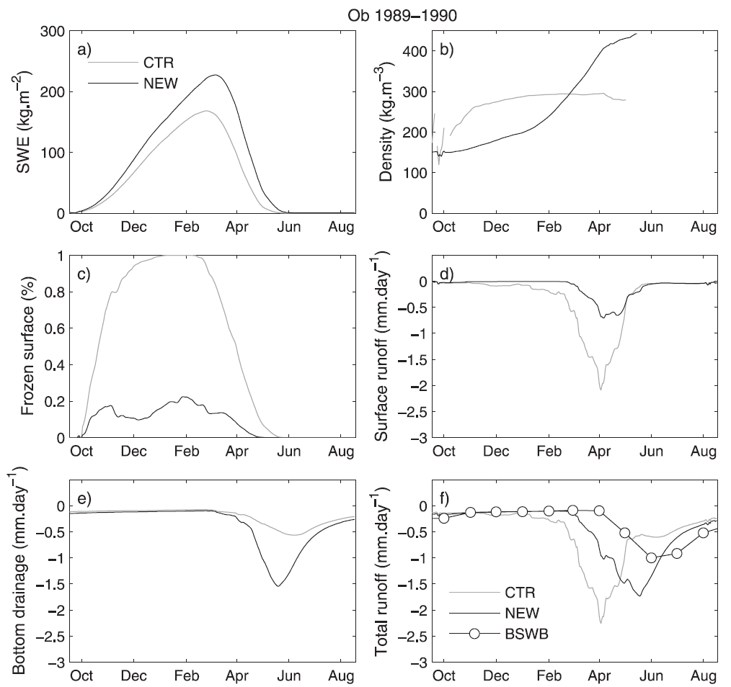
Basin scale evaluation
Regional offline simulations over the Ob (Siberia basin)
Increase in snow mass
  Interception of rainfall
Lower densities during accumulation/winter seasons
Reduction of soil freezing
Increase of surface runoff
Decrease of bottom drainage
Improvement of total runoff
Lower densities -> less coupling -> less soil freezing -> less surface runfoff

Slide 21
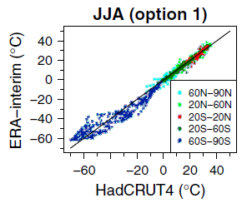
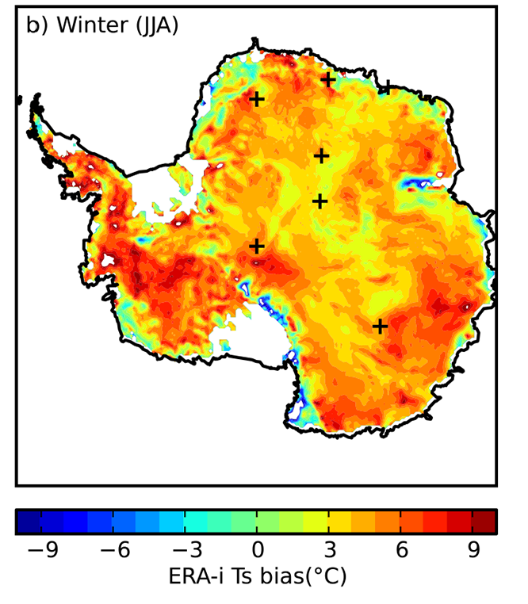
Warm temperature bias over Antarctica
Several studies reported a warm bias of surface & T2m during the polar night over Antarctica:
  Difficulties representing strong radiative cooling events (skin and T2m);
  Can it be associated with the surface turbulent fluxes under very stable conditions ?
  Land-atmosphere coupling (surface thermal inertia) ?
Mitchell & Jone 2005
T2m ERAI vs HadCRUT4
Fréville et al. 2014
Skin temperature vs MODIS

Slide 22
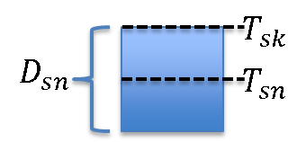
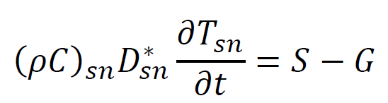
Surface and snow energy balance
(1)
S
Net longwave H=Sensible heat S= Surface heat
- Polar night: no shortwave and latent heat is very small
G
Glaciers are represented with 30 m snow with 1 m thermally active (D_{sn}=1m)
(2)
1 meter snow has a large thermal inertia and ground heat flux (G) is unrealistic:
  DSN: in (2) we reduce the thermally active layer to 10 cm and neglect G (proxy for snow muti-layer);
Surface heat flux is small during radiative cooling events (T_{sk} ≈ T_{sn} ):
  COND: in (1) skin conductivity changed from 7 to a very small value;
Sensible heat flux – transfer coefficient (C_{H}) :
  ROU :Reduce momentum roughness from 1.3x10⁻³ to 1x10⁻⁴ and heat from 1.3x10⁻⁴ to 5x10⁻⁵;
  EXC: Different formulation of the transfer coefficient C_{H} as used in SURFEX (from Holtslag and De Bruin (1988) to Louis (1979)).

Slide 23
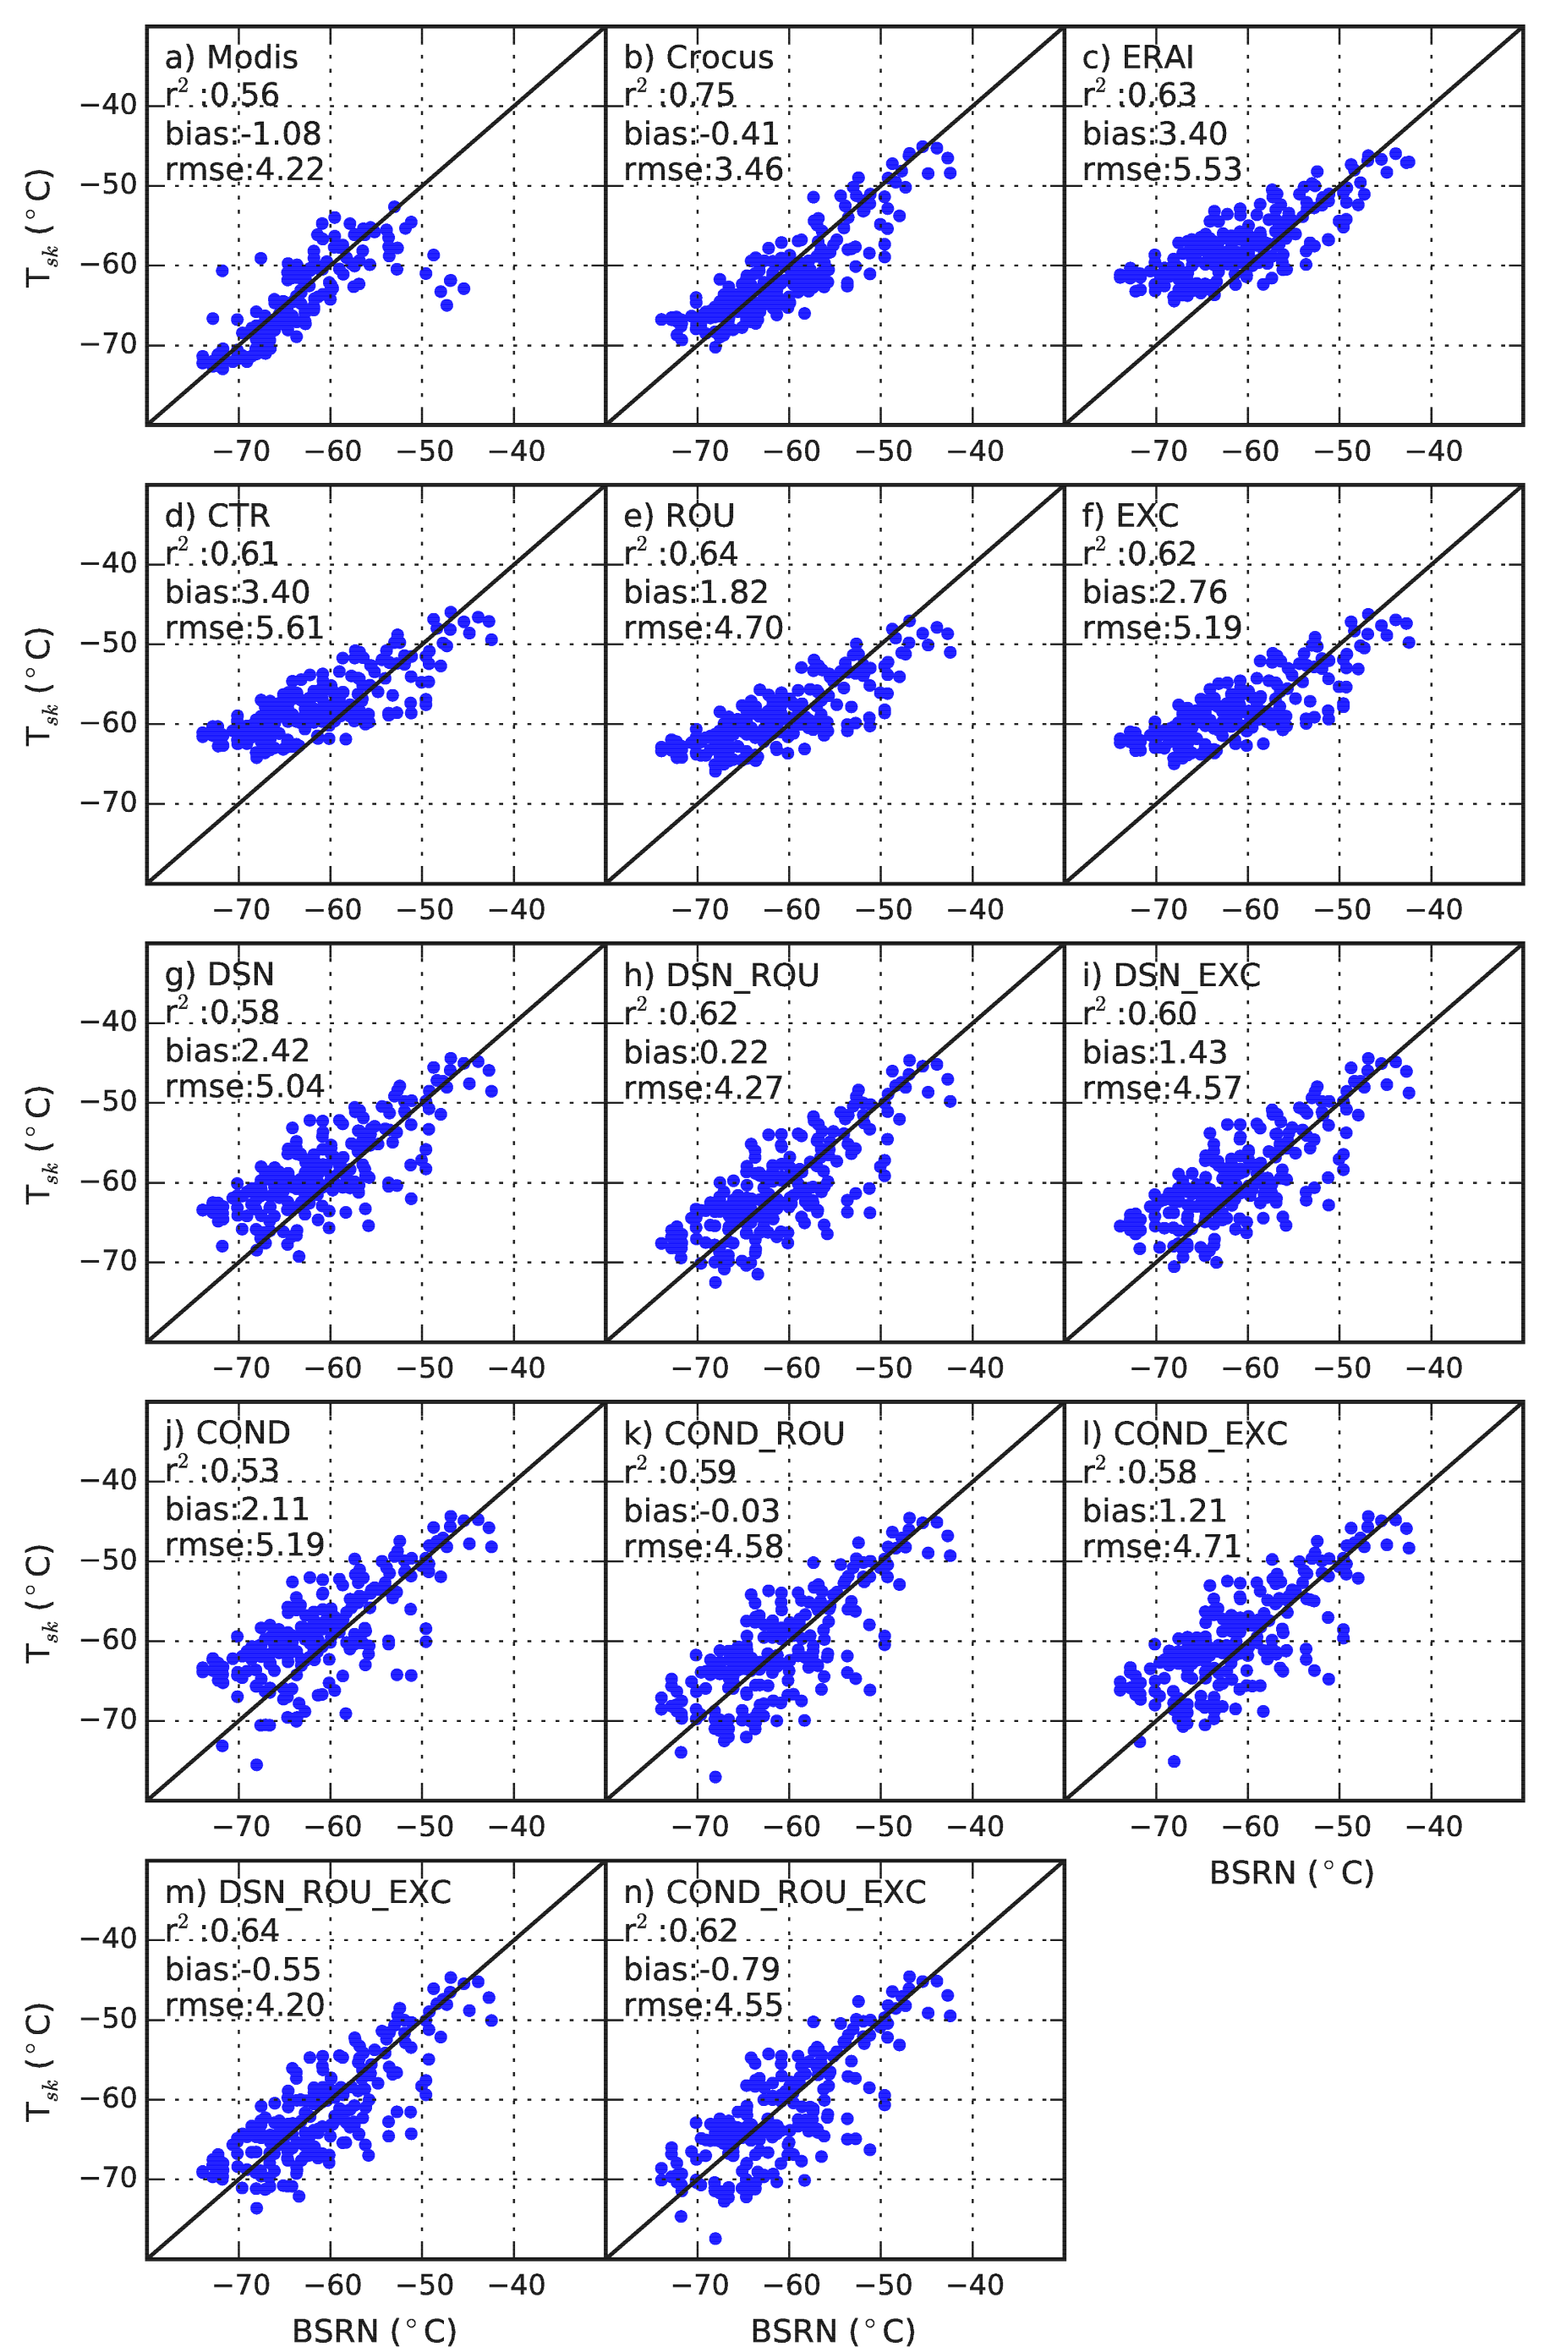
South Pole surface-only simulations (1)
We start by running the ECMWF land surface model (HTESSEL) in stand-alone mode forced by the atmospheric conditions of ERA-Interim (similar to what Fréville et al. 2014 did with CROCUS).
South Pole station : comparing with BSRN, MODIS, CROCUS with our simulations:
DSN (or COND) are necessary to remove the “tail” in cold situations, i.e. need a fast thermal response at the surface;
Decreasing the roughness (ROU) or the different formulation of the transfer coefficients (EXC) act on the systematic bias;
MODIS
CROCUS
ERAI
CTR
ROU
EXC
DSN
DSN_ROU
DSN_EXC
Scatter plots of simulated skin temperature vs. BSRN during August 2009
DSN_ROU_EXC

Slide 24
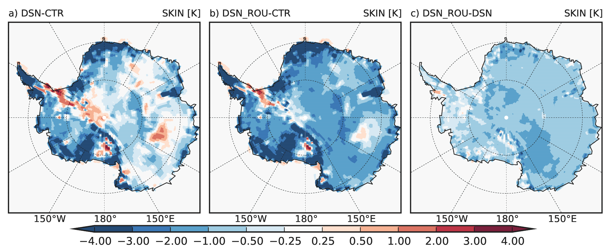
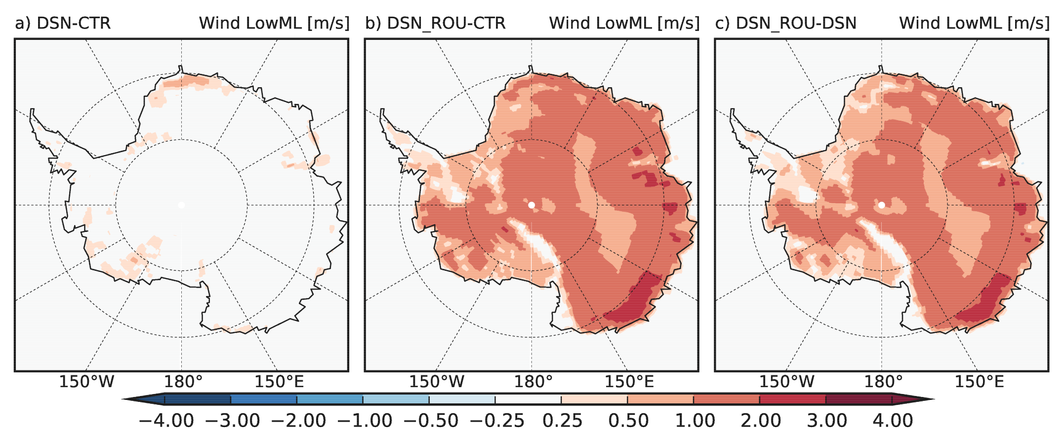
Forecasts with the coupled system
Current model version with T255 (about 0.7°) and 137 vertical levels: short-range forecasts initialized every day at 00 UT for August 2009 using ERA-Interim. Monthly mean computed with forecast steps +12/18/24/30h
Skin temperature
Reduction of thermally active snow layer (DSN) reduces skin temperature, but restricted to mainly clear sky regions;
Roughness reduction: general decrease of temperature but increased wind speed: impact in coupled mode damped compared with stand-alone
DSN-CTR
DSN_ROU-CTR
DSN_ROU-DSN
Wind speed (lowest model level
Cloud cover
DSN-CTR
DSN_ROU-CTR
DSN_ROU-DSN

Slide 25
Outline
Snow in the climate system, an overview:
      Observations;
      Modeling;
      Forecasts impact.
Snow representation in the ECMWF model:
      Energy/Water balance;
      Density/ Albedo / Snow cover fraction;
      Evaluation examples.
Soil heat & water in frozen conditions
      Soil heat transfer and phase changes
      Soil water in frozen conditions
  Ongoing & future work.

Slide 26
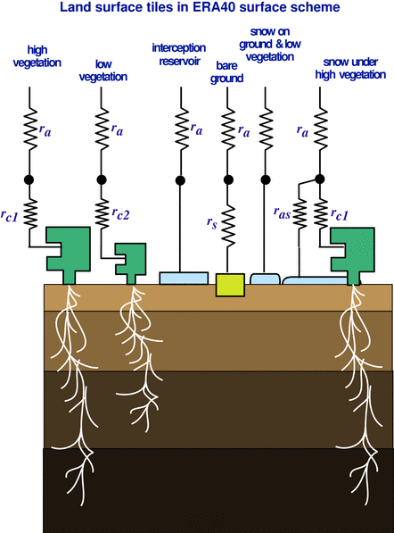
HTESSEL heat transfer
Solution of heat transfer equation with the soil discretized in 4 layers, depths 7, 21, 72, and 189 cm.
No-flux bottom boundary condition
Heat conductivity dependent on soil water
Thermal effects of soil water phase change
↓0.1~0.6 d
↓ 1.1~5.8 d
↓ 10.6 ~ 55.8 d
Time-scale for downward heat transfers in wet/dry soil

Slide 27
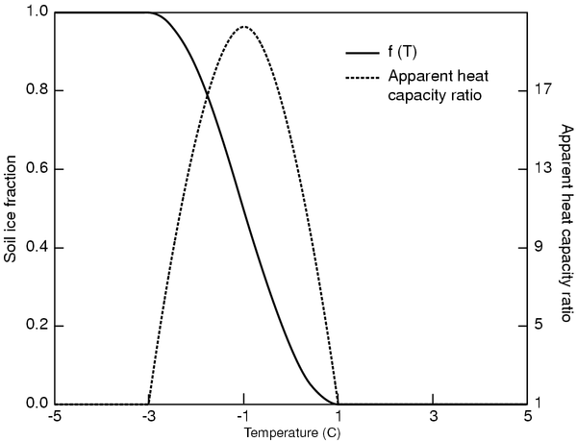
Winter: Soil water freezing
Soil heat transfer equation in soil freezing condition
Apparent heat capacity

Slide 28
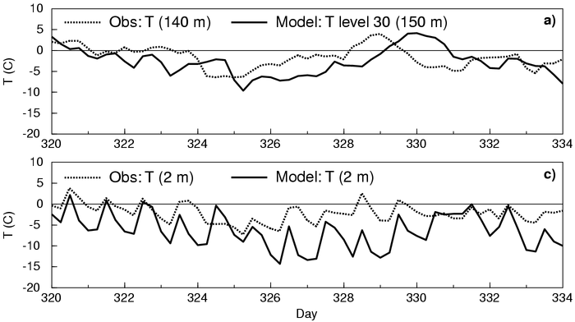
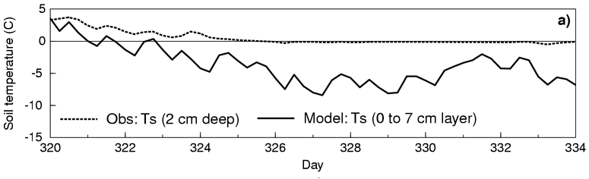
Case study: winter (1)
Model vs observations, Cabauw, The Netherlands, 2nd half of November 1994
140 m
2 m
Soil

Slide 29
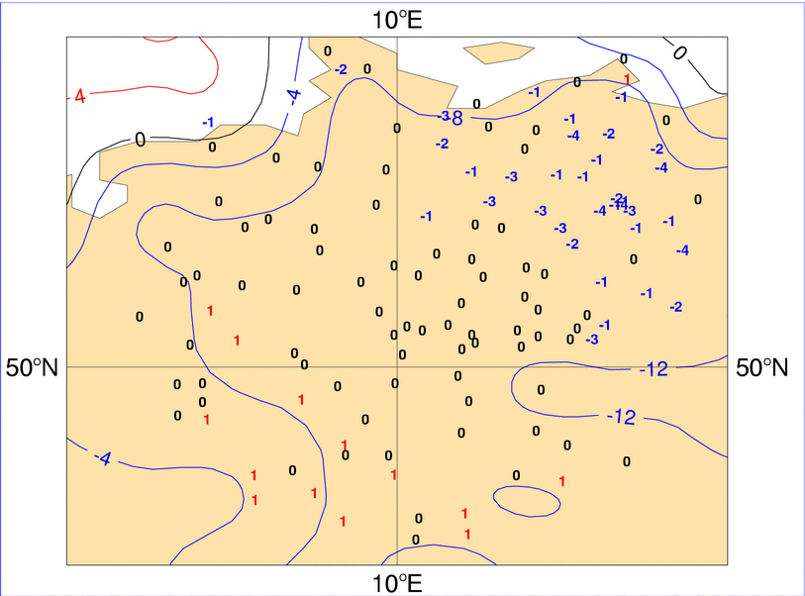
Case study: winter (2)
Soil Temperature, North Germany, Feb 1996: Model (28-100 cm) vs OBS 50 cm
Observations: Numbers
Model: Contour

Slide 30
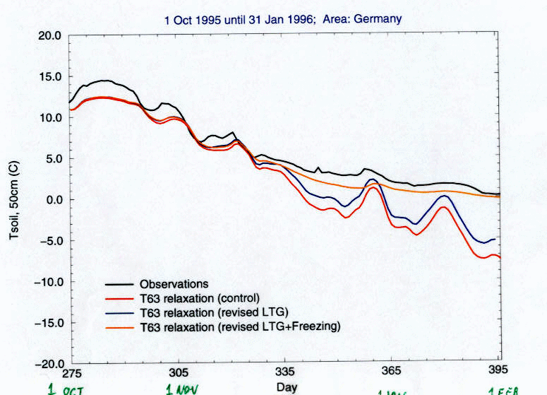
Case study: winter (3)
Germany soil temperature: Observations vs Long model relaxation integrations
Observations
Stab+Freezing
Stability
Control
1 Oct
1 Nov
1 Jan
1 Feb

Slide 31
HTESSEL soil water equations
Volumetric soil water transfer equation
Sink term (root extraction)
↓0.1~19.7 d
Darcy’s Law
↓ 1.2~195.9 d
↓ 11.7 ~ >> d
Hydraulic diffusivity conductivity )
The half levels (layer interface) diffusivity & conductivity
Fraction of soil frozen
Wilting point : almost now water movement
Time-scale for downward water transfers in wet/dry soil

Slide 32
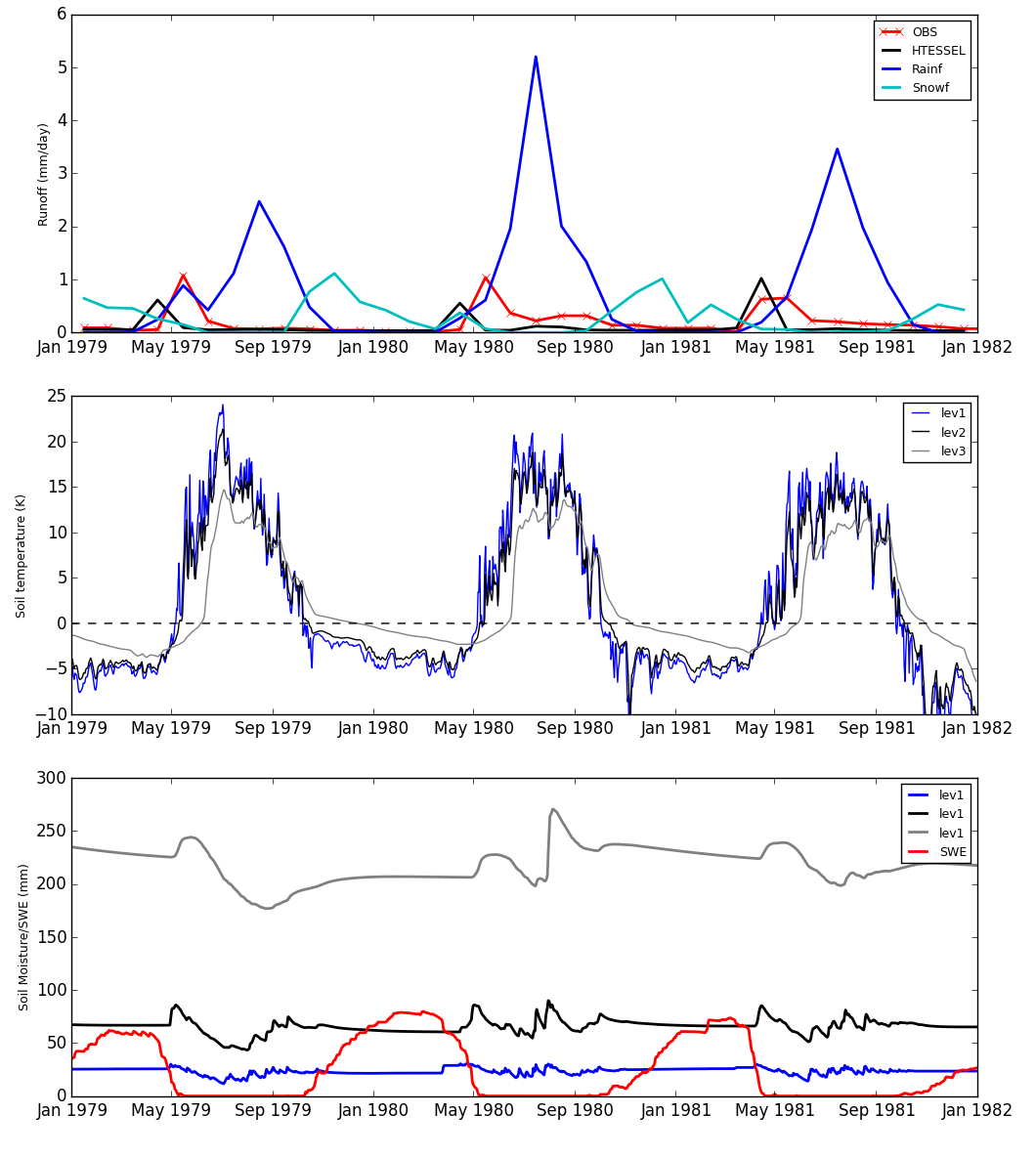
HTESSEL soil water/snow/runoff
Runoff / precipitation
Simulation of runoff in a northern catchment:
Early runoff peak:
Early snow melt ?
Too much soil frozen ?
Water movement in freezing conditions?
Soil Temperature
Soil moisture / SWE

Slide 33
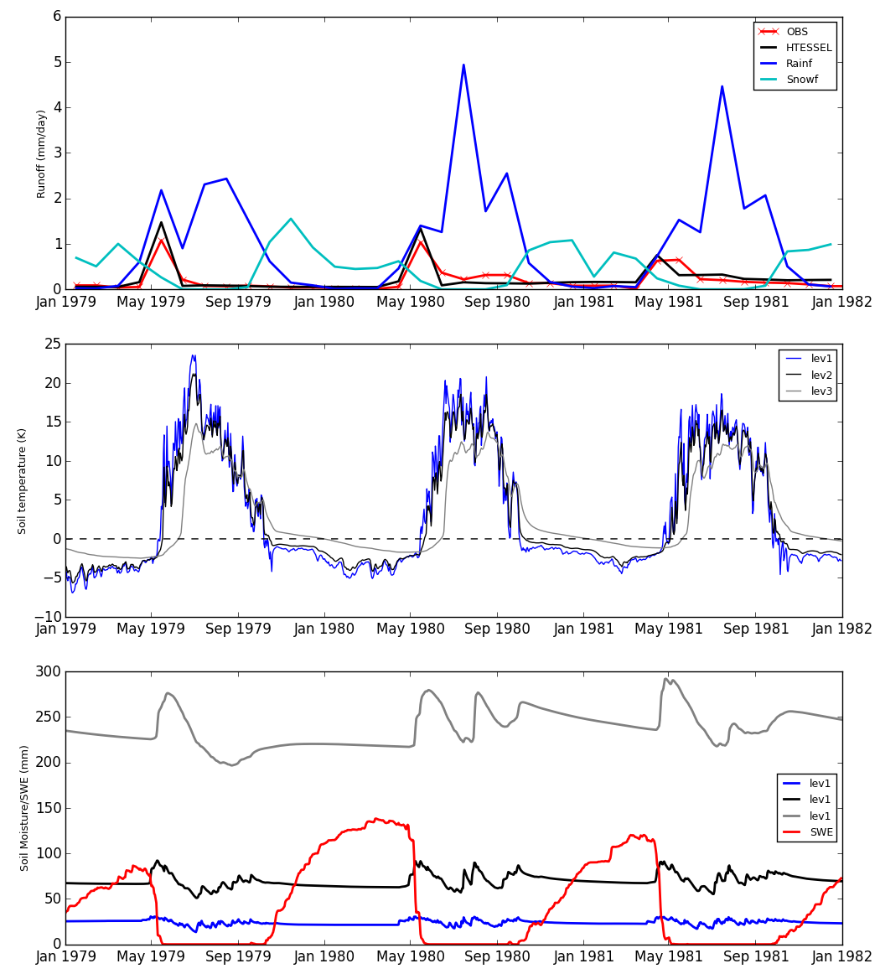
HTESSEL soil water/snow/runoff
Runoff / precipitation
Simulation of runoff in a northern catchment:
Early runoff peak:
Early snow melt ?
Too much soil frozen ?
Water movement in freezing conditions?
Soil Temperature
Yes & No
Under-estimation of snow accumulation
  Early snow & soil melting
Large uncertainty in Snowfall observations, but data assimilation can correct snow depth.
Soil moisture / SWE

Slide 34
Neglected processes
Rain on snow
  Rainfall is assumed to fall at freezing point : No heat flux advection
  Rainfall interception partially treated but would require a prognostic liquid water reservoir for a proper evolution;
Blowing snow
  No snow mass displacement (reasonable at the resolutions we ran the model );
  Neglect the effects of blowing snow sublimation (estimates of about +/- 5 kg m ² during a winter season over Siberia (Brun et. al 2012);
Snowfall interception by vegetation:
  Changes albedo, different sublimation rates;
Vertical structure of snowpack
  Single layer cannot represent the vertical structure (memory); Thermal implications;
Snow on top of Glaciers / Sea-ice
  Glaciers set to 10 meters of snow ! And no snow on top of sea-ice.
Soil Freezing
  Once the soil is frozen there is no infiltration (sub-grid scale variability ? Preferential flow?)

Slide 35
Further Reading
Armstrong, R. L., and Brun, E., 2008: Snow and Climate. Physical processes, surface energy exchange and modeling. Cambridge University press, 222 pp.
Brun, E., V. Vionnet, et al. (2012). "Simulation of Northern Eurasian Local Snow Depth, Mass, and Density Using a Detailed Snowpack Model and Meteorological Reanalyses." Journal of Hydrometeorology 14(1): 203-219.
Cohen, J. and J. Jones (2011). "A new index for more accurate winter predictions." Geophysical Research Letters 38(21): L21701.
Derksen, C. and R. Brown (2012). "Spring snow cover extent reductions in the 2008–2012 period exceeding climate model projections." Geophysical Research Letters 39(19): L19504.
Dutra, E., G. Balsamo, et al. (2010). "An Improved Snow Scheme for the ECMWF Land Surface Model: Description and Offline Validation." Journal of Hydrometeorology 11(4): 899-916.
Dutra, E., S. Kotlarski, et al. (2011). "Snow cover sensitivity to horizontal resolution, parameterizations, and atmospheric forcing in a land surface model." Journal of Geophysical Research-Earth Surface 116(D21): D21109.
Dutra, E., P. Viterbo, et al. (2012). "Complexity of Snow Schemes in a Climate Model and Its Impact on Surface Energy and Hydrology." Journal of Hydrometeorology 13(2): 521-538.
Dutra, E., I. Sandu, G. Balsamo, A. Beljaars, H. Freville, E. Vignon and E. Brun (2015). "Understanding the ECMWF winter surface temperature biases over Antarctica." ECMWF Tech. Memo. 762: 16pp.
Fréville, H., et al. (2014). "Using MODIS land surface temperatures and the Crocus snow model to understand the warm bias of ERA-Interim reanalyses at the surface in Antarctica." The Cryosphere 8(4): 1361-1373.
Gong, G., J. Cohen, et al. (2007). "Hemispheric-scale climate response to Northern Eurasia land surface characteristics and snow anomalies." Global and Planetary Change 56(3-4): 359-370.
Jeong, J.-H., H. W. Linderholm, et al. (2012). "Impacts of Snow Initialization on Subseasonal Forecasts of Surface Air Temperature for the Cold Season." Journal of Climate 26(6): 1956-1972.
Orsolini, Y. J., R. Senan, et al. (2013). "Impact of snow initialization on sub-seasonal forecasts." Climate Dynamics 41(7-8): 1969-1982.
Peings, Y. and H. Douville (2010). "Influence of the Eurasian snow cover on the Indian summer monsoon variability in observed climatologies and CMIP3 simulations." Climate Dynamics 34(5): 643-660.
Viterbo, P., A. Beljaars, J. F. Mahfouf and J. Teixeira (1999). "The representation of soil moisture freezing and its impact on the stable boundary layer." Quarterly Journal of the Royal Meteorological Society 125(559): 2401-2426.
Viterbo, P. and A. K. Betts (1999). "Impact on ECMWF forecasts of changes to the albedo of the boreal forests in the presence of snow." Journal of Geophysical Research-Atmospheres 104(D22): 27803-27810.

