Slide 1
Variational Quality Control
Elias Holm
Data Assimilation Section, ECMWF
Acknowledgements to Lars Isaksen, Christina Tavolato and Erik Andersson, ECMWF

Slide 2
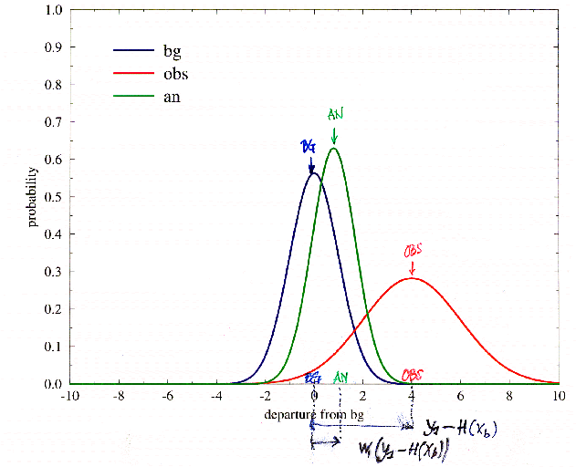
Introduction
Assuming Gaussian statistics, the maximum likelihood solution to the linear estimation problem results in observation analysis weights (w) that are independent of the observed value.
Outliers will be given the same weight as good data, potentially corrupting the analysis

Slide 3
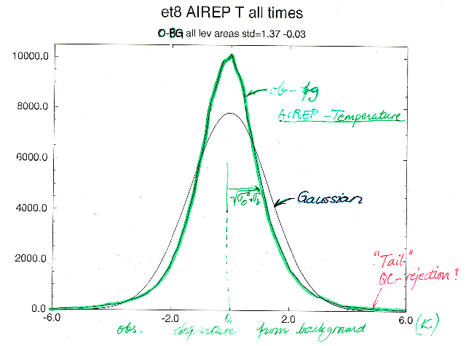
Even good-quality data show significant deviations from the pure Gaussian form
Actual distribution
Gaussian
“Tail”
QC-rejection or good data?
obs-bg departures
K
The real data distribution has fatter tails than the Gaussian
Aircraft temperature observations shown here

Slide 4
The Normal observation cost function Jo (1)
The general expression for the observation cost function is based on the probability density function (the pdf) of the observation error distribution (see Lorenc 1986):
arbitrary constant,
chosen such that
Jo=0 when y=Hx
p is the probability density function of observation error

Slide 5
The Normal observation cost function Jo (2)
When for p we assume the normal (Gaussian) distribution (N):
we obtain the expression
y: observation
x: represents the model/analysis variables
H: observation operators
σ_{o}: observation error standard deviation
Normalized departure
In VarQC a non-Gaussian pdf will be used,
resulting in a non-quadratic expression for Jo.

Slide 6
Accounting for non-Gaussian effects
In an attempt to better describe the tails of the observed distributions, Ingleby and Lorenc (1993) suggested a modified pdf (probability density function), written as a sum of two distinct distributions:
Normal distribution (pdf),
as appropriate for
‘good’ data
pdf for data affected by
gross errors
A is the prior probability of gross error

Slide 7
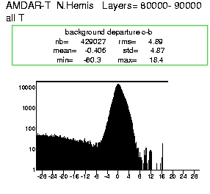
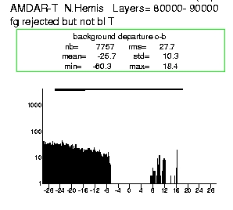
Gross errors of that type occur occasionally…
Positive observed temperatures (˚C) reported with wrong sign.
(Chinese aircraft data 1-21 May 2007)
Innovation Statistics Sample=429,000
All data
Rejected data

Slide 8
Variational quality control
Thus, a pdf for the data affected by gross errors (p^{G}) needs to be specified. Several different forms could be considered.
In the ECMWF 1998-2009 implementation (Andersson and Järvinen 1999, QJRMS) a flat distribution was chosen.
2d is the width of the distribution
The consequence of this choice will become clear in the following

Slide 9
VarQC formulation
Inserting p^{QC} for p in the expression Jo=-ln p + const, we obtain:
We can see how the presence of γ modifies the normal cost function and its gradient

Slide 10
Probability of gross error
The term modifying the gradient (on the previous slide) can be shown to be equal to:
the a-posteriori probability of gross error P, given x and assuming that Hx is correct (see Ingleby and Lorenc 1993)
Furthermore, we can define a VarQC weight W:
It is the factor by which the gradient’s magnitude is reduced.
Data which are found likely to be incorrect (P≈1) are given reduced weight in the analysis.
Data which are found likely to be correct (P ≈ 0) are given the weight they would have had using purely Gaussian observation error pdf.

Slide 11
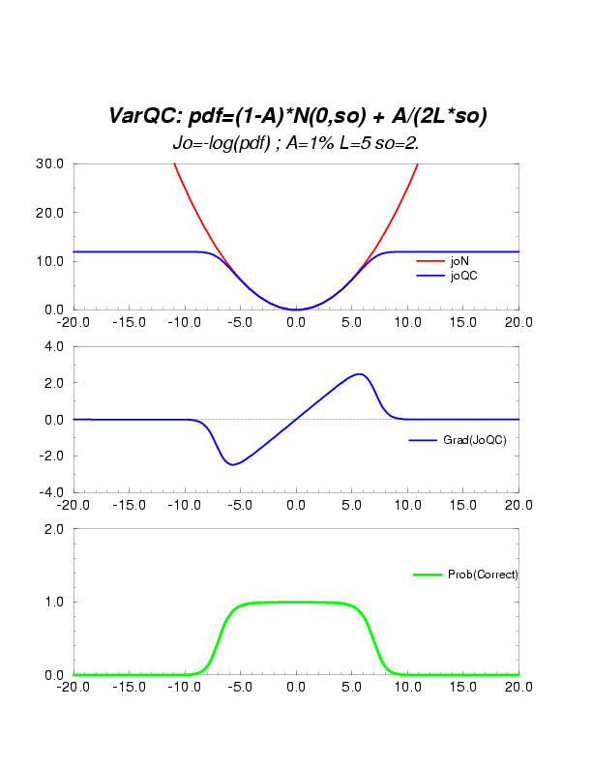
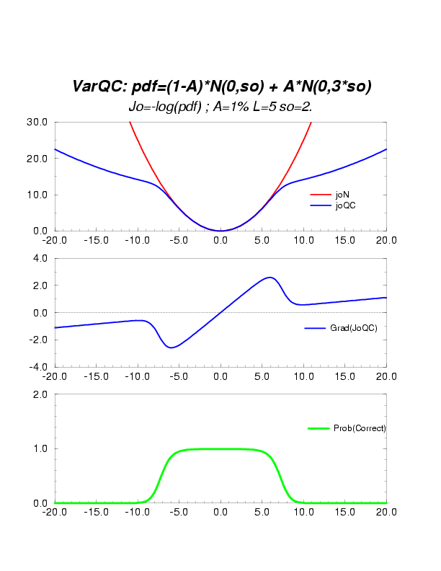
Gaussian + flat PDF
Sum of 2 Gaussians
Gradient
Gradient
QC Weight
QC Weight

Slide 12
Application
In the case of many observations, all with uncorrelated errors, Jo^{QC} is computed as a sum (over the observations i) of independent cost function contributions:
The global set of observational data includes a variety of observed quantities, as used by the variational scheme through their respective observation operators. All are quality controlled together, as part of the main 4D-Var estimation.
The application of VarQC is always in terms of the observed quantity.

Slide 13
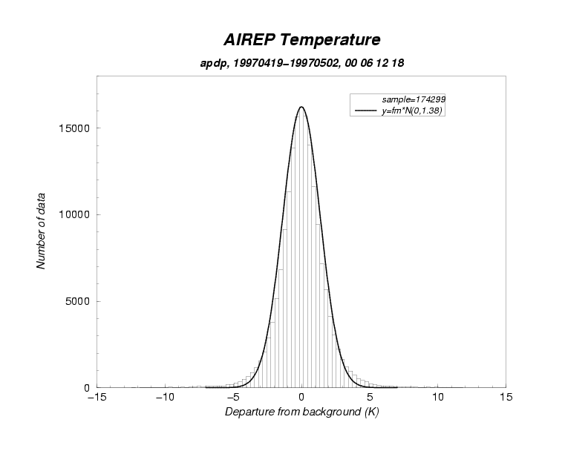
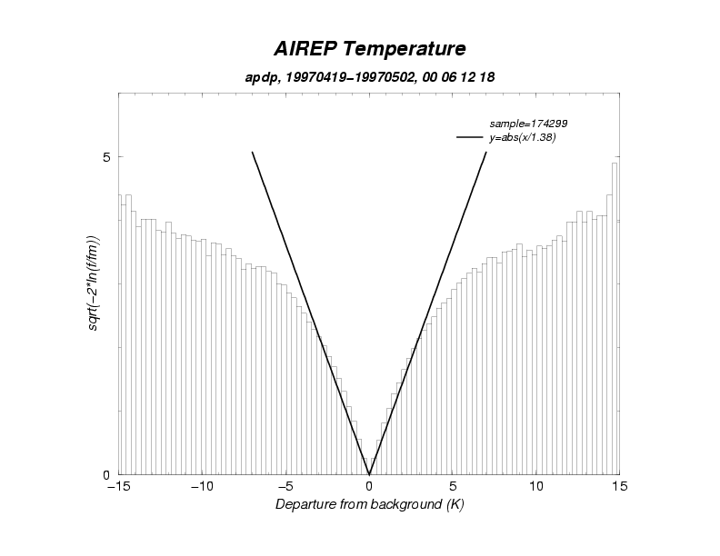
Tuning the rejection limit
The histogram on the left has been transformed (right) such that the Gaussian part appears as a pair of straight lines forming a ‘V’ at zero.
The slope of the lines gives the Std deviation of the Gaussian.
The rejection limit can be chosen to be where the actual distribution is some distance away from the ‘V’ - around 6 to 7 K in this case, would be appropriate.

Slide 14
Transforming the Gaussian pdf
y: observation
x: represents the model/analysis variables
H: observation operators
σ_{o}: observation error standard deviation

Slide 15
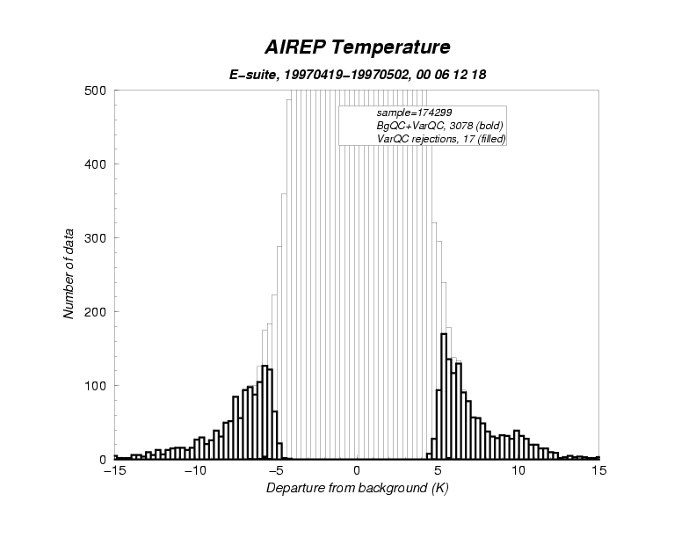
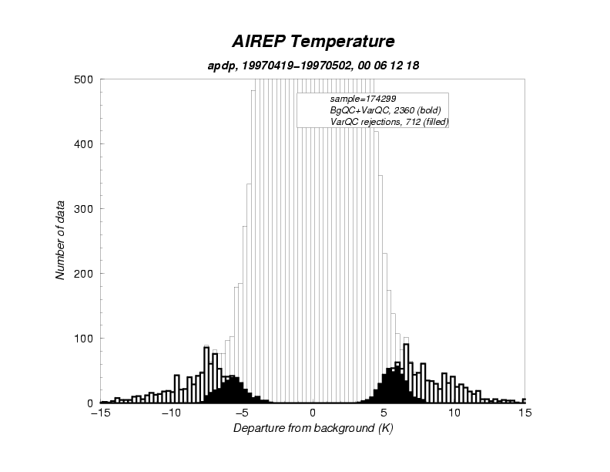
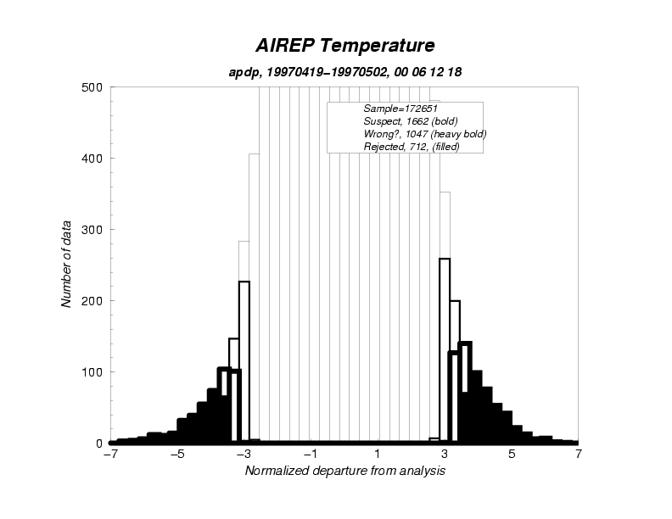
Tuning example
BgQC too tough
BgQC and VarQC correctly tuned
The shading reflects the value of P,
the probability of gross error

Slide 16
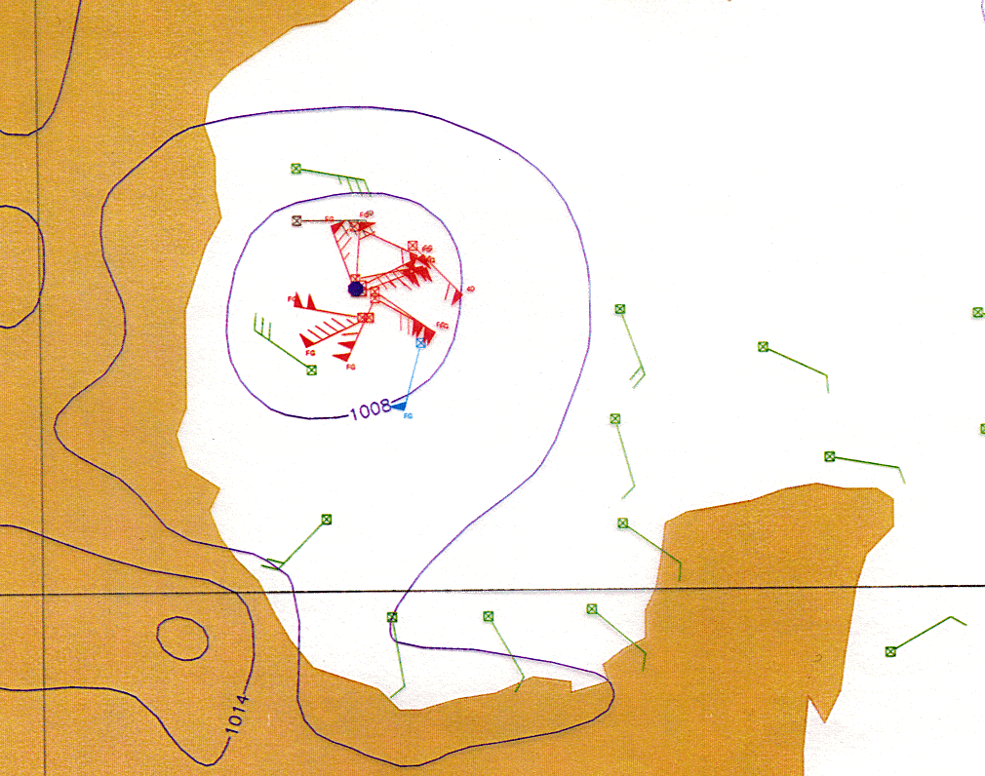
Tropical Cyclone example
Observations of intense and small-scale features may be rejected although the measurements are correct.
The problem occurs when the resolution of the analysis system (as determined by the B-matrix and model resolution) is insufficient.

Slide 17
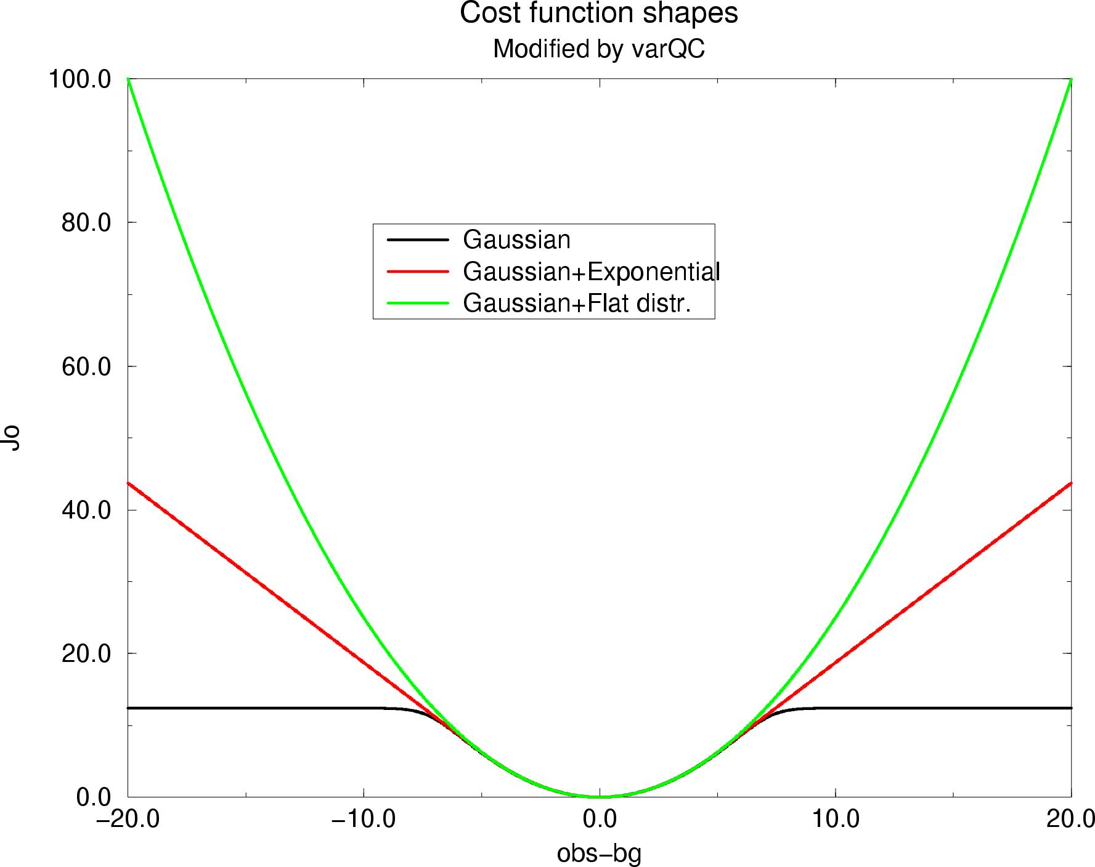
Huber-norm an alternative
A compromise between the l₂ and l₁ norms
Huber norm:
Robust method: a few erroneous observations does not ruin analysis
Adds some weight on observations with large departures
A set of observations with consistent large departures will influence the analysis
Concave cost function
Gaussian
Huber norm (New operational)
Gaussian + flat (old operational)

Slide 18
Huber norm variational quality control
The pdf for the Huber norm is:
Equivalent to L₁ metric far from x, L₂ metric close to x.
With this pdf, observations far from x are given less weight than observations close to x, but can still influence the analysis.
Many observations have errors that are well described by the Huber norm.

Slide 19
Transforming the Gaussian and exponential pdf
y: observation
x: represents the model/analysis variables
H: observation operators
σ_{o}: observation error standard deviation

Slide 20
Comparing observation weights:
Huber-norm (red) versus Gaussian+flat (blue)
More weight in the middle of the distribution
More weight on the edges of the distribution
More influence of data with large departures
  Weights: 0 – 25%
25%

Slide 21
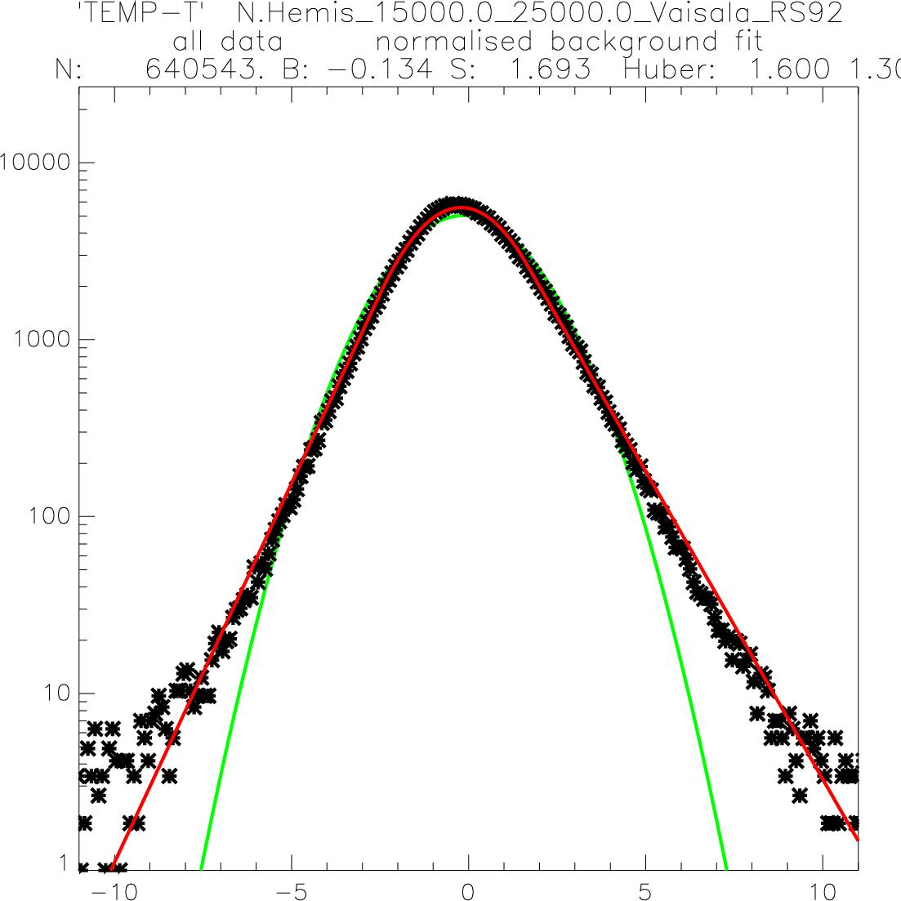
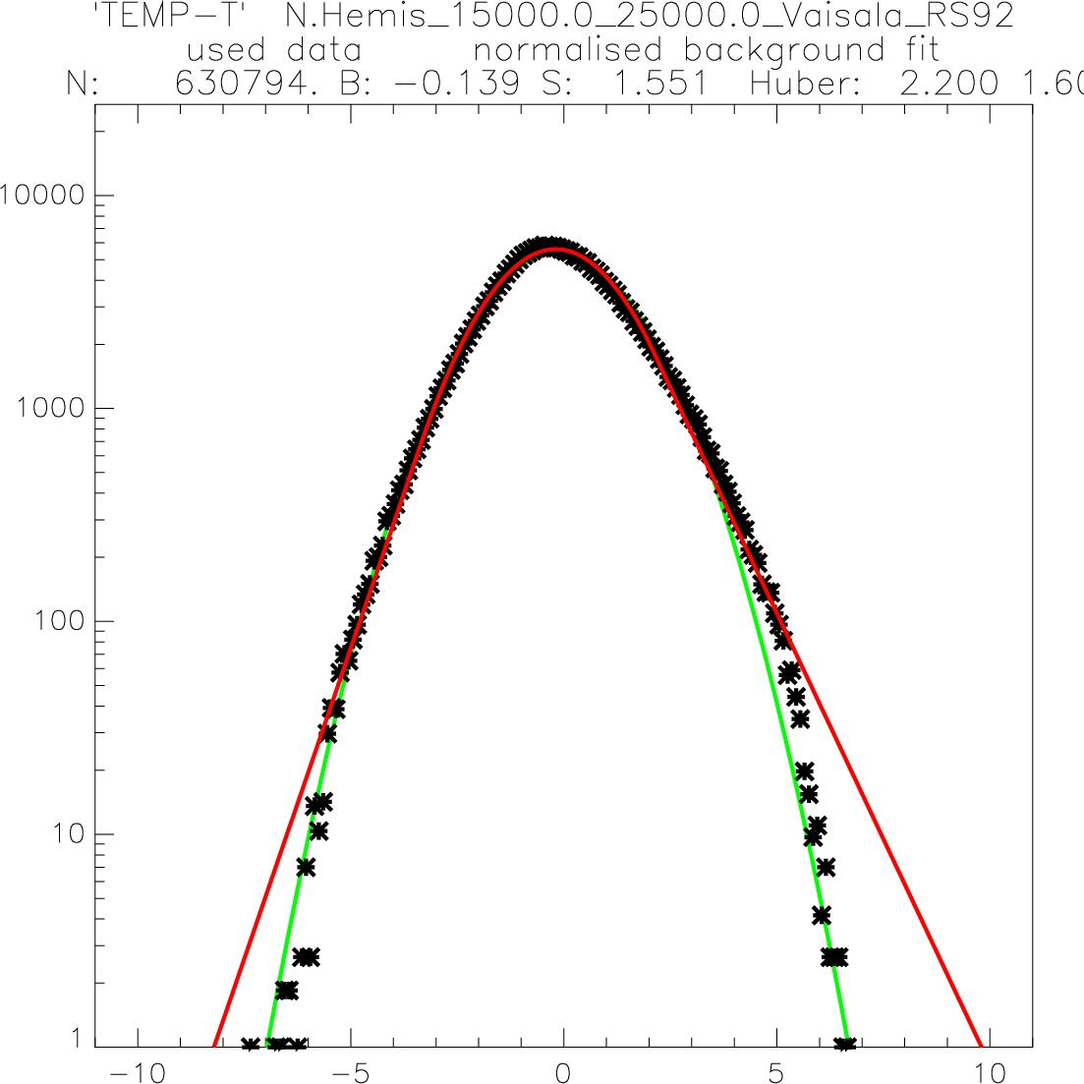
Departure statistics for radiosonde temperatures is well described by a Huber-norm distribution
Based on 18 months of data
  Feb 2006 – Sep 2007
Normalised fit of pdf to data
  Best Gaussian fit
  Best Huber norm fit
All data
Used data
Data counts (log scaling)
Normalized departures

Slide 22
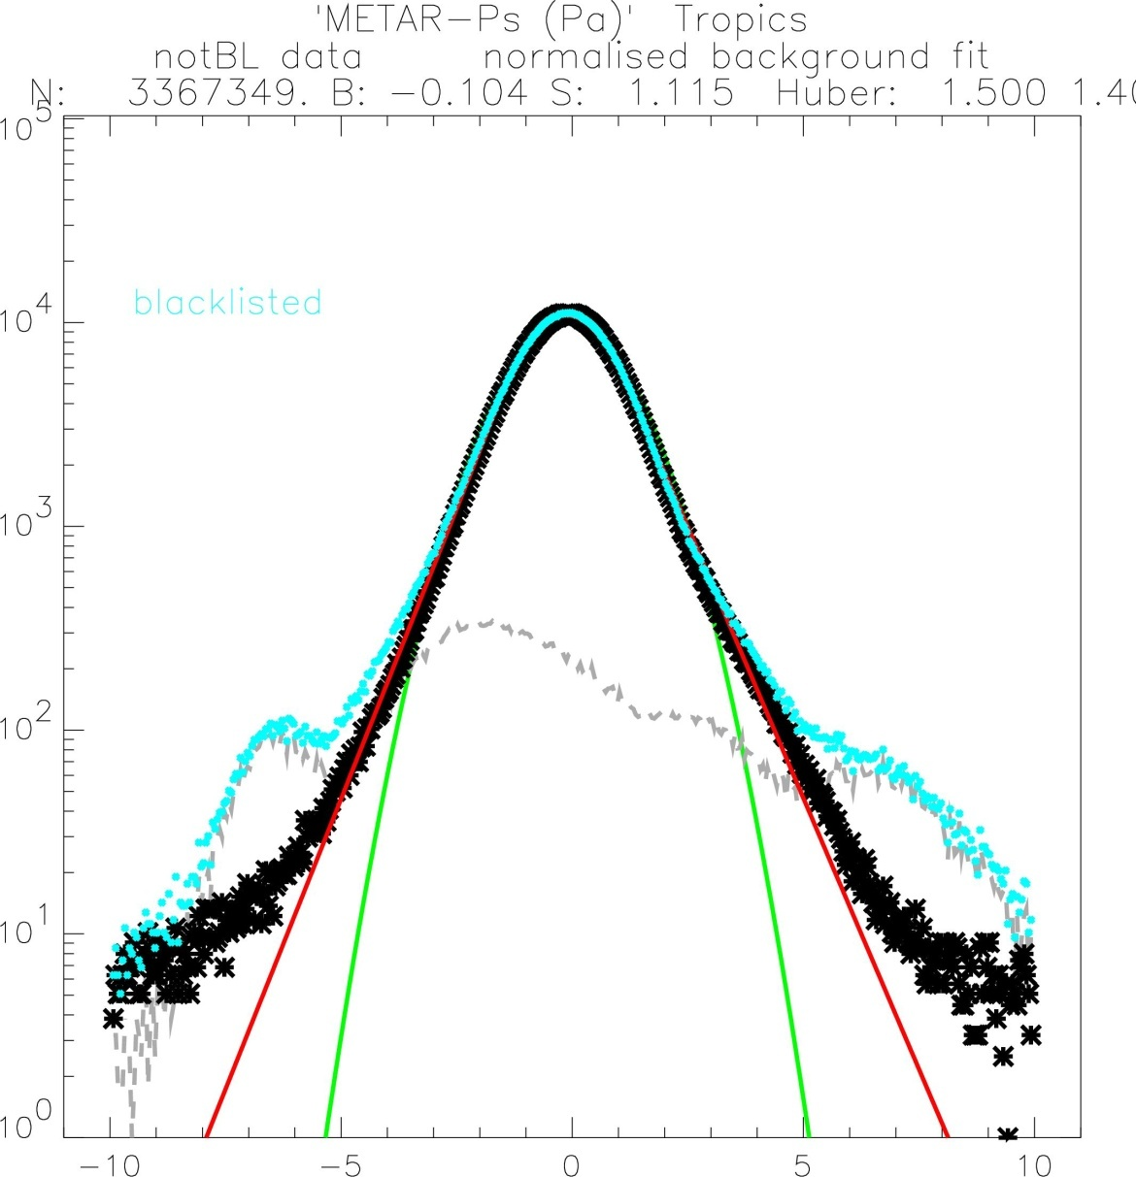
METAR surface pressure data (Tropics) Blacklisting data may well contain gross errors
Blacklisted data included
After removing the blacklisted data the departures are well described by a Huber norm (black crosses & red line)
Data counts (log scaling)
What is left after removing blacklisted data
Normalized departures

Slide 23
VarQC Summary
VarQC is efficient quality control mechanism – all data types are quality controlled simultaneously as part of the 3D/4D-Var minimization.
The implementation is very straight forward.
VarQC does not replace the pre-analysis checks - the checks against the background for example. However, with Huber-norm these are relaxed significantly.

