Slide 1
Coupled ocean-atmosphere variability - MJO
Frédéric Vitart
European Centre for Medium-Range Weather Forecasts

Slide 2
INDEX
Description of the MJO and its impacts
Prediction of the MJO
Air-sea Interaction

Slide 3
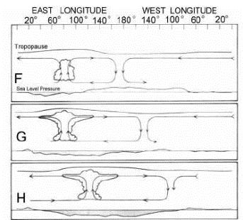
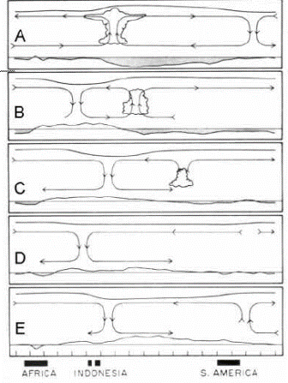

The Madden-Julian Oscillation (MJO)
From Madden and Julian (1972)
Notes:
Slide 3: The MJO was first described by Madden and Julian (1971). By looking at rawinsonde data provided by a station in the central Pacific (Canton), they discovered large coherence between surface pressure, zonal winds and temperature at various levels over a broad period range that maximized between 41 and 53 days. By looking at data from other stations, they discovered a coherence in the 40-50 day range between stations far removed from one another. The sum of evidence pointed toward an oscillation, which is an eastward movement of large-scale circulation.

Slide 4
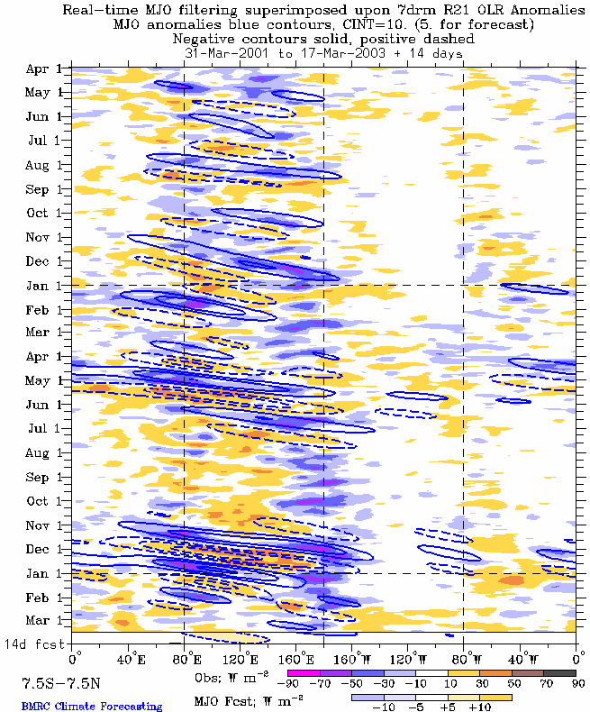
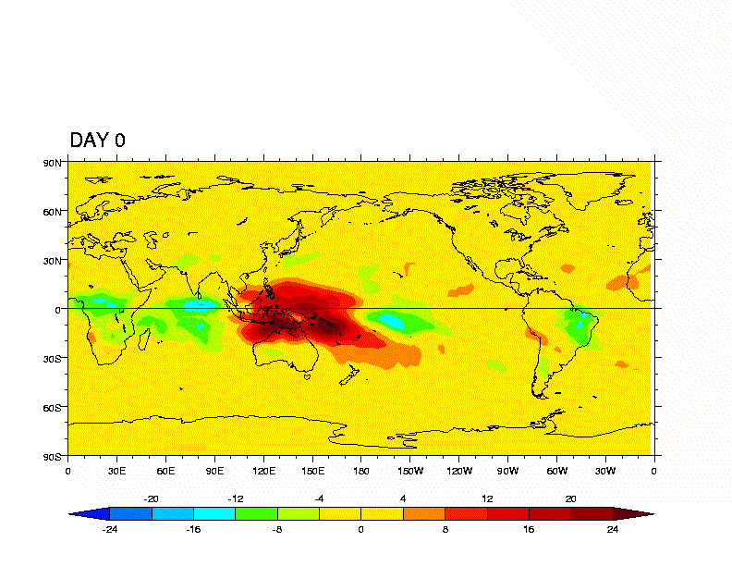
The Madden Julian Oscillation (MJO)
MJO life cycle
(From NASA)
From http://www.bom.gov.au/bmrc/clf
Notes:
Slide 4 : The left panel shows the evolution of OLR anomalies during a typical MJO. The blue colour indicates increased convection (positive phase of the MJO) and the red colour indicates suppressed convection (negative phase of the MJO). The MJO starts with increased convection in the Indian Ocean. This convection propagates eastwards, and it reaches the Maritime continent by about day 9. It reaches the western Pacific by day 15, and stops at the dateline (180E). Then, the negative phase of the MJO starts, with suppressed convection over the Indian Ocean propagating eastward. The right panel shows the time evolution of OLR anomalies over a period of 3 years from observations (2001 to 2003). In this Hovmoeller diagram, MJO episodes are well visible, but they are not regular. There are periods of strong MJO activity, and periods with low MJO activity. The different MJO events display a lot of variability in intensity and main characteristics, in the same way as ENSO events do not look all the same. The non-regularity in the occurrence of the MJO, makes the forecast of the MJO non trivial.

Slide 5
The Madden Julian Oscillation (MJO)
The MJO is a 40-50-day oscillation
The MJO is a near-global scale, quasi-periodic eastward moving disturbance in the surface pressure, tropospheric temperature and zonal winds over the equatorial belt (4 to 8 m/s).
The Madden-Julian Oscillation (MJO) is the dominant mode of variability in the tropics in time scales in excess of 1 week but less than 1 season.
The MJO has its peak activity during Northern winter and spring.
Notes:
Slide 5: This is a summary of the previous slide: the MJO is a 40-50-day oscillation. The MJO is a near-global scale, quasi-periodic eastward moving disturbance in the surface pressure, tropospheric temperature and zonal winds over the equatorial belt. The Madden-Julian Oscillation (MJO) is the dominant mode of variability in the tropics in time scales in excess of 1 week but less than 1 season. The MJO has its peak activity during Northern winter and spring.

Slide 6
Theories for the onset of an MJO event
Local recharge/discharge processes ( e.g. Hendon 1988, Blade and Hartmann 1993, Hu and Randall 1994…)
Upstream effects of circumnavigating waves ( e.g. Knutson et al 1986, Knutson and Weickmann 1987, Lau and Peng 1987)
Stochastic forcing (Wilson and Mak 1984, Neelin and Yu 1994, Yu and Neelin 1994)
Extratropical influences (e.g. Lau and Peng 1987, Hsu et al 1990, Lin et al 2007, Ray et al 2010, Wedi and Smolarkiewicz 2010..)
Notes:
Slide 6 The mechanisms behind the onset of an MJO event are still not fully understood. Several theories have been proposed. It is possible that MJO onsets can be explained by different mechanisms.

Slide 7
The Madden Julian Oscillation (MJO)
Why is the MJO so important?
Impact on the Indian and Australian summer monsoons (Yasunari 1979), Hendon and Liebman (1990)
Impact on ENSO. Westerly wind bursts produce equatorial trapped Kelvin waves, which have a significant impact on the onset and development of an El-Niňo event. Kessler and McPhaden (1995)
Impact on tropical storms (Maloney et al, 2000; Mo, 2000)
Impact on Northern Hemisphere weather
Notes:
Slide 7: The MJO has a significant impact on the Indian summer monsoon (Yasunari 1979). Clouds associated with the active phase of the Indian monsoon propagate northward through the Indian Ocean and Indian subcontinent at about 1 degree latitude per day (Murakami, 1976). Yasunari (1979) associated these northward moving clouds to the MJO.
The MJO has also a significant impact on the Australian monsoon. Hendon and Liebmann (1990) noticed that 27 of the 30 monsoon onsets from 1957 to 1987 coincided with the arrival of clouds associated with the MJO.
Several papers have suggested an impact of the MJO on the onset and development of the 1997 El-Nino event. During an active phase of the MJO, intense near-surface westerly wind events develop over the tropical Pacific Ocean, known as westerly wind bursts (Kiladis et al, 1994). Kindle and Phoebus (1995) documented a significant impact of the westerly wind bursts on the ocean through the initiation of equatorial trapped Kelvin waves. Kessler and McPhaden (1995) suggested that westerly wind bursts have a significant impact on the onset and development of an El-Nino event.
The MJO impacts the low-level vorticity and vertical wind shear over the eastern North Pacific and the Gulf of Mexico (Maloney et al, 2000), which has a significant impact on the tropical storm cyclogenesis. Mo (2000) documented that the suppression of deep convection over the Pacific during the early phase of the MJO is conducive to more easterly wind in the upper troposphere over Atlantic, which implies less vertical wind shear of the horizontal wind, and therefore more favorable conditions for cyclogenesis.

Slide 8
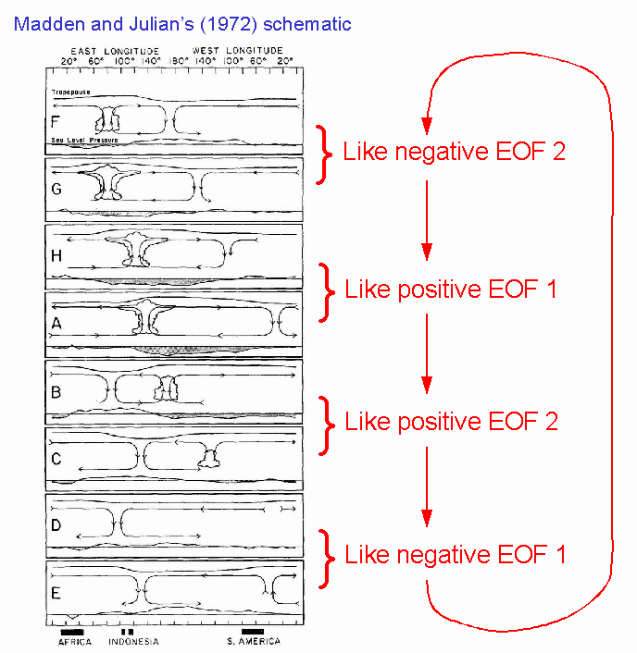
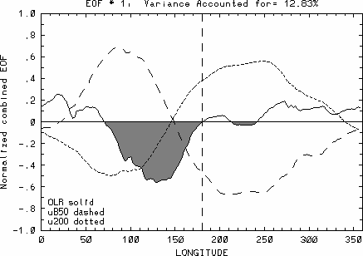
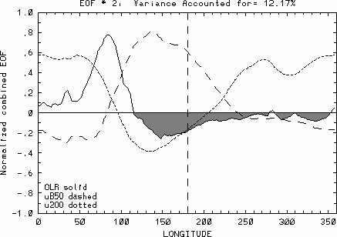
MJO Index
Combined EOF1
Combined EOF2
From Wheeler and Hendon, BMRC
Notes:
Slide 8: In order to assess the skill of the monthly forecasting system to predict an MJO event, the forecasts are projected into combined EOFs of U200, U850 and OLR (see Wheeler and Hendon, 2004). Those combined EOFs have been computed using NCEP reanalysis and the two dominant combined EOFs , which represent about 12% of the total variance each, give a good representation of the MJO propagation.

Slide 9
MJO FORECAST
Notes:
Slide 9: The time evolution of the MJO in a monthly forecast is described by a multivariate MJO index (Wheeler and Hendon 2004 Mon. Wea. Rev. vol. 132, 8 p 1917-1932). The diagram represents 8 regions of the two dimensional phase space defined by the first two principal components (RMM1 and RMM2) of combined fields (OLR, zonal wind at 850 hPa and 200 hPa) averaged between 15S and 15N. Individual ensemble member values at day 1, 5, 10, 15 and 20 are represented respectively by a red, pink orange blue and green circle. The ensemble mean values (black triangles) are joined by a solid black line and the analysis values of the preceding 30 days are joined by a grey line. The grey squares represent the analysis values of the preceding 5, 10, 15, 20, 25 and 30 days. Points representing sequential values trace anticlock-wise circles around the origin, which signifies systematic eastward propagation of the MJO. Large amplitudes (outside of the circle) indicate strong cycles of the MJO, while weak activity appears as rather random motion near the origin. The solid blue line represents the verification computed from the ECMWF operational analysis.

Slide 10
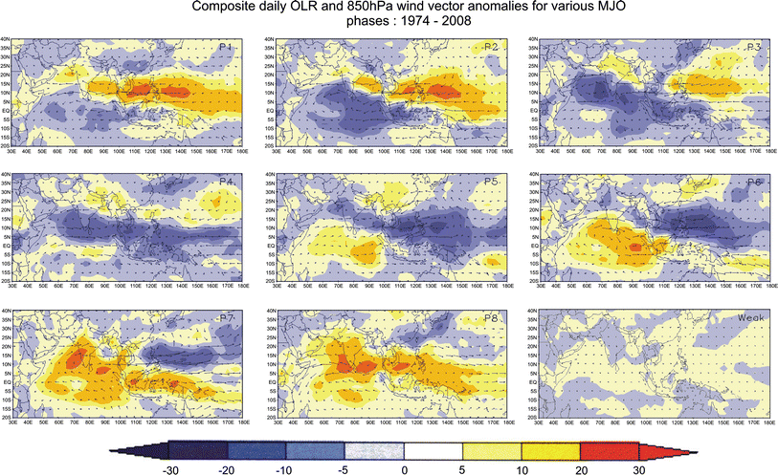
Impact of MJO on Indian Monsoon
Pai et al, 2009
Notes:
Slide 10; Maps of composite daily OLR anomaly (W m−2) superposed with composite 850 hPa wind vector anomaly in respect of eight strong phases and the weak category of MJO derived using data for the period 1974–2008 (excluding 1978). Maps for the eight strong MJO Phases are labelled as ‘P1’, ‘P2’ etc. and the map for weak category is labelled as ‘weak’

Slide 11
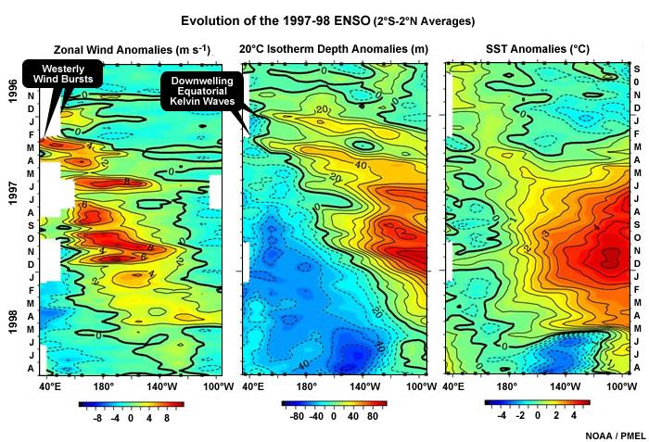
Impact of MJO on ENSO
Notes:
Slide 11: Observed anomalies (relative to the mean seasonal cycle) of equatorial surface zonal wind, representing MJO events (left panel), 20°C isotherm depth, an index for the thermocline depth representing oceanic Kelvin waves (middle), and SST (right) for a period of January 1996 - December 1998 covering the warm event of 1997-98. Plots were made using data from the Tropical Atmosphere Ocean Project (http://www.pmel.noaa.gov/tao/).

Slide 12
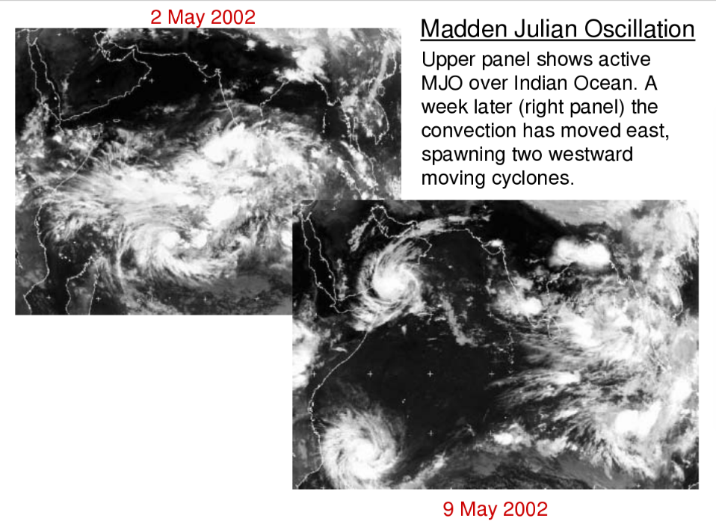
From Slingo et al., 2003
Notes:
Fig 12: MJO events can trigger tropical cyclone genesis

Slide 13
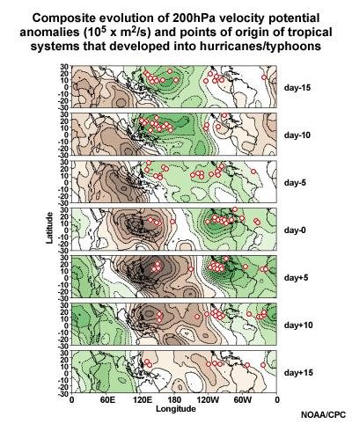
Impact of MJO on tropical cyclones
Notes:
Slide 13:Tropical cyclone genesis (red circles) during an MJO event

Slide 14
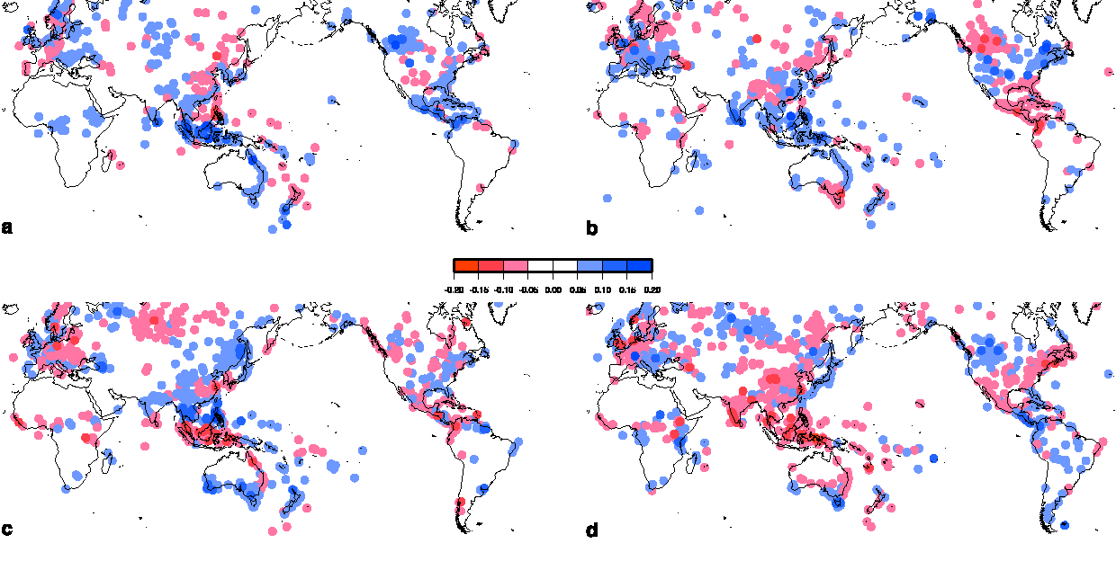
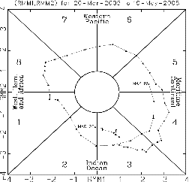
MJO and Precipitation
Observational study (precipitation)
Phase 2
Phase 4
Phase 6
Phase 8
Donald et al. (2006,GRL)
Notes:
Slide 14: Station data precipitation anomaly composites during phase 2, 4, 6 and 8 of the MJO. This slides suggest that the MJO has not only an impact on precipitation over the tropics (as expected) but also in the Extratropics.

Slide 15
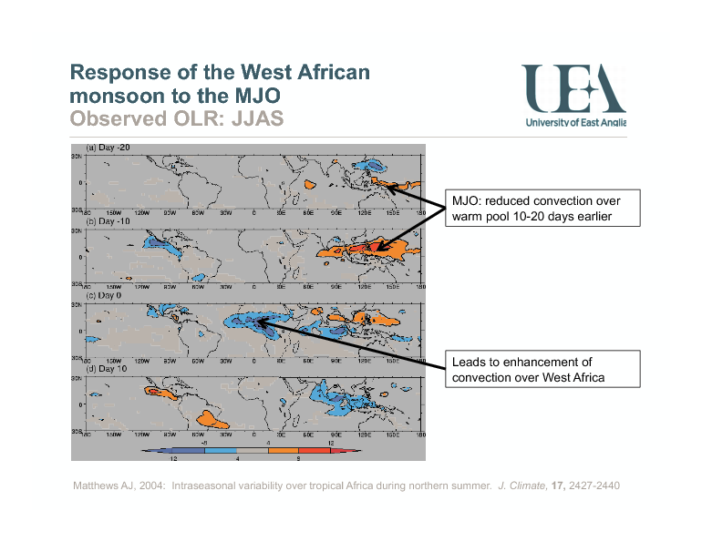
Impact of MJO on African Summer precipitation
Matthews, JCLIM 2004
Notes:
Figure 15: Lag composites of heavy precipitation events in Central Africa. This plots shows that the African heavy precipitation events are preceded by reduced convection (negative phase of the MJO) over the warm pool 10-20 days earlier.

Slide 16
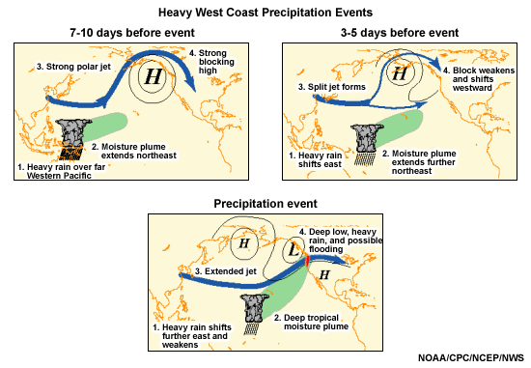
Link of the passage of the MJO across the Pacific to development of intense wintertime precipitation in western North America
“Pineapple Express events”
Notes:
Slide 16: The typical scenario linking the pattern of tropical rainfall associated with the MJO to extreme precipitation events in the Pacific Northwest features a progressive (i.e. eastward moving) circulation pattern in the tropics and a retrograding (i.e. westward moving) circulation pattern in the midlatitudes of the North Pacific (Fig. 1). Typical wintertime weather anomalies preceding heavy precipitation events in the Pacific Northwest are as follows:
(1) 7-10 days prior to the heavy precipitation event:
Heavy tropical rainfall associated with the MJO shifts eastward from the eastern Indian Ocean to the western tropical Pacific. A moisture plume extends northeastward from the western tropical Pacific towards the general vicinity of the Hawaiian Islands. A strong blocking anticyclone is located in the Gulf of Alaska with a strong polar jet stream around its northern flank.
(2) 3-5 days prior to the heavy precipitation event:
Heavy tropical rainfall shifts eastward towards the date line and begins to diminish. The associated moisture plume extends further to the northeast, often traversing the Hawaiian Islands. The strong blocking high weakens and shifts westward. A split in the North Pacific jet stream develops, characterized by an increase in the amplitude and areal extent of the upper tropospheric westerly zonal winds on the southern flank of the block and a decrease on its northern flank. The tropical and extratropical circulation patterns begin to "phase", allowing a developing midlatitude trough to tap the moisture plume extending from the deep tropics.
(3) The heavy precipitation event

Slide 17
Impact of the MJO on Extratropics
Lin et al, MWR 2010
See also
Simmons et al JAS 1983
Ting and Sardeshmukh JAS 1993
Notes:
Slide 17: Impact of imposing a Heat source in the Tropics on Z500 circulation in the Extratropics. This shows a heat source over the maritime continent (consistent with MJO EPF1) has little impact o the Z500 circulation. Imposing a heat source over the Indian Ocean and a cooling over the west Pacific (consistent with MJO EOF2) has a significant impact on the Extratropics.

Slide 18
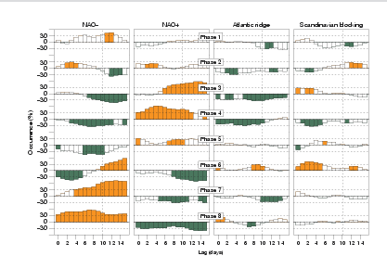
Impact over Europe
Cassou (2008)
Notes:
Slide 18: Lagged relationships between the eight phases of the MJO (rows) and the four North Atlantic weather regimes (columns) from ERA40. This figure shows a significant impact of some phases of the MJO on the NAO (see Cassou 2008)

Slide 19

The multi-scale organisation of tropical convection and its two-way interaction with the global circulation.
The NAO
The MJO
How large scale oscillations interact?
From Brunet, 2015
Notes:
Figure 19: Schematic of the impact of the MJO on the Extratropics. The NAO can also impact the MJO.

Slide 20
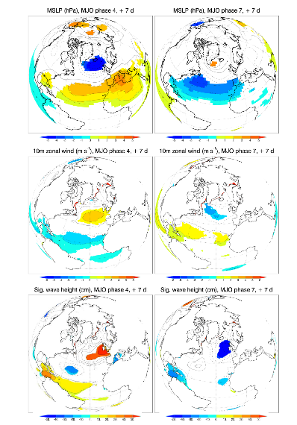
MJO impacts on Wave height
MJO-NAO teleconnection: modulates significant wave height in NE Atlantic
Marshall et al. 2015
Notes:
Slide 20: The top panels show composites of mean sea level pressure 7 days after an MJO in phase 4 (left panel) and 7 days after an MJO in phase 7 (right panel) using ERA Interim. The middle panel shows composites of 10 m wind from ERA Interim. The bottom panels show the composite of wave height anomalies from a wave model forced by ERA Interim. This panel suggests that the MJO can have an impact on wave height over the Atlantic, which suggests some potential predictability at this time range.

Slide 21
MJO Prediction

Slide 22
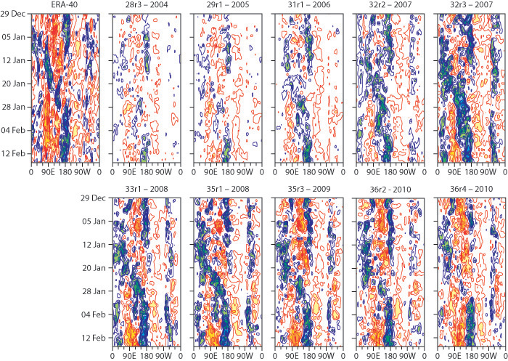
OLR anomalies - Forecast range: day 15
Notes:
Slide 22: Various versions of the IFS have developed increasing powers to foresee MJO behavior up to one month into the future. These attempts to simulate an actual MJO event (top left) 15 days in advance show the improvement in successive model iterations from 2004 (upper left) to 2010 (lower right). The model version is abbreviated at the top of each plot. Each plot is a Hovmöller diagram, a common way to show how atmospheric events evolve over time. The colors show outgoing long-wave radiation in the equatorial zone between 10°S and 10°N as it evolves over time (top to bottom of each plot). Red shading denotes warm anomalies in outgoing long-wave radiation (corresponding to the negative phase of the MJO, when convection is suppressed) and blue shading indicates cold anomalies (the convectively active phase of the MJO). The actual event at top left took place from December 29, 1992, to February 15, 1993.

Slide 23
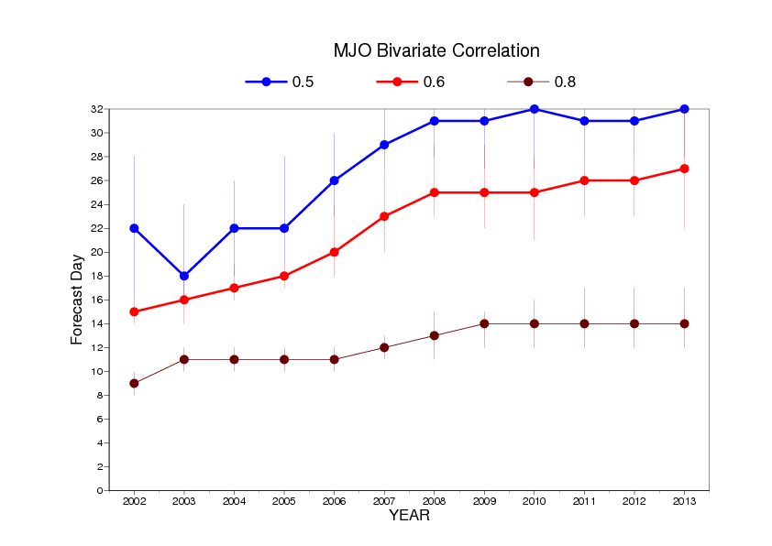
MJO skill scores
Notes:
Slide 23: ECMWF has produced monthly forecasts routinely since March 2002. This figure shows the evolution of MJO skill scores since 2002. The MJO skill scores (bivariate correlations) have been computed on the model hindcasts produced during a complete year. For instance, 2002 indicates the hindcasts that were produced from March 2002 until March 2003. 2011 corresponds to the hindcasts produced from March 2011 until March 2012. The blue line indicates the day when the MJO bivariate correlation reaches 0.5. The red line indicates the day when the MJO bivariate correlation reaches 0.6 and the brown line indicates the day when the MJO bivariate correlation reaches 08. This suggests that the MJO skill scores have significantly improved over the past 10 years. If we consider the 0.6 correlation as a measure of MJO predictability, then the gain is of about 9 days of predictability.

Slide 24
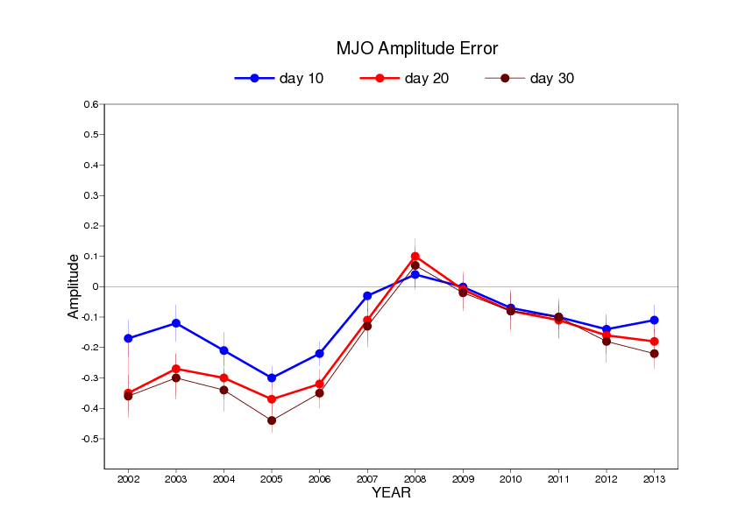
MJO amplitude
Notes:
Slide 24 ECMWF has produced monthly forecasts routinely since March 2002. This figure shows the evolution of MJO amplitude error since 2002. The mean MJO amplitude has been normalized by the amplitude of the MJO in ERA Interim. Negative values indicate that the MJO in the model is weaker than in re-analysis. Positive values indicate that the MJO in the model is stronger than in the re-analysis. For instance a value of -0.1 means that the MJO in the model is on average 10% weaker than in the re-analysis.

Slide 25
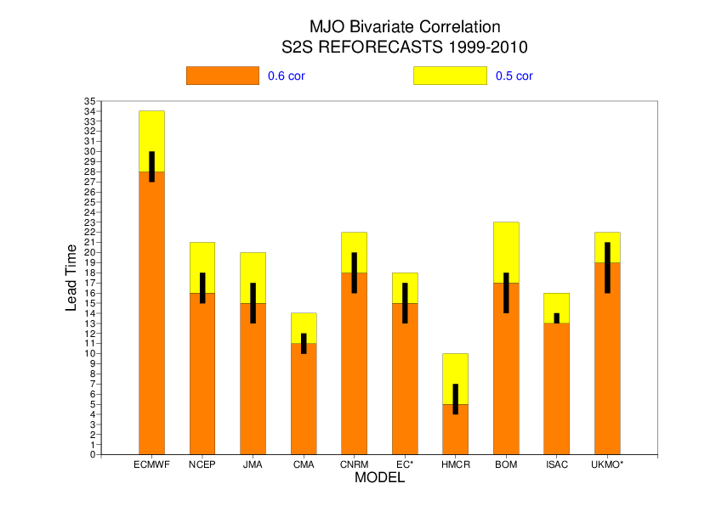
Notes:
Slide 25: MJO bivariate correlation between ensemble mean and ERA Interim. This plots shows a model intercomparison of MJO skill scores between 10 model re-forecasts from the S2S database. The re-forecast period is 1999-2010. The orange (yellow) bars indicate when the bivariate correlation reaches 0.6 (0.5). The black vertical bars represent the 95% level of confidence. This plot suggests that current state-of-the-art operational models have, on average, skill to predict the evolution of an MJO event up to 3 weeks.

Slide 26
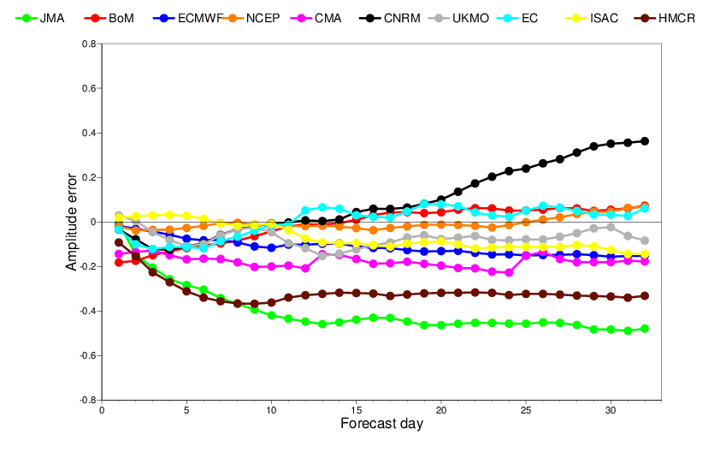
Amplitude error relative to ERA Interim
Notes:
Slide 26: MJO amplitude error relative to ERA interim as a function of forecast lead time. A positive (negative) value indicates an MJO stronger (weaker) than in ERA Interim. This plot suggests that most models produce a too weak MJO at the intra-seasonal time range.

Slide 27
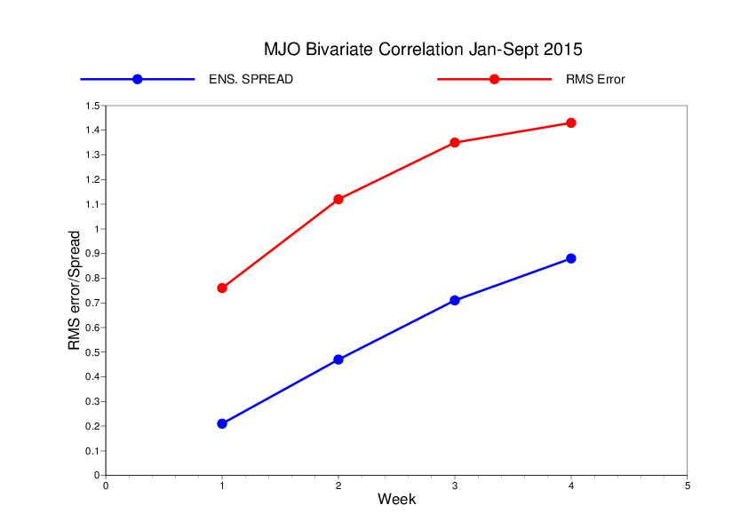
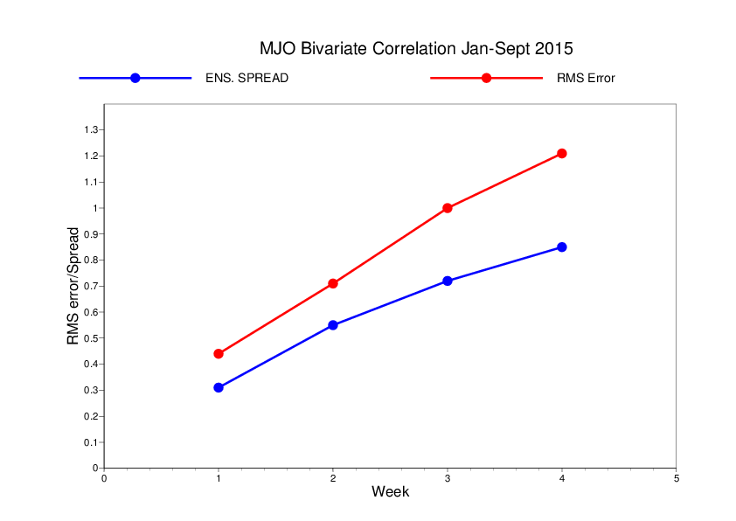
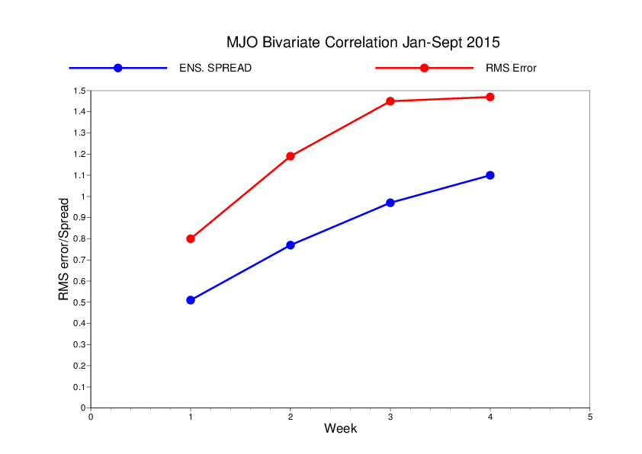
Spread/RMS error relationship - 2015
ECMWF
BoM
NCEP
Notes:
Slide 27: Weekly evolution of MJO RMS error and spread as a function of lead time (in weeks). The red curves corresponds to RMS error and the blue curve shows the ensemble spread. For the 3 models displayed, the ensemble spread is much smaller than the RMS error, which suggest a model spread too small for MJO prediction. In other words, the ensemble MJO forecast is over-confident.

Slide 28
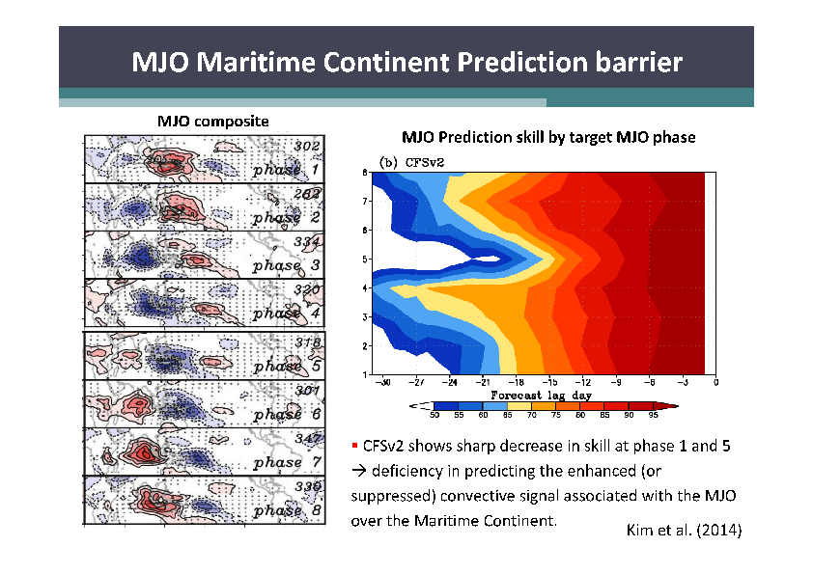
Year Of Maritime Continent - 2017
Notes:
Slide 28: Most models have difficulties propagating the MJO across the Maritime Continent. This slide shows that CFSv2 displays much lower skill to predict the MJO before an MJO in phase 5.

Slide 29
Impact of the MJO on precipitation
JJA
Notes:
Slide 29: Impact of the MJO on precipitation anomalies. The plots show the anomalies of precipitation anomalies composited over all the cases in phases 2+3, 4+5, 6+7 and 8+1 of the MJO in the model (left panel) and in the analysis (right panel). The orange colour indicates positive precipitation anomalies. The blue colour indicates negative precipitation anomalies. The model simulates well the impact of the MJO on precipitation anomalies, including the northward propagation of precipitation anomalies as the MJO moves eastward and the remote MJO impacts over Central America and Africa.

Slide 30
Impact on Tropical Cyclone Density (Summer)
Vitart, GRL 2009
Notes:
Slide 30: Impact of the MJO on tropical storm activity. The plots show the anomalies of tropical storm density composited over all the cases in phases 2+3, 4+5, 6+7 and 8+1 of the MJO in the model (left panel) and in the analysis (right panel). The model seems to represent very well the impact of the MJO on tropical cyclones.

Slide 31
Impact of the MJO on the N. Extratropics
2002 MOFC hindcasts
2012 MOFC hindcasts
ERA Interim
Notes:
Slide 31: Composites of Z500 10 days after an MJO in Phase 3, from the re-forecasts that were produced with the version of IFS that was operational in 2002 (left panel), the current operational cycle (middle panel) and verification from ERA Interim.

Slide 32
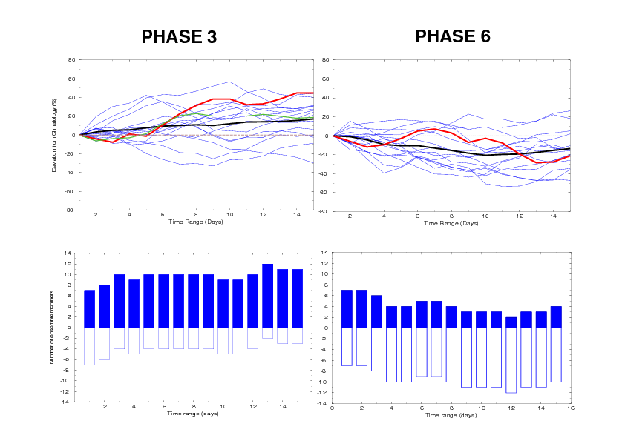
Weather Regimes : Impact of MJO on NAO+
Notes:
Slide 32: Evolution of NAO index anomalies 1in the 15 days following an MJO in phase 3 (left panels) or phase 6 (right panels). The red curve corresponds to ERA Interim. The solid black line corresponds to the ensemble mean.

Slide 33
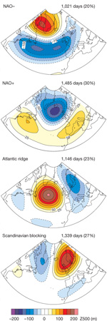

Impact on weather regimes in hindcasts
Phase3+10 days
Phase6+10 days
NAO-
NAO+
Atlantic ridge
Scandinavian blocking
Notes:
Slide 33: Lagged relationships between the eight phases of the MJO (rows) and the four North Atlantic weather regimes (columns) from ERA40. This figure shows a significant impact of some phases of the MJO on the NAO (see Cassou 2008)

Slide 34
T850 anomalies – NDJFM 1989-2008
Phase 3 + 10 days
Phase 6 + 10 days
ERA
MODEL
Degree C
Notes:
Slide: 34 Composites of T850 anomalies 10 days after an MJO in phase 3 (left panels) and phase 6 (right panels) for ERA Interim (tor panels) and model (bottom panels). This slide shows that the model capture relatively well the teleconnection patterns, but their amplitude is weaker than in ERA Interim.

Slide 35
Probabilistic skill scores – NDJFMA 1989-2008
Reliability Diagram
Probability of 2-m temperature in the upper tercile
Day 19-25
N. Extratropics
Europe
0.04
0.03
-0.06
-0.09
MJO in IC
NO MJO in IC
Notes:
Slide 35: Reliability of the probability that 2-metre temperature anomalies are in the upper tercile for the period day 19-25 for the Northern Extratropics (left panel) and Europe (right panel). The red (blue) line represents the reliability diagram obtained with all the cases with an MJO (no MJO) in the initial conditions. The numbers represent the Brier Skill Scores. Only land points have been included in the calculation of the reliability diagram and the Brier skill scores. This figure shows that the MJO has a major source of predictability for the time range day 19-25 in the ECMWF forecasting system.

Slide 36
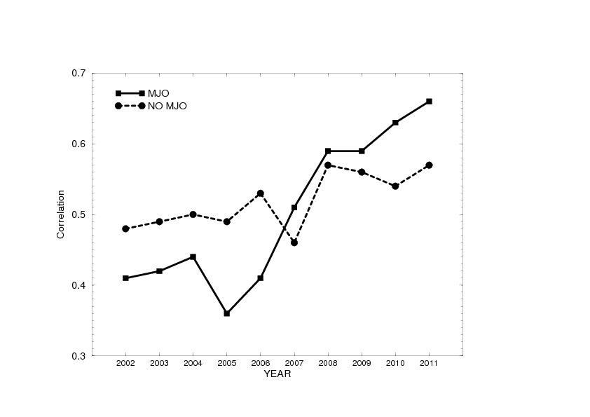
NAO skill scores – Day 19-25
Notes:
Slide 36: This panel shows the NAO forecast skill scores (correlations with analysis) as we separate the cases when there is a strong MJO in the initial conditions (solid black curve) and the cases when there is no MJO in the initial conditions (dotted curve). This suggests that the improved NAO prediction may come essentially from the improved prediction of the MJO.

Slide 37
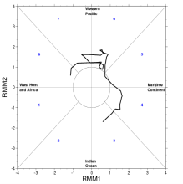
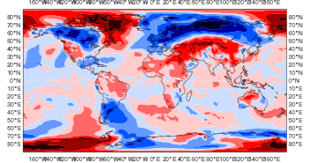
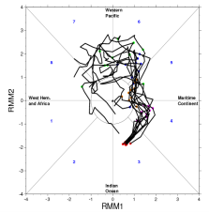
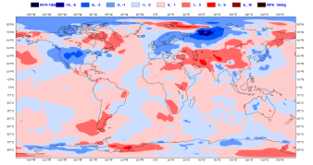
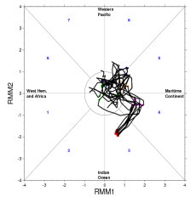
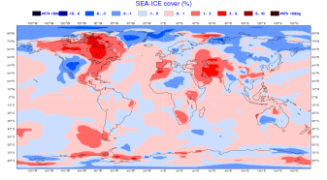
14 Feb 2013 -Day 26-32
Notes:
Slide 37: An example of MJO impact on the Northern Extratropical weather. March 2013 was exceptionally cold over western Europe and the northern part of Asia. This extreme event coincided with an MJO propagation in the western Pacific, which could explain the negative NAO which developed in that period and which is conducive to cold temperature anomalies over western Europe (see slide 24).
The ECMWF monthly forecast starting on 14 February 2013 was successful in predicting the onset of this event up to 4 weeks in advance, although the ensemble mean anomalies are weaker than the observed anomalies. To evaluate the impact of the MJO, a composite of the 10 ensemble members which predicted the strongest MJO event in the western Pacific (middle panel) and a composite of the 10 ensemble members which did not predict an MJO in the western Pacific (bottom panel) were produced. Results suggest that 10 ensemble members with the strongest MJO produced 2-meter temperature anomaly forecasts over the northern Extratropics consistent with analysis (top panel). On the other hand, the 10 ensemble members which did not predict the MJO event produced bad 2-metre anomaly forecasts over Europe. This result suggests that the MJO event played a key role in the successful prediction of the cold event over Europe.

Slide 38
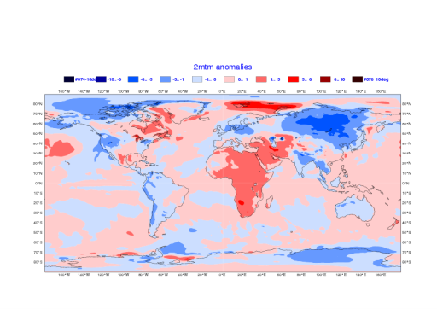
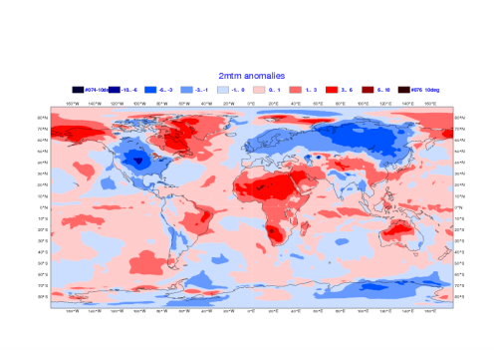
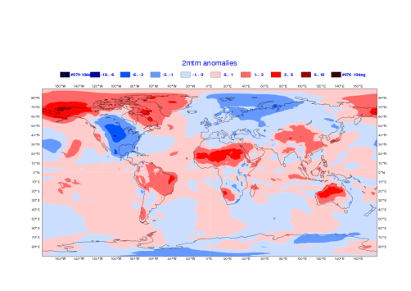

Control
Tropics relaxed to analysis
Analysis
Relax-Control
Notes:
Slide 38: Another way to demonstrate the impact of the Tropics on the extropical weather is to perform relaxation experiments. This slides shows the 2-metre temperature anomalies predicted by monthly forecast integrations starting on 14 February 2013 (same case as in the previous slide). The forecast time range is day 26-32. The top left panel shows 2-metre temperature anomalies produced by the ensemble mean forecasts at day 26-32. The top right panel shows the same forecast but from an experiment where the tropics (20S-20N band) have been relaxed towards analysis. The bottom left panel shows the verification produced from the operational analysis, and the bottom right panel shows the difference between the relaxation and the control experiments. This slide shows that the relaxation experiment produced a better forecast of the cold event over Europe.

Slide 39
Simulation of the MJO in climate models
Horizontal resolution: not important
Vertical resolution: positive impact
Air-sea coupling: Positive impact but not crucial
Convection scheme: crucial

Slide 40
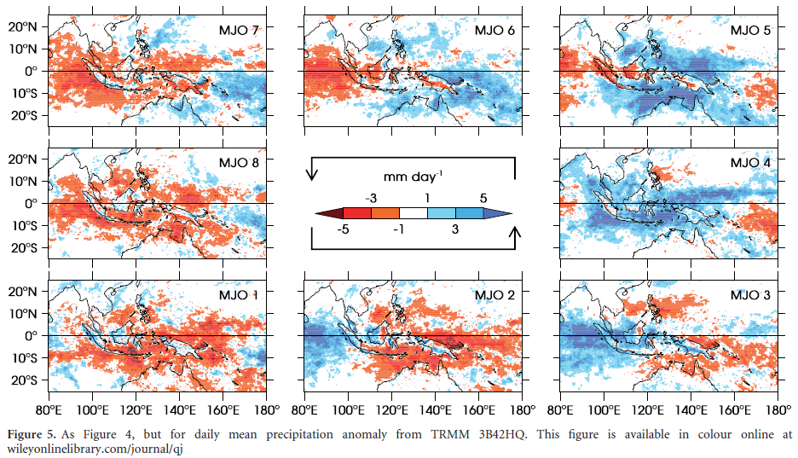
Peatman et al. (2013)
TRMM 3B42HQ rainfall, 1998-2012. Nov-Apr
When looking at multiple phase of the MJO, the pattern is shown to be more complicated, with a 'vanguard' of precipitation over the islands which jumps ahead of the main body of oceanic convection.
This does not happen for the MJO over the Indian Ocean.
Notes:
Slide 40: Precipitation anomalies over the maritime Continent as a function of MJO phase. This shows that the impact of the MJO on the precipitation over the maritime Continent is more complex than the RMMs suggest.
The precipitation anomalies over some islands can be out of phase with precipitation anomalies over sea (Peatman et al. 2013)

Slide 41
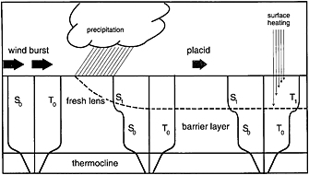
Air-sea Interaction
Notes:
Slide 41: Schematic illustration of barrier and mixed layer development: wind mixing homogenizes temperature (T0) and salinity (S0) to the thermocline depth; subsequent rainfall generates a less saline fresh lens (S1) and upper ocean stable layer (the mixed layer). Salinity stratification resists vertical mixing, and heating from solar radiation remains trapped in the upper ocean, leading to warming (T1) (Anderson et al. [[9]]

Slide 42
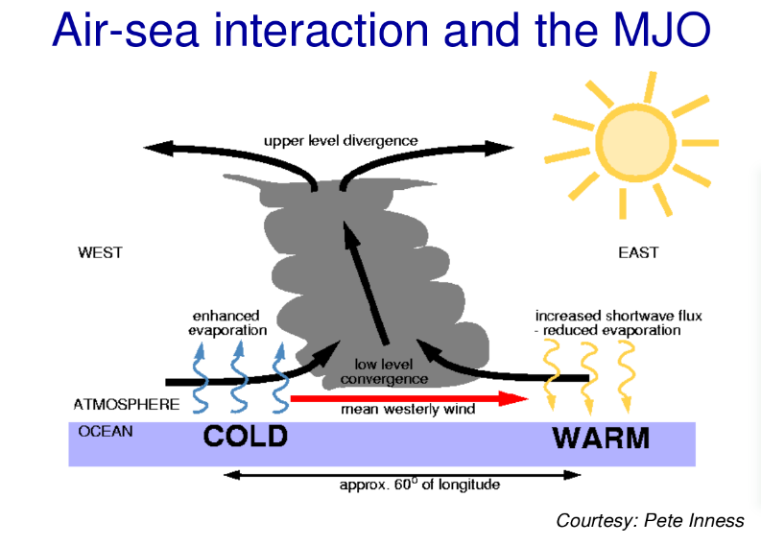
Air-sea Interaction
Notes:
Slide 42: SSTs warm ahead of the convection associated to the MJO event and cool behind. The warming of SSTs should enhance convection ahead of the current position of MJO and therefore help it more further eastward. This contributes to accelerate the propagation of the MJO.

Slide 43
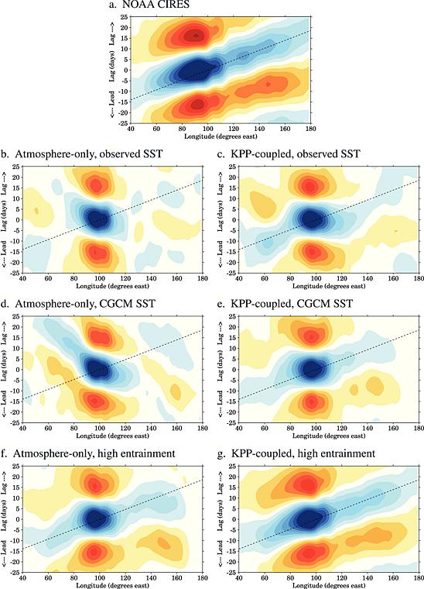
Klingaman and Woolnough 2014
Notes:
Slide 43: Lag regressions of 10°S–10°N averaged, 20–100 day bandpass-filtered OLR against the same at 100°E for (a) NOAA OLR (1989–2008) and (in Figures 15b–15g) 20 year simulations of MetUM GA3.0 (b) AGCM with climatological observed SSTs, (c) coupled to the KPP 1-D ocean model and constrained to observed climatological SSTs, (d) AGCM with climatological SSTs from the MetUM CGCM with the NEMO dynamical OGCM, (e) coupled to KPP and constrained to the MetUM CGCM SST, and (f, g) as in Figures 15b and 15c but with a 50% increase to the convective entrainment and detrainment rates. Adapted from Klingaman and Woolnough [2014, Figures 4 and 9].

Slide 44
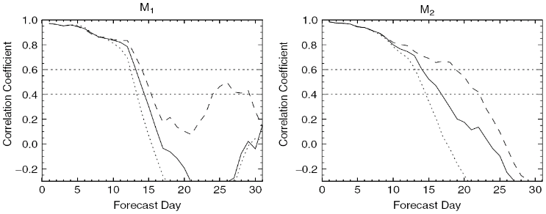
Improvement of MJO Skill with Ocean Coupling
CONT : solid line
ML : dashed line
PERS : dotted line
Woolnough et al. (2007,QJRMS)
Notes:
Figure 44: Correlation of the observed M1 and M2 time series with the ensemble mean forecast time series, based on 47 start dates, for the control experiment CONT (solid line), the mixed layer experiment ML (dashed line), and the persisted SST experiment PERS (dotted line). M1 and M2 are essentially equivalent to Wheeler and Hendon [2004] RMM1 and RMM2, but replace 200 hPa zonal wind with 200 hPa velocity potential. The horizontal dotted lines highlight threshold correlation values of 0.6 and 0.4 (Woolnough et al. [2007, Figure 5].

Slide 45
Impact of N. Extratropics on MJO forecast skill
Vitart and Jung
Notes:
Slide 45: Bivariate correlation (forecast skill) as a function of the forecast lead time: control integration (CNT, black), relaxation of the Northern Hemisphere extratropical towards initial conditions (red) and analysis data (blue). The shaded areas represent 5% level of confidence intervals computed using a bootstrap resampling technique. This slide suggests a significant impact of the Northern Extratropics on the MJO.

Slide 46
Impact of N. Extratropics on MJO forecast skill
North Atlantic
Eurasia
West Pacific
East Pacific
Notes:
Slide 46: Bivariate correlation (forecast skill) as a function of the forecast lead time: CNT (black) and relaxation experiments are in blue. The shaded areas represent 5% level of confidence intervals computed using a bootstrap resampling technique. Shown are the scores when the (a) North Atlantic region, (b) North Eurasia, (c) Northwest Pacific, and (d) Northeast Pacific are relaxed towards re-analysis. (from Vitart and Jung, 2010). This slide suggests that it is the northwest Pacific region which has the strongest impact on the MJO.

Slide 47
Conclusions
MJO is the main source of tropical variability between a week and a season
Global Impact of the MJO including over Europe. Main source of sub-seasonal predictability.
MJO prediction: success story – Significant improvement in the prediction of MJO over the past decade. Operational systems show predictive skill up to week 3
Importance of SST coupling, although not crucial
Extratropics can also impact MJO

