Slide 1
The Monthly Forecast system at ECMWF
Frédéric Vitart
European Centre for Medium-Range Weather Forecasts

Slide 2
Forecasting systems at ECMWF
ECMWF:
Weather and Climate
Dynamical Forecasts
Medium-Range
Forecasts
Day 1-10(15)
Extended range
Forecast
Day 10-46
Seasonal
Forecasts
Month 2-7
Product
Notes:
Slide 2: The monthly forecasting system fills the gap between two currently operational forecasting systems at ECMWF: medium-range weather forecasting and seasonal forecasting. Medium-range weather forecasting produces weather forecasts out to 15 days, whereas seasonal forecasting produces forecasts out to 7 months. The two systems have different physical bases. Medium-range weather forecasting is essentially an atmospheric initial value problem. Seasonal forecasting (2-7 months forecasts), on the other hand, is justified by the long predictability of the oceanic circulation (of the order of several months) and by the fact that the variability in tropical SSTs has a significant global impact on the atmospheric circulation.

Slide 3
10⁴
ENSO
ISO
Teleconnection
Stationary Rossby wave
Blocking
Monsoons
Synoptic
systems
Horizontal scale
10³
10²
S2S
Day Week Month Season Year
Time scale
Notes:
Slide 3: Forecast at different time scales predict different types of events. The sub-seasonal to seasonal time scale (more than 2 weeks and less than a season) is too long for the prediction of synoptic scale events at a give place and given time and too short for the prediction of ENSO. Therefore the main target of the ECMWF monthly forecasting system id the prediction of intraseasonal oscillation (MJO), teleconnections, stationary Rossby waves, weather regimes such as blockings.

Slide 4
Index
Use of monthly forecasts in applications
Main sources of predictability on the monthly time-scale
  Madden Julian Oscillation
  Soil Moisture
  Stratospheric Initial conditions
  Rossby waves
The ECMWF extended range forecast system
  Description
  Some examples of forecasts
  Skill
S2S database

Slide 5
Use of sub-seasonal forecasts in applications
Growing, and urgent, requirement for the employment of sub-seasonal predictions for a wide range of societal and economic applications which include:
Warnings of the likelihood of severe high impact weather (droughts, flooding, wind storms etc.) to help protect life and property
Humanitarian Planning and Response to disasters
Agriculture particularly in developing countries — e.g. wheat and rice production
Disease planning/control — e.g. malaria, dengue and meningitis
River-flow — for flood prediction, hydroelectric power generation and reservoir management for example

Slide 6
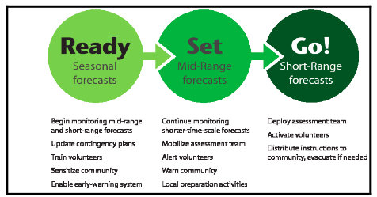
Opportunity to use information on multiple time scales
Red Cross - IRI example
Notes:
Slide 6: Sub-seasonal forecasts can be use in a multiple time scale framework like in this example from IRI-Red Cross. In this example, seasonal forecasts (READY) are used to get ready for a possible emergency situation, monthly forecasts (SET) are used to mobilize and warn the population. Short and medium range forecasts (GO) are used to take action.

Slide 7
Bridging the gap between Climate and weather prediction
A particularly difficult time range: Is it an atmospheric initial condition problem
as medium-range forecasting or is it a boundary condition problem as seasonal forecasting?
Some sources of predictability :
  Sea surface temperatures
  Land surface conditions: snow-soil moisture
  The Madden Julian Oscillation
  Stratospheric variability
  Atmospheric dynamical processes
  (Rossby wave propagations, weather regimes…)
  Sea ice cover –thickness ?
Notes:
Slide 7: The time range 10 to 30 days is a very difficult time range for weather forecasting. It is not clear if it is an atmospheric initial condition problem as medium-range weather forecasting or if it is a boundary condition problem as seasonal forecasting. Most likely, it is a combination of both. The time range 10 to 30 days is probably too long for the atmosphere to keep a memory of its initial conditions, and too long for the ocean variability to have an impact on the atmospheric circulation. Therefore, for a long time, it was assumed that there was almost no predictability in this time scale. However, two main sources of predictability in this timescale have been discovered in the recent years:
The Madden-Julian Oscillation (MJO)
- The impact of the stratosphere on the troposphere

Slide 8
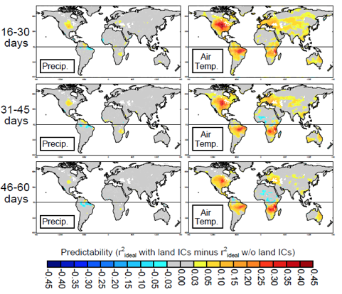
Impact of soil moisture
Koster et al, GRL 2011
Notes:
Slide 8: Impact of land moisture initialization on the skill of a multi-model ensemble to predict 2-metre temperature and precipitation anomalies for different time ranges (16-30 days, 31-45 days and 46-60 days).

Slide 9
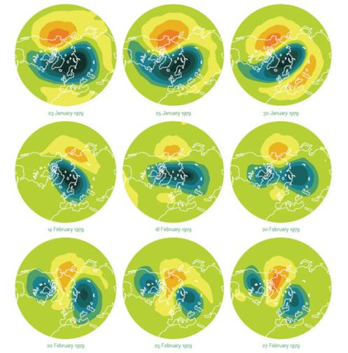
Sudden Stratospheric Warmings
Chui and Kunz, 2009
Notes:
Slide 9: A series of images shows the development of the first Stratospheric Sudden Warming monitored by satellite, in early 1979. As the air warms, the winds that normally circle the North Pole counterclockwise switch direction. The low pressure area over the pole, in blue, distorts and splits. These warming events may affect winter weather patterns on the ground. (Source: Chui and Kunz, 2009, symmetry).

Slide 10
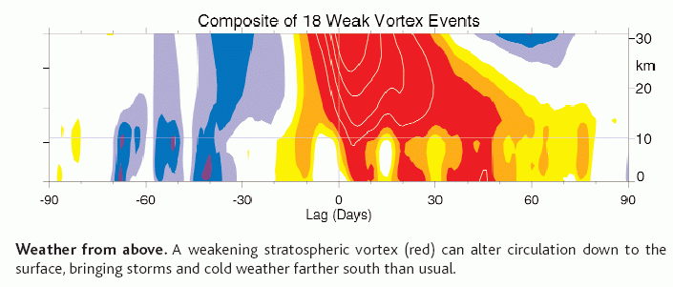
Stratospheric influence on the troposphere?
Baldwin and Dunkerton, 2001
Notes:
Slide 10: Baldwin et al. (2003) found that the stratospheric polar vortex varies relatively slowly compared to the tropospheric circulation, and that it has an impact on the troposphere. Slide 7 shows the vertical cross section of a composite of 18 weak vortex events as a function of time. This figure displays a propagation from the stratosphere to the lowest levels of the troposphere, well beyond 10 days. This suggests that there is predictability in the monthly timescale.

Slide 11
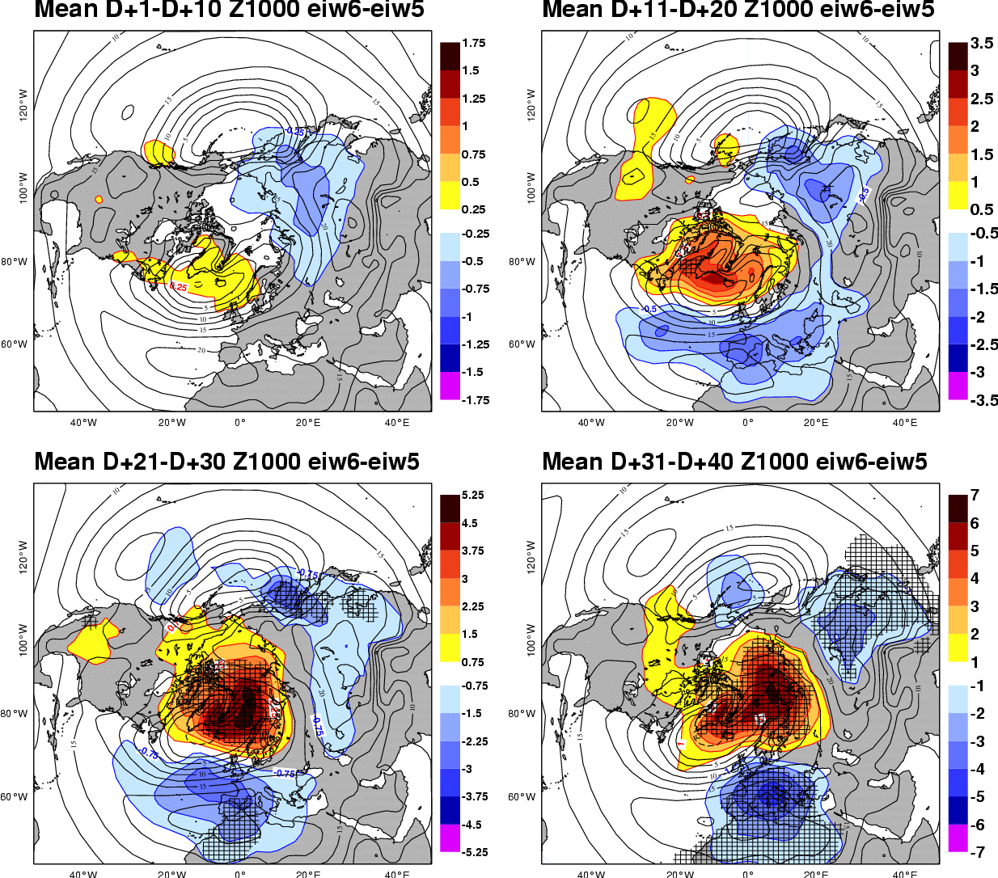
Z1000 Response
(Weak vortex-CTL)
Stratospheric influence on the troposphere?
Stratospheric influence on the troposphere?
D+1-D+10
D+11-D+20
D+21-D+30
D+31-D+40
From T. Jung et al 2005
Notes:
Slide 11: This slide shows the impact of the stratospheric forcing on the geopotential height at 1000 hPa in a GCM. Close to the surface, the largest and most statistically significant response is found in the north-eastern North Atlantic and parts of the Arctic, at least after more than 20 days in the integration.

Slide 12
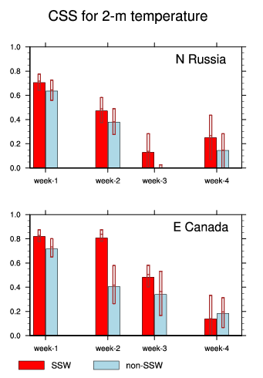
Impact of SSWs on skill scores
Impact of SSWs on forecast skill scores
From Tripathi et al. (2015)
Notes:
Slide 12: This plot shows the skill scores for week 1 to 4 from the ECMWF monthly forecasts when there is a sudden stratospheric warming in the initial conditions (red) and when there is no SSW in the initial conditions (blue) over North Russia (top panel) and East Canada (bottom panel). This plot shows that over some regions, SSWs can have a significant impact on the monthly forecast skill scores.

Slide 13
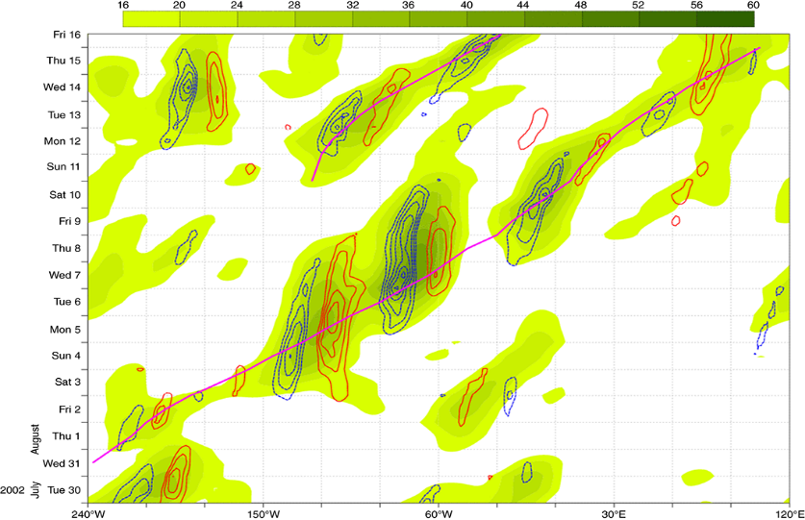
Rossby Wave Packets
Notes:
Slide 14: An example of the tracking procedure applied to the RWP linked to the flooding in central Europe in August 2002. The dashed/solid contours represent the v-component wind at 250 hPa plotted every 5 m s−1 starting from 15 m s−1 (red solid contours) and from −15 m s−1 (blue dashed contours). The shading refers to the WPA (in m s−1, starting from 16 m s−1 every 4 m s−1). Solid straight lines join the RWP centroid recognized by the automated tracking procedure. The x-axis shows the longitudes at 30° intervals, starting and ending respectively from 240 °W (120°E), corresponding to the East China Sea. (Grazzini and Vitart, 2015)

Slide 14
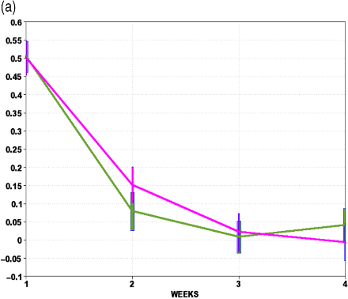
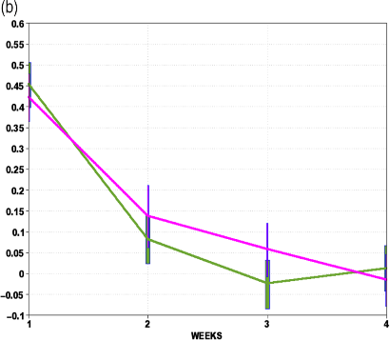
Rossby Wave Packets
Notes:
Slide 14: Ranked Probability Skill Score (RPSS) Z500 for weekly forecast ranges, stratified according to the presence of RWPs in initial conditions. The purple/lighter curves represent forecasts with RWPs in the initial conditions, the green/darker curves represents forecasts with no conditions. Bars show significance intervals at 90% level. In panel (a) the purple curve represents the skill of ENS 32-day real- time forecasts (2010–2012), starting with RWPs longer than 5 days. In panel (b) the purple curve is obtained with forecasts containing only RWP_pac_eu calculated over the enlarged sample of ENS re-forecasts (18 years of 5-member ensembles, 32-day forecasts once a week). (Grazzini and Vitart, 2015)

Slide 15

Pioneers in subseasonal predictions
Pioneering and challenging work of Miyakoda et al. (1983), Spar et al. (1976), Shukla (1981) opened the door for subseasonal predictions.
These studies
explored the predictability at a subseasonal
time-scale (beyond deterministic predictable
limit),
recognized that the subseasonal prediction
can be seen as an initial value problem with
external forcings (boundary value problem).
“Predictability In the Midst of Chaos” Shukla (1998), Palmer (1993)
Dr. Kikuro Miyakoda
Source: Princeton Univ. webpage
Miyakoda et at. (1983) Simulation of a blooking event in January 1977. MWR
Spar et al. (1976) Monthly mean forecast experiments with the GISS model. MWR
Spar et al. (1978) An initial state perturbation experiment with the GISS model. MWR
Shukla (1981) Predictability of time averages. Part I. Dynamical predictability of monthly means. JAS

Slide 16
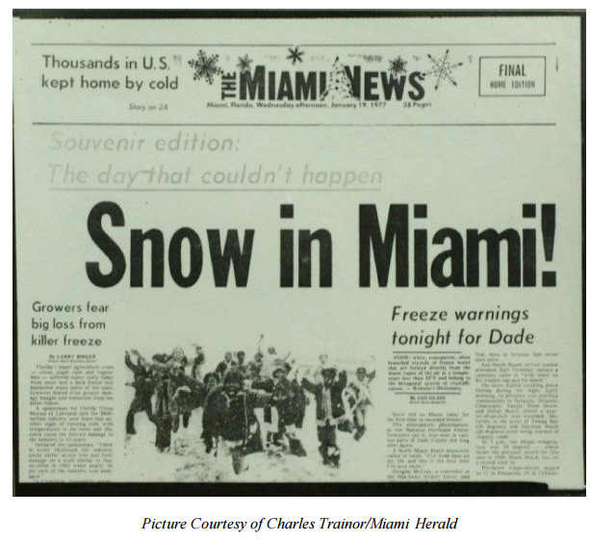
January 1977
Source: NOAA/NWS
http://www.srh.noaa.gov/images/mfl/news/SnowSouthFlorida35th.pdf

Slide 17
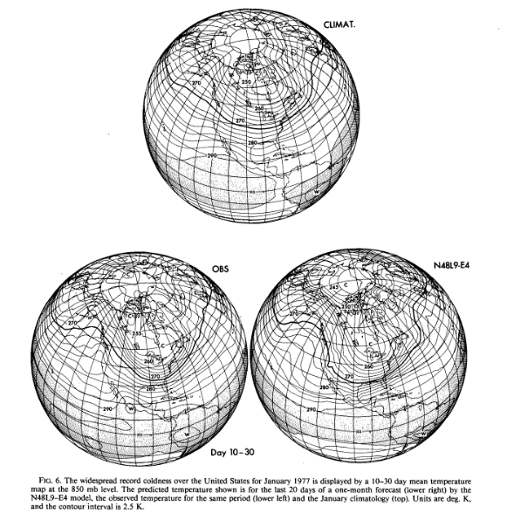
January 1977
T850 Forecast (Day10-30)
Miyakoda et al. 1983
Notes:
Slide 17: First (successful) monthly forecast produced by Miyakoda in the early 1980s. This plot shows that the GFDL model predicted well the extreme weather cold event over the US in January 1977 which led to snow in Miami.

Slide 18
ECMWF monthly forecasts
A 51-member ensemble is integrated for 46 days twice a week (Mondays and Thursdays at 00Z)
Atmospheric component: IFS with the latest operational cycle and with a Tco639L91 resolution up to day 15 and Tco319L91 after day 15.
Ocean-atmosphere coupling from day 0 to NEMO (about 1 degree) every 3 hours.
Initial conditions:
Atmosphere: Operational 4-D var analysis + SVs+ EDA perturbations
Ocean: 3D-Var analysis (NEMOVAR) + wind stress perturbations
Notes:
Slide 18: Description of the ensemble forecasting system. Twice a week, the coupled model is integrated forward to make a 32 day forecast with 51 different initial conditions, in order to create a 51-member ensemble.

Slide 19
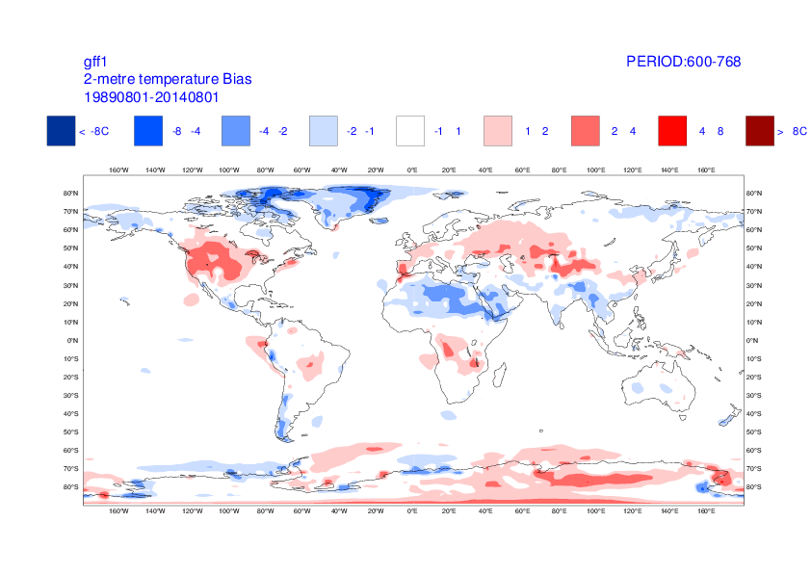
Biases (eg 2mT as shown here) are often comparable in magnitude to the anomalies which we seek to predict
Notes:
Slide 19: Example of model biases for week 4 (day 26-32). The magnitude of the bias is of the same order of magitude as the anomalies we try to predict.
Therefore the model needs calibration.

Slide 20
The ENS re-forecast suite to estimate the M-climate
… 28 6 2 5 May 9 12
51
Tco639
L91
51
Tco319
L91
2016
11
11
2015
11
11
11
11
11
11
11
11
Initial conditions:
ERA Interim+
ORAS4 ocean Ics+
Soil reanalysis
Perturbations:
SVs+EDA(2016)+SPPT+SKEB
11
11
2014
11
11
11
11
20y
11
11
11
11
11
11
2013
11
5
11
11
11
11
11
11
…..
11
11
1996
11
11
11
11
11
11
11
11
Notes:
Slide 20: Model climatology: An 11 member ensemble is run starting the same day and month as the real-time but over the past 20 years. The ECMWf monthly forecasts are calibrated by using 3 consecutive sets of re-forecasts. In total this represents a 660-member ensemble which is compared to the 51-member real-time ensemble.

Slide 21
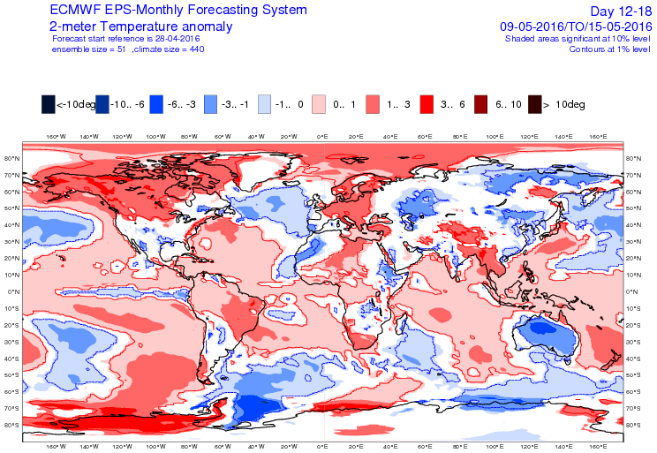
The ECMWF monthly forecasts
Anomalies (temperature, precipitation..)
-
Notes:
Slide 21: Anomaly maps are similar to seasonal forecasting charts, but with weekly means instead of monthly means. Over each point of the map, atmospheric variables such as 2-metre temperature, total precipitation, mean sea-level pressure or surface temperature, have been averaged over a weekly period and also over the 51 members of the real-time forecast and the 660 members of the back statistics. The plots display the difference between the ensemble mean of the real-time forecast and the ensemble mean of the back-statistics. The product therefore displays the shift of the forecast ensemble mean from the estimated "climatological" mean (created from ensemble runs over the past 20 years). In addition, a Wilcoxon-Mann-Whitney test (WMW-test, see for instance Wonacott and Wonacott 1977) has been applied to estimate whether the ensemble distribution of the real-time forecast is significantly different from the ensemble distribution of the back-statistics. Regions where the WMW-test displays a significance less than 90% are blank. Regions where the WMW-test displays a significance exceeding 95% are delimited by a solid contour (blue or red depending on whether the anomaly is positive or negative respectively). The blanking of "non-significant" shifts does not mean that there is no signal in the blanked regions, but only that, with the particular sampling we have, we cannot be sure that there is a signal. For this reason, there are likely to be many areas where a signal is real but remains undetected.

Slide 22
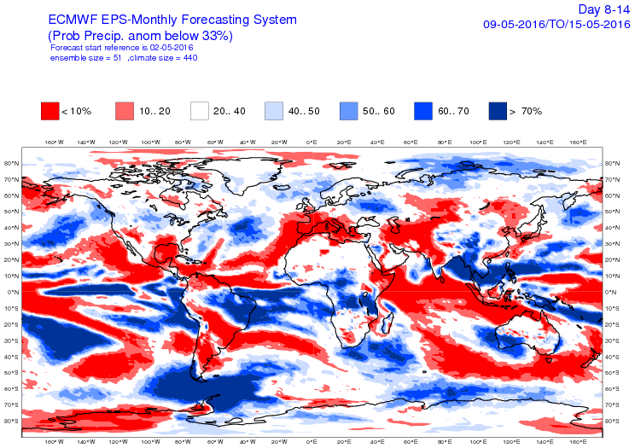
The ECMWF monthly forecasts
Probabilities (temperature, precipitation..)
-
Notes:
Slide 22: Probability and tercile maps are also produced. An example of tercile map for the period day 15-21 is displayed on this slide.

Slide 23
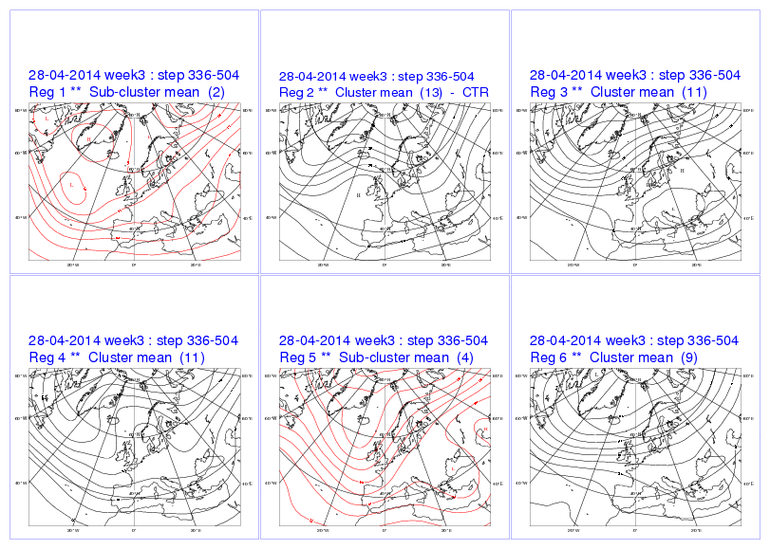
The ECMWF monthly forecasts
Notes:
Slide 23: This product displays the patterns computed by averaging all the ensemble members that are attributed to six pre-defined patterns computed for the Atlantic/Europe region (see ECMWF Technical Memorandum 317). The red plots corresponds to clusters with at least one member but less than 5 members.

Slide 24
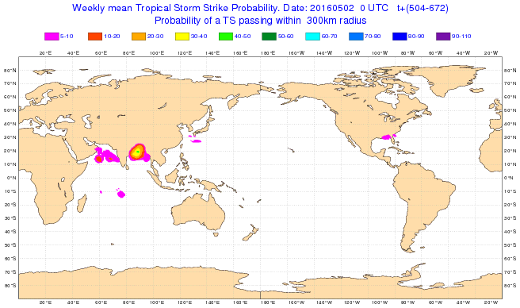
Tropical cyclone activity
The ECMWF monthly forecasting system
Notes:
Slide 24: Forecast of tropical cyclone activity. This plot shows the probability of tropical storm strike within 300 km predicted by the monthly forecast starting on 2 May 2016and for the period day 22-28.

Slide 25
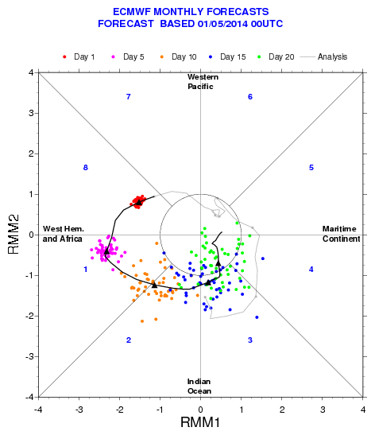
MJO Forecasts
Notes:
Slide 25: An example of real-time MJO forecast. The grey line represents the evolution of the MJO over the past 30 days. The black lines represents the ensemble mean forecast. Each dot represents the position of the MJO at day 1,5,10,15,20 in the PC1/PC2 phase space. See slides 15 and 16 for more details.

Slide 26
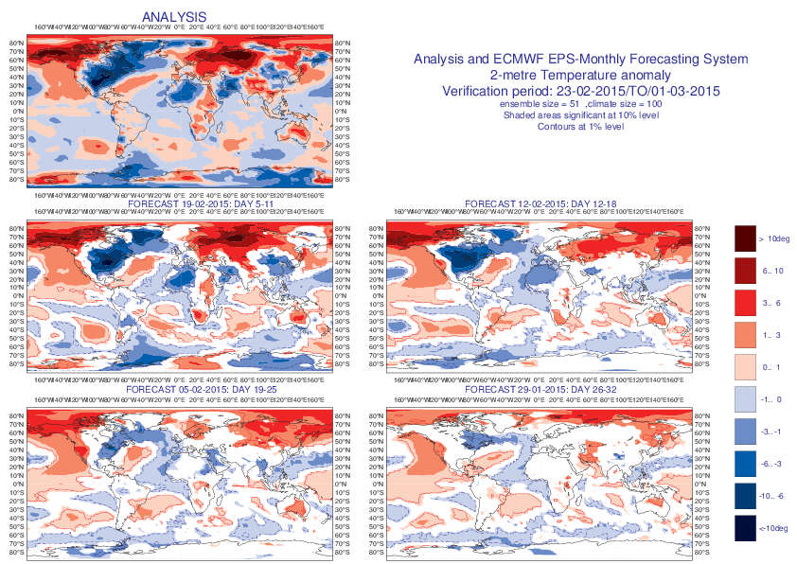
ECMWF Extended-range forecasts
Notes:
Figure 26: Example of verification of weekly mean anomalies. The top left panel represents the verification form ERA Interim. The 4 lower panels show the forecasts starting one week apart and verifying the same week as the top panel. Therefore they represent different time ranges: day 5-11, 12-18, 19-25 and 26-32.

Slide 27
Precip anomalies : 26 July 2010 – 01 August 2010
Notes:
Slide 27: Prediction of the Pakistan flooding in 2010. The top left panel shows the precipitation anomalies during the week 26/07/2010-01/07/2010 computed rom the operational analysis. The other panels show the ensemble mean precipitation anomalies from the ECMWF monthly forecasts for the time ranges: day 5-11, day 12-18 and day 19-25. This figure suggests that this event was predicted three weeks in advance.

Slide 28
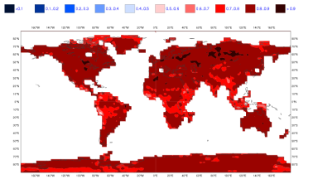
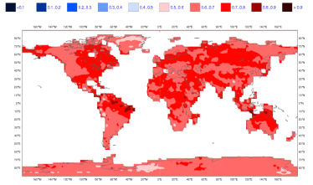
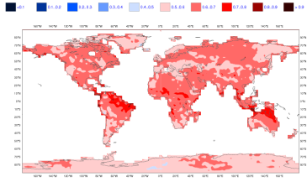
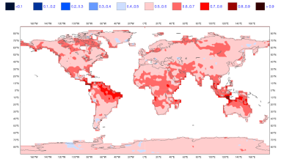
Skill of the ECMWF Monthly Forecasting System
ROC score: 2-meter temperature in the upper tercile
Day 5-11
Day 12-18
Day 19-25
Day 26-32
Notes:
Slide 28: Maps of ROC scores of the probability that 2-meter temperature averaged over the period day 12-18 is in the upper tercile. Only the scores over land points are shown. The terciles have been defined from the model climatology. The verification period is Oct 2004-May 2008. Red areas indicate areas where the ROC score exceeds 0.5 (better than climatology). This plot shows that the coupled model performs better than climatology for the period days 12-18.
For the period days 19-26, the skill is much lower than for days 12-18, as expected. The red is largely dominating overall, suggesting that the model generally performs better than climatology at this time scale. Europe seems to be a difficult region, with very low skill at this time range. Tropical regions display the strongest skill after 30 days, suggesting that the coupled model at this time range starts to behave more like seasonal forecasting.

Slide 29
Skill of the ECMWF Monthly Forecasting System
2-meter temperature in upper tercile - Day 12-18
ROC score
Reliability diagram
Persistence of day 5-11
Day 12-18
Monthly forecast day 12-18
Day
19-25
Persistence of day 5-18
Monthly forecast day 19-32
Notes:
Slide 29: The toughest test for monthly forecasting is a comparison with the persistence of the medium-range forecasts. The top left plot shows the ROC diagram obtained with the monthly forecasting system for days 12-18 (red) and the persistence of the probabilities of days 5-11 (blue). The event is the probability that 2-meter temperature is in the upper tercile. The top right panel represents the reliability diagram of the monthly forecast for day 12-18 (blue line) and persistence of day 5-11 (red line). This slide demonstrates that the monthly forecast of days 12-18 performs better than persisting the medium range forecast, and therefore can be useful. The difference is statistically significant according to WMW test. This result is also valid for all the other variables and other probabilistic events. It can be concluded that the model show some skill over the northern Extratropics at this time range.
The bottom panels show the same figures for the time range day 19-32 and the persistence of day 5-18.

Slide 30
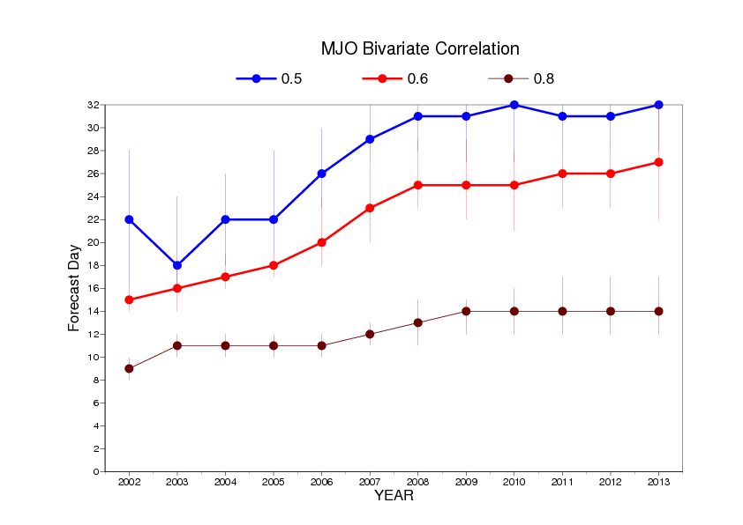
MJO skill scores
Notes:
Slide 30: ECMWF has produced monthly forecasts routinely since March 2002. This figure shows the evolution of MJO skill scores since 2002. The MJO skill scores (bivariate correlations) have been computed on the model hindcasts produced during a complete year. For instance, 2002 indicates the hindcasts that were produced from March 2002 until March 2003. 2011 corresponds to the hindcasts produced from March 2011 until March 2012. The blue line indicates the day when the MJO bivariate correlation reaches 0.5. The red line indicates the day when the MJO bivariate correlation reaches 0.6 and the brown line indicates the day when the MJO bivariate correlation reaches 08. This suggests that the MJO skill scores have significantly improved over the past 10 years. If we consider the 0.6 correlation as a measure of MJO predictability, then the gain is of about 9 days of predictability.

Slide 31
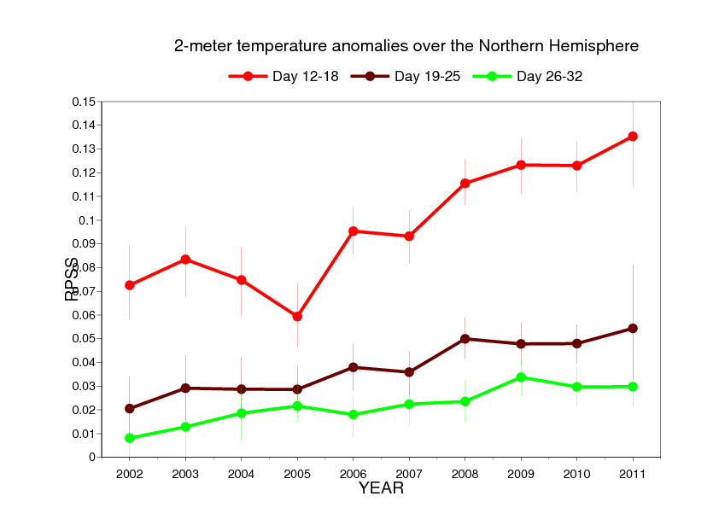
Performance of the monthly Forecasts
2-metre temperature ROC area over Northern Extratropics
Day 12-18
Day 19-25
Day 26-32
Notes:
Slide 31: Evolution of the skill (ROC area of 2-metre temperature) of the monthly forecasting system year by year since 2002 (ROC area of the probability that 2-metre temperature anomaly is in the upper tercile). There has been an improvement in the skill of the monthly forecasting system since 2002. The skill for day 19-25 is now close to the skill of the day 12-18 in 2002.

Slide 32
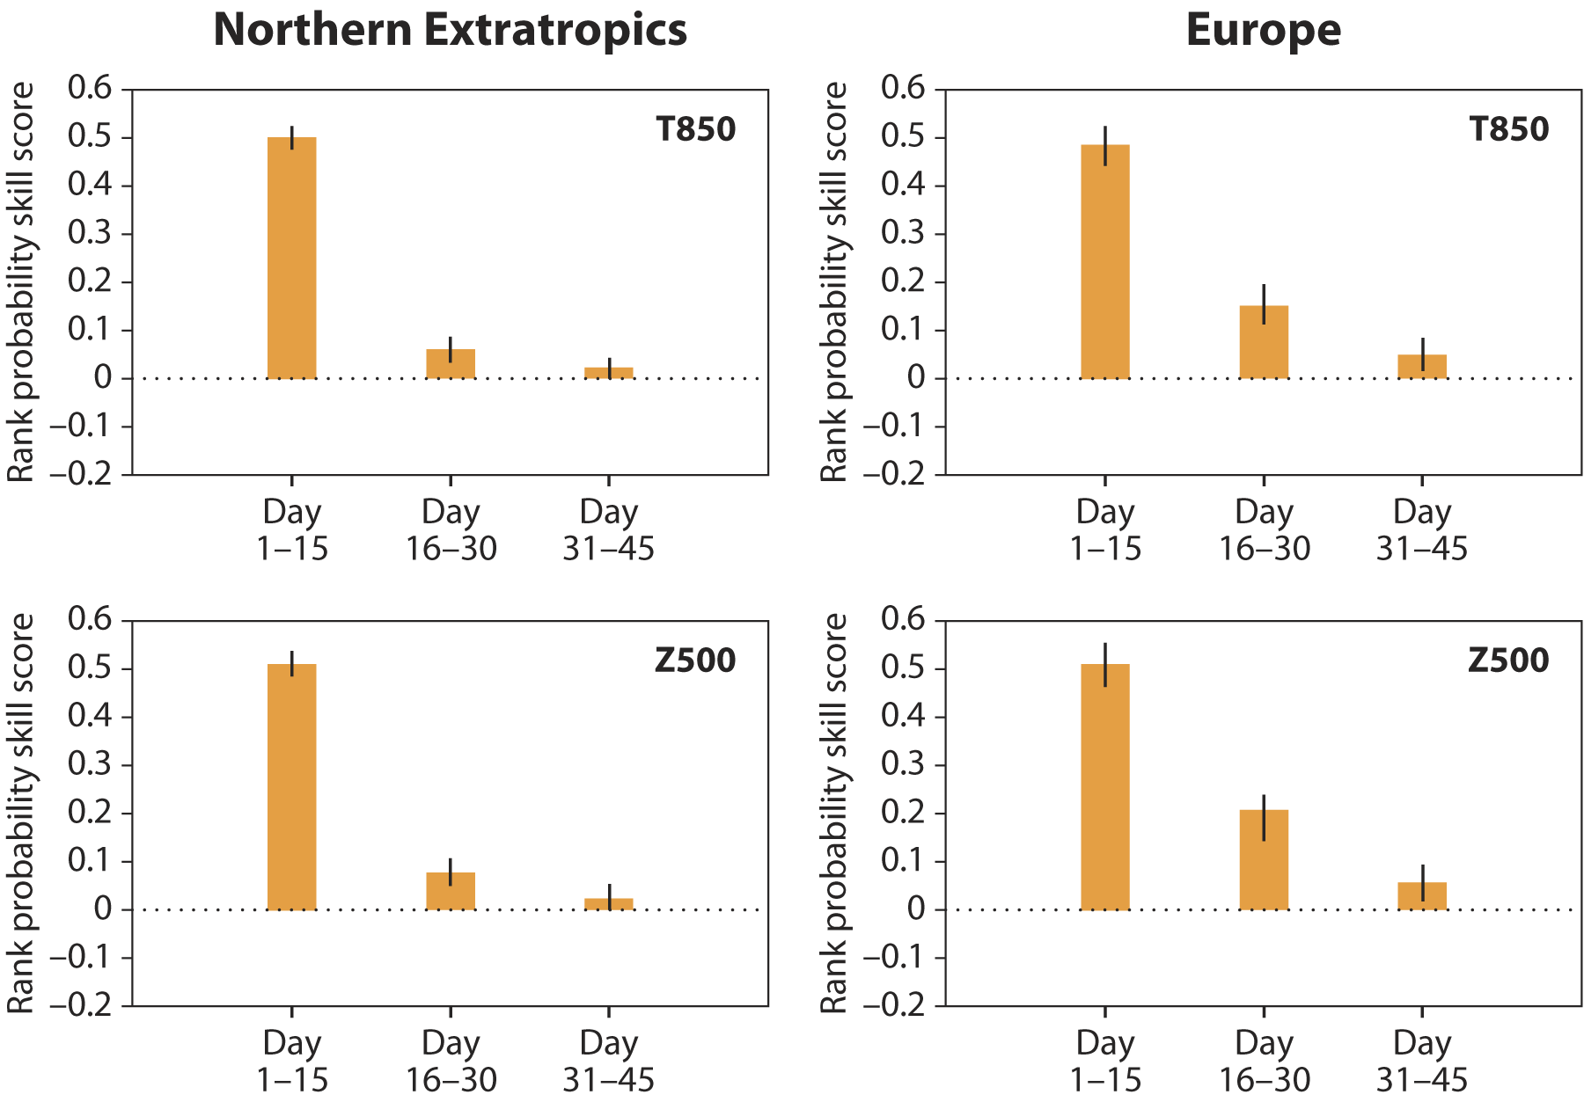
Extension to 46 days
80 case, starting on 1st Feb/May/Aug/Nov 1989-2008
Notes:
Slide 32: Ranked Probability Skill Score (RPSS) of temperature at 850 hPa (top panel) and Geopotential height at 500 hPa (bottom panel) over Europe for day 1-15, 16-30 and 31-45. This plot shows that there is skill for Day 31-45 over Europe (RPSS statistically significantly positive).

Slide 33
Future Model Changes

Slide 34
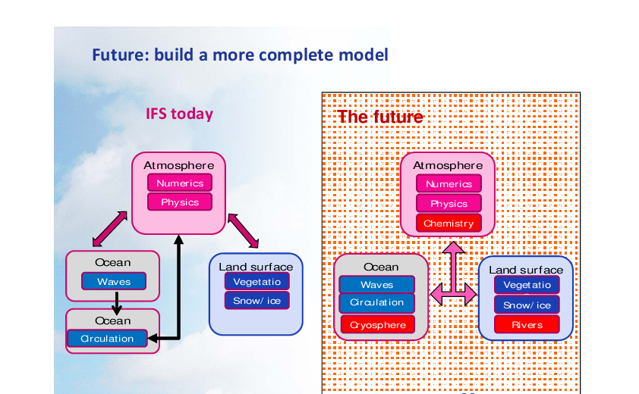
Notes:
Slide 34: In order to produce better forecasts we need to take into account more physical processes which are currently not simulated in the ECMWF forecasting system. These processes include: chemistry, cryosphere, rivers..

Slide 35
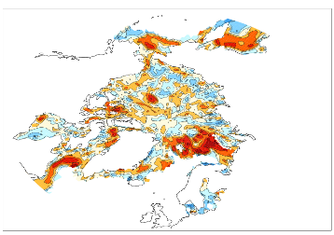
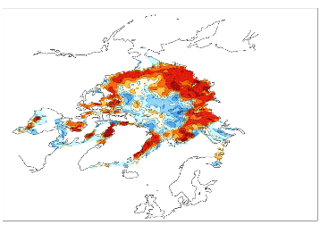
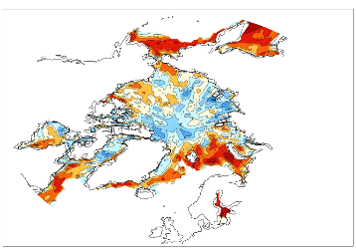
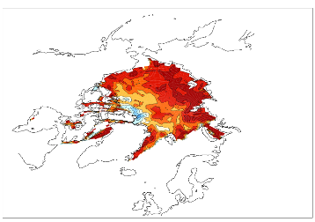

Correlations for week 4
Northern Hemisphere
Winter Summer
Current system
With sea-ice model
(LIM2)
Notes:
Slide 35: Grid point correlation map between the sea-ice cover predicted by the monthly forecast at week 4 and ERA Interim for winter months (left panel) and summer months (right panel). The top panel are produced from the current forecasting system (sea ice is persisted from initial conditions up to day 15 and then relaxed towards the past 5-year climatology). The bottom panel shows the anomaly correlations when using an active sea ice model (LIM2). Scores are generally higher in the bottom panels than in the top panels.

Slide 36
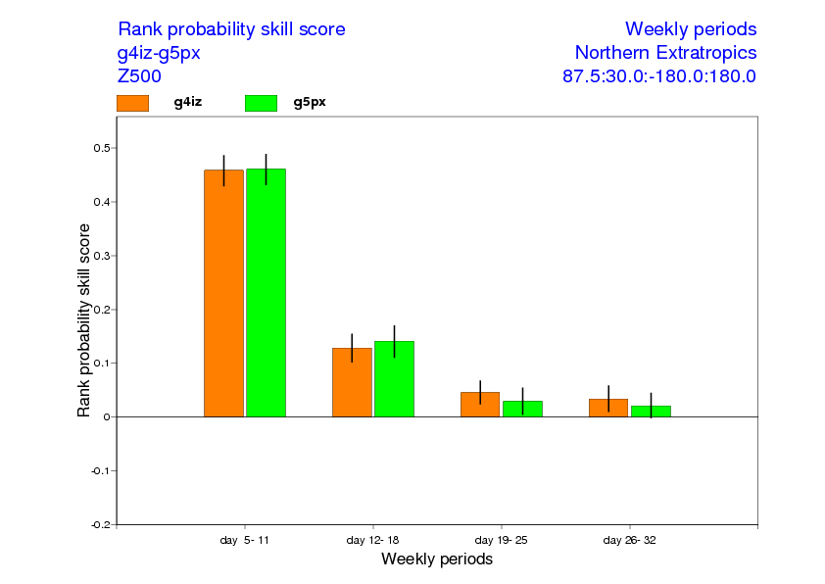
Active sea ice model: Z500 Forecast Skill (weeks 1-4)
SEA ICE
Control
80 cases – The vertical bars represent the 95% level of confidence
Notes:
Slide 36: Ranked Probabilistic skill scores of Z500 over Europe for week 1 to 4. The orange bars represent the RPSS obtained when there is an active sea ice model (LIM2) and the green bars represent the RPSS with the current monthly forecasts (persisted sea-ice cover followed by relaxation towards climatology).

Slide 37
WWRP-WCRP sub-seasonal to seasonal prediction Project (s2S)
“To improve forecast skill and understanding on the sub-seasonal to seasonal timescale with special emphasis on high-impact weather events”
“To promote the initiative’s uptake by operational centres and exploitation by the applications community”
“To capitalize on the expertise of the weather and climate research communities to address issues of importance to the Global Framework for Climate Services”

Slide 38
S2S database
Daily real-time forecasts + re-forecasts
3 weeks behind real-time
Common grid (1.5x1.5 degree)
Variables archived: about 80 variables including ocean variables, stratospheric levels and soil moisture/temperature
Archived in GRIB2 – NETCDF conversion available
Database to open in 2015, initially with 3 models (ECMWF, NCEP and JMA)
Notes:
Slide 37:WMO has set up a new project on sub-seasonal to seasonal prediction called S2S. An important deliverable of this project is the establishment of a database containing sub-seasonal forecasts (up to day 60) from 11 centres. The data is available 3 weeks behind real-time and re-forecasts is also be archived.

Slide 39
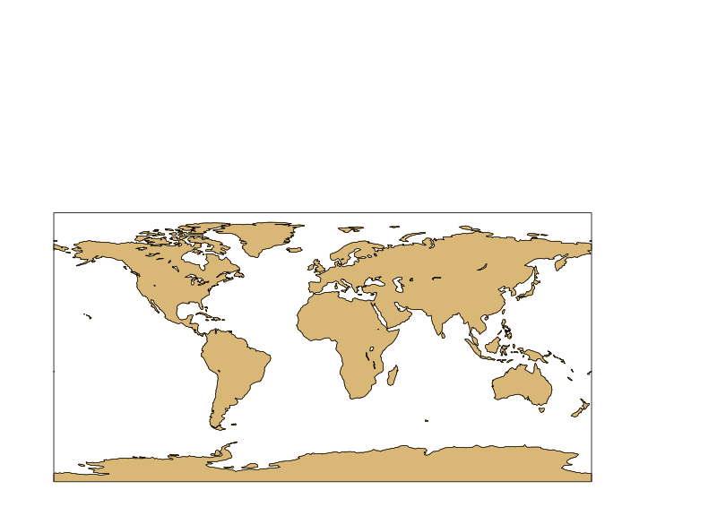
S2S Database
11 data providers and 2 archiving centres
Data provider
Archiving centre
ECMWF
UKMO
HMCR
EC
KMA
NCEP
CNR
Météo
France
JMA
CMA
CAWCR
Notes:
Slide 37: Circles indicate the 11 data providers. Red dots indicate the 2 archiving centres (CMA and ECMWF).

Slide 40
S2S partners
 | Time-range | Resol. | Ens. Size | Freq. | Hcsts | Hcst length | Hcst Freq | Hcst Size
ECMWF | D 0-46 | T639/319L91 | 51 | 2/week | On the fly | Past 20y | 2/weekly | 11
UKMO | D 0-60 | N216L85 | 4 | daily | On the fly | 1996-2009 | 4/month | 3
NCEP | D 0-44 | N126L64 | 4 | 4/daily | Fix | 1999-2010 | 4/daily | 1
EC | D 0-32 | 0.6x0.6L40 | 21 | weekly | On the fly | 1995-2014 | weekly | 4
CAWCR | D 0-60 | T47L17 | 33 | weekly | Fix | 1981-2013 | 6/month | 33
JMA | D 0-34 | T319L60 | 25 | 2/weekly | Fix | 1981-2010 | 3/month | 5
KMA | D 0-60 | N216L85 | 4 | daily | On the fly | 1996-2009 | 4/month | 3
CMA | D 0-45 | T106L40 | 4 | daily | Fix | 1886-2014 | daily | 4
CNRM | D 0-32 | T255L91 | 51 | Weekly | Fix | 1993-2014 | 2/monthly | 15
CNR-ISAC | D 0-32 | 0.75x0.56 L54 | 40 | weekly | Fix | 1981-2010 | 6/month | 1
HMCR | D 0-63 | 1.1x1.4 L28 | 20 | weekly | Fix | 1981-2010 | weekly | 10
Notes:
Slide 38: Description of the sub-seasonal forecasting systems contributing to the S2S database.

Slide 41
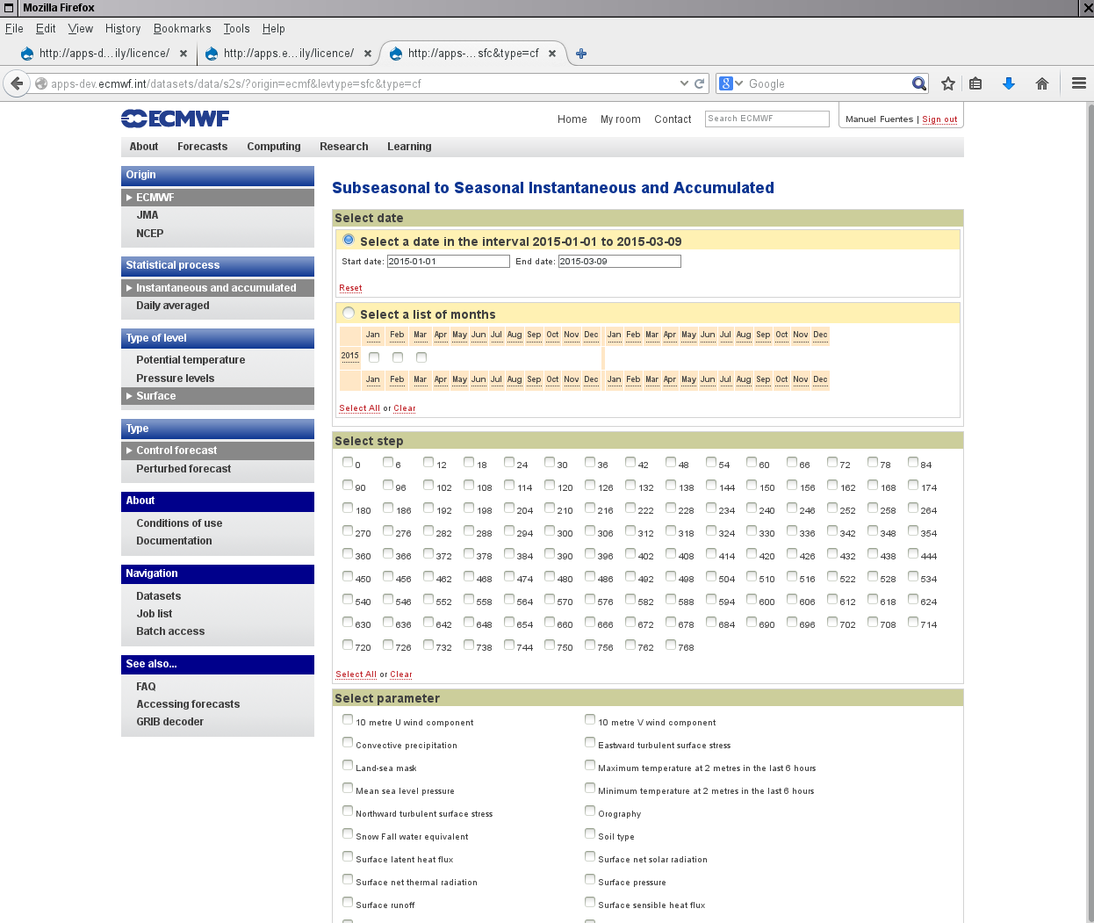
http://apps.ecmwf.int/datasets/data/s2s/levtype=sfc/type=cf/
Notes:
Slide 39: ECMWF S2S data server.

Slide 42
S2S Database current status
Open access to researchers from ECMWF (since May 2015) and CMA (since Nov 2015). Subset of data also available from IRI. Data from nine data providers:
    ECMWF, NCEP, JMA, BoM, CMA, Météo-France, HMCR, ISAC and UKMO
    Total size of the database: 37.7 Tbytes:
    - real-time: 5 Tbytes
    - re-forecast: 32.6 Tbytes
Plans
  End of 2016: all 11 Data Providers
  Add new ocean sub-surface and sea-ice variables
  Compute and archive indices such as MJO RMMS, SSW index, Weather regimes, Tropical storm tracks, Monsoon indices to be available for the research community from ECMWF and IRI servers.

Slide 43
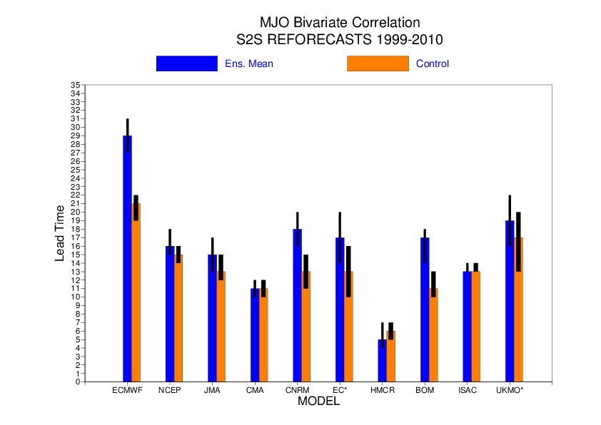
Bivariate Correlation – Ensemble vs control
Notes:
Slide 42: MJO skill scores in the S2S re-forecasts for the ensemble mean (blue bars) and control run (orange bars).

Slide 44
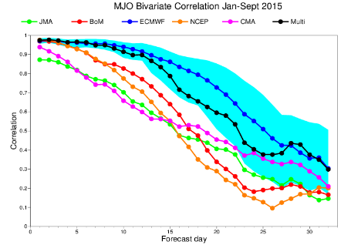
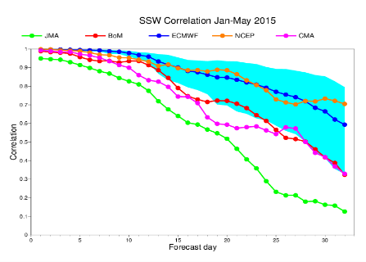
S2S verification – S2S real-time forecasts

Slide 45
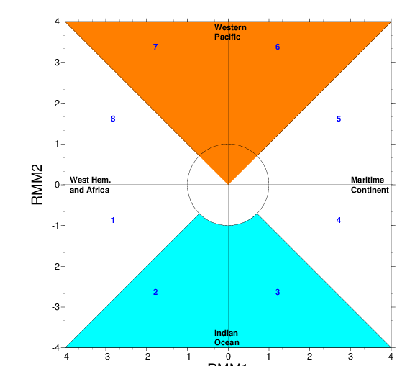
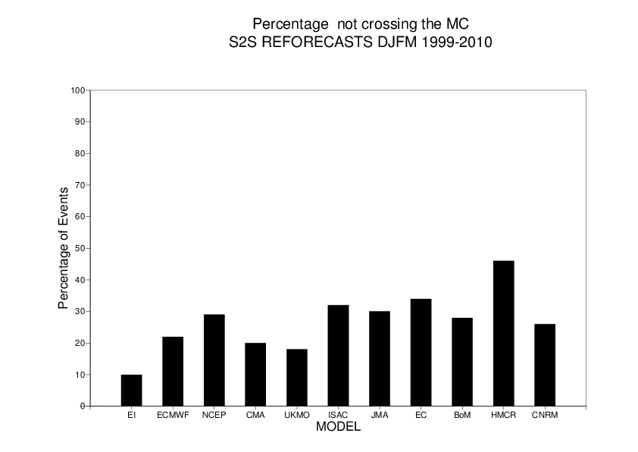
MC crossing
Day 1-30
IC
Notes:
Slide 43: Percentage of MJO events which do not cross the Maritime continent. The proportion is much high in all the model than in ERA Interim.

Slide 46
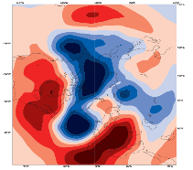
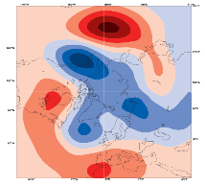
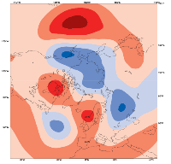
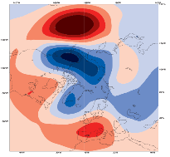
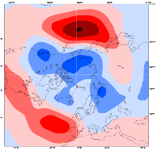
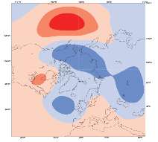
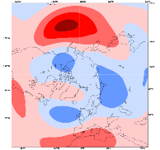
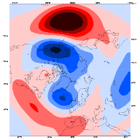
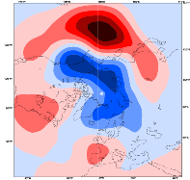
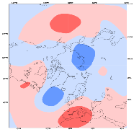
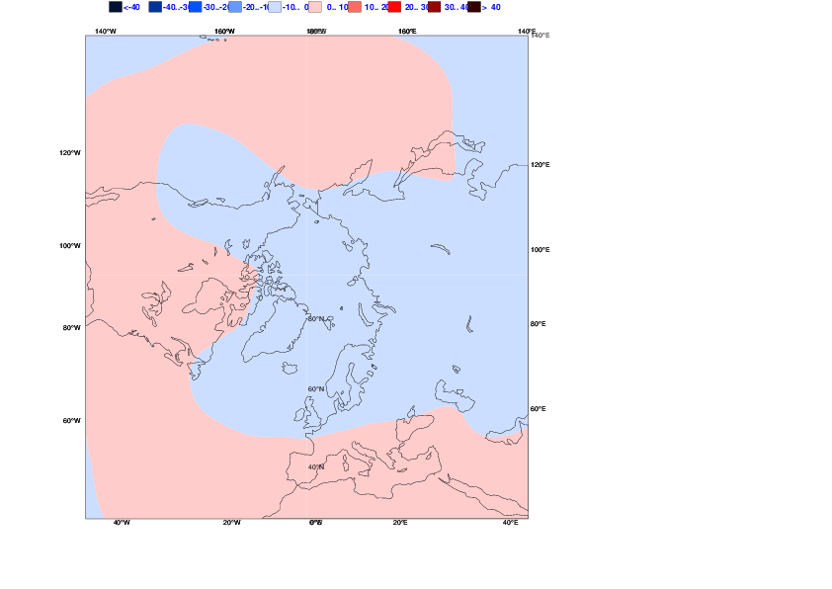
Z500 anomalies 10 days after an MJO in Phase 2-3
MJO Teleconnections (S2S re-forecasts)
ONDJFM 1999-2010
Analysis
ECMWF
JMA
NCEP
ISAC
BoM
CNRM
EC
UKMO
CMA
Notes:
Slide 44: Z500 composite 10 days after an MJO in Phase 3. The S2S models represent generally well the pattern of the MJO teleconnections, but the amplitude is too strong over the North Pacific and the impact on the NAO is too weak in the models.

Slide 47
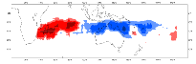
























Modulation of tropical cyclone density anomaly by MJO
MJO Phase 2-3
MJO Phase 4-5
MJO Phase 6-7
MJO Phase 8-1
OBS
ECMWF
NCEP
JMA
BoM
Multi
Notes:
Modulation of TC activity by the MJO. The plots show the anomaly of TC density as a function of MJO phase for 5 different S2S models and the multi-model combination for the time range day 10-32. The figure shows a remarkable agreement with observations and suggest that all the model simulate very well the modulation of TCs by the MJO. This is an encouraging result for TC prediction

Slide 48


Tropical Cyclone Pam case study
Multi-model prediction of TC strike probability anomalies- 9-15 March 2015
(NCEP/ECMWF/BoM/JMA/CMA)
2015/02/19 day 19-25
2015/02/26 day 12-18
Notes:
PAM case study: Tropical cyclone strike (within 300 km) probability anomaly (relative to model climatology) for the forecasts starting on 19 February 2015 (left panel) and 26 February 2016 (right panel) and verifying on 9-15 March 2015. During the 9-15 March 2015, Pam, the strongest tropical cyclone of the season, hit Vanuatu (black dot on the map) with devastating consequences.
The multi-model forecasts (combination of NCEP/ECMWF/BoM/JMA and CMA) shows an increased risk of tropical storm strike in the area of Vanuatu at both time ranges.
In fact the anomaly map is consistent with the impact of an MJO event (in this case it was the strongest MJO event on record) on TC density. During the week the MJO active phase was over the west Pacific, which is consistent with less TC activity over the Indian ocean and more TC activity over the western pacific, and the possibility of twin TC genesis (over the northern and Southern hemisphere). The model seems able to predict the increased risk of a twin TC.

Slide 49
Conclusion
SSTs, Soil moisture, stratospheric initial conditions and MJO are sources of predictability at the intra-seasonal time scale. The MJO has a significant impact on the forecast skill scores beyond day 20.
The monthly forecasting system produces forecasts for days 12-18 that are generally better than climatology and persistence of day 5-11. Beyond day 20, the monthly forecast is marginally skilful. For some applications and some regions, these forecasts could however be of some interest.
There has been a clear improvement in the monthly forecast skill scores since 2002. This improvement is likely to be related to improved prediction in the Tropics and most especially improved MJO prediction.
S2S database is now available. It is an important tool to better identify model’s sources of predictability and teleconnections.

