Slide 1
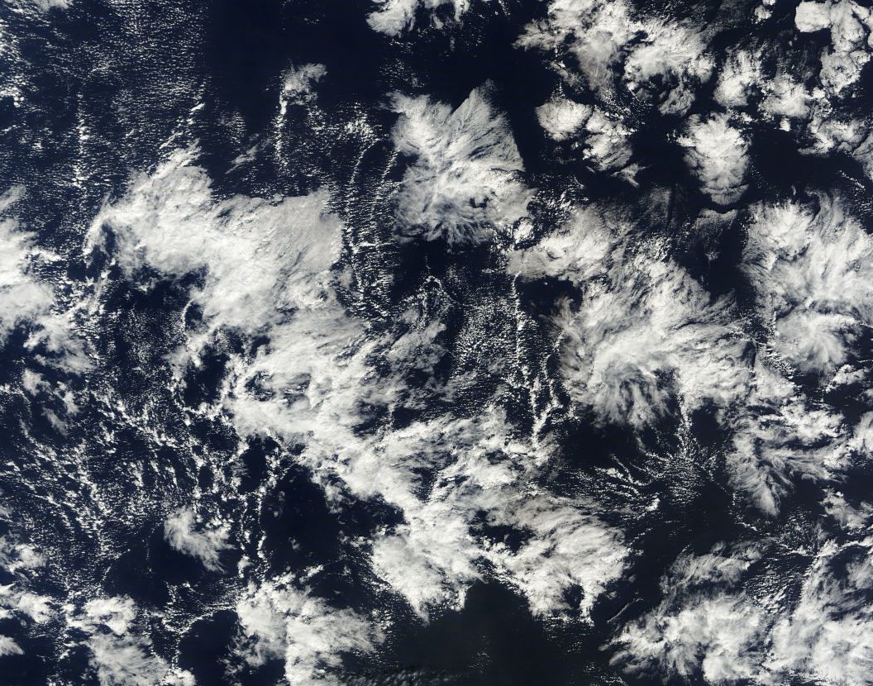
Numerical Weather Prediction Parametrization of Subgrid Physical Processes
Clouds (3)
Sub-grid Cloud Cover
(or “Sub-grid heterogeneity of cloud and humidity”)
Richard Forbes
(With thanks to Adrian Tompkins and Christian Jakob)
forbes@ecmwf.int

Slide 2
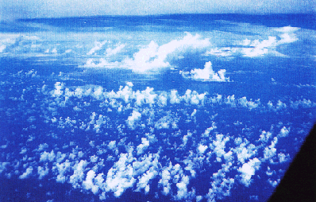
Clouds in GCMs:
Representing sub-grid heterogeneity
Many of the observed clouds and especially the processes within them are of subgrid-scale size (both horizontally and vertically)
GCM Grid cell 10-300km

Slide 3
Clouds in GCMs:
Representing sub-grid heterogeneity
Many heterogeneity assumptions across the model parametrizations…
Radiation
Convection
Boundary layer turbulent mixing
Cloud scheme
Surface Exchange
Notes:
Parametrizations traditionally compartmentalized BL turbulence-convection-microphysics – all sub-grid cloud
Important for radiation (reflection, absorption, emission)

Slide 4
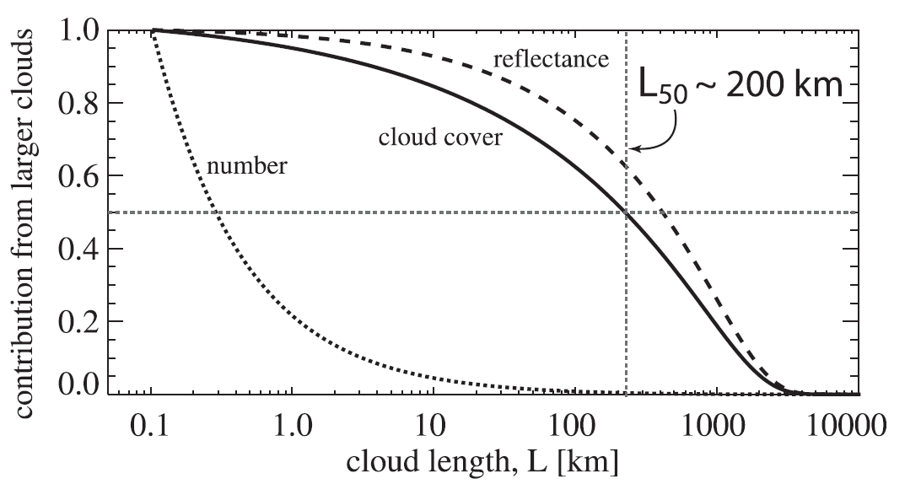
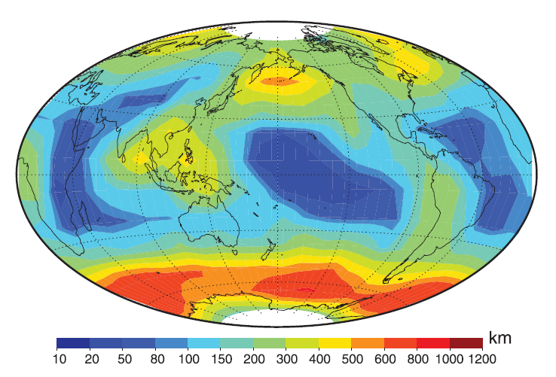
Why represent heterogeneity?
Important scales of cloud cover & reflectance
Contribution to global cloud cover (solid),
number (dotted) and SW reflectance (dashed) from clouds with chord lengths greater than L
(based on MODIS, aircraft and NWP data).
50% of cloud cover is from clouds with scale > 200 km
85% of cloud cover is from clouds with scale > 10 km
15% of cloud cover is from clouds with scale < 10 km
Map of the cloud size for which 50% of cloud cover comes from larger clouds (from 2 years of MODIS data)
Larger scales dominate mid-latitude storm tracks
Small scales dominate over subtropical ocean
(from Wood and Field 2011, JClim)
Notes:
ECMWF Training Course
02 May 2000
Moist Processes
In Wood and Field (2011) conclusion, “In addition, over much of the globe, clouds larger than typical numerical weather prediction and even climate model grid boxes tend to constitute the majority of the cloud cover. This makes one wonder about whether the target for subgrid cloud parameterization scheme development should be the correct distribution of condensate as opposed to better prediction of cloud fractional coverage.”

Slide 5
Why represent heterogeneity?
Important for microphysics
Imagine a cloud with condensate mass q_{l} and cloud fraction C
The in-cloud mass mixing ratio is q_{l} /C
C small
C large
GCM grid box
precipitation not equal in each case since
cloud-to-rain autoconversion is nonlinear
Complex microphysics perhaps a wasted effort if assessment of cloud fraction C is poor!
In addition, in-cloud condensate heterogeneity should also be represented, i.e. not all the cloud is precipitating?

Slide 6
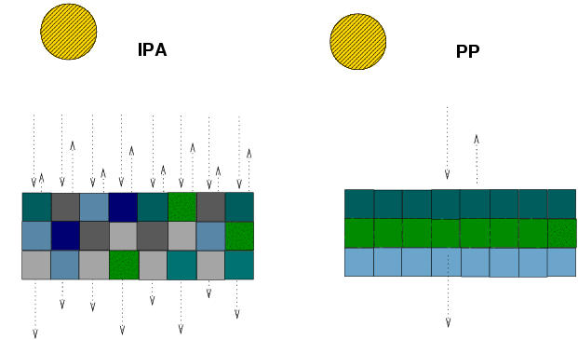
Why represent heterogeneity?
Important for radiation
Assuming homogeneity can lead to biased radiative calculations (e.g. Cahalan et al. 1994, Barker et al 1996).
Monte Carlo Independent Column Approximation, for example, can treat the inhomogeneity of in-cloud condensate and vertical overlap in a consistent way between the cloud and radiation schemes
Independent Column Approximation, e.g. MCICA
Traditional approach (homogeneous)

Slide 7
Macroscale Issues of Parameterization
VERTICAL COVERAGE
Most models assume that this is 1
This can be a poor assumption with coarse vertical grids
(e.g. in climate models)
z
~500m
~100km
x

Slide 8
Macroscale Issues of Parameterization
HORIZONTAL COVERAGE, C
Spatial arrangement ?
z
~500m
~100km
x

Slide 9
Macroscale Issues of Parameterization
Vertical overlap of cloud
Important for radiation and microphysics interaction
z
~500m
Maximum overlap
Random overlap
~100km
x

Slide 10
Macroscale Issues of Parameterization
In-cloud inhomogeneity
in terms of cloud water, particle size/number
z
~500m
~100km
x

Slide 11
Macroscale Issues of Parameterization
Just these issues can become very complex!!!
z
~500m
~100km
x

Slide 12
First: Some assumptions!
q_{v} = water vapour mixing ratio
q_{c} = cloud water (liquid/ice) mixing ratio
q_{s} = saturation mixing ratio = F(T,p)
q_{t} = total water (vapour+cloud) mixing ratio
RH = relative humidity = q_{v} / q_{s}
Local criterion for formation of cloud: q_{t} > q_{s}
  This assumes that no supersaturation can exist
Condensation process is fast (cf. GCM timestep)
q_{v} = q_{s} q_{c}= q_{t} – q_{s}
!!Both of these assumptions less applicable in ice clouds!!

Slide 13
Partial cloud cover
Homogeneous distribution of water vapour and temperature:
q_{t}
Note in the second
case the relative humidity=1 from our assumptions
x
One Grid-cell
Partial coverage of a grid-box with clouds is only possible if there is an inhomogeneous distribution of temperature and/or humidity.

Slide 14
Heterogeneous Distribution of T and q
cloudy=
q_{t}
RH=1
RH<1
x
Another implication of the above is that clouds must exist before the grid-mean relative humidity reaches 1.

Slide 15
Heterogeneous Distribution of q only
cloudy
q_{t}
RH=1
RH<1
x
The interpretation does not change much if we only consider humidity variability
Throughout this talk I will neglect temperature variability
Analysis of observations and model data indicates humidity fluctuations are more important most of the time.

Slide 16
Simple Diagnostic Cloud Schemes:
Relative Humidity Schemes
q_{t}
RH=60%
x
Take a grid cell with a certain (fixed) distribution of total water.
At low mean RH, the cloud cover is zero, since even the moistest part of the grid cell is subsaturated
1
C
0
RH
60
80
100

Slide 17
Simple Diagnostic Cloud Schemes:
Relative Humidity Schemes
q_{t}
RH=80%
x
1
Add water vapour to the gridcell, the moistest part of the cell become saturated and cloud forms. The cloud cover is low.
C
0
RH
60
80
100

Slide 18
Simple Diagnostic Cloud Schemes:
Relative Humidity Schemes
q_{t}
RH=90%
x
1
Further increases in RH increase the cloud cover
C
0
RH
60
80
100

Slide 19
Simple Diagnostic Cloud Schemes:
Relative Humidity Schemes
RH=100%
q_{t}
x
The grid cell becomes overcast when RH=100%,due to lack of supersaturation
Diagnostic RH-based parametrization C =f(RH)
1
C
0
RH
60
80
100

Slide 20
Diagnostic Relative Humidity Schemes
Many schemes, from the 1970s onwards, based cloud cover on the relative humidity (RH)
e.g. Sundqvist et al. MWR 1989:
1
C
0
RH
60
80
100
Remember this for later!
RH_{crit} = critical relative humidity at which cloud assumed to form
(= function of height, typical value is 60-80%)

Slide 21
Diagnostic Relative Humidity Schemes
Since these schemes form cloud when RH<100%, they implicitly assume subgrid-scale variability for total water, q_{t}, (and/or temperature, T).
However, the actual PDF (the shape) for these quantities and their variance (width) are often not known.
They are of the form: “Given a RH of X% in nature, the mean distribution of q_{t} is such that, on average, we expect a cloud cover of Y%”.

Slide 22
Diagnostic Relative Humidity Schemes
Advantages:
  Better than homogeneous assumption, since clouds can form before grids reach saturation.
Disadvantages:
  Cloud cover not well coupled to other processes.
  In reality, different cloud types with different coverage can exist with same relative humidity. This can not be represented.
Can we do better?

Slide 23
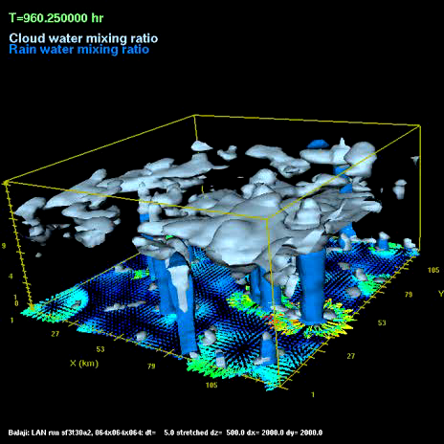
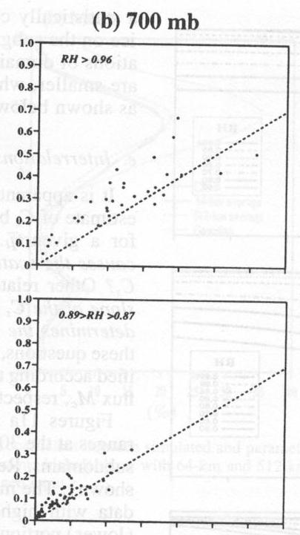
Diagnostic Relative Humidity Schemes
Could add further predictors
E.g: Xu and Randall (1996) sampled cloud scenes from a 2D cloud resolving model to derive an empirical relationship with two predictors:
More predictors, more degrees of freedom = flexible
But still do not know the form of the PDF (is model valid? representative for all situations?)
Can we do better?

Slide 24
Diagnostic Relative Humidity Schemes
Another example is the scheme of Slingo, operational at ECMWF until 1995.
This scheme also adds dependence on vertical velocities
Use different empirical relations for different cloud types, e.g., middle level clouds:
Relationships seem Ad-hoc? Can we do better?

Slide 25
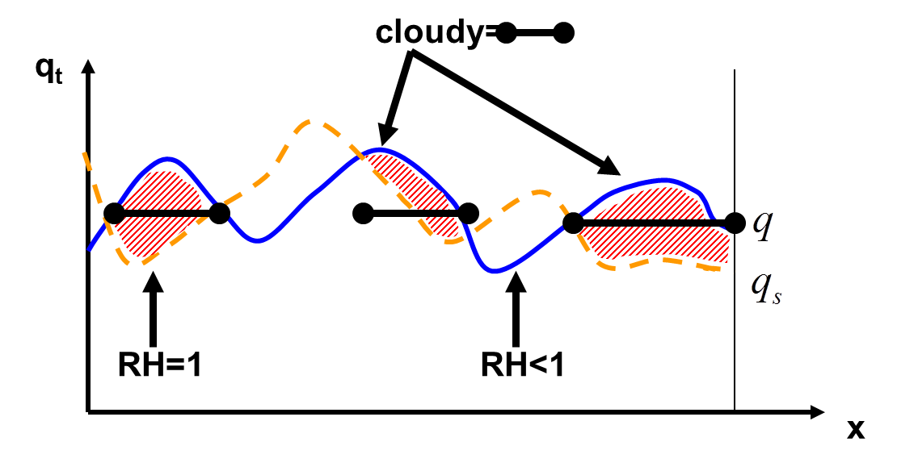
Statistical PDF Schemes
Statistical schemes explicitly specify the probability density function (PDF), G, for the total water q_{t} (and sometimes also temperature)
Grid box
Cloud cover is integral under supersaturated part of PDF
G(q_{t})
q_{t}
q_{s}
Sommeria and Deardorff (1977), Mellor (1977)

Slide 26
Statistical PDF Schemes
Knowing the PDF has advantages:
  Information concerning subgrid fluctuations of humidity and cloud condensate is available (for all parametrizations) , e.g.
    More accurate calculation of radiative fluxes
    Unbiased calculation of microphysical processes
  Use of underlying PDF means cloud variables (condensate, cloud fraction) are always self-consistent.
  Physically-based. Can evaluate with observations.
  (Note, location of clouds within grid cell is still not known)

Slide 27
Statistical PDF scheme:
Consistency across parametrizations
Microphysics
Convection Scheme
Can use information in
other schemes
Statistical Cloud Scheme
Radiation
Boundary Layer

Slide 28
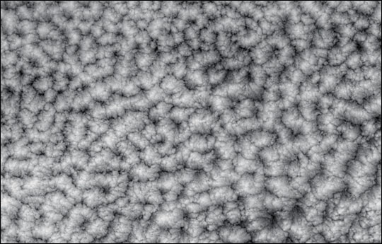
Building a statistical cloud scheme
What do we observe?
Limited observations to determine q_{t} PDF
  Aircraft data
    limited coverage
  Tethered balloon
    boundary layer only
  Satellite
    difficulties resolving in vertical
    no q_{t} observations
    poor horizontal resolution
  Ground-based radar/Raman Lidar
    one location
Cloud Resolving models have also been used
    realism of microphysical parametrization?
Modis image from NASA website

Slide 29
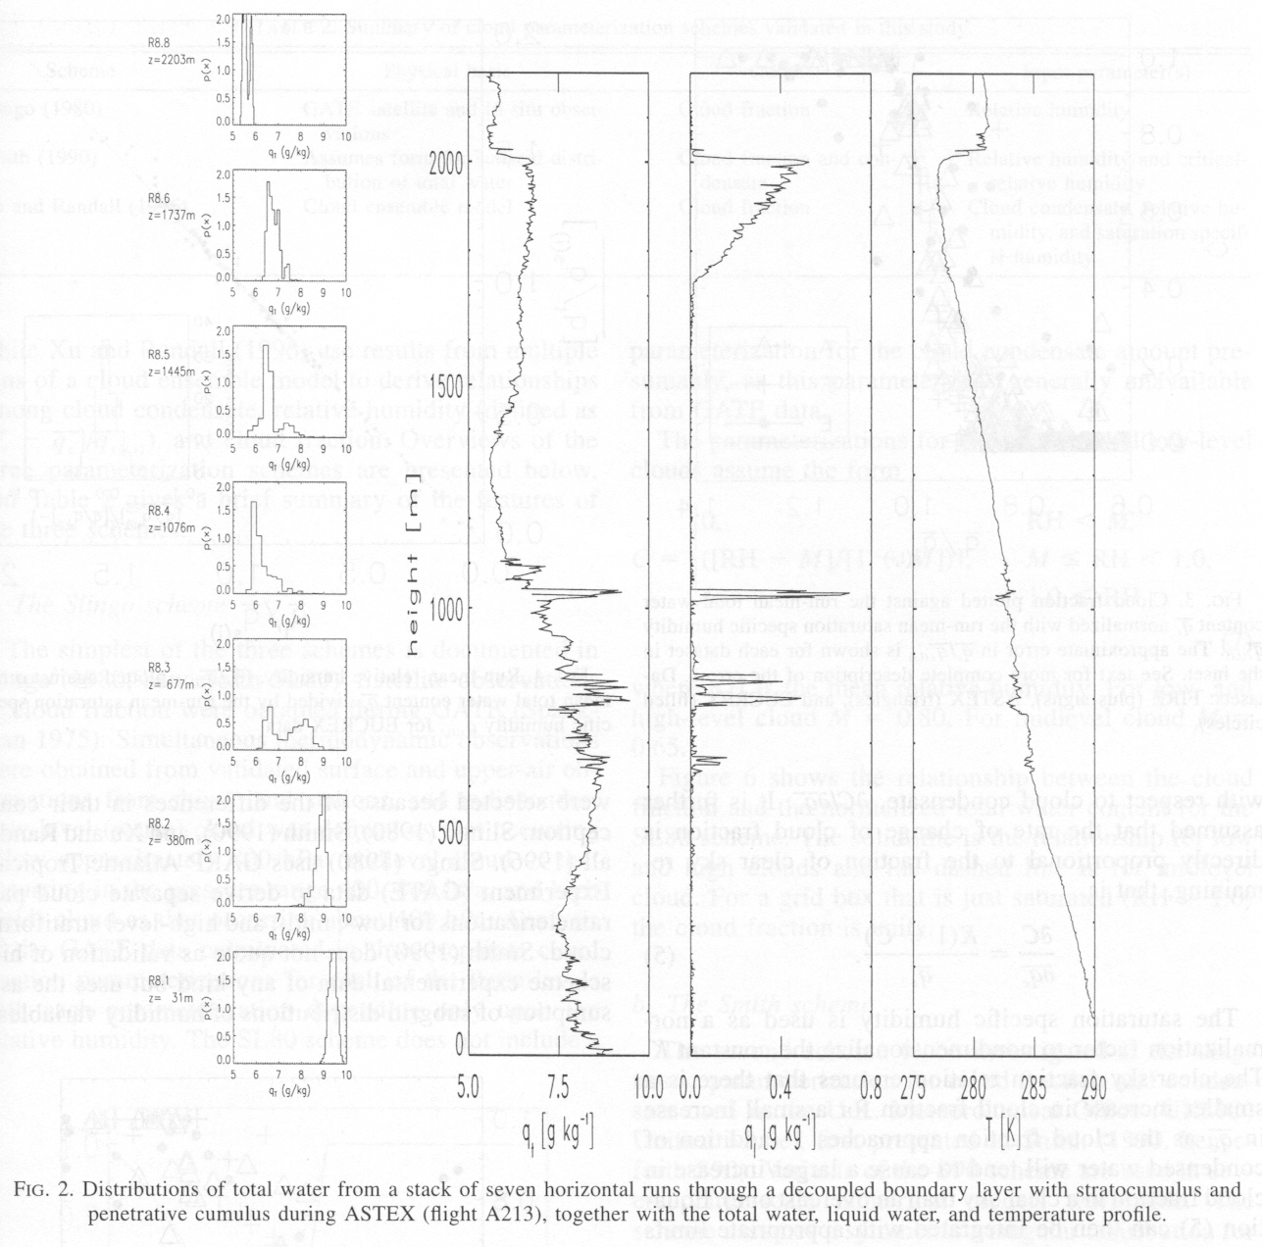
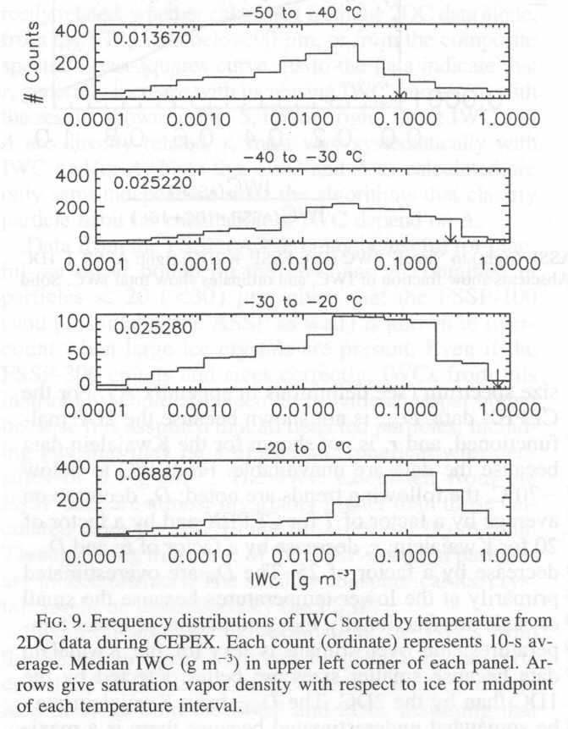
Aircraft Observed PDFs
Wood and Field JAS 2000
Aircraft observations low clouds < 2km
Height
Heymsfield and McFarquhar
JAS 96
Aircraft IWC obs during CEPEX
PDF(q_{t})
q_{t}

Slide 30
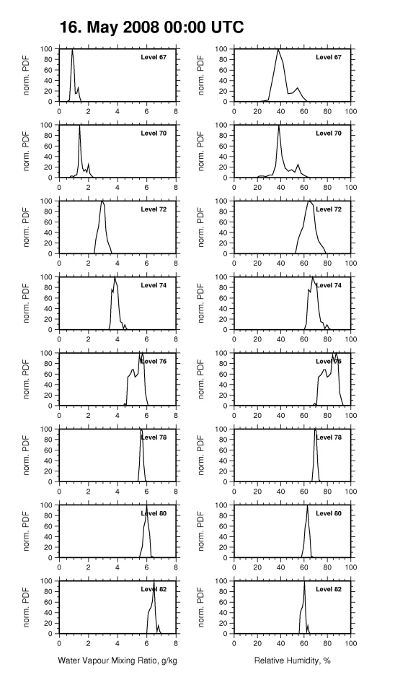
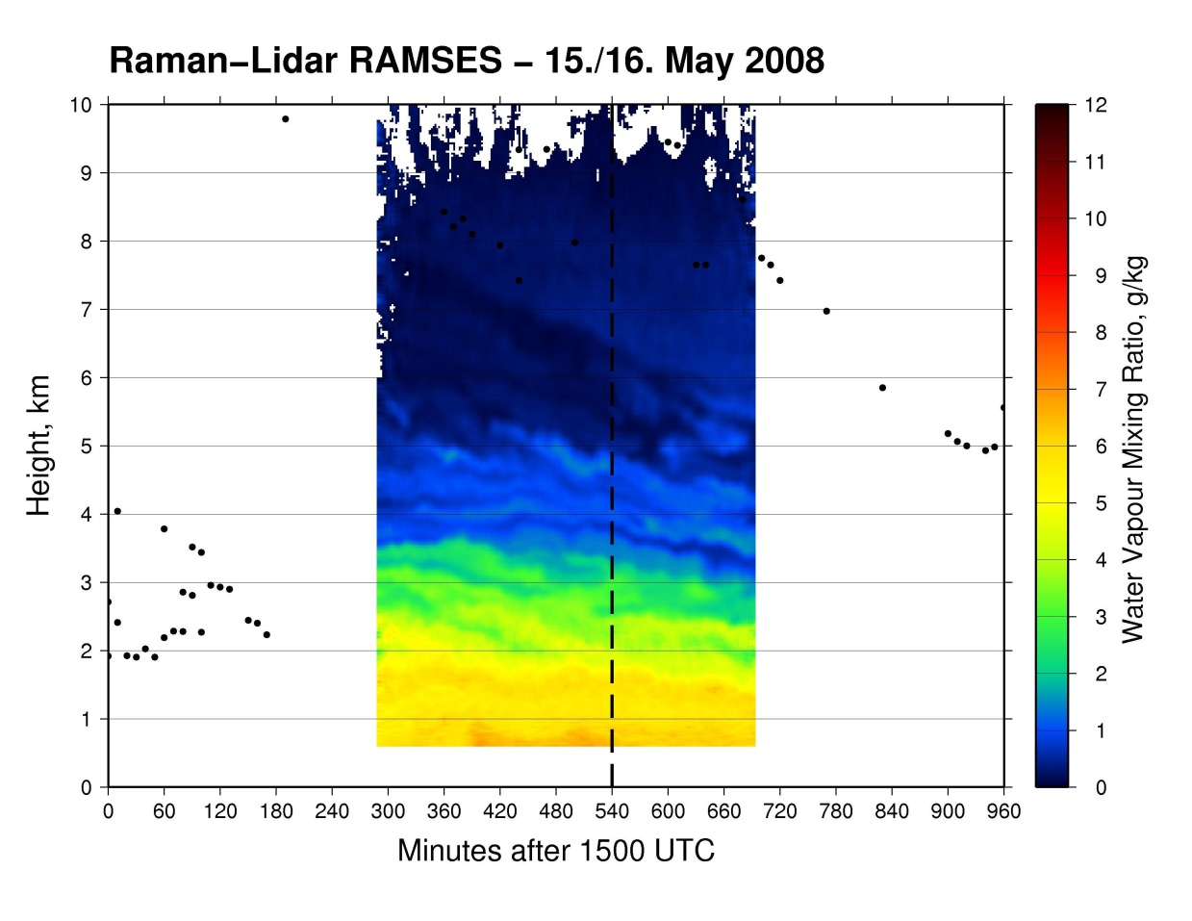
Building a statistical cloud scheme
Observed PDF of water vapour/RH Raman Lidar
From Franz Berger

Slide 31
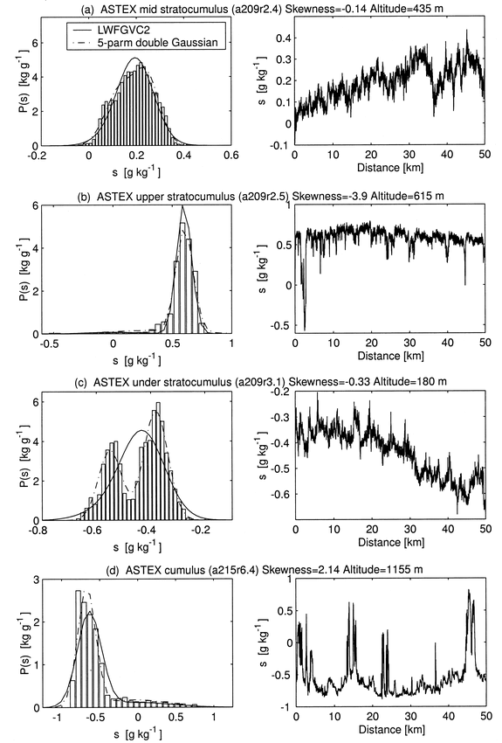
Building a statistical cloud scheme
Observed PDF example from aircraft
PDF
Data
Example, aircraft data from Larson et al. 01/02
PDFs are mostly approximated by uni or bi-modal distributions, describable by a few parameters

Slide 32
Building a statistical cloud scheme
Need to represent with a functional form, specify the:
  (1) PDF shape (unimodal, bimodal, symmetrical, bounded?)
  (2) PDF moments (mean, variance, skewness?)
  (3) Diagnostic or prognostic (how many degrees of freedom?)
G(q_{t})
q_{t}

Slide 33
Building a statistical cloud scheme
(1) Specification of PDF shape
Many function forms have been used
symmetrical distributions:
PDF( q_{t})
Bounded
q_{t}
q_{t}
Uniform:
Letreut and Li (91)
Triangular:
Smith QJRMS (90)
Unbounded:
Can clip, but need additional parameters
q_{t}
q_{t}
Gaussian:
Mellor JAS (77)
s⁴ polynomial:
Lohmann et al. J. Clim (99)

Slide 34
Building a statistical cloud scheme
(1) Specification of PDF shape
skewed distributions:
Unbounded, always skewed
PDF( q_{t})
q_{t}
q_{t}
q_{t}
Exponential:
Sommeria and Deardorff JAS (77)
Lognormal:
Bony & Emanuel JAS (01)
Gamma:
Barker et al. JAS (96)
q_{t}
q_{t}
q_{t}
Beta:
Tompkins JAS (02)
Double Gaussian:
Lewellen and Yoh JAS (93),
Golaz et al. JAS 2002
(CLUBB)
Uniform-delta:
Tiedtke (1993)
(ECMWF)
Bounded, symmetrical or skewed

Slide 35
Building a statistical cloud scheme
(2) Specification of PDF moments
Need also to determine the moments of the distribution:
Variance (Symmetrical PDFs)
Skewness (Higher order PDFs)
Kurtosis (4-parameter PDFs)
saturation
PDF(q_{t})
cloud forms?
q_{t}
e.g. HOW WIDE?
Skewness
Kurtosis
Moment 1=MEAN
Moment 2=VARIANCE
Moment 3=SKEWNESS
Moment 4=KURTOSIS
negative
positive
positive
negative
Functional form – needs to fit data but be sufficiently simple

Slide 36
Building a statistical cloud scheme
(3) Diagnostic or prognostic PDF moments
(1-RH_{crit})q_{s}
Some schemes fix the moments (diagnostic e.g. Smith 1990) based on critical RH at which clouds assumed to form.
Some schemes predict the moments (prognostic, e.g. Tompkins 2002). Need to specify sources and sinks.
If moments (variance, skewness) are fixed, then statistical schemes are identically equivalent to a RH formulation
e.g. uniform q_{t} distribution = Sundqvist formulation
G(q_{t})
C
1-C
q_{t}
Sundqvist formulation!!!

Slide 37
Building a statistical cloud scheme
Processes that can affect PDF moments
convection
microphysics
turbulence
dynamics

Slide 38
Example: Turbulence
In presence of vertical gradient of total water,
turbulent mixing can increase horizontal variability
dry air
moist air
Rate of change of total water variance

Slide 39
Example: Turbulence
In presence of vertical gradient of total water,
turbulent mixing can increase horizontal variability
dry air
moist air
while subgrid mixing in the horizontal plane naturally reduces the horizontal variability

Slide 40
Building a statistical cloud scheme
Predicting change of q_{t} variance due to turbulence
turbulence
If a process is fast compared to a GCM timestep, an equilibrium can be assumed, e.g. turbulence
Local
equilibrium
Source
Dissipation
Example: Ricard and Royer, Ann Geophy, (93), Lohmann et al. J. Clim (99)
Disadvantage:
  Can give good estimate in boundary layer, but above, other processes will determine variability, that evolve on slower timescales

Slide 41
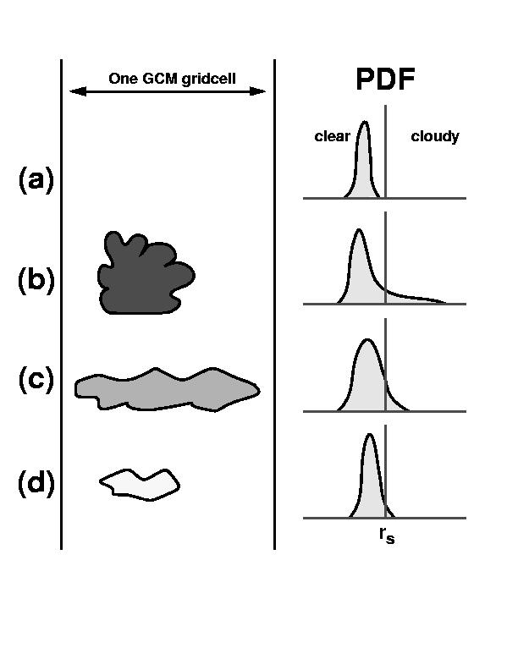
Building a statistical cloud scheme
Example: Tompkins (2002) prognostic PDF
Tompkins (2002) prognostic statistical scheme (implemented in ECHAM5 climate GCM).
Prognostic equations are introduced for variables representing the mean, variance and skewness of the total water PDF (Beta fn)
Some of the sources and sinks are rather ad-hoc in their derivation!
convective detrainment
precipitation
generation
mixing
q_{s}

Slide 42
The ECMWF Cloud Scheme
Comparison with Tompkins prognostic PDF scheme
Tompkins (2002)
Tiedtke(1993) in ECMWF IFS
C
G(q_{t})
G(q_{t})
1-C
1-C
C
q_{s}
q_{t}
q_{s}
q_{t}
A bounded beta function with positive skewness.
Effectively 3 prognostic variables:
  Mean q_{t}
  Variance of PDF
  Skewness of PDF
A mixed ‘uniform-delta’ total water distribution is assumed for the condensation process.
3 prognostic variables:
  Humidity, q_{v}
  Cloud condensate, q_{c}
  Cloud fraction, C
Same degrees of freedom ?

Slide 43
Prognostic statistical PDF scheme:
Which prognostic variables/equations?
Take a 2 parameter distribution & partially cloudy conditions
(1) Can specify distribution with
  Mean
  Variance of total water
(2) Can specify distribution with
  Water vapour
  Cloud water mass mixing ratio
q_{t}
q_{sat}
q_{sat}
Cloud
Cloud
q_{v}
q_{l}
Variance

Slide 44
Prognostic statistical scheme:
(1) Water vapour and cloud water ?
q_{sat}
Cloud water budget conserved.
Microphysical sources and sinks easier to parametrize.
Water vapour
Cloud water
mass mixing ratio
q_{v}
q_{l}
But problems arise in...
Overcast conditions
(…convection +
microphysics)
q_{sat}
Clear sky conditions
(turbulence)
Need to specify width, RH_{crit}
q_{v}
q_{v}+q_{l}

Slide 45
Prognostic statistical scheme:
(2) Total water mean and variance ?
q_{sat}
Mean
Variance
of total water
“Cleaner solution”.
But conservation of liquid water may be difficult (eg. advection)
Parametrizing microphysics sources, sinks can be more difficult.

Slide 46
Cloud inhomogeneity in microphysics
q_{s}
Many current microphysical schemes use the grid-mean or cloud fraction cloud mass
(i.e: neglect in-cloud variability)
G(q_{t})
q_{t}
cloud
Homogeneous
Sub-grid PDF
Cloud range
For example, Kessler autoconversion scheme: Result is not equal in the two cases since microphysical processes are non-linear
In the homogeneous case the grid mean cloud is less than threshold and gives zero precipitation formation
Grid
mean
precip
generation
q_{L0}
q_{L}

Slide 47
Prognostic statistical PDF scheme:
Knowing the PDF….
Advantages
  Information concerning subgrid fluctuations of humidity and cloud condensate is available (for all parametrizations)
  Use of underlying PDF means cloud variables (condensate, cloud fraction) are always self-consistent.
Challenges…
  Deriving these sources and sinks rigorously is difficult, especially for higher order moments for more complex PDFs!
  Limited observations to define PDF
  If variance and skewness are used instead of cloud water and humidity, conservation of the latter is not ensured.
  Is a fixed PDF shape, even with variable moments, able to represent the wide range of variability in the atmosphere?
  How do we treat the ice phase, supersaturation, mixed-phase cloud, sedimentation? These are important questions!

Slide 48
Subgrid heterogeneity:
How do we treat subgrid heterogeneity and sedimentation ?
Analytically, can quickly get intractable
Subcolumn approach, as for radiation? but computationally expensive.
Memory of subgrid precipitation fluxes?

Slide 49
Sub-grid cloud parametrization
Current status in GCMs…?
The ECMWF global NWP model has prognostic water vapour, cloud water and cloud fraction. With a uniform function for heterogeneity in the clear air and a delta function (homogeneous) in-cloud.
The UK Met Office global NWP model (PC2 scheme) also has prognostic water vapour, cloud water and cloud fraction.
Many other operational global NWP/climate models have diagnostic sub-grid cloud schemes, e.g. NCEP GFS: Sundquist et al. (1989)
q_{t}
Uniform-delta:
Tiedtke (1993)
q_{t}
Research is ongoing for statistical schemes with prognostic PDF moments (e.g. Tompkins scheme tested in ECHAM, CLUBB tested in CAM).
q_{t}
Double-Gaussian
(CLUBB)

Slide 50
Summary
Representing subgrid scale heterogeneity
      Representing sub-gridscale heterogeneity in GCMs is important for cloud formation, microphysical processes, radiation etc.
      Many different approaches have been tried, with varying degrees of complexity to represent the variability observed in the atmosphere.
      More degrees of freedom allow greater flexibility to represent the real atmosphere, but we need to have enough knowledge/information to understand and constrain the problem (form of pdf/sources/sinks)!
      Cloud, convection and BL turbulence are all part of the subgrid heterogeneity – active research into unified schemes.
      Statistical prognostic PDF schemes have many advantages but challenges remain for clouds other than warm-phase boundary layer cloud!
      However, we should continue to strive for a consistent representation of this heterogeneity for all processes in the model.
Notes:
Take a global view

Slide 51
References
Larson, V. E., R. Wood, P. R. Field, J.-C. Golaz, T. H. Vonder Haar, and W. R. Cotton, (2001). Small-Scale and Mesoscale Variability of Scalars in Cloudy Boundary Layers: One-Dimensional Probability Density Functions. J. Atmos. Sci., 58, 1978-1994
Sundqvist, H. Berge, E., Kristjansson, J. E., 1989: Condensation and cloud parametrization studies with a mesoscale numerical weather prediction model. Mon. Wea. Rev., 177, 1641-1657.
Tompkins, A. M., (2002). A prognostic parametrization for the subgrid-scale variability of water vapor and clouds in large-scale models and its use to diagnose cloud cover. J. Atmos. Sci., 59, 1917-1942.
Wood, R., Field, P. R., (2000). Relationships between total water, condensed water and cloud fraction in stratiform clouds examinied using aircraft data. J. Atmos. Sci., 57, 1888-1905.
Xu, K. M., and D. A. Randall, (1996). A semi-empirical cloudiness parameterization for use in climate models. J. Atmos. Sci., 53, 3084-3102.

