Slide 1
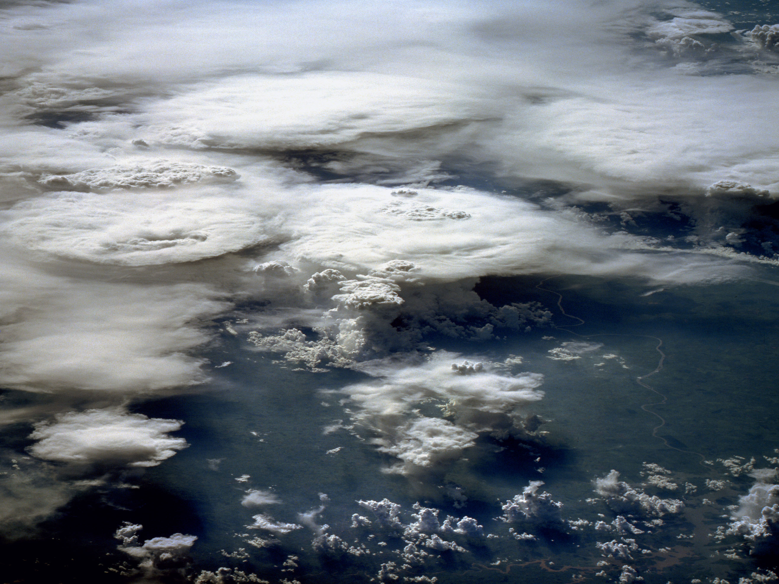
Numerical Weather Prediction
Parametrization of Subgrid Physical Processes
Clouds (1)
Overview &
Warm-phase Microphysics
Richard Forbes
(with thanks to Adrian Tompkins and Christian Jakob)
forbes@ecmwf.int

Slide 2
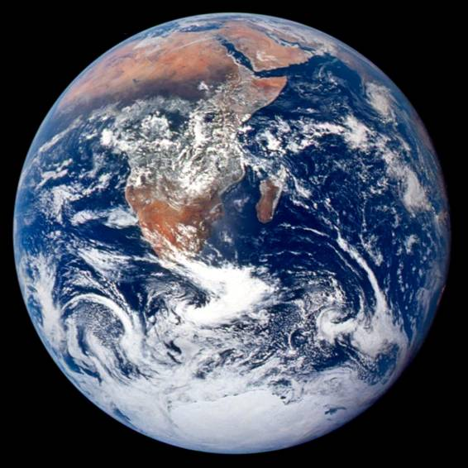
Where is the water?
97% Ocean
2% Ice Caps
~1% Lakes/Rivers
0.001% Atmosphere (13,000 km³, 2.5cm depth)
0.00001% Clouds
Global precipitation
500,000 km³ per year
≈ 1 m/year
≈ 3 mm/day
Notes:
50000 is 40x 13000 and 365/40 is 9 days recycle time

Slide 3
Cloud Lectures - Outline
Overview of cloud parametrization issues (Lecture 1)
Liquid-phase microphysical processes (Lecture 1)
Ice and mixed-phase microphysical processes (Lecture 2)
Sub-grid heterogeneity (Lecture 3)
Notes:
Microphysics, but first a few words on parametrization issues to help to put into context

Slide 4
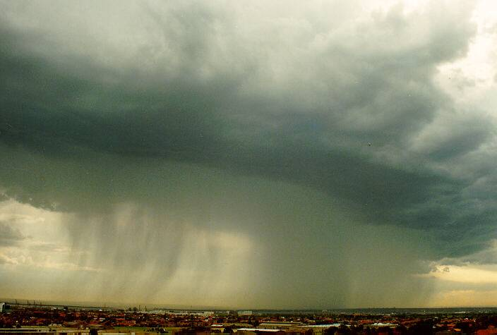
1. Overview of Cloud Parametrization Issues

Slide 5
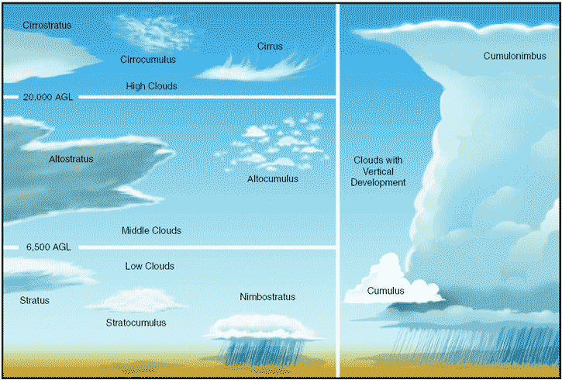
The Importance of Clouds
Water Cycle
(precipitation)
2. Radiative Impacts
(longwave and shortwave)
3. Dynamical Impacts
(latent heating, transport)

Slide 6
Representing Clouds in GCMs What are the problems ?
radiation
convection
microphysics
turbulence
dynamics
Clouds are the result of complex interactions between a large number of processes

Slide 7
Representing Clouds in GCMs What are the problems ?
Example: cloud-radiation interaction – many uncertainties
Cloud top and base height
Cloud fraction and overlap
Amount of condensate
In-cloud conden-sate distribution
Cloud-radiation interaction
Cloud environment
Phase of condensate
Cloud particle shape
Cloud particle size
Cloud macrophysics
Cloud microphysics
“External” influence

Slide 8
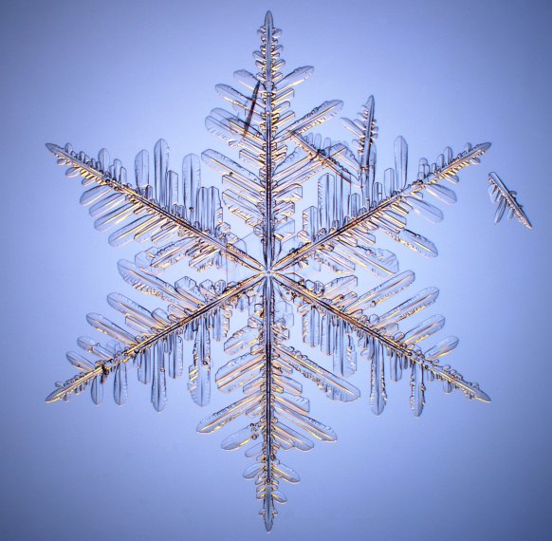
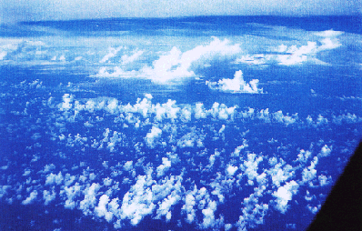
Cloud Parametrization Issues:
Microphysical processes
Macro-physical
  subgrid heterogeneity
Numerical issues

Slide 9
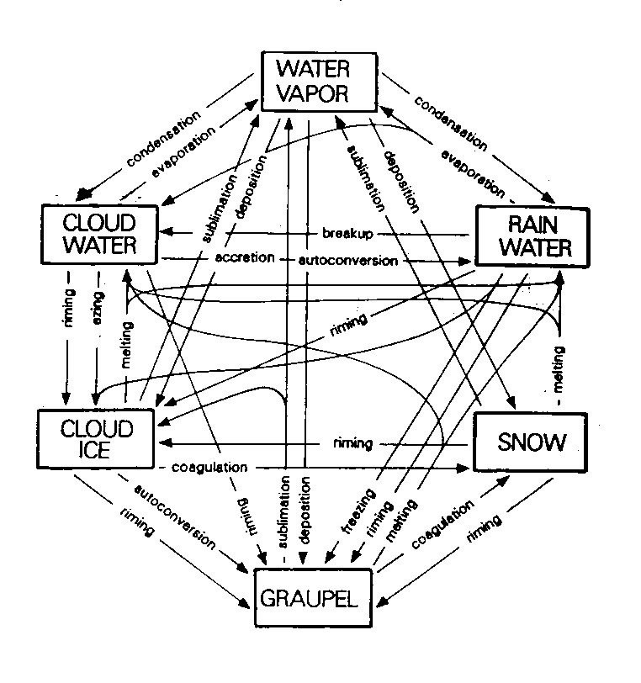
Microphysics Parametrization Issues:
Which quantities to represent ?
Water vapour
Cloud water droplets
Rain drops
Pristine ice crystals
Aggregate snow flakes
Graupel pellets
Hailstones
Note for ice phase particles:
  Additional latent heat.
  Terminal fall speed of ice hydrometeors significantly less.
  Optical properties are different (important for radiation).
Notes:
Real world a continuum of different particles, but can be simplified into discrete categories.

Slide 10
Microphysics Parametrization Issues:
Complexity ?
Complexity
Small ice
Ice Mass
Ice mass
Cloud
Mass
Medium ice
Liquid Mass
Ice number
Large ice
“Single Moment”
Schemes
“Double Moment”
Schemes
“Spectral/Bin”
Microphysics
GCMs have single-moment or double-moment schemes

Slide 11
Cloud Parametrization Issues:
Diagnostic or prognostic variables ?
Cloud condensate mass (cloud water and/or ice), q_{l}
Diagnostic approach (dependent on large scale variables e.g. T,q)
e.g. rain in models with long timestep (1hr) - timescale for fallout of rain << model timestep therefore can assume rain profile is in equilibrium
Prognostic approach (parametrized sources and sinks)
Sources
e.g. snow has a slower fallspeed so can take many timesteps to reach the ground, can be advected many grid lengths.
Advection + sedimentation
Sinks
CAN HAVE MIXTURE OF APPROACHES

Slide 12
Microphysics Parametrization: Simple schemes
(…in many GCMs not that long ago, still some now, and in many convection parametrizations!)
Total water
q_{t}
Condensate = saturation adjustment liquid/ice = fn(T)
Evaporation
Autoconversion
Kessler (1969)
Precipitation
(diagnostic)
rain/snow = fn(T)

Slide 13
Microphysics Parametrization: The “category” view
Single moment schemes
Water vapour
q_{v}
Condensation Evaporation
Deposition Sublimation
Condensation Evaporation
Cloud water
q_{l}
Cloud ice
q_{i}
Deposition Sublimation
Freezing – Melting - Bergeron
Rutledge and Hobbs (1983)
Autoconversion Collection
Collection
Autoconversion Collection
Rain
q_{r}
Snow
q_{s}
Freezing - Melting
Sedimentation
Notes:
Use in many GCMS, typical in CRMs, with addition of graupel and hail.

Slide 14
Microphysics Parametrization: The “category” view Double moment schemes
Water vapour
q_{v}
Condensation Evaporation
Deposition Sublimation
e.g.
Ferrier (1994)
Seifert and Beheng (2001)
Morrison et al. (2005)
Condensation Evaporation
Cloud water
q_{l} + N_{l}
Cloud ice
q_{i} + N_{i}
Deposition Sublimation
Freezing – Melting - Bergeron
Autoconversion Collection
Collection
Autoconversion Collection
Rain
q_{r} + N_{r}
Snow
q_{s} + N_{s}
Freezing - Melting
Sedimentation

Slide 15
Microphysics Parametrization: The “category” view Double moment schemes – multiple ice categories
Water vapour
q_{v}
Condensation Evaporation
Deposition Sublimation
e.g.
Lin et al. (1983)
Meyers et al. (1997)
Milbrandt and Yau (2005)
Condensation Evaporation
Cloud water
q_{l} + N_{l}
Cloud ice
q_{i} + N_{i}
Deposition Sublimation
Freezing – Melting - Bergeron
Snow
q_{s} + N_{s}
Autoconversion Collection
Collection
Graupel
q_{g} + N_{g}
Rain
q_{r} + N_{r}
Freezing - Melting
Hail
q_{h} + N_{h}
Sedimentation

Slide 16
Microphysics Parametrization: The “category” view
Double moment + ice particle properties
Water vapour
q_{v}
Condensation Evaporation
Deposition Sublimation
Condensation Evaporation
e.g.
Morrison and Grabowski (2008)
Morrison and Milbrandt (2015a,b) ‘P3’
Cloud water
q_{l} + N_{l}
Ice particles
q_{i_total}
+ q_{i_rime}
+ V_{i_rime}
+ N_{i}
Deposition Sublimation
Freezing – Melting - Bergeron
Autoconversion Collection
Collection
Rain
q_{r} + N_{r}
Freezing - Melting
Sedimentation
Notes:
That’s a whole history of bulk cloud microphysics schemes in 2 minutes. Of course there are bin models etc.

Slide 17
Microphysics Parametrization: The “category” view
What is important?
Water vapour
Condensation Evaporation
Deposition Sublimation
Condensation Evaporation
Cloud water
Cloud ice
Deposition Sublimation
Freezing – Melting - Bergeron
Autoconversion Collection
Collection
Autoconversion Collection
Rain
Snow
Freezing - Melting
Sedimentation
Notes:
Let’s go back. As a model developer, when ever I’m thinking of making a change I have to consider the question of what is most important.
Let’s look at three perspectives, hydrological, radiative and diabatic…

Slide 18
Microphysics Parametrization:
The hydrological perspective
Water vapour
Condensation Evaporation
Deposition Sublimation
Condensation Evaporation
Deposition Sublimation
Cloud water
Freezing – Melting - Bergeron
Cloud ice
Autoconversion Collection
Collection
Autoconversion Collection
Rain
Snow
Freezing - Melting
Sedimentation

Slide 19
Microphysics Parametrization:
The radiative perspective
Water vapour
Condensation Evaporation
Deposition Sublimation
Condensation Evaporation
Cloud water
Cloud ice
Deposition Sublimation
Freezing – Melting - Bergeron
Autoconversion Collection
Collection
Autoconversion Collection
Rain
Freezing - Melting
Snow
Sedimentation

Slide 20
Microphysics Parametrization:
The “diabatic process” perspective
Water vapour
Condensation
Deposition
Evaporation
Sublimation
Cloud water
Freezing
Cloud ice
Sublimation
Condensation
Deposition
Evaporation
Melting
Autoconversion Collection
Collection
Autoconversion Collection
Freezing
Rain
Snow
Melting
Sedimentation

Slide 21
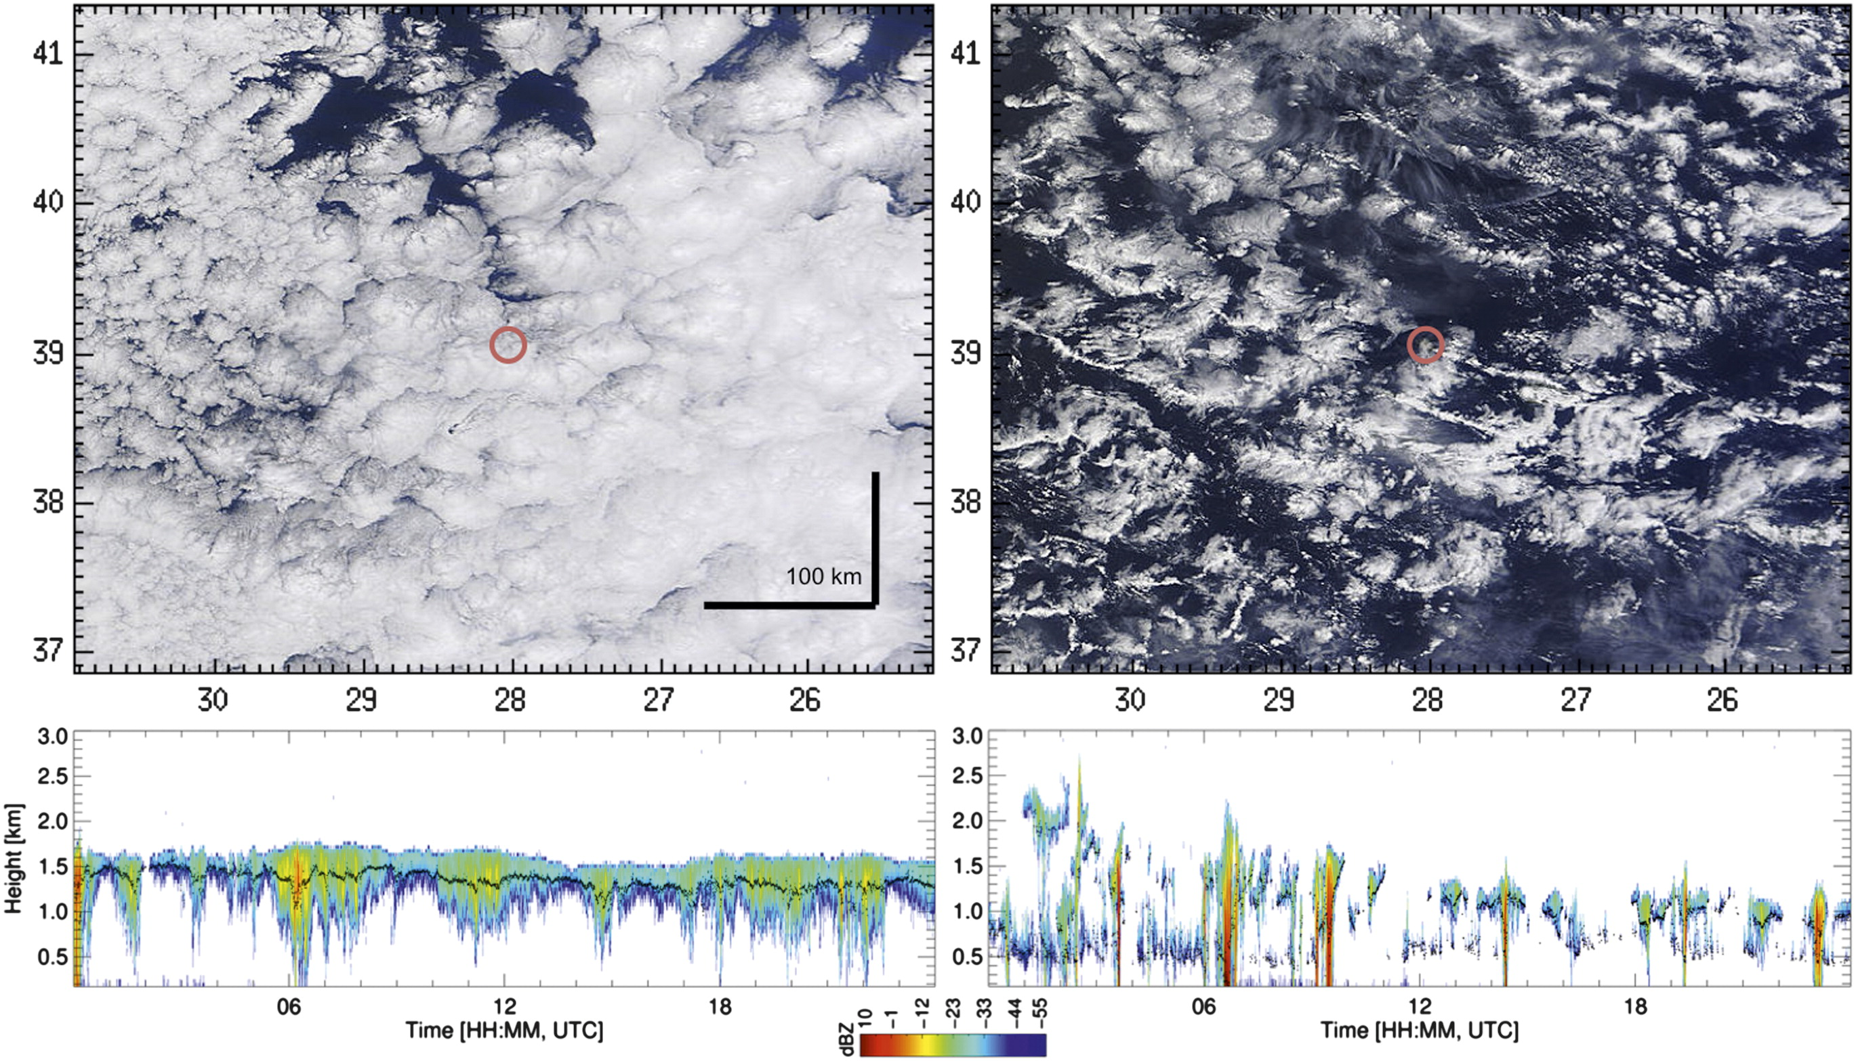
Microphysics does not occur in isolation
– turbulence/convection
Azores
Rémillard et al. (2012, JClim, Fig 2)
Notes:
ECMWF Training Course
02 May 2000
Moist Processes
But that was microphysics. Microphysics doesn’t exist alone. I

Slide 22
Moist process parametrizations:
The box view: A problem of microphysics-turbulence interactions
Dynamics
Radiation
Microphysics
Subgrid convection
Subgrid cloud
Subgrid BL turbulent mixing
Surface interactions
How the different parametrizations interact can be as important as the parametrizations themselves

Slide 23
Moist process parametrizations:
The integrated view
Examples:
Increased consistency between existing parametrizations
Prognostic cloud PDF schemes
(e.g. Tompkins et al 2002)
Eddy-diffusivity + multiple mass flux plumes (e.g. EDMF Dual-M)
Higher order closure (e.g. CLUBB)
Dynamics
Radiation
Subgrid
convection
Subgrid cloud
Microphysics
Surface interactions
Subgrid BL turbulent mixing
How the different parametrizations interact can be as important as the parametrizations themselves

Slide 24
2. Warm-phase
Microphysical Processes

Slide 25
Cloud microphysical processes
To describe warm-phase cloud and precipitation processes in our models we need to represent:
  Nucleation of water droplets
  Diffusional growth of cloud droplets (condensation)
  Collection processes for cloud drops (collision-coalescence), leading to precipitation sized particles
  the advection and sedimentation (falling) of particles
  the evaporation of cloud and precipitation size particles

Slide 26
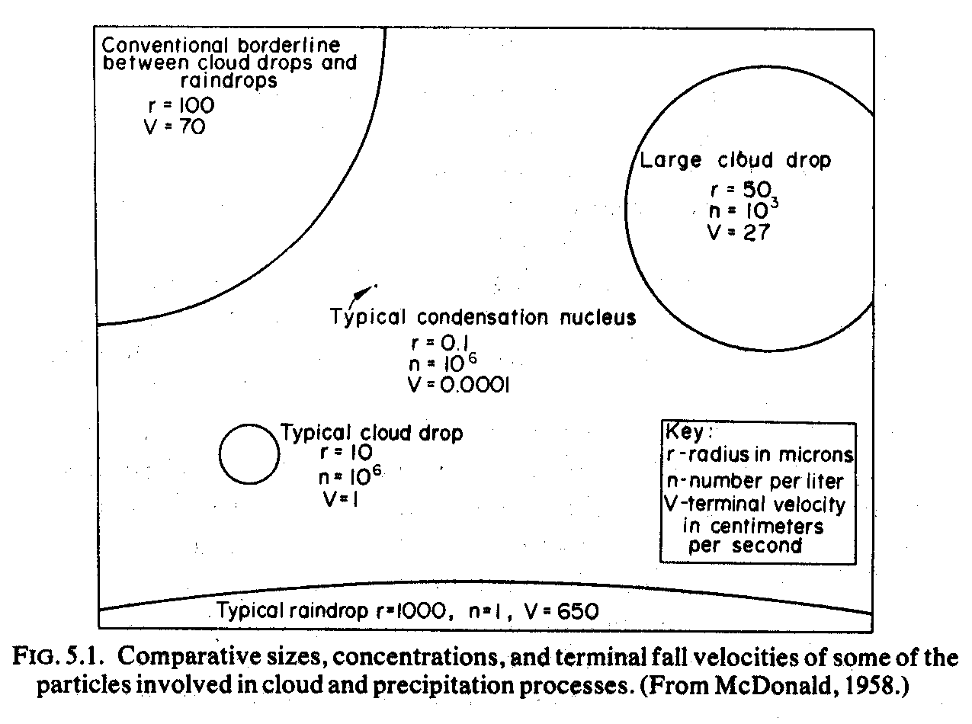
Droplet Classification

Slide 27
Nucleation of cloud droplets:
Important effects for particle activation
Planar surface: Equilibrium when atmospheric vapour pressure = saturation vapour pressure (e=e_{s}) and number of molecules impinging on surface equals rate of evaporation
Surface molecule has fewer neighbours
Curved surface: saturation vapour pressure increases with smaller drop size since surface molecules have fewer binding neighbours.
i.e. easier for a molecule to escape, so e_{s} has to be higher to maintain equilibrium

Slide 28
Nucleation of cloud droplets:
Homogeneous Nucleation
Drop of pure water forms from vapour.
Small drops require much higher super saturations.
Kelvin’s formula for critical radius (R_{c}) for initial droplet to “survive”.
Strongly dependent on supersaturation (e/e_{s})
Would require several hundred percent supersaturation (not observed in the atmosphere).

Slide 29
Nucleation of cloud droplets:
Heterogeneous Nucleation
Collection of water molecules on a foreign substance, RH > ~80% (Haze particles)
These (hydrophilic) soluble particles are called Cloud Condensation Nuclei (CCN)
CCN always present in sufficient numbers in lower and middle troposphere
Nucleation of droplets (i.e. from stable haze particle to unstable regime of diffusive growth) can occur at very small supersaturations (e.g. < 1%)

Slide 30
Nucleation of cloud droplets:
Important effects for particle activation
Planar surface: Equilibrium when e=e_{s} and number of molecules impinging on surface equals rate of evaporation
Surface molecule has fewer neighbours
Curved surface: saturation vapour pressure increases with smaller drop size since surface molecules have fewer binding neighbours.
Effect proportional to 1/r (curvature effect or “Kelvin effect”)
Dissolved substance reduces vapour pressure
Presence of dissolved substance: saturation vapour pressure reduces with smaller drop size due to solute molecules replacing solvent on drop surface (assuming e_{solute}<e_{v})
Effect proportional to -1/r³ (solution effect or “Raoult’s law”)

Slide 31
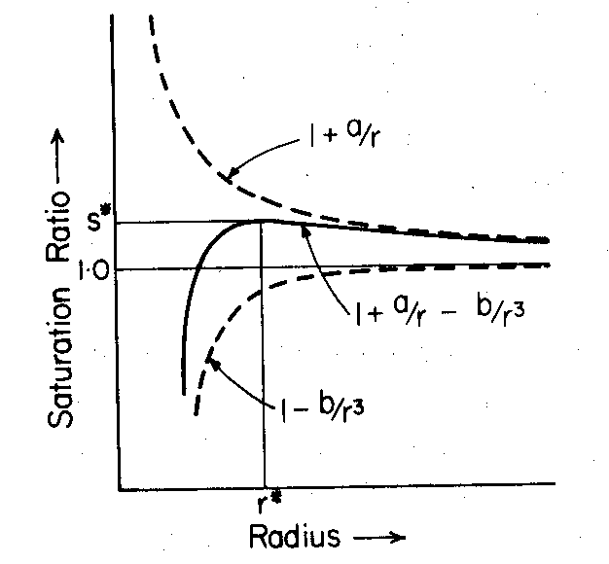
Nucleation of cloud droplets:
Heterogeneous Nucleation
“Curvature term”
Small drop – high radius of curvature, easier for molecule to escape
Haze particle in equilibrium
e/e_{s}
_{equilibrium}
Activation:
e / e_{s} = s*=1.01
r > r* = 0.12μm
(dependent on solute)
“Solution term”
Reduction in vapour pressure due to dissolved substance
“Köhler Curve”

Slide 32
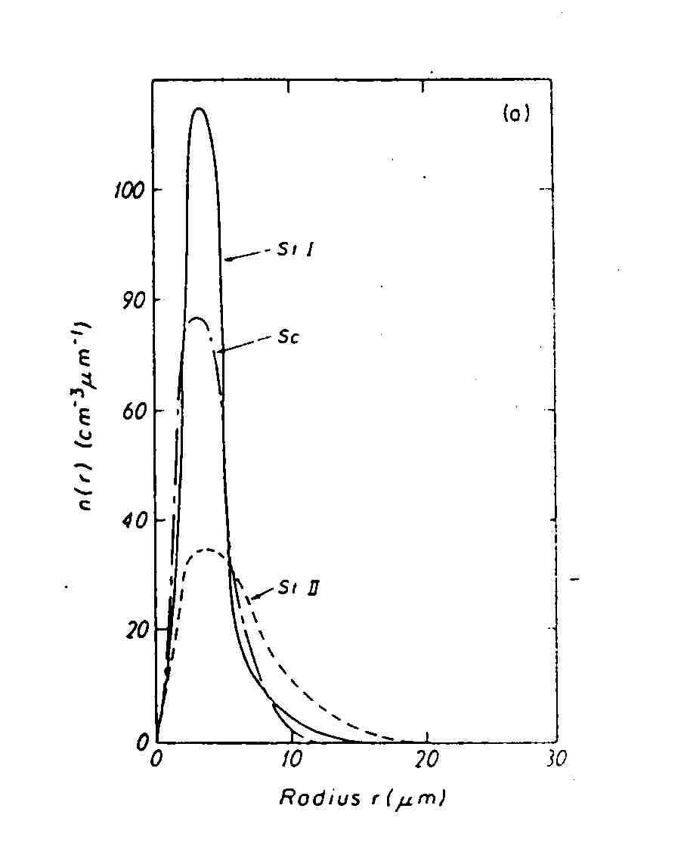
Diffusional growth of cloud water droplets
Once droplet is activated, water vapour diffuses towards it = condensation
Reverse process = evaporation
Droplets that are formed by diffusion growth attain a typical size of 0.1 to 10 μm
Rain drops are much larger
  drizzle: 50 to 100 μm
  rain: >100 μm
Other processes must also act in precipitating clouds
For r > 1 μm and neglecting diffusion of heat
D=Diffusion coefficient, S=Supersaturation
Note inverse radius dependency

Slide 33
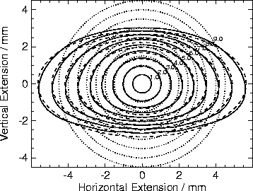
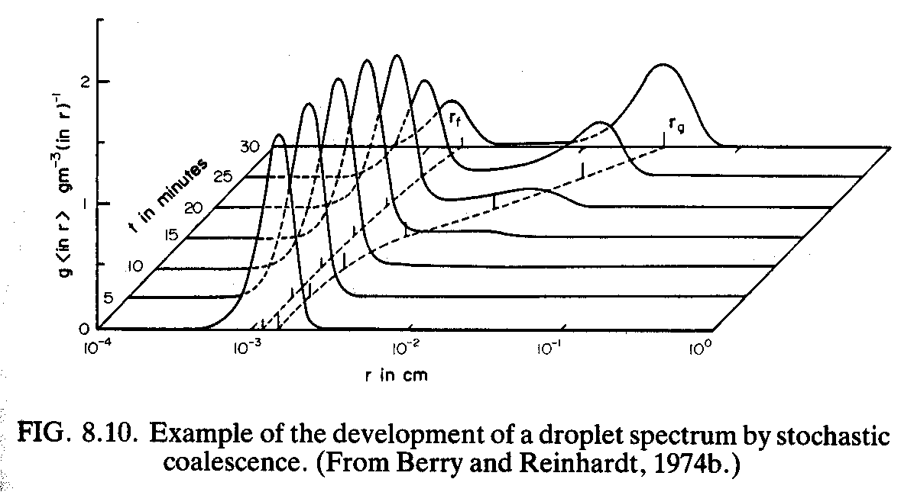
Collection processes
Collision-coalescence of water drops
Rain drop shape Chuang and Beard (1990)
Drops of different size move with different fall speeds - collision and coalescence
Large drops grow at the expense of small droplets
Collection efficiency low for small drops
Process depends on width of droplet spectrum and is more efficient for broader spectra – paradox – how do we get a broad spectrum in the first place?
Large drops can only be produced in clouds of large vertical extent – Aided by turbulence (differential evaporation), giant CCNs ?
Notes:
Cloud ParametrizationClouds 1
33

Slide 34
Parametrizing nucleation and water droplet diffusional growth
Nucleation: Since CCN “activation” occurs at water supersaturations less than 1%, most schemes assume all supersaturation with respect to water is immediately removed to form water droplets.
So usually, the growth equation is not explicitly solved. In single-moment schemes simple (diagnostic) assumptions are made concerning the droplet number concentration when needed (e.g. radiation).

Slide 35
Parametrizing collection processes “Autoconversion” of cloud drops to raindrops
Simplified with simple functional form, e.g.
Linear function of q_{l} (Kessler, 1969)
Function of q_{l} with additional term to avoid singular threshold and non-local precipitation term (Sundqvist 1978)
Or more non-linear, double moment functions such as Khairoutdinov and Kogan (2000), or Seifert and Beheng (2001) derived directly from the stochastic collection equation.
Kessler
G_{p}
q_{l}^{crit}
q_{l}
Sundqvist
G_{p}
q_{l}^{crit}
q_{l}
Microphysics - ECMWF Seminar on Parametrization 1-4 Sep 2008 35
Notes:
Cloud ParametrizationClouds 1
35

Slide 36
Parametrizing collection processes
“Accretion” of cloud drops by raindrops
Representing autoconversion and accretion in the warm phase (liq. to rain).
Sundqvist (1978, 1989)
Enhancement due to accretion
G_{p} = autoconversion rate
P = precipitation rate
G_{p}
Accretion
q_{l}^{crit}
q_{l}
Khairoutdinov and Kogan (2000)
Functional form is different
More non-linear process
Slower autoconversion initially, then faster
With prognostic rain, have memory in q_{r}
Then faster accretion for heavier rain.

Slide 37
Parametrizing evaporation
- cloud and precipitation
Evaporation of cloud droplets is generally assumed to be fast (instantaneous) as cloud particles are small, so as soon as the air becomes subsaturated, the cloud evaporates.
Larger precipitation size particles take longer to evaporate, so precipitation may fall into drier air below cloud base before it evaporates. Parametrized by integrating over an assumed droplet size spectrum. Evaporation is proportional to the subsaturation (e.g. Kessler 1969):
which assumes an exponential drop size distribution (Marshall-Palmer), although light rain (drizzle) is found to contain many more small droplets and therefore evaporation rates are enhanced (relative to M-P).

Slide 38
Schematic of Warm Rain Processes
RH>100.6%
“Activation”
Diffusional
Growth
Heterogeneous Nucleation
RH>78% (Haze)
CCN
Coalescence
~10 microns
Different fall speeds

Slide 39
Summary
Cloud important for it’s radiative, hydrological and dynamical impacts (also transport)
Different complexities of microphysics parametrization
Microphysics doesn’t occur in isolation – dynamics, turbulence, convection
Warm rain – nucleation, collision-coalescence Parametrization: autoconversion, accretion, evaporation
Next Lecture:
Ice and mixed-phase processes

Slide 40
References
Reference books for cloud and precipitation microphysics:
Pruppacher. H. R. and J. D. Klett (1998). Microphysics of Clouds and Precipitation (2nd Ed). Kluwer Academic Publishers.
Rogers, R. R. and M. K. Yau, (1989). A Short Course in Cloud Physics (3rd Ed.) Butterworth-Heinemann Publications.
Mason, B. J., (1971). The Physics of Clouds. Oxford University Press.
Hobbs, P. V., (1993). Aerosol-Cloud-Climate Interactions. Academic Press.
Houze, Jr., R. A., (1994). Cloud Dynamics. Academic Press.
Straka, J., (2009). Cloud and Precipitation Microphysics: Principles and Parameterizations. Cambridge University Press.

