Slide 1
The semi-Lagrangian semi-implicit technique in the ECMWF model
by Michail Diamantakis (room 2107; ext. 2402)
michail.diamantakis@ecmwf.int

Slide 2
What do we want to achieve?
We want to build an accurate and robust global weather forecasting system at the lowest possible cost
Role of numerical technique is central into achieving this goal
Semi-Lagrangian (SL) semi-implicit (SI) technique is ideal!
  Unconditionally stable advection scheme having good phase speeds with little numerical dispersion
    No CFL restriction in Δt!
  Unconditional stability of semi-implicit technique
    No restriction in Δt from integration of “fast forcing” terms such as gravity wave + acoustic terms (in non-hydrostatic models)

Slide 3
What is a semi-Lagrangian method?
A numerical technique for solving transport PDEs which applies Lagrangian “thinking” on grid-point models:
  It is like a Lagrangian method: fluid parcels follow a Lagrangian trajectory
  However, at each time-step a parcel trajectory always arrives on a grid-point. Mesh is not allowed to “depart” from its original form (constant resetting at every time-step).
  It gradually evolved to current form from schemes introduced in the ’50s, ’60s and 70s (Wiin-Nielsen, Krishnamurti, Sawyer, Leith, Purnel)

Slide 4
History of semi-Lagrangian IFS
IFS: Integrated Forecast System for medium range forecasts operating since 1979
Until the beginning of 1991 IFS is a spectral Eulerian model on a full Gaussian grid at T106 horizontal resolution and 19 levels
  An increase to T231 L31 resolution was planned
  This upgrade required at least 12 x available CPU power
  Funding was available for 4 x CPU increase …
Upgrade was made possible only due to switching to:
  A semi-Lagrangian scheme on a reduced Gaussian grid
  The new model was 6 x faster!

Slide 5
Basic concepts: the departure point
Linear advection equation:
At time t parcel is at d and at t +∆t arrives at a grid-point
Finding the “departure point” is an essential part of the technique:
  Solution at t+Δt is obtained by interpolating the available (defined at time t) grid-point -values at the d.p.
Advection term absorbed by the Lagrangian derivative (advection nonlinearity vanishes)

Slide 6
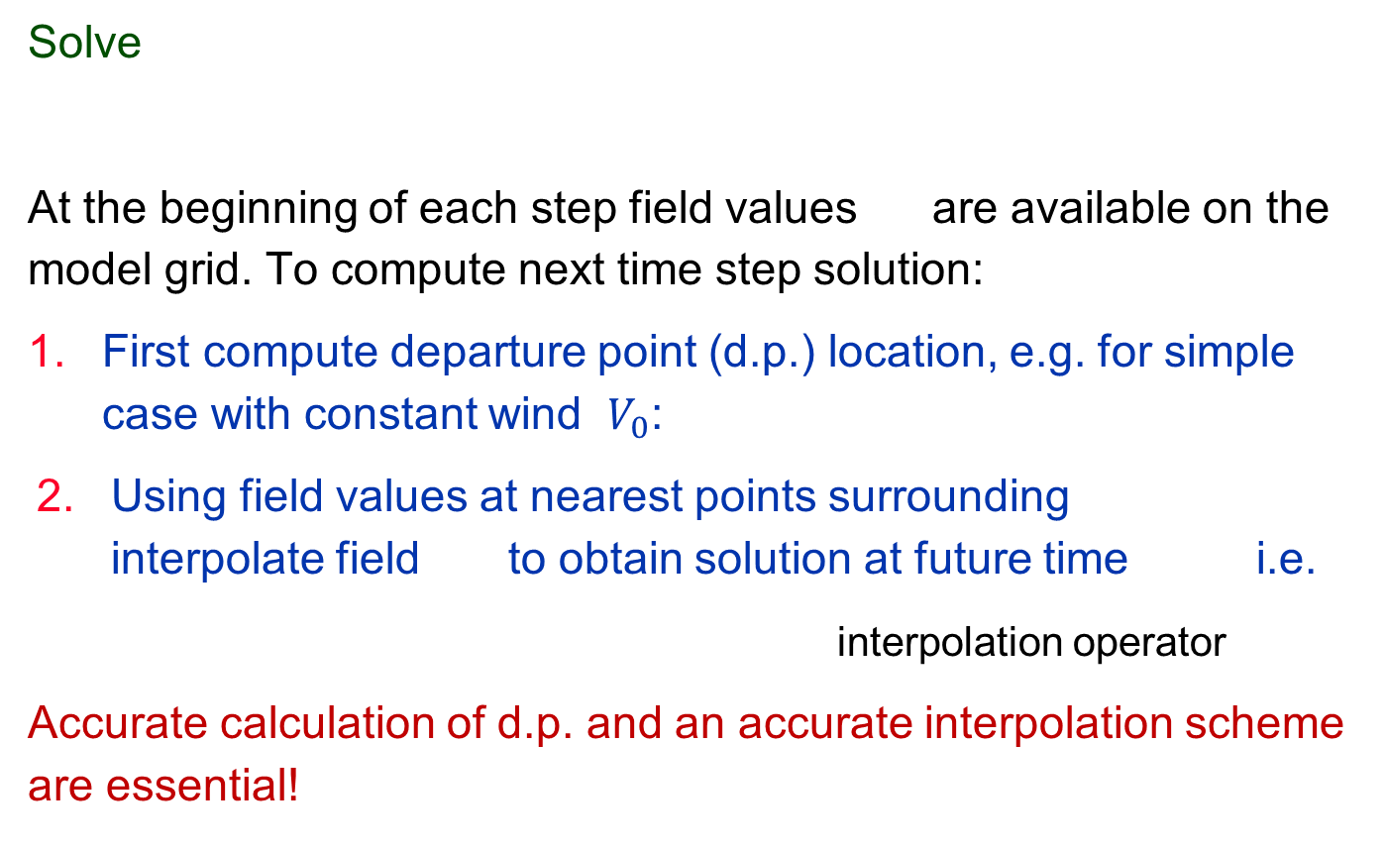
A simple Semi-Lagrangian algorithm
Solve
At the beginning of each step field values are available on the model grid. To compute next time step solution:
First compute departure point (d.p.) location, e.g. for simple case with constant wind $V_{0}$:
Using field values at nearest points surrounding interpolate field to obtain solution at future time i.e.
interpolation operator
Accurate calculation of d.p. and an accurate interpolation scheme are essential!

Slide 7
Stability in one dimension
p
j-p-1
j-p
j
(constant wind)
x
α ∆x
Departure to arrival pt distance (displacement):
p: integer
Assuming linear interpolation
conduct Von Neuman stability analysis:
|λ|≤1 if 0 ≤α ≤1
(interpolation from
two nearest points)
Amplification factor:
NOTE: when p=0 => α is the CFL number => SL with linear interpolation is essentially Eulerian upstream differencing!
Linear interpolation = damping!

Slide 8
How to find d.p. in SL NWP models
In atmospheric flows wind field changes in space and time
To find departure points, solve equation:
where the position and wind vector
along a trajectory. Second order mid-point rule is often used:
Departure point is computed iteratively
t-extrapolation needed:
Trajectory midpoint
For 3-time level scheme:
No t-extrapolation but more expensive

Slide 9
Iterative mid-point scheme for d.p.
Consider two time-level (TL) scheme and assume that during a time-step parcels follow straight lines (great circle) trajectories
  To find d.p. iterate discretized trajectory equation
    2nd order midpoint scheme iterations:
Interpolate V at midpoint
(using linear interpolation)
Extrapolate V at t+∆t/2
normally K=2 (2nd order)
Smolarkiewicz & Pudikiewicz (J. Atmos. Sci.1992): Convergence requires satisfaction
of a Lipschitz condition (parcels trajectories do not cross):
Doesn’t depend on mesh size and less restrictive than CFL for atmospheric flows

Slide 10
Time extrapolated winds and stability
When computing d.p extrapolating V at t+∆t/2 can be a source of weak instability Cordero et al (QJRMS, 2005). Solutions:
Iterative (expensive) approach:
  Time-step dynamics once to obtain V(t+∆t) estimate (predictor)
  Time-step again BUT now use predictor to interpolate at t+∆t/2: V(t+∆t/2)=[V(t)+V(t+∆t)]/2
Use Stable Extrapolating Two Time-Level Semi-Lagrangian (SETTLS) scheme (low cost) by Hortal (QJRMS, 2002)
T forecast 200 hPa
(from 1997/01/04)
Standard extrapolation
SETTLS

Slide 11
SETTLS for computing departure points
Taylor expansion to second order:
AV: average value along SL trajectory
and
Hence,
Therefore d.p. can be computed by iterative sequence:
Interpolate at

Slide 12
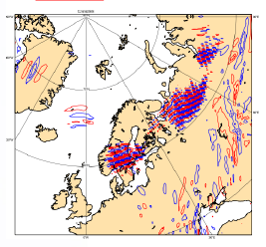
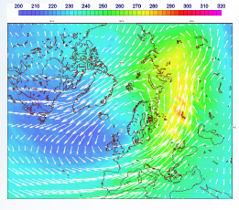
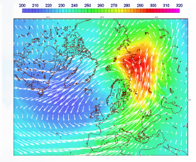
SETTLS extrapolation weaknesses
Noise in upper stratosphere often occurring in “Sudden Stratospheric Warming” events (model doesn’t predict accurately the warming event)
A solution: use hybrid SETTLS/non-extrapolating scheme in vertical (see ecmwf newsletter No.141 Autumn 2014, M. Diamantakis)
noisy divergence
24hrs forecast: weak warming
no noise + “correct” warming
(hybrid vertical scheme)
SETTLS

Slide 13
Interpolation in the IFS semi-Lagrangian scheme
Two important steps in SL algorithm:
Compute departure point (trajectory calculation)
Interpolate advected field to d.p. to obtain:
  Interpolation must use (for stability) neighbouring to d.p. gridpoints
ECMWF model uses quasi-monotone quasi-cubic Lagrange interpolation
Cubic Lagrange interpolation:
,
y
x
x
x
x
x
Number of 1D cubic interpolations in 2D: 5 =>3D: 21 (64pt stencil)
x
x
x
x
x
x
To save computations: cubic interpolation only for nearest neighbour rows, linear interpolation remaining i.e. “quasi-cubic interpolation”=> 7*cubic+10*linear in 3D (32 pt stencil)
x
x
x
x
x
x
x
x
x
x
x

Slide 14
Shape-preserving (locally monotonic) interpolation
• Creation of “artificial” maxima /minima
x
x: grid point values
x
x
x: interpolated value
x
x
• Shape-preserving (quasi-monotone) interpolation
- Quasi-monotone cubic interpolation:
x
φ_{cub}
x
φ_{max}
x
φ_{min}
- Alternative: Spline or Hermite interpolation (not used in IFS operationally)

Slide 15
A note on SL advection on the sphere
Temperton et al (QJRMS 2001)
Momentum eq. is discretized in vector form (a vector is continuous across the poles, components are not!)
- To transport a vector use local reference
system and apply rotation matrix from D to A
to take into account earth’s curvature
- Interpolations at D are done for u & v
components of the velocity vector relative to
the system of reference local at D.
Trajectories are arcs of great circles if
constant (angular) velocity is assumed
for the duration of a time step.
Z
V
x
D
A
Y
X
Rotation
matrix
Trajectory calculation

Slide 16
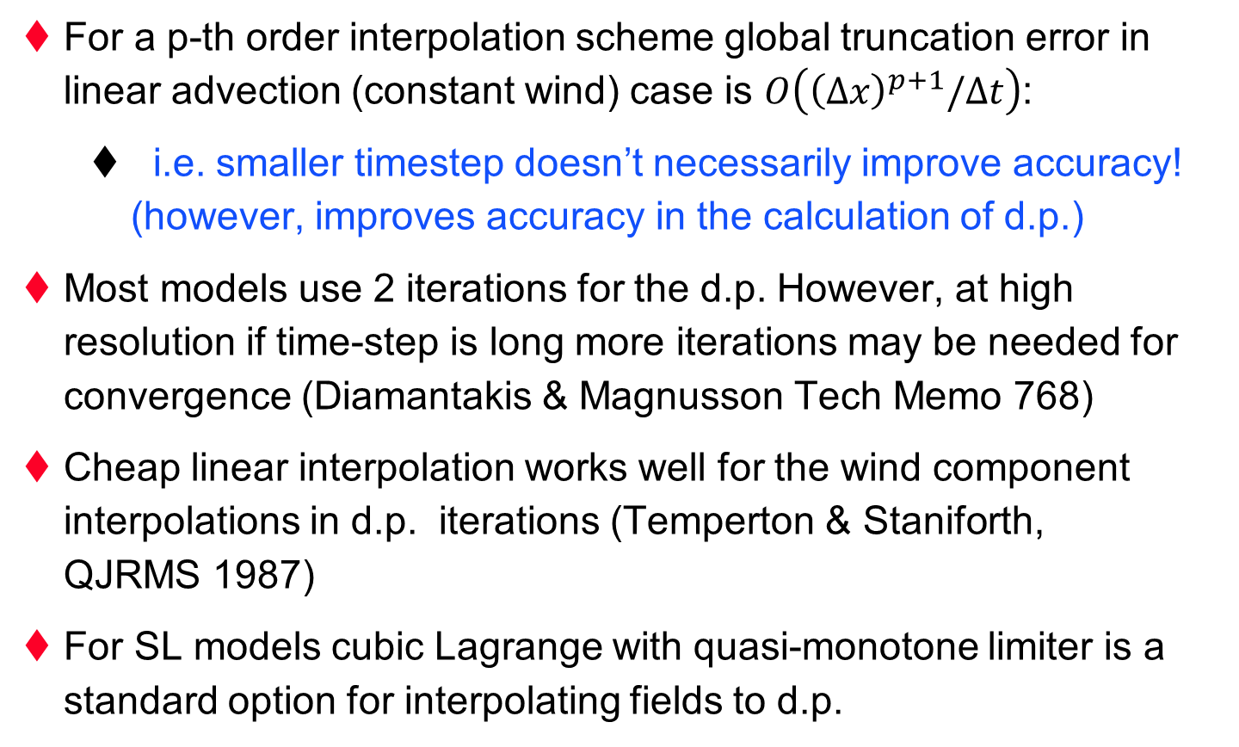
SL issues and practices to be aware
For a p-th order interpolation scheme global truncation error in linear advection (constant wind) case is $O\left({\left(∆x\right)}^{p+1}/∆t\right)$:
  i.e. smaller timestep doesn’t necessarily improve accuracy! (however, improves accuracy in the calculation of d.p.)
Most models use 2 iterations for the d.p. However, at high resolution if time-step is long more iterations may be needed for convergence (Diamantakis & Magnusson Tech Memo 768)
Cheap linear interpolation works well for the wind component interpolations in d.p. iterations (Temperton & Staniforth, QJRMS 1987)
For SL models cubic Lagrange with quasi-monotone limiter is a standard option for interpolating fields to d.p.

Slide 17
Applying SLSI time stepping to NWP eqns
We want to solve a nonlinear system of m-prognostic equations:
Integrate along SL trajectory and approximate (using 2nd order trapezoidal scheme):
  Linearize fast nonlinear terms e.g.
e.g. X=(u,v,T,p,q,…)
Implicit and nonlinear coupling.
nonlinear “slow” terms: these will be integrated explicitly
“Fast linearized” (GW/acoustic) terms will be integrated implicitly

Slide 18
Applying SLSI to NWP eqns (II)
Two-time-level, 2nd order IFS discretization (Temperton et al, QJRMS 2001):
interpolate to d.p.
can be obtained “explicitly” using one of the two extrapolation schemes discussed:
Simple 2nd order scheme
all right-hand side terms are given
SETTLS: operational forecast scheme
2nd order accurate formula (can be verified by Taylor expansion)

Slide 19
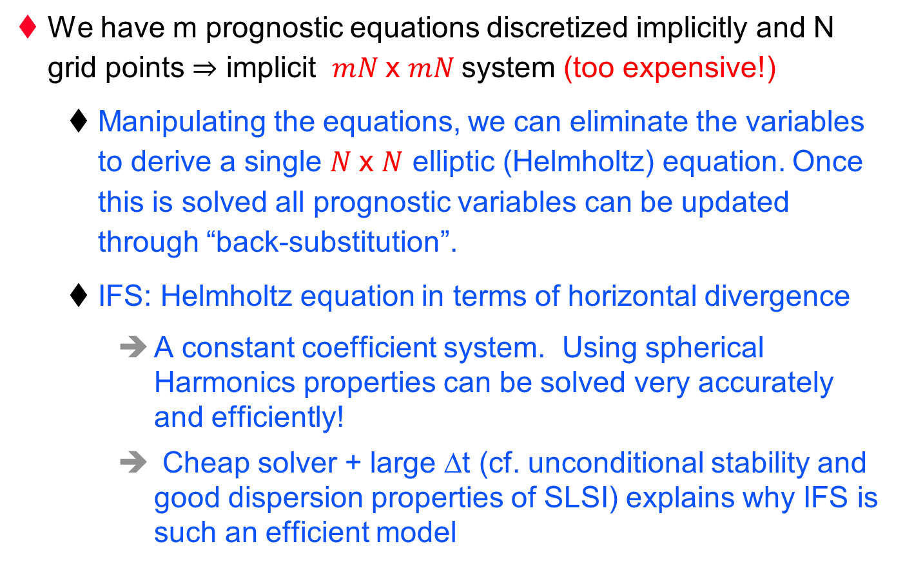
Assembling all equations: Helmholtz solver
We have m prognostic equations discretized implicitly and N grid points ⇒ implicit $mN$x $mN$system (too expensive!)
  Manipulating the equations, we can eliminate the variables to derive a single $N$x $N$ elliptic (Helmholtz) equation. Once this is solved all prognostic variables can be updated through “back-substitution”.
  IFS: Helmholtz equation in terms of horizontal divergence
    A constant coefficient system. Using spherical Harmonics properties can be solved very accurately and efficiently!
    Cheap solver + large ∆t (cf. unconditional stability and good dispersion properties of SLSI) explains why IFS is such an efficient model

Slide 20
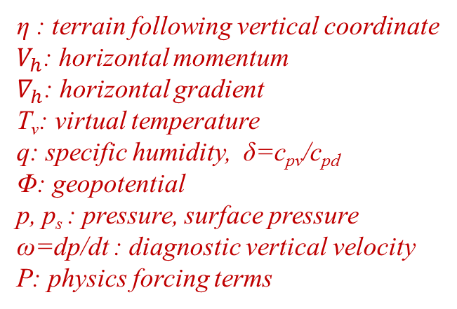
2-TL SLSI integration of IFS hydrostatic PE set
η : terrain following vertical coordinate
$V_{h}$: horizontal momentum
$∇_{h}$: horizontal gradient
T_{v}: virtual temperature
q: specific humidity, δ=c_{pv}/c_{pd}
Φ: geopotential
p, p_{s} : pressure, surface pressure
ω=dp/dt : diagnostic vertical velocity
P: physics forcing terms
Continuity derivation:
(Eulerian form)
BCs:
Fast nonlinear terms linearized to define L, N:
Term is further simplified using vertical coordinate definition: p=A(η)+B(η)p_{s}
nonlinear but slow changing
linear but fast changing
Notes:
2 omega x r = (2 omega cos(theta),0)

Slide 21
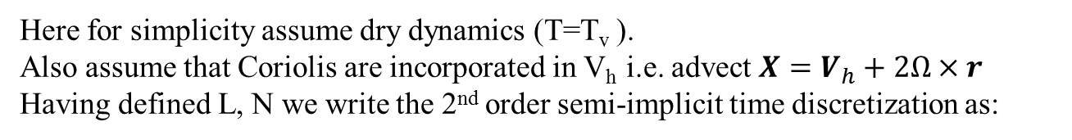
Deriving Helmholtz equation (part I)
Here for simplicity assume dry dynamics (T=T_{v} ).
Also assume that Coriolis are incorporated in V_{h} i.e. advect ${X=V}_{h}+2Ω×r$
Having defined L, N we write the 2nd order semi-implicit time discretization as:

Slide 22
Deriving and solving Helmholtz equation
Eliminate T, ln p_{s} to derive a Helmholtz equation wrt to D:
α=0.5
( off-centring i.e. α-value >0.5 increases damping. It is an option in IFS code but is not used operationally – reduces accuracy while not needed mostly due to continuity formulation)
Define:
Decouple equations by diagonalizing Γ, transform in spectral space
1 trivial eqn/lev
Back-substitute to update remaining fields

Slide 23
A simplified view of IFS timestepping
Transform variables from Spectral->Gridpoint space
Compute R.H.S. terms of equations at time t
Call radiation parametrization scheme (currently every 3 hrs) and store output
Call SL advection: compute d.p. + interpolate model variables and RHS terms at d.p.
and update time t estimate of model variables
Update variables adding radiation tendencies ->call vertical diffusion + update -> call GWdrag + update -> call convection + update -> call cloud scheme + update
Transform variables: Gridpoint-> Spectral space
Solve Helmholtz problem -> do final update of variables (back-substitution) -> add horizontal diffusion

Slide 24
Issues in SI time stepping to be aware
SI time stepping as implemented in IFS and other operational models is not strictly unconditionally stable
  extrapolations are a source of instability. Therefore,
    need to carefully consider how to split the right hand side to fast linear (L) and slow nonlinear (N) terms
  In IFS SETTLS extrapolation of nonlinear terms is used
Iterative approach can eliminate such stability problems
  Available in IFS (ICI: Iterative Centred Implicit)
  Iterative approach works like predictor-corrector: no need to extrapolate at the corrector stage as a good predictor for the atmospheric state at t+∆t exists. However, expensive!

Slide 25
Limitations of the SLSI approach
Not formally conserving
  In long integrations mass drifts and needs to be “fixed”
  In IFS and most SL models mass fixers are used for tracers and air mass in long simulations (GMD 2014, Diamantakis & Flemming)
  Inherently mass conserving SL schemes do exist but haven’t been used into operations so far (expensive, issues with complex terrain)
Scalability issues at convection permitting resolution:
  IFS: high communication cost of transpositions (gridpoint -> spectral -> gridpoint)
  UKMO: high cost Helmholtz solver on lat/lon grid

Slide 26
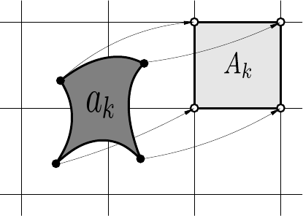
Brief note on inherently conserving SL schemes
Air mass / tracer local and global mass conservation
Essentially, they are finite-volume SL methods (e.g. UK Met Office SLICE-ENDGAME version) . Ensuring that:
  mass in dep volume=mass in arrival (grid) volume
However,for NWP, these are costly alternatives to standard SLSI. But they can outperform Eulerian flux-form methods especially when many tracers are advected (e.g. climate models), an example is CSLAM (Lauritzen et al, JCP 2010)
Picture from
JCP 2010
Lauritzen et al
advected fluid volume
arrival / departure volume

Slide 27
Some references
Staniforth and Cote (MWR 1990) review paper: “Semi Lagrangian schemes for Atmospheric models”
Ritchie et al (MWR 1995): “Implementation of the Semi-Lagrangian Method in a High-Resolution version …”
Temperton, Hortal, Simmons (QJRMS 2001): “A two-time-level semi-Lagrangian global spectral model”
Hortal (QJRMS 2002): “The development and testing of a new two-time level semi-Lagrangian scheme (SETTLS) in the ECMWF forecast model”
Dale Durran’s book: “Numerical methods for Wave Equations in Geophysical Fluid Dynamics” (1999)
Training course notes & references in slides

Slide 28
Thank you for your attention!

