Slide 1
ECMWF/EUMETSAT NWP-SAF Satellite data assimilation Training Course
14-18 Mar 2016

Slide 2
Practical Exercises with 1DVAR

Slide 3
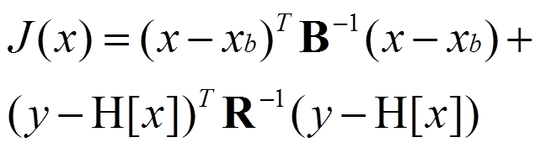
…a helpful linear analogue …
background error
covariance
model state
observations
observation* error
covariance
observation operator
(maps the model state to the observation space)
…when we minimise J(x) …

Slide 4
...we correct background errors
It can be shown that the state that minimizes the cost function is equivalent to a linear correction of the background using the observations:
…where the correction is the Kalman Gain Matrix multiplied by the innovation vector (observation minus radiances simulated from the background)
correction term =
Kalman gain x
innovation

Slide 5
How does the 1DVAR simulator work ?
Define a background profile Xb
Define a background error covariance B
Define an observation error covariance R
Define a true profile Xt
Simulate observed radiances Y from Xt (added noise consistent with assumed R)
Compute H from RT model applied to Xb

Slide 6
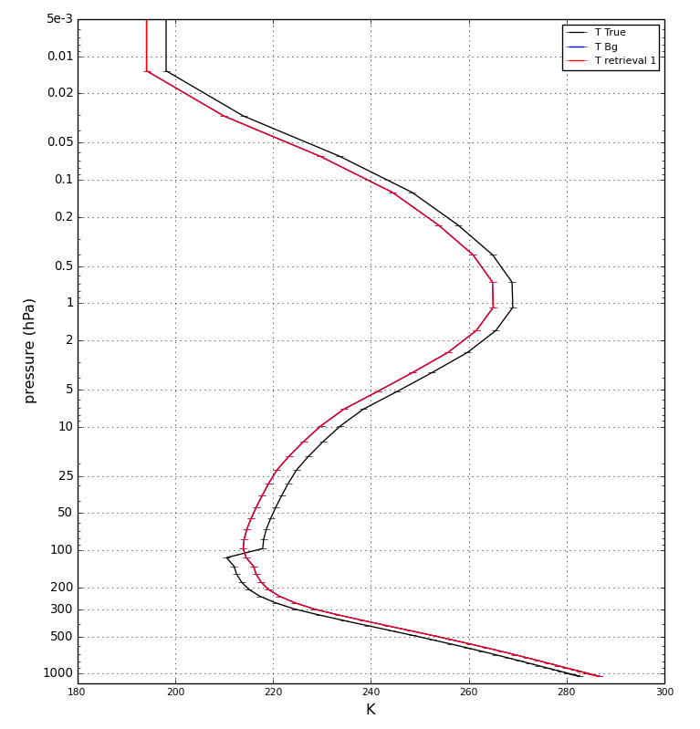
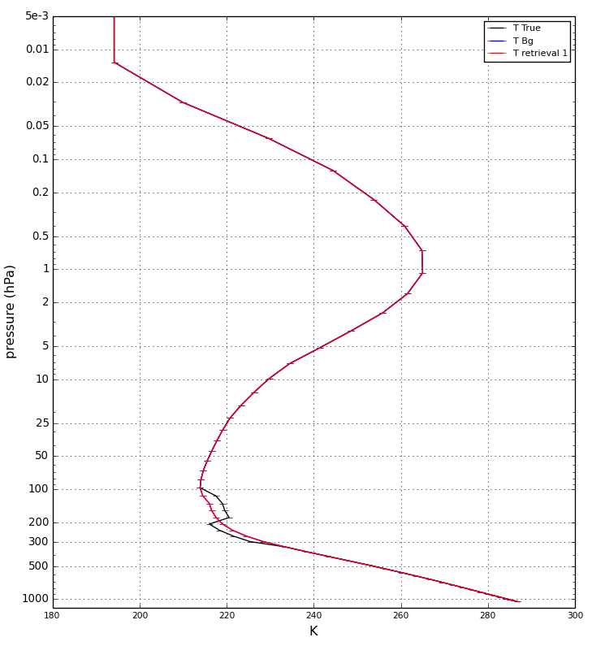
The Background and True profile
OPTION:1
OPTION:2

Slide 7
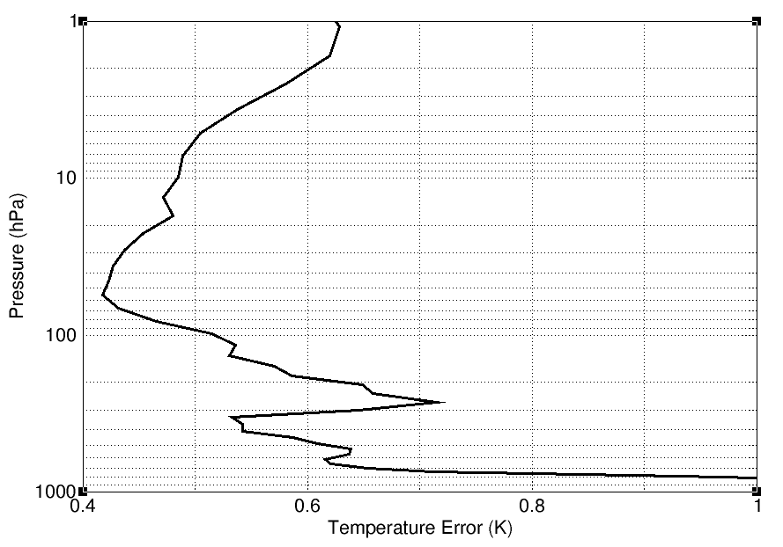
Assumed Background Errors (T)

Slide 8
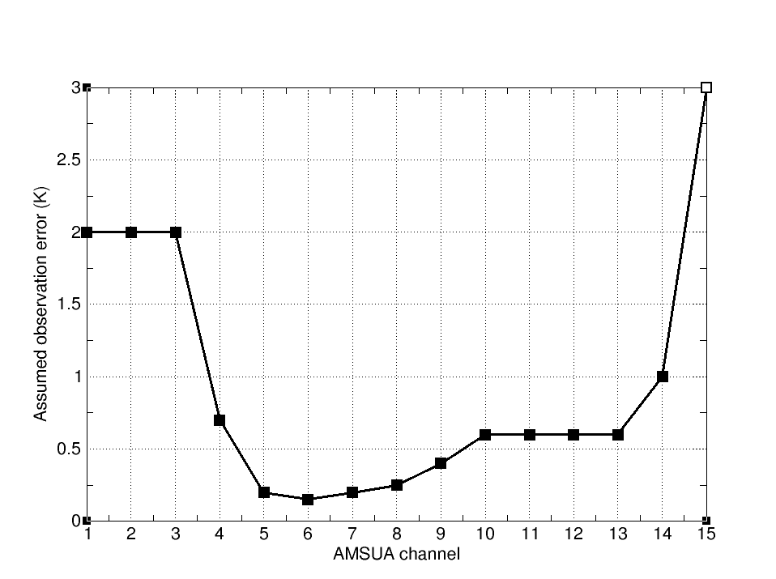
Assumed Observation error for AMSUA

Slide 9
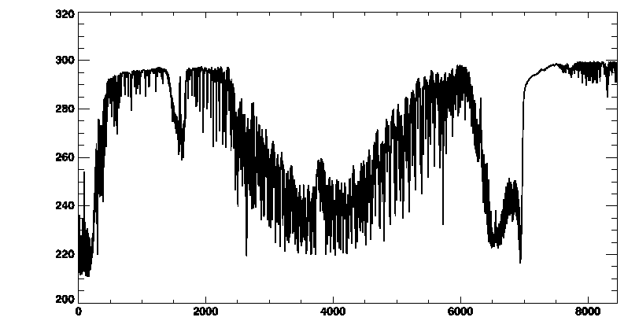
Assumed Observation error for IASI
1.0 K
2.0K
0.4K
15 um
6.4 um
4.2um
3.7 um

Slide 10
Start up the RTTOV GUI with
type:
module load rttov
rttovgui
Class01,trd00, 2tDQohR,

Slide 11
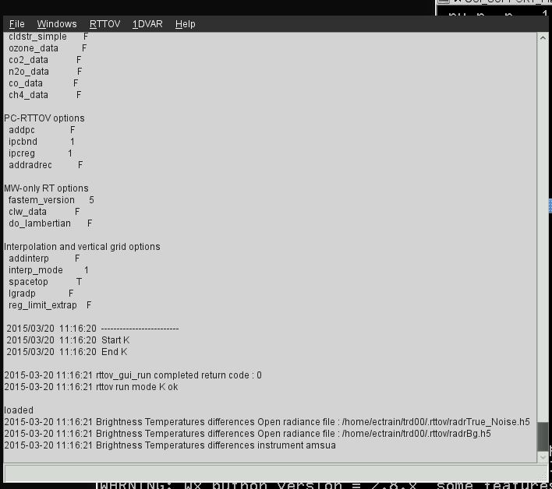
GUI main control window

Slide 12
GUI pull down menus

Slide 13
Open a background profile

Slide 14
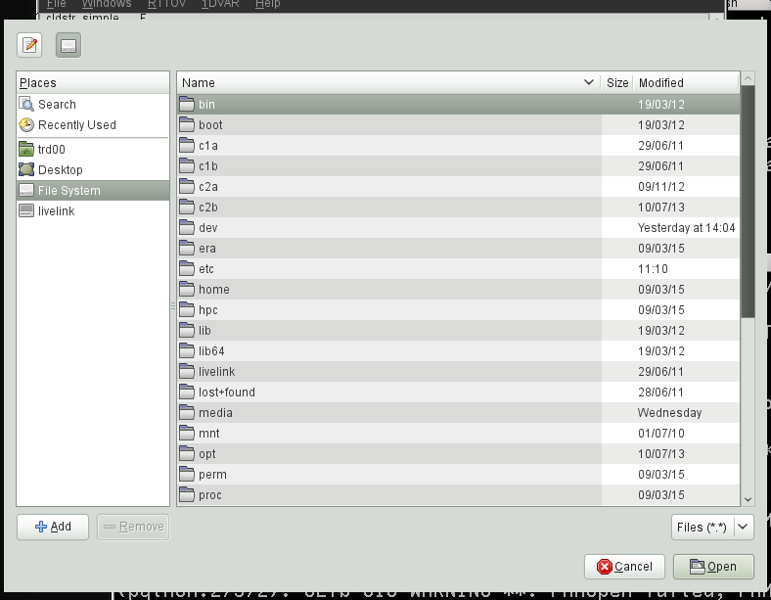
Open a background profile

Slide 15
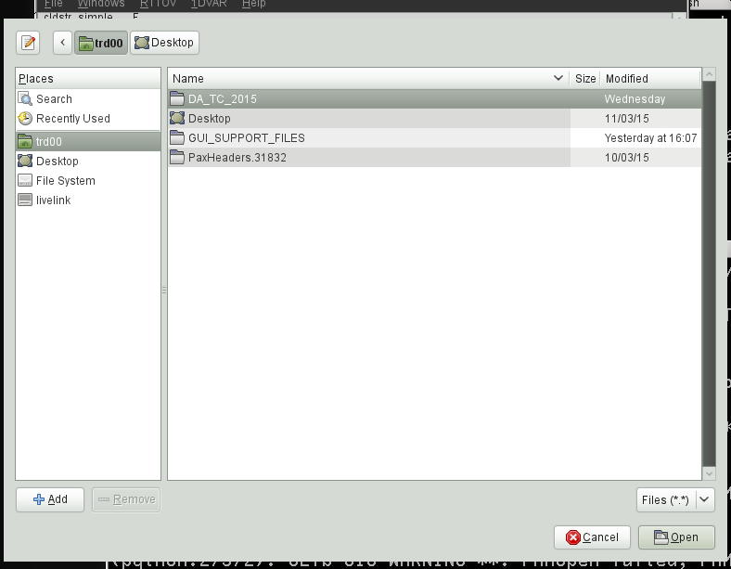
Open a background profile

Slide 16
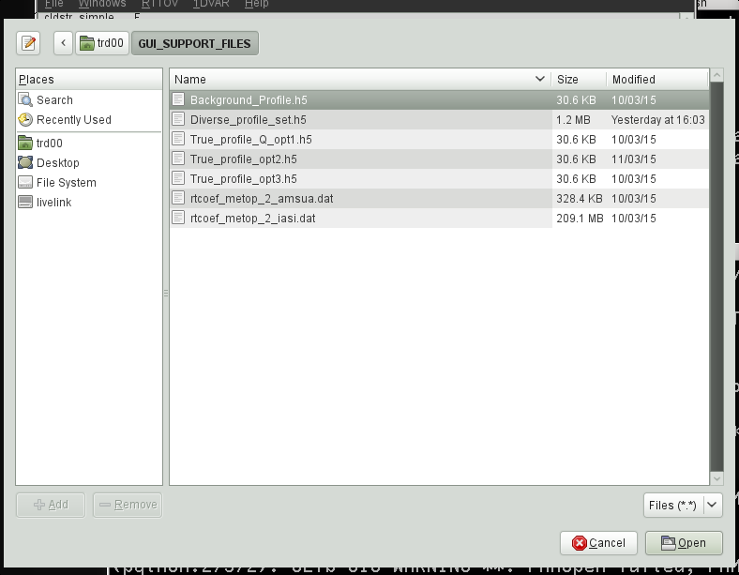
Open a background profile

Slide 17
Open a background profile

Slide 18
Have a quick look at the profile

Slide 19
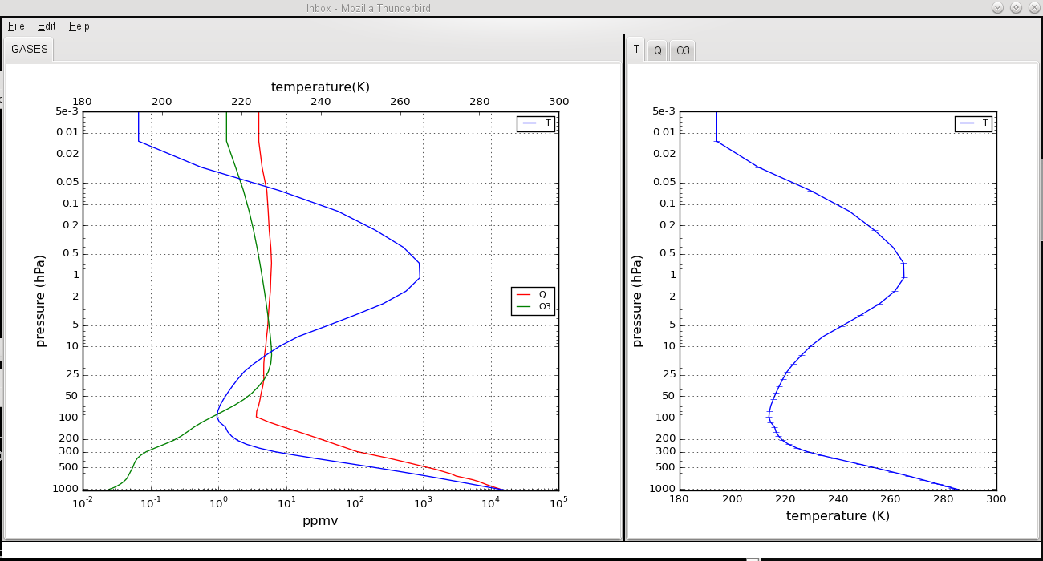
Have a quick look at the profile

Slide 20
Exercise #1 – A single-channel AMSUA retrieval
File/Open Profile to select and Open Background_Profile.h5 from profiles directory (have a quick look at the profile in the Windows/Profile Editor Window)
RTTOV/Load Coefficients to Choose and Open and Load AMSUA RT coefficients rtcoef_metop_2_amsua.dat from coefficients directory
RTTOV/Run RTTOV K to look at weighting functions (use the KP button to look at channel 14)
RTTOV/Select Channels to select channel 14 (peaks ~ 2hPa)
1DVAR/Configure 1DVAR/Open a True Profile to select and Open True_profile_opt1.h5
In 1DVAR algorithm window click RUN 1DVAR retrieval (drag left mouse button to zoom in Retrieved Profile Window, right click to un-zoom)
Play with assumed background error and re-run 1DVAR

Slide 21
Choose and Load AMSUA (RT) coefficients

Slide 22
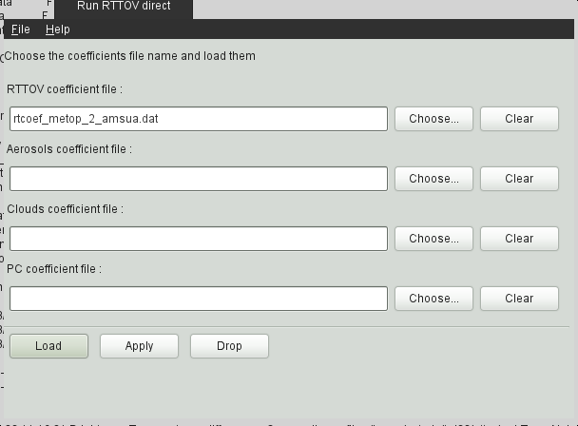
Choosing (RT) coefficients

Slide 23
Choosing (RT) coefficients

Slide 24
Choosing (RT) coefficients

Slide 25
Choosing (RT) coefficients

Slide 26
Choosing (RT) coefficients

Slide 27
Loading (RT) coefficients

Slide 28
Configure the 1DVAR

Slide 29
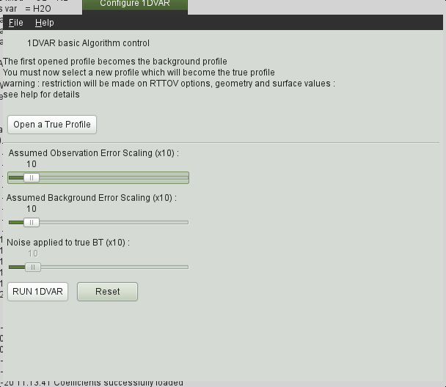
Open a true profile

Slide 30
Open a true profile

Slide 31
Open a true profile

Slide 32
Open a true profile

Slide 33
Open a true profile

Slide 34
Select Channels

Slide 35
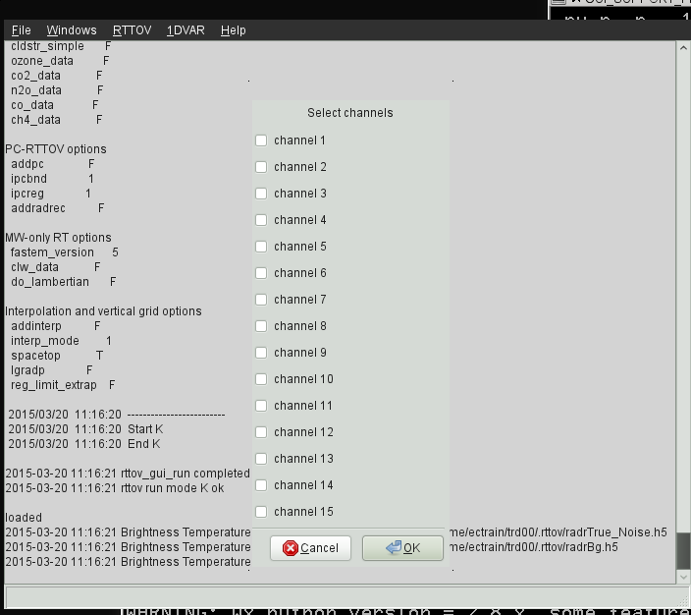
Select Channels (AMSUA-14)

Slide 36
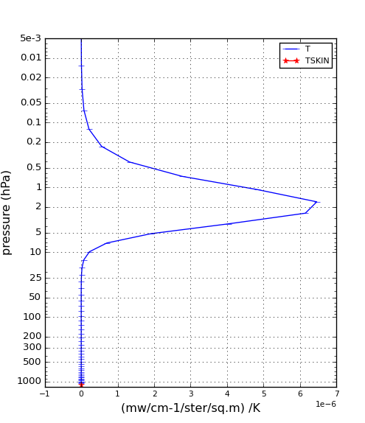
Select Channels (AMSUA-14)
Weighting function for AMSUA channel 14

Slide 37
Run the 1DVAR

Slide 38
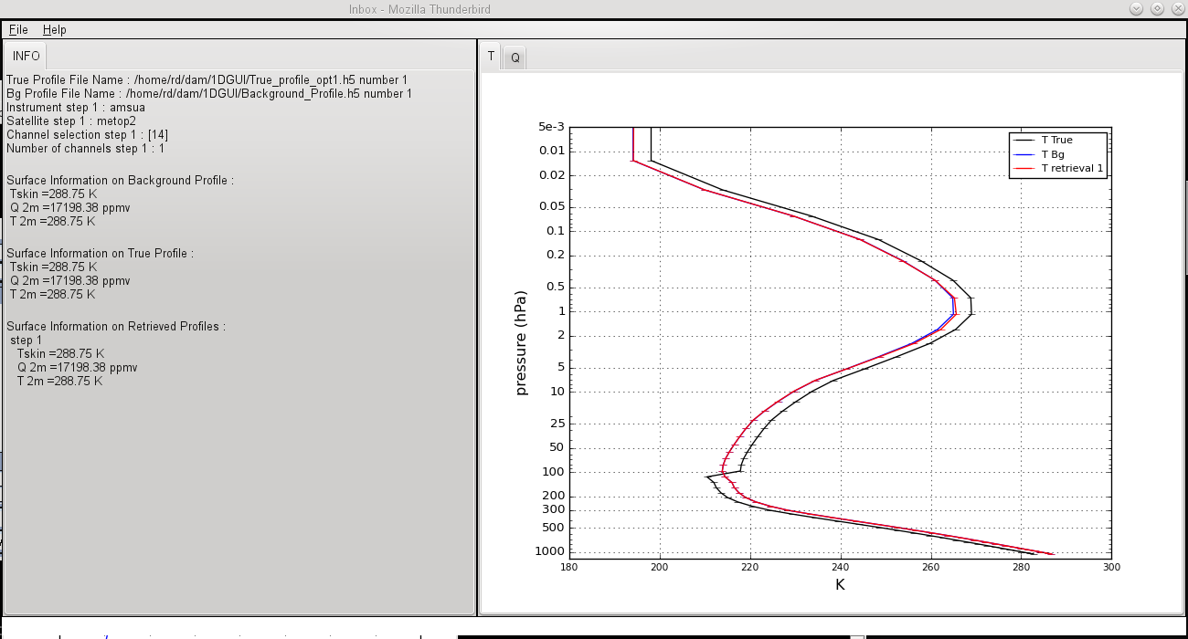
Run the 1DVAR

Slide 39
Try inflating background errors (x10)
…and run the 1DVAR again…

Slide 40
Exercise #2 – A multi-channel AMSUA retrieval
File/Open Profile to select and Open Background_Profile.h5 from profiles directory
RTTOV/Load Coefficients to Choose and Open and Load AMSUA RT coefficients rtcoef_metop_2_amsua.dat from coefficients directory
RTTOV/Run RTTOV K to look at weighting functions (note the use of all channels gives good vertical coverage through the profile column)
1DVAR/Configure 1DVAR/Open a True Profile to select and Open True_profile_opt1.h5
RUN 1DVAR retrieval (play with the background errors to tune)

Slide 41
Select Channels (AMSUA)

Slide 42
Run the 1DVAR

Slide 43
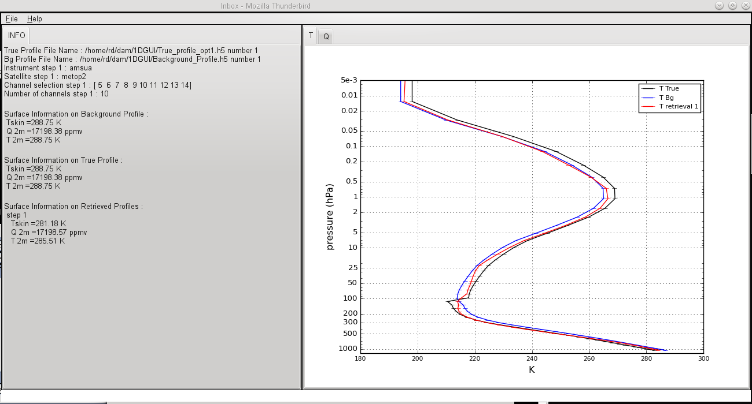
Run the 1DVAR

Slide 44
Exercise #3 – A multi-channel AMSUA retrieval
(difficult case)
File/Open Profile to select and Open Background_Profile.h5 from profiles directory
RTTOV/Load Coefficients to Choose and Open and Load AMSUA RT coefficients rtcoef_metop_2_amsua.dat from coefficients directory
RTTOV/Run RTTOV K to look at weighting functions (note the use of all channels gives good vertical coverage through the profile column)
1DVAR/Configure 1DVAR/Open a True Profile to select and Open True_profile_opt2.h5
RUN 1DVAR retrieval (play with the background errors to tune…does this work ?? What makes this retrieval difficult ?? )

Slide 45
Open a true profile

Slide 46
Open a true profile

Slide 47
Open a true profile

Slide 48
Open a true profile (option-2)

Slide 49
Open a true profile

Slide 50
Run the 1DVAR

Slide 51
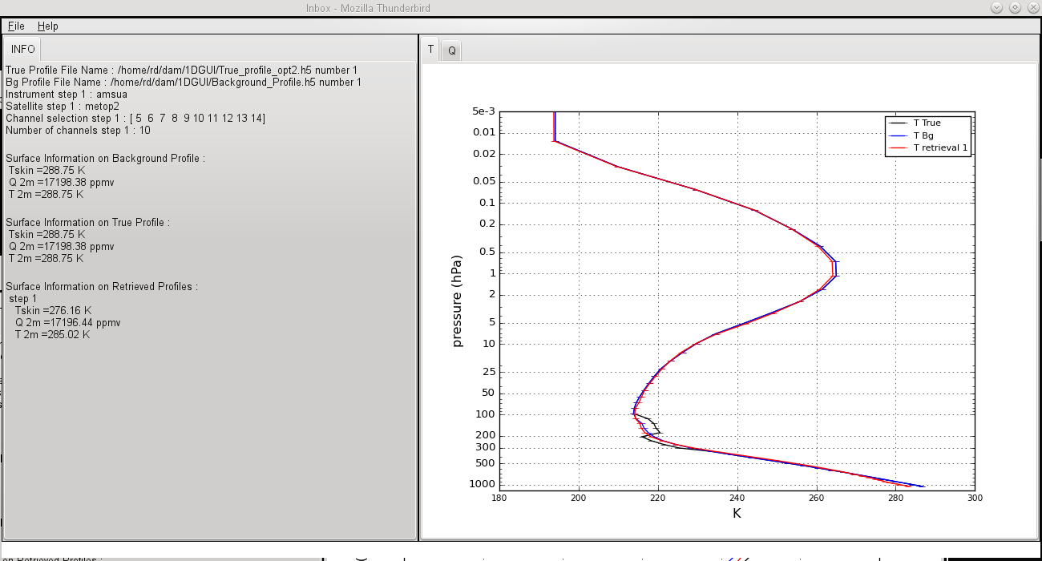
Run the 1DVAR
Why is the performance so bad ??

Slide 52
Exercise #4 – A multi-channel IASI retrieval
(difficult case)
File/Open Profile to select and Open Background_Profile.h5 from profiles directory
RTTOV/Load Coefficients to Choose and Open and Load IASI RT coefficients rtcoef_metop_2_iasi.dat from coefficients directory
RTTOV/Run RTTOV K to look at weighting functions (note the use of all channels gives good vertical coverage through the profile column)
RTTOV/Select Channels to select a channel thinning factor (e.g. 10)
1DVAR/Configure 1DVAR/Open a True Profile to select and Open True_profile_opt2.h5
RUN 1DVAR retrieval (play with the background errors to tune…does this work ?? Try using just different parts of the IASI spectrum)

Slide 53
Choose and Load (RT) coefficients

Slide 54
Choosing (RT) coefficients

Slide 55
Choosing (RT) coefficients

Slide 56
Choosing (RT) coefficients

Slide 57
Choosing IASI (RT) coefficients

Slide 58
Choosing (RT) coefficients

Slide 59
Loading (RT) coefficients

Slide 60
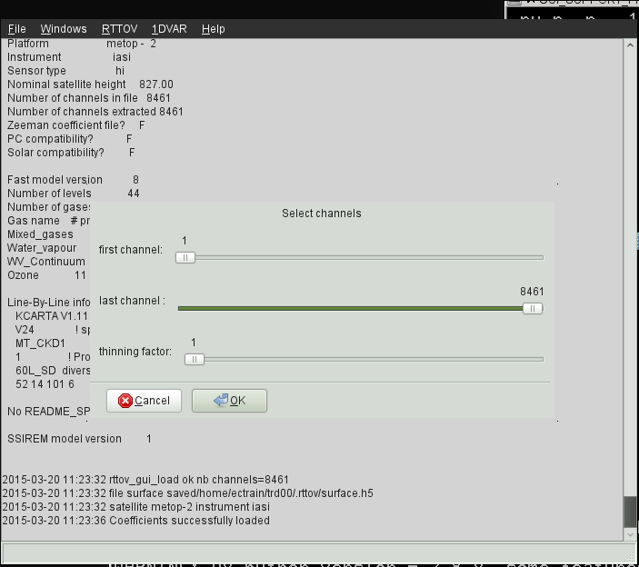
Select Channels (IASI) !!!

Slide 61
Run the 1DVAR

Slide 62
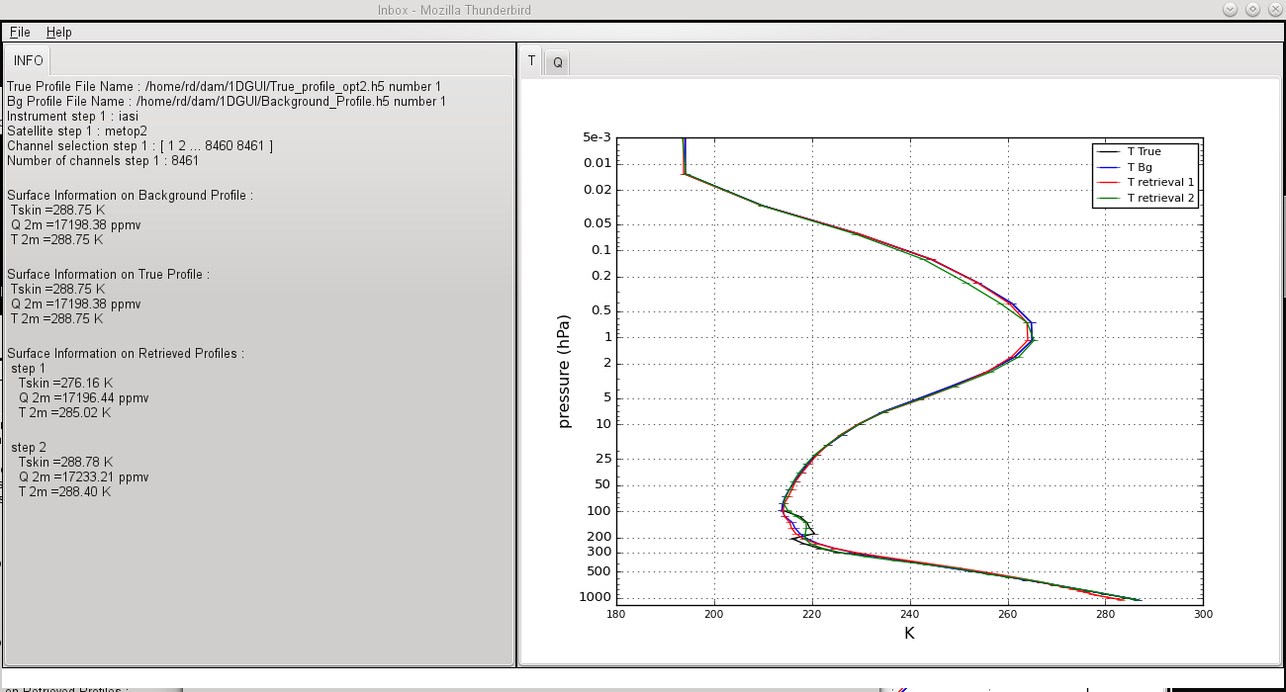
Run the 1DVAR
Why is the performance better than AMSUA ?

Slide 63
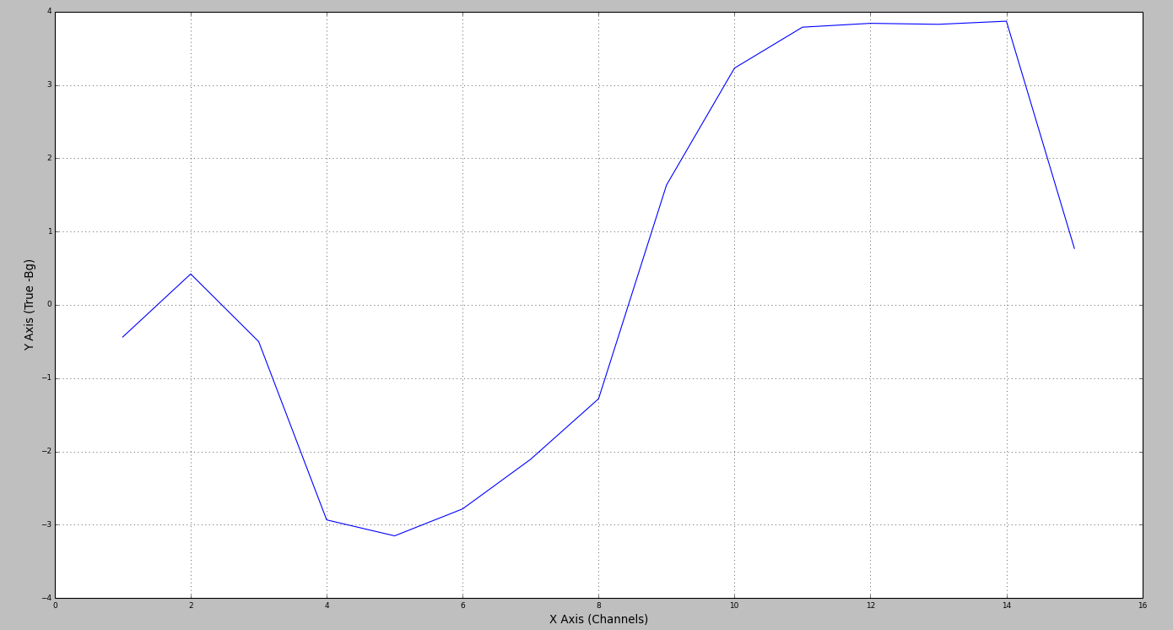
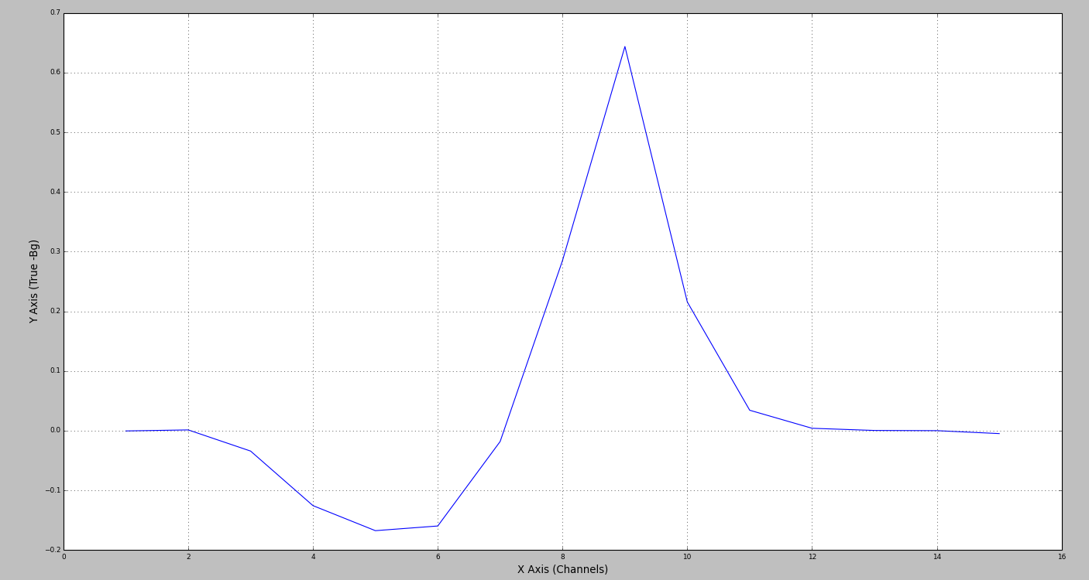
Innovations for AMSU-A channels
OPTION:1
OPTION:2

Slide 64
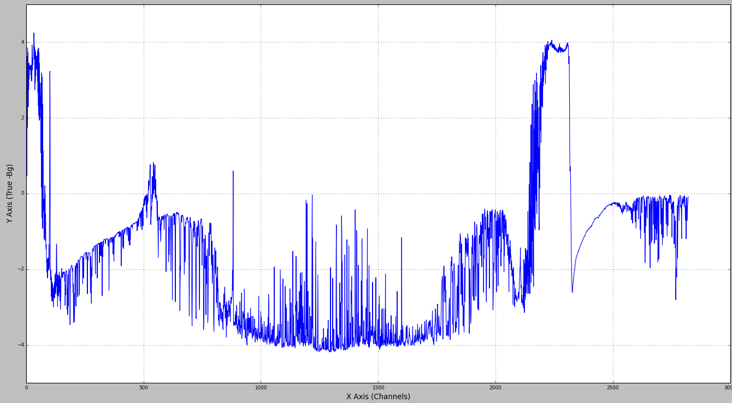
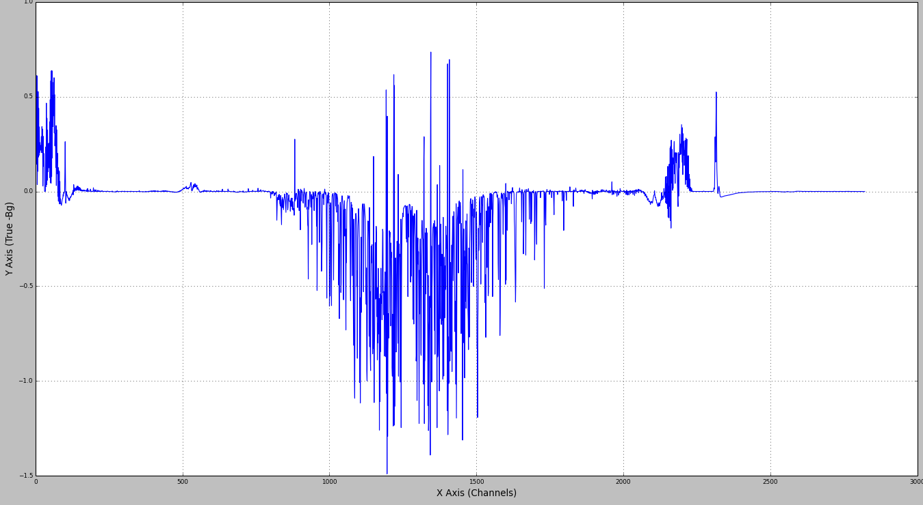
Innovations for IASI channels
OPTION:1
OPTION:2

