Slide 1
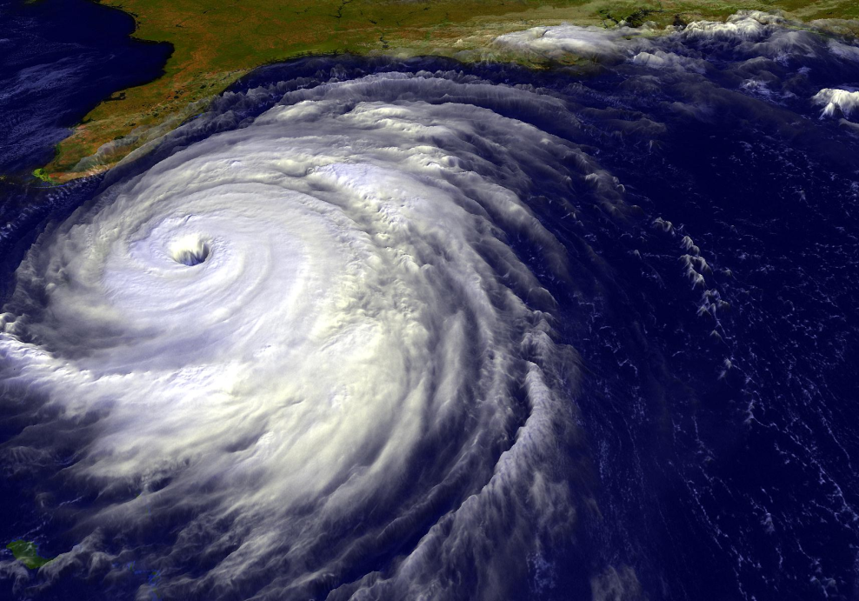
Approaches to
ensemble prediction:
the TIGGE ensembles
(EC/TC/PR/RB-L3)
Roberto Buizza
European Centre for Medium-Range Weather Forecasts
(http://www.ecmwf.int/en/staff/Roberto-buizza)
Notes:
The aim of this lecture is to illustrate the key characteristic of the nine operational global, medium-range ensemble systems.

Slide 2
Abstract and key learning points
The aim of this session is to illustrate the key characteristic of the nine operational global, medium-range ensemble systems. These are the ensembles available also within the TIGGE (Thorpex Interactive Grand Global Ensemble) project data-base. Similarity and differences in the approaches followed to simulate the sources of forecast uncertainties will be discussed, and their relevance for forecast performance will be illustrated.
By the end of the session you should be able to:
illustrate the main similarities and differences of the 9 TIGGE global ensembles
link the performance differences of TIGGE ensemble to their design
describe the main differences between singular vectors and EDA-based perturbations

Slide 3
Outline
Objectives and approaches to ensemble prediction
Comparison of the 2002 ECMWF, MSC and NCEP ensemble systems
The THORPEX/TIGGE global, medium-range ensembles
Notes:
In this lecture we will discuss three key points:
The objectives and approaches to ensemble prediction
The comparison of the three main different approaches to ensemble prediction, developed at ECMWF, MSC and NCEP
The main characteristics of the THORPEX/TIGGE global ensembles
In the first part of this lecture we will briefly review the main objectives and the key approaches to ensemble prediction.

Slide 4
1. Ensemble prediction
Ensemble prediction aims to estimate the probability density function of forecast states, taking into account all possible sources of forecast error:
Observation errors and imperfect boundary conditions
Data assimilation assumptions
Model errors
Model unc
Obs and BCs errors
DA assumptions
Model unc
Obs and BCs errors
DA assumptions
PDF(T)
PDF(0)
time
Notes:
We have seen in the previous lectures that ensemble prediction aims to estimate the probability density function of forecast states, taking into account all possible sources of forecast error:
Model errors (e.g. due to a lack of resolution, simplified parameterization of physical processes, arbitrariness of closure assumptions, the effect of unresolved processes)
Observation errors (observations have a finite precision, point observations may not be very representative of what happens inside a model grid box)
Imperfect boundary conditions (e.g. albedo, roughness length, soil moisture, snow cover, vegetation properties, sea surface temperature)
Data assimilation assumptions (e.g. relative weights given to observations, statistics).
There is not a unique way to achieve this.

Slide 5
1. What should an ensemble prediction simulate?
Two schools of thought:
Monte Carlo approach: sample all sources of forecast error, perturb any input variable and any model parameter that is not perfectly known. Take into consideration as many sources as possible of forecast error.
Reduced sampling: sample leading sources of forecast error, prioritize. Rank sources, prioritize, optimize sampling: growing components will dominate forecast error growth.
There is a strong constraint: limited resources
(man and computer power)!
Notes:
Generally speaking, we could identify two main schools of thought:
A pure ‘Monte Carlo’ one: sample all sources of forecast error. Rationale: perturb any input variable (observations, boundary fields, …) and any parameter that is not perfectly known. Take into consideration as many sources as possible of forecast error
A ‘reduced sampling’ one: sample leading sources of forecast error (prioritize). Rationale: due to the complexity and high dimensionality of the system properly sampling the leading sources of errors is crucial. Rank sources, prioritize, optimize sampling: growing components will dominate forecast error growth.

Slide 6
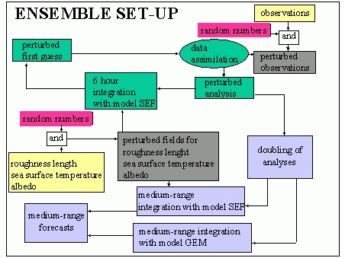
1. Monte Carlo approach (MSC): all-inclusive design
The original (1995) MSC ensemble was designed following a Monte Carlo approach to simulate:
observation errors (random perturbations);
imperfect boundary conditions (perturbed surface fields);
model errors (different parameterisations and originally also 2 models, random error component added to the initial perturbations).
The MSC ensemble
Notes:
The original MSC ensemble aimed to develop a full, Monte Carlo appraoch to ensemble prediction. In the original MSC ensemble the perturbed initial conditions were generated by running an ensemble of assimilation cycles that use perturbed observations and different models (Monte Carlo approach). Now MSC uses an Ensemble Kalman Filter (EnKF) to generate the initial perturbations.

Slide 7
1. Simulation of init-unc: selective sampling
In the original ECMWF and NCEP ensembles (1992), the initial conditions are generated by adding perturbations to the unperturbed analysis.
The initial perturbations were designed to span only a subspace of the phase space of the system (selective sampling):
  ‘dynamically dominant’ directions at ECMWF
  ‘analysis dominant’ directions at NCEP
Notes:
By contrast, both ECMWF and NCEP, acknowledging that resources are limited and not all sources of uncertainty can be simulated, decided to identify the key sources of forecast uncertainty, and to simulate those. This is the approach followed by the two centres who, first, implemented operational ensembles at the end of 1992.

Slide 8
1. Selective sampling: singular vectors (ECMWF)
A perturbation time evolution is linearly approximated:
The singular vectors, i.e. the perturbations with the fastest finite-time growth:
are computed by solving:
time T
Notes:
At ECMWF, attention initially focused on the initial uncertainties, and a method was developed to compute perturbations with maximum growth measured in terms of total energy. The adjoint of the tangent forward propagator with respect to the total-energy norm was defined, and the singular vectors, i.e. the fastest growing perturbations, were computed by solving an eigenvalue problem. SVs are still used in the operational ENS.

Slide 9
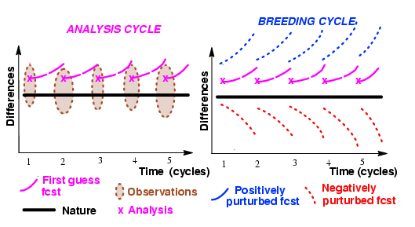
1. Selective sampling: breeding vectors (NCEP)
At NCEP a different strategy based on perturbations growing fastest in the analysis cycles (bred vectors, BVs) was followed
Each BV was computed by a cycle of (a) adding a random perturbation, (b) evolving and (c) rescaling it, and then repeat steps (b-c).
Notes:
At NCEP also attention initially focused on the initial uncertainties. A different strategy based on perturbations growing fastest in the analysis cycles (bred vectors, BVs) was followed (as we will discuss later, please note that today NCEP uses the Ensemble Transformed with Rescaling, ETR, method, a refinement of their original scheme). The breeding cycle was designed to mimic the analysis cycle: each BV was computed by a cycle of (a) adding a random perturbation, (b) evolving and (c) rescaling it, and then repeat steps (b-c).

Slide 10
Outline
Objectives and approaches to ensemble prediction
Comparison of the 2002 ECMWF, MSC and NCEP ensemble systems
The THORPEX/TIGGE global, medium-range ensembles
Notes:
After this brief recap of the main objectives and approaches to ensemble prediction, let’s now focus on the three ensembles developed at ECMWF, MSC and NCEP. These three systems were the first to be implemented operationally. The ones that followed are based on the ideas that were developed at these three centres. This is why it is worth to re-examine how their design affected ensemble performance (reliability, spread, skill, ..).

Slide 11
2. The 2002 ECMWF, MSC and NCEP systems
Results based on the 2002 operational systems are relevant since they highlight the relative impact of initial perturbation methods, analysis and model characteristics on ensemble performance.
In all ensembles, each member is given by integrating the following equation:
Notes:
The results in this section are based on the comparison of the three systems operational in 2002, when NCEP was still using BVs and MSC a system simulation approach (see Buizza et al 2005). The results from this comparison are still relevant since they highlight the relative impact of initial perturbation methods, analysis and model characteristics on ensemble performance. Generally speaking, in all ensembles each single forecast is given by integrating the model equations from e_{j}(0), its initial conditions. P_{j}(e_{j},t) represents the model tendency component due to parameterized physical processes, dP_{j}(e_{j},t) represents random model errors (e.g. due to parameterized physical processes or sub-grid scale processes) and A_{j}(e_{j},t) is the remaining tendency component.

Slide 12
2. The 2002 ECMWF, MSC and NCEP systems
The perturbed initial conditions can be defined directly by a perturbed analysis
or by adding a perturbation to the unperturbed analysis e₀(0)
where e_{j}(-τ) is the DA starting point and o_{j}(-τ÷τ) represents observations.
Notes:
In terms of initial uncertainties, at ECMWF and NCEP, the ICs of each ensemble member were computed by adding a perturbation (defined differently at the two centres) to an unperturbed IC, defined by the interpolation (at the ensemble resolution) of the operational analysis. At MSC, instead, each IC was computed by a separate assimilation procedure.

Slide 13
2. The 2002 ECMWF, MSC and NCEP systems
The three ensembles differ also in size, resolution, daily frequency and forecast length. In 2002, the three systems had the following characteristics:
Notes:
In terms of model uncertainties, in 2002 the Canadian ensembles was using two different dynamical cores, different parameterisations and a stochastic model error schemes. At ECMWF, we were using the original version of the SPPT scheme. At NCEP, there was no model error scheme. The three ensembles differed also in resolution, membership and forecast length.

Slide 14
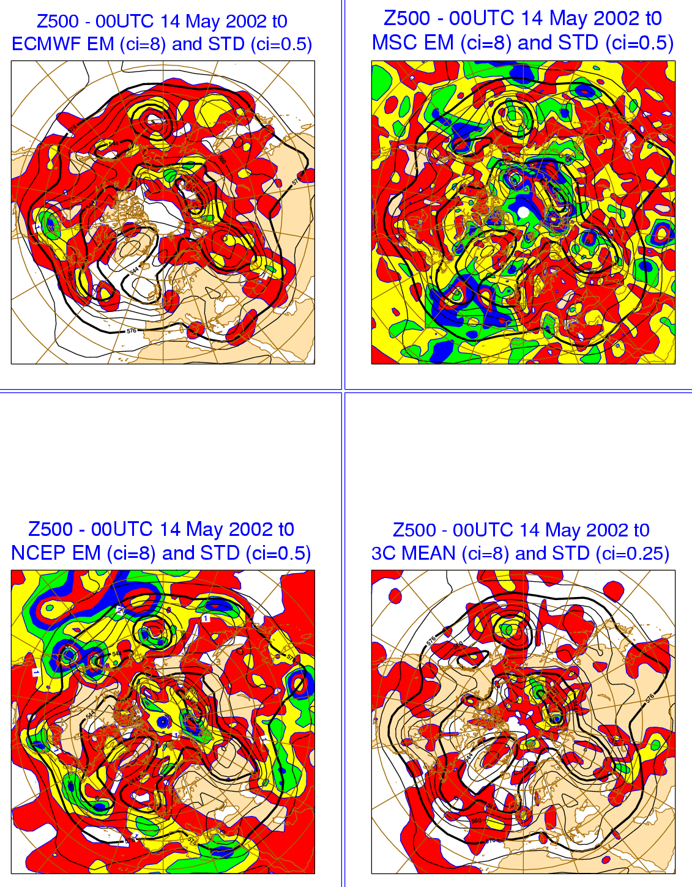
2. Similarities in EM & STD: 14/05/02 t=0
Due to the different methodologies, the ensemble initial states are different.
Area: the ensembles’ put emphasis on different areas; EC has the smallest amplitude over the tropics.
Amplitude: the ensembles’ stds are larger than the std of the 3-centers’ analyses (2 times smaller contour interval); EC has ~2 times lower values over NH.
Ref=std(ANj)
Notes:
How similar/different were PDFs from the three ensembles? We will illustrate this by looking at one specific case (IC 14 May 2002, 00 UTC) and at average statistics (May 2002). The comparison is based on 10-member ensembles from each system.
This figure shows the ensemble mean and standard deviation at initial time for 00UTC of 14 May 2002. The bottom-right panel shows the mean and the std of the 3 centers’ analyses.
Area: the three ensembles’ put emphasis on different areas; EC has the smallest amplitude over the tropics.
Amplitude: the ensembles’ stds are larger than the std of the 3-centers’ analyses (2 times smaller contour interval); EC has ~2 times lower values over NH.

Slide 15
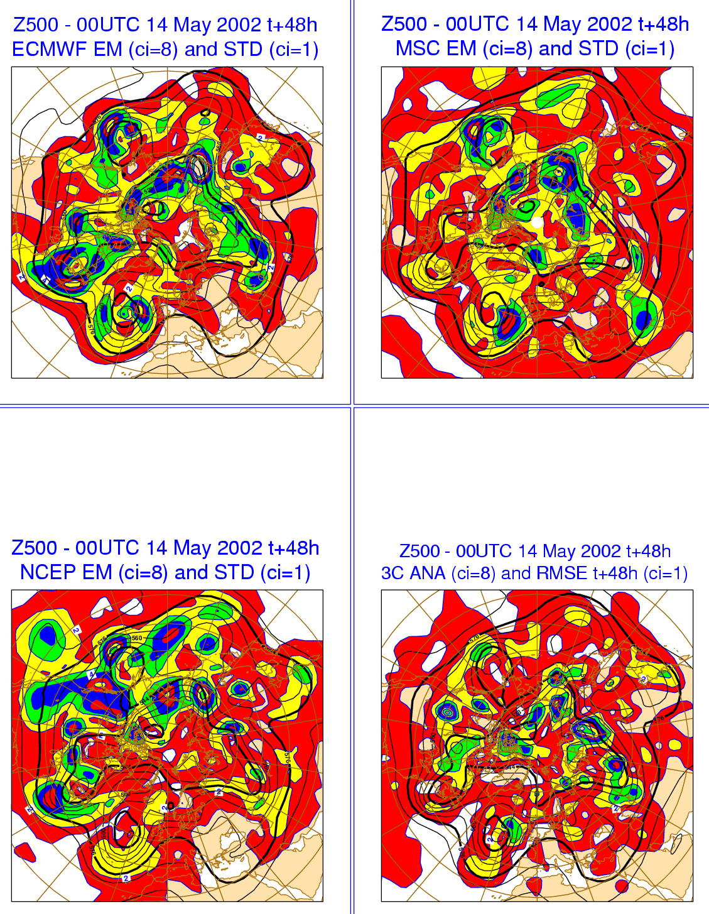
2. Similarities in EM & STD: 14/05/02 +48h
After 48h, the ensemble spreads are more similar, all identifying the main areas where the average of the ens-mean errors is larger.
Area: there is some degree of similarity among the areas covered by the evolved perturbations.
Amplitude: similar over NH; EC smaller over tropics.
Std-vs-rmse: certain areas of large spread coincide with areas of large error.
Ref=std(EMj-ANj)
Notes:
This figure shows the t+48h ensemble mean and standard deviation started at 00UTC of 14 May 2002. The bottom-right panel shows the 3-centers’ average analysis and root-mean-square error.
Area: there is some degree of similarity among the areas covered by the evolved perturbations.
Amplitude: similar over NH; EC smaller over tropics.
Std-vs-rmse: certain areas of large spread coincide with areas of large error.

Slide 16
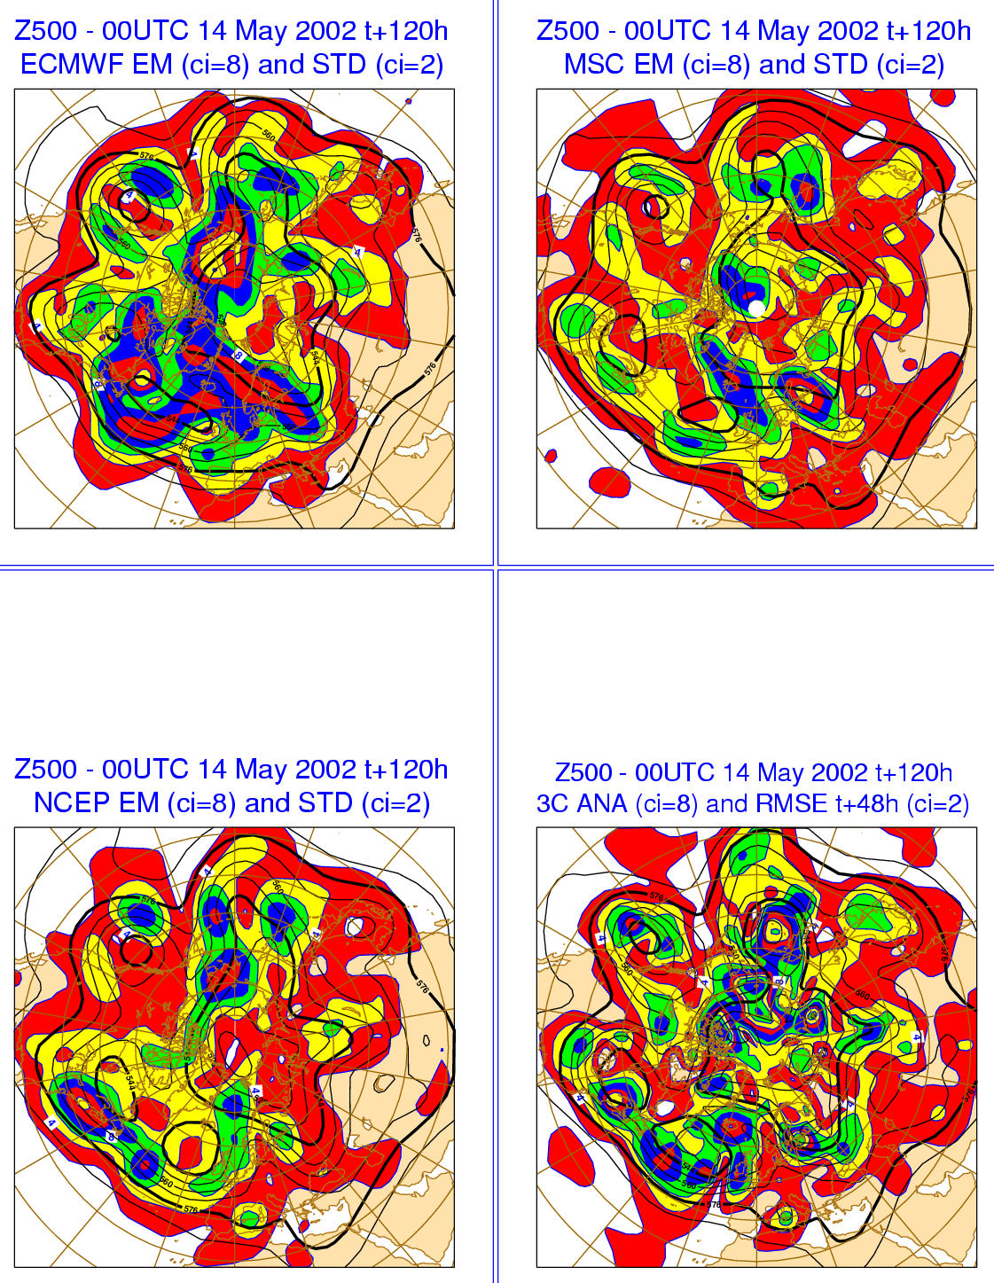
2. Similarities in EM & STD: 14/05/02 +120h
After 120h, ensemble spreads are even more similar, all identifying the main regions where the average of the ens-mean errors is larger.
Area: perturbations show maximum amplitude in similar regions.
Amplitude: EC perturbations have larger amplitude.
Std-vs-rmse: there is a certain degree of agreement between areas of larger error and large spread.
Ref=std(EMj-ANj)
Notes:
This figure shows the t+120h ensemble mean and standard deviation started at 00UTC of 14 May 2002. The bottom-right panel shows the 3-centres’ average analysis and average forecast root-mean-square error.
Area: perturbations show maximum amplitude in similar regions.
Amplitude: EC perturbations have larger amplitude.
Std-vs-rmse: there is a certain degree of agreement between areas of larger error and large spread.

Slide 17
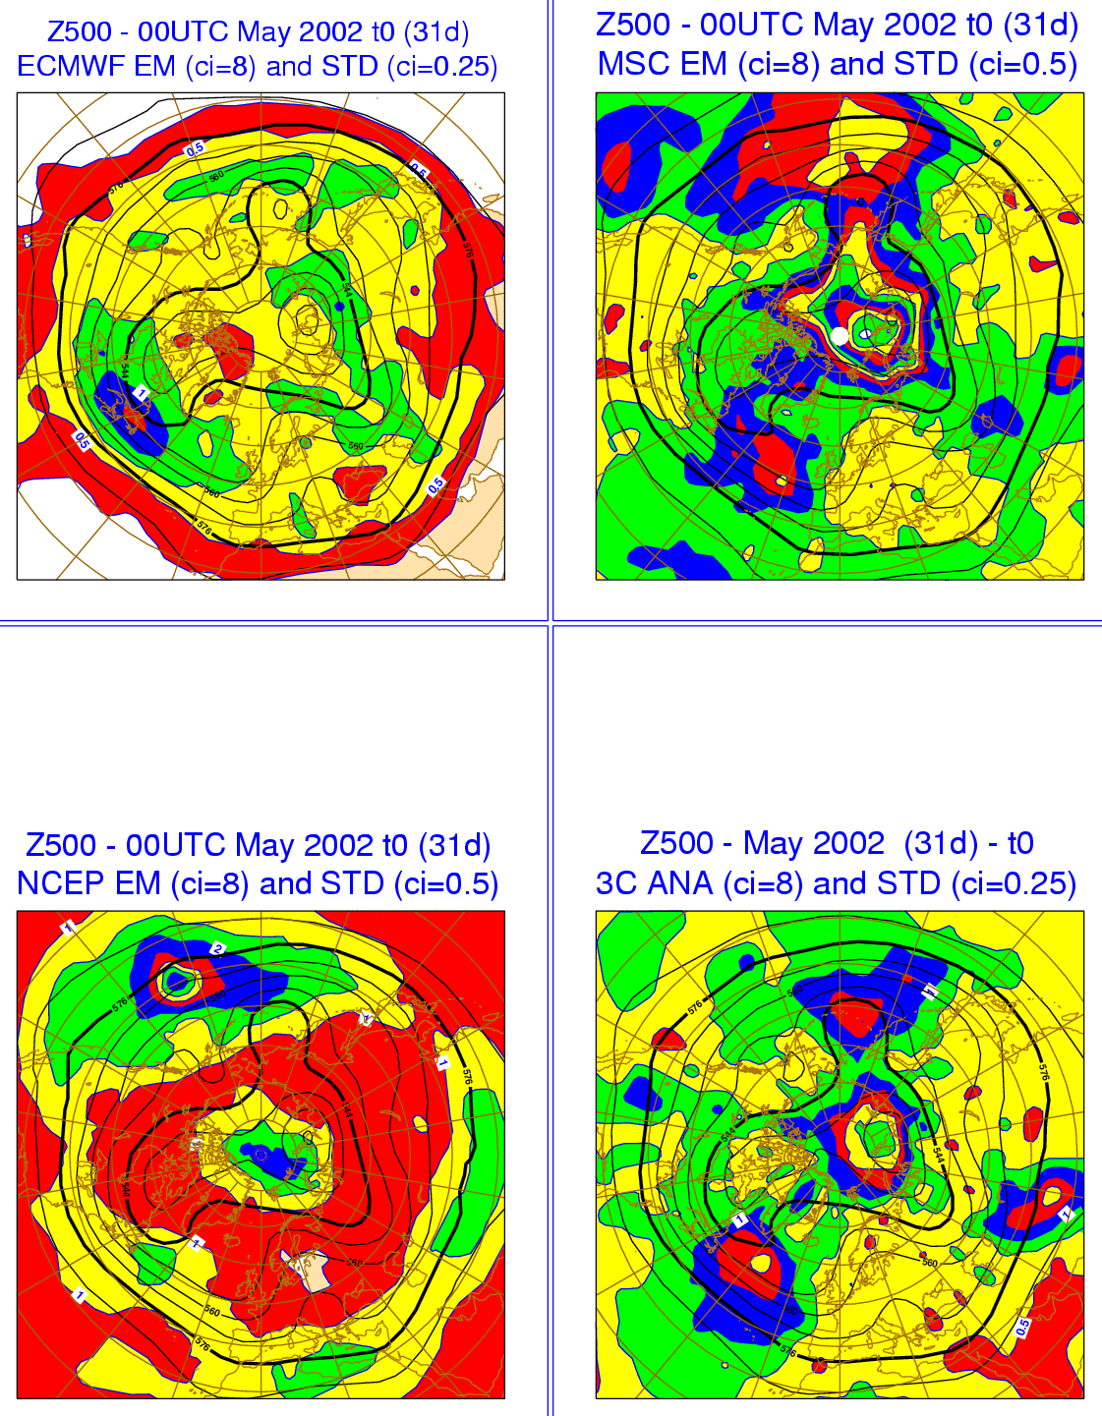
2. Similarities in EM & STD: May ‘02 t=0
Average results for May 2002 confirm that the three ensembles have different initial-time spread.
Area: NCEP and MSC peak over the Pacific ocean and the Polar cap while EC peaks over the Atlantic ocean; MSC shows clear minima over Europe and North America.
Amplitude: MSC and NCEP are ~2 times larger than the std of the 3 centres’ analyses (2-times larger contour interval); EC has amplitude similar to 3C-std over NH but has too small amplitude over the tropics.
Ref=std(EMj-ANj)
Notes:
This figure shows the May02-average ensemble mean and standard deviation at initial time (10 members, 00UTC). The bottom-right panel shows the average and the std of the 3-centres’ analyses.
Area: NCEP and MSC peak over the Pacific ocean and the Polar cap while EC peaks over the Atlantic ocean; MSC shows clear minima over Europe and North America.
Amplitude: MSC and NCEP are ~2 times larger than the std of the 3 centres’ analyses (2-times larger contour interval); EC has amplitude similar to 3C-std over NH but has too small amplitude over the tropics.

Slide 18
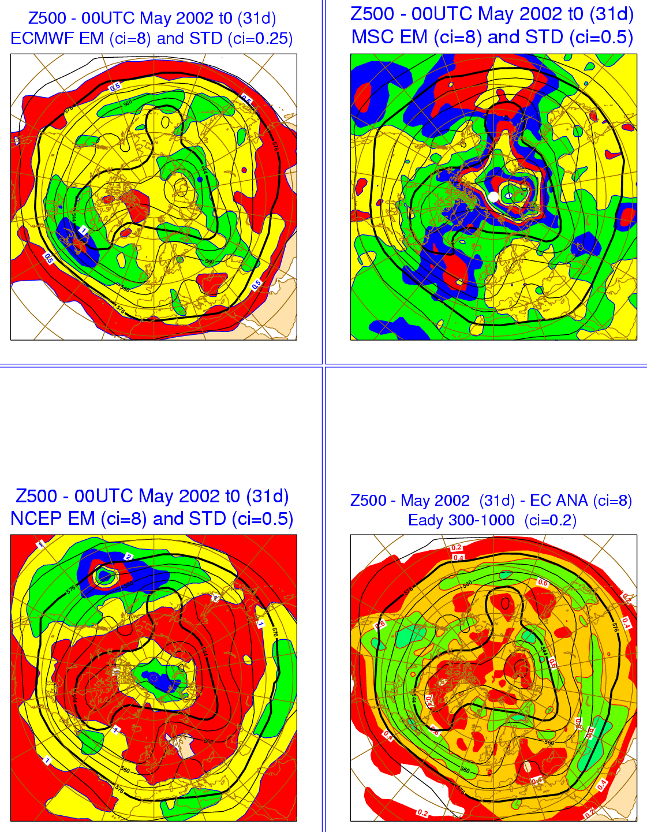
2. Similarities in EM & STD: May ‘02 t=0
The EC std shows a closer agreement with areas of baroclinic instability, as seen by comparing the stds with the Eady index (Hoskins and Valdes 1990:
(with static stability N and wind shear computed using the 300- and 1000-hPa potential temperature and wind).
Ref=Eady index
Notes:
This figure shows the May02-average ensemble mean and standard deviation at initial time (10 members, 00UTC).
The bottom-right panel shows the EC analysis and the Eady index (Hoskins and Valdes 1990), which is a measure of baroclinic instability:
(the static stability N and the wind shear have been computed using the 300- and 1000-hPa potential temperature and wind).
EC std shows a closer agreement with areas of baroclinic instability.

Slide 19
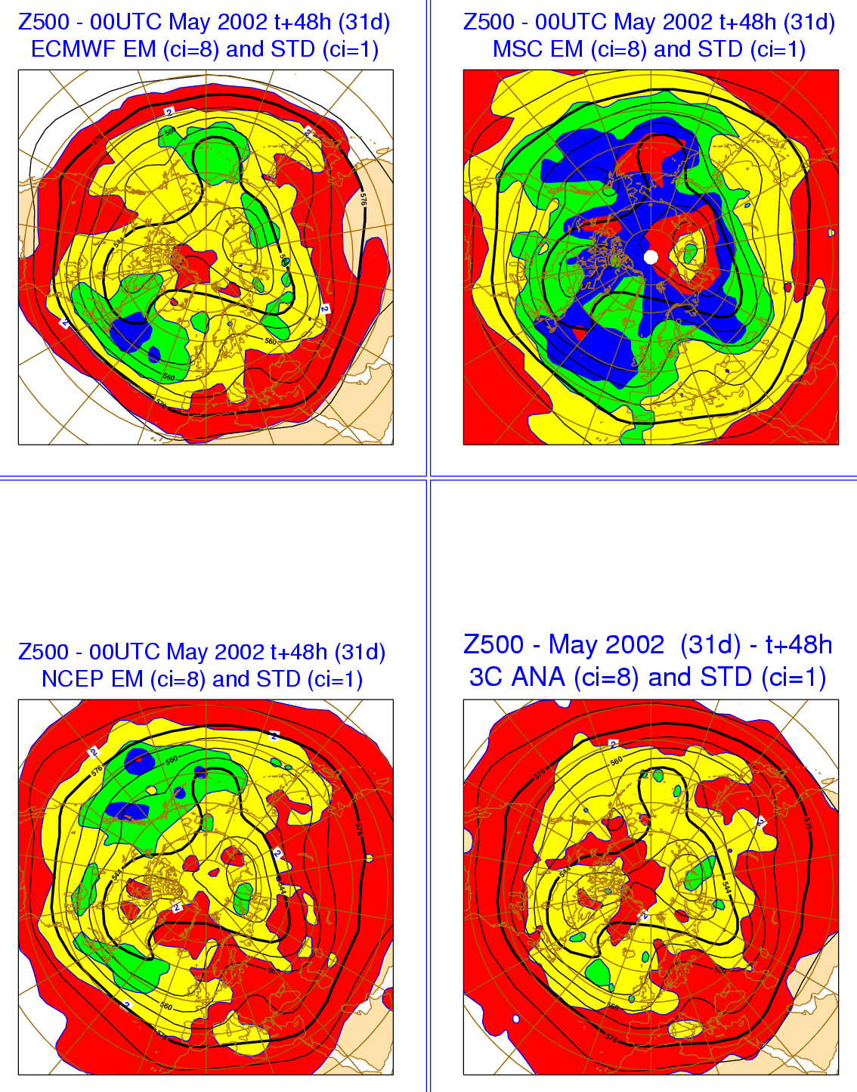
2. Similarities in EM & STD: May ‘02 +48h
After 48 hours, the ensemble spreads are more similar.
Area: NCEP and MSC give more weight to the Pacific while EC gives more weight to the Atlantic; NCEP initial relative maximum over the North Pole cap has disappeared; MSC shows still a large amplitude north of Siberia.
Amplitude: MSC has the largest amplitude over NH; EC has the smallest amplitude over the tropics.
Ref=std(EMj-ANj)
Notes:
This figure shows the May02-average ensemble mean and standard deviation at t+48h (10 members, 00UTC) The bottom-right panel shows the average and the std of the 3-centres’ analyses.
Area: NCEP and MSC give more weight to the Pacific while EC gives more weight to the Atlantic; NCEP initial relative maximum over the North Pole cap has disappeared; MSC shows still a large amplitude north of Siberia.
Amplitude: MSC has the largest amplitude over NH; EC has the smallest amplitude over the tropics.

Slide 20
2. Main conclusions from the comparison
In terms of spread, the three systems differ substantially at initial time, while they are more similar after 2 days.
The spread of the ECMWF ENS grows faster than in the other two systems because of the combined effect of sustained SV-based perturbations’ growth and the stochastic simulation of random model errors.
Skill has not been compared in this talk. Buizza et al (2005) concludes that ensemble performance depends on the quality of the data assimilation system used to generate the initial conditions, the model used to produce the forecasts, and the perturbation strategies. Overall, the ECMWF EPS was the most reliable and performed best.
Notes:
The key conclusion from this comparison of the ECMWF, MSC and NCEP ensembles is that the initial perturbation strategy strongly affects the ENS spread (and reliability) in the first few days. In the ECMWF ENS, spread grows faster than in the other two systems because of the combined effect of sustained SV-based perturbations’ growth and the stochastic simulation of random model errors. When compared to average error statistics, the ECMWF ENS appears to be the most reliable. If you want to read more also about the skill of the three systems, please look at the full report (Buizza et al 2005).

Slide 21
Outline
Objectives and approaches to ensemble prediction
Comparison of the 2002 ECMWF, MSC and NCEP ensemble systems
The THORPEX/TIGGE global, medium-range ensembles
Notes:
So, we have seen that ensemble design affects ensemble performance, in particular spread (and reliability). Let’s now look at the 10 ensembles available within the THORPEX/TIGGE project, discuss their design and compare not only their spread characteristics, but also their skill.

Slide 22
3. THORPEX/TIGGE objectives
THORPEX (THe Observing system Research and Predictability Experiment) was established in 2003 as a WMO World Weather Research Program to accelerate improvements in the accuracy of one-day to two-week high-impact weather forecasts for the benefit of society, the economy and the environment.
TIGGE (the THORPEX Interactive Grand Global Ensemble eXperiment), a key component of THORPEX, is a framework for international collaboration in ensemble prediction systems. It aimed to enhance collaboration and to foster the development of new methods of combining ensembles from different sources and of correcting for systematic errors (biases, spread over-/under-estimation).
Notes:
THORPEX (THe Observing system Research and Predictability Experiment) was established in 2003 as World Weather Research Program aiming to accelerate improvements in the accuracy of one-day to two-week high-impact weather forecasts for the benefit of society, the economy and the environment. THORPEX key objectives are:
To increase fundamental understanding of dynamics and predictability of the atmosphere
To make significant, quantifiable, worldwide improvements in decision-making skills and consequent measurable reduction in societal distress
To promote and fully exploit advances in NWP, observations, communications and data-assimilation techniques
To deliver improved global and regional forecasting system with active involvement of developed, developing and least developed nations
TIGGE (the THORPEX Interactive Grand Global Ensemble eXperiment) is a framework for international collaboration in development and testing of ensemble prediction systems. TIGGE’s key objectives include:
to enhanced collaboration on predictability and ensemble prediction
to foster the development of new methods of combining ensembles from different sources and of correcting for systematic errors (biases, spread over-/under-estimation)
to help understanding the feasibility of interactive ensemble system responding dynamically to changing uncertainty (including use for adaptive observing, variable ensemble size, on-demand regional ensembles) and exploiting new technology for grid computing and high-speed data transfer

Slide 23
3. TIGGE relies on existing ensemble systems
There are 10 operational global, medium-range ensemble systems (BMRC, CMA, CPTEC, ECMWF, FNMOC, JMA, KMA, MSC, NCEP and UKMO) with horizontal resolution ranging from T62 to T_{L}639 (~32km), and with forecast length ranging from 8 to 16 days.
9 of the 10 (all but FNMOC) medium-range ensembles, plus the short-range Meteo-France ensemble are archived in TIGGE. Today (Feb 2015), every day 436 forecasts generated by the 8 operational, global, medium-range TIGGE ensembles are shared, and archived in the TIGGE archive. They can be freely accessed by users with a 48-hour delay mode.
The TIGGE data-base includes many parameters from all contributing centres (see http://tigge.ecmwf.int/ for more information).
Notes:
Worldwide, to my knowledge there are 10 operational global, medium-range ensemble systems (BMRC, CMA, CPTEC, ECMWF, FNMOC, JMA, KMA, MSC, NCEP and UKMO) with horizontal resolution ranging from T62 to T_{L}639 (~32km), and with forecast length ranging from 8 to 16 days. Nine of the TIGGE ensembles plus the short-range Meteo-France ensembles are archived in TIGGE (in total 557 forecasts!). Two further global, medium-range systems (NCMRWF, SAWS) are under development and testing.
Furthermore, it is worth mentioning that there are many regional, limited-area ensembles. In Europe, there are 5 operational Limited-area ensembles (SRNWP-PEPS, COSMO-LEPS, INM, LAMEPS and PEACE) that produce daily ~50 forecasts with horizontal resolution ranging from 7 to 25 km, and with forecast length ranging from 30 to 120 hours. Six further LEPSs (UKMO, DMI, HMS, MeteoSwiss, SAR, PIED-SE) are under development and testing. In North-America, there is 1 operational Limited-area ensembles (NCEP-SREF) that produces daily 30 forecasts with horizontal resolution of 32 km, and a 63-hour forecast length. Another system (MSC) is under development and testing. In Australia, BMRC is testing a 16-member, 0.5 degree resolution, 72-hour LEPS.

Slide 24
3. The TIGGE ensembles (updated May 2016)
The 9 TIGGE operational, medium-range, global ensembles use different methodologies to simulate initial-time and model uncertainties. Every day, the 7 ensembles that are still operational, put 436 forecasts into the TIGGE archive. These forecasts have horizontal resolution ranging from about 210 km to about 16 km, and forecast length between 10 and 46 days. They all simulate initial/observation and model uncertainties in different ways.
Notes:
The 9 TIGGE operational, global, medium-range ensembles use different methodologies to simulate initial-time and model uncertainties, that can be grouped since some of the methods are similar or related. Note that BMRC has stopped issuing medium-range ENS forecasts at the end of 2010. Thus today, every day 436 global forecasts spanning a forecast range of up to 16 days, are generated and exchanged within TIGGE. These forecasts are available, with a 48-hour delay, from the TIGGE archive.
In the next slides we will first discuss the key characteristics of the different methods, and then show how ensemble design affects performance.

Slide 25
3. The SV-based ensembles: BOM, ECMWF, JMA, MF
In these ensembles, the perturbed initial conditions are defined by adding to the unperturbed analysis (the interpolated high-resolution analysis) perturbations defined by a linear combination of SVs:
BMRC: initial-time SVs computed over NH and SH extra-tropics
ECMWF: a combination of initial-time SVs, computed over NH and SH extra-tropics, and over few tropical regions , and perturbations generated from an Ensemble Data Assimilation (EDA) system
JMA: initial-time SVs computed over the NH extra-tropics and the tropics
MF: initial-time SVs optimized to grow over a European region plus EDA-based perturbations
Notes:
Four ensembles have been using SVs: BMRC, ECMWF, JMA and MF. See references for more details.

Slide 26
3. The EnKF-based ensemble: MSC
The MSC ensemble uses an EnKF to generate the initial conditions (Houtekamer & Mitchell 2005). The perturbed initial conditions are defined by 20 EnKF members (randomly-selected from the 192 available members). The EnKF (Evensen 1994) is an approximation of the Kalman Filter that improves as the ensemble size increases.
The MSC EnKF uses a model error parameterization based on the forecast error description of the MSC 3D-Var. Thus, it should be considered as a hybrid scheme (Hamill & Snyder 2000). The EnKF runs with:
a 6 hour cycle;
four streams of 48 members;
randomly perturbed observations, with random perturbations sampled from a normal distribution with obs-error statistics.
Notes:
One ensemble is using an Ensemble Kalman Filter to define its ICs, the Canadian one. See references for more details.

Slide 27
3. The BV-based ensemble: CMA
In these ensembles, the perturbed initial conditions are defined by adding to the unperturbed analysis (the interpolated high-resolution analysis) perturbations defined by BVs (Toth & Kalnay 1997), computed following the method that was used at NCEP from 1992 till recently.
Each BV is computed by adding a random perturbation to the starting analysis, evolving it for 24-hours and then rescaling it. BVs are grown non-linearly at full model resolution.
Notes:
The CMA ensemble uses bred vectors, as they ere originally implemented at NCEP. See references for more details.

Slide 28
3. The ETKF-based ensemble: UKMO, KMA
The Ensemble Transform Kalman Filter (ETKF) method was first proposed by Bishop et al (2001) in targeted observation studies, and used in ensemble systems by Wang & Bishop (2003).
In the UKMO ETKF, perturbations are cycled and re-orthogonalized, and then ‘transformed’ using an estimate of the analysis error covariance matrix defined by observations and short-time forecast errors. ETKF perturbations can be considered as modified BVs, with BVs transformed using ETKF ideas. KMA uses the same system.
The perturbed initial conditions are defined by adding to the unperturbed analysis (the interpolated high-resolution analysis) perturbations defined by the difference of ETKF members.
Notes:
The UKMO ensemble uses the ETKF method, which is a modification of the original bred vector method developed at NCEP. KMA uses the same system, since they have adopted the UKMO Unified model environment. See references for more details.

Slide 29
3. The ETR-based (BV-inspired) ensemble: NCEP
The Ensemble Transform (ET) method was first proposed by Bishop & Toth (1999) in target observation studies. The ET with rescaling (ETR) method is an extension of breeding (Wei et al 2008).
Given a set of perturbations, in the ET method perturbations are ‘transformed’ using analysis error variances from the best possible data-assimilation system (instead of using an estimate of the analysis error covariance matrix defined by observations and short-time forecast errors, as it is done in the ETKF method). In the ETR method, the ET perturbations are re-scaled to have an initial spread distribution similar to an estimate of the analysis error variance.
As for ETKF perturbations, ETR perturbations can be considered modified BVs, with BVs transformed using the ET method and rescaled.
The perturbed initial conditions are defined by adding to the unperturbed analysis (the interpolated high-resolution analysis) perturbations defined by the difference of ETR members.
Notes:
At NCEP, they are now using an Ensemble Transformed with Rescaling method. See references for more details.

Slide 30
3. The EOF-based (BV-inspired) ensemble: CPTEC
The EOF-based method was developed by Zhang & Krishnamurti (1999) to apply an ensemble technique to hurricane forecasting:
an ensemble of forecasts is performed by adding random perturbations to the unperturbed analysis
each model is integrated for 36 hours with full physics
an EOF analysis is performed on the time series of the differences between the perturbed and the control forecast
the modes whose EOF coefficients increase rapidly are used as initial perturbations
The perturbed initial conditions are defined by adding to the growing modes to the unperturbed analysis (the interpolated high-resolution analysis). EOF perturbations can be considered modified BVs, with BVs transformed using the EOF method
As for ETKF and ETR perturbations, these.
Notes:
In Brazil, they are using EOF perturbations. The method used to compute them can be considered a modification of the original bred-vector method developed at NCEP. See references for more details.

Slide 31
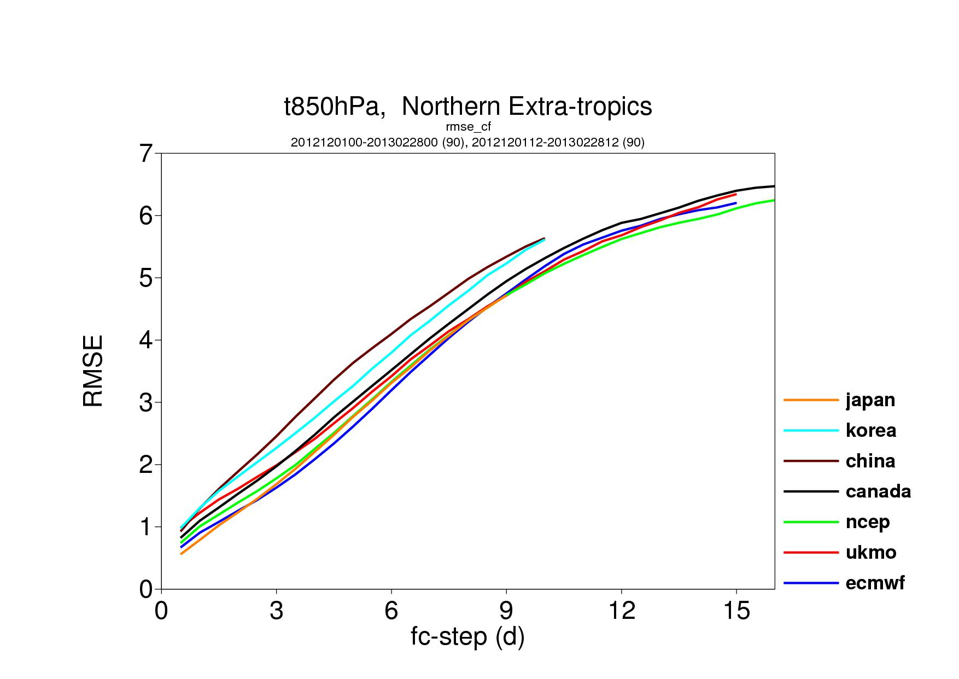
3. D12JF13 (90c): T850 rmse(CF) over NH
RMSE(control) for T850 over NH, for winter 2012-13 (90 cases).
Notes:
How different are the 9 global, TIGGE ensembles? We are now going to look at some average statistics (spread, error of the ensemble-mean, skill of probabilistic forecasts) over NH. For more comparisons, see ‘extra material’ at the end of this lecture (maps are also shown). This figure shows the average D12JF13 rmse(control) for T850 over NH.

Slide 32
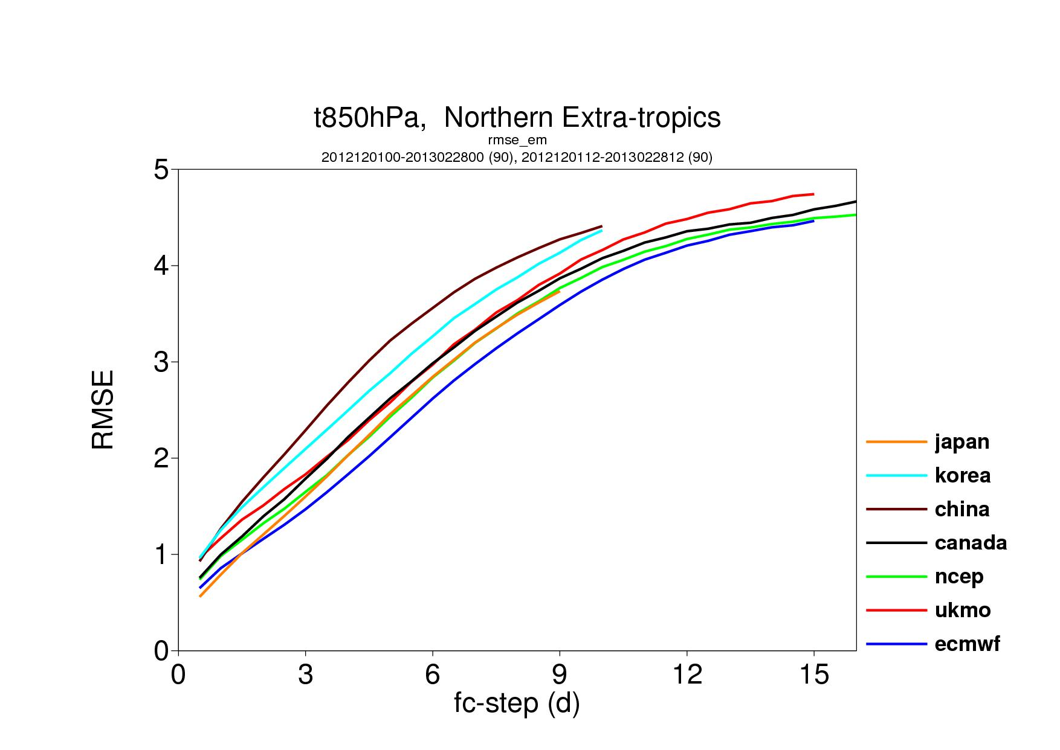
3. D12JF13 (90c): T850 rmse(EM) over NH
RMSE(ensemble-mean) for T850 over NH, for winter 2012-13 (90 cases).
Notes:
This figure shows the average D12JF13 rmse(ensemble-mean) for T850 over NH.

Slide 33
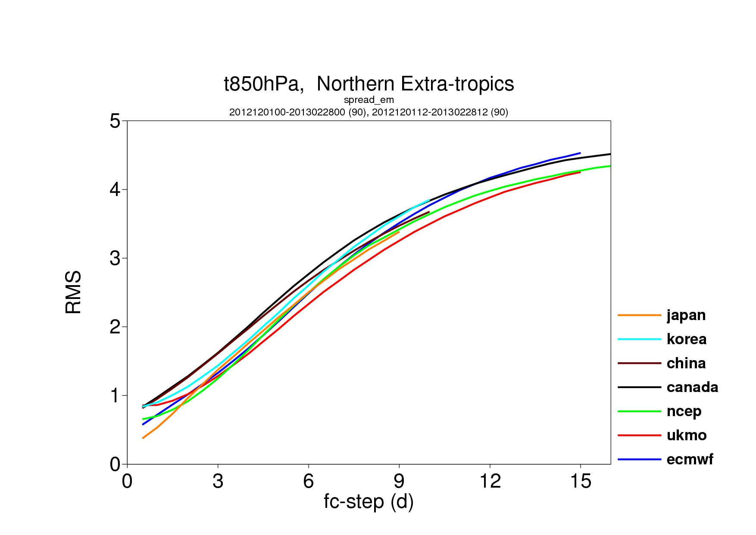
3. D12JF13 (90c): T850 std over NH
Spread (std) for T850 over NH, for winter 2012-13 (90 cases).
Notes:
This figure shows the average D12JF13 spread for T850 over NH.

Slide 34
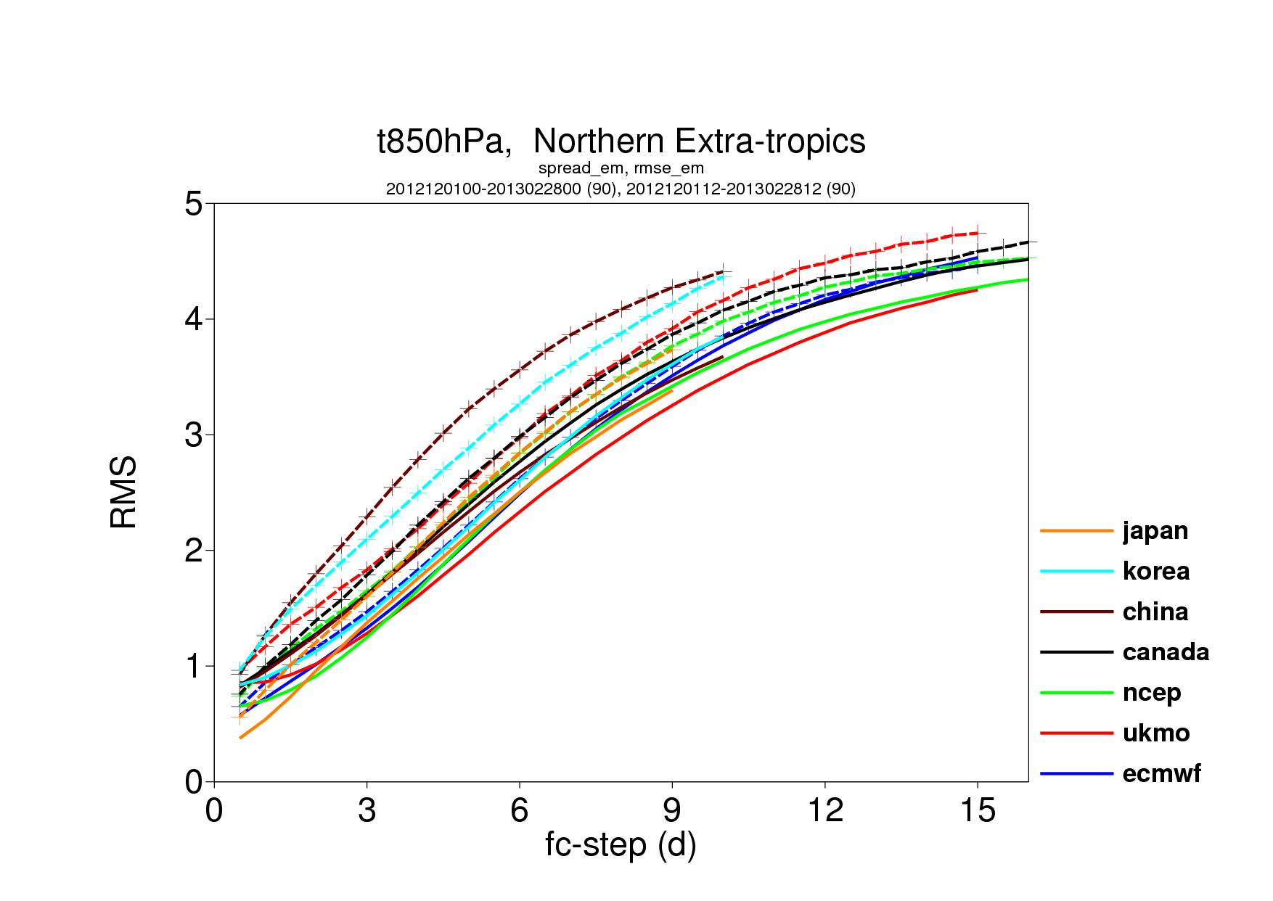
3. D12JF13 (90c): T850 std and rmse(EM) over NH
RMSE(ensemble-mean ) and spread for T850 over NH, for winter 2012-13 (90 cases).
Notes:
This figure shows the average D12JF13 spread and rmse(ensemble-mean) for T850 over NH.

Slide 35
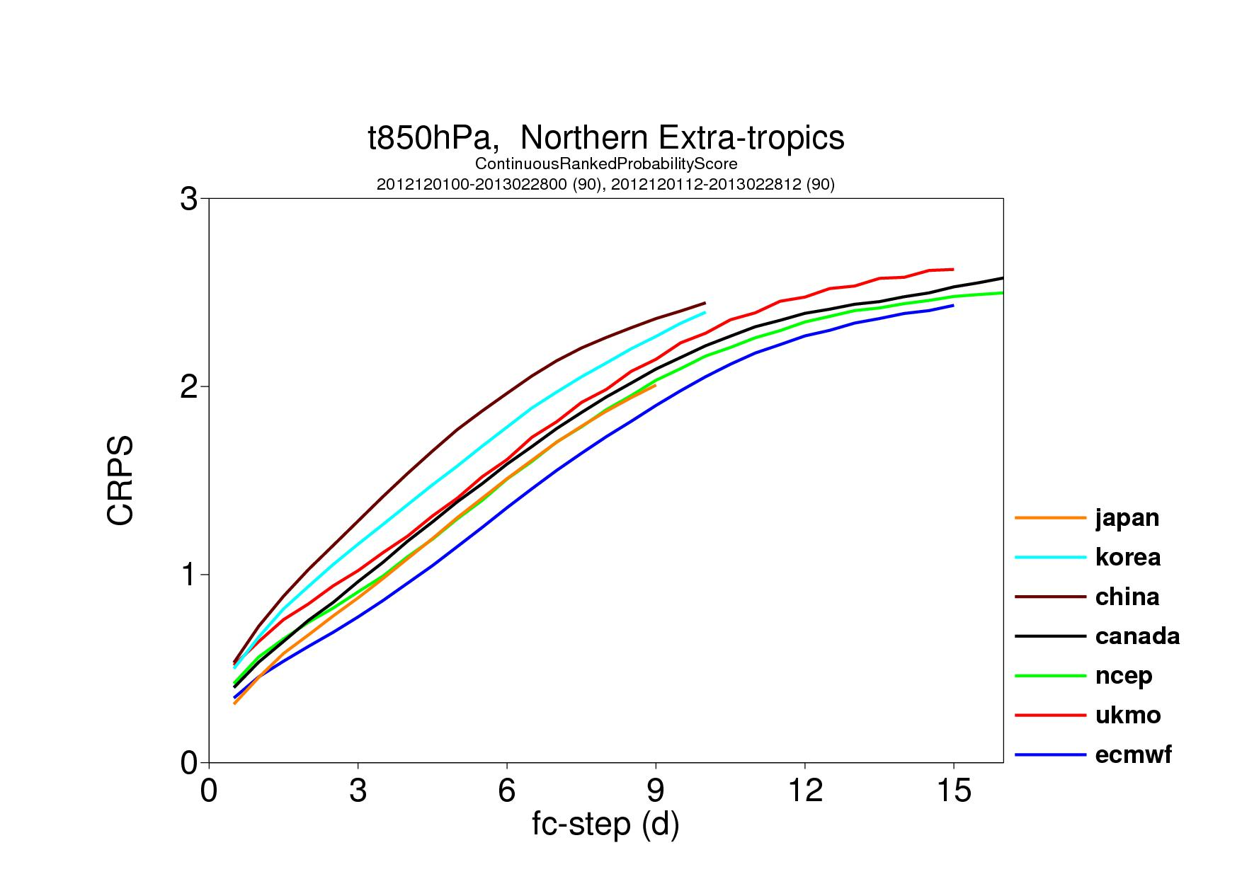
3. D12JF13 (90c): T850 CRPS over NH
CRPS for T850 over NH, for winter 2012-13 (90 cases).
Notes:
This figure shows the average D12JF13 CRPS for T850 over NH.

Slide 36
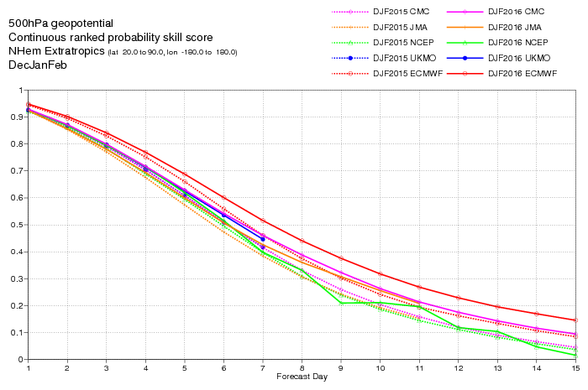
3. D15JF16: CRPSS(Z500,NH)
More recent results: average D15JF16 (solid) and D14JF15 (dashed) CRPSS for Z500 over NH for the 4 best TIGGE ensembles:
ECMWF (red)
JMA (violet)
NCEP (green)
CMC (pink)
ECMWF
~ 18h
Notes:
Let’s now move to more recent results from the past winter. This plot shows the average CRPSS for Z500 over NH for D15JF16 (and D14JF15, dotted lines) for the 4 best operational TIGGE ensembles:
ECMWF (red)
JMA (violet)
NCEP (green)
CMC (pink)
The difference between the best and the second best in the medium-range is about 18 hours, which is equivalent to about 8 years of R&D.

Slide 37
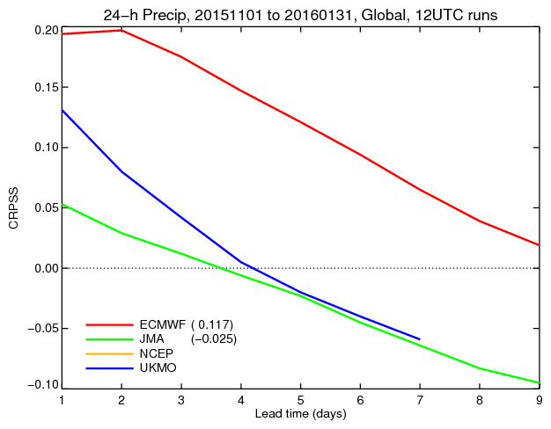
3. D15JF16: CRPSS(TP24,Global)
More recent results: average D15JF16 (solid) CRPSS for 24h precipitation over the globe for 4 TIGGE ensembles:
ECMWF (red)
JMA (green)
NCEP (yellow)
UKMO (blue)
Differences here between the best and the second best are about 4 days!
UKMO
ECMWF
~ 5 days
Notes:
Here are some more recent TIGGE results: average CRPSS for TP24 over the globe for ND14J15 for 4 systems:
ECMWF (red)
JMA (green)
NCEP (yellow)
UKMO (blue)
Note the much larger difference between ECMWF and the others, compared to the difference between the single control forecasts shown in the next slide. This is due to the fact that the ECMWF ENS is much more reliable (spread matching error statistics) and realistic (energy level in the resolved scales closer to reality).

Slide 38
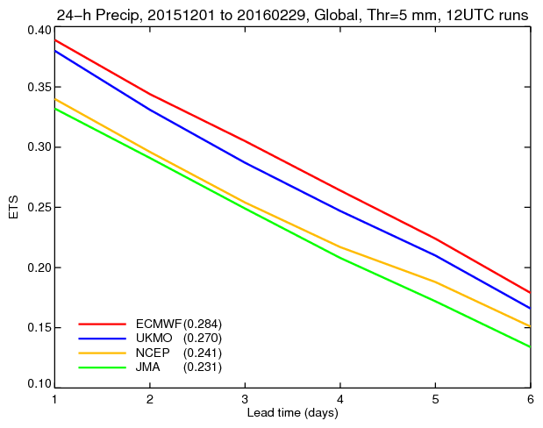
3. D15JF16: ETS(TP24>5mm,Global)
More recent results: average ND14J15 (solid) ETS for 24h precipitation greater than 5mm over the globe for 4 single forecasts:
ECMWF (red)
JMA (green)
NCEP (yellow)
UKMO (blue)
Differences here between the best and the second best is about 6 hours.
JMA
ECMWF
~ 6h
Notes:
Here are some more recent TIGGE results: average CRPSS for TP24>5mm/d over the globe for D15JF16 for 4 systems:
ECMWF (red)
JMA (green)
NCEP (yellow)
UKMO (blue)
Note the much larger difference between ECMWF and the others, compared to the difference between the single control forecasts shown in the previous slide. This is due to the fact that the ECMWF ENS is much more reliable (spread matching error statistics) and realistic (energy level in the resolved scales closer to reality).

Slide 39
Conclusions
TIGGE makes it easy to compare the performance of ensemble systems and to understand the impact of system’s design on ensemble performance.
Comparison have shown that the ECMWF ensemble continues to be the best of the single ensemble systems. Compared to a multi-model system, over the extra-tropics the ECMWF ensemble performs similarly to a TIGGE multi-model system, but over the tropics it performs worse.
TIGGE data can be used to address fundamental predictability questions, e.g. which is the best way to simulate model error? Can a single-system ensemble outperform a multi-system ensemble? Which is the best way to combine ensemble members from different ensembles?
Notes:
Concluding, I hope you now know more about the TIGGE global ensembles, how they have been defined and how they do perform. One key conclusion from this comparison is that the quality of an ensemble system depends from a variety of elements: model, data-assimilation system and quality of its analyses, approaches used to simulate initial and model uncertainties. I have tried to include updated references at the end of this lecture, so that you can read more about the ever changing systems (best is to look at each centre’s website for latest news).
Please contact me if you want more information.

Slide 40
Acknowledgements
The success of the ECMWF EPS is the result of the continuous work of ECMWF staff, consultants and visitors who had continuously improved the ECMWF model, analysis, diagnostic and technical systems, and of very successful collaborations with its member states and other international institutions. The work of all contributors is acknowledged.

Slide 41
Bibliography
On TIGGE
Buizza, R., 2014: The TIGGE medium-range, global ensembles. ECMWF Research Department Technical Memorandum n. 739, ECMWF, Shinfield Park, Reading RG2-9AX, UK, pp. 53.
Hagedorn, R., Buizza, R., Hamill, M. T., Leutbecher, M., & Palmer, T. N., 2012: Comparing TIGGE multi-model forecasts with re-forecast calibrated ECMWF ensemble forecasts. Q. J. Roy. Meteorol. Soc., in press.
Johnson, C., & Swinbank, R., 2009: Medium-range multi-model ensemble combination and calibration. Forecasting Research Technical Report, Meteorology R&D Technical Report no. 517, Met Office (Q. J. Roy. Meteorol. Soc., submitted).
Pappenberger, F., Bartholmes, J., Thielen, J., Cloke, H.L., Buizza, R. & de Roo, A., 2008: New dimensions in early flood warning across the globe using grand-ensemble weather predictions. Geophys. Res. Lett., 35, L10404, DOI:10.1029/2008GL33837.
Park, Y.-Y., Buizza, R., & Leutbecher, M., 2008: TIGGE: preliminary results on comparing and combining ensembles. Q. J. Roy. Meteorol. Soc., 134, 2029-2050 (also EC TM 548).
Richardson, D., R., Buizza and R. Hagedorn, 2005: Final report of the 1st Workshop on the THORPEX Interactive Grand Global Ensemble (TIGGE). WMO TD No. 1273, WWRP-THORPEX No. 5 (available from http://tigge.ecmwf.int/references.html).

Slide 42
Bibliography
On the different ensemble prediction systems
ECMWF (SV) system
See bibliography list in lecture 1.
MSC (EnKF) system
Evensen, G., 1994: Sequential data assimilation with a nonlinear quasi-geostrophic model using Monte Carlo methods to forecast error statistics. J. Geophys. Res., 99, 10143-10162.
Hamill, T. M., & Snyder, C., 2000: A hybrid ensemble Kalman filter-3D variational analysis scheme. Mon. Wea. Rev., 128, 2905-2919.
Houtekamer, P. L., L. Lefaivre, J. Derome, H. Ritchie & H. L. Mitchell, 1996. A system simulation approach to ensemble prediction. Mon. Wea. Rev., 124, 1225-1242.
Houtekamer, P. L., & H. L. Mitchell, 2005. Ensemble Kalman filtering. Q. J. Roy. Meteorol. Soc., 131, 3269-3289.
CPTEC (EOF) system
Zhang, Z., & Krishnamurti, T.N., 1999: A perturbation method for hurricane ensemble predictions. Mon. Wea. Rev., 127, 447-469.

Slide 43
Bibliography
CMA, KMA, NCEP, UKMO (BV/ETKF/ET/ETR) systems
Bishop, C H, & Toth, Z, 1999: Ensemble transformation and adaptive observations. Mon. Wea. Rev., 129, 1748-1765.
Bishop, C H, Etherton, B J, & Majumdar, S, 2001: Adaptive sampling with the ensemble transform Kalman filter. Part I: theoretical aspects. Mon. Wea. Rev., 129, 420-436.
Goo, T.-Y., S.-O. Moon, J.-Y. Cho, H.-B. Cheong, & W.-J. Lee, 2003: Preliminary results of medium-range ensemble prediction at KMA: Implementation and performance evaluation as of 2001. Korean J. Atmos. Sci., 6, 27-36.
Toth, Z., & Kalnay, E., 1997: Ensemble Forecasting at NCEP and the breeding method. Mon. Wea. Rev., 125, 3297-3319.
Wei, M., Toth, Z., Wobus, R., Zhu, Y., Bishop, C., & Wang, X., 2006: Ensemble Transform Kalman Filter-based ensemble perturbations in an operational global prediction system at NCEP. Tellus A, 58, 28-44.
Wang, X, & Bishop, C H, 2003: A comparison of breeding and ensemble transform Kalman filter ensemble forecast schemes. J Atmos. Sci., 60, 1140-1158.
Wei, M, Toth, Z, Wobus, R, & Zhu, Y, 2008: Initial perturbations based on the ensemble transform (ET) technique in the NCEP global operational forecast system. Tellus, 60A, 62-79.

Slide 44
Bibliography
UKMO (ETKF) system
Bowler, N. E., Arribas, A., Mylne, K. R., & Robertson, K. B., 2007: The MOGREPS short-range ensemble prediction system. Part I: system description. MetOffice NWP Technical Report N. 497, available from The MetOffice, FitzRoy Rd, Exeter, EX1 3PB, UK, pp. 18 (see also UKMO web page).
BMRC (SV) system
Bourke, W., T. Hart, P. Steinle, R. Seaman, G. Embery, M. Naughton, & L. Rikus, 1995: Evolution of the Bureau of Meteorology's Global Assimilation and Prediction system. Part 2: resolution enhancements and case studies. Aust. Met. Mag., 44, 19-40.
MF (SV) system
Nicolau, J, 2002: Short-range ensemble forecasting at Meteo France. In Proceedings CBS Technical Conferences on Data Processing and Forecasting Systems, Cairs, 2-3 Dec 2002, 1-4.
On the comparison of ECMWF, NCEP and MSC systems operational in 2002
Buizza, R., Houtekamer, P. L., Toth, Z., Pellerin, G., Wei, M., & Zhu, Y., 2005: A comparison of the ECMWF, MSC and NCEP Global Ensemble Prediction Systems. Mon. Wea. Rev., 133, 5, 1076-1097.

Slide 45
… extra material …

Slide 46
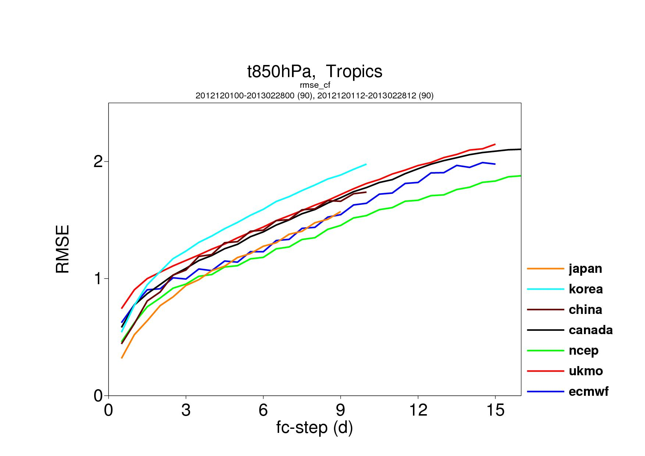
3. J12FM13 (90c): T850 rmse(CF) over TR
RMSE(control) for T850 over the tropics, for winter 2012-13 (90 cases).
Notes:
How different are the 9 global, TIGGE ensembles?
We are now going to look at some average statistics (spread, error of the ensemble-mean, skill of probabilistic forecasts).

Slide 47
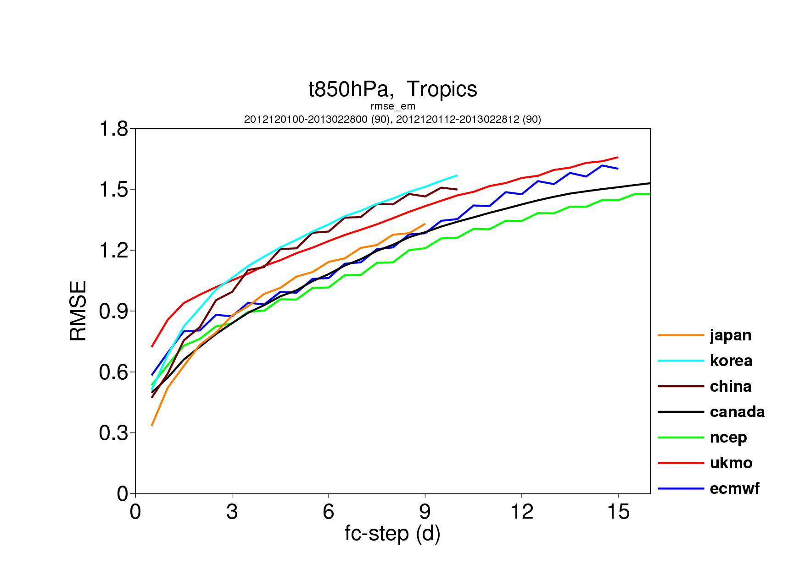
3. J12FM13 (90c): T850 rmse(EM) over TR
RMSE(ensemble-mean) for T850 over the tropics, for winter 2012-13 (90 cases).
Notes:
How different are the 9 global, TIGGE ensembles?
We are now going to look at some average statistics (spread, error of the ensemble-mean, skill of probabilistic forecasts).

Slide 48
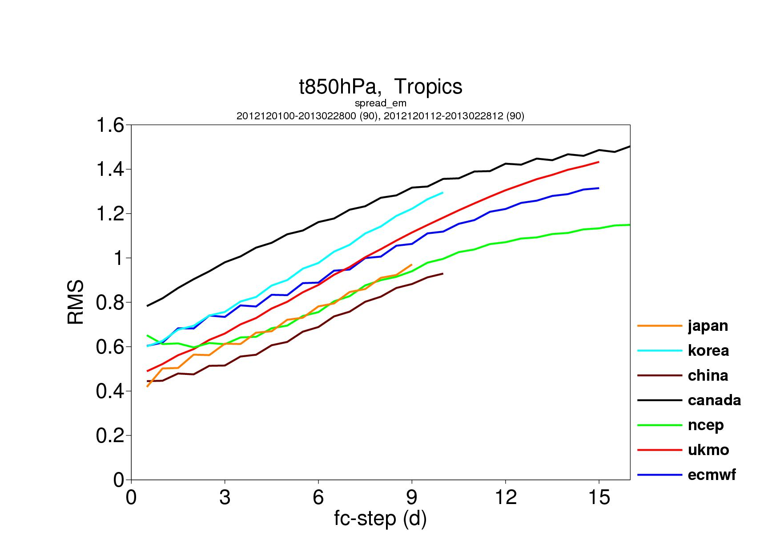
3. J12FM13 (90c): T850 std over TR
Spread (std) for T850 over the tropics, for winter 2012-13 (90 cases).
Notes:
How different are the 9 global, TIGGE ensembles?
We are now going to look at some average statistics (spread, error of the ensemble-mean, skill of probabilistic forecasts).

Slide 49
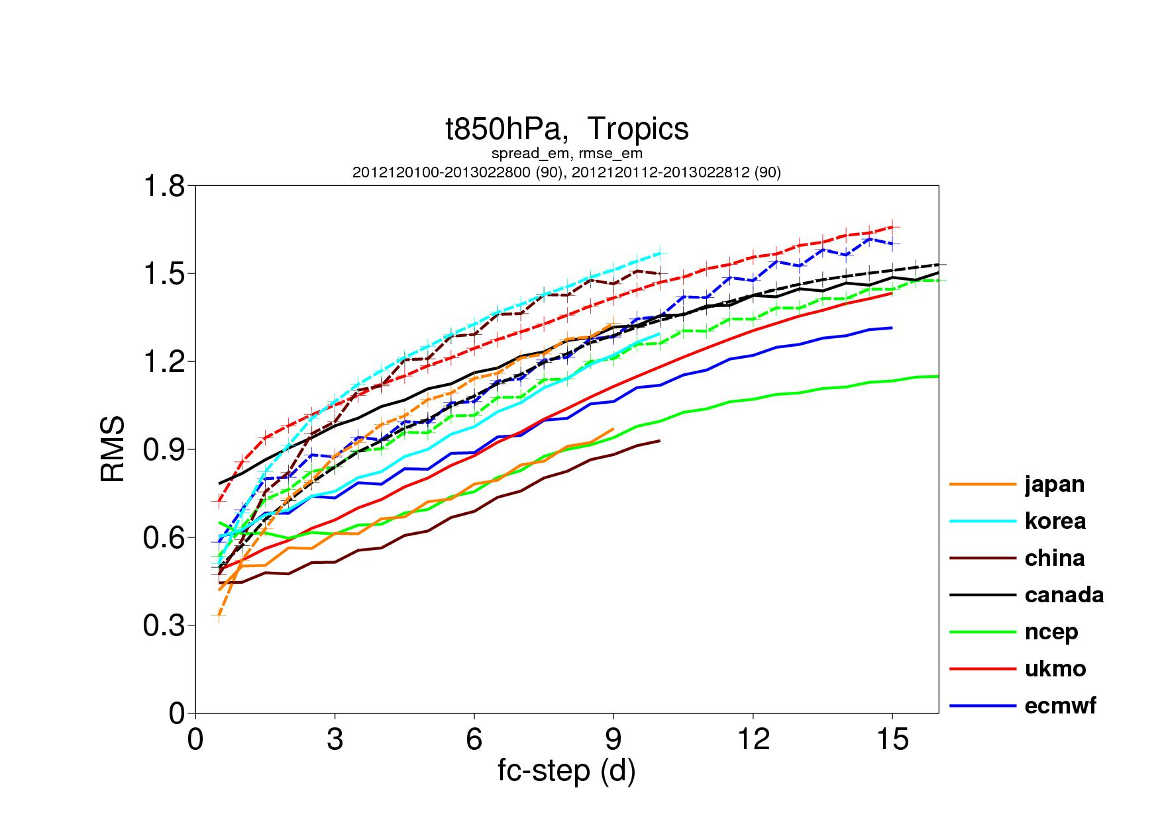
3. J12FM13 (90c): T850 std and rmse(EM) over TR
RMSE(ensemble-mean ) and spread for T850 over NH, for winter 2012-13 (90 cases).
Notes:
How different are the 9 global, TIGGE ensembles?
We are now going to look at some average statistics (spread, error of the ensemble-mean, skill of probabilistic forecasts).

Slide 50
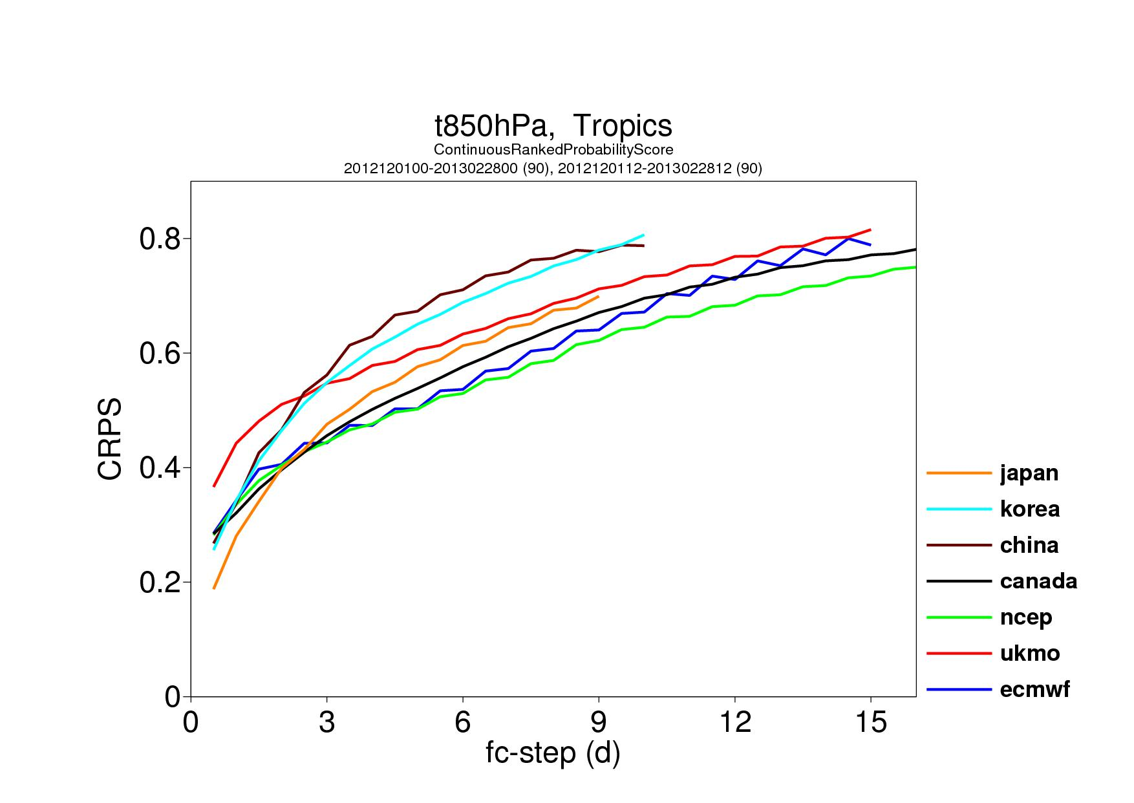
3. J12FM13 (90c): T850 CRPS over TR
CRPS for T850 over the tropics, for winter 2012-13 (90 cases).
Notes:
How different are the 9 global, TIGGE ensembles?
We are now going to look at some average statistics (spread, error of the ensemble-mean, skill of probabilistic forecasts).

Slide 51
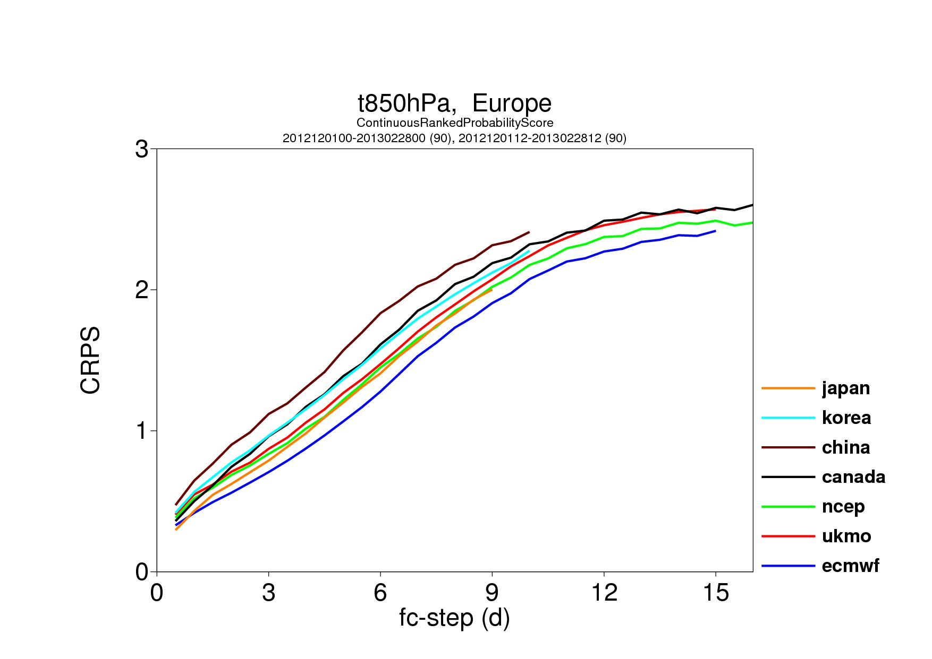
3. J12FM13 (90c): T850 CRPS over Europe
CRPS for T850 over Europe, for winter 2012-13 (90 cases).
Notes:
How different are the 9 global, TIGGE ensembles?
We are now going to look at some average statistics (spread, error of the ensemble-mean, skill of probabilistic forecasts).

Slide 52
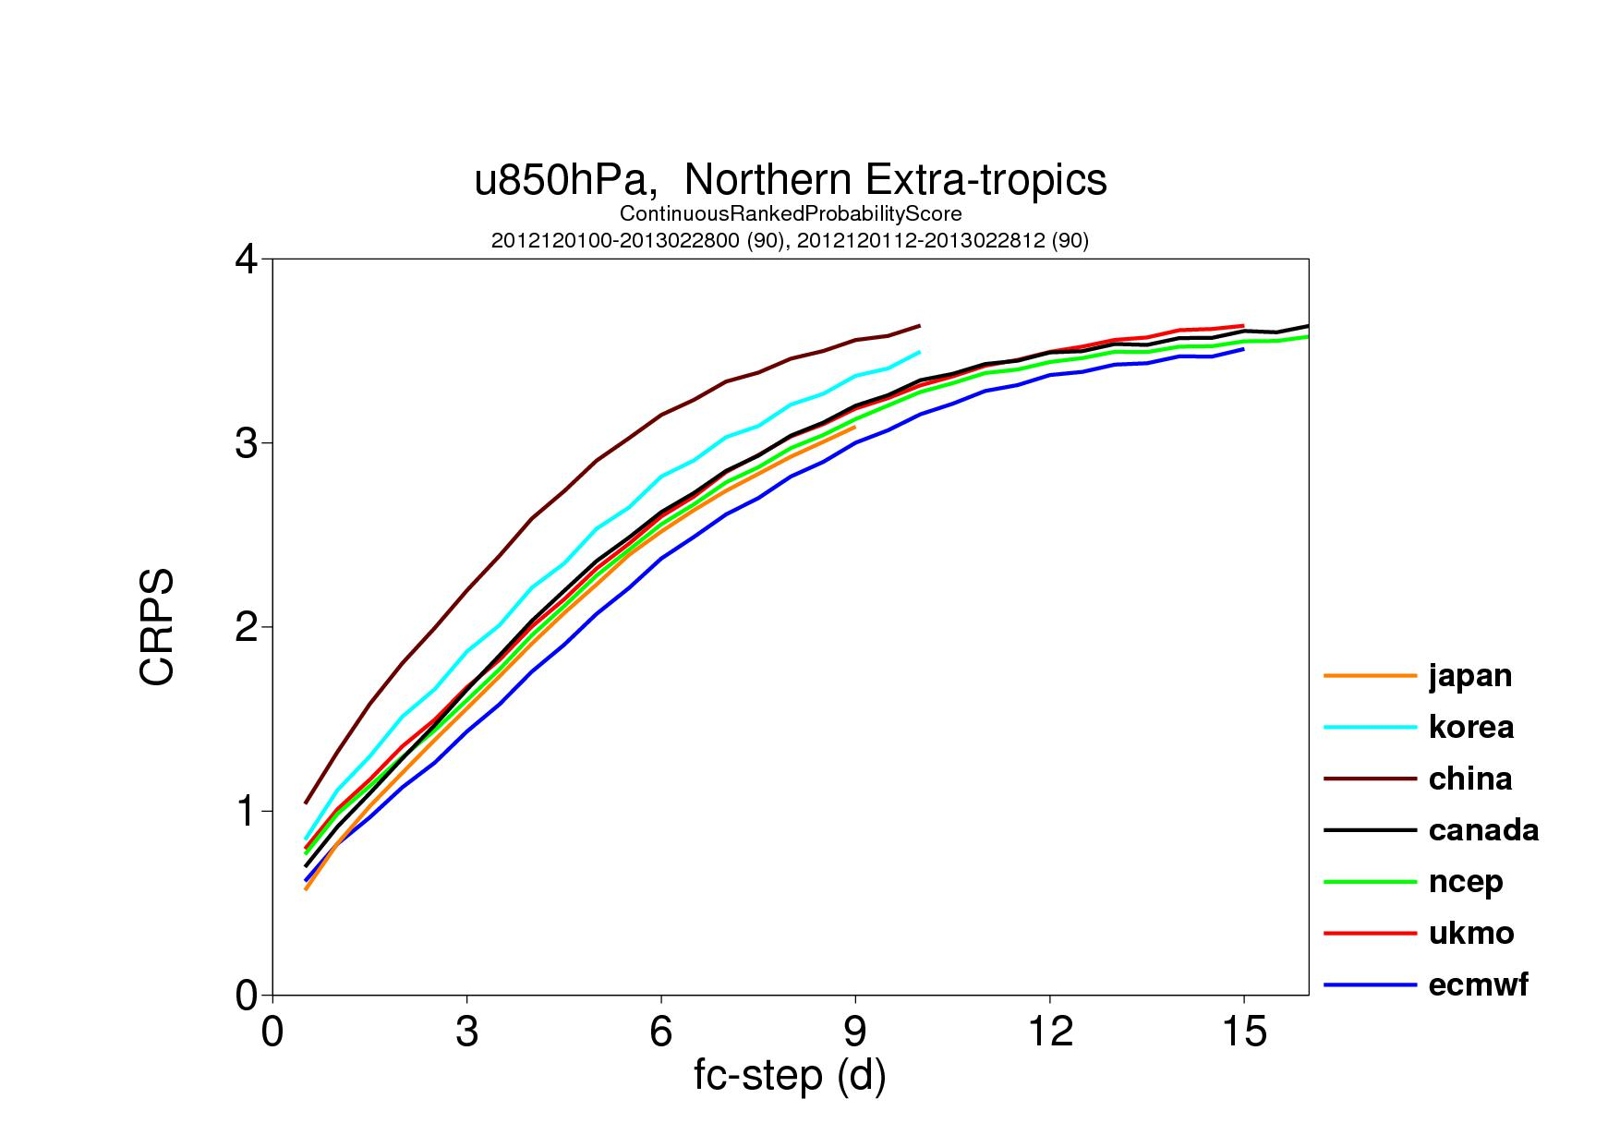
3. J12FM13 (90c): U850 CRPS over NH
CRPS for U850 over the NH, for winter 2012-13 (90 cases).
Notes:
How different are the 9 global, TIGGE ensembles?
We are now going to look at some average statistics (spread, error of the ensemble-mean, skill of probabilistic forecasts).

Slide 53
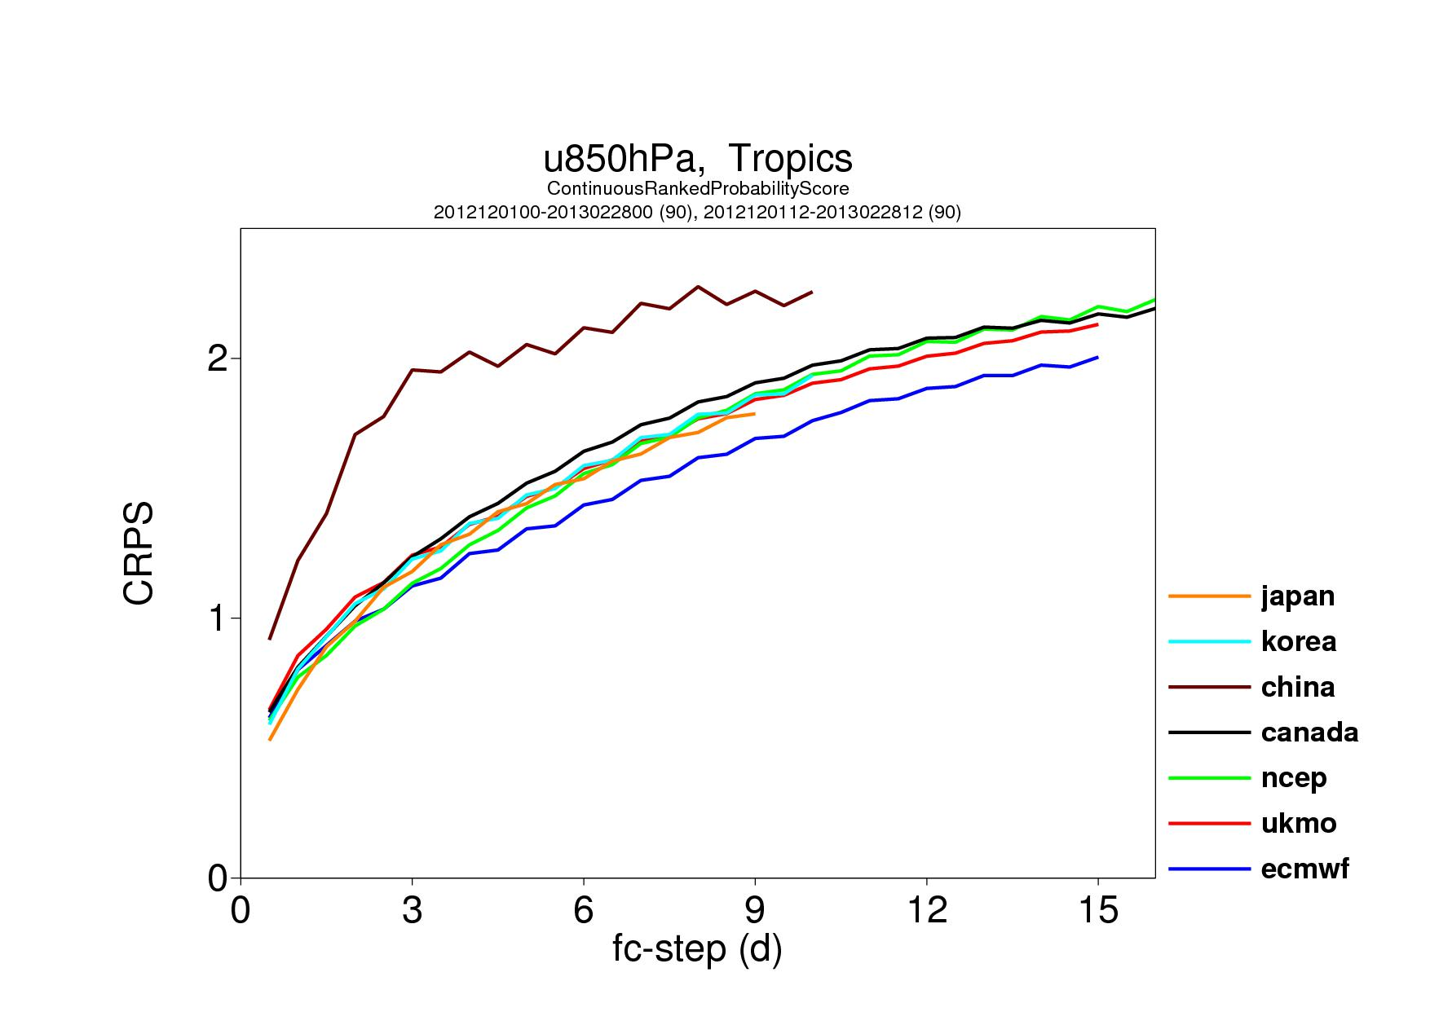
3. J12FM13 (90c): U850 CRPS over TR
CRPS for U850 over the tropics, for winter 2012-13 (90 cases).
Notes:
How different are the 9 global, TIGGE ensembles?
We are now going to look at some average statistics (spread, error of the ensemble-mean, skill of probabilistic forecasts).

Slide 54
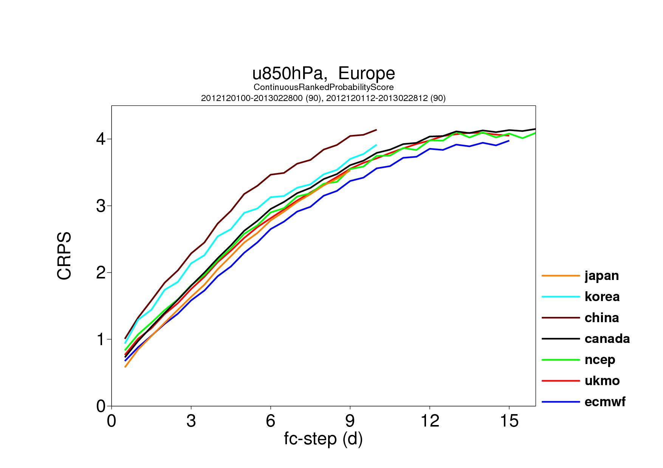
3. J12FM13 (90c): U850 CRPS over Europe
CRPS for U850 over Europe, for winter 2012-13 (90 cases).
Notes:
How different are the 9 global, TIGGE ensembles?
We are now going to look at some average statistics (spread, error of the ensemble-mean, skill of probabilistic forecasts).

Slide 55
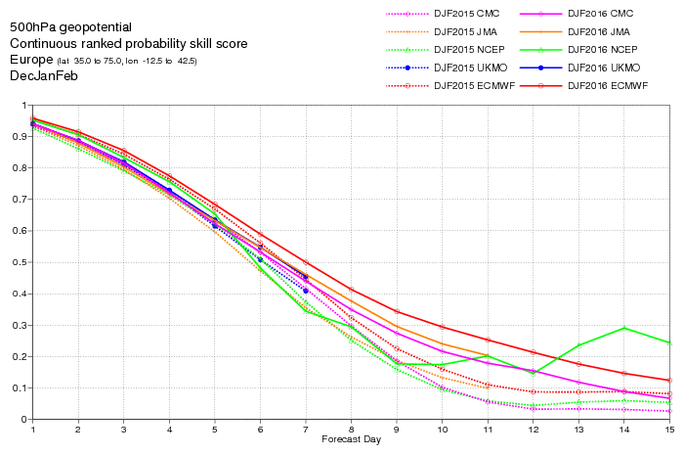
3. D15JF16: CRPSS(Z500,EU)
More recent results: average D15JF16 (solid) and D14JF15 (dashed) CRPSS for Z500 over Europe for the 4 best TIGGE ensembles:
ECMWF (red)
JMA (violet)
NCEP (green)
CMC (pink)
ECMWF
~ 12h
Notes:
Here are some more recent TIGGE results: average CRPSS for Z500 over Europe for D15JF16 for the 4 best TIGGE ensembles:
ECMWF (red)
JMA (violet)
NCEP (green)
CMC (pink)
Differences between the best and the second best in the medium-range is about 12 hours (this is equivalent to about 5 years worth of R&D).

Slide 56
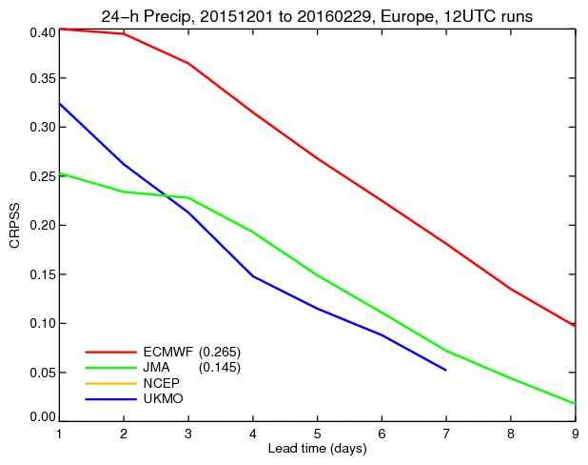
3. D15JF16: CRPSS(TP24,Europe)
More recent results: average D15JF16 (solid) CRPSS for 24h precipitation over Europe for 4 TIGGE ensembles:
ECMWF (red)
JMA (green)
NCEP (yellow)
UKMO (blue)
Differences here between the best and the second best are about 2 days!
ECMWF
JMA
~ 3 days
Notes:
Here are some more recent TIGGE results: average CRPSS for TP24 over EU for D15JF16 for 4 operational ensembles:
ECMWF (red)
JMA (green)
NCEP (yellow)
UKMO (blue)
Note the much larger difference between ECMWF and the others, compared to the difference between the single control forecasts shown in the next slide. This is due to the fact that the ECMWF ENS is much more reliable (spread matching error statistics) and realistic (energy level in the resolved scales closer to reality).

Slide 57
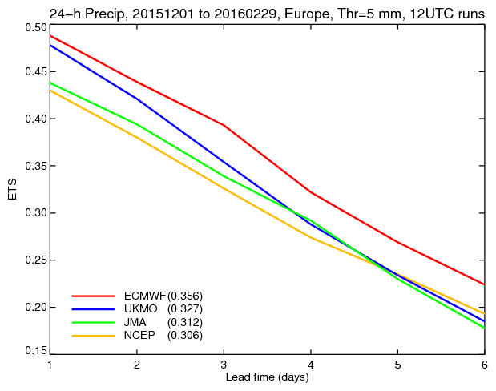
3. D15JF16: ETS(TP24>1mm,Europe)
More recent results: average D15JF16 (solid) CRPSS for 24h precipitation over Europe for 4 single forecasts:
ECMWF (red)
JMA (green)
NCEP (yellow)
UKMO (blue)
Differences here between the best and the second best are about 18 hours.
ECMWF
JMA
~ 18h
Notes:
Average Equitable Threat Score (ETS) for TP24>5mm/d over Europe in D15JF16 for 4 operational single forecasts:
ECMWF (red)
JMA (green)
NCEP (yellow)
UKMO (blue)
The difference between the single forecasts is about 18 hours.

