Slide 1
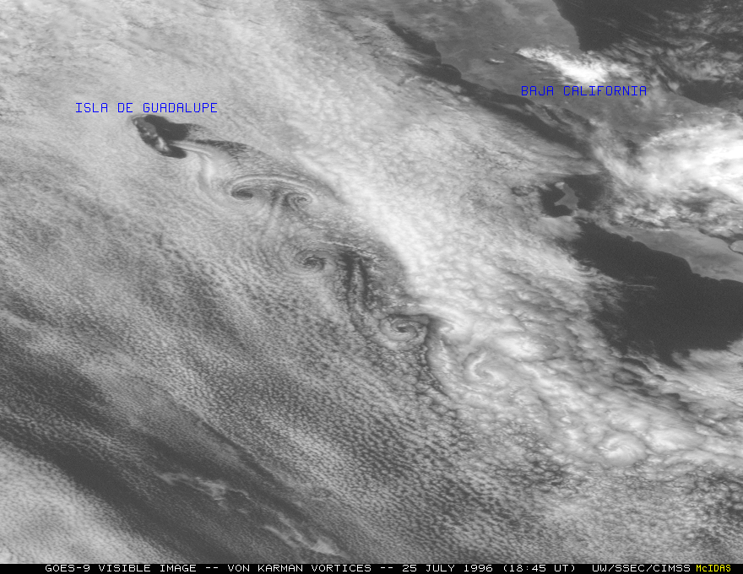
Simulation of initial
uncertainties using
singular vectors (SVs)
and the ECMWF
ensemble
of analyses (EDA)
(EC/TC/PR/RB-L2)
Roberto Buizza
European Centre for Medium-Range Weather Forecasts
(http://www.ecmwf.int/en/staff/Roberto-buizza)
Notes:
The aim of this lecture is to discuss why and how to simulate initial uncertainties using a combination of Singular Vectors (SVs) and perturbations generated using the ECMWF Ensemble of Data Assimilations (EDA).

Slide 2
Abstract and key learning points
The aim of this session is to introduce the singular vectors (SVs) and the ECMWF ensemble of data assimilation (EDA). The SVs are defined, and their key characteristics are illustrated. Then, the rationale and methodology of the EDA is introduced, and its use in to simulate initial uncertainties in the ECMWF ensemble prediction system (ENS) is presented.
By the end of the session you should be able to:
Know what a SV is
know what is the ECMWF EDA
illustrate how the SVs and the EDA are used to simulate initial uncertainty in ensemble prediction
understand the main differences between SV- and EDA-based perturbations

Slide 3
Outline
The original SV-based ECMWF ensemble
Ensemble Data Assimilation characteristics
The EDA-SVINI ensemble
Notes:
In this lecture we will discuss three key points:
The original SV-based ECMWF ensemble
The characteristics of the ECMWF Ensemble of Data Assimilations (EDA)
The simulation of initial perturbations using a combination of SVs and EDA-based perturbations
In the first part of this lecture we will briefly recap how initial uncertainties were simulated in the ‘old’ (before June 2010) ENS.

Slide 4
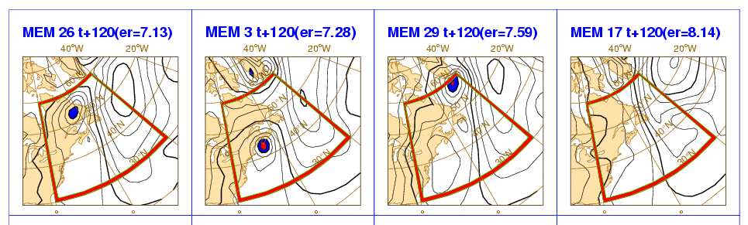
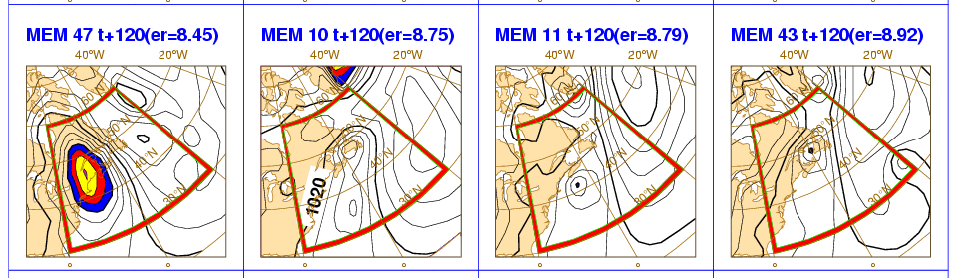
1. The operational ensemble in 2016
ENS includes 51 forecasts with resolution:
T_{co}639L91 (~16km, 91 levels) from day 0 to 15
T_{co}319L91 (~32km, 91 levels) from day 15 to 32 (only at 00UTC on Mon and Thu).
Initial uncertainties are simulated by adding to the unperturbed analyses a combination of T42L91 singular vectors, computed to optimize total energy growth over a 48h time interval (OTI), and perturbations generated by the ECMWF Ensembles of Data Assimilation (EDA) system.
Model uncertainties are simulated by adding stochastic perturbations to the tendencies due to parameterized physical processes (SPPT and SKEB schemes).
The unperturbed analysis is given by the T_{co}1279L137 4DVAR. The EDA resolution is T_{co}639L137.
ENS runs daily at 00 and 12 UTC, with a TOA at 0.01 hPa.
NH
SH
TR
Definition of the
perturbed ICs
1
2
…..
50
51
Products
Notes:
This is a schematic of the ECMWF EPS operational in February 2015. ENS also includes a 5-member re-forecast suite, with forecasts run once a week, up to 32 days, for the past 20 years. The re-forecasts are used to generate some ENS products (e.g. the Extreme Forecast Index) and to assess predictability.

Slide 5
1. Total-energy metric (and norm) definition
Given two state-vectors x and y expressed in terms of vorticity ζ, divergence D, temperature T, specific humidity q and surface pressure π, the total energy metric (and the associated norms) is defined (<..,..> is the Euclidean inner product) as:
Notes:
To define the singular vectors, we need to be able to measure growth. This means that we need to introduce a ‘metric’ in the phase space of the system, so that we can measure the length of vectors (i.e. perturbations) as they evolve. We have been using a dry total energy metric (see Palmer et al 1998 for a discussion of the impact of the norm definition on the SVs’ structures).

Slide 6
1. The adjoint operator
Given any two vectors x and y, the adjoint operator L* of the linear operator L with respect to the Euclidean norm <..,..> is the operator that satisfies the following property:
Using the adjojnt operator L* the time-t E-norm of z’ can be written as:
Notes:
The second concept that we need to introduce is the ‘adjoint’ of a linear operator. Using the adjoint operator, the norm of a perturbation at time t, evolved linearly using the linear operator L, can be computed by applying the linear, and then the adjoint the operator, to the initial state, and then by taking the inner product (defined by the metric) with its initial state. In this way, we do not have to compute the linear and adjoint matrices (and store them in memory), but we can simply apply the linear and adjoint operators.

Slide 7
1. Singular vector definition
Consider an N-dimensional system:
Denote by z’ a small perturbation around a time-evolving trajectory z:
The time evolution of the small perturbation z’ is described to a good degree of approximation by the linearized system A_{l}(z) defined by the trajectory. Note that the trajectory is not constant in time.
Notes:
Now, let’s consider an N-dimensional non-linear system. The time evolution of small perturbations can be approximated by the tangent linear version of the non-linear model. In other words, the state of an initial perturbation at time t, can be computed by integrating in time the linear model from the initial state.

Slide 8
1. Singular vector definition
The solution of the linearized system can be written in terms of the linear propagator L(t,0):
The linear propagator is defined by the system equations and depends on the trajectory characteristics.
The E-norm of the perturbation at time t is given by:
Notes:
We can formally write the linear integration in a matrix form, using the linear forward propagator L, and we can compute the norm at time t by applying the linear and adjoint operators, using the metric weights E.

Slide 9
1. Singular vector definition
The computation of the directions of maximum growth can be stated as ‘finding the directions in the phase-space of the system characterized by the maximum ratio between the time-t and the initial norms’:
The problem reduces to solving the following eigenvalue problem:
Notes:
The singular vectors (SVs) are the perturbations with the maximum ratio of the final-time over the initial-time norms. These perturbations with the maximum can be computed by solving an eigenvalue problem, defined by the product of the norm matrices E0 and E, and the linear and adjoint operators L and L*. The computation is done using a Lanczos method, which is an iterative procedure that give the fastest growing perturbations. The highest the number of iterations, the more SVs can be computed. At T42L91 resolution, for each hemisphere we use about 75 iterations to compute the first 50 SVs with their singular value with a 1% accuracy. The Lanczos-based computation include a sequence of linear and adjoint integrations, each followed by an ortho-normalization step.

Slide 10
1. SVs’ geographical distributions and Eady index
The geographical distribution of the singular vectors reflect the characteristics of the underlying basic-state flow. A measure of the baroclinic instability of the basic-state flow is given by the Eady index:
which is the growth rate of the most unstable Eady mode (Hoskins & Valdes 1990). In this equation, the static stability N and the vertical wind shear can be estimated using the 300- and 1000-hPa potential temperature and wind. Results indicate that locations with maximum singular vector concentration coincide with regions with maximum Eady index.
Notes:
Do SVs identify areas of baroclinic instability? Do they identify areas where small perturbations can grow fastest? One way to address these questions is to compare SV maps with maps of the Eady index.

Slide 11
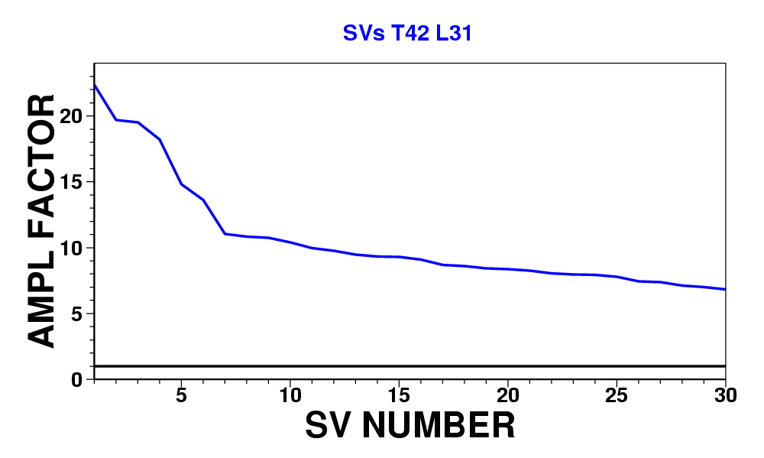
1. Example 1: singular vectors for 18-20 Jan 1997
This figure shows the amplification rate (i.e. the singular value) of the leading 30 unstable singular vectors growing between 18 and 20 January 1997.
The SVs were computed at the resolution T42L31 and were used to generate the EPS initial conditions.
Notes:
How do SVs look like? How does a SV spectrum look like? The following slides present some maps of the leading SVs for one case, computed by the operational ENS in 1997. See Buizza et al (1993) and Buizza and Palmer (1995).

Slide 12
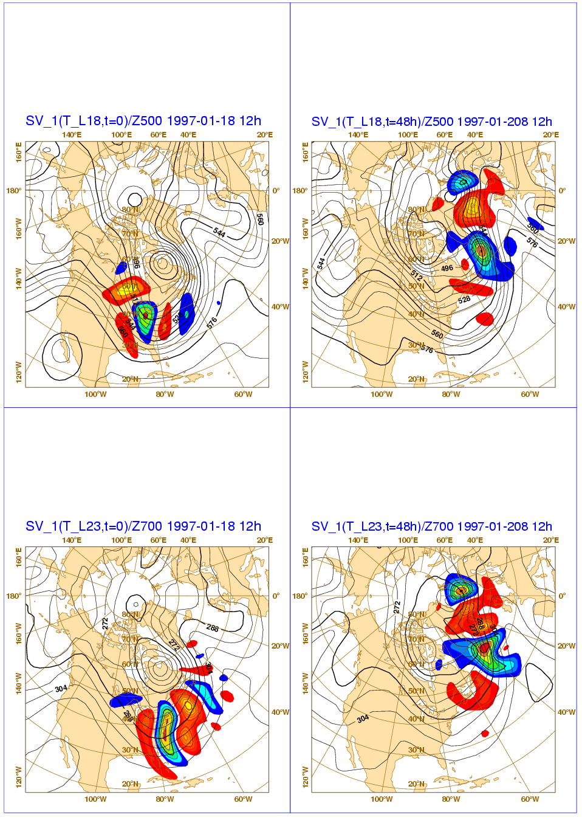
1. Ex 1: singular vector 1 for 18-20 Jan 1997
This figure shows the most unstable singular vector growing between 18 and 20 Jan 1997. Left (right) panels show the SV at initial and final (i.e. +48h) time.
The top panels show the SV T at model level 18 (~500hPa, shading) and the Z500 analysis; the bottom panels the SV T at model level 23 (~700hPa, shading).
The contour interval is 8dam for Z, and 0.01 (0.05) deg for T at initial (final) time (the SV is normalized to have unit total energy norm at initial time).
T=0
T=+48h
500hPa
700hPa
Notes:
Geographically, SVs are localized. During their time evolution, they propagate extracting energy from the basic-state flow, and show an upscale energy transfer. SO at final time (in this case 48 hours), they have a larger scale than at initial time.

Slide 13
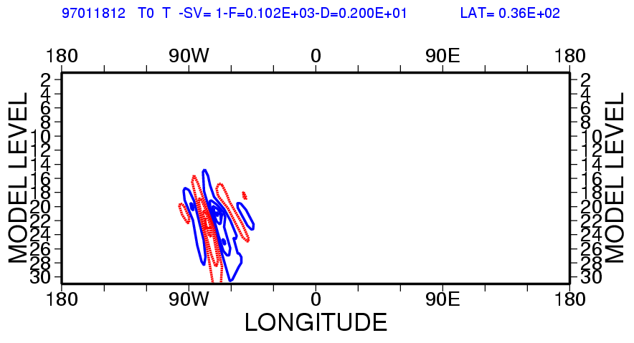
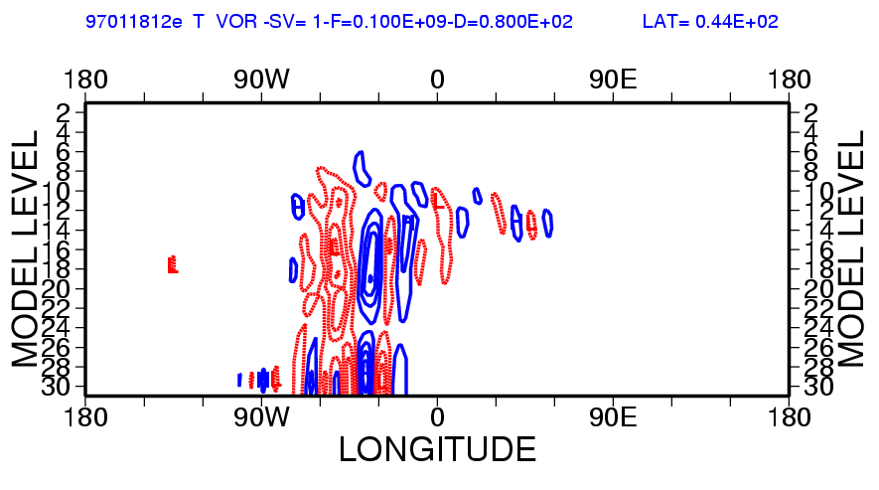
1. Ex 1: vertical cross section of SV 1 for 18-20 Jan 1997
This figure shows, for SV 1, the vertical cross section of the T component at initial time (top, for 36N) and of the vorticity component at final time (bottom, for 44N).
The two cross sections have been taken along the parallel where the SV had maximum amplitude.
Note the strong initial tilt, suggesting baroclinic instability, and the final time more barotropic-type structure. Note that T is shown at initial time and vor at final time because the initial time SV has a strong potential energy part.
Notes:
In the vertical, they propagate upward, and change their tilt from an initial-time westward tilt (typical of baroclinically unstable structures), to a final-time more barotropic structure.

Slide 14
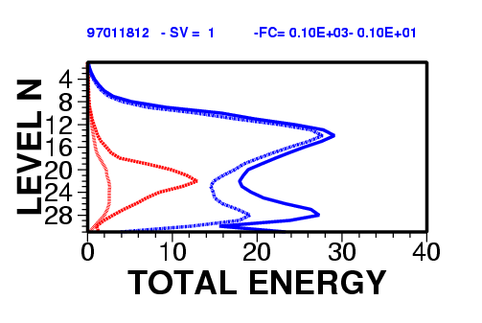
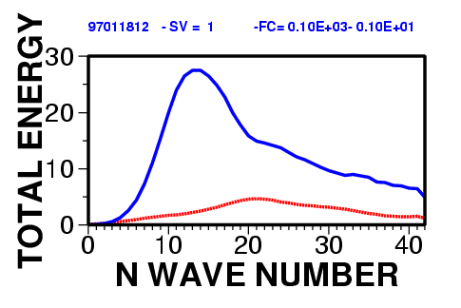
1. Ex 1: energy distribution of SV 1 for 18-20 Jan 1997
The top figure shows, for SV 1, the vertical distribution at initial time of the kinetic (red dotted, x100) and total (red solid, x100) energy, and the corresponding final time distributions (blue).
The bottom figure shows the total energy spectrum at initial (red solid, x100) and at final time (blue solid). Note the upward and upscale energy transfer/growth, and the transformation from initial potential to mainly final kinetic energy.
Notes:
In terms of energy (kinetic in dotted and total in solid), the SVs show an upward propagation and an upscale energy transfer.

Slide 15
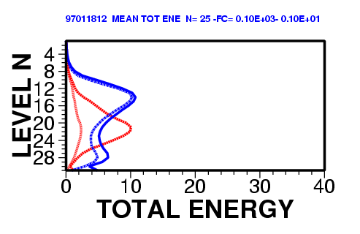
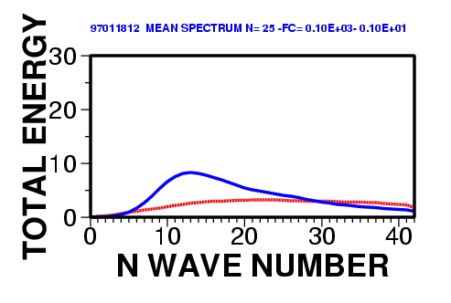
Ex 1: average energy distribution for 18-20 Jan 1997
The top figure shows the SV1:25 average vertical distribution at initial time of the kinetic (red dotted, x100) and total (red solid, x100) energy, and the corresponding final time distributions (blue).
The bottom figure shows the SV1:25 average total energy spectrum at initial (red solid, x100) and at final time (blue solid). Note the SV typical upward and upscale energy transfer/growth, and the transformation from initial potential to mainly final kinetic energy.
Notes:
In terms of energy (kinetic in dotted and total in solid), the SVs show an upward propagation and an upscale energy transfer.

Slide 16
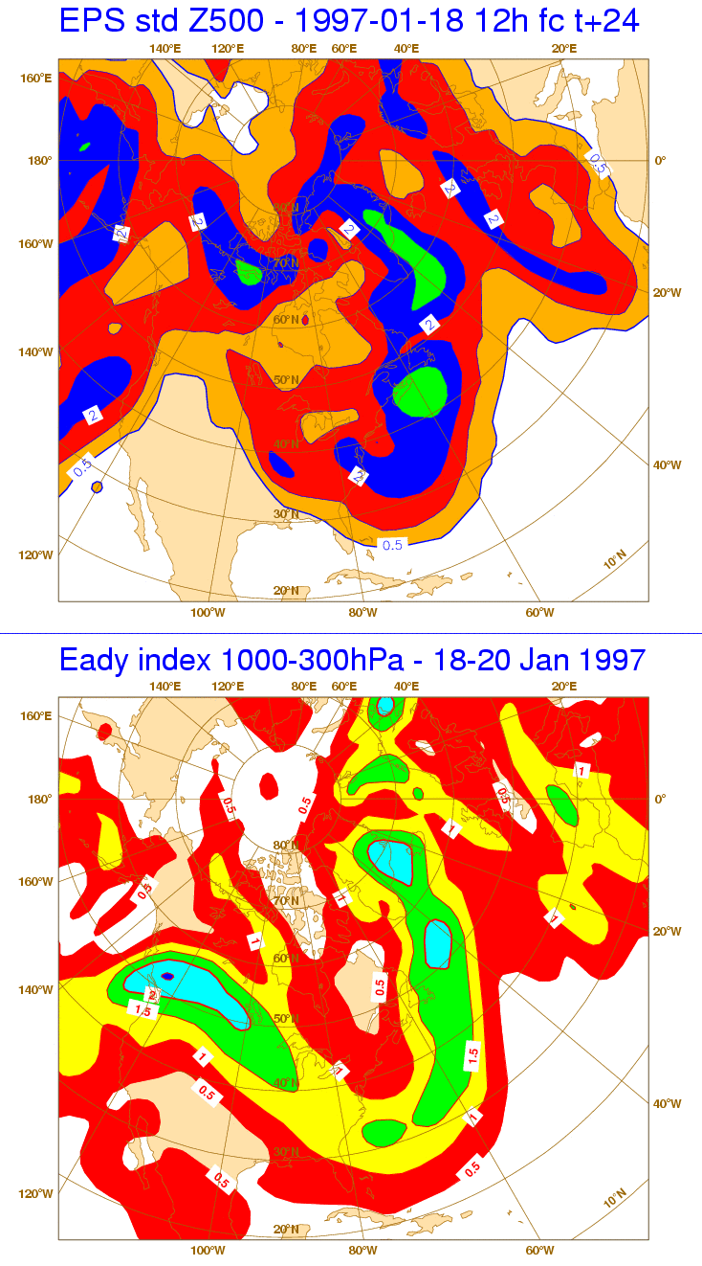
1. Ex 1: SVs’ and Eady index for 18-20 Jan 1997
The top panel shows the t+24h average root-mean-square (rms) amplitude (in terms of Z500) of the first 25 singular vectors growing between 18 and 20 January 1997. The bottom panel shows the 18-20 January 1997 average Eady index.
The contour isolines are 0.5dam for the SV’s rms amplitude and 0.5d⁻¹ for the Eady index. Results indicate a good correspondence between areas of SV concentration and of maximum value of the Eady index.
Notes:
Do SVs identify areas of baroclinic instability? Do they identify areas where small perturbations can grow fastest? One way to address these questions is to compare SV maps with maps of the Eady index. This plot compares the ensemble standard deviation and the Eady index. At that time (1997), the ensemble initial perturbations were defined only using initial-time SVs.

Slide 17
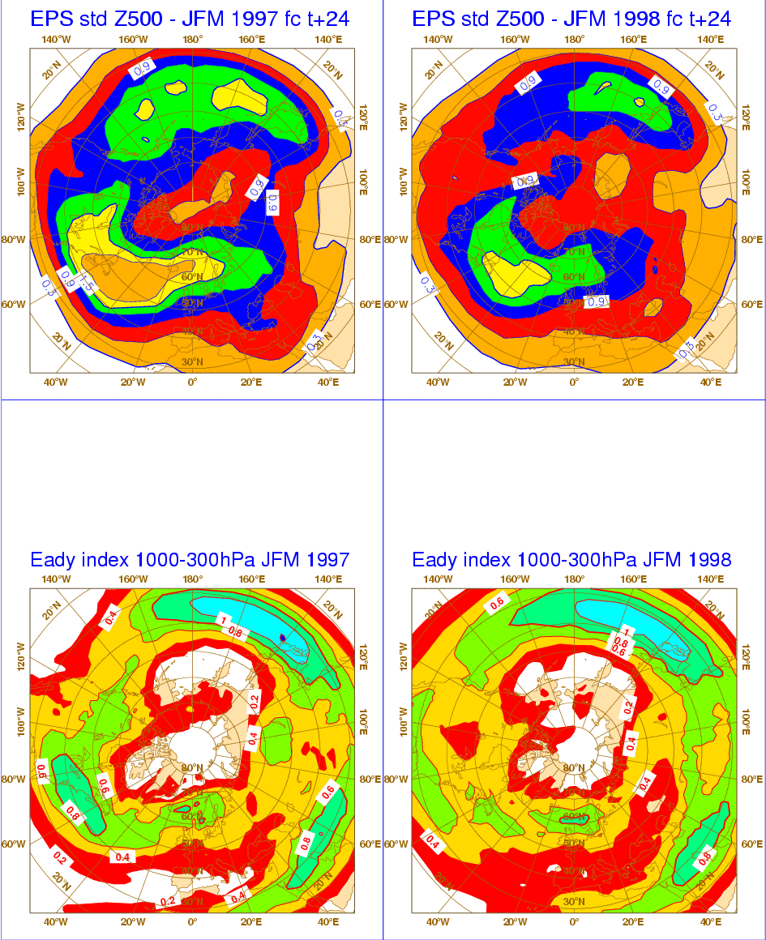
1. Ex 2: NH SVs and Eady index - JFM 1997 and 1998
The top panels show the average t+24h root-mean-square amplitude (in terms of Z500, ci=0.3dam) of the first 25 singular vectors during JFM 1997 (left) and 1998 (right) over the NH.
The bottom panels show the average Eady index computed between 1000 and 300 hPa (ci=0.2d⁻¹). Results indicate a good agreement between areas of large Eady index and high SV concentration.
Notes:
The correspondence between SV location and the Eady index is stronger if we look at seasonal averages. In this case, for example, if we look at the Euro-Atlantic sector, 1997 was more unstable (higher Eady index values, and larger ensemble STD) than 1998, indicating that this sector was more unstable.

Slide 18
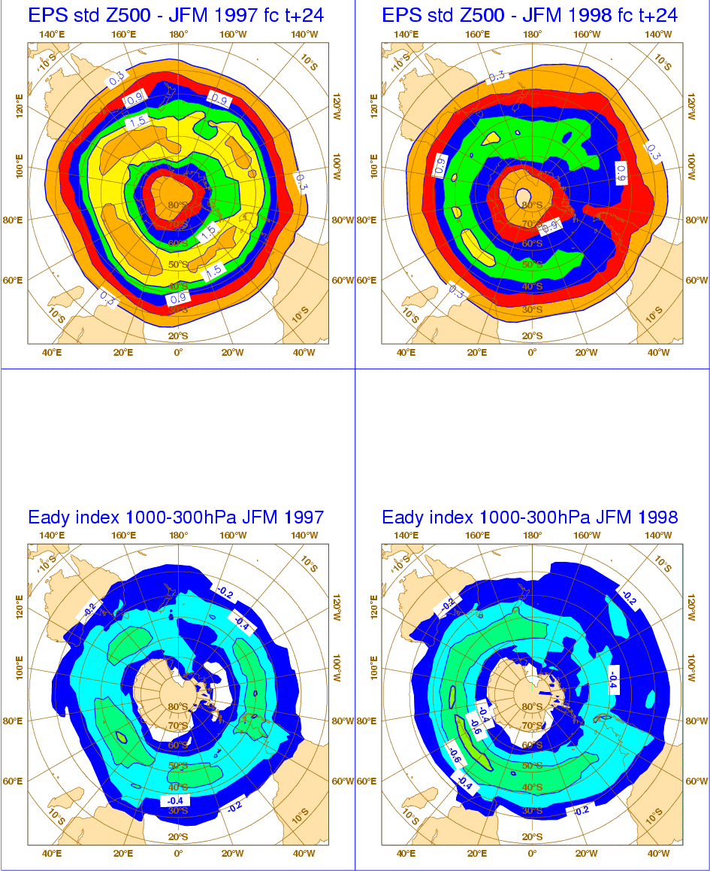
1. Ex 2: SH SVs and Eady index - JFM 1997 and 1998
The top panels show the average t+24h root-mean-square amplitude (in terms of Z500, ci=0.3dam) of the first 25 singular vectors during JFM 1997 (left) and 1998 (right) over the SH.
The bottom panels show the average Eady index computed between 1000 and 300 hPa (ci=0.2d⁻¹). Results indicate a good agreement between areas of large Eady index and high SV concentration.
Notes:
The correspondence between SV location and the Eady index is stronger if we look at seasonal averages. In this case, for example, over the SH 1997 was unstable in a more symmetric way (higher Eady index values, and larger ensemble STD) than 1998. 1997 also had larger values overall, indicating that it was more unstable than 1998.

Slide 19
1. The original ENS (before 2010)
Each ensemble member evolution is given by the time integration
of perturbed model equations starting from perturbed initial conditions
The model tendency perturbation is defined at each grid point by
where r_{j}(t;Φ,λ) is a random number.
Notes:
In the original ENS (implemented in Nov 1992, and run three days a week till 1 May 1994, when daily runs started), and up to June 2010, initial uncertainties were simulated using a combination of initial-time and evolved SVs. The (linear) weights were computed by comparing the SVs with the 4D-Var analysis error estimate. Perturbations were scaled to have an amplitude locally similar to the analysis error estimate. Model uncertainties were (and still are) simulated using stochastic model error schemes. Why did we use a combination of initial time and evolved SVs?
The initial-time SVs, growing for 48 hours into the future represent errors that can grow in the first forecast hours (up to the time when perturbations grow linearly)
The evolved SVs, that has grown in the 48 hours up to the initial time, represent errors that have been growing during the assimilation period leading to the intial state.

Slide 20
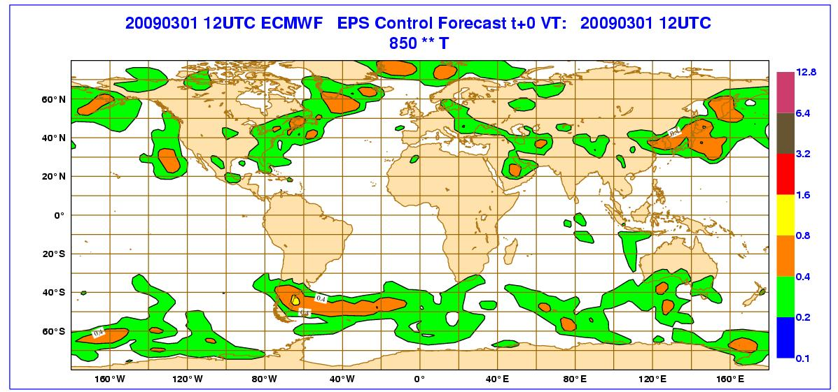
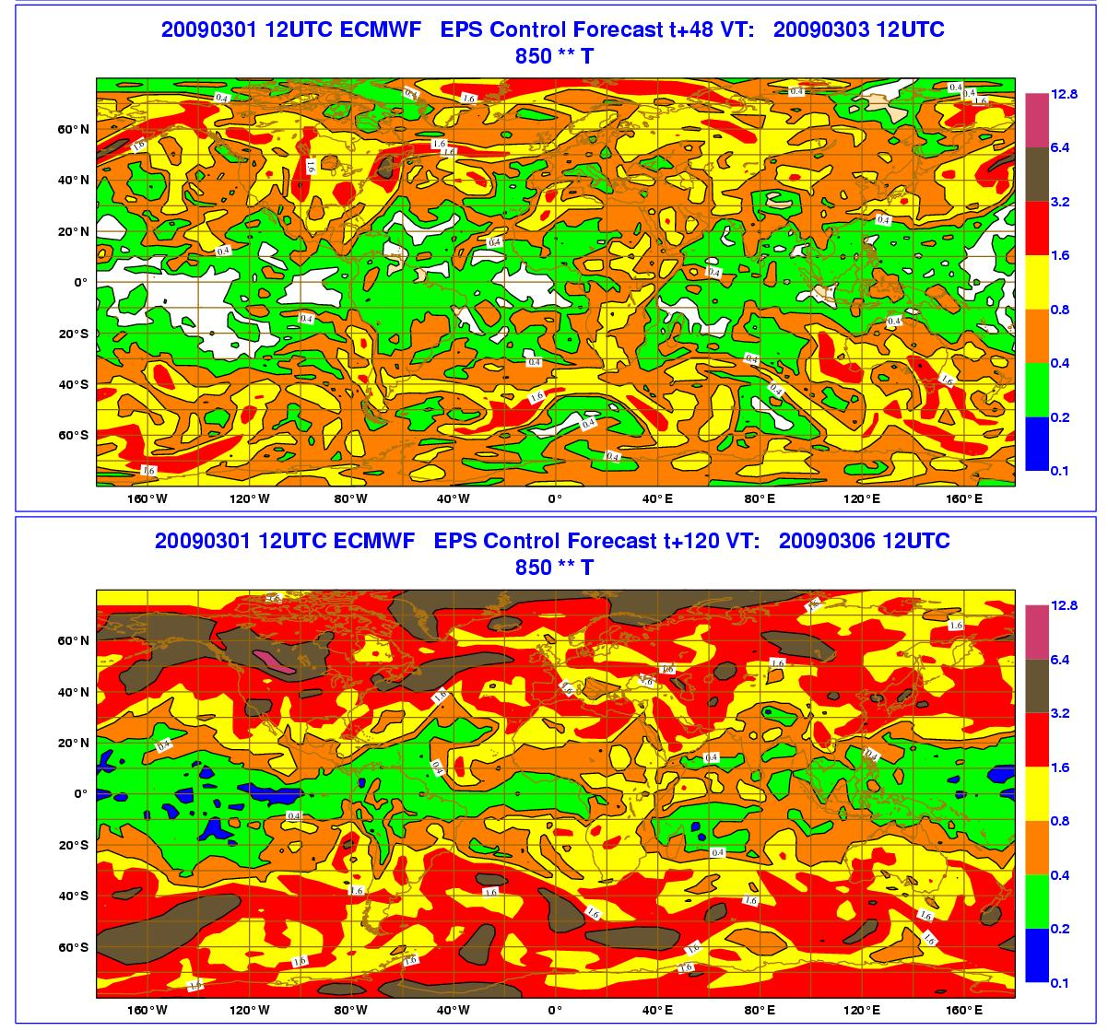
1. The original ENS (before 2010)
T=0
+48h
+120h
The initial perturbations do not sample the tropics in an appropriate way. The system is not ‘reliable’ (spread under estimation).
Notes:
The ENS initial perturbations did not sample the tropics in an appropriate way, since over this region SVs were computed only for few (up to 6) selected regions and only 10 initial-time SVs are used for each of these regions. The computation over the tropics was restricted to areas where large scale features as TS/TC were developing. This is because, at T42 resolution and with a 48h OTI, the SVs were not able to capture in an accurate way perturbations growing in this area, where convection is dominant. Thus, it was not surprising to detect a lack of spread in the tropics. In this region, the system was not reliable, and due the under dispersion the forecasts were often over confident.

Slide 21
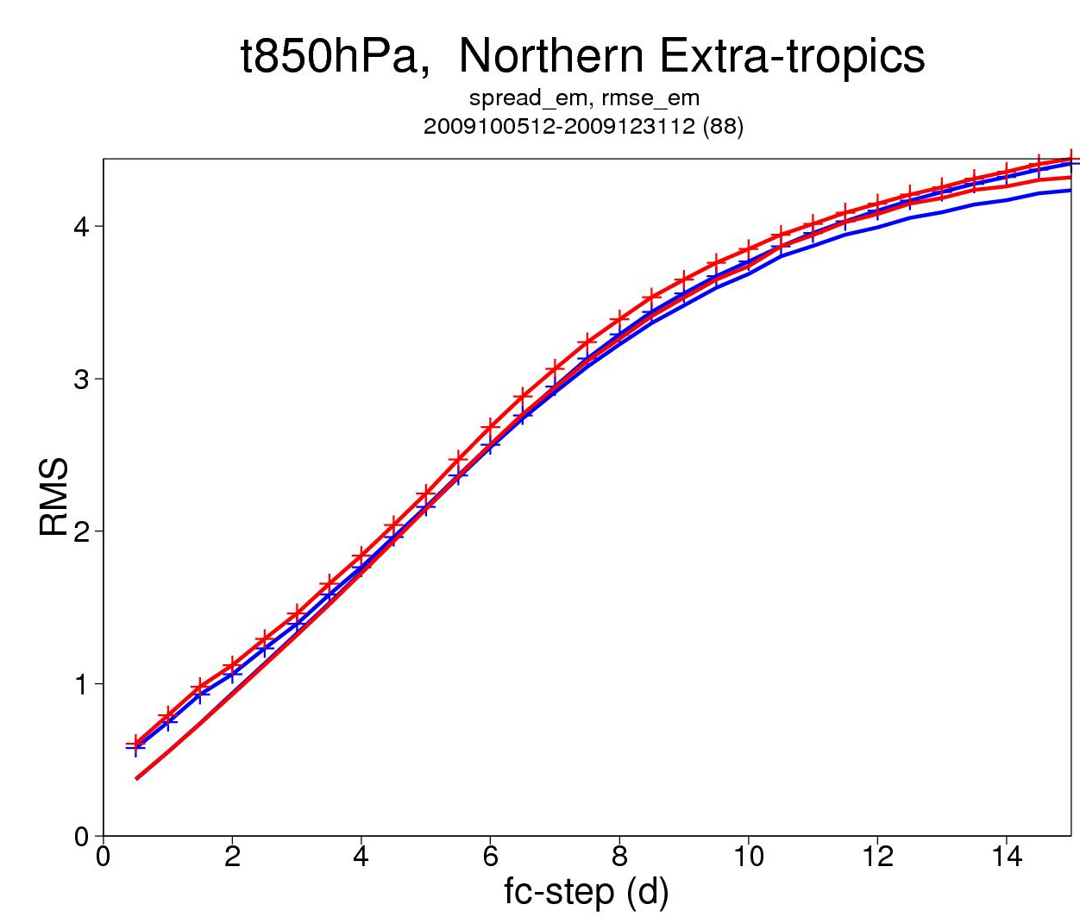
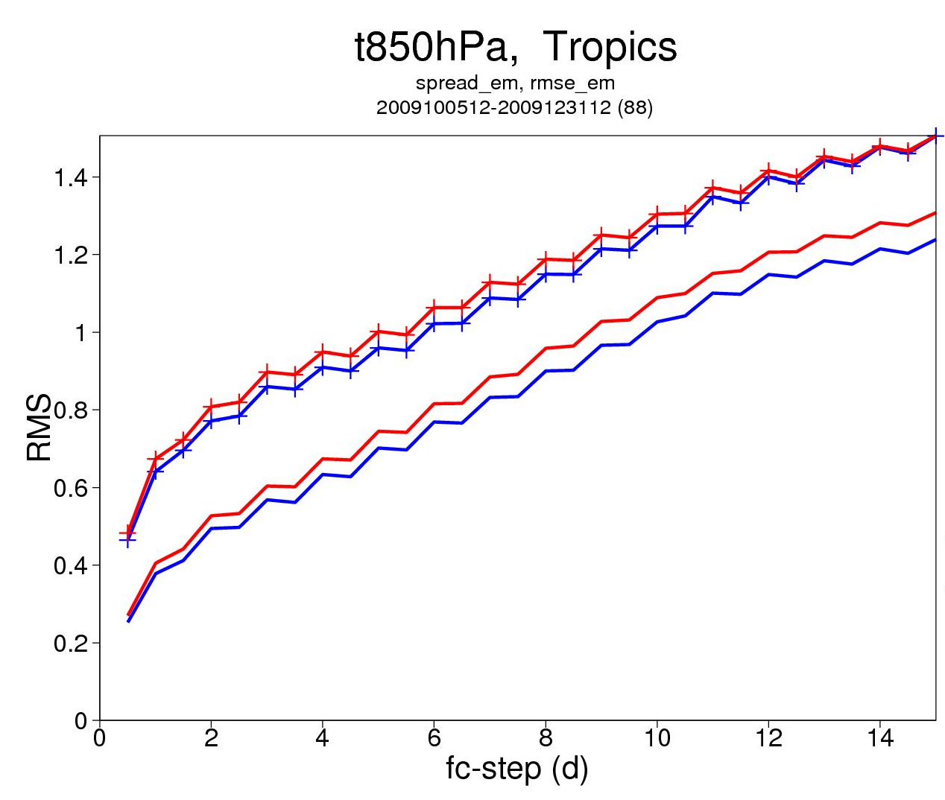
1. std/EM of ECMWF 399v255 and 639v319 ENS
NH: apart for the first 2 days the spread-skill relationship is very good, with the 639v319 version (implemented in Jan 2010) showing a better match.
Tropics: both systems are under-dispersive for the whole forecast range.
Is this a symptom of a weakness of the initial perturbation strategy?
399v255 (up to Jan 2010)
639v319
399v255 (up uo Jan 2010)
639v319
Notes:
A similar, albeit smaller in amplitude, problem was also seen over the extra-tropics in the short forecast range (say up to 2 days), where ENS was under dispersive. This figure shows results for the T399v255 ENS which was operational in 2009, and the T639v319, which was implemented in Jan 2010 (and is operational now). Over the NH (left), during the first 2 days both ensembles are under dispersive. Over the Tropics (right), both systems are under-dispersive for the whole forecast range. Could the use of a different set of initial perturbations mitigate this under dispersion?

Slide 22
1. The TIGGE ensembles (updated May 2016)
The 9 TIGGE operational, medium-range, global ensembles use different methodologies to simulate initial-time and model uncertainties. Every day, the 7 ensembles that are still operational, put 436 forecasts into the TIGGE archive. These forecasts have horizontal resolution ranging from about 210 km to about 16 km, and forecast length between 10 and 46 days. They all simulate initial/observation and model uncertainties in different ways.
Notes:
The 9 TIGGE operational, global, medium-range ensembles use different methodologies to simulate initial-time and model uncertainties, that can be grouped since some of the methods are similar or related. Note that BMRC has stopped issuing medium-range ENS forecasts at the end of 2010. Thus today, every day 436 global forecasts spanning a forecast range of up to 16 days, are generated and exchanged within TIGGE. These forecasts are available, with a 48-hour delay, from the TIGGE archive.
In the next slides we will first discuss the key characteristics of the different methods, and then show how ensemble design affects performance.

Slide 23
Outline
The original SV-based ECMWF ensemble
Ensemble Data Assimilation characteristics
The EDA-SVINI ensemble
Notes:
So far we have discussed the configuration of the ECMWF ensemble up to mid 2010. Let’s now illustrate the characteristics of the ECMWF Ensemble of Data Assimilations (EDA), and discuss why it is beneficial to use EDA-based perturbations to simulate initial uncertainties.

Slide 24
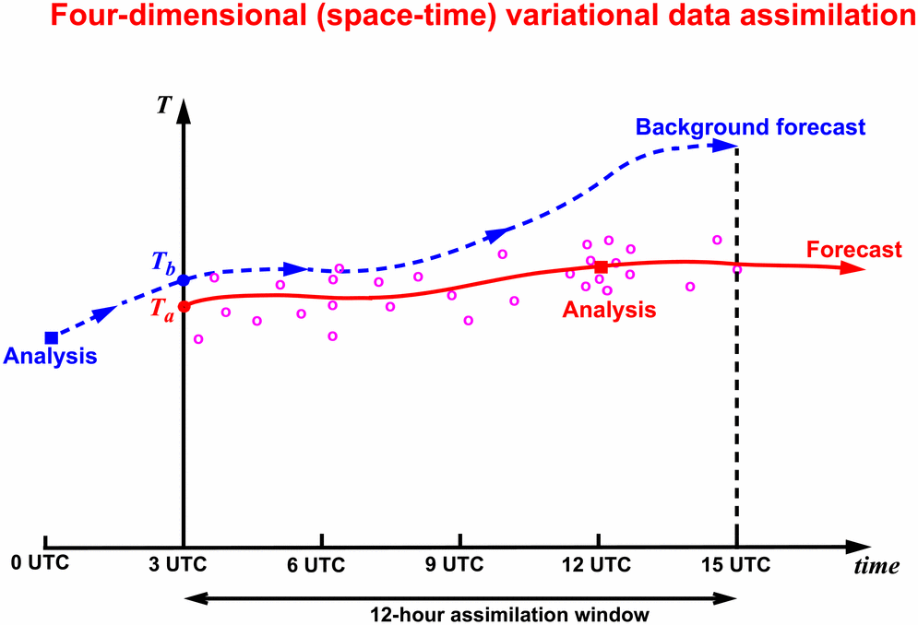
2. The ECMWF 4D-Var data-assimilation system
The ECMWF 4-dimensional data-assimilation system determines a correction to the background initial condition (blue line) that would lead to a forecast trajectory (red line) that passes closer to the observations (red circles).
Notes:
Before introducing the EDA, let’s very briefly remind what we mean with ‘data assimilation’. We mean a complex procedure to marge a first-guess forecast and observations to estimate the state of the atmosphere, expressed in terms of the model state variables (i.e. in model space). At ECMWF, a 4-dimensional variational assimilation system is used, with a 12 hour window. The high-resolution 4D-Var (hereafter called simply 4DVAR) has the following resolution:
3 outer loops at T_{L}1279L137
3 inner loops at T_{L}159L137 (70 iter), T_{L}255L137 (25-30 iter) and T_{L}255L137 resolution (25-30 iter)
The Ensemble of Data Assimilations (hereafter EDA) include 25 members of 4D-Var run at a lower resolution:
2 outer loops at T_{L}399L137
2 inner loops at T_{L}95L137 (50 iter) and T_{L}159L137 (25-30 iter)
In each 4D-Var cycle, the minimisation finish when DFS increase per iteration is less than 5%. Minimum 10 iterations, maximum 50 for 2nd/3rd minimization.
At the end of this lecture, in the ‘extra material’ section, you will find 4 slides that briefly summarize the key concepts behind the ECMWF 4-dimensional variational system.

Slide 25
2. The ECMWF EDA
Each observation has an error (instrument, representativeness) and model error should be taken into account. A way to simulate both these effects is to run an ensemble of assimilations.
Notes:
In the EDA, we run an ensemble of 4-dimensional variational assimilations at lower resolution than the high-resolution 4D-Var because of computational constraints. The EDA has been designed to provide estimates of the background error, by taking into account observation and model uncertainties. Each observation has an error (instrument, representativeness) and also each model trajectory should take model error into account. In the EDA, each observation is perturbed and each model trajectory is computed with a stochastic model error scheme to take into account model uncertainty.
At the end of this lecture, in the ‘extra material’ section, you will find 4 slides that briefly summarize the key concepts behind the ECMWF 4-dimensional variational system.

Slide 26
2. Ensemble Data Assimilation and Prediction
The EDA analyses are generated by randomly perturbing the observations and the SST; the observations are assumed unbiased, with obs-error std defined by a normal distribution
Model error is simulated using stochastic schemes
Differences between pairs of analyses (and forecast) fields have the statistical characteristics of analysis (and forecast) error.
The EDA analyses can be used to specify flow-dependent background error statistics
Notes:
In the EDA, the perturbed analyses are generated by randomly perturbing the observations and the SST, and by running the forecast model with stochastic physics. The observation random perturbations are defined by sampling a normal distribution with zero mean (it is assumed that observations do not have any bias) and standard deviation defined by the observation error standard deviation.
Differences between pairs of analyses (and forecast) fields should have the statistical characteristics of analysis (and forecast) error, and can be used to generate a new set of initial perturbations for the ENS, to further improve the simulation of initial uncertainties.
In data assimilation, the EDA analyses are used to specify the background errors “of the day” in the high-resolution 4D-Var. The ensemble of analyses indicate where good data should be trusted in the analysis (yellow shading). Work is progressing to use flow dependent background error statistics also in each EDA member (to date, each EDA member uses static background error statistics).

Slide 27
2. The ECMWF Integrated Forecasting System (IFS)
PDF(0) << 4DVAR+EDA²⁵+ORAS4⁵
PDF(0) << ERAI+ORAS4⁵ (refc suite)
PDF(T) << HRES+ENS⁵¹/S4⁵¹
EDA²⁵
ERA-I
ENS⁵¹
S4⁵¹
HRES
4DVAR
ORAS4⁵
System components simulate the effect of:
Observation uncertainties
Model uncertainties (2 stochastic schemes)
Notes:
In the EDA, the perturbed analyses are generated by randomly perturbing the observations and the SST, and by running the forecast model with stochastic physics. The observation random perturbations are defined by sampling a normal distribution with zero mean (it is assumed that observations do not have any bias) and standard deviation defined by the observation error standard deviation.
Differences between pairs of analyses (and forecast) fields should have the statistical characteristics of analysis (and forecast) error, and can be used to generate a new set of initial perturbations for the ENS, to further improve the simulation of initial uncertainties.
In data assimilation, the EDA analyses are used to specify the background errors “of the day” in the high-resolution 4D-Var. The ensemble of analyses indicate where good data should be trusted in the analysis (yellow shading). Work is progressing to use flow dependent background error statistics also in each EDA member (to date, each EDA member uses static background error statistics).

Slide 28
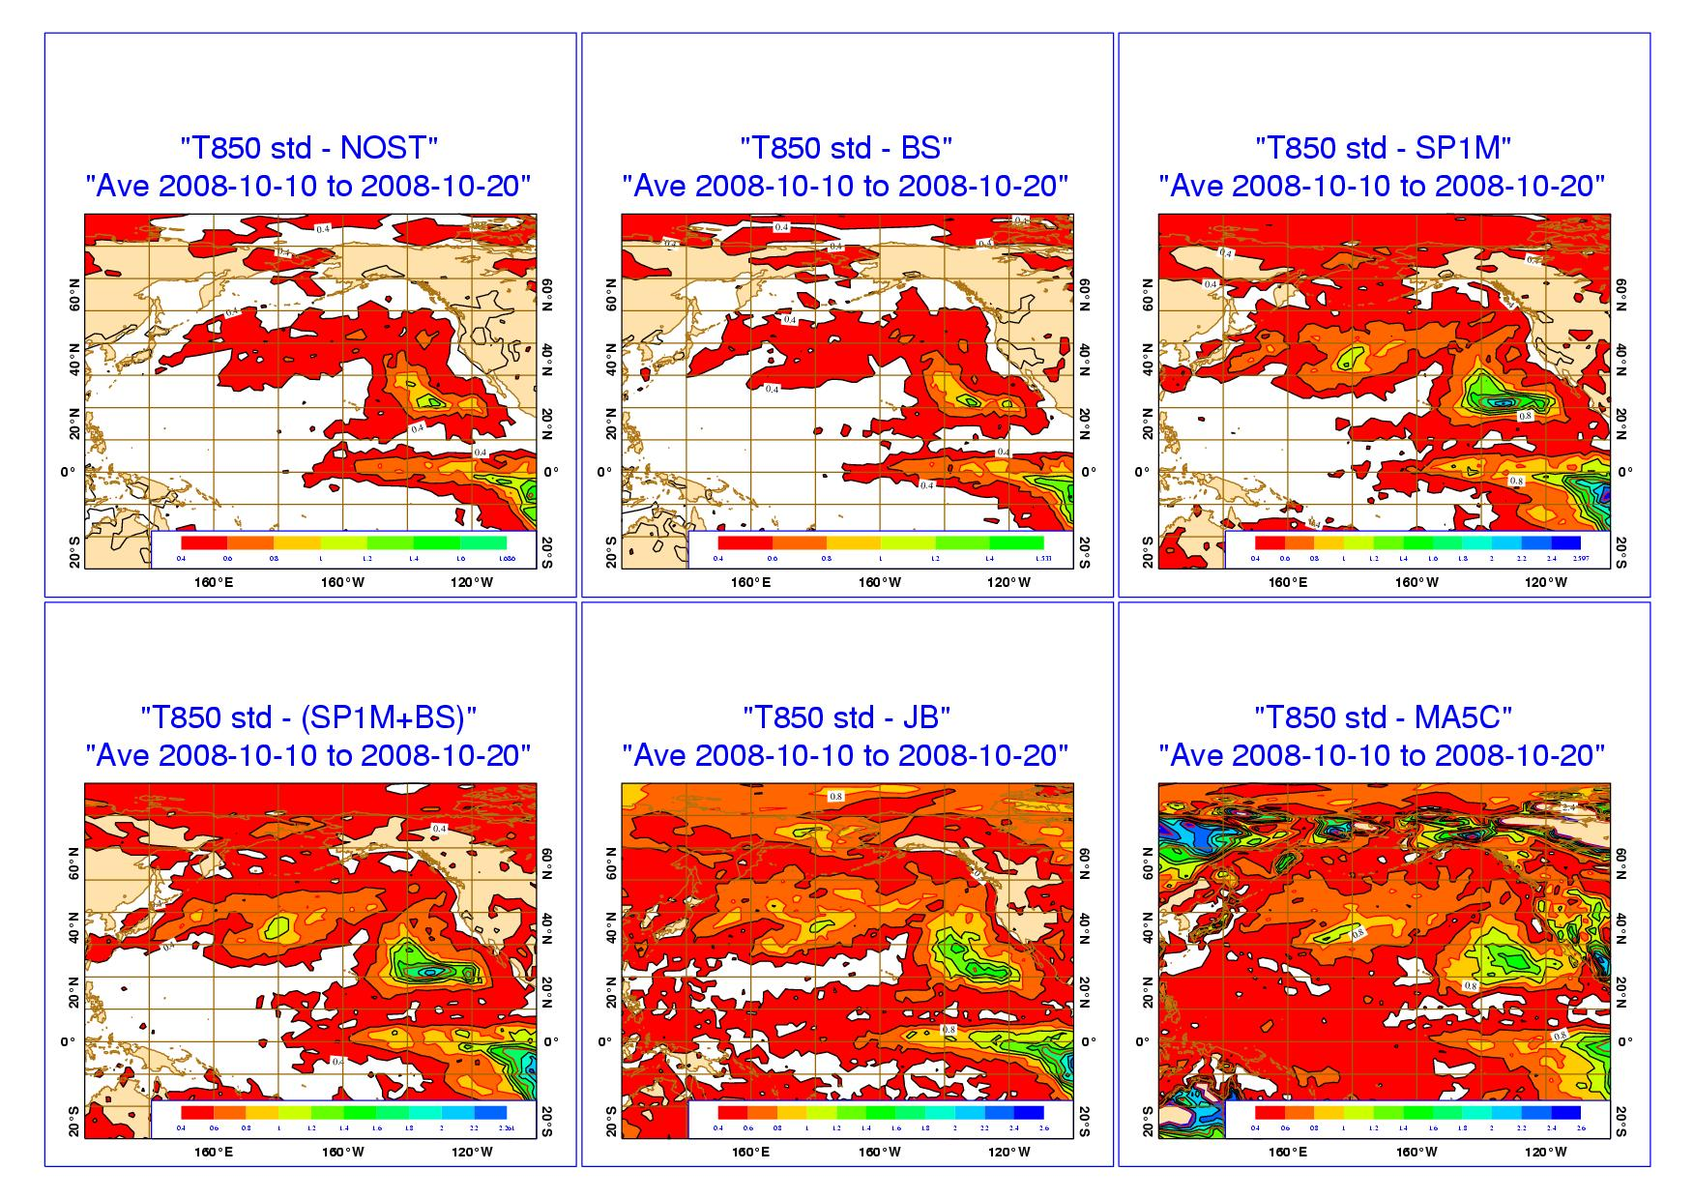
2. EDA spread sensitivity to stochastic physics
T850 EDA spread sensitivity to model error:
NOST
BS (back-scatter)
SP1M (rev SPPT)
SP1M+BS
Jb (model error from Jb stats)
MA5C: 5-member multi-analysis system.
Notes:
It is worth discussing in some details few aspects of the EDA. The first aspect regards the simulation of model error: should the EDA include a model error simulation scheme? The comparison of the ensemble spread (measured by the standard deviation) of EDAs generated in 5 configurations will provide us with indications of the impact of simulating model error. The std of these EDA configurations are going to be compared with the std of 5 operational analysis (CMC, ECMWF, MF, NCEP and UKMO), which can be considered as a reference, our best estimate of analysis uncertainty.
Can the ECMWF (single-system) EDA with a model error scheme provide a reliable estimate of analysis uncertainty? A reliable EDA configuration should lead to an EDA spread comparable to this reference. These are the 5 EDA configurations that are being compared:
NOST (no model error simulation)
BS (back-scatter model error scheme only)
SP1M (stochastically perturbed parameterisation tendency, SPPT, scheme version 1, with 1 scale only)
SP1M+BS
Jb (model error simulated by adding perturbations generated from Jb statistics)
The std of these EDAs is compared to the std of a 5-member multi-analysis system (an independent estimate of analysis error).

Slide 29
2. EDA spread sensitivity to stochastic physics
EDA spread sensitivity to model error scheme: relative impact for different variables and levels over NH.
Notes:
How do the spread of these EDAs compare with the reference? This plot shows the relative difference between the spread (std) of EDA generated in 4 different configurations and of the multi-analysis ensemble with respect to the NOST-EDA for 6 variables over NH.

Slide 30
Outline
The original SV-based ECMWF ensemble
Ensemble Data Assimilation characteristics
The EDA-SVINI ensemble
Notes:
Let’s now discuss how SV- and EDA-based perturbations can be combined to improve the simulation of initial uncertainties in the ensemble.

Slide 31
3. The EDA-SVINI ENS
Each ensemble forecast is given by the time integration of perturbed equations
Initial perturbations are defined using 25 perturbed analyses (generated by the ECMWF Ensemble of Data Assimilations) and initial singular vectors (SVINI)
with the ‘central’ (unperturbed) analysis defined by
Notes:
This is how ENS initial conditions have been computed since June 2010, using a combination of initial-time and initial-time SVs. For the EDA component, perturbations are generated by computing differences between 6-hour forecasts from EDA members and the EDA mean (this is because the EDA runs in delayed mode, and at the time when ENS is run the EDA analyses are not yet available). For the SV component, as in the past the (linear) weights are computed by comparing the SVs with the 4D-Var analysis error estimate. Perturbations are scaled to have an amplitude locally similar to the analysis error estimate. Model uncertainties were (and still are) simulated using stochastic model error schemes.

Slide 32
3. The EDA-SVINI ENS
Consider the 00UTC ENS:
EVO-SVINI ENS: the initial perturbations were generated using initial-time and evolved SVs.
EDA-SVINI ENS: the evolved SVs are replaced by EDA-based perturbations, defined by differences between 6h forecasts from the previous-cycle EDA (blue lines).
The unperturbed (control) analysis is defined by the 6h HRES 4DVAR analysis (green box), with fg started from the previous DCDA analysis (black box).
Notes:
This diagram illustrates how the EDA-based and SV perturbations are generated in the current operational system.

Slide 33
3. Ensemble experiments
What is the impact of the ENS reliability and skill of using the EDA?
These results are based on a set of T_{L}399L62 ensembles (model cycle 31r2)
The following 4 ensembles configurations are compared:
  SVINI: with initial uncertainties defined by initial SVs only
  SVEVO-INI: with initial uncertainties defined by evolved and initial SVs
  EDA: with initial uncertainties defined by EDA-only initial perturbations
  EDA-SVINI: with initial uncertainties defined by EDA- and initial SVs
Notes:
Let’s now look at the impact of the introduction of the EDA-based perturbations on ENS. EDA-based perturbations were introduced in ENS in June 2010, to improve the simulation of initial uncertainties. It is worth mentioning another criticism of the SVs often raised in the past: SVs did not take into account observation/analysis uncertainty (e.g. due to instruments quality, representativeness error, spatial coverage, ..). By contrast, the EDA perturbations take it into account, by design.
In the next slides ENS run in different configurations are compared, to highlight similarities and differences between the two perturbation basis (EDA-based perturbations and SVs). Results are based on a set of T_{L}399L62 experiments (model cycle 31r2, run at the time of the EDA-SVINI system development) with the following characteristics:
The EDA analyses have been generated with 12-hour cycling 4D-Var, resolution T_{L}399L91 in the outer-loop, and T_{L}159L91/T_{L}95L91 in the inner loops
The SVs have been computed with a T42L62 resolution, a 48-hour optimisation time interval and a total energy norm (as in the operational system)
The ensemble forecasts have been run up with a T_{L}399L62 resolution, 50 perturbed members, stochastic tendency perturbations and a 10-day forecast length.

Slide 34
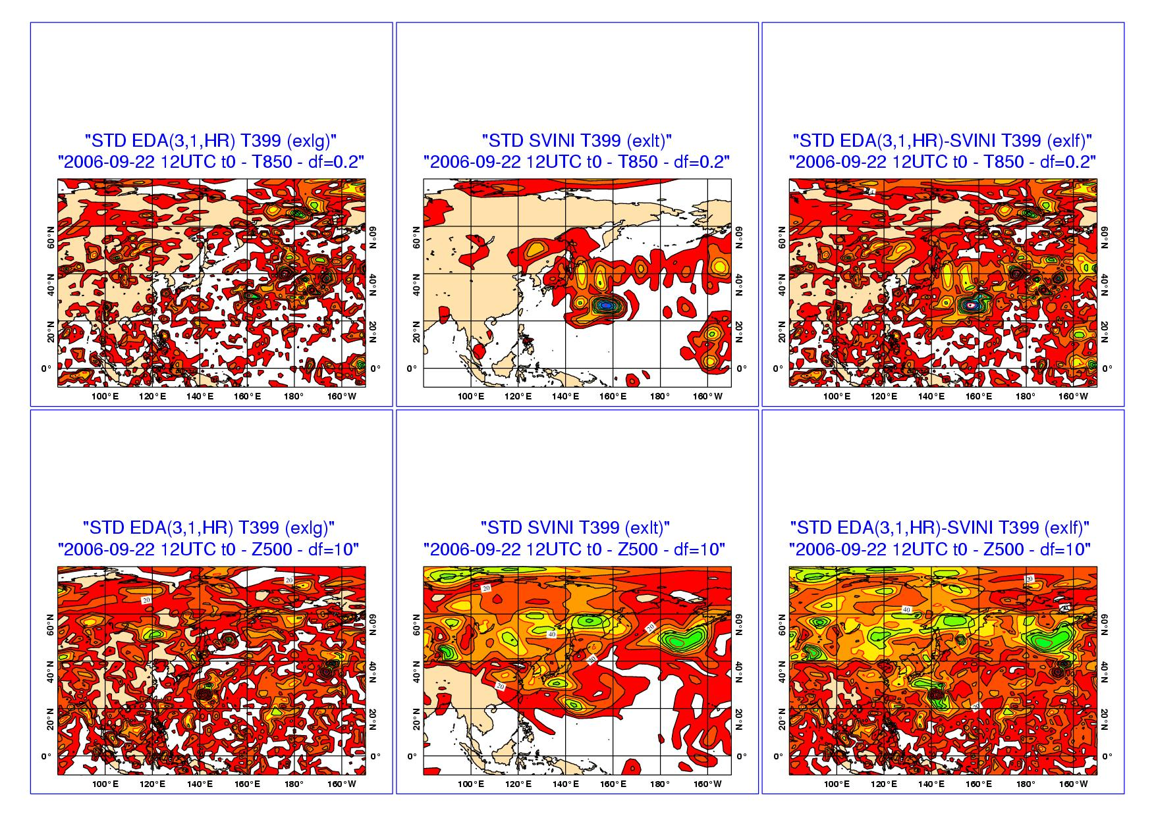
3. std EDA, SVINI & EDA-SVINI - t0 (22/09/07)
EDA-only initial perturbations (left panels) are smaller in amplitudes and in scale than SVINI perturbations (middle panels), but are geographically more global.
The right panels show the effect of using both EDA and SVINI perturbations.
EDA SVINI EDA-SVINI
Notes:
How similar/different are the two sets of perturbations? In this figure, T850 and Z500 maps of initial-time (t=0) spread of ENS run in different configurations are compared, to highlight similarities and differences between the two perturbation basis (EDA-based perturbations and SVs). The following 4 ensembles configurations are compared:
SVINI: with initial uncertainties defined by initial SVs only
SVEVO-INI: with initial uncertainties defined by evolved and initial SVs
EDA: with initial uncertainties defined by EDA-only initial perturbations
EDA-SVINI: with initial uncertainties defined by EDA- and initial SVs

Slide 35
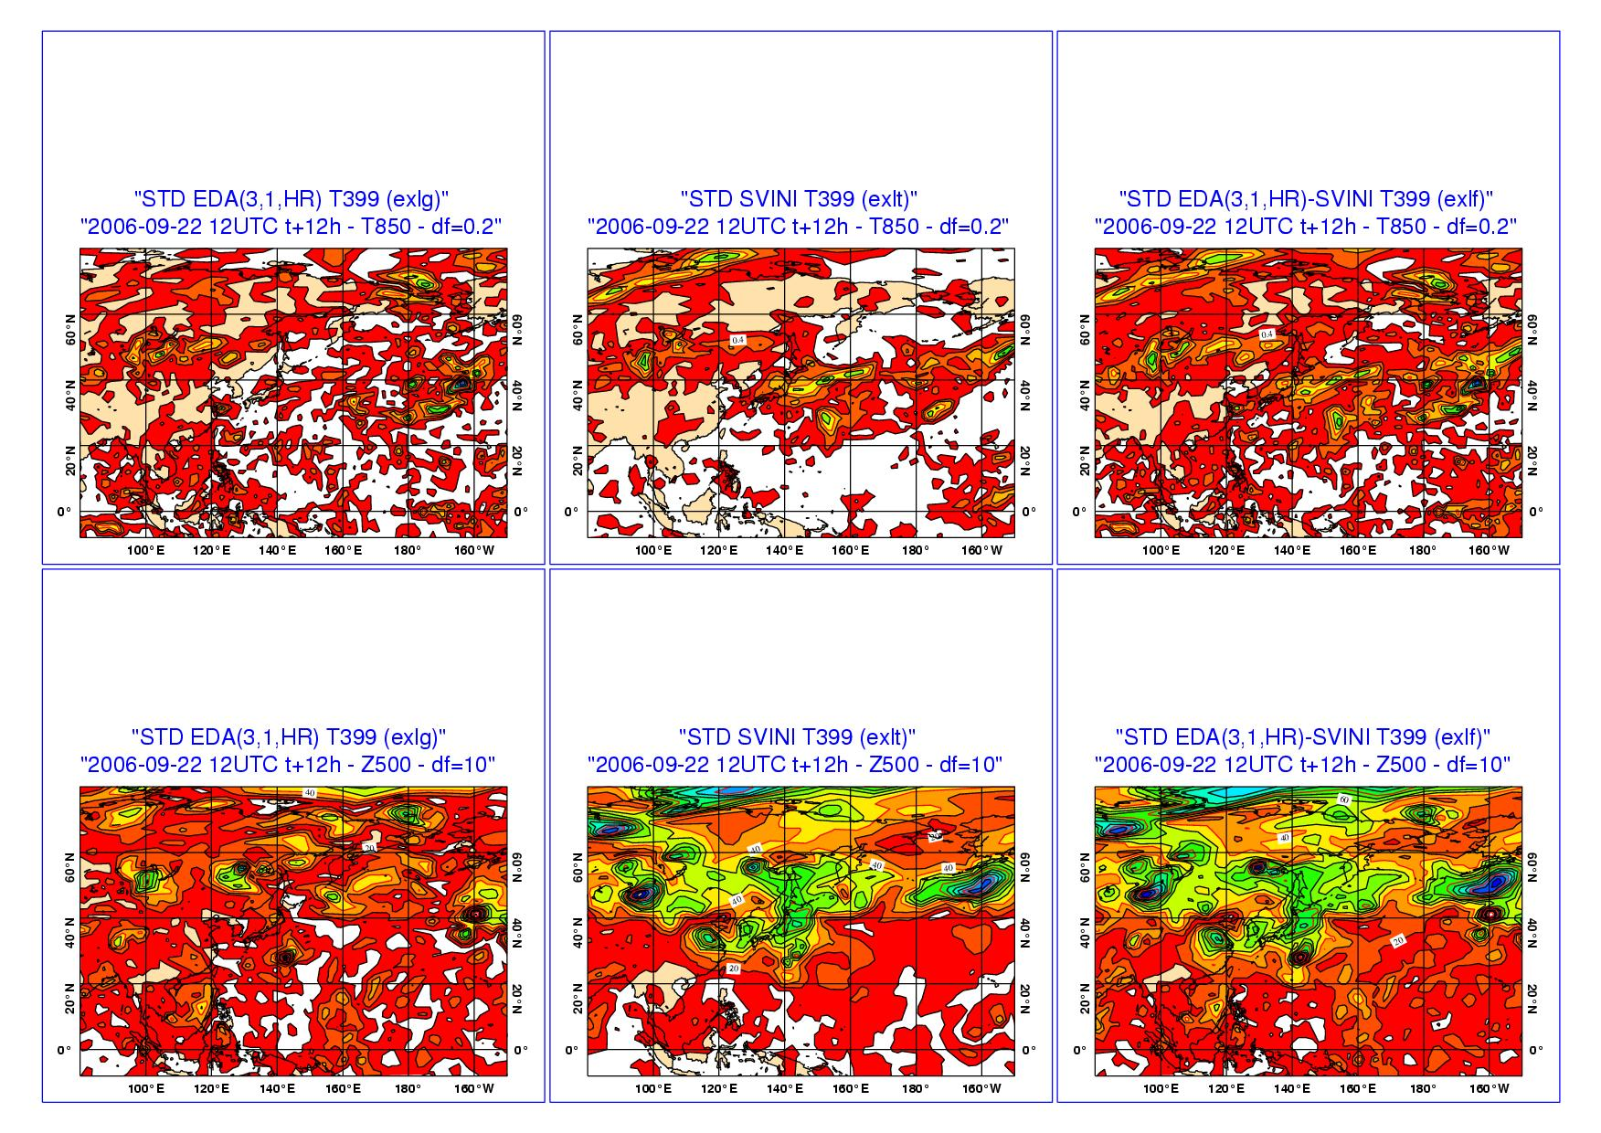
3. std EDA, SVINI & EDA-SVINI - t+12h
EDA perturbations (left panels) grow less rapidly than SVINI perturbations (middle panels).
In the combined EDA-SVINI ensemble, the SVINI component dominates the perturbations’ growth.
EDA SVINI EDA-SVINI
Notes:
This plot shows T850 and Z500 maps of +12-hour spread of ENS run in different configurations are compared, to highlight similarities and differences between the two perturbation basis (EDA-based perturbations and SVs). The following 4 ensembles configurations are compared:
SVINI: with initial uncertainties defined by initial SVs only
SVEVO-INI: with initial uncertainties defined by evolved and initial SVs
EDA: with initial uncertainties defined by EDA-only initial perturbations
EDA-SVINI: with initial uncertainties defined by EDA- and initial SVs

Slide 36
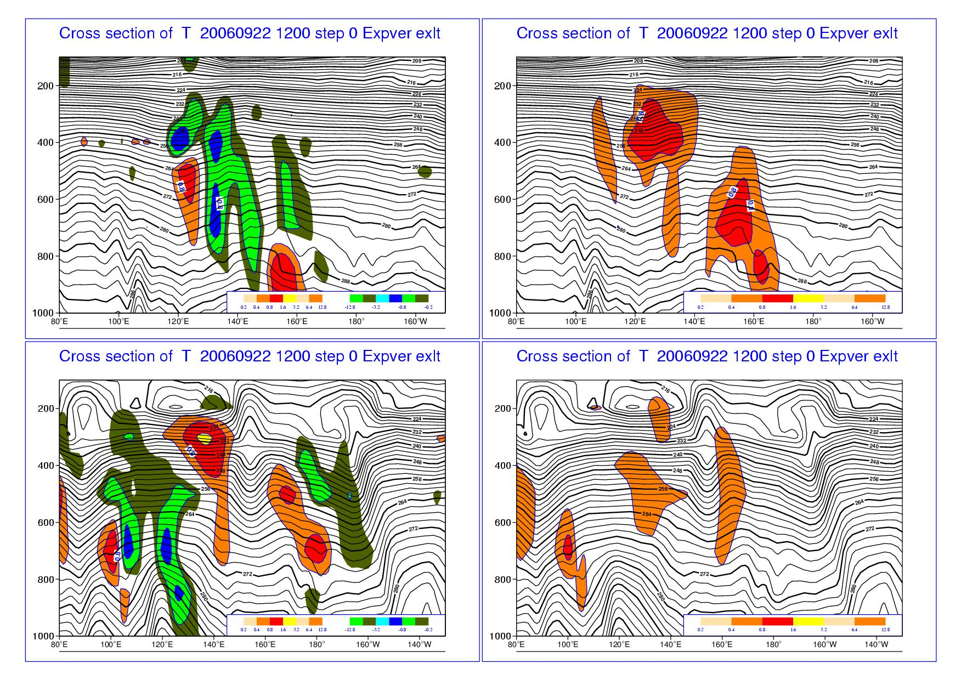
3. (MEM5-CON) SVINI ENS - 22/09/2007 t=0
At t=0, SVINI perturbations are more localized in space, and have a larger component in potential than kinetic energy. They also show a westward tilt with high, typical of baroclinically unstable structures.
T – (MEM5-CON) U – (MEM5-CON)
30°N
50°N
Notes:
To highlight similarities/differences in the vertical structure, this figure shows one specific perturbation, p=(MEM5-CON), defined using initial-time SV only. The plot shows T and U vertical initial-time cross-sections at 30 and 50 degree North latitude of initial time spread of SVINI ENS.

Slide 37
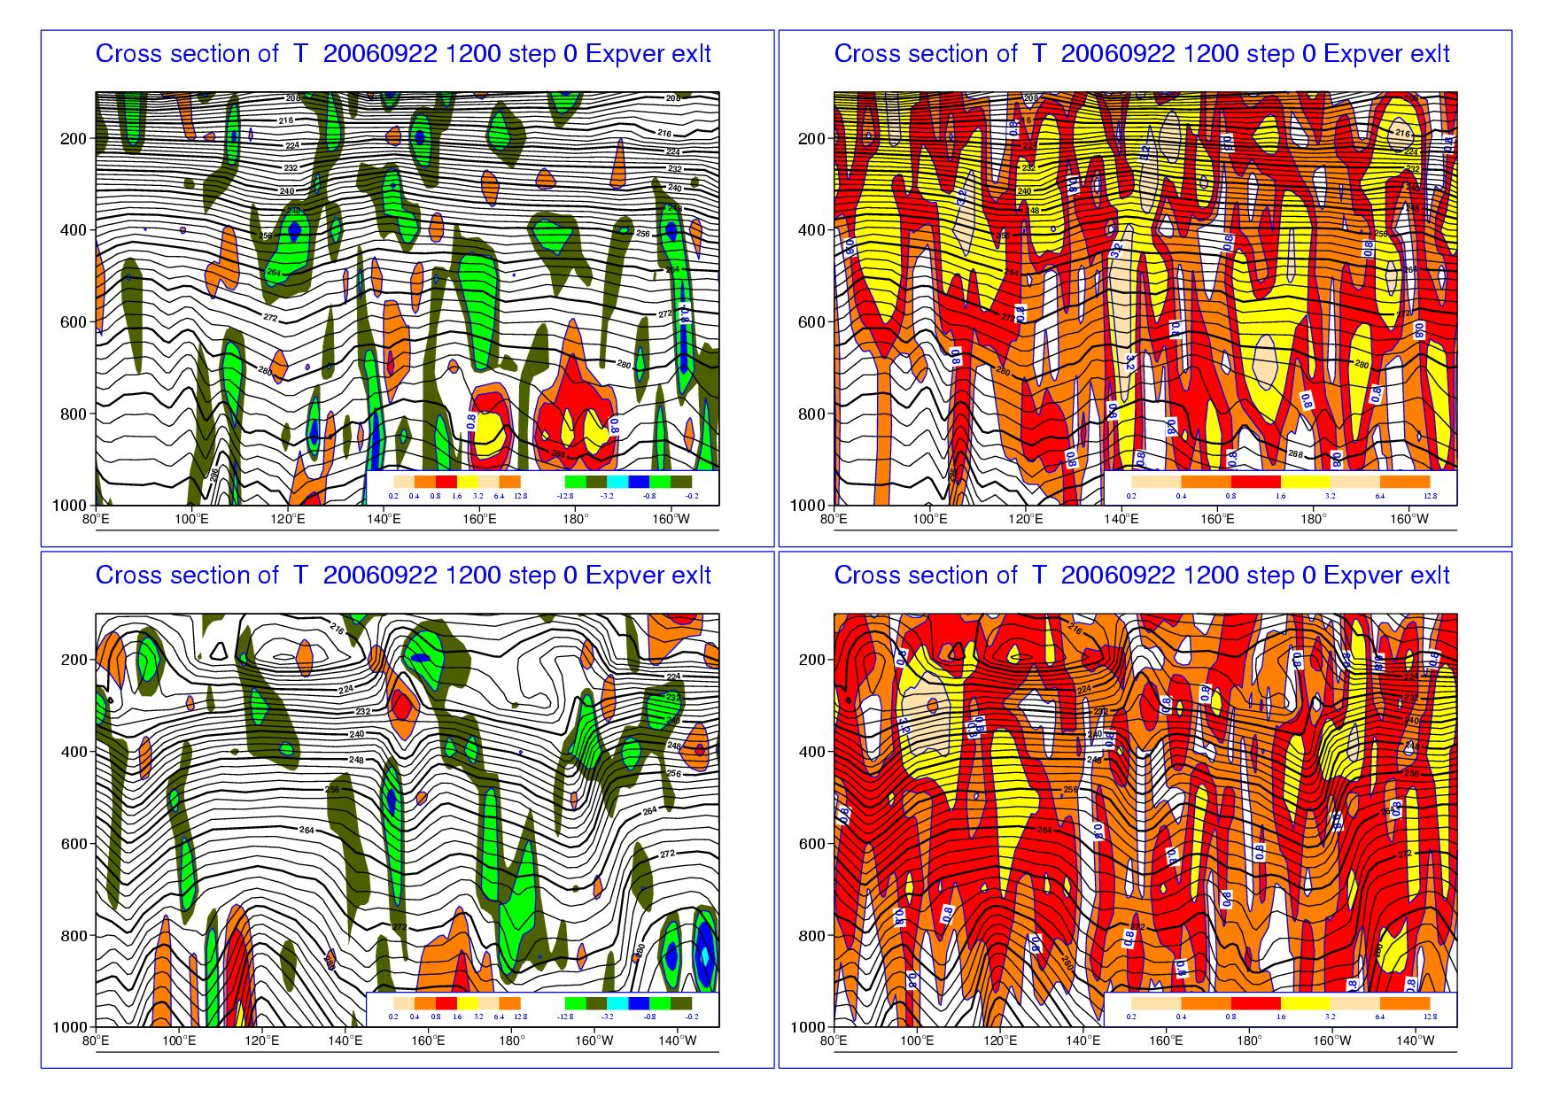
3. (MEM5-CON) EDA ENS - 22/09/2007 t=0
At t=0, EDA perturbations have a smaller scale than the SVINI perturbations, and are less localized in space. They have a similar amplitude in potential and kinetic energy. They tend to have more a barotropic than a baroclinic structure.
T – (MEM5-CON) U – (MEM5-CON)
30°N
50°N
Notes:
To highlight similarities/differences in the vertical structure, this figure shows one specific perturbation, p=(MEM5-CON), defined using EDA-based perturbations only. The plot shows T and U vertical initial-time cross-sections at 30 and 50 degree North latitude of initial time spread of EDA ENS.

Slide 38
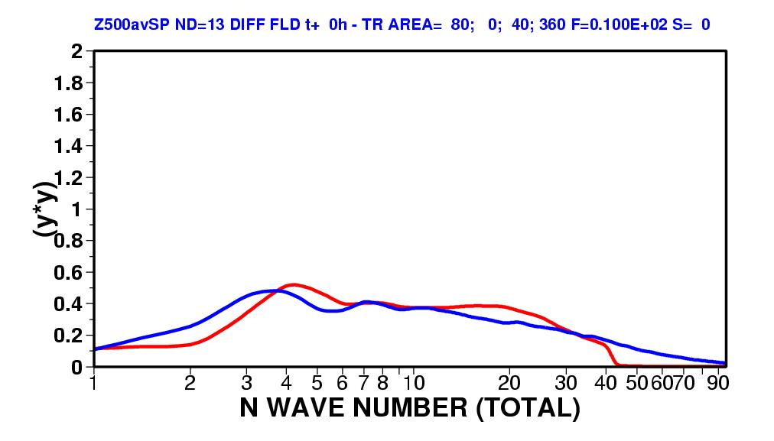
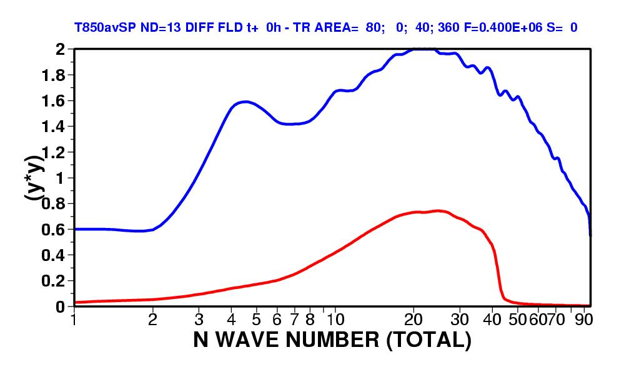
3. Spectra of EDA & SVINI ENS – NH t0
The top figure shows the squared amplitude of the SVINI (red) and EDA (blue) perturbations in terms of Z500 over NH. The bottom panel shows the same but for T850. Results have been averaged over 13 cases.
At initial time, the SVINI perturbations are confined to T42 by construction.
The EDA perturbations are larger in terms of T850.
Notes:
To highlight the scale characteristics of the two sets of perturbation, we can compare spectra of squared amplitudes. This plot shows the average (over 20 cases) spectra (function of total wave number N) of Z500 and T850 initial-time spread over NH of SVINI and EDA ENS.

Slide 39
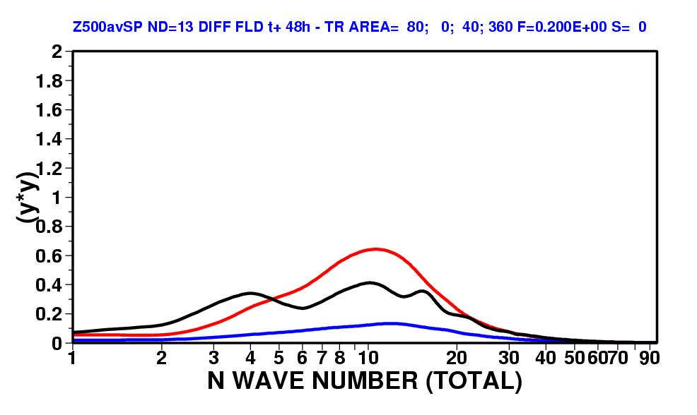
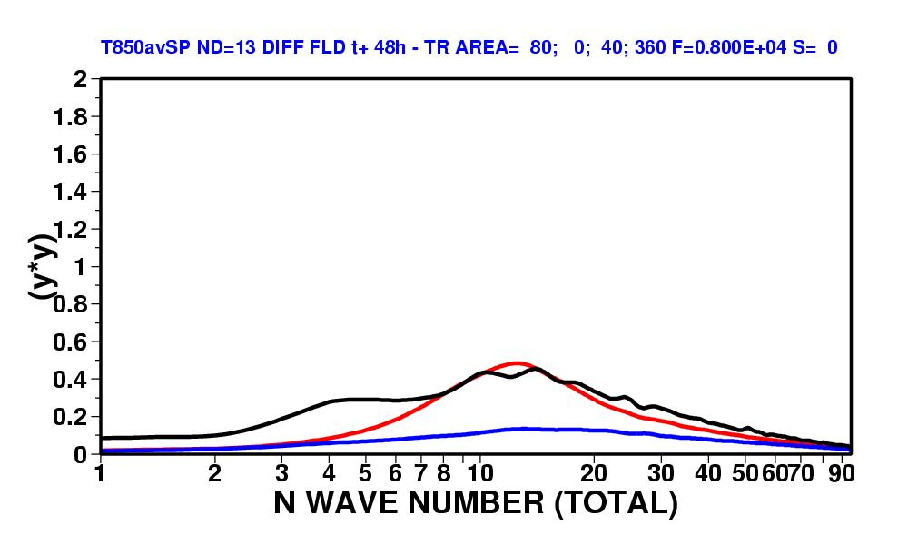
3. Spectra of EDA & SVINI ENS – NH +48h
The top figure shows the squared amplitude of the SVINI (red) and EDA (blue) perturbations in terms of Z500 over NH, and of the error of the t+48h control forecast (black). The bottom panel shows the same but for T850. Results have been averaged over 13 cases.
At t+48h, the SVINI perturbations have a larger amplitude than the EDA perturbations, especially in the wave-numbers where the SVs total energy peaks at optimisation time.
On average, the spectra of the SVINI ensemble spread is closer to the spectra of the control error.
Notes:
To highlight the scale characteristics of the two sets of perturbation, we can compare spectra of squared amplitudes. This plot shows the average (over 20 cases) spectra (function of total wave number N) of Z500 and T850 +48-hour spread over NH of SVINI and EDA ENS, compared to the spectra of 48-hour control-error.

Slide 40
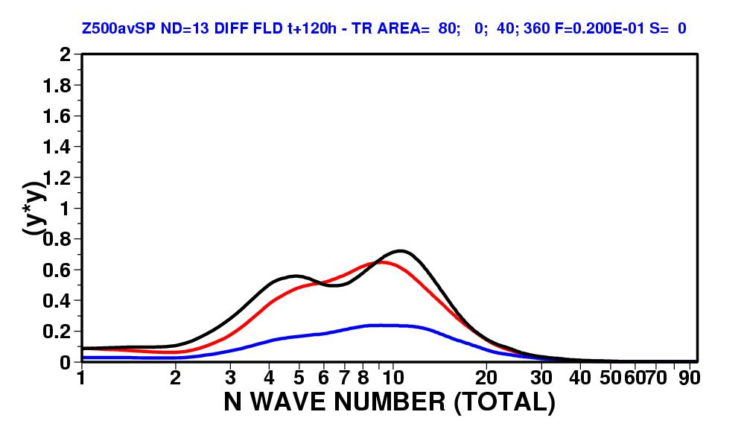
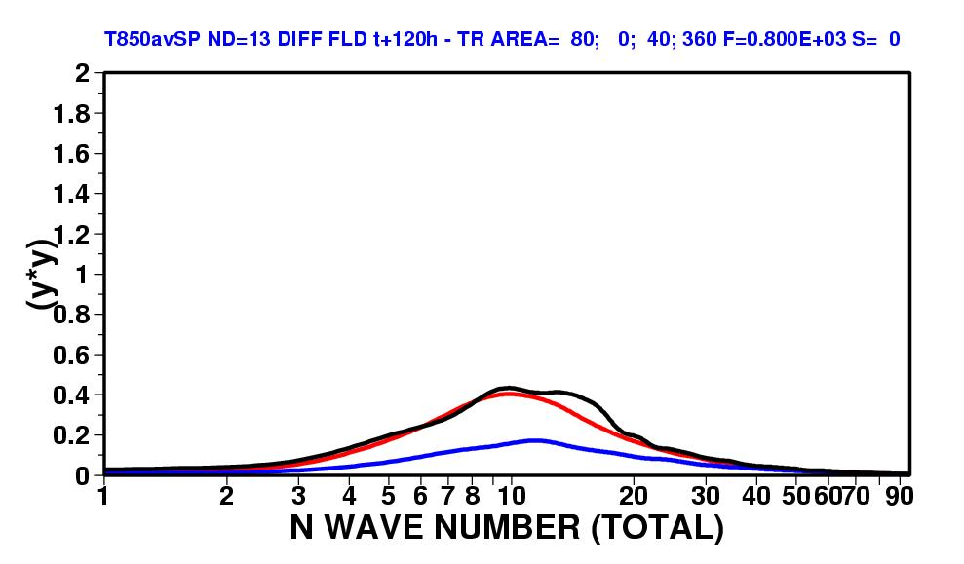
3. Spectra of EDA & SVINI ENS – NH +120h
The top figure shows the squared amplitude of the SVINI (red) and EDA (blue) perturbations in terms of Z500 over NH, and of the error of the t+120h control forecast (black). The bottom panel shows the same but for T850. Results have been averaged over 13 cases.
At t+120h, the difference in spread between the SVINI and the EDA is even more evident.
On average, the spectra of the SVINI ensemble spread is very close to the spectra of the control error.
Notes:
To highlight the scale characteristics of the two sets of perturbation, we can compare spectra of squared amplitudes. This plot shows the average (over 20 cases) spectra (function of total wave number N) of Z500 and T850 +120-hour spread over NH of SVINI and EDA ENS, compared to the spectra of 120-hour control-error.

Slide 41
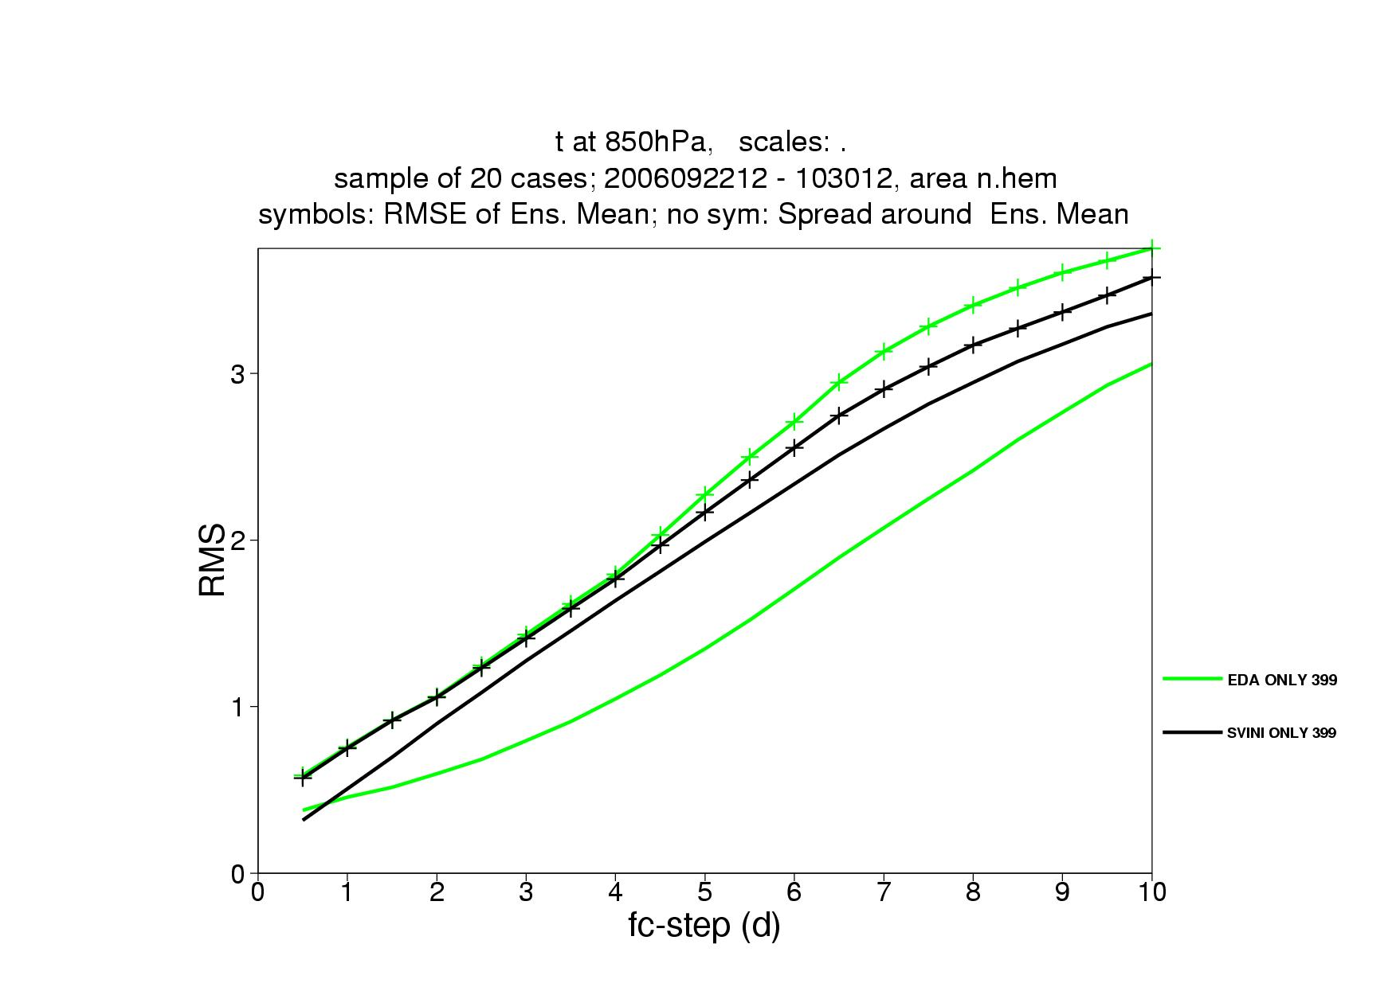
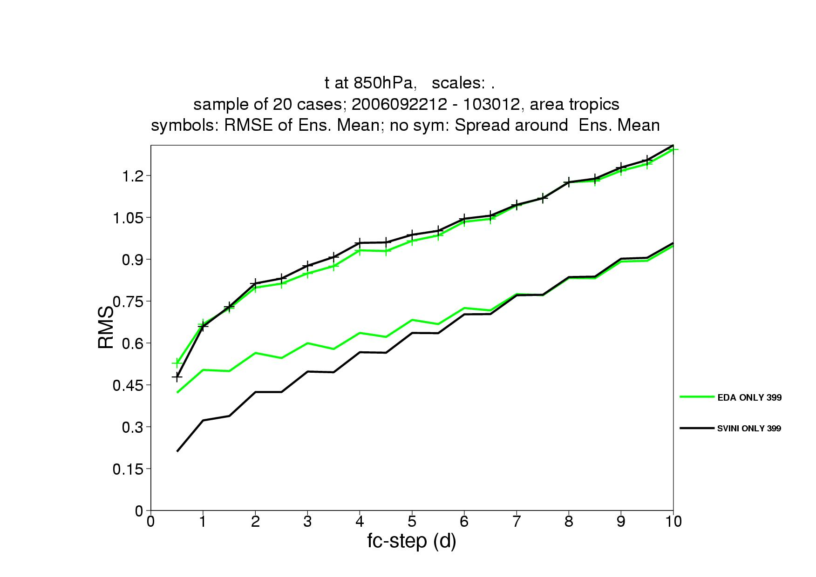
3. std/EM of EDA and SVINI ENS
Over the NH (left), the EDA ensemble have smaller spread, and a larger ensemble-mean error from forecast day 3.
Over the Tropics (right), the EDA ensemble has larger spread (in terms of T850), and this has a small positive impact on the error of the ensemble-mean, which is slightly smaller between forecast day 2 and 6.
EDA
SVINI
EDA
SVINI
Notes:
Let’s now look at average spread/skill characteristics. First, let’s just look at the SVINI and EDA ENS. This plot shows the average (over 20 cases) root-mean-square error of the ensemble-mean forecast and the spread (defined as the ensemble std) of the EDA and SVINI ENS, for T850 over NH and tropics.

Slide 42
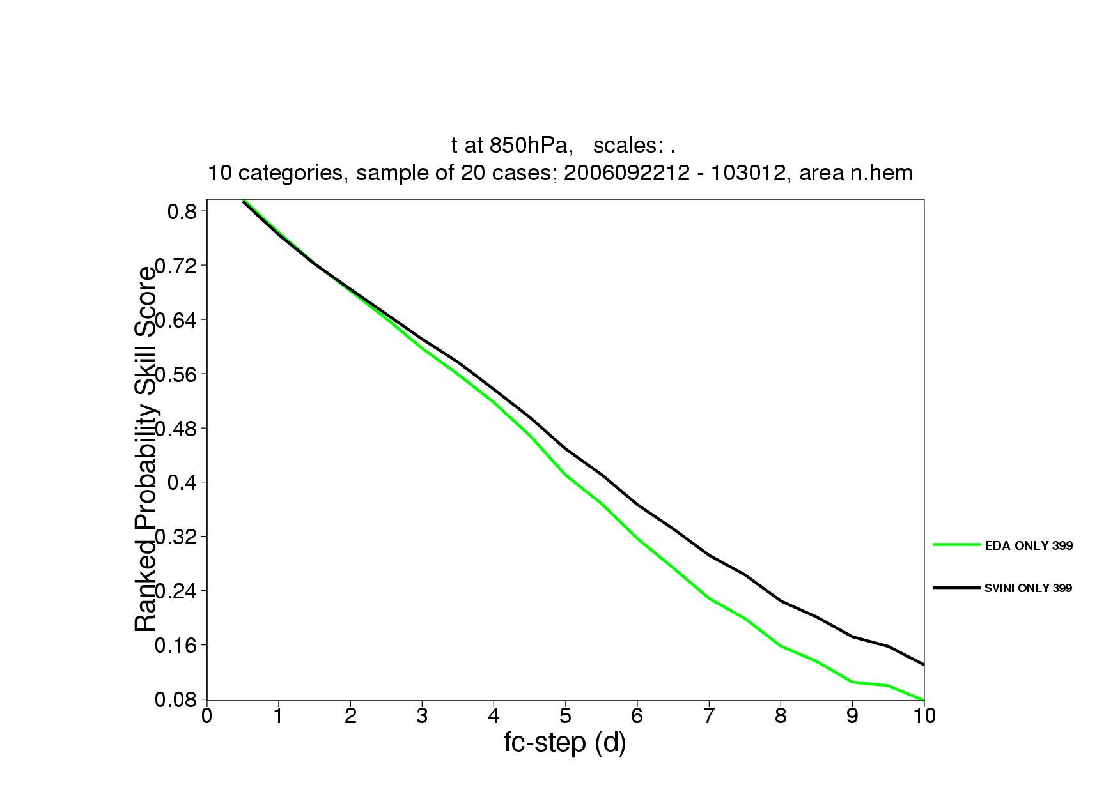
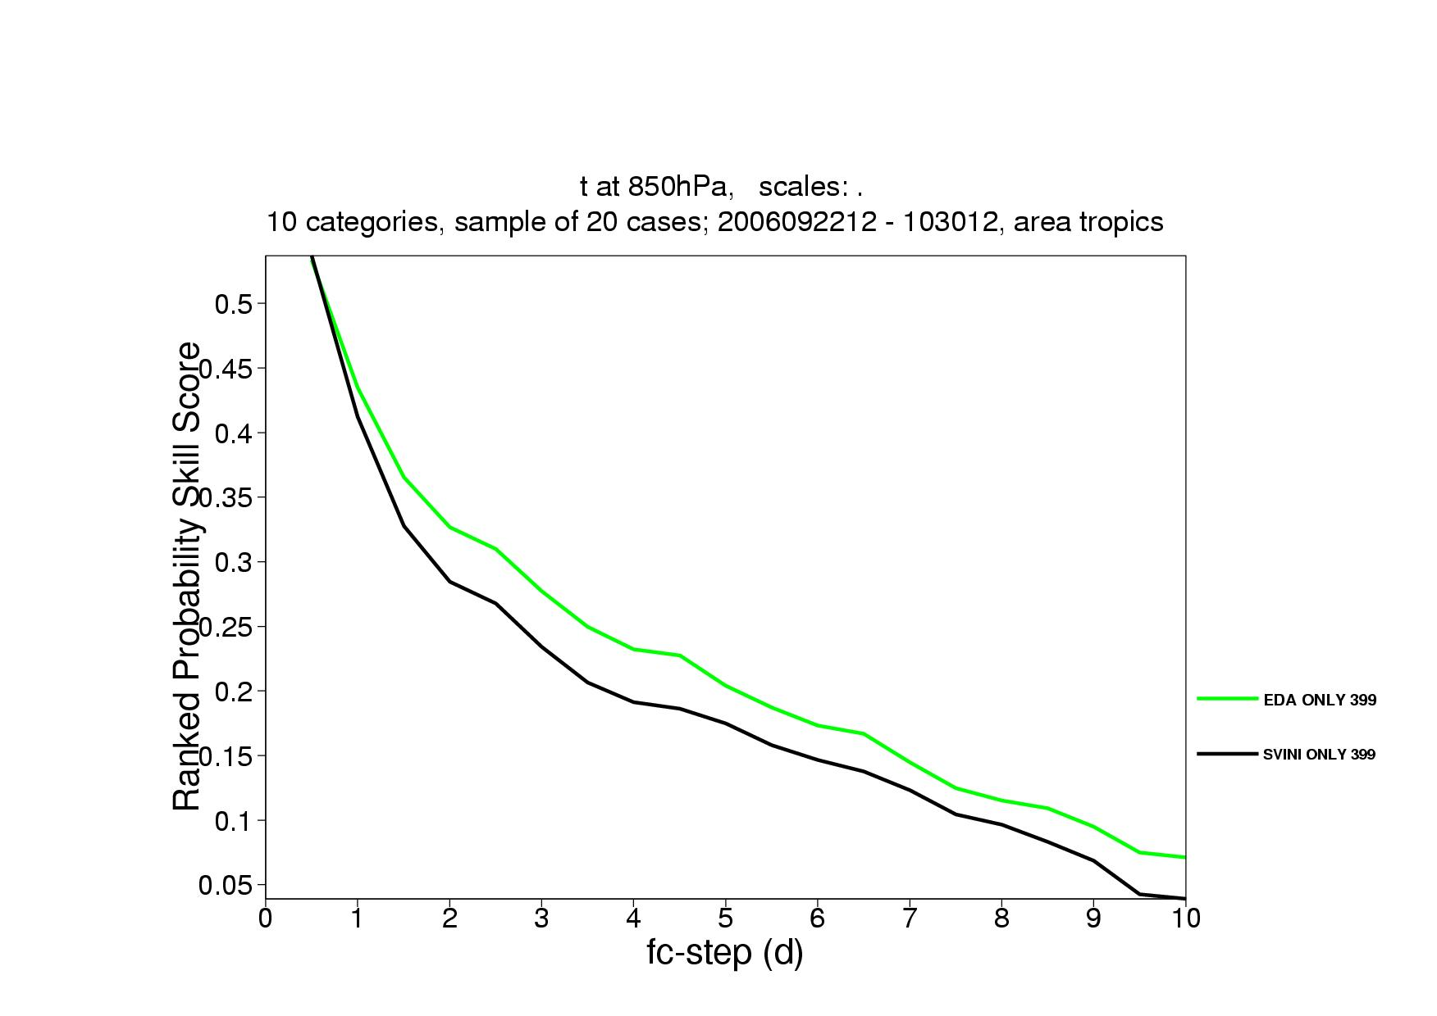
3. RPSS of EDA and SVINI ENS
Over the NH (left), the EDA ensemble has a smaller RPSS for T850 probabilistic predictions from forecast day 3, while over the tropics it has a higher RPSS from day 1 (right panel).
These results suggest that combining the ensemble of analysis and the initial singular vectors would lead to a better system.
EDA
SVINI
EDA
SVINI
Notes:
This plot shows the average (over 20 cases) Ranked Probability Skill Score (RPSS) of the EDA and SVINI ENS, for T850 over NH and tropics. The RPS is a metric used to compare PDF: it is the equivalent, in probability space, of the root-mean-square-error for single fields. It provides a measure of the distance between the forecast and observed PDFs. The skill score, RPSS, is computed using the sample climatology as PDF forecast. RPSS is 1 for perfect forecasts, and 0 for forecasts as skilful as the sample climatology.

Slide 43
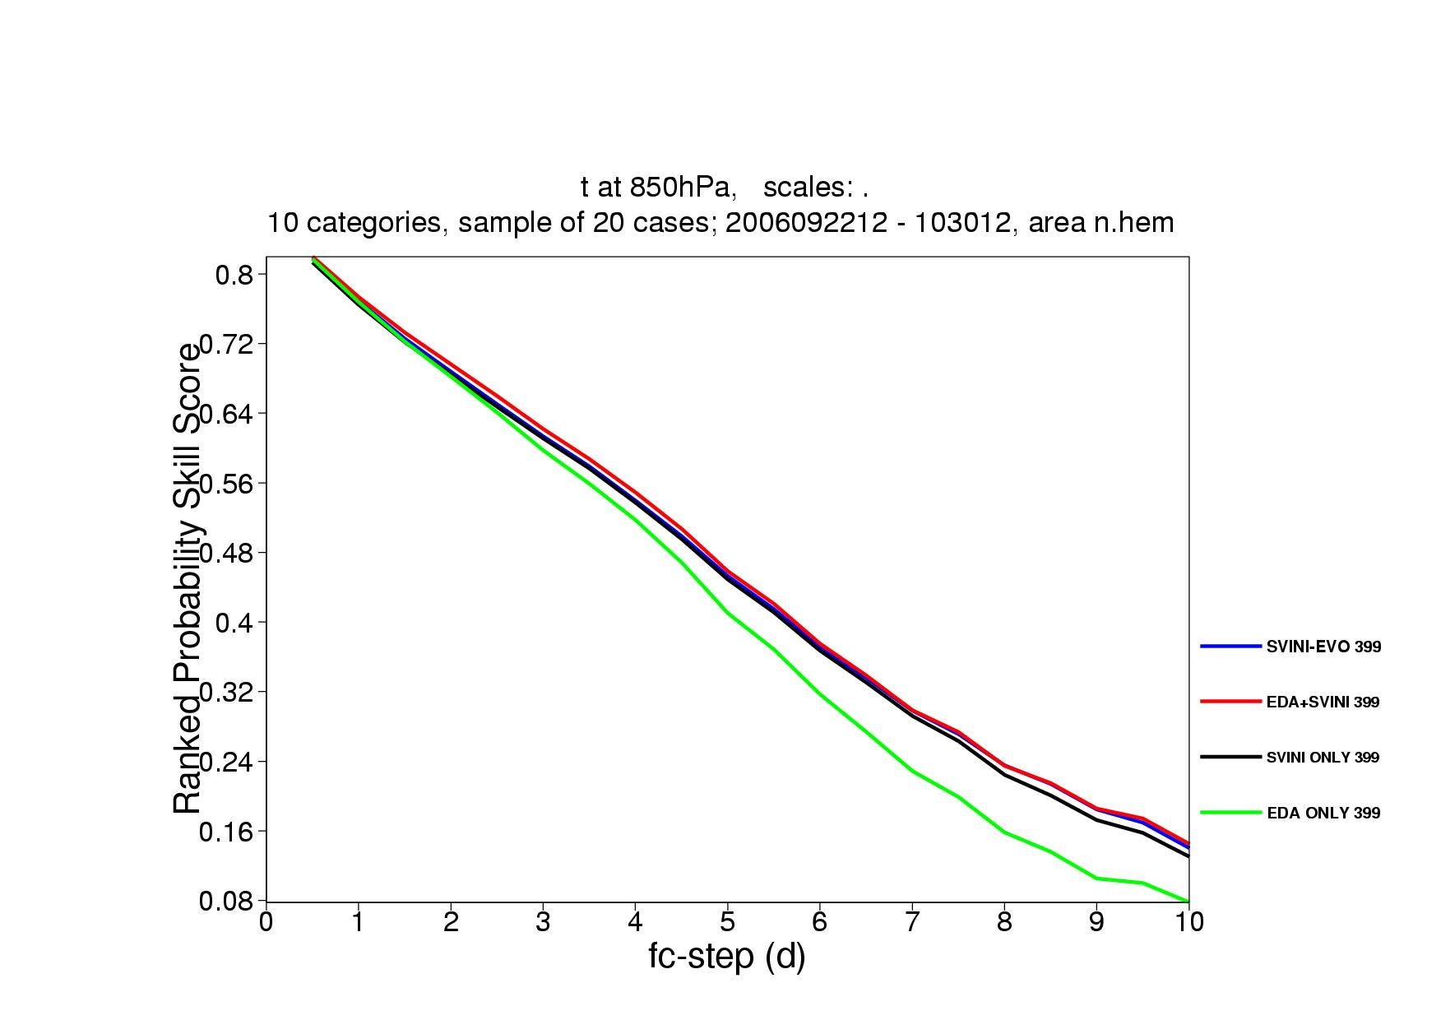
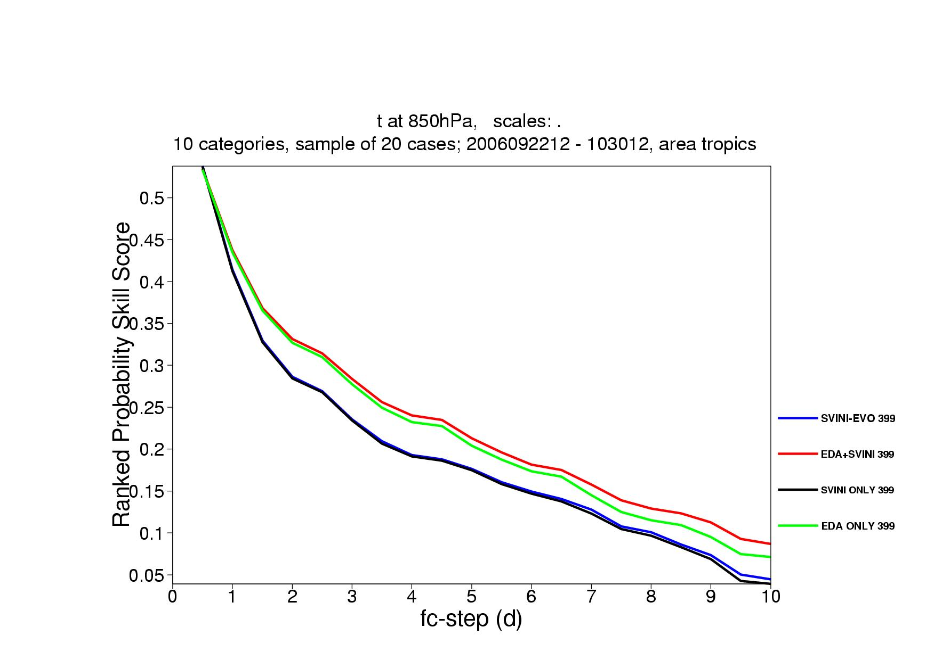
3. EDA, SVINI, EDA-SVINI & SVEVO-INI ENS
The EDA-SVINI ensemble combines the benefits of the EDA and the SV techniques. Over both the NH (left), the EDA-SVINI ensemble is only marginally better than the SVEVO-INI ensemble. But over the tropics (right), the EDA-SVINI ensemble has a higher RPSS. Note that the combination of EDA- and SVINI-based perturbations leads to an ensemble that outperforms one based on EDA-based perturbations only.
SVEVO-INI
EDA-SVINI
SVINI
EDA
SVEVO-INI
EDA-SVINI
SVINI
EDA
Notes:
This plot shows the average (over 20 cases) RPSS of the four ENS configurations, for T850 over NH and tropics.

Slide 44
Conclusions
SV- and EDA-based perturbations have different characteristics:
  Geographically, EDA-based perturbations are less localized. In particular, they have a larger amplitude over the tropics.
  Spectrally, EDA perturbations are smaller in scale.
  Vertically, EDA-perturbations are more barotropic than SV-based perturbations, while these latter show westward tilt with height typical of baroclinically unstable structures.
  At initial time, SV-based perturbations have a larger amplitude in potential than kinetic energy, while EDA-based perturbations have a similar amplitude in potential and kinetic energy.
  EDA perturbations grow less rapidly.
An EDA-based ensemble severely underestimate the ensemble spread
More reliable and accurate forecasts are obtained with a combination of EDA- and SV-based perturbations (operational since Jun 2010).
Notes:
Concluding, I hope you now know more about the ECMWF Ensemble of Data Assimilations (EDA), how similar/different are EDA-based perturbations to SVs, and how they can be combined to define the ENS initial conditions. You are invited to look at the published literature (see some references below) for more detailed information.
Please contact me if you want more information.

Slide 45
Acknowledgements
The success of the ECMWF ensemble is the result of the continuous work of ECMWF staff, consultants and visitors who had continuously improved the ECMWF model, analysis, diagnostic and technical systems, and of very successful collaborations with its member states and other international institutions. The work of all contributors is acknowledged.

Slide 46
Bibliography
On the ECMWF Ensemble Prediction System
Buizza, R., Tribbia, J., Molteni, F., & Palmer, T. N., 1993: Computation of optimal unstable structures for a numerical weather prediction model. Tellus, 45A, 388-407.
Buizza, R., & Palmer, T. N., 1995: The singular vector structure of the atmospheric general circulation. J. Atmos. Sci., 52, 1434-1456.
Buizza, R., & Hollingsworth, A., 2002: Storm prediction over Europe using the ECMWF Ensemble Prediction System. Meteorol. Appl., 9, 1-17.
Buizza, R., Bidlot, J.-R., Wedi, N., Fuentes, M., Hamrud, M., Holt, G., & Vitart, F., 2007: The new ECMWF VAREPS. Q. J. Roy. Meteorol. Soc., 133, 681-695 (also EC TM 499).
Buizza, R., 2008: Comparison of a 51-member low-resolution (TL399L62) ensemble with a 6-member high-resolution (TL799L91) lagged-forecast ensemble. Mon. Wea. Rev., 136, 3343-3362 (also EC TM 559).
Buizza, R., Leutbecher, M., & Isaksen, L., 2008: Potential use of an ensemble of analyses in the ECMWF Ensemble Prediction System. Q. J. R. Meteorol. Soc., 134, 2051-2066.
Buizza, R., 2010: The Value of a Variable Resolution Approach to Numerical Weather Prediction. Mon. Wea. Rev., 138, 1026-1042.
Leutbecher, M. 2005: On ensemble prediction using singular vectors started from forecasts. ECMWF TM 462, pp 11.
Leutbecher, M. & T.N. Palmer, 2008: Ensemble forecasting. J. Comp. Phys., 227, 3515-3539 (also EC TM 514).

Slide 47
Bibliography
Molteni, F., Buizza, R., Palmer, T. N., & Petroliagis, T., 1996: The new ECMWF ensemble prediction system: methodology and validation. Q. J. R. Meteorol. Soc., 122, 73-119.
Palmer, T N, Buizza, R., Leutbecher, M., Hagedorn, R., Jung, T., Rodwell, M, Virat, F., Berner, J., Hagel, E., Lawrence, A., Pappenberger, F., Park, Y.-Y., van Bremen, L., Gilmour, I., & Smith, L., 2007: The ECMWF Ensemble Prediction System: recent and on-going developments. A paper presented at the 36th Session of the ECMWF Scientific Advisory Committee (also EC TM 540).
Palmer, T. N., Buizza, R., Doblas-Reyes, F., Jung, T., Leutbecher, M., Shutts, G. J., Steinheimer M., & Weisheimer, A., 2009: Stochastic parametrization and model uncertainty. ECMWF RD TM 598, Shinfield Park, Reading RG2-9AX, UK, pp. 42.
Vitart, F., Buizza, R., Alonso Balmaseda, M., Balsamo, G., Bidlot, J. R., Bonet, A., Fuentes, M., Hofstadler, A., Molteni, F., & Palmer, T. N., 2008: The new VAREPS-monthly forecasting system: a first step towards seamless prediction. Q. J. Roy. Meteorol. Soc., 134, 1789-1799.
Vitart, F., & Molteni, F., 2009: Simulation of the MJO and its teleconnections in an ensemble of 46-day EPS hindcasts. ECMWF RD TM 597, Shinfield Park, Reading RG2-9AX, UK, pp. 60.
Zsoter, E., Buizza, R., & Richardson, D., 2009: 'Jumpiness' of the ECMWF and UK Met Office EPS control and ensemble-mean forecasts'. Mon. Wea. Rev., 137, 3823-3836.

Slide 48
Bibliography
On different approaches to ensemble prediction
Bourke, W., Buizza, R., & Naughton, M., 2004: Performance of the ECMWF and the BoM Ensemble Systems in the Southern Hemisphere. Mon. Wea. Rev., 132, 2338-2357.
Buizza, R, Houtekamer, P L, Toth, Z, Pellerin, G, Wei, M, & Zhu, Y, 2005: A comparison of the ECMWF, MSC and NCEP Ensemble Prediction Systems. Mon. Wea. Rev., 133, 1076-1097.
Harrison, M, Palmer, T N, Richardson, D, & Buizza, R, 1999: Analysis and model dependencies in medium-range ensembles: two transplant case studies. Q. J. R. Meteorol. Soc., 126, 2487-2515.
Hagedorn, R., Buizza, R., Hamill, M. T., Leutbecher, M., & Palmer, T. N., 2010: Comparing TIGGE multi-model forecasts with re-forecast calibrated ECMWF ensemble forecasts. Mon. Wea. Rev., submitted.
Majumdar, S, Bishop, C, Buizza, R, & Gelaro, R, 2002: A comparison of PSU-NCEP Ensemble Transform Kalman Filter targeting guidance with ECMWF and NRL Singular Vector guidance. Q. J. R. Meteorol. Soc., 128, 2527-2549.
On ensemble data assimilation and prediction
Buizza, R., Leutbecher, M., & Isaksen, L., 2008: Potential use of an ensemble of analyses in the ECMWF ensemble prediction system. Q. J. R. Meteorol. Soc., 134, 2051-2066.
Leutbecher, M., Buizza, R., & Isaksen, L., 2008: Ensemble forecasting and flow-dependent estimates of initial uncertainty. Proceedings of the ECMWF Workshop on Flow dependent aspects of data-assimilation, 11-13 June 2007, pp. 185-201 (available from ECMWF, Shinfield Park, Reading RG2-9AX).

Slide 49
Bibliography
On SVs and targeting adaptive observations:
Buizza, R., & Montani, A., 1999: Targeting observations using singular vectors. J. Atmos. Sci., 56, 2965-2985 (also EC TM 286).
Buizza, R., Cardinali, C., Kelly, G., & Thepaut, J.-N., 2007: The value of targeted observations - Part II: the value of observations taken in singular vectors-based target areas. Q. J. R. Meteorol. Soc., 133, 1817-1832 (also EC TM 512).
Cardinali, C., Buizza, R., Kelly, G., Shapiro, M., & Thepaut, J.-N., 2007: The value of observations - Part III: influence of weather regimes on targeting. Q. J. R. Meteorol. Soc., 133, 1833-1842 (also EC TM 513).
Gelaro, R., Buizza, R., Palmer, T. N., & Klinker, E., 1998: Sensitivity analysis of forecast errors and the construction of optimal perturbations using singular vectors. J. Atmos. Sci., 55, 6, 1012-1037.
Kelly, G., Thepaut, J.-N., Buizza, R., & Cardinali, C., 2007: The value of observations - Part I: data denial experiments for the Atlantic and the Pacific. Q. J. R. Meteorol. Soc., 133, 1803-1815 (also EC TM 511).
Majumdar, S J, Aberson, S D, Bishop, C H, Buizza, R, Peng, M, & Reynolds, C, 2006: A comparison of adaptive observing guidance for Atlantic tropical cyclones. Mon. Wea. Rev., 134, 2354-2372 (also EC TM 482).
Palmer, T. N., Gelaro, R., Barkmeijer, J., & Buizza, R., 1998: Singular vectors, metrics, and adaptive observations. J. Atmos. Sci., 55, 6, 633-653.
Reynolds, C, Peng, M, Majumdar, S J, Aberson, S D, Bishop, C H, & Buizza, R, 2007: Interpretation of adaptive observing guidance for Atlantic tropical cyclones. Mon. Wea. Rev., 135, 4006-4029.

Slide 50
… extra material …

Slide 51
2. The assimilation problem
Denote by x the atmospheric state, M(x) the (non-linear) model, x_{b} a first-guess (background) state, H(x) the observation operator, ε.. the error fields.
Assume that the model, background and observations errors are independent and have probability density functions P_{m}(ε_{m},t), P_{b}(ε_{b},t), P_{o}(ε_{o},t).
This assumption (of independence) means that the total probability density function can be written as the product of the three:
The optimal analysis x_{a} is the state for which the total pdf P is maximum.
x
H(x)
y
y₁
0
t₁
time
(Adapted from E. Holm, 2008: Lecture notes on assimilation algorithms, ECMWF)
Notes:
In the next four slides we will briefly review how a 4-dimentsional variational assimilation system works, looking at the assimilation of one observation with a simple model.
The assimilation part 1/4.

Slide 52
2. The assimilation problem
Finding the state x(0) for which the total pdf P
is maximum is equivalent to finding the state x(0) for which the negative of the exponent of P has a minimum
Compared to the background (blue line), following the assimilation of the observation y₁ at time t₁, the new forecast trajectory starting from x(0) goes closer to y1.
x
x
H(x)
H(x)
y
y
y₁
y₁
0
t₁
time
0
t₁
time
(Adapted from E. Holm, 2008: Lecture notes on assimilation algorithms, ECMWF)
Notes:
In the next four slides we will briefly review how 4-dimentsional variational assimilation system works, looking at the assimilation of one observation with a simple model.
The assimilation part 2/4.

Slide 53
2. The assimilation problem
Example. Suppose that the model error can be neglected (ε_{m}=0) and that the observation and model errors can be modelled by a Gaussian distribution
The cost function is:
The analysis state x_{a}, is the state x that minimizes J:
(Adapted from E. Holm, 2008: Lecture notes on assimilation algorithms, ECMWF)
Notes:
In the next four slides we will briefly review how 4-dimentsional variational assimilation system works, looking at the assimilation of one observation with a simple model.
The assimilation part 3/4.

Slide 54
2. The assimilation problem
Now let’s approximate H(x) using its linear approximation H, and its adjoint H(x)^{T} by the adjoint of its linear approximation H^{T}:
Then the linearized equation becomes:
The solution is:
observation error covariance
background error covariance in observation space
(Adapted from E. Holm, 2008: Lecture notes on assimilation algorithms, ECMWF)
Notes:
In the next four slides we will briefly review how 4-dimentsional variational assimilation system works, looking at the assimilation of one observation with a simple model.
The assimilation part 4/4.

Slide 55
2. EDA spread sensitivity to stochastic physics
EDA spread sensitivity to model error scheme: relative impact for different variables and levels over the tropics.
Notes:
How do the spread of these EDAs compare with the reference? This plot shows the relative difference between the spread (std) of EDA generated in 4 different configurations and of the multi-analysis ensemble with respect to the NOST-EDA for 6 variables over the tropics.

Slide 56
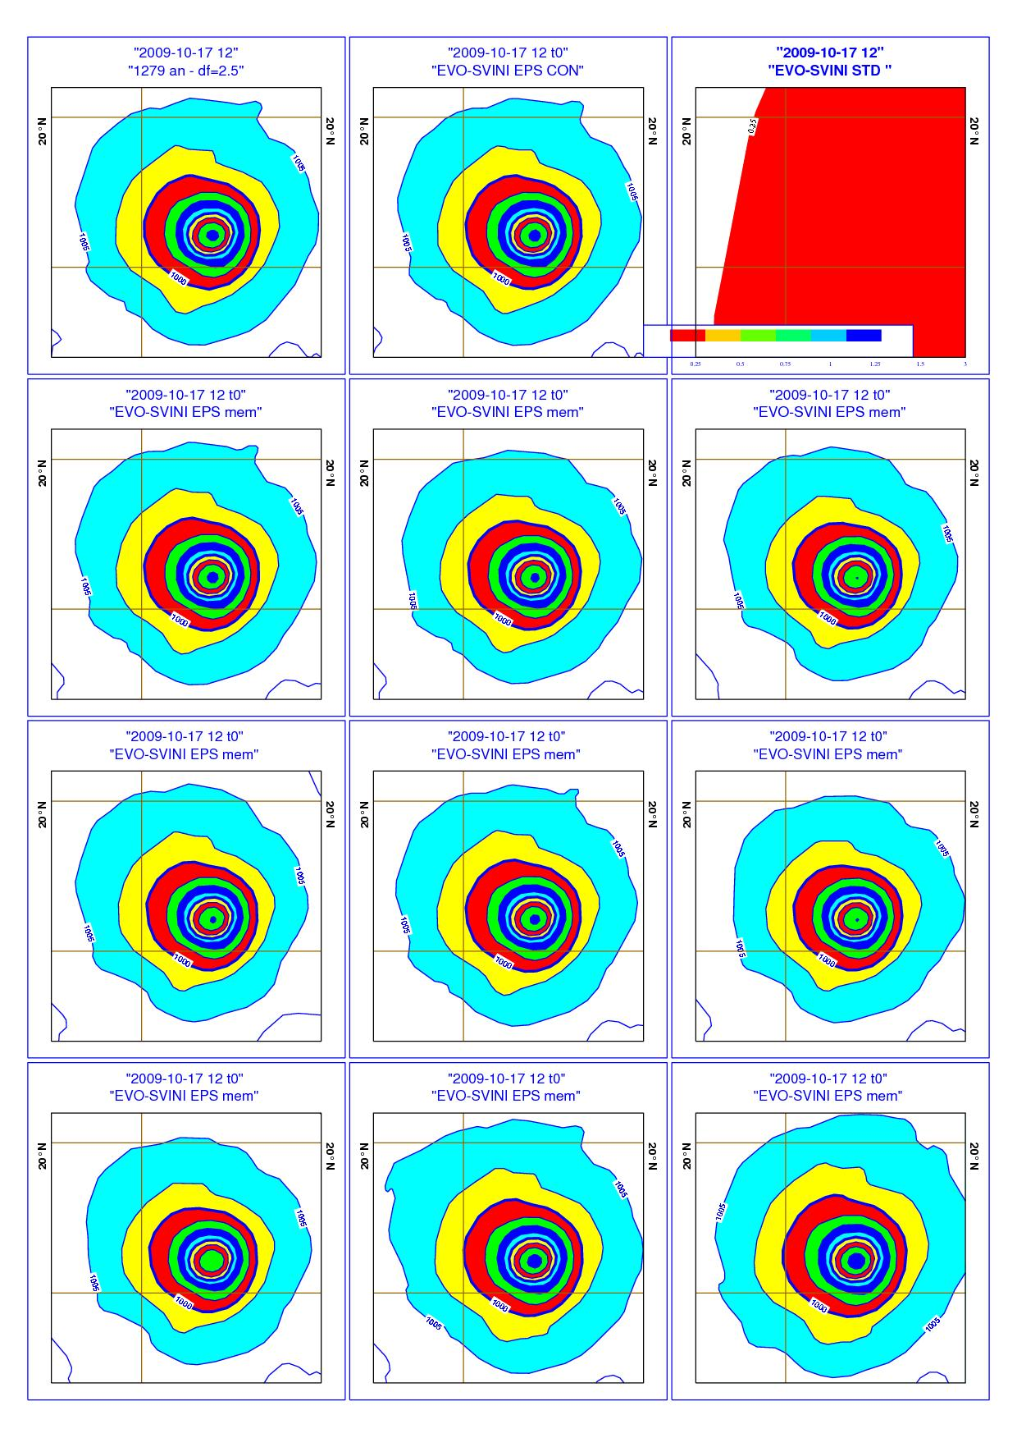
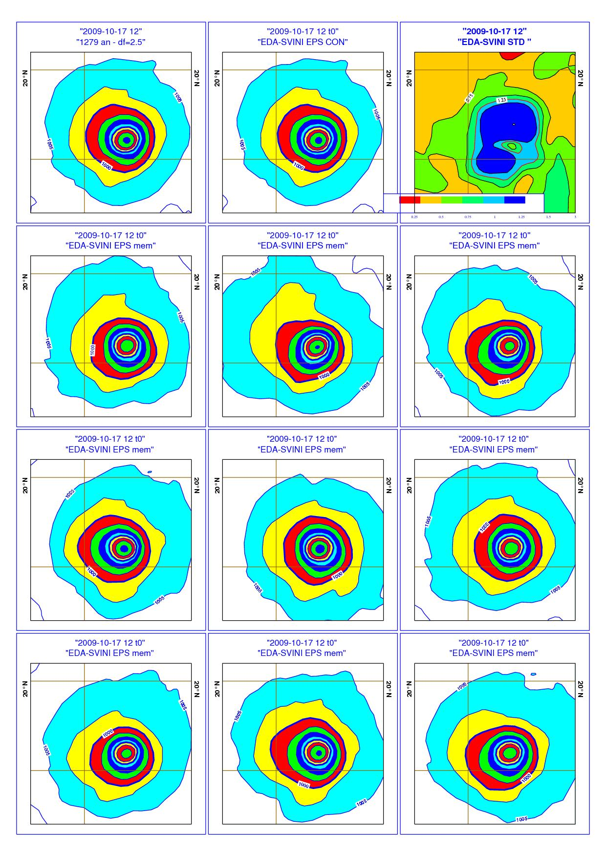
2. EDA spread as an indicator of analysis error
EVO-SVINI ENS
EDA-SVINI ENS
The tropics is the region where the old and the new ensembles differ mostly.
Notes:
Another key aspect that we investigated was the spread of the EDA analyses in the case of a tropical storm developments. We checked that the EDA analyses were realistic, and that we did not generate unrealistic features by perturbing the observations and using stochastic model error scheme in 4D-Var. This check was essential since the tropics is the region where the old and the new ENS differ mostly. These two plots compare the EVO-SVINI and the EDA-SVINI initial conditions at 12UTC of 20091017 when a tropical depression is present in the analysis at about (130ºE, 15ºN).

Slide 57
2. EDA spread as an indicator of analysis error
On the 23rd of Dec 2009 a cyclone that developed during the previous 36h in the Atlantic reached Portugal and caused lots of damages.
T799 (operational suite) and T1279 (e-suite) analyses on 21st of Dec showed larger differences in the area of storm development, and forecasts starting from these two analyses differed substantially.
Did the EDA identify the Atlantic area where the 799 and the 1279 analyses differ as an area with large spread?
Notes:
The second aspect refer to the spread of the EDA analyses in a specific synoptic case. Does the ECMWF (single system) EDA identify analysis uncertainty in a specific situation of a storm development over the Atlantic region? Does the EDA provide spread in regions not captured by SVs? In this case we are going to use the difference between two ECMWF high resolution analyses provided by the T799L91 4DVAR operational at that time and the experimental one under testing, run with a different model cycle and at higher resolution, T_{L}1279L91.

Slide 58
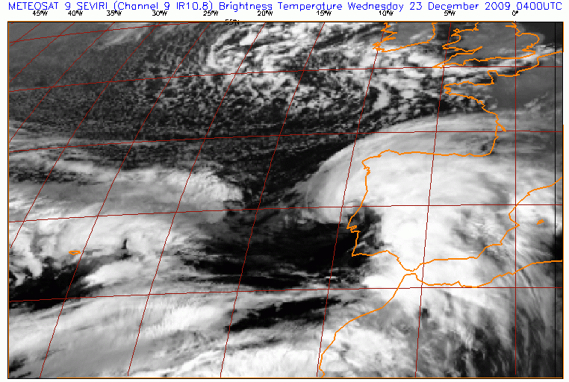
2. The EDA spread as an indicator of analysis error
On the 23rd of Dec 2009 a well defined cloud head with a dry slot region ahead of the low centre can be seen in a Meteosat satellite image (left). An area of maximum radial velocity can be seen from the Doppler radar (east of Lisbon).
St Cabo Carvoeiro – Min mslp 969 hPa at 0420 UTC – Max wind gust 140 km/h at 0450 UTC
Max winds at fixed elevation angle 0.1(quasi-horizontal map)
0400 UTC
0436 UTC
40 – 48 m/s
Notes:
On the 23rd of Dec 2009 that day a cyclone that developed during the previous 36h in the Atlantic reached Portugal and caused lots of damages.
On that day a well defined cloud head with a dry slot region ahead of the low centre can be seen in a Meteosat satellite image (left). The area of maximum radial velocity can be seen from the Doppler radar figure from Coruche/Cruz de Leao (east of Lisbon, right).
T799 and T1279 analyses showed larger differences in the area of storm development, and forecasts starting from these two analyses differed.
The EDA system has been designed to identify areas of potentially large analysis differences. Did the EDA identify the Atlantic area where the 799 and the 1279 analyses differ as an area with large spread?

Slide 59
2. EDA spread as an indicator of analysis error
At that time two analysis and ensembles were running:
O-suite: operational T799 analysis and EVO-SVINI 639v319 ENS
E-suite: the new T1279 analysis and the EDA-SVINI 639v319 ENS
Let’s compare the spread of the old (EVO-SVINI) and new (EDA-SVINI) ensembles, to assess whether the EDA-based perturbations improved the simulation of the analysis uncertainty.
Notes:
ENS forecasts run with two configurations are compared:
O-suite is the EVO-SVINI ENS operational at that time, with initial perturbations generated only using SVs (initial-time SVs and evolved SVs)
E-suite is the experimental EDA-SVINI ENS, due to be implemented in June 2010, with initial perturbations generated using a combination of EDA-based perturbations and initial time SVs

Slide 60
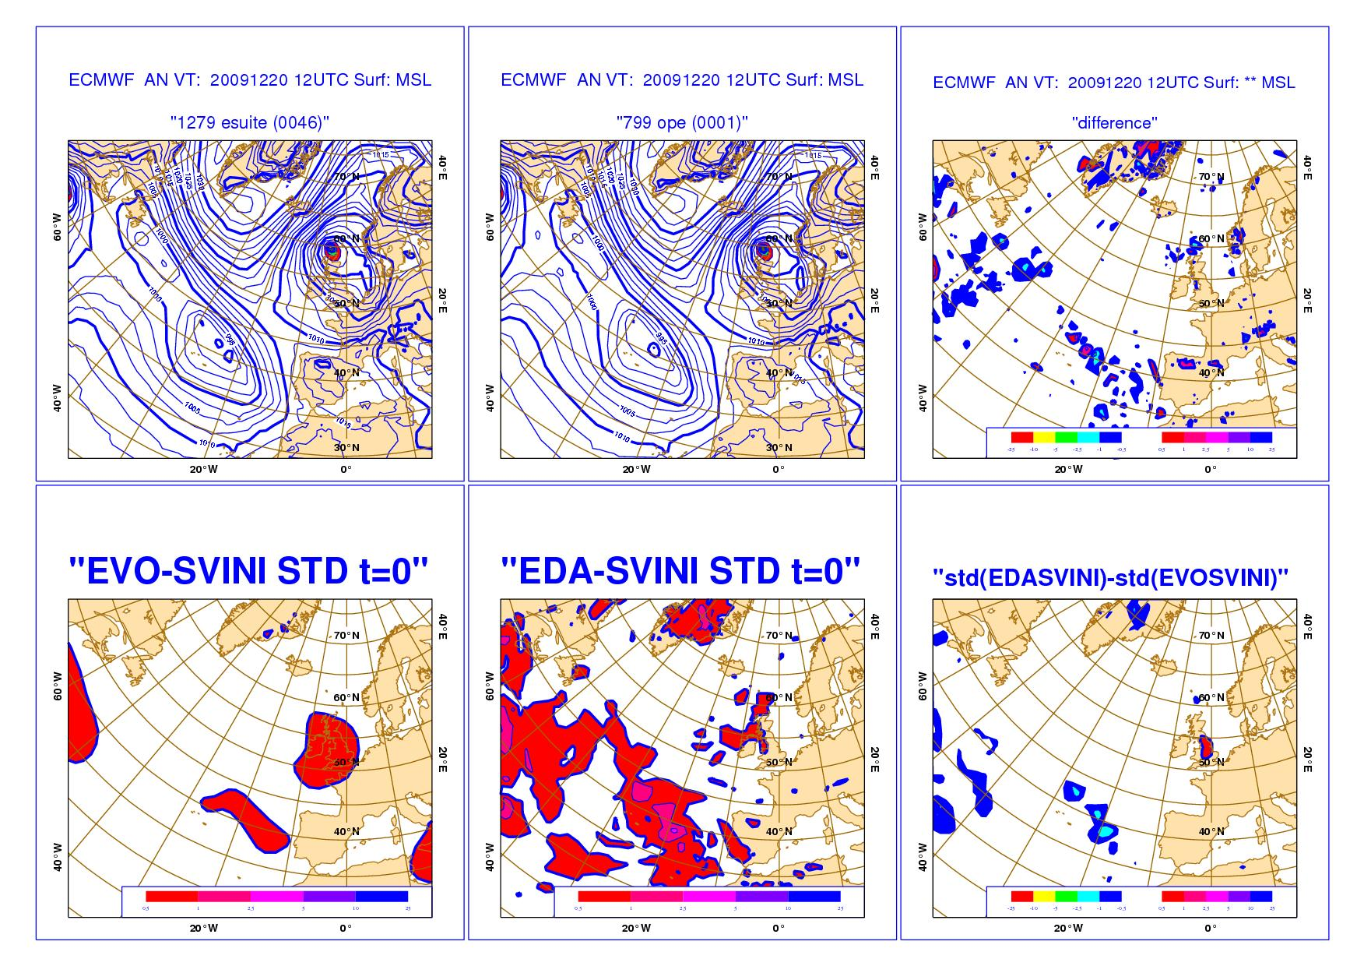
2. EDA spread as an indicator of analysis error
IC 20@12:
the top row shows the two analyses and their difference.
the bottom row shows the std of the EVO-SVINI and the EDA-SVINI ensembles, and their difference.
Notes:
The next three slides compares the spread of the O-suite (EVO-SVINI) and E-suite (EDA-SVINI) ENS, with the difference between the two high-resolution analyses run at T_{L}1279L91 (esuite) and T_{L}799L91 (ope). This figure refers to the situation at 12 UTC of 20 Dec 2009.

Slide 61
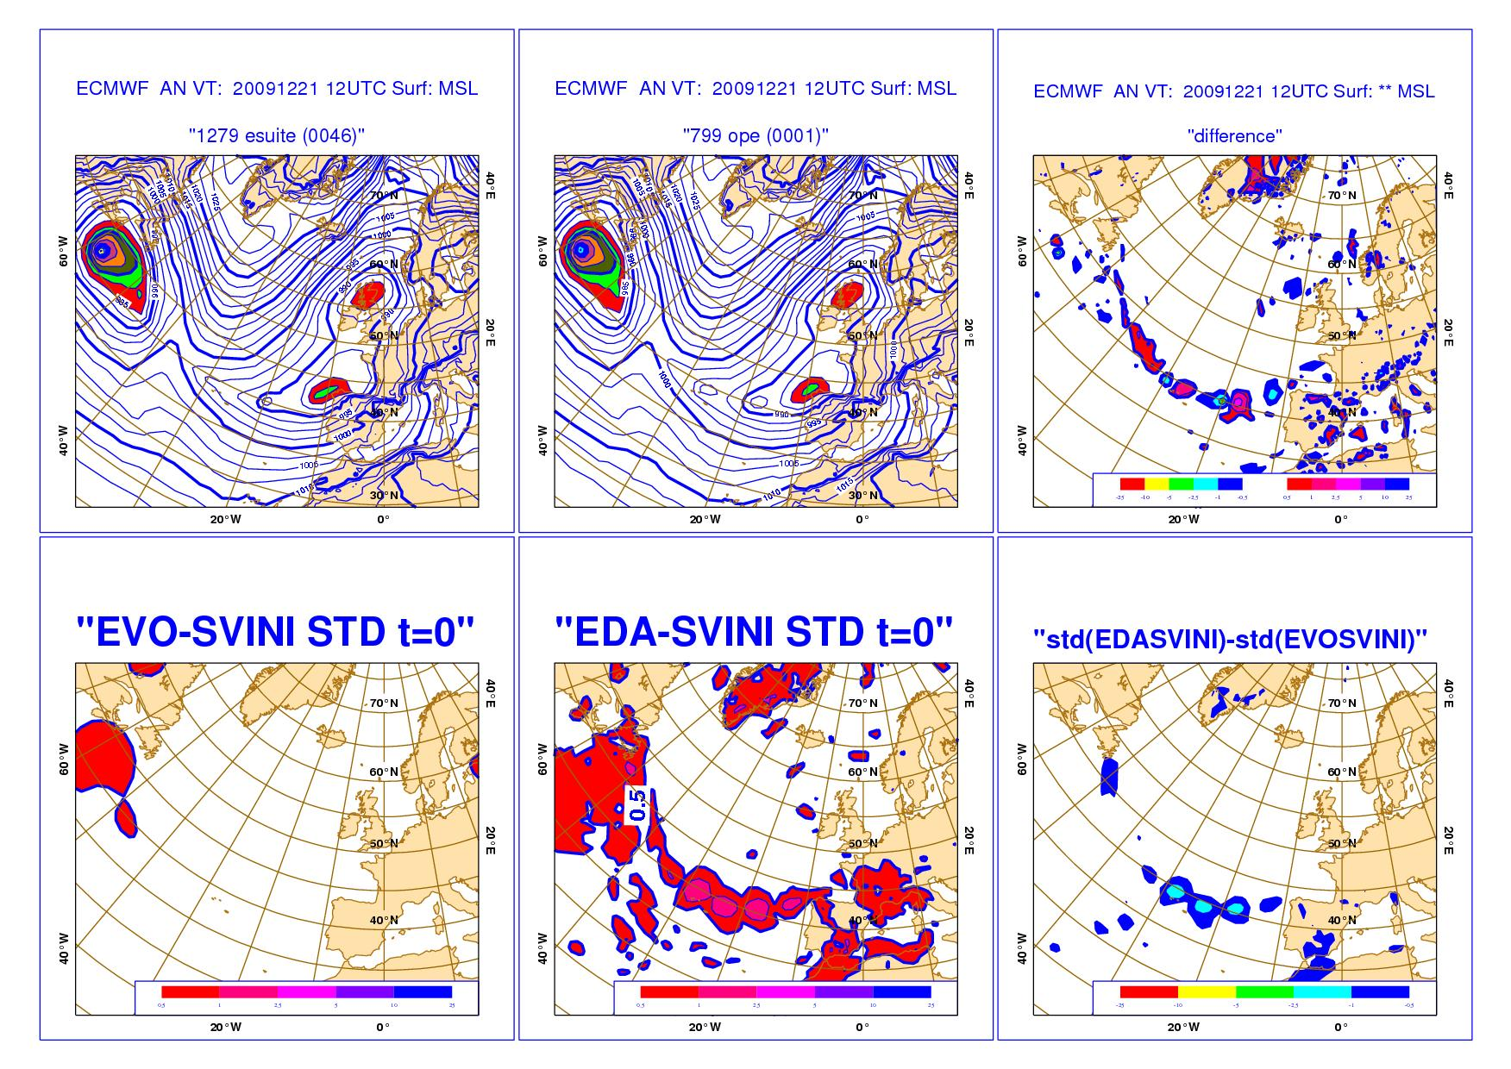
2. EDA spread as an indicator of analysis error
IC 21@12:
the top row shows the two analysis and their difference.
the bottom row shows the std of the EVO-SVINI and the EDA-SVINI ensembles, and their difference.
Notes:
The next three slides compares the spread of the O-suite (EVO-SVINI) and E-suite (EDA-SVINI) ENS, with the difference between the two high-resolution analyses run at T_{L}1279L91 (esuite) and T_{L}799L91 (ope). This figure refers to the situation at 12 UTC of 21 Dec 2009.

Slide 62
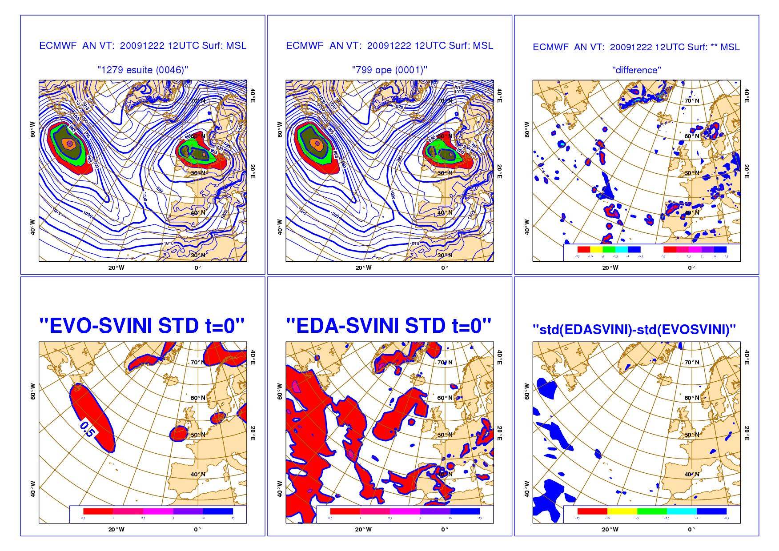
2. EDA spread as an indicator of analysis error
IC 22@12:
the top row shows the two analyses and their difference.
the bottom row shows the std of the EVO-SVINI and the EDA-SVINI ensembles, and their difference.
Notes:
The next three slides compares the spread of the O-suite (EVO-SVINI) and E-suite (EDA-SVINI) ENS, with the difference between the two high-resolution analyses run at T_{L}1279L91 (esuite) and T_{L}799L91 (ope). This figure refers to the situation at 12 UTC of 22 Dec 2009.

Slide 63
3. The EDA-SVINI ENS
The EDA-based perturbations are defined by differences between +6h forecasts:
This choice is consistent with data-assimilation practice followed when computing J_{b} statistics. In operation, this allows ENS to start as soon as the control analysis (T_{co}1279L137) is available.
21
00
6
9
12
18
21
00
6
9
Notes:
This slide illustrates how the EDA-based and SV perturbations are generated in the current operational system.

Slide 64
3. The EDA-SVINI ENS
The choice of using 6h forecasts from the EDA run during the previous DA cycle is consistent with the fact that the operational 48h-SVs are also computed starting from a 6-hour forecast, i.e. along a t+6h to t+54h trajectory:
SV_{k}(d,0)
SV_{k}(d,48)
48h-SV traj A_{T42L62}(d-6,6) to (d-6,54)
A_{T42L62}(d-6,0)
A_{center}(d-6,+6)
A_{T42L52}(d-6,+54)
21
00
6
9
12
18
21
00
6
9
12
EDA cycle
A_{centre}(d,0)=A_{Tco1279L137}(d,0)
Aj(d,0)
Aj(d-6,+6)
Notes:
This slides illustrates how SV perturbations are generated in the current operational system.

Slide 65
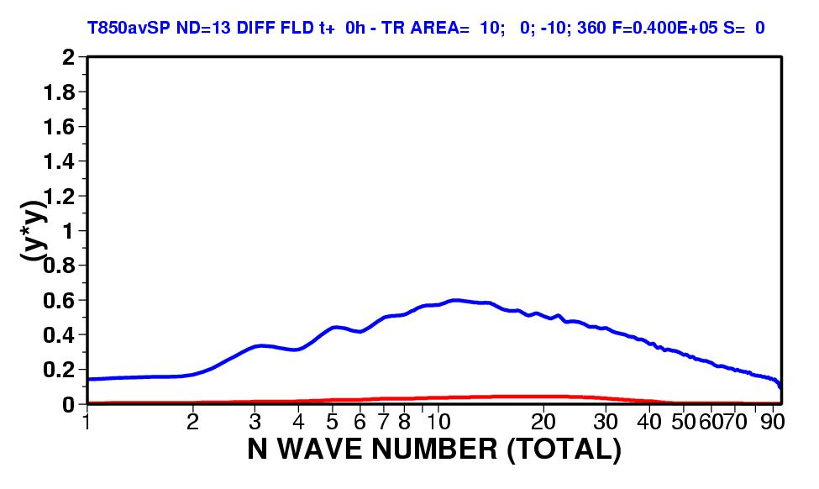
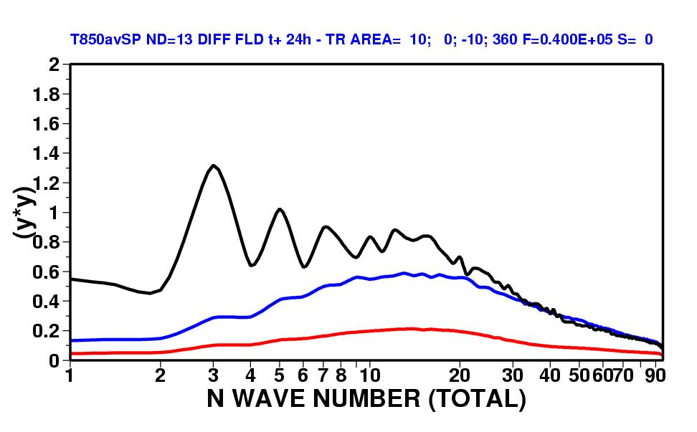
3. Spectra of EDA & SVINI ENS – TR 0/24h
The top figure shows the squared amplitude of the SVINI (red) and EDA (blue) perturbations in terms of T850 over the tropics at initial time. The bottom panel shows the same but for t+24h. Results have been averaged over 13 cases.
Results confirm that the SVINI ensemble has too little spread over the tropics.
Notes:
To highlight the scale characteristics of the two sets of perturbation, we can compare spectra of squared amplitudes. This plot shows the average (over 20 cases) spectra (function of total wave number N) of T850 initial-time and +24-hour spread of SVINI and EDA ENS over the tropics. The 24h spectra are compared to the spectra of 24-hour control-error.

