Slide 1

Sources of uncertainty
(EC/TC/PR/RB-L1)
(Magritte)
Roberto Buizza
European Centre for Medium-Range Weather Forecasts
(http://www.ecmwf.int/en/staff/Roberto-buizza)
Notes:
The aim of this lecture is to give a brief overview of Numerical Weather Prediction (NWP), identify the sources of forecast error, illustrate why a probabilistic approach to NWP is more complete, and discuss how ensemble methods can be used to forecast probabilities.

Slide 2
Abstract and key learning points
The aim of this session is to introduce the main sources of uncertainty that lead to forecast errors. The weather prediction problem will be discussed, and stated in terms of an appropriate probability density function (PDF). The concept of ensemble prediction based on a finite number of integration will be introduced, and the reason why it is the only feasible method to predict the PDF beyond the range of linear growth will be illustrated.
By the end of the session you should be able to:
explain which are the main sources of forecast error
illustrate why numerical prediction should be stated in probabilistic terms
describe the rationale behind ensemble prediction

Slide 3
Outline
The Numerical Weather Prediction (NWP) problem
Sources of forecast uncertainties and chaotic behaviour
Ensemble prediction as a practical tool for probabilistic prediction
The ECMWF medium-range/monthly ensemble
Notes:
In this lecture we will discuss four key points:
The NWP problem
The sources of forecast uncertainty and the chaotic behaviour of the atmosphere
Ensemble prediction
The ECMWF medium-range/monthly ensemble
Let’s start with the first point, how forecasts are generated.

Slide 4
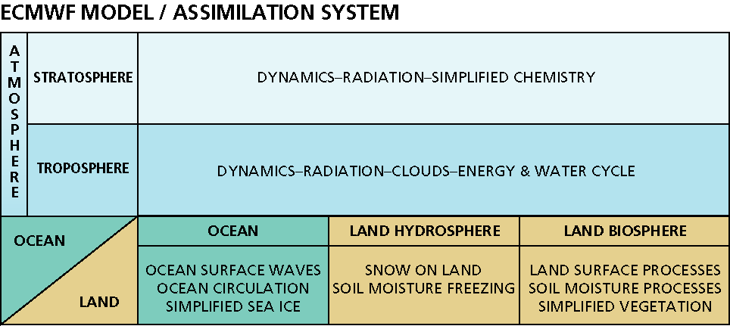
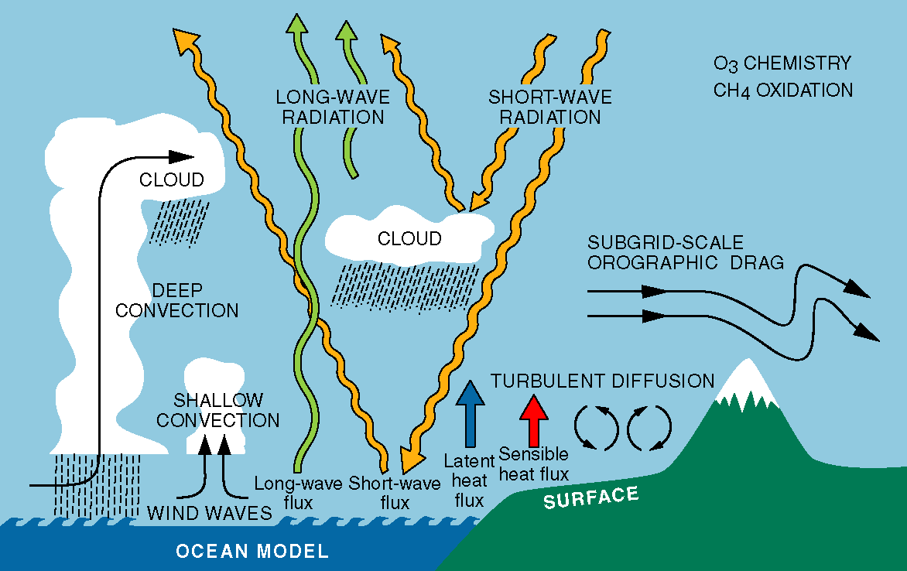
1. Numerical Weather Prediction (NWP) models
The behavior of the atmosphere is governed by a set of physical laws that express how the air moves, the process of heating and cooling, the role of moisture, and so on.
Interactions between the atmosphere and the underlying land and ocean are important in determining the weather.
Notes:
Skilful numerical weather prediction requires (i) a very good model capable to describe as accurately as possible all relevant physical processes, (ii) observations sampling the whole globe and a very good data-assimilation system capable to use them to estimate the initial conditions, and (iii) a computer powerful enough to complete the analysis and forecast steps in a reasonable amount of time.

Slide 5
1. Numerical Weather Prediction (NWP) models
Momentum conservation
Energy conservation
Water vapour conservation
Mass conservation
Hydrostatic balance
These terms represent the effect of clouds, mountains, radiation, vegetation, waves, …
Notes:
The ECMWF model is based on the atmospheric fluid equations. Solved on a finite ‘mesh’ of points that cover the whole globe.

Slide 6
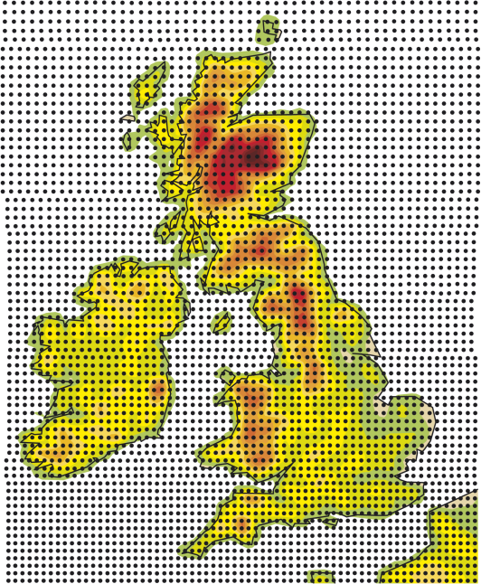
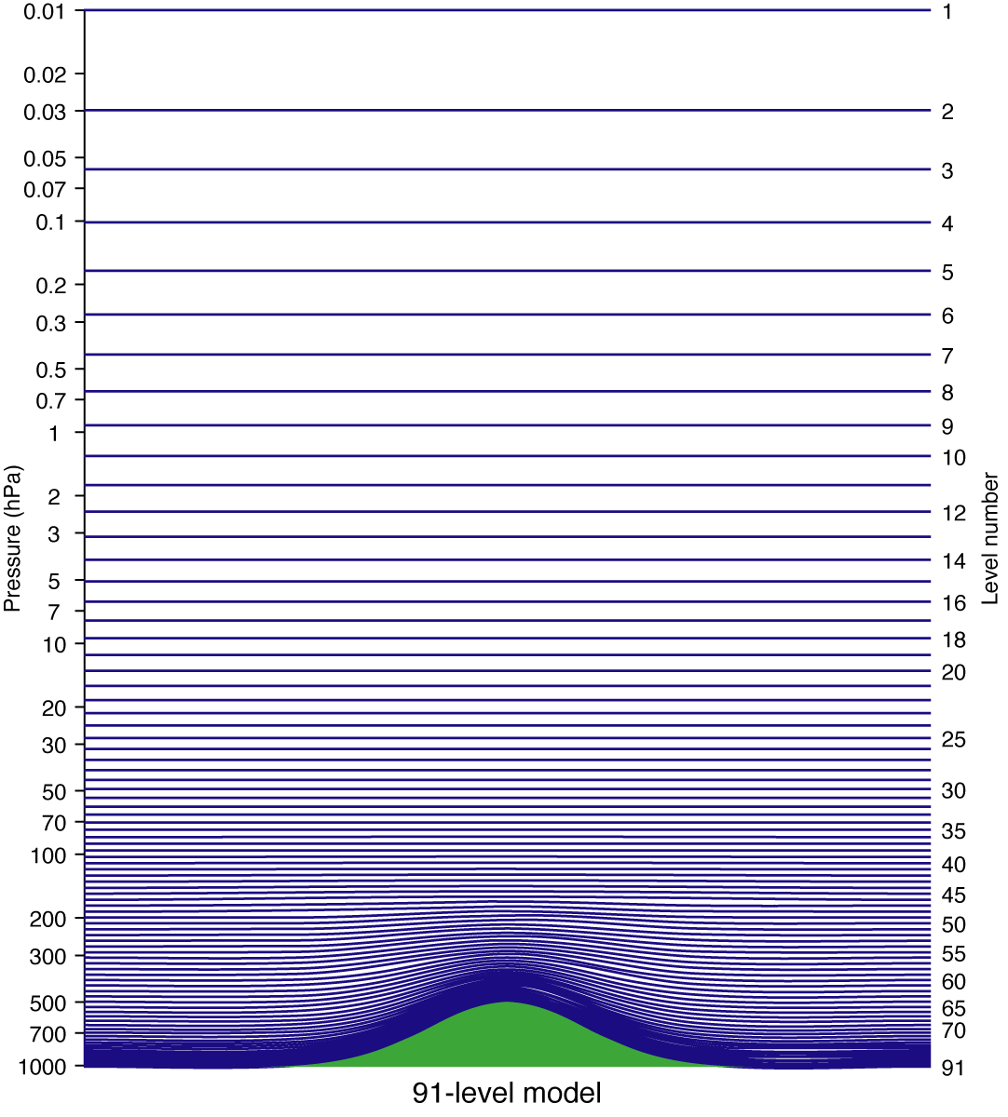
1. Model grid & v-levs of the Tco639L91 ENS
T_{CO}639
(ENS)
L91
(ENS)
Notes:
Today, 4D-Var and HRES uses a spectral triangular truncation Tco1279 with a cubic-octahaedral grid in physical space (resolution corresponding to about 9 km). ENS uses a variable resolution approach since March 2008, when the medium-range ensemble was merged with the monthly ensemble. Today, ENS first 15-days are run with spectral triangular truncation Tco639 (about 16 km), and with a Tco319 truncation thereafter (about 32 km). EDA uses also a Tco639 horizontal resolution. 4DVAR, EDA and HRES use 137 vertical levels, with the top of the atmosphere (TOA) at 0.01hPa, while the ENS uses 91 vertical levels (same TOA). Resources (human, to develop the systems, and computing, to run the systems) sets the constraints on the systems’ configurations (horizontal and vertical resolution, forecast length, and number of members).

Slide 7
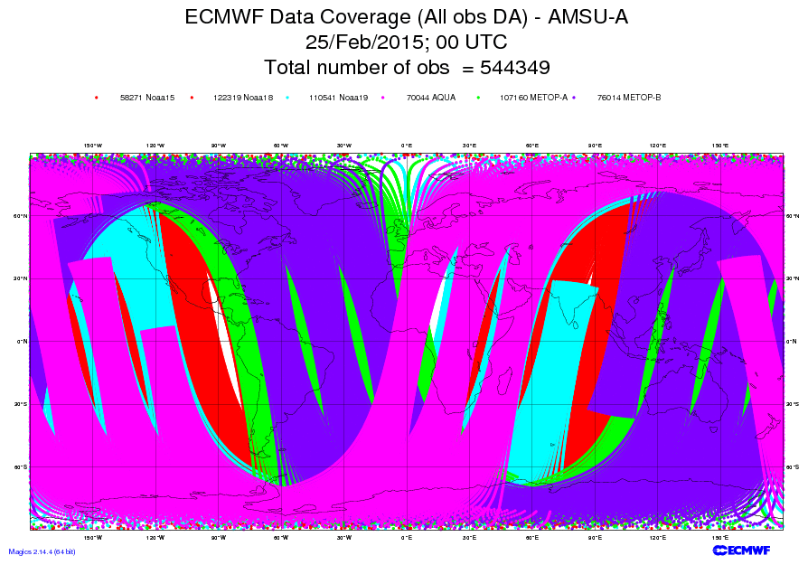
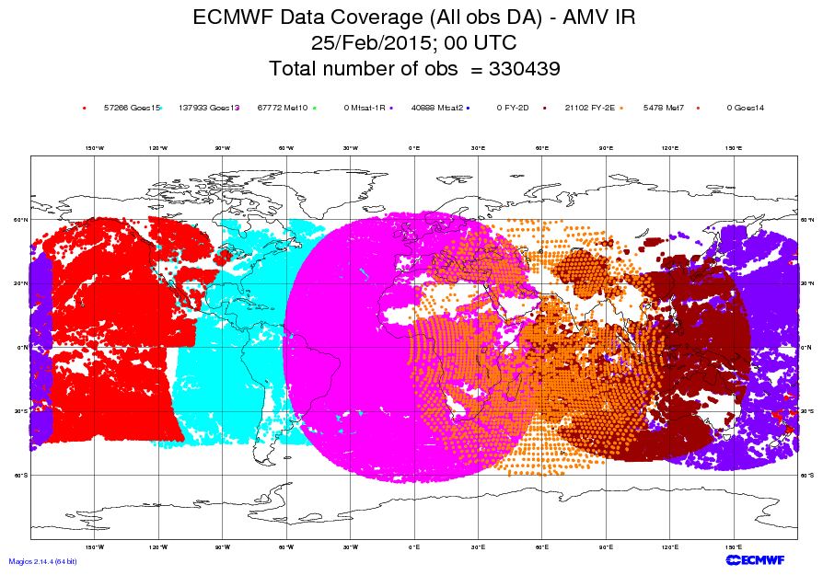
1. Observations coverage and accuracy
To make accurate forecasts it is important to know the current weather:
  ~ 155M obs (99% from satellites) are received daily;
  ~ 15M obs (96% from satellites) are used every 12 hours.
Notes:
Thanks to the continuous increase in the number of satellite systems, which provide today about 95% of the available observations, the whole globe is now better observed than in the past. Still, land has a larger number of more accurate observations. The ocean, for example, is still very poorly observed. Some regions still have a very limited number of high quality observations. In other words, there are still inhomogeneities in the number and quality of observations.

Slide 8
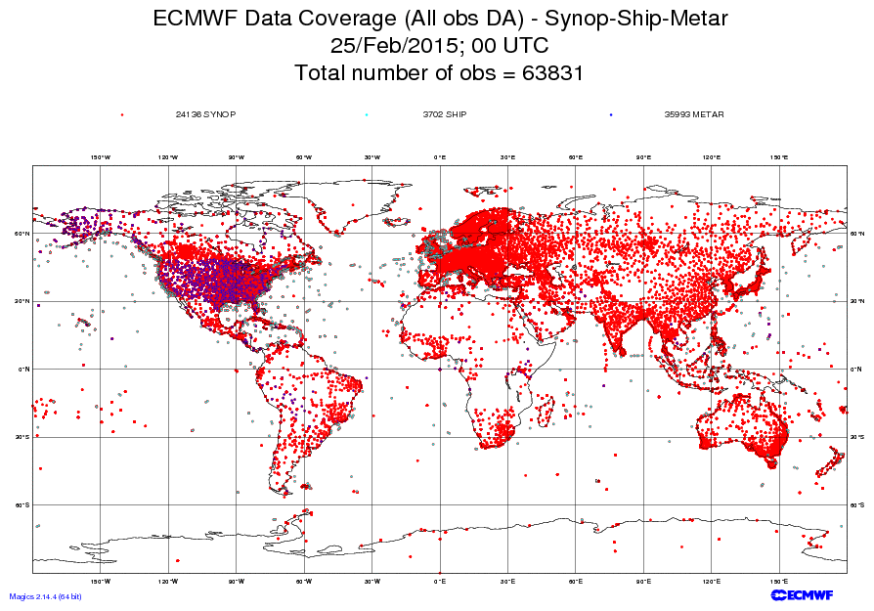
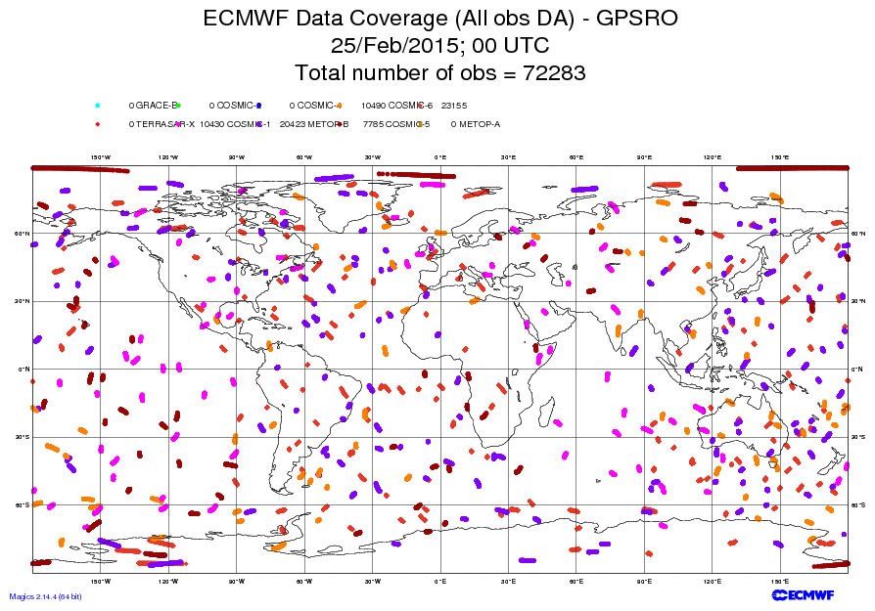
1. Observations coverage and accuracy
To make accurate forecasts it is important to know the current weather:
  ~ 155M obs (99% from satellites) are received daily;
  ~ 15M obs (96% from satellites) are used every 12 hours.
Notes:
Thanks to the continuous increase in the number of satellite systems, which provide today about 95% of the available observations, the whole globe is now better observed than in the past. Still, land has a larger number of more accurate observations. The ocean, for example, is still very poorly observed. Some regions still have a very limited number of high quality observations. In other words, there are still inhomogeneities in the number and quality of observations.

Slide 9
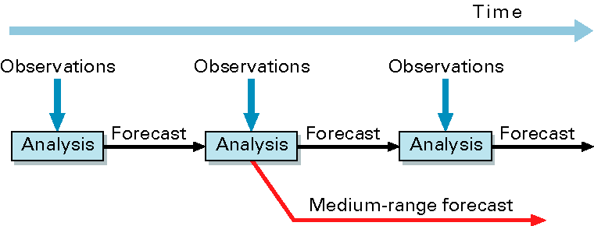
1. Obs are assimilated to estimate the initial state
Observations are used to correct errors in the short forecast from the previous analysis time
Every 12 hours ~ 15M observations are assimilated to correct the 100M variables that define the model’s virtual atmosphere
The assimilation relies on the quality of the model
Notes:
How do we construct initial conditions (ICs)? Observations are used to correct errors in the short forecast from the previous analysis time. Every 12 hours, about 15M observations are assimilated to correct the ~10⁸ variables that define the model’s atmosphere. At ECMWF, the assimilation is performed using a 4-dimensional approach, which merges a first guess field (generated by integrating the model equations) and the observations, at the right time. In terms of computer time, the T1279 4DVAR takes about 5 times for computer power as the 10-day T1279 forecast.

Slide 10
1. Observations used at ECMWF
Notes:
One of the key factors that has been contributing to advances in NWP have been the increased number and quality of satellite data. Thanks to advances in data-assimilation, these observations can be used to estimate the initial state in a very efficient way. Today, about 90% of the observations come from satellites. At ECMWF, ~ 10% of all the available observations (~30 of the received ~310 million) are used daily.

Slide 11
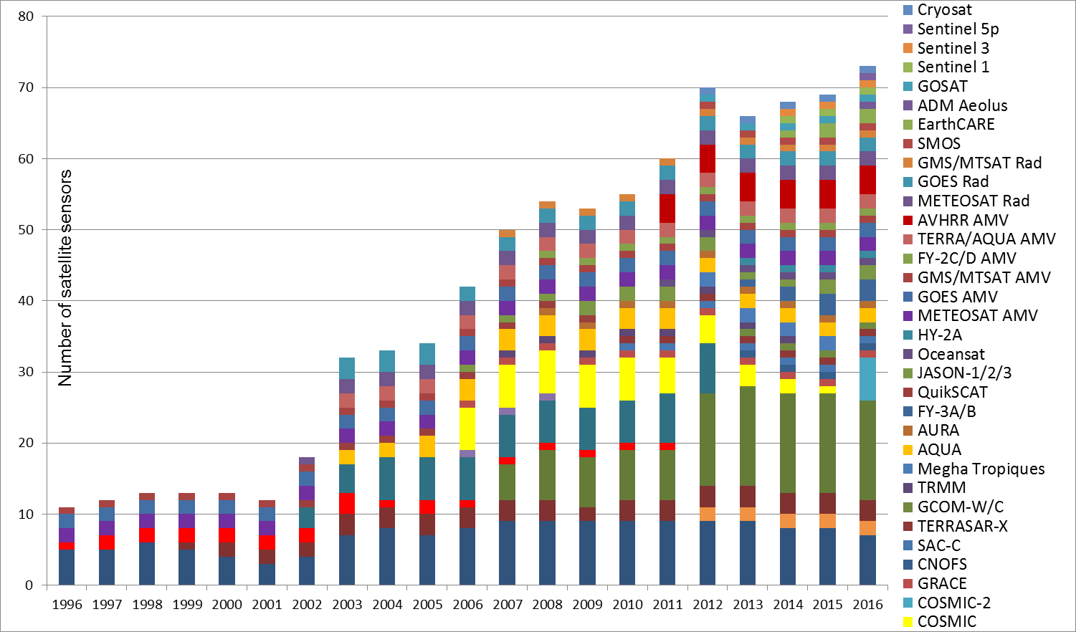
1. Satellite data used at ECMWF
Notes:
Since 2010, ~ 300 million satellite observations from ~ 50 instruments are received daily. At ECMWF, ~ 10% of all the available observations (~30 of the received ~310 million) are used daily.

Slide 12
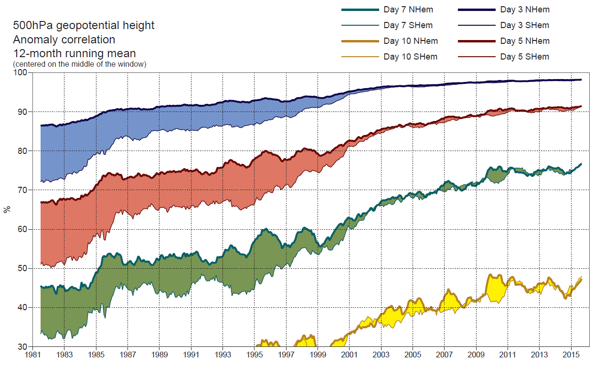
1. Forecast improvements over NH and SH for Z500
Improved models and data-assimilation systems, larger number of satellite observations and increased computer power contributed to forecast improvements, and a reduction of the gap between NH and SH scores.
NH: 2d/25y (2014-1989)
SH: 2d/16y (2014-1998)
Notes:
The combination of improved data-assimilation and forecasting models, an increased number and better observations (especially from satellites), and more computer power have led to increasingly accurate weather forecasts. For example, improvements between fc-days 3-to-5: NH 2d/25y (0.8d/decade) – SH 2d/16y (1.25d/decade). 3D-Var was implemented in 1996, 4D-Var in 2000. The gap reduction between NH and SH scores is due to a combination of an increased number of satellite obs and improvements in data-assimilation (3D- and 4D-Var).

Slide 13
Outline
The Numerical Weather Prediction (NWP) problem
Sources of forecast uncertainties and chaotic behaviour
Ensemble prediction as a practical tool for probabilistic prediction
The ECMWF medium-range/monthly ensemble
Notes:
We have seen how NWP are produced, and the role of models and observations in their generation. Let’s now move to the second part of this lecture, and discuss why forecasts fail and which are the sources of forecast errors.

Slide 14
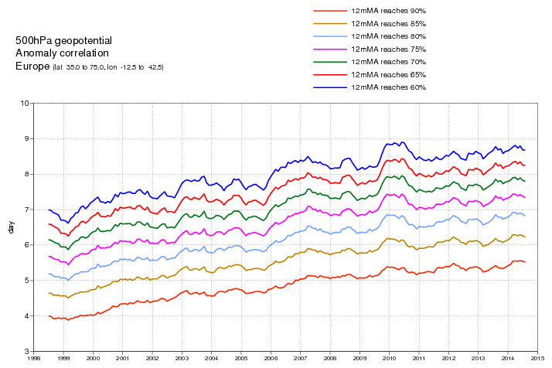
2. Forecast improvements over Europe for Z500
Over Europe, on average 6-day forecasts for Z500 have ACC of about 0.85, and forecasts have ACC of about 0.6 up to about 8.5-9 days.
8.5d < T < 9.0d
<ACC>=0.60
<ACC>=0.85
Notes:
Thanks to (a) better and more observations, (b) better and more realistic models (more and better process simulation, higher resolution), (c) scientific advances (e.g. the use of 4-D assimilation algorithm to estimate ICs, the use of ensemble methods), and (d) the availability of faster computers, forecasts keep improving. Considering Europe, e.g., today (on average) ECMWF single high-resolution forecasts reach the 0.6 ACC line between forecast day 8.5-9.0 (blue lines). Forecasts at day 6 have on average ACC of about 0.85.

Slide 15
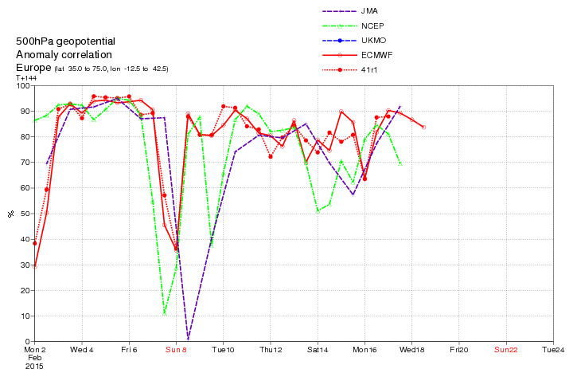
2. February 2015: drop in forecast skill
But on single cases we still see severe forecast busts. In February 2015, 6-day forecasts issued on the 2nd and the 8th had ACC of about 40%, much less than their average ACC value of 0.85.
0.85
0.60
Notes:
Despite progress, forecasts still fail, as the following two examples illustrate. The first example is from February 2015. The figure shows the Anomaly Correlation Coefficient for Z500 over Europe of single, high-resolution forecasts from JMA, NCEP, UKMO and ECMWF. A forecast bust is defined as a case when the forecast error, over a region, is unusually large when compared to the average skill. As shown by the previous slide, on average over Europe the +6d Z500 forecast has ACC of about 0.85. During February 2015, fcs from all centres were particularly poor. In particular, ECMWF 6d forecasts issued on 8 February at 00 UTC (valid for 14@00) had ACC of about 0.35, far below the average value.

Slide 16
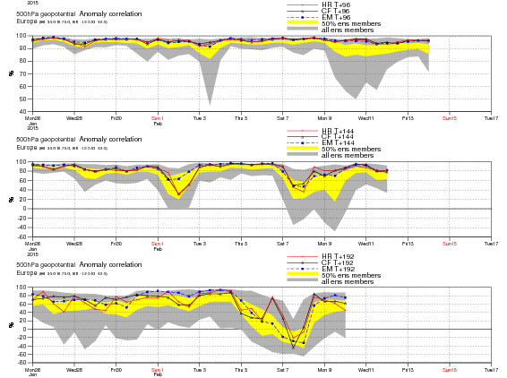
2. February 2015: drop in forecast skill
Consider the t+144h forecasts issued on 8@00 and valid for 14@00 (middle): not only the HRES and the ENS-control, but also the whole ENS members showed a drop in skill. This can be detected also 2 days earlier (bottom) and later (top).
This unpredictable situation was flagged by the ENS, which showed a very large spread.
+96h
+144h
+192h
Notes:
If we consider the whole ensemble of ECMWF forecasts (51 from ENS plus the high-resolution one), they all had difficulties in predicting the Euro-Atlantic circulation for 14@00 not only 6 days ahead, but also 8 (bottom) and 4 (top) days ahead. The fact that the distribution of the ACC values of the 52 forecasts is very wide for forecasts verifying 14@00, indicates that this was a particularly difficult situation to predict.

Slide 17
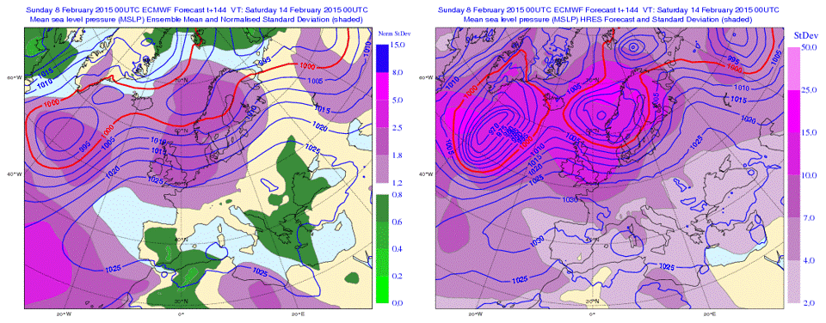
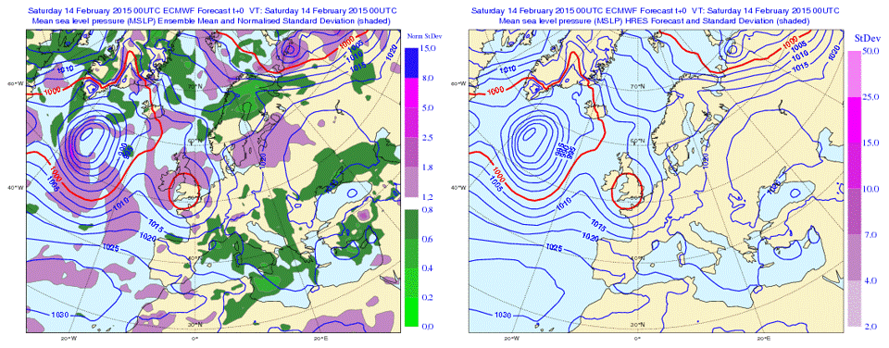
2. February 2015: drop in forecast skill
08@00+6d
<ENS>+NSTD
08@00+6d
HRES+STD
14@00
<ENS>+NSTD
14@00
HRES+STD
Notes:
The large forecast error was due to the forecast failing to develop an intense, cut-off low over southern UK (bottom)! The ENS spread (top) indicated the UK as one of the areas with largest spread.

Slide 18
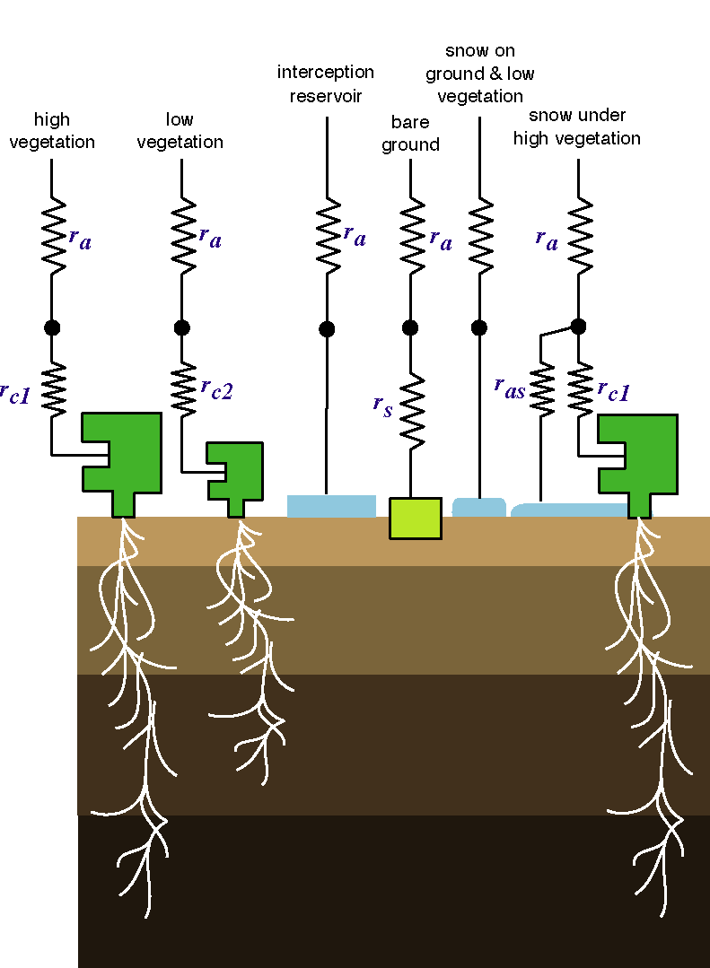
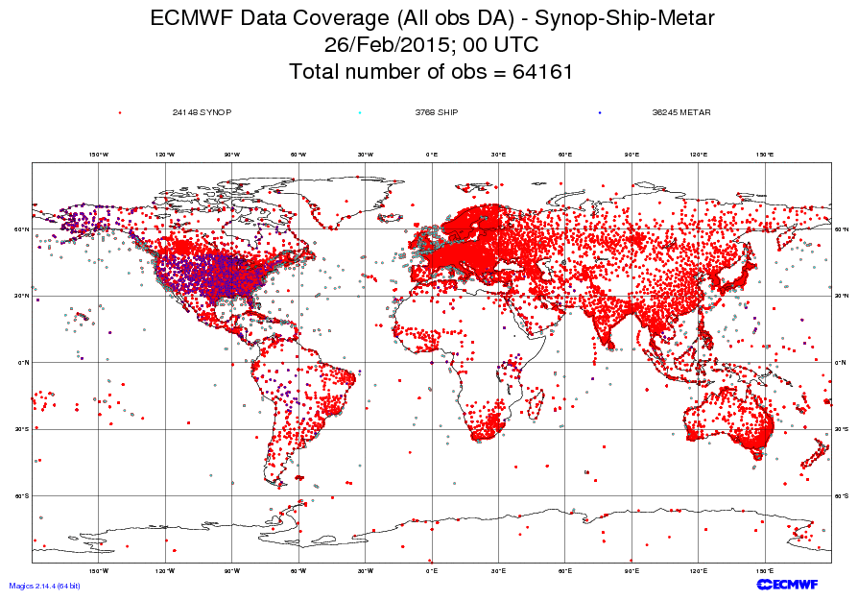
2. Why do forecasts fail?
Forecasts can fail because:
The initial conditions are not accurate enough, e.g. due to poor coverage and/or observation errors, or errors in the assimilation (initial uncertainties).
The model used to assimilate the data and to make the forecast describes only in an approximate way the true atmospheric phenomena (model uncertainties).
t=T2
t=T1
t=0
Notes:
The combination of initial and model uncertainties leads to wrong forecasts. With ‘model’ we mean not only the representation of physical processes in our model of the atmosphere/land/ocean (the Integrated Forecasting System, IFS), but also assumptions made in data assimilation to determine the initial conditions (ICs), and in any algorithm used to relate the ‘real’ and the ‘model’ phase spaces. Distinguishing which source is dominant is not possible, especially since modern data-assimilation systems rely strongly on the model to assimilate the observations. Models are used to relate the model and the observation phase spaces (to transform from one set of state variables to the other); initial conditions are estimated by merging, in an optimal way, first guess estimates (provided by a model forecast) with observations.

Slide 19

2. The atmosphere chaotic behavior
Furthermore, the atmosphere is a chaotic system, with flow-dependent errors growth. This was illustrated for the first time by Edward Lorenz, with his 3-dimensional model.
Notes:
The problem is made even more challenging by the fact that the atmosphere is a chaotic system. Flow-dependent, chaotic behavior, whereby trajectories passing very close at one time can diverge subsequently, makes weather prediction a particularly hard problem. Chaos theory, which describes the behavior of dynamical systems that are highly sensitive to initial conditions, can be used to understand the system behavior, and to design prediction systems. This was illustrated very clearly by the work of Edward Lorenz, in particular with his 3-dimensional non-linear model of the atmosphere.

Slide 20
Outline
The Numerical Weather Prediction (NWP) problem
Sources of forecast uncertainties and chaotic behaviour
Ensemble prediction as a practical tool for probabilistic prediction
The ECMWF medium-range/monthly ensemble
Notes:
Let’s recap. We have seen how NWP are produced, and the role of models and observations in their generation. We have also discussed why forecasts fail and which are the sources of forecast errors. We now move to the third part of this lecture, and focus on why a probabilistic approach to NWP is more complete, and how ensemble methods can be used to generate probabilistic forecasts.

Slide 21
3. What is the aim of weather forecasting?
We have seen that single forecasts can fail due to a combination of initial and model uncertainties, and that the NWP problem is made extremely complex by the chaotic nature of the atmosphere.
Does it make sense to issue single forecasts?
Can something better be done?
More generally, what is the aim of weather forecasting?
Should it be to predict only the most likely scenario, or should it aim to predict also its uncertainty (give a ‘confidence band’), for example expressed in terms of weather scenarii or probabilities that different weather conditions can occur?
Notes:
Let’s pose for a moment and think about a more general question: what is the aim of weather forecasting? A weather prediction approach based on single forecasts is not optimal (short-sighted, a lame duck, …). A more complete approach should (must?) provide also a measure of forecast uncertainty.

Slide 22
3. Ensemble prediction
Temperature
Temperature
fc_{j}
fc₀
PDF(t)
reality
PDF(0)
Forecast time
Notes:
This is illustrated in this simple schematic. A complete description of weather prediction can be stated in terms of an appropriate probability density function (PDF). Ensemble prediction based on a finite number of deterministic integration appears to be, up to now at least, the only feasible method to predict the PDF beyond the range of linear growth. Generally speaking, forecasts should all be stated in probabilistic terms, in terms of analyses and forecasts PDFs.

Slide 23
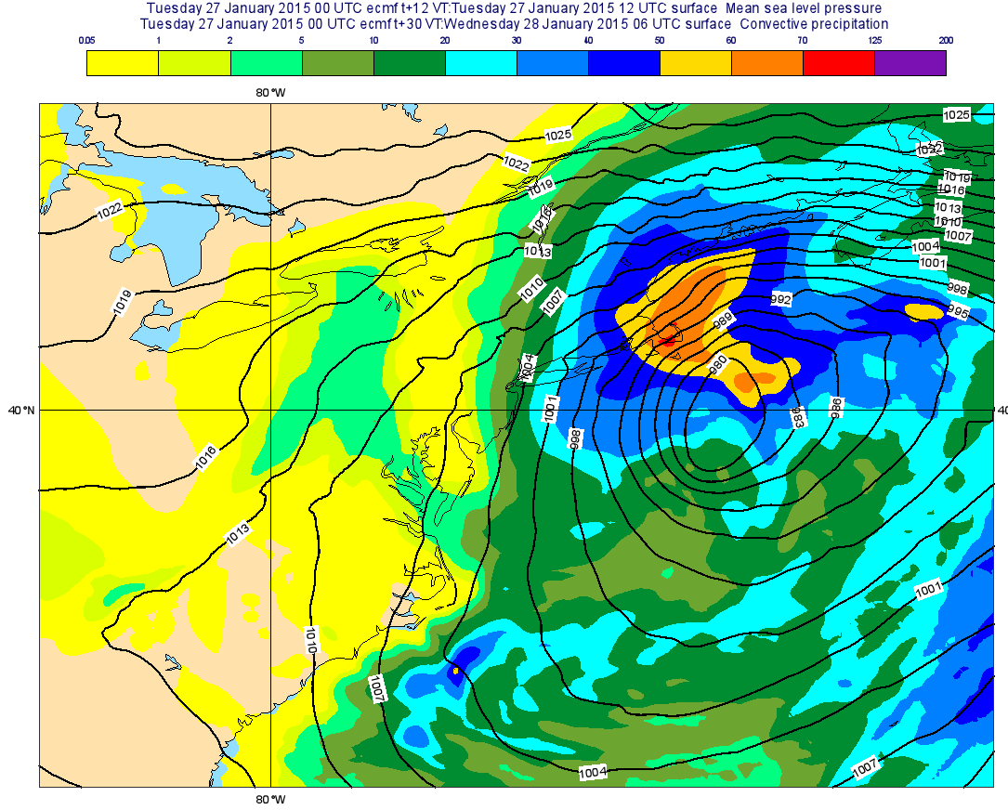
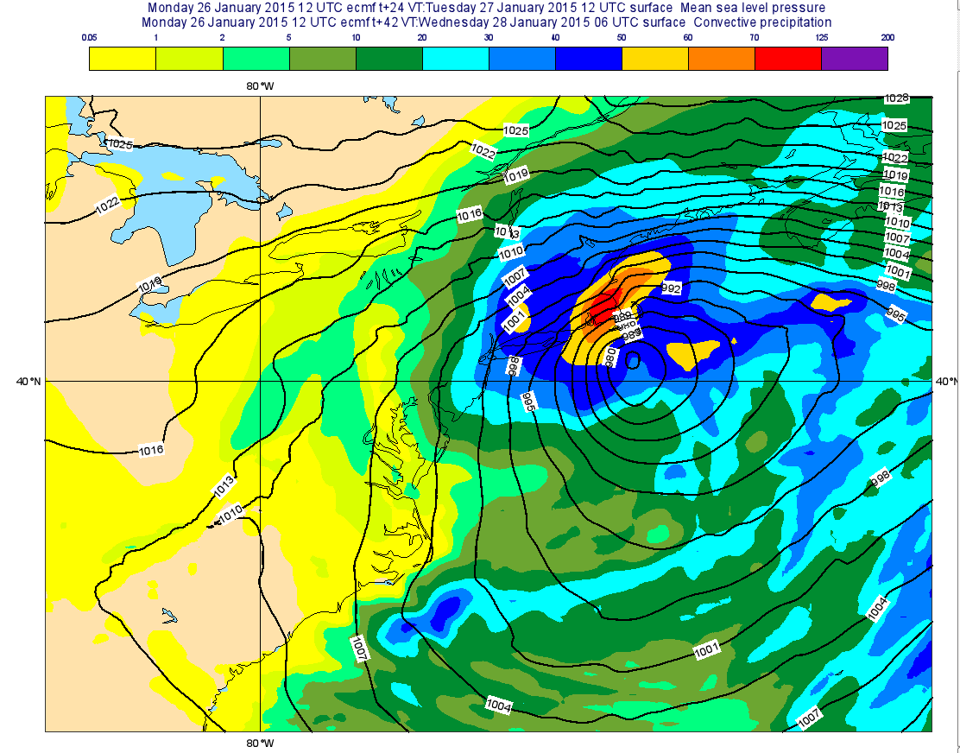
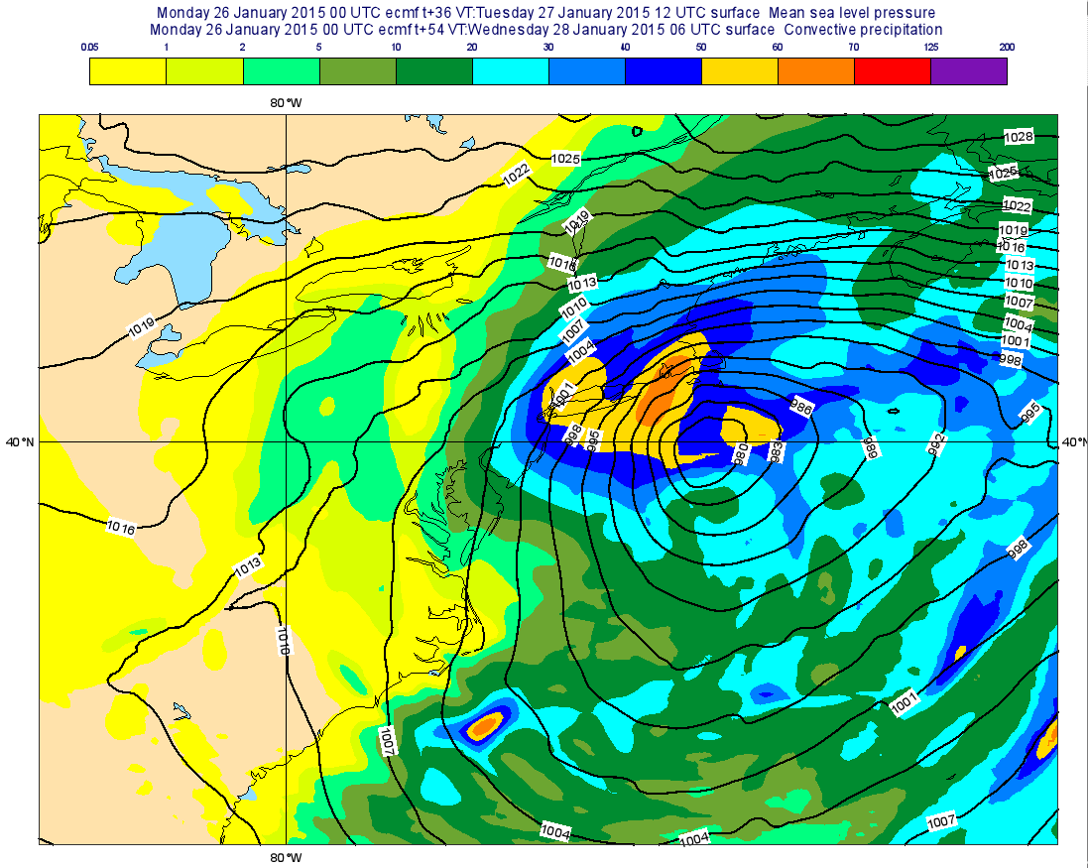
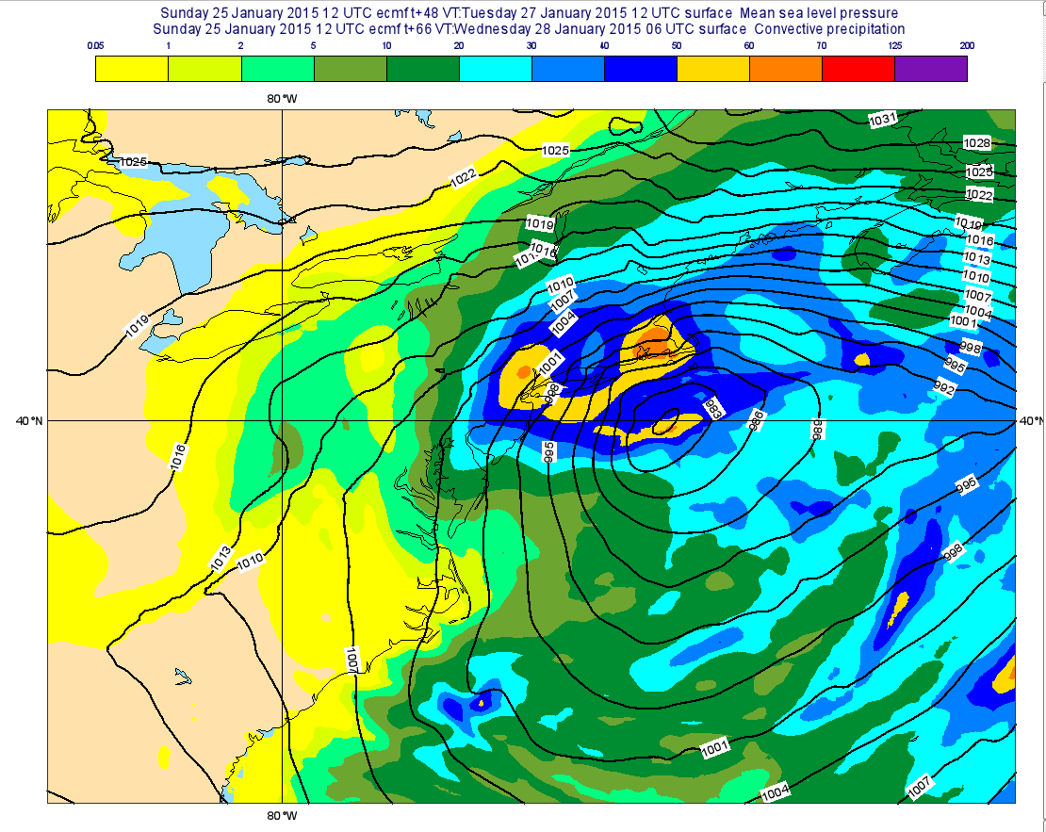
3. US Storm, 27-28/01/2015: single HRES fc
Single HRES fcs failed to positioned correctly the storm, and this lead to snowfall overestimation for NY of in the 24-36-48h forecasts.
MLSP+TP maps show a 150-200 km eastward shift in the storm centre.
27@00+12h
26@12+24h
26@00+36h
25@12+48h
Notes:
What does it mean to ‘predict the PDF time evolution’? Consider the case of the snowstorm that hit NY and Boston on 27-28 Jan 2015. The single HRES fc wrongly positioned the storm in the 24-36-48 hour range.

Slide 24
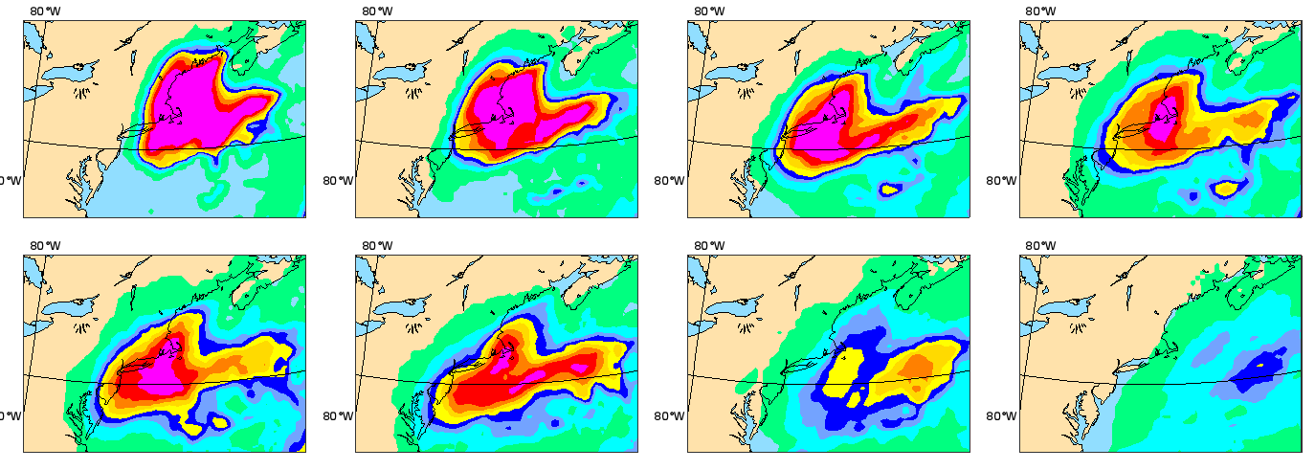
3. US Storm, 27-28/01/2015: ENS PR fcs
ENS-based probabilistic forecasts can be used to estimate the level of confidence (predictability) of single forecasts. They show that NY was closer to the edge of the area with high probability of more than 30mm of precipitation (between 27@00 and 28@06) than Boston, indicating higher uncertainty.
ENS PR[TP(27@00–28@06)>30mm]
27@00+12h
26@12+24h
26@00+36h
25@12+48h
25@00+60h
24@12+72h
24@00+84h
23@12+96h
Notes:
To ‘predict the PDF time evolution’ means being able to estimate the probability of weather events of interest (e.g. whether it will snow more than 30 cm).
ENS-based probabilities can be used to assess how confident we should be about this forecast, to estimate how predictable the conditions were for NY and Boston. The combined use of the single precipitation map and the probabilities provide a more complete forecast, since it allows users to attach a confidence level to the single precipitation field. It helps investigating whether the event could be more or less intense than given by that map alone. Without the probabilities, forecasters would have only ‘one shot’.

Slide 25
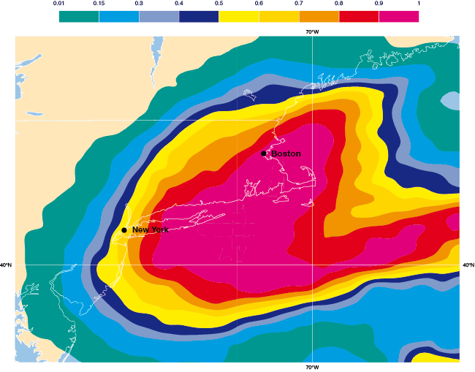
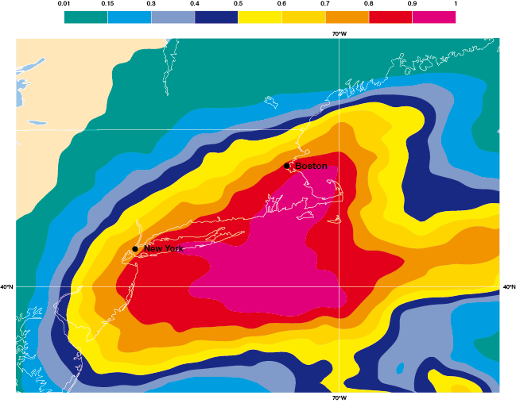
3. US Storm, 27-28/01/2015: ENS PR fcs
These figures show a larger version of the probability maps issued on 26@00 (left; t+36h) and 25@00 (right; t+60h).
ENS PR[TP(27@00–28@06)>30mm]
26@00+36h
25@00+60h
Notes:
To ‘predict the PDF time evolution’ means being able to estimate the level of confidence in a forecast
The ensemble indicated greater uncertainty in the forecast for New York than for Boston. From Saturday 24 January onwards, successive ECMWF ensemble forecasts consistently predicted the development of a major snow storm that would affect the north-east coast of the USA on 27 January. However, whilst there was high confidence in the occurrence of a severe storm, the precise track of the storm remained less certain. On 25 January most of the 52 ENS members were taking a slightly more westerly track than the forecasts from the previous day. The probability of substantial snow (more than 30mm of precipitation, equivalent roughly to 30cm or 1 foot of fresh snow) was over 80% for both NYC and Boston (right figure). This outcome was supported by the single higher resolution member, which was predicting over 40mm rain-equivalent precipitation widely in NE coastal regions, with 50mm in both cities. The overall signal was that a major event was likely to occur in both NYC and Boston. The ENS probabilities show a sharp gradient over the NYC area, see figure; those ENS members that did maintain a track further to the east predicted significantly less snow for NYC although overall this was a less likely outcome.
The probability for an exceptional snowfall event for Boston increased with each new forecast. In contrast, for NYC the likelihood of heavy snow decreased from 80% to 60% and then 40% as more ensemble members predicted the storm would pass slightly further to the east (left figure). The ensemble demonstrated that the situation was rather more uncertain for NYC than for Boston, even at shorter range. The ensemble approach is essential to provide forecast users with information about the range of future weather scenarios and the likelihood of high-impact weather events. The ensemble aims to account for all sources of uncertainty in the forecasting system, and ECMWF is continuing to improve its forecasting system, including by increasing its horizontal resolution. The aim is to both reduce and reliably quantify the uncertainty.
Figures:
- Left: forecast from 00UTC 26 January 2015: predicted probability of greater than 30mm precipitation accumulated over the 30-hour period from 00 UTC on 27 January to 0600 UTC on 28 January.
- Right: forecast from 00UTC 25 January 2015: predicted probability of greater than 30mm precipitation accumulated over the 30-hour period from 00 UTC on 27 January to 0600 UTC on 28 January.

Slide 26
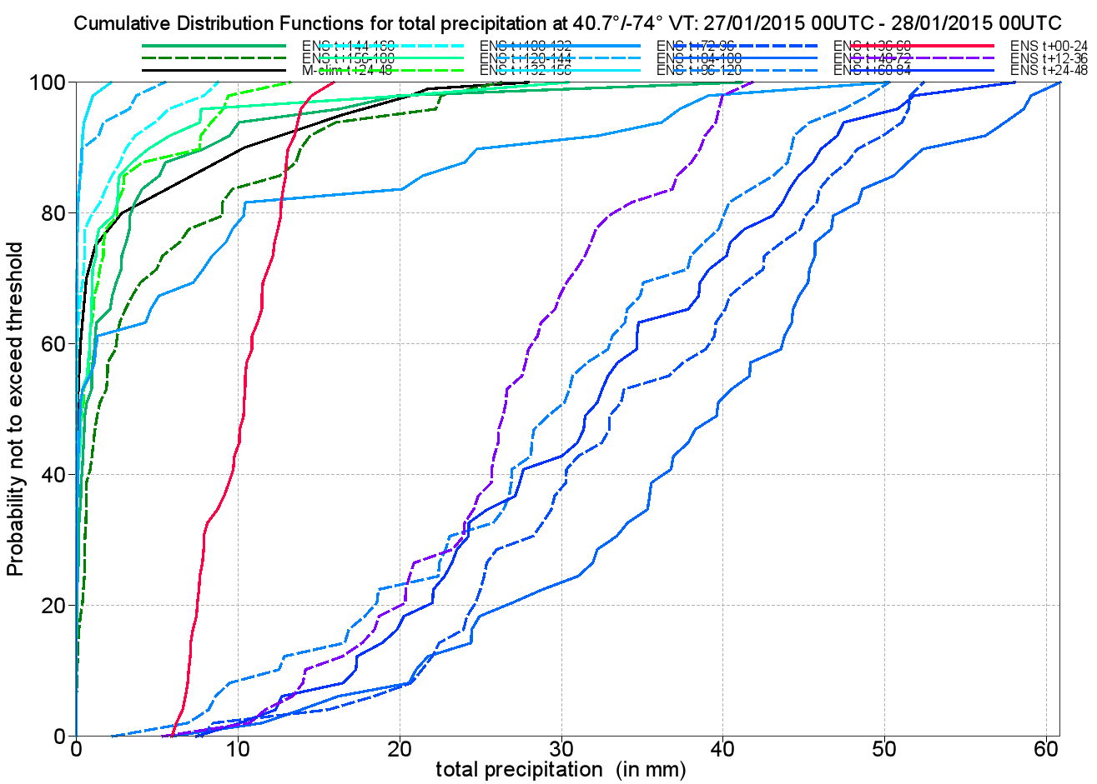
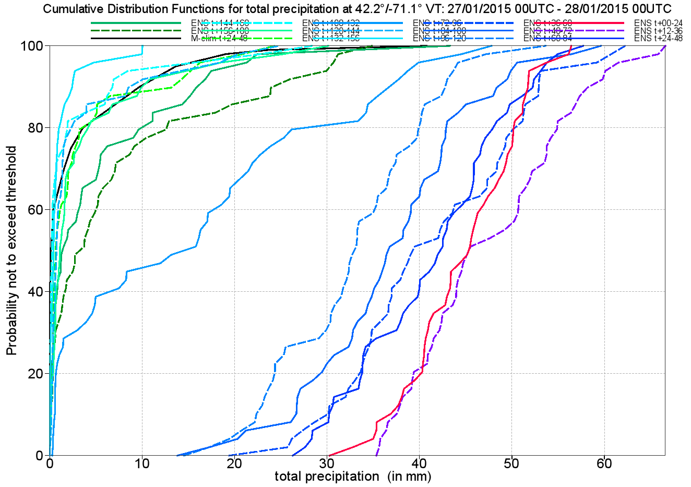
3. US Storm, 27-28/01/2015: ENS PR fcs
ENS-based probabilistic forecasts expressed in terms of CDF shows that the fcs for NY were more uncertain (the slope of the CDF curves is steeper) than the fcs for Boston.
New York
Boston
24-48h
24-48h
12-36h
00-24h
12-36h
00-24h
Obs (NEXRAD) 5-10 mm
Obs (NEXRAD) 30-35 mm
Notes:
To ‘predict the PDF time evolution’ means being able to identify areas/places where predictability might be higher or lower.
The comparison of the ENS-based grid-point cumulative distribution functions (CDFs) for NY (left) and Boston (right) confirms that the situation was more predictable for Boston. The NY CDFs have a steeper slope, indicating a larger ensemble spread. By contract, the Boston CDFs are steeper, indicating small spread, which in a reliable ensemble should indicate higher predictability (i.e. lower error; see discussion in the next slides). In fact, the CDF forecasts for Boston were closer to the observed value of about 30-35 mm (estimated from NEXRAD observations).

Slide 27
3. A necessary ensemble property: reliability
M₁
<M_{j}>
M₂
O
σ
e_{EM}
A reliable ensemble has, on average over many cases M, spread measured by the ensemble standard deviation σ, equal to the average error of the ensemble mean e_{EM}: <σ>_{M}=<e_{EM}>_{M}
Notes:
Not all PDF are useful. How can we judge whether a probabilistic forecast is skilful and valuable? A necessary property that an ensemble-based, probabilistic forecast must have is ‘reliability’. There are different ways to measure whether a probabilistic forecast is reliable:
In a probabilistic forecast based on ensembles, on average, the range spanned by the ensemble members includes the verification;
Small spread indicate high predictability (i.e. small forecast errors);
A probabilistic forecast is reliable if, on average, when the forecast probability is P%, the predicted even occurs P% of the times.
This figure illustrates point (i).

Slide 28
3. In a reliable ensemble, small spread>small error
Case 1
σ
Case 2
e_{EM}
In a reliable ensemble, small ensemble standard deviation indicates a more predictable case, i.e. a small error of the ensemble mean e_{EM}.
σ
e_{EM}
Notes:
A necessary property that an ensemble-based, probabilistic forecast must have is ‘reliability’. There are different ways to measure whether a probabilistic forecast is reliable:
In a probabilistic forecast based on ensembles, on average, the range spanned by the ensemble members includes the verification;
Small spread indicate high predictability (i.e. small forecast errors);
A probabilistic forecast is reliable if, on average, when the forecast probability is P%, the predicted even occurs P% of the times.
This figure illustrates point (ii).
Why should we expect, in a perfect and reliable ensemble, that on average the ensemble standard deviation should be equal to the root-mean-square-error fo the ensemble-mean? In a perfect and reliable ensemble, we could assume that ‘the true’ state of the atmosphere coincide with a randomly chosen ensemble member. This means that, on average over many cases, the error of the ensemble-mean [which in this case is the distance between the ensemble-mean and a (randomly chosen) member] should match the ensemble standard deviation (ie the average distance between the ensemble-mean and the ensemble members).

Slide 29
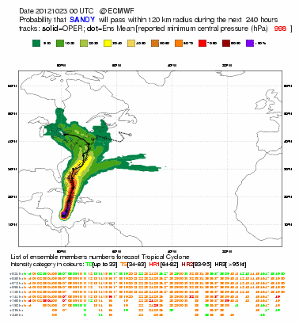
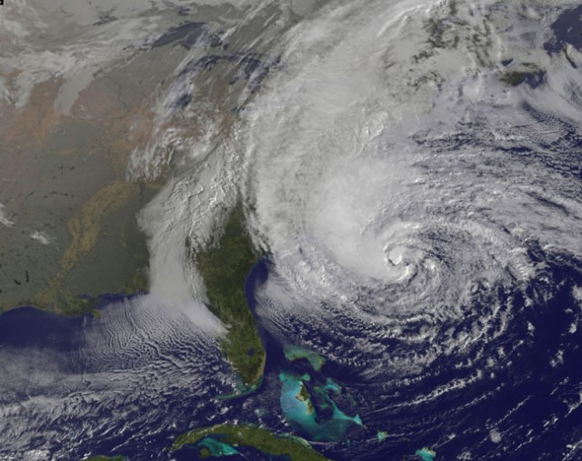
3. Track dispersion & predictability: Sandy (Oct 2012)
Sandy (Oct 2012) - Dispersion of ENS tracks in the 10d forecast issued on 2012.10.23@00 was relatively large after forecast day 5, indicating high uncertainty on direction and landfall location.
Notes:
This and the next two slides illustrate the use of ensemble spread as a predictor for forecast uncertainty in TC cases. More precisely, they illustrate how the dispersion of TC tracks can be used as predictor for the single HRES forecast uncertainty (small dispersion>small error i.e. high predictability). The first case is Hurricane Sandy (29 Oct 2012), which hit New York. The dispersion of the ENS tracks in the 7 day forecast was still rather large, with most of the tracks going west and few predicting that the hurricane would turn east.

Slide 30
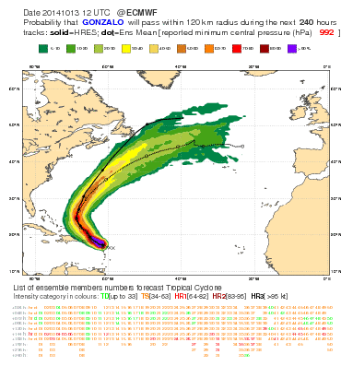
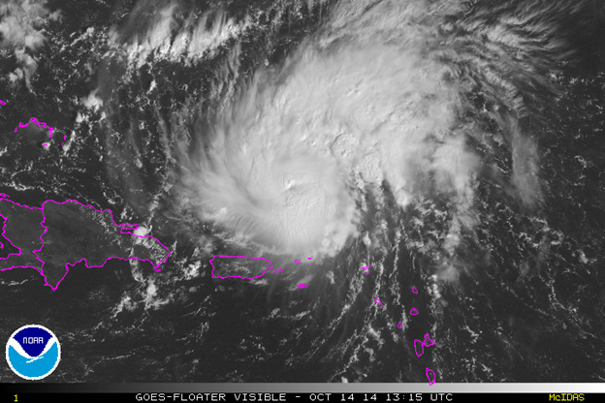
3. Track dispersion & predictability: Gonzalo (Oct 2014)
Gonzalo (Oct 2014) - Dispersion of ENS tracks in the 10d forecast issued on 2014.10.13@12 was relatively small for the whole 10 day range, indicating more confidence on direction of travel.
Notes:
The second case is Hurricane Gonzalo (Oct 2014), which hit Cuba and then move north-eastward in the Atlantic. In this case the tracks’ dispersion is smaller than for the case of Sandy, indicating that this was a more predictable case, with a smaller uncertainty on the path that the actual system would follow.

Slide 31
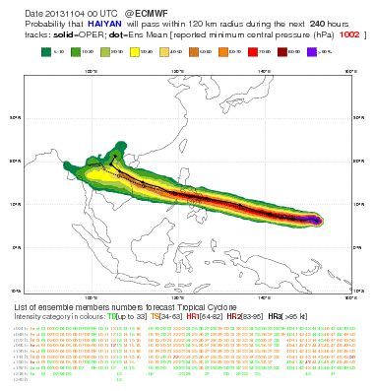
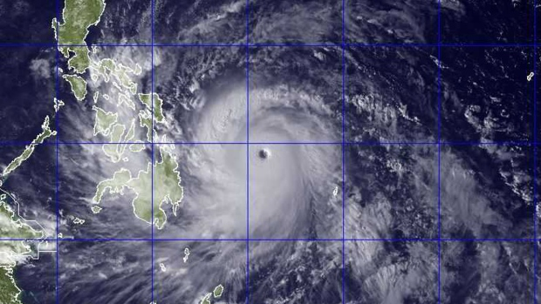
3. Track dispersion & predictability: Haiyan (Nov 2013)
Haiyan (Nov 2013) - Dispersion of ENS tracks in the 10d forecast issued on 2014.10.13@12 was very small for the whole 10 day range, indicating high confidence on direction of travel.
Notes:
The third case is Typhoon Haiyan (Nov 2013), which hit the Philippines causing massive damages and loss of lives. In this case the tracks’ dispersion was very small, the smallest of the three cases discussed here, indicating that this a much more predictable case, with a very small uncertainty on the path that the actual system would follow.

Slide 32
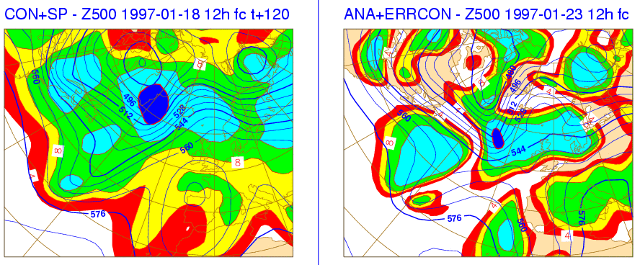
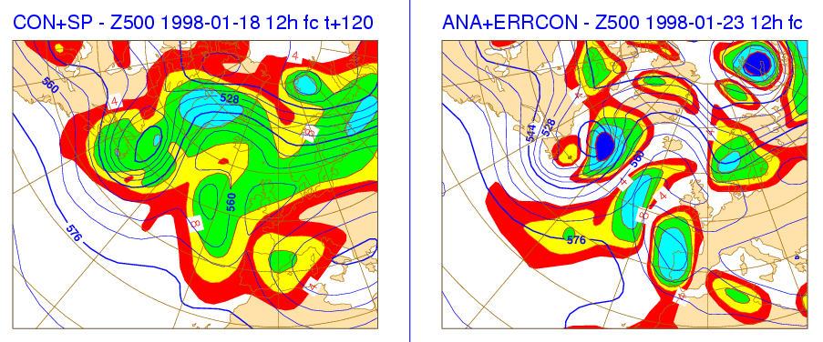
3. ENS spread as an index of predictability
Small ensemble spread should identify predictable conditions:
On average, the spread in 1998 (top left) is smaller than in 1997 (bottom left), and the control error is also smaller (right)
For both cases, areas of smaller spread indicates areas of small error
Notes:
Spread can also be used to identify geographical regions where error is expected to be small. More precisely, ENS standard deviation maps can be used to identify where forecast uncertainty is lower. These panels show the 5-day control forecast and ensemble spread (left) and the verifying analysis and control error (right) for forecasts started 18 Jan 1997 (top) and 1998 (bottom). A small ensemble spread should identify predictable conditions. On average, the spread in 18 Jan is smaller, and the control error is also smaller. For both cases, areas of smaller spread indicates areas of small error.

Slide 33
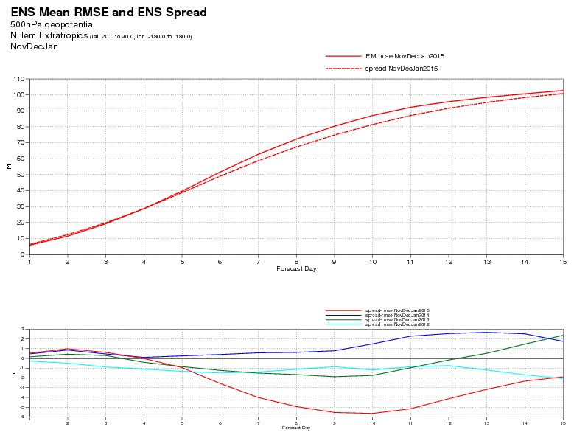
3. In a reliable ensemble, <spread>~<er(EM)>
One way to check the ensemble reliability is to assess whether the time evolution of the seasonal average ensemble standard deviation and error of the ensemble mean are similar.
This plot shows these two curves for Z500 over NH in DN14J15.
Z500 - NH
Notes:
In a reliable ensemble, on average the ENS dispersion measured e.g. by its standard deviation, should match the error of the ENS-mean forecast. The top panel compares these two curves for Z500 over NH for this winter (ND14J15). The bottom panel shows the difference between the two curves for the past 4 winters. For this variable, the match is very good.

Slide 34
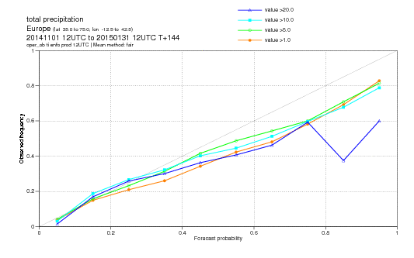
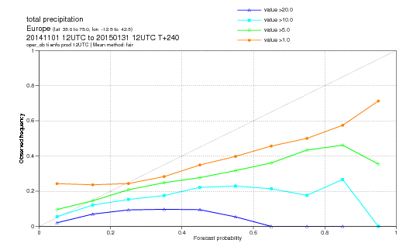
3. In a reliable ensemble, <fc-prob>~<obs-prob>
One way to check the ensemble reliability is to assess whether the average forecast and observed probabilities of a certain event are similar.
These plots compare the two probabilities at t+144h and t+240h for the event ‘24h precipitation in excess of 1/5/10/20 mm’ over Europe for ND14J15 (verified against observations).
T+144h
T+240h
Notes:
A necessary property that an ensemble-based, probabilistic forecast must have is ‘reliability’. There are different ways to measure whether a probabilistic forecast is reliable:
In a probabilistic forecast based on ensembles, on average, the range spanned by the ensemble members includes the verification;
Small spread indicate high predictability (i.e. small forecast errors);
A probabilistic forecast is reliable if, on average, when the forecast probability is P%, the predicted even occurs P% of the times.
This figure illustrates point (iii). It shows the ND14J15 average reliability diagram for the probabilistic prediction of 24h precipitation in excess of 1/5/10/20 mm/d over Europe, verified against synop stations, at two forecast times, 6 and 10 days.
The figures show that the reliability is much higher in the 6-day forecast, and that at both forecast times it is lower for the higher threshold (20 mm/d).

Slide 35
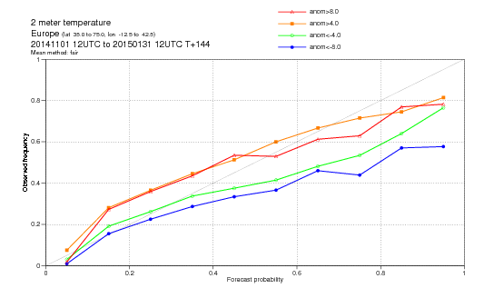
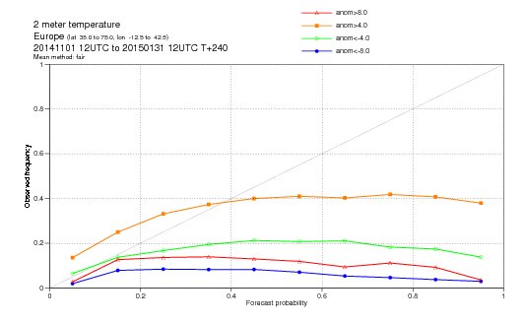
3. In a reliable ensemble, <fc-prob>~<obs-prob>
One way to check the ensemble reliability is to assess whether the average forecast and observed probabilities of a certain event are similar.
These plots compare the two probabilities at t+144h and t+240h for the event ‘2-meter temperature anomaly lower than -8/-4 and higher than +4/+8 degrees’ over Europe for ND14J15 (verified against observations).
T+144h
T+240h
Notes:
A necessary property that an ensemble-based, probabilistic forecast must have is ‘reliability’. There are different ways to measure whether a probabilistic forecast is reliable:
In a probabilistic forecast based on ensembles, on average, the range spanned by the ensemble members includes the verification;
Small spread indicate high predictability (i.e. small forecast errors);
A probabilistic forecast is reliable if, on average, when the forecast probability is P%, the predicted even occurs P% of the times.
This figure illustrates point (iii). It shows the ND14J15 average reliability diagram for the probabilistic prediction of 2-meter temperature anomalies lower than -8 and -4 degrees, and higher than 4 and 8 degrees over Europe, verified against synop stations, at two forecast times, 6 and 10 days.
The figures show that the reliability is much higher in the 6-day forecast, and that at both forecast times it is lower for the cold anomalies, suggesting that the ensemble has a cold bias.

Slide 36
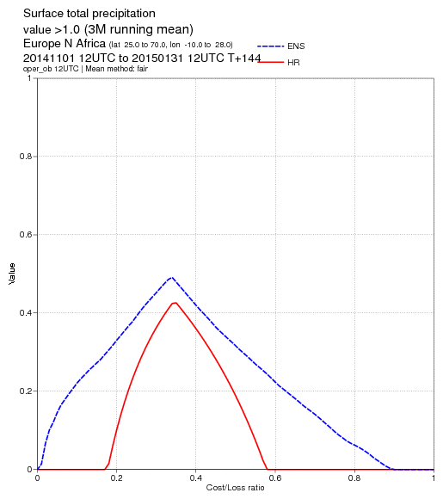
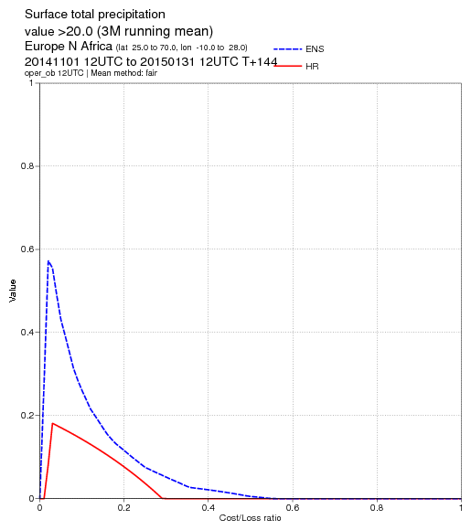
3. Are ensembles more valuable than single fcs?
ENS probabilistic forecasts have higher Potential Economic Value (PEV) than the single high-resolution forecast. These plots refer to t+144h precipitation forecasts (ND14J15).
T+144h – 1 mm/d
T+144h – 20 mm/d
C/L=0.1
C/L=0.1
Notes:
Let’s now move to another aspect, i.e. the ‘value’ of single and probabilistic forecasts. Why should we move towards ensemble-based probabilistic forecasts? We said earlier that ensemble-based, probabilistic forecasts provide a more complete information than single forecasts. If this is really the case, than probabilistic forecasts should also have a higher ‘economic value’. PEV can be defined as the reduction of mean expenses that can be achieved using it relative to the reduction that can be achieved by using a perfect forecast, with the EV estimated using a simple cost/loss model. A user can protect against a loss ‘L’ by taking an action that costs ‘C’; thus the user has a cost/loss ratio C/L. Now, consider two users, with a cost/loss that depends on ‘24h precipitation in excess of 1mm/d (left panel) and 20mm/d’ (right panel), with C/L=0.1 (i.e. it costs 10% to protect against a loss of 1 unit). For the first user (1 mm/d, left), the PEV of the single HRES forecast is zero, while the PEV of the ENS probabilistic forecast is 0.22. For the second user (20 mm/d, right), the PEVs are 0.12 and 0.24. These figures show results based on precipitation forecasts for ND14J15 over Europe: ENS-based probabilistic forecasts have higher PEV than single high-resolution forecasts.

Slide 37
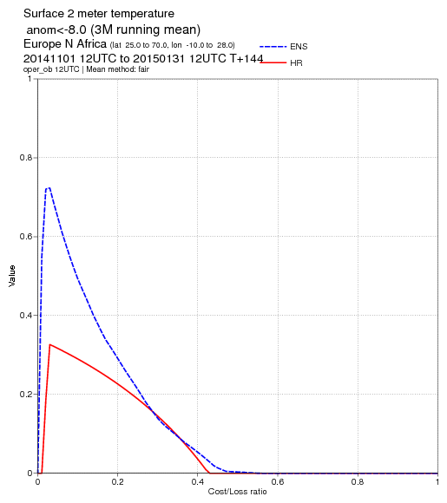
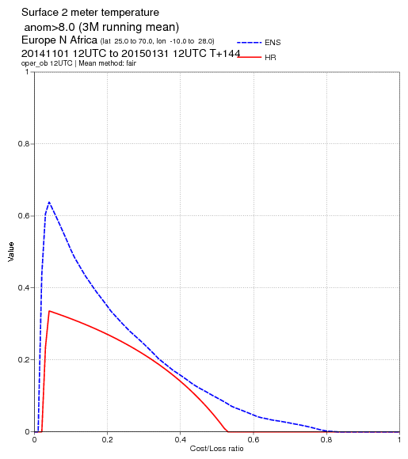
3. Are ensembles more valuable than single fcs?
ENS probabilistic forecasts have higher Potential Economic Value (PEV) than the single high-resolution forecast. These plots refer to t+144h 2m temp. forecasts (ND14J15).
C/L=0.1
C/L=0.1
Notes:
Let’s now move to another aspect, i.e. the ‘value’ of single and probabilistic forecasts. Why should we move towards ensemble-based probabilistic forecasts? We said earlier that ensemble-based, probabilistic forecasts provide a more complete information than single forecasts. If this is really the case, than probabilistic forecasts should also have a higher ‘economic value’. PEV can be defined as the reduction of mean expenses that can be achieved using it relative to the reduction that can be achieved by using a perfect forecast, with the EV estimated using a simple cost/loss model. A user can protect against a loss ‘L’ by taking an action that costs ‘C’; thus the user has a cost/loss ratio C/L. Now, consider two users, with a cost/loss that depends on ‘2mT anomaly lower than 8 degrees (left panel) and greater than 8 degrees’ (right panel), with C/L=0.1 (i.e. it costs 10% to protect against a loss of 1 unit). For the first user (-8 degrees, left), the PEV of the single HRES forecast is 0.30, while the PEV of ENS probabilistic forecast is 0.48. For the second user (+8 degrees, right), the PEVs are 0.32 and 0.50. These figures show results based on 2mT forecasts for ND14J15 over Europe: ENS-based probabilistic forecasts have higher PEV than single high-resolution forecasts.

Slide 38
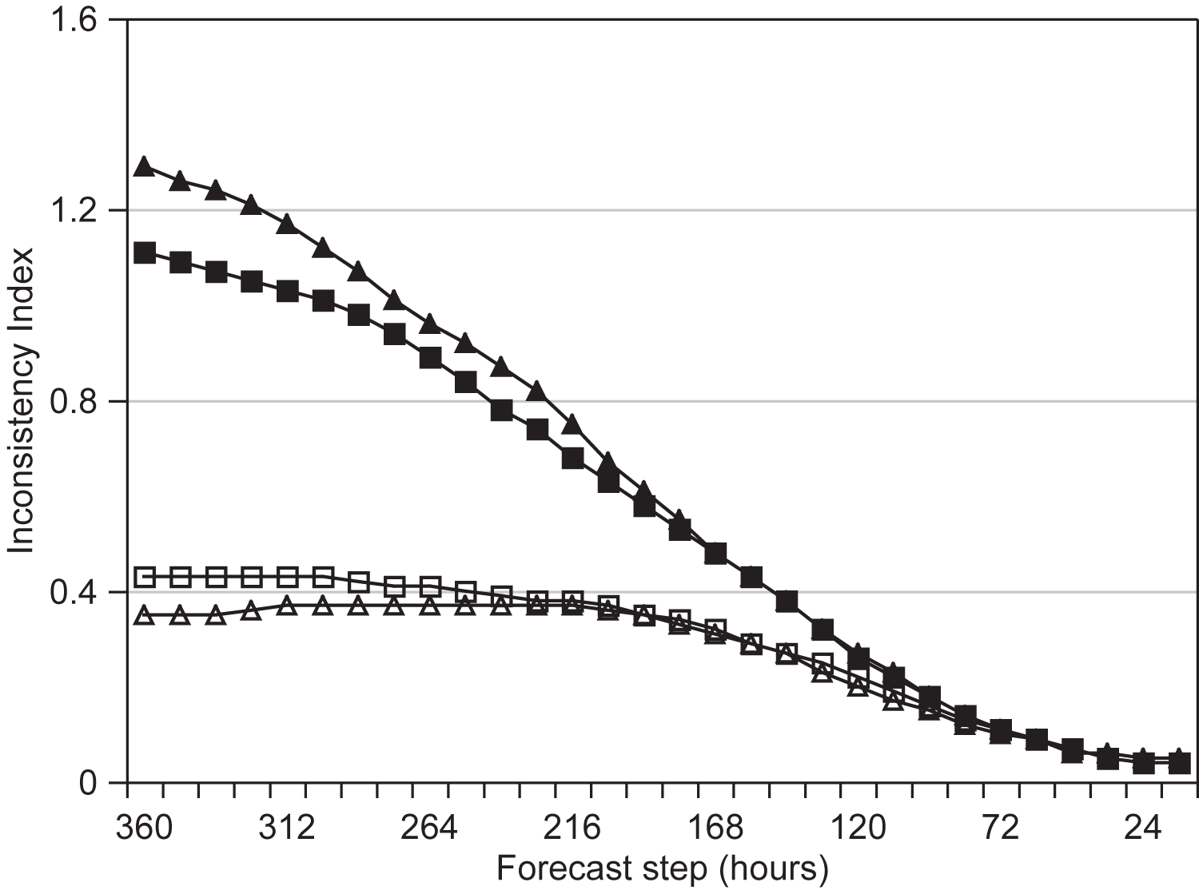
3. Ensembles are more consistent
Ensemble-mean forecasts issued 24-hour apart and valid for the same time are more consistent than corresponding single forecasts.
Ensemble-averaging filters dynamically the unpredictable scales (Zsoter et al 2009).
ECMWF ENS-con
UKMO ENS-con
UKMO ensemble-mean
ECMWF ensemble-mean
Notes:
Another reason why ensemble-based probabilistic forecasts are more valuable than single forecasts is that they are more consistent. This can be seen, e.g., by comparing the consistency of ENS-control and the ensemble-mean forecasts. Ensemble-mean forecasts issued 24-hour apart and valid for the same verification time jump less, i.e. are more consistent, than the corresponding single forecasts. In other words, ensemble-based averaging filters (in a dynamical way) the unpredictable scales: the result is that successive forecasts are more consistent. This was shown, e.g., by Zsoter et al (2009). Note that in the comparison care must be taken in ‘normalizing’ the results to take into account the fact that the ensemble-mean is a smoother field than the control forecast. This figure shows the period-average (18 months, Feb ’07-Aug ’08) inconsistency of forecasts issued 24-hour apart and valid for the same time over North-western Europe for the control and the ensemble-mean Z500 forecasts of the EC- and the UK-ENS.

Slide 39
Outline
The Numerical Weather Prediction (NWP) problem
Sources of forecast uncertainties and chaotic behaviour
Ensemble prediction as a practical tool for probabilistic prediction
The ECMWF medium-range/monthly ensemble
Notes:
So … we have seen how NWP are produced, and the role of models and observations in their generation. We have also discussed why forecasts fail and which are the sources of forecast errors. We then illustrated why a probabilistic approach to NWP is more complete, and how ensemble methods can be used to generate probabilistic forecasts. We now move to the final point of this lecture, and introduce the ECMWF medium-range/monthly ensemble prediction system (ENS).

Slide 40
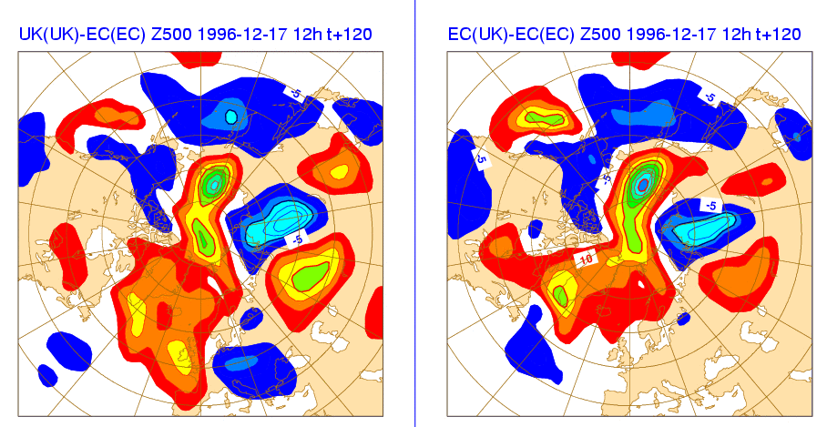
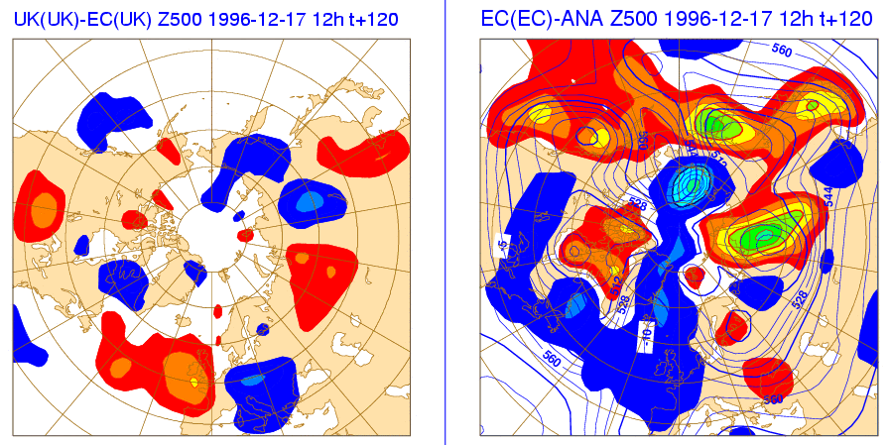
4. Sensitivity to initial and model uncertainty
What is the relative contribution of initial and model uncertainties to forecast error?
Harrison et al (1999) have shown that initial differences explains most of the differences between ECMWF-from-ECMWF-ICs and UKMO-from-UKMO-ICs forecasts.
Notes:
We said earlier that the two sources of forecast errors that we should simulate are initial condition (observation) and model uncertainties. In the early 1990s, when we started to develop ENS, we performed some sensitivity experiments to assess whether one of the two sources was ‘dominant’. Experiments indicated that in the short forecast range (say up to forecast day 3-5), initial uncertainties dominate. Thus, the first version of the ECMWF ENS simulated only the effect of initial uncertainties and assumed that model uncertainties were secondary. This figure shows the relative contribution of initial and model uncertainties to forecast error. Harrison et al (1999) have compared forecasts run with two models (UKMO and ECMWF) starting from either the UKMO or the ECMWF ICs. Results have indicated that initial differences explains most of the differences between ECMWF-from-ECMWF-ICs and UKMO-from-UKMO-ICs forecasts.

Slide 41
4. How should initial uncertainties be defined?
The initial perturbations’ components pointing along the directions of maximum growth amplify most.
If we knew the directions of maximum growth we could estimate the potential maximum forecast error.
t=T2
t=T1
t=0
Notes:
How should we simulate initial uncertainties? Earlier (1980s) work suggested that random perturbations would not lead to ensemble divergence (i.e. the ensemble forecasts would be very close at forecast times). Following work by Lorenz and Farrell, we decided to perturb the initial conditions along the phase-space directions characterized by the fastest amplification rates. As a consequence, the initial PDF is stretched principally along directions of maximum growth. Initial (analysis) error components pointing along a direction of maximum growth amplifies more than a component along another direction (Buizza et al 1997), and thus dominates forecast error growth.

Slide 42
4. Definition of the initial perturbations
To formalize the computation of the directions of maximum growth a metric (inner product) should be defined to ‘measure’ growth.
The metric used at ECMWF in the ensemble system is total energy.
time T
Notes:
How can we formalize the problem of the ‘computation of the fastest growing perturbations’? Firstly, we need to define a ‘metric’ to be used to measure objects, and its associated inner product to be able to compare two of them (e.g. to compute whether they are parallel or orthogonal).

Slide 43
4. Asymptotic and finite-time instabilities
Farrell (1982) studying perturbations’ growth in baroclinic flows noticed that the long-time asymptotic behavior is dominated by normal modes, but that there are other perturbations that amplify more than the most unstable normal mode over a finite time interval.
Farrell (1989) showed that perturbations with the fastest growth over a finite time interval could be identified solving an eigenvalue problem defined by the product of the tangent forward and adjoint model propagators. This result supported earlier conclusions by Lorenz (1965).
Calculations of perturbations growing over finite-time interval intervals have been performed, for example, by Borges & Hartmann (1992) using a barotropic model, Molteni & Palmer (1993) with a quasi-geostrophic 3-level model, and by Buizza et al (1993) with a primitive equation model.
Notes:
Secondly, we need to define the time internal during which we are going to measure the growth. Are we concerned about a finite time interval? Or an asymptotic time?

Slide 44
4. Singular vectors
The problem of the computation of the directions of maximum growth of a time evolving trajectory is solved by an eigenvalue problem:
where:
  E₀ and E are the initial and final time metrics
  L(t,0) is the linear propagator, and L* its adjoint
  The trajectory is time-evolving trajectory
  t is the optimization time interval
Notes:
Once the metric is defined, and the time interval has been set to be finite, we can also assume that initially the perturbations are small, and that during the finite time interval we are concerned, they evolve linearly. This allows us to simplify their evolution equation and write their computation as an eigenvalue problem, of which the eigenvalues and eigenvectors are the solutions.

Slide 45
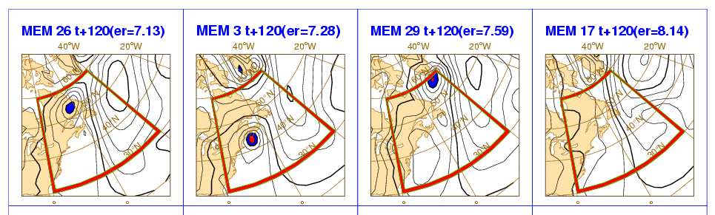
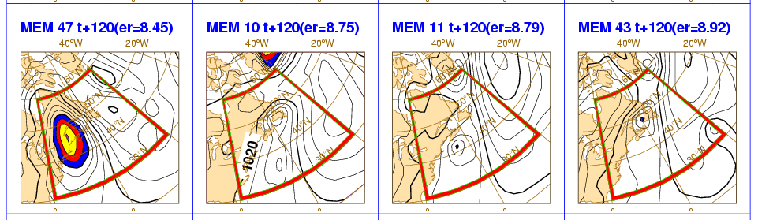
4. The operational ensemble in 2015
ENS includes 51 forecasts with resolution:
T_{L}639L91 (~32km, 91 levels) from day 0 to 10
T_{L}319L91 (~64km, 91 levels) from day 10 to 15 (32 at 00UTC on Mon and Thu).
Initial uncertainties are simulated by adding to the unperturbed analyses a combination of T42L91 singular vectors, computed to optimize total energy growth over a 48h time interval (OTI), and perturbations generated by the ECMWF Ensembles of Data Assimilation (EDA) system.
Model uncertainties are simulated by adding stochastic perturbations to the tendencies due to parameterized physical processes (SPPT and SKEB schemes).
The unperturbed analysis is given by the T_{L}1279L137 4DVAR.
ENS runs daily at 00 and 12 UTC, with a TOA at 0.01 hPa.
NH
SH
TR
Definition of the
perturbed ICs
1
2
…..
50
51
Products
Notes:
This is a schematic of the ECMWF EPS operational in February 2015. ENS also includes a 5-member re-forecast suite, with forecasts run once a week, up to 32 days, for the past 20 years. The re-forecasts are used to generate some ENS products (e.g. the Extreme Forecast Index) and to assess predictability.

Slide 46
4. Major changes of ENS configuration (updated Apr 2015)
Since 1992 the ENS configuration has been modified significantly several times.
 | Description | Singular Vectors's characteristics |  |  |  |  |  |  |  | Forecast characteristics
 |  | HRES | VRES | OTI | Area | past | future | sampl |  | HRES | VRES | Tend | # | Mod Unc | Coupling | refc suite
Dec 1992 | Oper Impl | T21 | L19 | 36h | globe | NO | SVINI | simm |  | T63 | L19 | 10d | 33 | NO | NO | NO
Feb 1993 | SV LPO | " | " | " | NHx | " | " | " |  | " | " | " | " | " | " | "
Aug 1994 | SV OTI | " | " | 48h | " | " | " | " |  | " | " | " | " | " | " | "
Mar 1995 | SV hor resol | T42 | " | " | " | " | " | " |  | " | " | " | " | " | " | "
Mar 1996 | NH+SH SV | " | " | " | (NH+SH)x | " | " | " |  | " | " | " | " | " | " | "
Dec 1996 | resol/mem | " | L31 | " | " | " | " | " |  | TL159 | L31 | " | 51 | " | " | "
Mar 1998 | EVO SV | " | " | " | " | SVEVO | " | " |  | " | " | " | " | " | " | "
Oct 1998 | Stoch sch SPPT | " | " | " | " | " | " | " |  | " | " | " | " | STP | " | "
Oct 1999 | vert resol | " | L40 | " | " | " | " | " |  | " | L40 | " | " | " | " | "
Nov 2000 | FC hor resol | " | " | " | " | " | " | " |  | TL255 | " | " | " | " | " | "
Jan 2002 | TC SVs | " | " | " | (NH+SH)x+TC | " | " | " |  | " | " | " | " | " | " | "
Sep 2004 | sampling | " | " | " | " | " | " | Gauss |  | " | " | " | " | " | " | "
Jun 2005 | rev sampl | " | " | " | " | " | " | " |  | " | " | " | " | " | " | "
Feb 2006 | resolution | " | L62 | " | " | " | " | " |  | TL399 | L62 | " | " | " | " | "
Sep 2006 | VAREPS | " | " | " | " | " | " | " |  | TL399(0-10) / TL255(10-15) | " | 15d | " | " | " | "
Mar 2008 | VAREPS-mon | " | " | " | " | " | " | " |  | " | " | 15d/32d | " | " | HOPE from d10 | 1*5*18y
Sep 2009 | Rev SPPT | " | " | " | " | " | " | " |  | " | " | " | " | " | " | "
Jan 2010 | hor resol | " | " | " | " | " | " | " |  | TL639(0-10) / TL319(10-15) | " | " | " | revSTP | " | "
Jun 2010 | EDA EPS | " | " | " | " | 10*EDA | " | " |  | " | " | " | " | " | " | "
Nov 2010 | Rev Stoch scheme | " | " | " | " | " | " | " |  | TL639(0-10) / TL319(10-15) | " | 15d/32d | " | revSTP+BS | " | "
Nov 2011 | New ocean model | " | " | " | " | " | " | " |  | " | " | " | " | " | NEMO from d10 | "
Jun 2012 | Rev EDA-pert & refc suite | " | " | " | " | " | " | " |  | " | " | " | " | " | " | 1*5*20y
Nov 2013 | vert resol & coupling from d0 | " | L91 | " | " | 25*EDA | " | " |  | TL639(0-10) / TL319(10-15) | L91 | 15d/32d | " | " | NEMO from d0 | "
May 2015 | Extension to 46d and REFC suite to 22m | T42 | L91 | 48h | (NH+SH)x+TC | 25*EDA | SVINI | Gauss |  | TL639(0-10) / TL319(10-15) | L91 | 15d/46d | 51 | revSTP+BS | NEMO from d0 | 2*11*20y
Notes:
Since 1992, many model cycles (~ 60) were implemented, and the ENS configuration has been modified significantly several times.
Since November 2013, the ENS key characteristics are:
Model cycle 41r1 (since Sep 2014);
SVs computed at T42L91, with a 48h OTI, over NH, SH and up to six tropical regions (where tropical storms have been detected);
EDA with 25 members, with a T_{L}399L137 resolution of the outer loops;
Initial perturbations generated by combining EDA-based perturbations (to represent errors that have been growing during the assimilation period) and SVs (to represent the dominant errors that can grow during the first 48h of the forecast);
Unperturbed ICs (the one of the ENS-control) defined by the T_{L}1279L137 4DVAR, interpolated to the ENS resolution;
ENS resolution: T_{L}639L91 up to day 10, and T_{L}319L91 to day 15 every day, and to 46 days twice a week;
ENS members: 51 members, run twice daily up to 15 days (up to 46 days on Mon and Thu at 00UTC);
Model uncertainties simulated using two stochastic schemes (the revised SPPT and the stochastic back scatter);
Coupled to a dynamical ocean (NEMO, with 1 degree resolution and 45 vertical layers) from initial time;
Ocean ICs: from a 5-member NEMOVAR analysis/reanalysis stream;
ENS reforecast suite: 11 members run twice a week (on Mon and Thu at 00UTC), covering the past 20 years (starting from ERA-Interim atmosphere and ORAS4 ocean).

Slide 47
Conclusion
A complete solution of the weather prediction problem can be stated in terms of an appropriate probability density function (PDF). Ensemble prediction is the only feasible method to predict the PDF using dynamical forecasts beyond the range of linear growth.
Initial and model uncertainties are the main sources of error growth. Initial uncertainties dominate in the short range. Predictability is flow dependent.
The initial error components along the directions of maximum growth contribute most to forecast error growth. These directions can be identified by the leading singular vectors, computed solving an eigenvalue problem.
ENS has changed many times since 1992. Now it includes 51 15-day forecasts twice a day (00-12UTC), which are extended to 32 days twice a week (00UTC Mon/Thu). Each ENS ensemble member uses a coupled ocean-atmosphere forecasts with a T_{L}639v319 variable resolution in the atmosphere and 91 vertical levels, and a 1-degree resolution and 42 vertical levels in the ocean.
Notes:
Concluding, I hope it is now clearer why we should think of the NWP problem in probabilistic terms, which are the main sources of forecast error, and why ensemble methods can be used to provide a better, more complete approach to numerical weather prediction. You are invited to look at the published literature (see some references below) for more detailed information.
Please contact me if you want more information.

Slide 48
Acknowledgements
The success of the ECMWF EPS is the result of the continuous work of ECMWF staff, consultants and visitors who had continuously improved the ECMWF model, analysis, diagnostic and technical systems, and of very successful collaborations with its member states and other international institutions. The work of all contributors is acknowledged.

Slide 49
Bibliography
On optimal perturbations and singular vectors
Borges, M., & Hartmann, D. L., 1992: Barotropic instability and optimal perturbations of observed non-zonal flows. J. Atmos. Sci., 49, 335-354.
Buizza, R., & Palmer, T. N., 1995: The singular vector structure of the atmospheric general circulation. J. Atmos. Sci., 52, 1434-1456.
Buizza, R., Tribbia, J., Molteni, F., & Palmer, T. N., 1993: Computation of optimal unstable structures for a numerical weather prediction model. Tellus, 45A, 388-407.
Coutinho, M. M., Hoskins, B. J., & Buizza, R., 2004: The influence of physical processes on extratropical singular vectors. J. Atmos. Sci., 61, 195-209.
Farrell, B. F., 1982: The initial growth of disturbances in a baroclinic flow. J. Atmos. Sci., 39, 1663-1686.
Farrell, B. F., 1989: Optimal excitation of baroclinic waves. J. Atmos. Sci., 46, 1193-1206.
Hoskins, B. J., Buizza, R., & Badger, J., 2000: The nature of singular vector growth and structure. Q. J. R. Meteorol. Soc., 126, 1565-1580.
Lorenz, E., 1965: A study of the predictability of a 28-variable atmospheric model. Tellus, 17, 321-333.
Molteni, F., & Palmer, T. N., 1993: Predictability and finite-time instability of the northern winter circulation. Q. J. R. Meteorol. Soc., 119, 1088-1097.

Slide 50
Bibliography
On normal modes and baroclinic instability
Birkoff & Rota, 1969: Ordinary differential equations. J. Wiley & sons, 366 pg.
Charney, J. G., 1947: The dynamics of long waves in a baroclinic westerly current. J. Meteorol., 4, 135-162.
Eady. E. T., 1949: long waves and cyclone waves. Tellus, 1, 33-52.
On SVs and predictability studies
Buizza, R., Gelaro, R., Molteni, F., & Palmer, T. N., 1997: The impact of increased resolution on predictability studies with singular vectors. Q. J. R. Meteorol. Soc., 123, 1007-1033.
Cardinali, C., & Buizza, R., 2003: Forecast skill of targeted observations: a singular-vector-based diagnostic. J. Atmos. Sci., 60, 1927-1940.
Gelaro, R., Buizza, R., Palmer, T. N., & Klinker, E., 1998: Sensitivity analysis of forecast errors and the construction of optimal perturbations using singular vectors. J. Atmos. Sci., 55, 6, 1012-1037.
Harrison, M. S. J., Palmer, T. N., Richardson, D. S., & Buizza, R., 1999: Analysis and model dependencies in medium-range ensembles: two transplant case studies. Q. J. R. Meteorol. Soc., 126, 2487-2515.

Slide 51
Bibliography
On the validity of the linear approximation
Buizza, R., 1995: Optimal perturbation time evolution and sensitivity of ensemble prediction to perturbation amplitude. Q. J. R. Meteorol. Soc., 121, 1705-1738.
Gilmour, I., Smith, L. A., & Buizza, R., 2001: On the duration of the linear regime: is 24 hours a long time in weather forecasting? J. Atmos. Sci., 58, 3525-3539 (also EC TM 328).
On the ECMWF Ensemble Prediction System
Buizza, R., & Hollingsworth, A., 2002: Storm prediction over Europe using the ECMWF Ensemble Prediction System. Meteorol. Appl., 9, 1-17.
Buizza, R., Bidlot, J.-R., Wedi, N., Fuentes, M., Hamrud, M., Holt, G., & Vitart, F., 2007: The new ECMWF VAREPS. Q. J. Roy. Meteorol. Soc., 133, 681-695 (also EC TM 499).
Buizza, R., 2008: Comparison of a 51-member low-resolution (TL399L62) ensemble with a 6-member high-resolution (TL799L91) lagged-forecast ensemble. Mon. Wea. Rev., 136, 3343-3362 (also EC TM 559).
Leutbecher, M. 2005: On ensemble prediction using singular vectors started from forecasts. Mon. Wea. Rev., 133, 3038–3046 (also EC TM 462).
Leutbecher, M. & T.N. Palmer, 2008: Ensemble forecasting. J. Comp. Phys., 227, 3515-3539 (also EC TM 514).

Slide 52
Bibliography
Molteni, F., Buizza, R., Palmer, T. N., & Petroliagis, T., 1996: The new ECMWF ensemble prediction system: methodology and validation. Q. J. R. Meteorol. Soc., 122, 73-119.
Palmer, T N, Buizza, R., Leutbecher, M., Hagedorn, R., Jung, T., Rodwell, M, Virat, F., Berner, J., Hagel, E., Lawrence, A., Pappenberger, F., Park, Y.-Y., van Bremen, L., Gilmour, I., & Smith, L., 2007: The ECMWF Ensemble Prediction System: recent and on-going developments. A paper presented at the 36th Session of the ECMWF Scientific Advisory Committee (also EC TM 540).
Palmer, T. N., Buizza, R., Doblas-Reyes, F., Jung, T., Leutbecher, M., Shutts, G. J., Steinheimer M., & Weisheimer, A., 2009: Stochastic parametrization and model uncertainty. ECMWF RD TM 598, Shinfield Park, Reading RG2-9AX, UK, pp. 42.
Vitart, F., Buizza, R., Alonso Balmaseda, M., Balsamo, G., Bidlot, J. R., Bonet, A., Fuentes, M., Hofstadler, A., Molteni, F., & Palmer, T. N., 2008: The new VAREPS-monthly forecasting system: a first step towards seamless prediction. Q. J. Roy. Meteorol. Soc., 134, 1789-1799.
Vitart, F., & Molteni, F., 2009: Simulation of the MJO and its teleconnections in an ensemble of 46-day EPS hindcasts. ECMWF RD TM 597, Shinfield Park, Reading RG2-9AX, UK, pp. 60.
Zsoter, E., Buizza, R., & Richardson, D., 2009: 'Jumpiness' of the ECMWF and UK Met Office EPS control and ensemble-mean forecasts'. Mon. Wea. Rev., 137, 3823-3836.

Slide 53
Bibliography
On SVs and targeting adaptive observations
Buizza, R., & Montani, A., 1999: Targeting observations using singular vectors. J. Atmos. Sci., 56, 2965-2985 (also EC TM 286).
Palmer, T. N., Gelaro, R., Barkmeijer, J., & Buizza, R., 1998: Singular vectors, metrics, and adaptive observations. J. Atmos. Sci., 55, 6, 633-653.
Majumdar, S J, Aberson, S D, Bishop, C H, Buizza, R, Peng, M, & Reynolds, C, 2006: A comparison of adaptive observing guidance for Atlantic tropical cyclones. Mon. Wea. Rev., 134, 2354-2372 (also ECMWF TM 482).
Reynolds, C, Peng, M, Majumdar, S J, Aberson, S D, Bishop, C H, & Buizza, R, 2007: Interpretation of adaptive observing guidance for Atlantic tropical cyclones. Mon. Wea. Rev., 135, 4006-4029.
Kelly, G., Thepaut, J.-N., Buizza, R., & Cardinali, C., 2007: The value of observations - Part I: data denial experiments for the Atlantic and the Pacific. Q. J. R. Meteorol. Soc., 133, 1803-1815 (also ECMWF TM 511).
Buizza, R., Cardinali, C., Kelly, G., & Thepaut, J.-N., 2007: The value of targeted observations - Part II: the value of observations taken in singular vectors-based target areas. Q. J. R. Meteorol. Soc., 133, 1817-1832 (also ECMWF TM 512).
Cardinali, C., Buizza, R., Kelly, G., Shapiro, M., & Thepaut, J.-N., 2007: The value of observations - Part III: influence of weather regimes on targeting. Q. J. R. Meteorol. Soc., 133, 1833-1842 (also ECMWF TM 513).

