Slide 1
Observation errors
Niels Bormann
(n.bormann@ecmwf.int)

Slide 2
Outline of lecture
What are observation errors?
Estimating observation errors
Specification of observation errors in practice
Observation error correlations
Summary

Slide 3
Outline of lecture
What are observation errors?
Estimating observation errors
Specification of observation errors in practice
Observation error correlations
Summary

Slide 4
Observation error and the cost function
Every observation has an error vs the truth:
  Systematic error
    Needs to be removed through bias correction (see separate lecture)
  Random error
    Mostly assumed Gaussian; described by observation error covariance “R” in the observation cost function:
R is a matrix, often specified through the square root of the diagonals (“σ_{O}”) and a correlation matrix (which can be the identity matrix).

Slide 5
Role of the observation error
R and B together determine the weight of an observation in the assimilation.
In the linear case, the minimum of the cost function can be found at x_{a}:
  “Large” observation error → smaller increment, analysis draws less closely to the observations
  “Small” observation error → larger increment, analysis draws more closely to the observations
Increment
Departure, innovation,
“o-b”

Slide 6
Contributions to observation error
Measurement error
  E.g., instrument noise for satellite radiances
Forward model (observation operator) error
  E.g., radiative transfer error
Representativeness error
  E.g., point measurement vs model representation
Quality control error
  E.g., error due to the cloud detection scheme missing some clouds in clear-sky radiance assimilation

Slide 7
Situation-dependence of observation error
Observation errors can be situation-dependent, especially through situation-dependence of the forward model error.
Examples:
  Cloud/rain-affected radiances: Representativeness error is much larger in cloudy/rainy regions than in clear-sky regions
  Effect of height assignment error for Atmospheric Motion Vectors:
Strong shear – larger wind error due to height assignment error
Height
Low shear – small wind error due to height assignment error
Wind

Slide 8
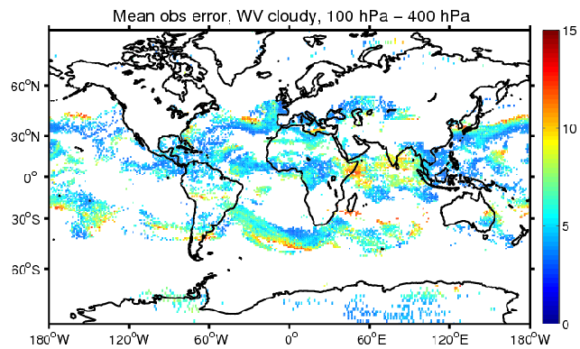
Situation-dependence of observation error
Observation errors can be situation-dependent, especially through situation-dependence of the forward model error.
Examples:
  Cloud/rain-affected radiances: Representativeness error is much larger in cloudy/rainy regions than in clear-sky regions
  Effect of height assignment error for Atmospheric Motion Vectors:

Slide 9
Current observation error specification for satellite data in the ECMWF system
Globally constant, dependent on channel only:
  ATMS, HIRS, AIRS, IASI, CrIS
Globally constant fraction, dependent on impact parameter:
  GPS-RO
Situation dependent:
  AMSU-A: dependent on satellite, channel, and RT-model contribution
  MW imagers, MHS: dependent on channel and cloud amount
  AMVs: dependent on level and shear (and satellite, channel, height assignment method)
Error correlations are neglected.
  To be changed soon for IASI and CrIS

Slide 10
Outline of lecture
What are observation errors?
Estimating observation errors
Specification of observation errors in practice
Observation error correlations
Summary

Slide 11
How can we estimate observation errors?
Several methods exist, broadly categorised as:
  Error inventory:
    Based on considering all contributions to the error/uncertainty
  Diagnostics with collocated observations, e.g.:
    Hollingsworth/Lönnberg on collocated observations
    Triple-collocations
  Diagnostics based on output from DA systems, e.g.:
    O-b statistics
    Hollingsworth/Lönnberg
    Desroziers et al 2006
    Methods that rely on an explicit estimate of B
  Adjoint-based methods

Slide 12
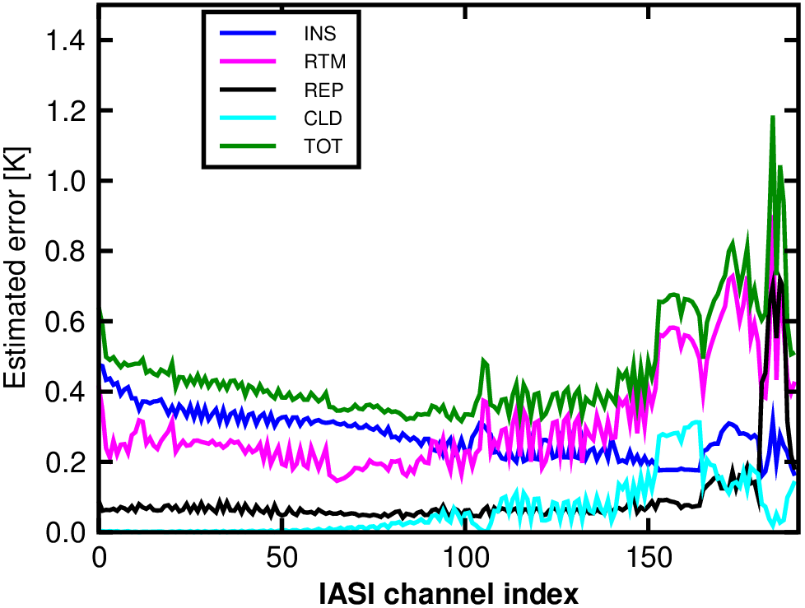
Error inventory
Estimate the error from all uncertainty contributions.
Example: error inventory for IASI
Instrument noise (from data providers)
Radiative transfer error (difficult…)
Spatial representativeness error
Cloud detection error
Total error
(Courtesy Hyoung-Wook Chun,
Reima Eresmaa)

Slide 13
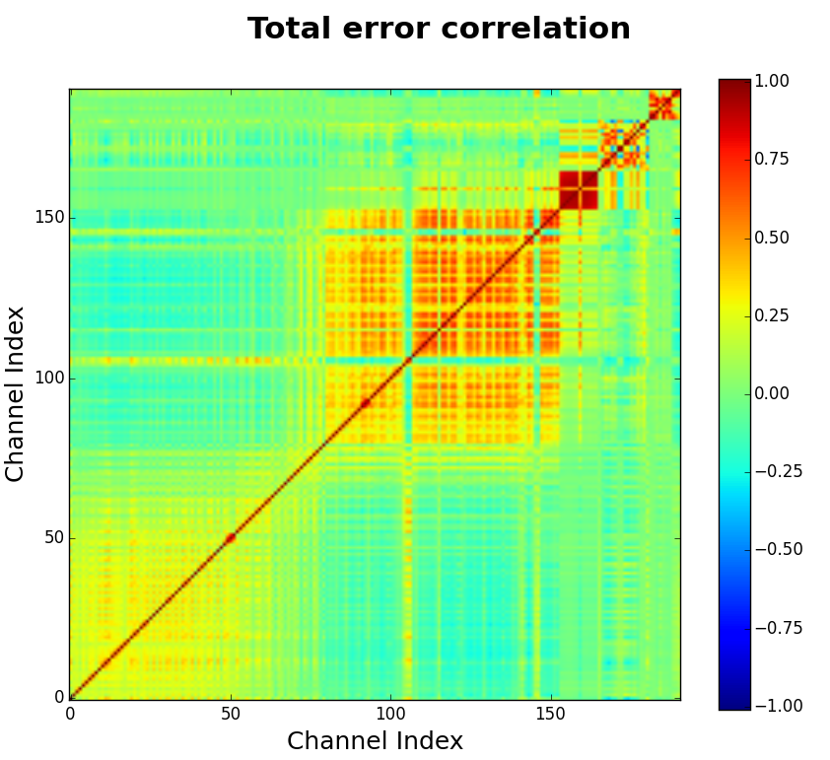
Error inventory
Estimate the error from all uncertainty contributions.
Example: error inventory for IASI
Very useful, but how realistic is each estimate?

Slide 14
How can we estimate observation errors?
Several methods exist, broadly categorised as:
  Error inventory:
    Based on considering all contributions to the error/uncertainty
  Diagnostics with collocated observations, e.g.:
    Hollingsworth/Lönnberg on collocated observations
    Triple-collocations
  Diagnostics based on output from DA systems, e.g.:
    O-b statistics
    Hollingsworth/Lönnberg
    Desroziers et al 2006
    Methods that rely on an explicit estimate of B
  Adjoint-based methods

Slide 15
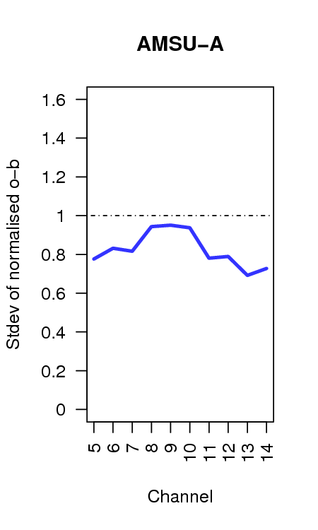
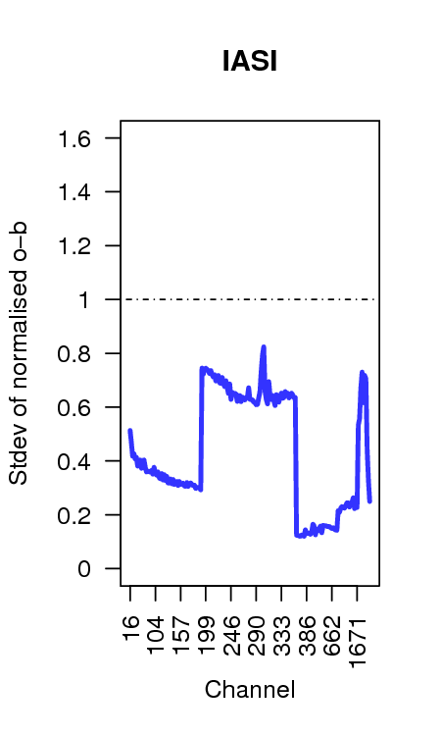
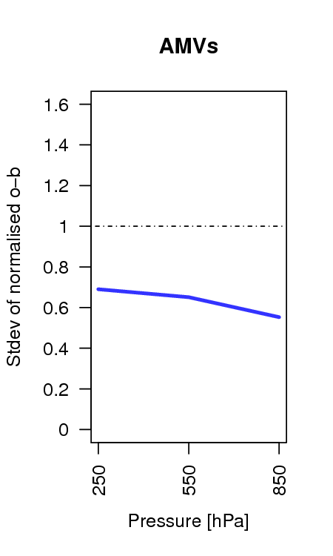
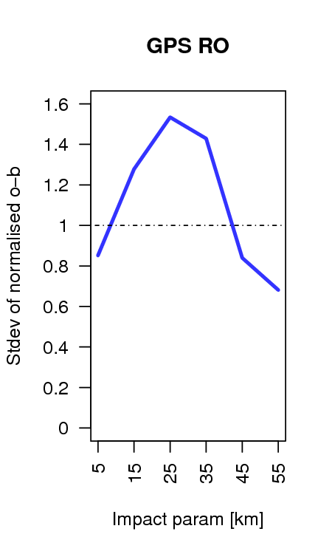
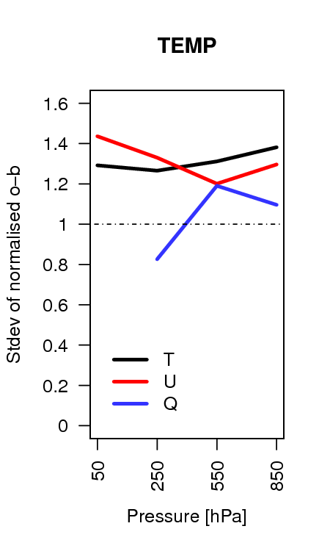
Basic departure-based diagnostics
If observation errors and background errors are uncorrelated then:
In this case, statistics of background departures give an upper bound for the true observation error characteristics.
  Standard deviations of background departures normalised by the assumed observation error used in the ECMWF system:

Slide 16
Departure-based diagnostics
Standard deviations of o-b give information on observation and background error combined.
Departure-based diagnostics try to separate contributions from background and observation errors by making assumptions (which may or may not be true). Such as:
  Assume we know the background error characteristics → remove B
  Assume a certain structure of the errors → Hollingsworth/Lönnberg
  Assume weights used in the assimilation system are accurate → Desroziers diagnostic
  All diagnostics in common use assume that the error in the observations and background are uncorrelated.

Slide 17
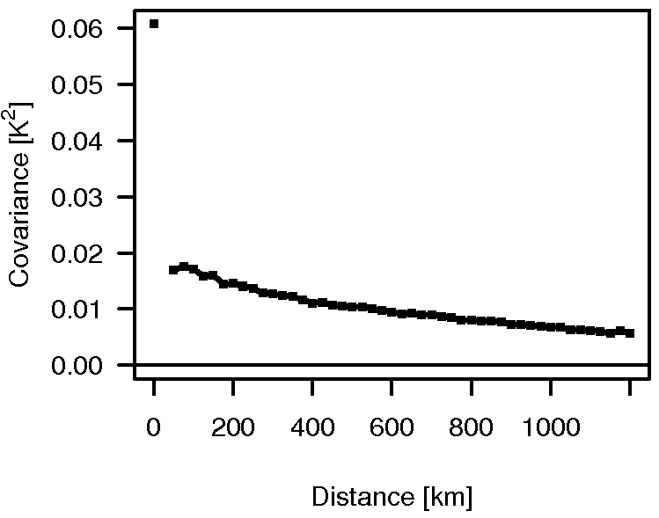
Observation error diagnostics:
Hollingsworth/Loennberg method (I)
Based on a large database of pairs of departures.
Basic assumption:
  Background errors are spatially correlated, whereas observation errors are not.
  This allows to separate the two contributions to the variances of background departures:
Spatially uncorrelated variance
→ Observation error
Covariance of
O—B [K²]
Spatially correlated variance
→ Background error
Distance between
observation pairs [km]

Slide 18
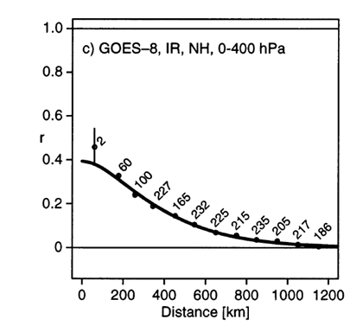
Observation error diagnostics:
Hollingsworth/Loennberg method (II)
Drawback: Not reliable when observation errors are spatially correlated.
Similar methods have been used with differences between two sets of collocated observations:
  Example: AMVs collocated with radiosondes (Bormann et al 2003).
    Radiosonde error assumed spatially uncorrelated.

Slide 19
Observation error diagnostics:
Desroziers diagnostic (I)
Basic assumptions:
  Assimilation process can be adequately described through linear estimation theory.
  Weights used in the assimilation system are consistent with true observation and background errors.
Then the following relationship can be derived:
with (analysis departure)
(background departure)
(see Desroziers et al. 2005, QJRMS)
Consistency diagnostic for the specification of R.

Slide 20
Observation error diagnostics:
Desroziers diagnostic (II)
Very easy to use.
Can be applied iteratively.
For real assimilation systems, the applicability of the diagnostic for estimating observation errors is still subject of research.

Slide 21
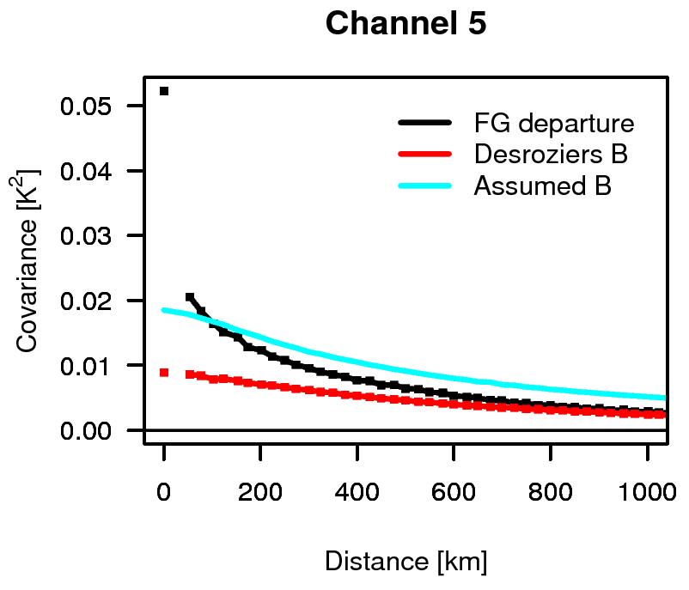
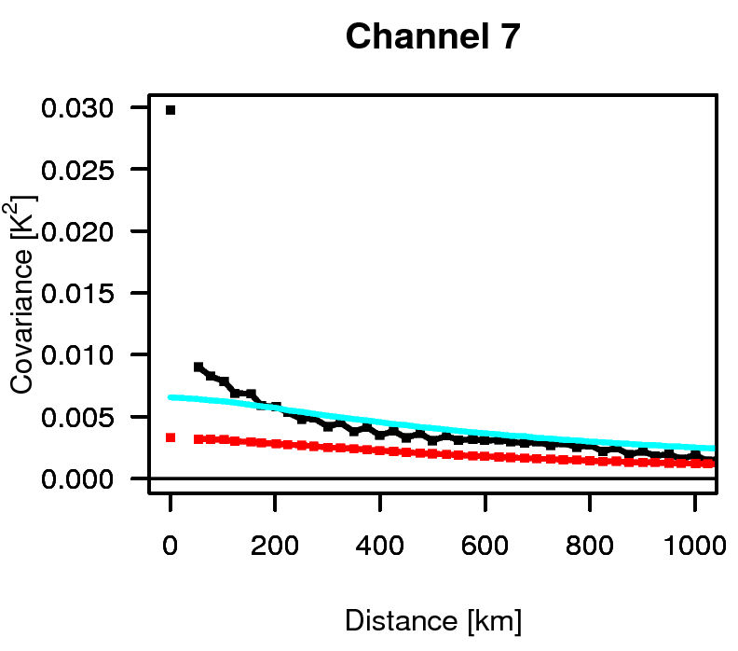
Examples of observation error diagnostics: AMSU-A
Spatial covariances of background departures:
(See also Bormann and Bauer 2010)

Slide 22
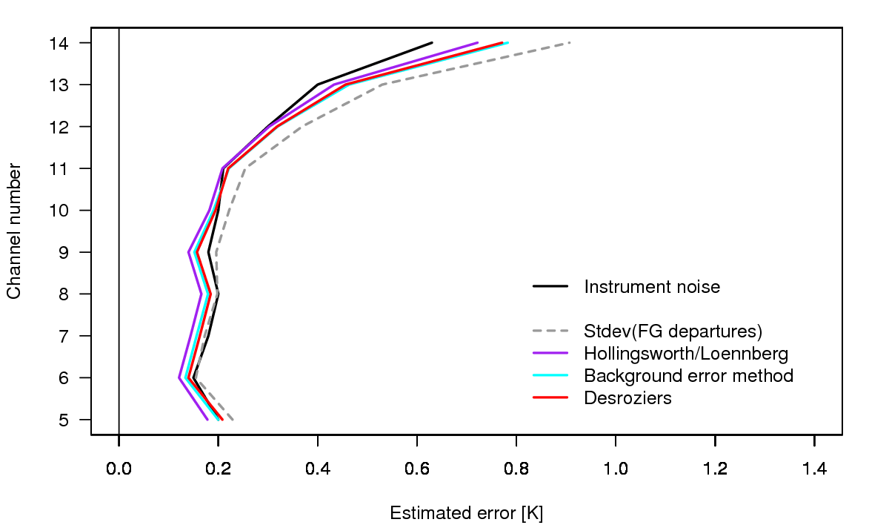
Examples of observation error diagnostics: AMSU-A
Diagnostics for σ_{O}

Slide 23
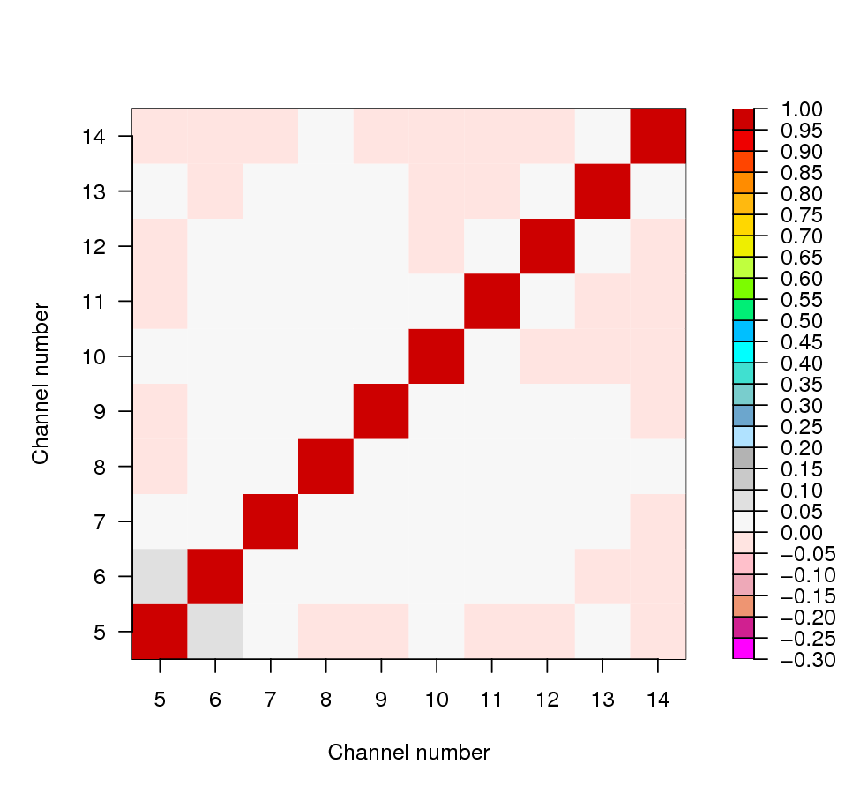
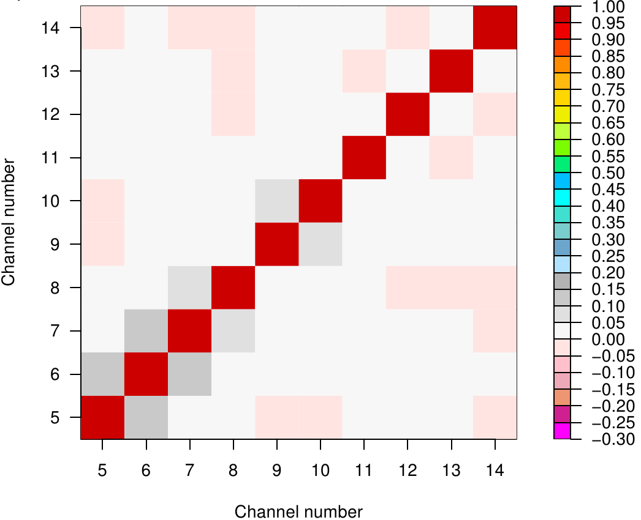
Examples of observation error diagnostics: AMSU-A
Inter-channel error correlations:
Hollingworth/Loennberg
Desroziers

Slide 24
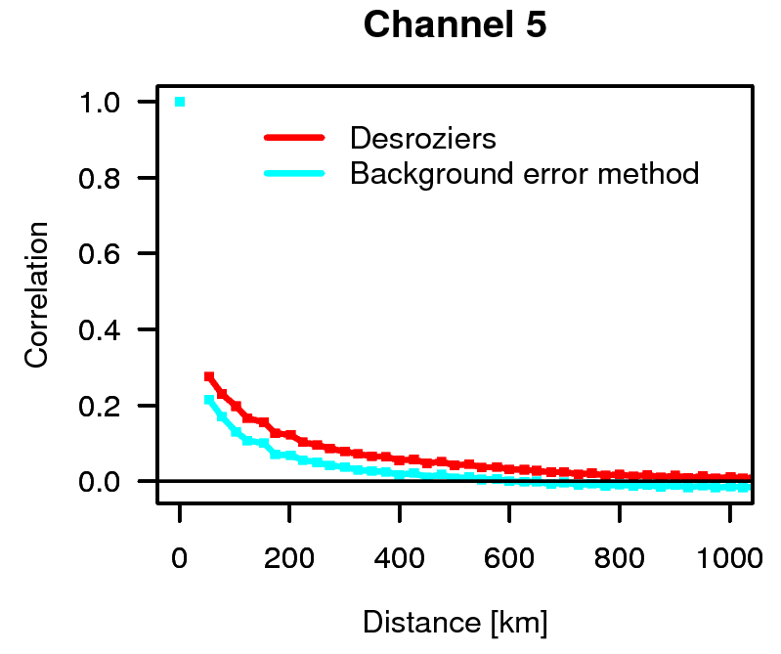
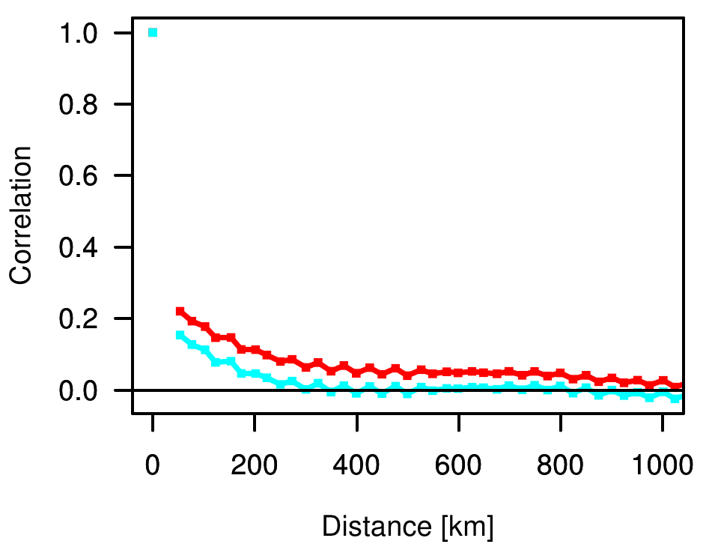
Examples of observation error diagnostics: AMSU-A
Spatial error correlations:
Channel 5
Channel 7

Slide 25
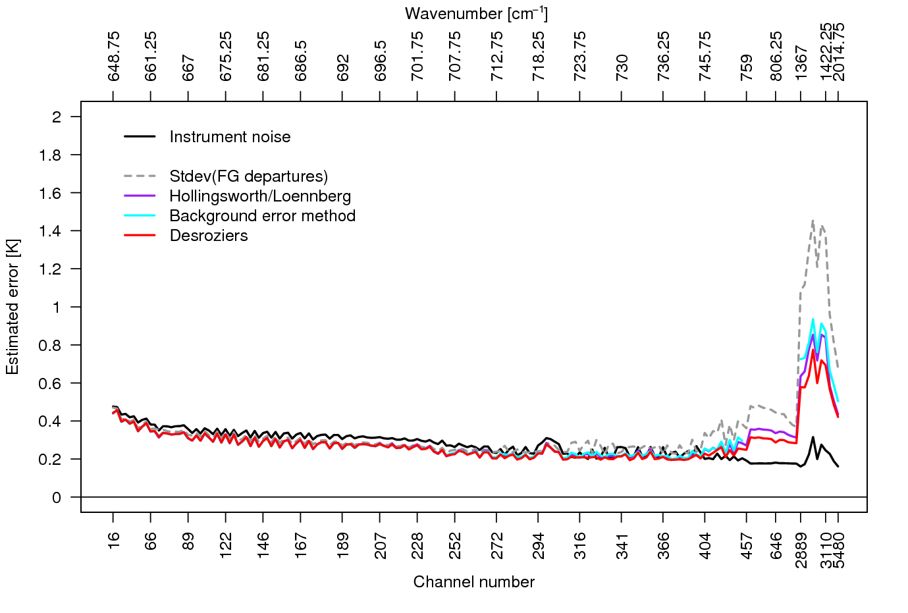
Examples of observation error diagnostics: IASI
Diagnostics for σ_{O}
Temperature sounding
LW
Window
WV

Slide 26
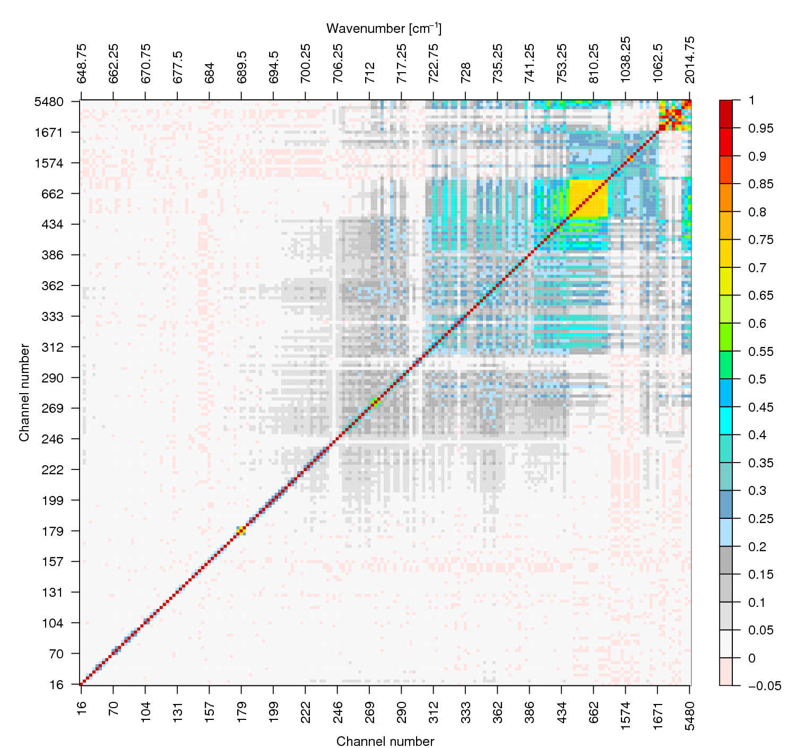
Examples:
IASI
Inter-channel error correlations:

Slide 27
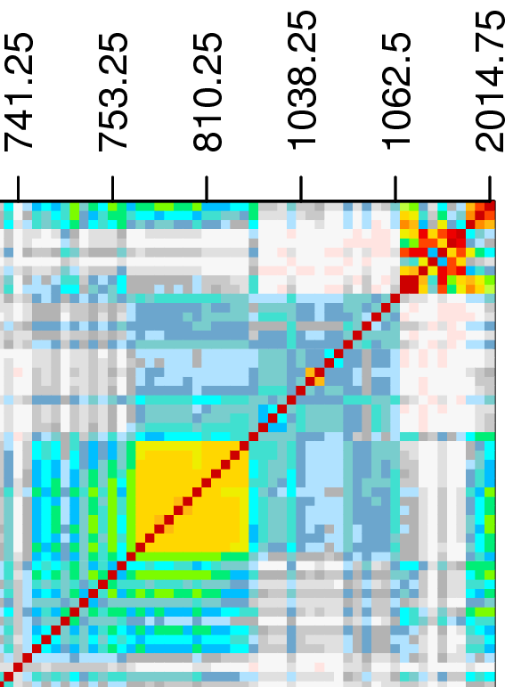
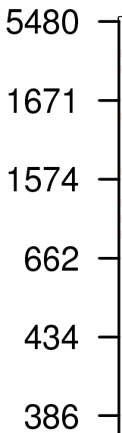
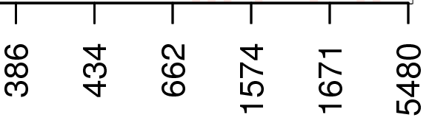
Examples:
IASI
Inter-channel error correlations:
Humidity
Ozone

Slide 28
Pitfalls of observation error diagnostics
Observation error diagnostics give useful estimates, but beware of mis-leading results when assumptions are violated:
  Observation and background errors may not be uncorrelated.
    E.g., quality control can introduce such error correlations.
  Assumed background error characteristics or weights used in the assimilation system may not be correct.
Diagnostics do not tell you where the error comes from.
  Additional physical understanding of the error sources may be beneficial → error inventory.

Slide 29
Outline of lecture
What are observation errors?
Estimating observation errors
Specification of observation errors in practice
Observation error correlations
Summary

Slide 30
How to specify observation errors in practice?
Estimates of the observation error characteristics provide guidance for observation error specification in DA, including:
  Relative size of observation and background errors:
  Presence of observation error correlations.
But: Observation errors specified in assimilation systems are often simplified:
  Observation error covariance is often assumed to be diagonal or globally constant.
  Assumed observation errors may need adjustments compared to estimated ones.

Slide 31
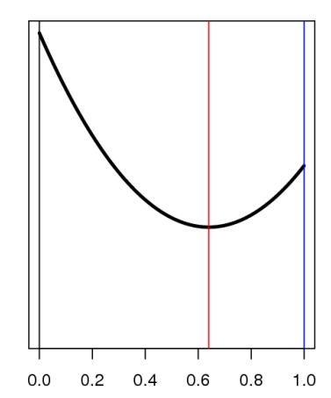
Too large assumed observation errors tend to be safer than too small ones.
Why?
σ_{o}²
Consider linear combination of two estimates x_{b} and y:
The error variance of the linear combination is:
σ_{b}²
Error variance of estimate σ_{a}²
Optimal weighting:
α
Danger zone: Too small assumed σ_{o} will lead to an analysis worse than the background when the (true) σ_{o}> σ_{b}.
Assuming an inflated σ_{o} will never result in deterioration.

Slide 32
Observation errors:
Specifying the correct observation error produces an optimal analysis with minimum error.
analysis
error
background error
optimal
analysis
true OBS
error
specified OBS
error

Slide 33
What to do when there are error correlations?
Thinning
  Ie, reduce observation density so that error correlations are not relevant.
Error inflation
  Ie, use diagonal R with larger σ_{O} than diagnostics suggest.
Take error correlations into account in the assimilation

Slide 34
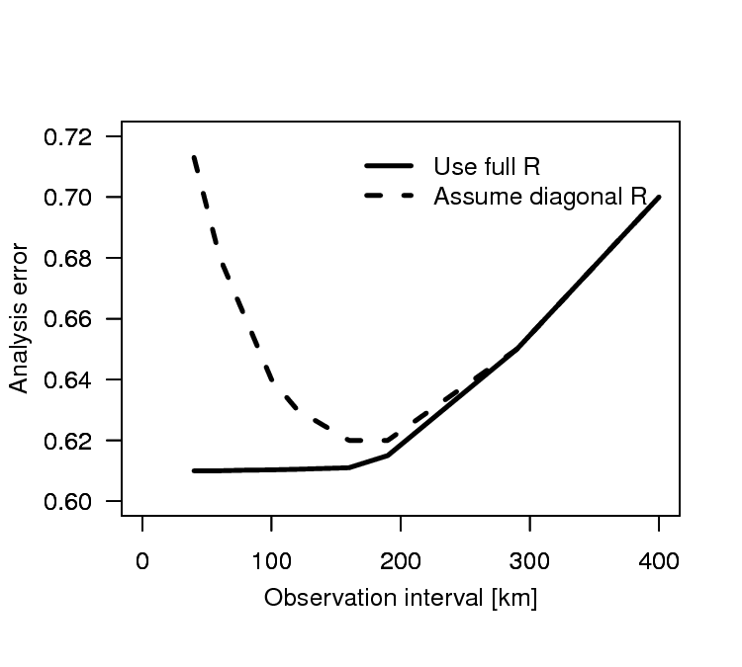
Spatial error correlations and thinning
If the observations have spatial error correlations, but these are neglected in the assimilation system, assimilating these observations too densely can have a negative effect.
Practical solution: Thinning, ie select one observation within a “thinning box”.
Using fewer observations gives better results!
See Liu and Rabier (2002), QJRMS: “Optimal” thinning when r ≈ 0.15-0.2

Slide 35

Example: AMSU-A
After thinning to 120 km, error diagnostics suggest little correlations…
Inter-channel error correlations:
Spatial error correlations for channel 7:

Slide 36
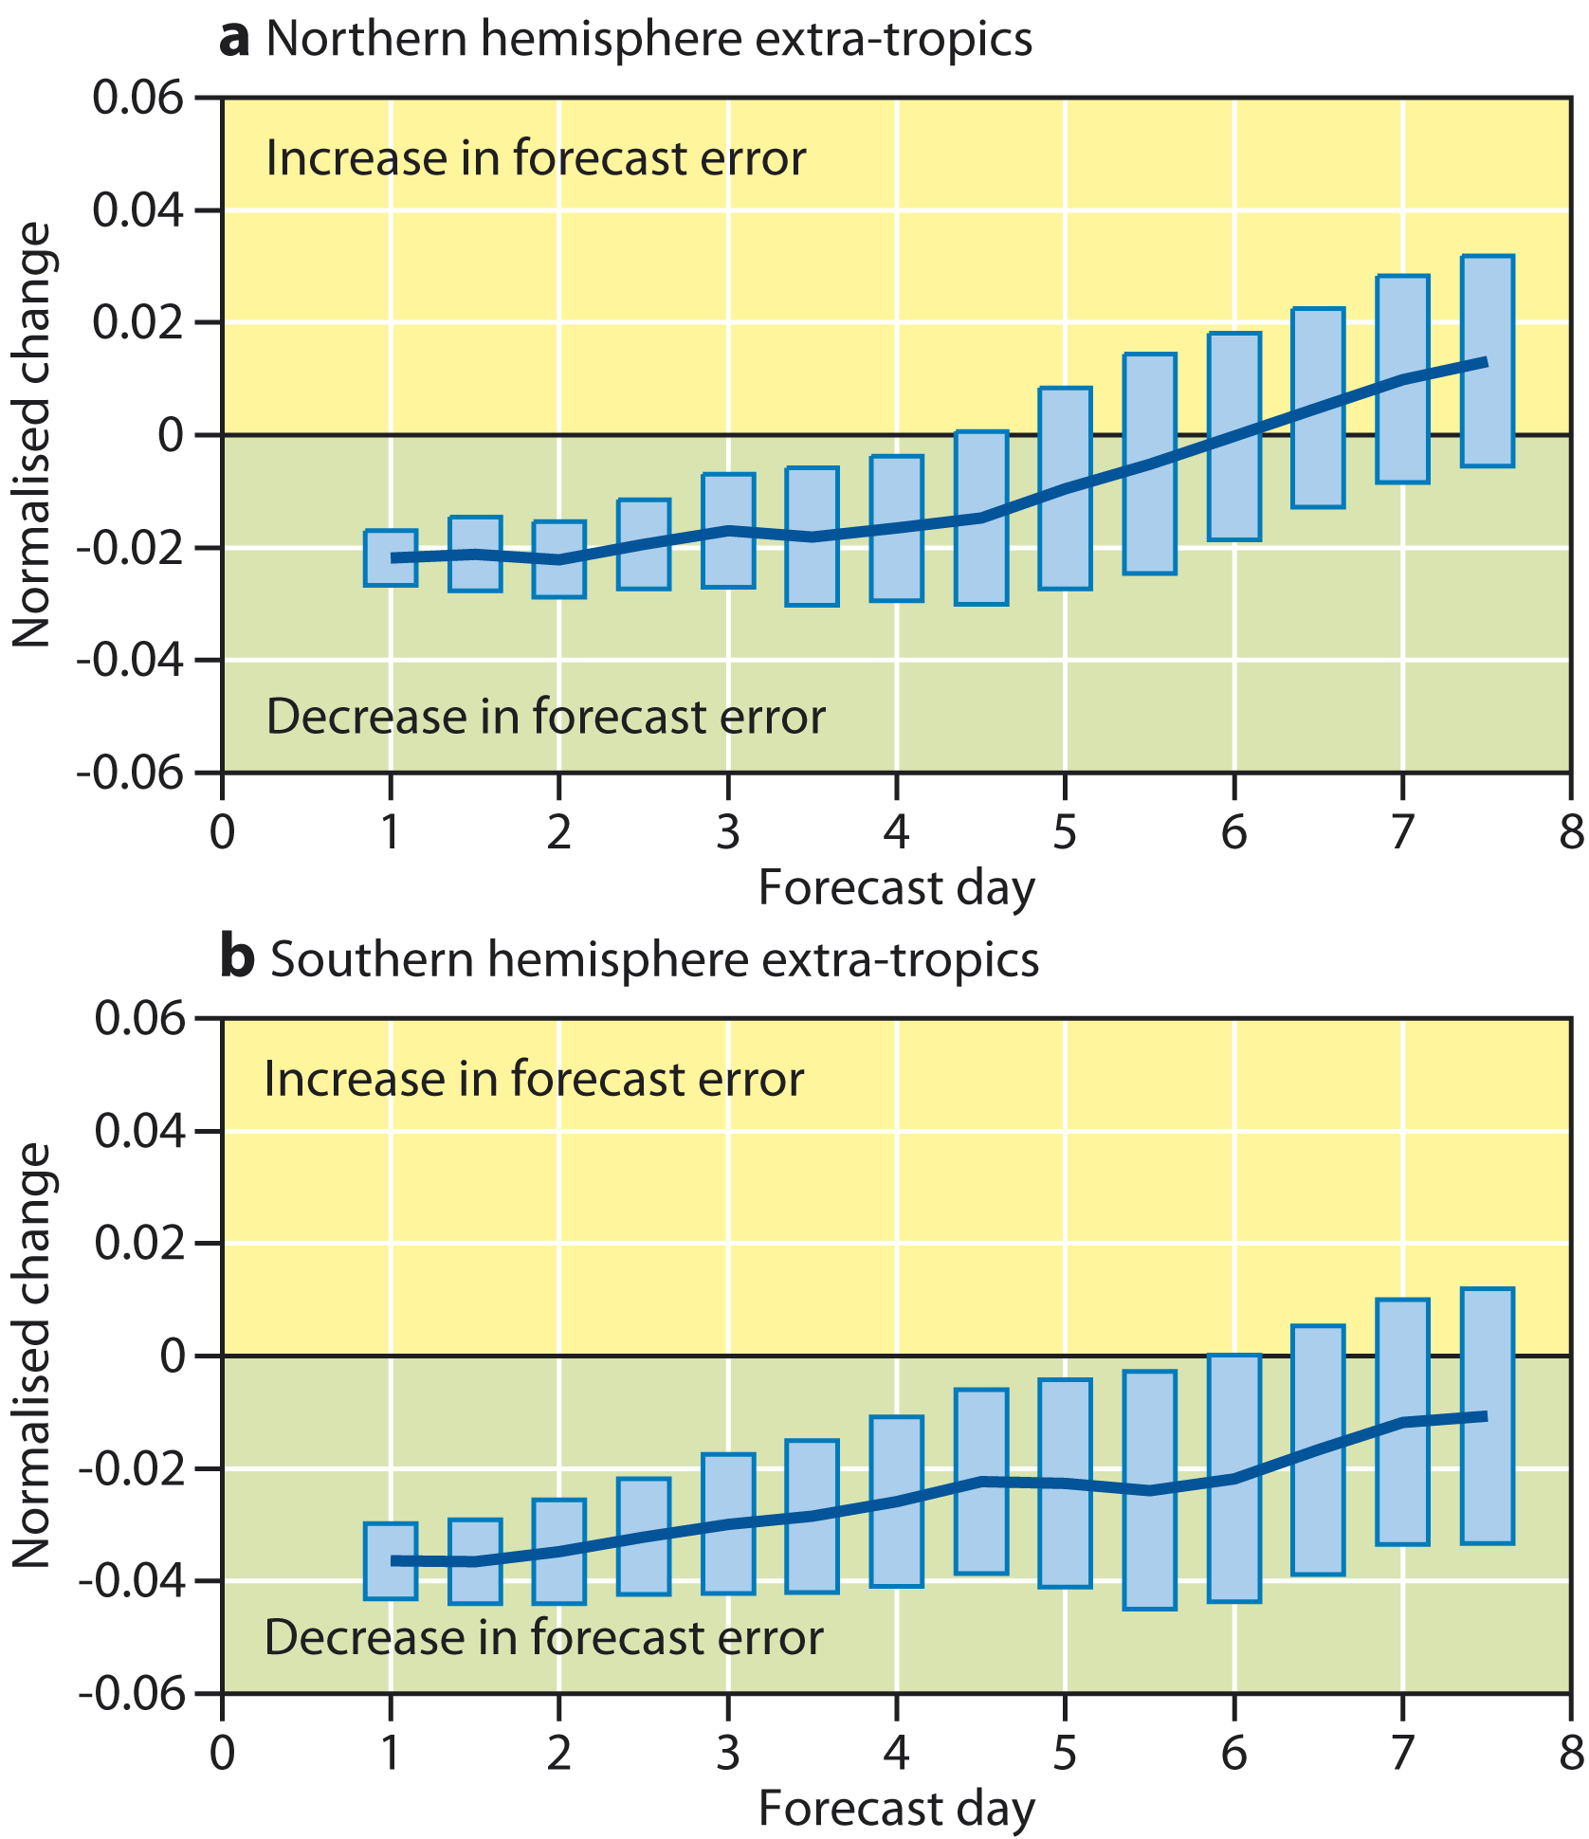
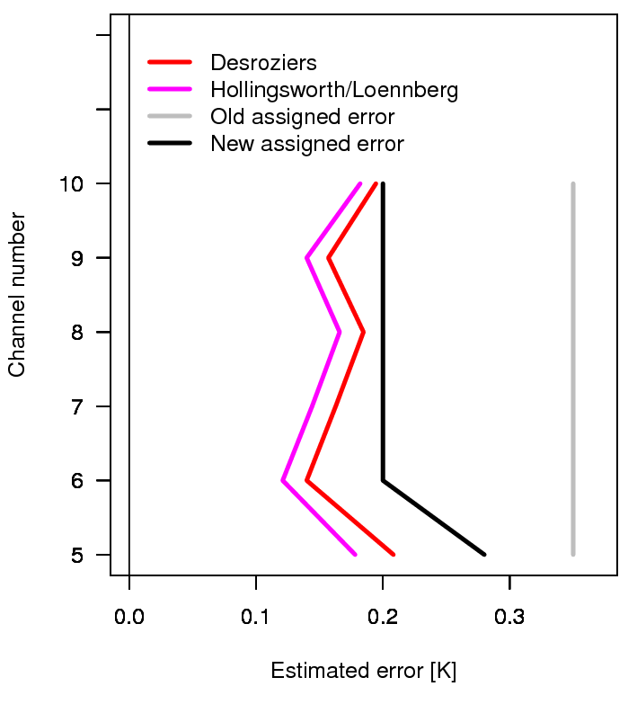
Example: AMSU-A
… diagonal R a good approximation.

Slide 37
Example: AMSU-A
… diagonal R a good approximation.
σ_{o}²
σ_{b}²
Error variance of estimate σ_{a}²
α

Slide 38
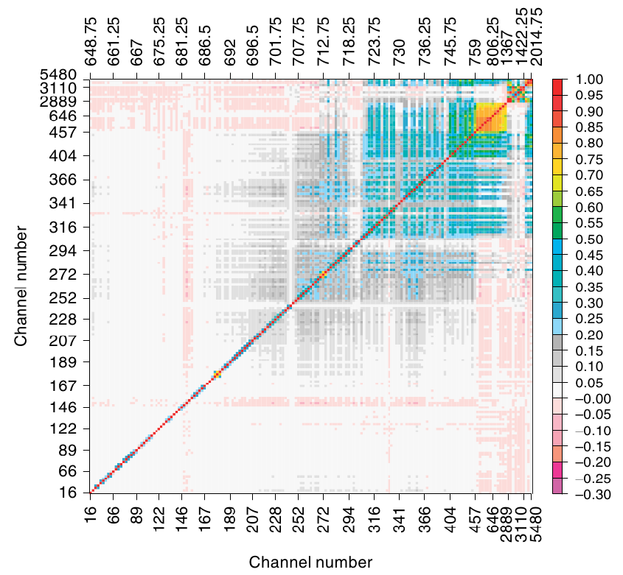
Examples of observation error diagnostics: IASI
Inter-channel error correlations:

Slide 39
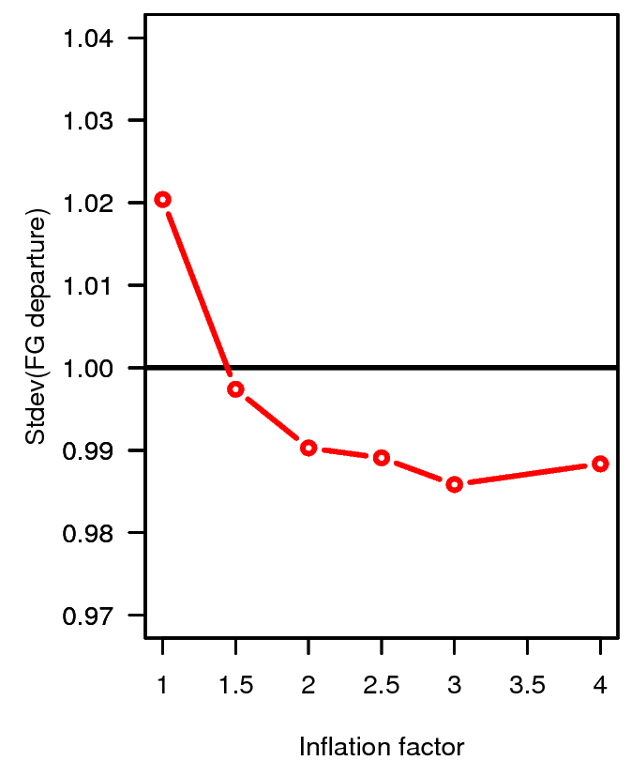
Example: IASI
Very common approach: Assume diagonal R, but with larger σ_{O} than diagnostics suggest (“Error inflation”).
Neglecting error correlation with no inflation can result in an analysis that is worse than the background!
Assimilation of IASI degrades upper tropospheric humidity
Normalised stdev(o-b) for MHS ch 3
Assimilation of IASI improves upper tropospheric humidity
Inflation factor for the diagonal values of R

Slide 40
Example: IASI
Background departure statistics for other observations are a useful indicator to tune observation errors.
Assimilation of IASI degrades upper tropospheric humidity
Normalised stdev(o-b) for MHS ch 3
Assimilation of IASI improves upper tropospheric humidity
Inflation factor for the diagonal values of R

Slide 41
Outline of lecture
What are observation errors?
Estimating observation errors
Specification of observation errors in practice
Accounting for observation error correlations
Summary

Slide 42
Accounting for error correlations
Accounting for observation error correlations is an area of active research.
Efficient methods exist if the error correlations are restricted to small groups of observations (e.g., inter-channel error correlations).
  E.g., calculate R⁻¹ (y – H(x)) without explicit inversion of R, by using Cholesky decomposition (algorithm for solving equations of the form Az = b).
  Used operationally for IASI at the Met Office.
Accounting for spatial error correlations is technically more difficult.

Slide 43
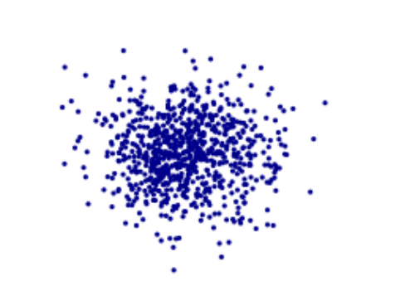
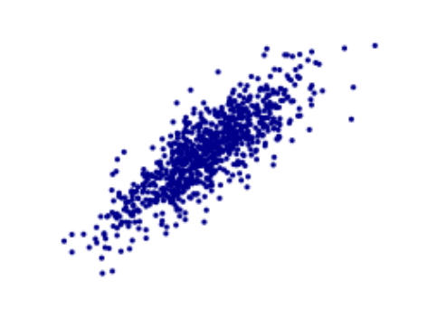
What is the effect of error correlations?
Uncorrelated error
Correlated error
Error in obs 2
Error in obs 2
Error in obs 1
Error in obs 1

Slide 44
What is the effect of error correlations?
Uncorrelated error
Correlated error
Error in obs 2
Error in obs 2
Larger
error
Smaller
error
Error in obs 1
Error in obs 1

Slide 45
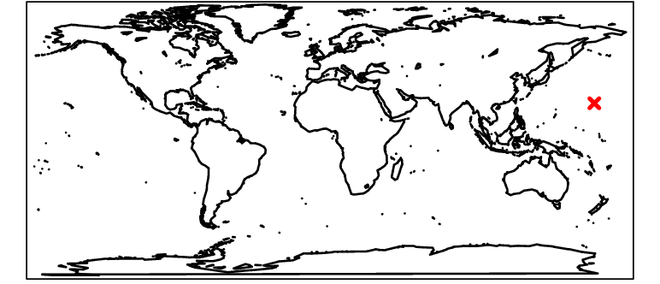
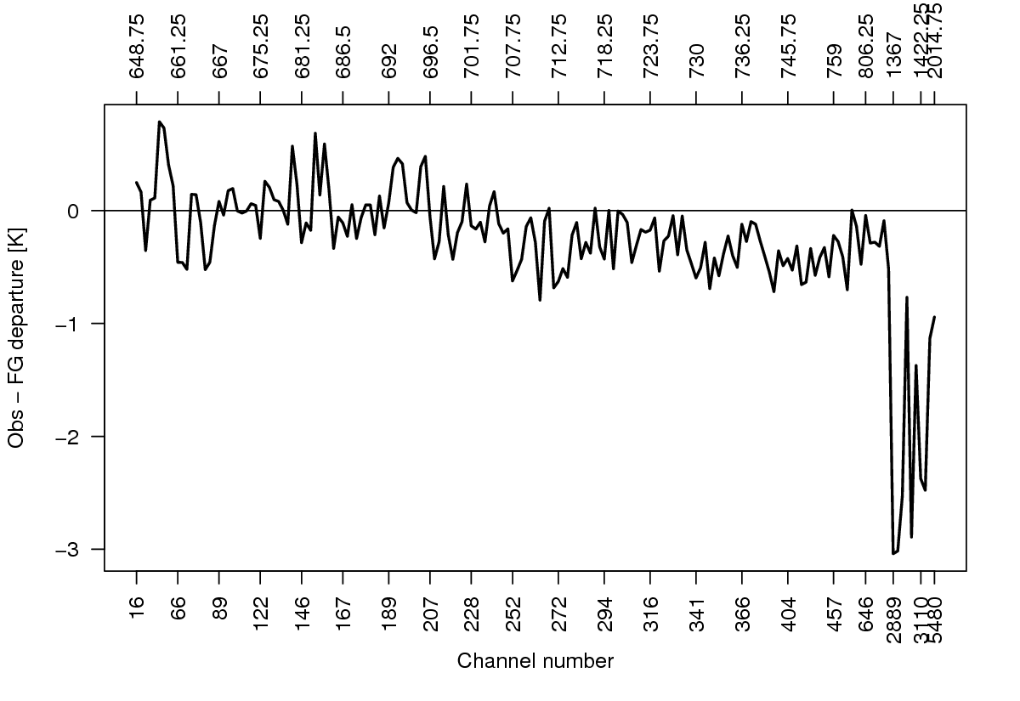
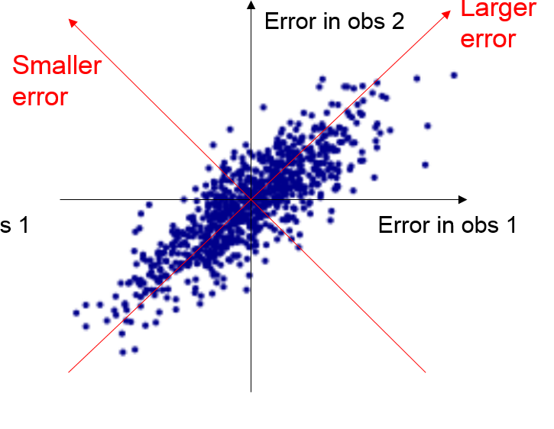
Single IASI spectrum assimilation experiments (I)
Error correlation matrix
Obs-FG departure
(all channels cloud-free)

Slide 46
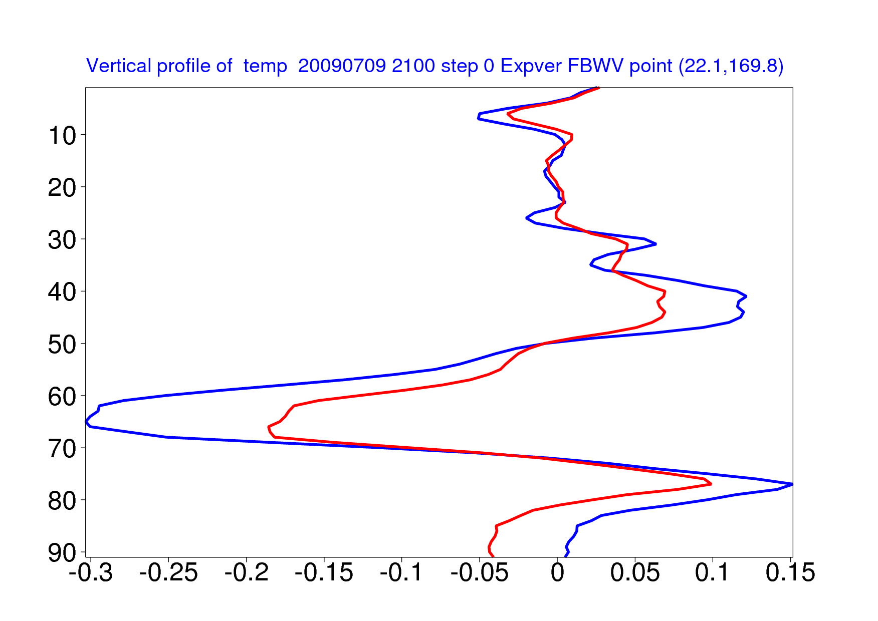
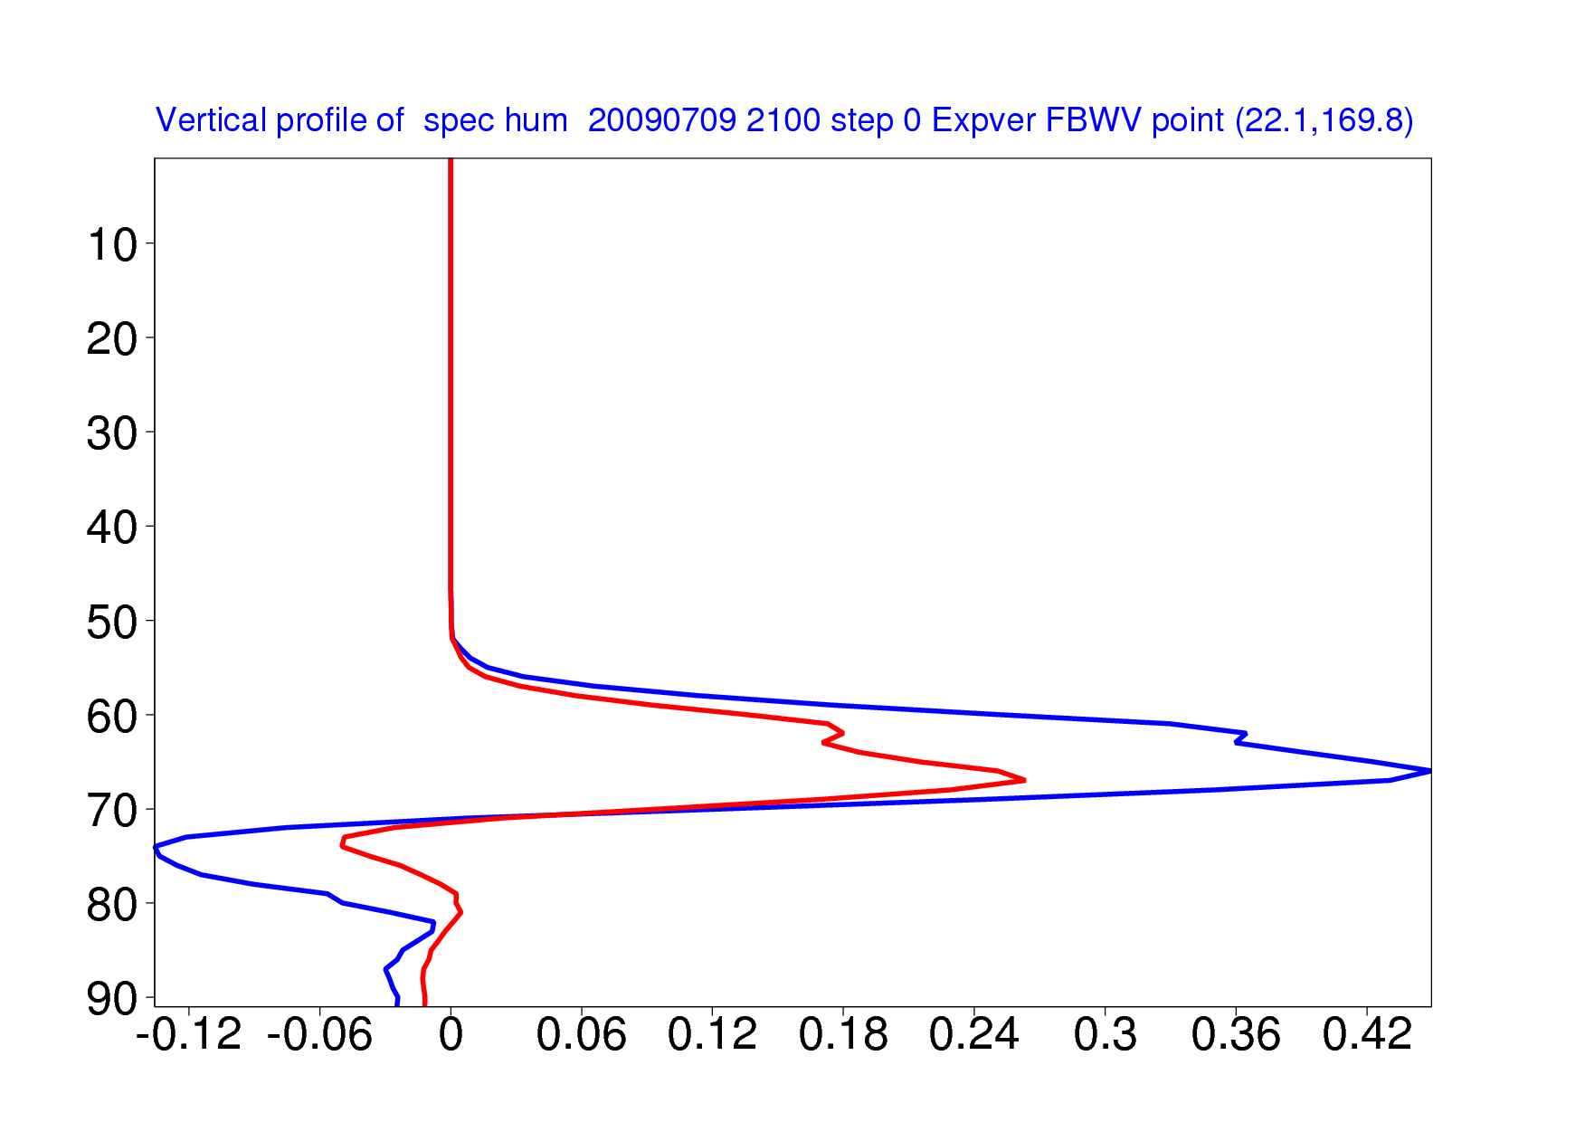
Single IASI spectrum assimilation experiments (I)
T
5
Without correlation
With correlation
30
100
Model level
Pressure [hPa]
500
850
Temperature increment [K]
Q
Without correlation
With correlation
5
30
100
Model level
Pressure [hPa]
500
Obs-FG departure
(all channels cloud-free)
850
Humidity increment [g/Kg]

Slide 47
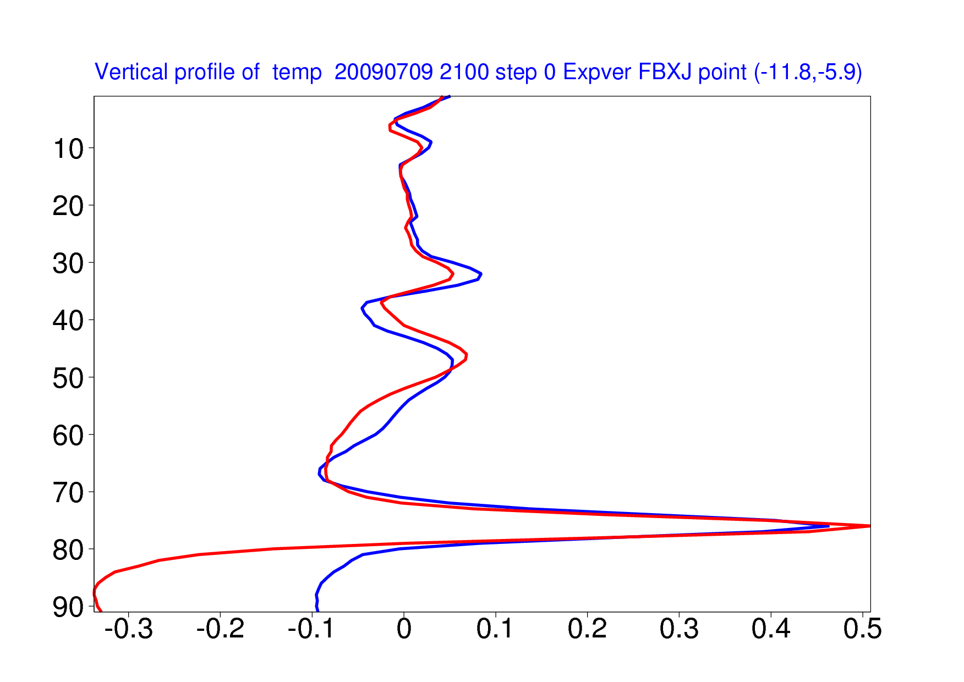
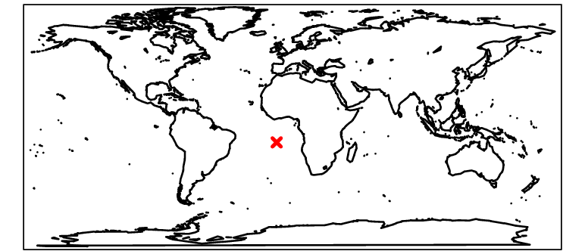
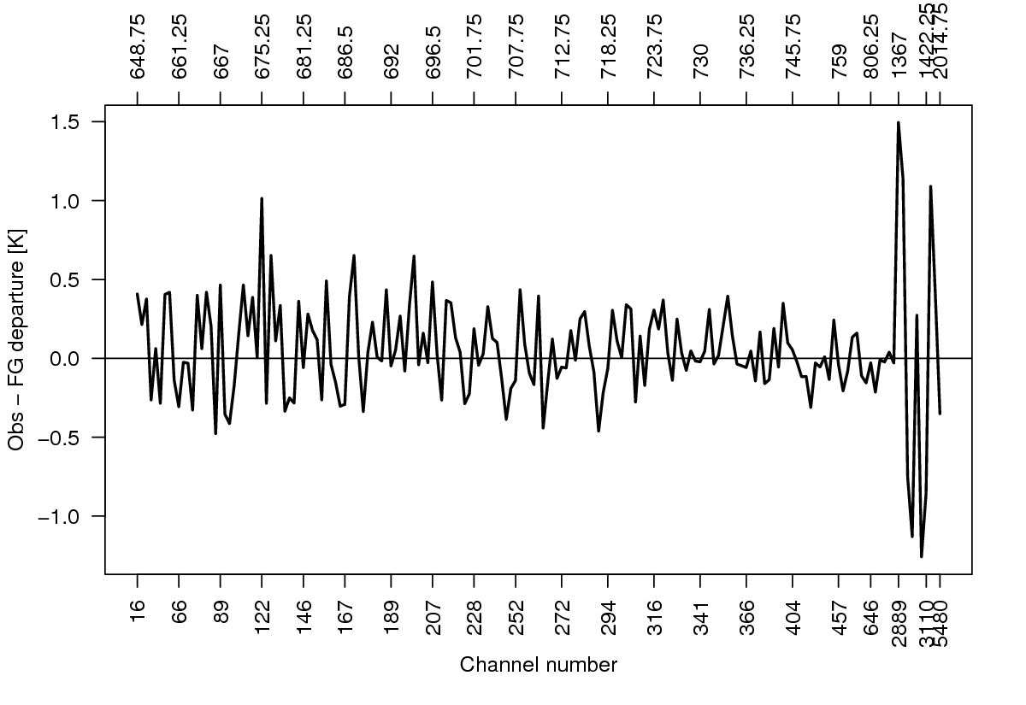
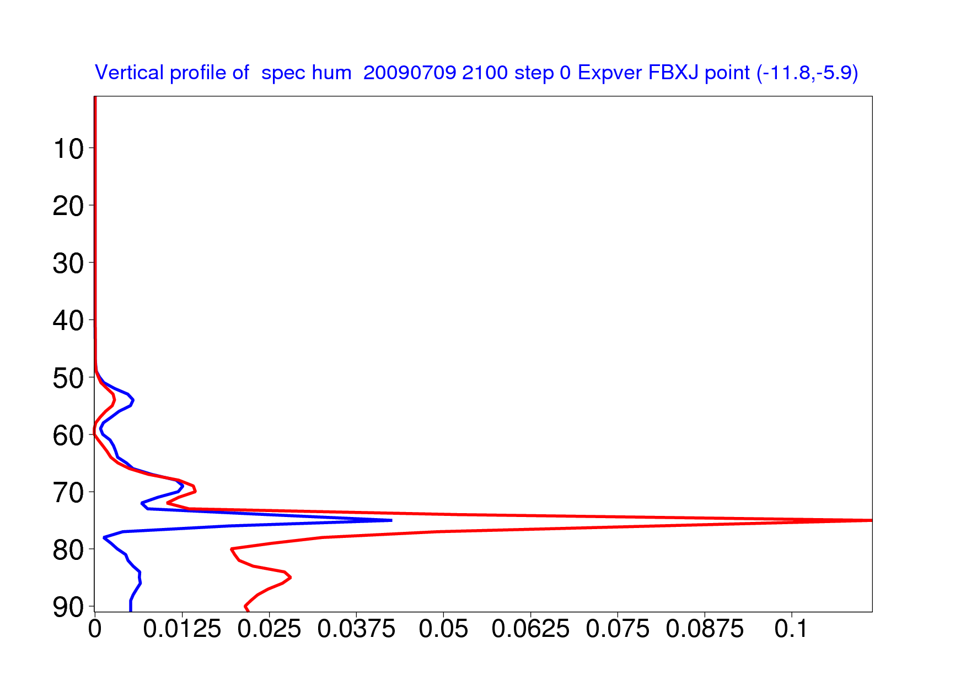
Single IASI spectrum assimilation experiments (II)
T
Without correlation
With correlation
5
30
100
Model level
Pressure [hPa]
500
850
Temperature increment [K]
Obs-FG departure
(all channels considered cloud-free)
Q
Without correlation
With correlation
5
30
100
Model level
Pressure [hPa]
500
850
Humidity increment [g/Kg]

Slide 48
Single IASI spectrum assimilation experiments (II)
T
Without correlation
With correlation
5
30
100
Model level
Pressure [hPa]
500
850
Introducing error correlations will change the weighting of the observations in a situation-dependent way.
Temperature increment [K]
Obs-FG departure
(all channels considered cloud-free)
Q
Without correlation
With correlation
5
30
100
Model level
Pressure [hPa]
500
850
Humidity increment [g/Kg]

Slide 49
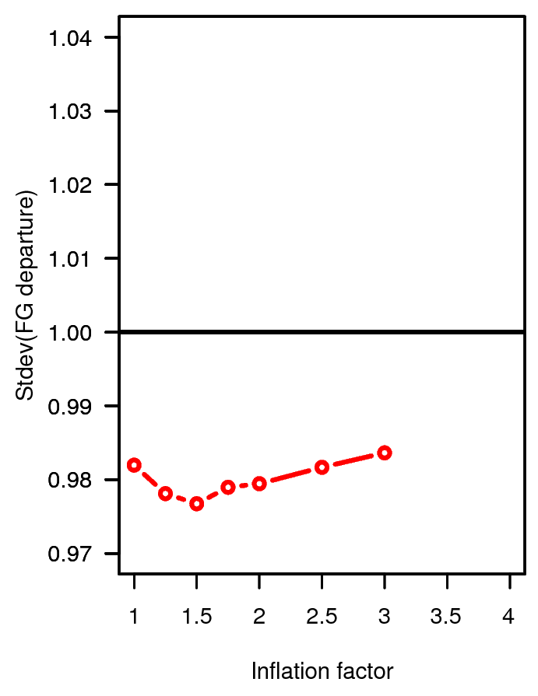
Effect of error correlations on the assimilation of AIRS and IASI
With correlations
Without correlations
Assimilation of IASI degrades upper tropospheric humidity
Normalised stdev(o-b) for MHS ch 3
Normalised stdev(o-b) for MHS ch 3
Assimilation of IASI improves upper tropospheric humidity
Inflation factor for the diagonal values of R
Inflation factor for the diagonal values of R

Slide 50
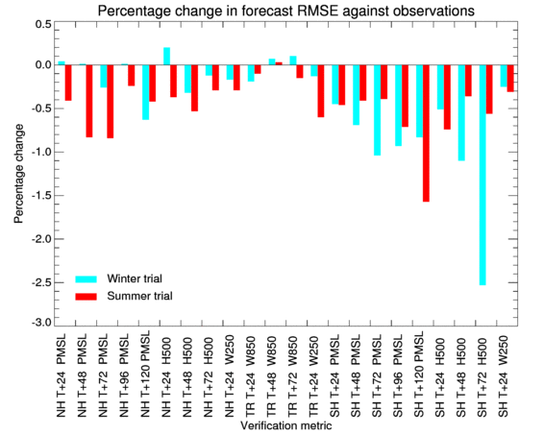
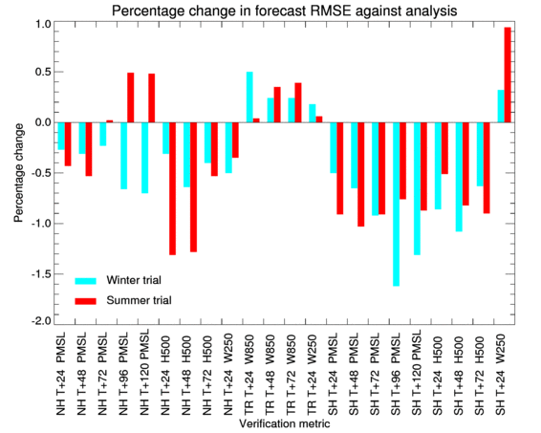
Correlated observation errors for IASI at Met Office
The use of correlated observation errors for IASI was implemented operationally at the Met Office in January 2013, Weston et al 2014.
Verification v Observations
Verification v Analyses
+0.209/0.302% UKMO NWP Index
+0.241/0.047% UKMO NWP Index

Slide 51
Outline of lecture
What are observation errors?
Diagnosing observation errors
Specification of observation errors in practice
Summary

Slide 52
Summary of main points
Assigned observation and background errors determine how much weight an observation receives in the assimilation.
For satellite data, “true” observation errors are often correlated (spatially, in time, between channels).
Diagnostics on departure statistics from assimilation systems can be used to provide guidance on the setting of observation errors.
Most systems assume diagonal observation errors, and thinning and error inflation are used widely to counter-act the effects of error correlations.

Slide 53
Further reading (I)
Bormann and Bauer (2010): Estimates of spatial and inter-channel observation error characteristics for current sounder radiances for NWP, part I: Methods and application to ATOVS data. QJRMS, 136, 1036-1050.
Bormann et al. (2010): Estimates of spatial and inter-channel observation error characteristics for current sounder radiances for NWP, part II: Application to AIRS and IASI. QJRMS, 136, 1051-1063.
Daescu, D. N. and Todling, R., 2010: Adjoint sensitivity of the model forecast to data assimilation system error covariance parameters. Q.J.R. Meteorol. Soc., 136, 2000–2012.
Desroziers et al. (2005): Diagnosis of observation, background and analysis error statistics in observation space. QJRMS, 131, 3385-3396.
Hollingworth and Loennberg (1986): The statistical structure of short-range forecast errors as determined from radiosonde data. Part I: The wind field. Tellus, 38A, 111-136.

Slide 54
Further reading (II)
Liu and Rabier (2003): The potential of high-density observations for numerical weather prediction: A study with simulated observations. QJRMS, 129, 3013-3035.
Weston et al (2014): Accounting for correlated error in the assimilation of high-resolution sounder data. Q.J.R. Meteorol. Soc., 140: 2420–2429. doi: 10.1002/qj.2306

Slide 55
Cost function diagnostics
Consistency diagnostic based on the minimum of the cost function:
  If background and observation errors are correctly specified, it can be shown that
  with the number of observations n and the expectation operator (see Talagrand 1999).
  Can be used to check/tune assumed error characteristics.

Slide 56
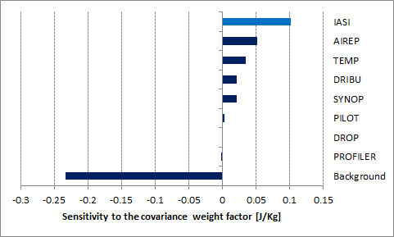
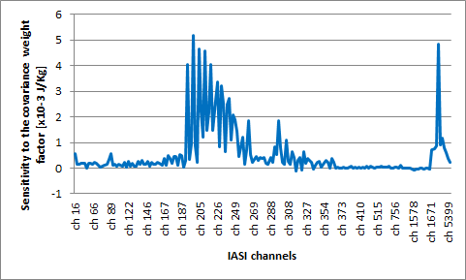
Adjoint diagnostics for observation errors
Adjoint diagnostics can be used to assess the sensitivity of forecast error reduction to the observation error specification (e.g., Daescu and Todling 2010).
Example: Assessment of IASI in a depleted observing system with only conventional and IASI data.
Increase of assigned error beneficial
Reduction of assigned error beneficial
(Cristina Lupu, Carla Cardinali)

Slide 57
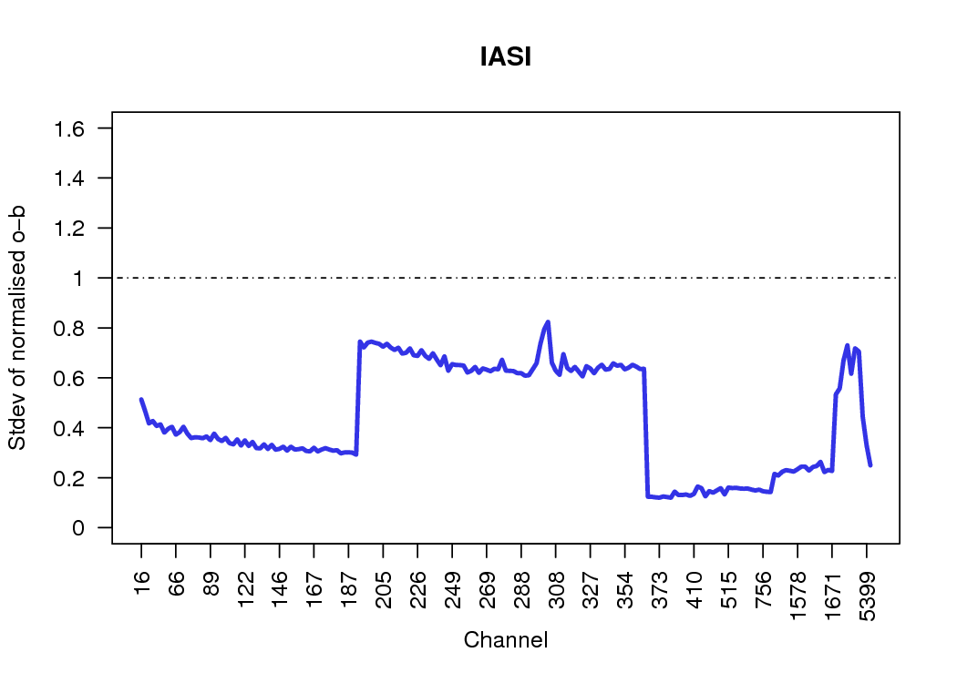
Adjoint diagnostics for observation errors
Adjoint diagnostics can be used to assess the sensitivity of forecast error reduction to the observation error specification.
Example: Assessment of IASI in a depleted observing system with only conventional and IASI data.
Stdev of o-b, normalised by assumed R:
Adjoint-based forecast sensitivity to R:
Further work required regarding the applicability of this diagnostic (consistency of results with estimates of true observation errors).

