Slide 1
The spectral transform method
by Nils Wedi
wedi@ecmwf.int
European Centre for Medium Range Weather Forecasts

Slide 2
The Integrated Forecasting System (IFS)
technology applied at ECMWF for the last 30 years …
A spectral transform, semi-Lagrangian, semi-implicit (compressible) (non-)hydrostatic model
Outline:
Theoretical foundations
Aliasing control
Spectral – gridpoint dual space
Speeding up the computations
  FFT / Fast Legendre transforms
  Accelerator use (GPUs, optical)
  MPI parallelization and “global” communications
The cost and competitiveness of spectral transforms in NWP
and climate simulations

Slide 3
Schematic description of the spectral transform method in the ECMWF IFS model
Grid-point space
-semi-Lagrangian advection
-physical parametrizations
-products of terms
FFT
Inverse FFT
No grid-staggering of
prognostic variables
Fourier space
Fourier space
LT
Inverse LT
Spectral space
-horizontal gradients
-semi-implicit calculations
-horizontal diffusion
FFT: Fast Fourier Transform, LT: Legendre Transform

Slide 4
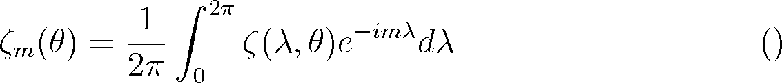
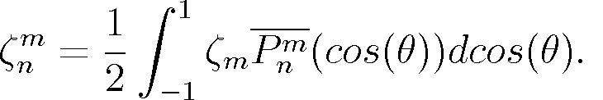
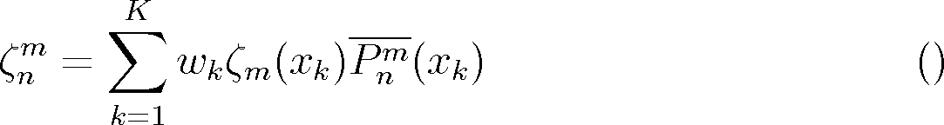
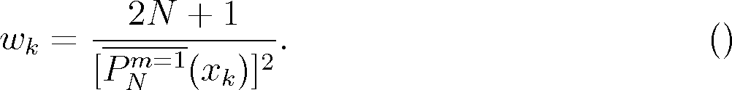
Direct spectral transform (Forward)
Fourier transform:
FFT (fast Fourier transform)
using
N_{F} ≥ 2N+1
points (linear grid)
(3N+1 if quadratic grid)
Legendre transform:
Direct Legendre transform
by Gaussian quadrature
using N_{L} ≥ (2N+1)/2
“Gaussian” latitudes (linear grid)
((3N+1)/2 if quadratic grid)
(normalized) associated Legendre polynomials

Slide 5
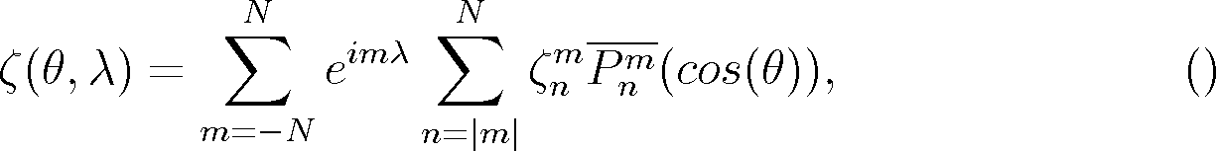
Inverse spectral transform (Backward)
Inverse Legendre transform
Triangular truncation
(isotropic)
Triangular truncation:
n
Spherical harmonics
N
m = -N
m = N
m

Slide 6
A useful property of spherical harmonics
total wavenumber
Earth radius

Slide 7
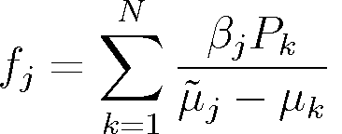
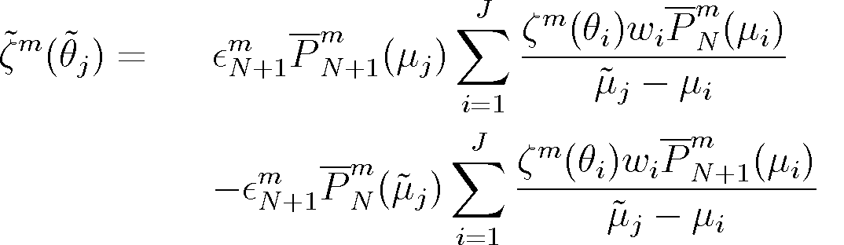
Fast Multipole Method (FMM) and spectral filtering
(Boyd, 1992; Jakob-Chien and Alpert, 1997; Tygert 2008)
For all j=1,..,J
FMM: We can do above sum for all points j
in O(J+N) operations instead of O(J*N) !
Example: From Christoffel-Darboux formula for associated Legendre polynomials
We can do a direct and inverse Legendre transform for a single Fourier mode as:

Slide 8
Aliasing control
Aliasing of quadratic (or cubic) terms on the linear grid (2N+1 gridpoints per N waves), where the product of two (or three) variables transformed to spectral space cannot be accurately represented with the available number of waves (as quadratic terms would need a 3N+1 gridpoints with N waves and cubic terms 4N+1 gridpoints with N waves).
Example of de-aliasing in IFS: By subtracting the difference between a specially filtered and the unfiltered pressure gradient term at every time-step the stationary noise patterns can be removed at a cost of approx. 5% at TL1279 (2 extra transforms); this is not needed when a “quadratic” or “cubic” grid is used with above gridpoint to wavenumber ratios.

Slide 9
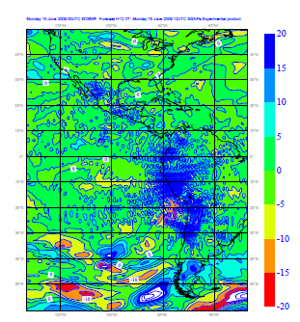
Aliasing
E-W
500hPa adiabatic
zonal wind
tendencies (T159)

Slide 10
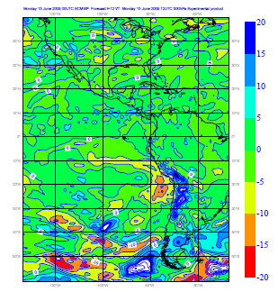
De-aliasing

Slide 11
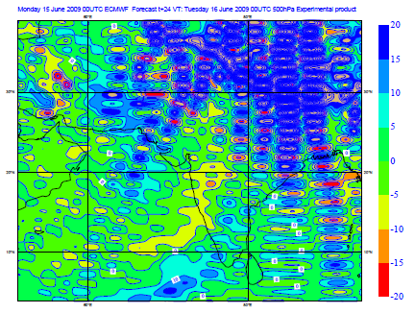
Aliasing
N-S
500hPa adiabatic
meridional wind
tendencies (T159)

Slide 12
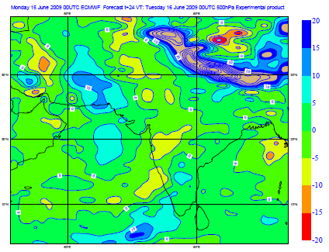
De-aliasing

Slide 13
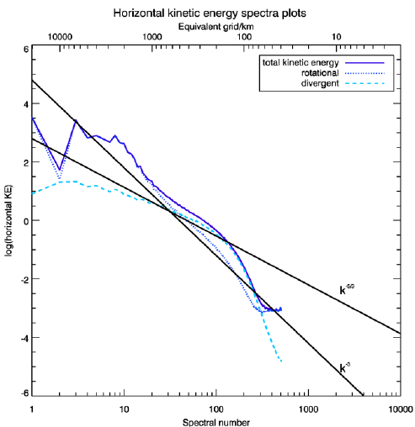
Aliasing in Kinetic Energy Spectra – 100 hPa

Slide 14
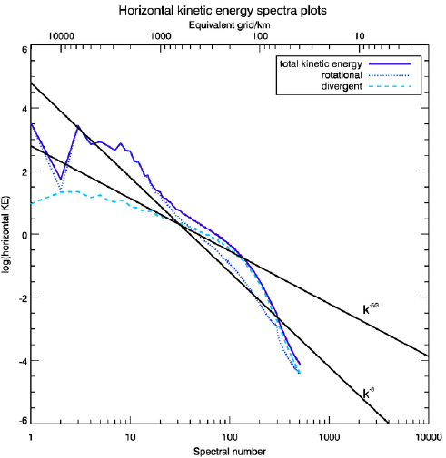
De-aliasing in Kinetic Energy Spectra – 100 hPa

Slide 15
Spectral vs. physical space
2N+1 gridpoints to N waves : linear grid
~ 1-2 Δ
3N+1 gridpoints to N waves : quadratic grid
~ 2-3 Δ
4N+1 gridpoints to N waves : cubic grid
~ 3-4 Δ
(Wedi, 2014)
Spatial filter range
Effective resolution of NWP models today : 6-8 Δ
(Abdalla et al, 2013)

Slide 16
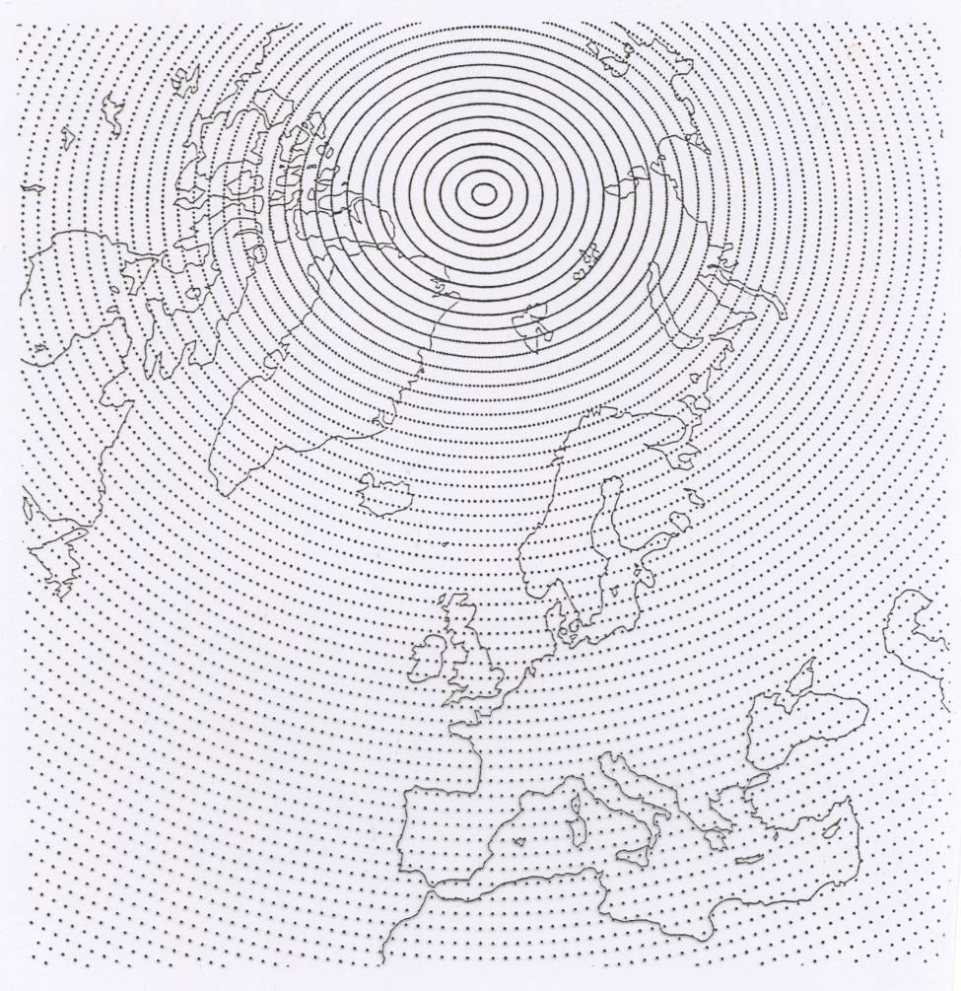
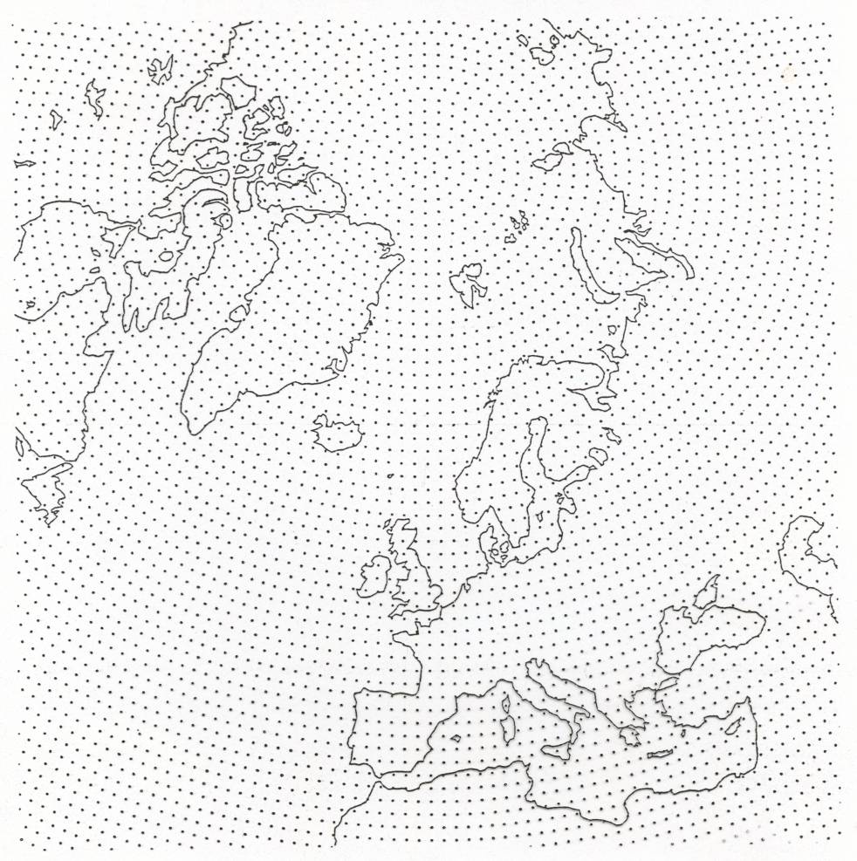
The Gaussian grid
About 30% reduction in number of points
Full grid
Reduced grid
Reduction in the number of Fourier points at high latitudes is possible because the
associated Legendre polynomials are very small near the poles for large m.
Note: number of points nearly equivalent to quasi-uniform icosahedral
grid cells of the ICON model.

Slide 17
Other Gaussian grids
current

Slide 18
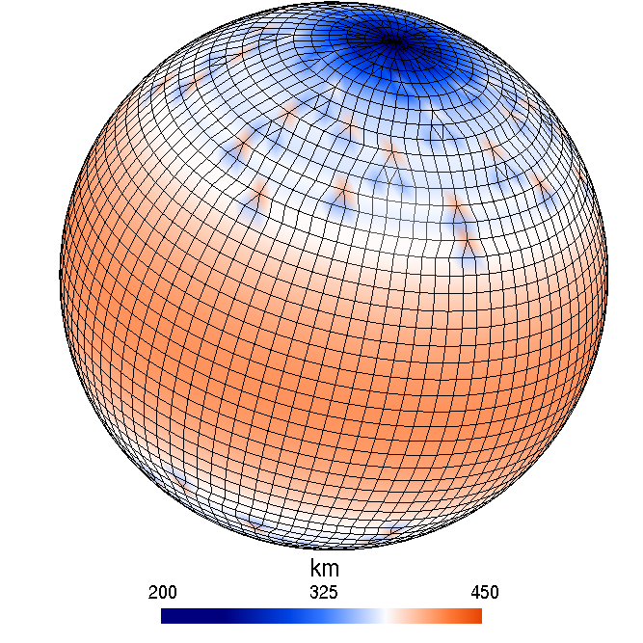
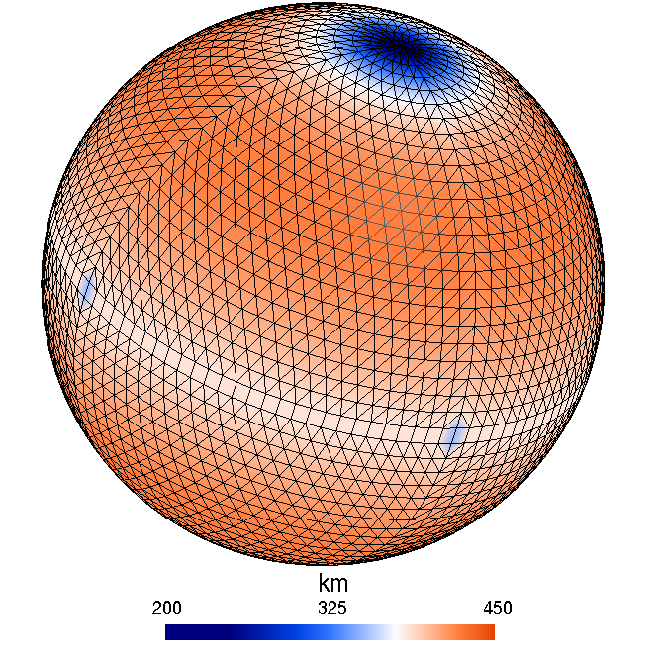
A new grid for ECMWF
A further ~20% reduction in gridpoints
Compared to full-grid
N24 reduced Gaussian grid
N24 octahedral Gaussian grid

Slide 19
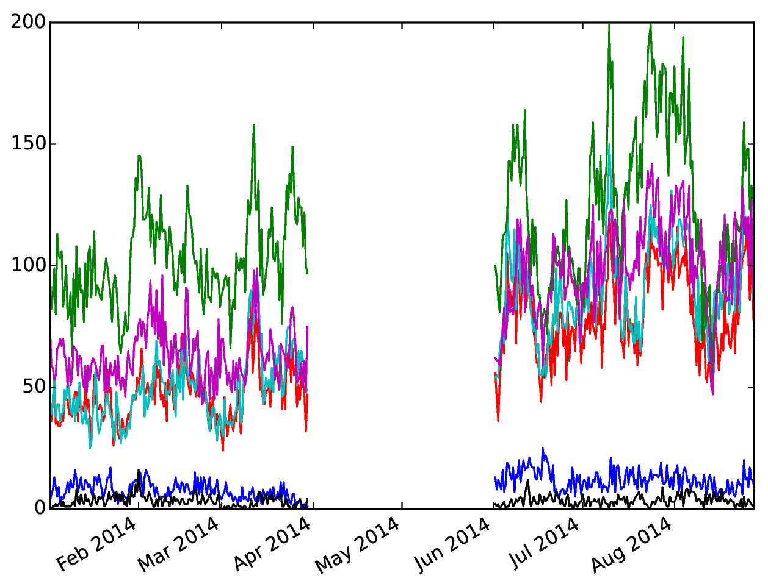
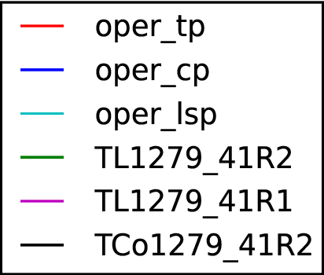
“resolved (lsp)” rainfall
(Ervin Zsoter & Sylvie Malardel)
Number of >50mm occurrences in a 5day forecast
Linear grid (TL1279)
Cubic grid (TCo1279)

Slide 20
A fast Legendre transform (FLT)
(O’Neil, Woolfe, Rokhlin, 2009; Tygert 2008, 2010)
The computational complexity of the ordinary spectral transform is O(N^3) (where N is the truncation number of the series expansion in spherical harmonics) and it was therefore believed to be not computationally competitive with other methods at very high resolution
The FLT is found to be O(N^2 log N^3) for horizontal resolutions up to T7999 (Wedi et al, 2013)

Slide 21
Number of floating point operations for direct or inverse spectral
transforms of a single field, scaled by N²log³N

Slide 22

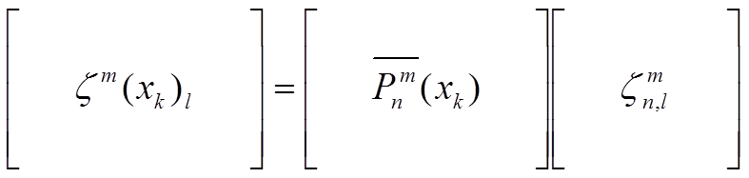
Matrix-matrix multiply for each zonal wavenumber m
total wavenumber
Gaussian latitude
apply butterfly compression,
this step is precomputed only once!
Field,
vertical level
zonal wavenumber

Slide 23
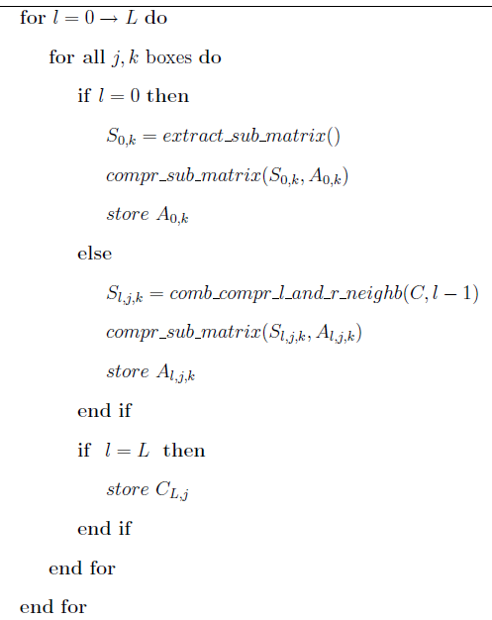
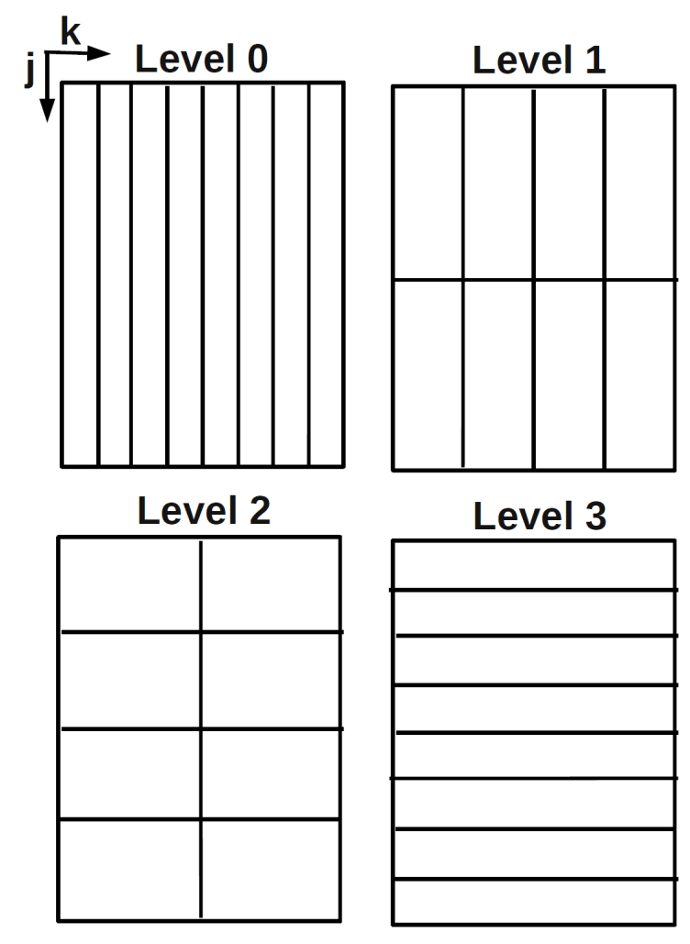
Butterfly algorithm: pre-compute
With each level l,
double the columns
and half the rows

Slide 24
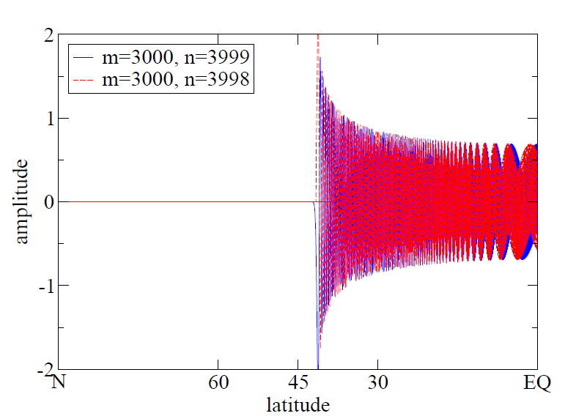
Selected associated Legendre polynomials

Slide 25
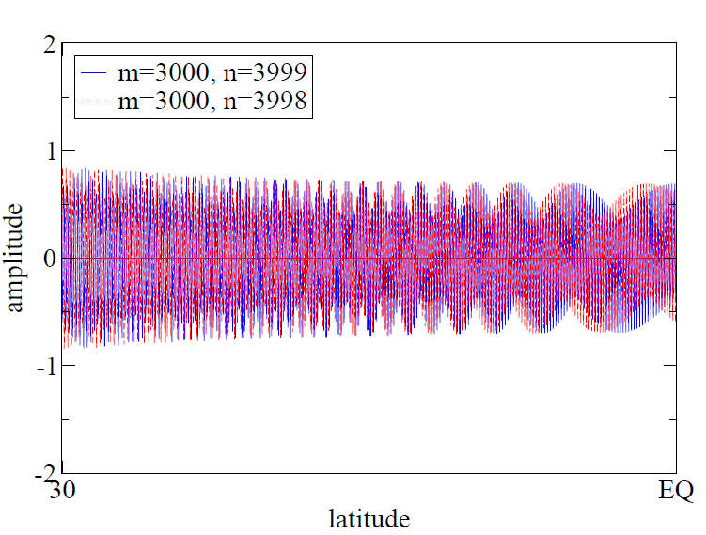
Selected associated Legendre polynomials

Slide 26
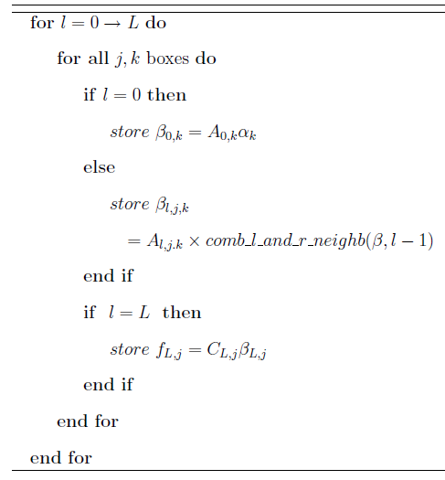
Butterfly algorithm: apply

Slide 27
Interpolative Decomposition (ID)
The compression uses the interpolative decomposition (ID) described in Cheng et al (2005).
The r x s matrix S may be compressed such that
With an r x k matrix C constituting a subset of the columns of S and the k x s matrix A containing a k x k identity as a submatrix. k is the ε-rank of the matrix S (see also e.g. Martinsson and Rokhlin, 2007).

Slide 28
The FLT in a nutshell – O(N²log³N)
Speed-up the sums of (matrix) products between associated Legendre polynomials at all Gaussian latitudes and the corresponding spectral coefficients of a field (e.g. temperature on given level)
The essence of the FLT:
  Exploit similarities of associated Legendre polynomials at all (Gaussian) latitudes but different total wavenumber
  Pre-compute (once, 0.1% of the total cost of a 10 day forecast) a compressed (approximate) representation of the matrices (for each m) involved
  Apply the compressed (reduced) representation at every time-step of the simulation.

Slide 29
Average wall-clock time compute cost of 10⁷ spectral transforms
scaled by N²log³N

Slide 30
Other ways of speeding up the computations
Accelerators
  GPUs
  Optical processors

Slide 31
Library approach (cuBLAS/cuFFT)
(the work of George Mozdzynski)
CALL DGEMM('N','N',KDGLU,KIFC,ILA,1.0_JPRB,S%FA(KMLOC)%RPNMA,KDGLU,&
&ZBA,ILA,0._JPRB,ZC,KDGLU)
USE CUBLAS_MOD
USE CUDA_DEVICE_MOD
!$ACC declare create(ZBA,ZC)
!$ACC data present(S%FA(KMLOC)%RPNMA)
!$ACC host_data use_device(S%FA(KMLOC)%RPNMA,ZBA,ZC)
CALL CUDA_DGEMM('N','N',KDGLU,KIFC,ILA,1.0_JPRB,S%FA(KMLOC)%RPNMA,KDGLU,&
&ZBA,ILA,0._JPRB,ZC,KDGLU)
!$ACC end host_data
IRET=CUDA_SYNCHRONIZE()
!$ACC end data

Slide 32
Library approach (cuBLAS/cuFFT)
CPU Ivybridge
GPU K20X

Slide 33
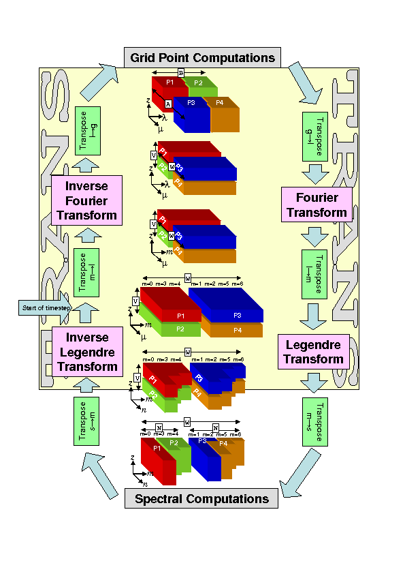
MPI/OpenMP parallelisation of spectral transforms
Several transpositions within the spectral transforms need to communicate, e.g. using MPI alltoallv
l-g and g-l “local” bandwidth limited
l-m and m-l “global” bandwidth limited

Slide 34
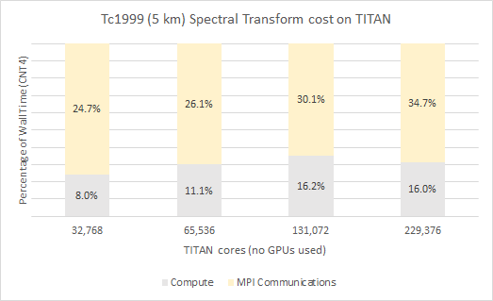
Absolute cost of spectral transform

Slide 35
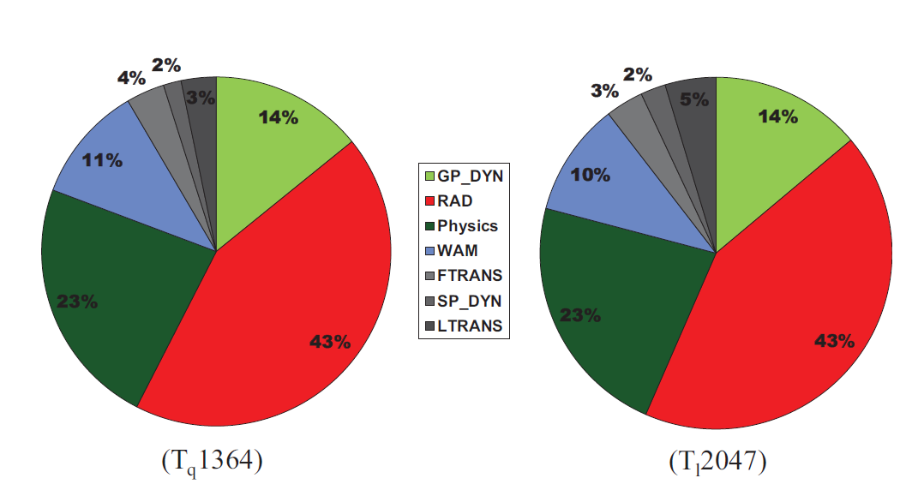
The computational cost distribution with full radiation and high-res wave model

Slide 36
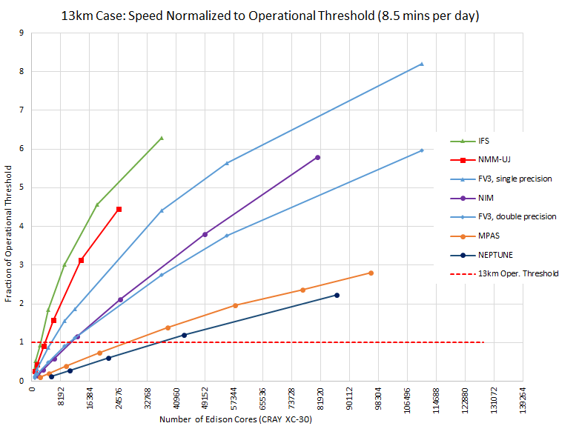
Time-to-solution at 13km
IFS
(Michalakes et al, NGGPS AVEC report, 2015)

Slide 37
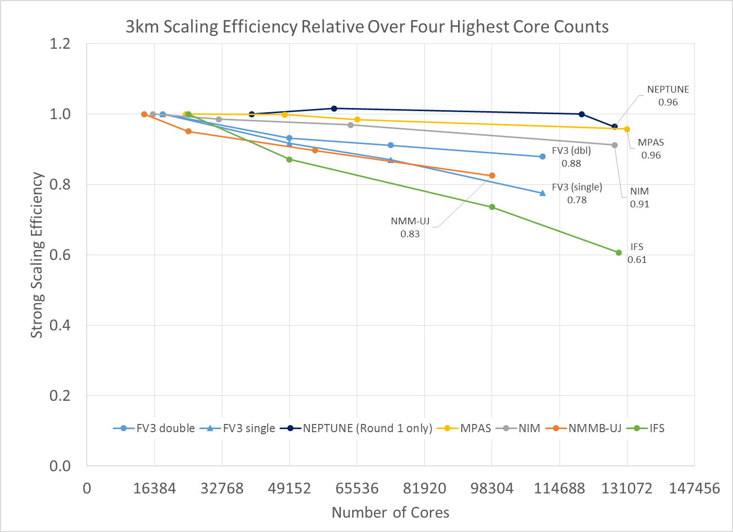
Scaling efficiency at 3km
IFS
(Michalakes et al, NGGPS AVEC report, 2015)

Slide 38
Communication and HPC interconnect requirements
MPI communication performance is influenced by
  Latency (1-10 ms)
  Bandwidth (e.g. measured by injection bandwidth per node)
In the past: fully connected networks of nodes (“fat-trees”, “crossbars”) were popular but too expensive as the number of nodes rises (i.e. too many cables)
Today hierarchical and managed networks are used, i.e. where the network topology matters and managing adaptively and dynamically the routing of messages through limited available cable connections(e.g. Aries network Cray XC30/40 with Dragonfly topology)
In the future ???
  Avoid communication ... (let’s be clear, this is not an option for NWP!)
  Use algorithms that reduce data movement, communication and synchronization (other lectures in this training course)
  Notably the fastest wireless connection measured to date is 7Gbyte/s …

Slide 39
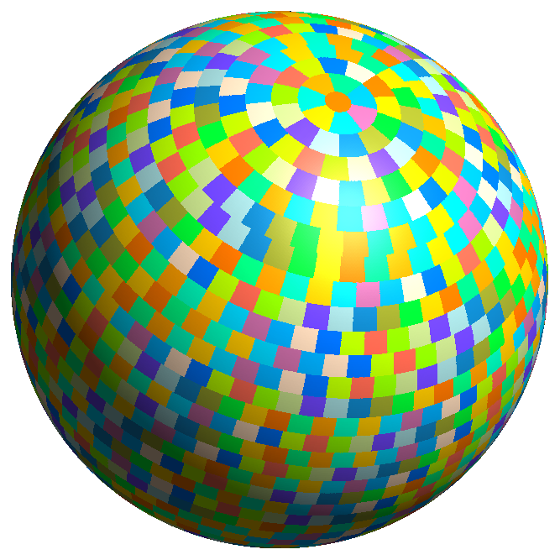
Equal area (MPI) parallel decomposition (1600 tasks)
6,599,680 points x 137 levels x 10 vars
at ~9km ~ 9 Billion points

Slide 40
Application performance XC30
MPI_send/recv
Alltoallv
Alltoallv
MPI_send/recv
TCo1279 on 360 nodes; TCo1999 on 720 nodes ; dt=450s; 48h forecast

Slide 41
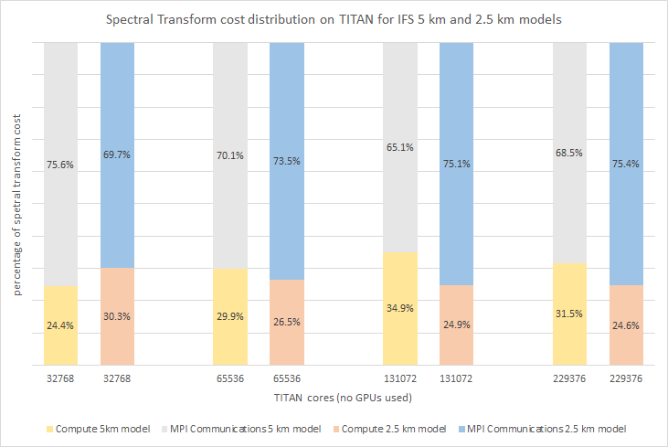
MPI communication cost at large core counts …

Slide 42
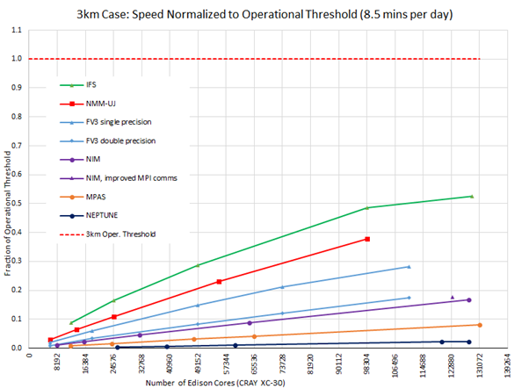
Time-to-solution 3km
Operational need!
IFS
(adapted from Michalakes et al, NGGPS AVEC report, 2015)

