Slide 1
ECMWF/EUMETSAT NWP-SAF
Satellite data assimilation
Training course, 14-18 March 2015
Use of satellite data for land surface analysis
Patricia de Rosnay
Notes:
1

Slide 2
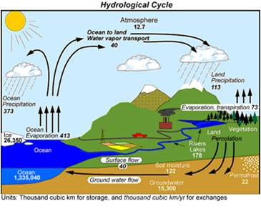
Introduction: Land Surfaces in
Numerical Weather Prediction (NWP)
  Processes: Continental hydrological cycle, interaction with the atmosphere on various time and spatial scales
  Boundary conditions at the lowest level of the atmosphere
  Crucial for near surface weather conditions, whose high quality forecast is a key objective in NWP
Land surface processes modelling & initialisation are important for NWP at all range (short to seasonal)
(Beljaars et al., Mon. Wea. Rev, 1996, Koster et al., Science 2004, Koster et al. J Hydrometeorol. 2011)
Trenberth et al. J. Hydrometeorol., 2007

Slide 3
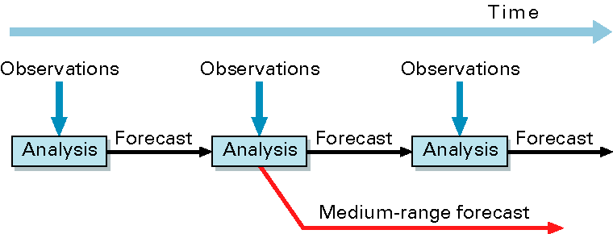
ECMWF Integrated Forecasting System (IFS)
(10-day)‏
Forecast Model: GCM including the H-TESSEL land surface model (fully coupled)
Data Assimilation → initial conditions of the forecast model prognostic variables
  4D-Var for atmosphere
  Land Data Assimilation System

Slide 4
ECMWF Integrated Forecasting System (IFS)
(10-day)‏
Forecast Model: GCM including the H-TESSEL land surface model (fully coupled)
Data Assimilation → initial conditions of the forecast model prognostic variables
  4D-Var for atmosphere
  Land Data Assimilation System
Several Systems:
NWP (oper): IFS (with 4D-Var and LDAS), 9km, version 41r2 (2016)
ERA-Interim: IFS (with 4D-Var and LDAS), 79km, version 31r1 (2006)
ERA5: IFS (with 4D-Var and LDAS), 39km, version 41r2 (2016)
ERA-Interim-Land: 79km
ERA5-Land: 39 km
Weakly coupled DA
H-TESSEL LSM simulations forced by ERA→ model only: no LDAS

Slide 5
Introduction: Land Surface Data Assimilation (LDAS)
Snow depth
  Methods: Cressman (DWD, ECMWF ERA-I), 2D Optimal Interpolation (OI) (ECMWF operational and ERA5, CMC)
  Conventional Observations: in situ snow depth
  Satellite data: NOAA/NESDIS IMS Snow Cover Extent (ECMWF), H-SAF snow cover (UKMO in dvpt)
Soil Moisture
  Methods:
    1D Optimal Interpolation (Météo-France, CMC, ALADIN and HIRLAM)
    Simplified Extended Kalman Filter (EKF) (DWD, ECMWF, UKMO)
  Conventional observations: Analysed SYNOP 2m air relative humidity and temperature, from 2D OI screen level parameters analysis
  Satellite data : ASCAT soil moisture (UKMO, ECMWF, KMA), SMOS (dvpt ECMWF, UKMO, Env.Canada) ‏
Soil Temperature and Snow temperature
  1D OI for the first layer of soil and snow temperature (ECMWF, Météo-France)
Notes:
5

Slide 6

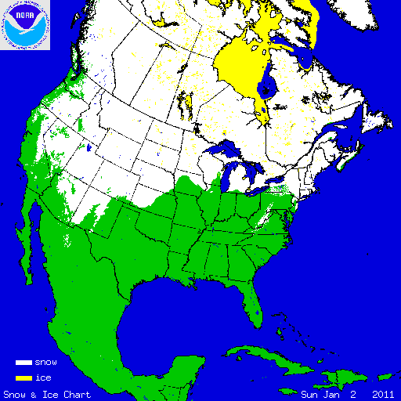
Snow in operational forecasting systems
Example of the ECMWF system:
Snow Model: Component of H-TESSEL ; Single layer snowpack
Snow water equivalent SWE (m), ie snow mass
Snow Density ρ_{s}
Snow Albedo
Snow depth (SD) is diagnostic: SD=SWE . ρ_{w} / ρ_{s}
with ρ_{w} water density
Observations:
- Conventional snow depth data: SYNOP and National networks
- Snow cover extent: NOAA NESDIS/IMS daily product (4km)
Data Assimilation:
Optimal Interpolation (OI) in operational IFS
Analysed variable: SWE, density
Prognostic
variables

Slide 7
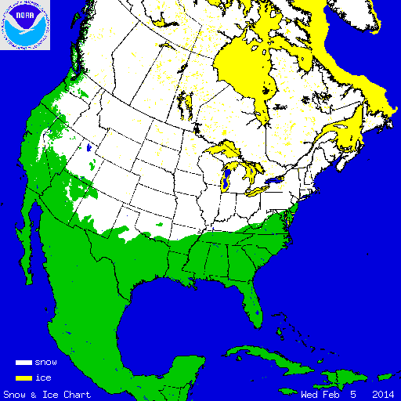
Snow Observations
Interactive Multisensor Snow and Ice Mapping System (IMS)
Time sequenced imagery from geostationary satellites
AVHRR,
SSM/I
Station data
Northern Hemisphere product
Daily
Polar stereographic projection
Information content: Snow/Snow free
Data used at ECMWF:
24km product (ERA-Interim)
4 km product (operational NWP, ERA5)
More information at: http://nsidc.org/data/g02156.html
NOAA/NESDIS
IMS Snow extent data
IMS Snow Cover 5 Feb. 2014

Slide 8
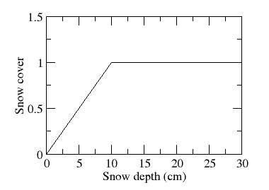
Use of NESDIS/IMS snow cover data
- IMS snow cover (SC) means SC>50%
- But no quantitative information on snow depth
- Relation snow cover (SC)/Snow Depth (SD): SC=50% corresponds to SD=5cm
- Previously: direct insertion of 10cm when IMS has snow & model has no snow
- Issues with overestimated snow
- IFS revision for current cycle: assimilate IMS
and account for IMS observation error
IMS has snow(SC>=50%)
→ Model eq depth >= 5cm
Fst Guess NESDIS | Snow | No Snow
Snow | x | DA 5cm
No Snow | DA | DA
Use of IMS at ECMWF
Error specifications:
BG: σb = 3cm
SYNOP σSYNOP = 4cm
IMS σims = 8cm
Model relation between Snow Cover
(SC) and Snow Depth (SD)

Slide 9
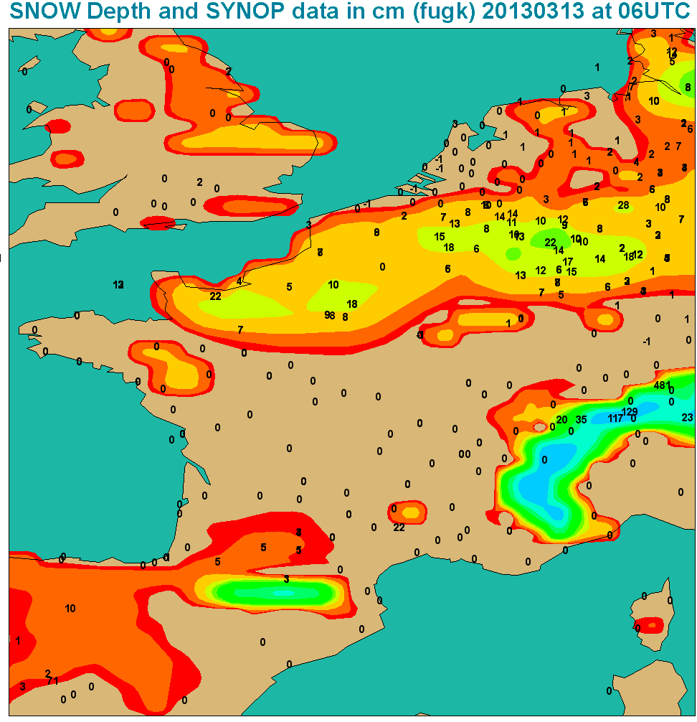
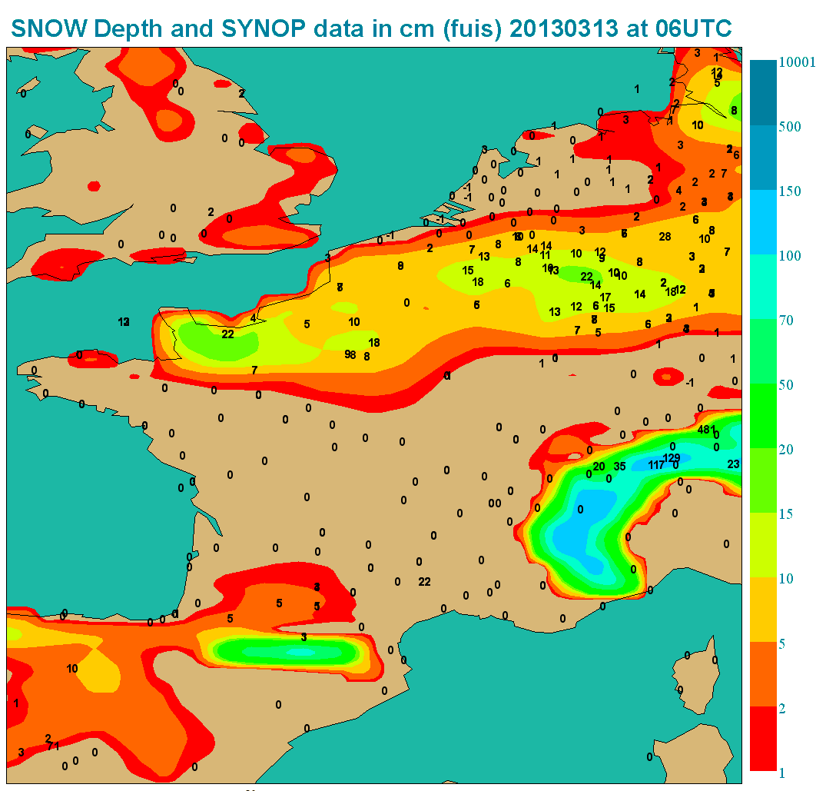
Case Study: Normandie 12-13 March 2013
Analysis 2013 03 13 at 06 UTC
Old: Direct insertion
Current: DA
500
150
100
70
50
20
15
10
5
2
Improved use of NESDIS/IMS snow cover combined with in situ snow depth
Account for NESDIS/IMS errors, better represents snow line.

Slide 10
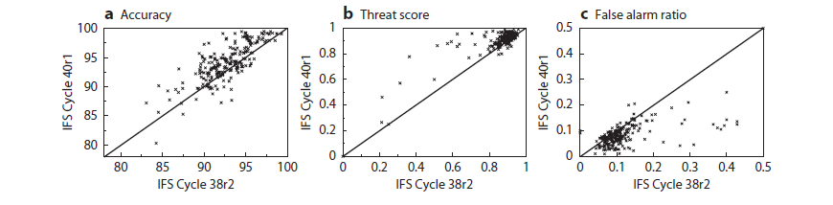
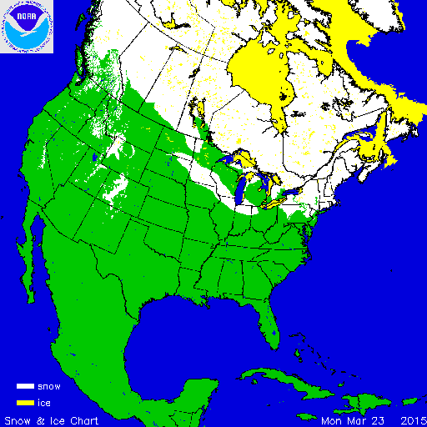
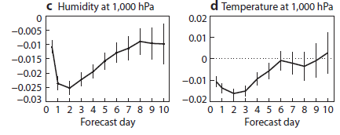

Snow analysis: Forecast impact
Revised IMS snow cover data assimilation (2013)
Impact on snow October 2012 to April 2013 (251 independent in situ observations)
☺
☺
☺
Impact on atmospheric forecasts
October 2012 to April 2013 (RMSE new-old)
→ Consistent improvement of snow and atmospheric forecasts
☺
☺
de Rosnay et al., ECMWF
NL 143, Spring 2015

Slide 11
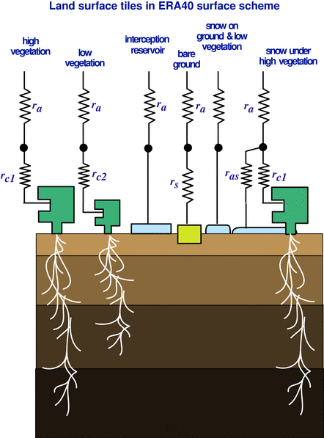
Simplifed EKF soil moisture analysis
For each grid point, analysed soil moisture state vector θ_{a}:
θ _{a}= θ _{b}+ K (y-H [θ _{b}])
θ background soil moisture state vector,
H non linear observation operator
y observation vector
K Kalman gain matrix, fn of
H (linearsation of H), B and R (covariance matrices
of background and observation errors).
Observations used at ECMWF:
For operational NWP:
  Conventional SYNOP pseudo observations (analysed T2m, RH2m)
  Satellite MetOp-A/B ASCAT soil moisture
Research: SMOS Data Assimilation
The simplified EKF is used to corrects the soil moisture trajectory of the
Land Surface Model
Used at ECMWF (operations and ERA5), DWD, UKMO
Drusch et al., GRL, 2009
de Rosnay et al., ECMWF News Letter 127, 2011
de Rosnay et al., QJRMS, 2013

Slide 12
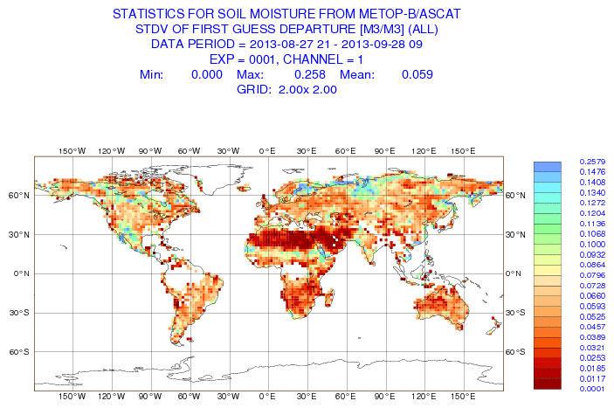
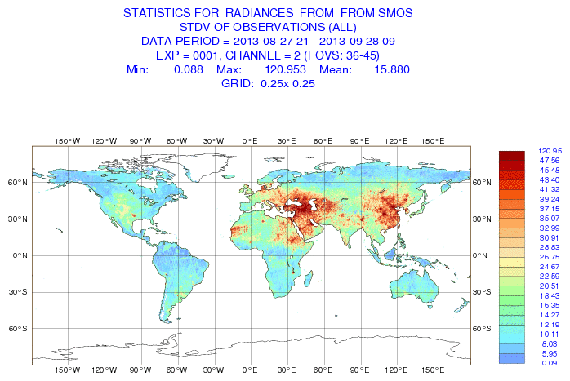


Satellite data for NWP soil moisture analysis
Active microwave data:
ASCAT: Advanced Scatterometer
On MetOP-A (2006-), MetOP-B (2012-)
C-band (5.6GHz)
NRT Surface soil moisture
Operational product
→ ensured operational continuity
Passive microwave data:
SMOS: Soil Moisture & Ocean Salinity
L-band (1.4 GHz)
NRT Brightness Temperature
Dedicated soil moisture mission
→ Strongest sensitivity to soil moisture
Active and Passive:
SMAP: Soil Moisture
Active Passive
L-band TB 2015
Dedicated
soil moisture mission
Operational Monitoring of surface soil moisture related satellite data:
ASCAT soil moisture (m³m⁻³) SMOS Brightness temperature (K)
Stdev FG_depar
Sept. 2013

Slide 13

Passive microwave remote sensing
Soil Moisture and Ocean Salinity mission
SMOS ESA Earth Explorer mission (2009-present)
L-band (1.4 GHz) instrument. Optimal frequency for soil moisture remote sensing
Sun-synchronous, quasi-circular orbit at altitude 758 km. 06.00 hrs local solar time at ascending node. Three days revisit at Equator
Dual polarisation: H and V in the Earth reference, xx and yy in the antenna frame reference
Multi-angular measurements 0 to 60°
ECMWF and CMC: use NRT SMOS Brightness Temperature (TB) data
Use observation operator to simulate L-band TB:
Community Microwave Emission Modelling Platform (CMEM)

Slide 14

Microwave emission modelling
→ Forward operator: microwave emission model
ECMWF Community Microwave Emission Modelling Platform (CMEM)
I/O interfaces for the Numerical Weather Prediction Community.
https://software.ecmwf.int/wiki/display/LDAS/CMEM
Also used at CMC, CSIRO,
GSFC, and others centres
Current version 5.0 (July 2015)
References:
Drusch et al. JHM, 2009
de Rosnay et al. JGR, 2009
de Rosnay, ESA Report, 2009

Slide 15
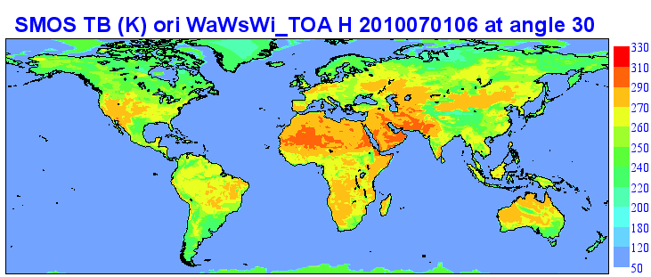
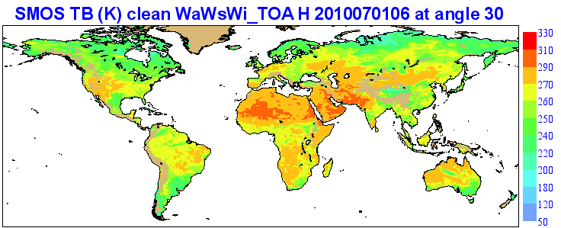
CMEM Simulations of L-Band Brightness Temperature (TB)
ECMWF TB
July 2010
TOA TBH
Global
Land only and
after QC
(remove areas with snow, frozen conditions and orography)
ECMWF TB

Slide 16
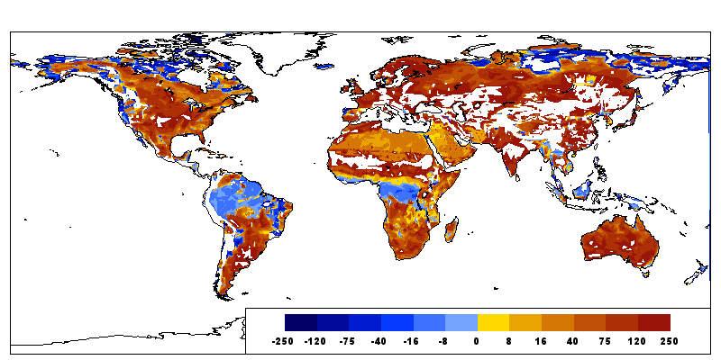
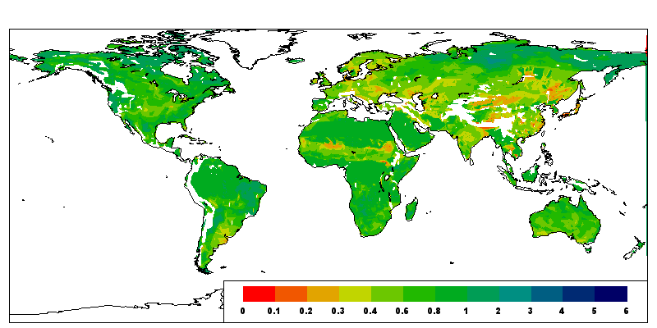
SMOS Bias correction (BC)
Cumulative Distribution Function CDF-matching → matches mean and variance of two distributions.
TBSMOS* = a + b TBSMOS
with a = TBECMWF – TBSMOS (σECMWF /σSMOS )
b = σECMWF / σSMOS
Matching parameters
on each grid point
for each month
- Based on ECMWF re-analysis: CMEM forward TB
- Long term data sets: January 2010 – March 2014
- Computed at 40km resolution (SMOS resolution)
- Monthly CDF: 3-month moving window
- Multi-angular and dual polarisation CDF
a
b

Slide 17
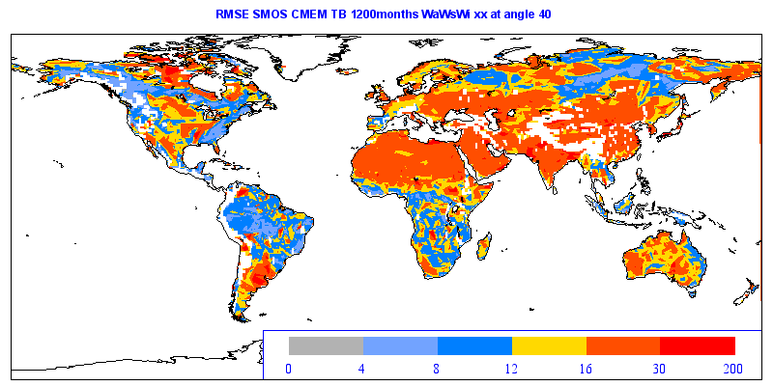
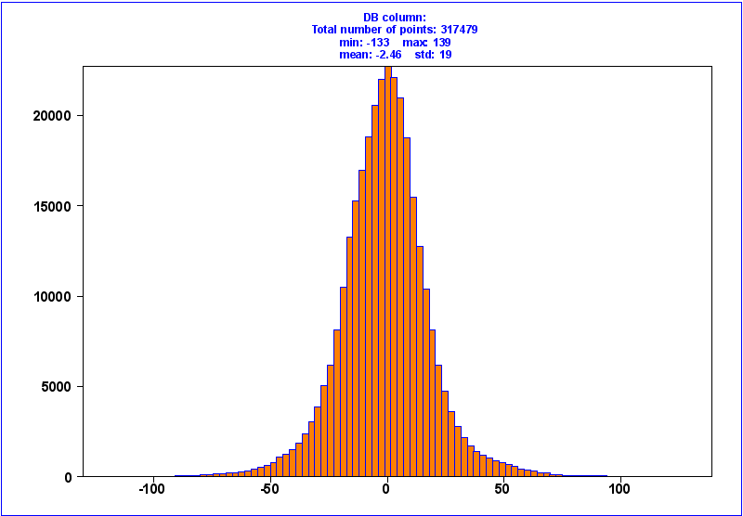
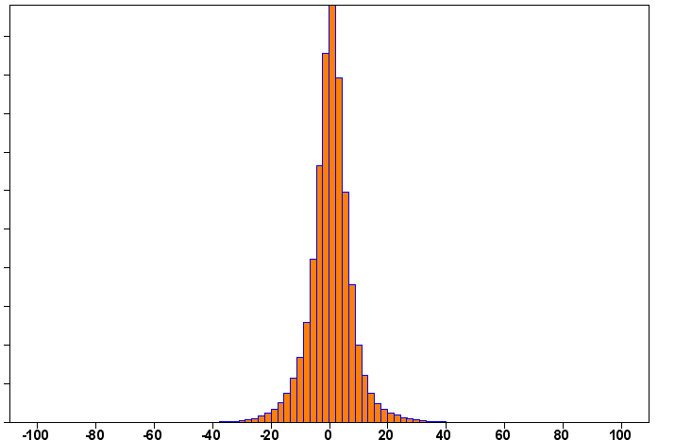
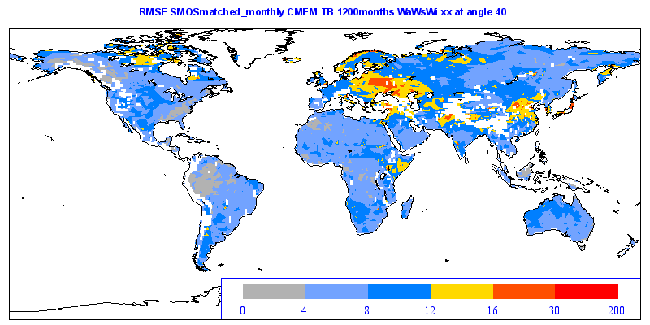
SMOS forward operator and Bias correction
Comparison between SMOS and ECMWF TB:
First Guess departure statistics
Jul 2012
St Dev 19K
RMSE (K)
Before BC
St Dev 8K
RMSE (K)
after BC

Slide 18
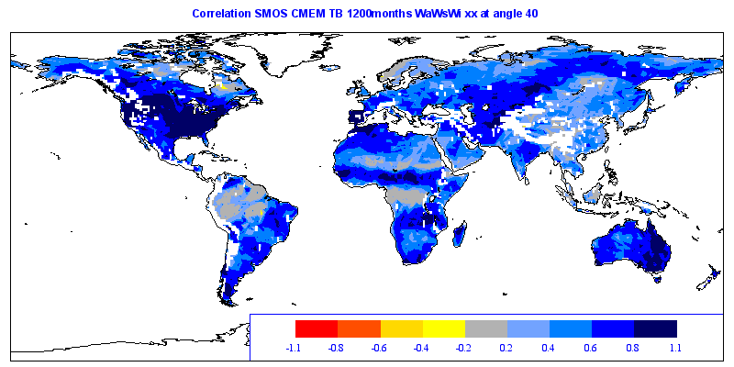

SMOS forward operator and Bias correction
Correlation (2012)
TBxx 40 degrees
Before SMOS BC (0.52)
After SMOS BC (0.57)
Monthly CDF-matching
→ improves correlation

Slide 19
Comparison between SMOS and ECMWF TB
Long term comparison between:
SMOS NRT TB (proc v505 reprocessed and NRT data sets) and
ECMWF-CMEM re-analysis using latest physiographic data base (IFS CY41R1).
 | RMSE (K) | R | Anomaly R
2010 | 8.68 | 0.545 | 0.277
2011 | 8.03 | 0.565 | 0.285
2012 | 7.78 | 0.567 | 0.302
2013 | 7.40 | 0.595 | 0.315
Table: Global mean statistics, after bias correction, considering xx and yy pol at 30,40,50 degrees incidence angles.
Consistent improvement of agreement between
SMOS and ECMWF reanalysis from 2010 to 2013

Slide 20
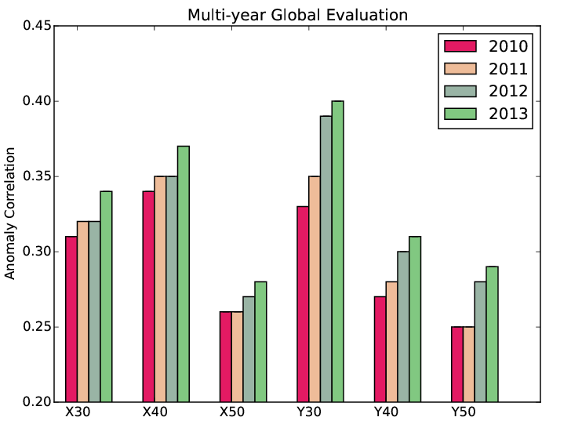
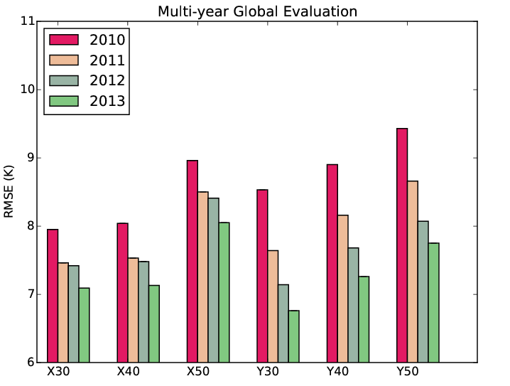
SMOS Forward modelling and Bias correction
CMEM: ECMWF Community Microwave Emission Modelling Platform
→ produce reprocessed ECMWF SMOS TB for 2010-2013
Comparison between ECMWF TB and SMOS NRT TB (both reprocessed)
Consistent improvement of SMOS data at Pol xx and yy, for incidence angles 30, 40, 50 degrees
de Rosnay et al, in prep
Anomaly correlation
RMSE
Polarisation (xx or yy) and incidence angle (30, 40, 50)
Polarisation (xx or yy) and incidence angle (30, 40, 50)

Slide 21
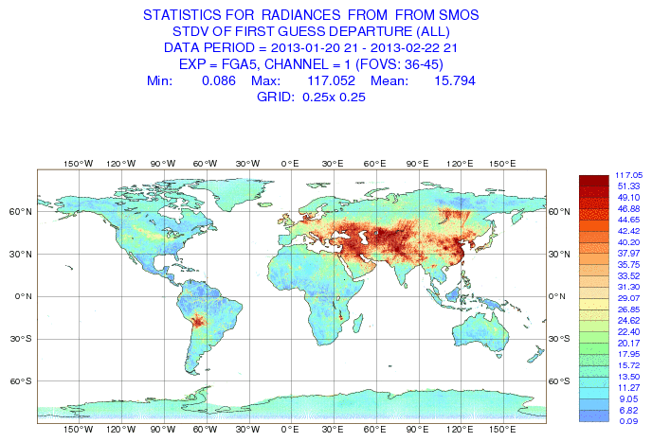
SMOS Monitoring
Near real time (NRT) monitoring of SMOS TB at ECMWF
(Muñoz Sabater et al. ECMWF Newsletter & IEEE TGRS 2011)
RFI (Radio Frequency Interference) sources impact on FG departures (Obs-model) : large standard deviation (StDev); Lots of RFI sources switched off in Europe, new sources identified in 2012,major issue in Asia.
StDev first guess departure (Obs-Model)
In Kelvin for Jan-Feb 2013

Slide 22
Satellite data for NWP soil moisture analysis
Active microwave data:
ASCAT: Advanced Scatterometer
On MetOP-A (2006-), MetOP-B (2012-)
C-band (5.6GHz)
NRT Surface soil moisture
Operational product
→ ensured operational continuity
Passive microwave data:
SMOS: Soil Moisture & Ocean Salinity
L-band (1.4 GHz)
NRT Brightness Temperature
Dedicated soil moisture mission
→ Strongest sensitivity to soil moisture
Active and Passive:
SMAP : Soil Moisture
Active Passive
L-band TB 2015
Dedicated
soil moisture mission
Operational Monitoring of surface soil moisture related satellite data:
ASCAT soil moisture (m³m⁻³) SMOS Brightness temperature (K)
Stdev FG_depar
Sept. 2013

Slide 23
ASCAT soil moisture
- ASCAT is a soil moisture index (0-1) ; models soil moisture variable is a volumetric quantity (m³m⁻³)
Systematic differences between model and observations
Data assimilation aims at correcting for the model random errors, so a bias correction method is necessary to match the observations ‘climatology’ to that of the model
(→ See D. Dee’s Lecture on Bias Correction)
For soil moisture data assimilation systems simplified Bias correction method often used
Cumulative Distribution Function Matching: CDF-Matching (e.g. Scipal et al. WRR 2008, Draper et al, JGR 2009)
ECMWF: Revised in 2011 to account for seasonal cycle (de Rosnay et al., ECMWF Res. Memo. 2011)

Slide 24
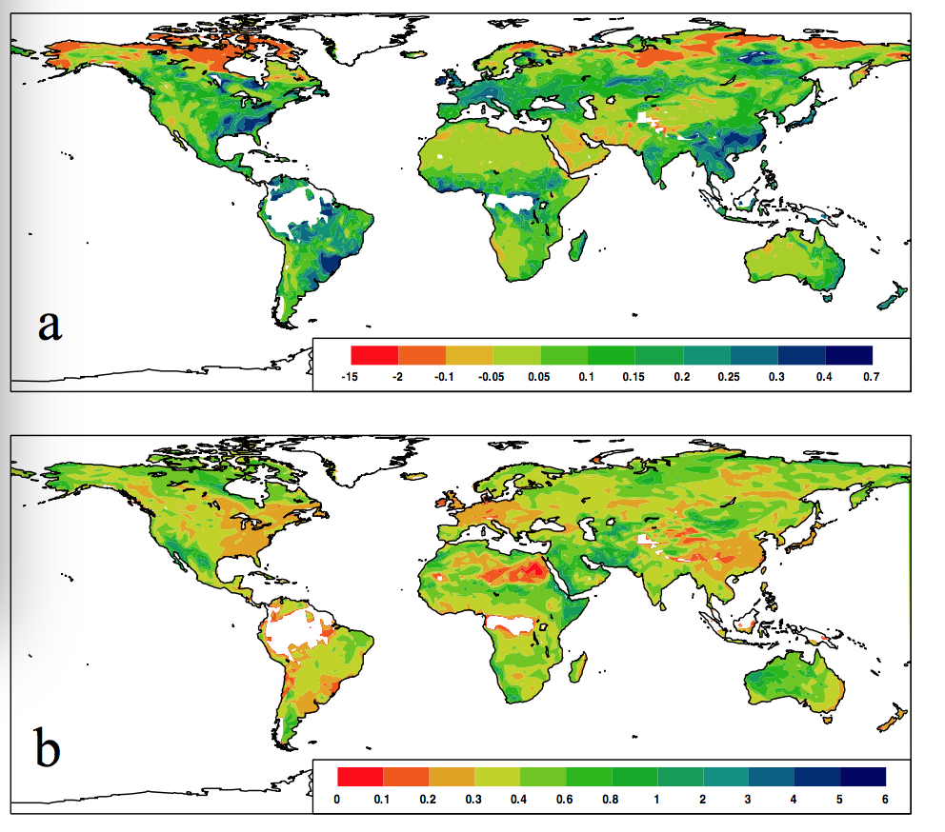
ASCAT Bias Correction (CDF matching)
- ASCAT soil moisture index ms_{ASCAT}
- Model soil moisture θ (m³/m⁻³)
Simple Cumulative Distribution Function
(CDF) matching (Scipal et al., 2008)
a and b are CDF matching parameters
computed on each model grid point
ASCAT CDF-matching has two objectives:
→ ASCAT index converted to
model equivalent volumetric soil moisture
Bias correction
θ_{ascat} = a + b ms_{ascat}
with a = θ_{model} – ms_{ascat} (σ_{model} /σ_{ms_ascat} )
b = σ_{model} / σ_{ms_ascat}
→ Matches mean and variance
ASCAT matching parameters
(de Rosnay et al., ECMWF Res memo R43.8/PdR/11100, 2011)

Slide 25
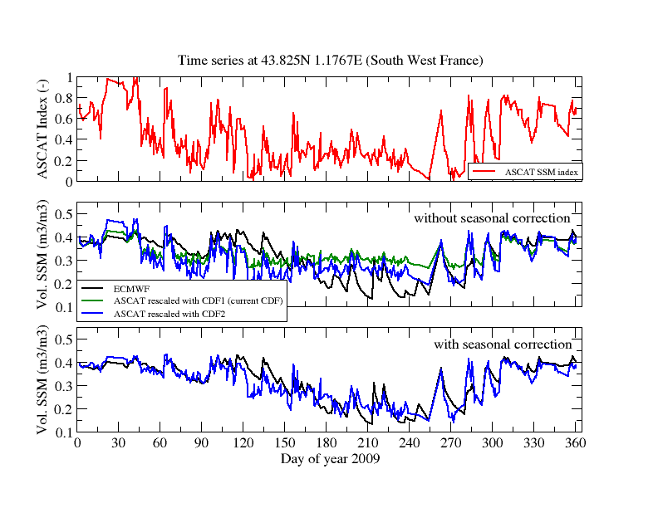
ASCAT Bias Correction (CDF matching)
Efficient data assimilation relies on accurate bias correction
ASCAT index
ECMWF model soil moisture
(ASCAT old BC)
ASCAT with static BC
ASCAT with dynamic (seasonal) BC

Slide 26
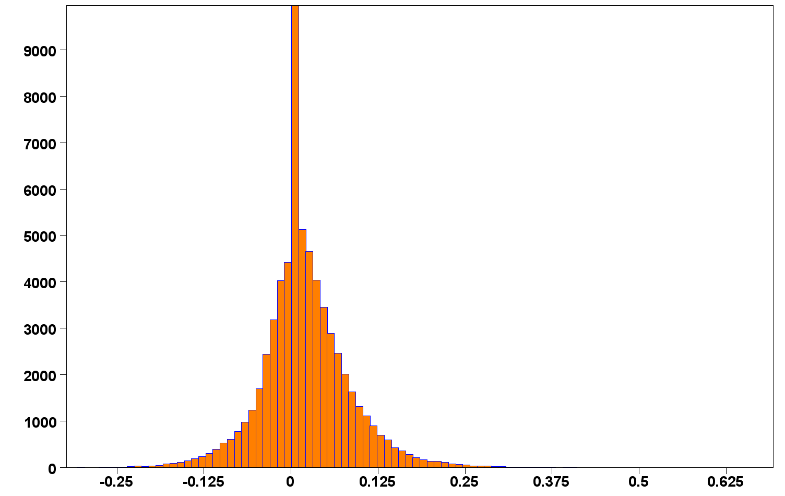
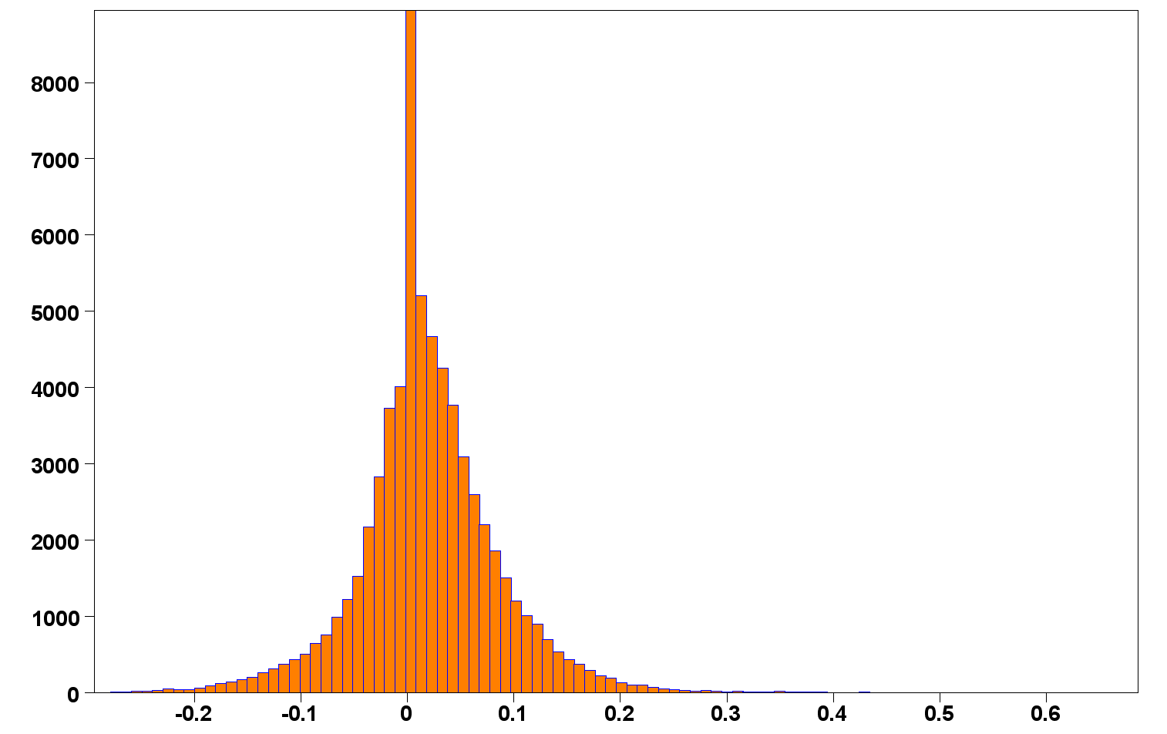
ASCAT-A and ASCAT-B
ASCAT SM – Model
(First guess departure, m³.m⁻³)
23-24 Nov 2012
Metop-A launched in 2006 Metop-B launched in 2012
Consistent ASCAT-A and ASCAT-B soil moisture
ASCAT-A
Departure statistics:
 | Nb | Mean m³.m⁻³ | Std m³.m⁻³
ASCAT-A | 64893 | 0.0152 | 0.0645
ASCAT-B | 65527 | 0.0149 | 0.0663
ASCAT-B
Operational monitoring:
http://www.ecmwf.int/en/forecasts/quality-our-forecasts/monitoring/soil-moisture-monitoring

Slide 27
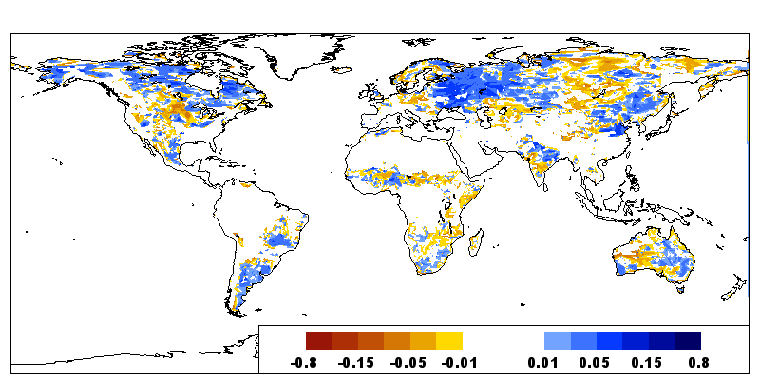
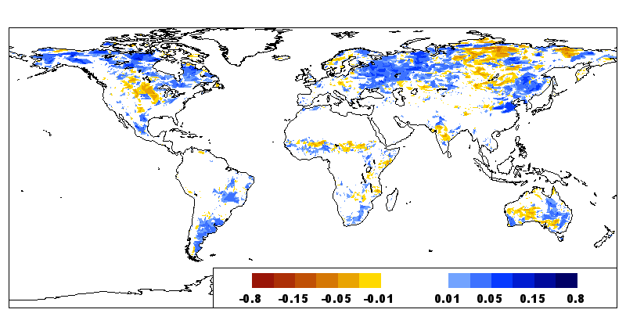
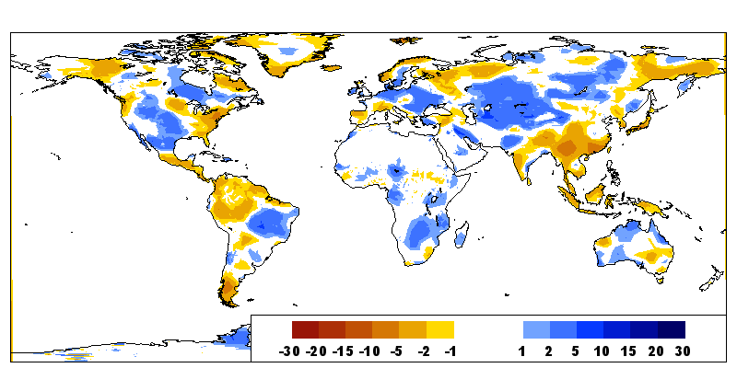
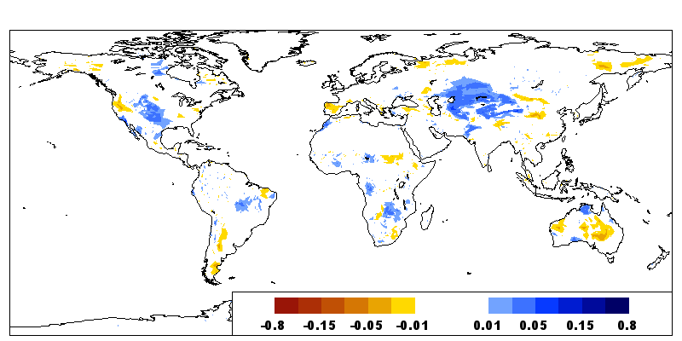
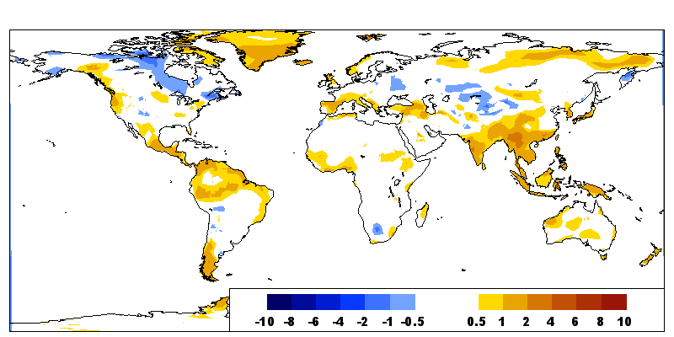
ASCAT Soil Moisture data assimilation for NWP
Innovation (Obs- model)
25-30 June 2013
Accumulated Increments (m³/m³)
in top soil layer (0-7cm)
ASCAT
(m3/m3)
Due to ASCAT
RH2m (%)
T2m (K)
Due to SYNOP T2m and RH2m

Slide 28
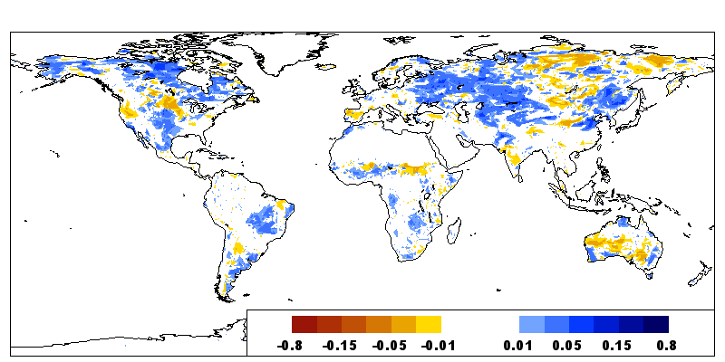
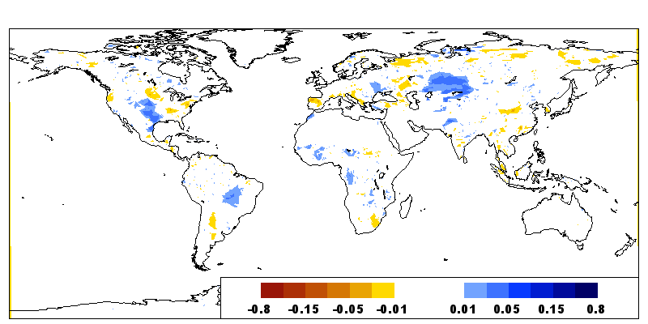
ASCAT Soil Moisture data assimilation for NWP
Volumetric Soil Moisture increments (m³/m³)
(accumulated)
25-30 June 2013
Vertically integrated
Soil Moisture increments (stDev in mm)
Layer1
(0-7cm)
 | SYNOP | ASCAT
Layer 1 | 0.68 | 1.43
Layer 2 | 1.48 | 0.68
Layer 3 | 4.28 | 0.46
ASCAT more increments than SYNOP at surface
SYNOP give more increments at depth
→ For 12h DA window, link obs to root zone stronger for T2m,RH2m than for surface soil moisture observations
Layer2
(7-28cm)

Slide 29
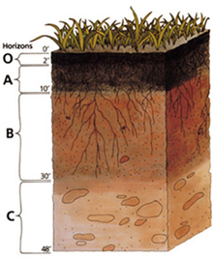
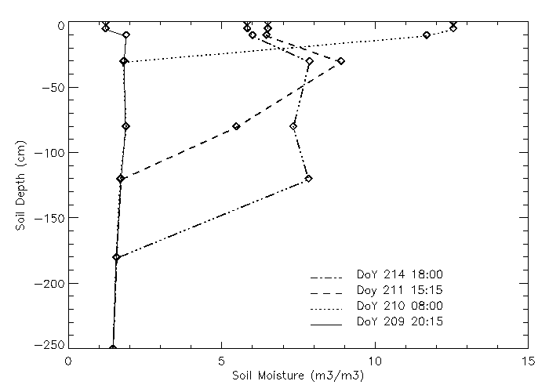
Root Zone Soil Moisture Retrieval
Satellite data → Surface information
Top soil moisture sampling depth: 0-2cm ASCAT, 0-5cm SMOS
Root Zone SM Profile
Variable of interest for
Soil-Plant-Atm interaction,
Climate, NWP and
hydrological applications
Accurate retrieval requires to account for
physical processes
→ Retrieval of root zone soil moisture using satellite data requires data assimilation approaches
Soil Moisture Vertical Profile
d2
d1
d3
d4
0 Soil Moist m3/m3 x 100 15

Slide 30

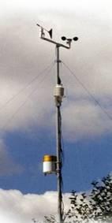
ASCAT root zone retrieval based on data assimilation
EUMETSAT Hydrology SAF
ECMWF Atmospheric conditions
SYNOP
T2m RH2m
analysis
SEKF
Soil Moisture
Analysis
ASCAT Root
Zone product
(SM-DAS-2)
ASCAT
Surface SM
Bias corrected
Analysed root zone
soil moisture on model levels
4 layers:
0-7cm
7-28 cm
28-100 cm
100-289cm
Quality Control → use data when:
Topographic complexity ≤ 20
Wetland Fraction ≤ 15
Noise level ≤ 8
processing flag=0

Slide 31
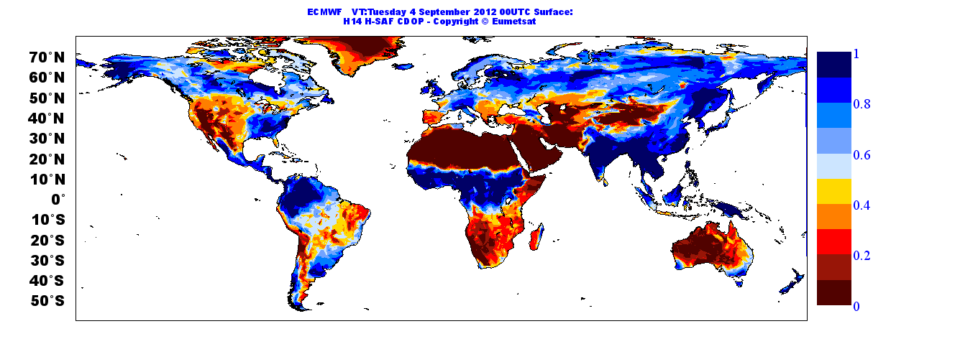
ASCAT root zone retrieval based on data assimilation
Assimilated ASCAT
Surface (0-7cm) soil moisture index (0-1)
04 Sept 2012 00UTC
ASCAT Root Zone Soil Moisture Product (H-SAF SM-DAS-2):
Data assimilation used to propagate in space and time the ASCAT surface swath soil moisture information
Daily Soil Moisture product valid at 00:00 UTC
Daily Global coverage
SM-DAS-2: Operational H-SAF since July 2012;
Contact: hsafcdop@meteoam.it
Notes:
ASCAT root zone soil moisture (layer-1 here) is a soil moisture index as ASCAT. It is available daily with global coverage and with a latency of 36h

Slide 32

ASCAT root zone retrieval based on data assimilation
SM-DAS-2 available on 4 soil layers
Assimilated ASCAT
soil moisture index (0-1)
04 Sept 2012 00UTC
Layer 1 (0-7cm)
Layer 2 (7-28cm)
Notes:
Illustrates layers 1 and deeper in the soil, layer-2

Slide 33
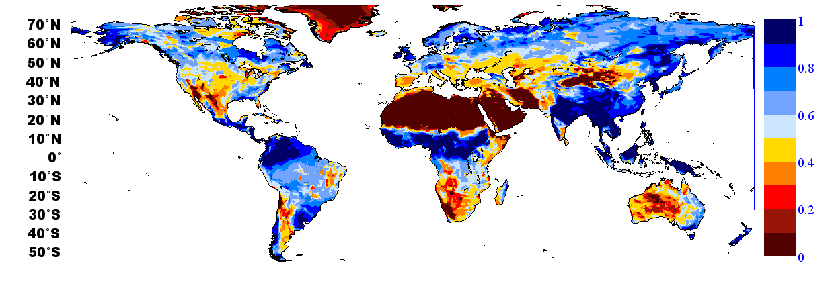
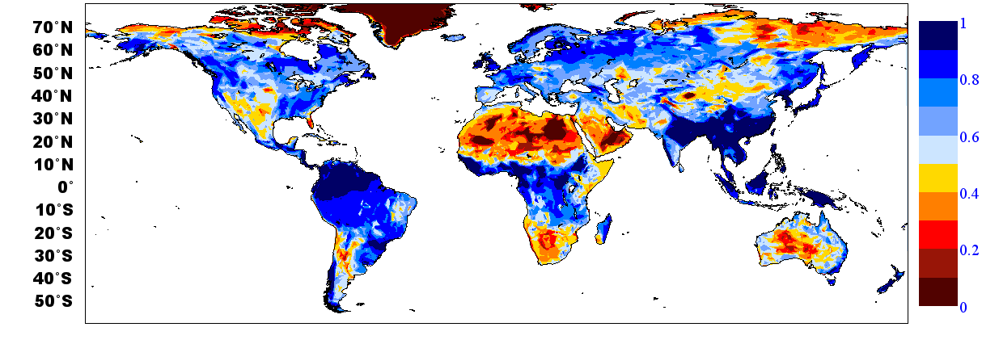
ASCAT root zone retrieval based on data assimilation
SM-DAS-2 available on 4 soil layers
Assimilated ASCAT
soil moisture index (0-1)
04 Sept 2012 00UTC
Layer 3 (28-100cm)
Layer 4 (100-289cm)
Notes:
Layer 3 is down to 1m and layer 4 down to 3m (the exact depth is 2.89m)

Slide 34
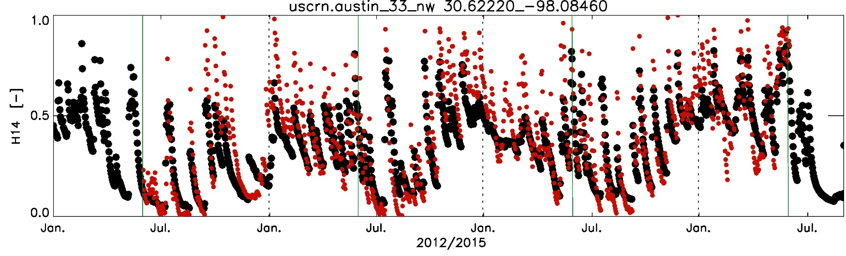
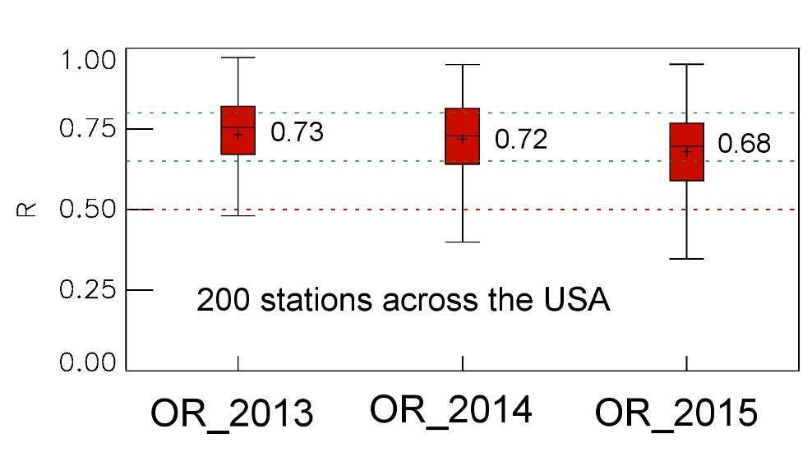

Soil moisture Validation
Scatterometer root zone soil moisture based on data assimilation
Albergel et al.
Evaluation of SM-DAS-2/H14
Surface and root zone liquid soil moisture content
OR_2013
OR_2014
OR_2015
Observation (5cm)
SM-DAS-2 (0-7cm)
Accuracy requirements for product SM-DAS-2 [R]
Unit | Threshold | Target | Optimal
Dimensionless | 0.50 | 0.65 | 0.80

Slide 35
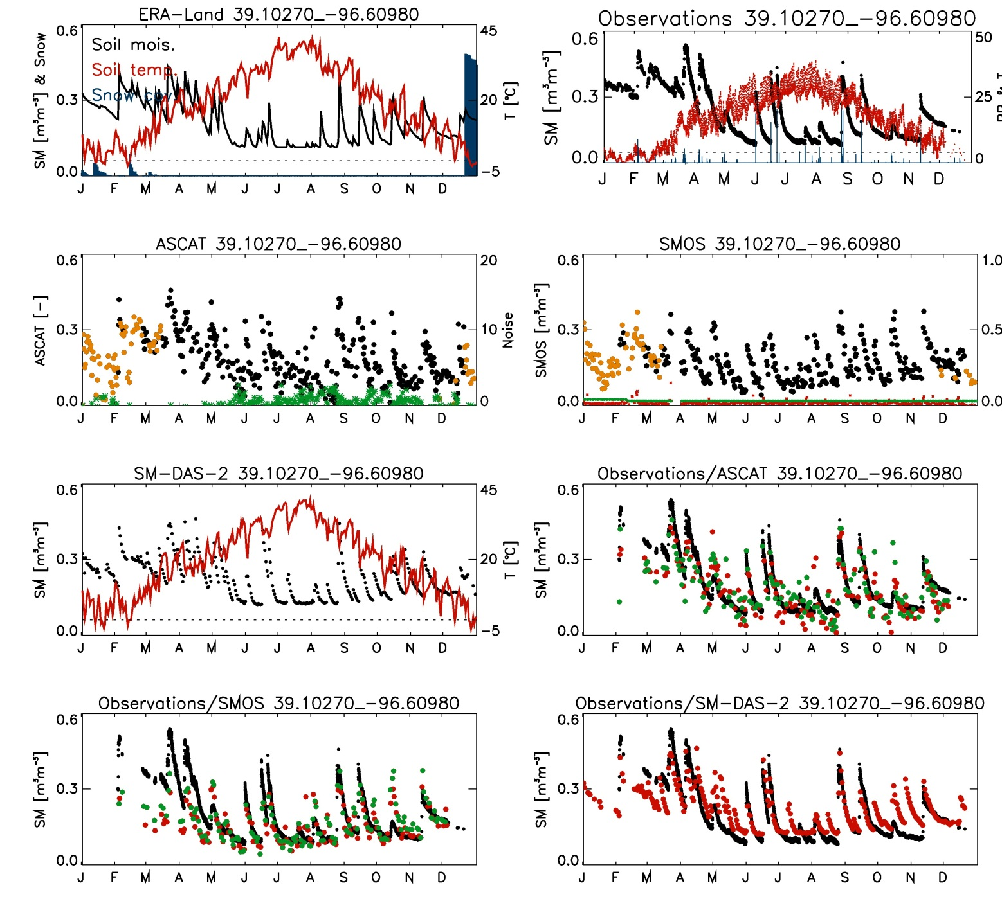
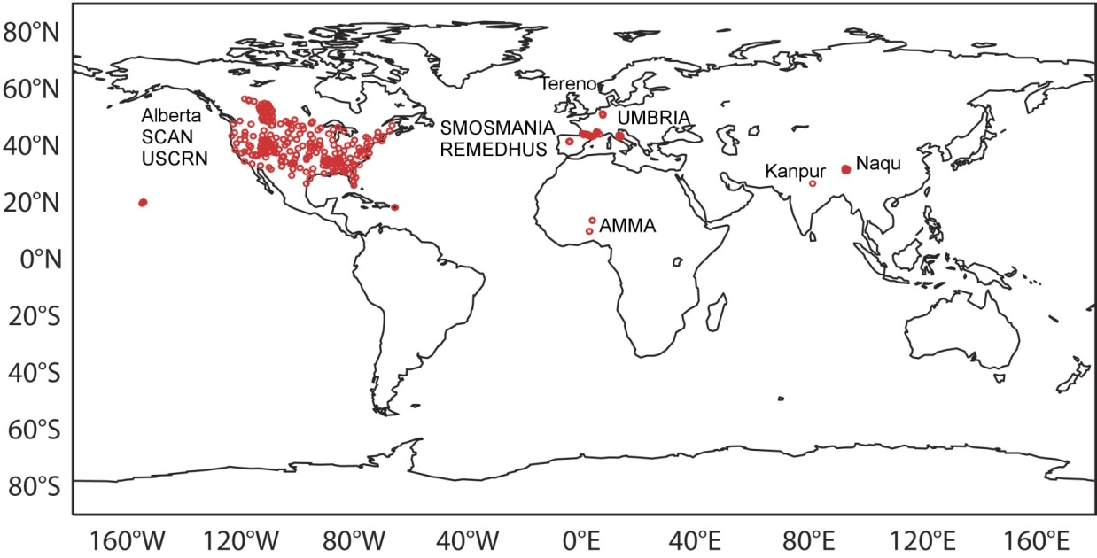
Validation with in situ soil moisture data
ASCAT
SMOS
406 stations from 10 networks
International Soil Moisture Network
Validation for 2012 of ASCAT, SMOS and SM-DAS-2
For each station, time series are compared
SM-DAS-2
Updated after Albergel et al. Remote Sens Env. 2012

Slide 36
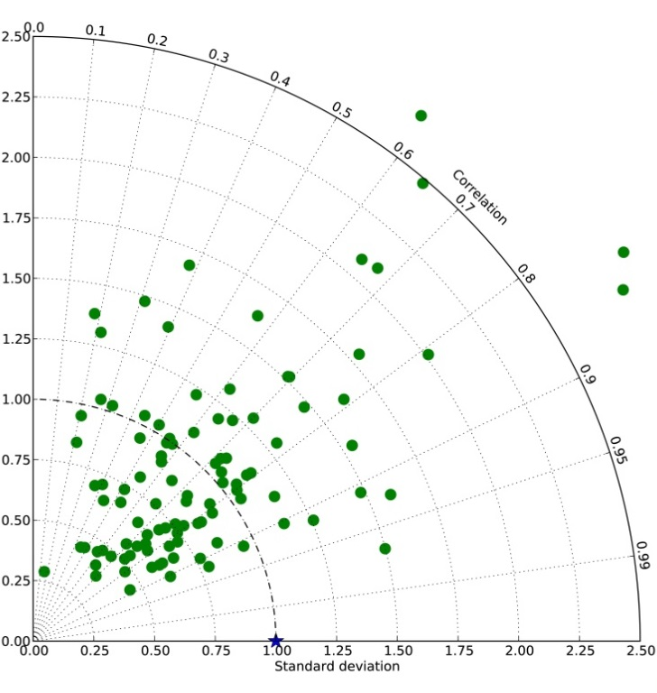
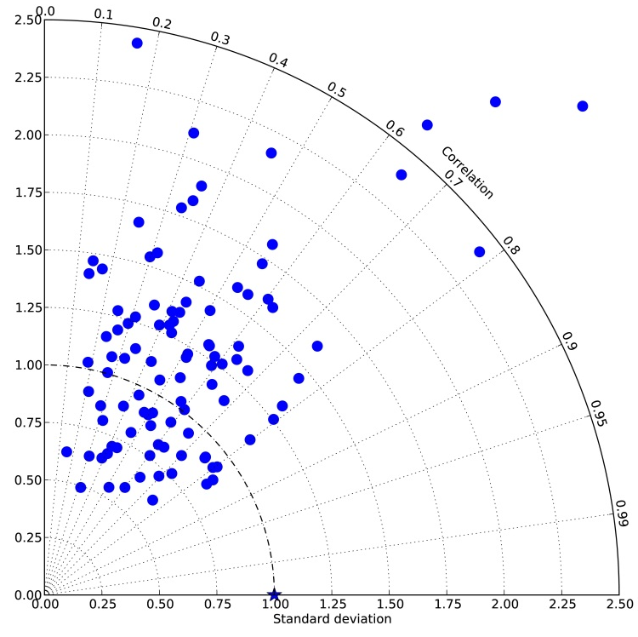
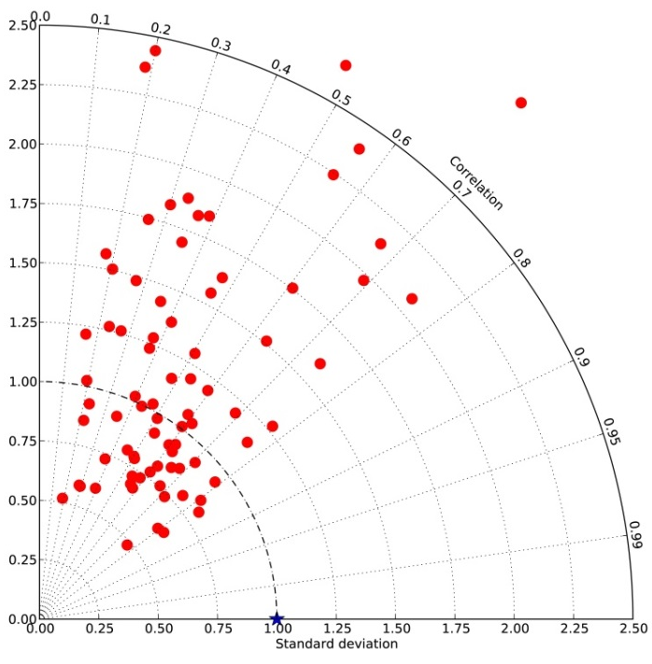
Validation with in situ soil moisture data
USCRN soil moisture network
SM-DAS-2
ASCAT
 | Correlation [-] (for stations with significant values)
 | SM-DAS-2 | ASCAT | SMOS
 | 0.67 (104 stations) | 0.50 (104 stations) | 0.50 (84 stations)
SMOS

Slide 37
Validation with in situ soil moisture data
Normalized Product (nb stations with significant R) | SM-DAS-2 (333) | ASCAT (322) | SMOS (258)
Correlation | 0.68 | 0.54 | 0.54
Bias (In Situ - Product) | -0.084 | -0.005 | 0.027
RMSD | 0.120 | 0.110 | 0.105
Updated after Albergel et al. RSE, 2012
Validation using the 10 Networks
Bias and RMSD expressed as soil moisture index (no unit)
Normalized Product (nb stations with significant R) | SM-DAS-2 (310) | ASCAT (291) | SMOS (234)
Correlation on Anomaly | 0.56 | 0.41 | 0.42
SMOS and ASCAT surface soil moisture have similar quality
Assimilated product (SM-DAS-2) has a larger bias, but in terms of dynamics it shows the best agreement with in situ soil moisture data

Slide 38
Satellite data for NWP soil moisture analysis
Active microwave data:
ASCAT: Advanced Scatterometer
On MetOP-A (2006-), MetOP-B (2012-)
C-band (5.6GHz)
NRT Surface soil moisture
Operational product
→ ensured operational continuity
Passive microwave data:
SMOS: Soil Moisture & Ocean Salinity
L-band (1.4 GHz)
NRT Brightness Temperature
Dedicated soil moisture mission
→ Strongest sensitivity to soil moisture
Active and Passive:
SMAP: Soil Moisture
Active and Passive
L-band TB 2015
Dedicated
soil moisture mission
Operational Monitoring of surface soil moisture related satellite data:
ASCAT soil moisture (m³m⁻³) SMOS Brightness temperature (K)
Stdev FG_depar
Sept. 2013

Slide 39
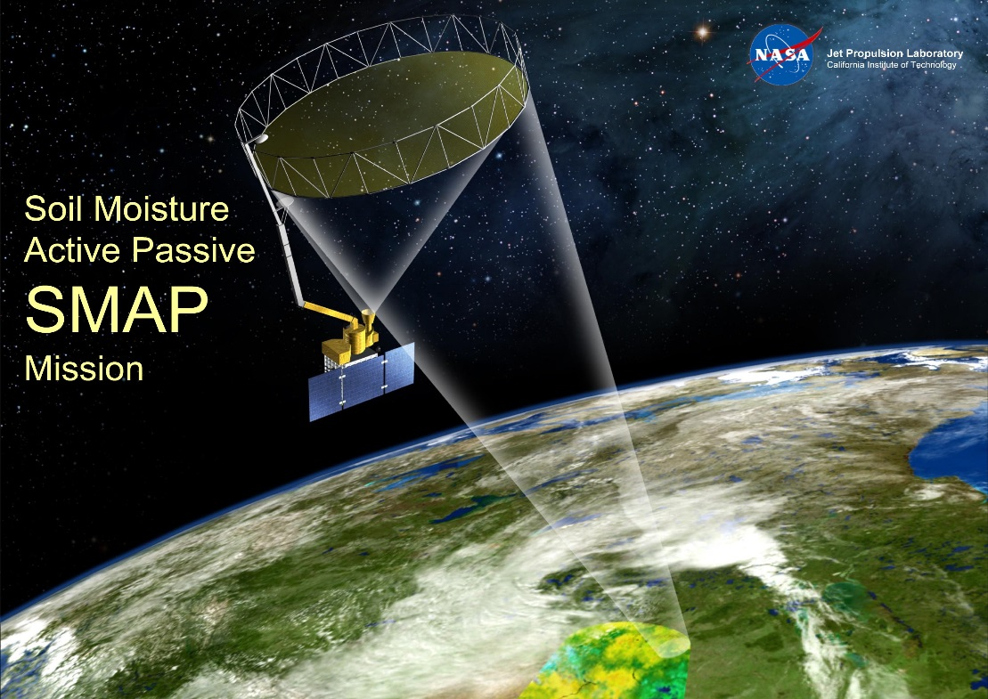

SMAP
SMAP Launched on 31 Jan 2015
Antenna spin-up end of March
First public data distribution in July 2015
Slide from Dara Entekhabi, SMAP Science Team Lead

Slide 40



SMOS ESA Near-Real-Time soil moisture product: based on Neural Networks
NRT designed and evaluated by CESBIO (Centre d’Etudes Spatiales de la Biosphere)
(Rodriguez-Fernandez et al. )
Input | STD | R | Bias
NN | 0.049 | 0.55 | -0.024
SMOS L3 | 0.064 | 0.50 | -0.026
SMOS NRT SM vs SMOS L3 SM:
Average temporal correlation = 0.8
Average stats vs USDA SCAN in situ measurements → better than SMOS L3
NRT implemented in operations at ECMWF in January 2016, operational ESA March 2016
A SM product very similar to the current operational one but in Near-Real-Time
ESA product distributed by GTS and EUMETCAST
NRT high quality SMOS soil moisture product
Very relevant for the scientific community as well as for operational NWP and hydrological forecasts communities

Slide 41
Passive microwave remote sensing
Satellite missions relevant for soil moisture:
Skylab, NASA, L-band, 1973-1974 (but only 9 overpasses available)
SMMR, Nimbus7, C-Band (6.6 GHz) , X-band (10.7 GHz), 1978-1987 (Scanning Multichannel Microwave Radiometer)
TMI (TRMM Microwave Imager), X-band (10.7 GHz), 1997-2014
SSMI (Special Sensor Microwave Imager, DMSP F8-13), 19.3 GHz, 1987-
AMSR-E 2002-2011, (Advanced Scanning Radiometer on Earth Observing System, NASA, C-band (6.9GHz)
SMOS (Soil Moisture and Ocean Salinity Mission): ESA Earth Explorer, L-band (1.4 GHz), launched November 2009 First satellite specifically devoted to soil moisture remote sensing
AMSR-2 on GCOM-W1 (Global Change Observation Mission) launched in 2012
SMAP (Soil Moisture Active and Passive), NASA, L-band, launched in January 2015

Slide 42

ESA Climate Change Initiative (CCI) Soil moisture:
Project overall objective: produce the most complete/consistent global soil moisture data record based on active and passive microwave sensors
http://www.esa-soilmoisture-cci.org

Slide 43


ESA-CCI SM & ERA-Interim/Land vs. in-situ measurements
2014 (based on daily data)
In-situ ESA-CCI-SM ERA-Interim/Land

Slide 44

Impact of soil vertical resolution for satellite soil moisture
H-TESSEL model soil resolution increased: top layer 0-7cm replaced by 3 layers 0-1cm, 1-3cm, 3-7cm
Anomaly Correlation between ECMWF surface soil moisture and ESA-CCI satellite soil moisture (diff between new-old)
(Albergel, Balsamo )
Globally Improved match to satellite soil moisture (shown is ΔACC calculate on 1-month running mean)
Anomaly correlation (1988-2014) measured with ESA-CCI soil moisture remote sensing (multi-sensor).
→ Provides a global validation of the usefulness of increase soil vertical resolution.
Notes:
Anomaly correlation calculated as centred reduce on a 1-month sliding window for the period 1988-2014.
Shown is the difference between the experiment (ge8f 0-1 cm depth of top soil) and ga89 (control 41r1).

Slide 45





The Global Flood Awareness System
www.globalfloods.eu
Output from global ECMWF NWP land-surface forecast is fed into a routing model (Simplified LISFLOOD (JRC)) to produce flood forecasts – benefiting from all the improvements in the ECMWF Integrated Forecasting System (model and assimilation)!

Slide 46
Summary and future plans
Most NWP centres analyse soil moisture and/or snow depth
Land Data Assimilation Systems: run separately from the atmospheric 4D-Var
Satellite data used for snow cover and soil moisture analyses
Snow analysis: NOAA NESDIS/IMS snow cover data (multi-sensor product). No Snow Water Equivalent products used for NWP (yet)
Soil moisture: ASCAT operational from April 2015 at ECMWF (also used at UKMO and KMA). SMOS under development (ECMWF, CMC), SMAP
Future plans: SMOS technical test in operational framework
Longer term: Assimilation of integrated hydrological variables such as river discharges: e.g. Surface Water Ocean Topography (SWOT 2020)

Slide 47
Thank you for your Attention!
Useful links:
ECMWF LDAS: https://software.ecmwf.int/wiki/display/LDAS/LDAS+Home
ECMWF SMOS: https://software.ecmwf.int/wiki/display/LDAS/SMOS
ECMWF CMEM: https://software.ecmwf.int/wiki/display/LDAS/CMEM
ECMWF Land Surface Observation monitoring:
https://software.ecmwf.int/wiki/display/LDAS/Land+Surface+Observations+monitoring

