Slide 1
ECMWF Data Assimilation Training course
Land Surface Data Assimilation – Part 2
Patricia de Rosnay
Notes:
1

Slide 2
Outline
Part I (Monday 7 March)
Introduction
Snow analysis
Screen level parameters analysis
‏
Part II (Tuesday 8 March)
Soil moisture analysis‏
Summary and future plans

Slide 3
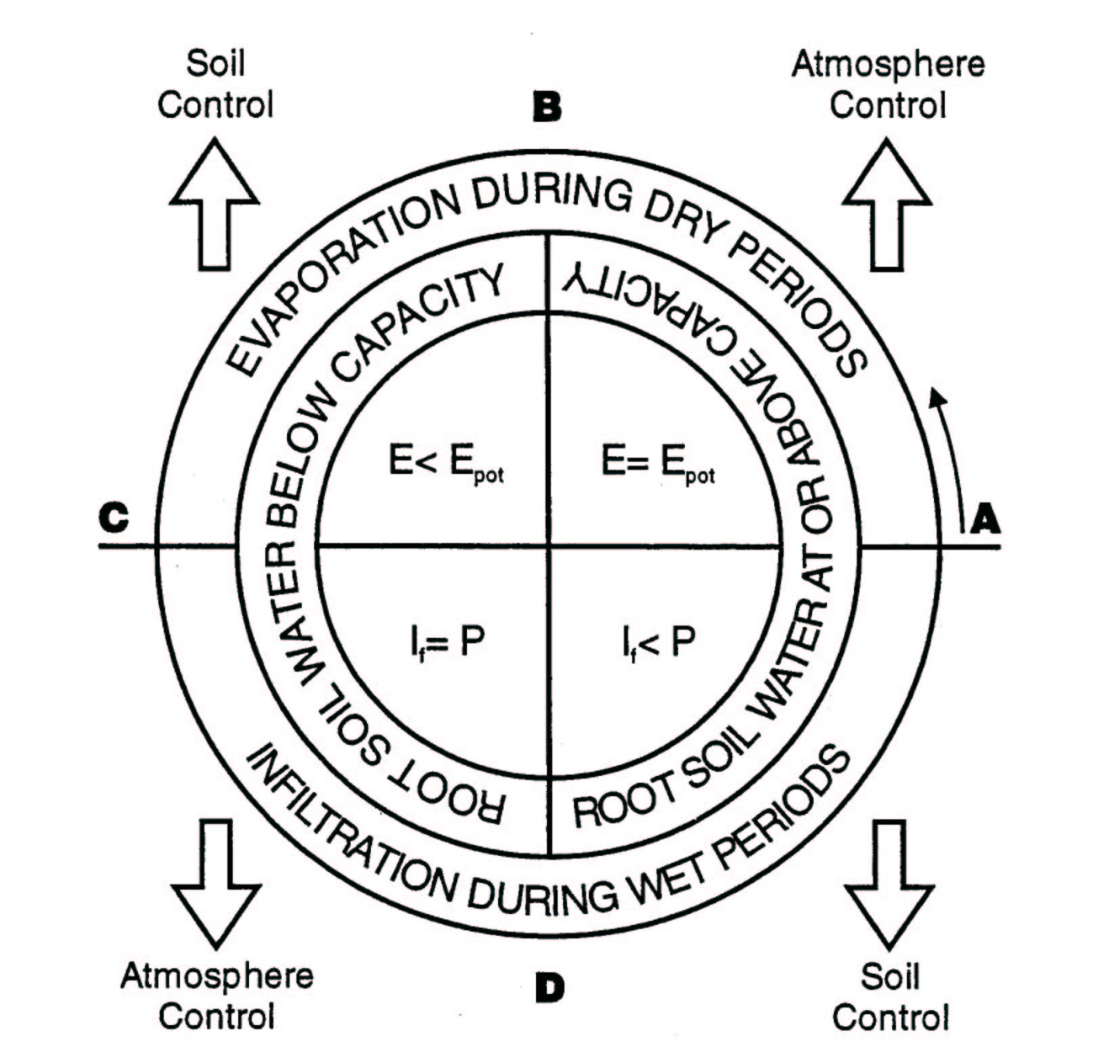
Soil Moisture – Atmosphere interactions
The hydrological ‘Rosette’ (P. Viterbo, PhD thesis, «The representation of surface processes
in General Circulation Models » ECMWF, 1996)
A → B: After rain,
Evaporation at potential rate,
Atmospheric control.
B → C: Below field capacity soil moisture,
Limitation of root extraction,
Soil control.
C → D: Precipitation & relatively dry soils,
High infiltration rate I,
Atmospheric control.
D → A: Precipitation and soil near saturation,
Soil infiltration is reduced.
Excess goes in runoff,
Soil control.
Rain
ends
Rain
starts
Simple representation, but illustrates how soil-plant-atmosphere interactions are controlled by different processes depending on the conditions.
Notes:
3

Slide 4
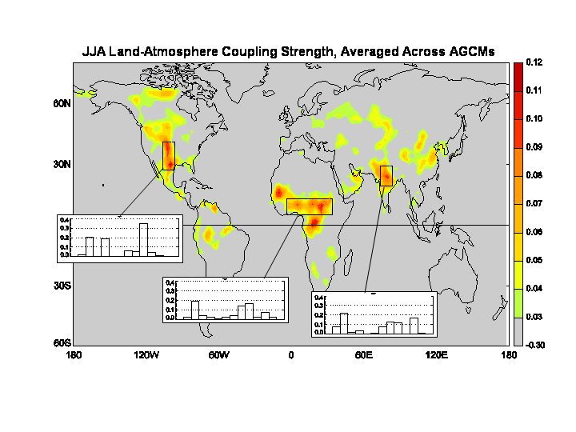
Soil Moisture – Atmosphere interactions
Based on a multi-model approach: characterization of the strength of the coupling between surface and atmosphere.
(Koster et al, Science 2004).
SM, variable of interface
Partition LE/H
Vegetation phenology,
Soil respiration,
Biogeochemical cycle
Hot spot areas → strong soil moisture-precipitation feedback
Notes:
4

Slide 5
Outline
Part I (Monday 7 March)
Introduction
Snow analysis
Screen level parameters analysis
‏
Part II (Tuesday 8 March)
Soil moisture analysis‏
  OI and SEKF soil moisture analyses
  Use of satellite data: ASCAT and SMOS
Summary and future plans

Slide 6






Soil Analysis for NWP
NWP Forecast
Coupled Land-Atmosphere
T_2m RH_2m background
SM1, SM2, SM3: soil moisture
background for layers 1-3
Jacobians,
screen observation operator
Soil Analysis (SEKF)
SWVL1, SWVL2, SWVL3
$$σo T2m =1K$$
$$σb =0.01 m3m_3$$
$$σoRH2m=4\%$$
$$σoASCAT=0.05 m3m_3$$
Screen level analysis (OI)
T_2m RH_2m
T_2m RH_2m
OBS
ASCAT SM OBS
$$σoT2m=2K$$
$$σoRH2m=10\%$$

Slide 7
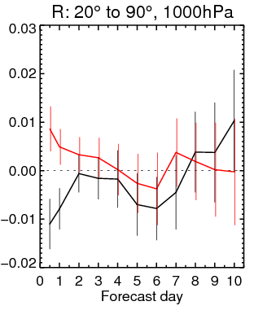
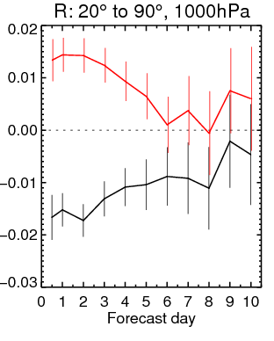
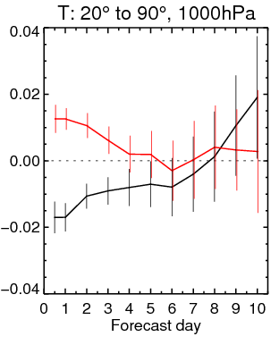
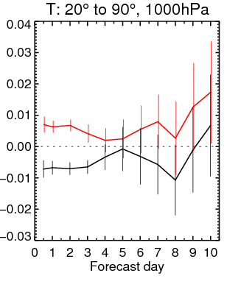
Soil Analysis for NWP: What impact on the forecast ?
Summer
Winter
No soil Analysis
IFS cycle 40r1 soil analysis
IFS cycle 41r1 soil analysis
(revised observation errors)
Humidity
Humidity
→ Very large impact of soil moisture initialisation on near-surface weather forecast
Temperature
Temperature

Slide 8
A history of soil moisture analysis at ECMWF
Nudging scheme (1995-1999): soil moisture increments (m³m⁻³):
D: nudging coefficient (constant=1.5g/Kg), Δt = 6h, q specific humidity
Uses upper air analysis of specific humidity
Prevents soil moisture drift in summer
Optimal interpolation 1D OI (1999-2010)
and : optimal coefficients
OI soil moisture analysis based on a dedicated screen level parameters (T2m Rh2m) analysis
Simplified Extended Kalman Filter (EKF), Nov 2010
  Motivated by better using T2m, RH2m
  Opening the possibility to assimilate satellite data related to surface soil moisture.
ΔΘ
ΔΘ
= Δt D
C
(
q
a
−
q
b
)
v
ΔΘ
=
α
(
T
a
−
T
b
)
+
(
Rh
a
−
Rh
b
)
β
Mahfouf, ECMWF News letter 2000,
Douville et al., Mon Wea. Rev. 2000
α
β
Drusch et al., GRL, 2009
de Rosnay et al., QJRMS 2013

Slide 9
1D Optimal Interpolation (OI) analysis
- 1D-OI Soil Moisture analysis : used at ECMWF in operations form 1999 to 2010, and currently in ERA-Interim, Météo-France, ALADIN, HIRLAM
- Relies on the link between soil variables and the lowest atmospheric level:
  Too dry soil soil → 2m air too dry & too warm
  Too wet soil soil → 2m air too moist & too cold
→ Soil Moisture increments based on the T2m and RH2m analysis increments:
H-TESSEL Land Surface Model
ΔΘ
=
α
(
T
a
−
T
b
)
+
β
(
rH
a
−
rH
b
)
i
i
i
For snow temperature and soil temperature (ERA-Interim and operations):
0 cm
7 cm
28 cm
100 cm
289cm
ΔT = c (Tª – T^{b})
a and b: analysis and background ; i: soil layer.
Optimal Coefficients , and c
Quality Control: no OI when Rain, snow, freezing, wind
References OI: Mahfouf, JAM, 1991,
Mahfouf et al, ECMWF NL 88, 2000
α
β
References HTESSEL:
Balsamo et al., JHM 2009
Notes:
9

Slide 10
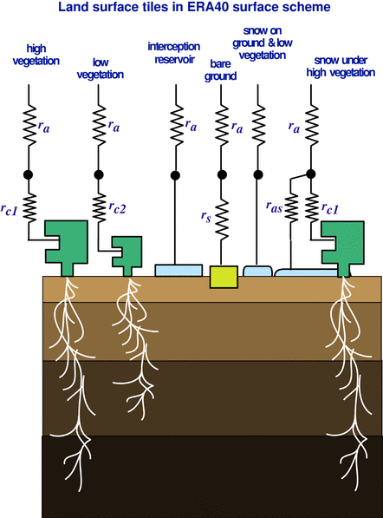
Simplifed EKF soil moisture analysis
For each grid point, analysed soil moisture state vector θ_{a}:
θ _{a}= θ _{b}+ K (y-H [θ _{b}])
θ background soil moisture state vector,
H non linear observation operator
y observation vector
K Kalman gain matrix, fn of
H (linearsation of H), B and R (covariance matrices
of background and observation errors).
Observations used at ECMWF:
For operational NWP:
  Conventional SYNOP pseudo observations (analysed T2m, RH2m)
  Satellite MetOp-A/B ASCAT soil moisture
Research: SMOS Data Assimilation
The simplified EKF is used to corrects the soil moisture trajectory of the
Land Surface Model
Used at ECMWF (operations and ERA5), DWD, UKMO
Drusch et al., GRL, 2009
de Rosnay et al., ECMWF News Letter 127, 2011
de Rosnay et al., QJRMS, 2013

Slide 11
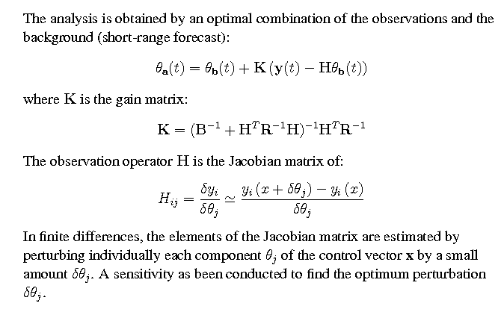
Simplifed EKF soil moisture analysis
H
[ ] )
With j obs and I model layer

Slide 12
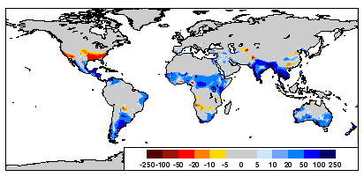
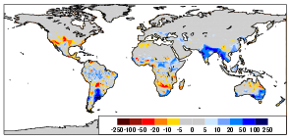
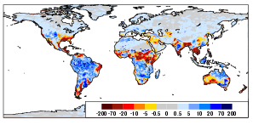
Simplified EKF and OI Comparison
0-1m Soil Moisture increments (mm)
January 2009‏
OI
Soil moisture analysis more active in the summer hemisphere than in the winter hemisphere
EKF
|EKF|-|OI|
Notes:
12

Slide 13
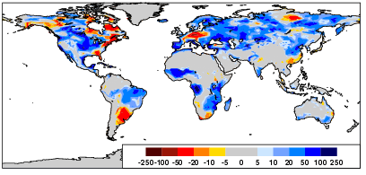
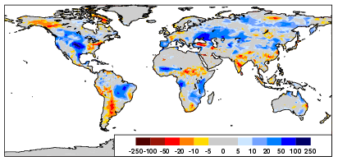
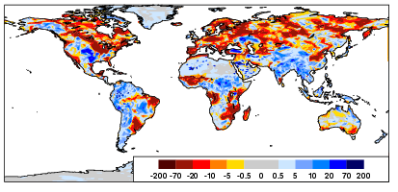
Simplified EKF and OI comparison
0-1m Soil Moisture increments (mm)
July 2009‏
OI
EKF
Much reduced root zone increments
with the EKF compared to the OI
|EKF|-|OI|
Notes:
13

Slide 14
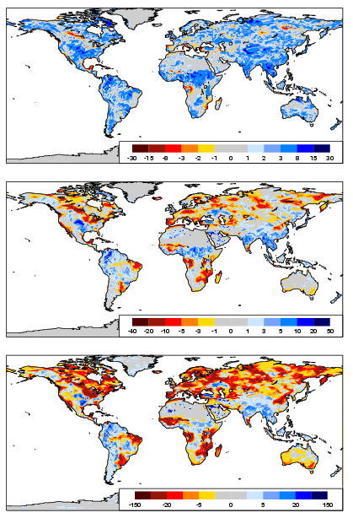
Simplified EKF and OI comparison
Vertical Profile
of Soil Moisture increments
difference |EKF|-|OI| July 2009
Layer 1 (0-7cm)
Layer 2 (7-28cm)
EKF compared to OI:
. Reduce increments at depth
. Increase increments for top soil layer
. Overall reduced increment
Layer 3 (100-289 cm)
Notes:
14

Slide 15
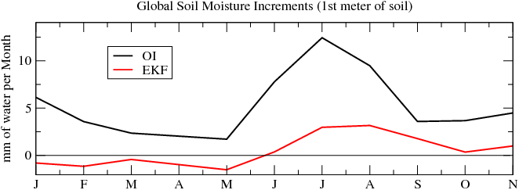
Simplified EKF and OI comparison
0-1m Soil Moisture increments for July 2009 (mm)‏
|EKF|-|OI|
OI
EKF
Two 1-year analysis experiments using the OI and the EKF
- Reduced increment with the EKF compared to the OI
- EKF accounts for non-linear control on the soil moisture increments: meteorological and soil moisture conditions
EKF prevents undesirable and excessive soil moisture corrections
Notes:
15

Slide 16
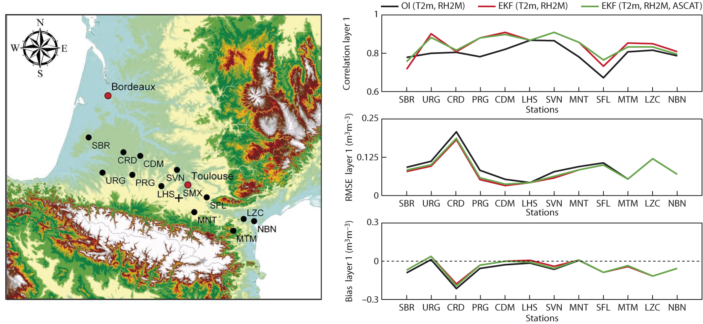
Soil Moisture Analysis verification
Validated for several sites across Europe (Italy, France, Spain, Belgium)
Verification of ECMWF SM over the SMOSMANIA Network
R
RMSE
Bias
(obs-Model)
Compared to the OI, the EKF improves soil moisture
Notes:
16

Slide 17
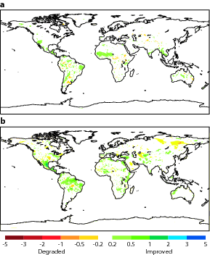
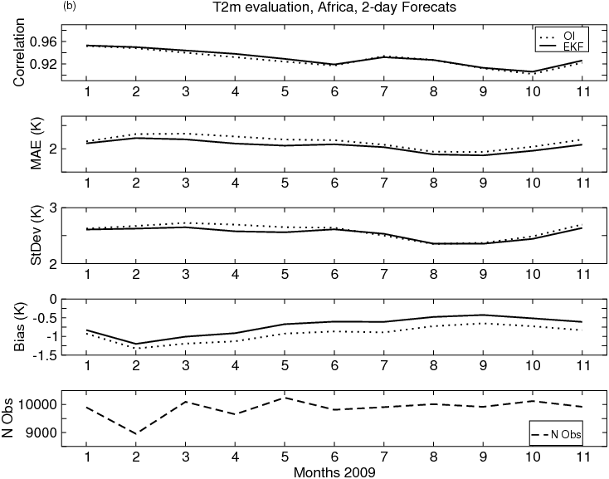
T2m 48-h Forecast Evaluation
T2m 48h forecats error (OI – EKF)
January
July
(K)
Degraded Improved
Compared to the 1D-OI, the SEKF improves analysis and forecasts of soil moisture and two-meter temperature. It also enables satellite data assimilation in the land data assimilation system.
Notes:
This slides shows the impact of the new EKF soil moisture analysis on the T2m forecast. Results are based on T255 experiments conducted for December 2008-November 2009. Results are shown for January-November 2009.
Left: evaluation of T2m 48h FC against SYNOP data for Africa.
Right: global evaluation of T2m FC against operational T2m analysis.
Compared to the previous OI analysis, the EKF soil moisture analysis improves T2m forecast.

Slide 18
Outline
Part I (Monday 7 March)
Introduction
Snow analysis
Screen level parameters analysis
‏
Part II (Tuesday 8 March)
Soil moisture analysis‏
  OI and SEKF soil moisture analyses
  Use of satellite data: ASCAT and SMOS
Summary and future plans

Slide 19
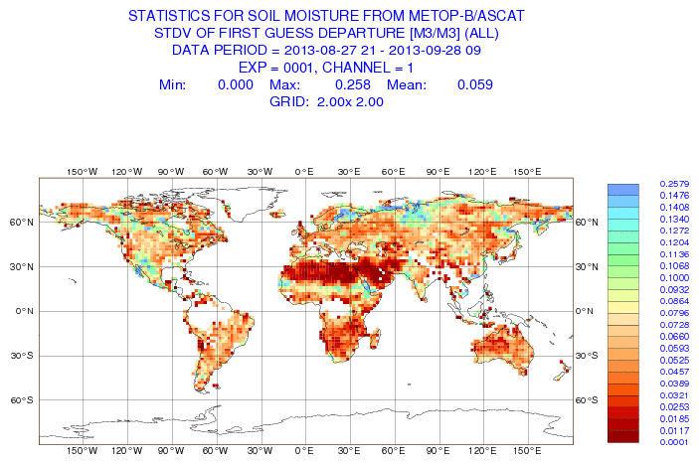
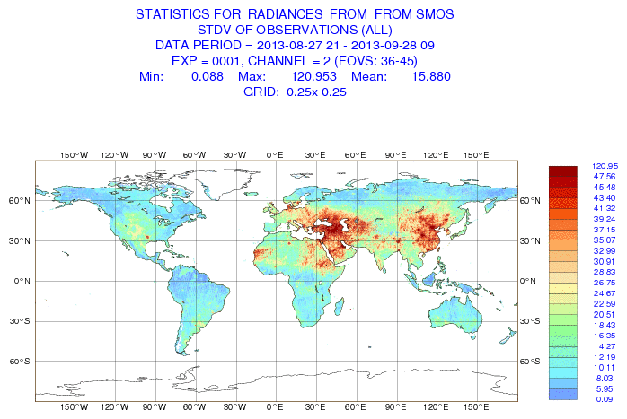


Satellite data for NWP soil moisture analysis
Active microwave data:
ASCAT: Advanced Scatterometer
On MetOP-A (2006-), MetOP-B (2012-)
C-band (5.6GHz)
NRT Surface soil moisture
Operational product
→ ensured operational continuity
Passive microwave data:
SMOS: Soil Moisture & Ocean Salinity
2009-
L-band (1.4 GHz)
NRT Brightness Temperature
Dedicated soil moisture mission
→ Strongest sensitivity to soil moisture
Active and Passive:
SMAP
L-band TB 2015-
Dedicated
soil moisture mission
Operational Monitoring of surface soil moisture related satellite data:
ASCAT soil moisture (m³m⁻³) SMOS Brightness temperature (K)
Stdev FG_depar
Sept. 2013

Slide 20
ASCAT soil moisture
- ASCAT is a soil moisture index (0-1) ; models soil moisture variable is a volumetric quantity (m³m⁻³)
Systematic differences between model and observations
Data assimilation aims at correcting for the model random errors, so a bias correction method is necessary to match the observations ‘climatology’ to that of the model
(→ See D. Dee’s Lecture on Bias Correction)
For soil moisture data assimilation systems simplified Bias correction method often used
Cumulative Distribution Function Matching: CDF-Matching (e.g. Scipal et al. WRR 2008, Draper et al, JGR 2009)
Revised in 2011 to account for seasonal cycle (de Rosnay et al., ECMWF Res. Memo. 2011)

Slide 21
ASCAT Bias Correction (CDF matching)
- ASCAT soil moisture index ms_{ASCAT}
- Model soil moisture θ (m³/m⁻³)
Simple Cumulative Distribution Function
(CDF) matching (Scipal et al., 2008)
a and b are CDF matching parameters
computed on each model grid point
ASCAT CDF-matching has two objectives:
→ ASCAT index converted to
model equivalent volumetric soil moisture
Bias correction
θ_{ascat} = a + b ms_{ascat}
with a = θ_{model} – ms_{ascat} (σ_{model} /σ_{ms_ascat} )
b = σ_{model} / σ_{ms_ascat}
→ Matches mean and variance
a
b
ASCAT matching parameters
(de Rosnay et al., ECMWF Res memo R43.8/PdR/11100, 2011)

Slide 22
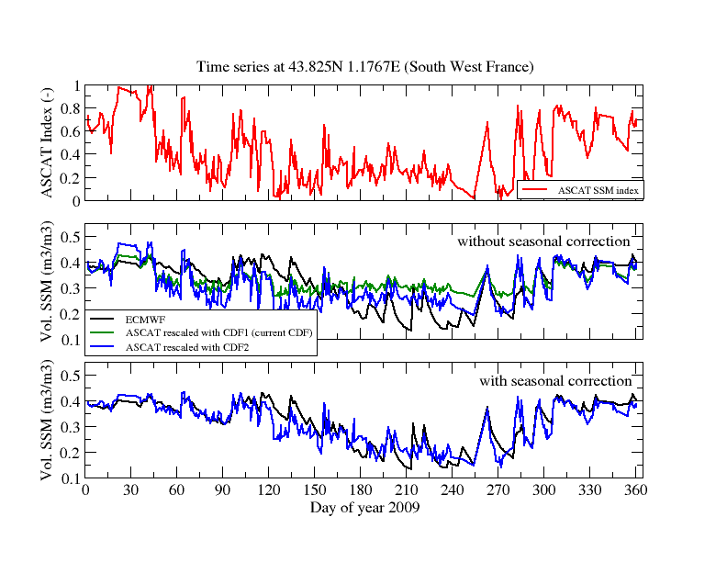
ASCAT Bias Correction (CDF matching)
Efficient data assimilation relies on accurate bias correction
ASCAT index
ECMWF model soil moisture
(ASCAT old BC)
ASCAT with static BC
ASCAT with dynamic (seasonal) BC

Slide 23
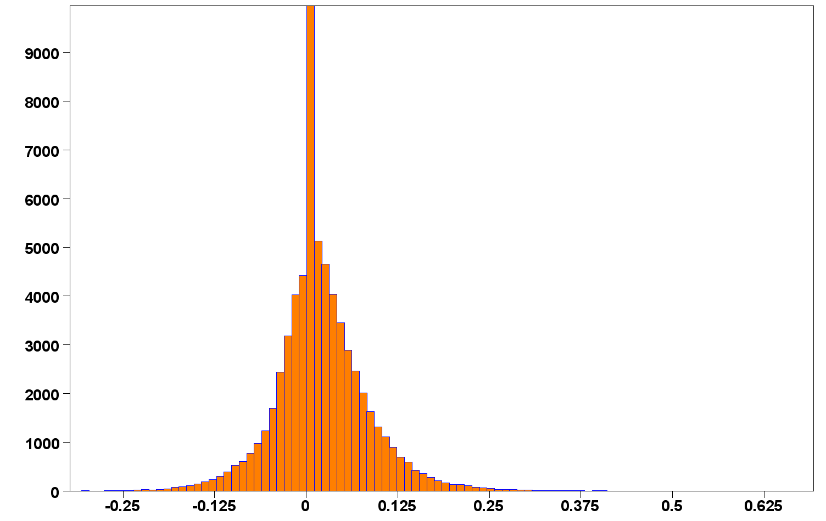
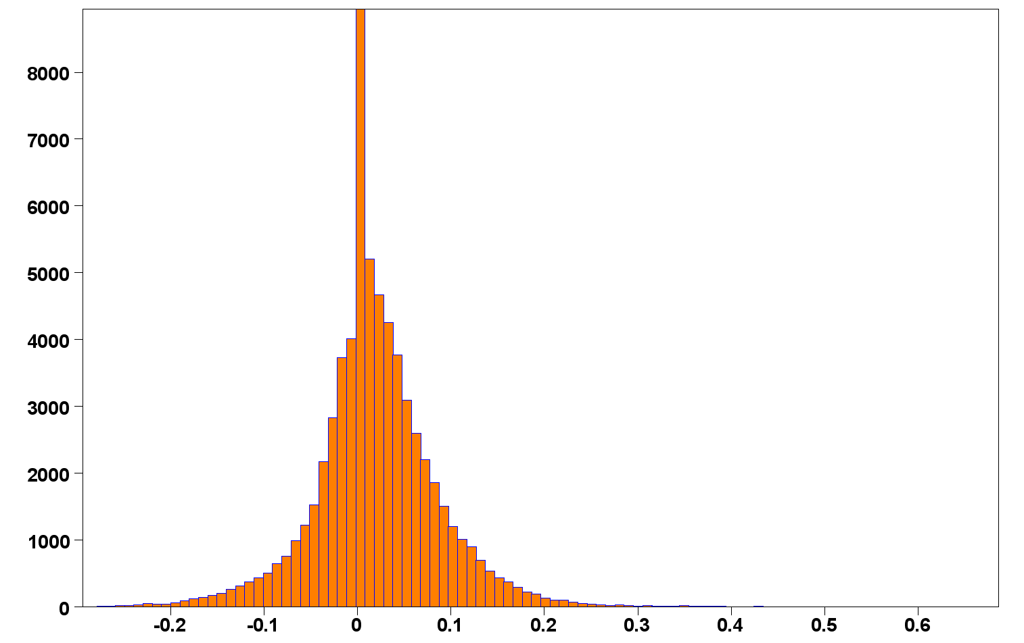
ASCAT-A and ASCAT-B
ASCAT SM – Model
(First guess departure, m³.m⁻³)
23-24 Nov 2012
Metop-A launched in 2006 Metop-B launched in 2012
Consistent ASCAT-A and ASCAT-B soil moisture
ASCAT-A
Departure statistics:
 | Nb | Mean m³.m⁻³ | Std m³.m⁻³
ASCAT-A | 64893 | 0.0152 | 0.0645
ASCAT-B | 65527 | 0.0149 | 0.0663
ASCAT-B
Operational monitoring:
http://www.ecmwf.int/en/forecasts/quality-our-forecasts/monitoring/soil-moisture-monitoring

Slide 24
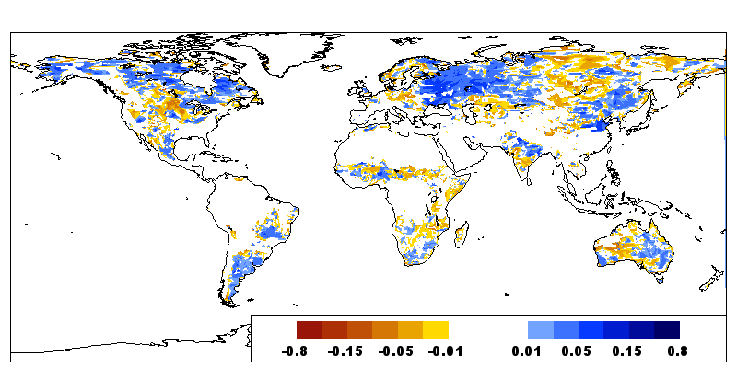
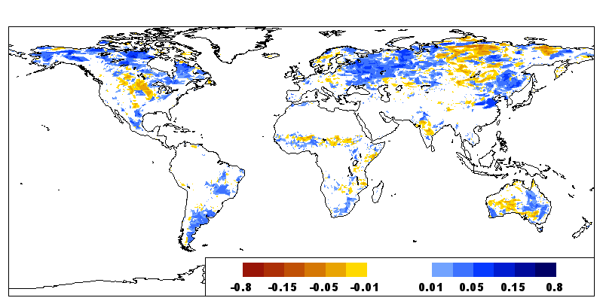
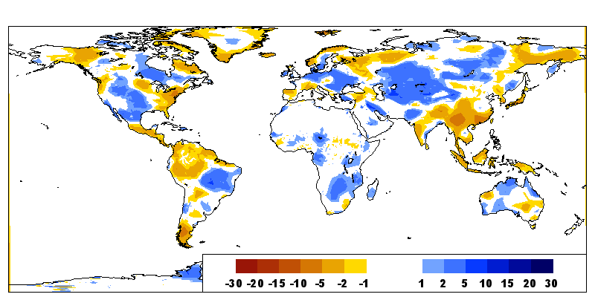
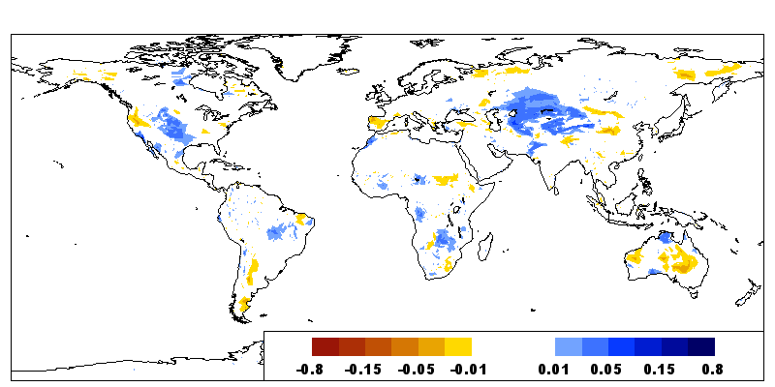
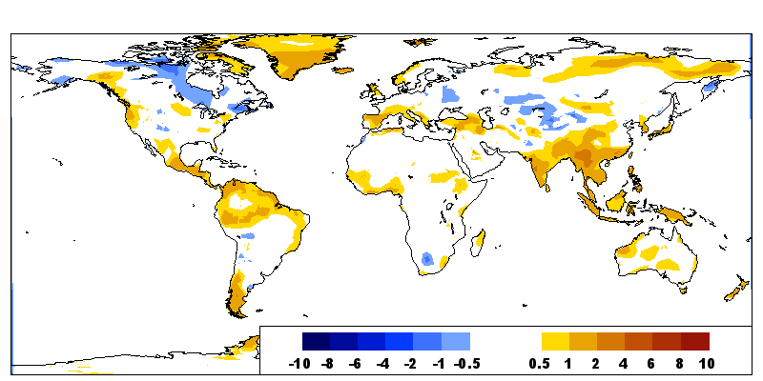
ASCAT Soil Moisture data assimilation for NWP
Innovation (Obs- model)
25-30 June 2013
Accumulated Increments (m³/m³)
in top soil layer (0-7cm)
ASCAT
(m3/m3)
Due to ASCAT
RH2m (%)
T2m (K)
Due to SYNOP T2m and RH2m

Slide 25
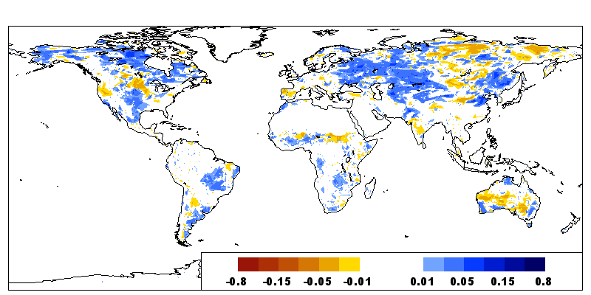
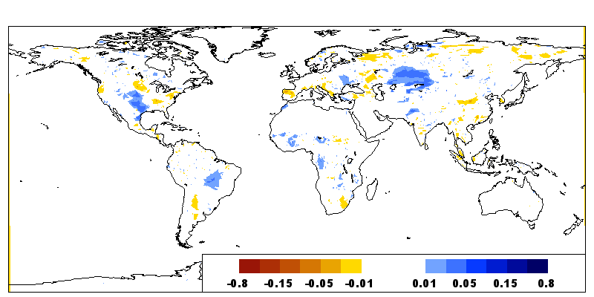
ASCAT Soil Moisture data assimilation for NWP
Volumetric Soil Moisture increments (m³/m³)
(accumulated)
25-30 June 2013
Vertically integrated
Soil Moisture increments (stDev in mm)
Layer1
(0-7cm)
 | SYNOP | ASCAT
Layer 1 | 0.68 | 1.43
Layer 2 | 1.48 | 0.68
Layer 3 | 4.28 | 0.46
ASCAT more increments than SYNOP at surface
SYNOP give more increments at depth
→ For 12h DA window, link obs to root zone stronger for T2m,RH2m than for surface soil moisture observations
Layer2
(7-28cm)

Slide 26
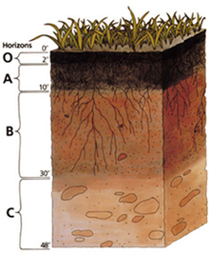
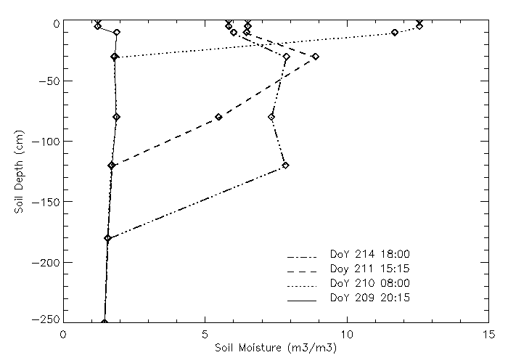
Root Zone Soil Moisture Retrieval
Satellite data → Surface information
Top soil moisture sampling depth: 0-2cm ASCAT, 0-5cm SMOS
Root Zone SM Profile
Variable of interest for
Soil-Plant-Atm interaction,
Climate, NWP and
hydrological applications
Accurate retrieval requires to account for
physical processes
→ Retrieval of root zone soil moisture using satellite data requires data assimilation approaches
Soil Moisture Vertical Profile
d2
d1
d3
d4
0 Soil Moist m3/m3 x 100 15

Slide 27

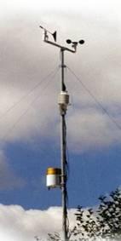
ASCAT soil moisture data assimilation
EUMETSAT Hydrology SAF
ECMWF Atmospheric conditions
SYNOP
T2m RH2m
analysis
SEKF
Soil Moisture
Analysis
ASCAT Root
Zone product
(SM-DAS-2)
ASCAT
Surface SM
Bias corrected
Analysed root zone
soil moisture on model levels
4 layers:
0-7cm
7-28 cm
28-100 cm
100-289cm
Quality Control → use data when:
Topographic complexity ≤ 20
Wetland Fraction ≤ 15
Noise level ≤ 8
processing flag=0

Slide 28
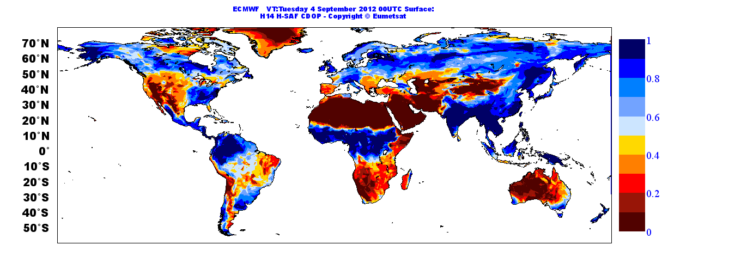
ASCAT soil moisture data assimilation
Assimilated ASCAT
Surface (0-7cm) soil moisture index (0-1)
04 Sept 2012 00UTC
ASCAT Root Zone Soil Moisture Product (H-SAF SM-DAS-2):
Data assimilation used to propagate in space and time the ASCAT surface swath soil moisture information
Daily Soil Moisture product valid at 00:00 UTC
Daily Global coverage
SM-DAS-2: Operational H-SAF since July 2012;
Contact: hsafcdop@meteoam.it
Notes:
ASCAT root zone soil moisture (layer-1 here) is a soil moisture index as ASCAT. It is available daily with global coverage and with a latency of 36h

Slide 29

ASCAT soil moisture data assimilation
SM-DAS-2 available on 4 soil layers
Assimilated ASCAT
soil moisture index (0-1)
04 Sept 2012 00UTC
Layer 1 (0-7cm)
Layer 2 (7-28cm)
Notes:
Illustrates layers 1 and deeper in the soil, layer-2

Slide 30
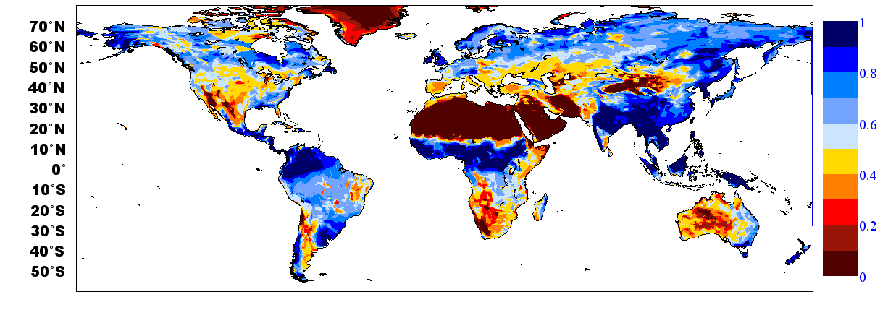
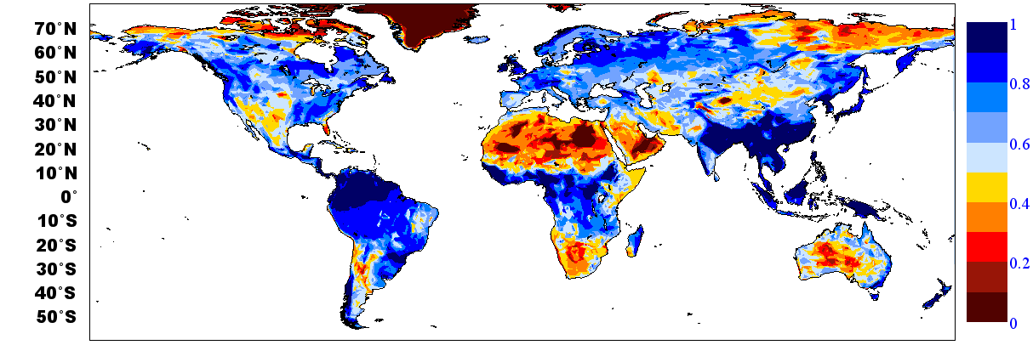
ASCAT soil moisture data assimilation
SM-DAS-2 available on 4 soil layers
Assimilated ASCAT
soil moisture index (0-1)
04 Sept 2012 00UTC
Layer 3 (28-100cm)
Layer 4 (100-289cm)
Notes:
Layer 3 is down to 1m and layer 4 down to 3m (the exact depth is 2.89m)

Slide 31
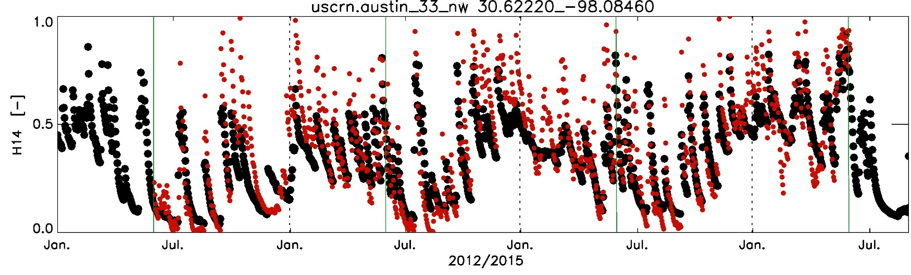
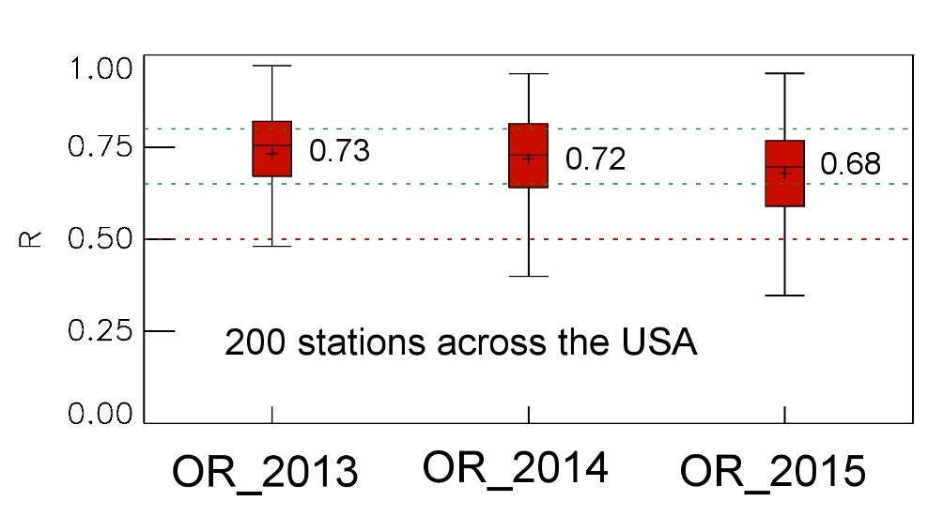

Soil moisture Validation
Scatterometer root zone soil moisture based on data assimilation
Albergel et al.
Evaluation of SM-DAS-2/H14
Surface and root zone liquid soil moisture content
OR_2013
OR_2014
OR_2015
Observation (5cm)
SM-DAS-2 (0-7cm)
Accuracy requirements for product SM-DAS-2 [R]
Unit | Threshold | Target | Optimal
Dimensionless | 0.50 | 0.65 | 0.80

Slide 32
Satellite data for NWP soil moisture analysis
Active microwave data:
ASCAT: Advanced Scatterometer
On MetOP-A (2006-), MetOP-B (2012-)
C-band (5.6GHz)
NRT Surface soil moisture
Operational product
→ ensured operational continuity
Passive microwave data:
SMOS: Soil Moisture & Ocean Salinity
L-band (1.4 GHz)
NRT Brightness Temperature
Dedicated soil moisture mission
→ Strongest sensitivity to soil moisture
Active and Passive:
SMAP
L-band TB 2015
Dedicated
soil moisture mission
Operational Monitoring of surface soil moisture related satellite data:
ASCAT soil moisture (m³m⁻³) SMOS Brightness temperature (K)
Stdev FG_depar
Sept. 2013

Slide 33

Passive microwave remote sensing
Soil Moisture and Ocean Salinity mission
SMOS ESA Earth Explorer mission (2009-present)
L-band (1.4 GHz) instrument. Optimal frequency for soil moisture remote sensing
Sun-synchronous, quasi-circular orbit at altitude 758 km. 06.00 hrs local solar time at ascending node. Three days revisit at Equator
Dual polarisation: H and V in the Earth reference, xx and yy in the antenna frame reference
Multi-angular measurements 0 to 60°
ECMWF and CMC: use NRT SMOS Brightness Temperature (TB) data
Use observation operator to simulate L-band TB:
Community Microwave Emission Modelling Platform (CMEM)

Slide 34
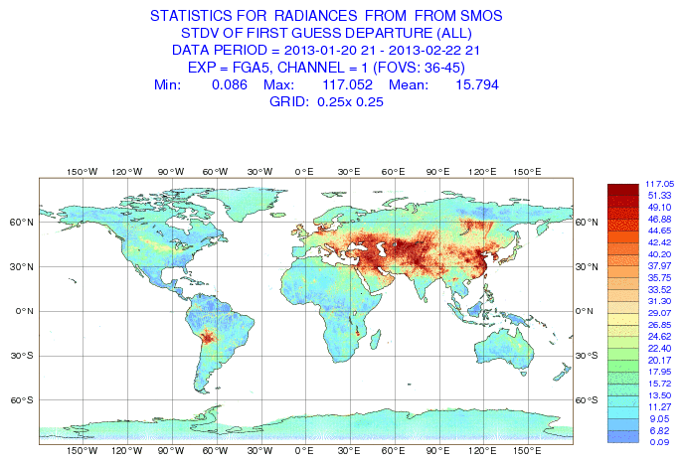
SMOS Monitoring
Near real time (NRT) monitoring of SMOS TB at ECMWF
(Muñoz Sabater et al. ECMWF Newsletter & IEEE TGRS 2011)
RFI (Radio Frequency Interference) sources impact on FG departures (Obs-model) : large standard deviation (StDev); Lots of RFI sources switched off in Europe, new sources identified in 2012,major issue in Asia.
StDev first guess departure (Obs-Model)
In Kelvin for Jan-Feb 2013

Slide 35
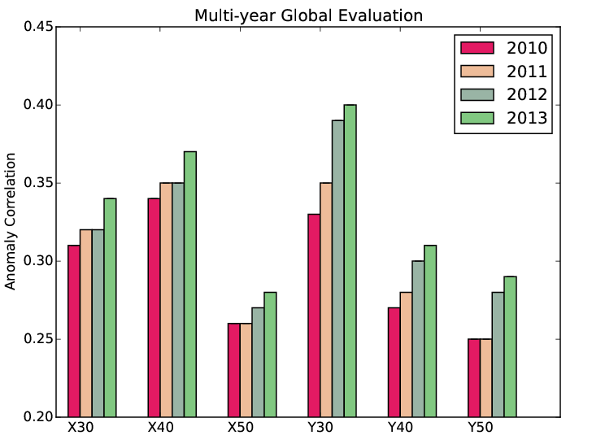
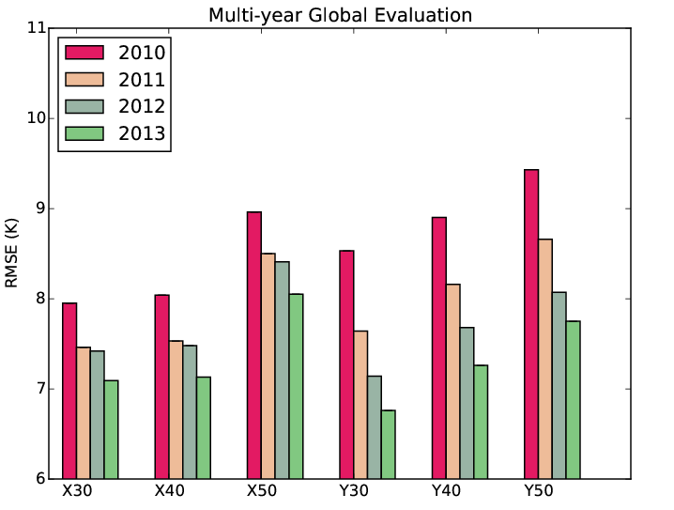
SMOS Forward modelling and Bias correction
CMEM: ECMWF Community Microwave Emission Modelling Platform
→ produce reprocessed ECMWF SMOS TB for 2010-2013
Comparison between ECMWF TB and SMOS NRT TB (both reprocessed)
Consistent improvement of SMOS data at Pol xx and yy, for incidence angles 30, 40, 50 degrees
de Rosnay et al, in prep
Anomaly correlation
RMSE
Polarisation (xx or yy) and incidence angle (30, 40, 50)
Polarisation (xx or yy) and incidence angle (30, 40, 50)

Slide 36
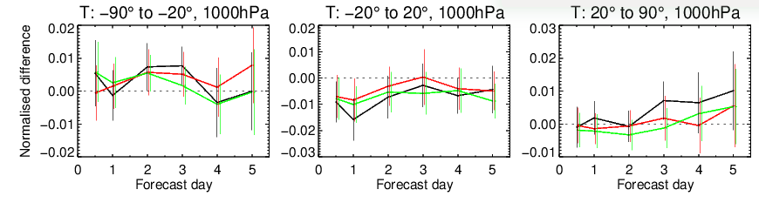
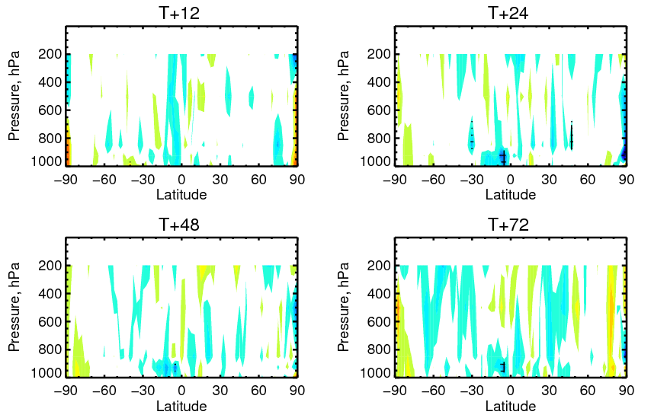


SMOS data assimilation impact on atmospheric scores
Config.1
Muñoz-Sabater et al. in prep
Normalized change in rms of fc error:
Config.2
Config.3
    SH- extratropics
    Tropics
    NH- extratropics
Several configurations tested with different background and observation errors
degradation
Based on short experiments
Longer experiment under evaluation
improvement

Slide 37
Outline
Part I
Introduction
Snow analysis
Screen level parameters analysis
‏
Part II
Soil moisture analysis‏
  OI and EKF analyses
  Use of Satellite data ASCAT and SMOS
Summary and future plans
Notes:
37

Slide 38
Summary and future plans
Most NWP centres analyse soil moisture and/or snow depth
Land Data Assimilation Systems: run separately from the atmospheric data assimilation
Variety of approaches for snow and soil moisture
Operational snow analysis systems:
  Rely on simple analysis methods (Cressman, 2D-OI, or climatology)
  Uses in situ snow depth data (SYNOP and national networks) and NOAA/NESDIS snow cover data
  No Snow Water Equivalent products used for NWP (yet)

Slide 39
Summary and future plans
Operational Soil Moisture analysis systems for NWP:
  Approaches: 1D-OI (Météo-France, CMC, ALADIN, HIRLAM, ECMWF ERA-I); EKF (DWD, ECMWF, UKMO); Offline Land Surface Model (LSM) using analysed atmospheric forcing (NCEP: GLDAS / NLDAS)
  Data: Most Centres rely on screen level data (T2M and RH2m) through a dedicated OI analysis, ASCAT (UKMO, ECMWF NWP & EUMETSAT H-SAF)
  Compared to the OI, the EKF analysis improves both Soil Moisture and T2m:
→ Relevance of screen level parameters to analyse soil moisture (ECMWF,CMC)
  Consistency in the Land surface models between soil moisture and screen level parameters

Slide 40
Summary and future plans
Developments of multi-variate and ensemble approaches (ECMWF, CMC, Météo-France)
Continuous developments to assimilate ASCAT soil moisture and SMOS brightness temperature in NWP systems
Use of new satellites, e.g. NASA SMAP (launched January 2015)
Assimilation of vegetation parameters (Leaf Area Index)
Increase coupling between land and atmospheric assimilation
Long term perspectives:
  Importance of horizontal processes (river routing)
  Assimilation of integrated hydrological variables such as river discharges: e.g. Surface Water Ocean Topography (SWOT 2019)

Slide 41
Thank you for your Attention!
Useful links:
ECMWF LDAS: https://software.ecmwf.int/wiki/display/LDAS/LDAS+Home
Snow Watch: http://globalcryospherewatch.org/reference/documents/
HarmoSnow COST Action: http://www.cost.eu/COST_Actions/essem/Actions/ES1404
http://costsnow.fmi.fi/
ECMWF Land Surface Observation monitoring: https://software.ecmwf.int/wiki/display/LDAS/Land+Surface+Observations+monitoring

