Slide 1
ECMWF Data Assimilation Training course
Land Surface Data Assimilation – Part 1
Patricia de Rosnay
Notes:
1

Slide 2
Outline
Part I (Monday 7 March)
Introduction
Snow analysis
Screen level parameters analysis
‏
Part II (Tuesday 8 March)
Soil moisture analysis‏
Summary and future plans

Slide 3
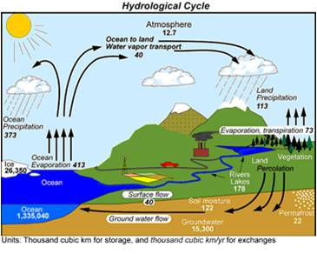
Introduction: Land Surfaces in
Numerical Weather Prediction (NWP)
  Processes: Continental hydrological cycle, interaction with the atmosphere on various time and spatial scales
  Boundary conditions at the lowest level of the atmosphere
  Crucial for near surface weather conditions, whose high quality forecast is a key objective in NWP
Land surface processes modelling & initialisation are important for NWP at all range (short to seasonal)
(Beljaars et al., Mon. Wea. Rev, 1996, Koster et al., Science 2004, Koster et al. J Hydrometeorol. 2011)
Trenberth et al. J. Hydrometeorol., 2007

Slide 4
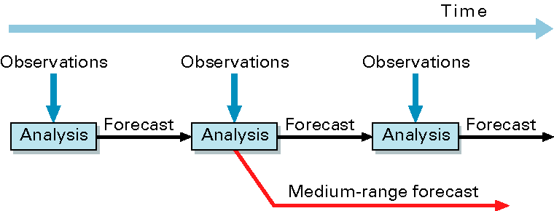
ECMWF Integrated Forecasting System (IFS)
(10-day)‏
Forecast Model: GCM including the H-TESSEL land surface model (fully coupled)
Data Assimilation → initial conditions of the forecast model prognostic variables
  4D-Var for atmosphere
  Land Data Assimilation System (LDAS)

Slide 5
ECMWF Integrated Forecasting System (IFS)
(10-day)‏
Forecast Model: GCM including the H-TESSEL land surface model (fully coupled)
Data Assimilation → initial conditions of the forecast model prognostic variables
  4D-Var for atmosphere
  Land Data Assimilation System (LDAS)
Several Systems:
NWP (oper): IFS (with 4D-Var and LDAS), 16km, version 41r1 (2015)
ERA-Interim: IFS (with 4D-Var and LDAS), 79km, version 31r1 (2006)
ERA5: IFS (with 4D-Var and LDAS), 39km, version 41r2 (2016)
ERA-Interim-Land: 79km
ERA5-Land: 39 km
Weakly coupled DA
H-TESSEL LSM simulations forced by ERA→ model only: no LDAS

Slide 6
Introduction: Land Surface Data Assimilation (LDAS)
Snow depth
  Methods: Cressman (DWD, ECMWF ERA-I), 2D Optimal Interpolation (OI) (ECMWF operational and ERA5, Env. Canada)
  Conventional Observations: in situ snow depth
  Satellite data: NOAA/NESDIS IMS Snow Cover Extent (ECMWF), H-SAF snow cover (UKMO in dvpt)
Soil Moisture
  Methods:
    1D Optimal Interpolation (Météo-France, Env. Canada, ALADIN and HIRLAM)
    Simplified Extended Kalman Filter (EKF) (DWD, ECMWF, UKMO)
  Conventional observations: Analysed SYNOP 2m air relative humidity and temperature, from 2D OI screen level parameters analysis
  Satellite data : ASCAT soil moisture (UKMO, ECMWF), SMOS (dvpt ECMWF, UKMO, Env.Canada) ‏
Soil Temperature and Snow temperature
  1D OI for the first layer of soil and snow temperature (ECMWF, Météo-France)
Notes:
6

Slide 7
Outline
Part I (Monday 7 March)
Introduction
Snow analysis
Screen level parameters analysis
‏
Part II (Tuesday 8 March)
Soil moisture analysis‏
Summary and future plans

Slide 8

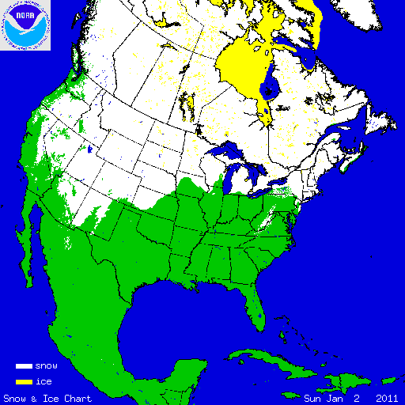
Snow in operational forecasting systems
Example of the ECMWF system:
Snow Model: Component of H-TESSEL ; Single layer snowpack
Snow water equivalent SWE (m), ie snow mass
Snow Density ρ_{s}
Snow Albedo
Snow depth (SD) is diagnostic: SD=SWE . ρ_{w} / ρ_{s}
with ρ_{w} water density
Observations:
- Conventional snow depth data: SYNOP and National networks
- Snow cover extent: NOAA NESDIS/IMS daily product (4km)
Data Assimilation:
Optimal Interpolation (OI) in operational IFS
Analysed variable: SWE, density
Prognostic
variables

Slide 9
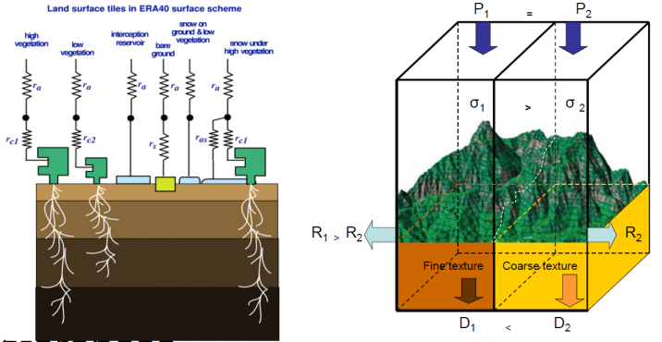
Snow Model
H-TESSEL accounts for up to 7 surface tiles over land: bare ground, low and high vegetation, interception, lakes and two tiles for snow: exposed snow; shaded snow (under high veg)
Snow model updated in 2009
Dutra et al., J. Hydrometeorol., 2010
 | OLD | CURRENT
Liquid water | Dry snow only | - Fraction of liquid water fn of snow mass & temp - Interception of rainfall
Snow Density | Empirical exponential increase and snowfall density constant=100 kg.m⁻³ | Physically based and snow fall density fn of temperature & wind speed
Snow Albedo | - Exponential(melting) / Linear decay - Reset to max (0.85) if snowfall > 1 mm hr⁻¹ - Shaded: constant albedo (0.15) | - Account for liquid water in exponential decay - Continuous reset to max depending on the amount of snowfall (10 mm to full reset) -Shaded : vegetation type dependent (Moody et al. Remote Sens. Environ. 2007)
SF: Snow fraction | Function of snow mass with a threshold SF=1 for SWE >= 15 mm | Function of snow depth (→ mass and density) with a threshold of SF=1 for SnowDepth >= 10 cm
H-TESSEL Land surface model
Balsamo et al J. Hydrometeorol. 2009

Slide 10
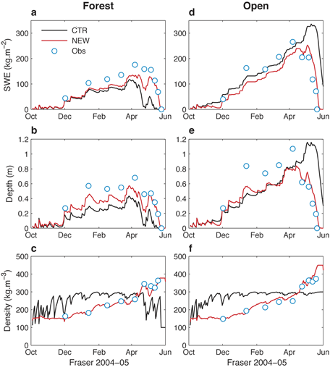
Snow Model
Validation against in situ snow observations (SnowMIP2 sites)
Melting period
Old: too early for forests (21days)
too late in open sites (10 days)
Current: Albedo → improves open sites
Rain interception → improves forest
OLD
Current
Obs
Snow mass
Snow depth
Dutra et al., JHM 2010
Notes:
Example of the impact of the changes in a local site: this is a very important step in model development (very cheap to run, uses local observations as forcing/verification – we can focus on model performance only)

Slide 11
Snow Model
Validation against in situ snow observations (SnowMIP2 sites)
Melting period
Old: too early for forests (21days)
too late in open sites (10 days)
Current: Albedo → improves open sites
Rain interception → improves forest
Snow density:
OLD: overestimated compaction
Current: Closer to observations
Decreased snow density
→ Increased thermal insulation
→ Reduce negative soil temperature bias
OLD
Current
Obs
Snow mass
Snow depth
Snow density
Dutra et al., JHM 2010
Notes:
Example of the impact of the changes in a local site: this is a very important step in model development (very cheap to run, uses local observations as forcing/verification – we can focus on model performance only)

Slide 12
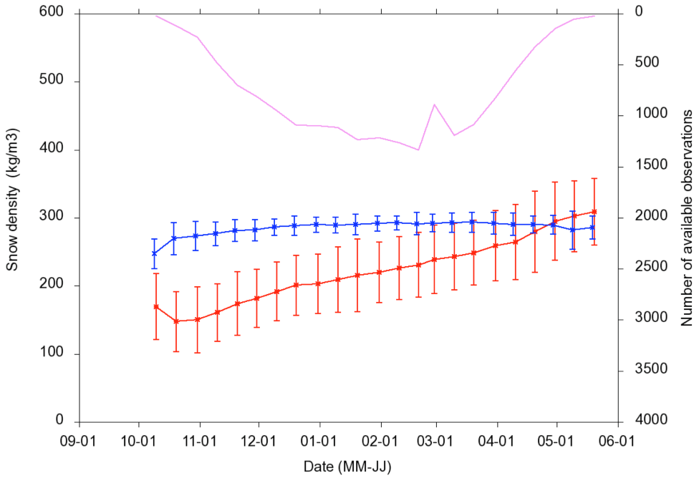
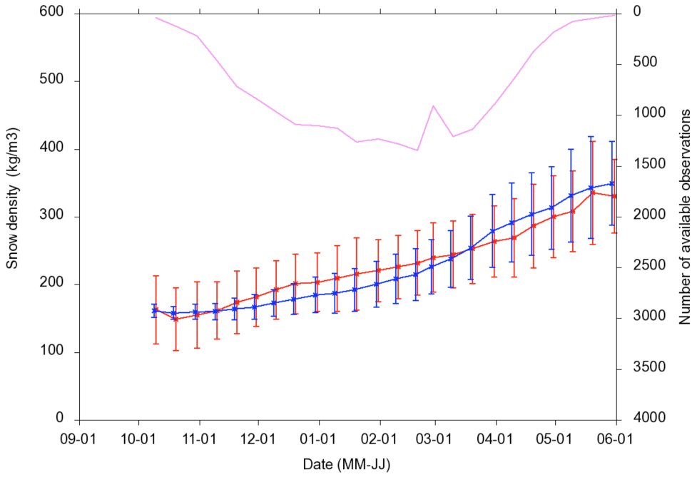
Snow Model
Snow density evolution (data from the former Soviet Union Hydrological Snow Surveys)
Comparing ERA-Interim (Old snow model)
with ERA-Interim/Land (New snow model)
Old model overestimates snow density
Current snow density formulation improves significantly the match with observations ERA-Interim/Land
A correct snow density simulation is very important to link SWE (model variable) to snow depth measurements (observations that enter the analysis)
OBS
ERA-Interim (old model)
OBS
ERA-Interim/Land (new model)
S O N D J F M A M J
(Balsamo et al. HESS 2015)
Notes:
Show the impact of the changes on the simulations of snow density. Since snow density is used to invert observed snow depth into the model snow mass, the benefits of DA of snow depth are dependent on the model background of snow density

Slide 13
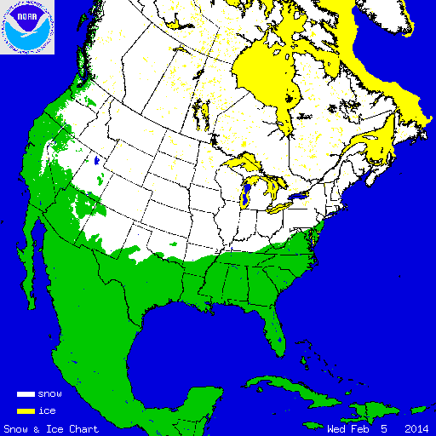
Snow Observations
Interactive Multisensor Snow and Ice Mapping System (IMS)
Time sequenced imagery from geostationary satellites
AVHRR,
SSM/I
Station data
Northern Hemisphere product
Daily
Polar stereographic projection
Information content: Snow/Snow free
Data used at ECMWF:
24km product (ERA-Interim)
4 km product (operational NWP, ERA5)
More information at: http://nsidc.org/data/g02156.html
NOAA/NESDIS
IMS Snow extent data
IMS Snow Cover 5 Feb. 2014

Slide 14
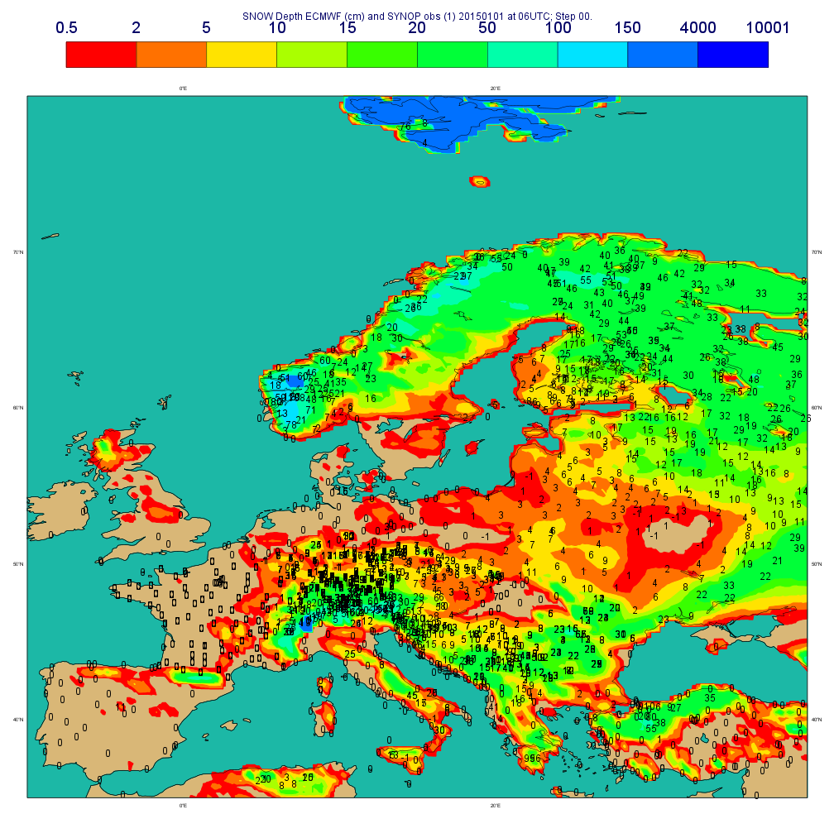
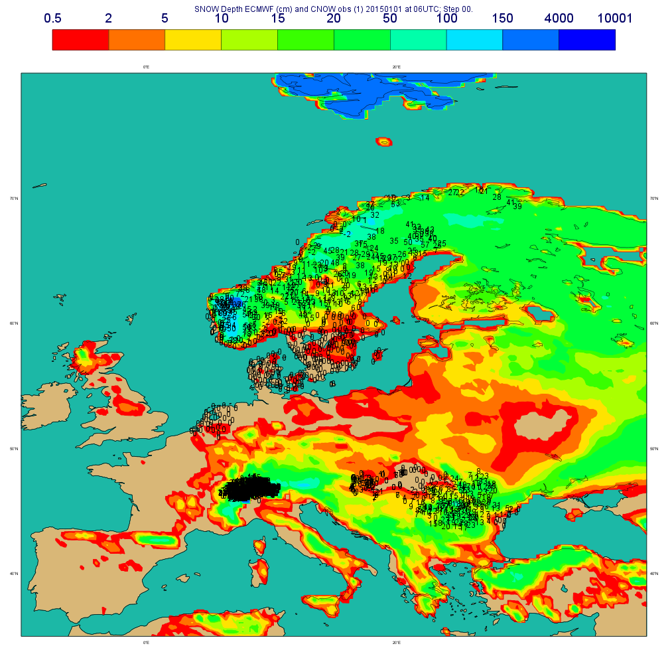
Snow Observations: SYNOP and National Networks
For NWP purpose: observations are exchanged in near real time (NRT) using the co-ordinated Global Telecommunication System (GTS)
Snow
Depth (cm)
Snow observations available on the GTS
2015 01 01 at 06UTC
SYNOP
(BUFR&TAC)
Additional
National
Networks
Snow
Depth (cm)
Additional data from national networks (7 countries):
Sweden (>300), Romania(78), The Netherlands (33), Denmark (43), Hungary (61), Norway (183), Switzerland (332).
Dedicated BUFR for additional national data
(de Rosnay et al. ECMWF Res. Memo, R48.3/PdR/1139, 2011)
Notes:
14

Slide 15
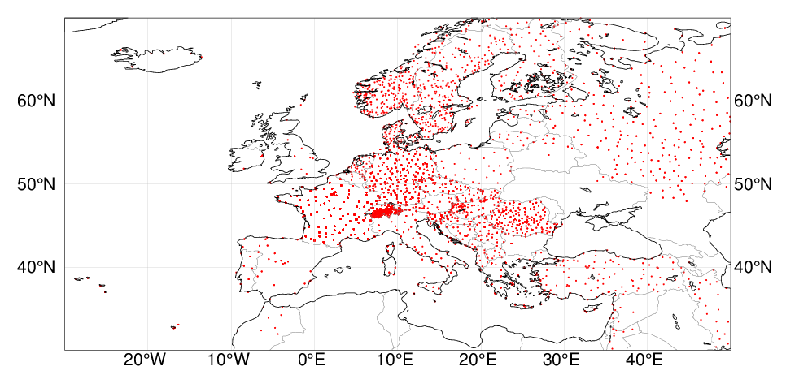
Snow Observations in Europe
Operational snow observations monitoring
(SYNOP TAC + SYNOP BUFR + national BUFR data):
20150301

Slide 16
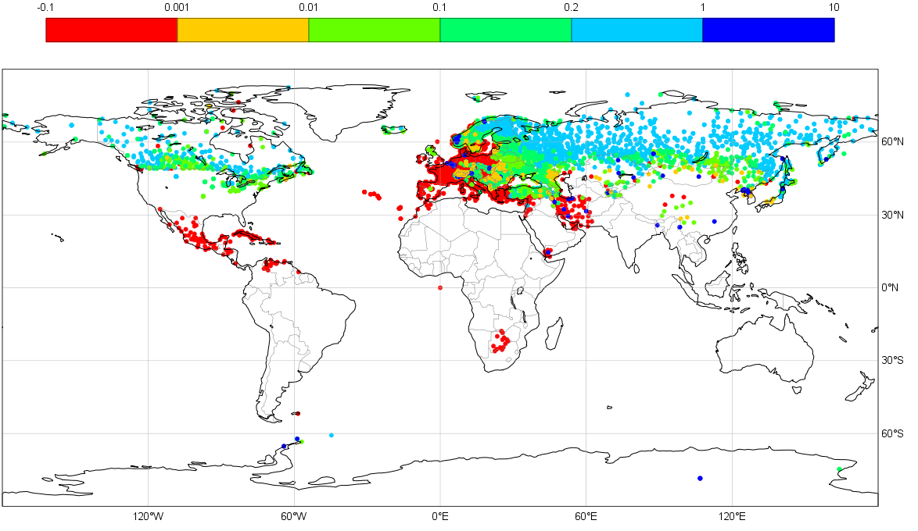
Snow Observations: GTS SYNOP Snow depth availability
Status in January 2015
Operational snow observations monitoring (SYNOP TAC + SYNOP BUFR + national BUFR data):
http://www.ecmwf.int/en/forecasts/charts/obstat/?facets=Category,Conventional%20Data%3BParameter,%20Snow%20depth
Observed snow depth in m
Gaps in USA, China and southern hemisphere
NRT data exist and is available (more than 20000 station in the US)
But it is not on the GTS for NWP applications.
World Meteorological Organization (WMO): Members States encouraged to report snow depth on the GTS
BUFR template for national data approved by WMO in April 2014
WMO GCW (Global Cryosphere Watch): Snow Watch initiative on snow reporting

Slide 17

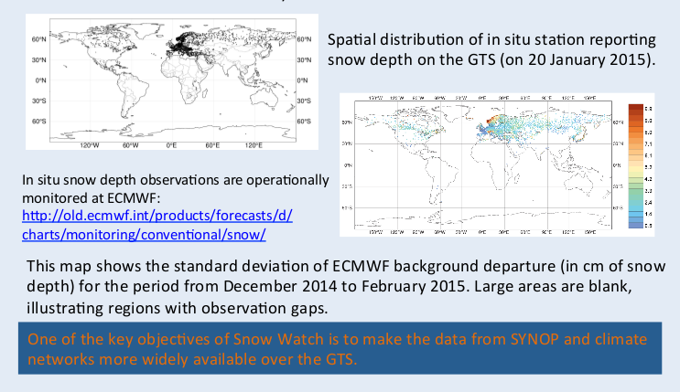
GCW Snow Watch Activity on Snow reporting
http://globalcryospherewatch.org/reference/documents/

Slide 18

European COST Action on Snow
COST is an intergovernmental framework for European Cooperation in Science and Technology . It supports networking activities within the COST action.
COST Action on Snow (ES1404): Harmosnow “A European network for a harmonised monitoring of snow for the benefit of climate change scenarios, hydrology and numerical weather prediction”.
Better connection between snow measurements and models, between snow observers, researchers and forecasters
Contribute to improve snow observation availability for NWP and research, far data assimilation and validation.
http://www.harmosnow.eu/

Slide 19
Snow Analysis at ECMWF
Pre-Processing:
  SYNOP reports converted into BUFR files.
  IMS converted to BUFR (and orography added)
  SYNOP BUFR data is put into the ODB (Observation Data Base)
Snow depth analysis at 00, 06, 12, 18 UTC :
- Cressman interpolation (Mon. Wea. Rev. 1959): Operationaly used at ECMWF for 1987-2010; Used in ERA-Interim, used at DWD.
- Optimal Interpolation (OI): Operational at ECMWF since November 2010
(de Rosnay et al; Surv Geophys. 2014)
Use NESDIS IMS data in the OI (00 UTC):
Errors sepcification
BG: σ_{b}= 3cm
SYNOP σ_{SYNOP}=4cm
IMS σ_{ims}=8cm
NESDIS: 1stGuess: | Snow | No Snow
Snow | x | DA 5cm
No Snow | DA | DA

Slide 20
Snow depth Optimal Interpolation
Used at Env. Canada, ECMWF Based on Brasnett, j appl. Meteo. 1999
1. Observed first guess departure ΔS_{i} are computed from the interpolated background at each observation location i.
2. Analysis increments ΔS_{j}ª at each model grid point j are calculated from:
3. The optimum weights w_{i} are given for each grid point j by: (B + O) w = b
b : background error vector between model grid point j and observation i (dimension of N observations)‏ b(i) = σ²_{b .} μ(i,j)
B : correlation coefficient matrix of background field errors between all pairs of observations (N × N observations); B(i₁,i₂) = σ²_{b} ×μ(i₁,i₂) with the correlation coefficients μ(i₁,i₂) and σ_{b} = 3cm the standard deviation of background errors.
O : covariance matrix of the observation error (N × N observations):
O = σ²_{o} × I
with σ_{o} the standard deviation of observation errors (4cm in situ, 8cm IMS)
‏

Slide 21
Snow depth Optimal Interpolation
Used at Env. Canada, ECMWF Based on Brasnett, j appl. Meteo. 1999
Correlation coefficients μ(i₁,i₂) (structure function):
Lz; vertical length scale: 800m, Lx: horizontal length scale: 55km
r_{i1,i2} and Z_{i1,i2} the horizontal and vertical distances between points i₁ and i₂
Quality Control: reject observation if ΔS_{i}> Tol (σ_{b}² + σ_{o}² )^{1/2} with Tol = 5
Observation rejected if first guess departure larger than 25 cm
Redundancy rejection: use observation reports closest to analysis time
And use a maximum of 50 observations per grid point)

Slide 22
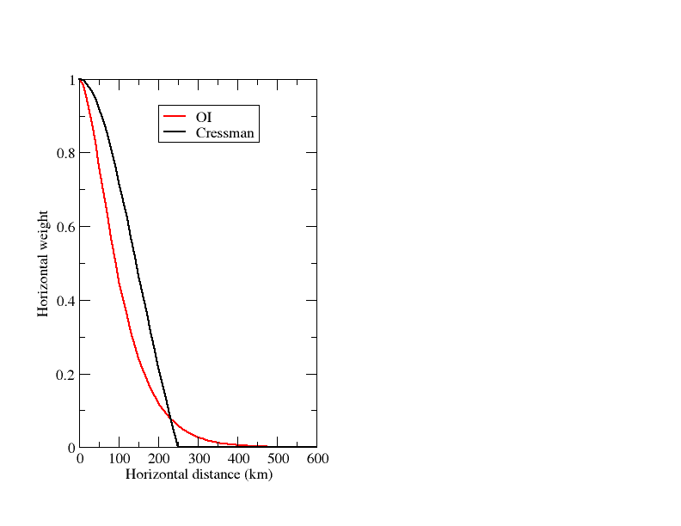
OI vs Cressman
In both cases, snow depth increments computed as :
Cressman: weights are function of horizontal and vertical distances. Do not account for observations and background errors.
OI: The correlation coefficients of B and b follow a second-order autoregressive horizontal structure and a Gaussian for the vertical elevation differences.
OI has longer tails than Cressman and considers more observations. Model/observation information optimally weighted using error statistics.
Structure function
Notes:
22

Slide 23
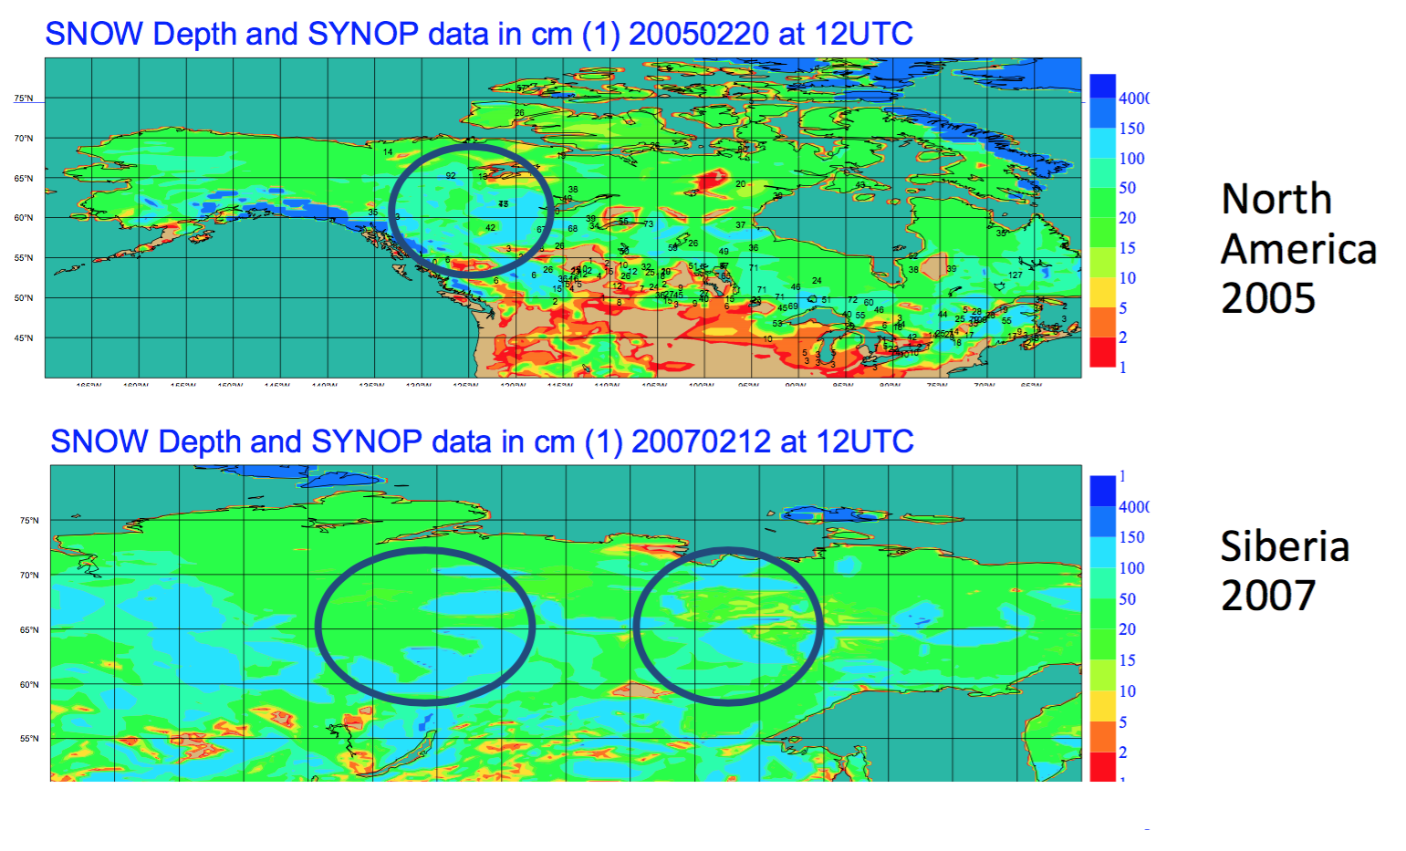
Snow Data assimilation
Cressman shows spurious snow patterns where observations are scarce (Kalnay, Cambridge Univ. Press 2003)
ERA-Interim snow analysis
Cressman (Mon. Wea. Rev. 1959)
→ Issues with Bull’s eyes as already indicated in Kalnay, Cambridge Univ. Press 2003

Slide 24
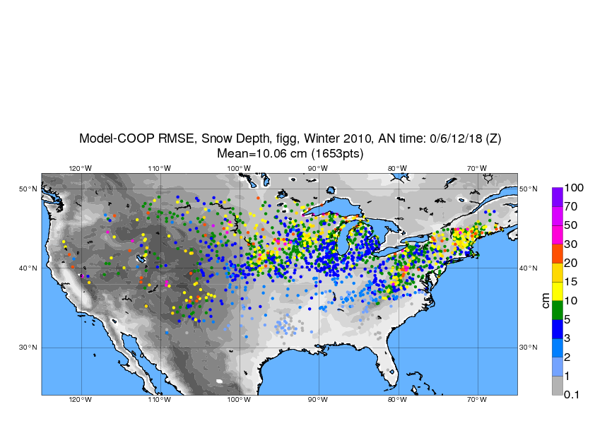
Snow Data assimilation
Validation data: NWS/COOP
National Weather Service Cooperative Observer Program
Independent data relevant for validation
RMSE (cm) for the new snow analysis, winter 2010
(OI, IMS 4km except in mountainous areas)

Slide 25
Snow Data assimilation
Validation data: NWS/COOP
Numerical Experiments | Bias (cm) | R | RMSE (cm)
Cressman, IMS 24 km | 1.1 | 0.66 | 18.0
OI, IMS 24 km | - 2.0 | 0.74 | 10.1
OI, IMS 4km <1500m | - 1.5 | 0.74 | 10.1
- Oper until Nov 2010
- ERA-Interim
- Oper since Nov 2010
Validation against ground data
→ Improvement in snow depth due to the OI compared to Cressman

Slide 26
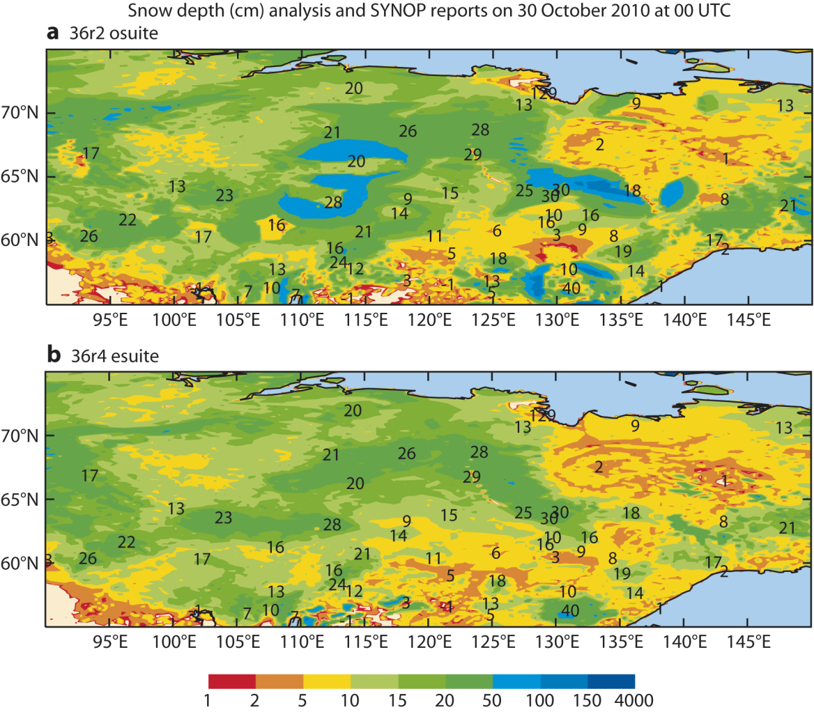
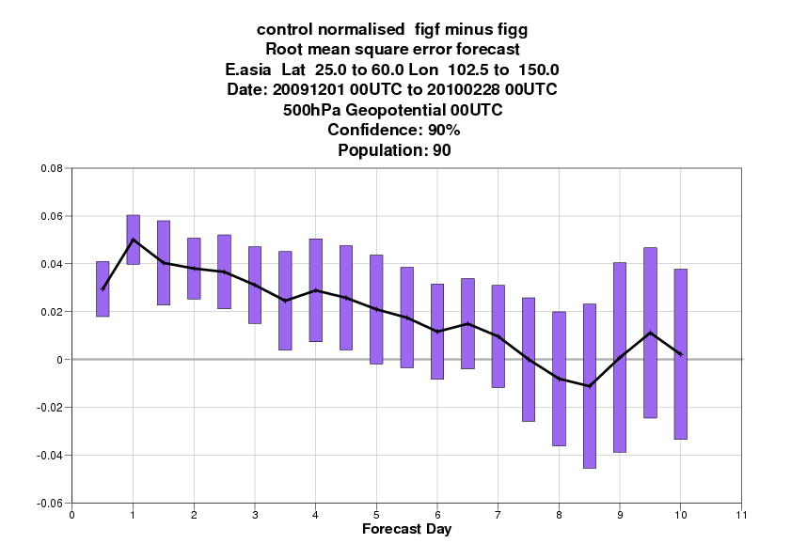
Snow Data assimilation
Cressman +24km NESDIS
New snow analysis improves
Snow depth patterns (OI impact)
Atmospheric forecasts (IMS 4km+QC impact)
Old (before 2010):
Cressman+ IMS 24km
New (from 2010):
OI+ IMS 4km
OI Brasnett 1999 +4km NESDIS
FC impact (East Asia) for DJF 2009-2010
RMSE Diff (Old – New) 500 hPa Geopot Height
☺
(de Rosnay et al Survey of Geophysics, 2015)

Slide 27
Snow Analysis improvements at ECMWF
2010: replace Cressman by OI and improved IMS use (4km data and revised preprocessing)
2013: further improvement in the ECMWF snow analysis (IFS 40r1):
  Revised observations error specification for IMS snow cover and assimilation of 5cm of snow instead of direct insertion,
  Generic snow blacklist,
  Revised surface analysis code and Observation data base (ODB) feedback
  New Land surface observations monitoring for conventional and IMS data
https://software.ecmwf.int/wiki/display/LDAS/Land+Surface+Observations+monitoring

Slide 28
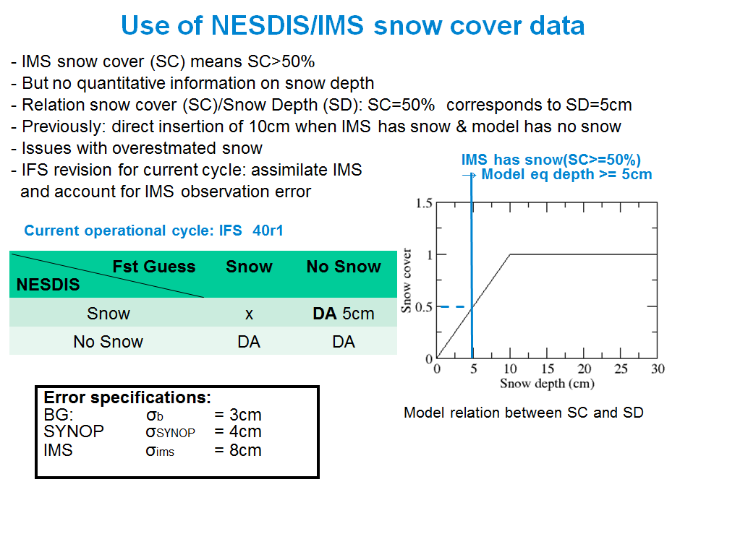
Assimilation of IMS snow cover
Revised Nov 2013 ( IFS 40 r1 and 41r1)
de Rosnay et al, ECMWF Newsletter 143, Spring 2015

Slide 29
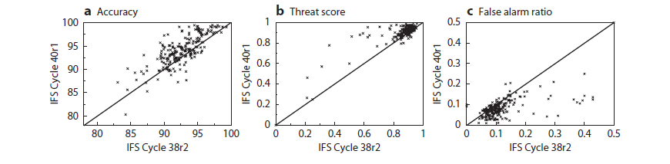
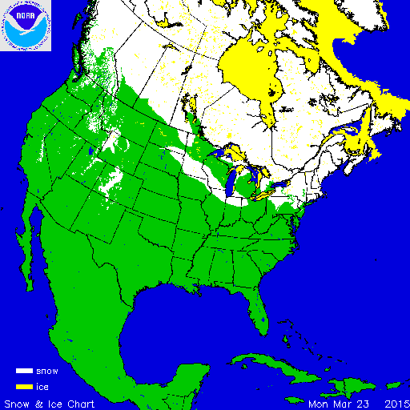
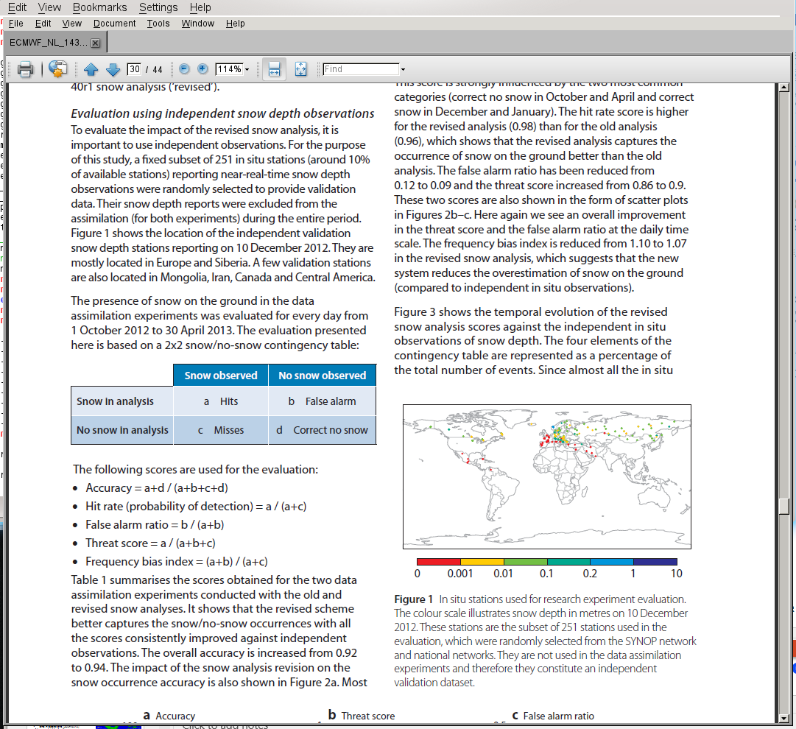
Snow analysis: Forecast impact
Revised IMS snow cover data assimilation (2013)
Impact on snow October 2012 to April 2013 (251 independent in situ observations)
☺
☺
☺

Slide 30
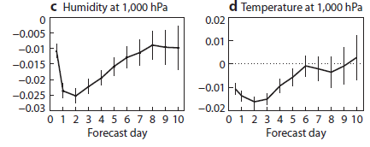

Snow analysis: Forecast impact
Revised IMS snow cover data assimilation (2013)
Impact on snow October 2012 to April 2013 (251 independent in situ observations)
☺
☺
☺
Impact on atmospheric forecasts
October 2012 to April 2013 (RMSE new-old)
→ Consistent improvement of snow and atmospheric forecasts
☺
☺
de Rosnay et al., ECMWF
NL 143, Spring 2015

Slide 31
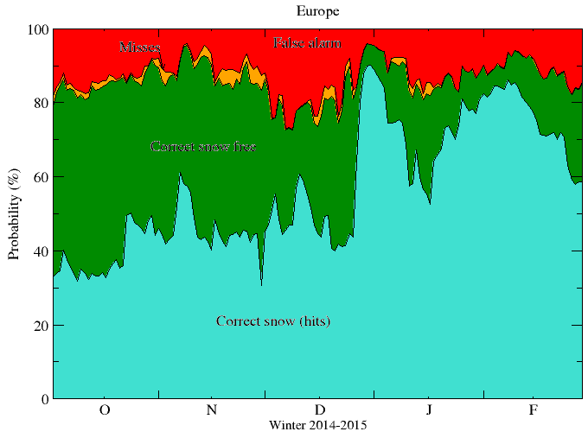
Operational snow analysis: winter 2014-2015

Slide 32
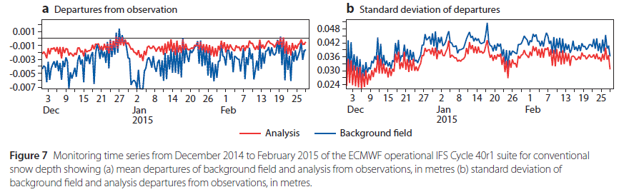
Operational snow analysis: winter 2014-2015
Operational snow monitoring
(Obs-Background)
Snow Depth in m
Others technical work in 41r2 (Q1 2016):
  BUFR SYNOP in LDAS
  New blacklist for LDAS conv obs
  Model improved treatment of
    snow depth update after snowfall
    Sub-grid scale energy partition affecting snow fraction

Slide 33
Summary on Snow analysis
1. Not all NWP systems have a snow analysis
Snow data assimilation systems relies on relatively simple approaches (Cressman,OI)
2. Mostly DA of in situ snow depth and the IMS multi sensor snow cover
- In situ snow depth reporting: issues on availability and reporting practices
- International initiatives to address snow reporting (harmonization and practices):
  Snow Watch snow reporting activity
  HarmoSnow COST action
  National Met services encouraged to improve snow depth reports availability on the GTS
3. Challenges in retrieving snow mass from satellite measurements → Novel mission concepts required for snow water equivalent
4. Snow initialisation has a large impact on Numerical Weather Forecast

Slide 34
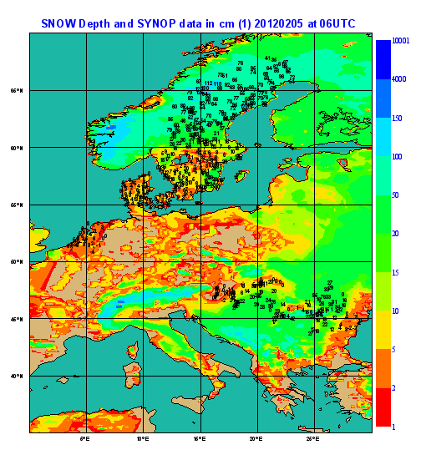
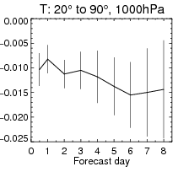
Snow in the ECMWF IFS history
2009 2010 2011 ….. 2013 2015
Snow Obs and DA
Ongoing
. BUFR SYNOP
. Snow COST action
. Snow Watch
Future:
Multi-layer snow model
Future snow missions?
RT modelling
Snow Model
. Liq. Water
. Density
. Albedo
. Fraction
Dutra et al., J. hydrometeorol. 2010
. OI
. 4km IMS
. Obs preproc/QC
. IMS latency/acquisition
. Additional in situ obs
. New BUFR template
. WMO/SnowWatch action
. IMS data assimilation
. obs error revision
de Rosnay et al., Res Memo 2010, 2011
Brun et al., Snow Watch 2013
de Rosnay et al., Surv. Geophys 2014
de Rosnay et., ECMWF Newsletter 143, Spring 2015

Slide 35
Outline
Part I (Monday)
Introduction
Snow analysis
Screen level parameters analysis
‏
Part II (Tuesday)
Soil moisture analysis‏
Summary and future plans

Slide 36
Screen Level parameters analysis
Screen level variables: 2m Air Temperature (T2m) and air Relative humidity (RH2m)
Analysis based on an Optimal Interpolation using SYNOP observations, every six hours: 00UTC, 06UTC, 12UTC, 18UTC
Screen level analysis increments are used for the soil moisture analysis (OI system, e.g. at Météo-France and ECMWF ERA-Interim)
Screen level analysis fields are used as input of the SEKF soil moisture analysis (ECMWF)
T2m and RH2m are diagnostic variables of the model, so their analysis only has an indirect effect on atmosphere through the soil and snow variables.
Screen level analysis reliable for evaluation purposes

Slide 37
OI Screen Level parameters analysis
Mahfouf, J. Appl. Meteo. 1991, & ECMWF News Lett. 2000
1. First guess departure ΔX_{i} estimated at each observation location i from the observation and the interpolated background field (6 h or 12 h forecast).
2. Analysis increments ΔX_{j}ª at each model grid point j are calculated from:
2D-OI like for snow analysis
3. The optimum weights w_{i} are given by: (B + O) w = b
b : error covariance between observation i and model grid point j
(dimension of N observations)‏
B : error covariance matrix of the background field (N × N observations)‏
B(i₁,i₂) = σ²_{b} ×μ(i₁,i₂) with the horizontal correlation coefficients μ(i₁,i₂)
and σ_{b} = 1.5 K for T2m and 5 % RH2m is the standard deviation of background errors.
O : covariance matrix of the observation error (N × N observations):
O = σ²_{o} × I with σ_{o} = 2.0 K for T2m and10 % RH2m is ths standard deviation of obs. errors

Slide 38
Screen Level parameters analysis
Quality control:
Number of observations N = 50, d = 300 km, scanned radius 1000km.
Gross quality checks as rH ∈ [0,100] and T > T_{dewpoint}
Observation points that differ more than 300 m from model
orography are rejected.
First-guess check:
Observation is rejected if : with γ = 3 (tolerance)
Redundancy rejection
Number of active observations > 16000 per 12 hour (less than 20% of the
available observations).

Slide 39
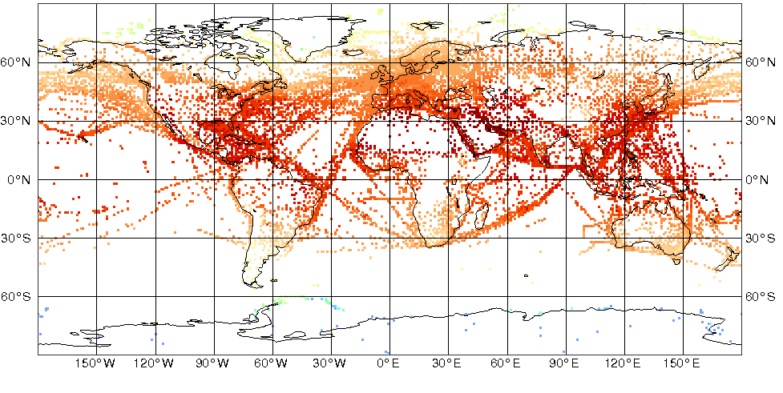
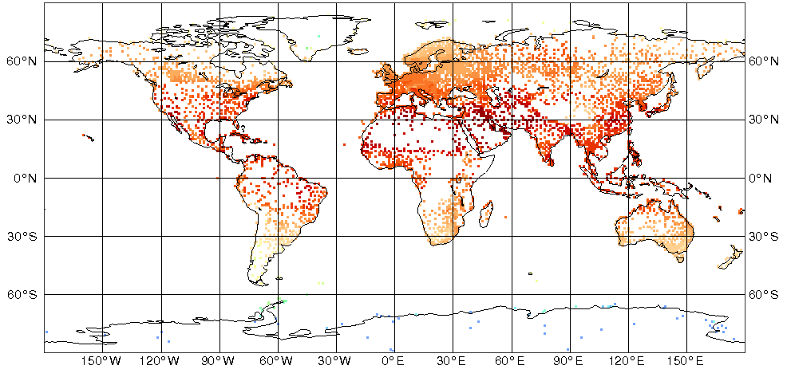
Screen level DA: Observation usage Land/Sea surface data in the OI
Ocean and Land observations
Screen level observations are: two meter temperature and relative humidity. Observations are available on the GTS:
Diversity of Report types:
- Drifting buoys, automatic and manual stations on ships, etc..
- Automatic and manual SYNOP stations, METAR (METeorological Airport Reports), etc…
For soil moisture analysis purpose, only Land observations are relevant
In coastal areas it is important to select land only report types for model land points (match with the land sea-mask).
→ only land report types enter the screen level analysis.
Used for Land Data Assimilation

Slide 40
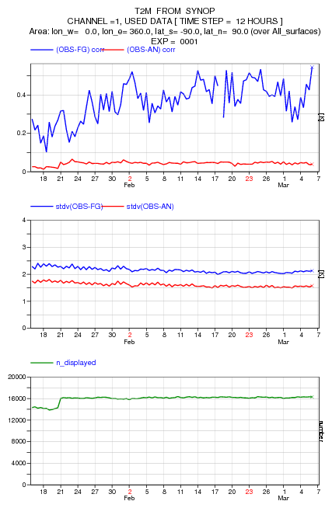
Screen level observations monitoring
http://www.ecmwf.int/en/forecasts/charts/obstat/?facets=Category,Conventional%20Data%3BParameter,%202m%20temperature
Global first guess departure
Global analysis departure
Standard deviation of departure statistics
Number of observations used:
>16000 per 12 hours
2014

Slide 41
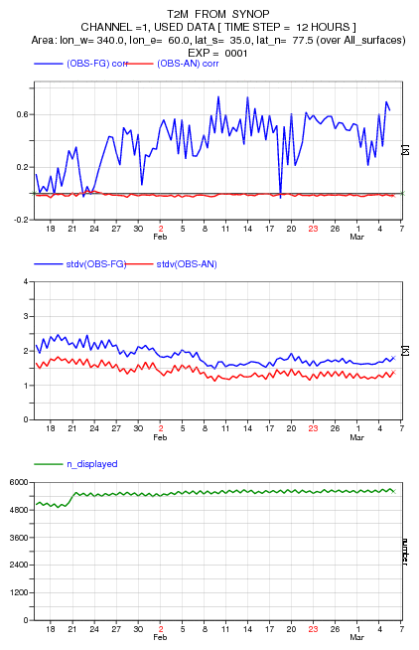
Screen level observations monitoring
http://www.ecmwf.int/en/forecasts/charts/obstat/?facets=Category,Conventional%20Data%3BParameter,%202m%20temperature
Europe first guess departure (Obs-Background, in K)
Europe analysis departure (Obs-Background, in K)
Standard deviation of departure statistics
Number of observations used over Europe:
~5000 per 12 hours
Feb-Mar 2014

Slide 42
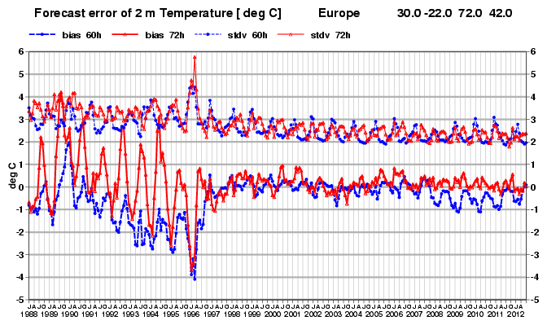
Screen level analysis:
2m temperature forecast verification
tm578.pdf
Soil freezing parameterisation
Snow albedo parameterisation
Verification for 60h (night time) and 72h (day time)‏
From Richardson et al., 2012, ECMWF Tech. Memo 688

