Slide 1
Aspects of using observations in Data Assimilation
Lars Isaksen
Earth System Assimilation Section, ECMWF
Acknowledgements to: Angela Benedetti, Erik Andersson, Mike Fisher, Bruce Ingleby, Marta Janisková, Tony McNally and Jean-Noël Thépaut

Slide 2
Overview of Lecture
Why observations are essential for data assimilation
Introduction to observation operators
Different flavours of observation operators
Jacobians (linearized operators)
Why variational data assimilation is very flexible with respect to observation usage

Slide 3
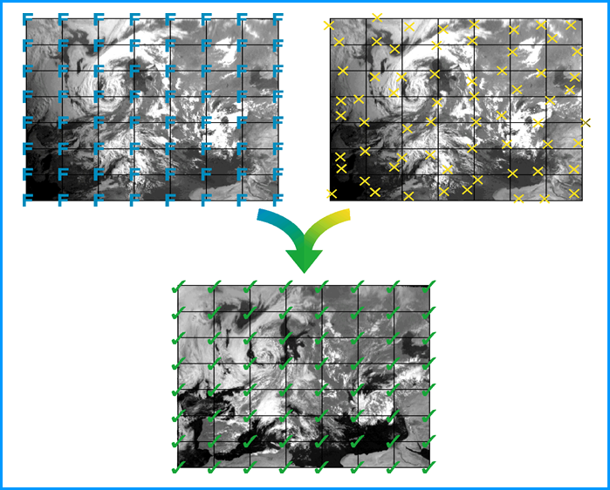
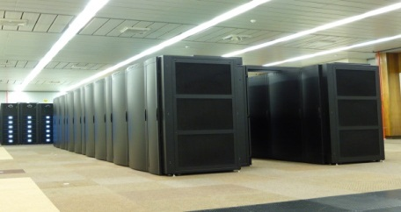


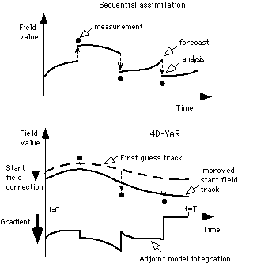
Model Forecast (with errors)
Observations (with errors)
People (with a lot of good ideas)
Computer (with a lot of CPUs)
Analysis (with - smaller – errors)
Notes:
What are the ingredients?, well we start with a model on grid (the model contains errors, which for some we know, for some we do not), but we need to do our best at estimating and characterising them. Likewise with observations, sometimes indirectly related to the model, with errors, heterogeneous in time, space, and in terms of measured quantities. The data assimilation process can be seen as a mixer, which requires as additional input a big and powerful computer and equally importantly clever people with a lot of good ideas to produce this analysis, which will statistically be more accurate than the prior informations put in the system

Slide 4
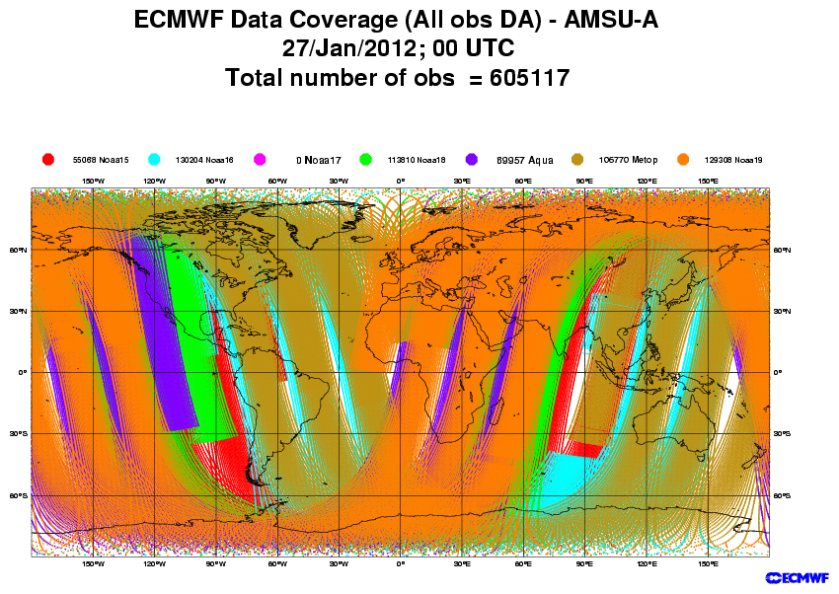
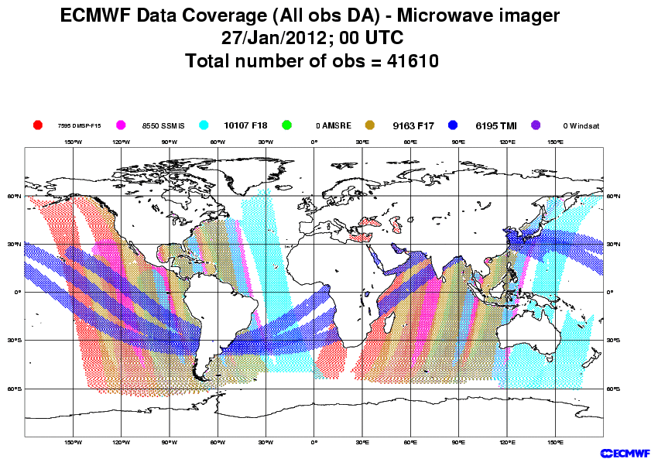
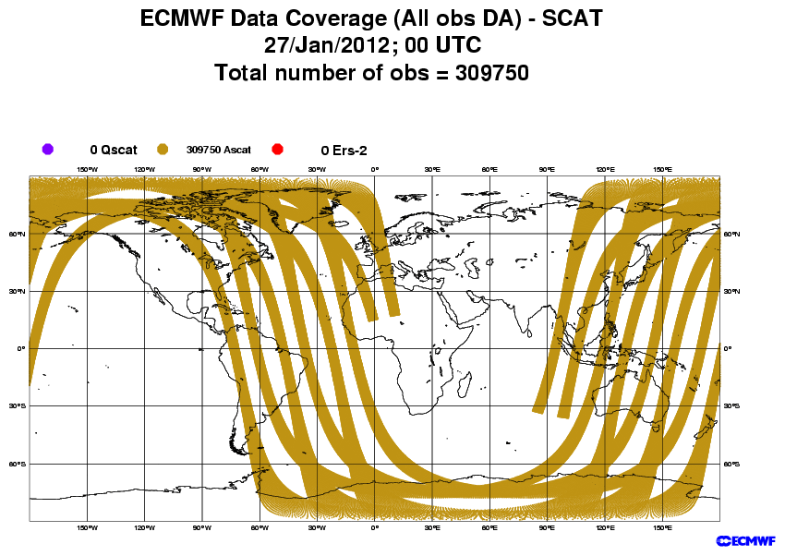
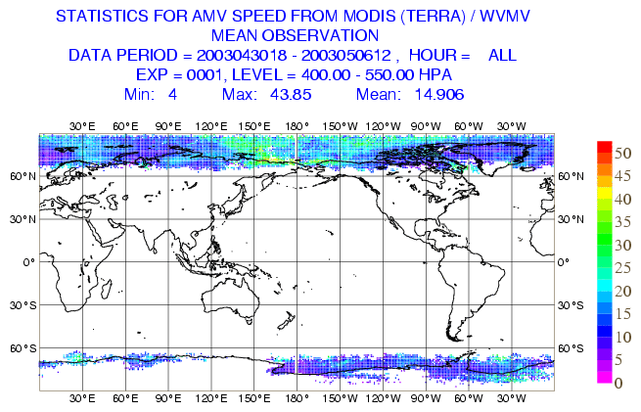
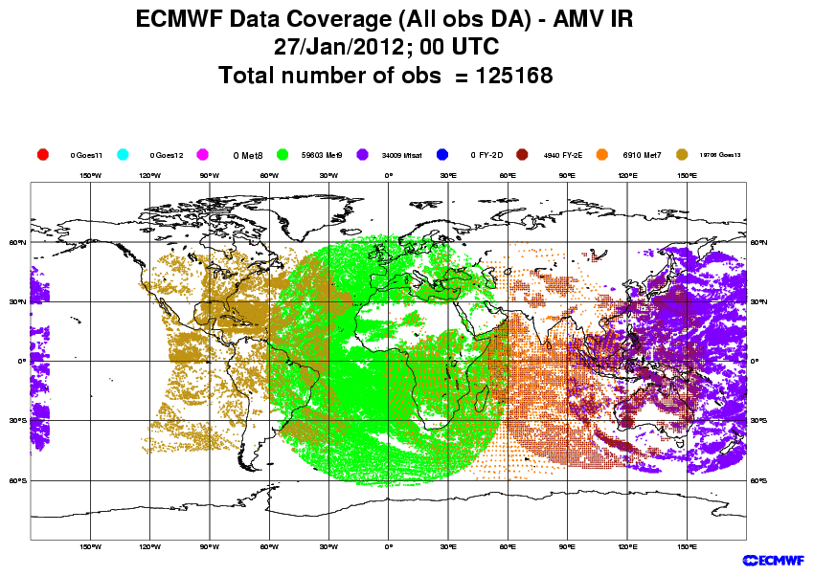
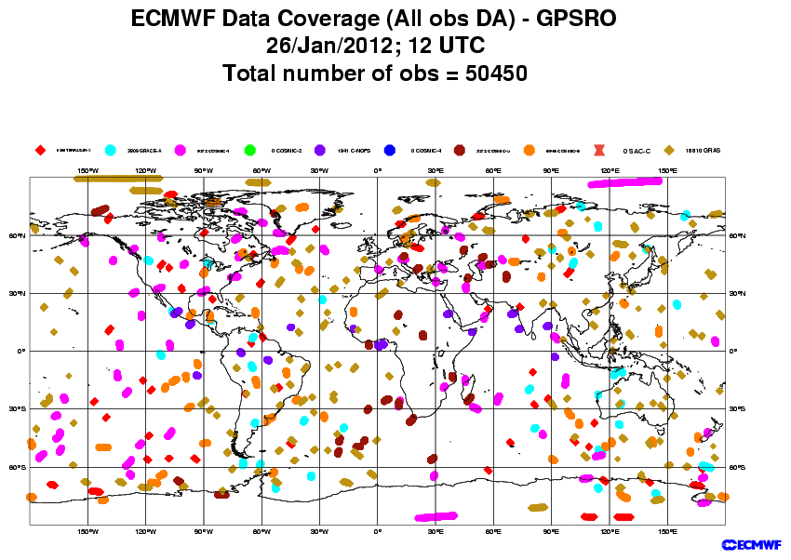
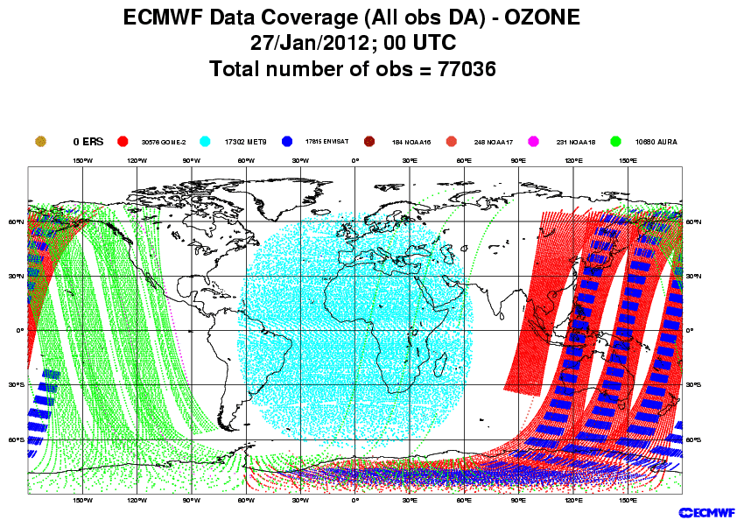
Satellite data sources used by ECMWF’s analysis
Sounders: NOAA AMSU-A/B, HIRS, AIRS, IASI, MHS
Imagers: SSMI, SSMIS, AMSR-E, TMI
Scatterometer ocean low-level winds: ASCAT
Geostationary+MODIS: IR and AMV
GPS radio occultations
Ozone

Slide 5
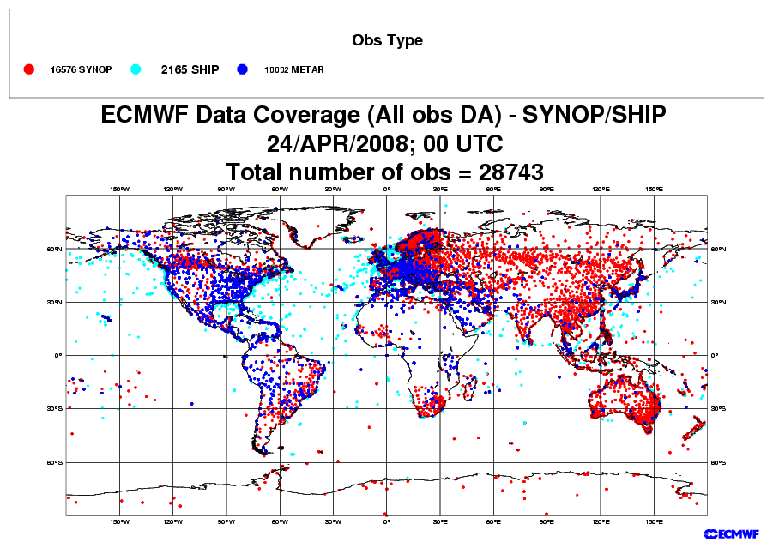
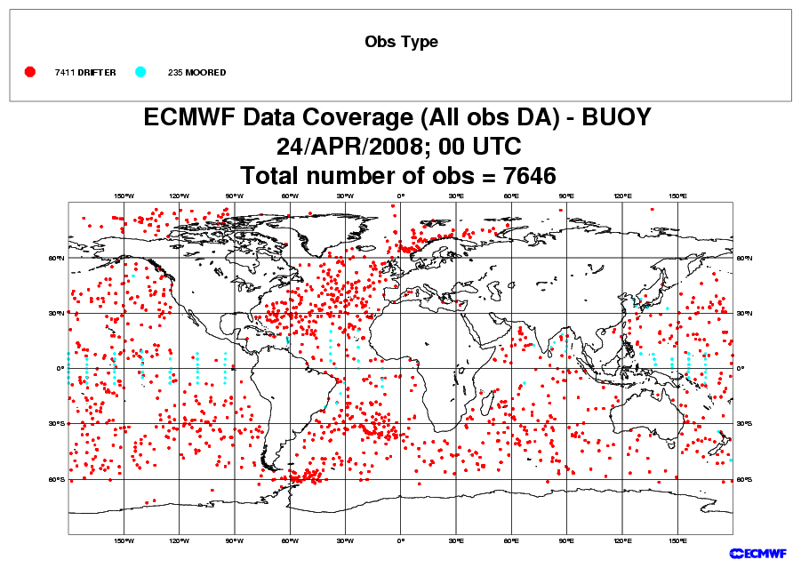
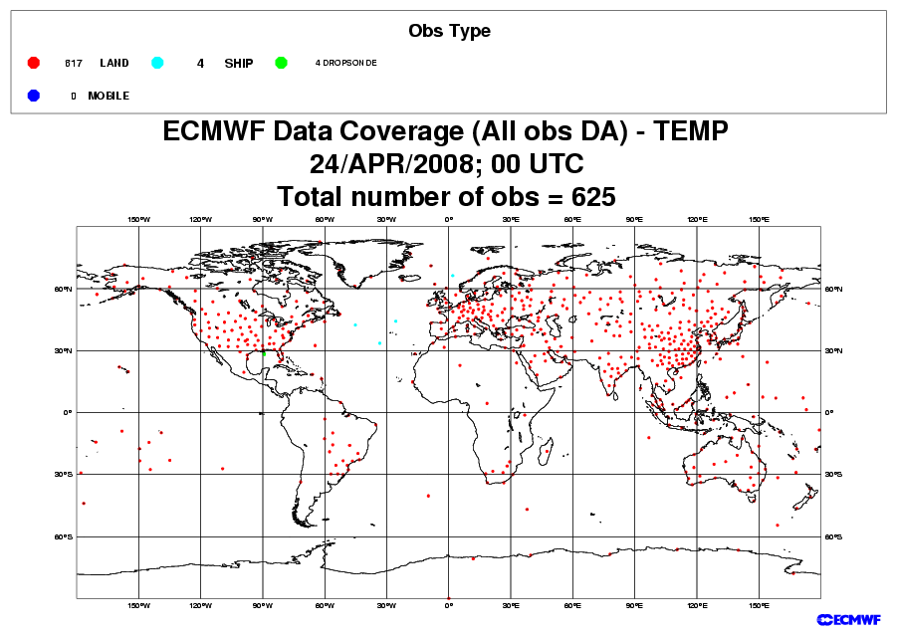
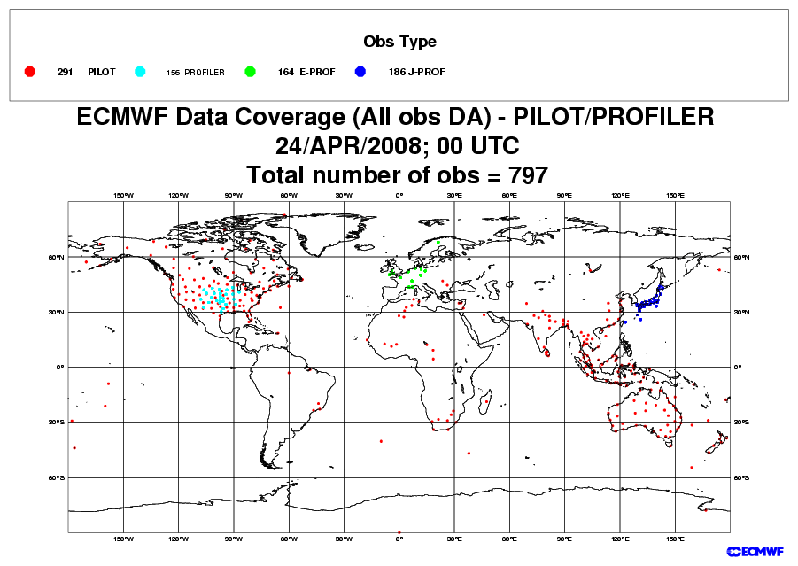
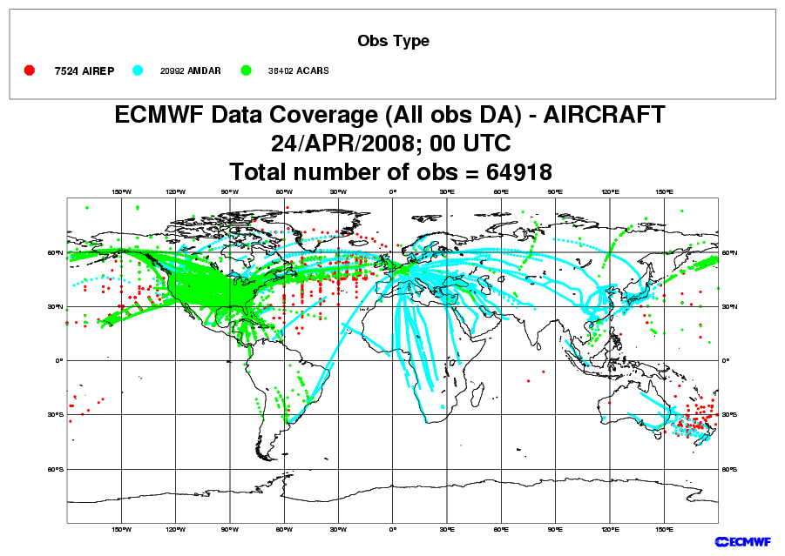
Conventional observations used by ECMWF’s analysis
SYNOP/METAR/SHIP:
MSL Pressure, 10m-wind, 2m-Rel.Hum.
DRIBU: MSL Pressure, Wind-10m
Radiosonde balloons (TEMP):
Wind, Temperature, Spec. Humidity
PILOT/Profilers: Wind
Note: Data assimilation only use a limited number of the observed variables - especially over land.
Aircraft: Wind, Temperature

Slide 6
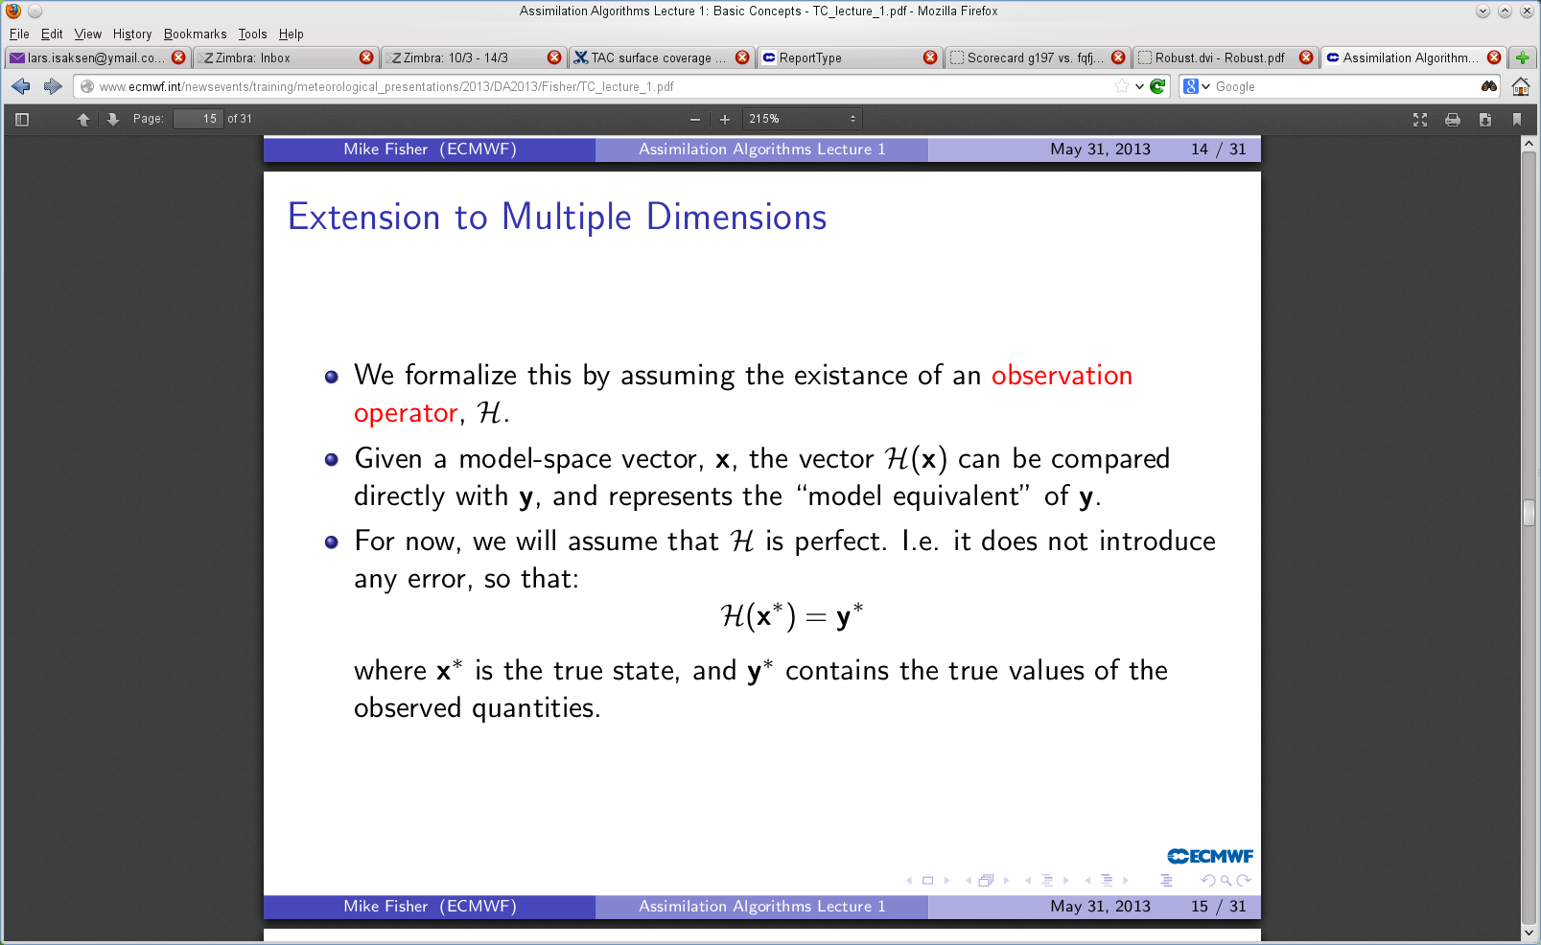
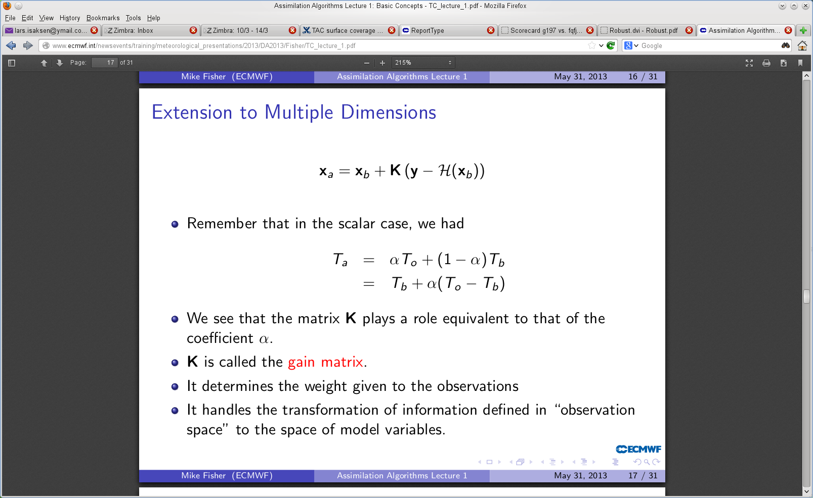
The observation operator H as defined in Mike’s talk today

Slide 7
Comparing model and observations
The forecast model provides the background (or prior) information to the analysis
Observation operators allow observations and model background to be compared (“o-b”)
The differences are called departures or innovations
They are central in providing observation information that corrects the background model fields
These corrections, or increments, are added to the background to give the analysis (or posterior estimate)
Observation operators also allow comparison of observations and the analysis (analysis departures “o-a”)

Slide 8
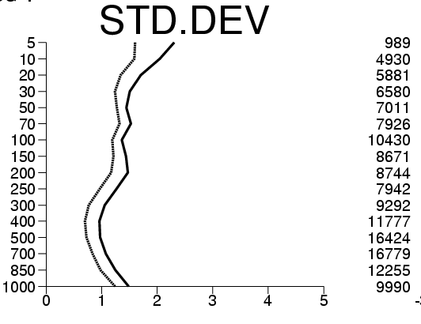
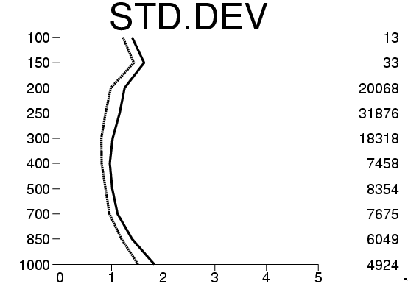
Example: Statistics of departures
Background departures:
Analysis departures:
(o-b)
(o-a)
= observations
= analysis state
= background state
Radiosonde temperature
Aircraft temperature
Pres-sure
(hPa)
Number
of obser-vations
The standard deviation of background departures for both radiosondes and aircraft is around 1-1.5 K in the mid-troposphere.
The standard deviation of the analysis departures is here approximately 30% smaller – the analysis has “drawn” to the observations.

Slide 9
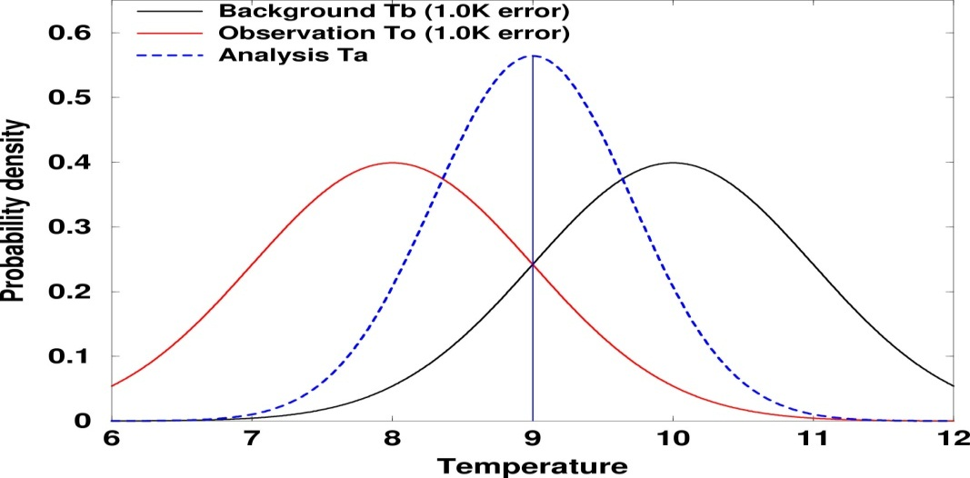
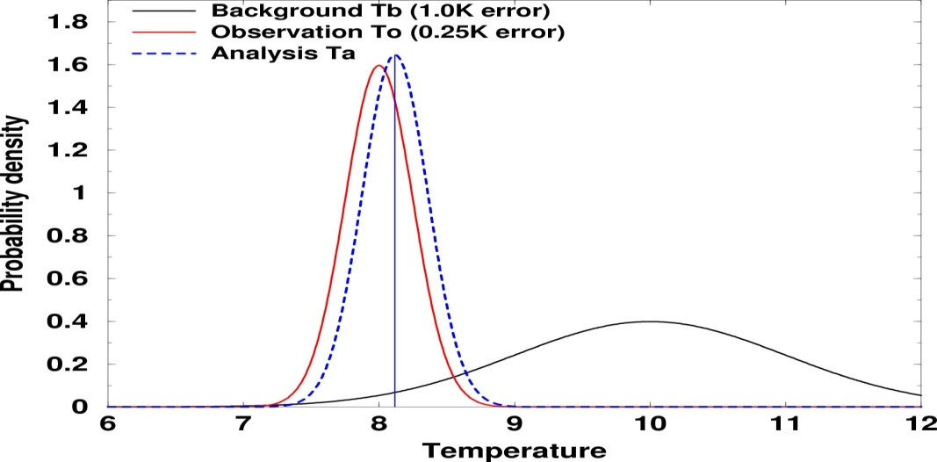
Observations and model background have errors
It is important to specify them accurately
Observed temperature (T_{o}): 8˚C
Background forecast temperature (T_{b}): 10˚ degrees.
Analysis (T_{a}): x˚C

Slide 10
The observation operator “H” for satellite data
Satellites measure radiances/backscatter/radar reflectivities, …. NOT directly temperature, humidity and ozone.
A model equivalent of the observation needs to be calculated to enable comparison in observation space (or related model-equivalent space).
For most satellite data H must perform complex transformations of model variables to, for example, the radiative transfer operator for satellite radiances:
Model
T,u,v,q,o3
Compare
H
Model radiance
Observed
satellite radiance
O-B
Obs-Background

Slide 11
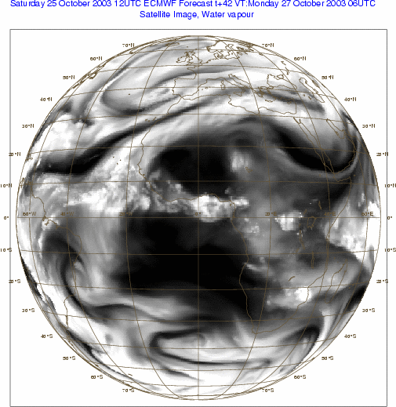
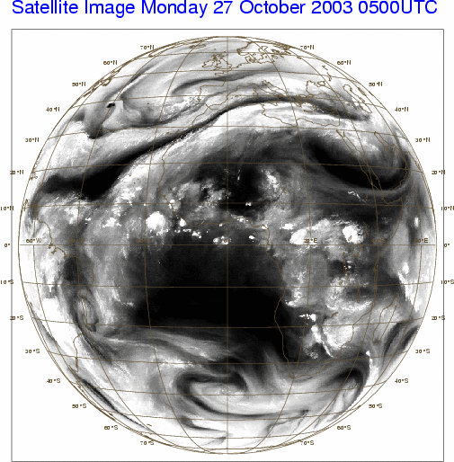
Accurate radiative transfer operator allows comparison of model and observed radiances
Model
T,u,v,q,o3
H
Model radiance
compare
Observed
satellite radiance
Meteosat imagery – water vapour channel

Slide 12
Radiative transfer operator
Satellite instruments (active and passive) simply measure the RADIANCE L that reaches the top of the atmosphere at given frequency ν . The measured radiance is related to geophysical atmospheric variables (T,q,O₃) by the radiative transfer equation (covered in detail in other lectures).
+
Surface
emission
+
Surface
reflection/
scattering
+
Cloud/rain
contribution
+ ...
The observation operator for satellite measurements is in this case a
convolution of the horizontal and vertical interpolation operators and the
radiative transfer equation applied to the interpolated model state variables
(for example, temperature, humidity) and solved via approximations which
depend on the specific channel/frequency.
More details in presentation by T. McNally on Thursday and at the SAT Training course next week!

Slide 13
Example of an “Unusual” observation operator:
Aerosol Optical Depth
The AOD operator is based on tabulated or parameterized optical properties of the N aerosol species that are modeled. These optical properties are then weighted by the mass of the particulate to provide the extinction coefficient and integrated vertically to give the total optical depth at a given wavelength:
where is the extinction coefficient which is a function of
particle size and height (and relative humidity for some aerosol types).
An aerosol optical depth operator is currently used in the Copernicus DA system for the assimilation of the Moderate Resolution Imaging Spectro- radiometer (MODIS) Aerosol Optical Depths at 550 nm.

Slide 14
Model versus observations example
CALIPSO satellite – lidar aerosol backscatter
Model
aerosols
H
Model lidar
backscatter
compare
Observed lidar
backscatter

Slide 15
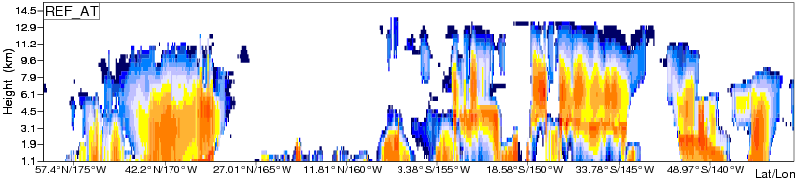
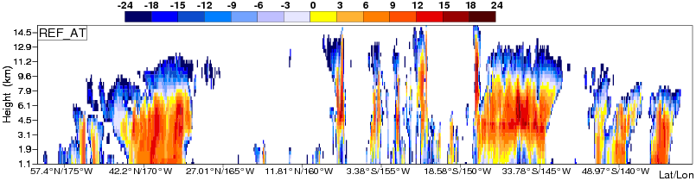
Another model versus observation example
CLOUDSAT is a NASA Satellite with a cloud profiling radar on-board
Model
Cloud Radar Reflectivity
Observations

Slide 16
Direct observations versus retrievals
What about transforming observations closer to model space before assimilation? It is possible to use “satellite retrievals” instead of “direct observations”.
H becomes simpler for a satellite retrieval product
Related tangent linear & adjoint operators also simpler
Retrieval assumptions made by data providers not always explicit/valid
Use of NWP data in retrieval algorithms can introduce correlated errors
The choice is often application dependent!
Satellite
retrieval
e.g. o3, T,
q, AOD
Retrieval
algorithm
Model
T,u,v,q,o3
Model
equivalent
Observed
satellite
quantity
H
O-B
Units of mixing ratio, K etc
Model
T,u,v,q,o3
Model
equivalent
Observed
satellite
quantity
H
O-B
Units of radiance

Slide 17
Actual implementation of observation operators used in the ECMWF 4D Variational Data Assimilation System
The observation operator provides the link between the model variables
and the observations (Lorenc 1986; Pailleux 1990).
The observation operator is typically implemented as a sequence of
operators transforming the analysis control variable x into the
equivalents of each observed quantity y, at observation locations.
This sequence of operators can be multi-variate (can depend on many
variables) and may include:
“Interpolation” from forecast time to observation time (in 4D-Var this is actually running the forecast model over the assimilation window)
Horizontal and vertical interpolations
Vertical integration
If limb-geometry, also horizontal integration
If radiances, radiative transfer computation
Any other transformation to go from model space to observation space.

Slide 18
Actual implementation of observation operators used in the ECMWF 4D Variational Data Assimilation System
The observation operator is typically implemented as a sequence of operators transforming the analysis control variable x into the equivalents of each observed quantity y, at observation locations:
These first three steps are common for all data types:
The inverse change of variable converts from control variables to model variables
The inverse spectral transforms put the model variables on the model’s reduced Gaussian grid
A 12-point bi-cubic (or 4-point bi-linear) horizontal interpolation gives vertical profiles of model variables at observation points
Change of variable
TL/AD Forecast
Inverse transforms
Forward
Horizontal interpolation
Adjoint
Vertical interpolation
Radiative transfer
Jo-calculation

Slide 19
Actual implementation of observation operators used in the ECMWF 4D Variational Data Assimilation System
The observation operator is typically implemented as a sequence of operators transforming the analysis control variable x into the equivalents of each observed quantity y, at observation locations:
Further steps (depend on the specific observations treated):
Vertical interpolation to the level of the observations. The vertical operations depend on the observed variable
Vertical integration of, for example, the hydrostatic equation to obtain geopotential, and of the radiative transfer equation to obtain top of the atmosphere radiances.
Change of variable
Forecast
Inverse transforms
Forward
Horizontal interpolation
Adjoint
Vertical interpolation
Radiative transfer
Jo-calculation

Slide 20
Upper-air observation operators
The following vertical interpolation techniques are employed:
Wind: Linear in ln(p) on full model levels
Humidity, Temperature, Ozone: Linear in p on full model levels
Geopotential: As for wind, but the interpolated quantity is
the deviation from the ICAO standard atmosphere

Slide 21
Interpolation of highly nonlinear fields
The problem of a “correct” horizontal interpolation is especially felt when dealing with heterogeneous model fields such as precipitation and clouds.
In the special case of current rain assimilation, model fields are not interpolated to the observation location. Instead, an average of observation values is compared with the model-equivalent at a model grid-point – observations are interpolated to model locations.
Different choices can affect the departure statistics which in turn affect the observation error assigned to an observation, and hence the weight given to observations.

Slide 22
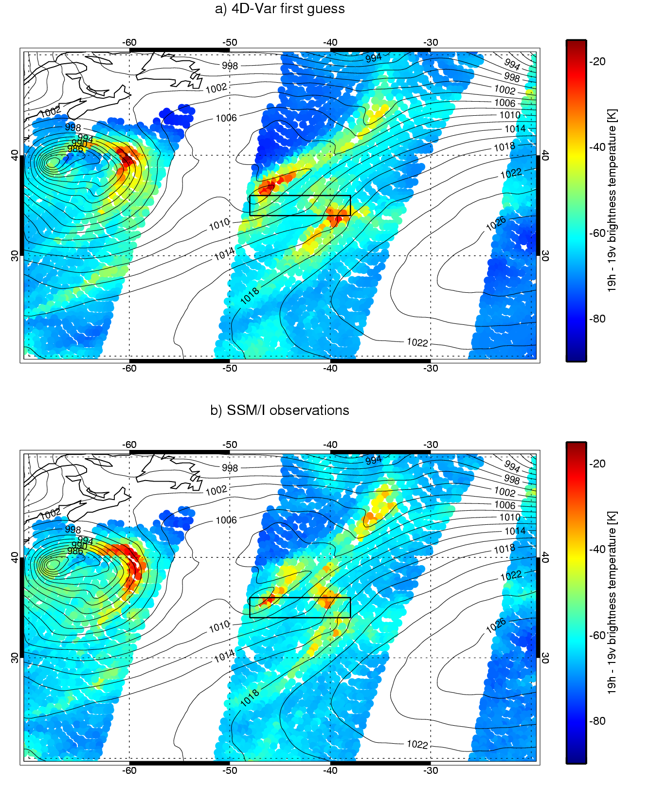
Observation operator for and use of rain affected microwave radiances – a difficult task
Main difficulties: inaccurate moist physics parameterizations (location/intensity), formulation of observation errors, bias correction, linearity assumptions
Model
T and q
H
Model radiance
compare
Observed
satellite radiance
4D-Var first guess SSM/I ΔTb 19v-19h [K]
SSM/I observational ΔTb 19v-19h [K]

Slide 23
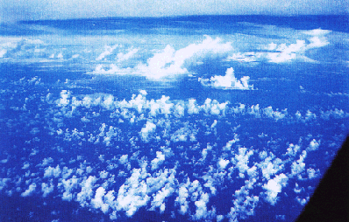
Representativeness Errors
Model grid box small, but it is still not possible to represent all features
Grid box 16km x 16km x 200m

Slide 24
Representativeness Errors
Errors introduced by the interpolation operator, and also by the finite resolution of the model fields, are often accounted for by adding “representativeness” errors to the “instrument” error of the observations.
For some data, e.g. radiosonde winds, the representativeness errors are the dominant contribution to the observation errors in the matrix R.
In effect, we compare model and observations not in observation space, but in model-equivalent space. We ask what would the observed quantity be if we degraded the atmosphere down to model resolution?

Slide 25
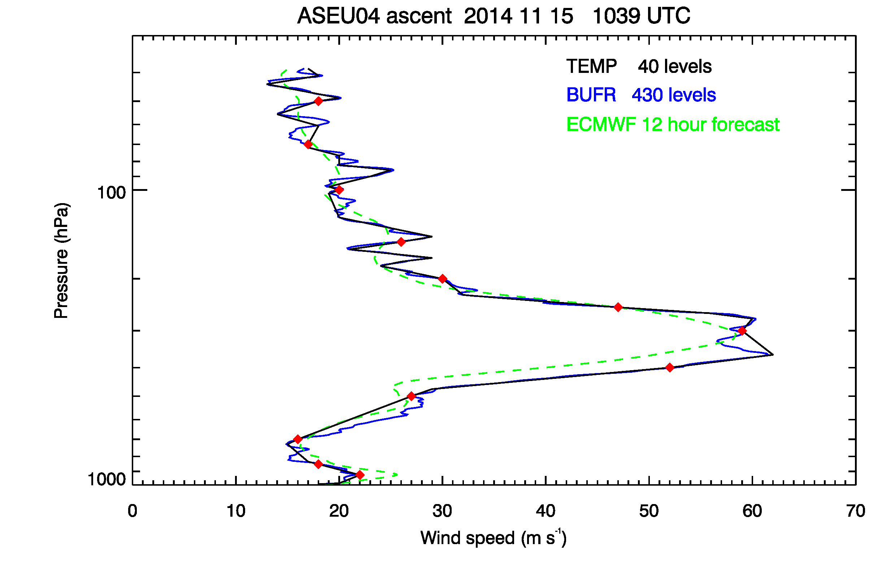
Radiosonde wind speed compared to ECMWF 12-h forecast
An example of representativeness aspects
Bruce Ingleby, ECMWF

Slide 26
The Jacobian matrix
The tangent linear of the observation operator H consists of the partial derivatives of H with respect to all of its inputs, expressing the variations of H in the vicinity of the background x_{b}.
H is sometimes referred to as the Jacobian of H. If H varies significantly with x_{b} then H is non-linear.
Needed for the incremental formulation of 4D-Var (adjoint too). You will learn more about this later this week.
But also, for complex observation operators, study of the Jacobian highlights observation sensitivities to input model variables at specific points (quantified as information content, effectively which model components have been “observed”).
In the case of radiances, for example, columns of H will express each channel’s ‘weighting function’ on the model geometry.

Slide 27
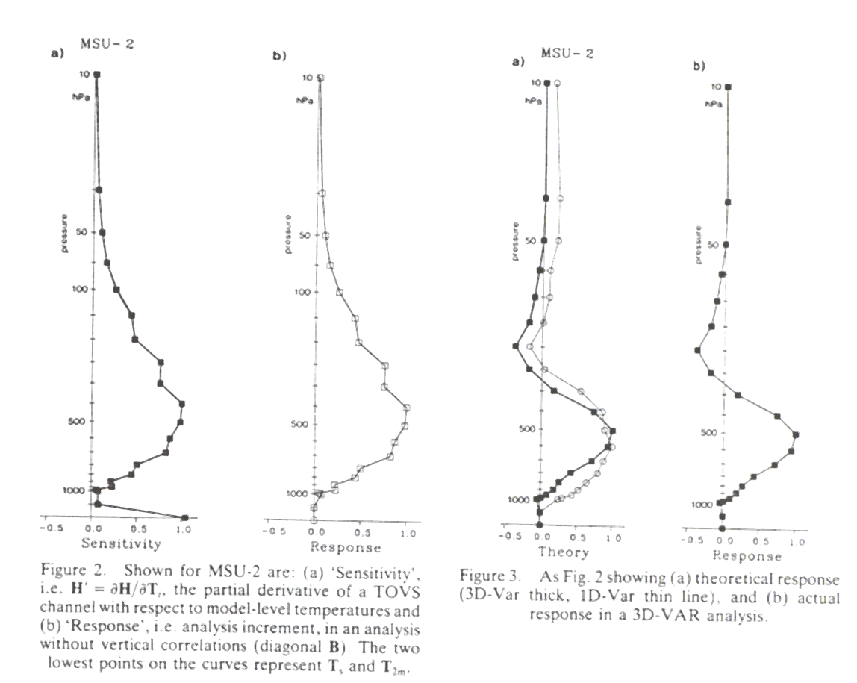
A Jacobian example: MSU-2
The Jacobian for TOVS channel MSU-2 is shown in the left diagram. It can be interpreted as a profile of weights for a vertically averaged temperature.
Jacobian/weighting functions (left) and analysis increments (right) are similar but not identical because they also include the background term (as per equation):
Jacobian
Analysis increments

Slide 28
Summary (1/4): Variational data assimilation allows easy use of direct observations
Variational data assimilation allows direct assimilation of radiances and other “non state space” observations (e.g. optical depth, reflectivities, lidar backscatter)
In 3D-Var (x-y-z):
  All observations are used simultaneously to produce the analysis
  Background constraints, like mass-wind balance, are imposed
  Spatial consistency is ensured
In 4D-Var (x-y-z-time):
  Consistency in time. Frequent data can be used.
  The dynamics of the model acts as additional constraint

Slide 29
Summary (2/4): This flexibility is very important
The ‘observation operators’ makes the use of observations in variational assimilation systems particularly flexible.
There is no need to convert the observed data to correspond to the model variables.
This has been shown to be of real importance for the assimilation of radiance data, for example
Every observed quantity that can be related to model variables in a meaningful way, can be used in variational data assimilation.

Slide 30
Summary (3/4): Role of the observation operator H
The observation operator H enables the comparison of model and observations.
Accurately computing H(x) is important for deriving accurate background departures and analysis increments.
Observation operator approximations need to be taken into account, e.g., interpolation error and representativeness error due to finite model resolution.
H may be non-linear. Some A-TOVS channels vary strongly non-linearly with q (humidity), for example. Its first derivative H (the Jacobian) then depends on the atmospheric state.
Difficulties may arise when the observations are significantly influenced by geophysical quantities that are not analysed or well described in the model (e.g. surface emissivity, skin temperature, clouds or precipitation).

Slide 31
Summary (4/4):
Typical issues associated with using novel observations
How can we compare the model to the observations?
  Can we implement a forward operator H ?
    Do we have all the model variables needed by the forward operator?
    Are the model variables accurate and representative? (e.g., precipitation is tricky)
    Can we develop accurate tangent linear and adjoint operators?
    Are the operators computationally affordable?
How much weight should we give to the observations and background?
  What are the sources and size of errors?
  Are the errors random or systematic?
  How accurate is the background?

Slide 32
Thank you for your attention!
Questions?

